Slide 1
Principle of Trigger and Trends of TDAQ
EPC/IHEP Seminar
Zhen-An LIU, TrigLab
IHEP, Jul. 18 2014

Slide 2
Outline
Background
Principle of trigger
Example of BES/BES III
Short DAQ introduction
Future trend with TDAQ

Slide 3
Backgrounds
What is a Trigger System?
  Chinese dictionary／Baidu wenku
  English dictionary／WIKI
  Trigger of Osciloscope
  Trigger of Experimental Physics
  Trigger of Accelerator

Slide 4


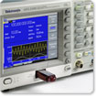
Trigger/触发
WIKI：
  trigger - lever that activates the firing mechanism of a gun
Oscilloscope:
  Trigger Level: a level over which the input signal will be captered and shown on the screen.
Digital Signal Analyser
  Trigger mode: signal will be captured and shown on the screen when match the predefined structure.
Accelerator
  Event triven

Slide 5
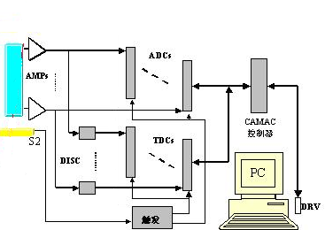
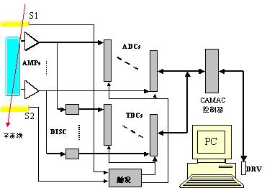
Trigger in physics experiment
Radiation source based
  Source
  collimator
  Signal level/threshold
  Combinational logic
Cosmic-ray based
  Long time
  Low efficiency
  As rain-dependant farmers
探测器
电子学
读出/DAQ
准直
放射源
DISC
So accelerator based experiment is very important

Slide 6
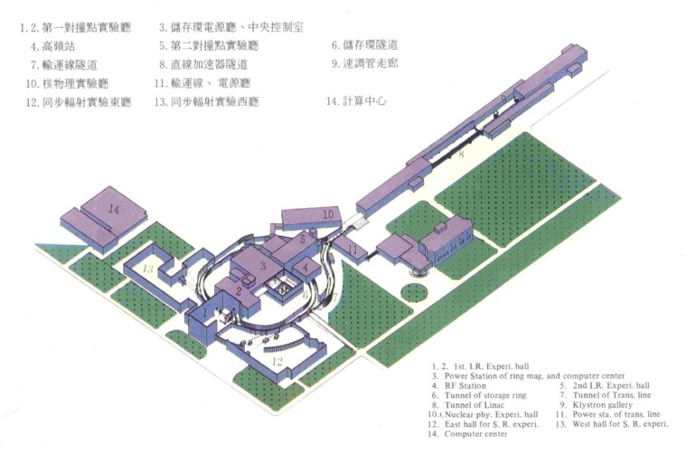
Trigger in physics experiment
Accelerator based
  advantages
    repeatertive
    High efficiency
    Short time
    Controllable physics aim
  disadvantages
    High backgrounds
    Mass data storage
    Offline analysis
Good event: find a needle in a Haystack

Slide 7




Trigger in physics experiment
How we define/design a trigger in an experiment
  Define good event(GE as needle) and background(BG as Haystack)
  Find their differences(simulation)
    Timing
    Hits
    Trajectory
    Energy loss
    Tracking multiplicity
    …….
  Conception design
  Electronic Implementation
  Tests and joint tests
  commissioning
backgrounds
Searching GE in BG
Good event in BG
GE found

Slide 8
Design Target of trigger in physics Experiment
Target:
  Accepts ALL physics interested events(GE), rejecting as many as possible backgrounds, with a total event number(trigger rate) limited by DAQ system, and small or no dead time.
Good events
  Any events wanted
  Maybe from collision
  Maybe also from cosmic-ray
  Depondse on experiment purpose
  Good events differ in different experiment
Backgrounds:
  Any events not wanted
  Cosmic-rays
  Beam loss particles or secondary(束unfocused, (Toucheck effect）

Slide 9
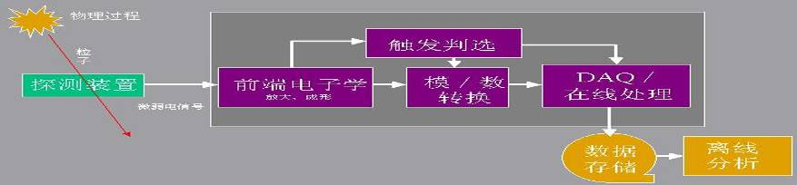
Position of trigger system
FEE: detector signal amplification, shaping, digitization and data buffering
Trigger: physics good event selection, backgrounds subpression
Readout and online analyses: move data selected by trigger from FEE buffer to permernance storage; monitoring Appratus status; extracts data for quality checking with histograms/plots
Offline Analysis: analyze data in terms of energy, momemtum, charge for particles.

Slide 10
Trigger Collaboration with DAQ
Collider Experiment
DAQ:
Saves only widgets
labeled “y”
Positron/Positive particle
IP
Storage Ring
Trigger
Electron/Negative particle
LINAR
Spectrometer
Collision cycle
DAQ
y/n
y
y
n
n
y
SAVE
Trigger:
Stamp “y” on the pink hexagonal widgets
Stamp “n” on the others
n
trash

Slide 11
Principle of trigger
How it is made?
  Timing from TOF
    Good event: <50 ns since collision
    Cosmic: random distributed.
    Supressing (800-50)/800=94% cosmic event
  Number of hits
  Number of tracks in tracking detector
  Number of clusters in calorimeter
  Energy thresholds in calorimeter
  Topology

Slide 12
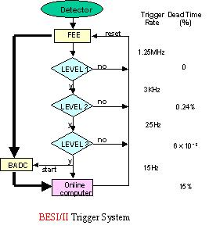
Trigger mode in early experiments
Stage processing
  Level one: logic process in one cycle(with fast signal)
  Level two: Logic processing in two cycles(with slow signals)
  Level three: decision by processor after digitization
First cycle
Second cycle

Slide 13
Trigger example with BESI/II
BEPCI
  low luminosity
  single bunch mode
  inter-bunch: 800ns
BESI/BESII trigger
  enough processing time
  latch-process-decision
  level 1,2,3

Slide 14
BES2 trigger
RUN1
RST
LIVE
CAMAC
RESETs
MHz
START
MINUS
BADC
GATEs
CLOCK
MHz
INQUIRE
100
4
1.25
BX
TMG0-2
PLL
DISCR
AMP
Scaler
TR53
TR5
*5
MASTER
TR51
北京譜仪触发判选系统框图
1999.9.11.
T0
LVL3
SAMPLE
HOLD
LVL1
LVL2
RUN3
RESET
LEVEL1
TR55B
LEVEL2
TR90
TR43
TR50
ACTIVE
B-B
>=1
>=2
>=4
electronics
>=2
>=1
>=2
>=1
>=2
Ntrk
Ntrk
Ntrk
To MU
Etof
Etof
TBB
Ntof
Ntof
Vtrk
Vtrk
Etrk
TR36B
Ntrk
RADIAL
-L
-H
Etrvs
Etot
Etot
Etot
ESC-
MU-OR
48
24
24
MATCH
TR37*3
VETO
-Add
TR38
G,R
-
-
48
G,R
TR28
Nhit
COMBNT
COMBNT
TR27
TR83
SDM2
MATCH
LATCH
OR
LATCH-
Nhit
TR14
TR15
TR84
TR16
TR42
Ntrk
48
Etot
Etot
TR32B*8
TRACK
8
8
8
48
48
40
16
16
2
SDM1
R
A
D
R
A
G,R
R,G
288
464
WINDOW
WINDOW
-LATCH
TR26*3
-LATCH
TR25*3
COMBNT
AND-
TR82*5
DISC-
TR11B*16
DAC TR17
TR12B*8
TR41*2
ADD
DISC
DISC-
ADD-
OR
Single bunch, 800ns spacing, enough time
TR31B
R,G
3/4
*36
MDC
ETOF
VC
1152
48
BTOF
480
96
BSC
560
ESC
460
MU
53

Slide 15
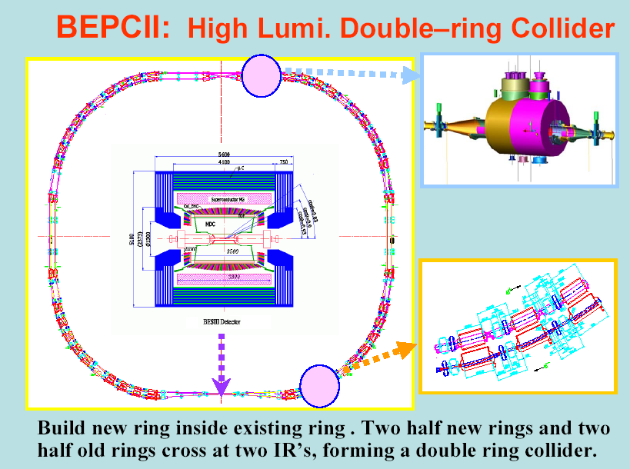
Example of BESIII at BEPCII
BEPCII
  high luminosity
  multi-bunch mode
  inter train: 48ns
  inter bunch: 8ns
BESIII+FEE
  new technology
  new design
  pipeline
Luminosity: 3~10×10³²cm⁻²s⁻¹ @ 3.77GeV

Slide 16
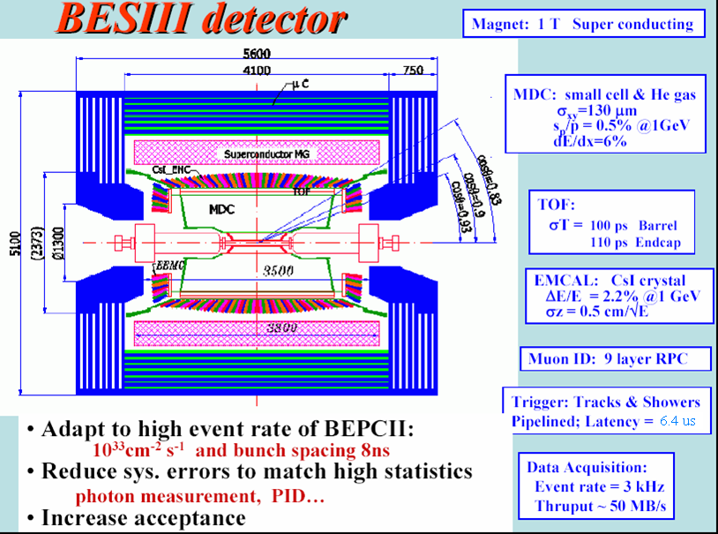

Slide 17
Pipeline working
To keep only pink hexagonal widgets moving down a conveyor belt.
IP
Storage Ring
Spectrometer
Saves only widgets
labeled “y”
Stamp “y” on the pink hexagonal widgets
Stamp “n” on the others
Collision cycles
DAQ
Trigger
y/n
y
n
n
y
y
SAVE
The problem is:
Working fast means you make some mistakes !
n
trash

Slide 18
Requirements: Decision Time
Each widget must get examined and stamped
- To decide on one before the next one comes along.
- The decision can’t take longer than Δt = d/v.
- Taking more time means making less mistakes.
Trigger
d
y/n
y
n
n
y
v

Slide 19
Requirements: Efficiency
Can’t stamp too many pink hexagonal widgets ”n”:
Trigger
DAQ
?
?
?
y/n
n
n
n
n
SAVE
n
n
n
trash

Slide 20
Requirements: Rejection
The rate of widgets stamped “y” can’t exceed the capacity of
the DAQ to save them.
Whenever the DAQ is busy saving something it causes “dead-time”
(he will miss the next few widgets). If he misses any marked “y”, this
causes a loss of efficiency.
Trigger
DAQ
y/n
y
y
y
y
y
SAVE
y
trash

Slide 21
Working in Steps: Pipelining
Have more than one person working in series
- Each individually one takes less than Δt = d/v
- Collectively, much more work is done
- A smarter decision can be made – less mistakes
Trigger
DAQ
d
y/n
y
n
n
y
y
v
SAVE
n
trash

Slide 22
BESIII Trigger System
BESIII requirement:
Trigger Rate
  Good event rate ~ 2000Hz
  Bhabha event rate ~800Hz
  Cosmicray rate <200Hz,
  rejection > 10:1
  Beam background <2000Hz,
  rejection > 10000:1
  Total event rate 4000 Hz
Pipeline processing in trigger
  BEPCII multibunch mode (93), spacing: 8ns
L1 uncertainty: 0.4 μs
Trigger latency: 6.4 μs
L1 used as index, not reference
Detector
Time Reference
0 s
Level 1
FEE
pipeline
6.4μs
Readout
buffer
switch
Event Filter
Farms
Disk
BESIII FEE pipeline and Data flow

Slide 23
Idea on BESIII trigger
Level I trigger
  Hardware
  Pipeline mode
  Isolation with fiber
Level 3 with CPU(event filter)
  Software
  Physics consideration

Slide 24
BESIII L1 trigger blockdiagram
Near Detectors
Counting Room
FC Daughters
High Lights: Optical Isolation-no ground loop current
Fast Control
TOF FEE
TOFPR
Hit/Seg Count
Global Trigger Logic
Track Match
MDC FEE
MFT
Track Seg. Finder
Track Finder
EMC FEE
Energy Balance
TCBA
TC Sum
Etotal Energy
Cluster Counting
L1P
MU FEE
FastOR
Mu track
BEPCII RF
TTC
499.8 MHz
41.65 MHz
6.4 μs

Slide 25
BESIII trigger scheme simulation
1:MakePattern
2:Generator
3:Det. Simu
4:Trig.Simu.
Patterns
Config data
Hits data
BESIII Turtle
BESIII Trigsimu
Graphics
BESIII Detector Simu
BES sober
Normal Output
Run(input cards)
Compile(Makefile)
Cosmic Ray
mkTSFcfg
mkPTDcfg
Effi. Plots via PAW
GetPattern
研究、比较了各种触发方案；研究了触发方案中各个参数的合理设置，并确定了径迹组合、阈值等

Slide 26
Definition of trigger conditions
Function
  TOF
    Timing and trigger for charged particles
    Background supression
  MDC
    Trigger for charged particles
    Background supression
  EMC
    Trigger for neutral particles
  Match
    Tracking match

Slide 27
Trigger table

Slide 28
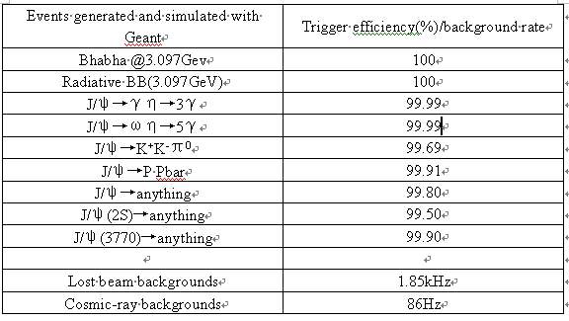
Trigger efficiency from simulation
Good enough. Fine tuning in commision

Slide 29
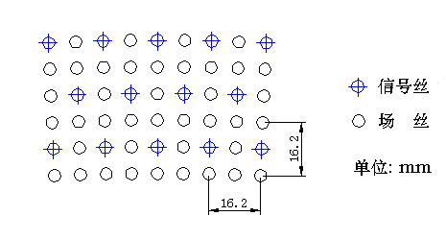
MDC subtrigger
Parameters of MDC trigger
Signal
Super Layer | Wire Layer | # of sig. |  |  |  | # of WL in SL | Pivot Layer | # of pivot cells SL
 |  | L1 | L2 | L3 | L4
SL-1 | ST-1/2/3/4 | 40 | 44 | 48 | 56 | 4 | 3 | 48
SL-2 | ST-5/6/7/8 | 64 | 72 | 80 | 80 | 4 | 3 | 80
SL-3 | AX-9/10/11/12 | 76 | 76 | 88 | 88 | 4 | 3 | 88
SL-4 | AX-13/14/15/16 | 100 | 100 | 112 | 112 | 4 | 3 | 112
SL-5 | AX-7/18/19/20 | 128 | 128 | 140 | 140 | 4 | 2 | 128
SL-6 | ST-21/22/23/24 | 160 | 160 | 160 | 160 | 4 | 2 | 160
SL-7 | ST-25/26/27/28 | 176 | 176 | 176 | 176 | 4 | 2 | 176
SL-8 | ST-29/30/31/32 | 208 | 208 | 208 | 208 | 4 | 2 | 208
SL-9 | ST-33/34/35/36 | 240 | 240 | 240 | 240 | 4 | 2 | 240
SL-10 | AX-37/38/39/40 | 256 | 256 | 256 | 256 | 4 | 2 | 256
SL-11 | AX-41/42/43 | 288 | 288 | 288 | 0 | 3 | 2 | 288
Total | 43 | 6796 |  |  |  | / | / | 1784
Field
Inner layers
Pivotal layers
Axial layers
Not used layers
To simplify the hardware implementations, super layers 1st – 5th and 10th are used as MDC trigger sources

Slide 30
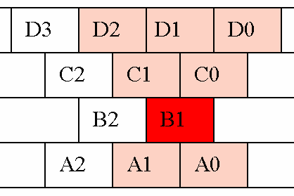
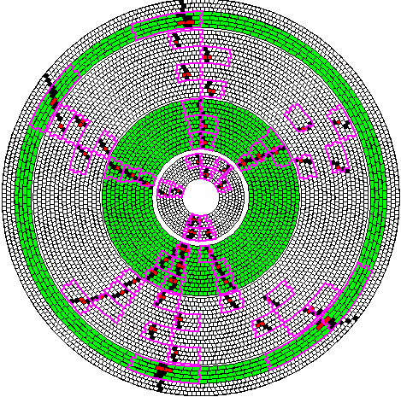
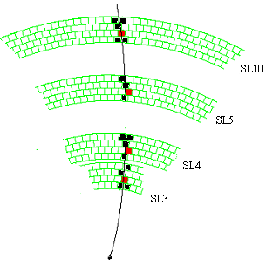
TSF
Layer D
Short Track
Layer C
Layer B (PL)
Layer A
TF
Pivot SL
Long Track

Slide 31
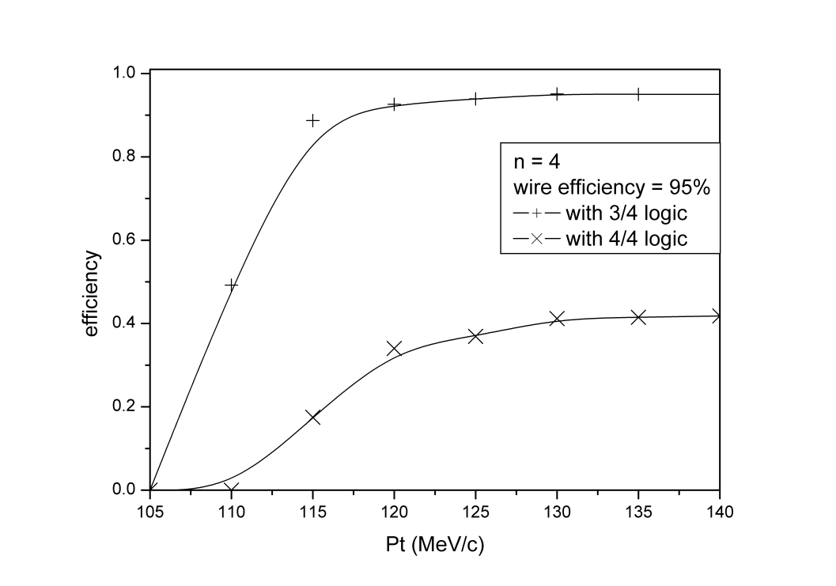
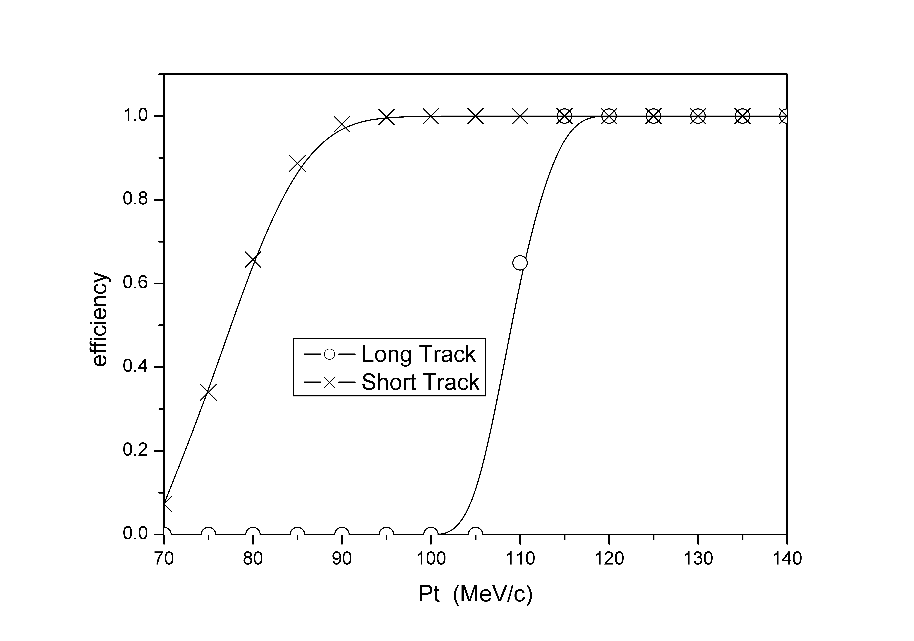
Some results of simulation
Relations between TSF efficiency and pt
Relations between TF efficiency and pt

Slide 32
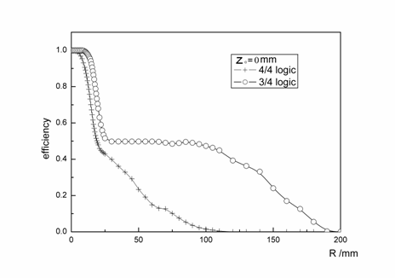
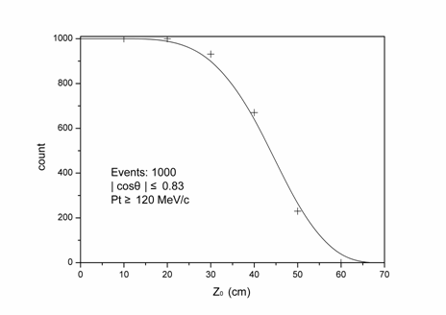
Some results of simulation (2)
The track finding efficiencies in the r-φ plane and Z direction.
  For a distance of 15 cm in the r-φ plane, the TF efficiency is about 30% for 3/4 TSF logic.
  For a distance of 50 cm in the Z direction, TF efficiency is about 30%.
It is good to reject backgrounds far from the Interaction Point

Slide 33
MDC trigger condition
NLtrk≥1 | Number of long track ≥1；
NLtrk≥2 | Number of long track ≥2；
NLtrk≥N | for MDC wires’ hits of high voltage sudden discharge
NStrk≥1 | Number of short track ≥1；
NStrk≥2 | Number of short track ≥ 2；
NStrk≥N | for MDC wires’ hits of high voltage sudden discharge ；
STrk-BB | Short Tracks back to back ；
NItrk≥1* | Number of the Track Segments of the SL1 and SL2 are equal to or greater than 1；
NItrk≥2* | Number of the Track Segments of the SL1 and SL2 are equal to or greater than 2。
10 trigger conditions of the MDC trigger are used in BESIII trigger system
3 charged channels：
  Charge1：NLtrk≥1 + Ntof≥1（Number of Hits of TOF）+ Etot-l (Low threshold of the whole EMC total energy，~200MeV)
  Charge2：NLtrk≥1 + NStrk≥2
  Charge3：STrk-BB
* NItrk >= 1 and NItrk >= 2 are for backups to reject
beam-related backgrounds.

Slide 34
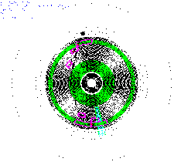
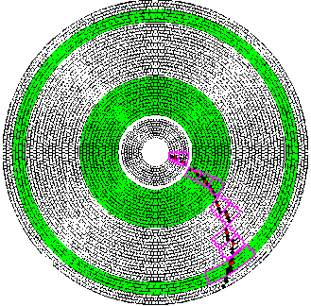
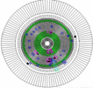
Trigger efficiency for different chanels
Physical channels | Rate of passed charged channels | Rate of passed Global trigger
J/ψ → Anything
95.38％
97.66％
99.79%
Good Event
J/ψ→ K⁺K－
95.58%
97.39%
99.68%
J/ψ→
95.54%
97.94%
/
J/ψ→
95.08%
95.82%
99.91%
ψ′→ Anything
97.72%
99.5%
99.96%
ψ〞→ → Anything
97.85%
99.9%
99.97%
Cosmic-ray | / | 18Hz | 18Hz
Beam related background | / | 99.9961%* | 1560Hz
( rejection)
Cosmic
BeamLost 1
BeamLost 2

Slide 35
MDC hardware implimentation
128
Long Track Counter
3
MDC Trigger Conditions
80 ch
Track
Finder
×1 LTKC
9
MDC
Q&T
MDC Fiber
Transmitter
128
Short Track Counter
4
1.75Gb/s
×8 TKF
TO
GTL
×96
Optical
Channels
16 ch
Inner- layer Track Finder
×1 STKC
×96 MFT
2
MDC Electronic Crates
×2 ITKF
MDC Trigger Crate
 | Type of PCB | Board name | # of boards | FPGA firmware
MDC Fiber Transmitter | 1 | MFT | 96 | 1
TracK Finder | 1 | ITKF | 2 | 2
 |  | TKF | 8 | 8
TracK Counter | 1 | LTKC | 1 | 1
 |  | STKC | 1 | 1
MDC Trigger Backplane | 1 | MTB | 1
Total | 4 |  | 109 | 13
MTB
ITKF
TKF

Slide 36
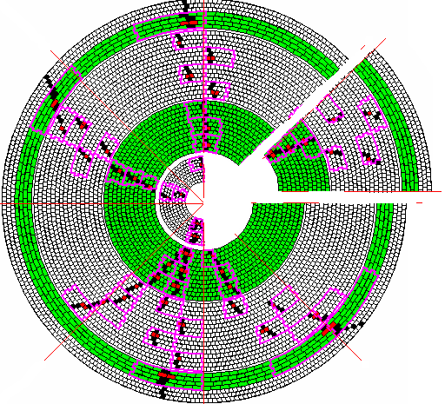
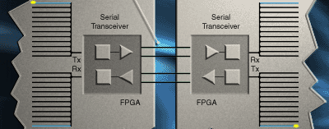
challenges
Sectors division and inter-link of neighbour boards
  Too many inter-link signals between TKF boards:
  Input 89, output 89, total 178
  To reduce cable connect, VME Back-of-Crate card is used in MDC trigger crate to inter-link neighbour boards.
RocketIO
  All logic, serial-to-parallel and serial-to-parallel are implemented in a Virtex-II Pro FPGA. It has RocketIO Multi-Gigabit Transceivers. The MGTs are flexible parallel-to-serial and serial-to-parallel embedded transceiver cores used for high speed data transfer.
  Trigger system data transmission:
  41.65MHz clock, 32-bit, 8b/10b, comma, idle, COR...
  Data transfer rate will be up to 1.75Gb/s each channel, 17.5Gb/s each board.

Slide 37
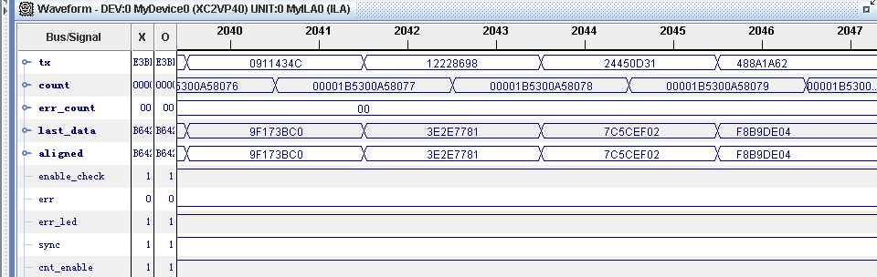
Optical transmission
MGT
MGT
HFBR5921L
HFBR5921L
TXP
TD+
TXP
TD+
TD-
PRBS
Data Generate
TXN
TD-
RD
TD
TD
RD
TXN
Data Aligned
& Checker
TXDATA
(31:0)
RXDATA
(31:0)
RXP
RD+
RXP
RD+
RD-
RXN
RD-
RXN
FPGA
FPGA
MFT
TKF
Tx Data
Total periods
# of errors
Rx random data
Rx data
errors
1
BER ＝
<
≈
8.3×10⁻¹⁶
periods × 40
3.0×10e13 × 40

Slide 38
Hardware task sharing
Xilinx VirtexII Pro
RocketIO 1.6Gbps
32bits de/serialization
MFT: one fiber per board
TKF: 8 boards hardware same
FPGA software similar
Backplane
TKF
Board
TKF
Board
TKF
Board
TKF
Board
MTC
Board
（×2）
MFT
Board
TKF
Board
(×8)
MDC Q&T Board
TKF
Board
TKC
Board
（×2）
80+16
Optical Fibers
TKF
Board
MFT
Board
TKF
Board
(×8)
MFT
Board
MFT
Board
MFT
Board
MFT
Board
MFT
Board
Trigger conditions
MFT
Board
TF Out
Ltk(0:15)
Stk(0:15)
data
ITF
Board
ITKF
Board
(×2)
data
MDC FEE crates
data
VME BUS
MDC trigger crate

Slide 39
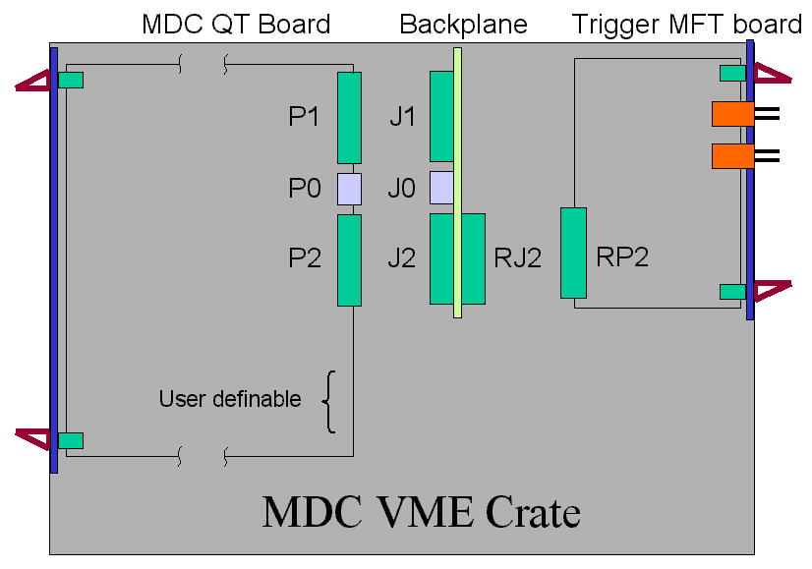
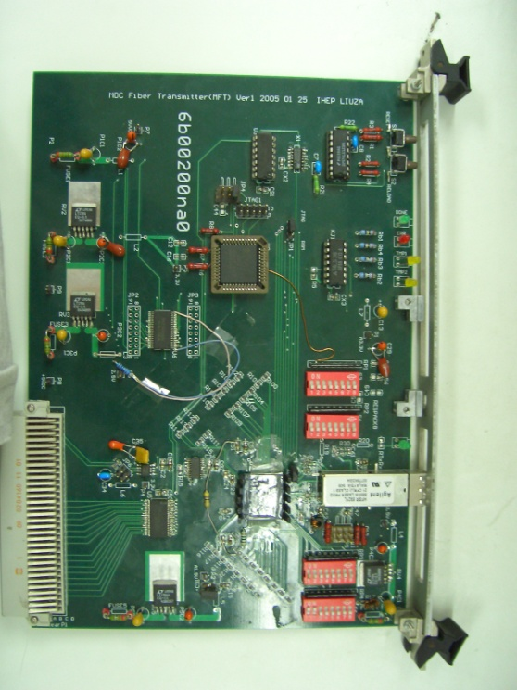
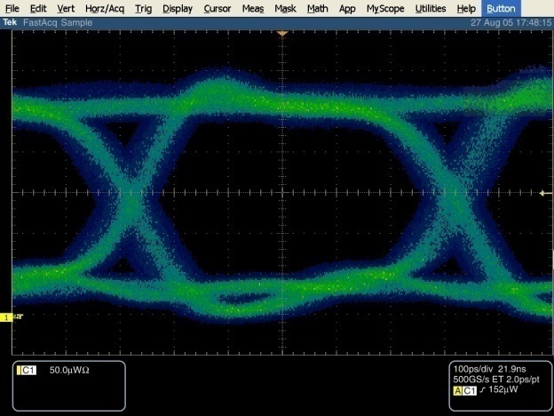
MFT (MDC Fiber Transmitter)
2796 hits signals from MDC QT boards are collected in MFT, 32 channels per MFT
Optical fibers are used between MFT and TKF(ITKF) to eliminate common-ground noises
Virtex-II Pro FPGA: XC2VP2
8 layers PCB

Slide 40
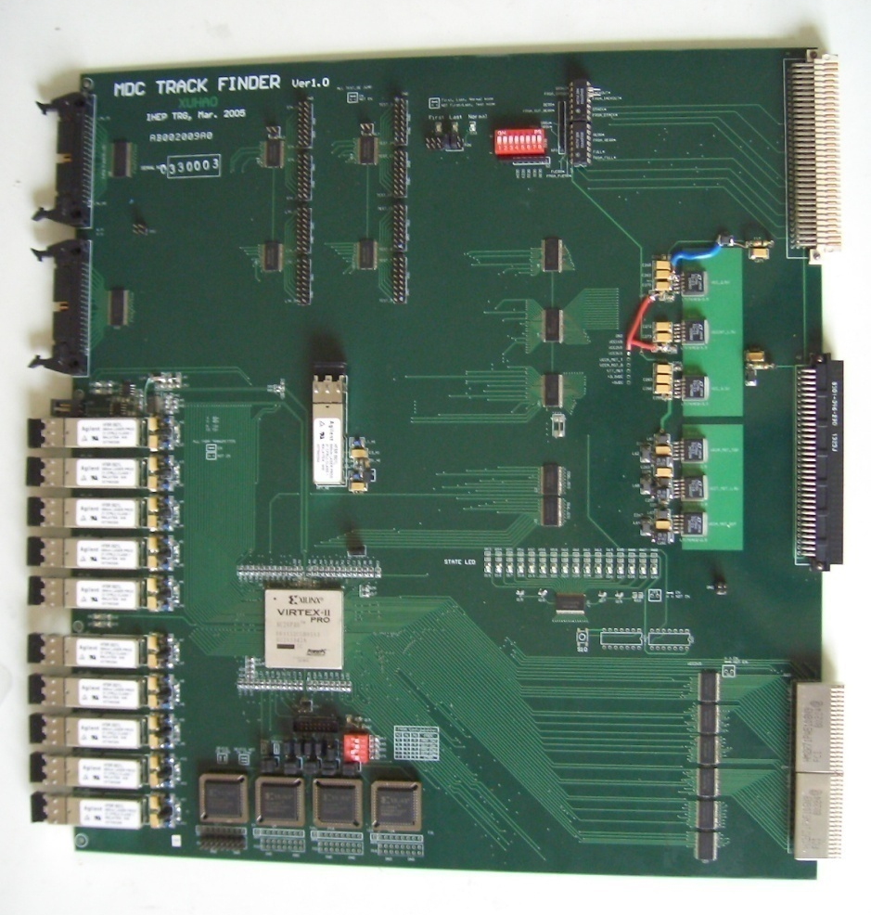
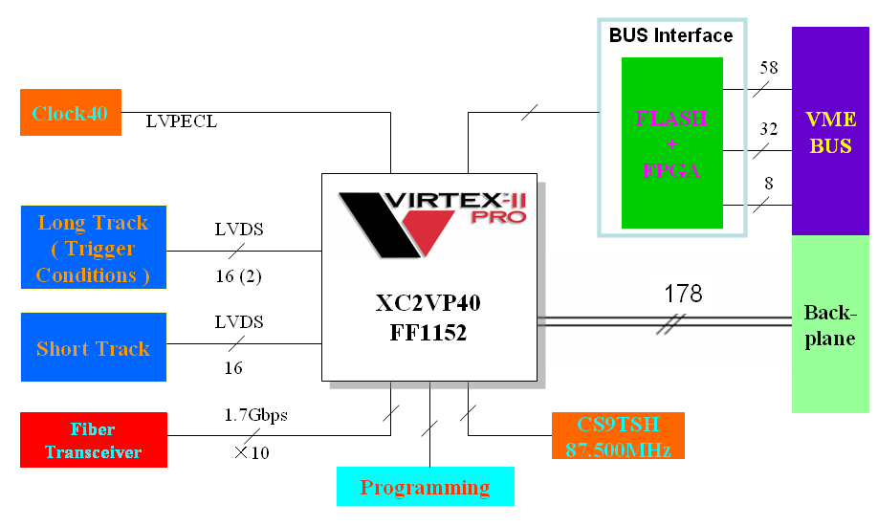
TKF (TracK Finder)
XC2VP40 : FF1152, 804 user IOs, 43,632 logic cells, 3,456Kbit BRAM,
12 RocketIOs, 2 PowerPCs, 192 multiplier blocks
10 layers 9UVME PCB
Functions:
  TSF
  TF
  Track information
HFBR5921L
XC2VP40

Slide 41
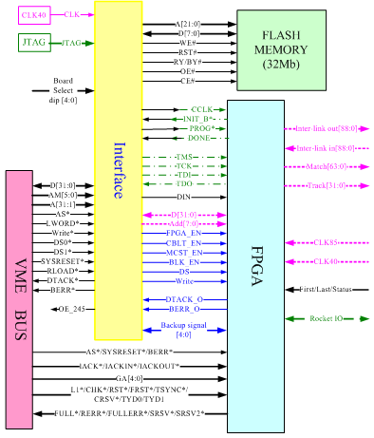

Slide 42
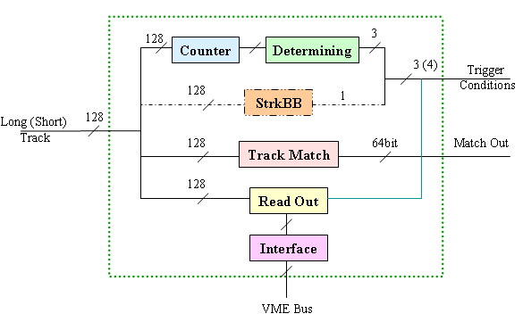
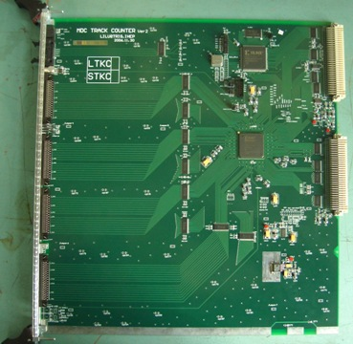
TKC (TracK Counter)径迹计数板
LTKC（Long TracK Counter）receives the number of long tracks from TKF and sends the trigger conditions to global trigger
STKC （Short TracK Counter） receives the number of short tracks from TKF and sends the trigger conditions to global trigger
8 layers PCB

Slide 43
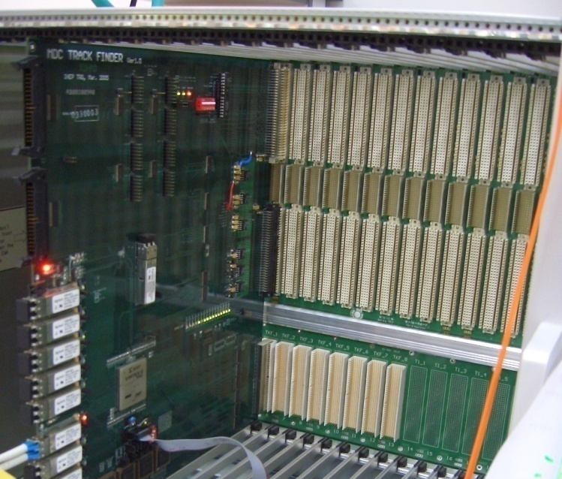
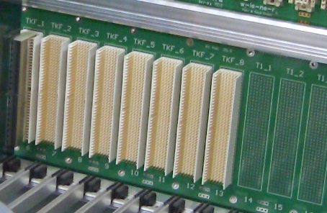
MTB (MDC Trigger Backplane)
Inter-link neighbour boards, to reduce the cables.
12 layers PCB
SI & EMC

Slide 44
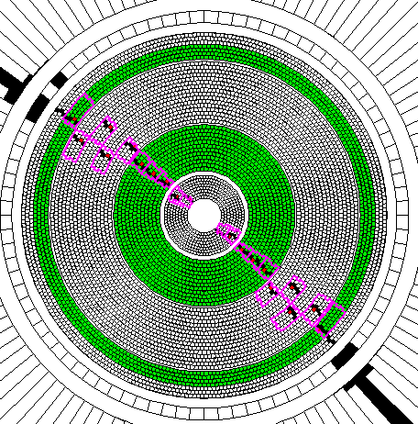
TOF subtrigger
Match
Trg cond.
Fast contr
Hit number/击中数
  NBtof>=1, NBtof>=2
  Netof>=1,Netof>=2
Barel back to back/桶部背对背 TBB
  Pt>837MeV
  12cells(3x2x2+1),53 °
Endcap back to back/端盖背对背 ETBB
  Pt>551MeV
  8cells(2x2x2+1),67 °
Track match/径迹配对信息（TKM）:
  TBhits(88),Tehits(48)
CLK
TOF trigger
9UVME
Opt-fiber
EndCap TOF FEE
Barrel TOF FEE，Mean Timer
TOF trigger block
Barrel:88 Endcap:48

Slide 45
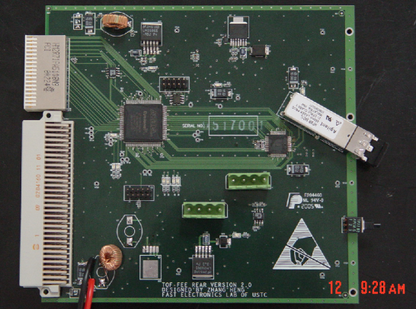
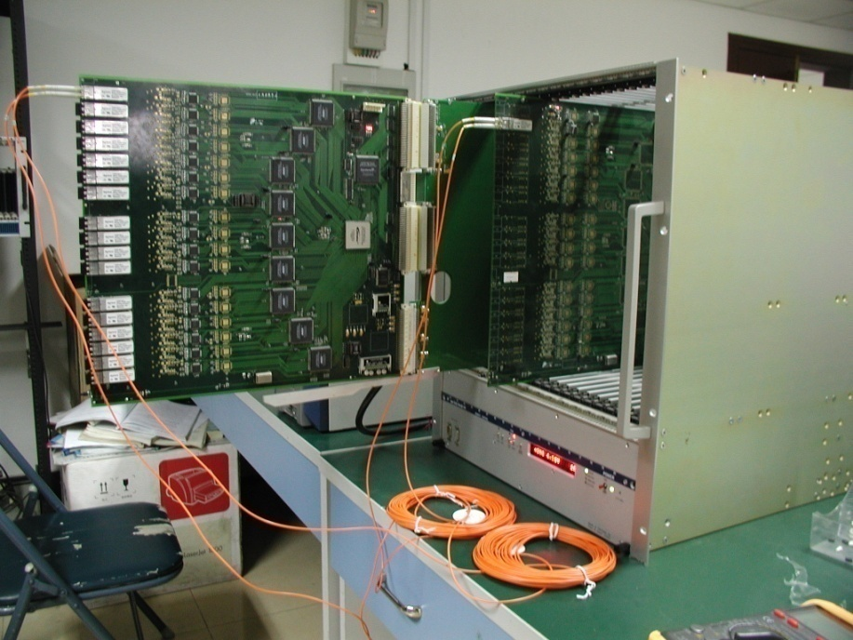
TOF trigger modules
14 FEE_Rear modules
  Transmitting mean timer signals to trigger
  The 2nd version has been tested
  Self- Synchronization
1 TOF sub-trigger module
  upgradable
  Firmware online modification/reconfiguration
  Dead time loss
  optical fiber transmission
    Minimized # of signal channels
    Decreased signal loss
    Decreased interference
  FPGA, simple and reliable

Slide 46
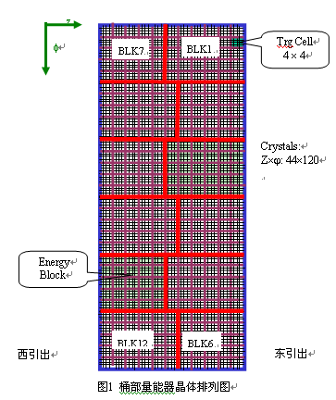
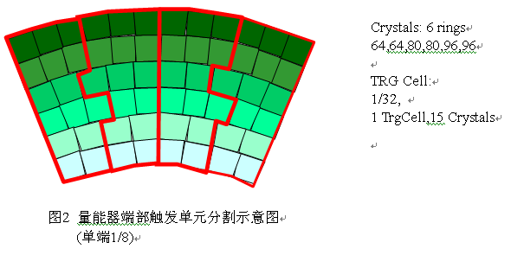
EMC subtrigger

Slide 47
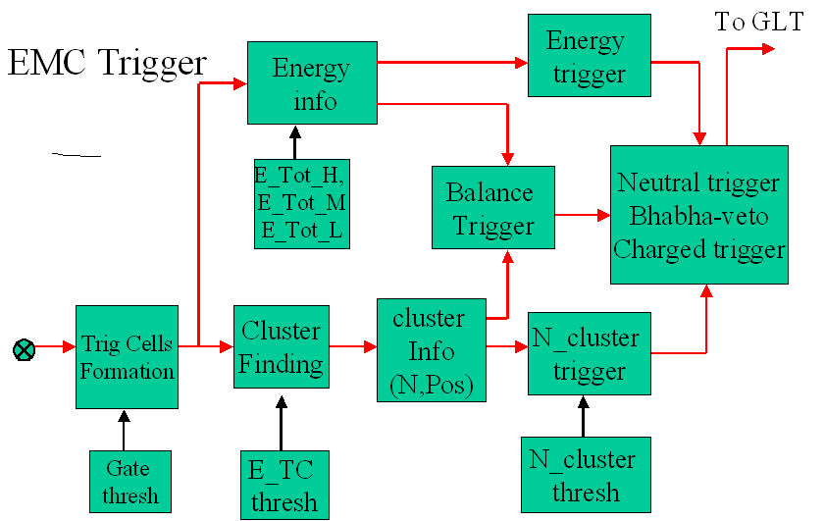
EMC Trigger
Etot, Ncluster, Balance, Position in phi, theta

Slide 48
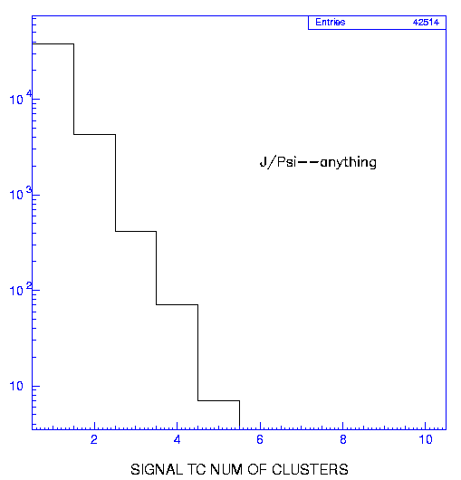
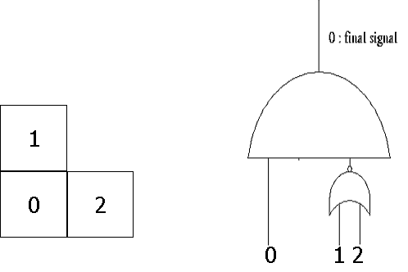
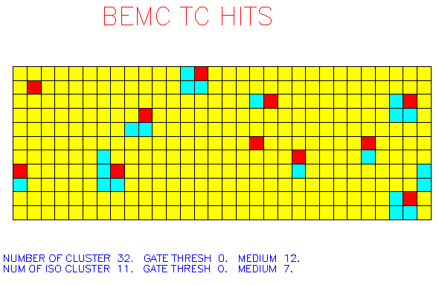
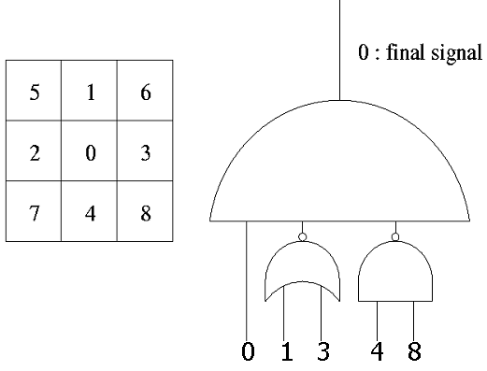
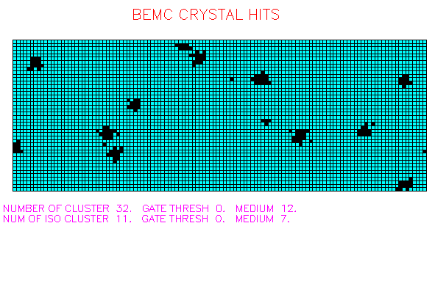
TC and Isolated Cluster finding
Barrel
Endcap
选取该组最右上角（即θ，φ向编号较大）中的触发单元为簇团位置。

Slide 49
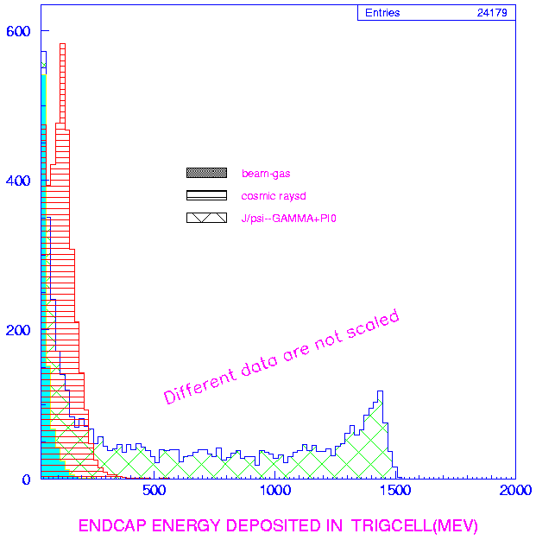
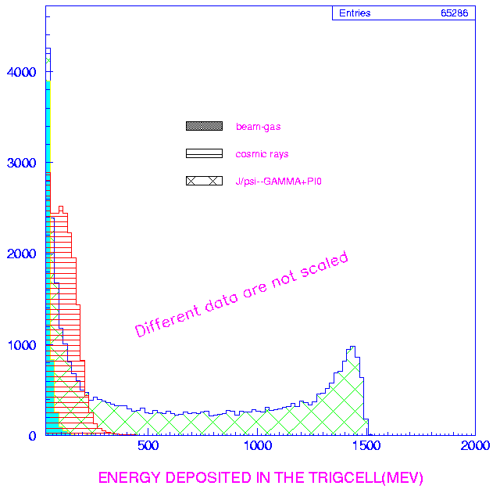
TC threshold selection 阈值的选取
barrel
Endcap
考虑信号堆积和基线涨落的限制，触发单元能量阈值确定为60—80Mev之间。
图中可见，束流—气体的本底的能谱集中在低能段，60—80Mev的触发单元能量阈值有能力排除在触发单元中单独沉积能量的束流本底

Slide 50
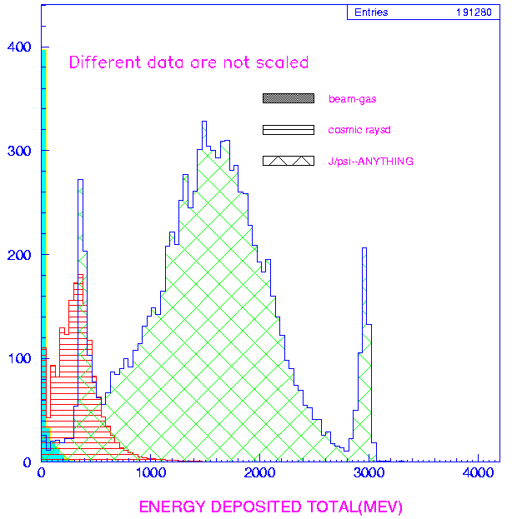
Total energy
Etot-L (~200MeV)
Threshold for background events
Etot-M (~800MeV)
Threshold for neutral events
Etot-H (~2.5GeV)
Threshold for bhabha event

Slide 51
EMC trigger conditions 触发条件
NClus>=1 Cluster number (>=1 for EMC timming)
NClus>=2
BclusBB Back to back cluster
EclusBB
Clus_PHI Cluster balance at ϕ
Clus_Z One cluser at each half of EMC
Diff_B Energy difference between each B half
Diff_E Energy difference between each E half
BL_BEMC Energy Balance between half BEMC
BL_BLK Energy Balance of barrel blocks
BL_EEMC Energy Balance between half EEMC
BL_Z Z energy balance (B+E)
Etot_L Total Energy >Thre-l
Etot_M Total Energy >Thre-m
BEtot_H Total energy of Barrel EMC
EEtot_H Total energy of Endcap EMC
To TKM:
  Bemc(40),Eemc(48)

Slide 52
EMC sub-trigger
TCBA:
  CCD base line restoration
  Input:twisted pair
  Time extraction and cluster signal
  Block energy sum and digitization with Flash ADC
  Fiber transmittion
CSUM:
  Cluster finding
  Cluster relative condition production
  Condition forming
ETOT:
  Total Energy cut conditions production
  Condition forming
12
ETOT
(1)
TCBA
（12）
E Condition(10)
MA
16ch
Adding
12×30
Barrel
(5280)
2
2×32
CSUM
(1)
C Condition(6)
Endcap
(1024)
TCBA
(2)
12
2
TRK Comb.
optical fiber

Slide 53
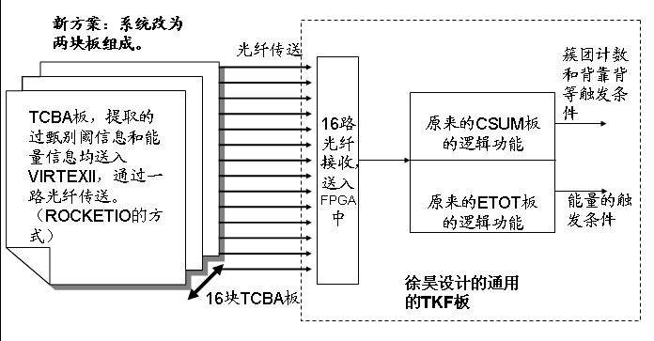
Implimentation of EMC subtrigger

Slide 54
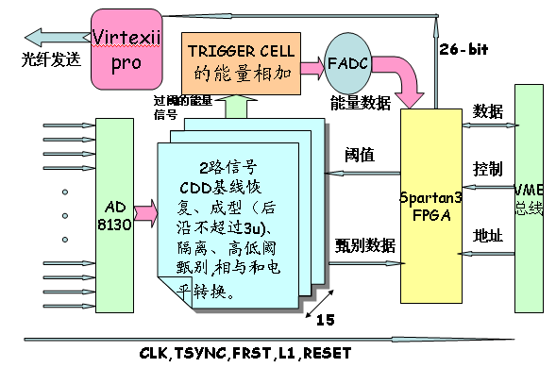
TCBA板原理框图

Slide 55
Global Trigger and Fast Control
总触发GLT子系统和快控制子系统
Trigger
Conditions
GTL
Level shift
3
40
Programmable
Pipeline delay
3
Programmable
Trigger Event
SAF
Decision
E-TYPE
Programmable
Multi-Scaler
TDC
Pre-scale
GLT
Reset
Trigger EVT
To 触发系统
FCS
FCTL
FCSF
TROC
加速器RF
光纤
时钟处理板
CLKF
快控制信号
FCDB
TOF电子学
To 电子学系统

Slide 56
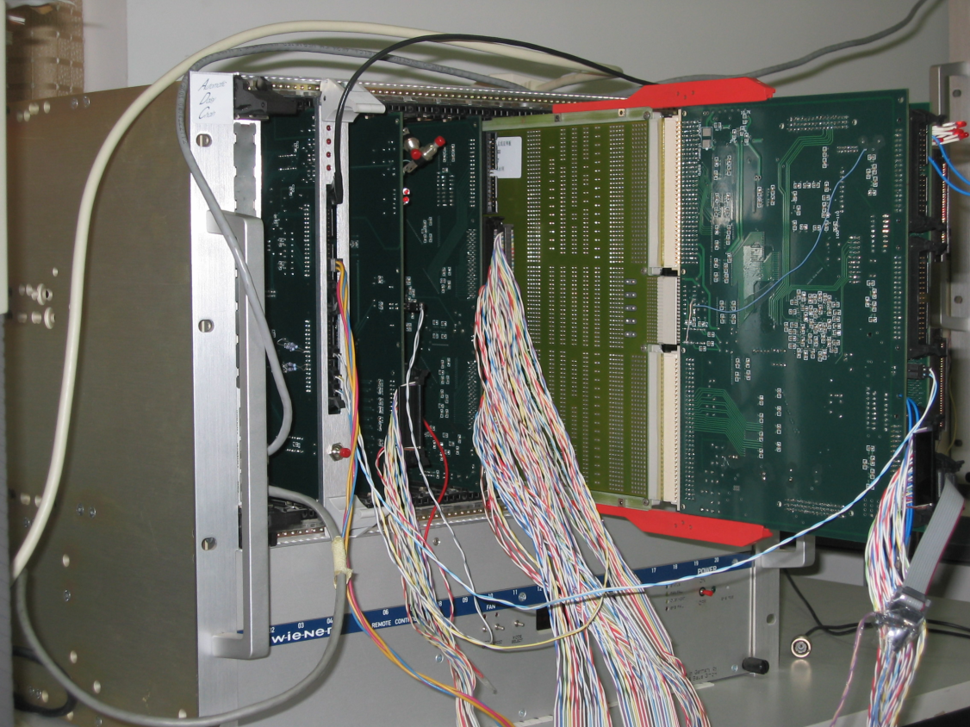

Global trigger
定标器
SAF 与GTL 插件

Slide 57
System Clock and Fast Control
RF
499
MHz
bunch
Sysclock
41
.
6
MHz
其他
可能
的
分频
结果
GLT
Pick
-
up
L1, Typ0,Typ1,Busy
To trigger
FCS
FCTL
FCSF
Pickup
TROC
Sync
RF
clock
Clock
Generator
optical
CLKF
Fast control
FCDB
TOFElectronics
To electronics

Slide 58



Installation cont’d
Fast Control
TDC
MDC
Trigger
EMC/TOF/GTL
Trigger
Optical Fibers
Optical
Cables
PCI based Multi-Channel Scaler

Slide 59
BESIII DAQ System/
BESIII数据获取系统
From KejunZhu
系统负责人 朱科军
首先要对数据获取系统单位时间内需要处理的数据量（事例率*平均事例大小）作出正确地估算

Slide 60
BESIII DAQ design parameters设计指标
Trigger rate/触发率： 4KHz
Event size/事例长度：12KB
Data bandwidth/数据带宽：48MB/s
Deardtime/死时间： < 5%
Sub-Detector | Channels
MDC (T+Q) | 6796+6796
EMC | 6240
TOF (T+Q) | 448+448
MUC | 9088
Total | ~ 30K
1000 * BESII DAQ

Slide 61
Function requirement功能需求
Data acquisition, including data readout, packing and online filtering/数据获取，包括数据读出、组装和在线过滤等
Data storage/数据存储
Run control/运行控制
Data monitoring, like event display, Histogram plots/数据监测，如单事例、直方图显示
Configuration data base/配置数据库
Error reporting/报错和容错

Slide 62
Techniques/技术措施
distributed paralell computing, layered structure/分布式并行计算、层次结构
Multithreading technology, OO/多线程技术、面向对象
network exchange based/基于网络交换技术
  A multi-processor distributed environment
  Parallel data streams working independently and concurrently
multilayer data buffering/多级数据缓存
upgradable and scalable/易升级和扩展
reliable and stable/系统可靠、稳定

Slide 63
Data size
Sudetector/ 子探测器 | # of Channels/ 通道数 | # of Crates/ 机箱数 | Average hit rate/ 平均击中率 | Single crate data/ 单机箱数据量 （B） | Total data/ 总数据量 （KB）
MDC | ~ 7000 | 16 | 10% | 400 | 6.4
TOF | 448 | 2 | 10% | 200 | 0.4
EMC | ~ 6200 | 16 | 17% | 350 | 5.6
MUC | ~ 9000 | 1 | 1% | 200 | 0.2
TRG | ~ 400 | 4 | 100% | 400 | 1.6
Total/合计 |  |  |  |  | 12.6 + 1.6

Slide 64
DAQ system components
FEE readout: Data reaout from Module by PowerPC via VME BUS
  CBLT (Chained Block Transfer) DMA readout mode
  Multi-events reading
Data stream: by network
  Module→ PowerPC→ Readout PC→ online farm→ server →CC
Online software: control and management in data taking, test and calibration, in addition to error reporting, run parameter management and realtime monitoring
Frame work similar to ATLAS TDAQ software

Slide 65


DAQ基本框架
VME based

Slide 66
FEE/VME readout and processing（1）
Single VMEbus read/write
  Average R/W operation: 1.7 / 1.1μs
  At 4KHz rate, single crate readout time: 1.7μs×100×4000=0.68s
DMA mode for big data transmission(reliase CPU)
  Average time for 4 bytes: 0.3μs
  At 4KHz rate, single crate readout time: 0.3μs×100×4000=0.12s
Network transmission
  50% CPU for 100Mbps speed

Slide 67
BESIII DAQ framework

Slide 68
Control and data flowchart

Slide 69
Future trend in Trigger and DAQ (TDAQ/TDAS)
未来触发与数据获取的发展
Brief introduction to other TDAQ/其他实验的TDAQ简介
Future trend in TDAQ/未来TDAQ的发展趋势
  Hardware trigger-less(data driven trigger)
  Moving from VME to xTCA
  Example: PANDA Experiment

Slide 70
Constrains → a multi-parameters problem
Detector Environment
Pileup
Multiple Interactions
Beam-gas Interactions
Bunch Spacing
Sustained Duty
Cycle
Bunch Train
Length
Trigger and DAQ go hand in hand
Accelerator
Upgradability
Trigger Complexity
What is required to make
the decision?
Simple Jet Finding
Complex Track Finding
Inter-detector Correlations
Cost
Trigger Requirements
Rejection
% Deadtime
Input/Output Rate
Physics
Implementation
Multi Level
Low level feature extraction
  ASIC, PLA, etc.
Farms
  PC Platforms
  Transfer Technology
  ATM, Gigabit, etc.
Technology/Capability Trade
off.
DAQ
Output
Accept Rate
Archive Ability
Reconstruction Capability
Moore’s Law for Triggers
Offline
Cost

Slide 71
World leading experiments
Exp.
Collision rate
Channel
count
L1A
rate
Event building
Processing.
Power
Sociology
Year
UA’s
3 µsec
-
-
-
5-10 MIPS
150-200
1980
LEP
10-20 µsec
250 - 500K
-
10 Mbit/sec
100 MIPS
300-500
1989
BESI/II
800nsec
-
15
1989
BaBar
4 ns
150K
2 KHz
400 Mbit/s
1000 MIPS
400
1999
Tevatron
396 ns
~ 800 K
10 - 50 KHz
4-10 Gbit/sec
5.10⁴ MIPS
500
2002
LHC
25 ns
200 M*
100 KHz
20-500 Gbit/s
>10⁶ MIPS
2500
2007
BESIII
8 ns
100K
4 KHz
400 Mbit/s
2008
ILC
330 ns
900 M*
3 KHz
10 Gbit/s
~10⁶ MIPS ?
> 3000 ?
2020 ?

Slide 72
Multilevel trigger widely used
Required rejection is orders of magnitude
  Algorithms to attain required rejection are too sophisticated.
  Accelerator backgrounds can also contribute to the problem
    → e⁺e⁻ vs pp
Level 1 is hardware based
  Crude signatures (hits, local energy deposit over threshold…)
  Operates on reduced or coarse detector data
Level 2 is often a composite
  Hardware to preprocess data
    Some Muon processors, Silicon Triggers
  Software to combine
    Matches, Jet finders, etc.
Level 3 is a farm → General Purpose CPUs
Almost every one uses this scheme
  Vary number and function of levels.

Slide 73
Trigger structure for Tevatron at FNAL (RUN 2)
7.6 MHz Xing rate
CDF
7.6 MHz Xing rate
D0
Detector
Detector
L1 Buffer
Pipeline)
L1 Buffer
Pipeline)
L1 Trigger
L1 Trigger
Accept
4 µs latency
10 KHz
Accept
4.2 µs
50 KHz
L2 Buffer
&
digitization
Preprocessing
Farm
L2 Buffer
L2 Trigger
L2
L2 Global
Asynchronous
20 µs latency
100 µs latency
Acc/rej
< 1KHz
Acce/rej
< 1KHz
48 Input nodes
1 s latency
L3 Farm
64 PCs
L3 Farm
20-50 Hz
Mass
Storage
Mass
Storage

Slide 74
Trigger for Experiments at LHC
40 MHz
“Local” identification of high Pt objects → use coarse dedicated data
  Electrons /Photons , Hadrons & Jets → Energy clusters
  Muons →Track segments
  Neutrinos → Missing Et
Particle signature (e/g,h,Jet, µ ...) → use final digitized data
  Refine Pt cuts → fine granularity & track reconstruction
  Combine detectors → Converted electron ,“Punchthrough”, decays
Global topology → multiplicity & thresholds
Identification & classification of physics process → trigger menu
  Partial event reconstruction → Vertices , Masses ,Missing Et....
Physics analysis
  “Off-line” type analysis of classified events
L1
100 KHz
L2
1 KHz
3
L3
L3
100 Hz

Slide 75
Logical structure at LHC
CMS
ATLAS
Sub- Detectors
40 MHz
Synchronous
Custom made
Hardware pipelined
rigger processor
Level 1
Front end buffers
( ~10⁷ channels)
Level 1
2.5 μs
fixed
1000 - 1500Gbit/s
100 KHz
Region Of Interest
ROI
Asynchronous
Commercial DSPs,
RISCs, etc.
Read Out Buffers
1000-1500 units
few m s
variable
Level 2
1KHz
20 Gbit/s
250-500 Gbit/s
10KHz
100 Mbit/sec
1 Gbit/sec
1000 x1000
256 x 256
Switching Network
(Event builder)
“Virtual”
level 2
Farms of RISCs,
workstations, etc.
Processor farm
(~2 to 5 x 10 MIPS)
High
Levels
Level 3
6
1-10 s
variable
10 Gbit/s
100 Hz
Permanent storage
100 MBytes/sec --> TBytes/day

Slide 76

Multi-layer trigger structure at LHC
Production Rate
# / sec
8
QCD
10
Hardwired processors
(ASIC , FPGA)
6
10
Level 1
4
H
L
T
10
Level 2
Standard CPUs farms
& Networks
2
Level 3
10
W,Z
0
Top
10
Z’
- 2
Recorded
Events
10
Higgs
25ns
few µsec
~ms
> Sec
- 8
- 6
- 4
- 2
0
2
10
10
10
10
10
10

Slide 77
Trigger evolution (Tevatron,LHC …)
Higher level trigger decisions are migrating to the lower levels → Software Migration is following functional migration
  Correlations that used to be done at Level 2 or Level 3 in are now done at Level 1.
  More complex trigger (impact parameter!) decisions at earlier times (HLT) → Less bandwidth out of detector?
Boundaries
  L2 and L3 are merging into High Levels Triggers
  DAQ and trigger data flow are merging
  On-line and off-line boundaries are flexible
Recent Developments in Electronics
  Line between software and hardware is blurring
  Complex Algorithms in hardware (FPGAs)
  Possible to have logic designs change after board layout
  Fully commercial components for high levels.
Hardware
Triggers
Characteristics
Function
Software
Triggers

Slide 78
Summary of T/DAQ structure evolution
结构演变小结
L1
L1
hardware
Today
  Tree structure and partitions
  Processing farms at very highest levels
  Trigger and DAQ dataflow are merging
Near future
  Data and control networks merged(Belle2link)
  Processing farm already at L2 (HLT)
  More complex algorithms are moving on line
  Boundaries between on-line and off-line are flexible
  Commodity components at HLT
L2
HLT
L3
On-line
Analysis
farm
Off-line
Analysis
Pass1
Analysis
Pass2
Analysis
Pass2

Slide 79
VME to xTCA
Developments in DESY,FNAL,IHEP,SLAC
Yearly Workshops in IEEE/NPSS society
Yearly Workshops at DESY
Application in experiments

Slide 80

范例：PANDA实验对TDAQ系统
要求
  预计打靶所产生反应事例率在20MHz（预留50MHz的处理能力)，通过前端电子学进行初步的噪声压低及数据筛选，事例大小在4kB到8kB（处决于最终探测器的选择），TDAQ系统需要处理的数据通量达到200GB/s;
在线触发与数据获取系统需要具有高速数据传输、大数据量缓存及快速数据处理的能力(事例重建)

Slide 81

PANDA触发与数据获取系统体系结构
采用自触发前端电子学及数据推动的结构(Self-triggered Data Push Architecture)，没有独立的触发数据通路(hardware trigger-less)，采用打全局时间戳的办法来对齐事例，同时解除了对触发Latency的限制.
L1:特征提取：来自前端的数据被打上精确的时间戳(Timestamp)后送入公共数据缓冲区；若干高性能的计算节点（Compute Node）通过高速串行传输技术组成可重配置的高速互联网络，采用多种特征提取手段挑选出感兴趣的物理信息；
L2:事例重建与筛选：L1提取的物理信息在L2进行基本事例重建，通过事例筛选来压缩数据量，经过L2的数据最后存储进海量存储设备供离线数据分析；

Slide 82


通用硬件平台—计算节点（高能所设计）
它是构成PANDA TDAQ系统的核心模块，
具有以下特点：
大容量数据处理能力
5x (Virtex4 FX 60 FPGA + 2GB DDR2)
高数据传输带宽
6 个千兆网口(包括背板的)
8 个光纤口(到3.125Gbps)
13个RocketIOs通过背板与同机箱内的其他板进行点对点的互联
嵌入式设计方式
通用的系统+专用的数据处理模块
智能平台管理
基于板上IPMC子板与机箱控制器的通信来实现系统监测及管理功能

Slide 83


通用高性能硬件平台
NFS服务器
串口服务器
交换机
高能所
德国吉森大学
机箱电源
机箱控制器
计算节点

Slide 84

通用硬件平台—计算节点
板级监测
控制管理

Slide 85

System on Programmable Chip
Trigger IP core
PowerPC
Gigabit Eth MAC
Optical Link core
基于Xilinx FPGA内嵌的PowerPC硬核和一些开源的IP和构建一个通用的硬件系统,移植开源Linux来实现系统管理以及UDP/TCP 协议栈的处理
在线触发算法设计成专用IP核以及基于多端口内存控制器实现片上数据交换模块

Slide 86
数据流的问题
从高速光口接收到的粗数据在DDR2内缓存（通过PLB主设备：低延时，高带宽）
数据从DDR2发送到触发算法IP核以及处理结果写回DDR2（通过LocalLink DMA设备，更加灵活，高带宽）
结果通过Gigabit Ethernet送出（通过UDP/TCP，标准设计）

Slide 87
EMC探测器
Barrel EMC:
11360块晶体

Slide 88
EMC TDAQ系统框图
First Stage
Second Stage
Read Out
Module
Compute
Node
Compute
Node
EMC info.
Compute
Node
Read Out
Module
Compute
Node
Compute
Node
Compute
Node
Read Out
Module
光纤连接
假设:150 Crystal/Module
10 Compute Node
other detectors info.
Barrel EMC需要76个Module
SODA
SODA
SODA
SODA: Synchronization Of Data Acquisition
1. Signal Feature extraction
(Time, Amplitude)
2. Data Zero suppression
1. Clustering
2. Cluster Properties
extraction
3. Pattern recognition
1. Correlation
2. Physical parameters
calculation
3. Event building
任务

Slide 89

簇团重建需要解决的问题
重叠簇团的处理
重建簇团信息:能量,位置
簇团查找
在线簇团重建：速度，效率

Slide 90
二维簇团查找算法

Slide 91

寻找区域最大值
为了避免找到假的区域最大值，需要选择更加严格的判选条件
Eseed>20MeV
ERatio<ERatioCut
ERationCut
1.0
0.028
0.009
fCutSlope
0.006
0.438
0.009
Split offs
and hadrons
Merged π
and photons
0.045
Unit: GeV
一个模拟的簇团有一个区域最大值以及6个相邻晶体
Number of Neighbors
0.0
fCutoffset

Slide 92

簇团位置计算
带电粒子必须提供簇团位置来与径迹探测器做匹配；
光子位置重建准确性对 质量的重建影响特别大；
线性权重位置计算
权重

Slide 93
适合V4Fx60 FPGA的设计
能量/位置计算模块速度较快，能完全流水线运行
从资源使用量上看，这是最优的配置
Cluster
Finder
Cluster
Finder
E&P
Calculation
SIMO FIFO
MISO FIFO
Cluster
Finder
Cluster
Finder
4 Cluster Finder + 1 Energy and Position Calculation
400KHz Events/FPGA=>1.6MHz/CN

Slide 94

Cluster Finder 模块框图

Slide 95
簇团查找有限状态机

Slide 96
逻辑验证方法
Event Gen.
.cxx
Software
Hardware
ISE and ModelSim
Data extraction
.C macro
ClusterFinder
.vhd
Event reco.
.cxx
EMC data
asic format
Data in/out module
.vhd
PandaRoot
framework
Run Par. Statistic
.vhd
Result analysis
.C macro

Slide 97


测试系统
NFS Server
NFS Server
PMC CPU
FINESSE
FINESSE
FINESSE
FINESSE
COPPER

Slide 98
Chipscope 截图

Slide 99
文件传输测试

Slide 100
Summary
Principle of trigger has been introduced
BES/BESIII trigger system has been described as examples
Shortly described BESIII DAQ
Future trend for TDAQ has outlooked with PANDA as an example
Thanks!

Slide 101
Thanks

Slide 102
方案与硬件实现的特点
经过认真仔细地模拟
采用光纤传输技术实现所有电子学系统间隔离，排除BESIII电子学的共地干扰问题
使用当前先进可靠的FPGA芯片，提高系统可靠性
使用IN－SYSTEM下载和VME下载技术，实现系统灵活性
硬件设计尽量一致，不同FPGA内容实现不同功能，提高系统可维护性(ITKF1-2,TKF1-8,LTKC/STKC,ETOT/CSUM,SAFA/B/C)
采用RocketIO技术，简化系统规模

Slide 103






System Clock and Fast Control
部分插件

Slide 104

MDC宇宙线实验正在进行
希望通过宇宙线试验发现问题及时解决

Slide 105
Mini trigger system
L1
TROCb
×1
CLK
CLKF
×1
9U Crate
10
9
MFT
×10
1.75 Gb/s
Track
Finder
×1
User BackPlane P3 P2 + P1 +
FCTL
×1
MFTT
×10
16
10fibers
GTL
×1
CLKF
×1
Long Track Counter
×1
SAF
×1
FCSF
×1
TROCa
×1
PPC
×1
3
PPC
×1
PPC
×1
TO
GTL
6U Crate
6U Crate
9U Crate
This mini trigger system had been proved in a review in August 2006
FCDB/Fout
×1

Slide 106


Slide 107


Slide 108



Installation

Slide 109


TOF sub-trigger
Hit map of TOF sub-trigger
TOF Electronics
Single End
11
TrgTOF
East && West

Slide 110


MDC sub-trigger
Hit map of MDC sub-trigger : Layer
MDC L19
MDC Trg L19

Slide 111




Hit map of MDC sub-trigger : TSF

Slide 112


Hit map of MDC sub-trigger : TRK
Short Tracks
Long Tracks

Slide 113



EMC sub-Trigger
Hit map of EMC sub-trigger : Energy

Slide 114



Hit map of EMC sub-trigger : TC Hits
Dead Channel
Sloved

Slide 115

Global Trigger
Event types and Timing types
Event Channel 5
Enabled &&
Fulfilled
Timing Channel 1
Fulfilled

Slide 116

Hit map of trigger conditions

Slide 117

Timing alignment : BTOF-BB

Slide 118

Timing alignment : BClus-BB

Slide 119

Timing alignment : Ltrk-BB

Slide 120

T value of TOF electronics

Slide 121

模拟部分整体原理框图
原理
设计

Slide 122



TCBA板各部分逻辑功能的设计和实现
原理设计
|时间信息提取部分的设计和实现
时间信息提取部分的原理框图
时间信息提取部分逻辑示意图

Slide 123

TCBA板各部分逻辑功能的设计和实现
原理
设计
——阈值产生部分的设计与实现
由FPGA和DAC模块组成。板上共需要3个阈值，高阈，低阈和能量阈值，通过VME总线朝FPGA中写入合适的数字，送入DAC，转变为模拟阈值，阈值可变
DAC原理图

Slide 124
TCBA板各部分逻辑功能的设计和实现
原理
设计
——数据的光纤发送与测试部分
数据‘并转串’由Virtexii Pro的FPGA完成。能量部分信号和甄别部分的信号，通过差分线从Sprartan3的FPGA连接到Virtexii Pro的FPGA，Virtexii Pro的片子支持ROCKETIO的光纤传输方式，内部通过8bit-10bit转换，把数据从并行变为串行，通过光纤发送，光纤收发器采用触发组通用的HFBR5921L。光纤发送FPGA选用XILINX公司的XC2VP2。

Slide 125

TCBA板各部分逻辑功能的设计和实现
原理
设计
—— FPGA逻辑部分（Spartan3）
FPGA(Spartan3)的原理框图

Slide 126


EMC sub-trigger
TCBA
TKF as Etot and Csum firmware

Slide 127
小结
27种不同的插件通过特殊设计缩减为21种（固件不同功能不同）
利用了光纤隔离技术排除共地干扰
采用最新的FPGA芯片进行设计
硬件设计标准化，提高了可维护性
系统可重构：采用了在线下载，功能可根据需要改变
克服了面临的挑战与困难:
  条件有限（工具、软件支持等）
  时间紧迫，任务重
该系统的设计在世界上是领先的，得到认可。
2008年运行以来稳定运行
因此，我们要有信心，我们能够做出世界水平的工作。
与大家共勉

Slide 128
设计指标细化
数据读出和组装，并发送到计算中心；
  最大触发率：4KHz
  单机箱数据处理能力：400B × 4KHz = 1.6MB/s
  单台读出计算机（连4台机箱）数据处理能力：6.4MB/s
  在线机群总处理能力和本地数据暂存能力：50MB/s
数据处理，格式转换、直方图填充和在线过滤框架等；
提供运行控制和实时探测器状态监测；
多级数据缓冲、并行处理以及网络技术；
模块化设计，易扩展和升级。

Slide 129
运行控制（RunControl）
负责系统运行控制，提供DAQ系统的状态管理，控制数据获取的动作行为
遵循有限状态机模型的控制器分级系统，组织成树型层次结构，避免单一控制结点产生消息瓶颈

Slide 132

前端VME数据读出框架
结构
Notes:
读出子系统框架分两层，第一层是框架层，第二层是子探测器相关层。这两层分别负责不同层次的任务。

Slide 133
前端VME数据读出框架
作用：
为整个读出子系统维护了一个状态图，该状态图和在线软件系统协作，以完成整个读出子系统的运行控制；
为整个读出子系统提供了网络连接、通用全局变量（如触发号、信号量、环形缓冲等）维护、系统状态信息报告等服务；
提供正常取数的运行任务；
识别子探测器系统；
提供子探测器层函数到框架层函数指针的连接。

Slide 134

Notes:
左边这张是完整的读出子系统的状态图，该图在读出系统框架设计早期编码用到。在经过一段时间的调试运行后，我们发现这张图中有些状态下读出子系统的行为是完全一样的，这样可以把其中具有相同行为的状态合并，减少状态和控制命令的个数。如右边所示。

Slide 135
状态图
动作的原子性
1. 在收到在线软件系统的一个控制命令后，读出子系统才开始执行动作；
2. 动作完成后由读出子系统向在线软件系统发出一个动作完成的响应标志，在线软件系统必须收到此标志才能发出下一个命令。
2. 动作完成后由读出子系统向在线软件系统发出一个动作完成的响应标志，在线软件系统在收集到所有机箱发来的动作成功完成的响应标志再发出下一个命令。
Notes:
状态图还要求状态转换引起的动作具有原子性。但是，读出子系统的一些动作可能是需要较长时间的，比如电子学插件的配置。这时动作的原子性要通过下面几点保证。

Slide 136
状态图
动作处理函数
Waiting to Initialized
建立传输控制命令和响应标志的套接字g_sktCmdAck，和传输状态信息的套接字g_sktStaInfo；
发起负责接受、解析控制命令的任务Dispatcher。
当前状态
转换
下一状态

Slide 137
状态图
动作处理函数
InitializedLOAD
接受配置信息：机箱配置信息、PowerPC配置信息，以及前端电子学插件配置信息；
确定工作模式；
对读出子系统的全局触发计数器、全局中断计数器和全局事例计数器清零；
执行子探测器层用户定义的动作函数。
当前状态
转换
下一状态

Slide 138
状态图
动作处理函数
LoadedCONF
创建消息队列g_msgQcblt和g_msgQnet，分别用于控制读出子系统所能处理的组装前后的事例数；
创建环形缓冲区g_DmaRng和g_NetRng，分别用于存储组装前后的事例数据；
创建信号量和定时器；
执行子探测器层的动作函数。
当前状态
转换
下一状态

Slide 139
状态图
动作处理函数
ConfiguredPREP
发起FWReportStatus任务；
执行子探测器层相关的动作处理函数（主要是根据工作模式发起取数任务）。
当前状态
转换
下一状态

Slide 140
状态图
动作处理函数
ReadySATR
开始正式取数。
在正常取数模式下读出子系统5个用户级任务的优先级按从高到低为：
控制命令接收与分发任务；
状态报告任务；
CBLT传输任务；
网络传输任务；
事例组装任务。
当前状态
转换
下一状态
Notes:
tDispatcher：该任务用以接收、解析在线软件系统发来的控制命令和配置参数；
tReportStatus：该任务向在线软件系统发送定期的状态信息，或者可能出错的信息。
tFWCbltTrans：该任务以CBLT传输方式从前端电子学插件读取原始数据片；
tFWNetTrans：该任务将由tMDCPackNormal任务组装好的数据段发送给在线软件系统
tMDCPackNormal：该任务将原始数据片组装成在线软件系统认可的数据段；
尽管上面5个任务都在一个处理器上运行，但在逻辑上这些任务是并发执行的。
解释为什么优先级如此安排

Slide 141

状态图
Running状态
Running
Notes:
在Running状态，主要有这三个任务参与正常取数。黄箭头和绿箭头亮起时表示有事例数据流过，CBLT任务把从前端电子学读到的数据放到一个缓冲区，并通知事例组装任务；事例组装任务从该缓冲区取得一个可用数据块进行组装，完成后放到另一个缓冲区中，并通知网络传输任务。由于采用了多缓冲，这三个任务可以并行执行，即在CBLT任务运行过程中，如果有组装好的事例，网络传输任务也可以将其发送。这里的黄箭头和绿箭头亮起时间是相对独立的。

Slide 142
状态图
动作处理函数
RunningSPTR
当前状态
转换
下一状态
Notes:
在Running状态收到停止TRIGGER的命令时，进入Ready状态。在这个状态，触发信号已经停止，但在电子学插件上可能还有缓冲的还没有读走的数据，因此在Running状态的三个任务还会继续运行。

Slide 143
状态图
动作处理函数
ReadySTOP
需要等待所有事例数据发送完毕之后再返回SUCC给在线软件系统。
当前状态
转换
下一状态
Notes:
在Ready状态收到STOP命令时，进入Configured状态。

Slide 144
状态图
动作处理函数
ConfiguredUNCF
删除信号队列、信号量和定时器，释放内存，以及关闭传输事例数据的套接字等。
当前状态
转换
下一状态

Slide 145
状态图
动作处理函数
LoadedUNLD
当前状态
转换
下一状态

Slide 146
状态图
动作处理函数
Waiting to Initialized
InitializedLOAD
LoadedCONF
ConfiguredPREP
ReadySATR
RunningSPTR
ReadySTOP
ConfiguredUNCF
LoadedUNLD
Notes:
一个完整的运行，读出子系统的状态转换回如图所示

Slide 147
状态图
状态图的实现：二维函数指针数组
状态 命令 | Initialized | Loaded | Configured | Ready | Running
LOAD | Loaded | Self-Trans
UNLD | Self-Trans | Initialized
CONF |  | Configured | Self-Trans
UNCF |  | Self-Trans | Loaded
PREP |  |  | Ready | Self-Trans
SATR |  |  |  | Running | Self-Trans
SPTR |  |  |  | Self-Trans | Ready
STOP |  |  | Self-Trans | Configured
EXIT | End | End | End | End | End
Notes:
前面的状态图可以用C语言实现。首先把状态图变成一个状态表，由行坐标指示控制命令，列坐标指示状态。单元格子的内容是在当前状态下收到命令后转换的状态。用C语言的二维函数指针数组，可以把设计和编码很好的对应起来。

Slide 148
状态图
状态图的实现：二维函数指针数组
Dispatcher任务
接收、解析在线软件系统发来的控制命令；
确定需要执行的动作处理函数。
Notes:
行指针和列指针唯一确定一个二维数组元素，

Slide 149
前端VME数据读出框架
框架层的作用
为整个读出子系统维护了一个和在线软件系统协作的状态图，在接收到在线软件系统的命令时进行状态转换，以完成整个读出子系统的运行控制；
为整个读出子系统提供了网络连接、通用全局变量（如触发号、环形缓冲等）维护、系统状态信息报告；
提供正常取数的运行任务；
识别子探测器系统；
提供子探测器层函数到框架层函数指针的连接；
Notes:
之前内容包括了框架层的前2个作用，此外，框架层还有以下功能

Slide 150
前端VME数据读出框架
子探测器系统的识别
通过PowerPC上的一个8位寄存器Software Readable Header实现。
子探测器系统编号
机箱编号
7
5
4
0
Notes:
该寄存器是8位的，值可以通过跳线设置。采用该寄存器值的高3位来标识是哪个探测器子系统，低5位来标识机箱在该探测器读出子系统中的编号。整个该寄存器的值代表了读出机箱在整个DAQ系统的全局编号。因为整个DAQ的VME读出机箱共有40多个，采用8位的编号来做机箱的全局编号是足够的。读出机箱的编号含义如表格3 所示：

Slide 151
前端VME数据读出框架
子探测器层函数到框架层函数指针的连接由LinkRoutines在框架层完成。
MDC
EMC
MUC
TOF
TRG
Empty
LinkRoutines
MDC
EMC
MUC
TOF
TRG
Empty

Slide 152
前端VME数据读出框架
子探测器相关层
1. 本层的动作处理函数；
2. 前端电子学系统的配置；
3. 运行任务，如第一级事例组装、正常取数、电子学刻度等。
子探测器层需要根据各个探测器子系统及其相应电子学系统实现。
Notes:
之前内容包括了框架层的前2个作用，此外，框架层还有以下功能

Slide 153
DAQ基本框架

Slide 154

前端VME数据读出和处理（2）
CBLT（Chained Block Transfer）方式
  启动DMA传输之前需指定传输的数据块长度
  每次触发产生的数据长度是随机的
  机箱中有多个电子学读出插件
  响应中断和启动传输都需要CPU干预
  CBLT方式不需要事先指定传输的数据块长度，由BERR信号结束传输，插件之间通过令牌传递
环形缓冲
  可以高效、紧凑地利用空间
多事例读出，降低CPU占用率
  减少响应中断和启动传输次数

Slide 155

前端VME数据读出和处理（3）
并发任务
  FWCbltTrans： 负责CBLT数据传输
  DataPack： 负责数据组装和格式转换
  FWNetTrans： 负责将组装后的数据通过网络发送
  FWReportStatus：负责报告当前状态和出错信息
出错处理和状态报告
  触发号检查
  电子学读出数据的格式检查
  定时报告运行信息，如本run的总中断事例数
自动识别不同的电子学系统
  简化程序设计，减少运行维护的工作量

Slide 156
PowerPC CPU占用率
与每次中断读出事例数的关系
触发率设定为 6KHz
单机箱每次触发的数据长度设定为 1K字节
→ 单机箱的数据量为 6MB/s

Slide 157
PowerPC CPU占用率
与事例率的关系
每次中断读出16个事例，事例率分别为2/4/6/8KHz
单机箱每次触发的数据长度设定为1KB
→ 单机箱的数据量分别为2/4/6/8MB/s

Slide 158
DAQ基本框架

Slide 159
运行停止时的时序控制

Slide 160
Configuration
SFI
… 4
SFI
Xeon 2.8G x 2
1 Gbps
Switch
Xeon 2.8G x 2
100 Mbps
DFM
1 Gbps
ROS
… 4
ROS
Xeon 2.8G x 2
Sub-event size in each readout PC
256, 4096, 16384 & 32768 Long words

Slide 161


TCP
UDP
256 256 4096 4096 16384 16384 32768 32768

Slide 162


TCP
UDP
256 256 4096 4096 16384 16384 32768 32768

Slide 163

硬件平台
以太网交换机
  - 9 x Catalyst 3750 24 10/100/1000 + 4 SFP
IBM服务器
  - 2个IBM刀片中心: 2 x 3.2GHz处理器 + 2 GB内存
  - 1个IBM刀片中心: 2 x 3.2GHz处理器 + 2 GB内存+ 1块千兆光纤网卡
  - 5台IBM x346服务器: 2 x 3.2GHz处理器 + 2 GB内存 + 1块千兆光纤网卡 + 1.5TB磁盘

Slide 164
DAQ系统部署

Slide 165






DAQ性能测试

Slide 166










其它测试和功能框架
2005年漂移室全长模型实验：测试软件的功能
  所有的功能组件都运行在一台PC机上，长时间稳定运行
  实现了四种运行模式：正常取数、基线、刻度和波形取数
  提供直方图和单事例显示，监测探测器和电子学的运行状态
与各电子学系统联合测试
  MDC电子学：由1台6U控制机箱和4台9U读出机箱组成，测试中设定25%的通道有击中，在事例率为6KHz的条件下，系统连续稳定运行41小时无故障
  EMC电子学：1块控制插件，14块电荷测量插件
  TOF电子学：1块快控制插件，2块读出FEE插件
  MUC电子学：1块控制插件，2块读出插件和24块FEC板
在线事例过滤框架、直方图和单事例显示等

Slide 167
MDC宇宙线实验中的DAQ
MDC电子学17个机箱
正常取数和刻度模式
1U长城服务器，CPU 2.8Gx2，Memory 2G
  部署Dataflow组件，包括数据读出，数据组装，同步管理，数据流控制等
  实验数据存储
PC, CPU 3.0G, Memory 512M, 显卡128M
  部署Online组件，包括DAQ系统控制，直方图显示，单事例显示等

Slide 168
漂移室宇宙线实验
2006年12月份至今
4-6个机箱长期运行；16个机箱短时间运行
实验要求每个通道的时间和电荷填注为单独的直方图，提供单事例显示
从运行的数月时间来看，数据获取系统运行稳定可靠，很好地配合了漂移室宇宙线实验的调试工作，达到了预定效果，为全部探测器的试运行工作奠定了基础

Slide 169









闪烁体
全部丝
单层
单丝

Slide 170


Slide 171
在线直方图
监测探测器运行状况，帮助系统调试
分布式集群环境，几十个节点并行填图
直方图全部更新一次数据传输量大

Slide 172


Slide 173
小结
DAQ系统中的关键技术问题得以解决
性能测试表明，整个DAQ系统的数据读出和在线控制都能正常工作，整体性能达到设计指标的4-5倍，充分满足BESIII实验的要求；
漂移室全长模型宇宙线和束流实验以及漂移室宇宙线实验证明DAQ系统的各个组件在真实的探测器和电子学环境中都能正常运行，达到预期设计目标；
DAQ系统可以通过软件灵活配置，易于扩展；
已于06年10月通过BEPCII工程办公室组织的鉴定；
2008年正式取数运行以来稳定运行。

Slide 174










实验物理中Trigger/触发的困难
大海捞针：find a needle in a Haystack
1.怎么办哪？？
无从下手！！
5.愁死啦！！！
4.有没有可能？？？
2.苦干加实干不信找不到！！
3.不行啊，哪天能找到啊！！
6.别愁啦，快找触发组啊！！

