Slide 1


ATLAS Upgrade II tracker strip detector mechanics
Stephanie Qing Yang （杨清）
Physics Department, University of Oxford
25th July 2014, Beijing, China

Slide 2
Outline
Brief introduction about Oxford Physics and ATLAS group;
Current development on ATLAS upgrade II tracker strip mechanics:
  Stave design and construction
  Stave support development (i.e.UK locking mechanism)
  Development on the global structure
    FEA studies on global and local structure behaviour of various components.
    CFD studies on understanding temperature distributions inside the strip barrels
Summary

Slide 3


Oxford Physics overview
Department of Physics
Denys Wilkinson Building
We are one of the largest physics departments in the world.
Sub-departments:
Astrophysics Particle Physics Theoretical physics
Atomic and Laser physics Condensed matter physics
Atmospheric, Oceanic, and Planetary Physics (AOPP)

Slide 4
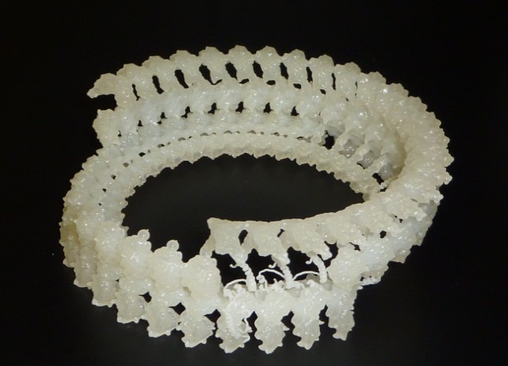
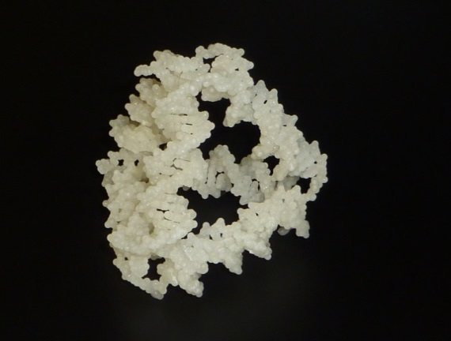
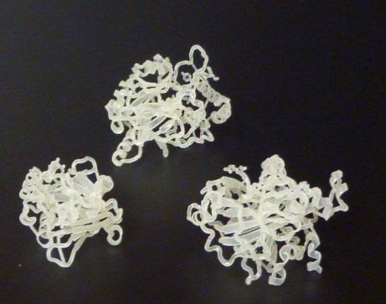
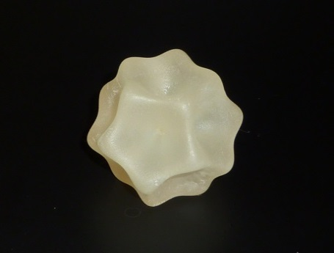
Engineers Group
The Engineers Group is a group that consists of Mechanical design office and Central Electronics Group. It provides service to all the sub-departments with the exception of the Theory group. Even then, we build the 3-D models of some complex shapes that for this group using our 3-D printer.
Here are some complex model made possible with a 3D printer…
The Protein model
The Icosahedron model
The Molecular motor model
The DNA tetrahedron model
25/07/2014

Slide 5
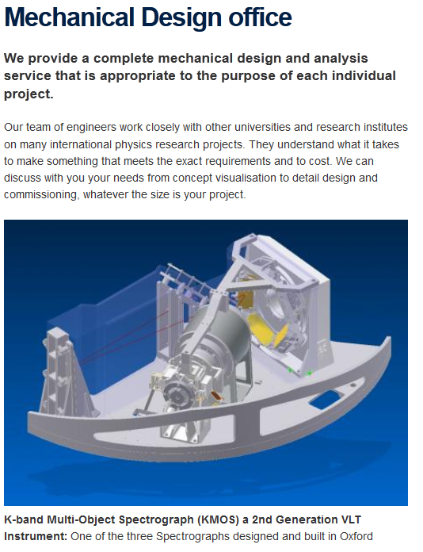
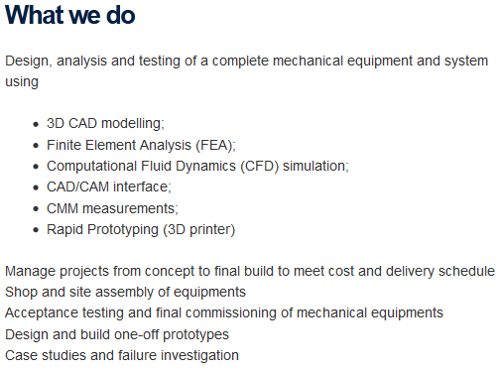
Mechanical Design office

Slide 6
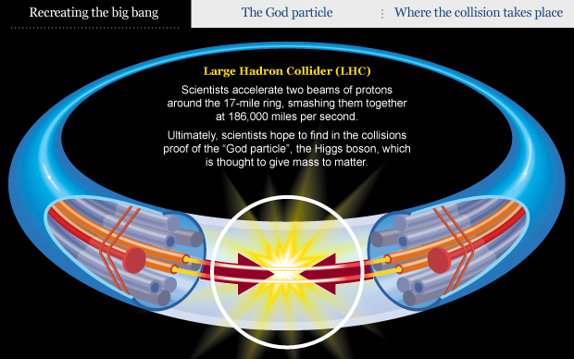
Oxford ATLAS Group
We have been collaborating with other universities and organisations e.g. CERN to produce world-leading experiments. The Large Hadron Collider (LHC) is the world’s largest and most powerful particle accelerator which has 4 main experiments, ALICE, CMS, ATLAS and LHCb. Oxford Group was involved in the design, construction and installation of two of them, ATLAS and LHCb.
The ATLAS detector is one of the 2 general purpose detectors to allow physicists to search for the Higgs boson which gives other particles their mass, and for direct searches for new physics beyond the Standard Model.
The Oxford ATLAS Group is one of the largest high-energy physics groups in the UK. It contribute actively to physics analyses, detector performance studies/improvements, computing, database development and detector running and R&D within the ATLAS collaboration.
25/07/2014

Slide 7

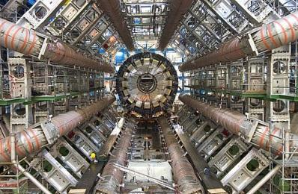

Current ATLAS detector
The ATLAS detector consists of a series of concentric cylinders around the interaction point where the proton beams from the LHC collide. It can be divided into four major parts:
  Inner Detector – tracks particles precisely;
  Calorimeters – measure the energy of easily stopped particles;
  Muon Spectrometer - makes additional measurements of highly penetrating muons;
  Magnet systems - bend charged particles in the Inner Detector and the Muon Spectrometer, allowing their momenta to be measured;

Slide 8
Oxford’s involvement in the ATLAS Project

Slide 9
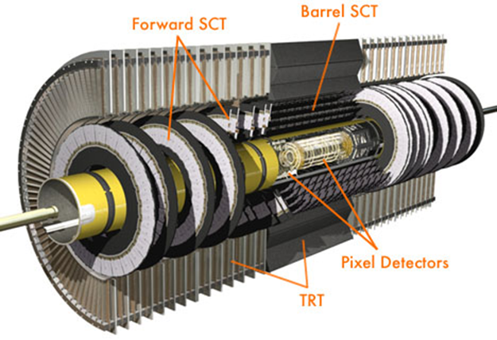
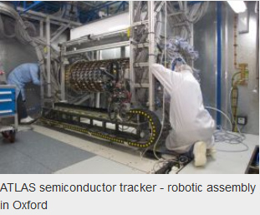
Current ATLAS detector > Inner detector
The Inner detector has three parts:
Pixel Detector – the innermost part of the detector;
Semi-Conductor Tracker (SCT) is the middle component of the Inner Detector. The existing SCT were assembled in Oxford.
Transition Radiation Tracker (TRT) – the outermost component of the inner detector.

Slide 10
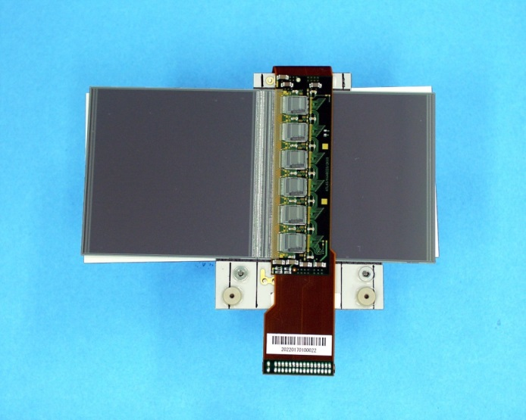
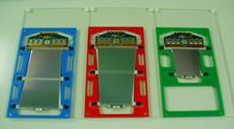
Module Technologies
Current SCT has 4088 independent modules
  Individually assembled & tested
  Individually mounted to support structures
  A robot was used to place the modules to meet precision requirement
  Individually connected to services
Notes:
Picture on the left is SCT module, on the right is End cap module

Slide 11
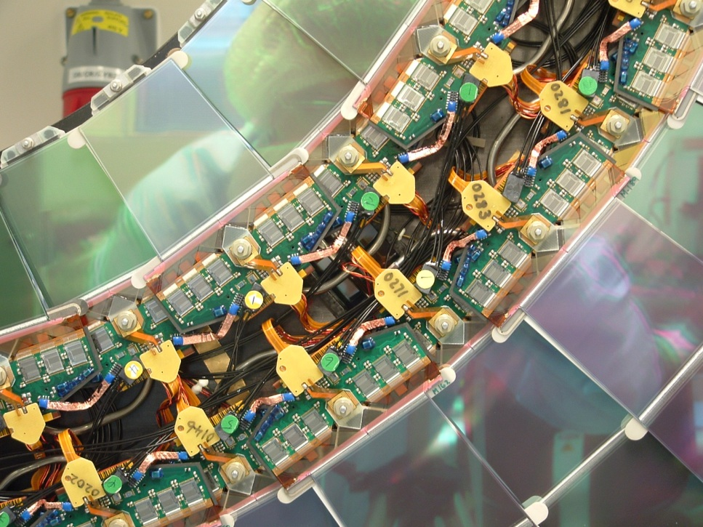
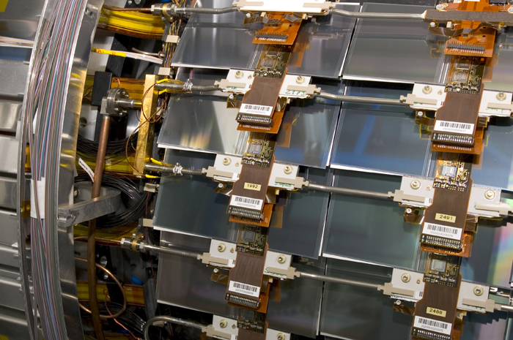
Mechanics & Services of the Existing Tracker
‘Classic’ Tracker Design
SCT Endcap disk showing outer and inner modules with their services interconnects
SCT Barrel cylinder showing rows of modules with their services interconnects

Slide 12
The ATLAS detector is now due for an upgrade
Notes:
The ATLAS experiment plans two stages of upgrades.
Upgrades are required to cope with the anticipated increase in the beam luminosity: a Phase I increase to 3 x 10³⁴ cm⁻² s⁻¹ (3 times design luminosity) by around 2015, followed by Phase II (the sLHC) bringing an increase to 10 x 10³⁴ cm⁻² s⁻¹ (10 times design luminosity) around 2020.

Slide 13
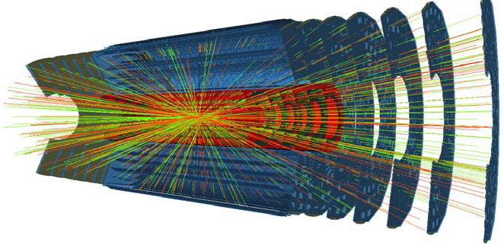
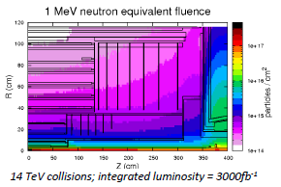
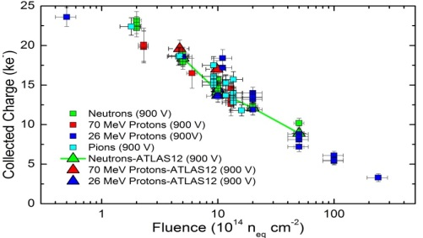
ATLAS Phase II Upgrade
Upgrade driven by:
Post LS3 (2023-2035) LHC enter full HL-LHC operation
  Typically 200 collisions per bunch crossing at intervals of 25ns.
  Integrated radiation levels will reach 3×10¹⁶n_{eq}/cm²
Replacement required to extend physics output into HL-LHC era
  Current tracker components will have accumulated radiation damage levels in excess of their original design specifications
  Current tracker will not cope with new data rates
Proposed replacement tracker exploits developments in silicon device technology & integrated mechanics

Slide 14
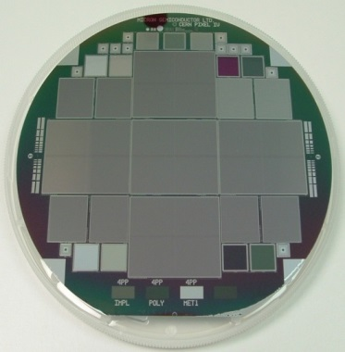
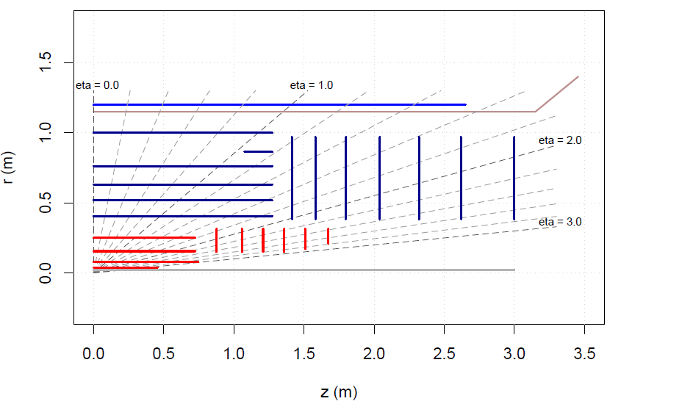
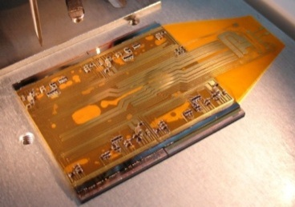
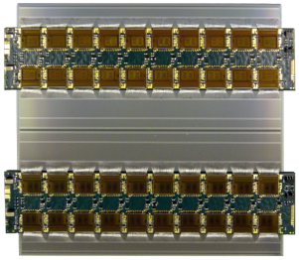
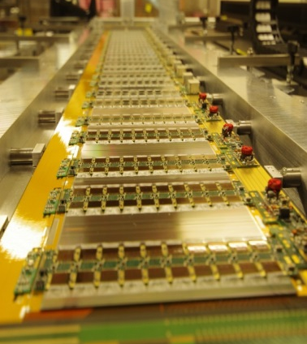
ATLAS Phase-II Tracker Upgrade
Barrel Strips
Forward Strips
Pixel Sensor Wafer and Module Prototype
Barrel Strips
Barrel pixel
Forward pixel
Baseline layout of the new ATLAS inner tracker aims to have at least 14 hits everywhere for robust tracking
All silicon Inner Detector
  4(pixel) + 5(strip-pairs)
  Strips: 200m² (5 ½ barrel layers + 2x7 disks) (x3.3)
  Pixels: 8 m² (x4.7)
Exploit “Integration by Design” to fight services complexity
Microstrip Module & Stave Prototype

Slide 15
What do engineers do to deliver the ATLAS detector that the physicists want
Roughly speaking, the category of work can be split as follow:
  Design
  Prototyping & Testing
  Analyses and simulation
  Assembly and Installation
Notes:
Design
To meet functionality;
To comply with geometry constraints;
To meet safety requirements
To meet manufacturability;
Prototyping & Testing
- To ensure components meet tolerance requirements;
- That they are repeatable during production
Analyses and simulation
- To make sure we understand exactly how components behave;
To understand the effect of any change in operational and environmental conditions
To make sure that the component works as it was intended to
Assembly and Installation
To provide all the necessary tooling during assembly and installation
To ensure logistics are well understood, tried and tested

Slide 16
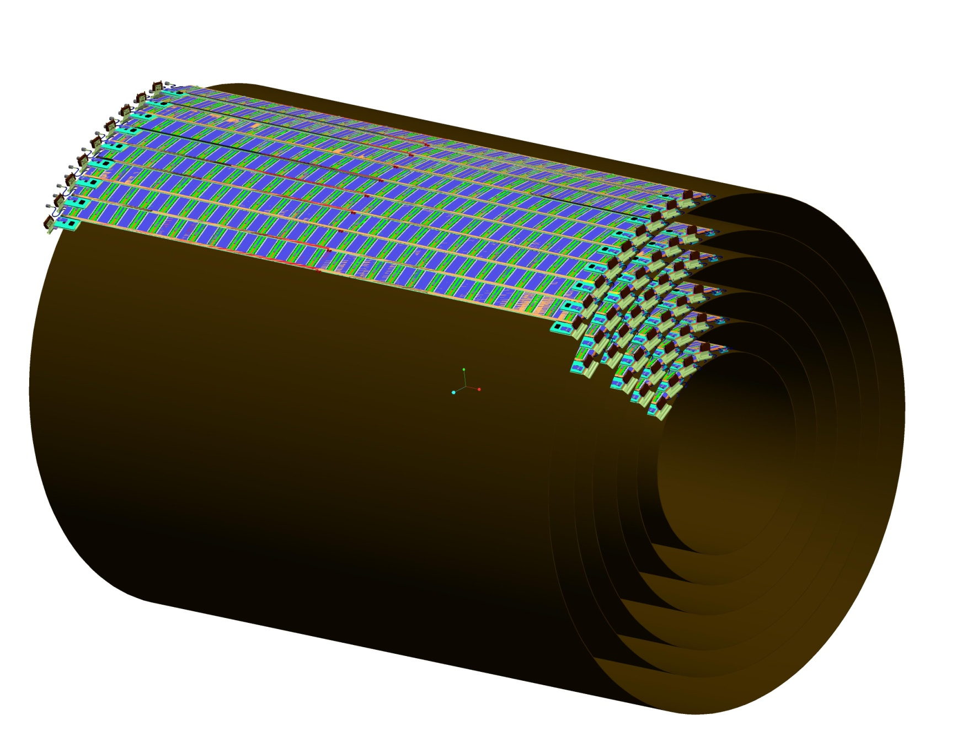
Barrel strip tracker geometry
Layer | No of Staves in 360° | Radii to Centre of Stave
0 | 28 | 405
1 | 36 | 519
2 | 44 | 631
3 | 56 | 762
4 (Stub) | 64 | 862
5 | 72 | 1000
Total Number of Cylinders: 5
Total Number of Staves: 600 (including stub and no spares)
  currently 8 different stave flavours
Total Number of Modules: 12784
  13 Modules per side of stave = 26 modules per stave
  2 Modules per side of stave for a stub

Slide 17
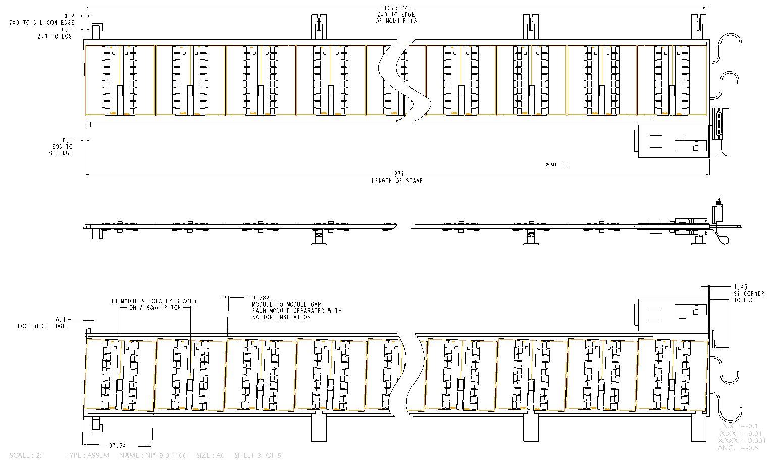
Stave Geometry
R Phi Side
Critical Dimensions:
Overall Length 1277
Width 115
EOS at Z=0 to Silicon Edge 0.1mm
Module to Module Gap 0.46mm
Pitch of Modules 98mm
Stereo Side
Peter Sutcliffe

Slide 18
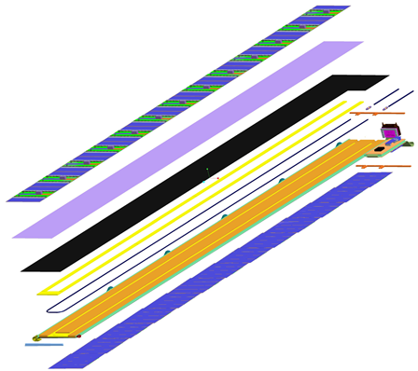
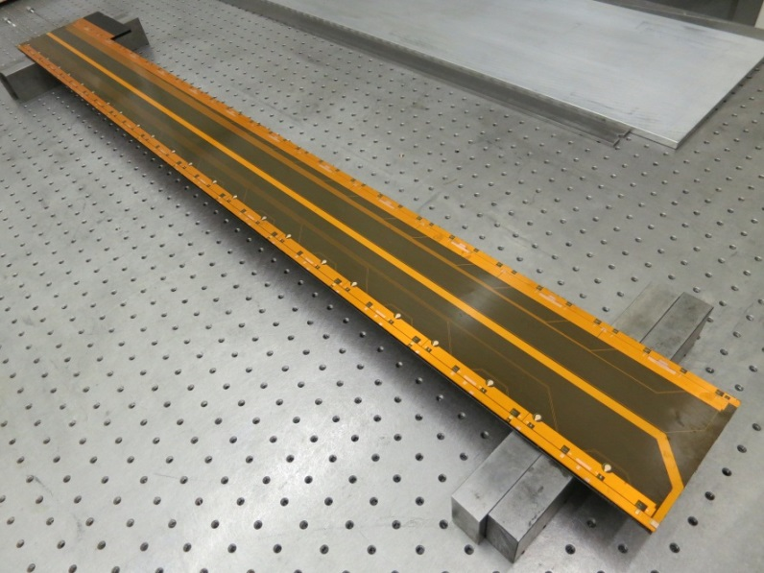
Barrel strip stave design
The stave is the local support in the ATLAS phase II upgrade barrel strip system
  Mechanically: Carbon fibre/honeycomb sandwich with an embedded cooling channel
  ~500 staves for complete barrel
Silicon strip modules are glued to both sides of the stave
The electrical service and data/control bus is a Cu/Kapton flex circuit (‘tape’) on top of the sandwich facesheets and underneath the modules.
  This bus connects modules to the end-of-stave card (EoS), which contains multiplexers and the stave connector to the external services
  All connections to the tape are done by wire-bonding
Prototype stave core with electrical tapes
13 modules = 1.3×0.1m²
Electrical tape
EOS card
Carbon fibre facesheet
Similar build on other side

Slide 19
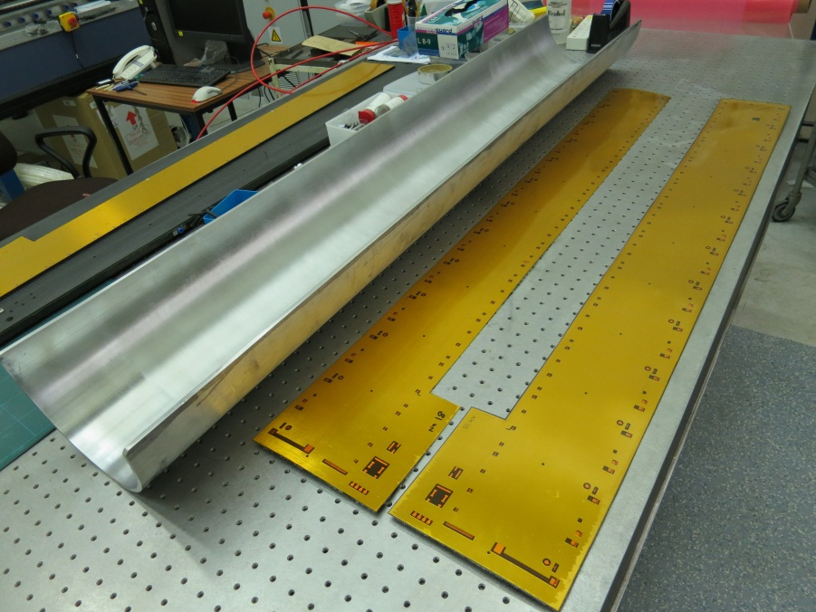
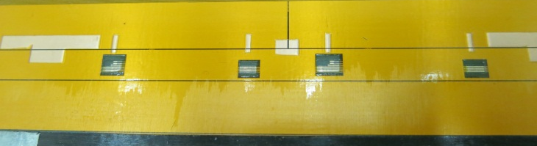
Co-curing
To save glue and avoid the challenging gluing of large flat objects we do co-cure the tape with the carbon fibre face sheets
  3 layers (0/90/0) of K13C2U(45gsm)/EX1515
  Cure at 120°C
Use half section pipe as a jig for this process
  To compensate for differential thermal expansion of tape and carbon fibre cure in an Ø10” Al half-pipe in the autoclave
  Resin bleed onto tape surface can be avoided by adding a 10mm sacrificial rim around the tape
    This rim is kept during stave build to prevent glue bleed in subsequent assembly steps and is milled away at the end of the sandwich production
Resin bleed
Sacrificial rim

Slide 20
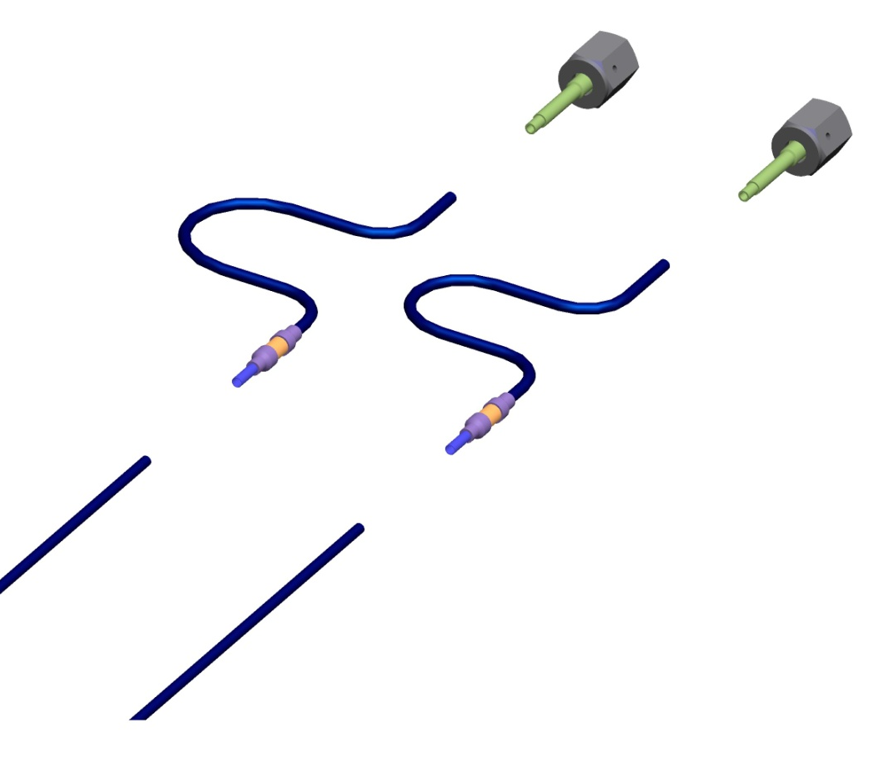
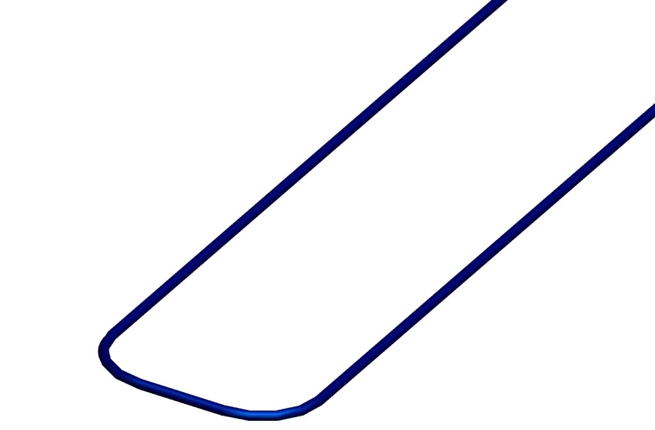
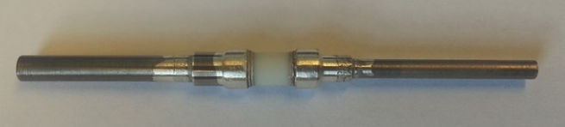
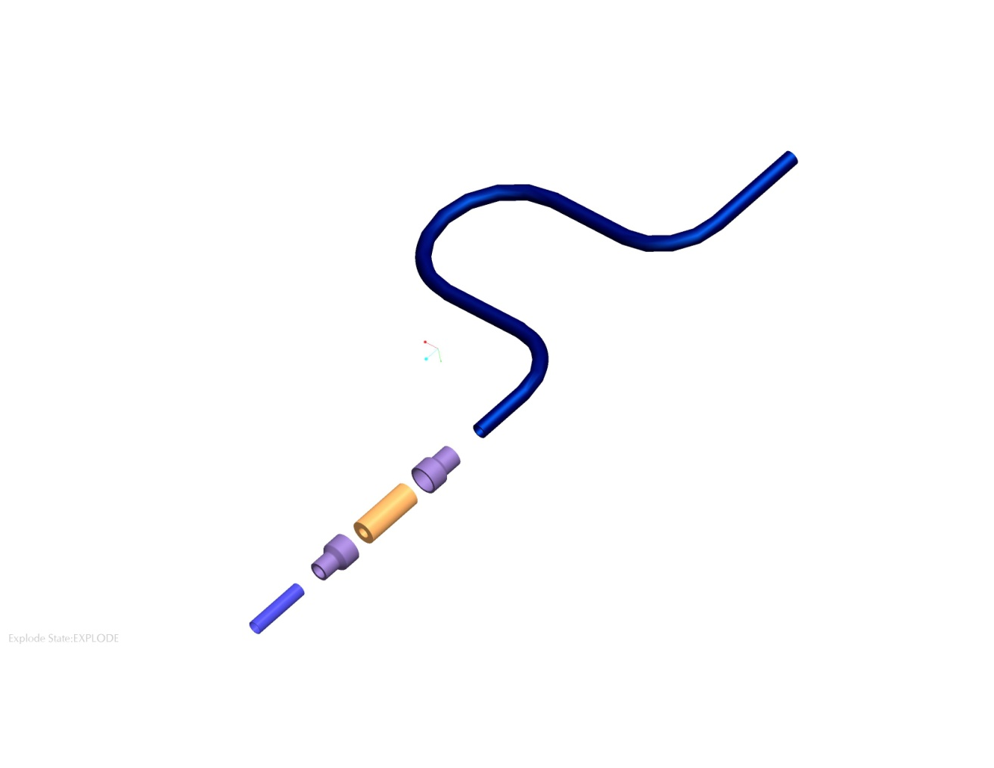
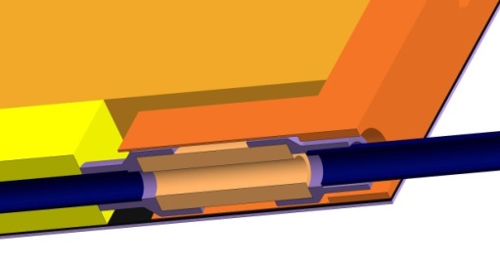
Cooling tube and Electrical Break Assembly
Assembly vacuum brazed with silver copper eutectic
  Brazing temperature around 780°C
Alumina insulator is very strong
Electrical break assembly is welded to the stave and inlet/exit tubes.
E break assembly is potted into the closeout
Cooling tube assembly procedure: tried and tested
St St Swagelok Fitting
Ti Gland
Electrical break assembly
2.5mm Dia Ti Tube
OD 2.275mm x 0.1 wall
Cooling Tube
Richard French
2.5mm Dia Ti reducer
Alumina insulator
2.275mm Dia Ti reducer
2.275mm Dia Ti Tube
Potted into end closeout
Notes:
Cooling tube assembly procedure:
Manufacture main cooling tube
Vac Braze E-Break and U tube assembly
Manufacture Ti Glands
TIG Weld Above 3 components
Eutectic 共晶

Slide 21
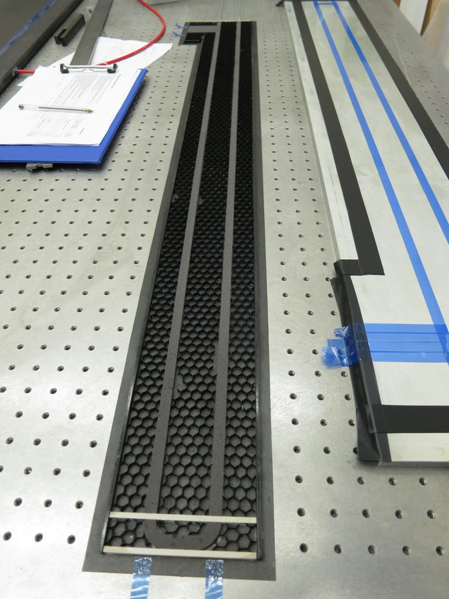
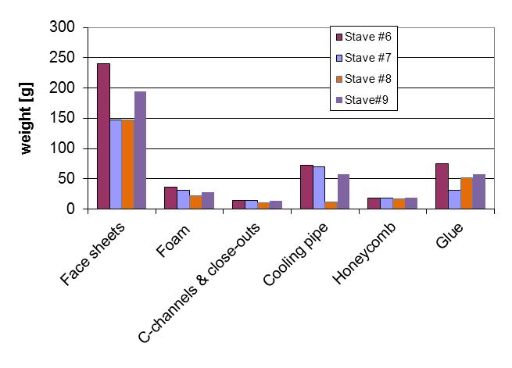
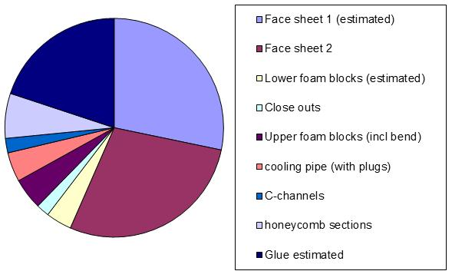
Plank #9 manufacture
Total weight of stave 330.37g
Notes:
Stave core material radiation length ~1%

Slide 22
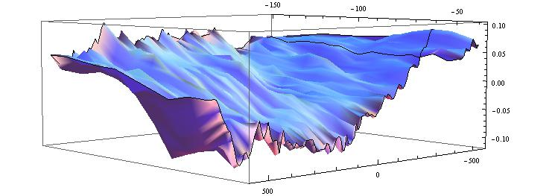
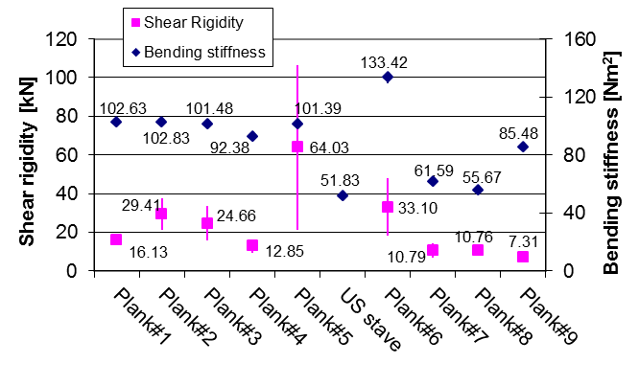
Plank #9 flatness and stiffness
Flatness is around 0.20 and a twist has been shown. Not as good as we would like although the overall thickness is very uniform, proving the CNC machining of the core works.
Bending stiffness of the planks made so far.

Slide 23
Stave assembly tooling (1)
Staves will be manufactured in-house
  Allows for complexity in the stave design, which ultimately leads to a tailored, compact low-mass solution
  ~600 staves needed
Assembly tooling and procedures development
  To minimise the risk, uniformity of tooling and procedures are needed;
  In UK, we have already started developing the standard tooling and procedures for this process:
  Stave assembly jig that was developed with a joint effort between Liverpool and Oxford was used to produce the last 4 prototype planks (250nm, 12 modules).
  The next iteration (‘130nm jig’, 13 modules) is designed and under manufacture now, again jointly between Liverpool and Oxford.
  In Oxford we also developed procedure checklists.

Slide 24
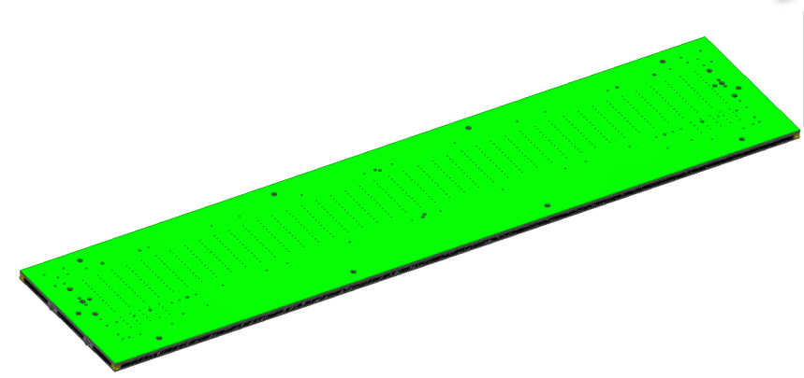
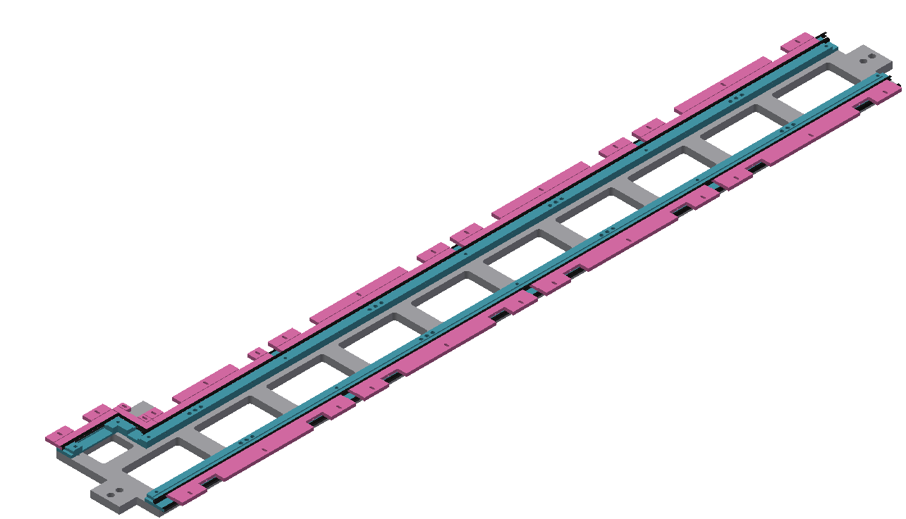
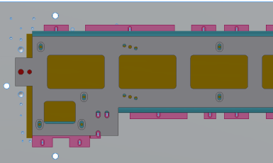
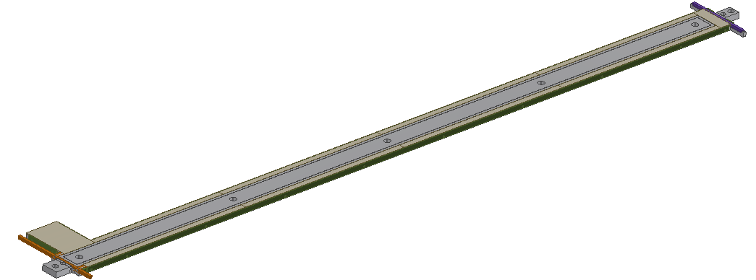
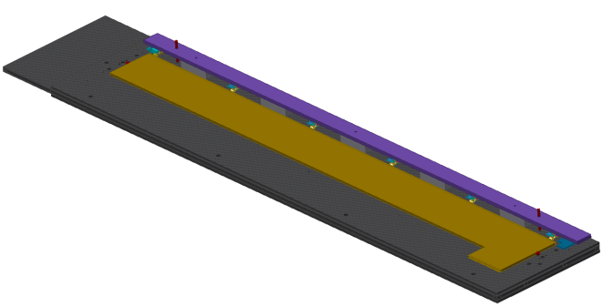
Stave assembly tooling (2)
Carbon fibre (for easier movements)
With dowel/screw inserts for placement of sub jigs
  Alignment rulers for glue masks
  Positioning jigs for close-outs (C-channels and end close-outs)
  Positioning jigs for locking points
Design for flexibility
  Different stave widths, different EOS geometries, stavelets
Vacuum jig
C-channel placement jig
Locking points gluing jig
Foam blocks and end closeouts alignment jig

Slide 25
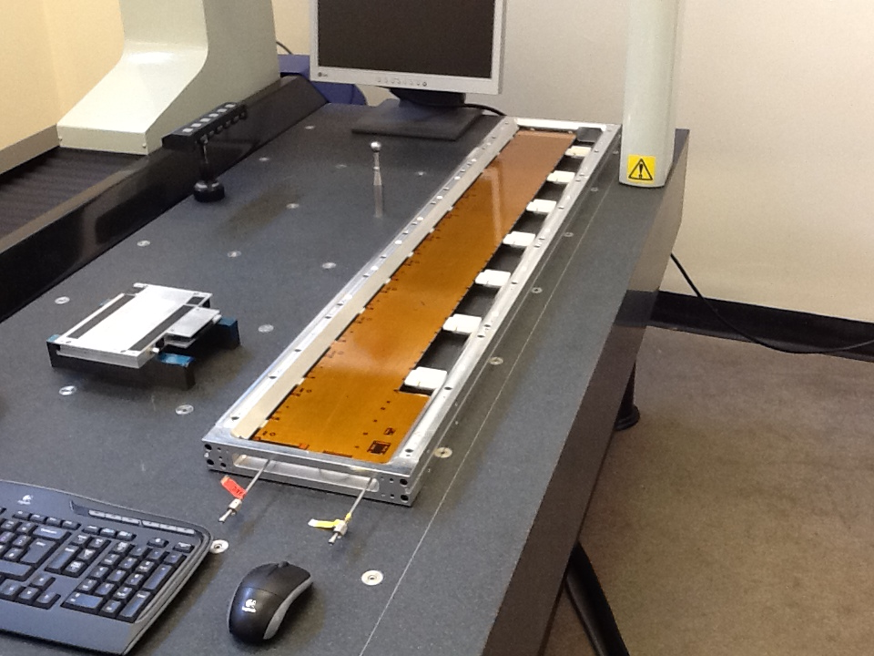
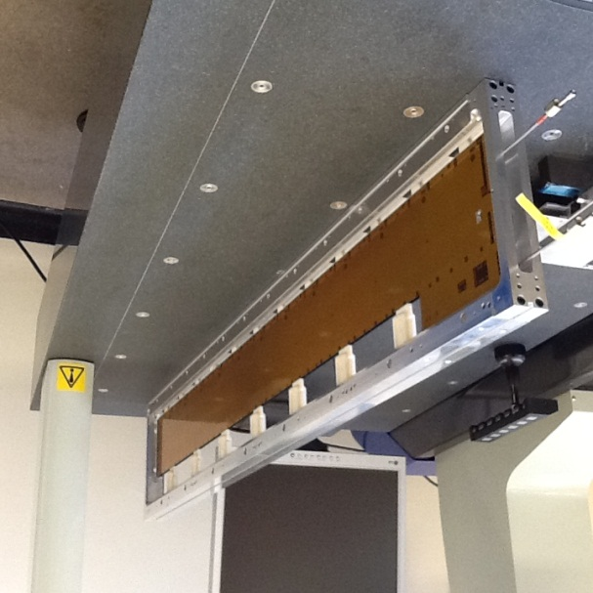
Stave assembly tooling (3)
Stave frame
One frame per stave:
  The plan is to have one stave frame, which is used to host the stave from after plank production through module mounting, testing, surveys, and transport and is used as part of the insertion tooling during the final integration
  A prototype of such a frame has been made and is used with plank#9 for wire bonding trials at RAL (12-module stave)
In future, the production of such frame can be done by Industry.

Slide 26
Stave support development

Slide 27
Design requirements for Stave support
  Material minimization
      Mass minimization
      Only those critical to the support of stave stay on cylinder;
      Low tilt angle –> save material
  Stability
    External influence: temperature variation and external vibration;
    Design control: Ability to provide rigid rotational constraint;
  Placement accuracy
    Stave position needs to be referenced accurately
  Stave separation
    The space envelope
  Z-constraint
    Stave is anchored at Z=0m end and allowed to slide at Z=1.3 end.
  Functionality:
    Easy insertion
    Ability to lock and unlock insitu
Notes:
material minimization is always a key requirement for the design of the tracker and its support structure.
Smaller angle allows better low momentum hermiticity and less material for high momentum tracks in overlaps.
Also all tooling needed is removable and none of it stays on the cylinder.
Stability : mainly from 2 sources, one is thermal movement or temperature changes, the other one is due to external vibration. Temperature change is difficult to predict, we need to tackle this by controlling temperature change. External vibration – we don’t know what exactly that should be. We need to take measurement in the next shut down from existing ATLAS barrel. but if we assume ASD of 10^-7 g^2 / Hz, then a plate of 50Hz will only displace under 1micron.
To maintain overlaps and provide mechanical and electrical clearances we require that the staves are positioned accurately.
The clearances for the staves are driven by the tilt angle, the radius and the separation between adjacent staves.
Many of these requirements are intuitive but not quantitive

Slide 28
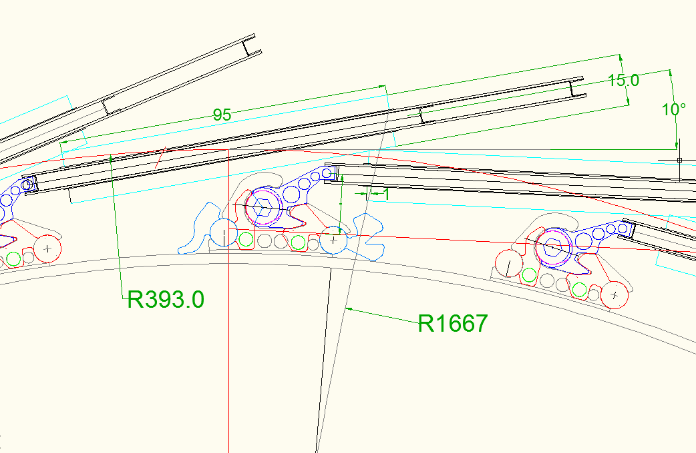
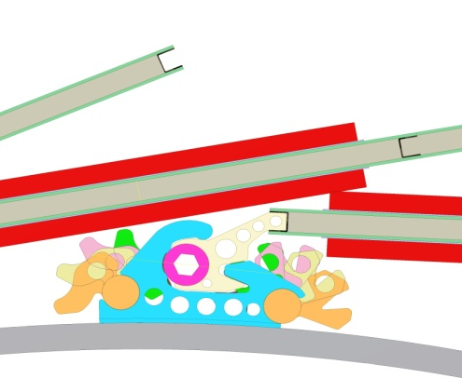
Space envelope that affects the stave support design
The current UK Stave locking mechanism is designed based on the Stave at 10 deg tilting angle, with 1mm overlap, at 1Gev/c track space envelop.
Notes:
For the purpose of our study, we require 1mm overlap with 2 hits per stave (4 per layer) for 1GeV/c tracks, which is very conservative. Should we decide at a later point that a relaxed requirement (for example zero overlap with 1 hit per stave) is sufficient to guarantee enough overlaps for the alignment and coverage, the separation for staves and with its clearances will increase.

Slide 29
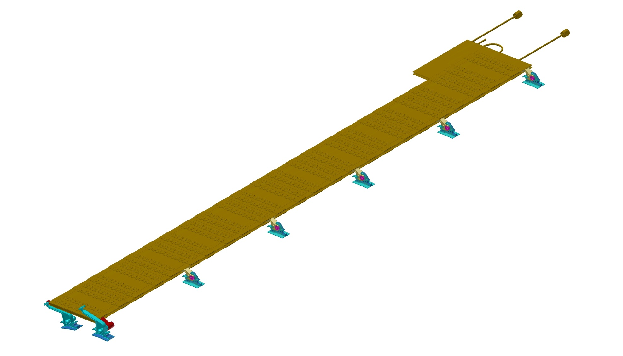
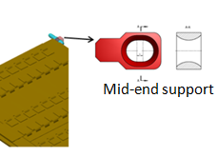
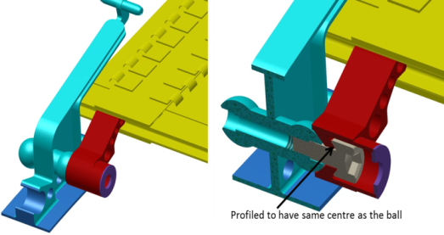
Stave support design overview
Pin support in a slot
5 off intermediate locking points
Y
Z
X

Slide 30



Locking mechanism design
Stay clear of adjacent staves during and after insertion;
Cam (retracted)
Reference faces –known positional reference datum
Over centre dimples -- positive locking
Force exerted by cam
Cam housing (bracket side)
Lock Cam

Slide 31
Prototyping and Testing

Slide 32



Prototype of the locking mechanism
All the parts on current locking point are injection moulded and is made of LCP (Liquid Crystal Polymer), as used in various components on current SCT.
The lower mass version has also been developed and prototyped out of PEEK, ~50% reduction in material volume.
Stave side lock Core
Cylinder side Mounting bracket
Lower mass locking point
Reference faces
Notes:
The current study mainly focus on the structure integrity of the locks. Having satisfied the design of the intermediate locking point that meets the design requirement, we have looked at the material optimization (see the PEEK locking point prototype which saves 50% in material volume).

Slide 33




ESPI measurement vs FEA
To evaluate the stability of the edge-mounting system, thermal deformation and frequency response of a stave have been measured using ESPI*.
The ESPI results are compared with the FEA predictions identified as the corresponding modes for the first three modes. Their mode shapes and frequencies matched well.
The thermal deformation measured to be 100µm at the outer free edge of stave when temperature cooled down from room temperature to -25ºC.
*Electronic Speckle Pattern Interferometry (ESPI)

Slide 34







Sector prototype
Has the dimension of one sector of the inner most cylinder, and is made of single skin CF (0/90 balanced layed up, 11 layers 0.7mm thick);
Prototype accommodates 3 staves;
To help develop insertion tooling as knowledge is built from insertion;
To help understand any potential problems during insertion;
To make sure insertion of the last stave is well understood and the stay- clear envelope can be met;

Slide 35




Stave End insertion
Insertion trials have demonstrated that the staves are within their designated envelopes.
the locking points
insertion onto a sector prototype
the end brackets and location in Z and R phi
12 O’clock position
Notes:
In conclusion, we have developed a low-mass edge mounting system capable of meeting the stability requirements and allowing insertion down to a tilt angle of 10° with the assumed module envelope.

Slide 36
Understanding the exact behaviour of the design using FEA and CFD modelling

Slide 37
Structural FEA
Understand the behaviour of the staves on the support structure.
  To see if the stave contributes to the stiffness of the support cylinder;
  How much does the stave deformation depend on the cylinder stiffness;
  Optimize stave mounting mechanics.
  Optimize cylinder design.
This depends critically on the understanding of the structure – stave interface
  How does this interface react to loads?
FEA studies on static loading and modal analysis at various configurations have been carried out.

Slide 38


FEA static loading results
Deflection of the cylinder under various interface conditions
No sliding of stave (stave bonded to locking points)
Stave allowed to slide axially at locking points
No staves, only stave weights added
δ_{max} = 11μm
no sliding of stave
Cylinder deflection more than halved when stave is bonded to the locks (no thermal movement);
However, if stave is allowed to slide at locking points, change in cylinder deflection is insignificant compared with one that has no stave attached.
δ_{max} = 29μm
staves are allowed to slide

Slide 39


Modal analysis results
The 1st frequency changes from 39 Hz with a 0.5 mm thick cylinder to 53 Hz with a 2mm thick cylinder.
When cylinder thickness increases by 4 fold, the frequency increases by less than ¼
However, in the static analysis, an increase in cylinder thickness by 2 would reduce the deflection by nearly ½.

Slide 40
The challenge of designing an effective “Global Structure”
The 3 pixel tubes and the 5 barrel cylinders are all “hung” concentrically and consecutively from the outer cylinder via a series of individual links;
This requirement allows the attachment or removal of the links during the stave insertion or removal without disturbing other staves while maintaining the structural stability of the cylinders during the operation;
The links need to be sufficiently strong in the radial direction of the cylinders to sustain the gravity load, and rigid enough to avoid low frequency vibration in the cylinder axial direction;
However ……….

Slide 41

Connecting the cylinders to one another is a nightmare!
Staves
Cylinder 5 flange face
Cylinder 3 flange face
Cylinder 5
Cylinder 3
Cylinder 2
Cylinder 4
Cylinder 2 flange face
Cylinder 4 flange face

Slide 42

How to connect Cylinder 4 to Cylinder 3 without blocking the access of the staves
Cylinder 4
Cylinder 3

Slide 43
Any link will have to wriggle around the available space between the cylinder gap and the stave end projection. This makes a radial link impossible.
Cylinder 4
Cylinder 3

Slide 44

Various interlink geometries have been looked at including the one shown below:
…. But the links are weak in bending, leading to low frequency in the cylinder axial direction,

Slide 45


The constraints…..
There are other constraints such as the need to provide as much space as possible at the cylinder end for the service modules routing;
Material volume needs to be kept to a minimum, and that makes any thick link undesirable
The final geometry of the link looks something like this. It is highly non-uniform. The study of its structural behaviour requires the use of FEA.

Slide 46





Extensive FEA studies were carried out to ensure link design meets all the structural and functional requirements
Robert Gabrielczyk
Latest studies on interlink and barrel end flange
Flat interlink vs kinky link

Slide 47
CFD studies
Objective:
  To understand how the heat generated from the electronics on the stave dissipated to the Barrel void (gas volume).
  To investigate if the resultant temperature could cause any unacceptable effect on the barrel behaviour
CFD natural convection studies have been carried out, to see if this could cause a concern. This was done in 2 steps:
  Using purely conductive FEA, it estimates T of the more crucial stave surfaces;
  Use these Ts as fixed temperature boundary conditions to model the convection in the gas.
  Two cases have been looked at:
    one at the EOS region,
    the other at the middle of stave region.

Slide 48


CFD modelling
Section view for the mesh detail
Inner ring (28 staves)
End of stave module
½ module deep

Slide 49




CFD results
Temperature profile at the middle of the sensor plane (i.e. through DCDC). Fixed Ts (DCDC+10C, Sensor/Stave-28C. [Area mean=-26.4C]
Velocity through the DCDC
Velocity plot at the end of module
(concentrated towards the top; elsewhere T comparable with mean stave surface T).

Slide 50
Remarks on CFD studies
A series of “sanity” checks were carried out on the CFD results to ensure they compare reasonably well with close form solutions and sensible observations. And they do…
The CFD results allowed us to understand how heat is distributed inside the cylinder;
It shows a non-negligible level of thermal asymmetry which requires further FEA study to see if this affects the final shape of the cylinders, and more importantly, the cooling performance of the silicon modules.
We have plans to build a more accurate model that includes conduction effects within the staves to see how the staves are affected.

Slide 51
Summary
We have been actively involved in Stave build and assembly logistics as well as the tooling development for ATLAS Phase II upgrade strip tracker. Currently we are working on design and manufacturing the tooling for Stave 130 which is next generation stave. The plan is to start using the new tooling to build the new stave in Sept this year.
The stave support concept has been accepted by the collaboration and UK locking mechanism prototype and insertion tooling have been developed and tested. We are now working on the next sector prototype which is going to be 1 to 1 scale 5 Barrels, with the latest interlink and flange design. It is mainly for service mock-up and end insertion.
FEA and CFD studies helped us to understand the global and local structure behaviour and the temperature distributions inside the barrel. Prototype and testing have been carried out alongside to provide a benchmark for the FEA and CFD models.

Slide 52
The End
Thank You!

Slide 53
Back up slides

Slide 54


Stave Construction and Materials
Component | Material | Remarks
Carbon Face sheet | Tencate K13C2U 45g/m² EX1515 Resin | 3 layers 0/90/0 total thickness 0.15mm Co-cured onto a kapton bus, thickness 0.2mm
Honeycomb Core | Ultracor Carbon Honeycomb UCF-126-3/8-2.0 | Final thickness 5.2mm
Carbon Foam Core | Allcomp K9 | Final thickness 5.2mm
Cooling tube | Titanium CP3 | 2.275 x 0.125 wall
End Closeouts | PEEK CF30
C Channels | Carbon Fibre
Stave is manufactured from 2 UD Carbon and kapton face sheets with a core manufactured from Ultracor Honeycomb and Allcomp Foam。
C Channel
Face sheet
Bus tape
Carbon foam
Honeycomb core
Peter Sutcliffe

Slide 55


Modules, End of Stave Cards and Locking Points
R Phi Module
Locking Point
SE4445 Glue
End of Stave Card
Exploded view of the
‘mechanically’ simple module
Stereo Module
Peter Sutcliffe

Slide 56






Z=0 End Closeout
Z=0 Closeout manufactured from PEEK/Torlon
3D Printed Model
Stave to Stave Dimensions at Z=0
Peter Sutcliffe

Slide 57


Stave Core Assembly
Assembled sandwich structure stave
Note mirror-like surface finish (global flatness ±100µm)

