Slide 1
Status of the Seatch for Kaonic Nuclei (E15) at J-PARC
RIKEN H. Outa
for E15 collabolation
✔ Kaonic nuclei
✔ Present status of the E15 experiment at J-PARC
Search for the K-pp bound state in the
³He(in-flight K-, n/p) reaction
－ 3He(in-flight K-, n) spectrum Hashimoto
arXiv: [nucl-ex]1408.5637 submitted to PLB
－ Λp+n(missing) channel analysis Sada
(－ 3He(in-flight K-, p) spectrum Tokuda )

Slide 2
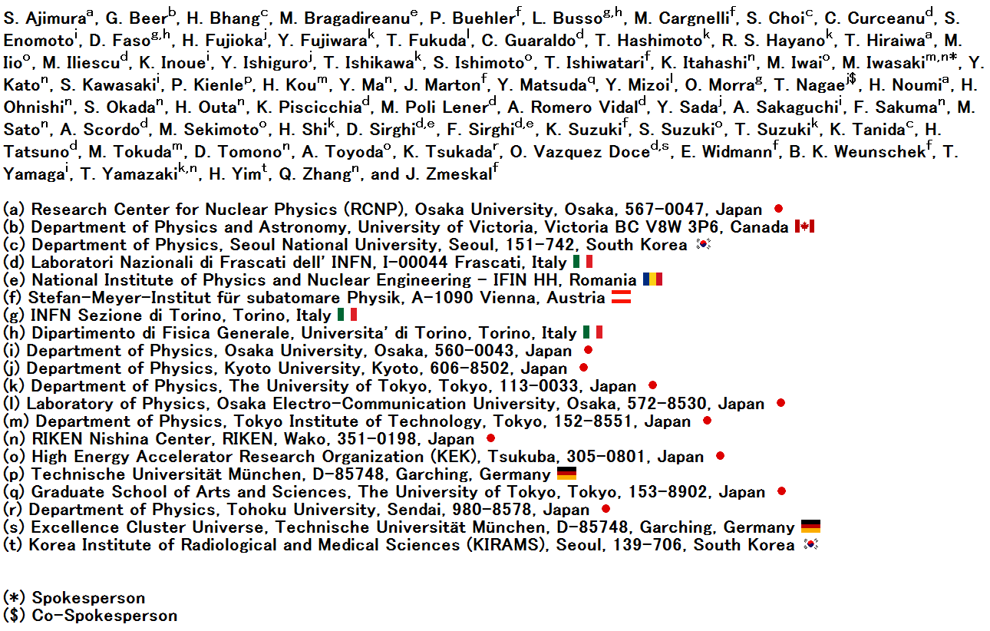
The J-PARC E15 Collaboration

Slide 3
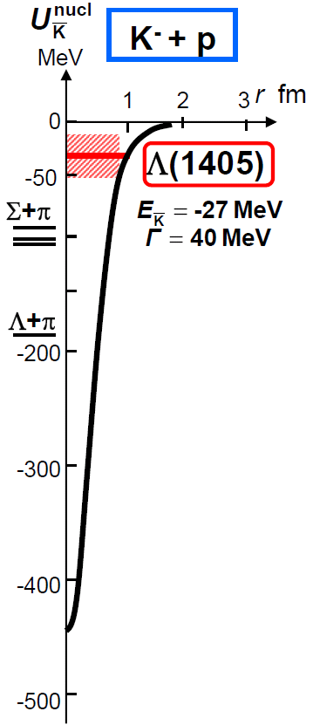
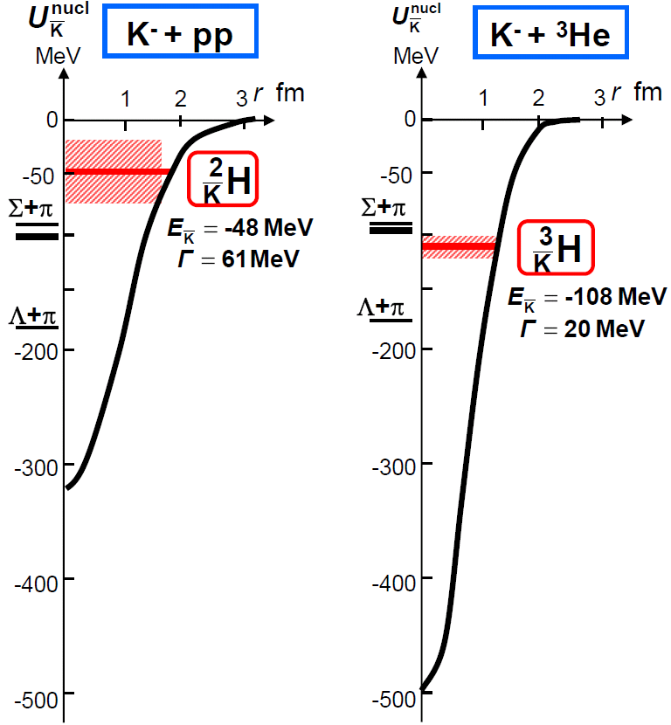
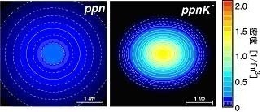
Kaonic Nuclei
Kaonic nucleus is a bound state of nucleus and anti-kaon (K^{bar}NN, K^{bar}NNN, K^{bar}K^{bar}NN, ...)
Density [1/fm³]
Y.Akaishi & T.Yamazaki, PLB535, 70(2002).
T.Yamazaki, A.Dote, Y.Akiaishi, PLB587, 167 (2004).

Slide 6
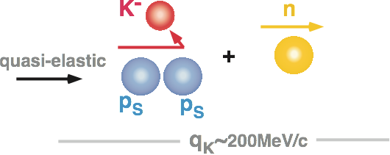
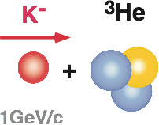
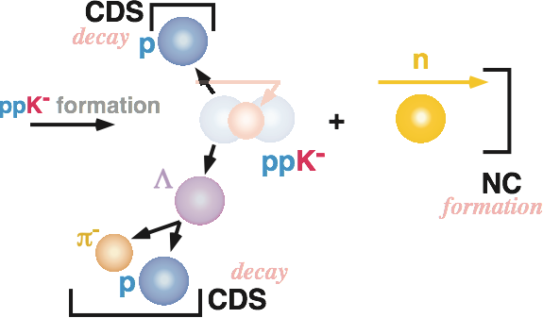
E15: “K⁻pp” search via ³He(K⁻,n) @pK=1GeV/c
without 2NA background
for efficient “ppK” formation
Formation & Decay
Y decay can be rejected
(quasi-free KN)

Slide 7
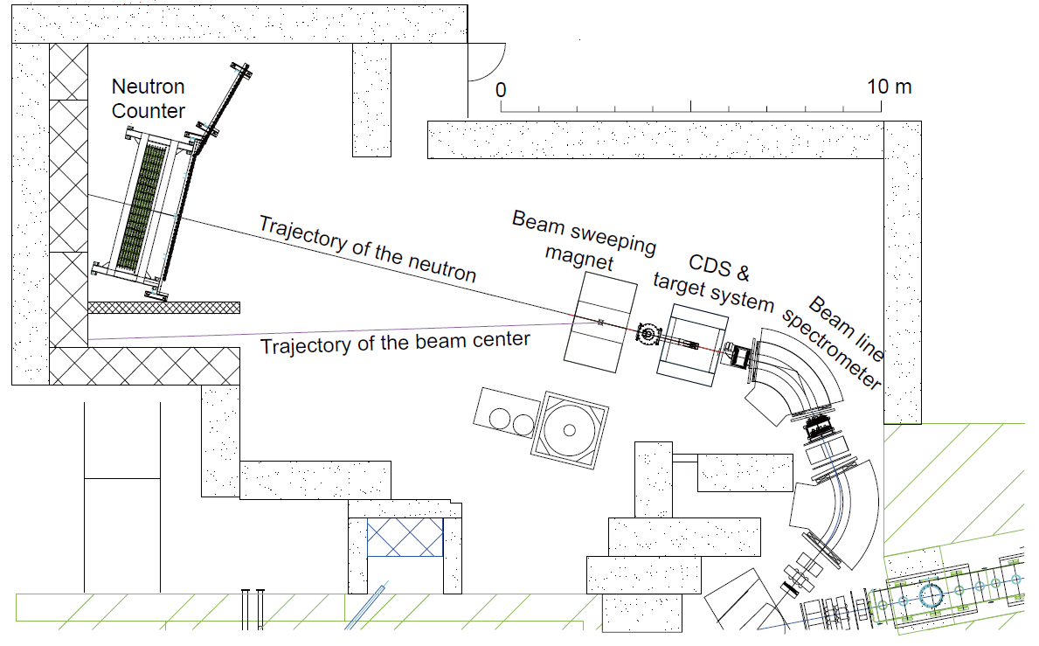
Experimental Setup
15m

Slide 8
E15 1st Stage Physics-Run
Production run of ~1% of the approved proposal was successfully performed in 2013.
All detector systems worked well as designed.
 | Primary-beam intensity | Secondary-kaon intensity | Duration | Kaons on target (w/ tgt selection)
March, 2013 (Run#47) | 14.5 kW (18 Tppp, 6s) | 80 k/spill | 30 h | 1.1 x 10⁹
May, 2013 (Run#49c) | 24 kW (30 Tppp, 6s) | 140 k/spill | 88 h | 5.3 x 10⁹
* production target: Au 50% loss, spill length: 2s, spill duty factor: ~45%, K/pi ratio: ~1/2
* ~70% of beam kaons hit the fiducial volume of ³He target

Slide 9
Analysis Status of E15-1st

Slide 10
3He (K-, n) semi-inclusive spectrum ( Hashimoto )

Slide 12
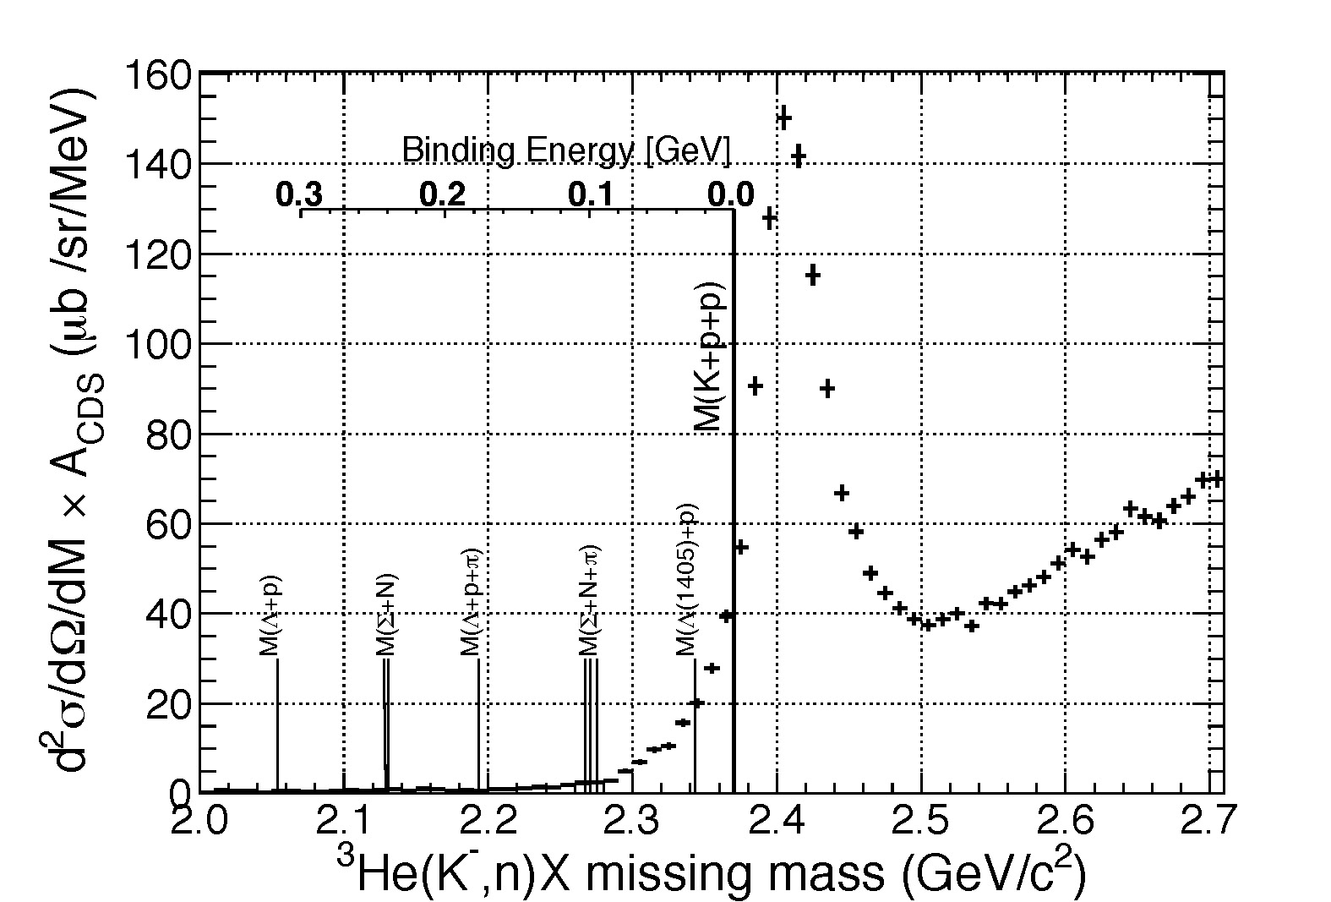
3He (K-, n) semi-inclusive spectrum

Slide 13
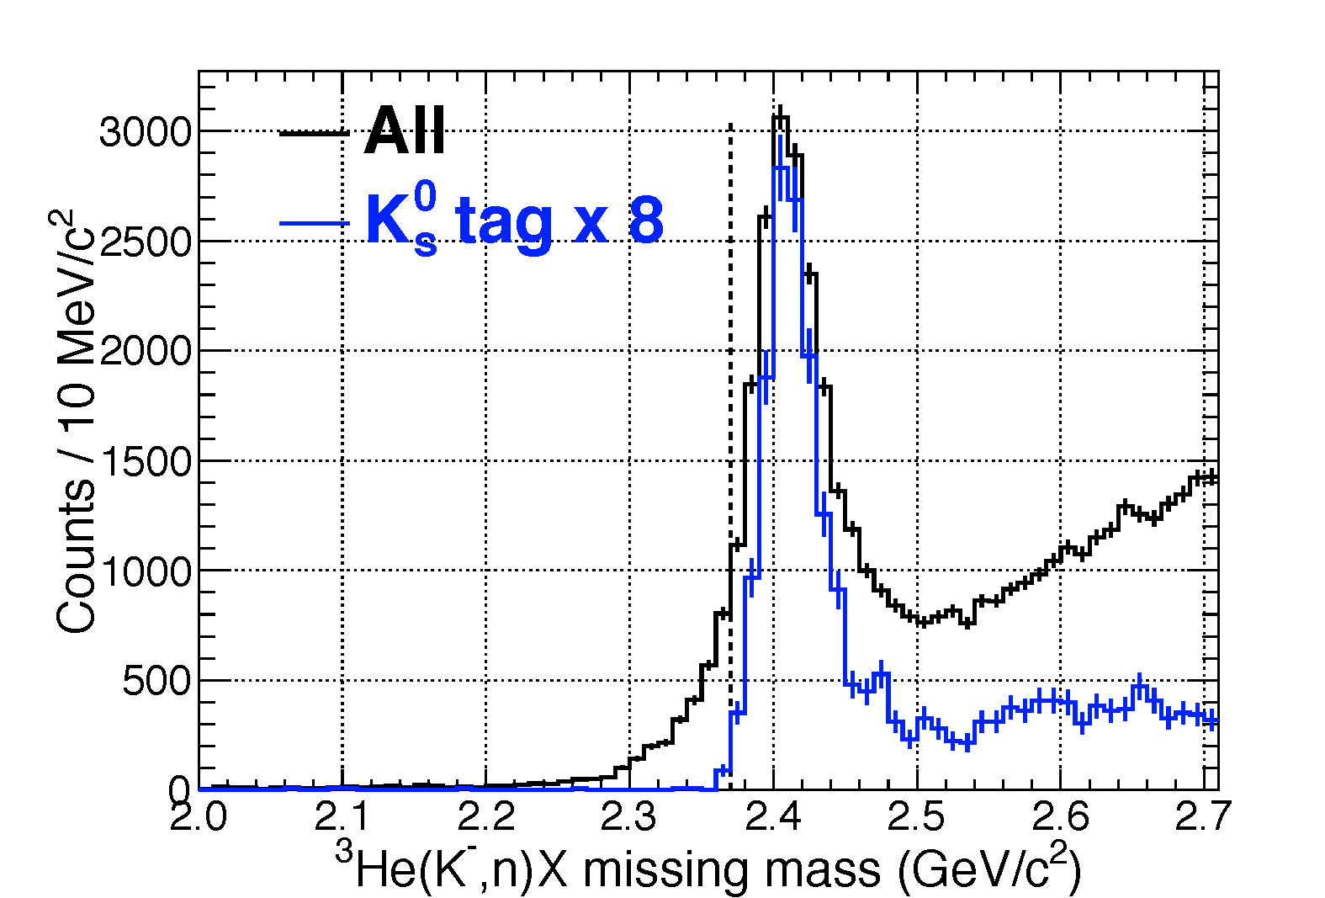
Tail component in the bound region is
NOT due to the detector resolution !!

Slide 14
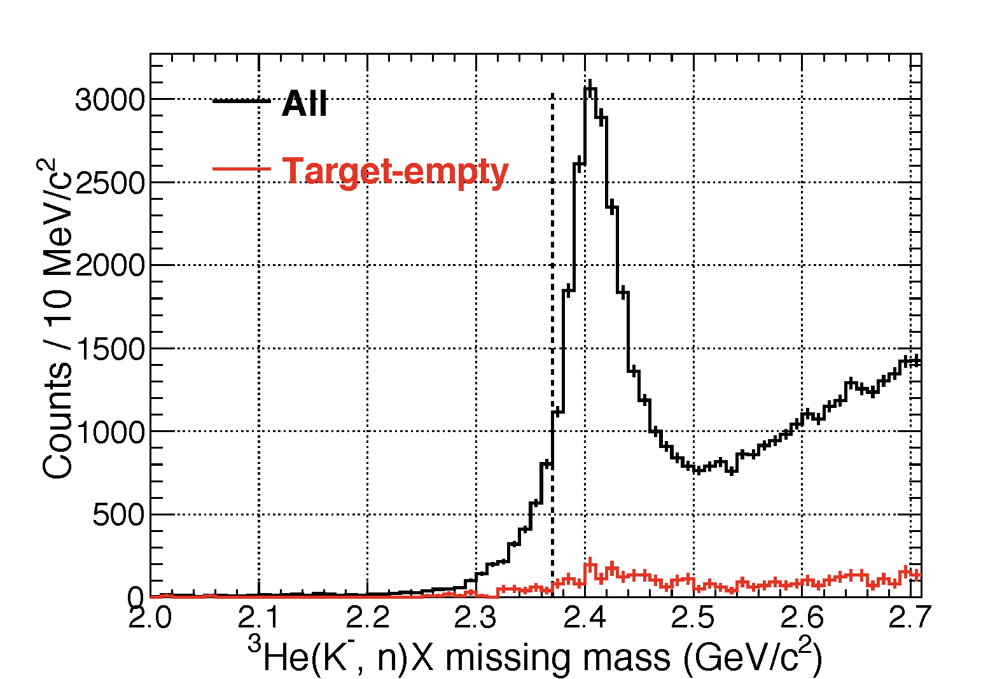

Slide 15
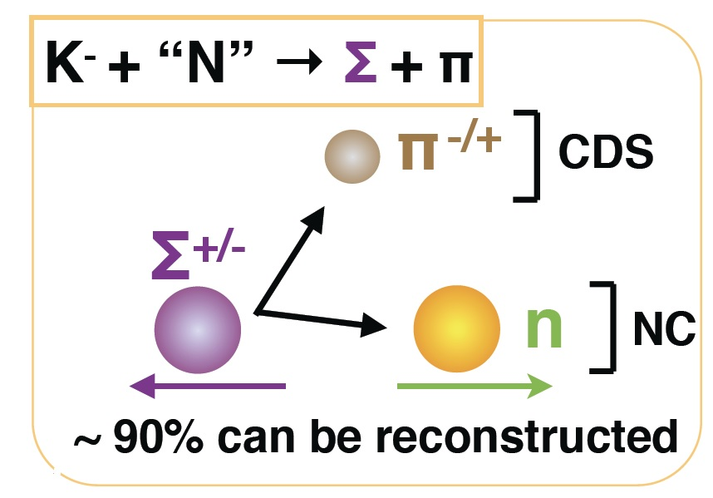
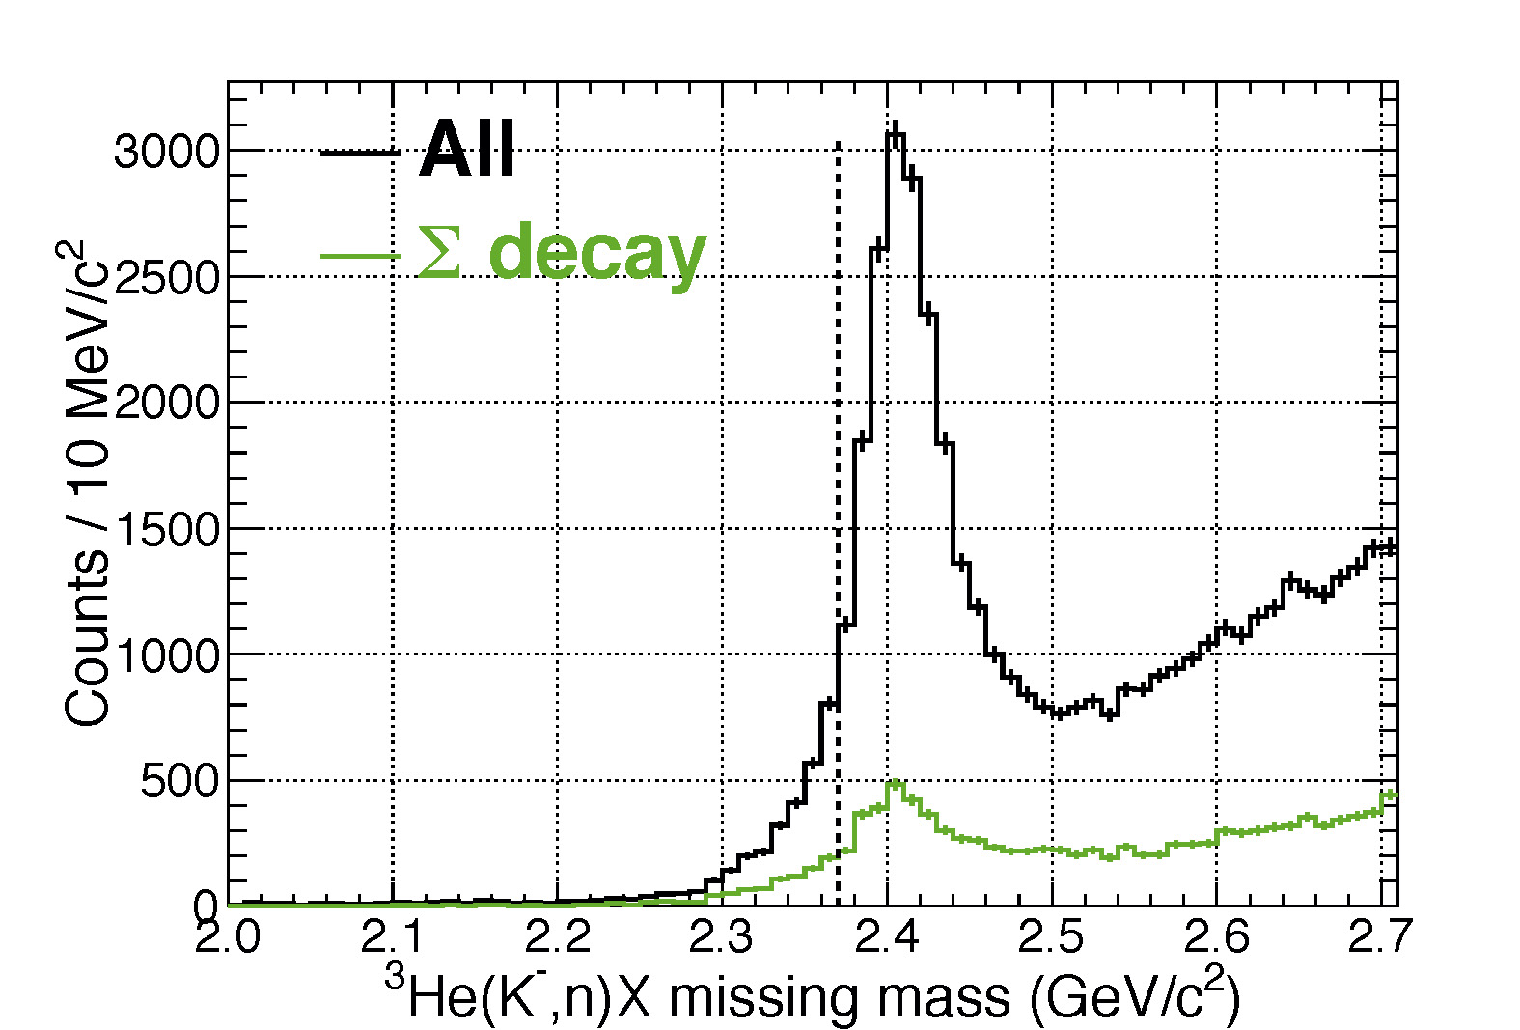
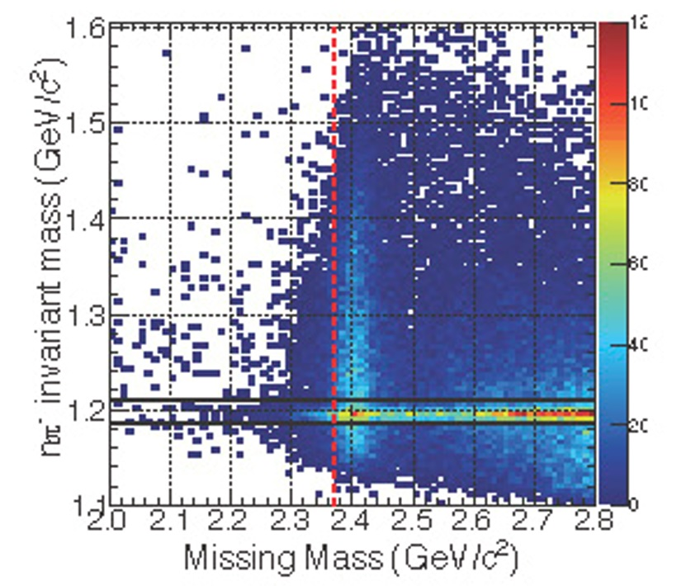

Slide 16
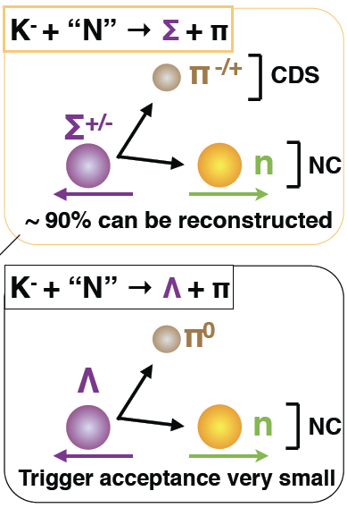
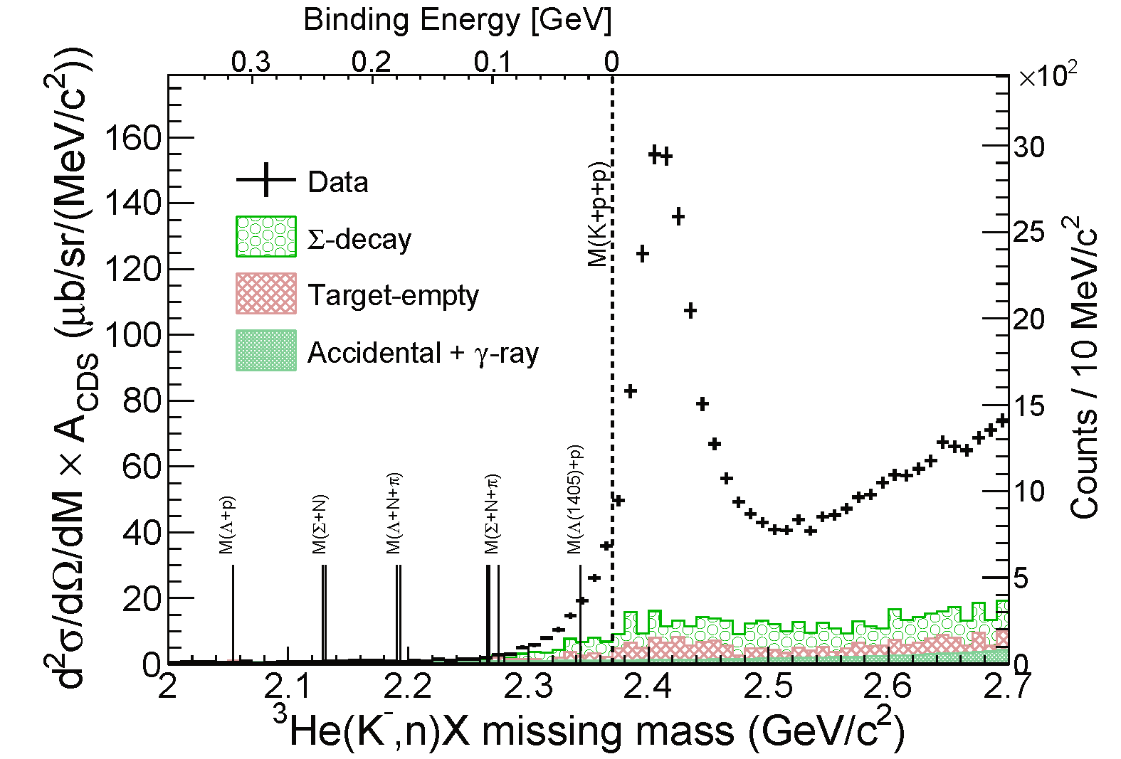
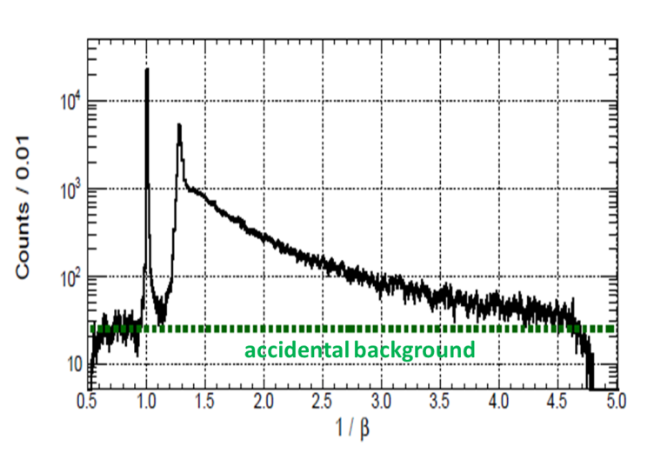
Background Evaluation
quasi-elastic KN
(Phys. BG)
evaluated using empty-target data
(Exp. BG)
(Exp. BG)
1/β distribution for ɤ/n
g
n

Slide 17
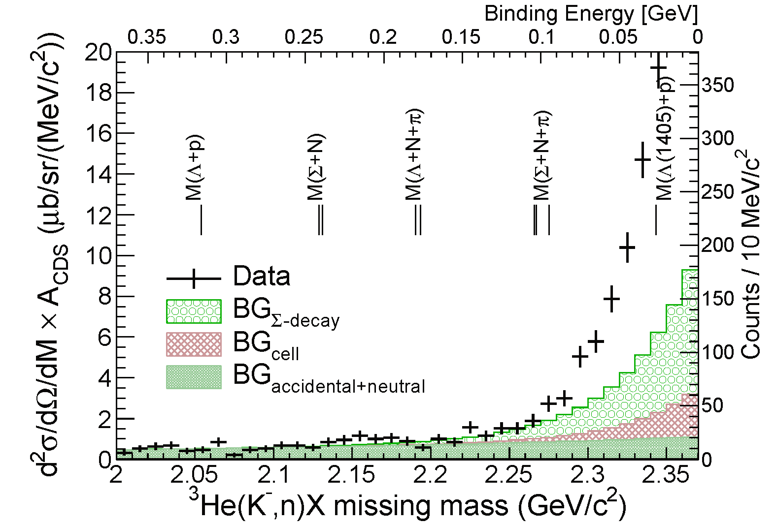
Spectrum below the Threshold
T.Hashimoto et al., arXiv:1408.5637, submitted to PLB
excess
FINUDA/
DISTO
✔ No significant structure in the deep-binding region
✔ Excess (tail) exist just below K⁻pp threshold

Slide 18
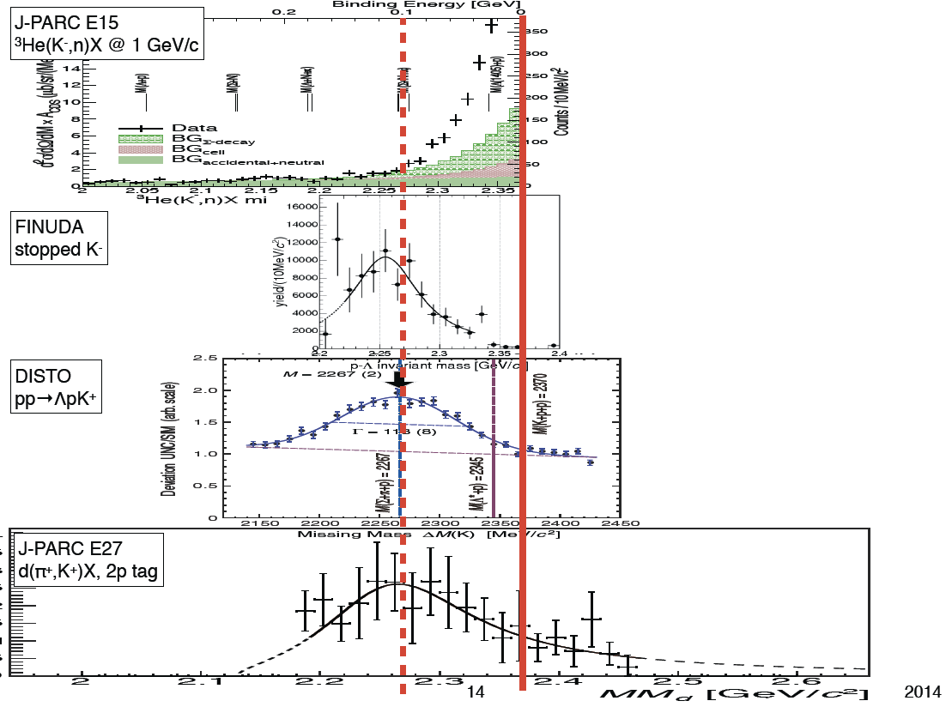
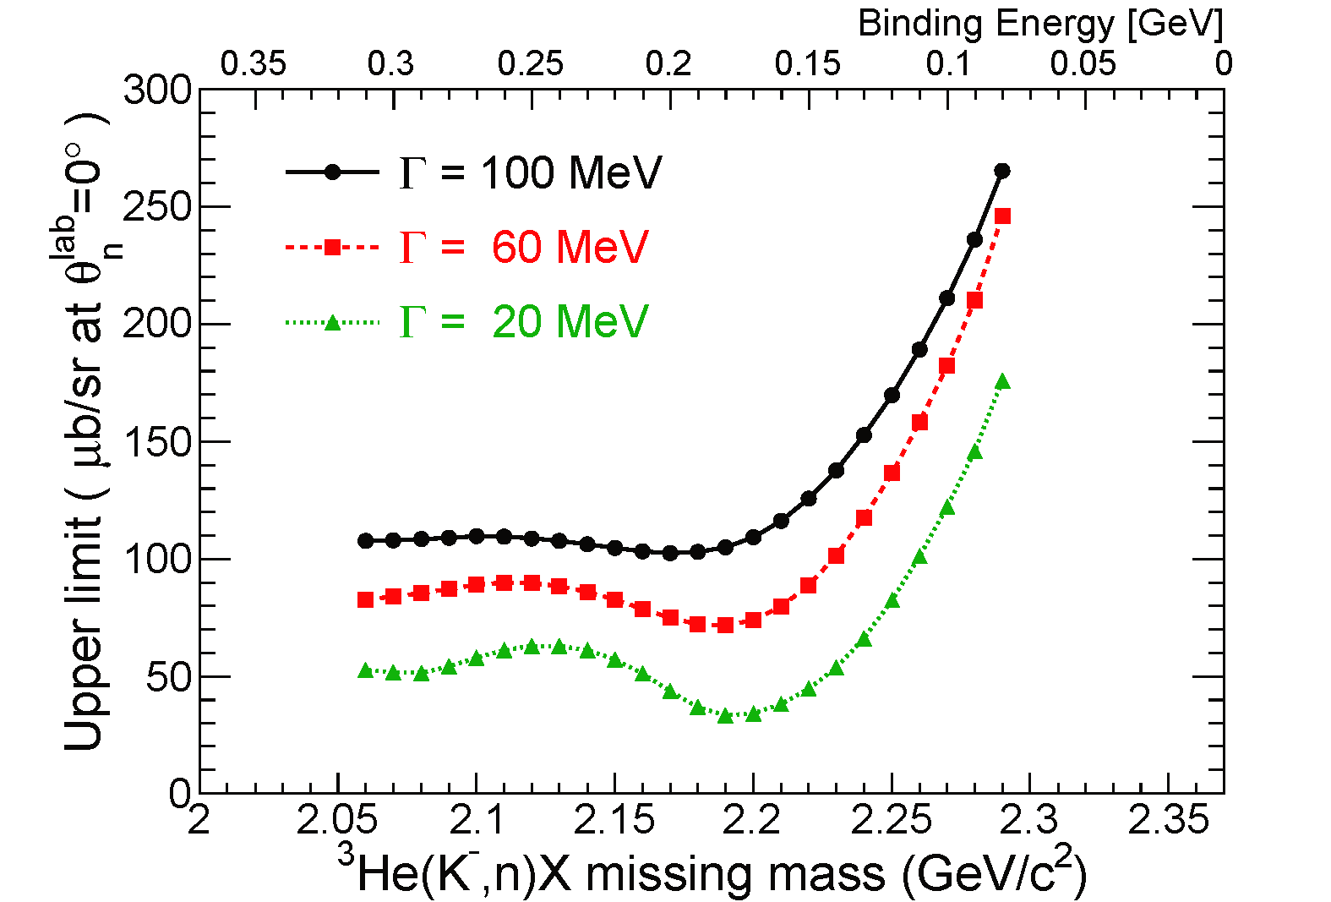
E15 and Other Experiments
U.L. evaluation with:
K⁻pp → Λp 100% (isotropic)
K⁻pp shape = Breit-Wigner
PRL94(2005)212303
E15(K⁻+³He):
(UL) 0.5-5% of QF
FINUDA(stopped K⁻):
~0.1% of stopped K⁻
DISTO(p+p):
larger than Λ* @ 2.85GeV
LEPS(γ+d)
(UL) 1.5-26% of γN→K⁺π⁻Y
PRL104(2010)132502
arXiv:1411.6708

Slide 19
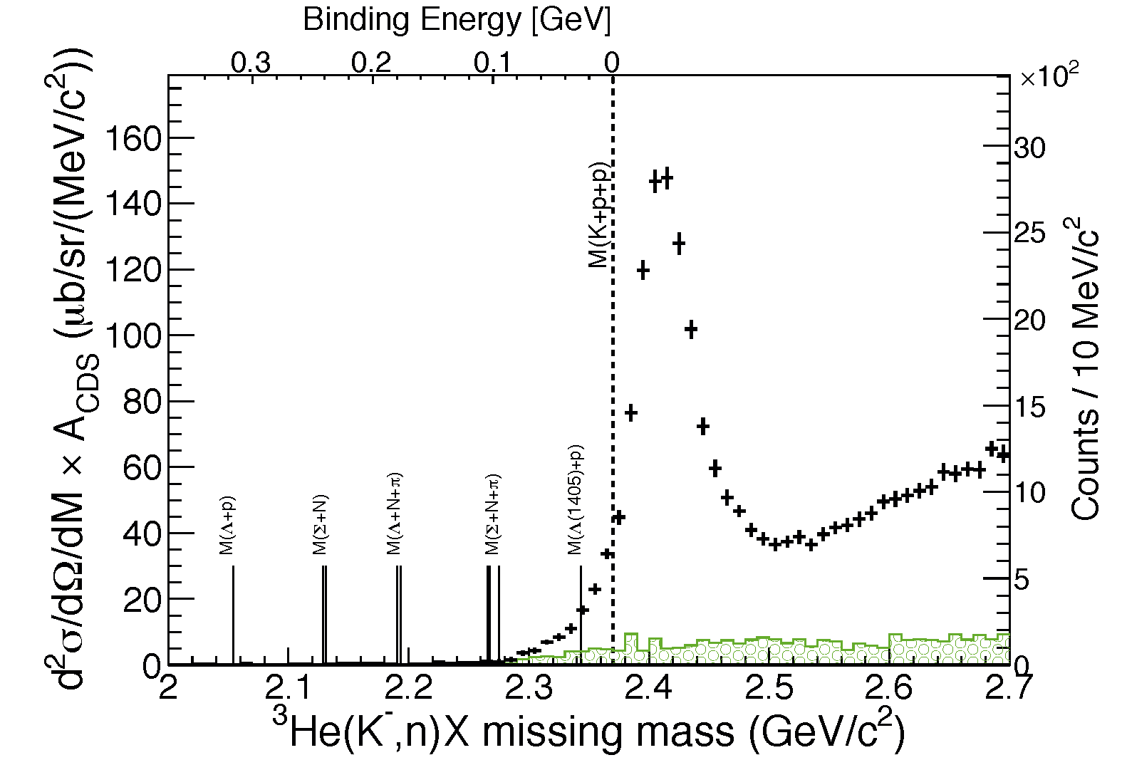
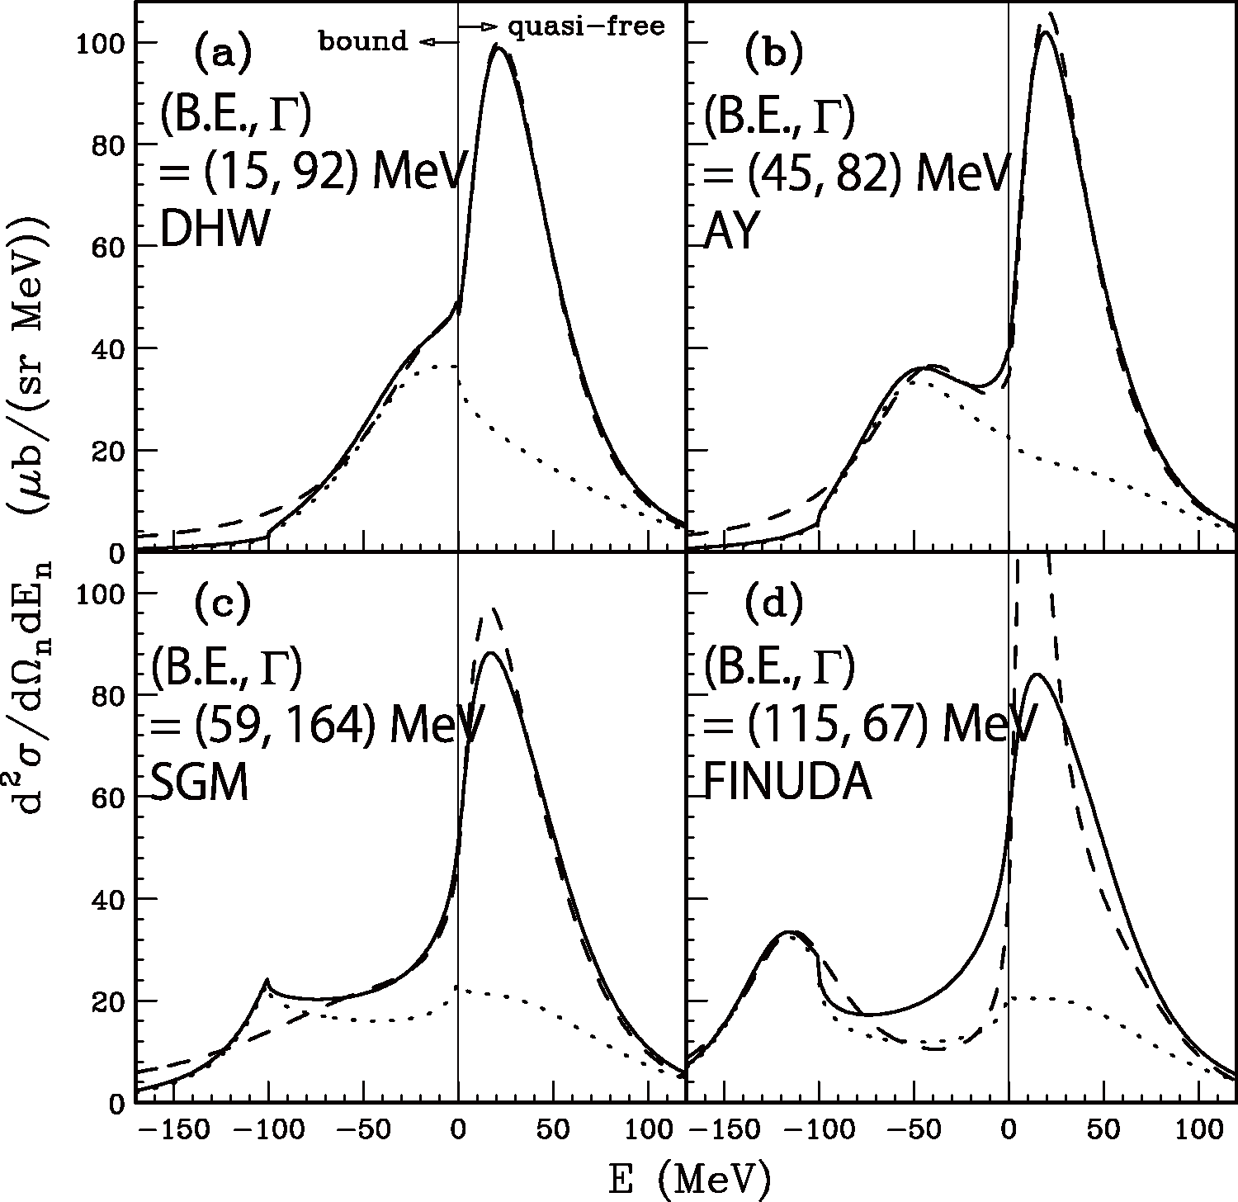
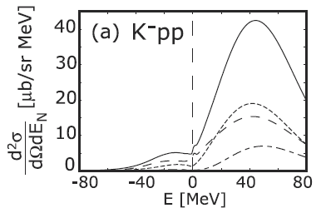
Comparison between E15 and Calc.
semi-inclusive
DATA
(BG subtracted)
semi-inclusive
DATA
(BG subtracted)
inclusive
Koite, Harada,
PRC80(2009)055208
inclusive
integrated CS:
~0.1 mb/sr
integrated CS:
~mb/sr
Yamagata-Sekihara, et al.,
PRC80(2009)045204
CS is roughly consistent with KH
Loosely-bound K-pp state ???
πΣN measurement
is an important key

Slide 20
Decay Channel Exclusive ³He(K⁻, Λp)n
kinematically complete,
w/ 4-momenta conservation
revised analysis!
pπ⁻ (=Λ) pair defined by probability
to improve the Λ definition

Slide 21
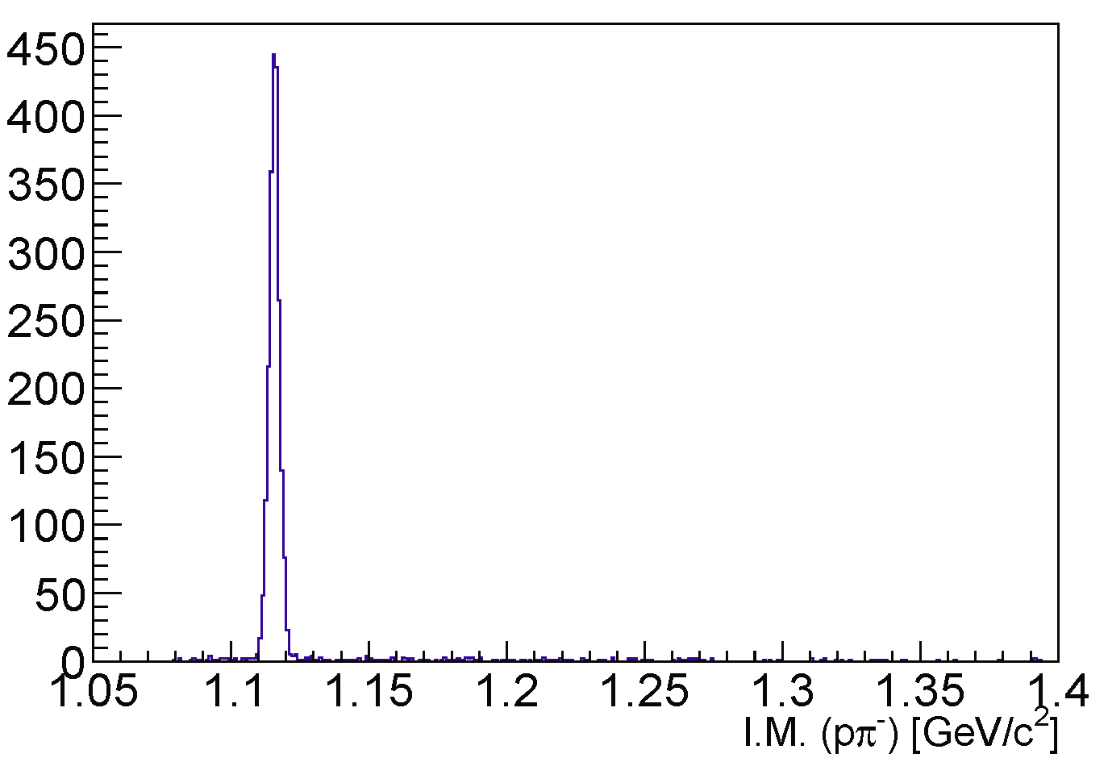
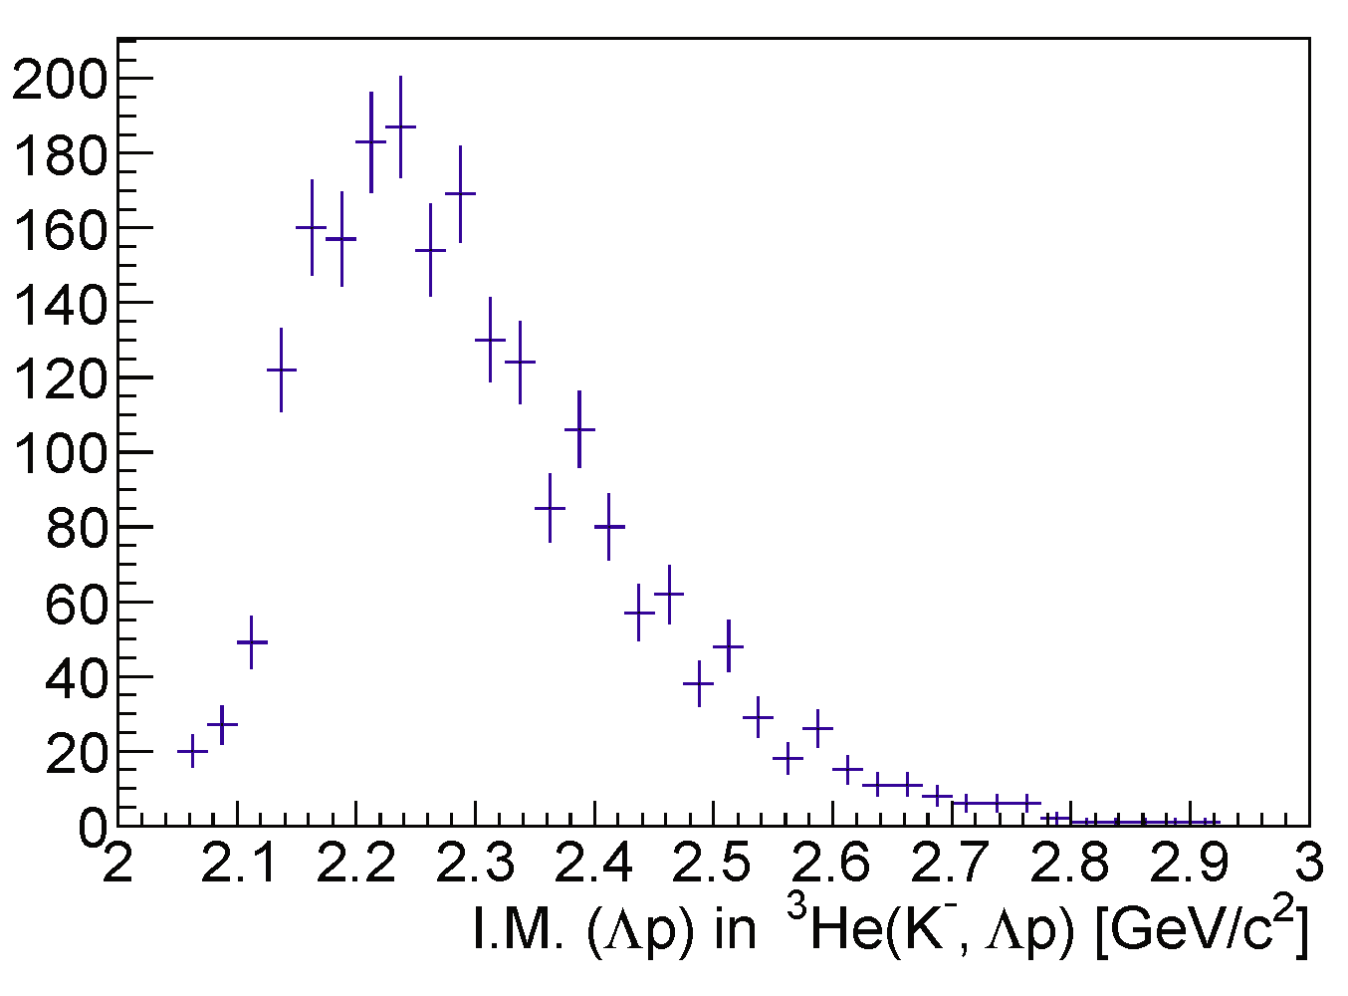
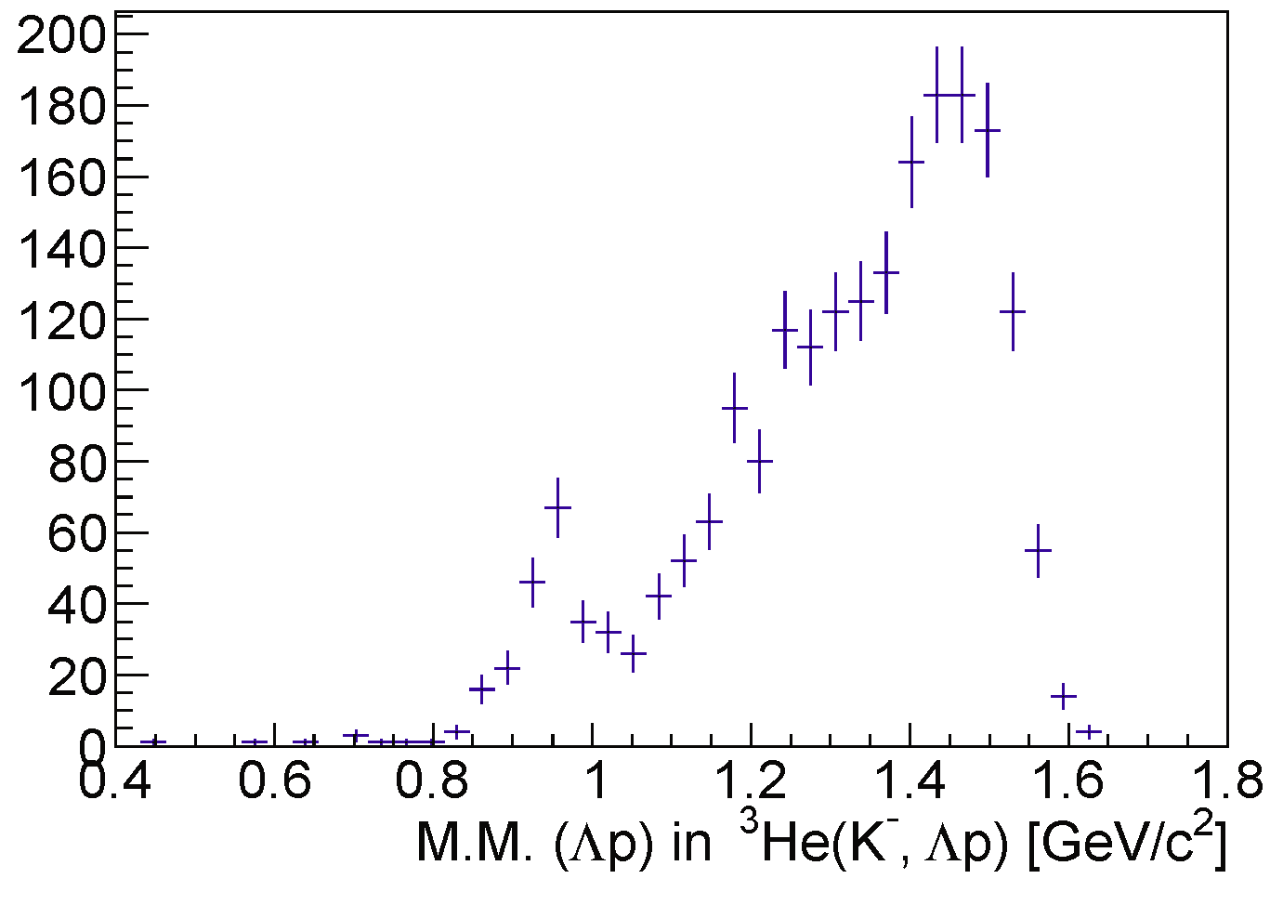
³He(K⁻,ppπ⁻)X = ³He(K⁻, Λp)nmis. events
CDS
Λ→pπ⁻ reconstruction
p
missing n
preliminary
Λ
π⁻
p
1GeV/c
K⁻ beam
IM(Λp)
MM of ³He(K⁻,Λp)X
preliminary
preliminary

Slide 23
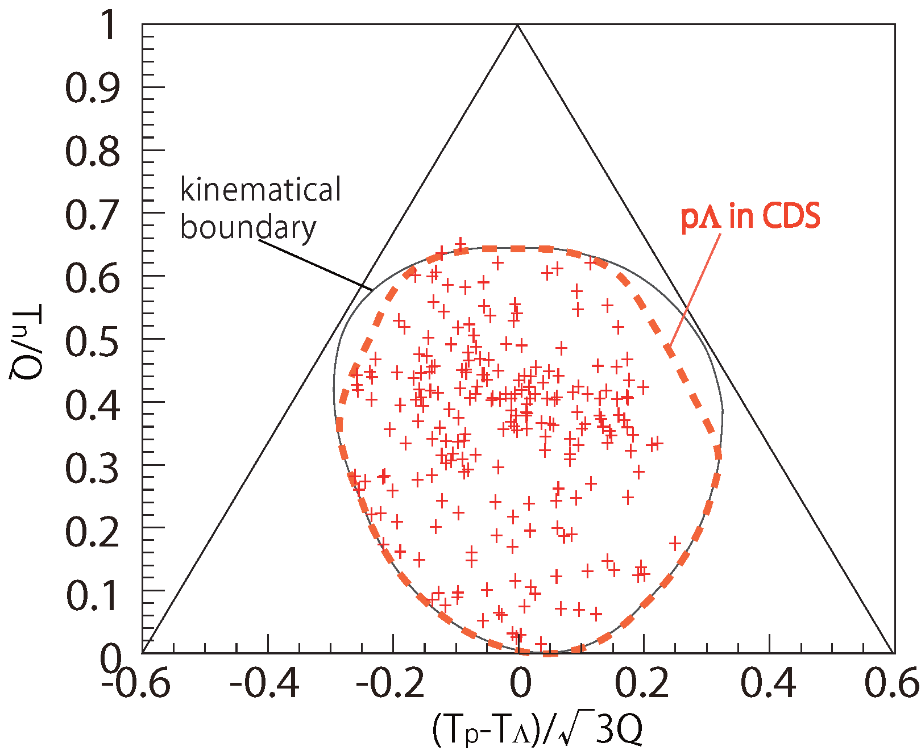
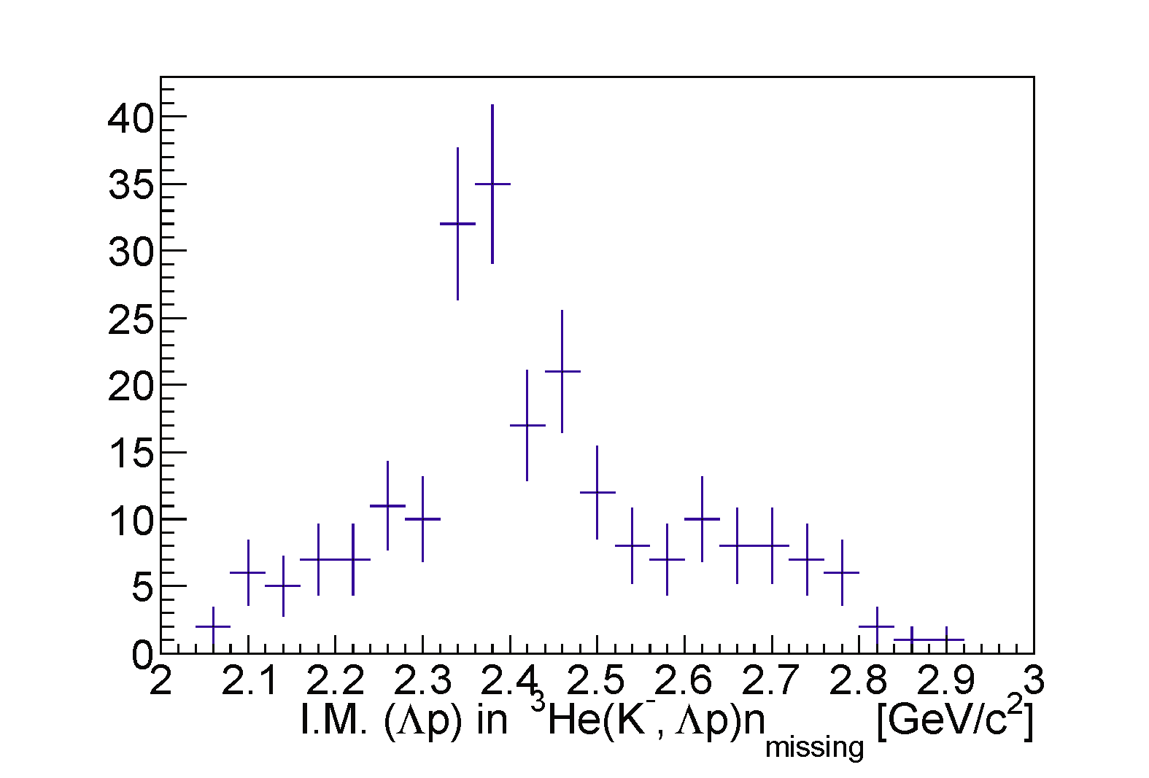
³He(K⁻, Λp)n Events
kinematically complete, w/ 4-momenta conservation
Dalitz plot in CM
preliminary
counts
preliminary
p at rest line
Λ at rest line
n at rest line
structure found near K⁻pp threshold
2NA reaction K⁻+³He → Λ+p+ns seem to be very weak
3NA reaction K⁻+³He → Λ+p+n exist, but weak as well
2NA Λ(1405) production excluded; Λ(1405)+n+p_{S} (2NA)

Slide 24
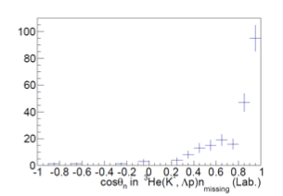
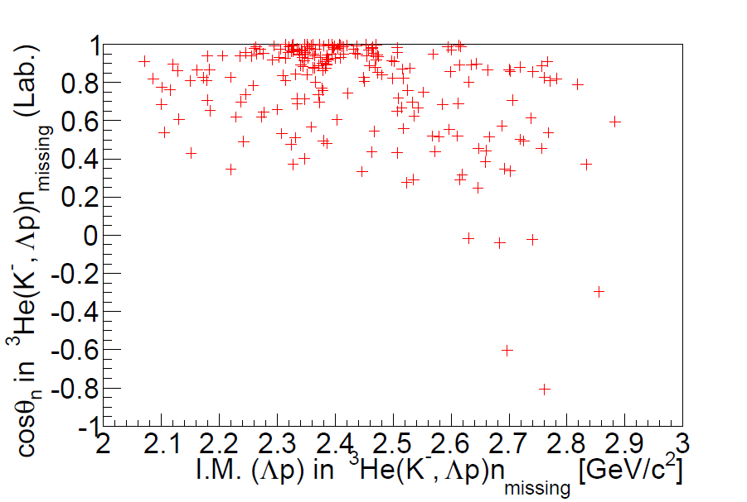
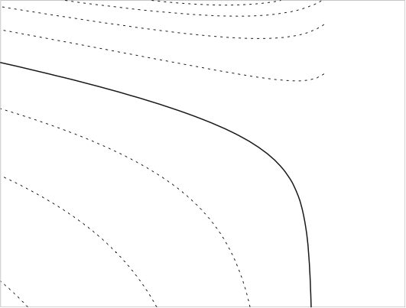
Angular distribution of the excess
counts
counts
preliminary
preliminary
— smaller qX
qX = 0.6 GeV/c
qX = 0.8 GeV/c
Forward neutron
qX = 1.0 GeV/c
=
preliminary
Low momentum transfer preferred
3NA-like events distribute widely in formation angle as expected
— larger qX

Slide 25
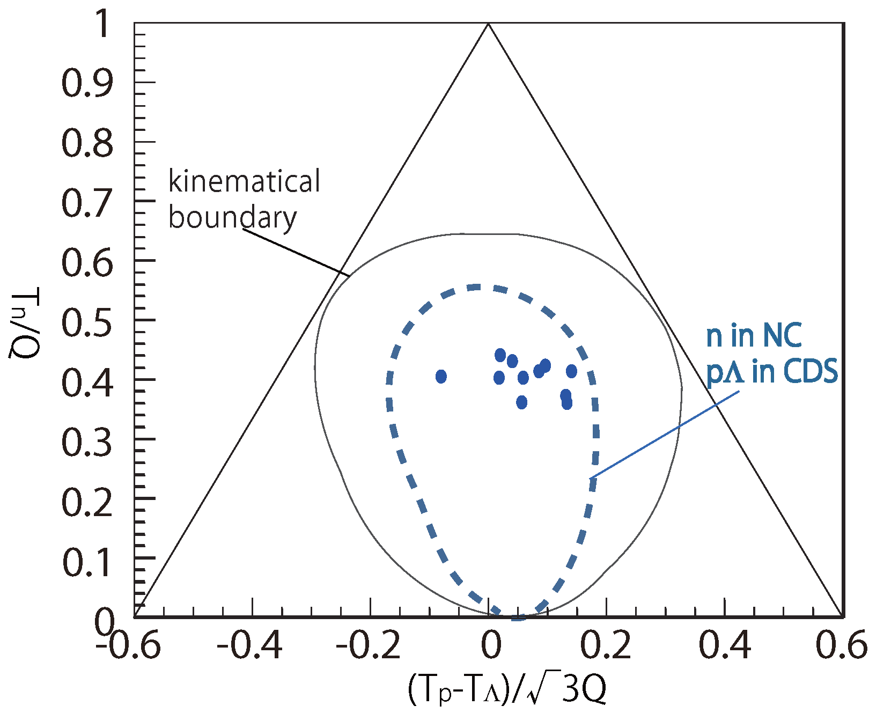
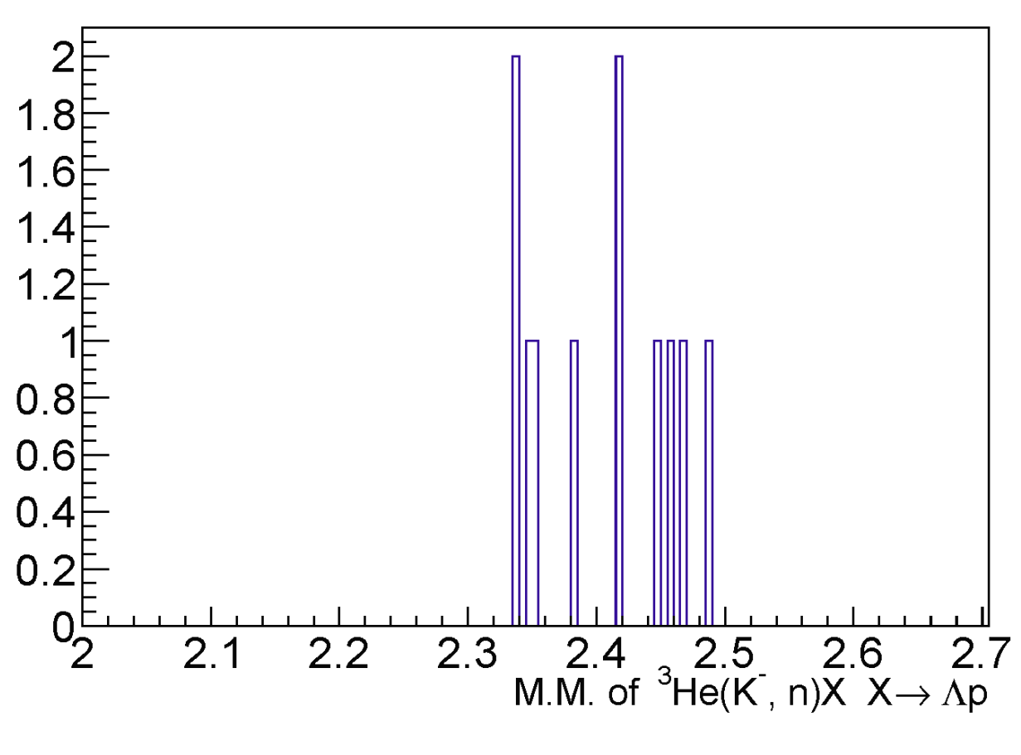
Kinematically-complete ³He(K⁻, Λpn)
redundant w/ 4-momenta conservation
Dalitz plot in CM
~10 events
preliminary
K⁻+p+p threshold
Count per 0.005 GeV/cª
preliminary
Σ⁰p
Formation neutron selectively (no effect from Λp / Σ⁰p)
3NA largely suppressed (consistent with nmis. events)
more data awaited

Slide 26
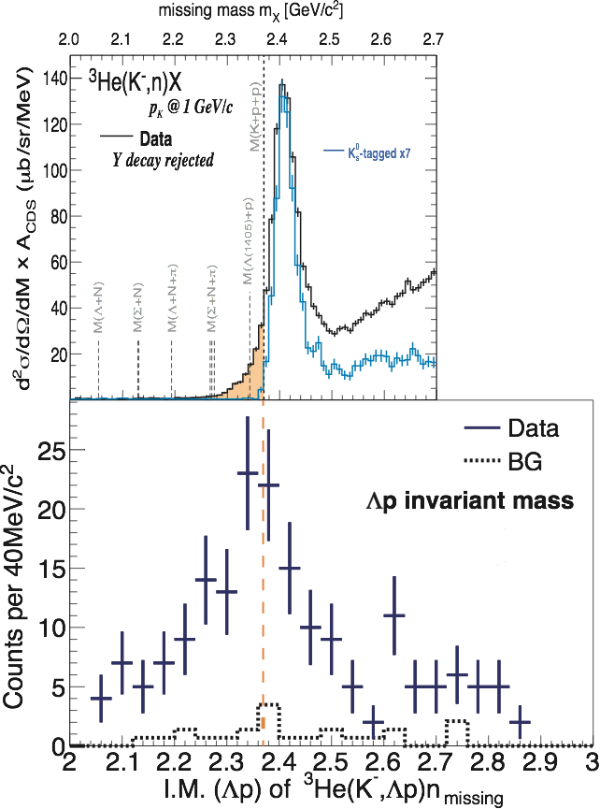
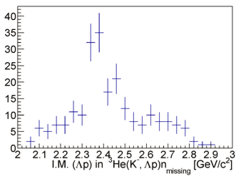
E15 1st
Formation vs Decay
³He(K⁻,n)X
quasi-elastic KN
Formation channel
θn=0
semi-inclusive
K⁻ + ³He → n + X (θn=0)
semi-inclusive
Preliminary
Y-decay free
on archive
excess below threshold
contribution from
Λ(1405)n + pS (2NA)
may exist
background-free
excess
³He(K⁻,Λp)n
K⁻ + ³He → Λ + p + nmis.
exclusive
Decay channel
Λp invariant mass
Preliminary
DISTO/FINUDA
σtot ~ 200 μb
exclusive
K⁻ + ³He → Λ + p + nmis.
excess exist near threshold
cannot be Λ(1405)n + pS (2NA), because F.S.= Λ p n
contamination Σ⁰ < 20%

Slide 27
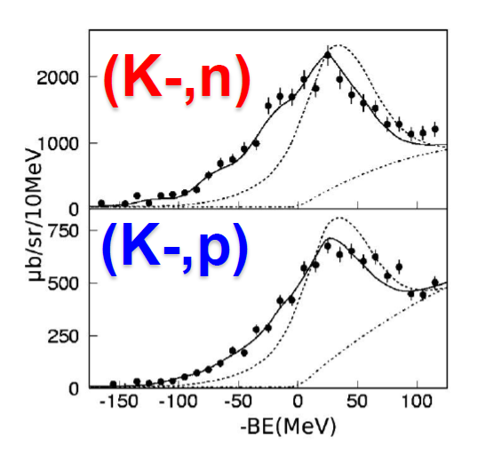
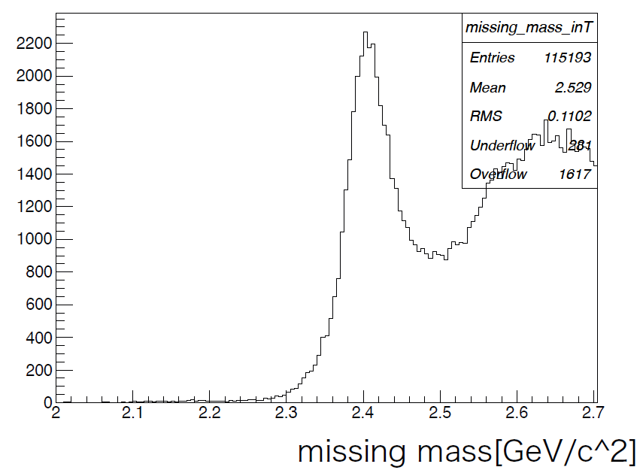
Semi-Inclusive ³He(K⁻,n/p)X M.M. spectrum
E548@KEK
(K⁻,n)
PTP118(2007)181
Re(V) = ~190MeV
preliminary
(K⁻,p)
Re(V) = ~160MeV
³He(K⁻,p) spectrum looks similar to (K⁻,n)

Slide 28
Summary
Inclusive (K⁻,n)X: submitted to PLB
✔ upper limit for deeply bound region
✔ excess in loosely bound region
Exclusive (K⁻ ,Λp) n: will be finalized soon
✔ Dalitz plot suggest two-components
－ Inclusive (K-,p)X : analysis undergoing

Slide 29
Thank you for attention!

Slide 30
Backup

Slide 32
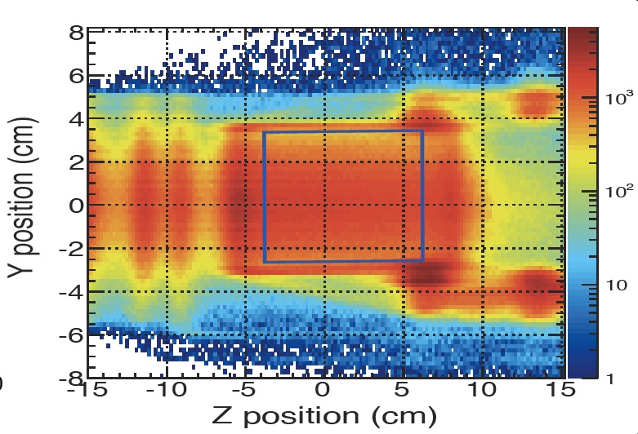

Slide 33
Efficiency = 23±4%
MM resolution ～10MeV

Slide 34
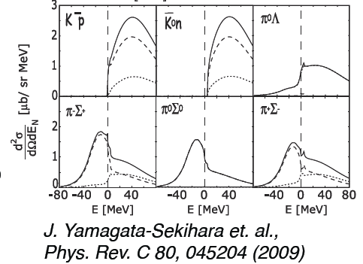
³He(K⁻, n): hint in exclusive ³He(K⁻,π⁺π⁻pn)n
Blue: in CDS / Red: in NC
K⁻ +³He →Σ⁺⁻ + π⁻⁺ + p + n
Σ⁺⁻ → n + π⁺⁻
or
K⁻ +³He →Σ⁺⁻ + π⁻⁺ + p + n
Σ⁺⁻ → n + π⁺⁻
E15^{1st}
preliminary
Very low statistics, but some structure in the binding region?

Slide 35
³He(K⁻, n): hints in Λ/pp-tagging
E15^{1st}
E15^{1st}
preliminary
preliminary
tagging method would address the origin of the sub-threshold excess

Slide 36
p(K-,K⁰_{S})n_{forward} yield (n in NC acc.)
N_{t} = 5.8*10²³ /cm²
ρ = 70.85*10⁻³ g/cm³
l = 13.67 cm
N_{K} = 1.1*10⁵ /spill/9s
σ = 3.92*10⁻²⁷ cm² (= 7.84 mb * 0.5)
ε(decay*(CDS*NC acc)) = 5.4*10⁻³
ε(beam ana) = 0.65
ε(loss) = 0.97
ε(fiducial selection) = 0.70
ε(trig*DAQ) = 0.80
ε(analysis) = 0.90
K*CDH2 pre-scale = 1/5
[run#49c * 0.8]
[past measurement]
[Monte-Carlo]
[Run#49c condition]
expected error:
K⁰_{S} in CDS w/ NC acc. ~ 3400
K⁰_{S} & n detection ~ 800
→ NC eff. ~ 0.23 +/- 0.007(stat.)
[~ run#49c / 0.8]
→ 3.4x10³ per 4 days (w/o NC eff.)

Slide 37
ε(NC) = 23+/-4%

Slide 38
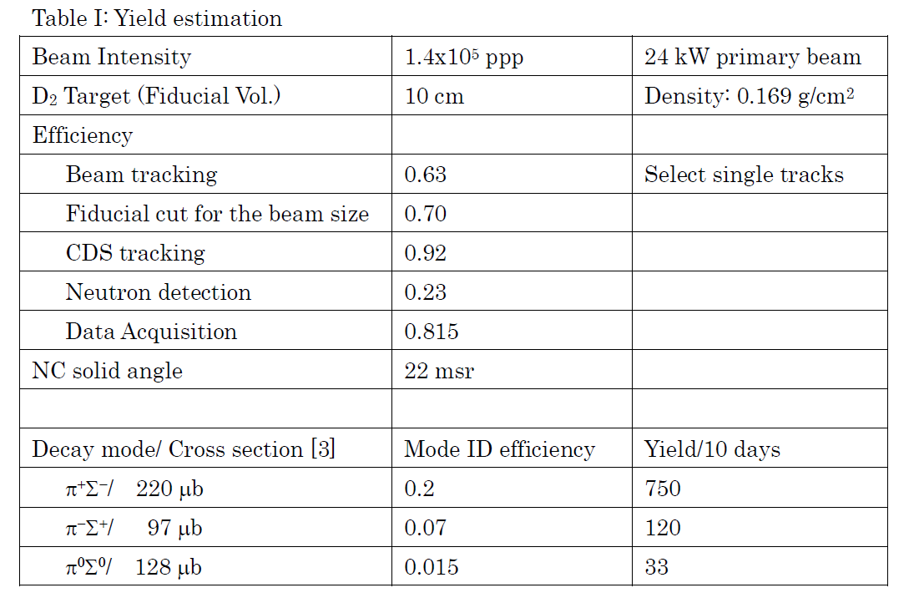
d(K⁻,n)Λ(1405) yield
E31 status report, May, 2014
1.1x10⁵
[Run#49c condition]
20 days
[prediction]

Slide 39
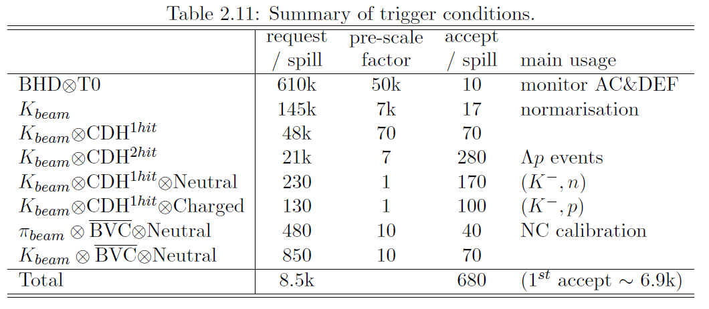
Typical Trigger Condition in 1GeV/c K⁻ + ³He @ Run#49c [24 kW (30 Tppp)]
Doctor thesis, T. Hashimoto, The University of Tokyo, 2014.3

Slide 40
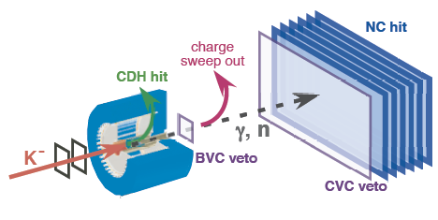
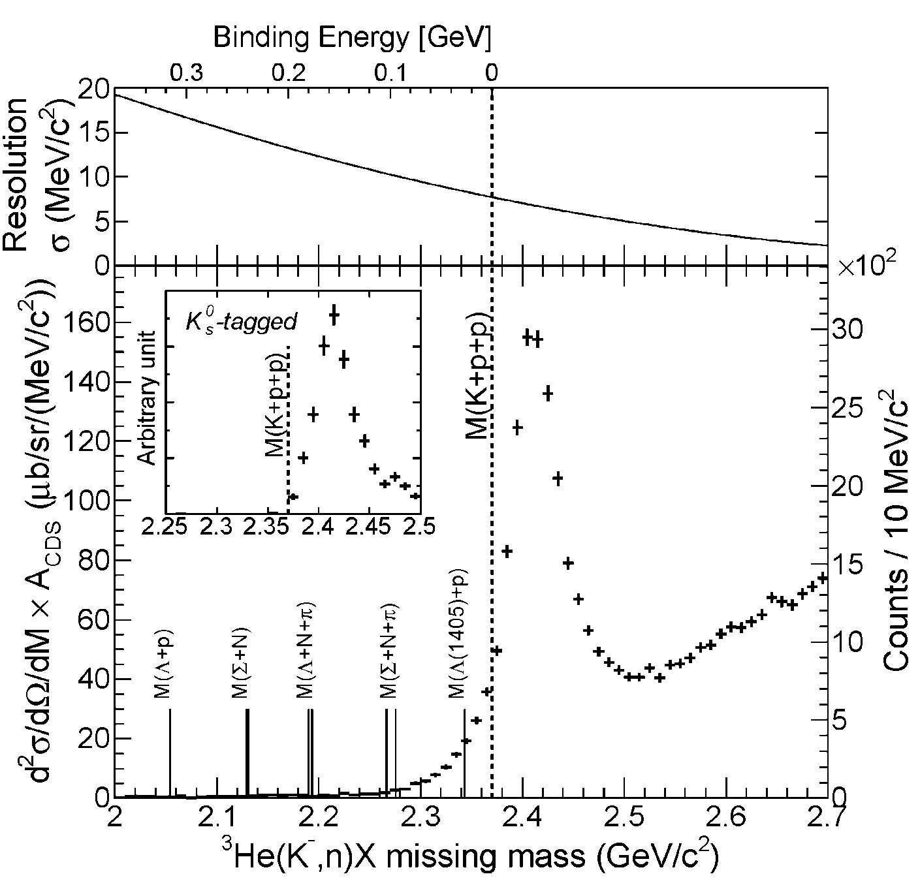
Semi-Inclusive Spectrum
Quasi Elastic
K⁻ + ³He → K⁻ + n + p_{s} + p_{s}
dσ/dΩ_{θ=0deg} ~ 6mb/sr
and
Charge-Exchange
K⁻ + ³He → K⁰ + n + d_{s}
K⁰ → π⁺ + π⁻
dσ/dΩ_{θ=0deg} ~ 11mb/sr
The tail structure is not due to “the detector resolution”

Slide 41
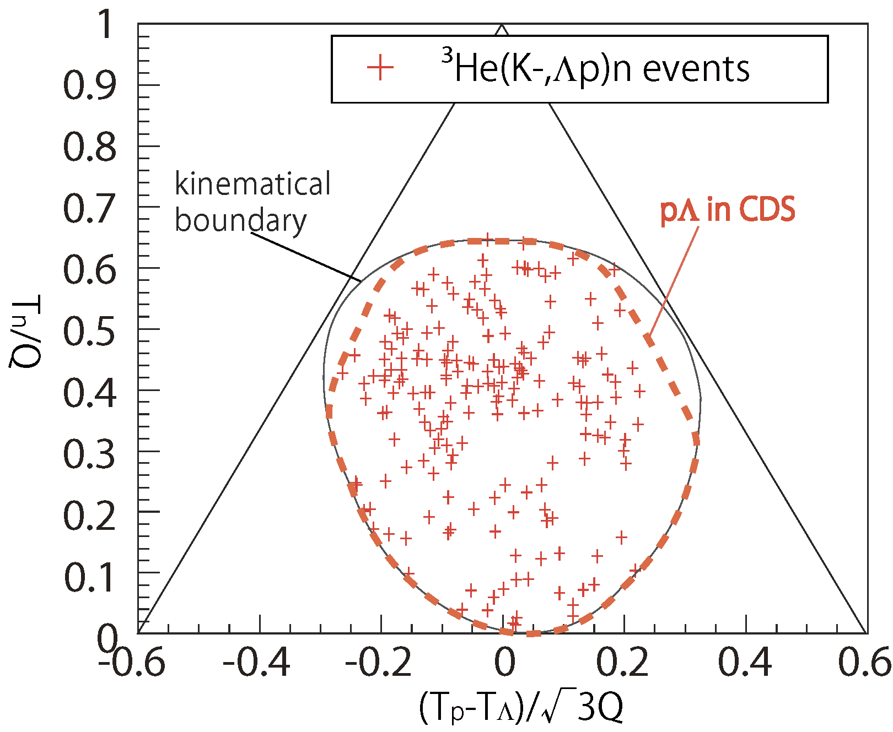
Dalitz plot
2NA:
e.g. K⁻³He→Λpn_{s}
preliminary
2NA+2step:
e.g. K⁻³He→Σ⁰pn_{s},
Σ⁰n_{s}→Λn
2NA+2step:
e.g. K⁻³He→Λpn_{s},
pn_{s}→pn
2NA+2step:
e.g. K⁻³He→Σ⁰np_{s},
Σ⁰p_{s}→Λp
K⁻pp form.:
K⁻³He→(K⁻pp)n,
K⁻pp→Λp

Slide 42
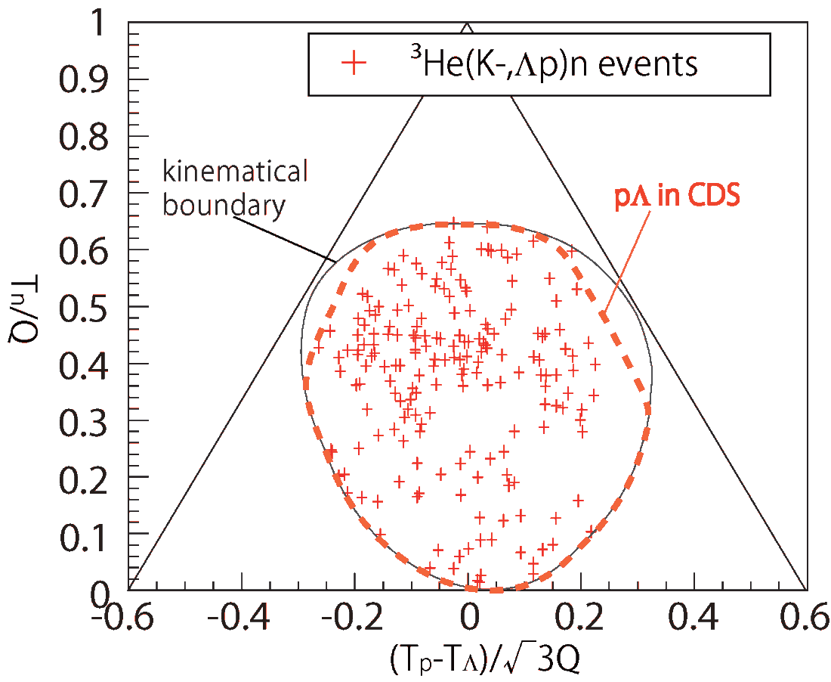
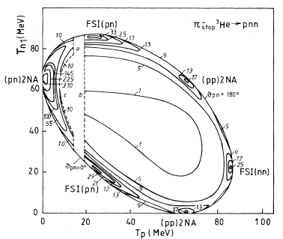
K-induced vs π-induced
[1] D. Gotta, et al., PRC51. 496 (1995)
[2] P. Weber et al., NPA501 765 (1989)
[3] G. Backenstoss et al., PRL55. 2782 (1985)
π⁻ stopped [1]
2nucleon absorption &FSI (50%/π _{stopped}) are clearly seen
3nucleon absorption <3% /π _{stopped}
π⁻ in-flight [2],[3]
2nucleon absorption 0.85 ± 0.17mb (266 MeV/c)
3nucleon absorption 3.7 ± 0.6 mb(220 MeV/c)
3NA/2NA ~ 4
in-flight K
preliminary
stopped π
Data suggests that
3NA reactions are dominant?

