Slide 1
Spectroscopic research of light to medium-heavy Λ hypernuclei with high quality electron beam
Graduate School of Science, Kyoto University
Toshiyuki Gogami (後神 利志)
Strangeness Nuclear Physics 2014 @Changsha, China
2014/12/12-14

Slide 2
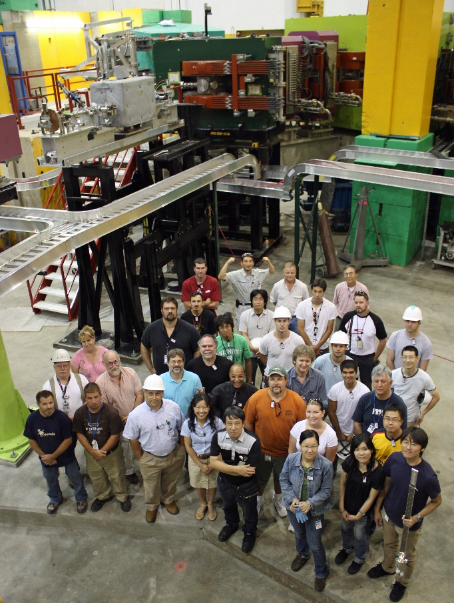
Contents
Introduction of (e,e’K⁺) experiment
Overview of JLab E05-115
Experimental setup
Data summary
Results
About systematic errors
⁷_{Λ}He

Slide 3
Contents
Introduction of (e,e’K⁺) experiment
Overview of JLab E05-115
Experimental setup
Data summary
Results
About systematic errors
⁷_{Λ}He

Slide 4
Systematic study of Λ hypernuclei

Slide 5
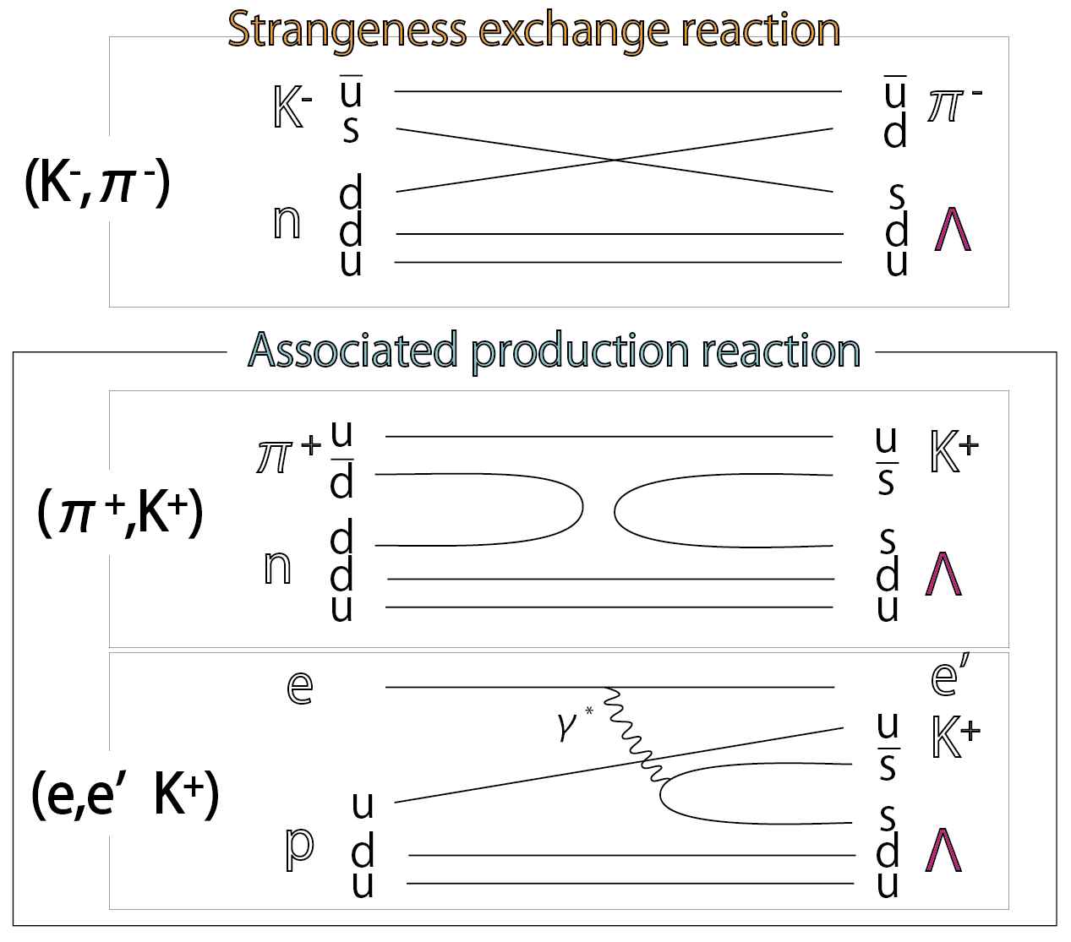
Typical reactions for missing mass spectroscopy
~ 1990’s
The (K⁻,π⁻) , (π⁺,K⁺) reactions
A few MeV (FWHM)
n →Λ
①Higher resolution
→ Finer structures
2000~
The (e,e’K⁺) reaction
Sub-MeV (FWHM)
p → Λ
②Mirror hypernucleus
③Absolute energy
Background $∝Z2$

Slide 6
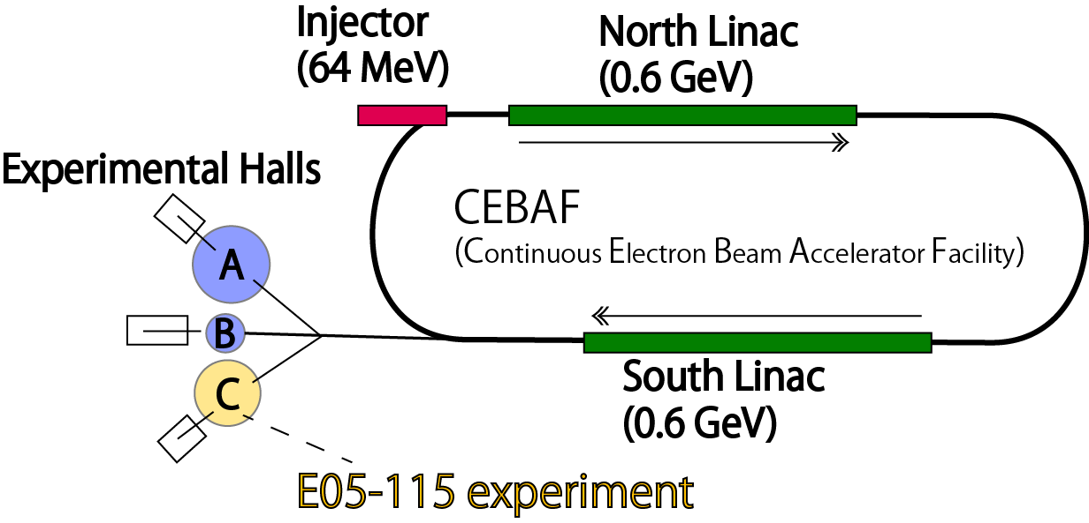
(e,e’K⁺) experiments at Jefferson Lab (JLab)
Requirements
Beam energy $≳$ 1.5 GeV
Energy spread ΔE/E < 10⁻⁴
Small emittance (2μm・mrad)
High intensity (a few - 50 μA)
Duty factor $≃$ 100%
(1 km round)
MAMI
CEBAF
2000 (E89-009)
12
Proof of principle
2005 (E01-011)
28
52
2009 (E05-115)
Mass number

Slide 7
Contents
Introduction of (e,e’K⁺) experiment
Overview of JLab E05-115
Experimental setup
Data summary
Results
About systematic errors
⁷_{Λ}He

Slide 8
Goals of JLab E05-115 experiment
Consistency confirmation with the previous experiments
¹²C(e,e’K⁺)¹²_{Λ}B
Will be talked by C.Chen
PRC90, 034320 (2014)
Spectroscopic measurements
⁷Li(e,e’K⁺)⁷_{Λ}He
CSB effect in ΛN interaction (αΛNN)
Λ Glue like role
¹⁰B(e,e’K⁺)¹⁰_{Λ}Be
CSB effect in ΛN interaction (ααΛN)
Λ Glue like role
Level inversion due to nuclear deformation
Preparing papers
Pilot measurement to medium-heavy hypernuclear study
⁵²Cr(e,e’K⁺)⁵²_{Λ}V
(the first challenge for medium-heavy mass region)
Λ single particle potential
Under Analysis

Slide 9
Missing mass spectroscopy
$${}_{}^{A}{Z (e,e^{′}K+){}_{Λ}^{A}{(Z−1)}}$$
Measure
CEBAF
CEBAF
$$M_{HYP}^{2}=\left(E_{e}+M_{t}−E_{K}−E_{e′}\right)2−\left(p_{e}−p_{K}−p_{e′}\right)2$$
Known
$$−B_{Λ}=M_{HYP} −M_{Λ} −M_{core}$$
(Λ’s binding energy)

Slide 10
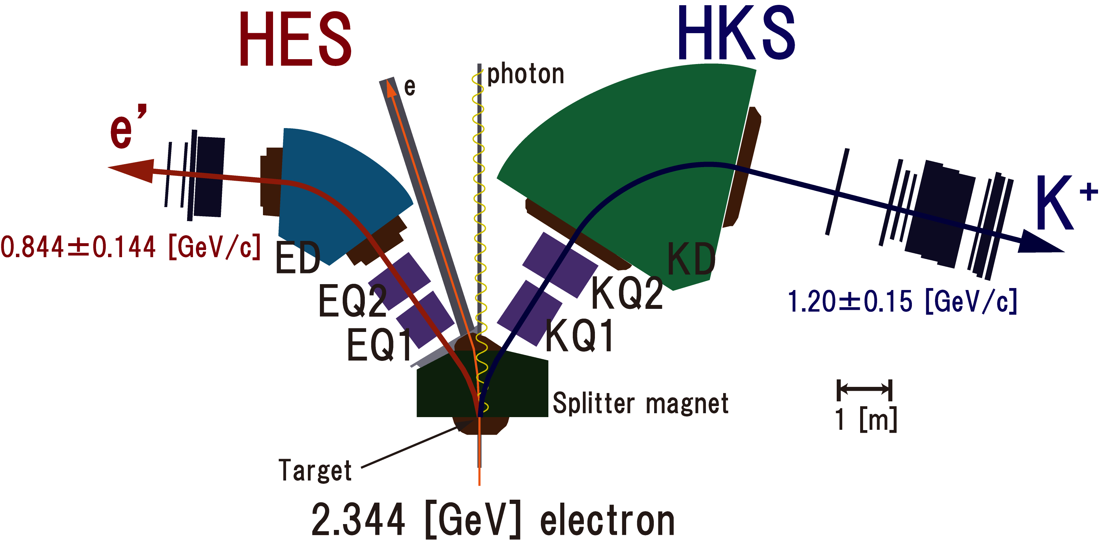
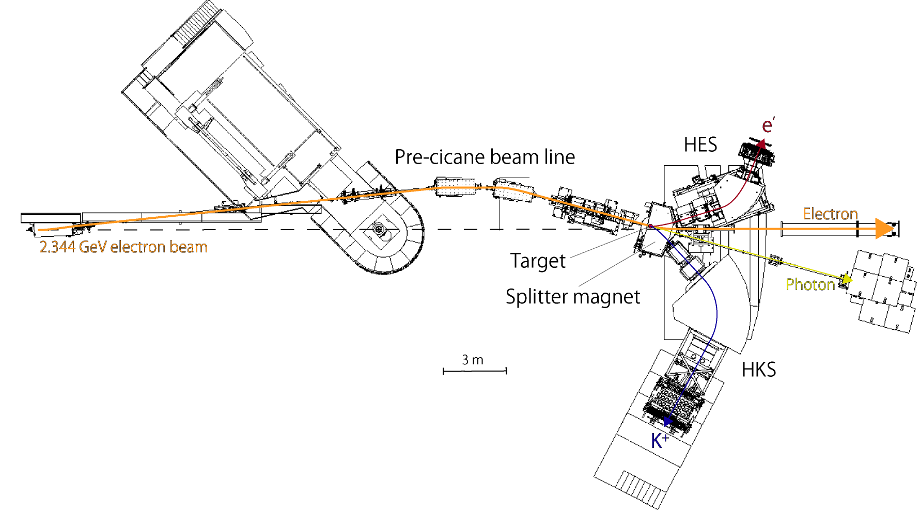
Experimental setup
Pre-chicane beam line
Δp/p ~ 2 × 10⁻⁴
Δp/p ~ 2 × 10⁻⁴
θ_{e’} = 6.5 ± 5.0 [degree]
Ω_{HKS} = 7.0 [msr]
θ_{K} = 5.7 ± 4.6 [degree]
Ω_{HKS} = 8.0 [mrad]

Slide 11
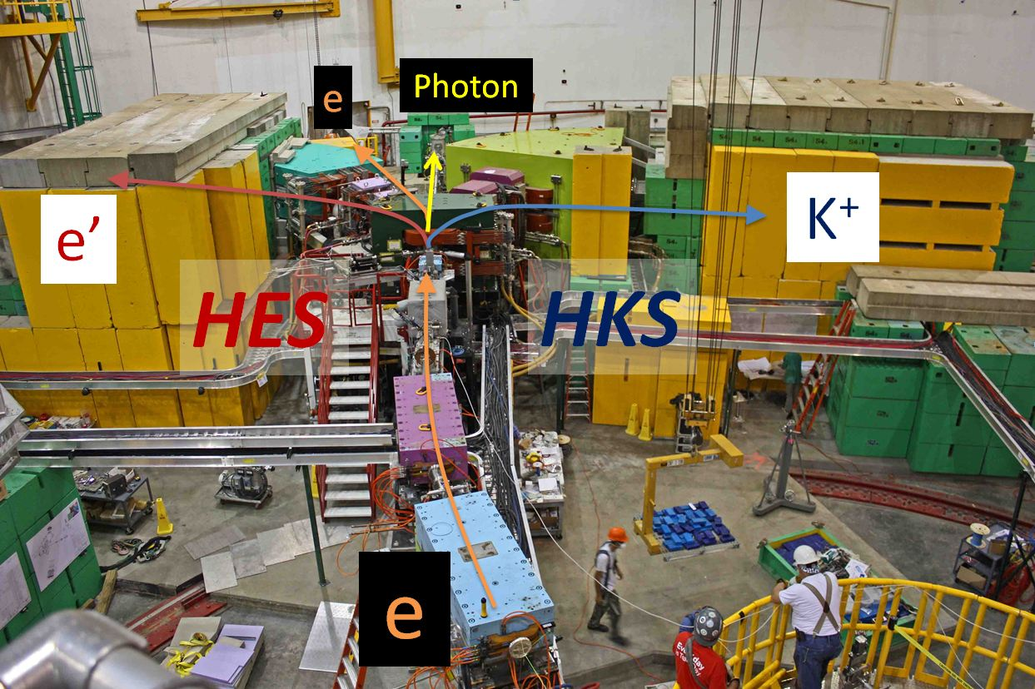
Experimental setup

Slide 12
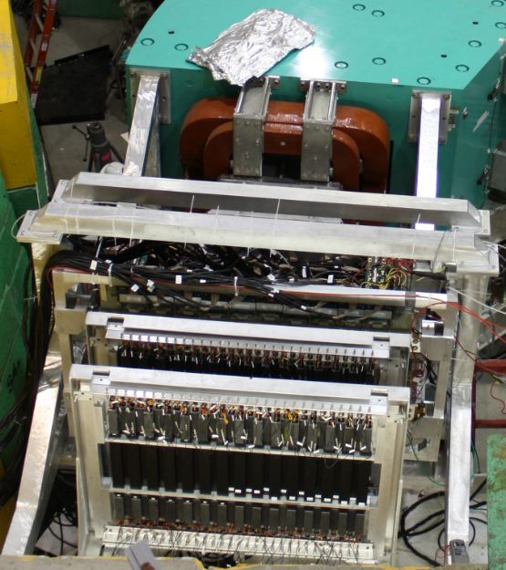
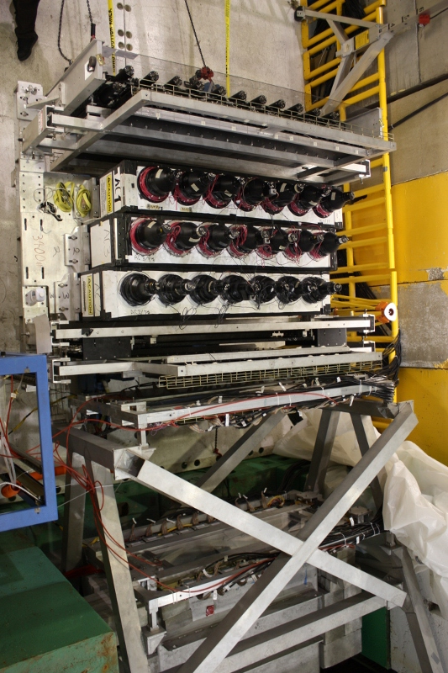
Detectors & Trigger
HKS
HES
K⁺
p, π⁺
e⁻
TOF walls
(Plastic scintillators)
Cerenkov detectors
Aerogel (n=1.05)
Water (n=1.33)
Drift chambers

Slide 13
Detectors & Trigger
HKS
HES
K⁺
p, π⁺
e⁻
TOF walls
(Plastic scintillators)
HES trigger
(TOF1x2)
~2000 kHz
HKS trigger
(TOF1x2x3) x Cerenkov
~10 kHz
Cerenkov detectors
Aerogel (n=1.05)
Water (n=1.33)
Coincidence trigger
HES x HKS
< 2 kHz
Drift chambers

Slide 14
Data summary (JLab E05-115)
( August – November in 2009)
Target ([mg/cm²]) | Hypernucleus Hyperon | Nominal beam current [μA] | Run time [h] | Total incident charge [C] (Number of incident e⁻)
CH₂ (450) | Λ, Σ⁰, ¹²_{Λ}B | 2.0 | 39 | 0.28 (0.17$×$10¹⁹)
H₂O (500) | Λ, Σ⁰, ¹⁶_{Λ}N | 2.5 | 21 | 0.20 (0.12$×$10¹⁹)
⁷Li (208) | ⁷_{Λ}He | 35 | 42 | 4.84 (3.0$×$10¹⁹)
⁹Be (188) | ⁹_{Λ}Li | 40 | 39 | 5.33 (3.3$×$10¹⁹)
¹⁰B (56) | ¹⁰_{Λ}Be | 40 | 45 | 6.25 (3.9$×$10¹⁹)
¹²C (88) | ¹²_{Λ}B | 20, 35 | 55 | 5.73 (3.6$×$10¹⁹)
⁵²Cr (154) | ⁵²_{Λ}V | 7.5 | 230 | 6.35 (4.0$×$10¹⁹)

Slide 15
Contents
Introduction of (e,e’K⁺) experiment
Overview of JLab E05-115
Experimental setup
Data summary
Results
About systematic errors
⁷_{Λ}He

Slide 16
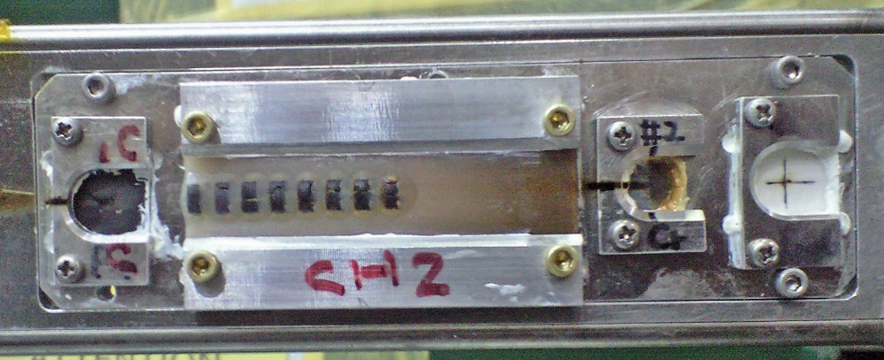
Energy scale calibration = Backward transfer matrix optimization
Polyethylene target
PDG values
(K.Nakamura et al., Journal of Physics G 37, 075021, 2010)
Λ: $1115.683±0.006$ MeV
Σ⁰: $1192.642±0.024$ MeV
ΔB_{mat} = 0.110 MeV
ΔE_{mat} = 0.050 MeV
Systematic Errors
for hypernuclei
Notes:
PDG values
(K.Nakamura et al., Journal of Physics G 37, 075021, 2010)
Λ: $1115.683±0.006$ MeV
Σ⁰: $1192.642±0.024$ MeV

Slide 17
Differential cross section for the (γ*,K⁺) reaction
Number of target nuclei
Efficiencies
HKS acceptance
Number of virtual photon
including HES acceptance

Slide 18
Contents
Introduction of (e,e’K⁺) experiment
Overview of JLab E05-115
Experimental setup
Data summary
Results
About systematic errors
⁷_{Λ}He

Slide 19
⁷_{Λ}He hyprenucleus
Resonant state
⁶He
⁷He
_{Λ}
n
α
n
α
n
+
n
Λ
Bound state
Λ
Unbound → Bound
CSB effect

Slide 20
Missing mass spectrum of ⁷_{Λ}He
Interested region
Bound region
Accidental background subtraction
Peak candidate search with statistical significance
Peak fitting

Slide 21
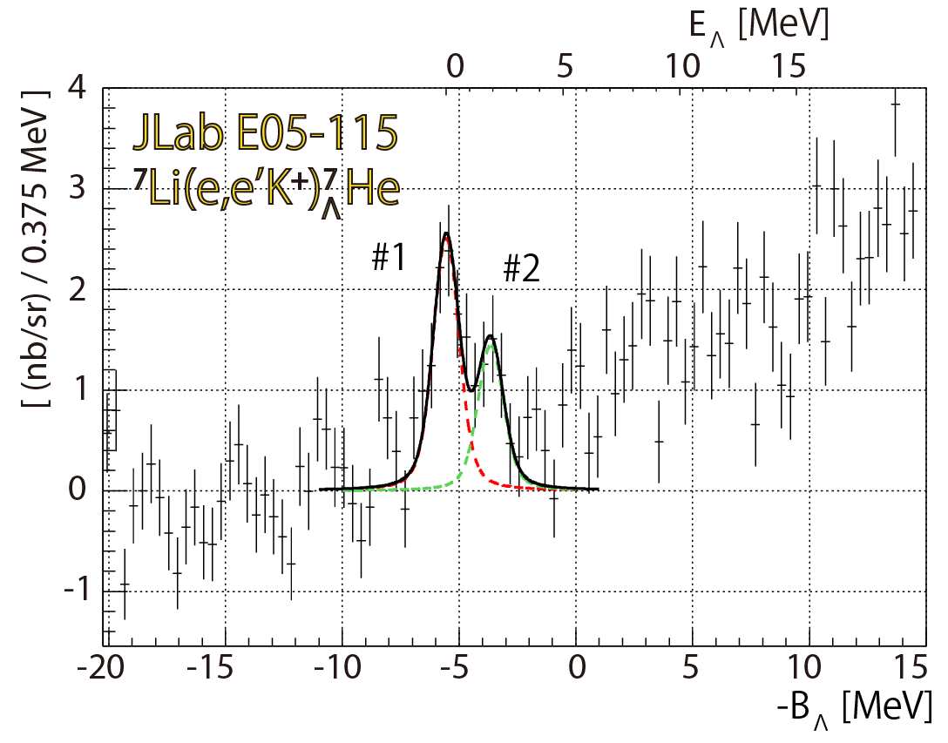
⁷_{Λ}He hyprenucleus
Resonant state
(FWHM = 1.3 MeV)
1/2⁺
3/2⁺, 5/2⁺
$${dσ}/{dΩ}$$
Present work
Bound state
Unbound → Bound
Peak | $−BΛ$ [MeV] (E_{x}) | ( $\frac{dσ}{dΩK}$)[nb/sr]
1 | $$−5.55±0.10±0.11$$ (0) | $$10.7±1.0±1.8$$
2 | $$−3.65±0.20±0.11$$ ($1.90±0.20±0.11$) | $$6.2±0.6±1.1$$
CSB effect

Slide 22
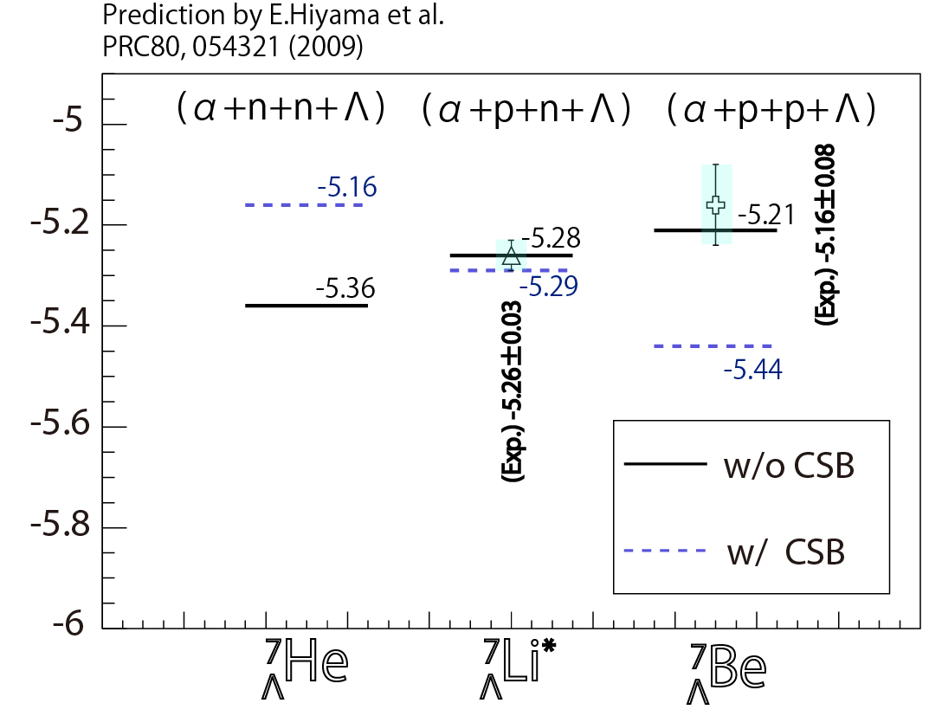
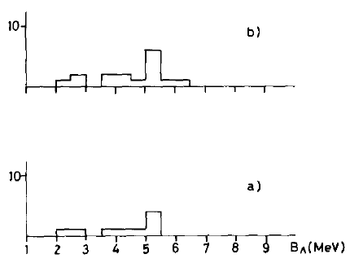
CSB interaction test in T=1 A=7 iso-triplet comparison
M.Juric et al., NPB52 (1973)
⁷_{Λ}Be
Counts
⁷_{Λ}Li
Counts
H.Tamura et al.,
PRL 84, 5963 (2000)
Counts
⁷_{Λ}He
B_{Λ} [MeV]
n
α
α
α
n
p
n
Λ
p
Λ
p
Λ

Slide 23
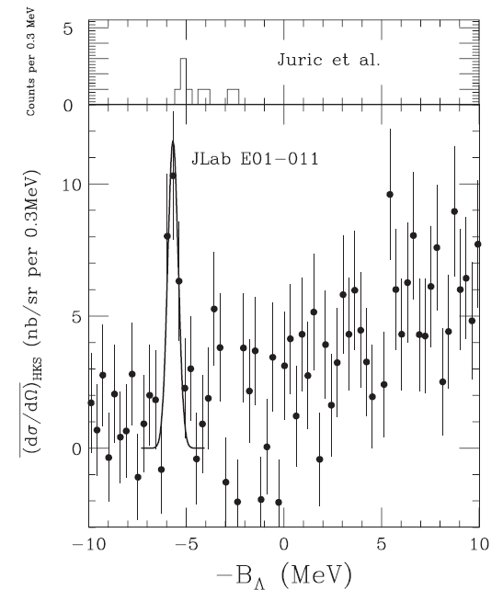
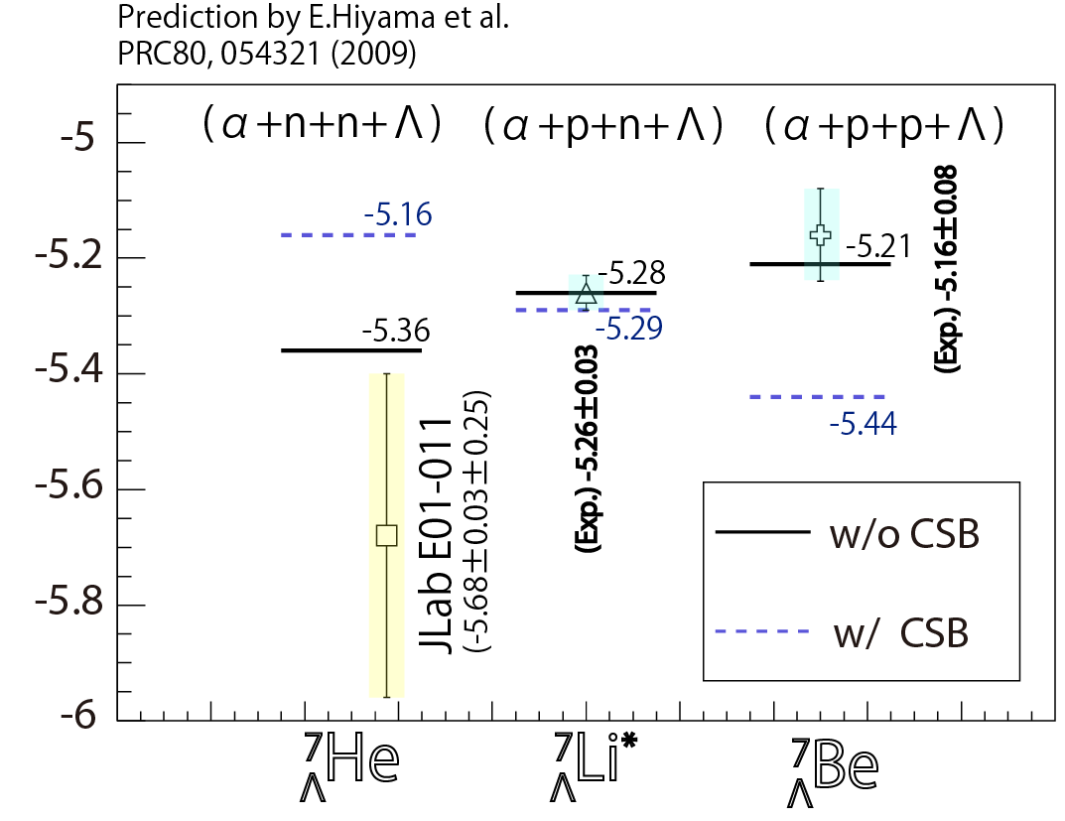
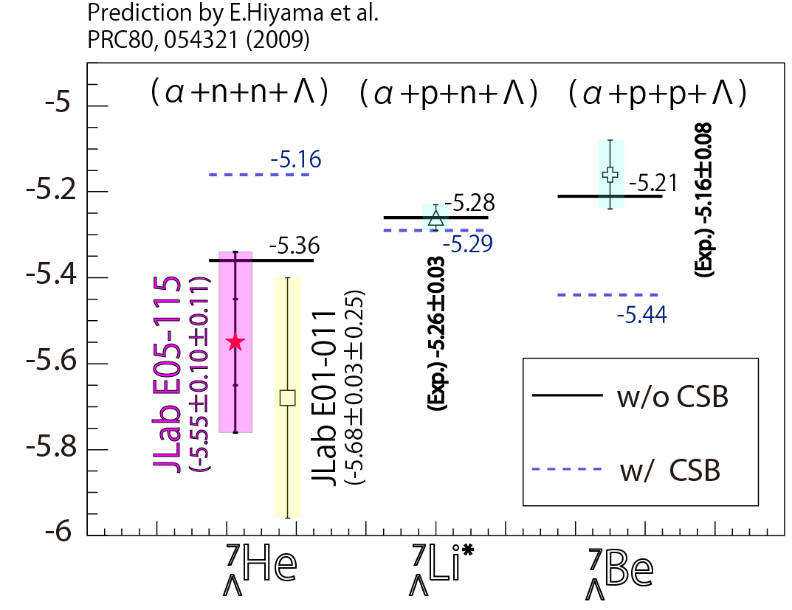
CSB interaction test in A=7 iso-triplet comparison
S.N.Nakamura et al., PRL 110, 012502 (2013)
E01-011
(2005)
E05-115
(2009)
Present work
n
α
α
α
n
p
n
Λ
p
Λ
p
Λ
1/2⁺

Slide 24
CSB interaction test in A=7 iso-triplet comparison
S.N.Nakamura et al., PRL 110, 012502 (2013)
E01-011
(2005)
⁷_{Λ}He g.s.
Consistent with the previous experiment
Prefer calc. w/o the CSB interaction
E05-115
(2009)
Present work
n
α
α
α
n
p
n
Λ
p
Λ
p
Λ
1/2⁺

Slide 25
The first report of ⁷_{Λ}He excited states
S.N.Nakamura et al., PRL 110, 012502 (2013)
Resonant state
 | E_{Λ} (3/2⁺,5/2⁺) [MeV]
JLab E05-115 | 1.90$±$0.22$±$ 0.05
E.Hiyama et al., PRC 80, 054321 (2009) | 1.70 (mean value)
M.Sotona et al., PTP 117 (1994) | 1.79 (mean value)
E01-011
(2005)
Bound state
E05-115
(2009)
Unbound → Bound
E_{Λ}
3/2⁺, 5/2⁺
Present work

Slide 26
Comparison with theoretical prediction of the differential cross section (⁷_{Λ}He)
Theoretical Prediction
1/2⁺:(3/2⁺,5/2⁺)
= 0.63
JLab E05-115
#1 : #2
$$=0.61±0.08$$

Slide 27
Comparison with theoretical prediction of the differential cross section (⁷_{Λ}He)
Theoretical Prediction
⁷_{Λ}He (3/2⁺, 5/2⁺)
Confirmed the glue-like role of Λ
[Unbound → bound ]
1/2⁺:(3/2⁺,5/2⁺)
= 0.63
JLab E05-115
#1 : #2
$$=0.61±0.08$$

Slide 28
Summary
JLab E05-115 experiment with the (e,e’K⁺) reaction in 2009
[HES (w/ tilt method) + HKS + SPL]
Spectroscopies with 0.11 MeV systematic errors
¹²C(e,e’K⁺)¹²_{Λ}B with FWHM=0.5 MeV
Consistent with the previous experiments
SPL(new)+HES(new) +HKS worked well
⁷Li(e,e’K⁺)⁷_{Λ}He with FWHM=1.3 MeV
Prefer the calculations w/o the ΛN CSB interaction
Confirmed 3/2⁺ and 5/2⁺ states (unbound → bound)
¹⁰B(e,e’K⁺)¹⁰_{Λ}Be with FWHM=0.78 MeV
The first spectroscopic measurement
ΛN CSB
Glue-like role
⁵²C(e,e’K⁺)⁵²_{Λ}V with FWHM=2.2 MeV
The first measurement with the (e,e’K⁺) in the medium-heavy mass region
Reported ¹²_{Λ}C g.s. might be shallower by ~0.5 MeV
The first measurement without the emulsion reference in the medium-heavy mass region
This talk

Slide 29
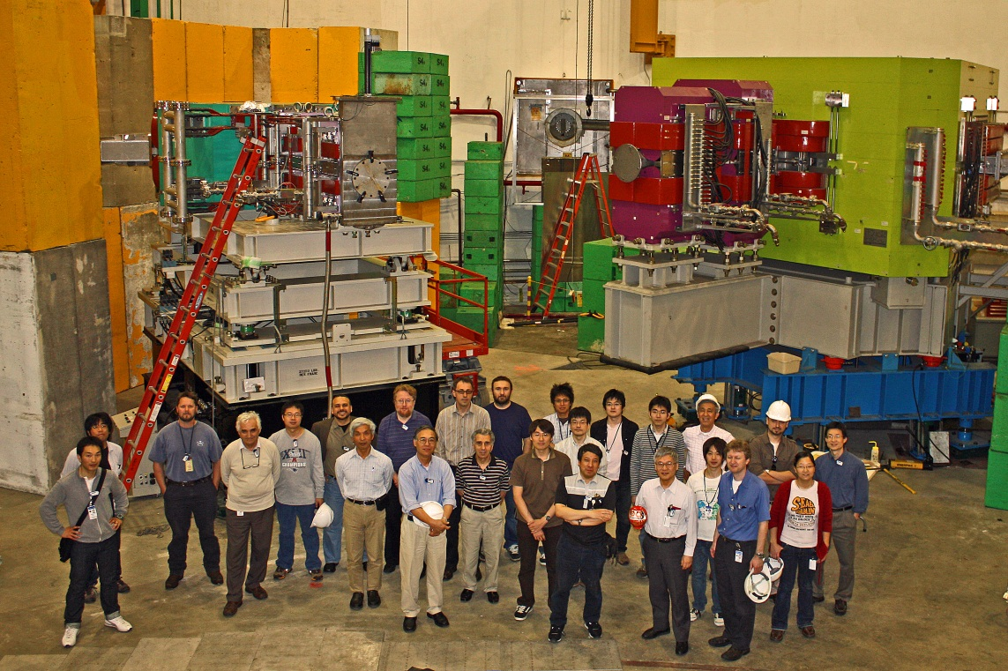
Thank you for your attention
Previous speaker: Patrick
Myself
Chair: Liguang
Next speaker: Chunhua

Slide 30
Backup

Slide 31
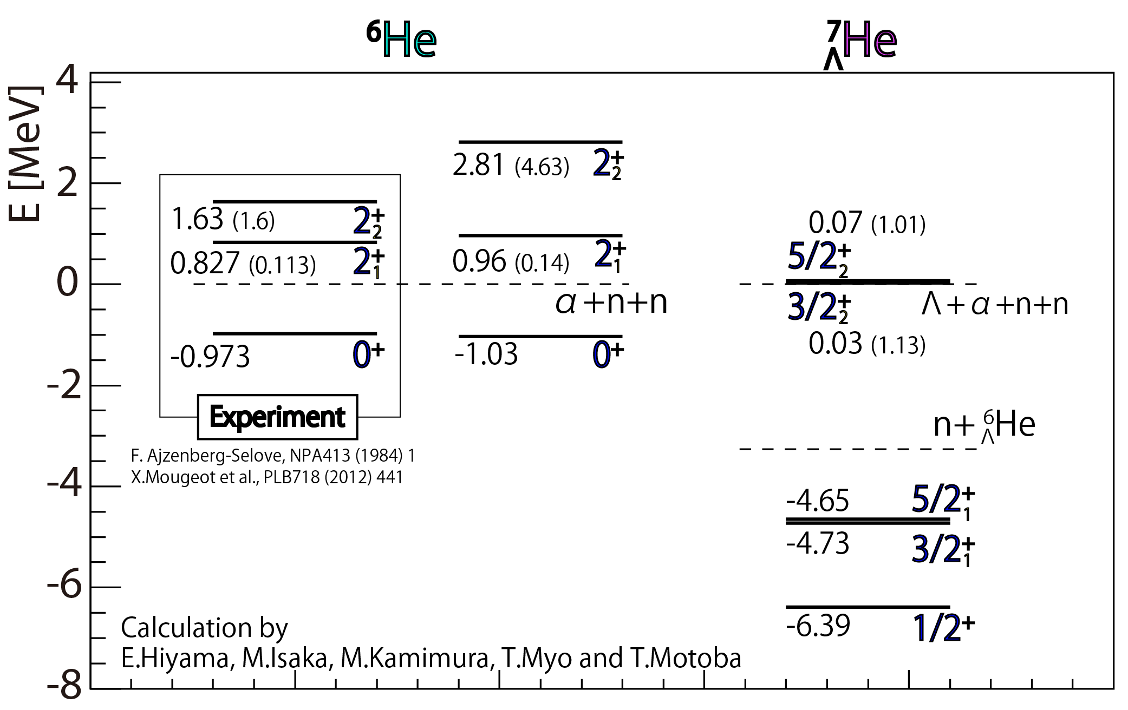
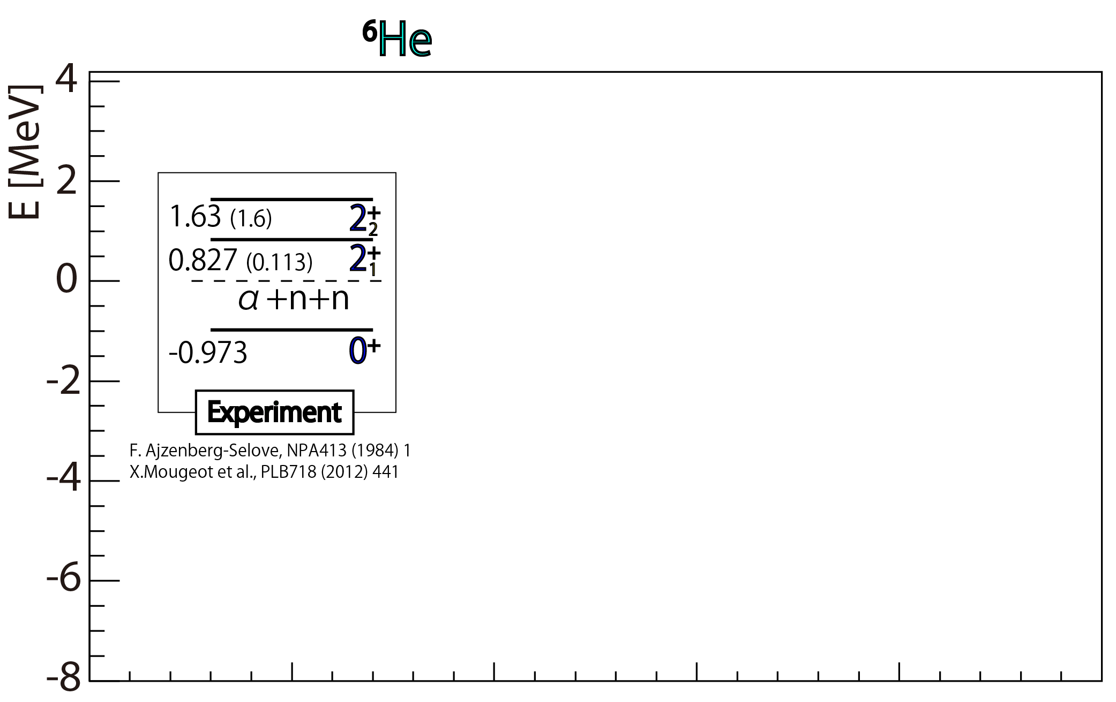
Second 2⁺ state of ⁶He
Present work
0.16
⁶He+Λ
0.54
1
n
α
Borromean state
α
n
n
n
Λ

Slide 32
Contents
Introduction of (e,e’K⁺) experiment
Overview of JLab E05-115
Experimental setup
Data summary
Results
About systematic errors
⁷_{Λ}He
¹⁰_{Λ}Be

Slide 33
¹⁰B(e,e’K⁺)¹⁰_{Λ}Be
Resonant state
⁹Be
¹⁰Be
_{Λ}
α
n
α
α
n
α
Λ
+
Bound state
Λ
Unbound → Bound
Level inversion
CSB effect

Slide 34
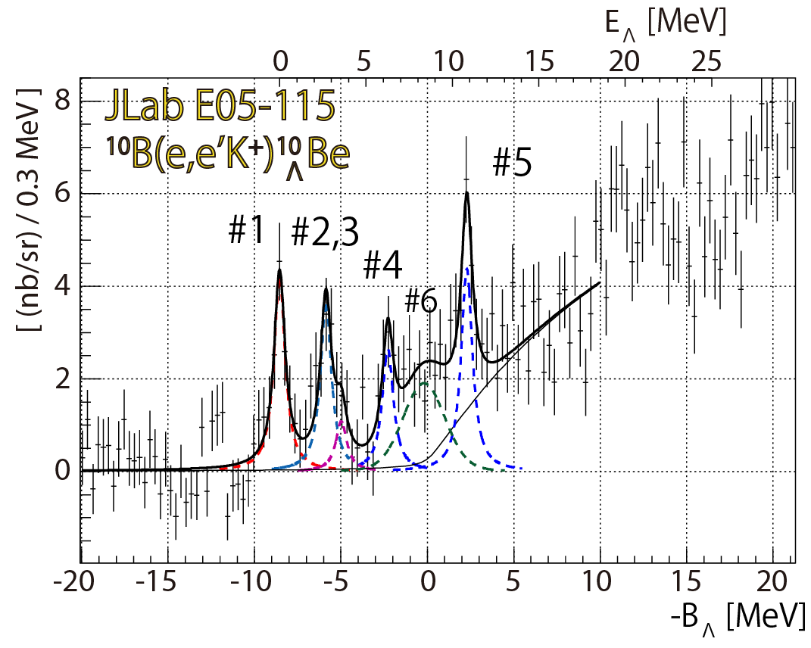
¹⁰B(e,e’K⁺)¹⁰_{Λ}Be
Resonant state
1⁻, 2⁻
Bound state
Unbound → Bound
Present work
Level inversion
3⁻, 2⁻ and 0⁺,1⁺
CSB effect

Slide 35
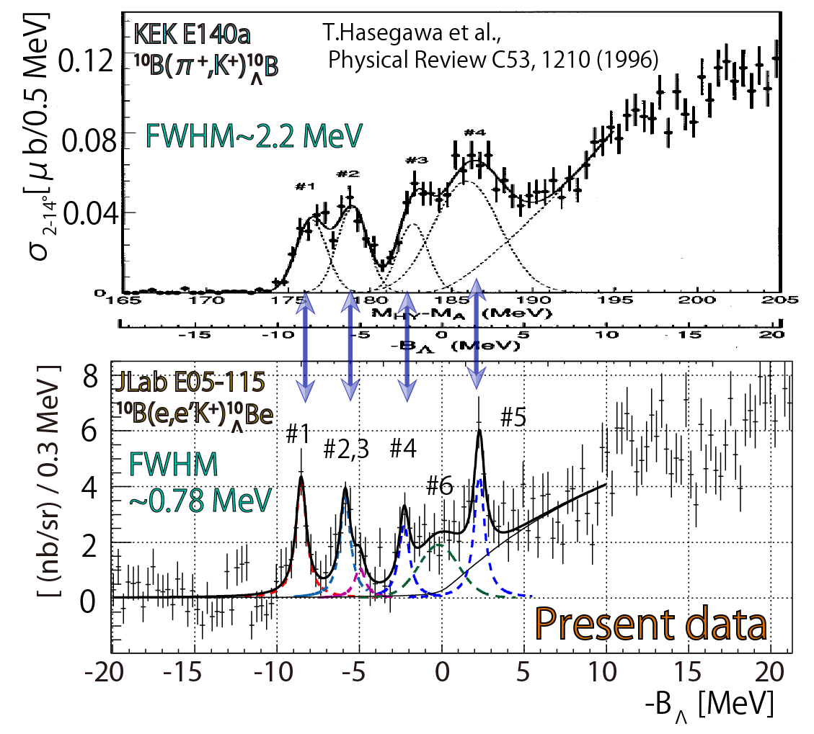
Comparison between ¹⁰_{Λ}B and ¹⁰_{Λ}Be
α
p
α
Λ
¹⁰B
_{Λ}
α
n
α
Λ
¹⁰Be
_{Λ}
$${dσ}/{dΩ}$$

Slide 36
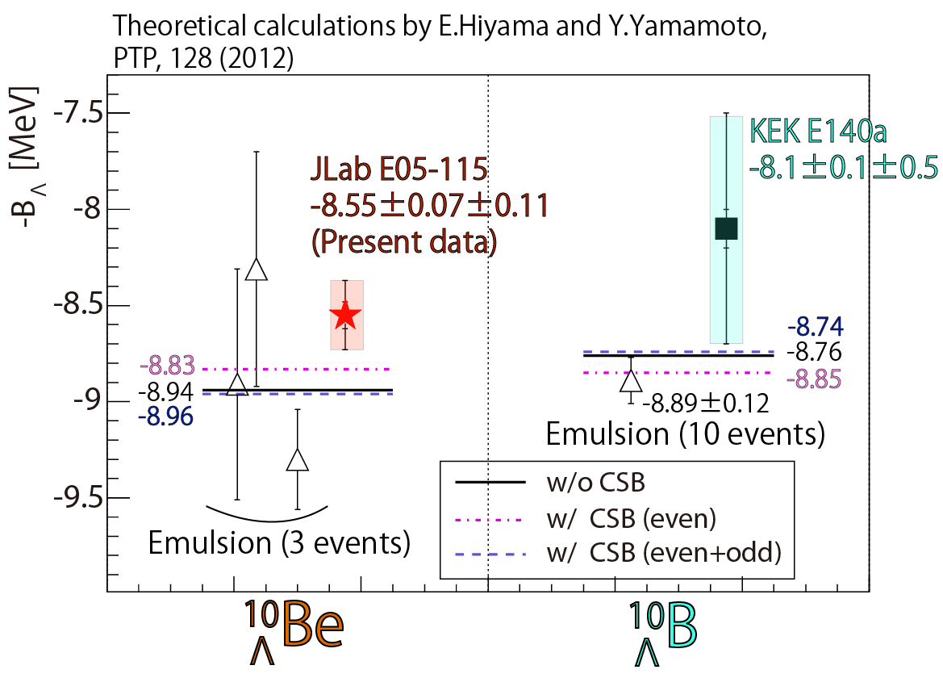
Comparison of the ground states (A=10)
$${dσ}/{dΩ}$$
Experiments
Theoretical calc.
CSB off : +0.22 MeV
CSB on : -0.02 MeV

Slide 37
Comparison of the ground states (A=10)
¹⁰_{Λ}Be – ¹⁰_{Λ}B
Further effort is needed
theoretically and experimentally
Experiments
Theoretical calc.
CSB off : +0.22 MeV
CSB on : -0.02 MeV

Slide 38
Comparison with theoretical predictions

Slide 39
Comparison with theoretical predictions
¹⁰_{Λ}Be structures with 0.78 MeV (FHWM)
Theoretical calculations (cross section)
are needed for further understanding

Slide 40
⁵²Cr(e,e’K⁺)⁵²_{Λ}V
Present data
High rate & multiplicity
(background $∝Z2$)
Resolution ↓
Efficiency ↓
FWHM = 2.2 MeV
Ground state (3⁻, 4⁻)
$−BΛ= −21.88±0.59±0.11$ MeV

Slide 41
Comparison between ⁵²_{Λ}V and ⁵¹_{Λ}V (1)
$∆BΛ=+1.91±0.60(stat.)±0.33(sys.)$ MeV
$A^{−\frac{2}{3}}$ dependence → +0.10^{*1)*2)} MeV
*1) D.J.Millener, private communication (2014)
*2) Y.Yamamoto, private communication (2014)

Slide 42
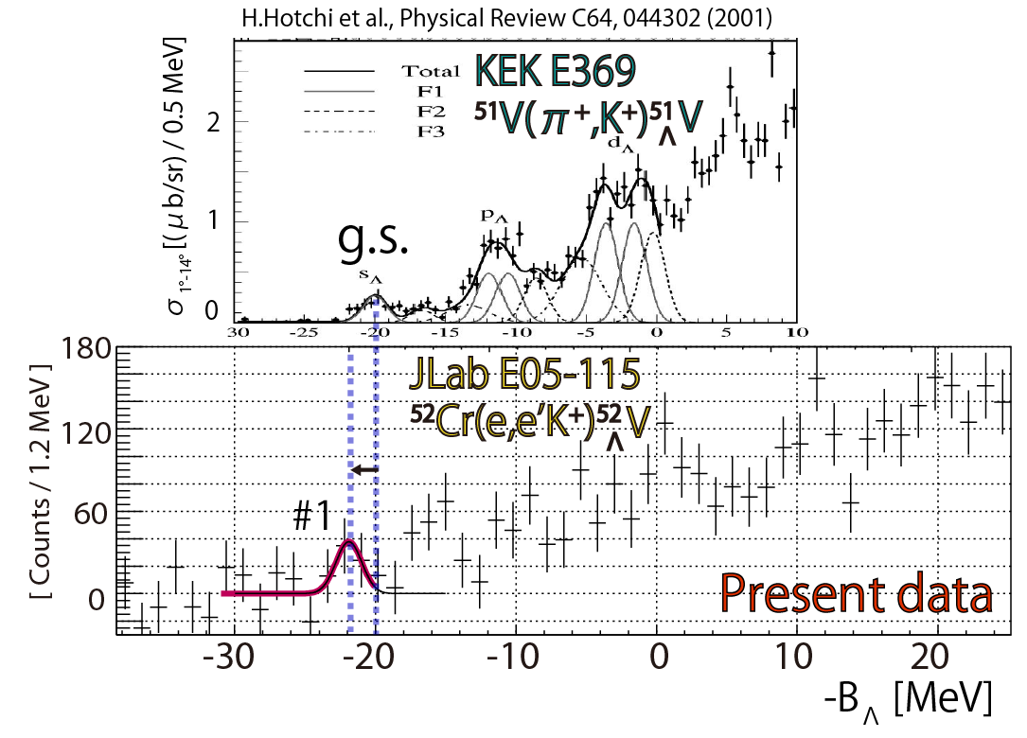
Comparison between ⁵²_{Λ}V and ⁵¹_{Λ}V (2)
$∆BΛ=+1.91±0.60(stat.)±0.33(sys.)$ MeV
Particle-hole state contamination
→ + 0.45 MeV

Slide 43
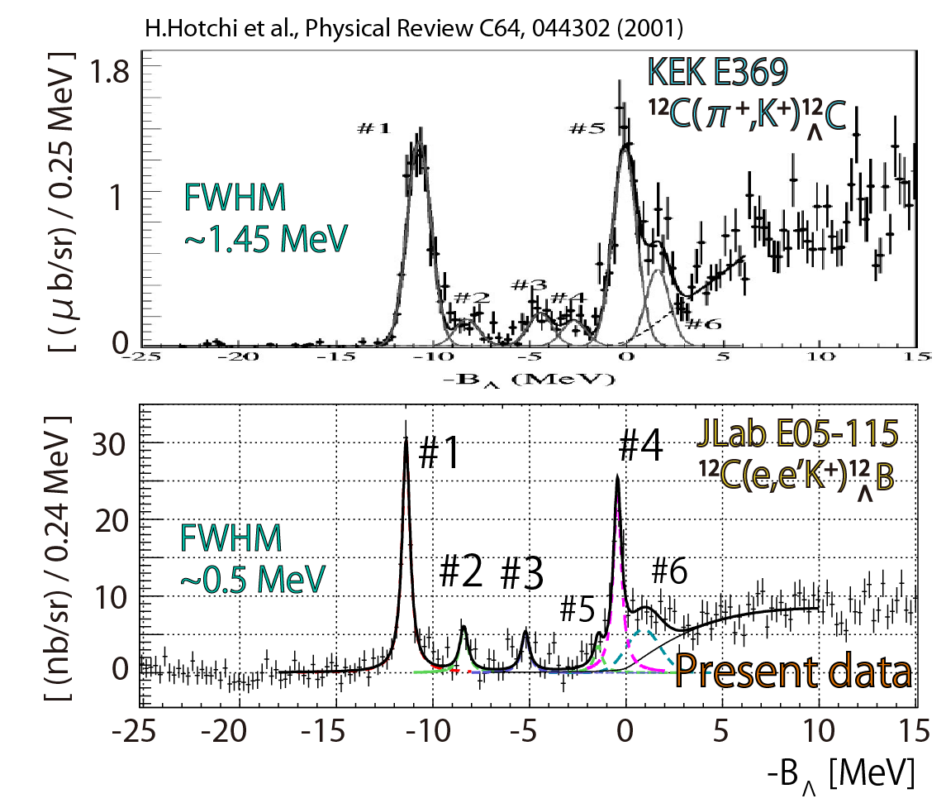
Comparison between ⁵²_{Λ}V and ⁵¹_{Λ}V (3)
¹²_{Λ}C: Emulsion data (6 events)^{*1)*2)}
→ $0.54±0.21$ MeV shifted
$∆BΛ=+1.91±0.60(stat.)±0.33(sys.)$ MeV
¹²_{Λ}C: Calibration data might be shifted
→ $+0.54±0.21$ MeV
*1) P.Dluzewski et al., NPA484, 520-524 (1988)
*2) D.H.Davis, NPA 754, 3c-13c (2005)

Slide 44
Comparison between ⁵²_{Λ}V and ⁵¹_{Λ}V
$A^{−\frac{2}{3}}$ dependence
→ +0.10 MeV
Particle-hole state contamination
→ + 0.45 MeV
¹²_{Λ}C might be shifted
→ $+0.54±0.21$ MeV
$∆BΛ=+1.91±0.60±0.33$ MeV
$+1.1±0.21$ MeV

Slide 45
Comparison between ⁵²_{Λ}V and ⁵¹_{Λ}V
$A^{−\frac{2}{3}}$ dependence
→ +0.26 MeV
Particle-hole state contamination
→ + 0.50 MeV
¹²_{Λ}C might be shifted
→ +0.54 MeV
Reported value of
¹²_{Λ}C might be shallower by $\sim 0.5$ MeV
$$∆BΛ=+1.91±0.59±0.11$$
$+1.1±0.21$ MeV

Slide 46
Λ single particle energy
The first data point without the emulsion reference
in the medium-heavy region
(e,e’K⁺) experiment
Absolute energy calibration with Λ and Σ⁰
High energy resolution

Slide 47
Λ single particle energy
The first data point without the emulsion reference
in the medium-heavy region
Medium to heavy hypernuclei
Important to measure with the (e,e’K⁺) reaction
① Absolute binding energy with Λ and Σ⁰
② Higher energy resolution (sub-MeV)
(e,e’K⁺) experiment
Absolute energy calibration with Λ and Σ⁰
High energy resolution

Slide 48
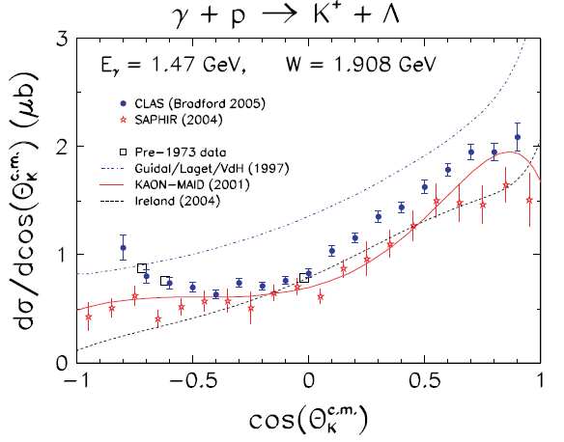
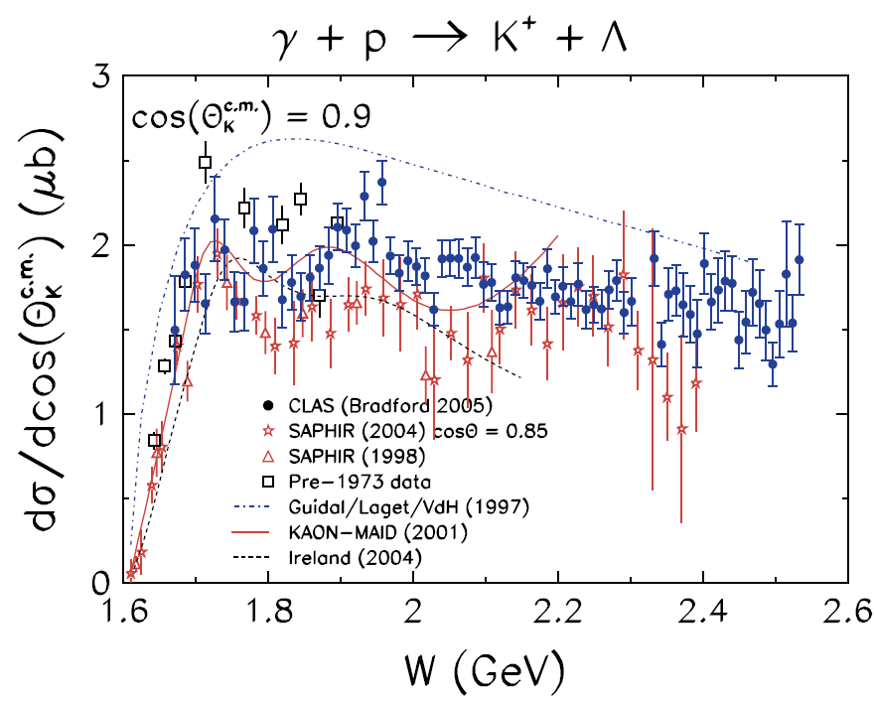
Kinematics
R.Bradford et al., PRC73, 035202 (2006)
JLab E05-115 by the (e,e’K⁺) reaction
R.Bradford et al., PRC73, 035202 (2006)
K⁺
1.2 GeV/c
θ_{γK}
(Small)
Cross section
Λ
p
0.9
1.3
1.7
2.1
2.6
3.1
γ*
E_{γ} [GeV]
1.5 GeV
E_{γ} = 1.5 GeV
γ* + p → K⁺ + Λ

Slide 49
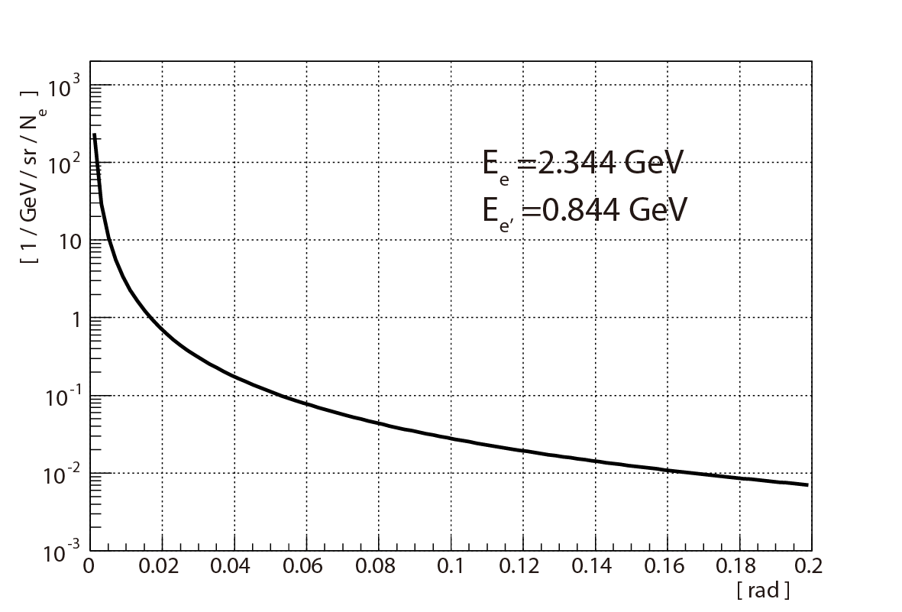
Kinematics
JLab E05-115 by the (e,e’K⁺) reaction
Virtual photon flux
K⁺
e’
1.2 GeV
e’ scattering angle (θ_{e’})
θ_{γK}
(Small scattering angle)
(Small)
0.844 GeV/c
θ_{e’}
(Small)
θ_{γ}
Λ
p
γ*
1.5 GeV
Electron
2.344 GeV

Slide 50
Kinematics
JLab E05-115 by the (e,e’K⁺) reaction
e’ spectrometer
K⁺ spectrometer
(SPL)
(HES)
(HKS)
B
K⁺
e’
1.2 GeV/c
θ_{γK}
(Small)
(Small)
0.844 GeV/c
θ_{e’}
(Small)
θ_{γ}
Λ
p
γ*
1.5 GeV
Electron
2.344 GeV

Slide 51
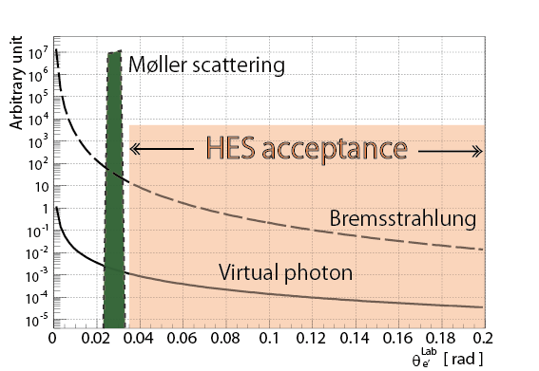
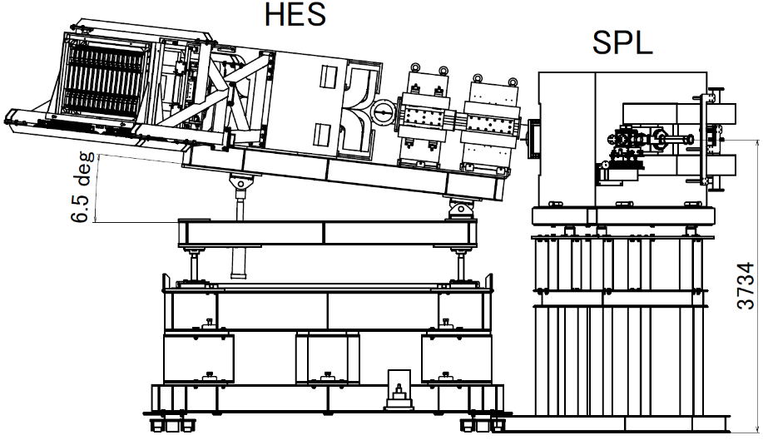
Background electrons in HES
E89-009 → E01-011
e’ rate: 1/200
Luminosity: ×200
SIMULATION
Tilt method
e’
0°
E_{e} = 2.344
p_{e’} = 0.844 MeV/c
Δp_{e’} = ±150 MeV/c
Optimized tilt angle = 6.5 deg
( S/N and Yield )

Slide 52
Contents
Introduction
JLab E05-115
Purpose of the present work
Kinematics and experimental setup
Data summary
Data analysis
Energy scale calibration
Systematic errors for binding energy
Results
¹²_{Λ}B, ⁷_{Λ}He, ¹⁰_{Λ}Be, ⁵²_{Λ}V
Summary

Slide 53
Data analysis
Calibration
x, x’, y, y’
x, x’, y, y’
Conversion with
inverse transfer matrices
@ Reference plane
@ Reference plane
p, x’, y’
p, x’, y’
@ Target
Missing Mass

Slide 54
Missing mass reconstruction
x, x’, y, y‘ @ RP
Reference plane
Inverse transfer matrix
(TOSCA + Geant4)
p, x’, y’ @ Target
Target
Missing mass

Slide 55
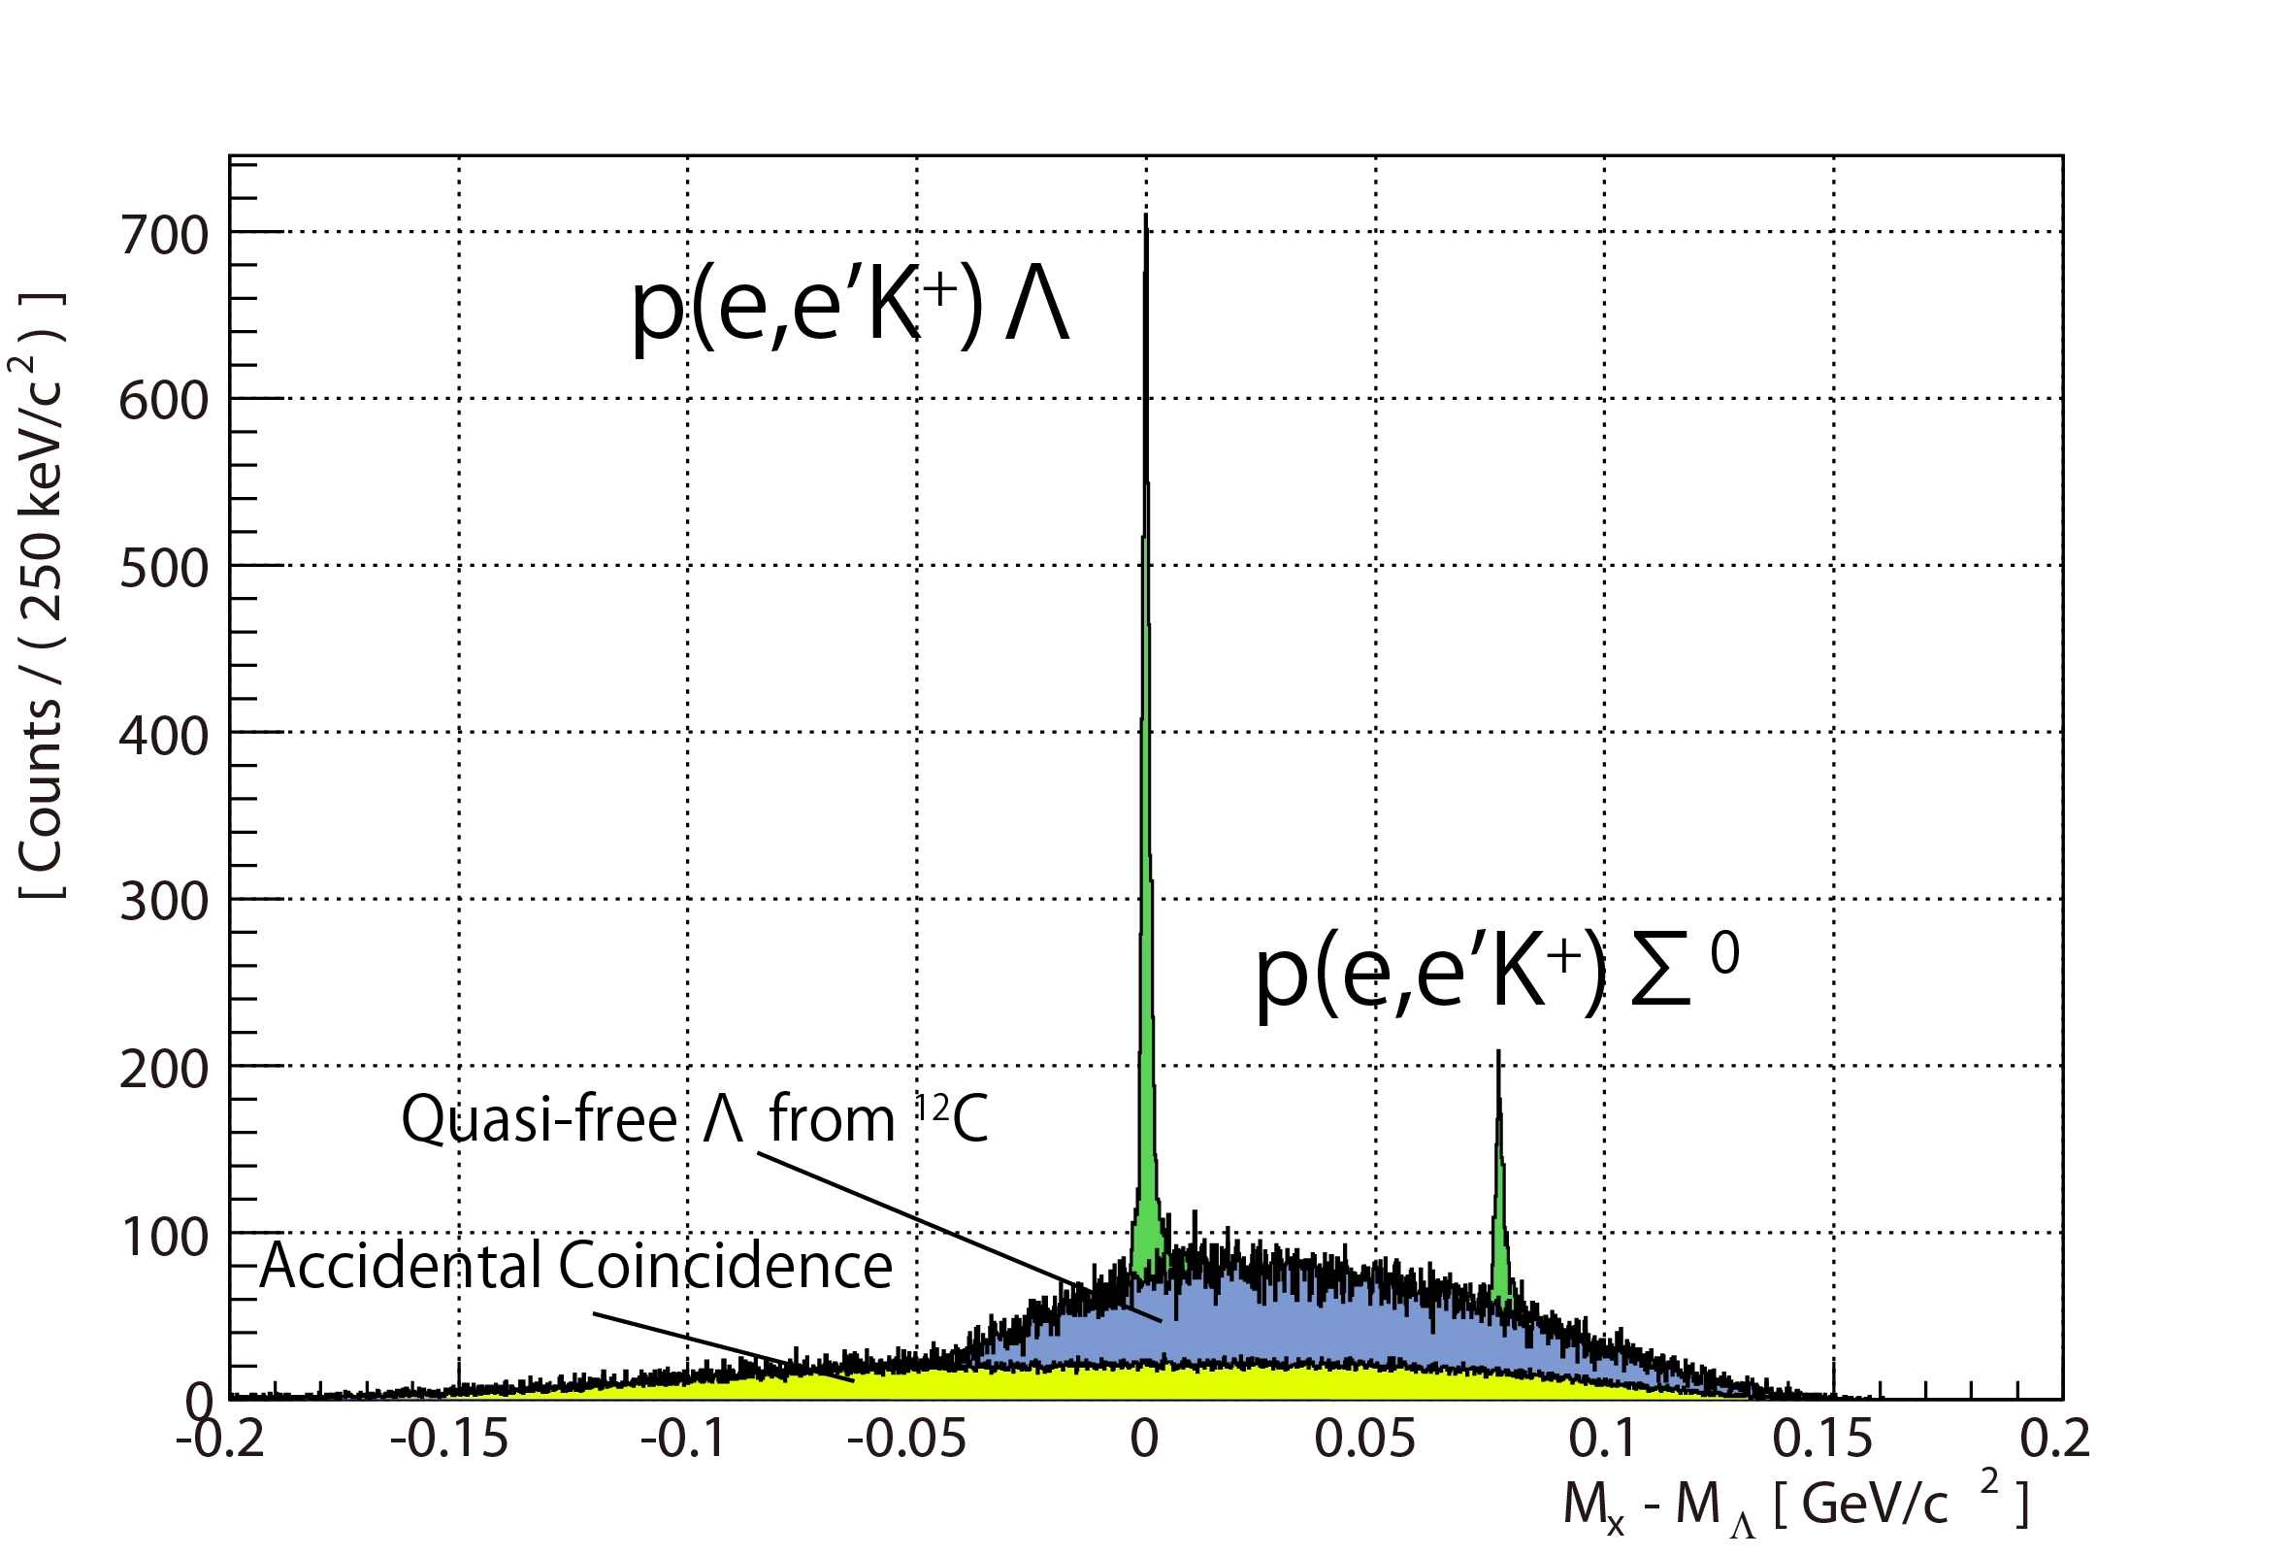
Absolute energy scale calibration with Λ and Σ⁰
x, x’, y, y‘ @ RP
Inverse transfer matrix
ITERATION
Tune
p, x’, y’ @ Target
Missing mass
PDG values
(K.Nakamura et al., Journal of Physics G 37, 075021, 2010)
Λ: $1115.683±0.006$ MeV
Σ⁰: $1192.642±0.024$ MeV

Slide 56
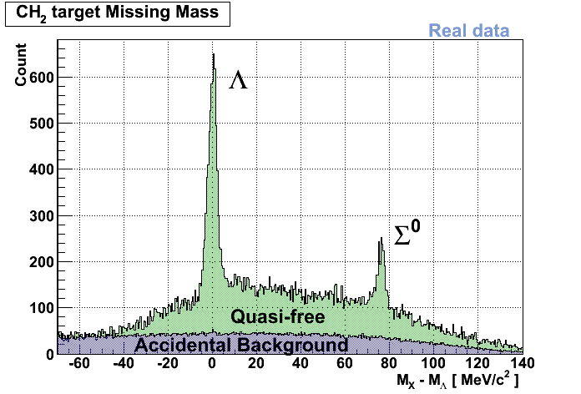
Momentum resolution comparison
Before
(Δp/p ~ 10⁻³)
4 MeV (FWHM)
After
(Δp/p ~10⁻⁴)
1.5 MeV (FWHM)
~ 0.5 MeV (FWHM) for ¹²_{Λ}B

Slide 57
Momentum resolution comparison
Before
(Δp/p ~ 10⁻³)
4 MeV (FWHM)
How good is the binding energy determined ?
(Systematic error)
After
(Δp/p ~10⁻⁴)
1.5 MeV (FWHM)
~ 0.5 MeV (FWHM) for ¹²_{Λ}B

Slide 58
Systematic errors for binding energy
( TOSCA + Geant4 )

Slide 59
Systematic errors for binding energy
Full simulation
Realistic dummy data
S/N
Yields
Energy straggling in target
Beam raster
Beam energy spread
Spectrometer acceptance
Detector resolution

Slide 60
Systematic errors for binding energy
Compare
Full simulation
Realistic dummy data
S/N
Yields
Energy straggling in target
Beam raster
Beam energy spread
Spectrometer acceptance
Detector resolution

Slide 61
Systematic errors for binding energy
Compare
Full simulation
ΔB_{mat} = 0.110 MeV
ΔE_{mat} = 0.050 MeV
Realistic dummy data
S/N
Yields
Energy straggling in target
Beam raster
Beam energy spread
Spectrometer acceptance
Detector resolution

