Slide 1
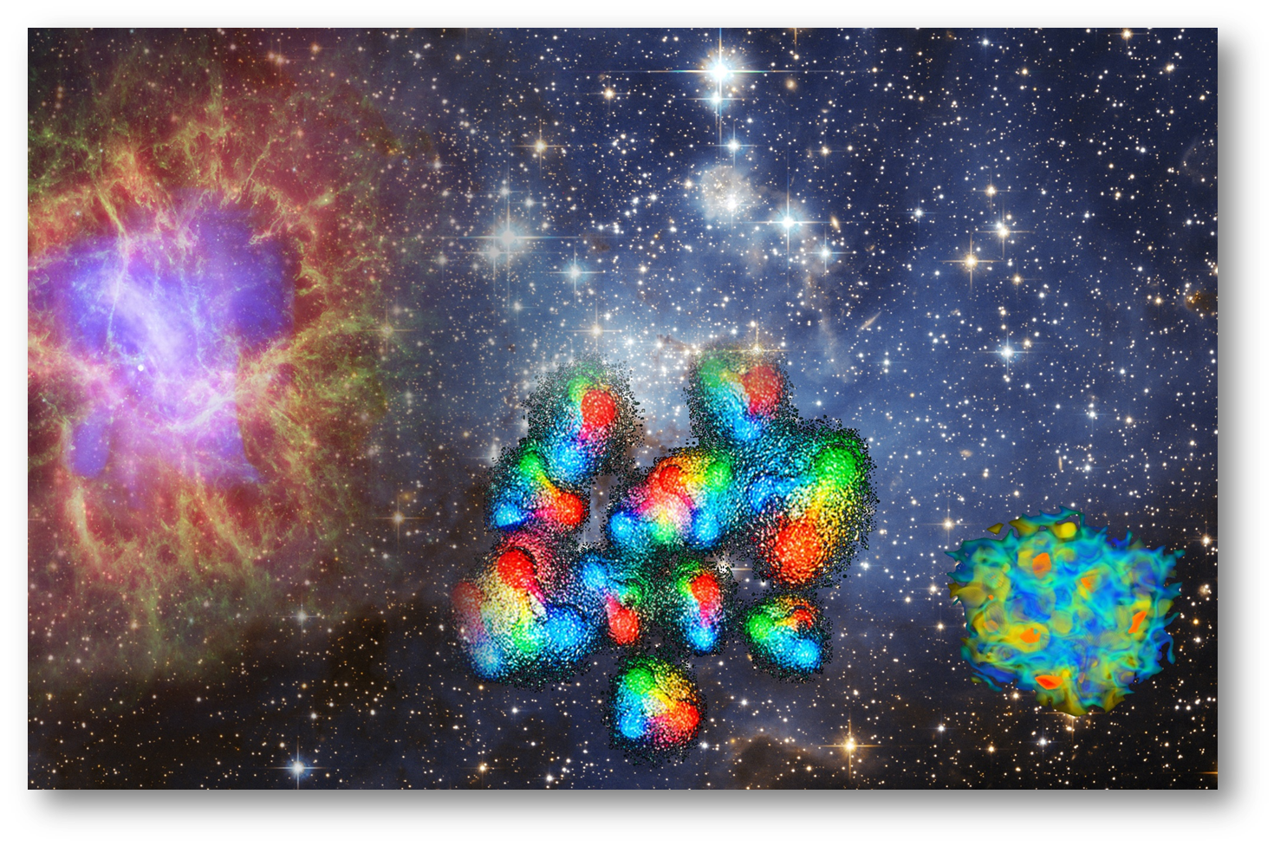
2014 International Symposium on Strangeness Nuclear Physics Changsha, China
Antiproton beams:
a unique tool to study
antihyperons embedded in nuclei
Josef Pochodzalla
Helmholtz-Institut Mainz
Institute für Kernphysik Mainz
Motivation
Antihyperons in nuclei at PANDA
Future options

Slide 2
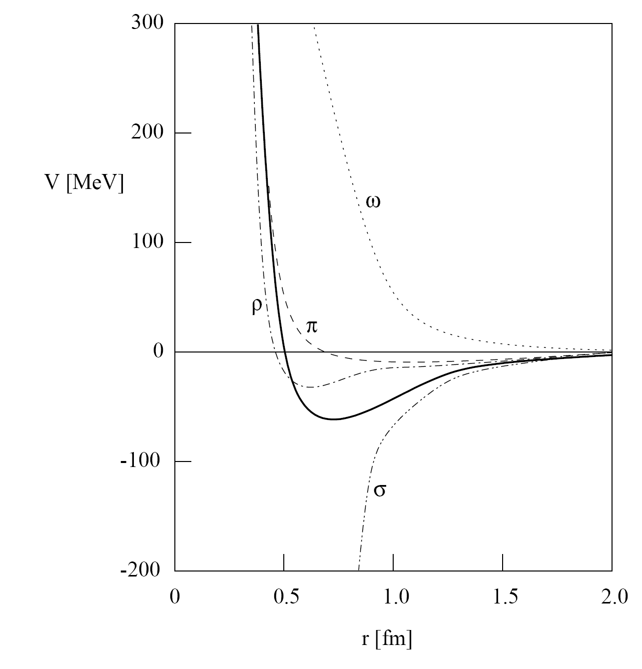
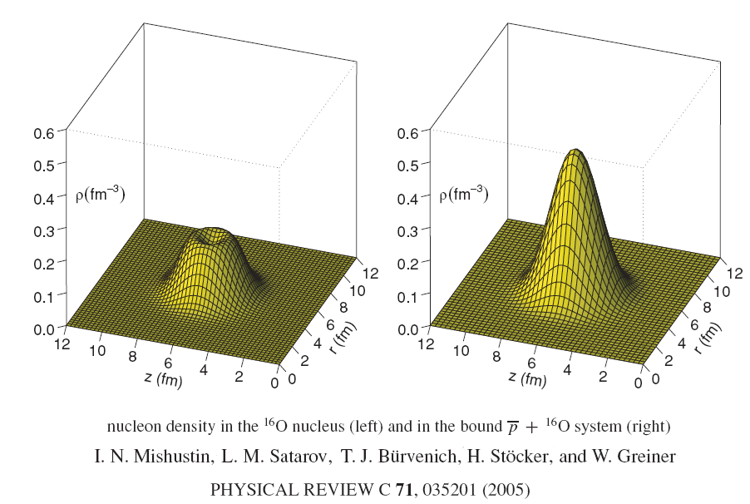
Antihyperons in Nuclei
How is g-parity borken? U(p)=-150MeV
Cold compression by antibaryons?
Hans-Peter Dürr and Edward Teller, Phys. Rev. 101, 494 (1956):
sign change in coupling constant when going from NN to NN
quark picture
-
+
-
+

Slide 3
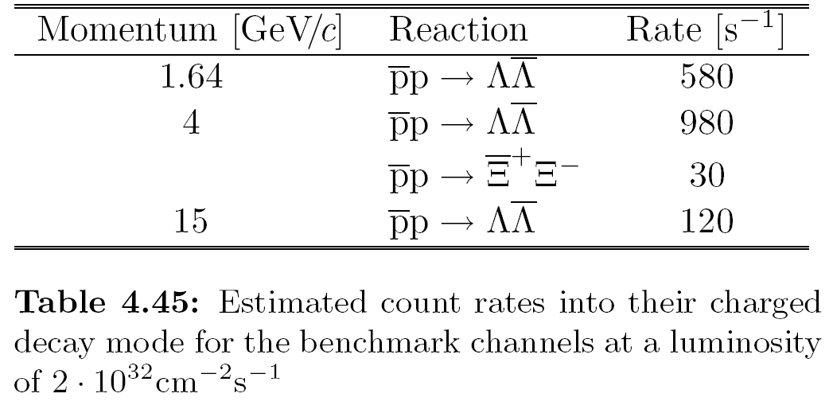
PANDA – a Factory for strange and charmed YY-Pairs

Slide 4
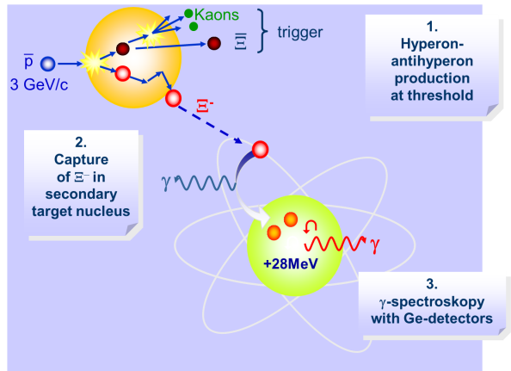
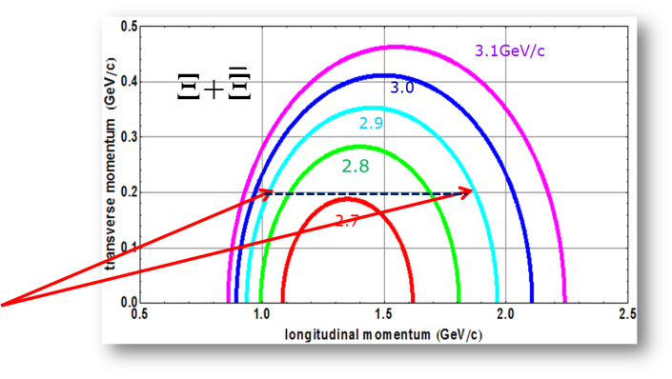
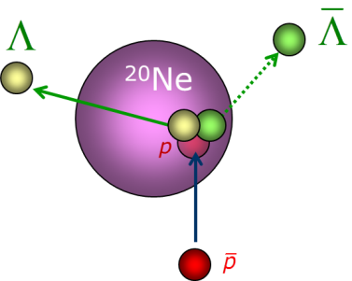
Exploring (anti-)hyperon interactions
Excited particle stable state spectroscopy
  γ-spectroscopy PANDA@FAIR
  Secondary scattering of momentum tagged hyperons and antihyperons
Antihyperons in atomic nuclei

Slide 5
reaching for the unthinkable
ANTIHYPRONS IN NUCLEI
at PANDA
Notes:
Goal: trigger a fully selfconsistent dynamical treatment of antihyperons in nuclei

Slide 6
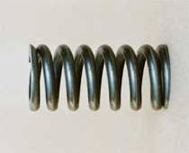
L Potential
exclusive p+p(A)  Y+Y close to threshold within a nucleus
Λ and L that leave the nucleus will have different asymptotic momenta depending on the respective potential
⇒ transverse momentum close to threshold of coincident YY pairs
J.P., PLB 669 (2008) 306
²⁰Ne
p

Slide 7
GiBUU Simulations
GiBUU
  G-parity used to estimate anti-baryon potentials except for N
  Approximately 15k exclusive ΛL pairs in each set
  corresponds to ~15 min PANDA incl. efficiency at 10⁷s⁻¹
Aim of the present work
  Explore sensitivity of α_{T} to a scaling of the real Y potential
  Proof the feasibility of a measurement at PANDA
  Trigger a fully self-consistent dynamical treatment of antihyperons in nuclei
Energy (MeV) | Momentum (MeV/c) | Excess energy (MeV)
850 | 1522 | 30.6
1000 | 1696 | 92.0
Notes:
GIBUUPhys. Rev. C 85, 024614 (2012)
HIMSTER
2600 cores
100GB RAM
The Helmholtz Institute Mainz (HIM) is running a big cluster dedicated for experiment simulation - the HIMster. The HIMster consists of 130 compute nodes each having 2 AMD 8-core processors (Magny Cours series) running at a clock frequency of 2.3 GHz. All nodes are equipped with 3 1-Gbit Nics and a QDR Infiniband-HCA (Mellanox Connect-X). Currently we are running the system in diskless mode, where:
the first 14 Nodes have 64 GByte RAM ⇒ 4 GByte / core
and the remaining nodes have 32 GByte RAM ⇒ 2 GByte / core
The central storage amounts to roughly 130 TByte net capacity, with FhGFS as the underlying parallel file system. The peak read/write performance is roughly 1.4 GByte/s. The storage is built up of 2 file servers, where each server is connected to
2 Promise VTrak Subsystems via Fibre-Channel ⇒ total of 40 2 TByte disks
4 Promise JBODs via SAS ⇒ total of 80 2 TByte disks
Currently the volumes are grouped in 4 RAID6 arrays.

Slide 8
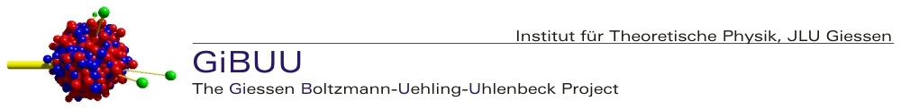
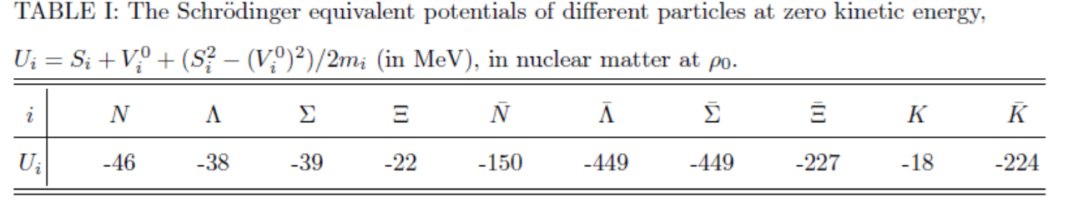
GiBUU 1.5
https://gibuu.hepforge.org/trac/wiki
G-parity used to estimate anti-baryons potential (except for N)
Antiproton potential is scaled by 0.22 to obtain -150MeV
Notes:
GIBUUPhys. Rev. C 85, 024614 (2012)
HIMSTER
260 cores
100GB RAM
The Helmholtz Institute Mainz (HIM) is running a big cluster dedicated for experiment simulation - the HIMster. The HIMster consists of 130 compute nodes each having 2 AMD 8-core processors (Magny Cours series) running at a clock frequency of 2.3 GHz. All nodes are equipped with 3 1-Gbit Nics and a QDR Infiniband-HCA (Mellanox Connect-X). Currently we are running the system in diskless mode, where:
the first 14 Nodes have 64 GByte RAM ⇒ 4 GByte / core
and the remaining nodes have 32 GByte RAM ⇒ 2 GByte / core
The central storage amounts to roughly 130 TByte net capacity, with FhGFS as the underlying parallel file system. The peak read/write performance is roughly 1.4 GByte/s. The storage is built up of 2 file servers, where each server is connected to
2 Promise VTrak Subsystems via Fibre-Channel ⇒ total of 40 2 TByte disks
4 Promise JBODs via SAS ⇒ total of 80 2 TByte disks
Currently the volumes are grouped in 4 RAID6 arrays.

Slide 9
Impact Parameter
Free ΛL production selects peripheral collisions

Slide 10

Rescattering effects
Typical 15000 LΛ pairs produced
Coplanarity distorted $$strong rescattering or refraction

Slide 11
Absorption, rescattering, geometry…
Mikroscopic transport models needed

Slide 12
Rescattering & Momentum Distributions
longitudinal momentum (GeV/c)
Is Y –Y pair production at all sensitive to the Y potential ?
Test case: Λ-L production
transverse momentum (GeV/c)

Slide 13
Scan of L Potential
U(L)= -449MeV, -225MeV, -112MeV, 0MeV
All other potentials unchanged
E(p)=850MeV
Λ−L

Slide 14
Scan of L Potential
U(L)= -449MeV, -225MeV, -112MeV, 0MeV
All other potentials unchanged
E(p)=1000MeV
Λ−L

Slide 15
The PANDA detector
Antiproton beam
Clusterjet or pellet target point
Interaction point
PID detectors
TOF
DIRC
Muon
Forward RICH
PWO Caolorimter
Forward Shaslyk EMC
Micro vertex detector
Straw Tube tracker
GEM detectors
Forard tracking
Luminosity monitor
Official timeline
  2013-2017: (partial) pre-assembling at COSY, Jülich
  ≥2018: first beam expected at FAIR

Slide 16
Antihyperon-Hyperon Pairs in PANDA
2018 first beam in PANDA expected → commissioning phase
We are right now exploring different scenarios
  different detector availability
  different solenoid fields (1T, 0.5T,…)
and other important aspects like
  luminosity
  length of typical running period
Typical (preliminary) LΛ pair efficiency ≈ 3-5% (better at higher momenta)
L+Λ case
  ^{nat}Ne target, H for calibration systematic check
  only charged particle detection easy
  assume average interactions rate 10⁶s⁻¹ (~10% of default luminosity)
  pair reconstruction efficiency ~3%
  ⇒ 144k detected L+Λ pairs per day ⇒ 10 × GiBUU
  Moderate data taking period ~14 days Ne target + 7 days p-target
  ⇒ 130 × present GiBUU simulations

Slide 17
Future Options
L+Σ⁻
  Ideal probe for interactions in the neutron skin
  ²⁰Ne; ²²Ne, H for calibration; later: ⁸⁶Kr (36 Protons, 50 Neutrons)
  Σ⁻ tracking, Σ⁻→nπ⁻
  similar production rate (at least in light nuclei)
Further options:
  Any other pair: Σ-S, Ξ-X, Λ_{c}L_{c}
  Long lived resonances in nuclei
  Λ(1520) (Γ= 15.6 MeV)
  Ξ(1530) (Γ=9.9 MeV)
  Λ_{c}(2880) (Γ=5.8MeV)
Unique change to study charmed baryons in nuclear systems ?

Slide 18
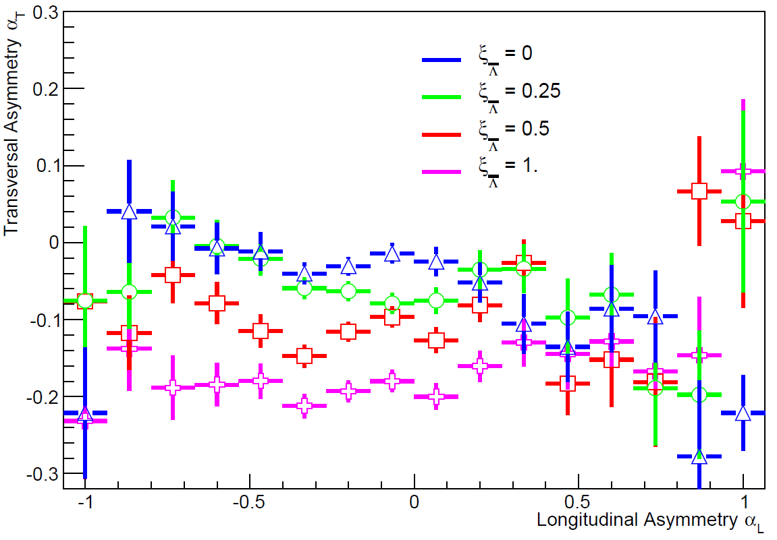
Other |s|=1 channels @ 1000MeV
p+p→L+Λ p+p→S⁰+Λ
p+n→L+Σ⁻ p+n→S⁺+Λ
all antihyperon potentials scaled by same factor
E(p)=1000MeV
Σ⁻−L
Notes:
Central heavy ion collisions are the usual tool to probe high densities
But…
Central collisions  hot hadronic finite matter with mesons and baryons
Neutron stars  Cold neutral baryonic infinite matter

Slide 19
Reactions within the Neutron Skin
1000MeV p+²⁰Ne and p+²²Ne; ξ(L) = 0.25
When going from ²⁰Ne to ²²Ne two competing effects
  more absorption of ingoing p in thicker n-skin ⇒ less LΛ and more LΣ⁻
  more absorption of outgoing L in thicker n-skin ⇒ less LΛ and less LΣ⁻
L+Σ⁻ and L+Λ production may probe the neutron skin
Possibility to explore potentials in neutron-rich environment ?
 | p+p →L+Λ | p+n →L+Σ⁻
²⁰Ne | 18808 | 3667
²²Ne | 15733 | 4516
²²Ne/²⁰Ne | 0.84 | 1.23

Slide 20
Stored antiproton beams at FAIR offer several unique opportunities to study the interactions of hyperons and antihyperons in nuclear systems
PANDA is an excellent and unique factory for strange and charmed YY pairs
The L-Λ production is an ideal experiment for the commissioning phase of PANDA
Notes:
HIM JSPS

