Slide 1
Precision Pion Spectroscopy on Light Λ-Hypernuclei
Fragmentation of excited hypernuclei from electro-production
and
Mesonic weak decay inside Nucleus
Free: Λ→ p + π ⁻
2-B: ^{A}_{Λ}Z → ^{A}(Z + 1) + π ⁻
Liguang Tang
Department of Physics, Hampton University
SNP2014, December 12-13, 2014, Changsha, China

Slide 2
Decay Pion Spectroscopy to Study Λ-Hypernuclei
Direct Production
Fragmentation Process
Example:
e’
e’
K ⁺
K ⁺
¹²C
¹²C
e
γ*
e
γ*
p
Fragmentation
(<10⁻¹⁶s)
p
γ
Λ
s
⁴_{Λ}H
Λ
¹²_{Λ}B*
γ
Low lying Hypernuclear States
Highly Excited
Hypernuclear States
Λ
E.M.
⁴_{Λ}H_{g.s.}
α
⁴He
α
¹²C
Λ
π ⁻
Λ
π ⁻
¹²_{Λ}B_{g.s.}
Weak two-body mesonic decay (~10⁻¹⁰s)

Slide 3
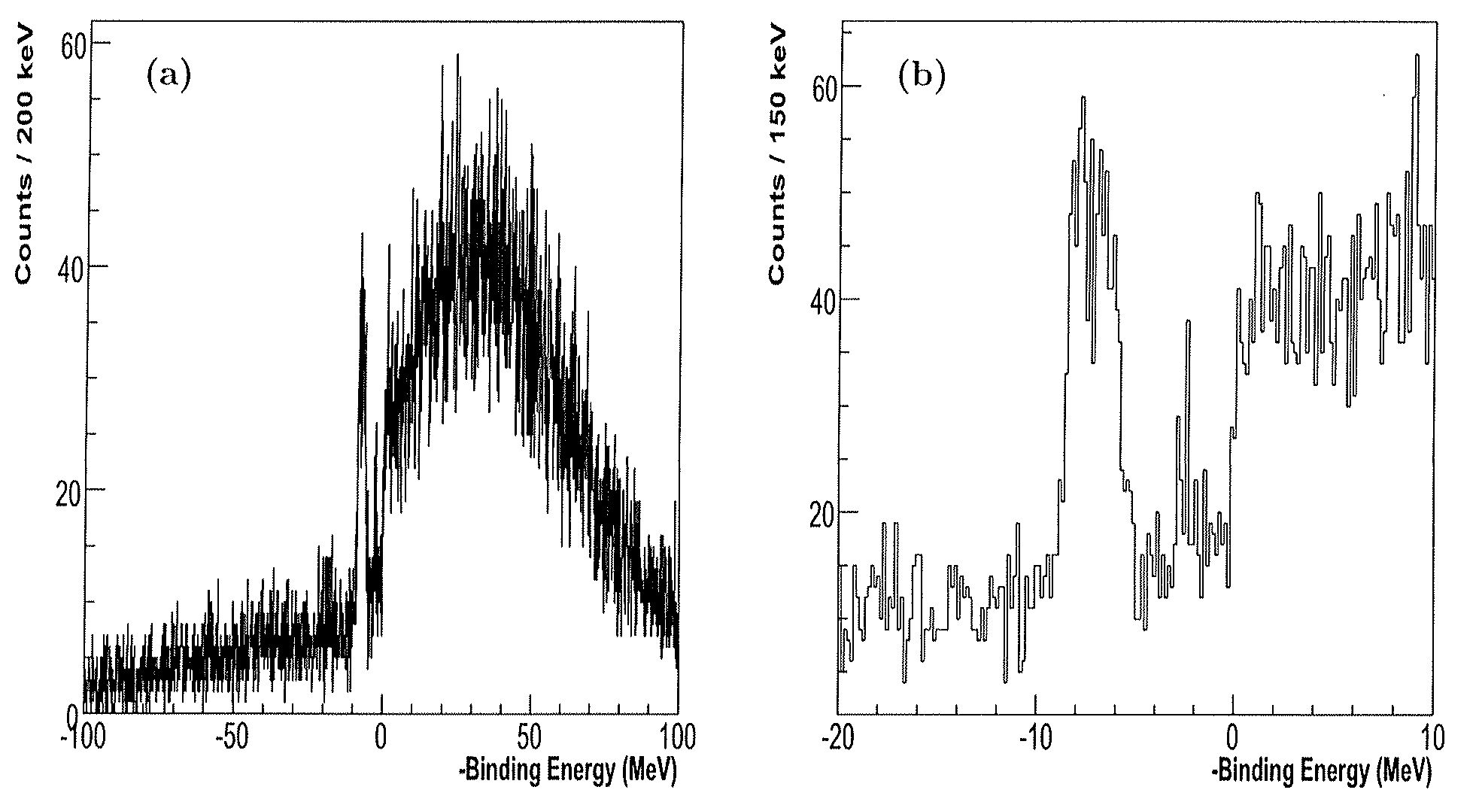
Example Excitation Spectrum Obtained at JLab
Excitation spectrum of ⁹_{Λ}Li measured using the ⁹Be(e, e’K⁺) reaction
by the JLab Hall A experiment - arXiv:1405.5839

Slide 4
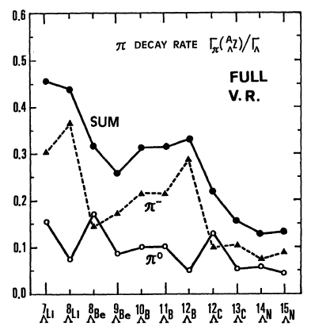
Study of Light Hypernuclei by Pionic Decay at MAMI and Jlab
Comparison of Spectroscopic and Background π⁻ Production
SPECTROSCOPY
BACKGROUND
e
e′
e
e′
γ*
K⁺
π⁻
γ*
K⁺
p
Λ
p(n)
π⁻
^{A1}_{Λ}Z_{1 stop}
Λ,Σ°(Σ⁻)
^{A}Z
N
^{A}Z
^{(A-1)}Z’
^{A2}Z₂
^{A}_{Λ}(Z-1)
^{A1}(Z1+1)
(Z-1) = Z₁+Z₂; A=A1+A2
Light Hypernuclei to Be Investigated w/ ⁷Li, ⁹Be and ¹²C targets
p
Previously measured
S/A ranges from ~10:1 to ~0.5:1
6
(b)
Mirror pairs
⁸_{Λ}B
⁹_{Λ}B
Additions from ⁹_{Λ}Li and its continuum
(Phase II: ⁹Be target)
5
1/2⁺
J^{p}=?
3/2⁺
¹⁰_{Λ}B
¹¹_{Λ}B
¹²_{Λ}B
⁷_{Λ}Li
⁸_{Λ}He
⁹_{Λ}Li
1⁻
⁸_{Λ}Be
⁸_{Λ}Li
¹¹_{Λ}Be
4
⁶_{Λ}Li
⁹_{Λ}Be
¹⁰_{Λ}Be
3B background
1⁻ ?
1/2⁺
⁷_{Λ}H
3/2⁺
⁶_{Λ}Li
5/2⁺
⁹_{Λ}Li
¹⁰_{Λ}Li
3
⁷_{Λ}Li
⁸_{Λ}Li
2⁻
0
1
E_{x}
0
1
E_{x}
0
1
E_{x}
2
⁶_{Λ}He
⁷_{Λ}He
⁸_{Λ}He
⁹_{Λ}He
0
2
E_{x}
1
³_{Λ}H
⁴_{Λ}H
⁵_{Λ}H
⁶_{Λ}H
⁷_{Λ}H
⁸_{Λ}H
A
1
2
3
4
5
6
7
8
9
10
11
12

Slide 5
Illustration of Decay Pion Spectroscopy
(c)
1⁻
¹²_{Λ}B
Additions from ¹²_{Λ}B and its continuum
(Phase III: ¹²C target)
⁹_{Λ}Be
¹⁰_{Λ}Be
⁹_{Λ}B
⁸_{Λ}Be
¹¹_{Λ}B
¹¹_{Λ}Be
⁹_{Λ}He
¹⁰_{Λ}Li
¹⁰_{Λ}B
J^{p}=?
5/2⁺
⁸_{Λ}H
⁸_{Λ}B
3B background
(b)
3/2⁺
Additions from ⁹_{Λ}Li and its continuum
(Phase II: ⁹Be target)
1/2⁺
1⁻
⁷_{Λ}Li
⁸_{Λ}He
⁹_{Λ}Li
⁸_{Λ}Li
⁶_{Λ}Li
1/2⁺
3B background
1⁻ ?
3/2⁺
5/2⁺
⁷_{Λ}H
2⁻
(a)
E_{x}
E_{x}
E_{x}
2-B decay from ⁷_{Λ}He and its continuum
(Phase I: ⁷Li target)
0
1
0
1
0
1
0⁺
0
2
E_{x}
1⁻ ?
³_{Λ}H
1/2⁺
⁴_{Λ}H
⁶_{Λ}He
1/2⁺
⁷_{Λ}He
⁶_{Λ}H
3B background
3/2⁺
⁵_{Λ}H
5/2⁺
P_{Min}
0
2
E_{x}
E_{x}
P_{Max}
0
2
90.0
100.0
110.0
120.0
130.0
140.0
π⁻ Momentum (MeV/c)

Slide 6
Physics Goal of Decay Pion Spectroscopy – Part I
Precise measurement of ground state B_{Λ} (ΔB_{Λ} <±50keV) for a series of light hypernuclei (A = 3-12) with high resolution (<130keV FWHM), spin-parity determination of g.s., charge symmetry breaking (CSB) from mirror pairs
Emulsion Results
Hypernucleus | B_{Λ} (MeV) | Total number of events
³_{Λ}H | 0.13 ± 0.05 | 204
⁴_{Λ}H | 2.04 ± 0.04 | 155
⁴_{Λ}He | 2.39 ± 0.03 | 279
⁵_{Λ}He | 3.12 ± 0.02 | 1784
⁶_{Λ}He | 4.18 ± 0.1 | 31
⁷_{Λ}He | Not averaged 5.44-expected | 16
⁷_{Λ}Li | 5.58 ± 0.03 | 226
⁷_{Λ}Be | 5.16 ± 0.08 | 35
⁸_{Λ}He | 7.16 ± 0.7 | 6
⁸_{Λ}Li | 6.80 ± 0.03 | 787
⁸_{Λ}Be | 6.84 ± 0.05 | 68
⁹_{Λ}Li | 8.53 ± 0.15 | 8
⁹_{Λ}Be | 6.71 ± 0.04 | 222
⁹_{Λ}B | 8.29 ± 0.18 | 4
¹⁰_{Λ}Be | 9.30 ± 0.26 | 1
¹⁰_{Λ}B | 8.89 ± 0.12 | 10
¹¹_{Λ}B | 10.24 ± 0.05 | 73
¹²_{Λ}B | 11.37 ± 0.06 | 87
¹²_{Λ}C | 10.76 ± 0.19 | 6
⁷_{Λ}He, ⁹_{Λ}Li, ¹⁰_{Λ}Be and ¹²_{Λ}B were recently measured by the (e,e’K⁺) reaction by JLab experiments, while ¹⁰_{Λ}B was measured earlier by the (π⁺, K⁺) reaction by KEK experiment. There are obvious disagreements to the emulsion results (A=9 and 10 systems).

Slide 7
Physics Goal of Decay Pion Spectroscopy – Part II
Charge Symmetry Breaking (CSB) in ΛN interaction
YN | B_{Λ} (³_{Λ}H) | B_{Λ} (⁴_{Λ}H) | B_{Λ} (⁴_{Λ}H*) | B_{Λ} (⁴_{Λ}He) | B_{Λ} (⁴_{Λ}He*) | B_{Λ} (⁵_{Λ}He)
SC97d(S) | 0.01 | 1.67 | 1.2 | 1.62 | 1.17 | 3.17
SC97e(S) | 0.10 | 2.06 | 0.92 | 2.02 | 0.90 | 2.75
SC97f(S) | 0.18 | 2.16 | 0.63 | 2.11 | 0.62 | 2.10
SC89(S) | 0.37 | 2.55 | Unbound | 2.47 | Unbound | 0.35
Emulsion | 0.13 ± 0.05 | 2.04 ± 0.04 | 1.00 ± 0.04 | 2.39 ± 0.03 | 1.24 ± 0.04 | 3.12± 0.02
No YN interaction model can make consistent predictions
Origin of large CSB: ΔB_{Λ}(⁴_{Λ}He_{gs} - ⁴_{Λ}H_{gs}) = 0.35 MeV is not known
Inconsistent for the excited states: ΔB_{Λ}(⁴_{Λ}He* - ⁴_{Λ}H*) = 0.24 MeV
Problems in theory or result from emulsion experiments?
CSB is thus one of the most important impacts by hypernuclear physics on the fundamental BB interactions and EOS used to predict the mass (density and radius) of neutron stars
Correct YN model must predict CSB consistently for multiple isospin doublets in s- and p-shell hypernuclei

Slide 8
Physics Goal of Decay Pion Spectroscopy – Part III
Neutron drip line hypernuclei: Does ⁶_{Λ}H exist? Predicted by [Dalitz & Levi Setti, Nuovo Cimento 30 (1963) 489], reinforced in estimates by Majling [NPA 585 (1995) 211c] with B_{Λ}^{Dalitz}(⁶_{Λ}H) = 4.2 MeV; and Akaishi (1999) predicted B_{Λ}^{Akaishi}(⁶_{Λ}H) = 5.8 MeV.
Explore the short range natures in ΛN interaction, i.e. so called “glue-like” role played by Λ to the core nucleus.
FINUDA found three ⁶_{Λ}H events in the ⁶Li(K⁻_{stop}, π⁺) reaction tagged by the 2-B decay π⁻ [PRL 108 (2012) 042501, NPA 881 (2012) 269], with estimation B_{Λ}(⁶_{Λ}H) = (4.0 ± 1.1) MeV
High precision decay pion spectroscopy using ⁷Li target has the best chance

Slide 9
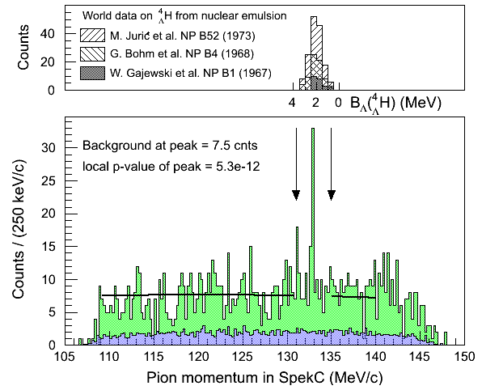
⁴_{Λ}H Peak Search
Emulsion data
MAMI data
2012
A good success of MAMI experiment

Slide 10
Summary
The decay pion spectroscopy program is important to provide precise and fundamental information needed to understand the ΛN interactions.
The 2012 MAMI result is encouraging on the technique and precision
To reach the ultimate physics goal via this technique, the needed improvements are:
Yield rate
Reduction of background from Σ decays

Slide 11
Tagging on recoil nucleus w/ Low Pressure MWPC (Possibility on two body decay?)
π⁻₁
Charge Screen
FFD Pair
SpekC
FFD Pair
F₂
F₁
Target Chamber with low pressure gas (~5 Torr)
π⁻₂
SpekA
Target
Beam

