Slide 1
Weekly meeting
Qi Li
IHEP,Beijing
October 1, 2014

Slide 2
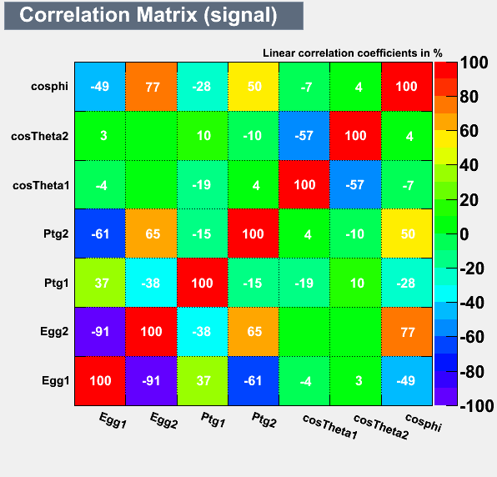
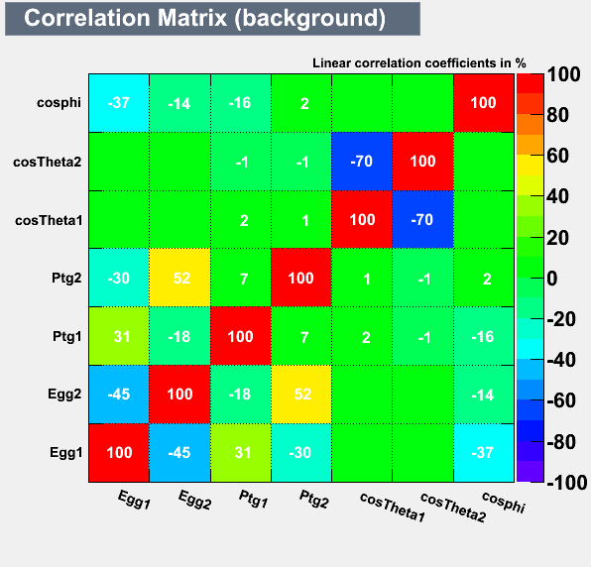
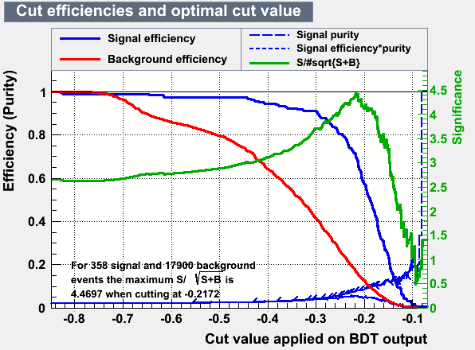
result after training

Slide 3
TMVA-BDT selection with BDT>=0.15
$N=L∗σ∗ε$
From the right diagram , we can get :
$ε\left[signal\right]={260}/{358}$
$ε\left[bkg\right]={3080}/{17886}$
$L=4000{fb}^{−1}$(get it from graph in the next slide)

Slide 4
The cross section in this two samples
eLpR electron Left positron Right .in the similar way, eRpL is …and the no pol

Slide 5
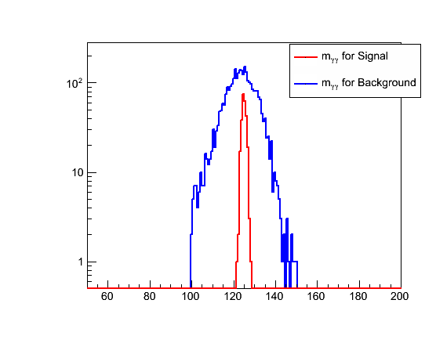
The result after the BDT selection

Slide 6
TMVA
N[signal]=4000*48.4345*0.67*0.228%=260
N[bkg]=4000*151.9008*0.013=3080
The significance is
$\frac{S}{\sqrt{S+B}}=\frac{N[signal]}{\sqrt{N\left[signal\right]+N[bkg]}}$=$\frac{260}{58}$=4.48

