Slide 1
Xsection: WWϒϒ VS ZZbb

Slide 2
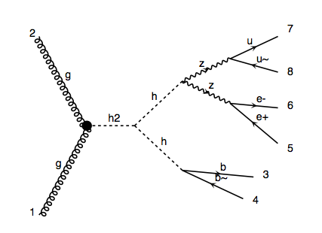
m_H=300GeV signal
pp > H > h h > Z Z b b > l l j j b b

Slide 3
BG:
p p > l+ l- q q b b~ 1.4 pb
p p > l v l v b b~ 48.5 pb
p p > l+ l- b b~ 70.2 pb

Slide 4
