Slide 1
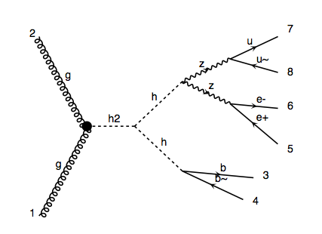
m_H=300GeV signal
pp > H > h h > Z Z b b > l l j j b b

Slide 2
The run_card parameter bwcutoff defines what is considered to be on-shell s-channel resonances: The resonance if considered to be on-shell if the invariant mass of an s-channel resonance is within M +/- bwcutoff*Gamma

Slide 3
bwcutoff = 15GeV

Slide 4
bwcutoff = 5GeV

