Slide 1
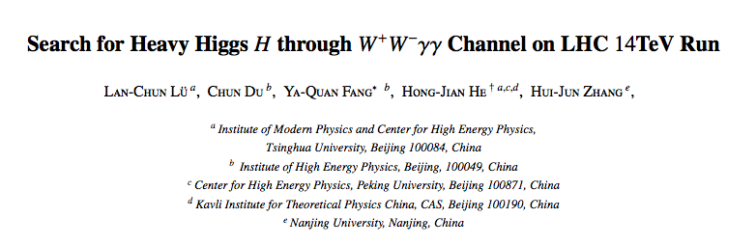
To be finished next week(planning)
To be submitted to PLB

Slide 2
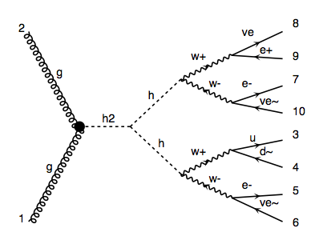
m_H=300GeV signal
pp > H > h h > w w w w > l v l v l v q q

Slide 4
BG
p p > l+ l- l v w, w > q q 2.2 fb
p p > w w w w > l v l v l v q q 0.011fb

