Slide 1
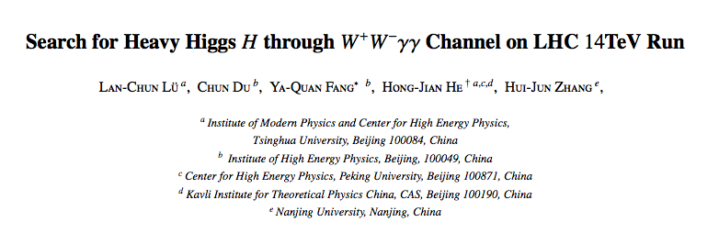
Some modifications
To be submitted to PLB

Slide 2
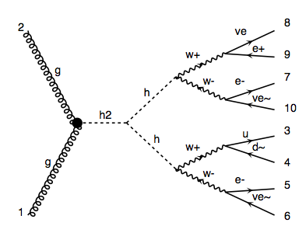
Signal: pp > H > h h > w w w w > l v l v l v q q
Generating q q from on-shell w and off-shell w separately

Slide 3
Parton level: ok

Slide 4
BG
p p > l v l v l v q q too many diagrams
p p > l l l v q q too many diagrams
p p > l v l v l v 3.8 fb
p p > l l l v 0.47 pb

Slide 5
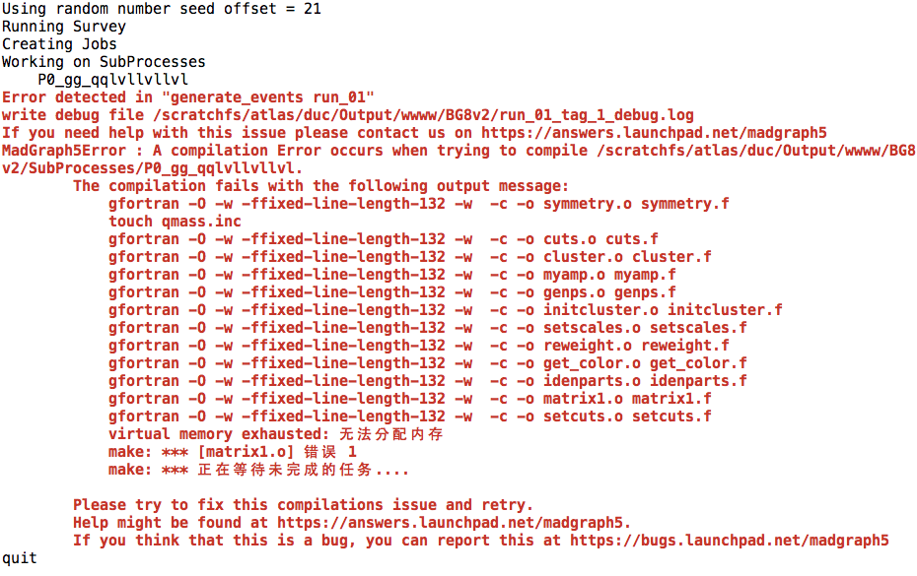
p p > e+ ve e- ve~ e- ve~ u d

Slide 6
BG
p p > w w w w > l v l v l v q q 0.011fb
p p > l+ l- l v w, w > q q 2.2 fb

