Slide 1
WWyy work status(4th week)
for hh pair search
Maosen Zhou

Slide 2
Temporary updates
hh NLO , 19.2.4.8.1
Copied generated ‘run_card.SM.dat’ to working directory
Changed ‘get_default_runcard()’ to ‘run_card.SM.dat’
not sure about this, but only if I do like this could 19.2.4.8.1 works which includs hh NLO patch.
Showering, Pythia8 for non-resonant, will be move to Herwig++
Showering, Herwig++ for resonant, Pythia8 doesn’t work
NOTE：for now, non-resonant JO still base on bbyy, resonant on WWbb

Slide 3
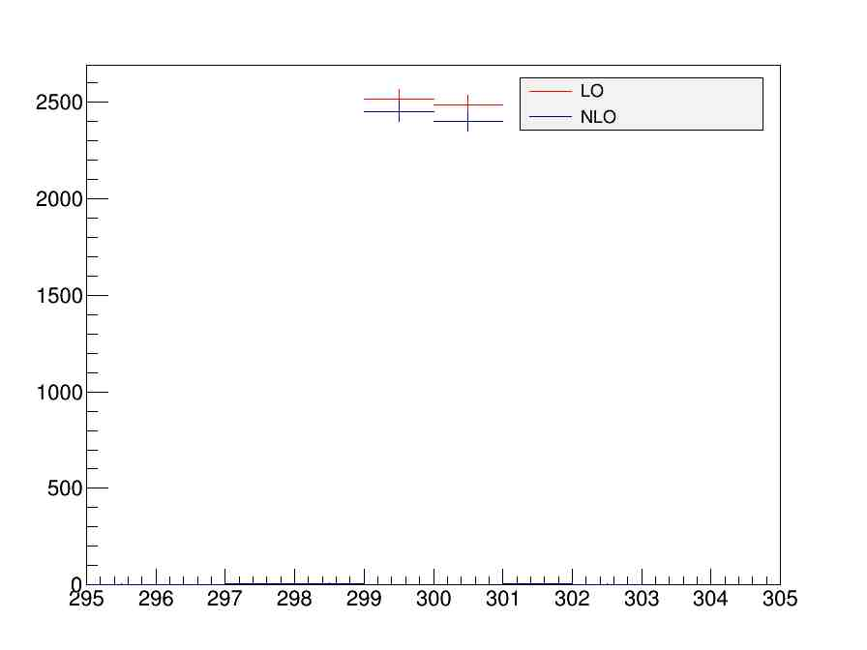
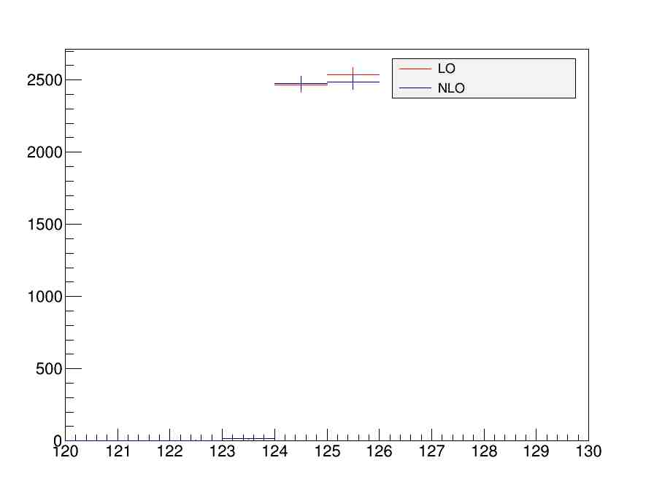
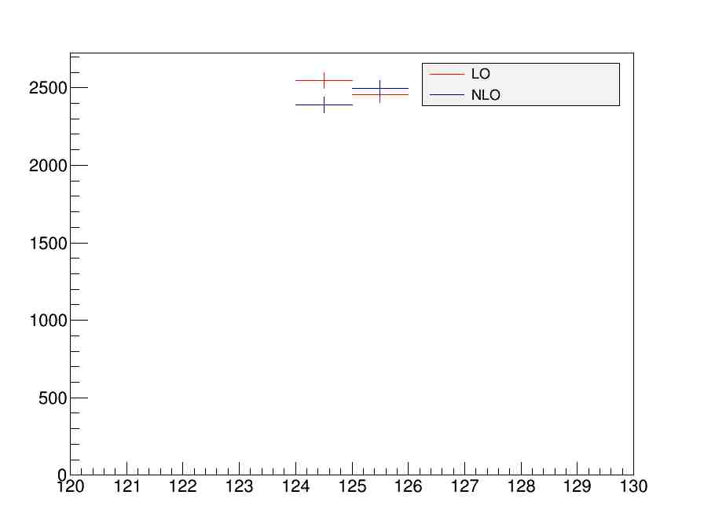
H_300GeV (width 10MeV)
M_wwyy
M_ww
M_yy

Slide 4
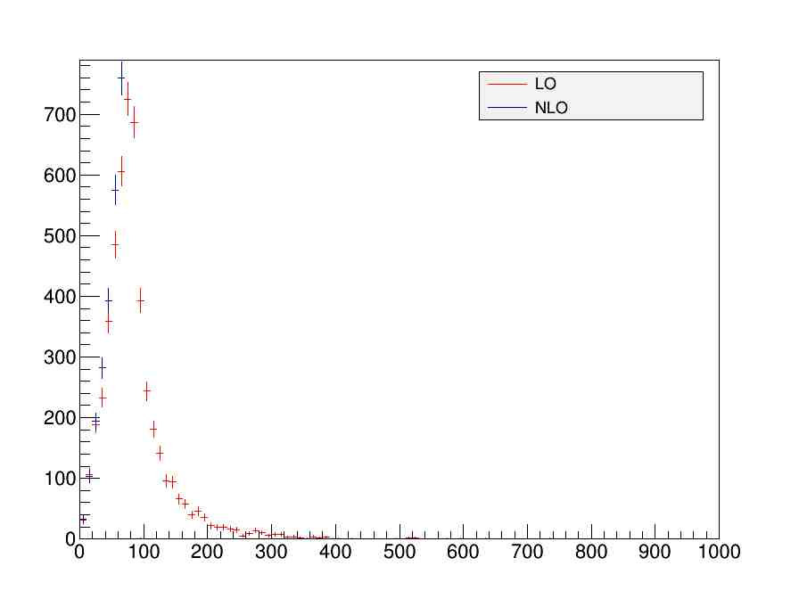

H_400GeV(width 10MeV)
Pt_ww
Pt_yy

Slide 5
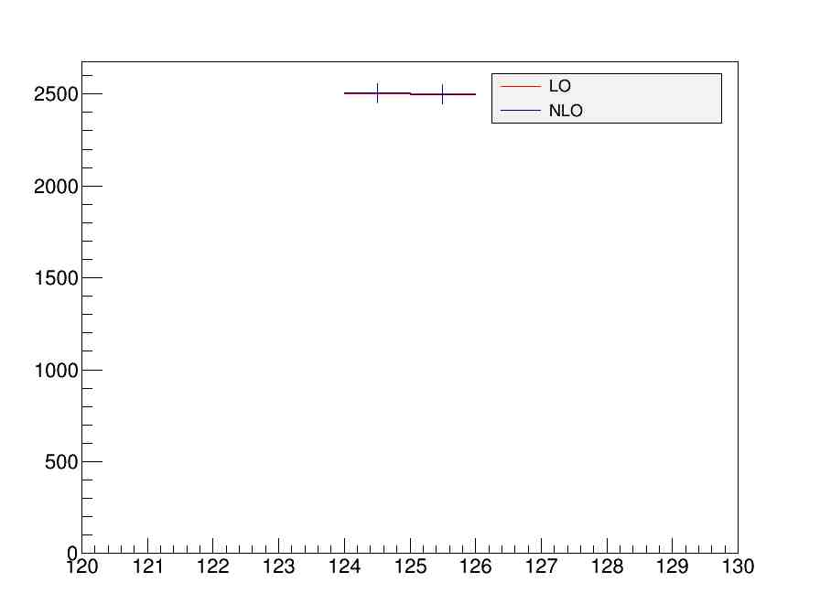
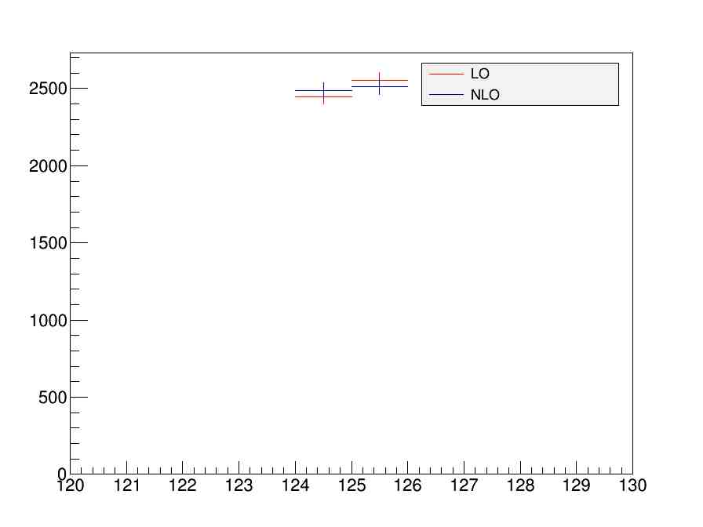
sm_hh
m_ww
m_yy

Slide 6
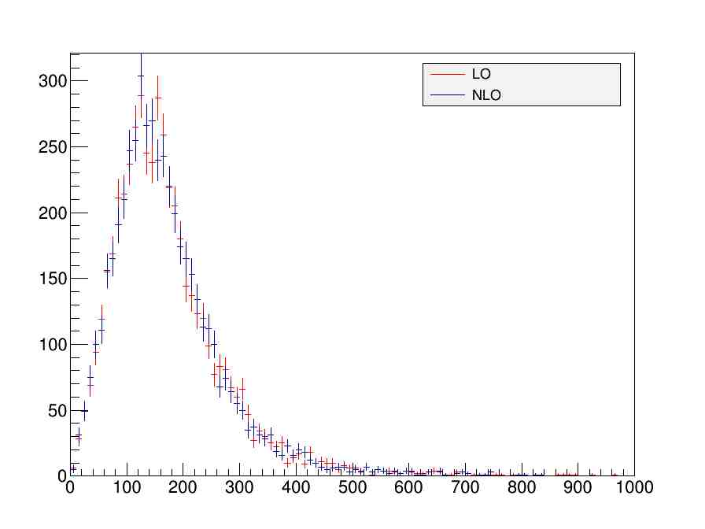
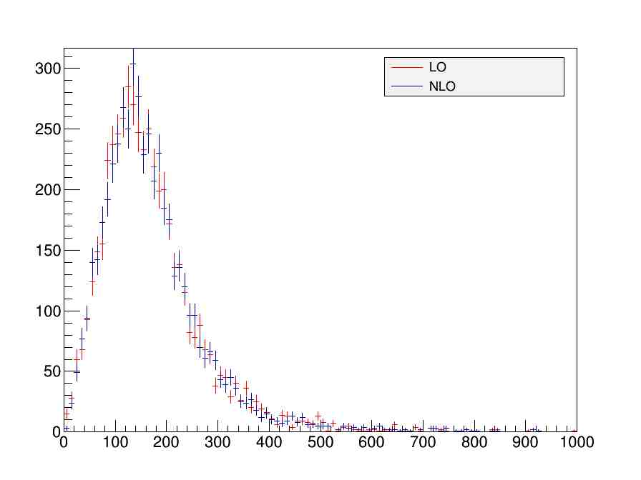
sm_hh
Pt_ww
Pt_yy

Slide 7
Summary&To do
Further test 19.2.4.8.1, NLO hh
Use Herwig for non-resonant showering

Slide 8
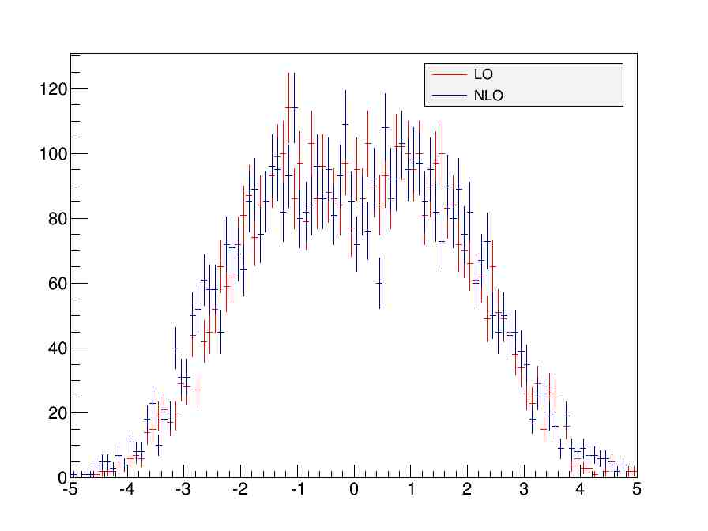
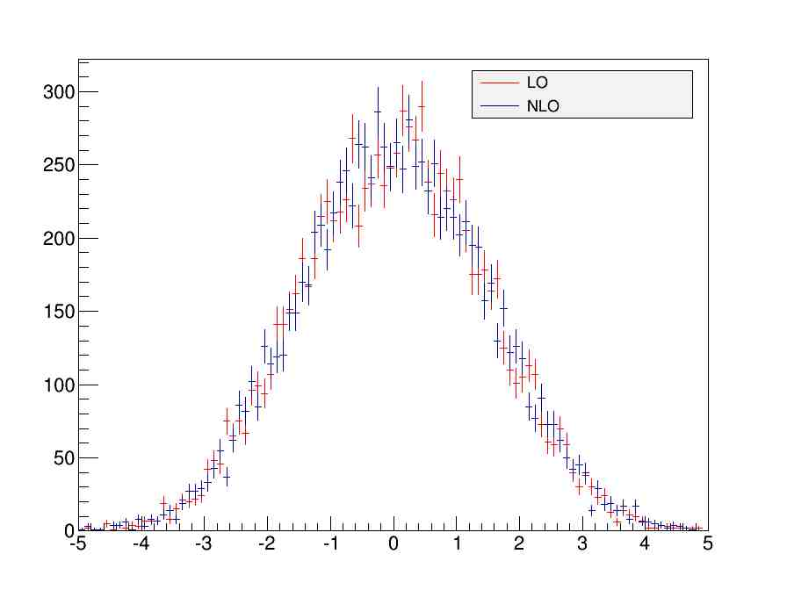
Backup 300GeV
Eta_w
Eta_y

Slide 9
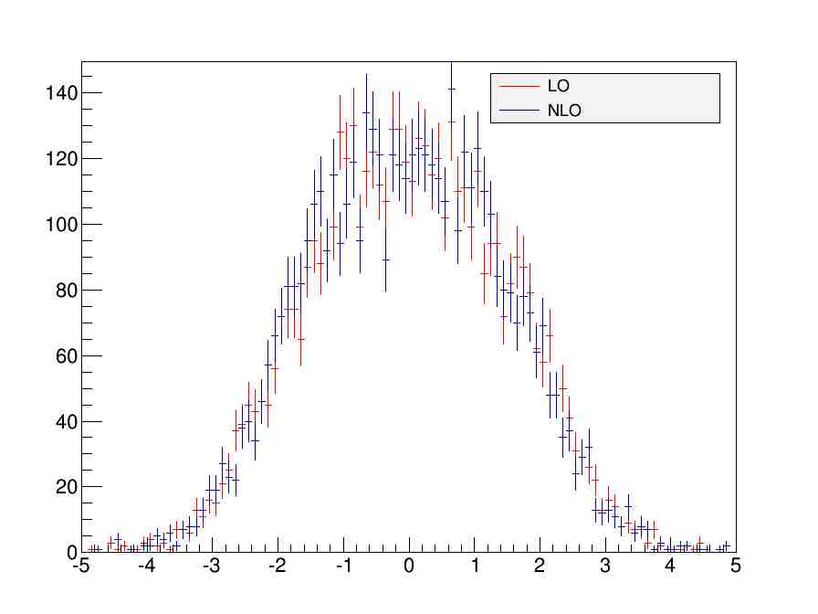
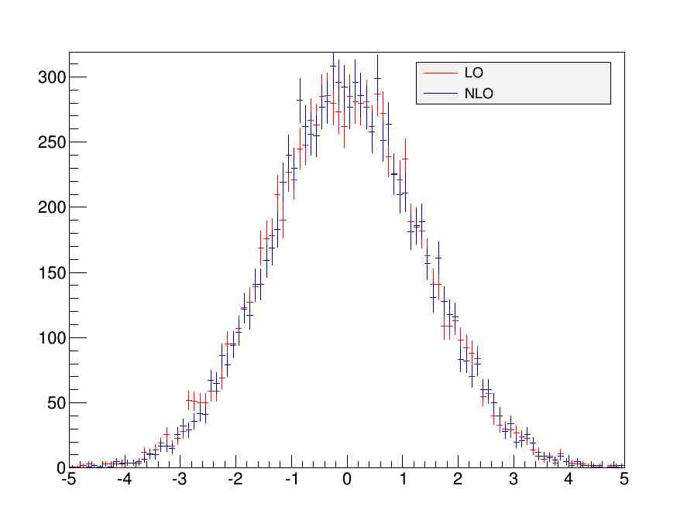
sm_hh
Eta_w
Eta_y

