Slide 1
WWyy work status(5th week)
for hh pair search
Maosen Zhou

Slide 2
Outline
Biagio produced 50k non-resonant NLO hh samples
Classify events into lvlv, jjlv and jjjj by counting number of leptons which are from w dedaying from higgs
Temporarily tested 5k events
Found 10 weird events, for example:
h > W+ > tau+, h > W+ > e+, h > W- > ?
Ignore these special events and do validation
Sample: 44%(hadhad), 45%(hadlep) and 11%(leplep),
PDG: 46%(hadhad), 43%(hadlep) and 11%(leplep)

Slide 3
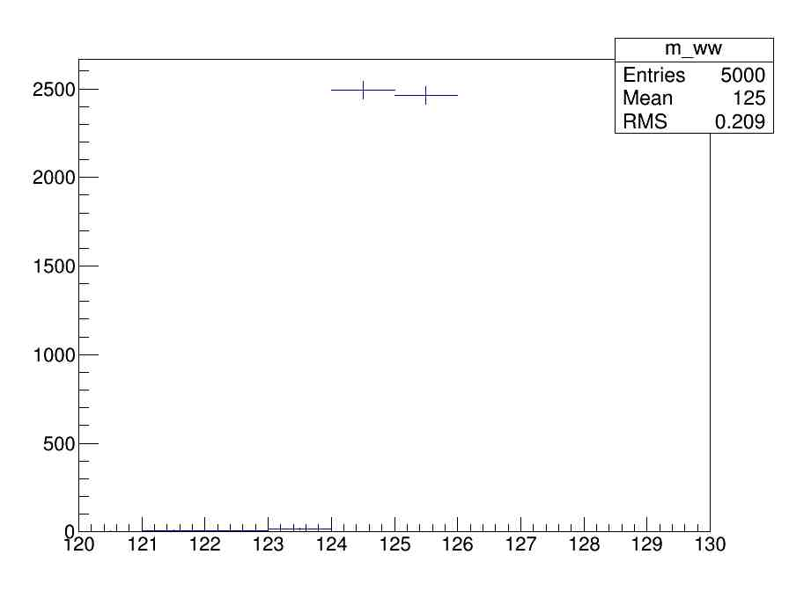
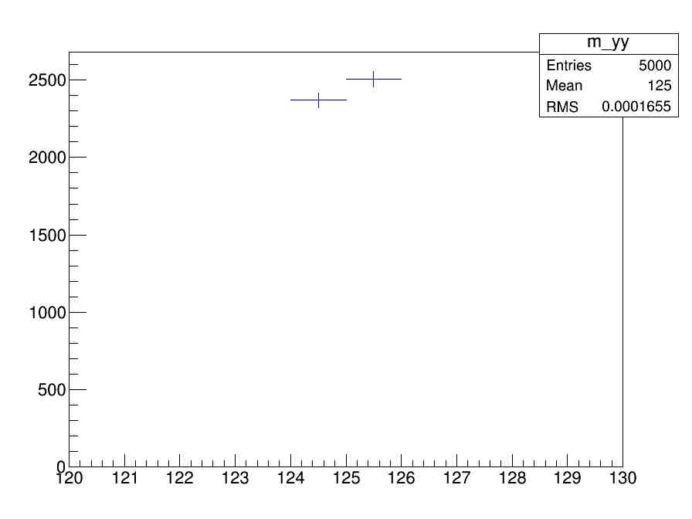
wwyy level

Slide 4
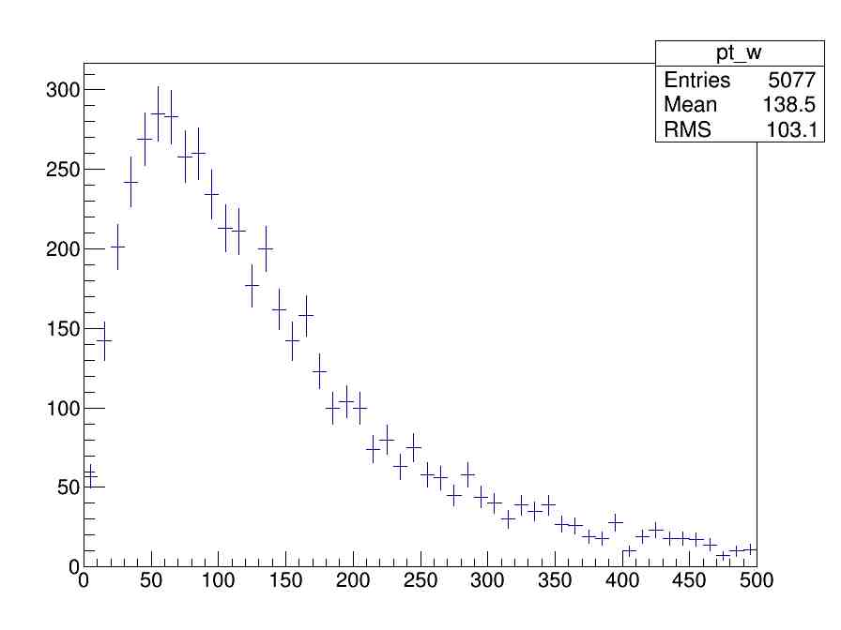
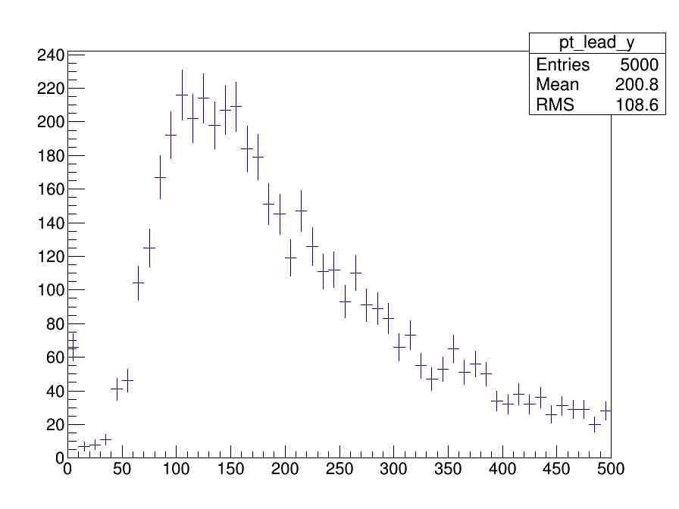
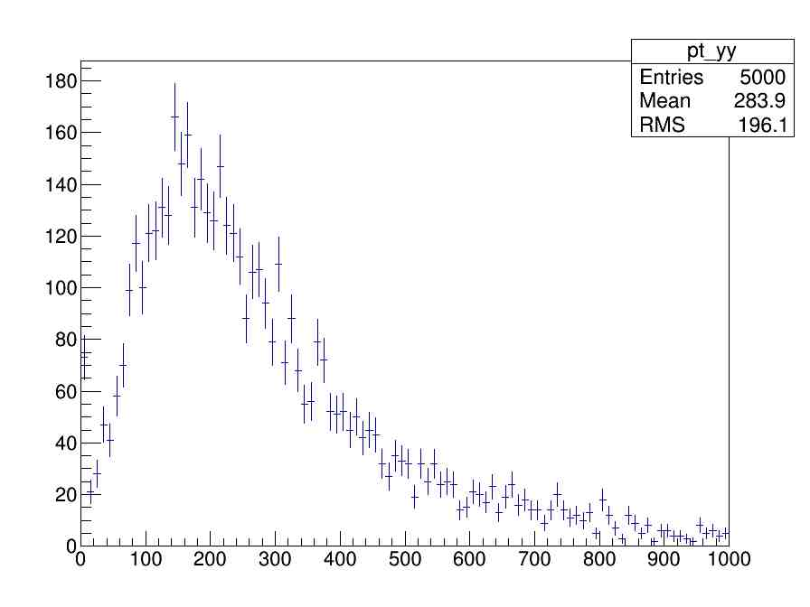
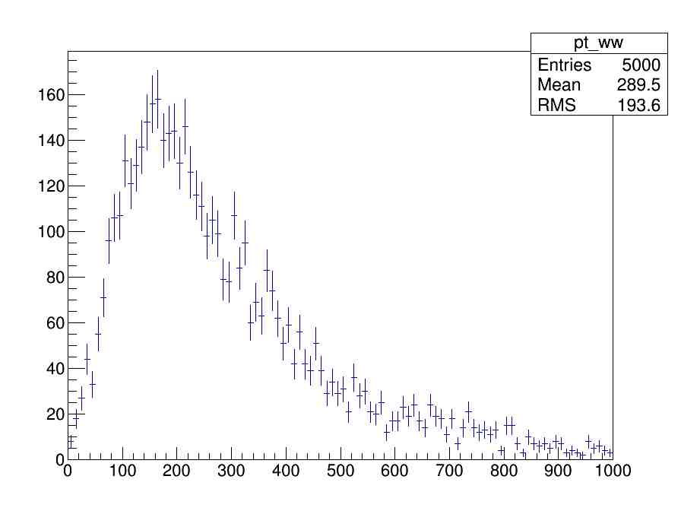
wwyy level

Slide 5
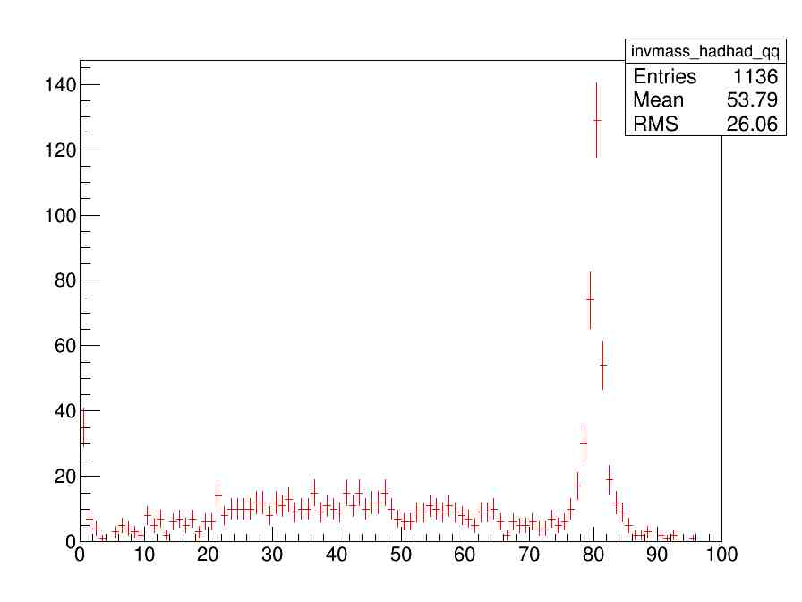
hadronic
Pt_quark>25GeV

Slide 6
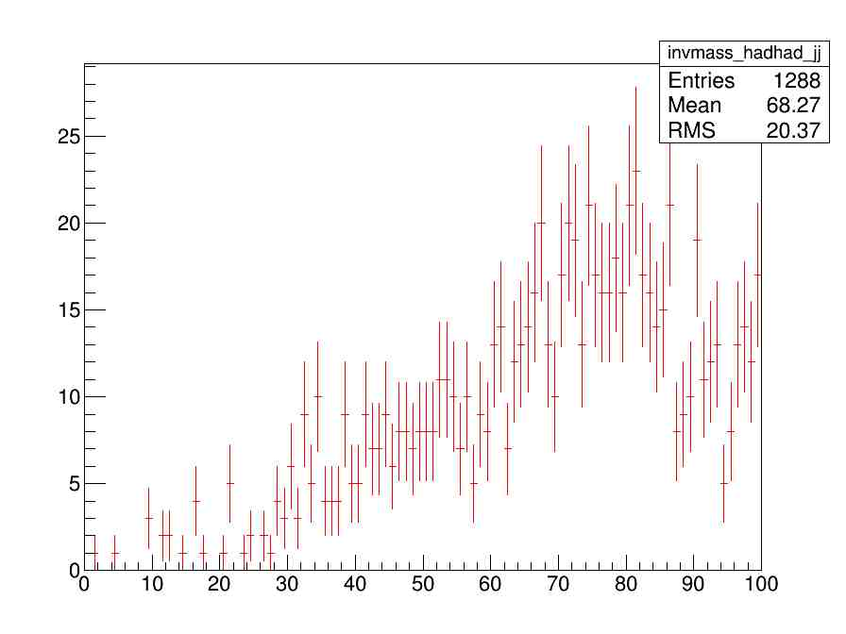
Hadronic channel
deltaR(j,R)<0.4

Slide 7
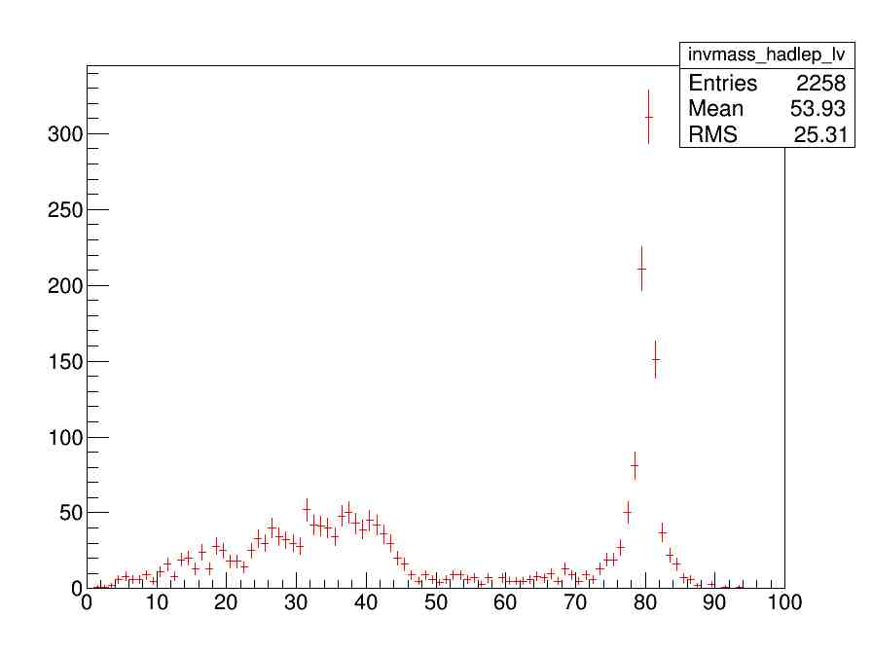
Semileptonic channel

Slide 8
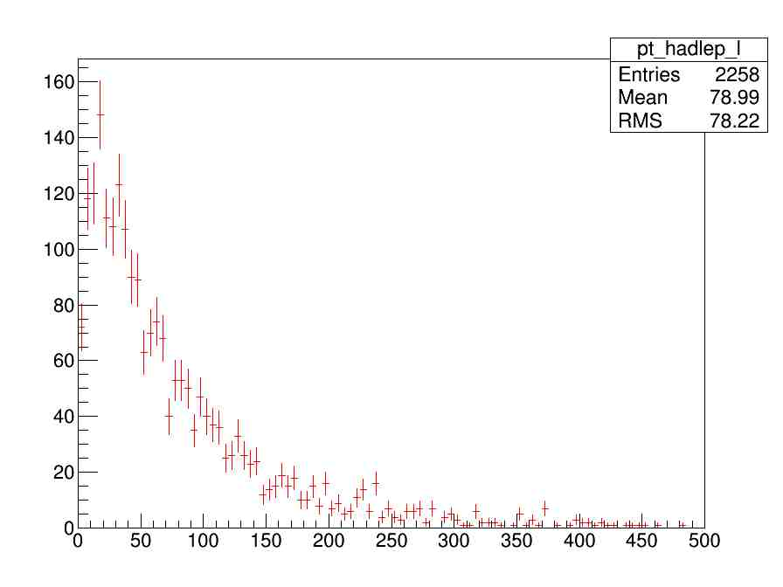
Semileptonic channel

Slide 9
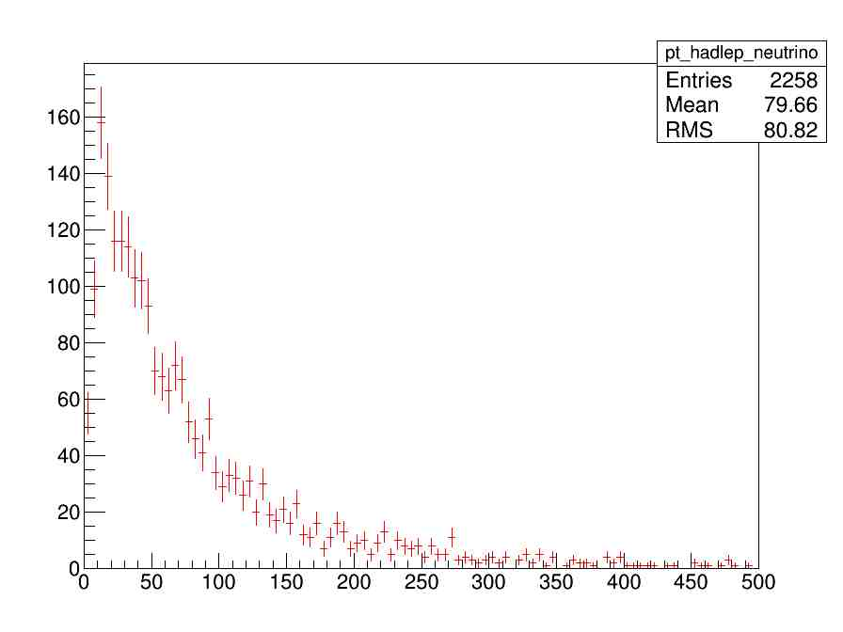
Semileptonic channel

Slide 10
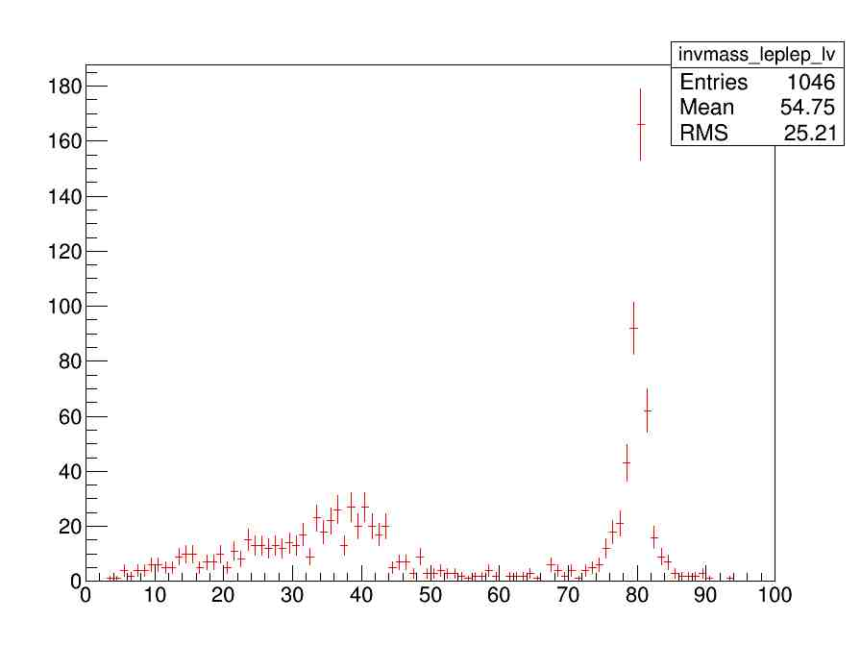
Leptonical channel

Slide 11
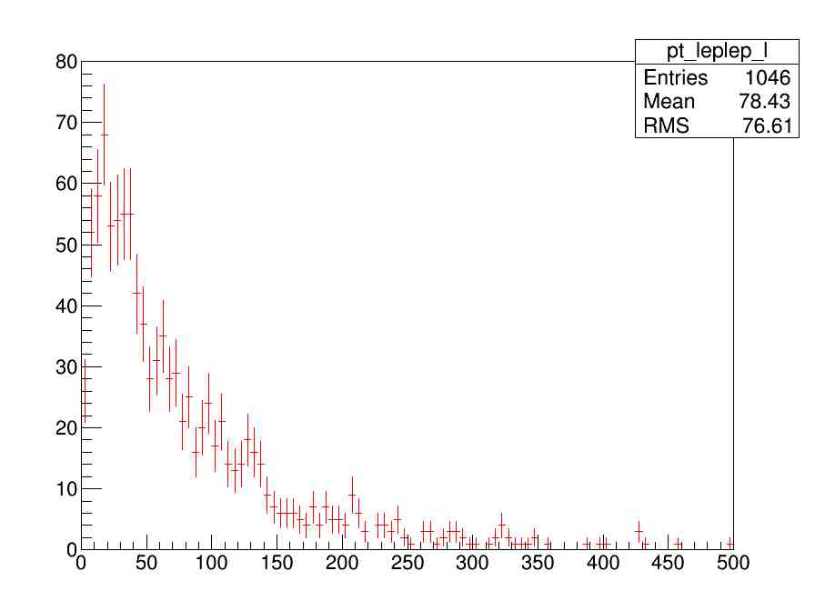

Slide 12
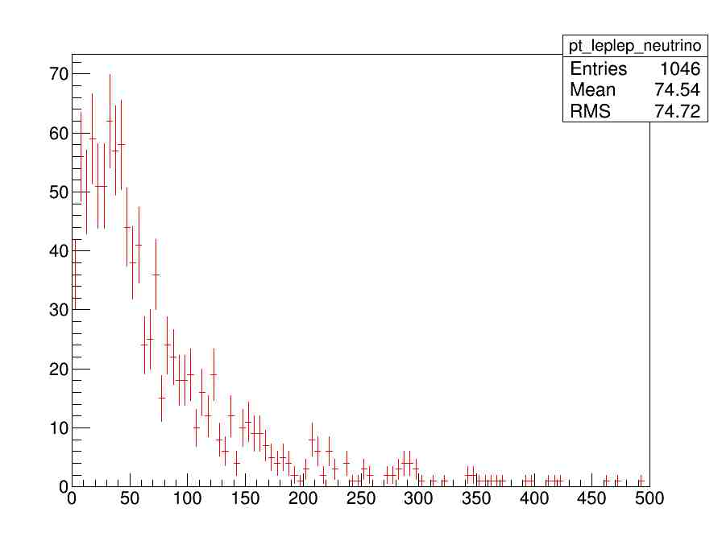

Slide 13
Summary&to do
Continue on validation, make plots better
Qualification task

