Slide 1
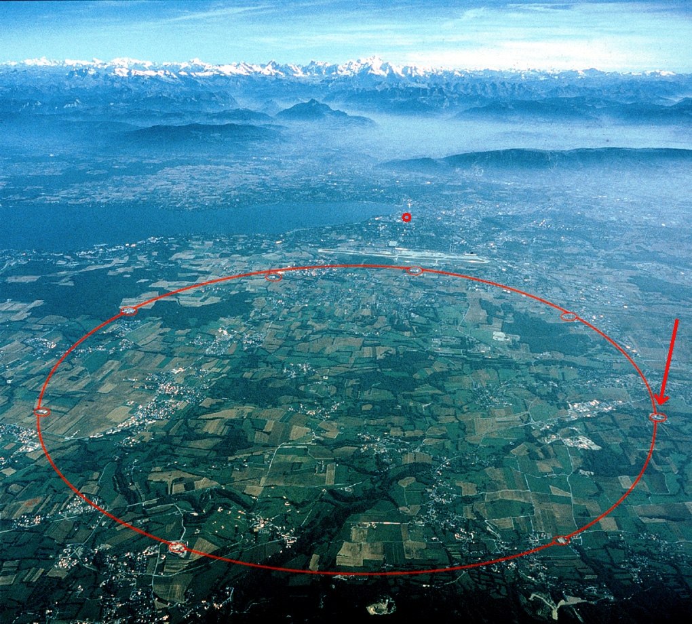
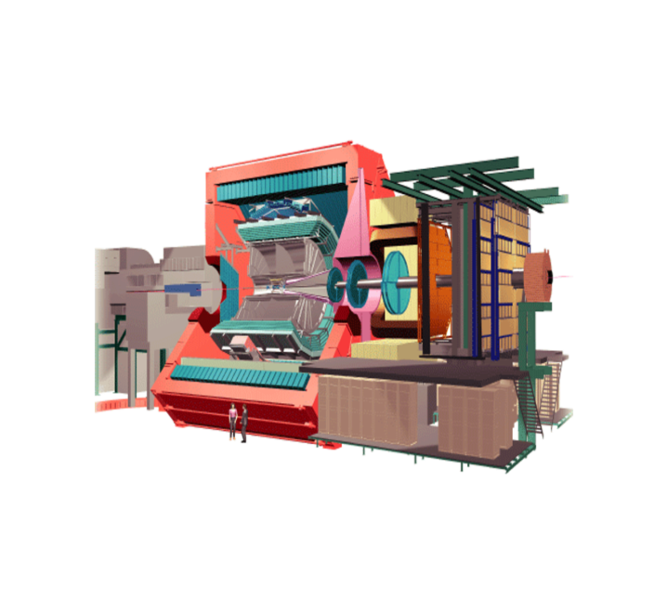
ALICE DETECTOR CONTROL SYSTEM
Presented at RT 2009, Beijing
Peter Chochula, Lennart Jirden, Andre Augustinus, Lionel Wallet, Marco Bocciolli, Peter Rosinsky, Giacinto de Cataldo, Cesar Torcato,Luis Granado
CERN - ALICE
ALICE

Slide 2
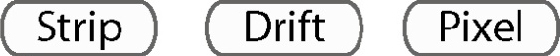



Experiment
Size: 16 x 26 meters (some detectors >100m away from IP)
Weight: 10,000 tons
Detectors: 18
Magnets: 2
Dedicated to study of ultra relativistic heavy ions collisions at LHC
ALICE DCS
Responsible for safe 24/7 operation of ALICE
Based on commercial SCADA system PVSSII
Controls 18 sub-detectors and about 150 subsystems (HV,LV,FEE…)
Provides infrastructure and services for the experiment
Collaboration
Members: 1000
Institutes: 90
Countries: 30
ALICE DCS PROJECT
Started 8 years ago
Small central team collaborating with:
  Detector groups (~100 people involved)
  LHC experiments

Slide 3
(Some of the) alice detectors

Slide 4
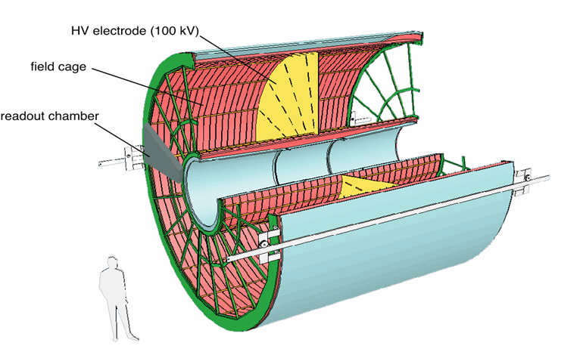
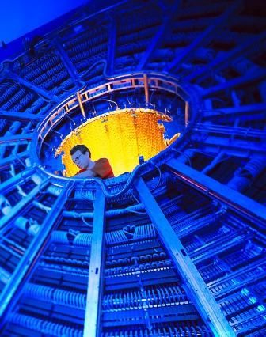
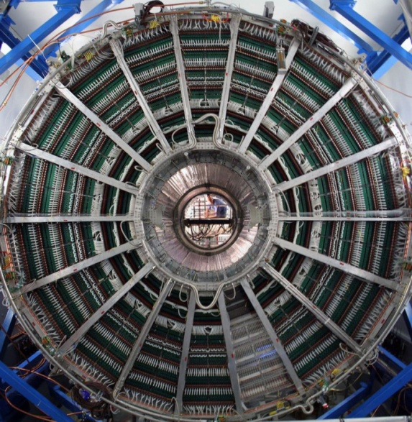
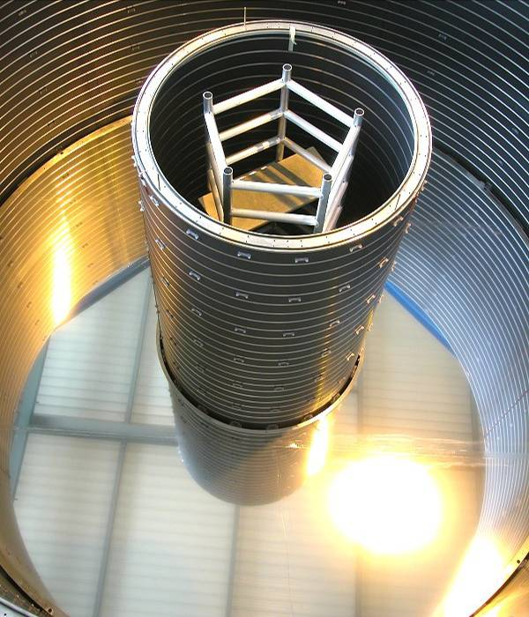
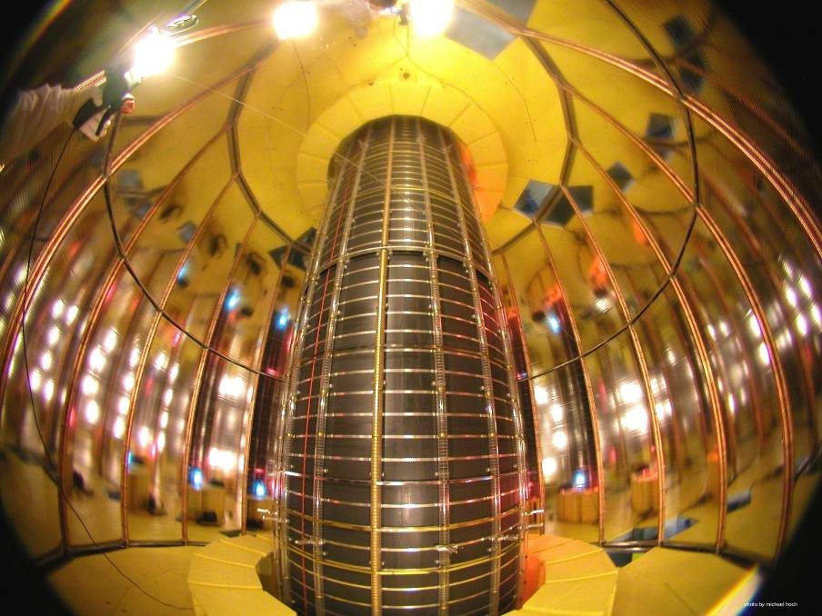
Very High Voltage (100 kV) 25um HV membrane
Gas (88 m³)
Cooling
0.1 ºC stability
Front-End
Electronics
Mounted on chambers
ALICE TPC
High Voltage (3 kV)
Low Voltage
(60 kW)
  l = 5.1 m, d = 5.6m
  570 k readout channels
  Largest Ever
510 cm

Slide 5
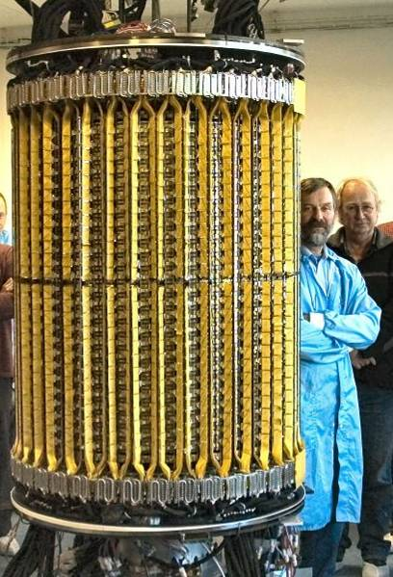
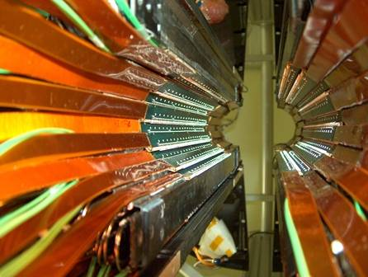
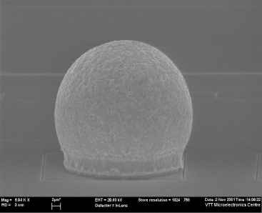
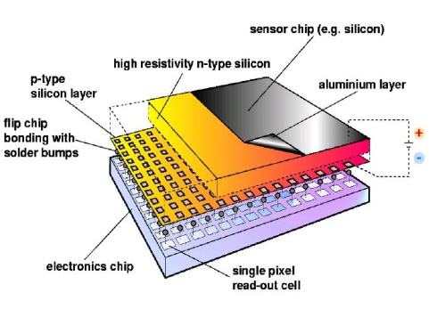
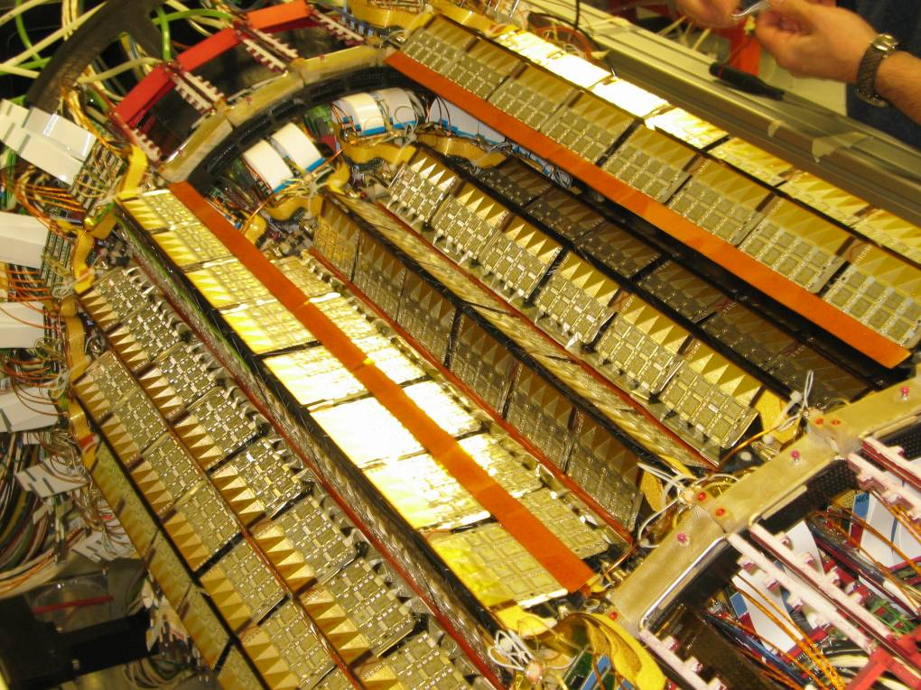
Pb-Sn solder bumps: ~30µm diameter
Readout chips: 725μm native thickness
thinned to 150μm after bump deposition
10 000 000 pixels, configured via DCS
ALICE Inner Tracking System (ITS)
Pixel layers
Inner Tracking System
~ 10 m² Si detectors, 6 layers
Pixels, Drift, double sided Strips
3.9 cm < r < 43 cm
Strip layers
Drift layers

Slide 6
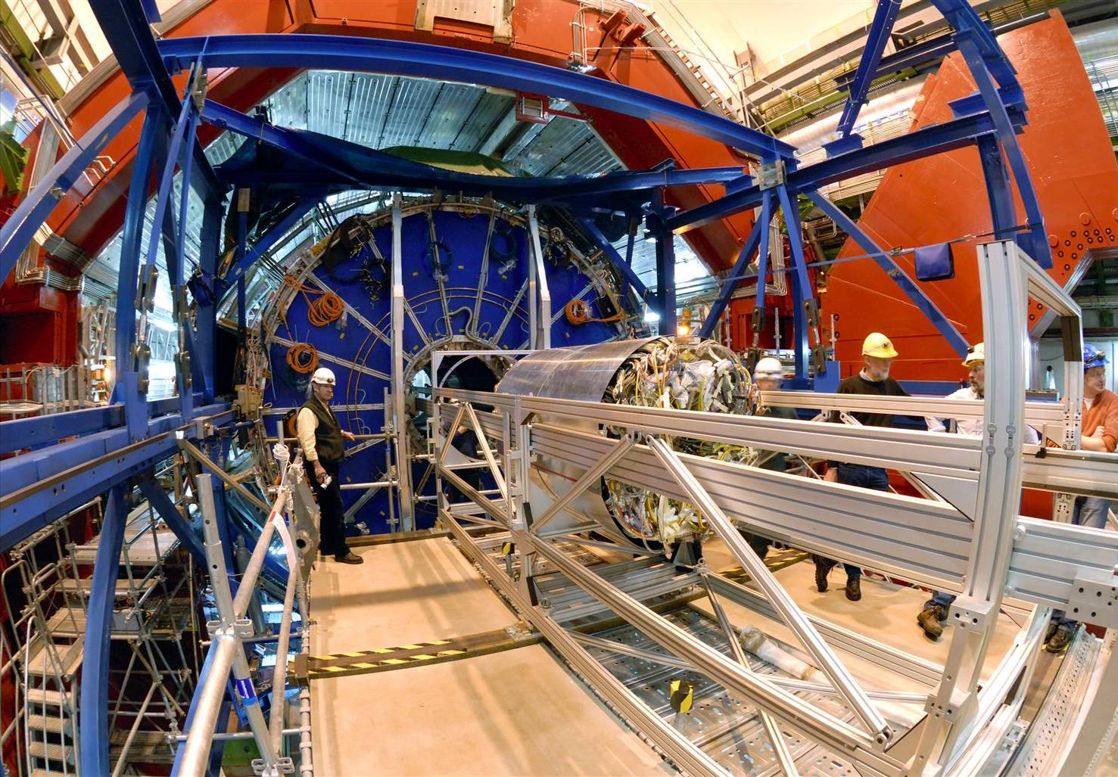
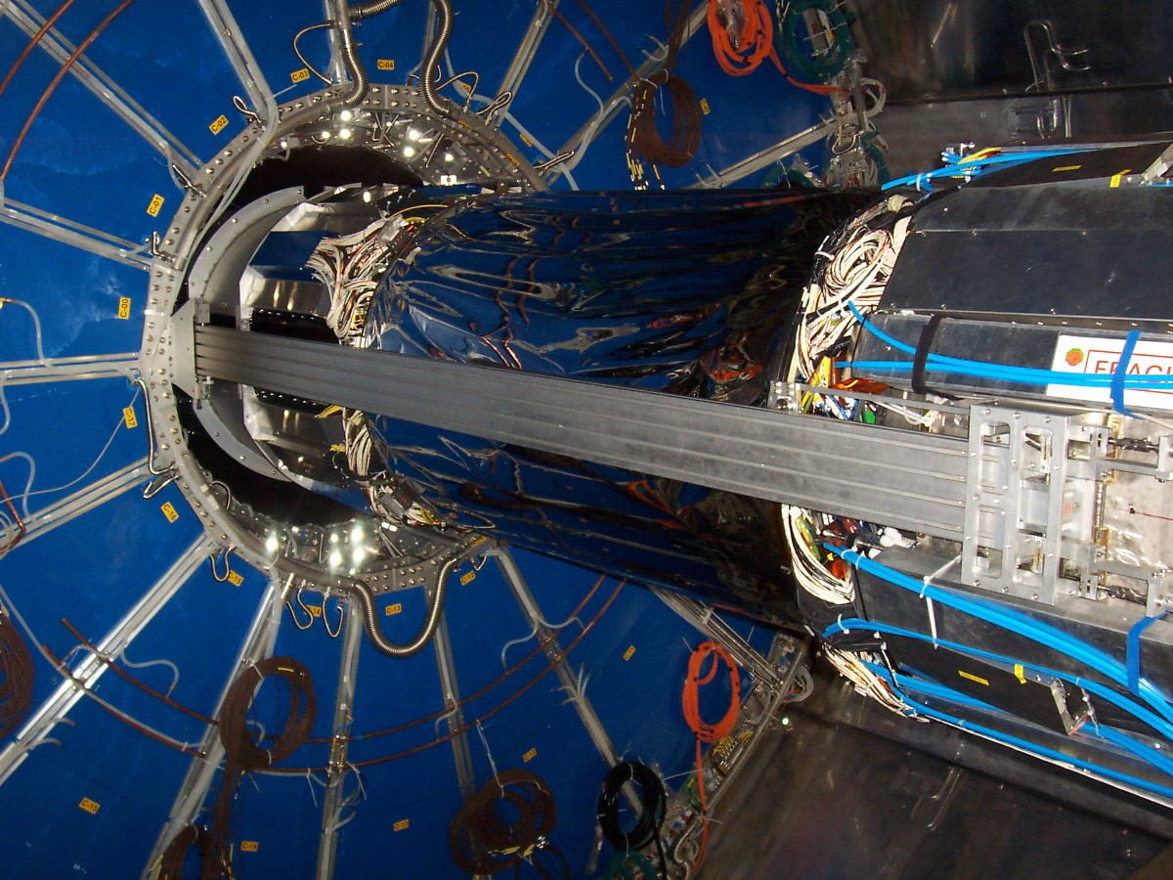
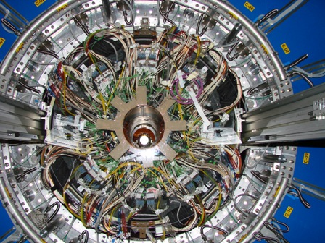
Installation of the ITS in ALICE

Slide 7
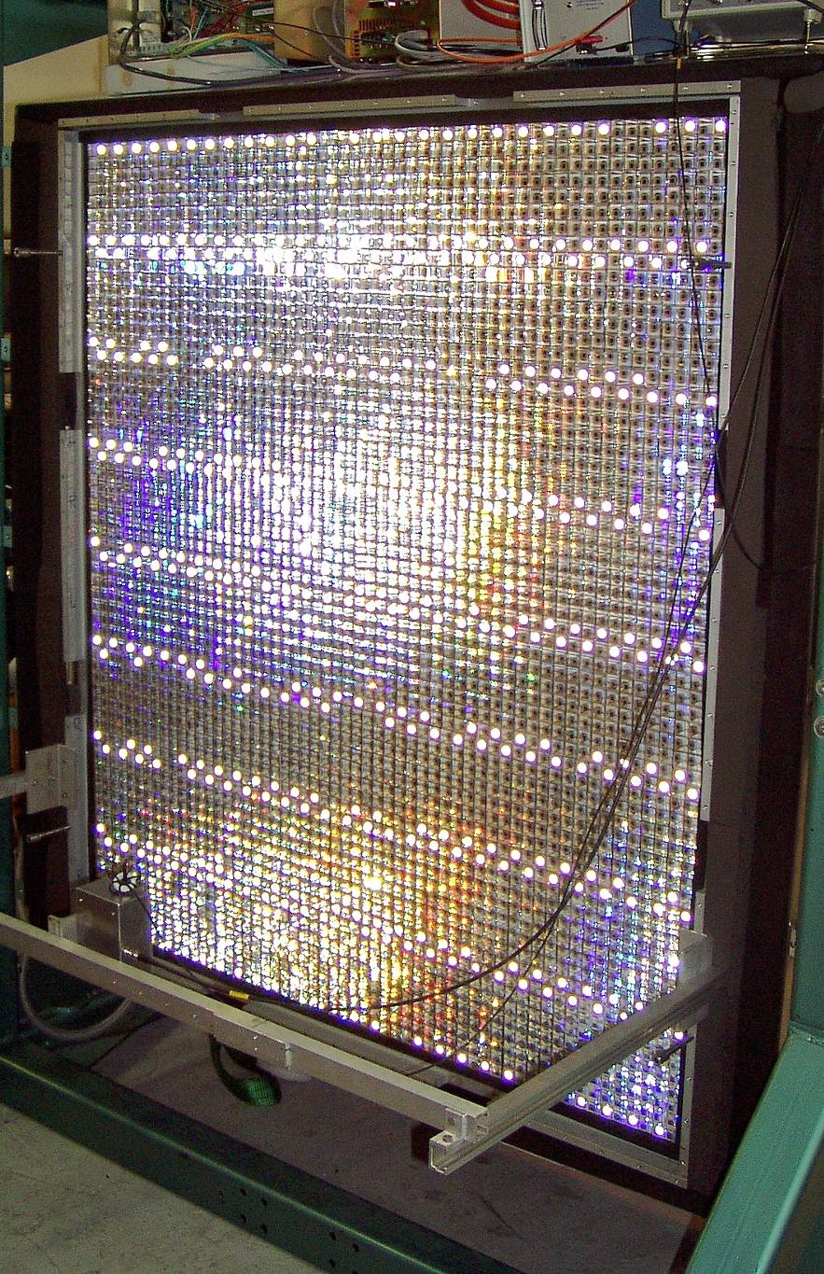
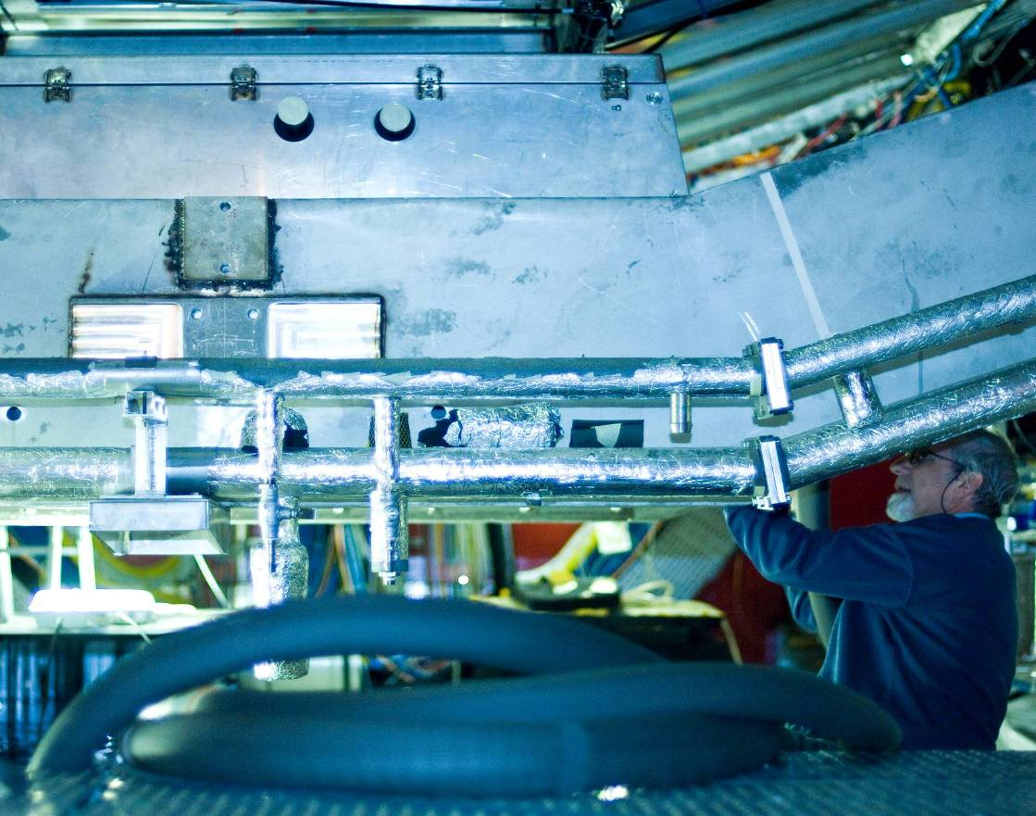
Photon Spectrometer
~ 8 m² PbW0₄ crystals,
r ~ 5m
Operating at -20C
18 k channels controlled and configured via DCS

Slide 8
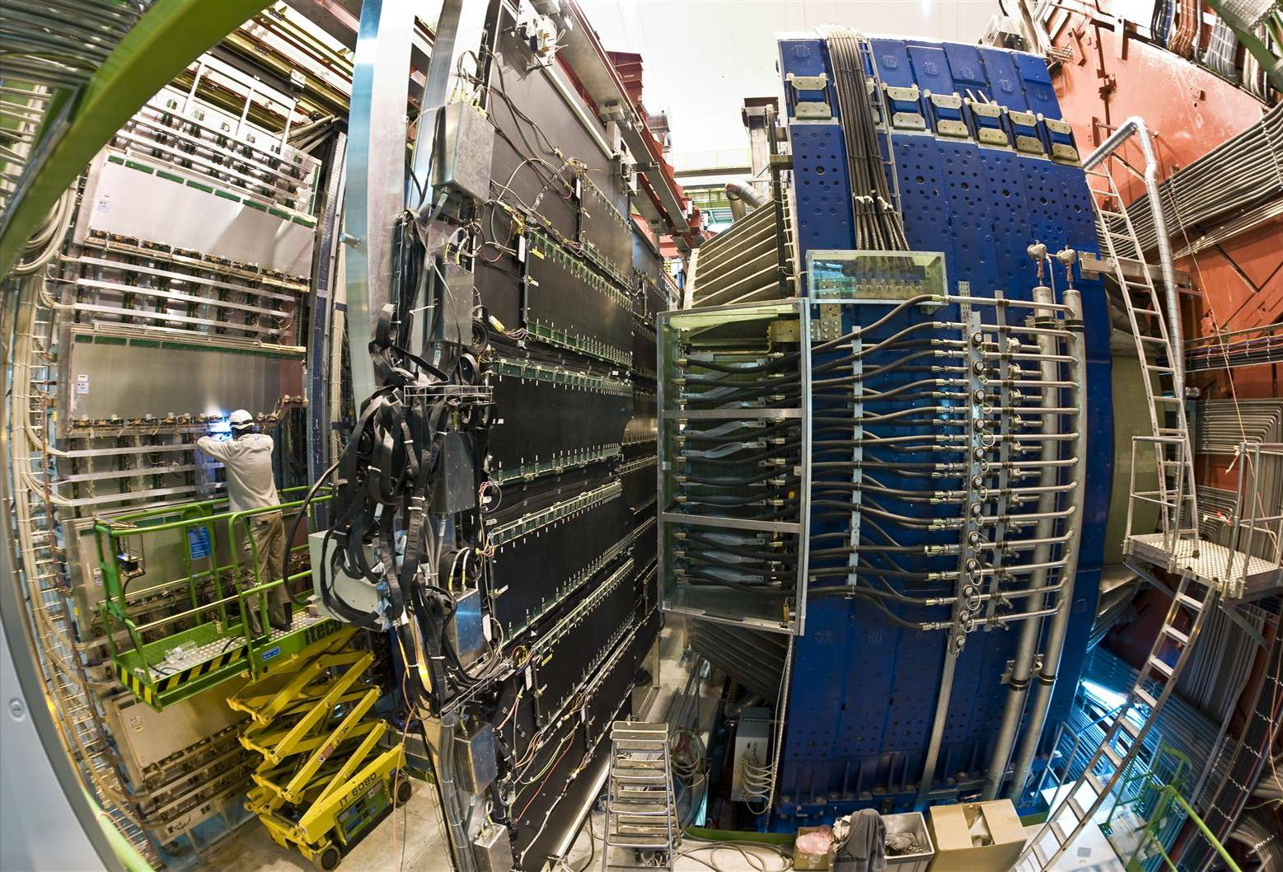
10 CSC tracking planes, 90 m²,
1.1 M FEE
Muon Spectrometer
4 RPC trigger planes, 120 m²,
20 k FEE

Slide 9
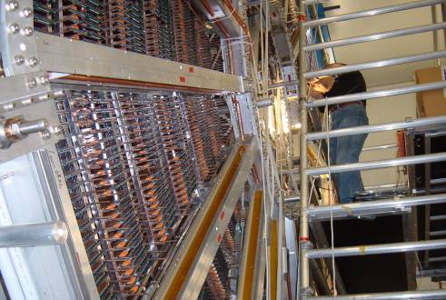
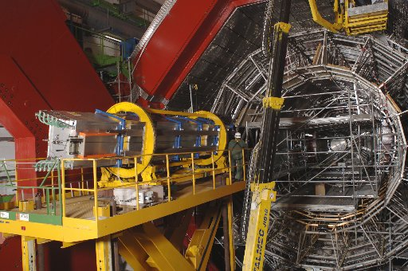
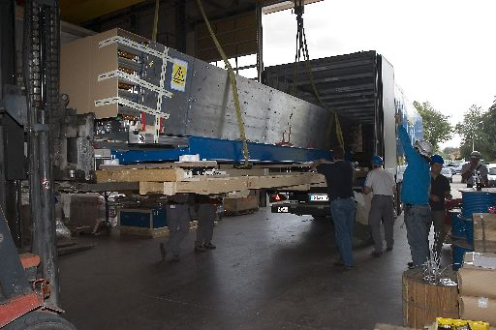
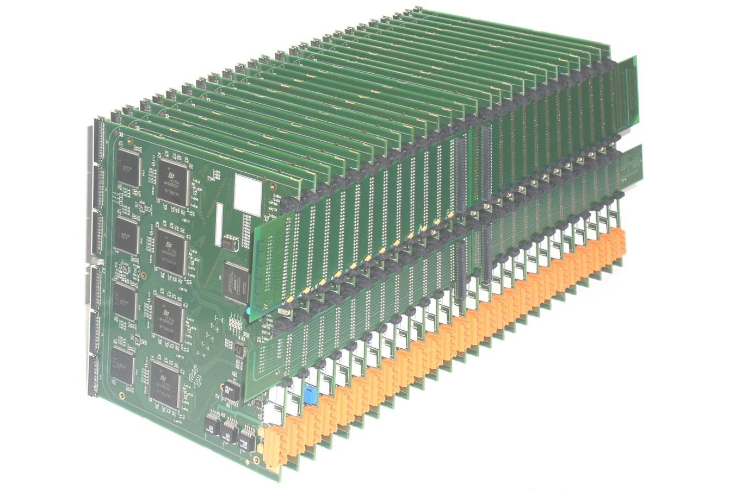
TPC
Frontend and readout electronics – new type of challenge for the DCS
    unlike in the past, DCS is now involved in configuration and control of large number of FEE modules
FEE cards often mounted directly on detectors
Large number of Ethernet ports required directly on detectors
    more than 700 SBCs in ALICE DCS
    operation in magnetic field
TRD
TPC Readout Partition
Examples:
ALICE TPC
4500 Front End cards
>500 000 channels
ALICE TRD
>1 000 000 readout channels
250 000 tracking CPUs configured via DCS

Slide 10
External Services and Systems
Alice Systems
OFFLINE
Conditions
Database
ECS
TRIGGER
Electricity
DAQ
HLT
Ventilation
Cooling
Detector Controls System
Magnets
Gas
Archival
Database
Access Control
SCADA
Controls Context
LHC
1000 ins/s
Safety
Infrastructure
Up to 6GB
Configuration
Database
B-field
Devices
Space Frame
Devices
Devices
Beam Pipe
Devices
Envitonment
Radiation
DETECTORS
SPD
SDD
SSD
TPC
TRD
TOF
HMP
PHO
FMD
T0
V0
PMD
MTR
MTK
ZDC
ACO

Slide 11
Dataflow in ALICE DCS
  6GB of data is needed to fully configure ALICE for operation
  Several stages of filtering applied to acquired data
GAS
COOLING
FEE
HV
LHC
ALICE on-detector electronics
LV
FEE
Magnets
Safety
Detector devices
300 000 values/s
read by software
External sub-systems
Offline
(GRID)
Operator UIs
DCS data processing farm
DCS data storage
(ORACLE, fileservers)
30 000 values/s
Injected into PVSS
Data Consumers
1000 values/s
Written to ORACLE after smoothing in PVSS
>200 values/s
Sent to consumers

Slide 12
Building blocks of ALICE DCS
1200 network-attached devices
270 crates (VME and power supplies)
4 000 controlled voltage channels
18 detectors with different requirements
  Effort to device standardization
    Still large diversity mainly in FEE part
      Large number of busses (CANbus, JTAG, Profibus, RS232, Ethernet, custom links…)
HVPS
LVPS
FEE
…

Slide 13
180 000 OPC items
100 000 Front-End (FED) services
1 000 000 parameters supervised by the DCS
Monitored at typical rate of 1Hz
Hardware diversity is managed through standard interfaces
  OPC servers for commercial devices
  FED servers for custom hardware
    Provides hardware abstraction, uses CERN DIM (TCP/IP based) protocol for communication
OPC SERVER
Device DRIVER
DEVICE ACCESS and ABSTRACTION
OPC SERVER
HVPS
Device DRIVER
LVPS
FED SERVER
Device DRIVER
FEE
FED SERVER
Device DRIVER
…

Slide 14
110 detector computers
60 backend servers
DCS Oracle RAC (able to process up to 150 000 inserts/s)
DNS
FS
BACKEND SYSTEMS
PVSS
MON
DETECTOR SYSTEM
RAC
CENTRAL SYSTEMS
PVSS
ACC
PVSS
PVSS
PVSS
PVSS
PVSS
Core of the DCS is based on commercial SCADA system PVSSII
PVSS
DETECTOR SYSTEM
OPC SERVER
Device DRIVER
PVSS
DEVICE ACCESS and ABSTRACTION
OPC SERVER
PVSS
HVPS
Device DRIVER
PVSS
LVPS
FED SERVER
PVSS
Device DRIVER
FEE
FED SERVER
Device DRIVER
…

Slide 15
PVSSII Architecture
User Application
UI
UI
UI
ALICE Framework
CTL
API
JCOP Framework
PVSSII
DM
EM
DRV
DRV
DRV
      PVSSII system is composed of specialized program modules (managers)
      Managers communicate via TCP/IP
      ALICE DCS is built from 100 PVSS systems composed of 900 managers
      PVSSII is extended by JCOP and ALICE frameworks on top of which User applications are built

Slide 16
User Interface
Manager
User Interface
Manager
User Interface
Manager
Control
Manager
API
Manager
In a simple system all managers run on the same machine
In a scattered system, the managers can run on dedicated machines
Data
Manager
Event
Manager
Driver
Driver
Driver

Slide 17
In a distributed system several PVSSII systems (simple or scatered) are interconnected
User Interface
Manager
User Interface
Manager
User Interface
Manager
User Interface
Manager
User Interface
Manager
User Interface
Manager
User Interface
Manager
User Interface
Manager
User Interface
Manager
Control
Manager
Control
Manager
Control
Manager
API
Manager
API
Manager
API
Manager
Distribution
Manager
Data
Manager
Distribution
Manager
Data
Manager
Data
Manager
Event
Manager
Event
Manager
Event
Manager
Distribution
Manager
Driver
Driver
Driver
Driver
Driver
Driver
Driver
Driver
Driver

Slide 18
Each detector DCS is built as a distributed PVSSII system
  Mesh, no hierarchical topology
  Detector specific
PVSS
CENTRAL SYSTEMS
DETECTOR SYSTEM
PVSS
PVSS
PVSS
PVSS
PVSS
PVSS
PVSS
DETECTOR SYSTEM
OPC SERVER
Device DRIVER
PVSS
DEVICE ACCESS and ABSTRACTION
OPC SERVER
PVSS
HVPS
Device DRIVER
PVSS
LVPS
FED SERVER
PVSS
Device DRIVER
FEE
FED SERVER
Device DRIVER
…

Slide 19
ALICE DCS is built as a distributed system of detector systems
Central servers connect to ALL detector systems
    global data exchange
    synchronization
    Monitoring…
PVSS
CENTRAL SYSTEMS
DETECTOR SYSTEM
PVSS
PVSS
PVSS
PVSS
PVSS
PVSS
PVSS
DETECTOR SYSTEM
OPC SERVER
Device DRIVER
PVSS
DEVICE ACCESS and ABSTRACTION
OPC SERVER
PVSS
HVPS
Device DRIVER
PVSS
LVPS
FED SERVER
PVSS
Device DRIVER
FEE
FED SERVER
Device DRIVER
…

Slide 20
OPERATIONS LAYER
PVSSII distributed system is not a natural system representation for the operator
ALICE DCS Is modeled as a FSM using CERN SMI++ tools
  Hide experiment complexity
  Focus on operational aspect
PVSS
PVSS
CENTRAL SYSTEMS
DETECTOR SYSTEM
PVSS
PVSS
PVSS
PVSS
PVSS
PVSS
CH
CH
CH
CH
CH
CH
CH
CH
CH
PVSS
CH
CH
CH
CH
DETECTOR SYSTEM
CH
CH
CH
CH
CH
CH
OPC SERVER
CH
CH
CH
CH
CH
CH
CH
CH
CH
CH
Device DRIVER
PVSS
CH
DEVICE ACCESS and ABSTRACTION
OPC SERVER
PVSS
HVPS
Device DRIVER
PVSS
LVPS
FED SERVER
PVSS
Device DRIVER
FEE
FED SERVER
Device DRIVER
…

Slide 21
Hierarchical approach:
  ALICE DCS is represented as a tree composed of detector systems
  Each detector system is composed of subsystems
  Subsystems are structured to devices (crates, boards) and channels
DCS
DET1
DET1
HV
LV
…
FEE
VHV
HV
…
LV
CH
CH
CH
CH
CH
CH
CH
CH
CH
CH
CH
CH
CH
CH
CH
CH
CH
CH
CH
CH
CH
CH
CH
CH
CH
CH
CH
CH
CH
CH
CH
CH
CH
CH
CH
CH

Slide 22
DCS devices are described as FSM
State diagrams are standardized for channels and devices of the same type
Top level DCS takes into account status of all leaves
(simplified) TOP LEVEL FSM
DCS
GO_BT
STB
RESET
Moving BT
ERR
GO_STB
DET1
BEAM
Tuning
GO_RDY
DET1
SINGLE CHANNEL FSM
Moving
Ready
Moving
BT
READY
HV
LV
…
CONFIGURE
FEE
OFF
GO_BT
RESET
VHV
HV
…
LV
CFG
ERR
GO_OFF
CH
CH
CH
CH
CH
CH
STB
CH
CH
CH
CH
CH
GO_ON
CH
CH
CH
CH
CH
CH
CH
CH
CH
CH
CH
CH
CH
CH
CH
CH
CH
CH
CH
CH
CH
CH
RAM
UP
RAMP
DWN
CH
CH
CH
ON
GO_STB

Slide 23

Top level DCS state is computed as a combination of all FSM states
Single channel can affect the top level state (hence the readiness of the whole DCS)
DCS
DET1
DET1
HV
LV
…
FEE
VHV
HV
…
LV
CH
CH
CH
CH
CH
CH
CH
CH
CH
CH
CH
CH
CH
CH
CH
CH
CH
CH
CH
CH
CH
CH
CH
CH
CH
CH
CH
CH
CH
CH
CH
CH
CH
CH
CH
CH

Slide 24
DCS operator can exclude any part of the DCS tree and release the control to other users
Top level DCS does not take excluded parts of the hierarchy into account
DCS
DET1
DET1
HV
LV
…
FEE
VHV
HV
…
LV
CH
CH
CH
CH
CH
CH
CH
CH
CH
CH
CH
CH
CH
CH
CH
CH
CH
CH
CH
CH
CH
CH
CH
CH
CH
CH
CH
CH
CH
CH
CH
CH
CH
CH
CH
CH

Slide 25
Subsystem expert can take control and take care of the problem
Excluded parts of the hierarchy can be returned to the central operator on fly
DCS
DET1
DET1
HV
LV
…
FEE
VHV
HV
…
LV
CH
CH
CH
CH
CH
CH
CH
CH
CH
CH
CH
CH
CH
CH
CH
CH
CH
CH
CH
CH
CH
CH
CH
CH
CH
CH
CH
CH
CH
CH
CH
CH
CH
CH
CH
CH

Slide 26
OPERATIONS LAYER
PVSS
PVSS
CENTRAL SYSTEMS
DETECTOR SYSTEM
PVSS
PVSS
PVSS
PVSS
PVSS
PVSS
CH
CH
CH
CH
CH
CH
CH
CH
CH
PVSS
CH
CH
CH
CH
DETECTOR SYSTEM
CH
CH
CH
CH
CH
CH
OPC SERVER
CH
CH
CH
CH
CH
CH
CH
CH
CH
CH
Device DRIVER
PVSS
CH
DEVICE ACCESS and ABSTRACTION
OPC SERVER
PVSS
HVPS
Device DRIVER
PVSS
LVPS
FED SERVER
PVSS
Device DRIVER
FEE
FED SERVER
Device DRIVER
…

Slide 27
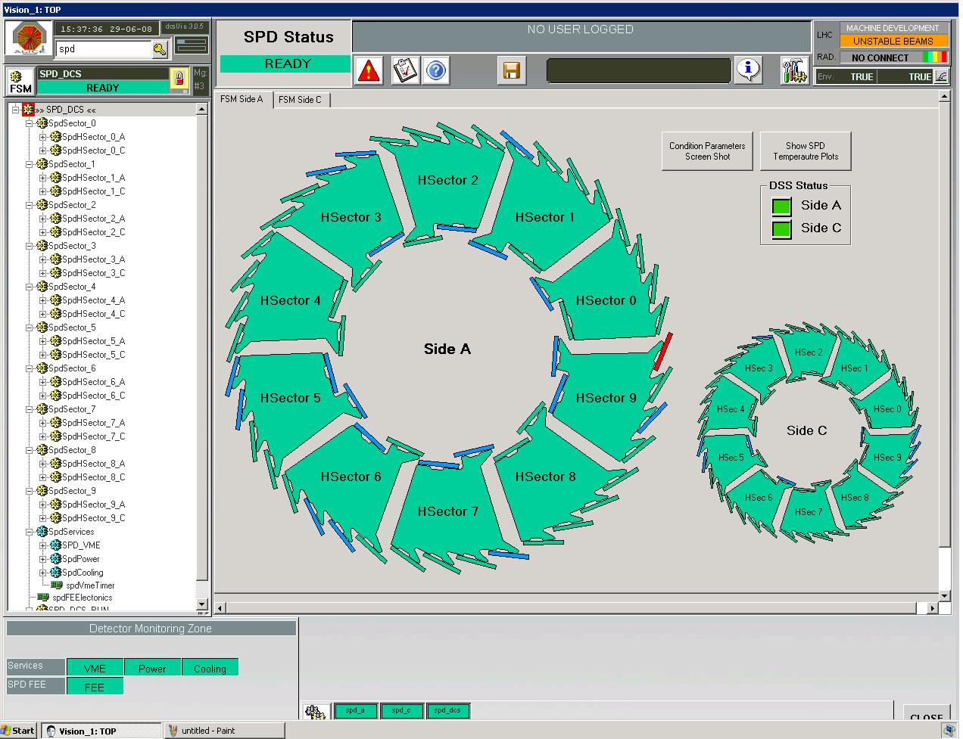
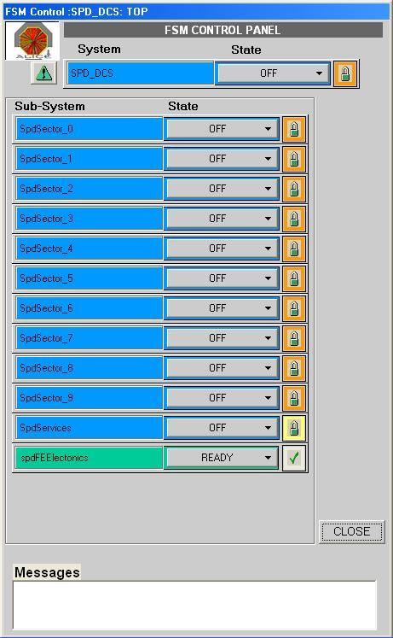
UI LAYER
OPERATIONS LAYER
PVSS
PVSS
CENTRAL SYSTEMS
DETECTOR SYSTEM
PVSS
PVSS
PVSS
PVSS
PVSS
PVSS
CH
CH
CH
CH
CH
CH
CH
CH
CH
PVSS
CH
CH
CH
CH
DETECTOR SYSTEM
CH
CH
CH
CH
CH
CH
OPC SERVER
CH
CH
CH
CH
CH
CH
CH
CH
CH
CH
Device DRIVER
PVSS
CH
DEVICE ACCESS and ABSTRACTION
OPC SERVER
PVSS
HVPS
Device DRIVER
PVSS
LVPS
FED SERVER
PVSS
Device DRIVER
FEE
FED SERVER
Device DRIVER
…

Slide 28
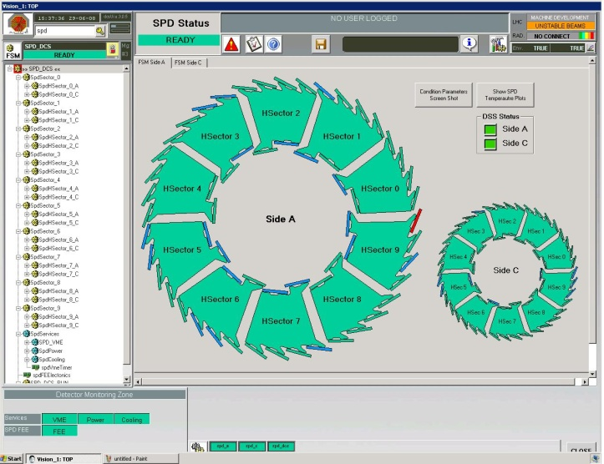
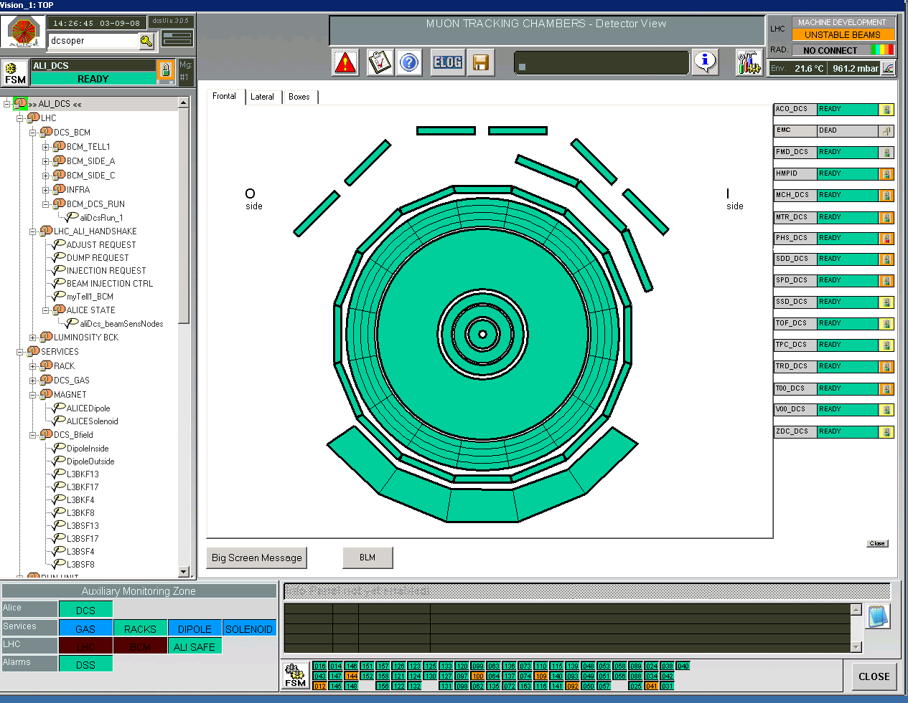
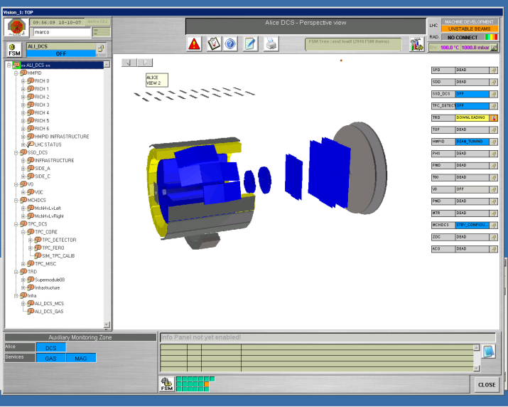
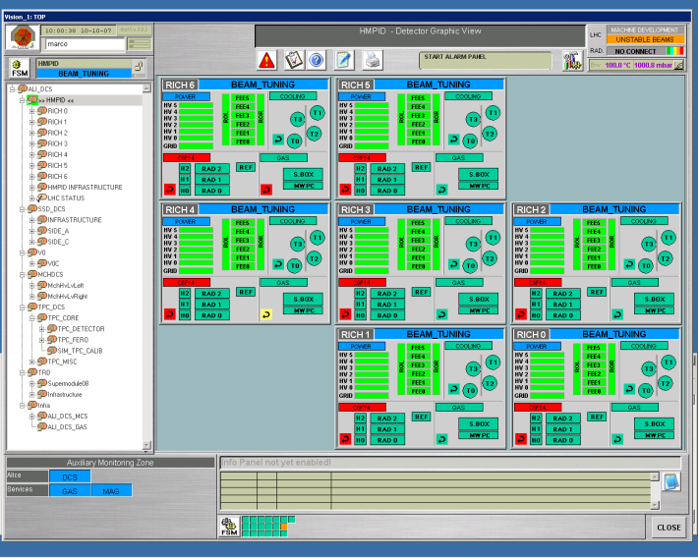
Detector Panel
FSM operation
Detector systems are developed by detector teams outside CERN
More than 100 integration session were organized with individual detectors
Verification of:
  Conformity to rules (naming conventions, interfaces, …)
  Stability
  Performance
  Safety (interlocks, alerts…)
  Dataflow (configuration, archival)
  Security (access control)
  Common operation with ALICE
Common sessions with all ALICE detectors
Central panel
DCS tree
DCS UI
  ALICE component used by all detectors
  Standardized operation representation
  Detector specific panels
    Central operator can browse and operate detector panels

Slide 29
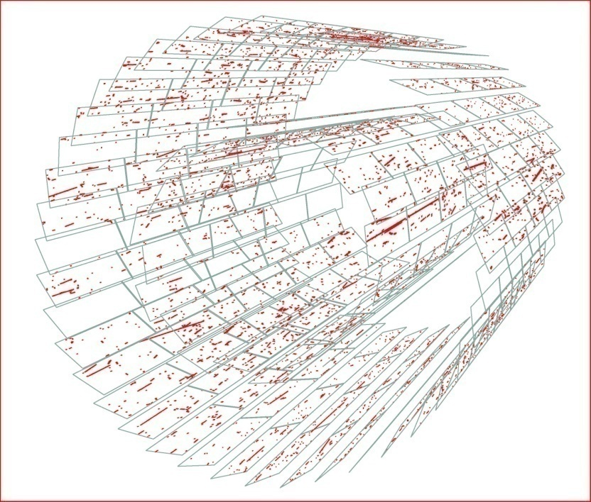
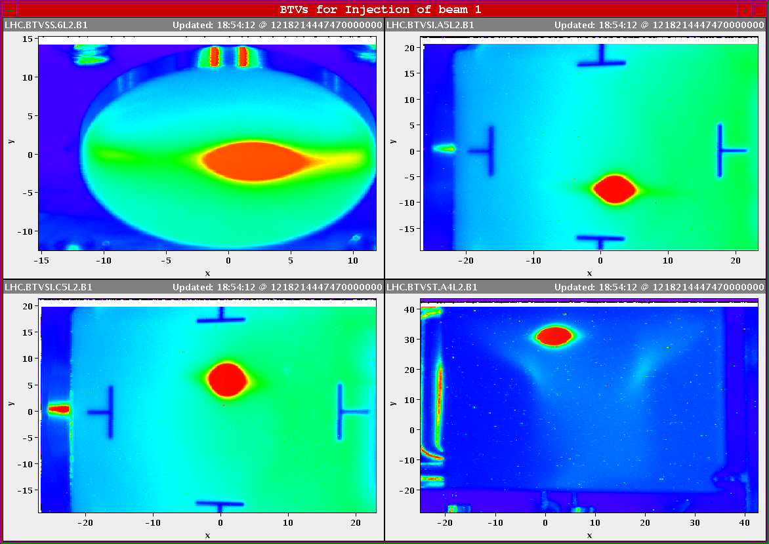

First tracks seen at LHC and
recorded by ALICE SPD during injection line tests
June 15, 2008
First beams injected to LHC and steered 3km around LHC, passing ALICE
8.8.2008 around 8pm (Beijing time)
… which triggered worldwide celebrations
(Beijing, 8.8.2008 around 8pm)

Slide 30
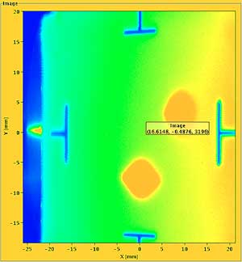
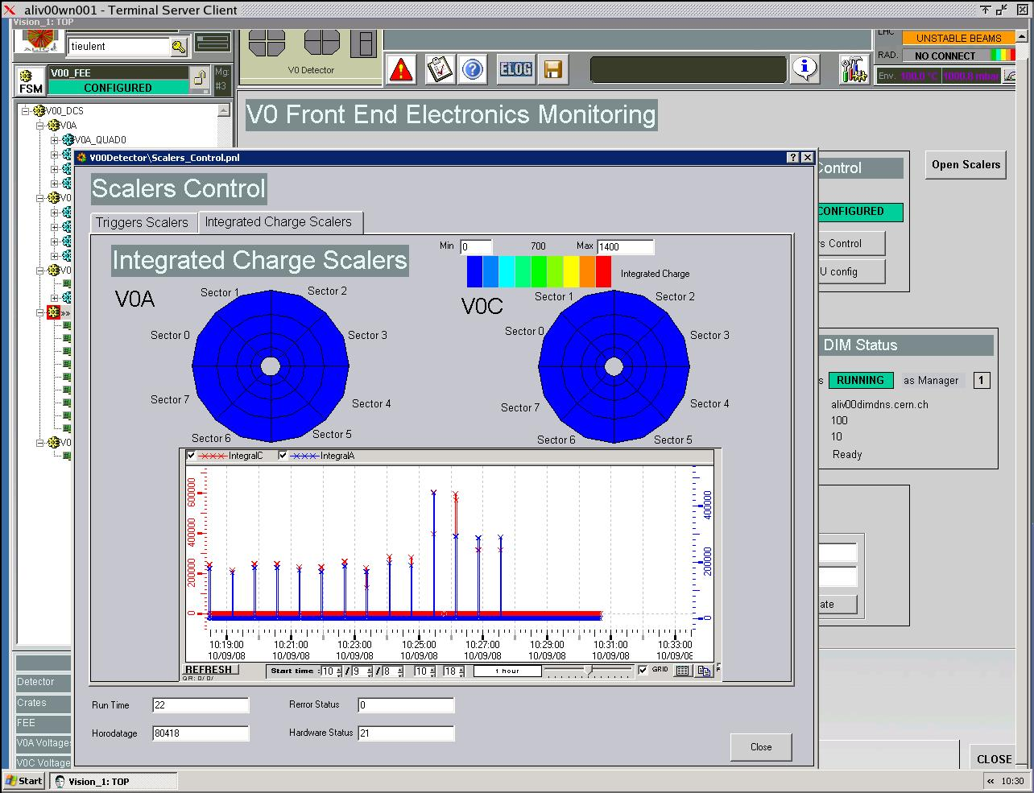
First beams circulating LHC
10, September 2008
Luminosity monitor (V0)
… and seen by ALICE DCS
… which was READY

Slide 31
Conclusions
ALICE DCS is built on commercial software (PVSS, OPC) with CERN extensions (Framework, SMI++, DIM, FED servers…)
Large distributed PVSS system operates according to specifications
ALICE DCS was READY for LHC beams in 2008
Looking forward for physics in 2009

