Slide 1
The ATLAS Trigger System
RT2009 Conference
Beijing (China)
14-May-2009
Cristobal Padilla (IFAE-Barcelona/CERN) on behalf of the ATLAS Collaboration
Outline:
Global Requirements for the ATLAS trigger system
Trigger/DAQ Architecture
LVL1 system
HLT System
Some results from LHC running
Summary

Slide 2
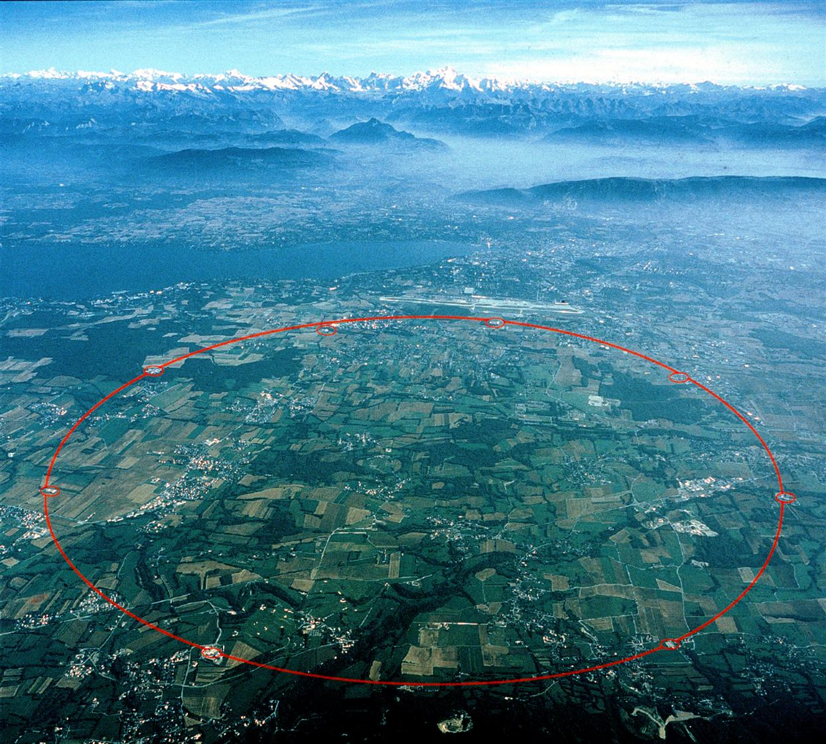
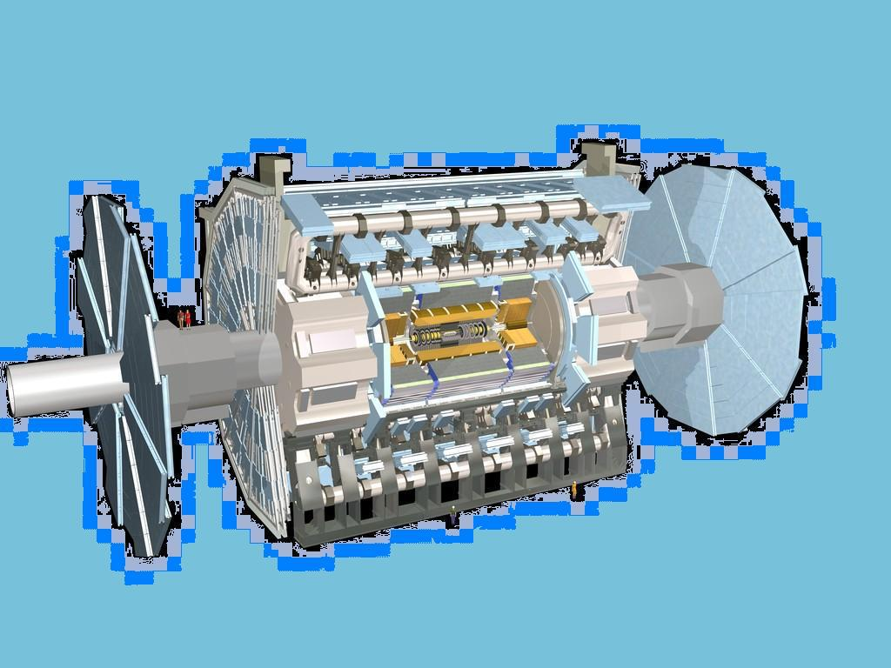
Notes:
The experiment is installed at what is called point 1, which is one of the 8 access points to the LHC tunnel. The tunnlls is a circle of 27 km in the swiss/french border near Geneva (see the airport and the lake)

Slide 3
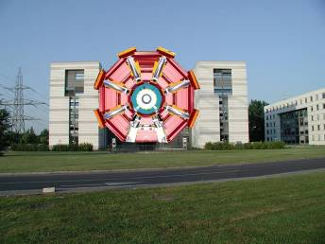
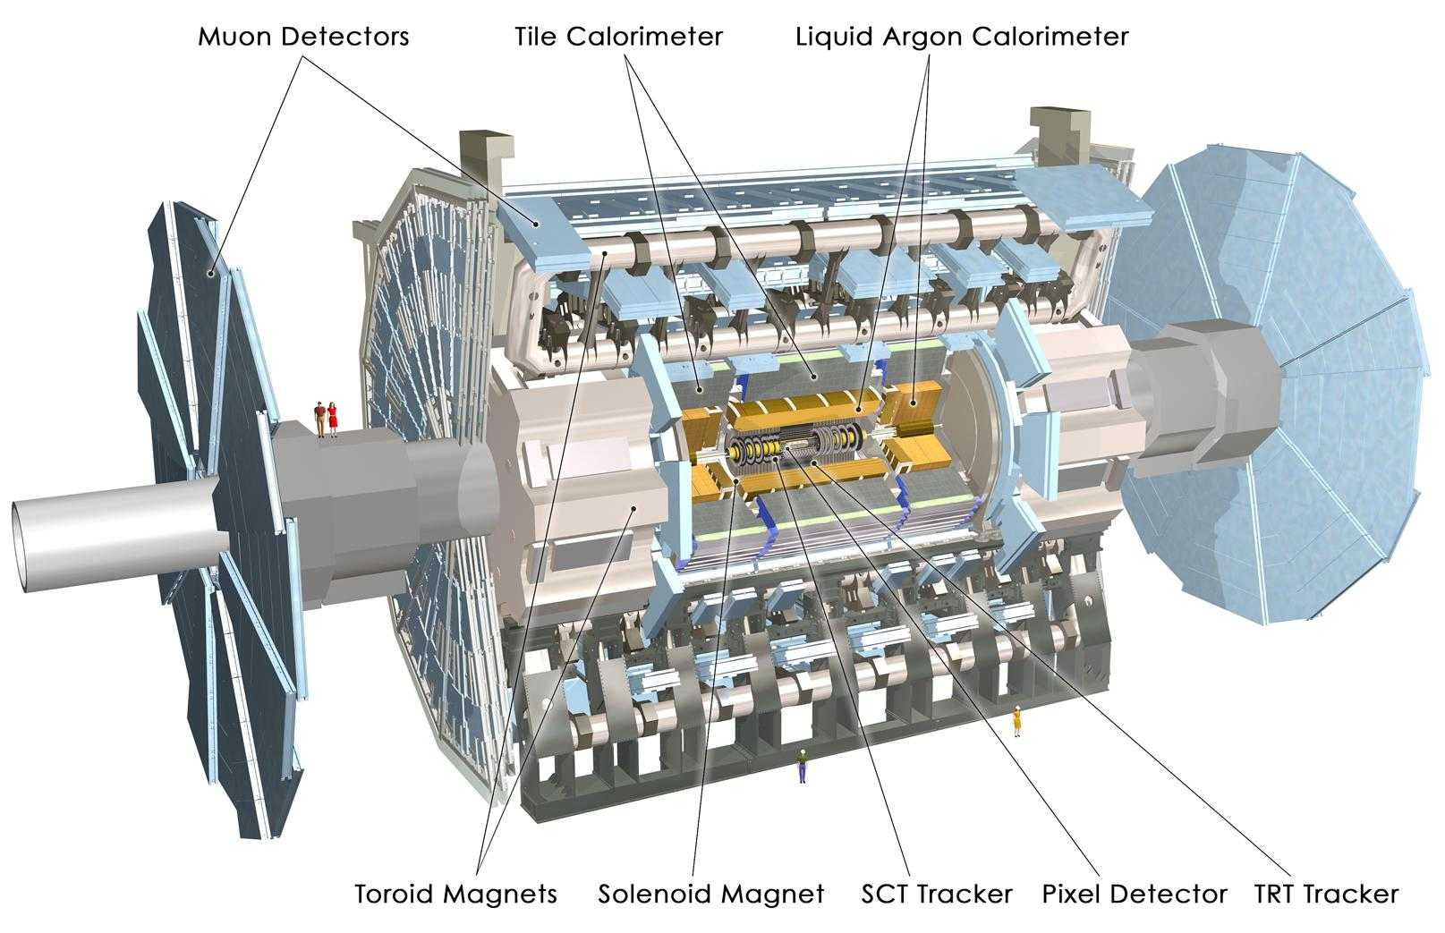
ATLAS Detector
45 m
ATLAS superimposed to
the 5 floors of building 40
24 m
7000 T
Notes:
The detector is a more or less typical cylindrical collider detector of 45 long and 24 m height (the size of a 5 floor building. It weight 7000T. One of he things that differetiante to a lot of other detectors is the fact that it has two magnetic fields, one solenoidal one and one toroidal external

Slide 4
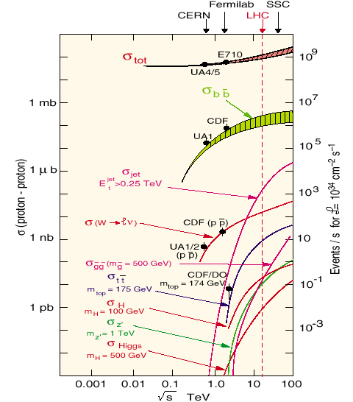
Global Requirements of Trigger Systems at ATLAS
At full luminosity, the LHC will produce:
Signal
100 GeV Higgs: 0.1 Hz
600 GeV Higgs: 0.01 Hz
SUSY: < Hz
Interesting b events: tenths of Hz
Background
Inelastic: 10⁹
Jets with E_{T} > 100 GeV: kHz
μ from π,K,D,B
b events: 250 kHz
Environment at the LHC:
Number of overlapping events/25 ns: 23
Number of particles in ATLAS/25ns: 1400
Need rejection powers of order up to 10¹³

Slide 5
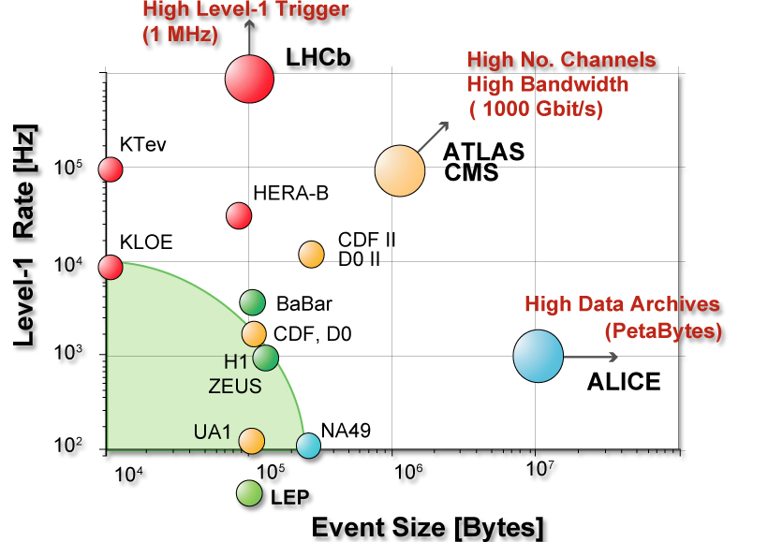
Global Requirements of Trigger Systems at ATLAS
ATLAS has O(10⁸) channels. Event size is ~1.6 MB
At ~30MHz LHC collision rate, that would imply ~50 TB/s data throughput
Estimated cost of storage would be ~100000 MCHF
Need to reduce throughput to an affordable level of ~200 Hz
Assume reconstruction takes 1 s/event
Would need to have ~10⁷ CPU cores to do a processing cycle in a year
Need to reduce the CPU needs by three orders of magnitude
Need a custom electronics-based trigger to reduce the rate input to the computer farms (which constitute the higher levels of the trigger)
Then a CPU farm to reduce the event rate to the affordable storage rate
The trigger system at ATLAS is required to work in higher regimes of bandwidth and trigger rates than previous similar experiments

Slide 6
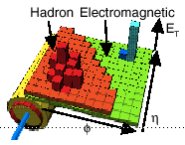
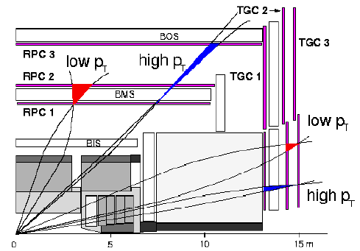
Trigger/DAQ Architecture
Trigger
DAQ
Calo MuTrCh
Other detectors
40 MHz
40 MHz
LV
L1
D
E
T
R/O
FE Pipelines
2.5 ms
RoI
Lvl1 acc = 75 kHz
75 kHz
ROD
ROD
ROD
Read-Out Drivers
RoI data = 1-2%
120 GB/s
Read-Out Links
120 GB/s
H
L
T
D
A
T
A
F
L
O
W
RoI
requests
ROS
~ 10 ms
RoI Builder
L2 Supervisor
LVL2
ROB
ROB
ROB
Read-Out Buffers
ROIB
L2SV
Read-Out Sub-systems
L2 N/work
L2 Proc Unit
L2N
L2P
~3 GB/s
~3 kHz
Lvl2 acc = ~2 kHz
EB
Dataflow Manager
DFM
EBN
Event Building N/work
~ sec
Event Filter
~4 GB/s
SFI
Sub-Farm Input
Event Filter
Processors
EFP
Event Builder
EFP
EFN
Event Filter N/work
EFP
EFP
EFacc = ~0.2 kHz
SFO
Sub-Farm Output
~ 200 Hz
~ 300 MB/s

Slide 7
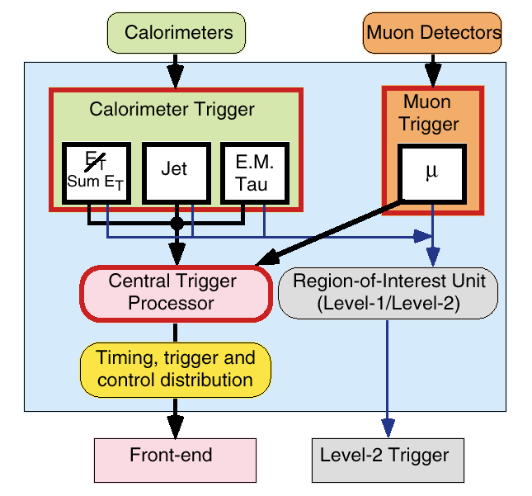
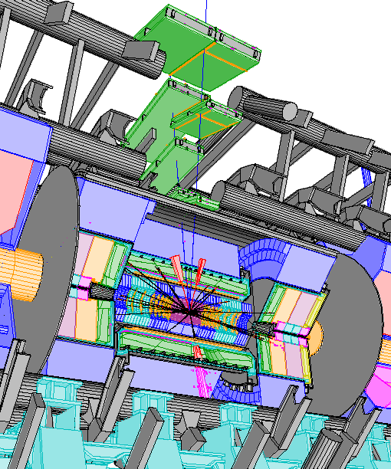
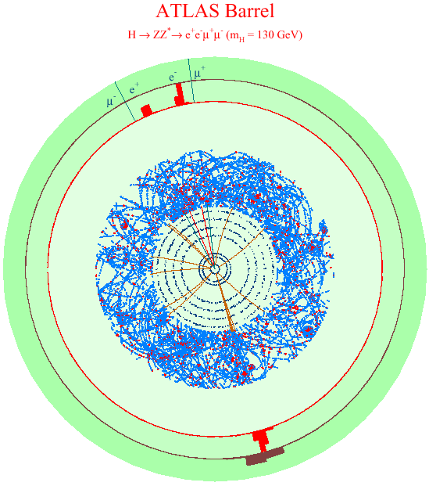
Region of Interest: Why?
Region of Interest: Implementation
Note that this example is atypical, the average number of RoIs/ev is just over ~1.6
The Level-1 selection is dominated by local signatures
Based on coarse granularity, no access to inner tracking
Important further rejection can be gained with local matching of full detector data
There is a simple correspondence region ↔ ROB number(s) (for each detector).
For each RoI the list of ROBs with the corresponding data from each detector is quickly identified (LVL2 processors).
The geographical addresses of interesting signatures identified by LVL1 (Regions of Interest)
Allow access to local data of each relevant detector
Sequentially
Normally, there is ONE RoI per event accepted by LVL1
<RoIs/ev> = ~1.6
The resulting total amount of RoI data is minimal
a few % of the Level-1 throughput
4 RoI
η−φ addresses
==> the ATLAS RoI-based Level-2 trigger
… ~ one order of magnitude
smaller ReadOut network …
… at the cost of a higher
control traffic …

Slide 8
First Level Trigger: LVL1
3 sub-systems
L1- Calorimeters
L1- Muons
Central Trigger Processor (CTP)
It does signature Identification
e/γ, τ/h, jets, μ
Multiplicities per p_{T} threshold
Isolation criteria
Missing E_{T}, total E_{T}, jet E_{T}
CTP
Receive and synchronize trigger information
Sends the L1 decision to the L2 and the detectors
LAr
Tile
RPC
TGC
Muon
Barrel
Trigger
Muon
Endcap
Trigger
Preprocessor
Cluster
Processor
e/γ , τ/h
Jet/Energy
Processor
jets , E_{T}
Muon-CTP
Interface
Central Trigger
Processor
RoIB
Detector readout
L2 supervisor

Slide 9
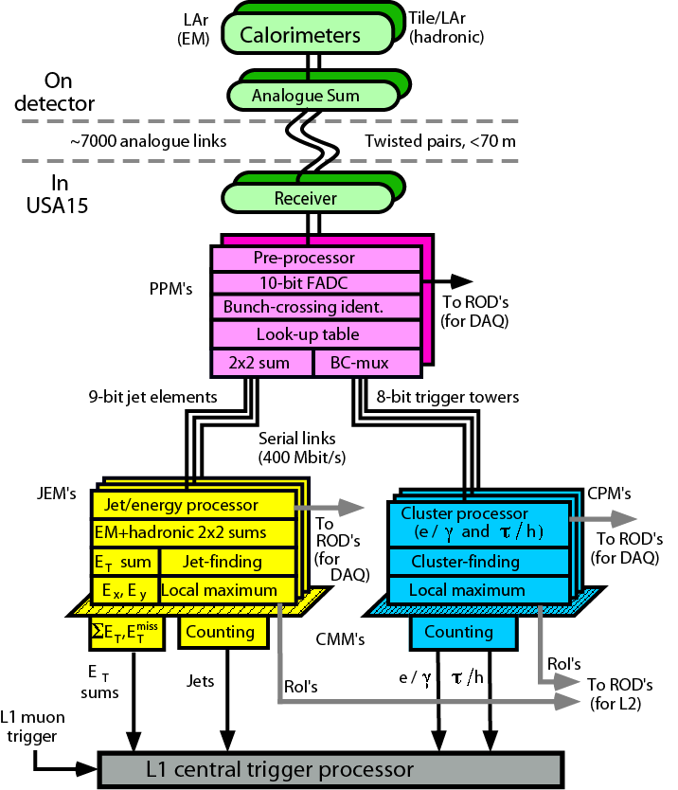
LVL1 Calorimeter architecture
Pre-processor (PPrs)
Receive and sample signals from carlorimeters
Uses coarse granularity (Trigger Towers)
Performs noise Filter
Does the bunch Crossing Identification (BCID) of the signals
Determine final E_{T} Value
Jet Energy and Cluster Processors
Physics algorithms that search for and identify
Isolated leptons, taus
Jets
Compute E_{T}, total Energy, missing E_{T} of the clusters
The LVL1 calorimeter system transmit signals to CTP, DAQ and RoI Builder

Slide 10
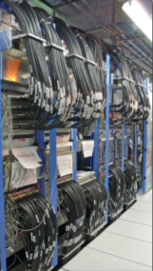
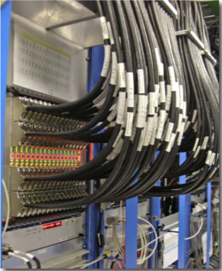
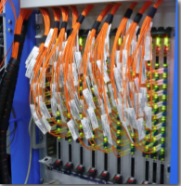
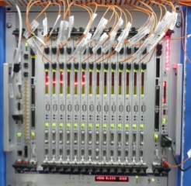
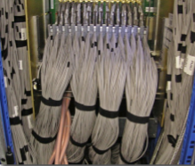
Installation and Commissioning of LVL1 Calorimeter
1 of 8 pre-processor crates
System is fully installed since end of 2007
Commissioning
Hardware/software has been tested
Calibration procedures with calorimeters exercised
Participation in data-taking
Analogue input cables
1 of 3 Read Out Driver crates with the fibres installed
1 of 4 cluster processor crates

Slide 11
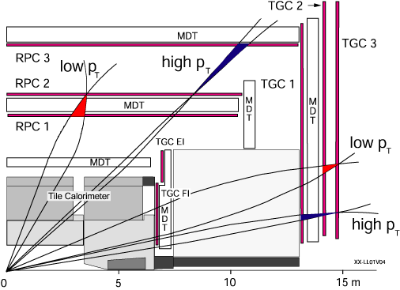
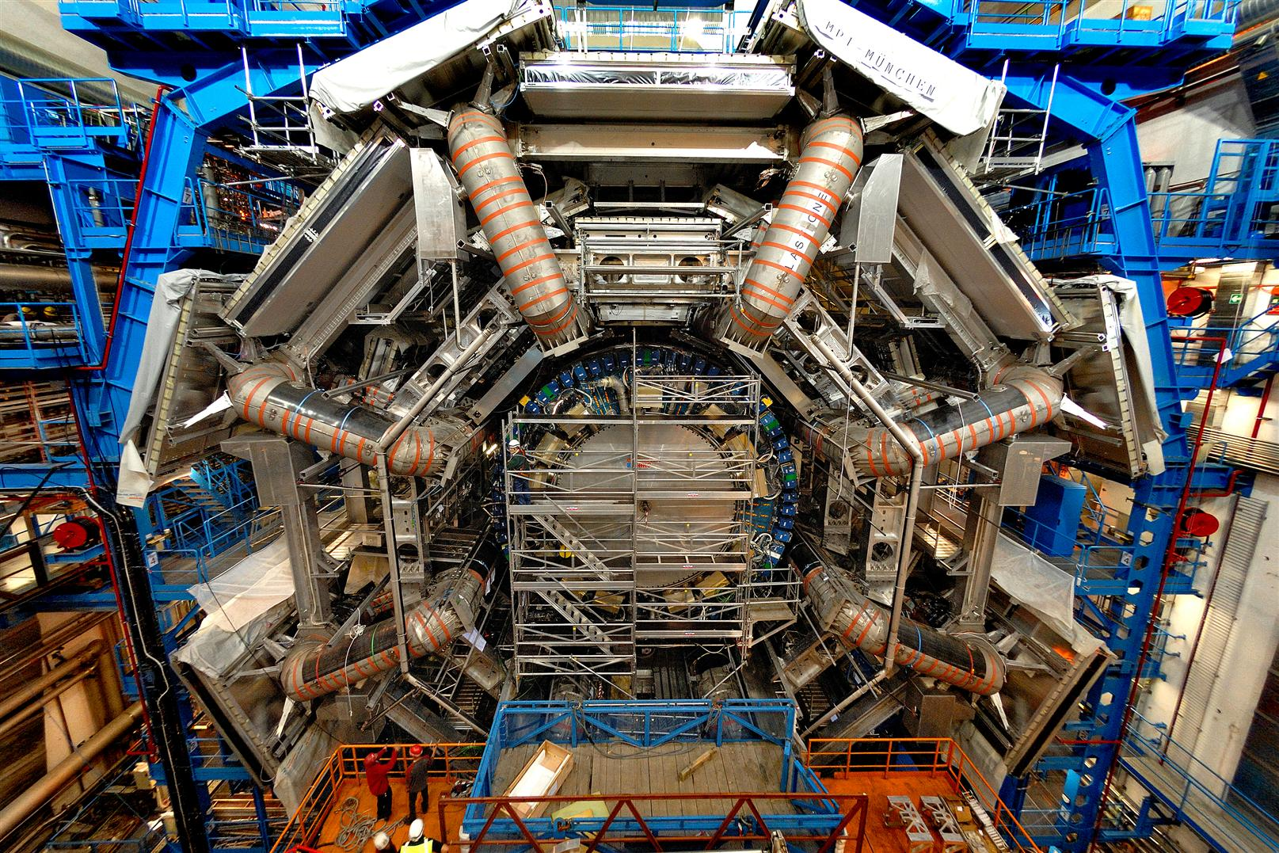
LVL1 Muon
The LVL1 muon system uses dedicated chambers providing very fast signals
Resistive Plate Chambers (RPC) in the barrel region
Thin Gap Chambers (TGC) in the end-cap region
Momentum of muons is defined by the deviation of a track assumed to have infinite momentum looking at hit coincidences inside so-called coincidence windows
It is a fast and high redundancy system with a wide p_{T} threshold range separated in systems for low and high p_{T} thresholds
The main issues are
Safe Identification (within 25 ns), which requires good time resolution
Precise time alignment of the signals that provide the muon coincidences
The system has been installed and, thanks to its highly programmable logic, been widely used during the cosmic ray runs

Slide 12
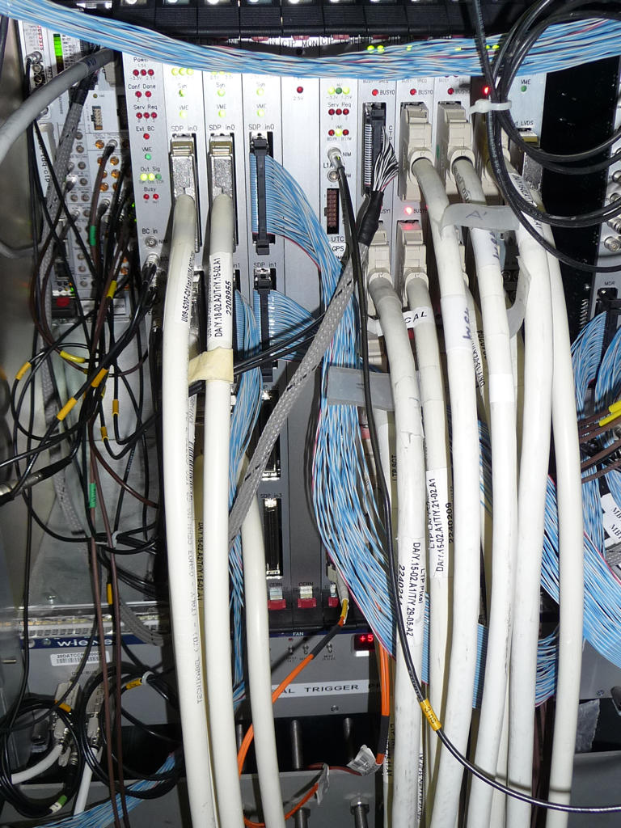
Central Trigger Processor (CTP)
Receives trigger information from calorimeters and muon detectors (CTPIN)
Synchronizes and aligns inputs
Forms Level 1 trigger decision from inputs, trigger menu, and prescale/passthrough set (CTPCore)
Generates deadtime, handles busy signals and calibration requests from sub-detectors
Passes trigger decision and region of interest to Level 2 (CTPOUT)
Reports to the Trigger and Timing Control (TTC) system
Receives timing signals from the LHC (CTPMI)
Monitors trigger information bunch-by-bunch (CTPMON)

Slide 13
Data Flow for the High Level Trigger (HLT)
LVL1 Result
LVL2 Decision
LVL2Supervisor
Event Building
Event
Fragments
Data
Request
Full
Event
LVL1
Result
ROS
SFI/SFO
LVL2
Decision
Event
Fragments
Selected
Full Event
Data
Request
Full Event
+ EF Result
Full
Event
LVL2 Result
L2PU
EFD
Database
LVL2
Selection
EF
Selection

Slide 14
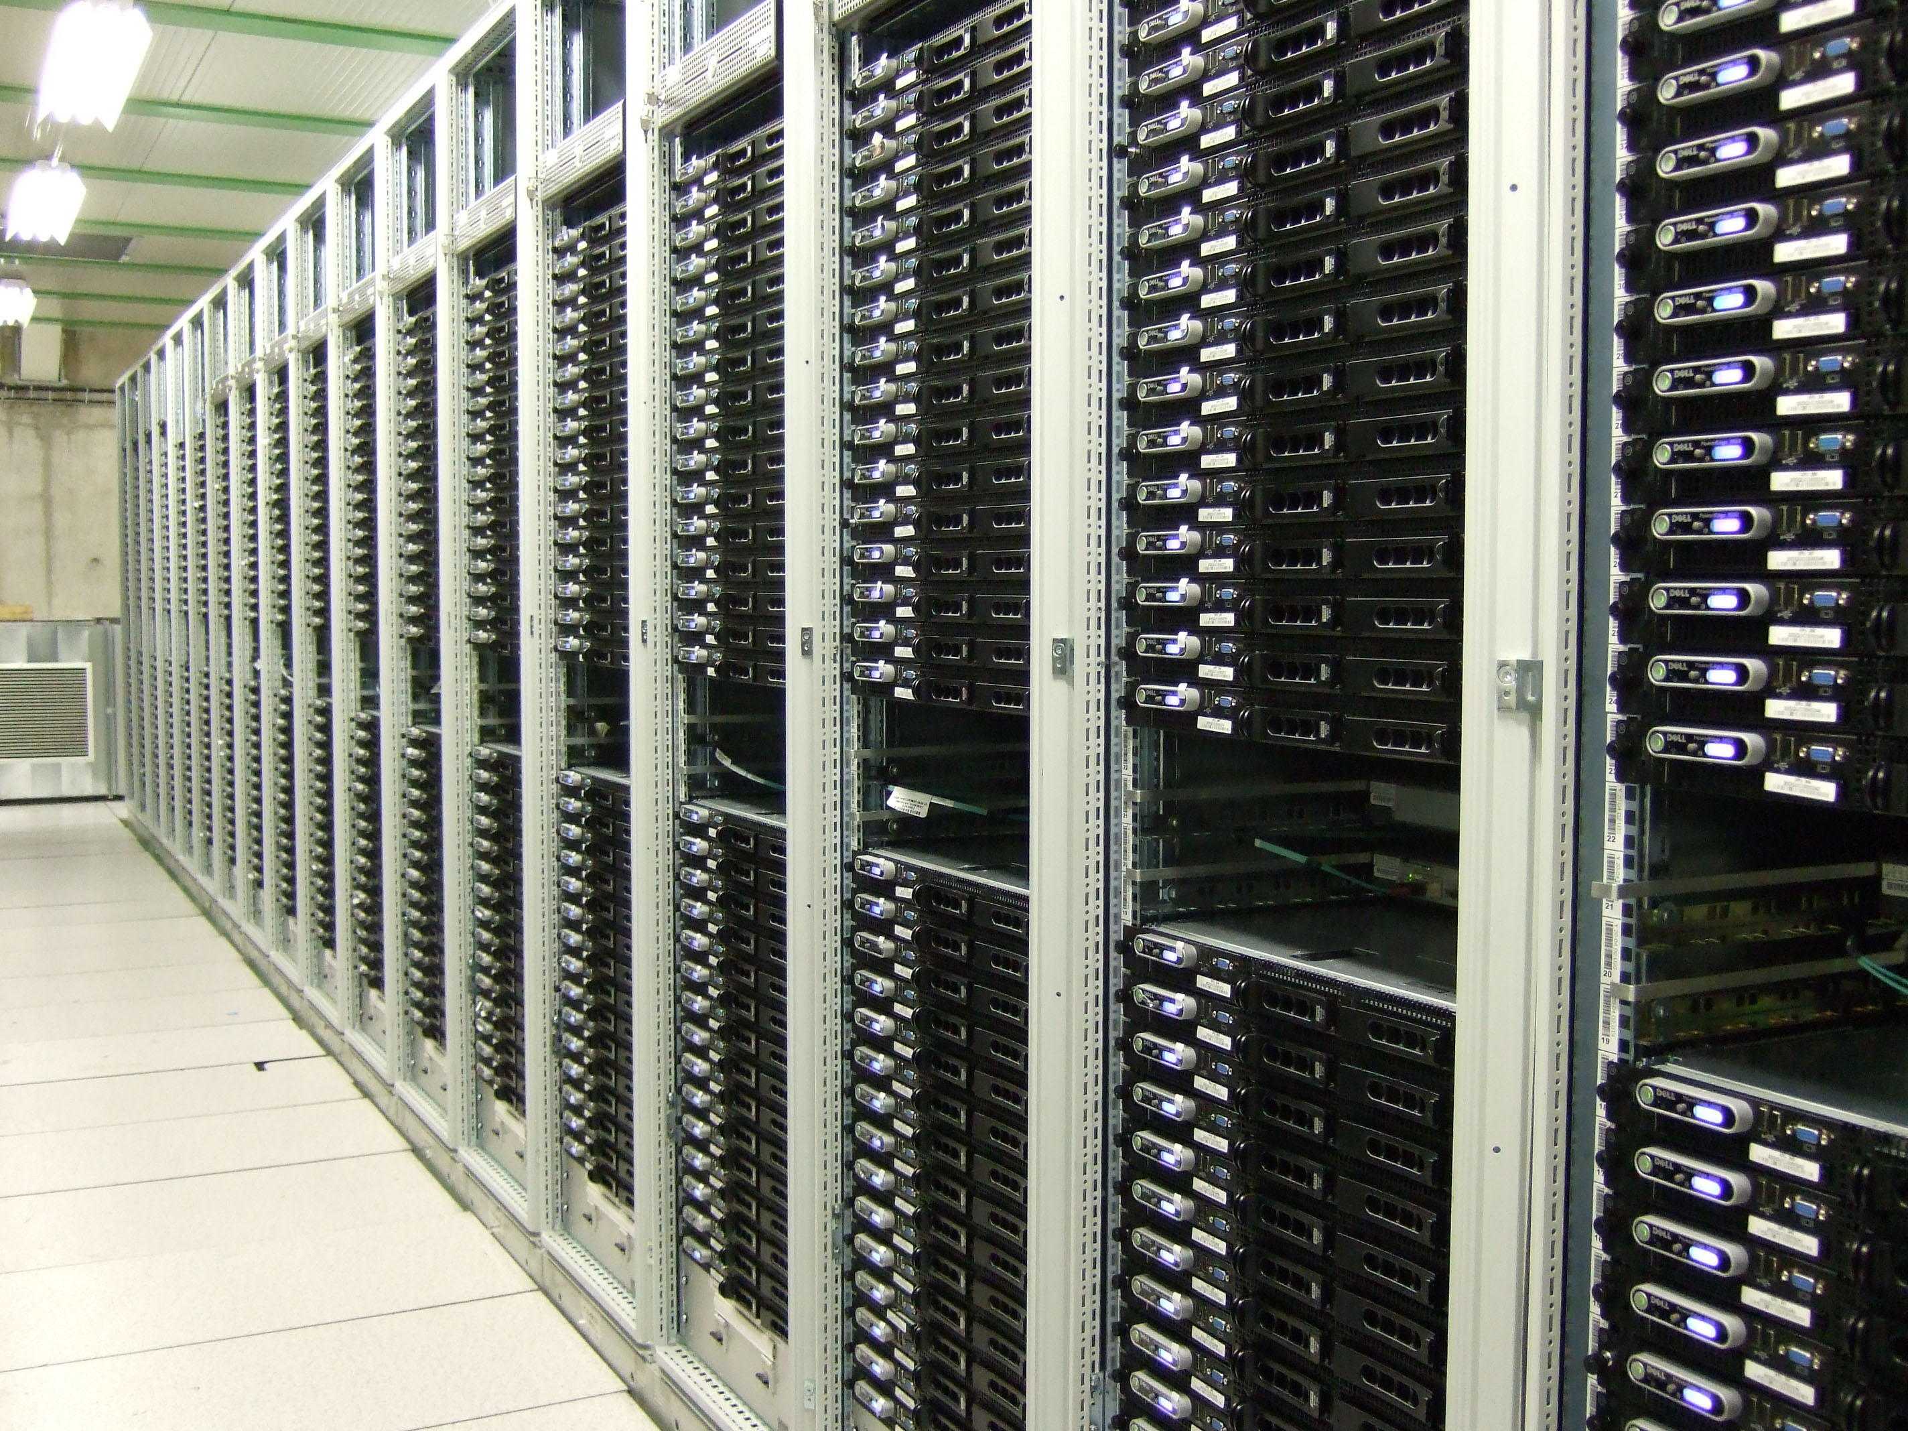
HLT Farms
Final size for max L1 rate
~ 500 PCs for L2 + ~ 1800 PCs for EF (multi-core technology)
850 PCs installed total of 27 XPU racks = 35% of final system (1 rack = 31 PCs) (XPU = can be connected to L2 or EF)
x 8 cores
CPU: 2 x Intel Harpertown quad-core 2.5 GHz
RAM: 2 GB / core, i.e. 16 GB
Final system : total of 17 L2 + 62 EF racks of which 28 (of 79) racks as XPU
Notes:
13

Slide 15
How the HLT Works
Sequential call of
algorithms
Found by LVL1 two isolated
em clusters with each pt>20GeV are found by LVL1
possible signature for Z-> e+e-
Goal: Validate step-by-step,
check intermediate signatures,
reject at earliest possible moment
Signature 
e30i
+
e30i
Iso
lation
Iso
lation
STEP 4
Signature 
e30
+
e30
STEP 3
pt>
30GeV
pt>
30GeV
Signature 
e
+
e
t i m e
track
finding
track
finding
STEP 2
Alg
Signature 
ecand
+
ecand
Alg
Alg
Alg
Alg
Alg
Cluster
shape
Cluster
shape
Alg
STEP 1
Alg
Alg
Alg
Alg
Level1 seed 
EM20i
+
EM20i

Slide 16
Algorithm Data Access
Region
Selector
Transient
EventStore
Data Access
Algorithm
Trans.
Event
Store
Byte
Stream
Converter
Data source
organized
by ROB
HLT
Algorithm
Region
Selector
region
list DetElem IDs
list DetElem IDs
list DetElem IDs
ROB ID
raw event
data
DetElems
DetElems
Realistic Data Access (in ByteStream* format) is vital to realistic modeling of Trigger Performance

Slide 17
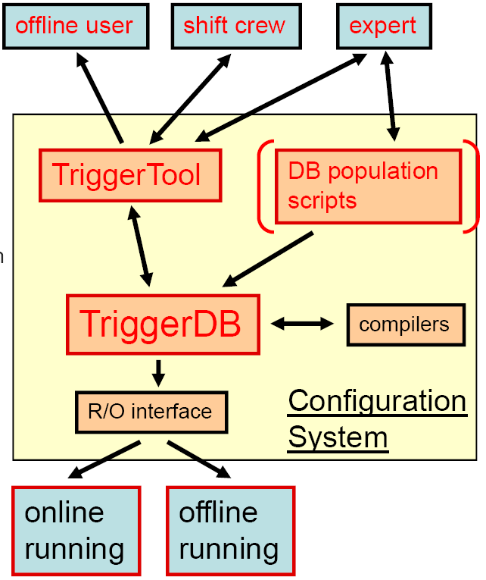
Trigger Database
Contains the trigger configuration:
active trigger Chains, algorithm parameters, prescale factors, passthrough fractions.
It has a relational database (TriggerDB) with no duplication of objects
four Database keys: LVL1 & HLT menu, L1 prescales, HLT prescales, bunch number;
There is a user interface (TriggerTool);
Read and write menu into XML format
Perform menu consistency checks
Experience of 2-month cosmic commissioning:
over 3k chains, 6k components (algorithms, tools, services), 5k parameters. [Counting all versions of all objects]
After run, Trigger Configuration becomes conditions data
During run, can change complete menu at any run stop/start, prescales/passthroughs at any lumi block boundary
Database proxy mechanism in place to avoid direct connection from every application

Slide 18
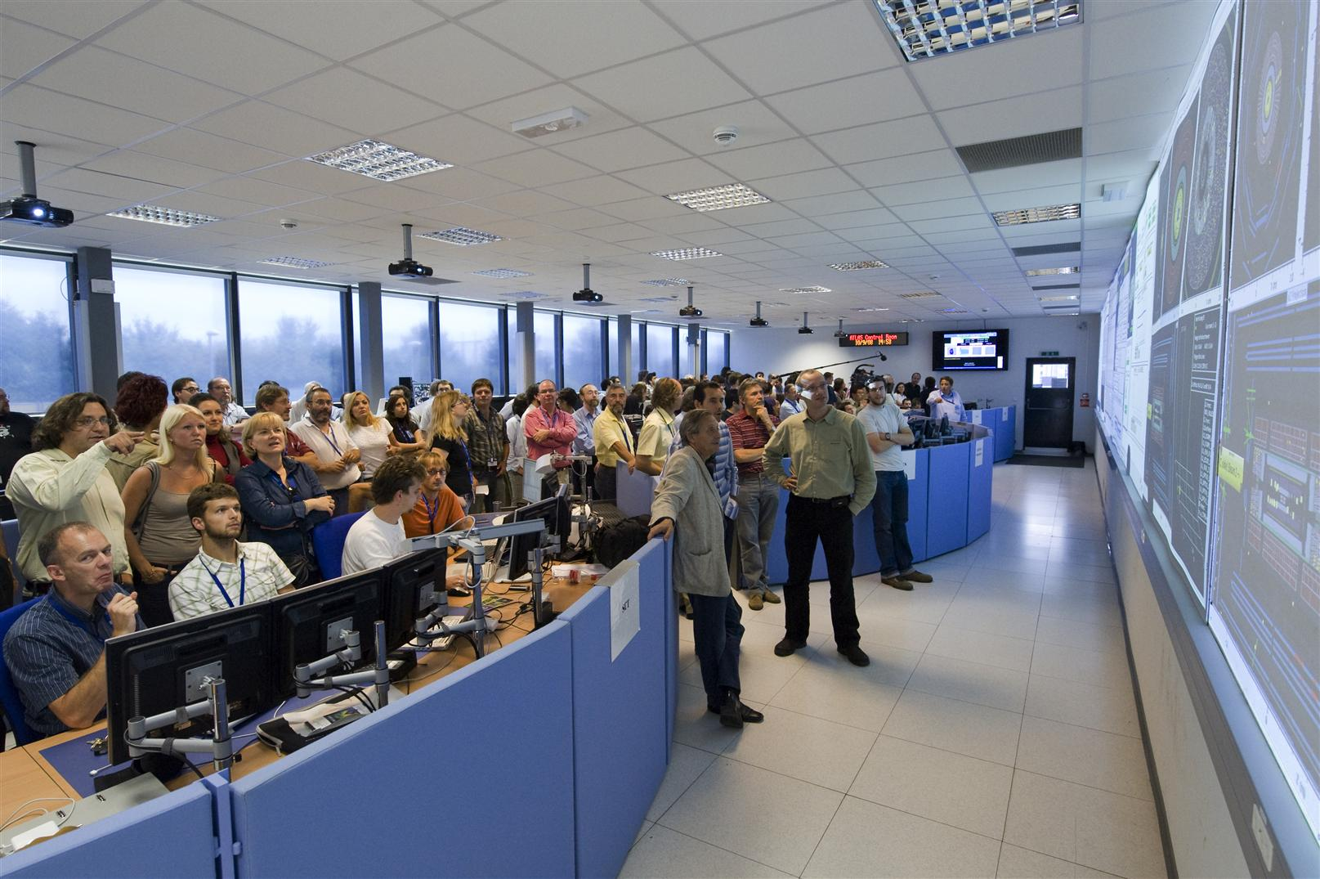
Excitement in the ATLAS Detector Control Room:
The first LHC event on 10th September 2008
Notes:
Needless to say 10th of September was a very special day. The Run coordinator, In spite of his efforts, did not manage to keep people out from the CR (he requested to behave only 2 people per desk)

Slide 19
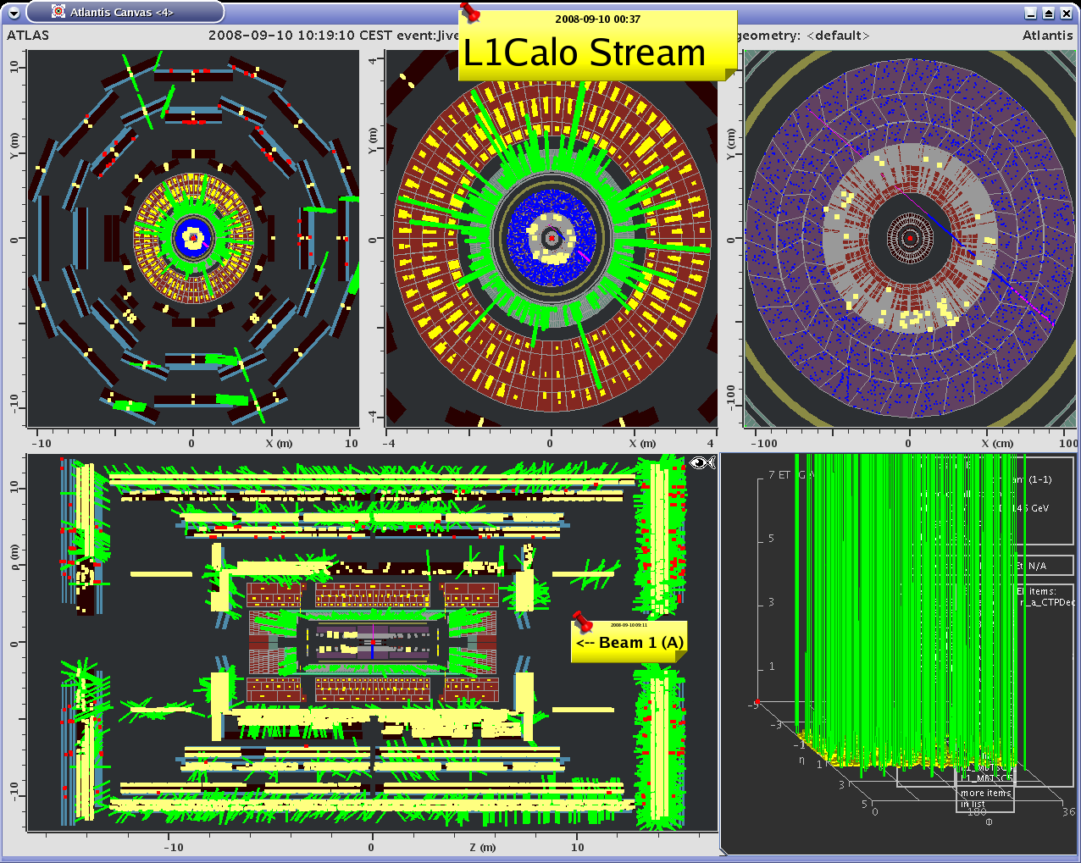
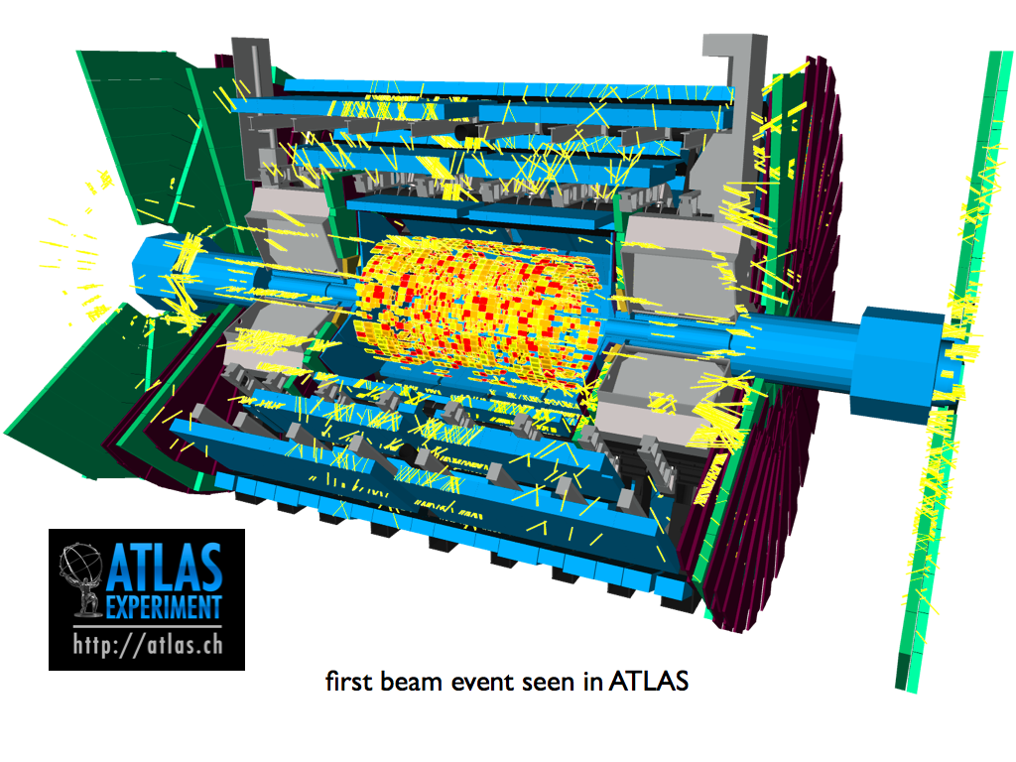
First Event in ATLAS
The very first beam-splash
event from the LHC in ATLAS
on 10:19, 10th September 2008
Online display
Offline display

Slide 20
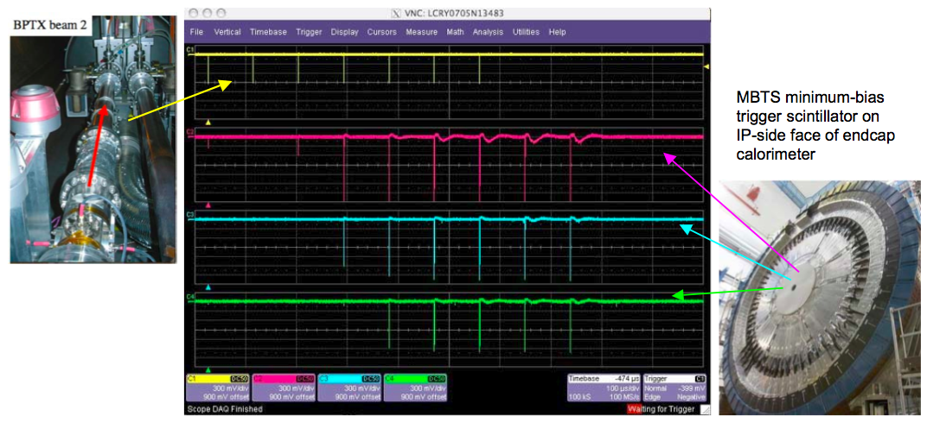
First Circulating Beams in ATLAS
ATLAS trigger during the circulating beams used the “Minimum Bias Trigger Scintillator” (MBTS) and the Beam Pick-up (BPTX)
Beam becoming unstable: MBTS, initially quiet, becomes more active after several runs. At the end the beam pick-up does not see the beam anymore while the MBTS still fires

Slide 21
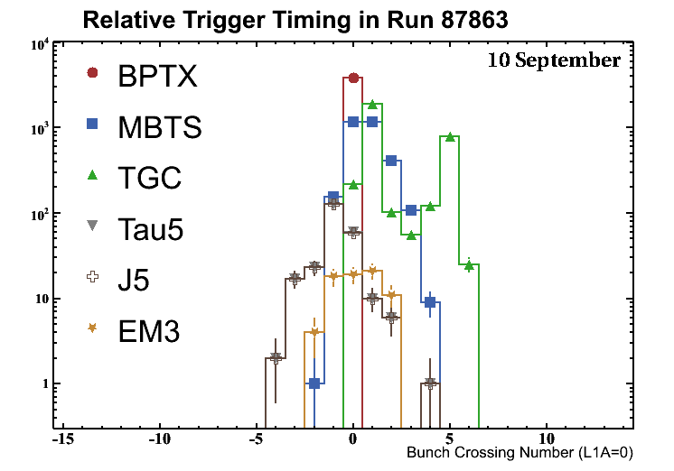
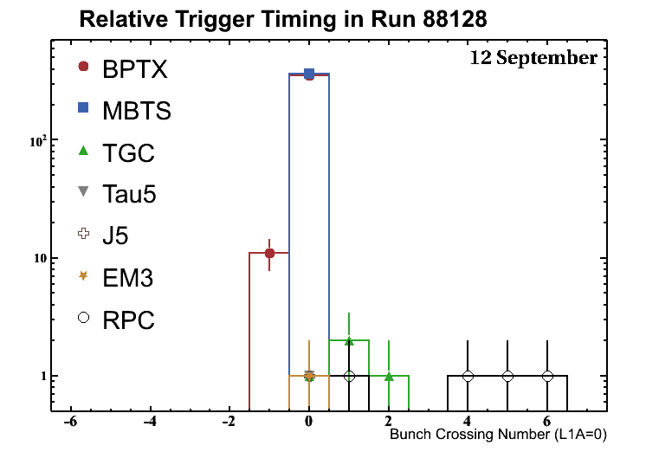
Timing-in the Trigger with Single Beams
Experiment timing based on beam-pickup (“BPTX”) reference
First task of LVL1 central trigger team on 10th September was to commission the beam pickups
Times of arrival of other triggers were adjusted to match
Plots show evolution from September 10th to September 12th
Each LVL1 sub-system also needs to be timed internally
L1-Calo, L1-RPC, L1-TGC, MBTS, etc.
Note change of scale!
Notes:
On 10 of september seen the two peaks of the TGC (time of flight) 12 of september is triggered with MBTS (which was times with MBTX) and can see the other triggers

Slide 22
Summary
The challenging LHC data-taking environment determines the design of the ATLAS Trigger architecture
Data reduction factors of more than five orders of magnitude are needed
Very fast and reliable algorithms are needed
The ATLAS Trigger system has chosen the following design parameters to efficiently select the events that contain interesting physics
A first level trigger based on custom electronics and fixed latency
Two software-based higher level triggers
Region of interest mechanism
Smaller readout network
Increases complexity in the data control traffic software
Wide use of offline-based software for event selection
The complete system is ready for the LHC operation in Fall 2009
Hardware equipment is installed
Commissioning with cosmic rays has been widely exploited (see other talks)
The system was successfully exercised in the single beam runs in 2008

Slide 23
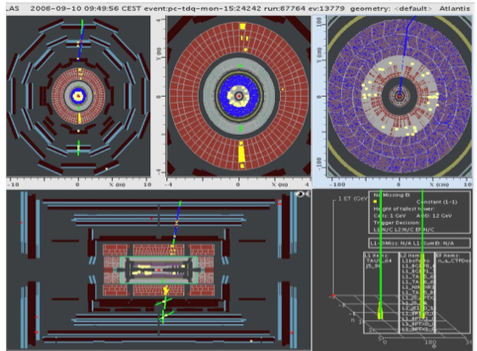
Cosmic Event Triggered by Jet and Tau Triggers

Slide 24
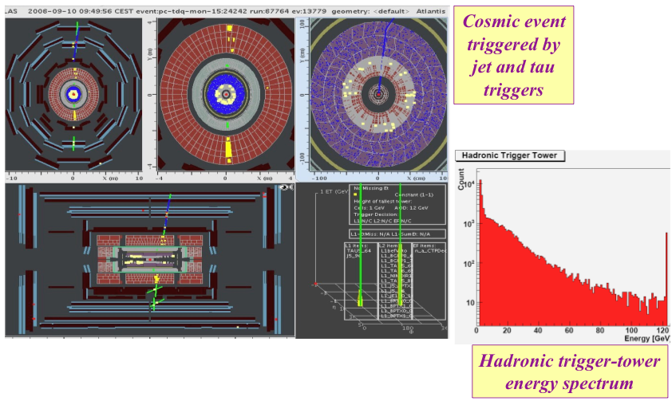
Cosmic Data

Slide 25
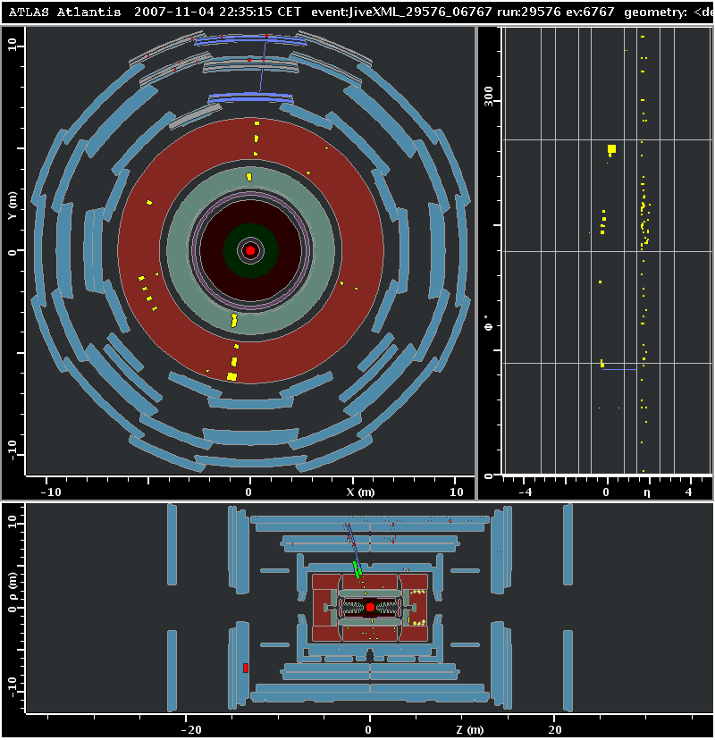
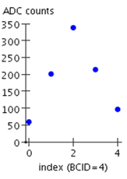
Event Display of a Cosmic Muon
Run 29576
EM calorimeter
Tile calorimeter
L1Calo - Had

Slide 26
Trigger/DAQ Architecture
Trigger
DAQ
Calo MuTrCh
Other detectors
40 MHz
40 MHz
LV
L1
D
E
T
R/O
FE Pipelines
2.5 ms
RoI
Lvl1 acc = 75 kHz
75 kHz
ROD
ROD
ROD
Read-Out Drivers
RoI data = 1-2%
120 GB/s
Read-Out Links
120 GB/s
H
L
T
D
A
T
A
F
L
O
W
RoI
requests
ROS
~ 10 ms
RoI Builder
L2 Supervisor
LVL2
ROB
ROB
ROB
Read-Out Buffers
ROIB
L2SV
Read-Out Sub-systems
L2 N/work
L2 Proc Unit
L2N
L2P
~3 GB/s
~3 kHz
Lvl2 acc = ~2 kHz
EB
Dataflow Manager
DFM
EBN
Event Building N/work
~ sec
Event Filter
~4 GB/s
SFI
Sub-Farm Input
Event Filter
Processors
EFP
Event Builder
EFP
EFN
Event Filter N/work
EFP
EFP
EFacc = ~0.2 kHz
SFO
Sub-Farm Output
~ 200 Hz
~ 300 MB/s

Slide 27
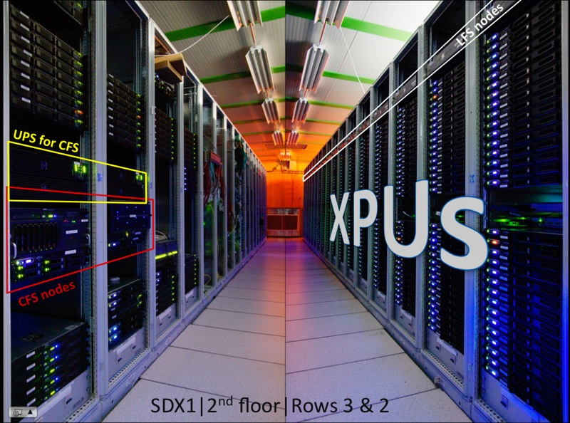
HLT Hardware Installation
Currently 824 nodes on 27 racks
8 cores/node in 2xHarpertown qued-core @2.5 GHz
2 GB memory/core
Can run L2 or EF

Slide 28
HLT Structure
EM ROI
EM ROI
The basic ingredient of the HLT is the HLT Steering which controls the flow of code execution inside the HLT processing units
Algorithms for feature extraction (FEX) and applying requirements (HYPO)
Configurable by parameters
Results (Features) cached by HLT steering
Sequences: FEX and HYPO algorithms producing TriggerElements (ex: L2_mu10)
Chains: Ordered list of defined numbers of TriggerElements
Steering aborts chains as soon as given step fails (early reject)
Menu: Collection of chains (and pass-through+prescales)
In python or xml, recorded in database
L2 Calorim.
L2 Calorim.
TrigEMCluster
Cluster?
Cluster?
L2 tracking.
TrigInDetTrakcs
Track?
Match?
EF Calorim,
EF Calorim,
CaloCluster
EF tracking
EFTrack
Track?
e/γ reconst.
e/γ reconst.
egamma
e OK?
γ OK?
FEX
HYPO
Feature

Slide 29
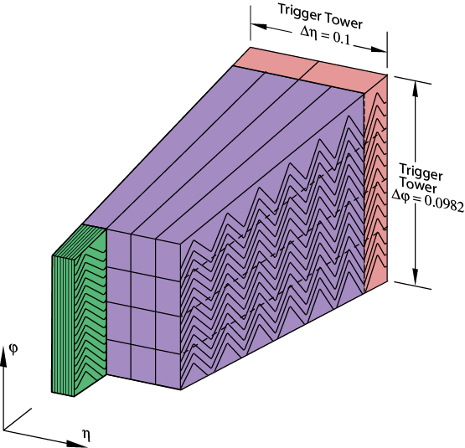
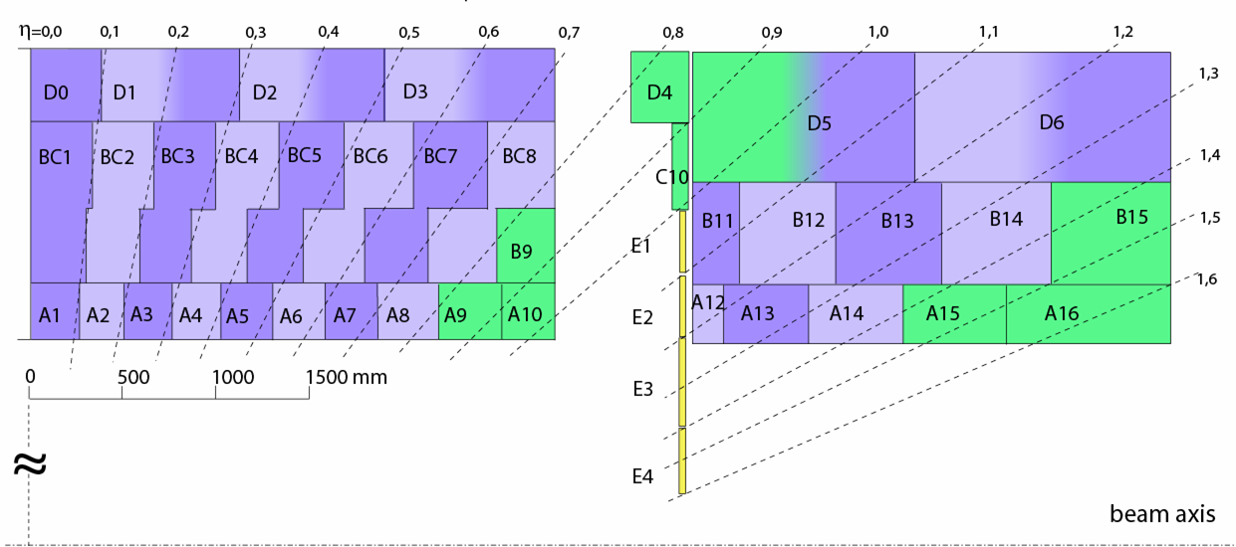
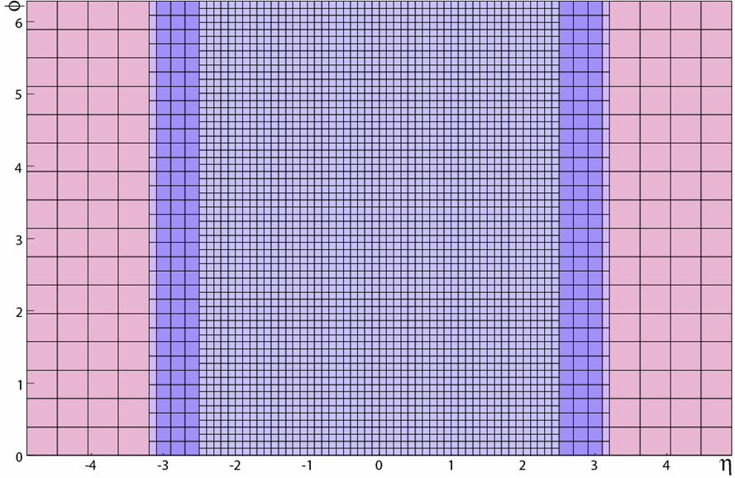
Trigger Towers (TT)
LAr
Tiles (semi-projective segmentation )
Analogue summation of calorimeter cells
3584 x 2 (EM+HAD) trigger towers
Position
Δη x Δϕ
|η|< 2.5
0.1x0.1
2.5 <|η|< 3.1
0.2x0.2
3.1 <|η|< 3.2
0.1x0.2
3.2 <|η|< 4.9
0.4x0.4125
trigger towers map

Slide 30
Pre-Processors – Energy Reconstruction
Receivers (Rx)
Input signal conditioning to L1 (2,5V  250GeV)
Variable gain amplifier (VGA)
E  E_{T} Conversion (Hadronic layers only)
Local signal monitoring
10b
PPr
Sampling
40 Mhz, Flash-ADC 10 bits
1 ADC = 250 MeV
Pedestal 40 ADC
a₄
a₃
a₂
a₁
FIR filter
a₀
+
Bunch crossing identification (BCID)
Finite impulse response filter (FIR)
Peak finder (linear/saturated)
Assign E_{T} to the ‘correct’ bunch crossing
10b
E_{T} calibration
Look-Up Table (LUT)
Pedestal subtraction, noise suppression
ADC (10b)  GeV (8b) conversion
255
E_{thres}
8b
Transmission to processors & DAQ
1023

Slide 31
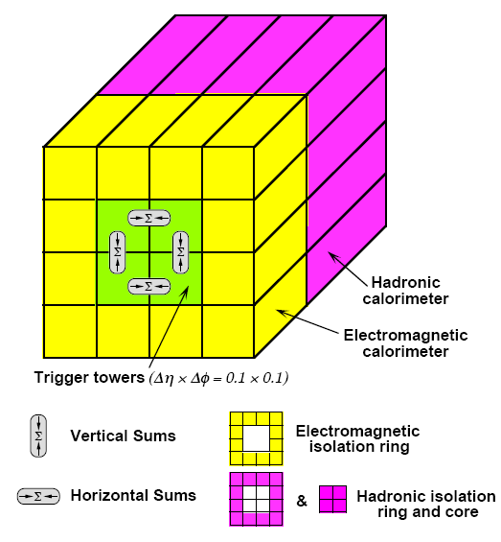
Regions of Interest (RoI)
Processors input is a matrix of tower energies
Algorithms look for physics signatures (sliding window)
RoI’s sent to Level-2 trigger
Cluster Processor
Jet/Energy-sum Processor
ECAL+HCAL
Criteria for e/γ or τ/h candidate:
EM or Had. cluster > E_{threshold}
Total E_{T} in EM Isolation Ring ≤ EM isolation thresh.
Total E_{T} in Had. Isolation Ring ≤ Had. isolation thresh.
Local E_{T} Maximum compared to neighbor windows.
e/γ only:
Had. core ≤ core isolation threshold
Jet candidate
Coarser granularity 0.2x0.2 (jet element)
Digital summation EM + Had.
Sliding, overlapping windows (3 sizes)
Missing energy

