Slide 1
High Rate Packets Transmission on 10 Gbit/s Ethernet LAN Using Commodity Hardware
Domenico Galli
Università di Bologna and INFN, Sezione di Bologna
16th IEEE NPSS Real Time Conference 2009
IHEP, Beijing, China, 12th May, 2009

Slide 2
Commodity Links
More and more often used in HEP for DAQ, Event Building and High Level Trigger Systems:
Limited costs;
Maintainability;
Upgradability.
Demand of data throughput in HEP is increasing following:
Physical event rate;
Number of electronic channels;
Reduction of the on-line event filter (trigger) stages.
Industry has moved on since the design of the DAQ for the LHC experiments:
10 Gigabit Ethernet well established;
100 Gigabit Ethernet is being actively worked on.
Notes:
Maintainability: since widespread commodity interfaces will continue to be available on the market.
Upgradability: system employing commodity interfaces can profit from the rapid development undergone by commodity components.
Trigger stages reduction: in order to have access to the higher possible granularity of the detector when making the trigger decision.

Slide 3
10-GbE Network I/O
“Fast network, slow host” scenario:
Already seen in transitions to 1 Gigabit Ethernet:
Presentation at IEEE-NPSS RT 2005 (Stockholm).
3 major system bottlenecks may limit the efficiency of high-performance I/O adapters:
The PCI-X bus bandwidth (peak throughput 8.5 Gbit/s in 133 MHz flavor):
Substituted by the PCI-E, (20 Gbit/s peak throughput in x8 flavor).
The memory bandwidth:
FSB has increased the clock from 533 MHz to 1600 MHz.
The CPU utilization:
Multi-core architectures.
Notes:
With the introduction of the 10-GbE we entered again the fast network, slow host scenario.
3 major system bottlenecks may limit the efficiency of high-performance I/O adapters.
In the last years a rapid development involved these items... CPUs have entered the multi-core era.

Slide 4
10-GbE Point-to-Point Tests
In real operating condition, maximum transfer rate limited not only by the capacity of the link itself, but also:
by the capacity of the data busses (PCI and FSB);
by the ability of the CPUs and of the OS to handle packet processing and interrupt rates raised by the network interface cards in due time.
Data throughput & CPU load measured:
NIC mounted on the PCI-E bus of commodity PCs as transmitters and receivers.
10GBase-SR
Notes:
In real operating conditions, the maximum achievable transfer rate through a network link is not only limited by the capacity of the link itself, …
The test-bed was composed of two PCs connected together through a point-to-point 10-GbE link. The 10 GBase-SR NICs were mounted on a 8-lane PCI-E slots.

Slide 5
Test Platform
Motherboard | IBM X3650
Processor type | Intel Xeon E5335
Procesors x cores x clock (GHz) | 2 x 4 x 2.00
L2 cache (MiB) | 8
L2 speed (GHz) | 2.00
FSB speed (MHz) | 1333
Chipset | Intel 5000P
RAM | 4 GiB
NIC | Myricom 10G-PCIE-8A-S
NIC DMA Speed (Gbit/s) ro / wo /rw | 10.44 / 14.54 / 19.07
Notes:
This table shows the test platform. Each PC was equipped with two quad-core CPUs running an 2 GHz.
APIC: Advanced Programmable Interrupt Controllers.
I/O APIC is used throughout the system's peripheral buses. There is typically one I/O APIC for each peripheral bus in the system.
Local APIC: manage all external interrupts for the processor that it is part of. In addition, it is able to accept and generate inter-processor interrupts (IPIs) between LAPICs. LAPICs may support up to 224 usable IRQ vectors from an I/O APIC.

Slide 6
Settings
net.core.rmem_max (B) | 16777216
net.core.wmem_max (B) | 16777216
net.ipv4.tcp_rmem (B) | 4096 / 87380 / 16777216
net.ipv4.tcp_wmem (B) | 4096 / 65536 / 16777216
net.core.netdev_max_backlog | 250000
Interrupt Coalescence (μs) | 25
PCI-E speed (Gbit/s) | 2.5
PCI-E width | x8
Write Combining | enabled
Interrupt Type | MSI
Notes:
The first two parameters govern respectively the maximum receive and send socket buffer size, and are given in bytes. The third and fourth parameters are arrays of 3 values defining the minimum, default and maximum size of receive and send buffers used by TCP sockets, respectively. They are also given in bytes. The parameter net.core.netdev_max_backlog controls the maximum number of packets processed by the net_rx_action() SoftIRQ in one invocation.
MSI: Message Signaled Interrupts, in PCI 2.2 and later and PCI Express, are an alternative way of generating an interrupt. Traditionally, a device has an interrupt pin which it asserts when it wants to interrupt the host CPU. While PCI Express does not have separate interrupt pins, it has special messages to allow it to emulate a pin assertion or deassertion. Message Signaled Interrupts allow the device to write a small amount of data to a special address in memory space. The chipset will deliver the corresponding interrupt to a CPU.
MSI: permits a device to allocate 1, 2, 4, 8, 16 or 32 interrupts.
MSI-X: allows a device to allocate any number of interrupts between 1 and 2048 and gives each interrupt separate data and address registers.
Write combining is a computer bus technique for allowing data to be combined and temporarily stored in a buffer -- the write combine buffer (WCB) -- to be released together later in burst mode instead of writing (immediately) as single bits or small chunks. Weak ordering: write/read/write -> read/write/write.

Slide 7
CPU Affinity Settings
10-GbE Receiver
Core | L2 Cache | Task
0 | 0 | (IRQ + softIRQ) from Ethernet NIC
1 |  | Receiver process
Notes:
On the receiver side, the CPU affinity was set in order to bind the receiver process to CPU 1 and the network IRQ and SoftIRQ handlers to the CPU 0, since CPU 0 and 1 of the processors in use shares the L2 cache memory, and were observed to run a bit faster in cooperation with respect to choosing CPU cores which did not share the L2 cache.
It is not possible in the Linux kernel to separate on different CPU cores the IRQ and the SoftIRQ raised by that IRQ, i.e. the Linux kernel always runs the SoftIRQ handler on the same core which scheduled it.

Slide 8
CPU Affinity Settings (II)
10-GbE Sender
Core | L2 Cache | Task
0 | 0 | (IRQ + softIRQ) from Ethernet NIC
1
2 | 1 | Sender process
3 |  | Second sender process [2 sender tests]
Notes:
On the sender side, the CPU affinity was set in order to bind the sender process to the CPU 2 and the network IRQ and SoftIRQ handlers to CPU core 0. These cores were chosen, although they do not share the L2 cache, in order to have a fair comparison with subsequent tests using two sender processes.

Slide 9
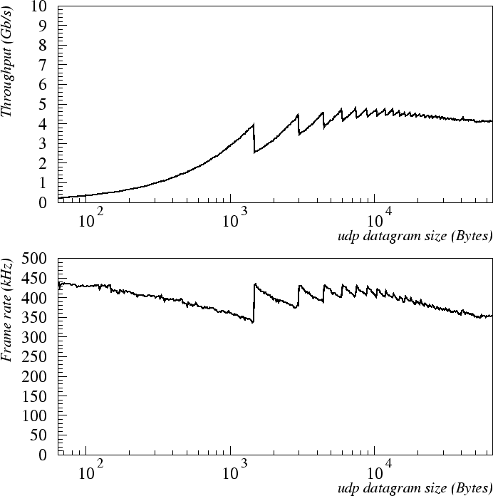
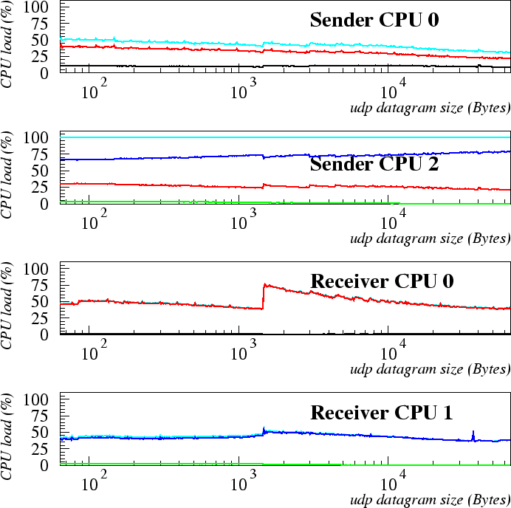
UDP – Standard Frames
User
System
IRQ
Soft IRQ
Total
1500 B MTU (Maximum Transfer Unit).
UDP datagrams sent as fast as they can be sent.
Bottleneck: sender CPU core 2 (sender process 100 % system load).
~ 4.8 Gb/s
softIRQ (4/5)
IRQ (1/5)
100% (bottleneck)
fake softIRQ
~ 440 kHz
softIRQ (~50%)
3 frames
2 frames
4 frames
system (~50%)
Notes:
Data transfer rate and the Ethernet frame rate, both measured as a function of the datagram payload size.
Discontinuities in the curves are due to the increase of the overhead occurring when an additional Ethernet frame (almost empty, overhead apart) is required by the fragmentation process, because the IP datagram does not fit to a single Ethernet frame.
A single sender process was not able, using 1500 B MTU frames on our test-bed platforms, to transfer more than 5 Gbit/s.
As the size of the Ethernet frames decreased below 3 KiB, we observed a further drop of the throughput, with a maximum of 440 kHz in the handled frame rate.
Inaccuracy in the kernel accounting leads to a wrong assignment of jiffy counts to the SoftIRQ partition, which should have been instead accounted as System.
The required CPU load on the sender side was much larger than that on the receiver side.
CPU 2 (the one which was running the sender process) exhibited a 100% total load, evidently leading to a bottleneck.

Slide 10
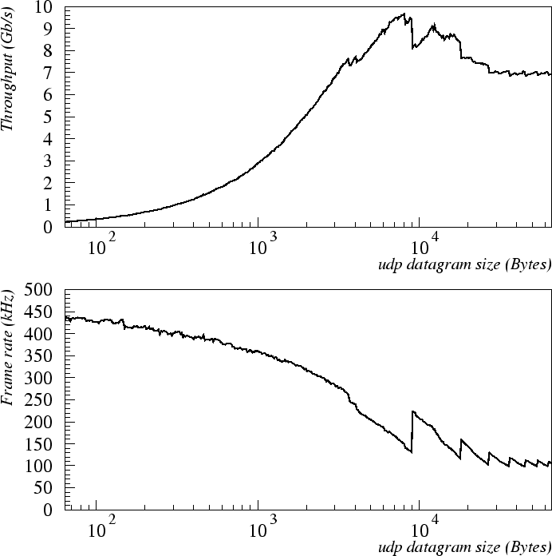
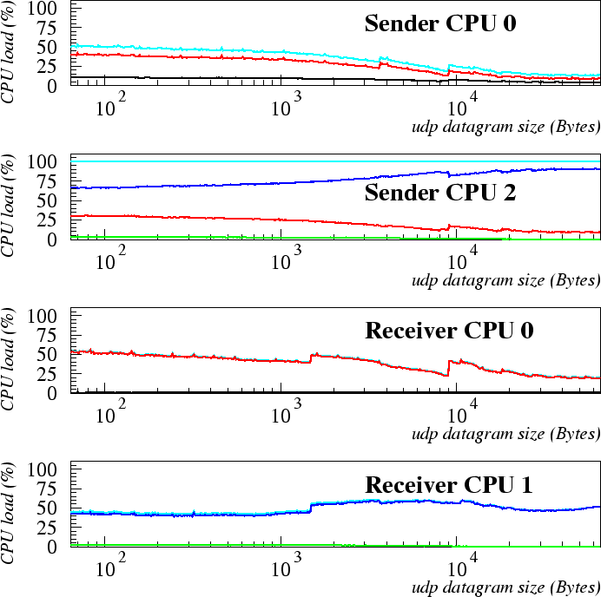
UDP – Jumbo Frames
User
System
IRQ
Soft IRQ
Total
9000 B MTU.
Sensible enhancement with respect to 1500 MTU.
3 PCI-E frames
~ 9.7 Gb/s
softIRQ (4/5)
IRQ (1/5)
2 PCI-E frames
2 frames
3 frames
4 frames
100% (bottleneck)
fake softIRQ
~ 440 kHz
2 frames
3 frames
4 frames
softIRQ (~50%)
2 PCI-E frames
3 PCI-E frames
system (~50%)
Notes:
Discontinuities in the curves, corresponding to a datagram payload size of about a multiple of 9000 B, are due to the increase of the overhead occurring when an additional (almost empty, overhead apart) Ethernet jumbo frame is required by the fragmentation process, because the IP datagram does not fit to a single Ethernet frame.
A change in the curve slopes is also perceptible at 4 and 8 KiB, corresponding to a change in the PCI-E frame multiplicity (4 KiB is the maximum payload size of a PCI-E frame).
From these plots it can also be noticed that, using 9000 B MTU frames, a single sender process was able to transfer almost at the full 10 Gbit/s bandwidth when the datagram size was close to 8 KiB.
On the receiver side, again, the CPU load was almost equally shared between SoftIRQ on CPU 0 and System on CPU 1. On both the cores the load did not exceed 50%, so that a receiver process would be able also to manage data got from two sender processes without CPU bottlenecks on the receiver side. In other words, this shows that a single receiver process can play against two sender processes.

Slide 11
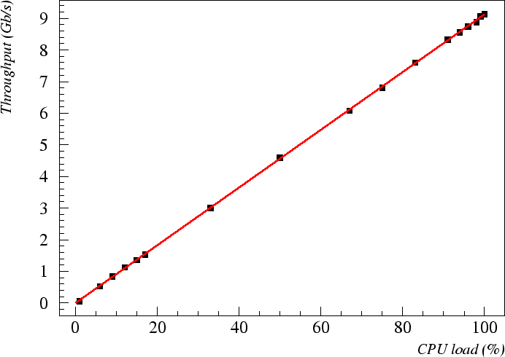
UDP – Jumbo Frames (II)
Additional dummy ps, bound to the same core of the tx ps (CPU 2), wasting CPU resources.
CPU available for tx process trimmed using relative priority.
The perfect linearity confirms that the system CPU load @ sender side was actually the main bottleneck.
2 GHz ➔ 3 GHz CPU (same architecture):
Potential increase of 50% in the maximum throughput:
Provided that bottlenecks of other kinds do not show up before such increase is reached.
Notes:
In order to cross-check that the CPU 2 on the sender PC was actually the main bottleneck so far identified, a specific test was made. Figure shows the throughput obtained using UDP datagrams traveling on single, completely filled, 9000 B jumbo frames, as a function of the load of the CPU core where the sender process was running (CPU 2).
The test was carried out by running an additional dummy process bound to CPU 2, which simply wasted CPU resources, thus limiting the availability of CPU cycles to the sender process. By varying the relative priority of the dummy and sender processes, it was possible to assign to the sender process a defined fraction of the total core load.

Slide 12
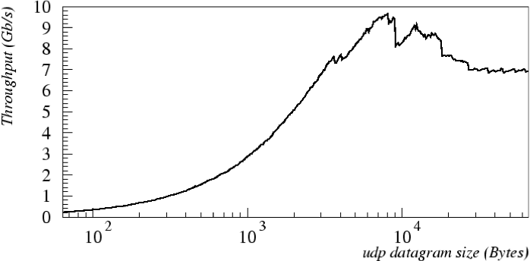
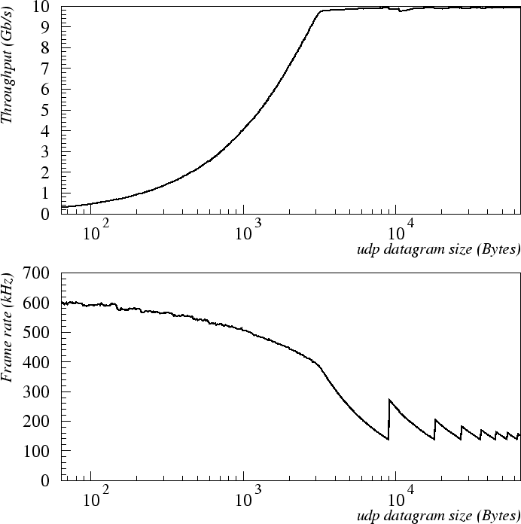
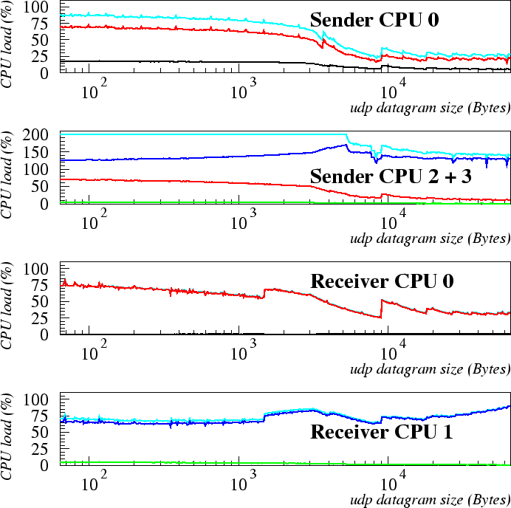
UDP – Jumbo Frames 2 Sender Processes
User
System
IRQ
Soft IRQ
Total
Doubled availability of CPU cycles to the sender PC.
10GbE fully saturated.
Receiver (playing against 2 senders) not yet saturated.
~ 10 Gb/s
4 frames
3 frames
~3 KiB
2 frames
softIRQ (4/5)
IRQ (1/5)
200% (bottleneck)
fake softIRQ
~5 KiB no more CPU bottleneck
~ 600 kHz
2 frames
3 frames
4 frames
softIRQ (25-75%)
~3 KiB
system (75-90%)
Notes:
Having realized with the previous tests that one CPU was not sufficient to saturate the full bandwidth of the NIC, we performed again the same test, but with data transferred from two sender processes. In this way we should in principle have doubled the availability of CPU cycles and consequently observe a relevant increase of the actual throughput.
It can be noticed that two sender processes using 9000 B MTU frames were able to fully saturate the 10 Gbit/s bandwidth, already when the datagram payload size was larger than 3 KiB.
As the size of the Ethernet frames decreased below 3 KiB, we observed a drop of the throughput, with a maximum of 600 kHz in the handled frame rate.
The CPU load of the single receiver process still did not saturate the CPU core (it was around 75% of the load), even playing against two sender processes, but we remark that process and IRQ/SoftIRQ handlers were kept on separate CPU cores.
The total load of the cores dedicated to the sender processes (CPU 2 and 3) was below 200% when the datagram payload size was larger than 5 KiB. In this regime in fact, the bottleneck was no longer due to the CPUs, but to the 10-GbE link which was completely saturated at 10 Gbit/s.

Slide 13
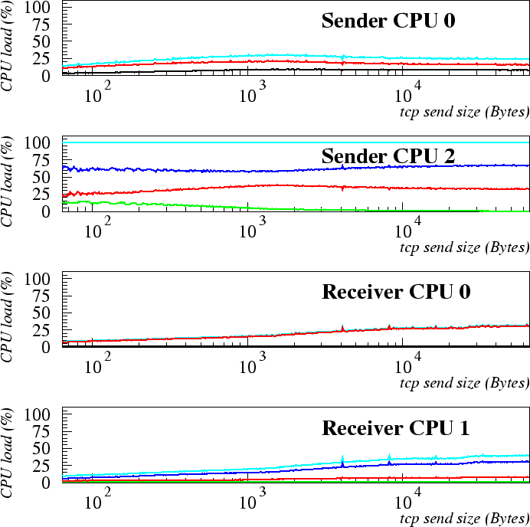
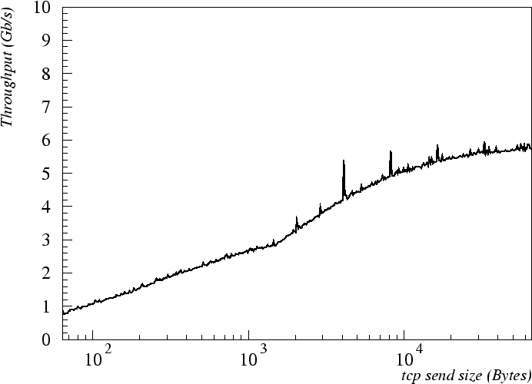
TCP – Standard Frames
User
System
IRQ
Soft IRQ
Total
1500 B MTU (Maximum Transfer Unit).
TCP segments sent as fast as they can be sent.
Bottleneck: sender CPU core 2 (sender process, 100% system load).
softIRQ (2/3)
IRQ (1/3)
100% (bottleneck)
fake softIRQ
~ 5.8 Gb/s
softIRQ (<35%)
system (<40%)
Notes:
The TCP layer accepts user data streams from local processes and breaks them into pieces (segments), sending each piece as a separate IP datagram. TCP transmission
involves much more control mechanisms with respect to UDP, such as sliding window, retransmission timer, Nagle's algorithm and congestion control.
The IP layer underlying the TCP layer is supposed to work in the condition of optimal exploitation of the 10-GbE bandwidth (i.e. using single, completely filled frames, in absence of IP fragmentation).

Slide 14
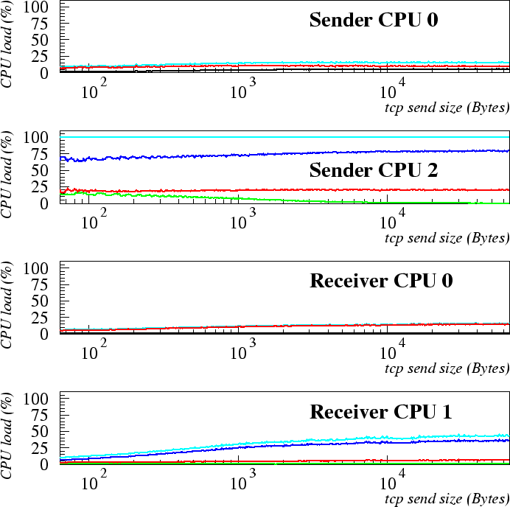
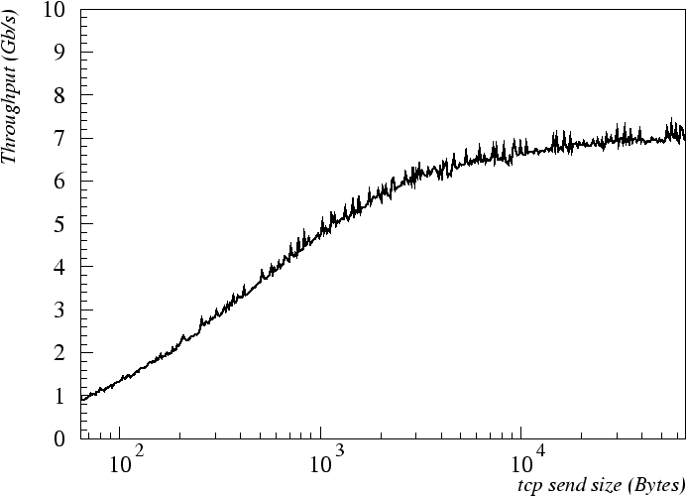
TCP – Jumbo Frames
User
System
IRQ
Soft IRQ
Total
9000 B MTU.
Enhancement with respect to 1500 MTU (6 ➔ 7 Gb/s).
Bottleneck: sender CPU core 2 (sender process, 100% system load).
~ 7 Gb/s
100% (bottleneck)
fake softIRQ
softIRQ (<15%)
system (<45%)
Notes:
The adoption of the 9000 B MTU with TCP slightly improved the throughput up to 7 Gbit/s.

Slide 15
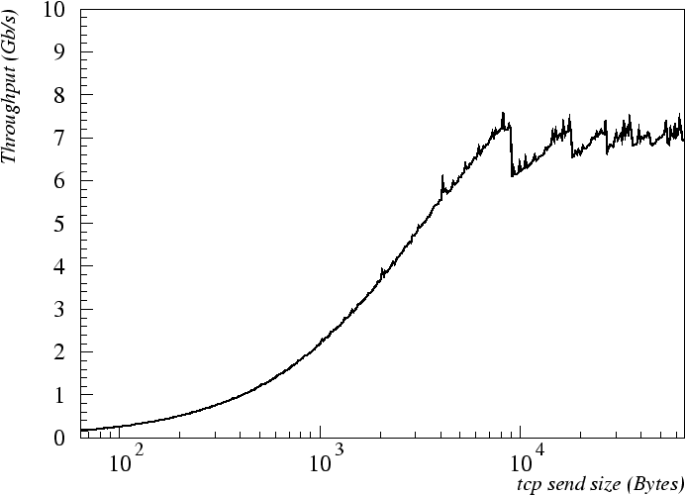
TCP – Jumbo Frames TCP_NODELAY
User
System
IRQ
Soft IRQ
Total
Nagle’s algorithm disabled. Segments are always sent as soon as possible, even if there is only a small amount of data.
Small data packets no longer concatenated.
Discontinuities of the UDP tests.
UDP throughput not reached, due to the latency overhead of the TCP protocol.
~ 7.2 Gb/s
100% (bottleneck)
fake softIRQ
softIRQ (<15%)
4 frames
3 frames
2 frames
system (<45%)
Notes:
In order to solve the so called small packet problem, the Nagle's algorithm has been introduced in the TCP/IP stack. The algorithm automatically concatenates a number of small data packets in order to increase the efficiency of a network application system, i.e. reducing the number of physical packets that must be sent.
When there are few bytes to send, but not a full packet's worth, and there are some unacknowledged data in flight, then the Nagle's algorithm waits keeping data buffered, until either the application provides more data or the other end acknowledges all the outstanding data, so that there are no longer any data in flight.
The Linux operating system provides two options to disable the Nagle's algorithm in two opposite ways, which can be set by means of the setsockopt() system call.
As expected, since small data packets were no longer concatenated, the curve shows the typical discontinuities of the UDP tests.
The throughput of the UDP tests is not reached however, due to the latency overhead of the TCP protocol and to control mechanisms.

Slide 16
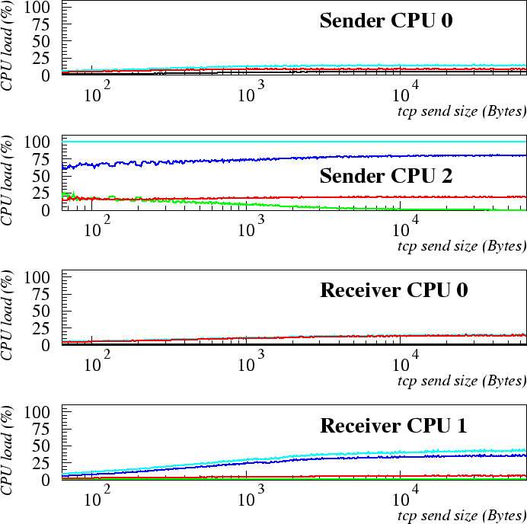
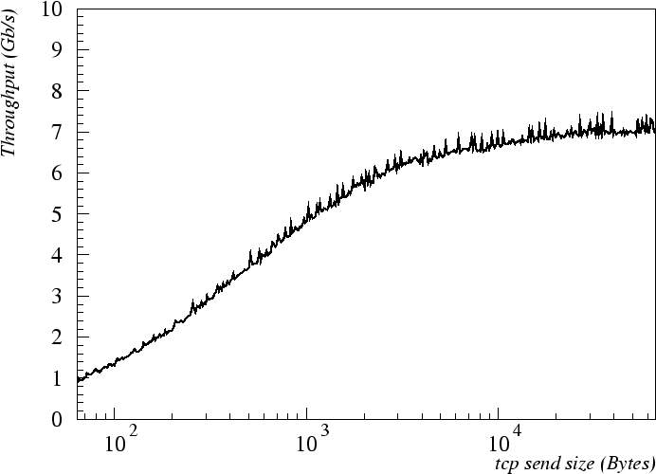
TCP – Jumbo Frames TCP_CORK
User
System
IRQ
Soft IRQ
Total
Nagle’s algorithm disabled. OS does not send out partial frames at all until the application provides more data, even if the other end acknowledges all the outstanding data.
No relevant differences.
~ 7 Gb/s
100% (bottleneck)
fake softIRQ
softIRQ (<15%)
system (<45%)
Notes:
In this case, the operating system does not send out partial frames at all until the application provides more data, even if the other end acknowledges all the outstanding data.
Since we were sending data at full rate also with the Nagle's algorithm turned on, we do not expect any relevant difference.

Slide 17
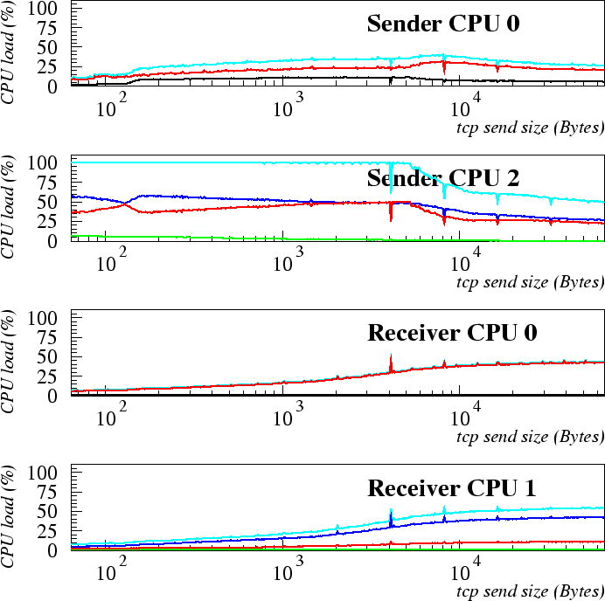
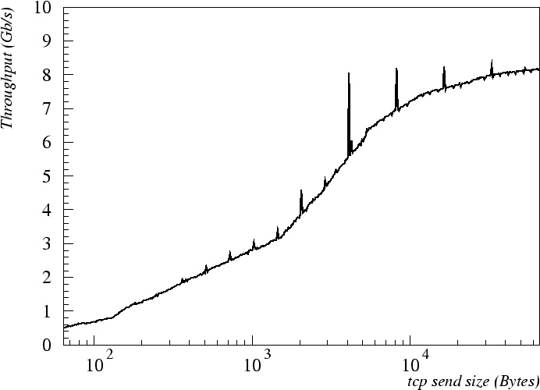
TCP – Standard Frames Zero Copy
User
System
IRQ
Soft IRQ
Total
sendfile() system call: transmit data read from a file descriptor to the network through a TCP socket.
Avoid copy:
user space ➔ kernel space.
1500 B MTU.
Significant increase in throughput
with respect to send().
IRQ (1-10%)
softIRQ (10-30%)
~ 8.2 Gb/s
100% (bottleneck)
~5 KiB no more CPU bottleneck
softIRQ (5-50%)
system (10-55%)
Notes:
While transfers in previous TCP tests were initiated using the send() system call, here we investigate the performance of an alternative method. The sendfile() system call.
When the send size was larger than 5 KiB, the total load of CPU 2 remained below 100%, hence the CPU was no longer a bottleneck.
These plots exhibit a significant increase of the throughput: the maximum passes from 5:5 Gbit/s to 8 Gbit/s with a lower CPU load.

Slide 18
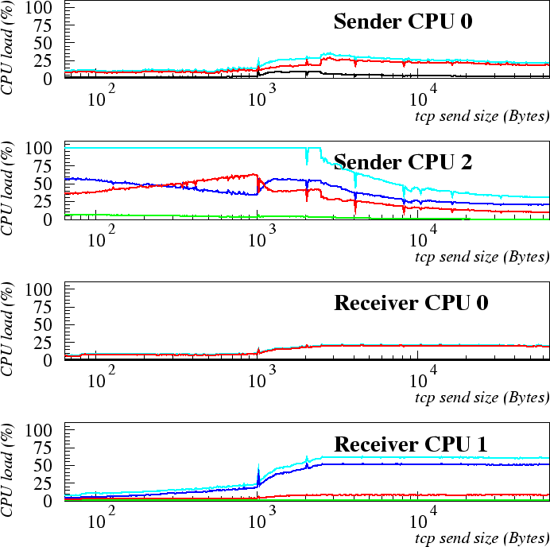
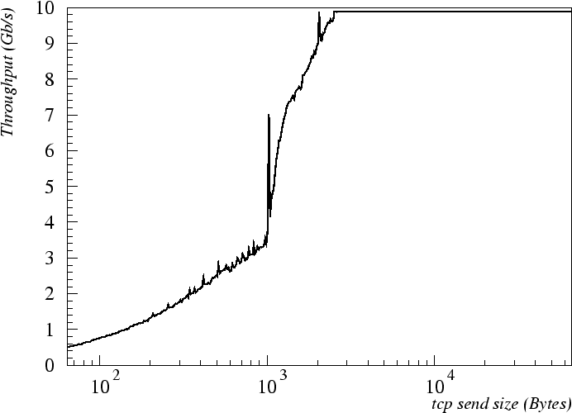
TCP – Jumbo Frames Zero Copy
User
System
IRQ
Soft IRQ
Total
sendfile() system call.
Improvement with respect to send() more significant.
For send size > 2.5 KiB:
Throughput = 10 Gbit/s
Sender CPU 2 load < 100%:
down to 30%.
Only test able to saturate 10-GbE with a single ps.
IRQ (1-10%)
softIRQ (10-30%)
~ 10 Gb/s
30%
2.5 KiB
100% (bottleneck)
~2.5 KiB no more CPU bottleneck
softIRQ (5-20%)
system (10-60%)
1 KiB
Notes:
Using 9000 B MTU Ethernet frames, the difference between the send() and the sendfile() performances was even more significant.
When the send size was larger than 2.5 KiB, the throughput reached the full 10 Gbit/s bandwidth of the 10-GbE link, and the total load of CPU stayed below 100% (down to 30%).
We emphasize that this is the only test so far able to saturate the 10-GbE link with a single running process. A discontinuity in the throughput plot is clearly evident around the send size of 1 KiB.

Slide 19
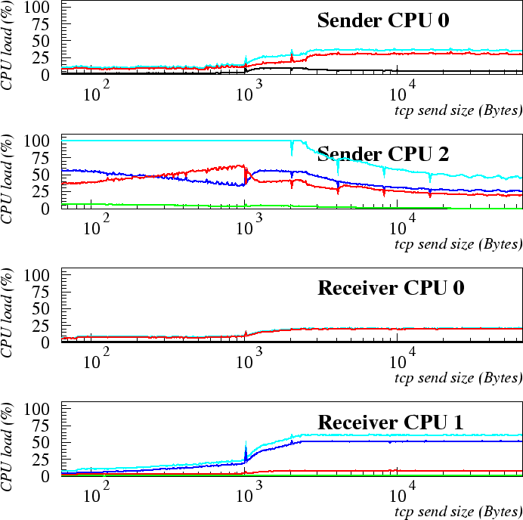
TCP – Jumbo Frames – Zero Copy No TSO
User
System
IRQ
Soft IRQ
Total
TSO (TCP Segmentation Offload) switched off.
TSO offloads segmentation in MTU-sized packets.
CPU can hand over up to 64 KiB of data to the NIC in a single transmit request.
No differences in throughput:
10-GbE link already saturated (size > 2.5 KiB).
CPU load reduced by TSO (size > 2.5 KiB).
IRQ (1-10%)
softIRQ (10-35%)
~ 10 Gb/s
50%
2.5 KiB
100% (bottleneck)
~2.5 KiB no more CPU bottleneck
softIRQ (5-20%)
system (10-60%)
1 KiB
Notes:
Modern network adapters, as the one in use in our tests, usually implement various kinds of hardware offload functionalities. This is one of the most effective means available to improve the performance and reduce the CPU utilization.
No sizable differences in the throughput were observed since we are already saturating in both cases the 10-GbE link.
However, at the maximum tested send size, the load of sender CPU 0 (SoftIRQ) was reduced by 40% and that of the sender CPU 2 (System) was reduced by 20%.

Slide 20
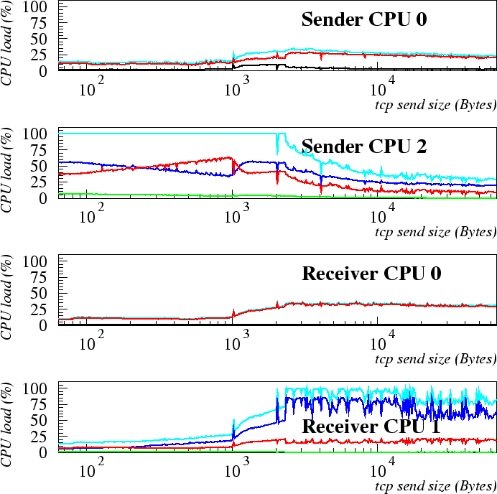
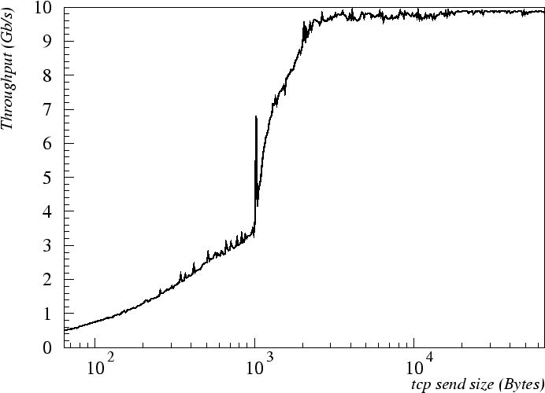
TCP – Jumbo Frames – Zero Copy No LRO
User
System
IRQ
Soft IRQ
Total
LRO (Large Receive Offload) switched off.
LRO aggregates TCP segments at the NIC level into larger packets:
Reducing the number of physical packets processed by the kernel.
The performance (sizes > 2.5 KiB) slightly worse;
Total load of the CPU 1 receiver sensibly increased, up to 100%.
IRQ (1-10%)
softIRQ (10-30%)
~ 10 Gb/s
2.5 KiB
100% (bottleneck)
~2.5 KiB no more CPU bottleneck
softIRQ (10-40%)
100% (bottleneck)
system (15-100%)
1 KiB
Notes:
Large Receive Offload (LRO) assists the host in processing incoming TCP packets by aggregating them at the NIC level into fewer larger packets. It may reduce considerably the number of physical packets actually processed by the kernel hence offloading it in a significant way.
The performance for send sizes larger than 2.5 KiB was just slightly worse, but the total load of the CPU 1 sensibly increased, even up to 100%.

Slide 21
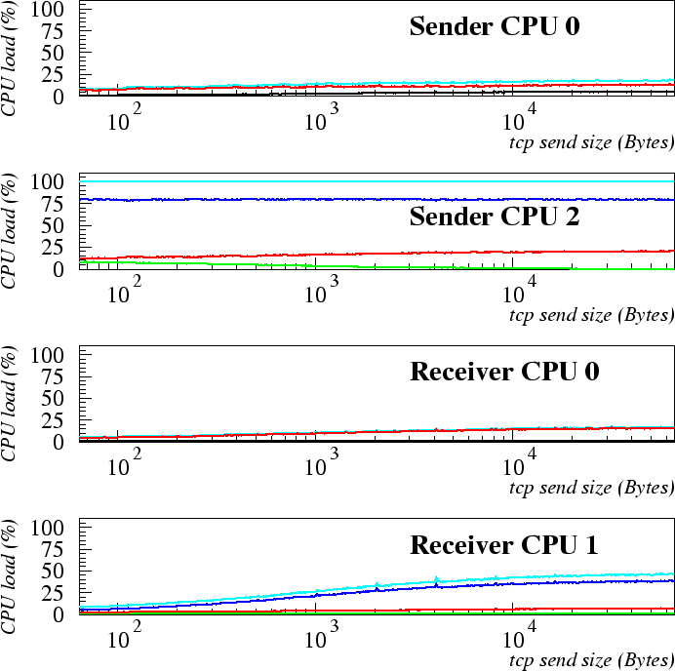
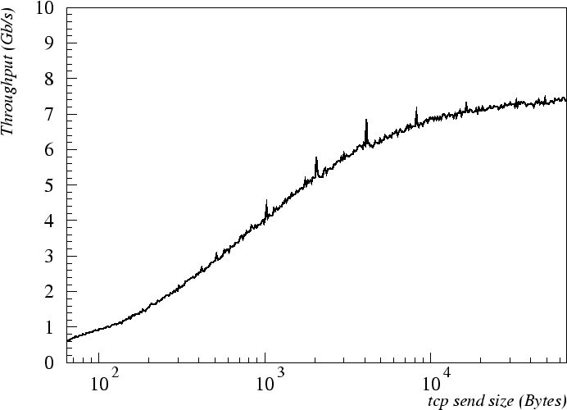
TCP – Jumbo Frames – Zero Copy No Scatter-Gather
User
System
IRQ
Soft IRQ
Total
Scatter-gather I/O switched off.
By using scatter-gather I/O the packet does not need to be assembled into a single linear chunk by kernel:
NIC is able to retrieve through DMA the fragments stored in non-contiguous memory locations.
Performance was significantly improved by SG I/O.
~ 7.4 Gb/s
100% (bottleneck)
softIRQ (5-15%)
system (10-45%)
Notes:
The process of creating a packet ready to be transmitted through the network, starting from the transmission requests coming from the TCP layer, in general requires data buffering in order to assemble packets of optimal size, to evaluate checksums and to add the TCP, IP and Ethernet headers. This procedure can require a fair amount of data copying into a new buffer to make the final linear packet, stored in contiguous memory locations.
However, if the network interface that has to transmit the packet can perform Scatter-Gather I/O, the packet does not need to be assembled into a single linear chunk, since the NIC is able to retrieve through DMA the fragments stored in non-contiguous memory locations. This hardware optimization frees the kernel from such a linearization duty, hence improving performance.

Slide 22
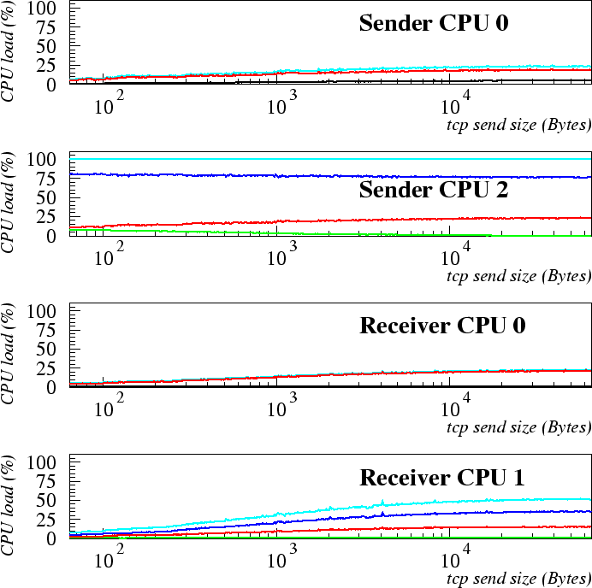
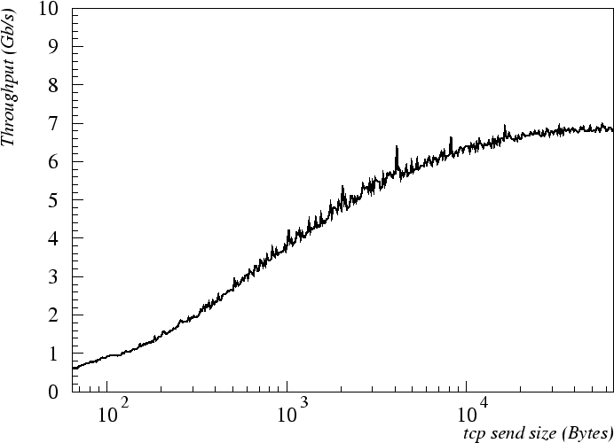
TCP – Jumbo Frames – Zero Copy No Checksum Offload
User
System
IRQ
Soft IRQ
Total
Checksum offload switched off.
The task of calculating the TCP checksum can be offloaded to the network card both at the sender and at the receiver side.
Performance is significantly improved.
However, when the checksum offload is off, all the other offload functionalities of the are also switched off (SG, TSO, etc.).
~ 6.9 Gb/s
100% (bottleneck)
softIRQ (5-25%)
system (10-50%)
Notes:
TCP checksum is performed to make sure that the packet is correctly transferred, by comparing, at the receiver side, the value of the checksum field in the packet headers (set by the sender) with the value calculated by the receiver from the packet payload.
The performance with the checksum offload functionality switched off is significantly worse. However, when the checksum offlooad functionality is switched off, all the other offload functionalities of the NIC are also switched off (SG, TSO, etc.). By comparing Figs we conclude that the SG optimization has the most effective impact on the maximum achievable throughput.

Slide 23
Fiber Channel to 10-GbE Test
Maximum throughput achievable by simultaneously reading data from 2 Fiber Channel links and sending them to a 10-GbE link:
Closely emulating the behavior of a SAN disk-server exporting data by means of a network file system (NFS, GPFS, Lustre).
A exports 2x20 GiB Disk Images as real SCSI devices (by using SCST) through FC.
B aggregates the 2 SCSI device in RAID-0 (strip 64 KiB).
File size: 5 GiB on XFS file system. Serial read.
Cached (as file ) at A but cannot be cached at B.
A
B
C
4 GiB
4 GiB
6 GiB
HBAs: Qlogic QLA2460
Notes:
SCSI target subsystem for Linux (SCST) : SCSI target emulator.

Slide 24
CPU Affinity Settings in FC➔10-GbE Test
10GbE Sender
Core | L2 Cache | Task
0 | 0 | (IRQ + softIRQ) from Ethernet NIC
1
2 | 1 | Sender process
3
4 | 2 | (IRQ + softIRQ) from Fiber Channel HBA 1 [FC tests]
5 |  | (IRQ + softIRQ) from Fiber Channel HBA 2 [FC tests]
10GbE Receiver
Core | L2 Cache | Task
0 | 0 | (IRQ + softIRQ) from Ethernet NIC
1 |  | Receiver process
Notes:
The IRQ handlers of the two HBAs were bound to CPU 4 and CPU 5 respectively, while the reader-sender process was bound to CPU 2.

Slide 25
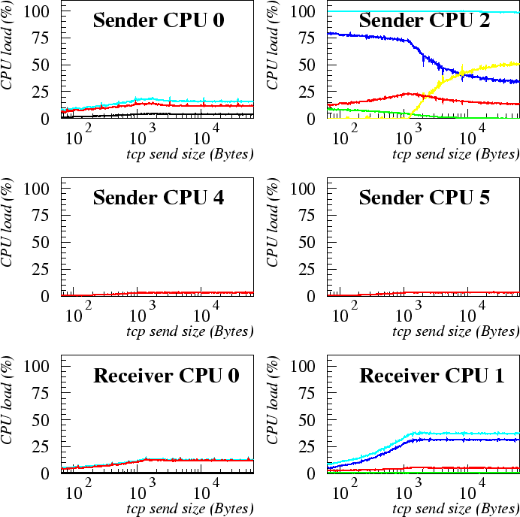
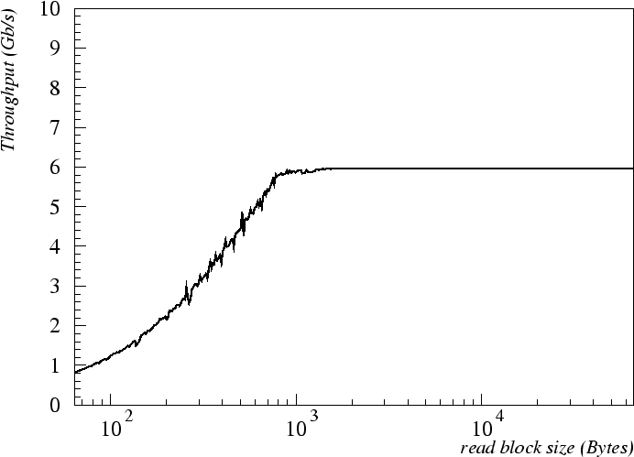
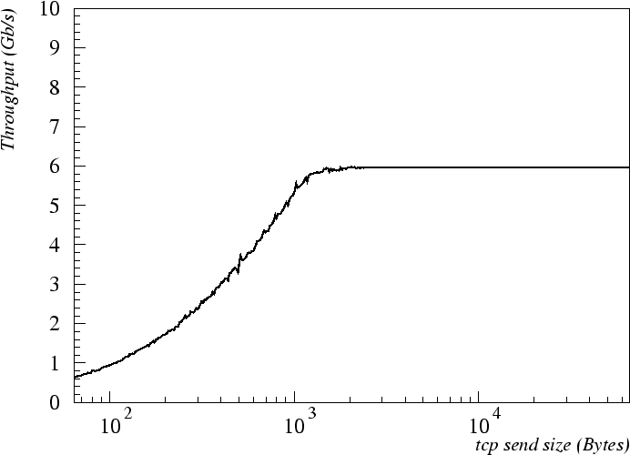
FC-Read 10-GbE-Send Test
User
System
IRQ
Soft IRQ
I/O wait
Total
Read-ahead 8 MiB (default 128 KiB).
Read-send at max speed from the 5 GiB file cyclically.
sendfile() to transmit.
Bottleneck:
10-GbE sender ps (system load);
but up to 50% I/O wait.
FC protocol lighter than 10GbE.
100% (bottleneck)
50% I/O wait
10-GbE IRQ+SoftIRQ
fake softIRQ
~ 6 Gb/s
FC HBA 1 SoftIRQ
FC HBA 2 SoftIRQ
read + send
read only
10-GbE IRQ+SoftIRQ

Slide 26
Conclusion
We performed a complete series of tests:
Transferring data via 10-GbE links at full speed;
Using either the UDP or the TCP protocol;
By varying the MTU and the packet send size.
Main bottleneck: CPU utilization at the sender side:
System load of the transmitter process.
Jumbo frames in fact mandatory for 10-GbE.
In TCP transmission:
Improvement can be obtained by zero-copy (sendfile());
Scatter-Gather functionality sensibly improves the performance;
The TSO functionality helps the sender CPU.
The LRO functionality helps the receiver CPU.
10-GbE fully support transmission from 2x 4 Gbit/s FC read:
Without any apparent interference between the two phases of getting data from the SAN and sending them to the Ethernet.

