Slide 1
XAL and Open XAL Software: the Development and Applications
Paul Chu
Professor

Slide 2
Outline
Introduction
Right software architecture
Data handling
Application Programming Interface/Automation
  Control system connectivity
  Online Model
  Tools
  GUI Framework
Applications and services
  General purpose applications
  Beam tuning applications
XAL -> Open XAL (new XAL)
Conclusion

Slide 3
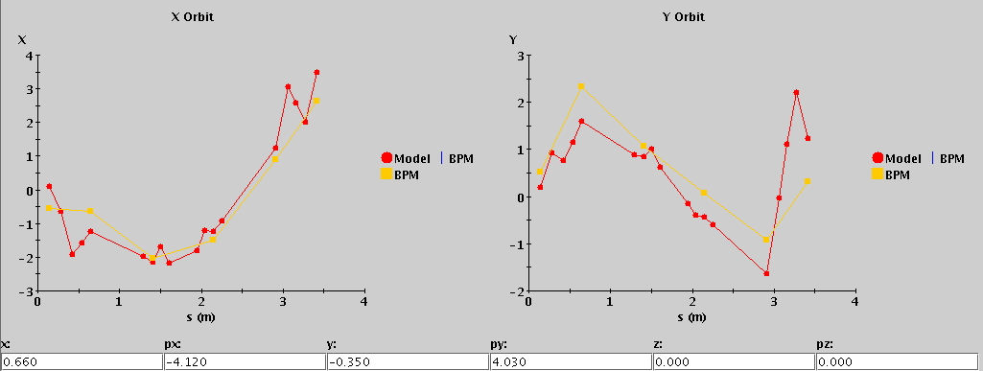
Introduction
A high-level software platform was needed for SNS commissioning
  Evaluated CDEV, SDDS, SAD…, but decided to build a new one based on UAL2 design
  Started (Summer 2002) just prior to the SNS Front-End commissioning
  Java based, i.e. API accessible from Java, JYTHON, PYTHON, MATLAB
Why do we need a high-level software platform?
  Easy for developing high-quality applications
  Easy for software maintenance
What do we need for the platform?
  Data structure
  Online Model
    Started with Trace-3D (modified as a callable module via Java Native Interface)
  Application Programming Interface (API)
  Many tools
First applications: Orbit Difference, Histogram Display, XY(Z) Plot
Orbit Diff. SNS MEBT, Jan. 2003

Slide 4
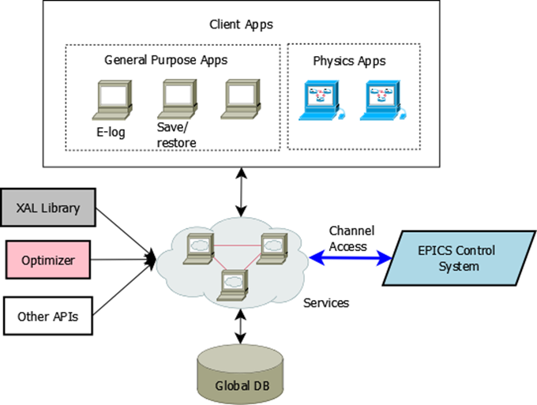
Software Architecture Overview
Software architecture considerations
  Portability – can be applied to other accelerator facility easily
    Using abstract classes for generic API and “adapters” for specific implementations
    Using configurations files as opposed to hard-code machine properties
    Compatible with various control systems
  Easy-to-use – intuitive API for physicist developers
  Robustness – important for user facilities
  Performance – must be fast enough for any online purposes
  Avoid over-engineering – keep as simple as possible
  Quick prototype support – scripting ideas
High-level = XAL + Database + tools
  Essential tools:
    Optimizer
    Data graphing
    Control system connectivity
    Database connectivity
    Graphical User Interface (GUI)

Slide 5
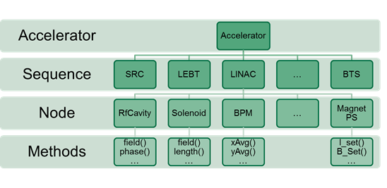
Open XAL Software Structure
Class hierarchy describing the accelerator structure
  Internal data structure matches this hierarchy
  APIs to access accelerator data
Other core components
  Online Model
  Channel Access support
  Core tools – anything else needed by core
Extensions (like EPICS’s) – supporting libraries
  Application (GUI) framework
  External lattice generator – hooks for other modeling tools, e.g. MAD-X
  Optimizer
  …
Plugins – site specific implementations, e.g. EPICS Channel Access, database flavors (Oracle, MySQL…)
Services
XAL acc. class structure

Slide 6
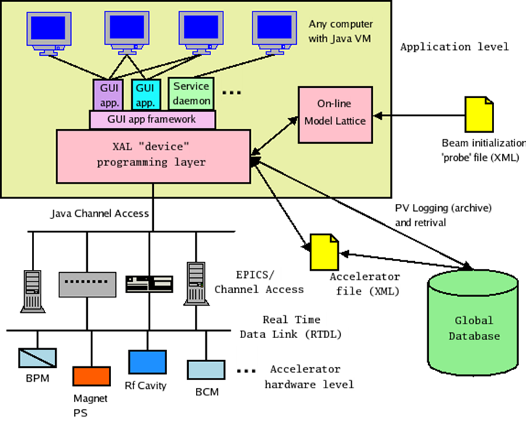
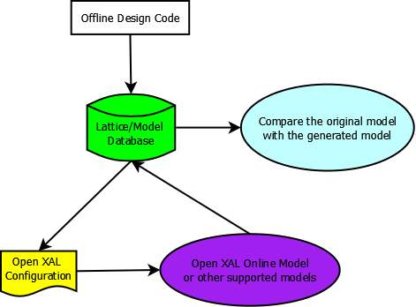
Data Handling
All static data saved in relational database
  Data needed for applications extracted from DB and stored in XML files
    Flexibility
    Can initialize directly from DB w API
  Database can be site specific
  A Lattice/Model Database developed
Data flow

Slide 7
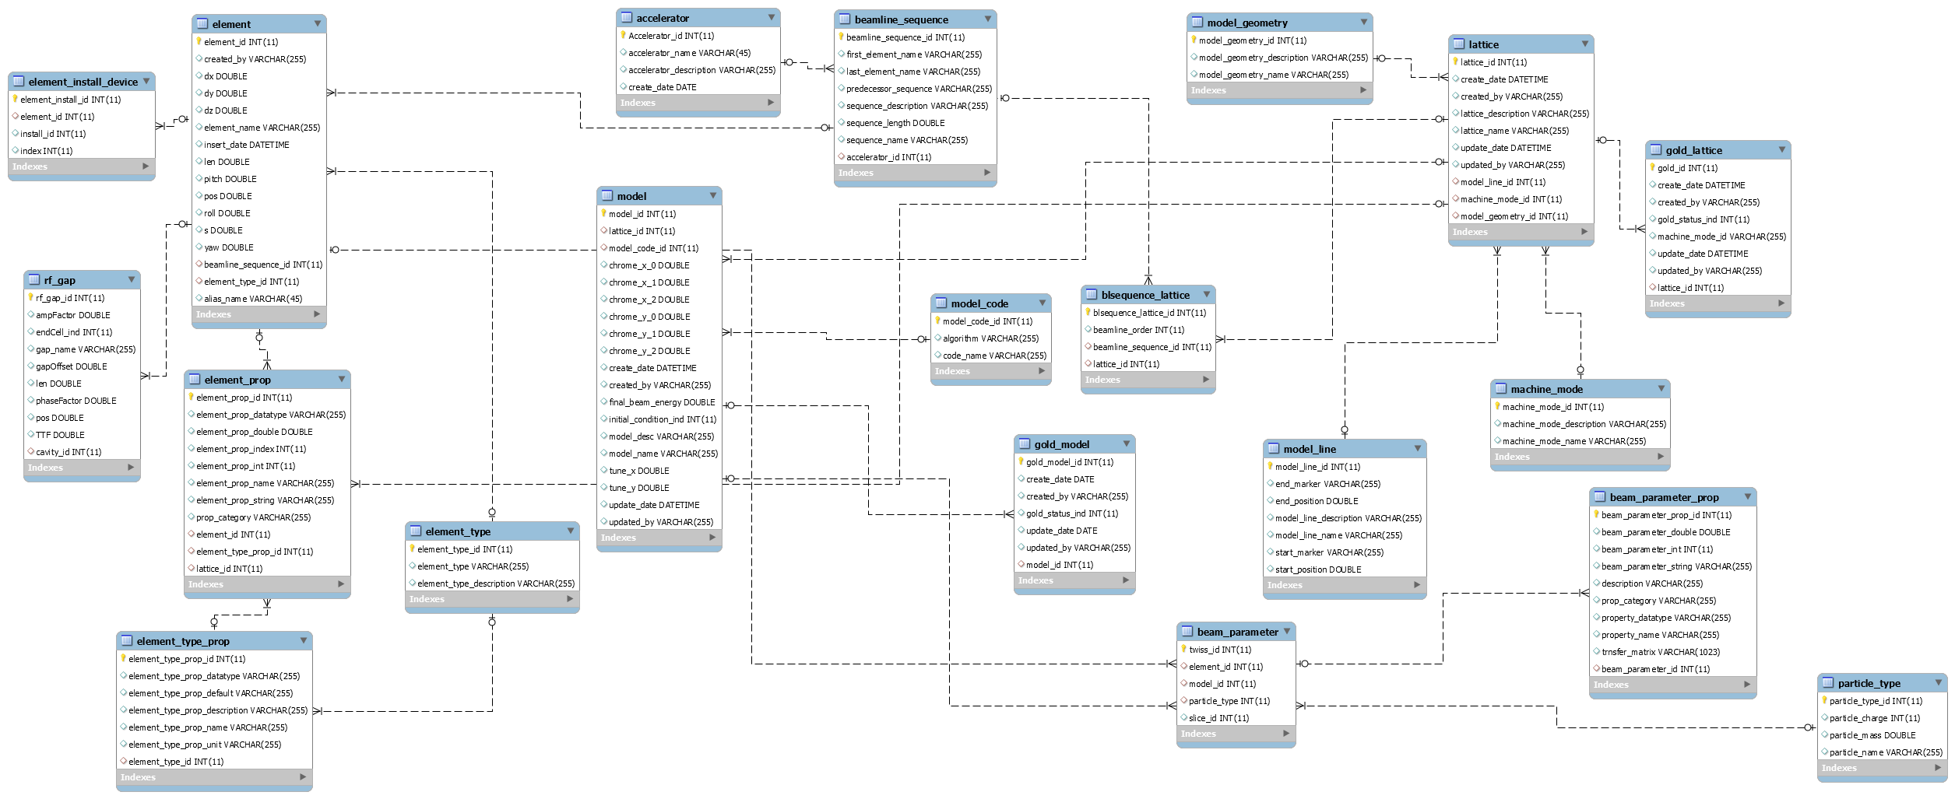
Lattice/Model Database (DISCS Collaboration)
Need a data container to store lattice and (optionally) model data
General enough for most machines/models
  Property name-value pair, not fixed column names
Prepare lattice data in Excel spreadsheet template
  Data upload routine for the template
    Apache POI package for Excel file parsing
  Data access API
    Generate XAL configuration files from DB
    Easy to write generators for other model tools
20 tables in DB covering lattice, model
DB schema is application oriented
Lattice/model service in progress
Model data display app in progress

Slide 8
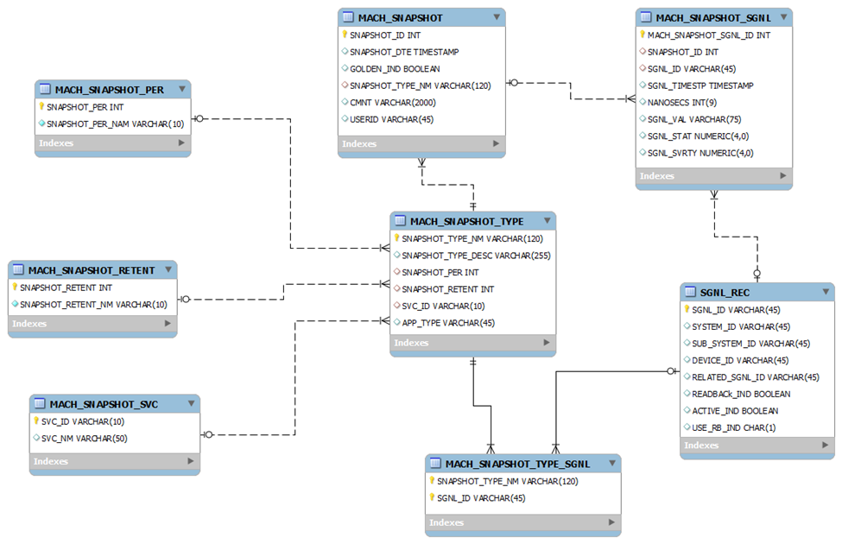
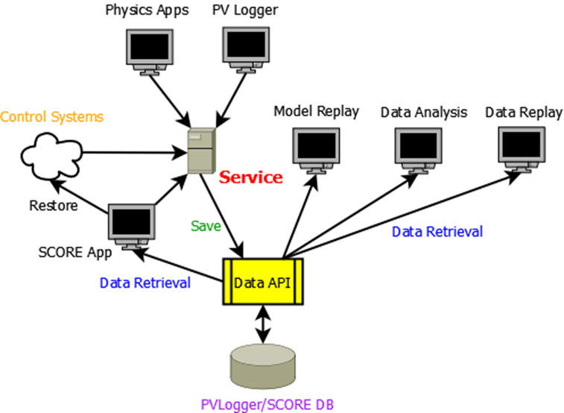
Data for Physics Applications
Database for “physics” applications (not the application configuration data)
  Machine snapshot
  Predefined “other” data
PVLogger
  General purpose PV logging
SCORE
  Save/Compare/Restore Application
2-in-1: PVLogger + SCORE
  Easy to set up (than any EPICS tools)
    Only needs an Excel file with PV names
  Periodic logging – JSON-RPC
  On-demand logging
  Restoring via SCORE GUI Application
  Online Model replay

Slide 9
Control System Connectivity
Channel Class
  An abstract class that provides an interface to the control system.
  Includes convenience functions to hide details of the connection mechanism.
JcaChannel
  A concrete class that uses the Java Channel Access (JCA) interface to EPICS v3 channel access protocol -- each EPICS signal is called a process variable (PV).
  It is a Plugin now which means EPICS v4 or any other protocols can be another Plugins, i.e. Open XAL is fully compatible with any communication protocols
Transformations: allows scaling/offset of the signal coming from the control system
  Can map one physical signal to > one “Channel” object, with different transformations
  Facilitates quick fixes, changes to signals
    Dipole corrector magnetic field computed from power supply current.
    BPM polarity fixes.

Slide 10
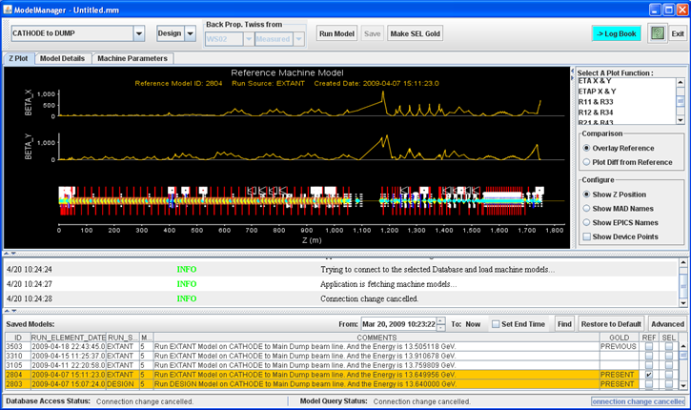
Online Model
Element-Probe-Algorithm design pattern
    Element is object for each individual modeling element along the beamline
    “Probe” object filled with all tracking results as model tracking along the beamline
    Algorithm is the way an element should be treated during the tracking (probing)
Matrix formalism for fast computation as opposed to multi-particle tracking in typical offline simulation
  Single particle tracking
  Envelope tracking
XAL Online Model for LCLS
linac

Slide 11
Online Model Features
Calculate beam parameters.
A lattice view of the machine constructed from the “device” structure (via a set of rules.
  Drifts are inserted at run-time, elements are split if needed
  Device view -> online model lattice
Lattice element values can be from the machine, design or logged data
Can do ‘what-if’ with any one of the above data sources
Mostly use an envelope model for single-pass linac tracking or closed orbit for ring

Slide 12
Online Model Details
Drift space calculated dynamically with lattice generator
Lattice – split all thick-lens elements with “begin”, “middle” and “end” markers
Linear space charge capable for linac
  Adaptive space charge algorithm further split elements accordingly
Closed-orbit transfer map for storage ring
Further improvement in progress
  Modeling fringe fields (overlapping fields)
  Dynamic path lengths, beam phase in RF accelerating gaps, multi-beams…
Performance
  ~sec for 1000+ elements online model tracking
  ~ms for short beamline segment, good enough for working with solver

Slide 13
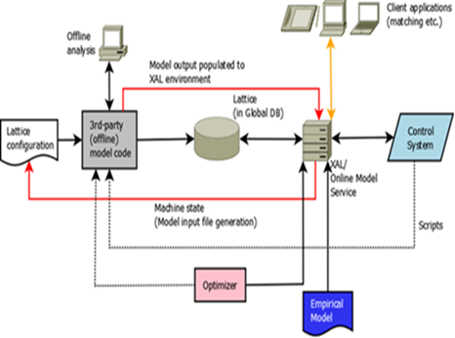
Simulation Platform
Open XAL Online Model may not cover all physics
  Improve Open XAL Model
  Make other models working w/ Open XAL, using Open XAL APIs
A model platform for various modeling tools
  Open XAL
  MAD-8
  MAD-X
  IMPACT
  DYNAC
  Trace-3D
  …
Model Database – universal data container
Data access API – model independent API
Can be used for model benchmark

Slide 14
Tools
Data graphing – a built-in plotting package, may be replaced by JavaFX in the future
Database connectivity – certain API for physics data, e.g. retrieval of machine snapshot for online model replay
Channel Transformation – may use for fudge physics parameters, channel time correlation among PVs
Mathematics – polynomial tools, matrix operation, special functions
Digital signal processing
Messaging – API for recording and passing information around
Solver – for optimal solution finding, the most important tool
Statistics
... Many more

Slide 15
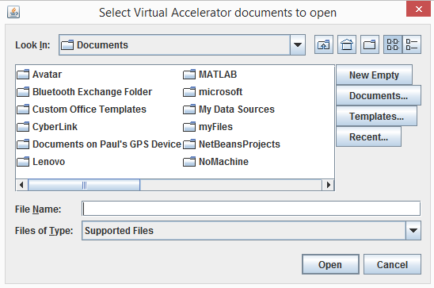
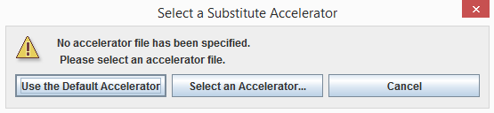


GUI Framework
A GUI Application Framework is developed and used as a common starting point for application programs
  Provides a common look feel for all apps
  Quick jump-start for application development
  Easy retro-fixes across many apps
  Use familiar “windows” look feel paradigm
Startup screen for opening a document
Accelerator selector
GUI Framework
Common default menu bar

Slide 16
Application Wish List for Commissioning
General purpose apps/services
  Beamline “Z-plot” widget – any kind of parameters along the beamline
    Orbit display, beam loss display, beam envelope…
  Multi-knob/bump orbit correction*
  Save/restore* (restoring physics, not just “numbers”)
  Scan/correlation plot*
  Time-correlated machine snapshot* (PVLogger)
  Machine Protection Post-mortem analysis (SNS implementation)
  PV Strip tool/histogram*
Physics apps – typically model-based beam tuning
  Orbit Difference*
  Orbit Correction*
  Linac Beta matching*
  Linac Cavity phase setting*
  Linac energy management*
  Machine simulator/virtual accelerator*…
*Open XAL

Slide 17
Other Available Open XAL Applications
Bricks – a GUI application builder
  Currently in Java Swing, may refactored in JavaFX
Experiment Automator – TRIUMF experiment automation
External Lattice Generator – external model input file generator
Application Launcher – grouping, sortable utility for applications
Machine Simulator – Online Model display
MTV (My Tuner Viewer) – general purpose device tuner/viewer
Optics Editor – provide a convenient way to enable/disable nodes
Optics Switcher – allow user to specify the default optics
Scope – virtual scope for viewing waveform channels

Slide 18
Services
If a procedure needs to be called by multiple applications or to be run periodically, it can be converted into a service
Currently there are 2 services provided by Open XAL
  PVLogger
    General purpose PV logging tool
    Can perform on-demand or periodic logging
    Common practice for beam invasive applications: take a machine snapshot prior to the invasive action, a “Restore” button can be provided for quickly reverting the action
  Worker
    A demo service
Services are JSON-RPC based
  No EPICS needed

Slide 19
From XAL to Open XAL
XAL 2.0 -> Open XAL, an international collaboration
  CSNS, ESS, FRIB, GANIL, SNS, TRIUMF
  Starting from 2010
  Project milestones updated every 6 months
Major code refactor
  More collaboration friendly – site specific configuration, extensions and plugin organization
  Use Java Generics in Online Model – ensure better code quality
Up-to-date technologies used
  Java 7 Runtime, migrating to Java 8 in 2015
  JRuby 1.6
  Jython 2.1
  ANT 1.9 for binary build without any Integrated Development Environment
Early control room adoption – gaining operation experience and user feedback

Slide 20
Open XAL Project Management
Open Source BSD License
Source code available on SourceForge
  Shared Git repositories
Issue ticket tracking system
  Reporting bugs, tracking fix progress
  Requesting Features, improvements
Mailing list
Meetings
  Online meetings
  In-person meetings, last at IPAC 2015
Wiki Pages
Website – http://xaldev.sourceforge.net

Slide 21
Open XAL Project Status [1] (Pelaia)
CSNS
  MEBT commissioning with XAL
  New applications developed for RCS, magnet database, lattice database
ESS
  Beam Physics Group decided to use Open XAL for beam commissioning
  Model modified to handle field maps for cavities
  Developed Python integration environment (JPype)
  Solver used for matching initial beam parameters based on ESS criteria
  Automated installation scripts
  Optics files generated as custom XML files
FRIB
  Several applications successfully demonstrated in control room for a new cryomodule commissioning
  Developed a model platform allowing integration with other accelerator codes
  Merged PVLogger and SCORE (Save/Compare/Restore)

Slide 22
Open XAL Project Status [2] (Pelaia)
GANIL SPIRAL2
  Adopted the Open XAL September 2014 snapshot
  Hibernate used for database interaction
  Accelerator input XML files generated from the database
  Core slightly modified to support accelerator object graph
  Developed tools for user interaction with process variables
  Custom SPIRAL2 application adaptor and document subclasses
SNS
  Old XAL code frozen, all active applications ported to Open XAL
  Deployed as default accelerator physics platform
  Ongoing software verification
TRIUMF
  Low energy empirical model has been successfully tested
  Developed magnet dithering an beam based alignment tool
  Developed Experiment Automator application
  Orbit correction package is planned

Slide 23
Conclusion
It’s been about 13 years since XAL first started
XAL/Open XAL core, applications, services and supporting database provide an integrated high-level application environment
XAL/Open XAL has a large community support with active development efforts
Open XAL software is adequate for both commissioning and operation, i.e. no need to rewrite operation applications after commissioning
Use software wisely might give you a lot more useful information, e.g. parasitically monitoring certain parameters/settings to collect machine statistics/stability data
Thank you!

