Slide 1
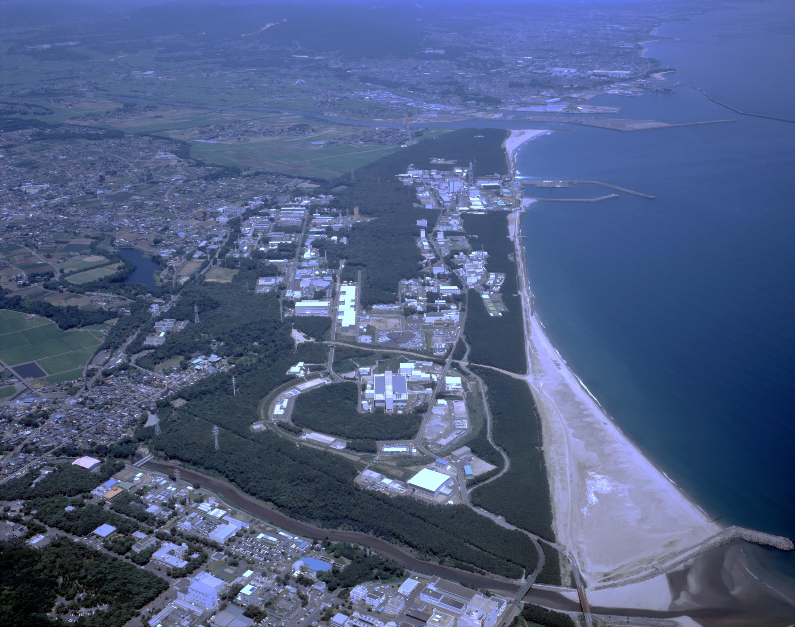
Commissioning experience of J-PARC RCS
Hiroyuki Harada
J-PARC beam commissioning group
ICFA mini-Workshop on Beam Commissioning for High Intensity Accelerators

Slide 2
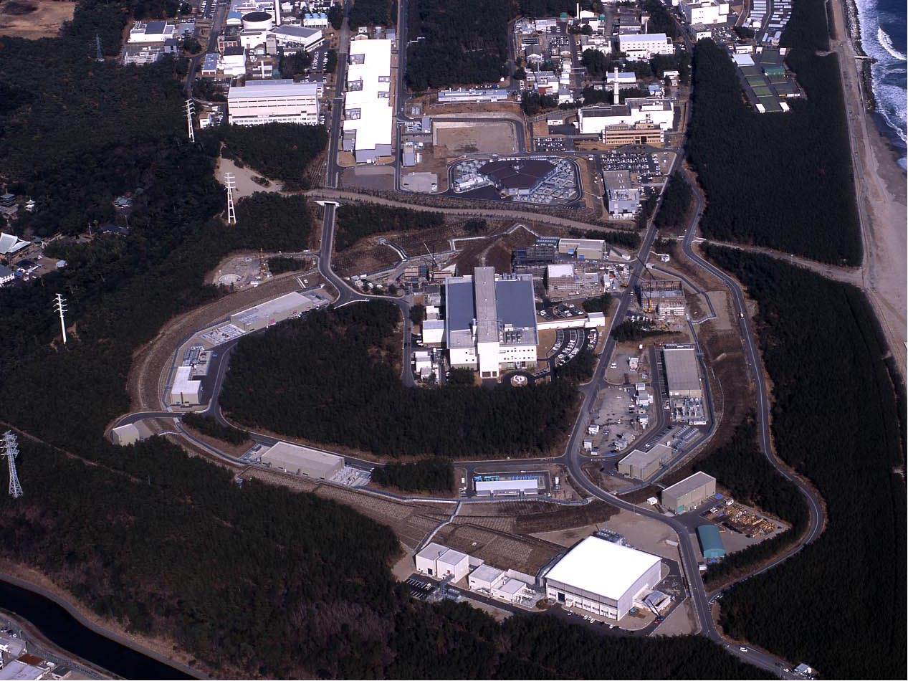
J-PARC
(JAEA & KEK)
400 MeV H⁻ Linac
3 GeV Rapid Cycling Synchrotron (RCS)
Neutrino Beam Line to Kamioka (NU)
1 MW
30 GeV Main Ring Synchrotron (MR)
Materials & Life Science Facility (MLF)
0.75 MW
JFY 2006 / 2007
JFY 2008
JFY 2009
Hadron Experimental Hall (HD)

Slide 3
Contents of this talk
Introduction and operational history of J-PARC 3GeV RCS
Simulation model for beam commissioning
Ring optics tuning and lattice imperfection measurement
Injection tuning, painting injection study and foil scattering
Extraction kicker field ringing compensation
High intensity beam study
Summary

Slide 4
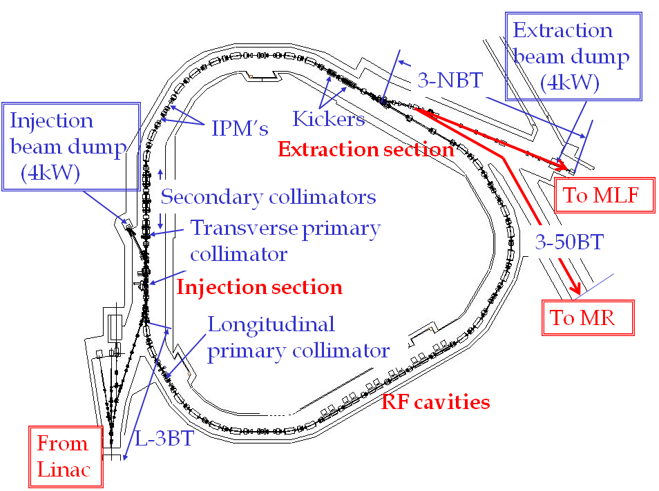
Design parameters of the J-PARC RCS
Pulse dipole magnet
to switch the beam destination
Circumference | 348.333 m
Superperiodicity | 3
Harmonic number | 2
Number of bunches | 2
Injection | Charge-exchange, Multi-turn
Injection energy | 181 MeV
Injection period | 0.5 ms (307 turns)
Extraction energy | 3 GeV
Repetition rate | 25 Hz
Particles per pulse | 5e13
Output beam power | 600 kW
Transition gamma | 9.14 GeV
Number of dipoles | 24
quadrupoles | 60 (7 families)
sextupoles | 18 (3 families)
steerings | 52
RF cavities | 12
Ring Collimator | <4 kW (< 3%)
⇒ 400 MeV in 2013
3GeV
proton
⇒ 8.3e13 in 2014
⇒ 1 MW
MLF : Material and Life Science
Experimental Facility
MR : 50-GeV Main Ring Synchrotron
400 MeV H-
Recently the hardware improvement of the injector linac
has been completed.
The RCS have just got all the design hardware parameters
to try the 1-MW design beam operation.

Slide 5
Operational history of the RCS
Injection energy
upgrade
Injection peak
current upgrade
E_{inj}=181 MeV
I_{max}=30 mA
E_{inj}=181 MeV
I_{max}=30 mA
E_{inj}=400 MeV
I_{max}=30 mA
E_{inj}=400 MeV
I_{max}=50 mA
1-MW-eq
beam test
Startup of the user program
in December 2008
Recovery works
from damages caused by
the “3/11-earthquake”
539-kW
beam test
573-kW-eq
beam test
Output power to MLF (kW)
300 kW
500 kW
for users
220 kW
4 kW
120 kW
Startup of the RCS beam commissioning in October 2007
The beam power ramp-up of RCS has steadily proceeded following;
- Progression in beam tuning, beam dynamics numerical simulation, hardware improvements
High intensity beam tests of up to 573 kW for both injection energies of 181 MeV and 400 MeV
1-MW beam tests from October 2014
Successful achievement of 1-MW eq. intensity output on January 2015
Present output beam power for the routine user program : 500 kW

Slide 6
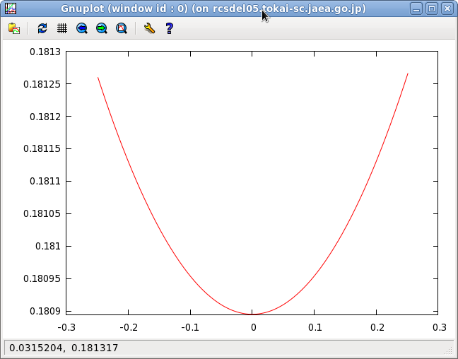
RCS injection process and acceleration cycle
Fast Extraction
B (T)
* Multi-turn H⁻ stripping injection (0.5ms~307turns).
* Acceleration in rapid cycling (25Hz).
* Fast extraction.
1.13
Magnetic field of Bending
Acceleration
0.93
600ns
0.28
Injection
Fast extraction
by kicker
~200ns
0 20 40 Time (ms)
Δp/p₀
h=2
0.5ms (307turns)
Intermediate
Pulses
B field
φ
Multi-turn H⁻
stripping injection
456ns
. . . . . .
. . . . . .
1st bunch
2nd bunch
814ns
Time (ms)

Slide 7
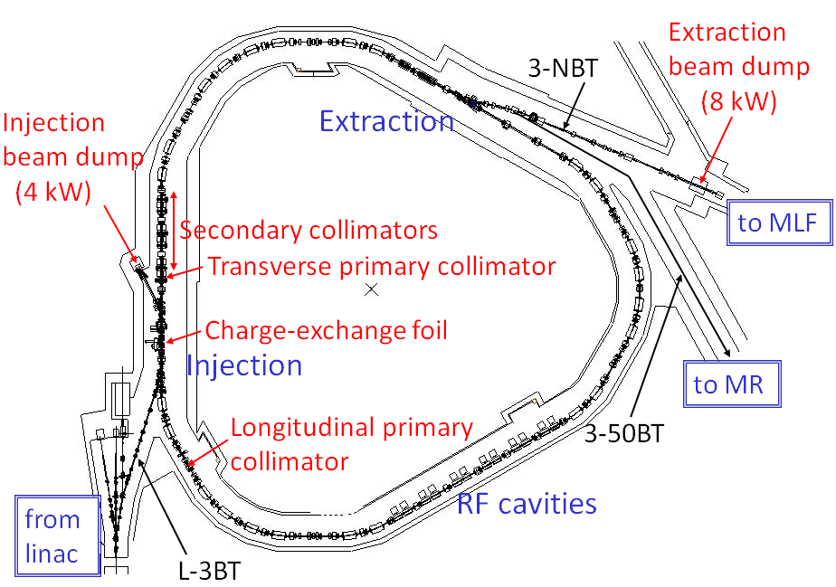
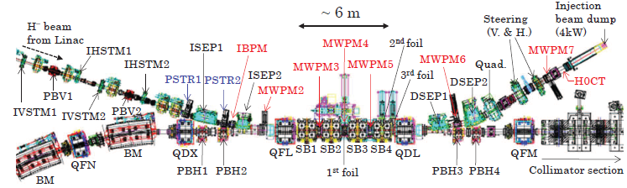
RCS Injection System
H⁻
ISEP1,2
3rd foil
QFL
2nd foil
QDL
<Injection scheme>
  Chopped beam
  H－charge exchange
  307 multi-turns (400MeV)
MWPM3
MWPM5
To beam dump
MWPM4
H⁺
x
H⁻
Beginning of painting
H⁻
s
H⁰
End of painting
H⁰
PB1,2
PB3,4
Circulating
beam
1st foil
H⁺
SB1
SB2
SB3
SB4
- depress beam density
- decrease foil scattering
“Painting injection”

Slide 8
Horizontal Painting Injection Process
3rd foil
H⁻
QFL
2nd foil
QDL
To beam dump
MWPM3
MWPM4
MWPM5
1st foil
H⁺
x
ISEP1,2
H⁻
s
H⁰
PB1,2
PB3,4
Circulating beam
Circulating beam
x’[mrad]
SB1
SB2
SB3
SB4
foil
current
SB
0
93
124.1
x[mm]
PB
-4.4
Injection Beam
time
Injection period(500μsec)

Slide 9
Horizontal Painting Injection Process
3rd foil
H⁻
QFL
2nd foil
QDL
To beam dump
MWPM3
MWPM4
MWPM5
1st foil
H⁺
x
ISEP1,2
H⁻
s
H⁰
PB1,2
PB3,4
Circulating beam
Circulating beam
x’[mrad]
SB1
SB2
SB3
SB4
Ring orbit
foil
current
SB
0
93
124.1
x[mm]
PB
-4.4
Injection Beam
time
Injection period(500μsec)

Slide 10
Horizontal Painting Injection Process
3rd foil
H⁻
QFL
2nd foil
QDL
To beam dump
MWPM3
MWPM4
MWPM5
1st foil
H⁺
x
ISEP1,2
H⁻
s
H⁰
PB1,2
PB3,4
Circulating beam
Circulating beam
x’[mrad]
SB1
SB2
SB3
SB4
foil
current
SB
0
93
124.1
x[mm]
Ring orbit
PB
-4.4
Injection Beam
Painting Area
Injection period(500μsec)
time

Slide 11
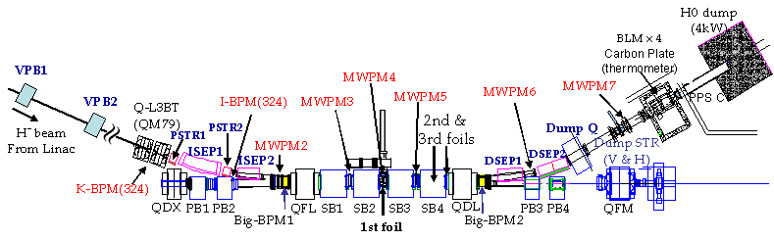
Vertical Painting Injection process
y‘
y
foil
s
MWPM3
MWPM4
MWPM5
VPB1
VPB2
y
H⁺
H⁻
1st foil

Slide 12
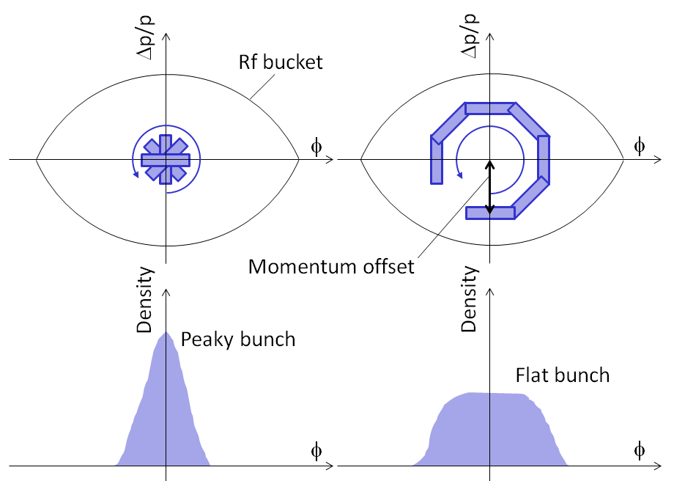
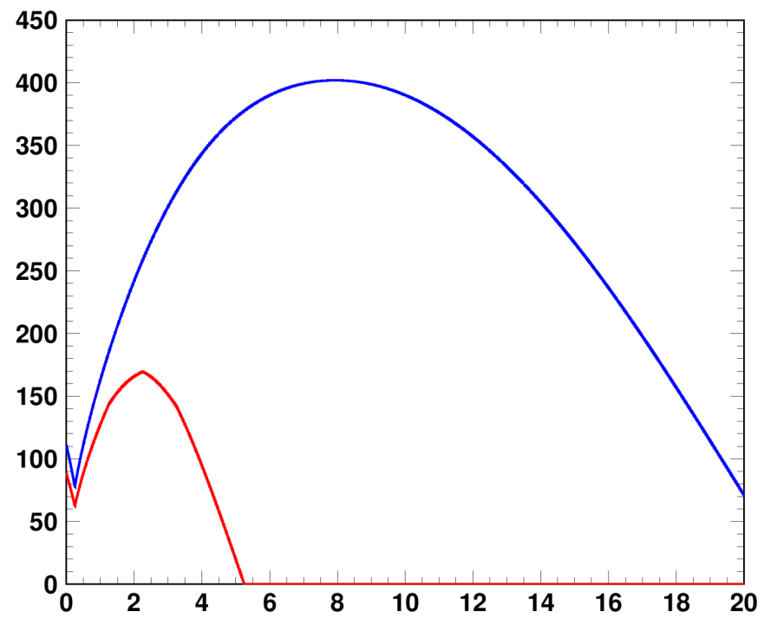
Longitudinal injection painting
F. Tamura et al, PRST-AB 12, 041001 (2009).
M. Yamamoto et al, NIM., Sect. A 621, 15 (2010).
Momentum offset injection
RF voltage pattern
Fundamental rf
V₁
RF voltage (kV)
V₂
Second harmonic rf
Time (ms)
Δp/p=0, −0.1 and −0.2%
V₂/V₁=80%
Uniform bunch distribution is formed through
emittance dilution by the large synchrotron motion excited by momentum offset.
The second harmonic rf fills the role in shaping flatter and wider rf bucket potential, leading to better longitudinal motion to make a flatter bunch distribution.
7/23

Slide 13
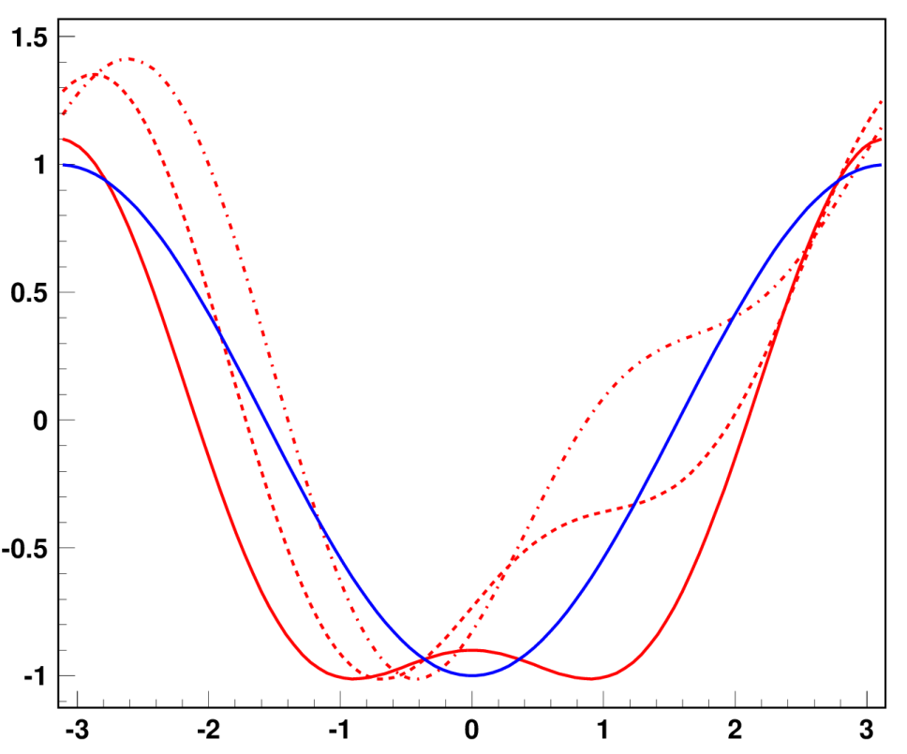
Longitudinal injection painting
Additional control in longitudinal painting ; phase sweep of V₂ during injection
V_{rf}=V₁sinφ-V₂sin{2(φ-φ_{s})+φ₂}
V₂/V₁=0
V₂/V₁=80%
(A) φ₂=−100 deg
φ₂=−100⇒0 deg
(B) φ₂=−50 deg
RF potential well (Arb.)
(C) φ₂=0
The second harmonic phase sweep method enables further bunch distribution control through a dynamical change of the rf bucket potential during injection.
φ (Degrees)
8/23

Slide 14
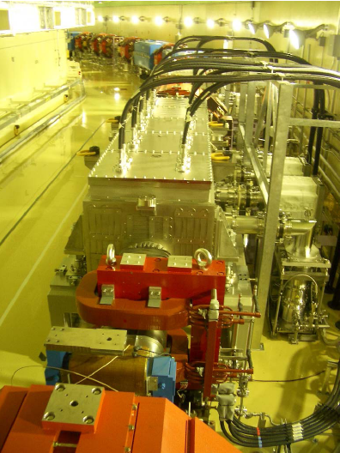
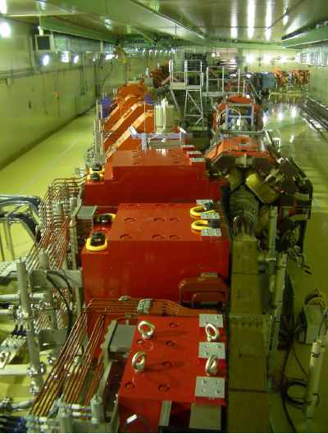
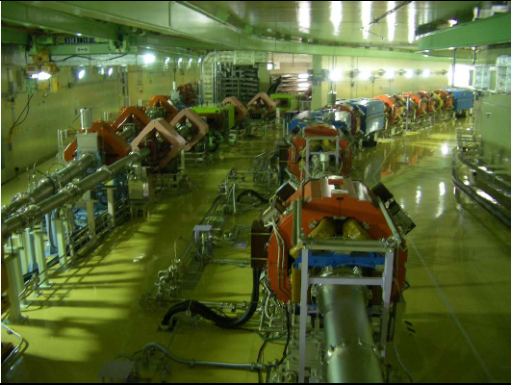
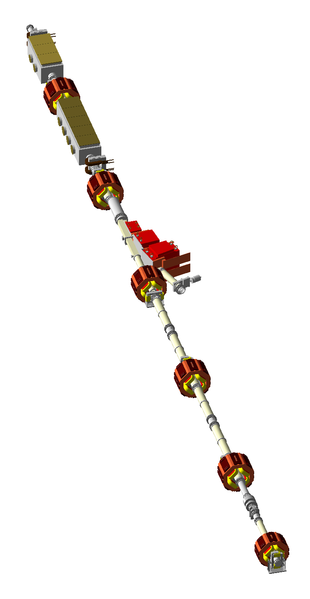
RCS fast extraction system
to MLF / MR
to MLF
to MR
RCS
RCS
RCS
3 DC septum magnets
Beam transport line
8 kicker magnets
to MLF
RCS
to MR

Slide 15
Contents of this talk
Introduction and operational history of J-PARC 3GeV RCS
Simulation model for beam commissioning
Ring optics tuning and lattice imperfection measurement
Injection tuning, painting injection study and foil scattering
Extraction kicker field ringing compensation
High intensity beam study
Summary

Slide 16
Simulation codes and imperfections
Simulation Codes:
  SAD (Powerful code in designs, simulations, commissioning developed by KEK)
  Simpsons (PIC particle tracking code developed by Dr. Shinji Machida[STFC/RAL])
Imperfections included:
  Time independent imperfections
  - Measured main and multipole field components for all the main magnets:
  BM (K_{0~6}), QM (K_{1, 5, 9}), and SM (K_{2, 8}) obtained from field measurements
  - Alignment errors (Δx, Δy, Δs, Δθ) after the earthquake
  Time dependent imperfections
  - Edge focus of the injection bump magnets:
  K₁ estimated from measured optical functions
  - Static leakage fields from the extraction beam line:
  K_{0,1} and SK_{0,1} estimated from measured COD and optical functions
  - BM-QM field tracking errors
  estimated from measured tune excursion over acceleration
  - 1-kHz BM ripple
  estimated from measured orbit variation
  - 100-kHz ripple induced by injection bump magnets
  estimated from turn-by-turn BPM data
  Foil scattering:
  Coulomb & nuclear scattering angle distribution calculated with GEANT

Slide 17
Contents of this talk
Introduction and operational history of J-PARC 3GeV RCS
Simulation model for beam commissioning
Ring optics tuning and lattice imperfection measurement
Injection tuning, painting injection study and foil scattering
Extraction kicker field ringing compensation
High intensity beam study
Summary

Slide 18
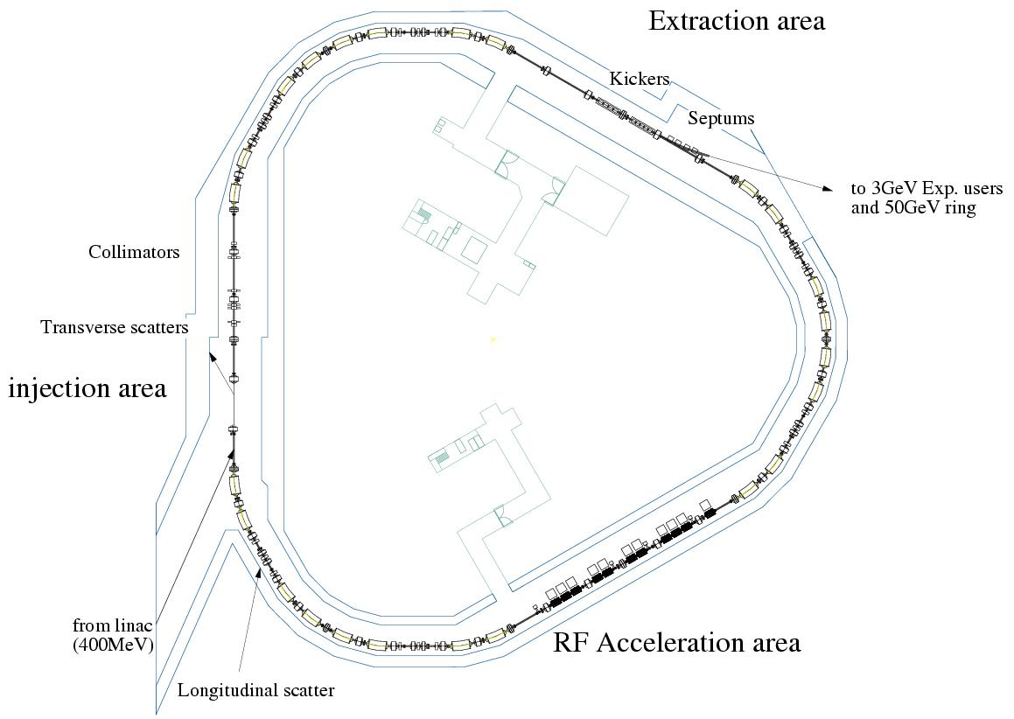
Tune Measurement
~Tune meter system and beam condition
Tune meter system
Transverse RF for beta oscillation excitation
Tune BPM for beta oscillation detection
Beam condition
Momentum spread control by shorter chopped width of injection beam (489 ⇒ 150nsec) for reduction of oscillation damping by chromatic tune spread
Tune BPM
Δp/p
Δp/p
φ
φ
Chopped width of injection beam :
489nsec ⇒ 150nsec
Δp/p:±0.60%
Δp/p:±0.15%
Transverse RF as exciter
Typical RF capture
RF capture for tune measurement

Slide 19
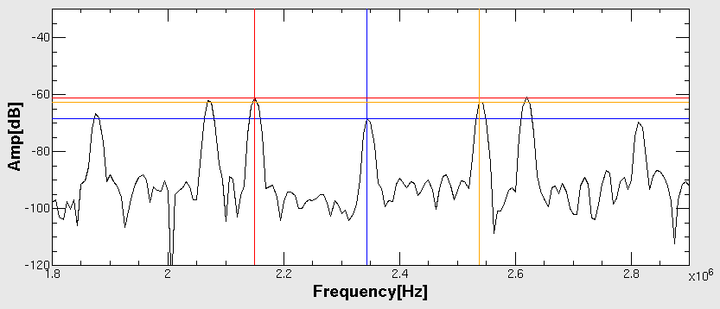
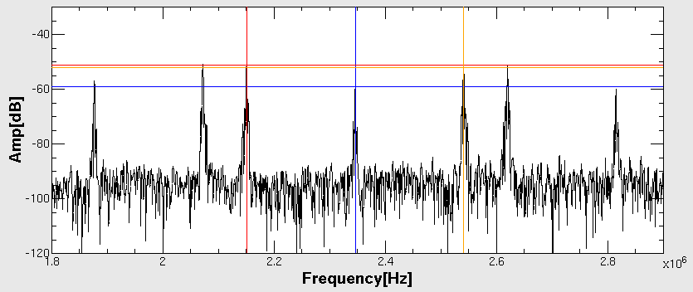
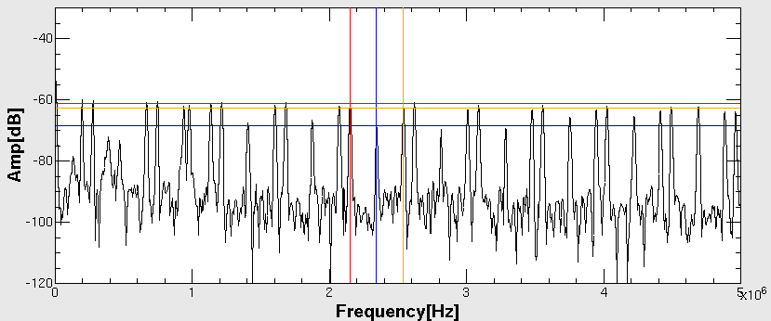
Tune Measurement
~FFT spectrum in DC mode (beam storage mode)
Pickup of betatron oscillation and FFT analysis
Identification of both revolution and betatron sideband peaks
Calculation of betatron tune
Sideband of betatron tune
Sideband of betatron tune
Sideband of betatron tune
Revolution frequency of h=5
Revolution frequency of h=5
Revolution frequency of h=5
Δν depends on Δf = 1/ΔT
ΔT : 160μsec, Δν = ±0.013
ΔT : 1600μsec, Δν = ±0.0013
FFT spectrum @ 2ms in the DC mode (ΔT=160μsec)
Zoom of FFT spectrum @ 2ms in the DC mode (ΔT=160μsec)
Zoom of FFT spectrum @ 2ms in the DC mode (ΔT=1600μsec)

Slide 20
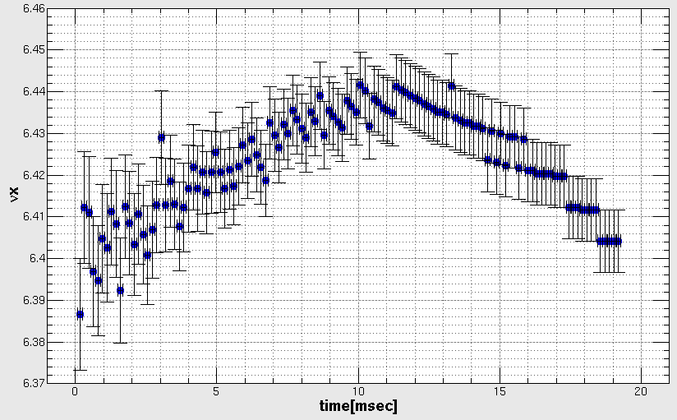
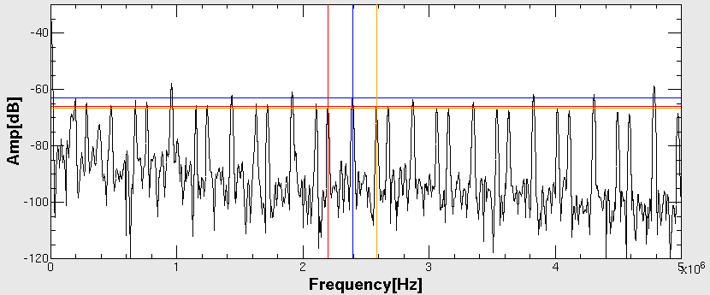
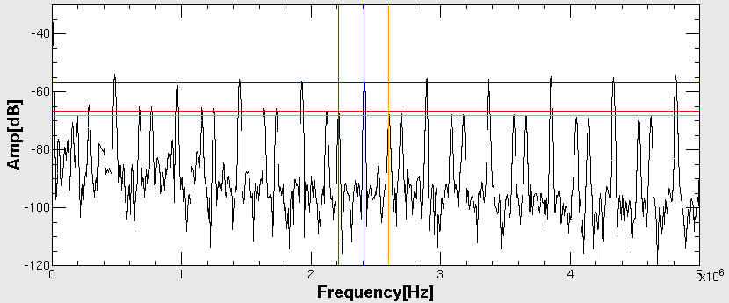
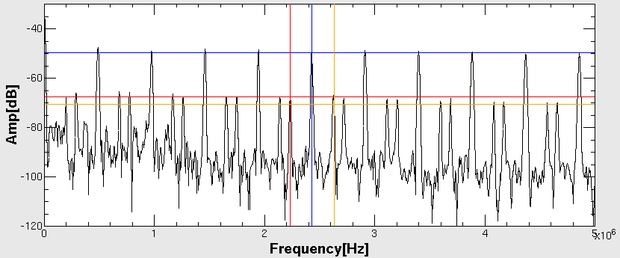
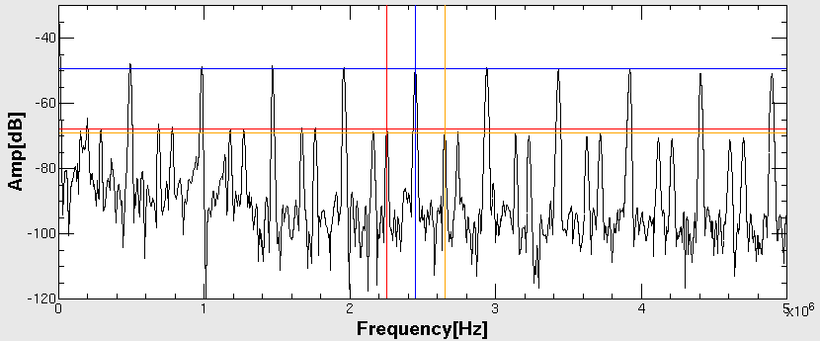
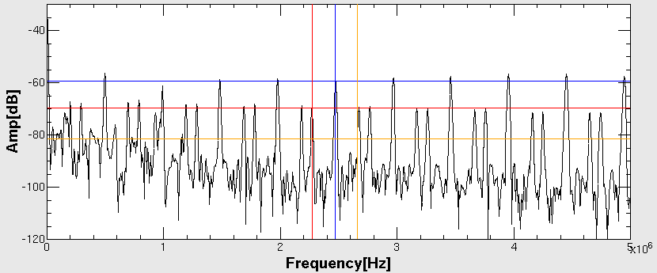
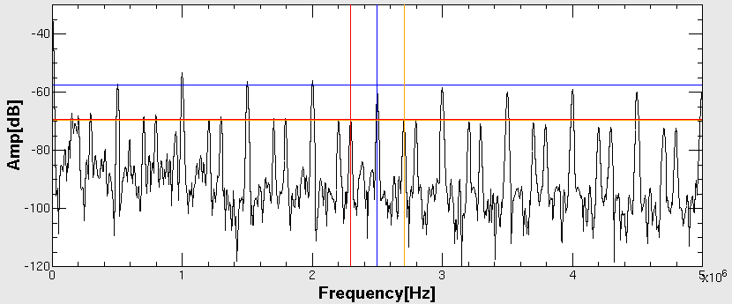
Tune Measurement
~FFT spectrum in AC mode
6.46
Tune is measured frame by frame
FFT spectrum in the AC mode (T=160μsec)
TuneX
6.37
time[msec]
0msec
Injection
20msec
Extraction
160μsec
Time(frame)
1
2
3
4
5
6

Slide 21
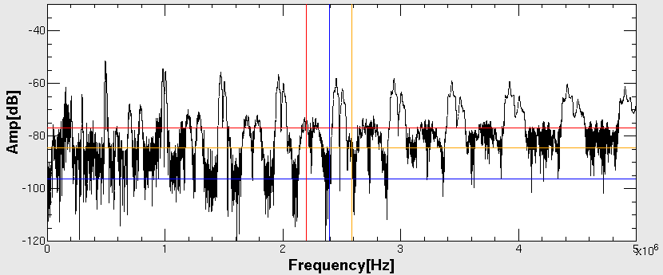
Tune Measurement
~FFT spectrum in AC mode
Accuracy of measured tune must be increased to understand tune tracking during acceleration
Revolution frequency shifts to higher one quickly in synchrotron such as RCS
FFT spectrum with the same method as DC mode has wider peaks
160μsec
FFT spectrum in the AC mode (T=160μsec)
FFT spectrum in the AC mode (T=1600μsec)
Time
1
1600μsec

Slide 22
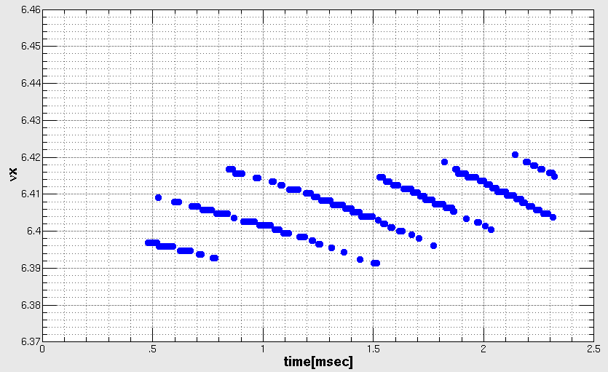
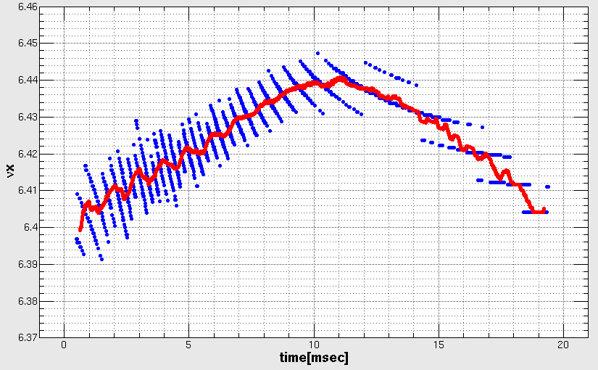
Tune Measurement
~New analytical technic in AC mode
Tune is NOT measured frame by frame.
Tunes are measured with sliding 1 frame (step = 8μsec)
160μsec
Time(frame)
Moving average
TuneX
TuneX
Moving average tune
160μs
0ms
2.5ms
0ms
20ms

Slide 23
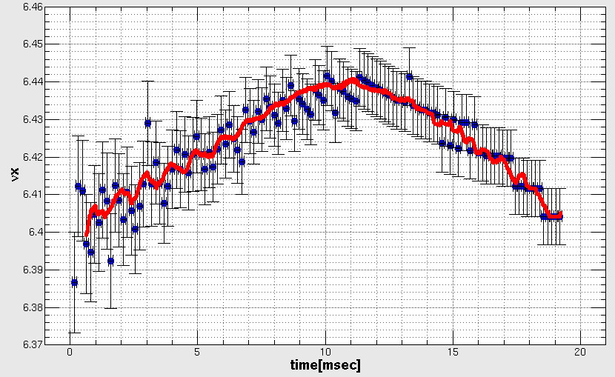
Tune Measurement
~Comparison between general and new analysis
general
new
Tunes during acceleration were measured with high accuracy by using new analysis.
We can clearly discuss tune excursion caused by B-Q tracking.

Slide 24
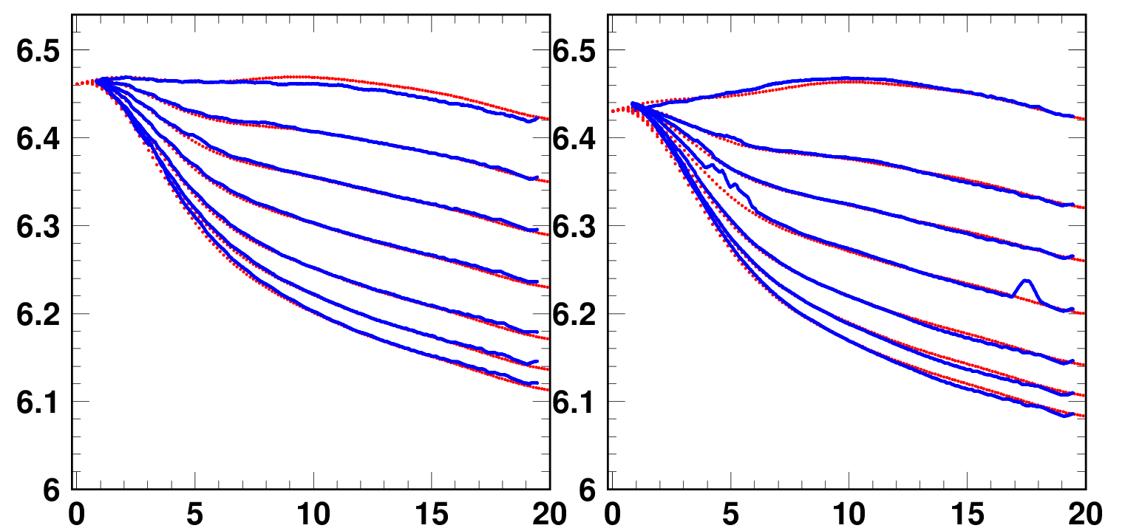
Tune control during acceleration
The measured tune patterns were well reproduced in our simulation.
Tune during acceleration was well controlled by changing QMs top current.
Horizontal
Vertical
Tune
Failure of peak search
Measured tune
Calculated tune
Measured tune
Calculated tune
Time (ms)

Slide 25
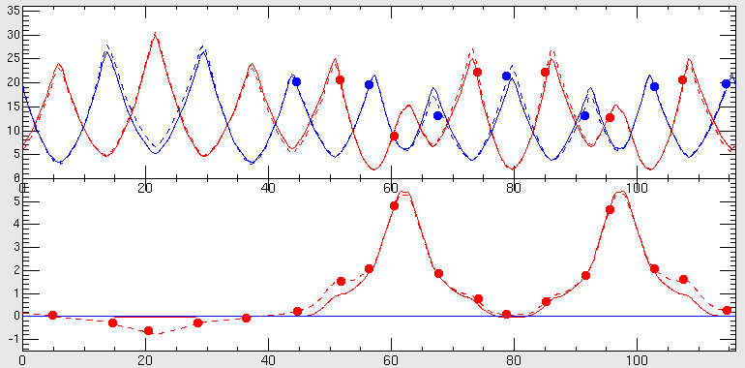
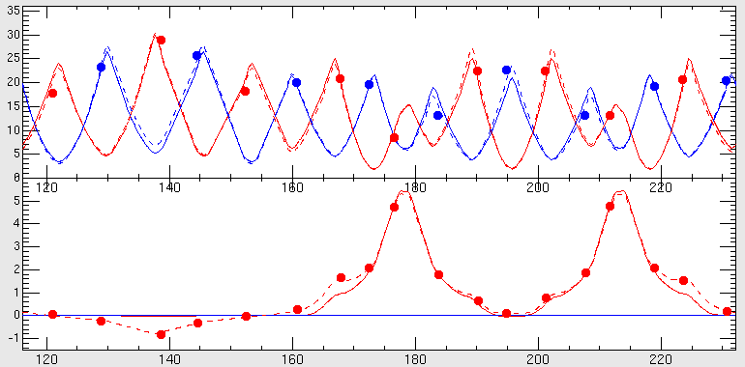
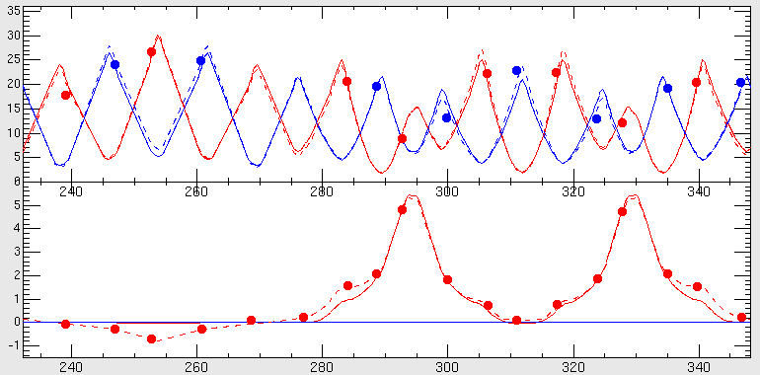
Optics Correction
β_{x}, β_{y}(m)
Betatron tunes : Measured by Fourier transform analysis of detected transverse beam oscillation
Injection + Arc
η_{x}(m)
Set tune : (6.640, 6.250)
Measured tune : (6.672, 6.240)
@ Day-1
Dispersion functions : Measured by looking at a rf-frequency dependence of the closed orbit
Extraction + Arc
Beta functions : Estimated from a response of the closed orbit for a dipole kick (STM) :
RF + Arc
The measured optics was reasonably well-reproduced in our accelerator model.
s(m)
Measured
Designed
Reproduced

Slide 26
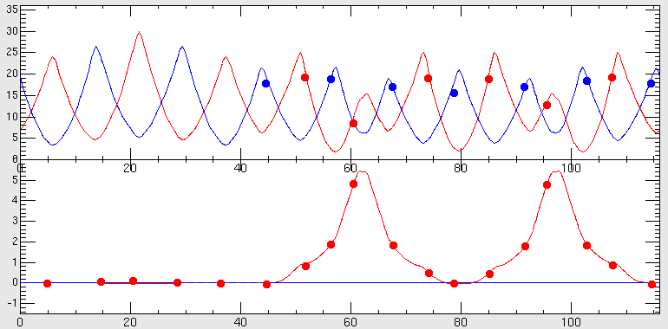
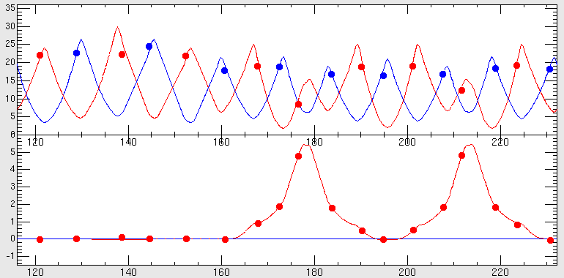
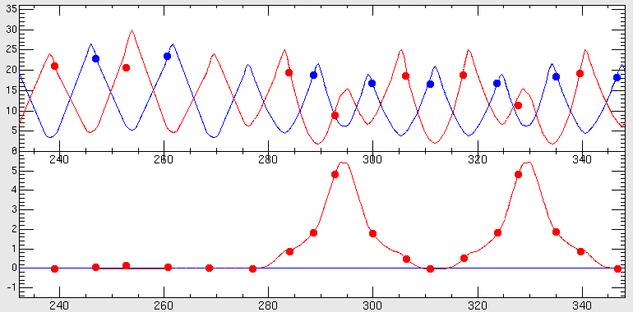
Optics Correction
- Based accelerator model
β_{x}, β_{y}(m)
Injection + Arc
“Fudge factor”: the difference of the set and reproduced quadrupole strength of 7 families in our accelerator model
η_{x}(m)
Extraction + Arc
The ring optics were well corrected to the design value with no iteration by our accelerator model.
RF + Arc
s(m)
Measured
Designed

Slide 27
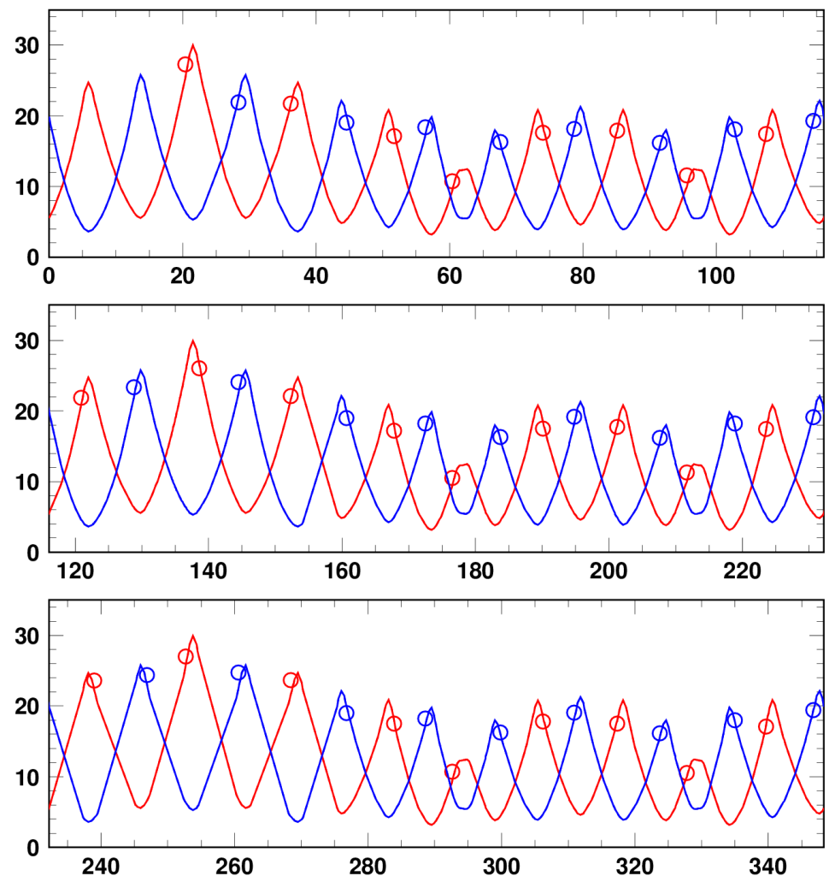
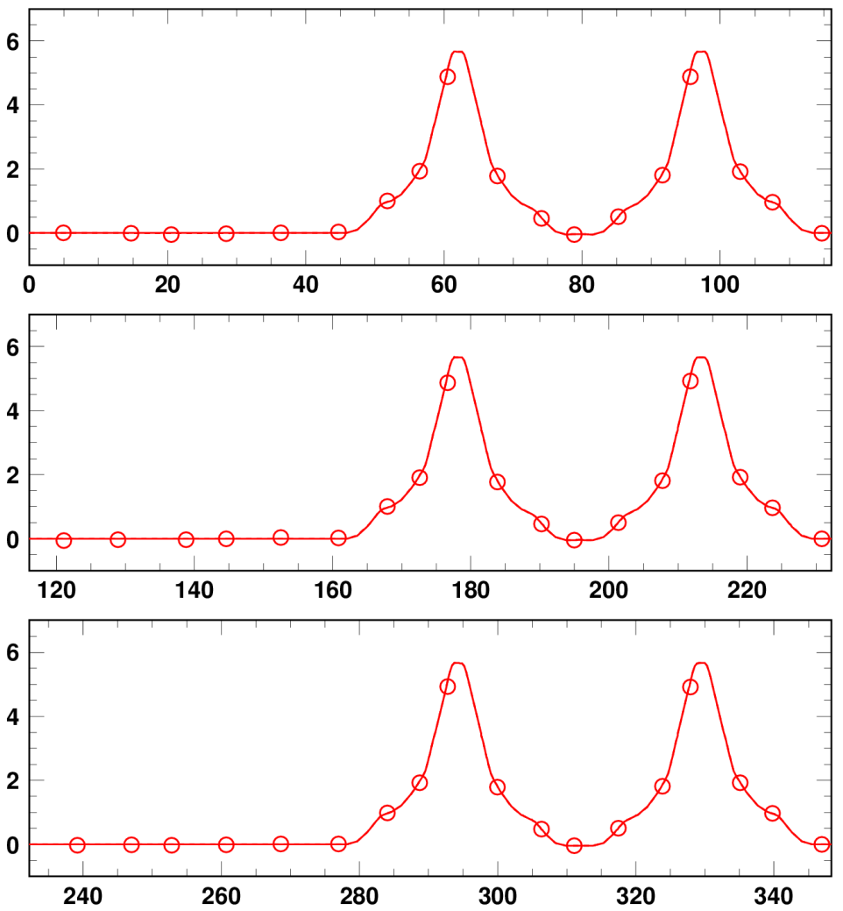
Optics control
We can control ring optics easily.
It was possible to do many beam tunings based-on our accelerator model.
Design curves
Measurements
Design curves
Measurements
Beta function
Dispersion function
β_{x}, β_{y} (m)
η_{x} (m)
s (m)
s (m)

Slide 28
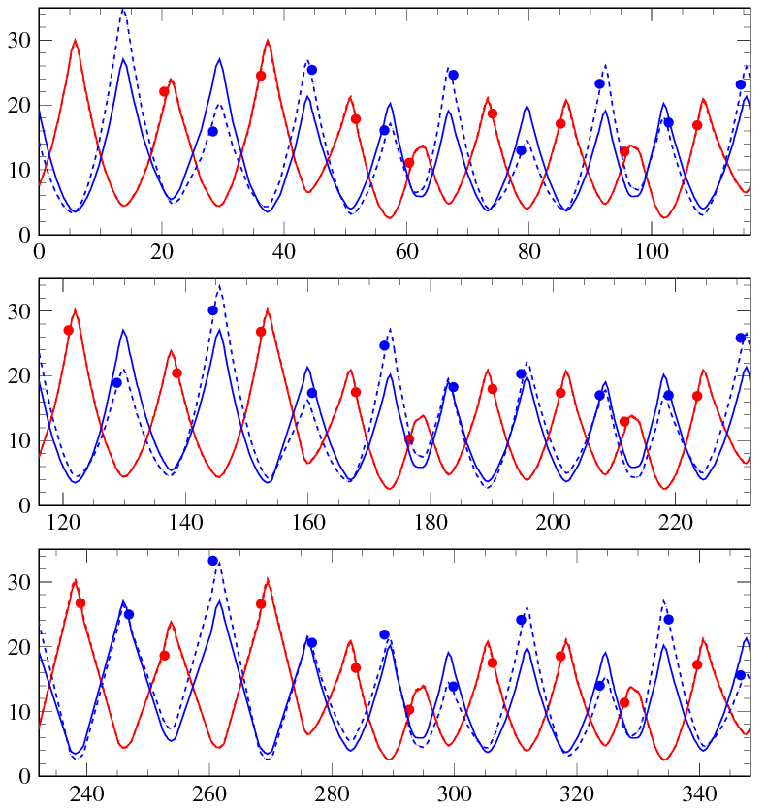
Beam-based measurements
of lattice imperfections in the RCS - I -
Edge focus of the injection-bump magnets
(0.5 ms flattop + 0.5 ms fall time)
Injection or bit bump
~58 mrad
Result of beta modulation measurements
Beta modulation caused by the edge focus;
- makes a distortion of the lattice super-periodicity
- drives random lattice resonances.
Horizontal beta function
Vertical beta function
β_{x} , β_{y} (m)
● measurement (injection bump ; ON)
calculation (injection bump ; ON)
calculation (injection bump ; OFF)
Edge focus
estimated; K₁~-0.003335m⁻¹
s (m)

Slide 29
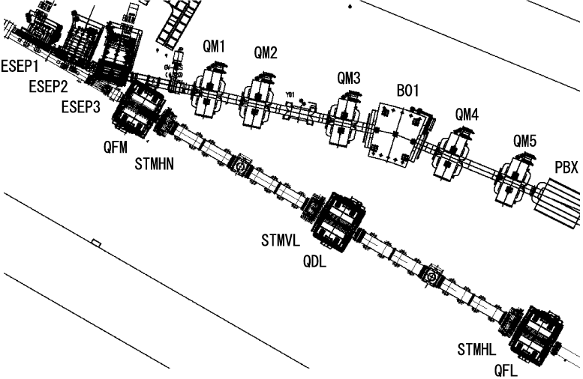
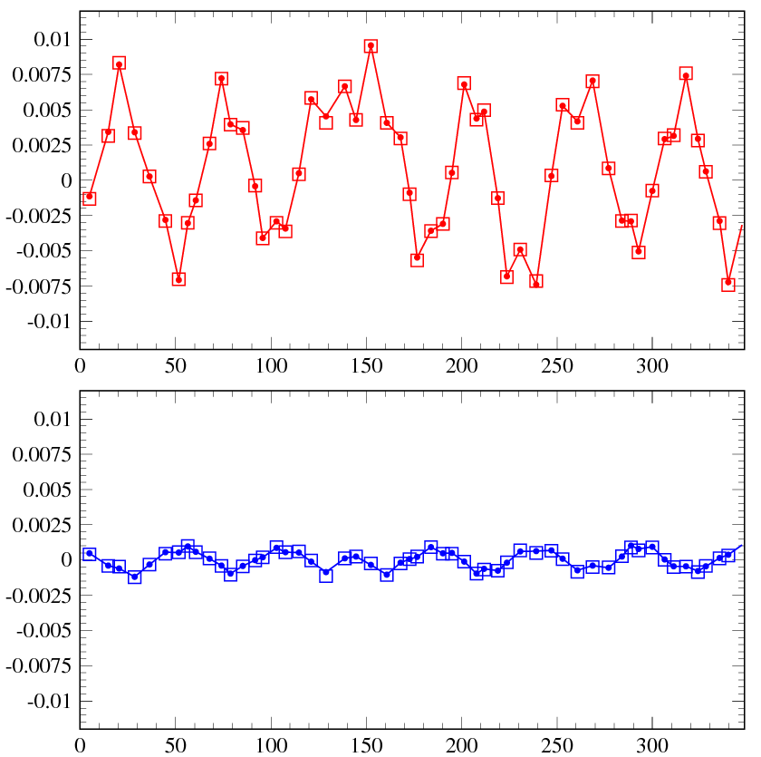
Beam-based measurements
of lattice imperfections in the RCS - II -
Leakage fields from the extraction beam line DC magnets;
- evaluation of dipole and normal quadrupole components
COD caused by the leakage fields
Extraction beam line DC magnets
Δx (m)
±10 mm
□ - calculation
Dipole component
estimated;
-1.14 mrad (hor.)
-0.12 mrad (ver.)
RCS ring
● - measurement
Leakage field includes;
・ Dipole component;
- makes COD
(correctable by steering magnets)
・ Normal quadrupole component;
- makes a distortion of the lattice
super-periodicity
- drives random lattice resonances
・ Skew quadrupole component;
- causes linear coupling
Δy (m)
±1.5 mm
□ - calculation
● - measurement
s (m)
Normal quadrupole component estimated
from the optics measurements; 0.0048 m⁻¹

Slide 30
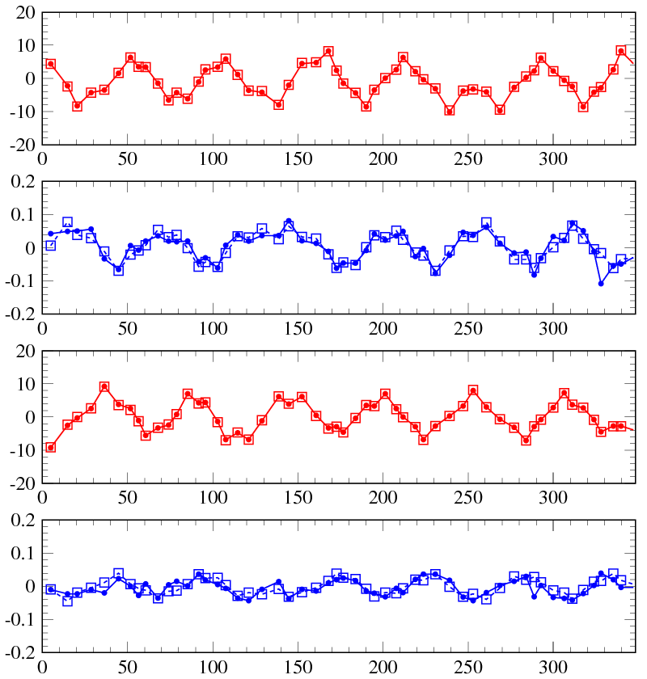
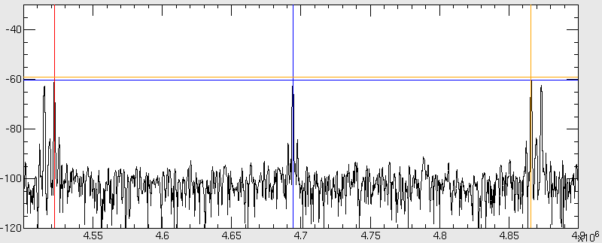
Beam-based measurements
of lattice imperfections in the RCS - II -
Leakage fields from the extraction beam line DC magnets;
- evaluation of skew quadrupole component
Orbit leak (Δy) to the vertical plane
by a horizontal single kick
Systematic measurement of
two normal mode betatron tunes (ν±)
near a linear coupling resonance
Kick
Δx (mm)
□ - calculation
● - measurement
Δy (mm)
ν±
FT spectrum of BPM signal
Kick
f_{rev}
Δx (mm)
Δy (mm)
(Hz)
s (m)
Skew quadrupole component estimated;
-0.00112 m⁻¹

Slide 31
Contents of this talk
Introduction and operational history of J-PARC 3GeV RCS
Simulation model for beam commissioning
Ring optics tuning and lattice imperfection measurement
Injection tuning, painting injection study and foil scattering
Extraction kicker field ringing compensation
High intensity beam study
Summary

Slide 32
Identification of phase space coordinates at injection point
Injection beam
Injection error correction
Painting injection process
Closed orbit
Injection bump
x₀ : Initial position, x₀’ : Initial angle,
ν_{x} : betatron tune , ｎ : Turn number
α_{x}, β_{x} : Twiss parameter
Fourier transform

Slide 33
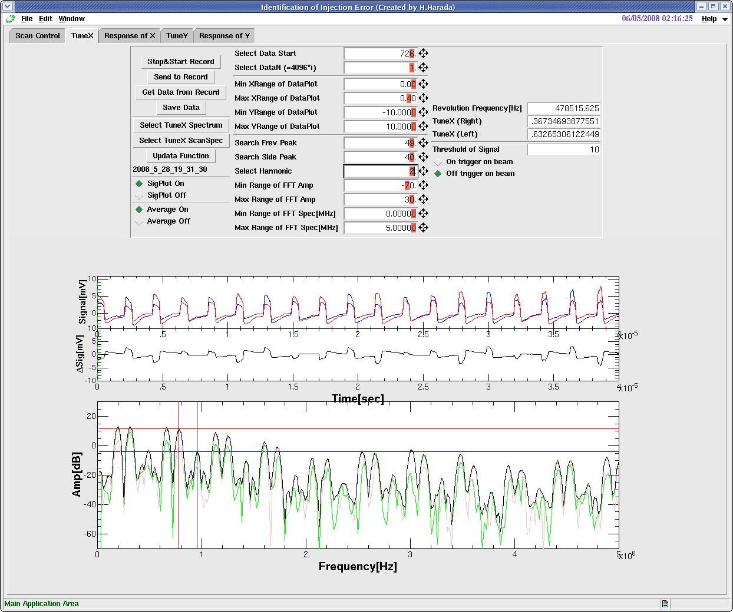
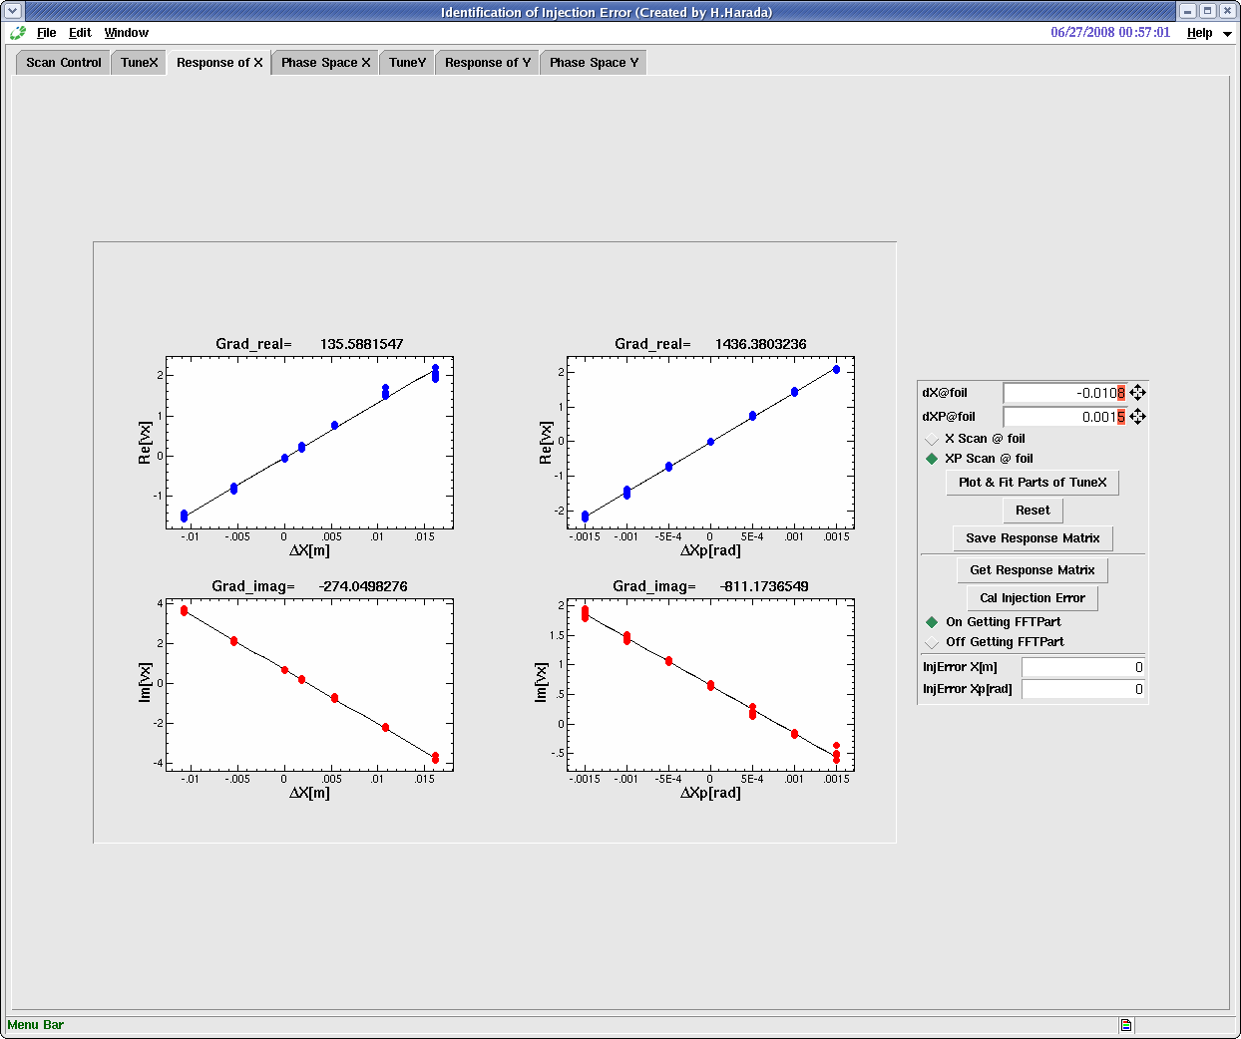
Measurement of response matrix
A₁₁
A₁₂
Detected signals at left-side and right-side electrode
A₂₁
A₂₂

Slide 34
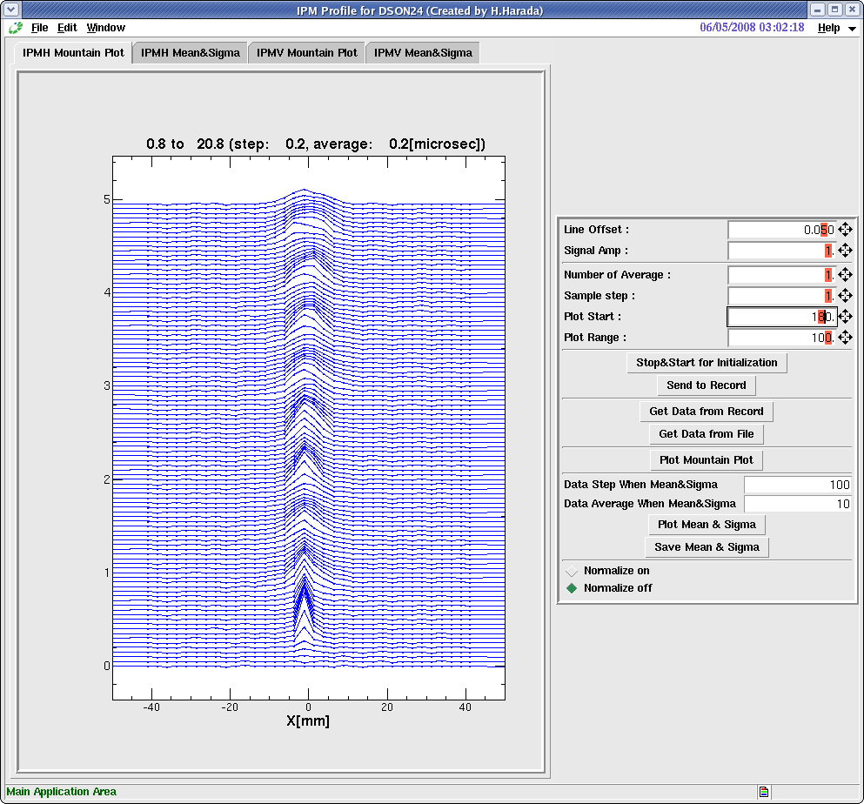
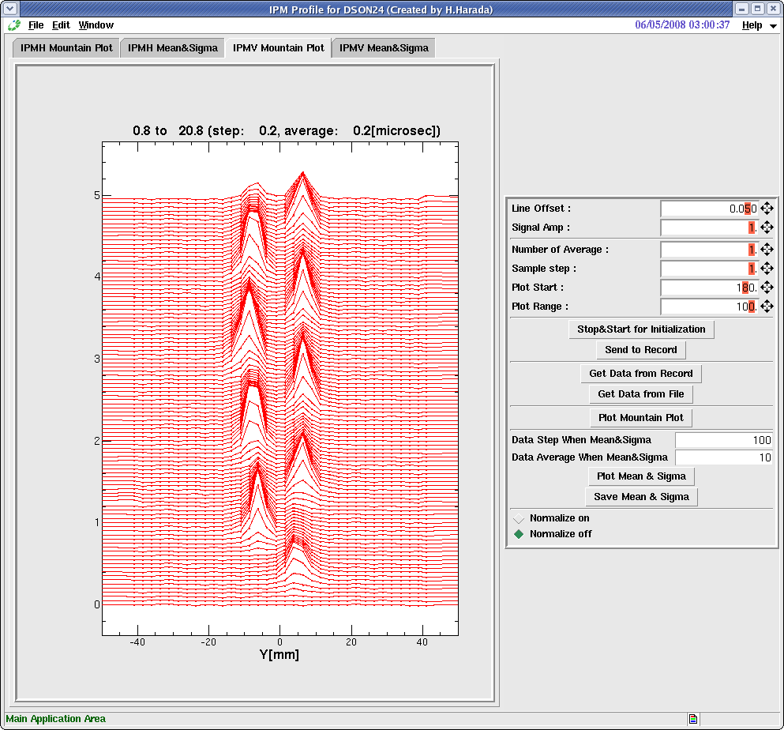
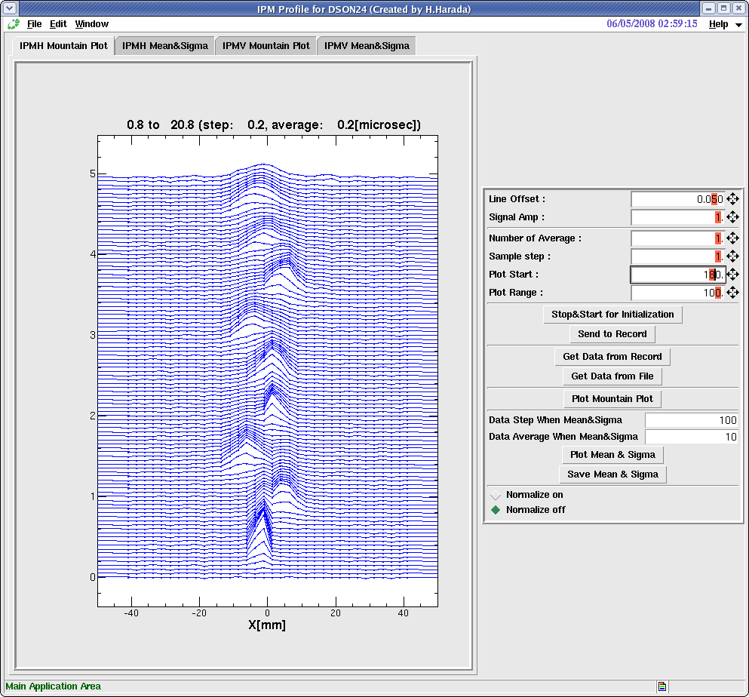
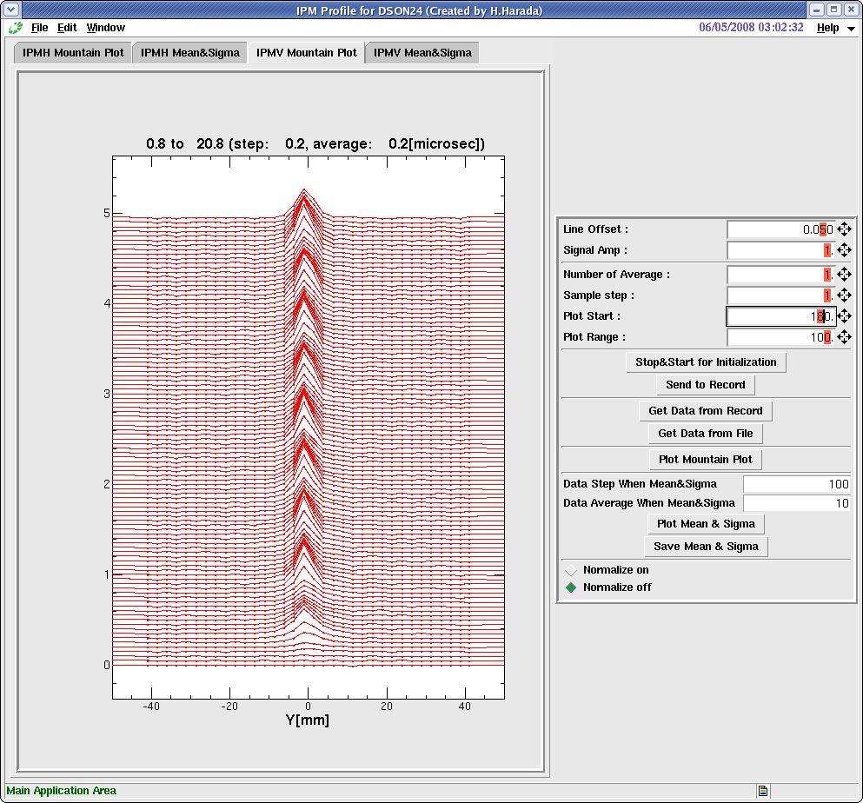
Injection error and betatron oscillation
Horizontal plane
Vertical plane
20 μsec
20 μsec
Injection
Injection
Mountain view of Ionization profile monitors in the ring (Injection to first 10 turns)

Slide 35
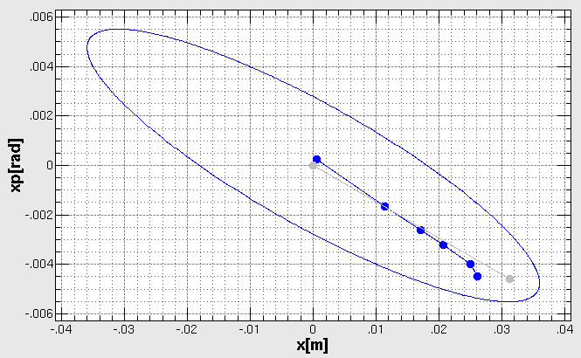

Horizontal and vertical painting injection process
500μs
Single pulse injection
500μs
PB
VPB
time
time
Horizontal phase space
Vertical phase space
100π
100π

Slide 36




Recent measurement method of painting injection process
Multi-turn injection just before PB decay
500μs
(x,x’)
(y,y’)
PB
x‘ (mrad)
y‘ (mrad)
time
Take BPM data
x (mm)
y (mm)
Measured ΔX (PBON – OFF)
Calculated orbit
T=0μs
T=250μs
T=500μs
x[mm]
s[m]

Slide 37


Switching transverse painting area pulse-by-pulse between MLF and MR
The RCS are required different beam emittance from the MLF and MR.
So, RCS is operating with switching transverse painting are pulse-by-pulse between MLF and MR.
Horizontal Paint bump patterns
Inj. start
500μsec
Inj. end
Foil
edge
Foil
edge
Foil
edge
50π
150π
100π
100π
50π
150π
Inj. beam
Inj. beam
Inj. beam
150π for MLF
100π for MR
50π for MR
Calculation

Slide 38


Beam loss issue by foil scattering
To H0 dump
Ring Collimator
H0-Septum2
Circulating beam
H0-Septum1
QDL
BPM
H0 branch
Injection beam
QFL
1st Foil
Beam loss
Circulating beam
Observed dose rates at surface
120kW Operation : 2 ~ 3 mSv/h
220kW Operation : 4 ~ 6 mSv/h
1st foil
QDL
H0
branch
BPM
QFM
Ring Col.
Notes:
38

Slide 39

Measures for the beam loss by the foil scattering
Simulation
θ_{scattering};
20- 30mrad
<20 mrad
Install absorber to catch a foil scattered particles into hot spots (A)
Hot spots
Shield
Absorbers
Build a shield of (A) including the new absorbers
BPM
Foil
QDL
PBH3-4
QFM

Slide 40



The localization results of the beam loss
・Beam Power : 220kW-eq. & 300kW-eq.
・Catcher Positions
Outside ： 66.0mm, Inside ： -55.0mm
BLM inside
BLM outside
S. Kato
w/o Catcher
220kW-eq.
w/ Catcher
220kW-eq.
12%
2%
17%
15%
w/ Catcher
300kW-eq.
Successful to localize the beam losses
(Dose rate of BPM @ 220kW operation : 6.2mSv/h → ~0.7mSv/h)

Slide 41
Contents of this talk
Introduction and operational history of J-PARC 3GeV RCS
Simulation model for beam commissioning
Ring optics tuning and lattice imperfection measurement
Injection tuning, painting injection study and foil scattering
Extraction kicker field ringing compensation
High intensity beam study
Summary

Slide 42
RCS kicker configuration (1)
Kicker Magnet
Numbers |  | 8 (S:3, M:2, L3)
Configuration |  | Twin-C distributed magnet
Dimension | Vertical | 960mm
 | Horizontal | 776mm
 | Length | 638mm
Aperture size | Vertical | 186mm (S), 206mm (M), 232mm (L)
 | Horizontal | 360mm
 | Length | 638mm
Magnet core |  | Ferrite [PE14, TDK ltd]
Unit number |  | 20units/magnet
Characteristic impedance |  | 10W
Schematic diagram of kicker system

Slide 43

RCS kicker configuration (2)
Configuration of the one unit of kicker magnet

Slide 44


Field measurement and Ringing
Measured field of kicker magnet
B
A
magnetic field [A.U]
D
D
magnetic field [A.U]
Field calculation of kicker magnet
time [sec]

Slide 45


Extraction beam quality
600nsec
Different beam positions between 1st and 2nd bunches by the field ringing
  Non-flatness of beam profile @ Neutron targets with octupole field
  Emittance growth by injection error @ MR injection points
2
1
2
400nsec
800nsec
Kicker field
For ringing cancellation
simulation results
w/o offset at oct.
w/ offset of 2mm at oct.
2
1
2
400nsec
800nsec
kicker(1,3,5,7)
Δt = -120 nsec
x[mm]@target
x[mm]@target
Beam fluctuation in 1st bunch by the ringing
  Emittance growth
  Beam instability source
kicker(2,4,6,8)
Δt = 0 nsec

Slide 46

Beam displacement measurement
caused by kicker field ringing
Beam condition : shorter single bunched beam (~150nsec→~30nsec)
Monitor : Beam Position Monitor (BPM) @ extraction beam transport line
Knob : Fire timing (Δt) of all kickers
Kicker field
+3.3mm
Measured Δx[mm]
−5.5mm
Δt [nsec]
Beam center positions of both 1st and 2nd bunches are ~0mm.
Beam fluctuation of 1st bunch is from -5.5 (-1.6%) to +3.3 mm(+0.75%).
Time structure of the ringing is not simple!

Slide 47

Timing scan kicker-by-kicker
Timing scan kicker-by-kicker were performed for understanding each ringing.
After that, we tried to optimize each kicker timing based on scan data for the ringing compensation.
KM1
KM2
KM3
KM4
KM5
KM6
KM7
KM8
Δt [nsec]

Slide 48


Comparison between all and each kicker timing scan
ID
① ΔT
② ΔT
①
KM1
0nsec
10nsec
KM2
0nsec
0nsec
KM3
0nsec
0nsec
KM4
0nsec
35nsec
Measured Δx[mm]
KM5
0nsec
0nsec
KM6
0nsec
0nsec
KM7
0nsec
10nsec
KM8
0nsec
-10nsec
: Summed positions for each scan
: Measured position for all scan
②
Summed scan position for each KMs ( ) is a good agreement with measured position for all KM timing ( ).
⇒ We can discuss with kicker ringing compensation by using each scan data.
Measured Δx[mm]
timing ΔT [nsec]

Slide 49


Timing optimization for ringing compensation
①
: Sum positions for each scan
: Measured position for all scan
Search of optimized timing were performed by using each scan data.
Measured Δx[mm]
③
ID
① ΔT
③ ΔT
KM1
0ns
60ns
KM2
0ns
-20ns
KM3
0ns
50ns
Measured Δx[mm]
KM4
0ns
30ns
KM5
0ns
200ns
KM6
0ns
-30ns
KM7
0ns
50ns
KM8
0ns
-40ns
timing ΔT [nsec]

Slide 50



: Sum positions for each scan
w/o compensation
Max ： Δ= 10.mm (＋2.33%)
Min ： Δ= -14.mm (－3.26%)
w/ old compensation until 2013
Max ： Δ= 3.2mm (＋0.75%)
Min ： Δ= -5.5mm (－1.38%)
w/ new compensation on 2014
Max ： Δ= 0.6mm (＋0.15%)
Min ： Δ= -1.1mm (－0.28%)
timing ΔT [nsec]

Slide 51

Online monitor and drift correction system for kicker timing
There is a gradual change in Thyratron condition and Thyratron output timing has a drift over a period of minutes.
Online monitor of Thyratron output
Thyratron outputs of kickers are monitored online.
If difference from reference is more than 10nsec, kicker timing is corrected automatically.
Extraction beam stability is kept by this system.
KM01
KM05
KM02
KM06
KM03
KM07
KM04
KM08

Slide 52
Contents of this talk
Introduction and operational history of J-PARC 3GeV RCS
Simulation model for beam commissioning
Ring optics tuning and lattice imperfection measurement
Injection tuning, painting injection study and foil scattering
Extraction kicker field ringing compensation
High intensity beam study
Summary

Slide 53


Longitudinal injection painting
Longitudinal beam distribution just after beam injection (at 0.5 ms)
No longitudinal
painting
V₂/V₁=80%
φ₂=-100 to 0 deg
Δp/p= 0.0%
V₂/V₁=80%
φ₂=-100 to 0 deg
Δp/p=-0.1%
V₂/V₁=80%
φ₂=-100 to 0 deg
Δp/p=-0.2%
Δp/p (%)
Δp/p (%)
Δp/p (%)
Δp/p (%)
φ (degrees)
φ (degrees)
φ (degrees)
φ (degrees)
B_{f} ~0.15
B_{f} >0.40
Density (Arb.)
Density (Arb.)
Density (Arb.)
Density (Arb.)
φ (degrees)
φ (degrees)
φ (degrees)
φ (degrees)
Measurements (WCM)
Numerical simulations
from H. Hotchi et. al., PRST-AB 15, 040402 (2011).
9/23

Slide 54

Measurement vs Simulation (Inj. Energy = 181MeV) :
bunching factor from injection to extraction
― Simulations
539 kW (500 μs)
433 kW (400 μs)
Time structure of measured bunching factor for each intense is in good agreement with simulated results.
Feed Forward of RF cavities is worked well up to 600 kW.
326 kW (300 μs)
217 kW (200 μs)
Bunching factor
Time (ms)
104 kW (100 μs)
F. Tamura
H. Hotchi
Time (ms)

Slide 55


Measurement vs Simulation (Inj. Energy = 181MeV) :
extraction beam profile at 3 GeV
MWPM @ extraction beam line
Horizontal
Vertical
Intensity dependence of RMS beam width
539 kW (500 μs)
― Simulations
● Measurements
○ Simulations
433 kW (400 μs)
Charge density (Arb.)
Vertical
326 kW (300 μs)
RMS width (mm)
217 kW (200 μs)
Horizontal
H. Hotchi
104 kW (100 μs)
Li pulse length (ms)
Position (mm)
H. Hotchi
Our numerical simulation well globally reproduced
the experimental results up to 540 kW intensity beam.

Slide 56



Painting parameter dependence of beam survival rate for 550 kW-eq. intensity
○ E_{inj}=181 MeV, 539 kW-eq. intensity (Nov. 2012)
○ E_{inj}=400 MeV, 553 kW-eq. intensity (Apr. 2014)
DCCT data
E_{inj}=400 MeV
By adding 100π
transverse painting
E_{inj}=181 MeV
Beam intensity (x10¹³)
By longitudinal
painting
Beam loss :
~30% ⇒ <1%
Beam survival rate
H. Hotchi
Time (ms)
No painting
Further space-charge mitigation
by higher injection energy
Expanded view
Painting parameter ID
This experimental data clearly show
  the big gain from the injection energy upgrade
  the excellent ability of “painting injection”.

Slide 57

Beam Loss up to 570 kW-eq. intensity (400MeV)
Scintillation type BLM @ Collimator
Run#56 (Jun., 2014) with 400MeV injection
25.5 mA, 0.5 ms, 489 ns, 2 bunches,
Thinning 6/32~32/32 : 107~573 kW-eq.
― 4.775 x 10¹³ : 573 kW-eq
― 3.579 x 10¹³ : 429 kW-eq
“ (6.38, 6.42) ”
― 2.681 x 10¹³ : 322 kW-eq
“Twiss mismatch tuning”
BLM signal (arb.)
― 1.787 x 10¹³ : 214 kW-eq
― 0.889 x 10¹³ : 107 kW-eq
Beam losses occurred only around injection energy and are mostly localized at the collimator section.
Integrated beam losses increase linearly with beam intensity
Beam loss up to 570 kW-eq. intensity is well minimized, only from foil scattering.
Time (ms)
Loss : ~< 0.1%
Loss power (W)
Foil scattering loss only
H. Hotchi
Intensity (x 10¹³)

Slide 58


Achievement of 1MW-eq. intensity beam acceleration
Mainly from foil scattering during injection
Circulating beam intensity over the 20 ms
from injection to extraction measured by CT
BLM @ collimator section
8.41 x 10¹³ ppp : 1010 kW-eq.
7.86 x 10¹³ ppp : 944 kW-eq.
8.41 x 10¹³ ppp : 1010 kW-eq.
6.87 x 10¹³ ppp : 825 kW-eq.
5.80 x 10¹³ ppp : 696 kW-eq.
4.73 x 10¹³ ppp : 568 kW-eq.
7.86 x 10¹³ ppp : 944 kW-eq.
BLM signals (a.u.)
BLM @ high dispersion area in the arc section
6.87 x 10¹³ ppp : 825 kW-eq.
H. Hotchi
5.80 x 10¹³ ppp : 696 kW-eq.
Particles /pulse (x 10¹³)
4.73 x 10¹³ ppp : 568 kW-eq.
In January 10, 2015
we successfully achieved
the 1-MW beam acceleration.
Time (ms)
The beam losses observed for the 944-kW (blue) and 1010 kW (red) beams can be interpreted as longitudinal beam loss.
For this issue, we plan to upgrade the anode power supply using this summer maintenance period.
Injection
Extraction
Time (ms)
H. Hotchi

Slide 59
Summary
The RCS was beam-commissioned in October 2007.
The output beam power has been steadily increasing progressions in the beam tuning, hardware improvements and realistic simulations.
After completing output energy and peak current upgrade of the LINAC, the RCS started the 1-MW beam tuning from October 2014.
The 1-MW beam acceleration was successfully demonstrated on January 2015.
Now we are gradually increasing the routine output beam power by a 100-kW step every one month. If this beam power ramp-up scenario is going well, the 1-MW routine beam operation is to start up from the next spring via the summer maintenance period.

Slide 60
Thank you for your attention.

Slide 61
Backup of slides

Slide 62
RCS beam commissioning system
Operation Interface
Operation Interface based on
Beam simulation
Accelerator Model
(code:SAD)
Control server of devices
and monitors (EPICS)
Control server of
simulation parameters
(EPICS)
IOC
IOC
IOC
File
Real accelerator
Virtual accelerator

Slide 63




High intensity beam and space charge effect
x=5.5
x=6
x=6.5
4x=27
x=7
x=7.5
y=7.5
x+2y=21
x+y=13
2x+2y=27
Tune footprint in tune diagram (Simulation)
(6.40, 6.42)
y=7
X-2y=-6
4y=27
Bare tune
Vertical tune, ν_{y}
y=6.5
2x+2y=24
ν_{y}
ν_{y} = 6
x+2y=18
400 MeV inj.
(for 1 MW)
y=6
181 MeV inj.
(for 550 kW)
ν_{x} = 6
y=5.5
Horizontal tune, ν_{x}
ν_{x}
Increasing beam intensity
Defocusing force by space charge
Different betatron tune particle-by-particle (tune spread)
Emittance growth and beam losses
Δν =
Δν =
Δν =
Notes:
５０π→２×10^15 [particle/m^3], 216π→4.5×10^14 [particle/m^3]

Slide 64


Transverse injection painting
Field forms of the injection bump magnets for 100π−mm-mrad painting
SB
PBH1
The flattop of SB was restored!!
PBH2
PBV1
PBH3
PBH4
PBV2
Horizontal painting
process by PBH1-4
Vertical painting
process by PBV1-2
100π
100π
Measured
painting process
Measured
painting process
ε_{tp}=100π mm mrad
x’(rad)
y’(rad)
Well adjusted.
Design
painting process
Design
painting process
x (m)
y (m)

Slide 65
Injection beam tuning : DB2
Momentum spread of the injection beam
estimated by the longitudinal tomography for turn-by-turn WCM data
DB2 off
M. Yoshimoto
Δp/p : ~0.082% (sigma)
DB2 -1865
Δp/p : ~0.182% (sigma)

Slide 66



Injection beam tuning : Twiss parameter @ RCS injection point
We adjusted the Twiss parameter of the injection beam so that the injection
beam ellipse fits the design painting area of 100π mm mrad as possible.
“DB2 -1865”
Beam envelop along the L3BT
Beam profile @ RCS injection point
Multi-wire profile monitors 1-4
I_{p}=25.5 mA
(Run#56)
I_{p}=45.9 mA
(Run#57)
RCS injection point
Horizontal
I_{p}=45.9 mA
Hor.
(U)
Hor.
(U)
I_{p}=25.5 mA
Beam size, sigma (mm)
Vertical
I_{p}=45.9 mA
Ver.
(V)
Ver.
(V)
I_{p}=25.5 mA
s (m)
T. Maruta & K. Okabe
Position (mm)

Slide 67
Emittance & Twiss parameter of the injection beam
 | DESIGN | DB2 OFF Run#56 I_{p}=25.5 mA | DB2 OFF Run#57 I_{p}=45.9 mA | DB2 -1865 Run#57 I_{p}=45.9 mA
α_{x} | -1.252 | -1.038 | -0.812 | -0.934
α_{y} | -1.822 | -1.618 | -1.714 | -1.644
β_{x} (m) | 10.226 | 10.436 | 6.552 | 6.106
β_{y} (m) | 8.995 | 11.147 | 9.485 | 9.717
ε_{x} (π mm mrad, rms, un-norm) | 0.25 | 0.600 | 0.889 | 0.957
ε_{y} (π mm mrad, rms, un-norm) | 0.25 | 0.537 | 0.587 | 0.564
Momentum spread (%) | 0.2 (full) | 0.066 (sigma) | 0.082 (sigma) | 0.182 (sigma)

Slide 68

Transverse injection painting area
estimated for the 46.0-mA injection beam (DB2 -1865)
Design painting area
(Circulating beam ellipse after painting)
Painting area estimated
for the case of I_{p}=25.5 mA (Run#56)
Painting area estimated
for the case of I_{p}=45.9 mA (Run#57)
Design injection beam ellipse
Injection beam ellipse
for the case of I_{p}=25.5 mA (Run#56)
Injection beam ellipse
for the case of I_{p}=45.9 mA (Run#57)
(x, x’)
(y, y’)
180π (I_{p}=45.9 mA)
Circulating
beam ellipse
115π (I_{p}=45.9 mA)
145π (I_{p}=25.5 mA)
110π (I_{p}=25.5 mA)
100π
100π
Painting
process
x’ (rad)
y’ (rad)
Injection
beam ellipse
Circulating
beam ellipse
Injection
beam ellipse
Painting
process
x (m)
y (m)

Slide 69


Result of the first 1-MW trial
Circulating beam intensity over the 20 ms
from injection to extraction measured by DCCT
Anode current measured as
a function of the beam power
1-MW-eq
W/ multi-harmonics (h=2,4,6)
feed-forward for
beam loading compensation
RF trip
6.87 x 10¹³ : 825 kW-eq
6.44 x 10¹³ (Thinning 24/32) : 773 kW-eq
773-kW-eq
5.84 x 10¹³ (Thinning 22/32) : 701 kW-eq
Cavity#12
Trip
5.33 x 10¹³ (Thinning 20/32) : 639 kW-eq
4.79 x 10¹³ (Thinning 18/32) : 574 kW-eq
Interlock 110 A
Particles /pulse (x 10¹³)
4.25 x 10¹³ (Thinning 16/32) : 510 kW-eq
3.73 x 10¹³ (Thinning 14/32) : 447 kW-eq
3.19 x 10¹³ (Thinning 12/32) : 383 kW-eq
Anode current (A)
2.65 x 10¹³ (Thinning 10/32) : 318 kW-eq
M. Yamamoto
2.10 x 10¹³ (Thinning 8/32) : 252 kW-eq
252-kW-eq
Injection
Extraction
Beam power (kW)
Time (ms)
The beam intensity was smoothly increased up to 770 kW with no significant beam loss, but when the beam intensity got to over 800 kW, the accelerating RFs suddenly tripped;
the anode power supply of the RF system tripped
due to the over current.
In the present condition,
the required anode current
surpasses the interlock level
when the beam intensity
gets to over 800 kW.

Slide 70

Possible measures against the RF trip & plan
Anode current measured as a function of the beam power
W/ multi-harmonics (h=2,4,6)
feed-forward
for beam loading compensation
Load map to 1 MW newly made after the beam test
Use a remaining margin
of the anode power supply;
110 A to 115 A
Cavity#12
115 A
124 A
109 A
Reduce the required anode current by
shifting the resonant frequency
of the RF cavity; 124 A to 109 A
110 A
Anode current (A)
M. Yamamoto
By taking these possible measures,
the required anode current for
the 1-MW beam acceleration will get to
be within the limit.
Re-try 1-MW beam acceleration
in Dec., 2014 & Jan., 2015
Beam power (kW)
Increase the anode power supply itself to get sufficient margin
using the next summer shutdown period of 2015;
115 A (15 sets of inverter units) ⇒ 138 A (18 sets of inverter units)
Start up the 1-MW user operation from Oct. 2015 as originally planned

Slide 71

Intensity dependence of beam loss (DB2 -1865)
BLM signal @ collimator over the first 5 ms in the low energy region
Injection bump OFF
4.78 x 10¹³ (Thinning 32/32) : 573 kW-eq
Injection
3.58 x 10¹³ (Thinning 24/32) : 429 kW-eq
Run# 56 (I_{p}=25.5 mA)
107 kW ~ 573 kW-eq
2.68 x 10¹³ (Thinning 18/32) : 322 kW-eq
1.79 x 10¹³ (Thinning 12/32) : 214 kW-eq
0.89 x 10¹³ (Thinning 6/32) : 107 kW-eq
Beam loss monitor signal (arb.)
6.44 x 10¹³ (Thinning 24/32) : 773 kW-eq
Time (ms)
5.84 x 10¹³ (Thinning 22/32) : 701 kW-eq
5.33 x 10¹³ (Thinning 20/32) : 639 kW-eq
Run# 57 (I_{p}=45.9 mA)
252 kW ~ 773 kW-eq
4.79 x 10¹³ (Thinning 18/32) : 574 kW-eq
4.25 x 10¹³ (Thinning 16/32) : 510 kW-eq
3.73 x 10¹³ (Thinning 14/32) : 447 kW-eq
3.19 x 10¹³ (Thinning 12/32) : 383 kW-eq
2.65 x 10¹³ (Thinning 10/32) : 318 kW-eq
2.10x 10¹³ (Thinning 8/32) : 252 kW-eq
Time (ms)
The beam loss appears mainly for the first 1 ms
of the beam injection.
The beam loss amount almost has
a linear response for the beam intensity.
The beam loss of up to 773-kW intensity beam
is nearly minimized, and its remaining beam loss
is mainly from foil scattering during injection.
Beam loss estimated for 773 kW intensity beam;
<0.2% (160 W << 4-kW collimator limit).
○ ・・・ Run#56
● ・・・ Run#57
773kW-eq
Loss power (W)
107kW-eq
Mainly from foil scattering
Beam intensity (x10¹³)

Slide 72


Beam loss : measurements vs calculations (Run#56)
BLM signals @ collimator
Calculations
Run# 56 (I_{p}=25.5 mA)
― 4.775 x 10¹³ (Thinning 32/32) : 573 kW-eq
― 3.579 x 10¹³ (Thinning 24/32) : 429 kW-eq
Number of
lost particles/turn
BLM signal (arb.)
― 2.681 x 10¹³ (Thinning 18/32) : 322 kW-eq
― 1.787 x 10¹³ (Thinning 12/32) : 214 kW-eq
― 0.889 x 10¹³ (Thinning 6/32) : 107 kW-eq
Time (ms)
Loss power (W)
Loss power (W)
Loss △:
0.08%
0.07%
0.07%
0.11%
0.09%
Intensity (x 10¹³)
Intensity (x 10¹³)
The numerical simulation well reproduced the experimental beam loss data.

Slide 73


Beam loss at the collimator
Measurements : BLM signals at the collimator over the first 6 ms
8.41 x 10¹³ ppp : 1010 kW-eq.
The beam loss at the collimator section appears
for the first 1-ms region.
The remaining beam loss mainly arises
from foil scattering during injection.
The other beam loss, such as space-charge
induced beam loss, was well minimized
by injection painting even for the 1-MW beam.
The remaining beam loss for the 1-MW beam
was estimated to be 0.17% (240 W in power)
<< Collimator limit of 4 kW.
We expect the 1-MW routine beam operation
will be ready after this summer maintenance
period, namely by solving the remaining
longitudinal beam loss after completing
the RF anode power supply upgrade.
7.86 x 10¹³ ppp : 944 kW-eq.
BLM signals (a.u.)
6.87 x 10¹³ ppp : 825 kW-eq.
5.80 x 10¹³ ppp : 696 kW-eq.
4.73 x 10¹³ ppp : 568 kW-eq.
Time (ms)
Calculations
Number of lost
particles per turn
Time (ms)
16/23

Slide 74

Recent efforts for further beam loss mitigation
H. Hotchi et al, NIM, Sect. A 778, 102 (2015).
Next issue : further mitigation of the foil scattering beam loss
Most of the foil scattering beam loss is well localized at the collimators,
but some of them with large scattering angles cause un-localized beam loss,
making relatively high machine activations near the charge-exchange foil;
~15 mSv/h @ chamber surface for the 400-kW routine beam operation.
The machine activation is expected to be within the permissible level
even if assuming the 1-MW routine beam operation, but we tried further
beam loss mitigation to keep the machine activation as low as possible.
Present : ε_{tp}=100 π mm mrad
ε_{tp}=150 π mm mrad
The foil scattering beam loss
can be reduced by larger
transverse painting, especially
on the horizontal plane.
But such a large transverse painting had not been realized
until recently due to
beta function beating
caused by the edge focus
of the injection bump magnets.
Average number
of foil-hits/particle:
x 0.6
~42
~27
17/23

Slide 75


Beta function beating caused by the injection bump magnets
Beam injection is performed with a time dependent
horizontal local bump orbit by using 8 sets of
rectangular pulse dipoles magnets (SB1-4 & PBH1-4 ).
Beta function beating caused by the edge
focus of the injection bump magnets
Horizontal (Bump off)
Horizontal (Bump on)
Vertical (Bump off)
Vertical (Bump on)
1st super-period
Edge focuses are generated
at the entrance and exit of the injection bump magnets.
2nd super-period
Beta functions (m)
There is no beta function beating on the horizontal plane,
because the horizontal edge focus effects are
canceled out by another focusing property
intrinsic on the bending plane.
3rd super-period
The vertical edge focus affect the beam as is,
making 30% beta function beating
on the vertical plane at maximum
during injection period.
s (m)
Beta function beating makes a distortion of the lattice super-periodicity and
additionally excites various random betatron resonances.
18/23

Slide 76


Random betatron resonances
excited through a distortion of the super-periodicity
Present
operating point
(6.45,6.42)
ν_{x}+2ν_{y}=19
Plotted up to
4th order resonances
Vertical tune ν_{y}
Vertical tune ν_{y}
Horizontal tune ν_{x}
Horizontal tune ν_{x}
Systematic resonances
Random resonances
that can be additionally excited through a distortion of the super-periodicity
on the vertical plane caused by the edge focus of the injection bump magnets
These random resonances cause an additional shrinkage of
the dynamic aperture during the injection period, and leads to
extra beam loss when applying large transverse painting.
Especially, the random 3rd order sum resonance (ν_{x}+2ν_{y}=19)
strongly affects the beam in the present operational condition.
19/23

Slide 77




Correction of beta function beating
We have recently installed 6 sets of pulse type quadrupole correctors (QDTs),
to compensate beta function beating, and to minimize the effect of the random resonances
through the recovery of the super-periodic condition.
QDT
Beta function beating correction by the quadrupole correctors.
Before correction
After correction
1st super-period
Vertical beta function
beating was successfully
corrected by QDTs,
while keeping the super-
periodic condition
on the horizontal plane.
2nd super-period
Beta functions (m)
Beta functions (m)
3rd super-period
s (m)
s (m)
20/23

Slide 78

Beam loss reduction by QDTs (Run#62)
Experimental condition
BLM signals @ collimator
Date : Apr. 3-8, 2015 (Run#62)
Injection beam condition
Injection energy : 400 MeV
Peak current : 29.8 mA
@ the entrance of RCS
Pulse length : 0.5 ms
Chopper beam-on duty factor : 60%
⇒ 5.58 x 10¹³ particles/pulse,
corresponding to 670 kW at 3 GeV
Operating point;
(6.45, 6.42)
Transverse painting area:
100π mm mrad (Horizontal)
100π mm mrad (Vertical)
150π mm mrad (Horizontal)
100π mm mrad (Vertical)
BLM signal (arb.)
When expanding the horizontal
painting area to 150π mm mrad,
significant extra beam loss appeared.
But this beam loss was well mitigated
as expected by introducing QDTs.
150π mm mrad (Horizontal)
100π mm mrad (Vertical)
+ QDTs
Now we are conducting the 500-kW routine
beam operation with this large transverse
painting using QDTs.
By this large transverse painting, and also by re-optimizing the foil position,
the residual radiation level near the charge exchange foil was well reduced as expected.
Time (ms)
21/23

Slide 79

Residual dose level at the charge exchange foil
Charge-exchange foil (330-μg/cm²-thick HBC)
Δx=13mm
30 mm
Injection
beam
Average number of foil-hits per particle
(Calculation)
The foil was pulled
out by 4 mm following
the improvement of
the injection beam
quality.
30 mm
Δx=9mm
44.7
x 0.69
By re-optimizing the foil position;
100π (Hor.)-100π (Ver.) mm mrad, Δx=9mm
Number of foil-hits
30.9
x 0.59
By expanding horizontal painting area;
150π (Hor.)-100π (Ver.) mm mrad, Δx=9mm
18.1
Reduction rate in total ; x 0.4
Parameter ID
By these attempts, the foil scattering beam loss was reduced, and as a result,
the residual dose level near the charge exchange foil was well reduced as expected;
~15 mSv/h @ chamber surface (2-hour after the 400-kW beam operation).
~8 mSv/h @ chamber surface (2-hour after the 500-kW beam operation).
Expectation ; (15 mSv/h) x 0.4 x (500 kW/400 kW) = 7.5 mSv/h
RCS beam tuning is in progress well towards realizing 1-MW routine beam operation.
22/23

