Slide 1
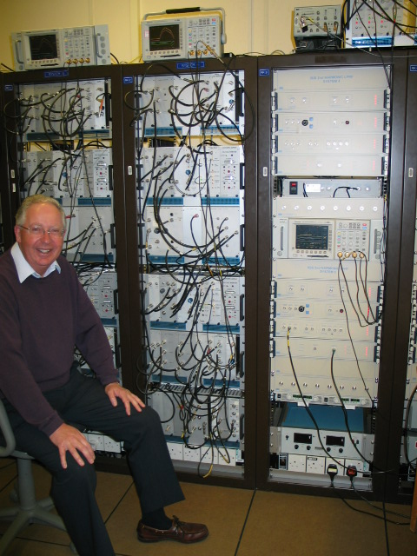
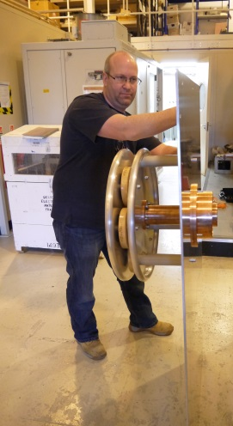
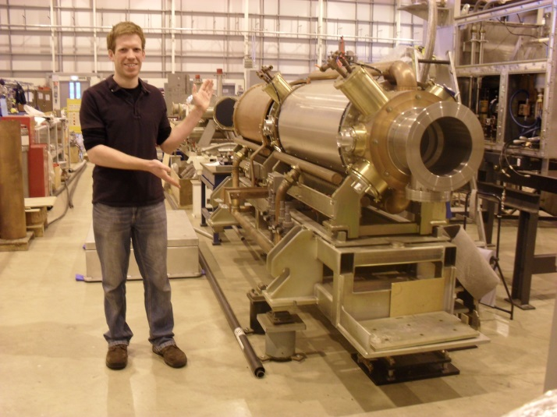
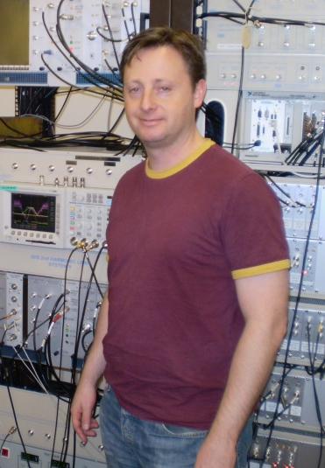
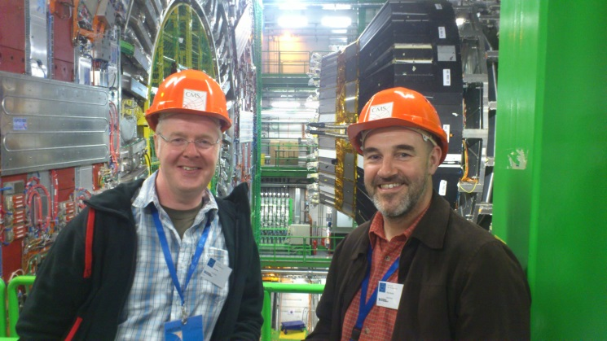
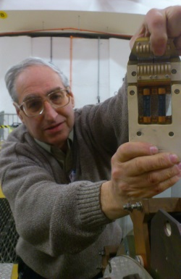
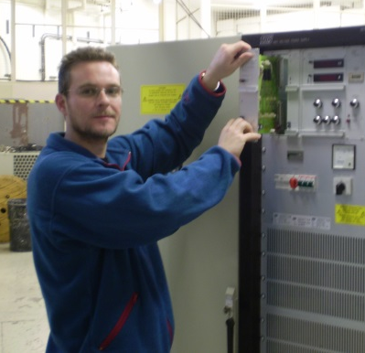
Commissioning of ISIS Ring RF Systems
Dave Gibbs
Rob Mathieson
Dean Adams
Ian Gardner
Dave Allen
Andy Seville
Derek Bayley
Neil Farthing
ICFA Beam Commissioning
Mini-workshop June 2015

Slide 2
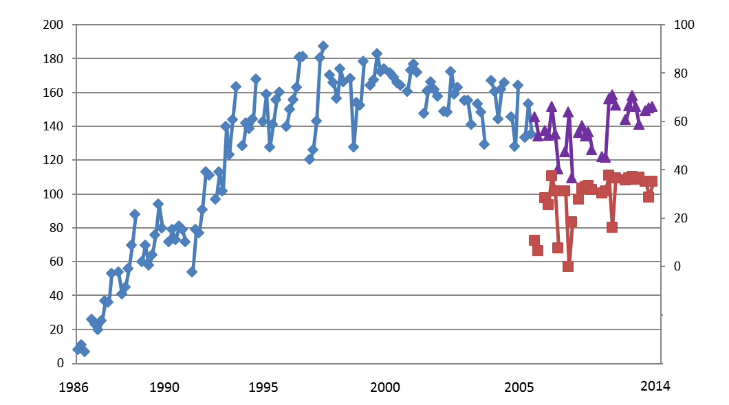
Commissioning of ISIS Ring RF Systems
Obsolescence: Bias Regs,
Anode PS, Digital LPRF, New HPDs
Average beam current per cycle (μA)
DHRF
commissioning
Commissioning of Beam
& RF Control loops 1
Commissioning of Cavity Tuning Loop, Feed Forward Beam Compensation & Introduction of Liquid Resistors
Commissioning of
Control loops 2
TS2
Contents
  Initial RF commissioning
  RF Control & Beam Loops
  Second Harmonic RF
  RF Control & Beam Loops (for DHRF Beam)
  Obsolescence

Slide 3
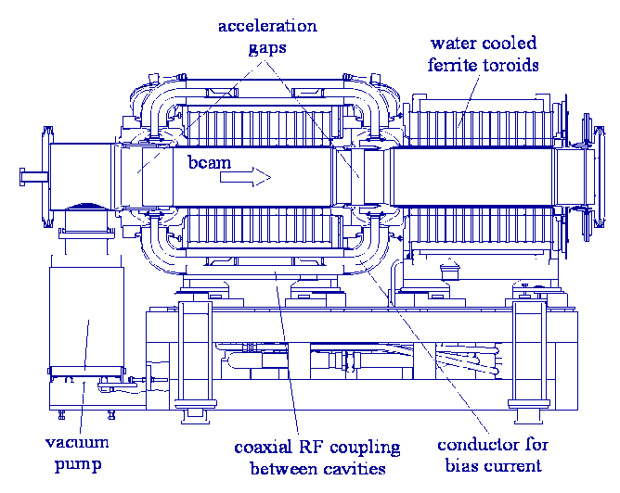

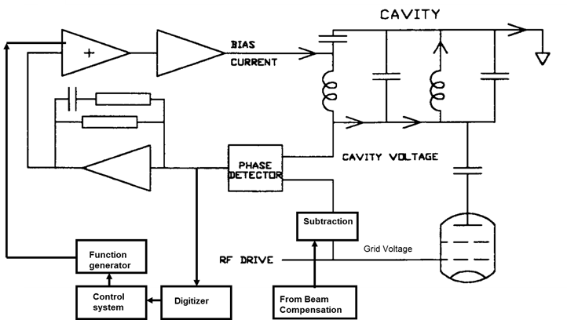
Commissioning of ISIS Ring RF Systems – Cavity Tuning
1986 basic
1988 basic /Fortran
2000 IDL
2014 LabView
Frequency response from Function Generator to Phase Detector output is measured and stored for all harmonics from 50 Hz to 10 kHz
Phase detector error signal is digitised and harmonic analysed
Each harmonic is adjusted for gain and phase
An error correcting function is calculated from the sum of these harmonics and subtracted from the existing function in the function generator with a gain of a little less than one.
A few iterations usually reduces the repetitive errors to less than 10 degrees.

Slide 4
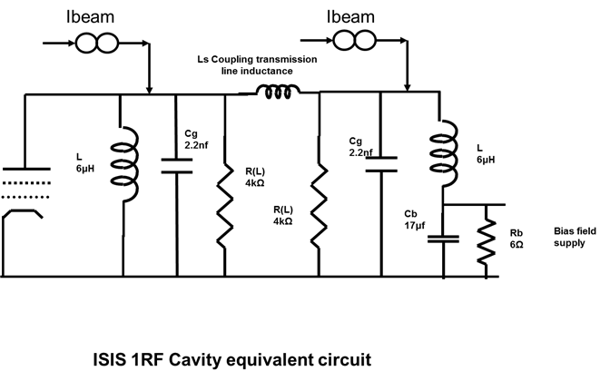
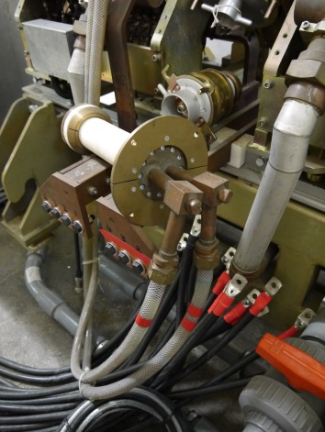
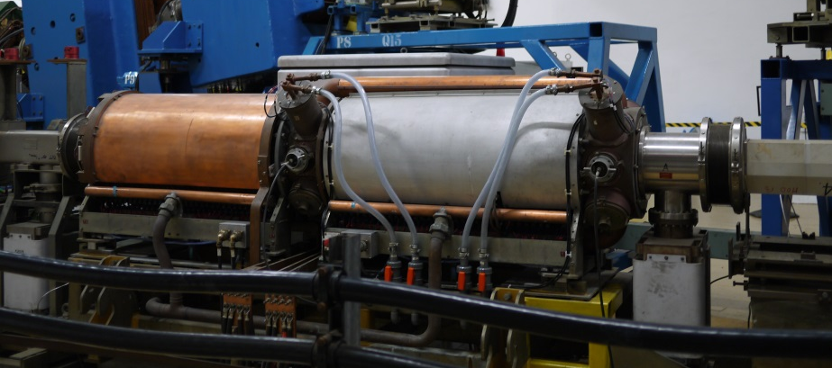
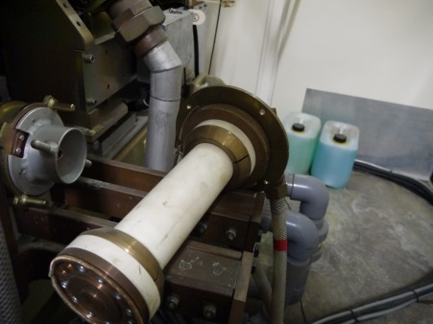
Commissioning of ISIS Ring RF Systems – Q damping
Cavity bandwidth to Phase or Amplitude modulation is ~F_{o}/2Q
Minimum F_{o} = 1.3 MHz
Q value changes with
    Frequency
    Voltage
    Rate of change of Voltage and Frequency
Cavity static Q at low voltage rises to ~100 giving a BW of ~6 kHz
Liquid resistors introduced to bring Q down to ~50 & BW to ~12 kHz
Liquid resistors also help with Beam
C_{b} resonates with the cavity inductors in series at ~11 kHz
The BW of the transistor regulator supplying the Bias current is also about 10 kHz
The overall BW of the tuning loop is about 5 kHz

Slide 5
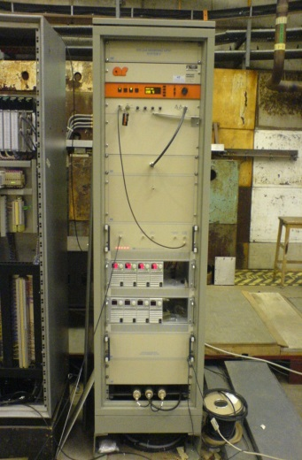
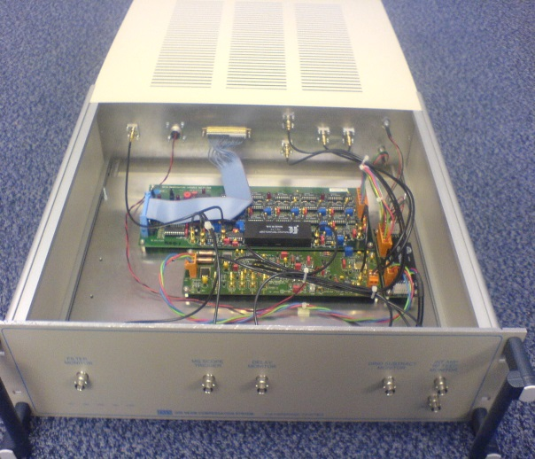

RF – Feed forward Beam Compensation
Level Control Servo / Cavity phase loop
RF
demand
Bunch 1
Tetrode
Amplifiers
Intermediate
Amplifier
Subtracter
-
Bunch 2
LP Filter
Variable
gain
Variable
delay
Sum
Electrode
Beam Compensation Unit
Function
Generator
100Hz
Compensator
Function
Generator
Required for beam intensity > 4 x${10}^{10}$ ppp

Slide 6
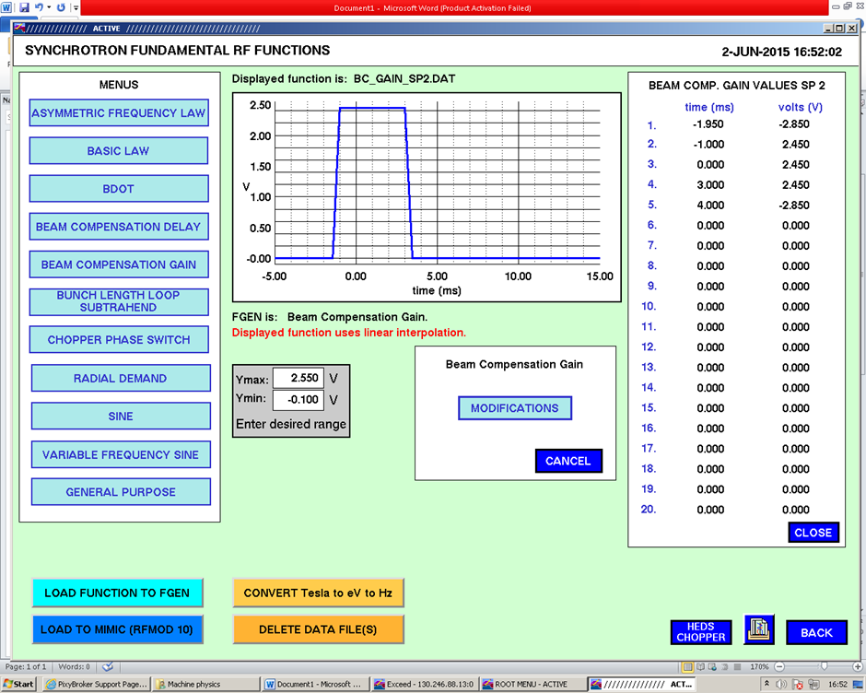
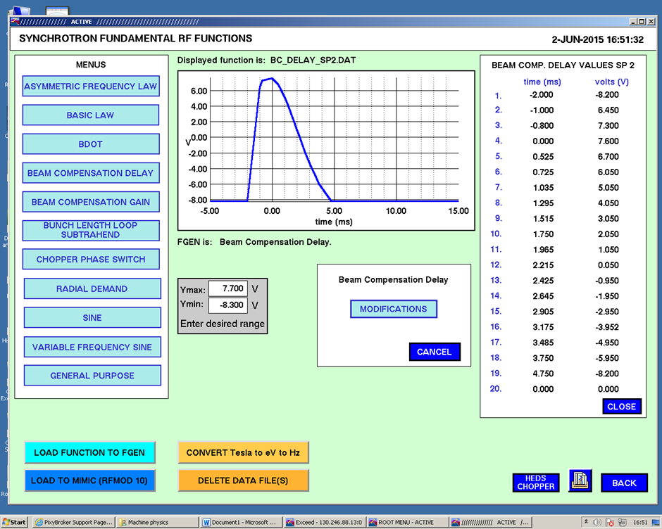
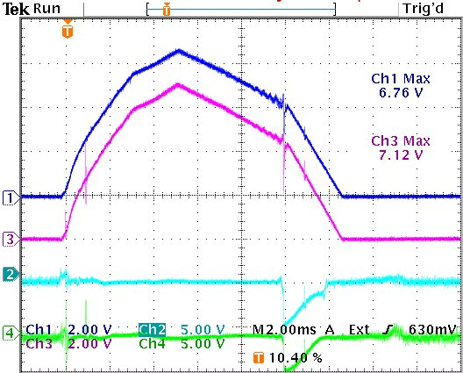
RF – Feed forward Beam Compensation
Limitations:
  100Hz gain compensation required as Feed-forward path not within voltage control loops – does not work perfectly!
  only used for 0-3ms (ie before swept 1RF reaches LP filter roll off for 2nd Harmonic start frequency) – but long enough for worst beam loading!
13.5kV
0.2kV
FFBC ontime
FFBC gain and delay functions empirically set to minimise beam loading
1RF Gapvolts
Commissioning (originally 1986-87):
  Set-up of 1RF FFBC - originally done by accelerating beam for few ms and turning off one fundamental cavity at a time and optimising induced gap-volts
  This approach easier for 2RF cavities – can be turned off and still accelerate beam for whole cycle.
  More recently – try to match envelope of RF drive signal for
  no–beam case

Slide 7
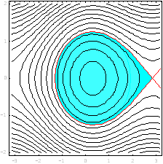
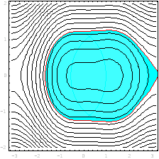
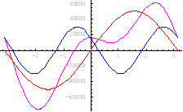
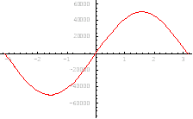
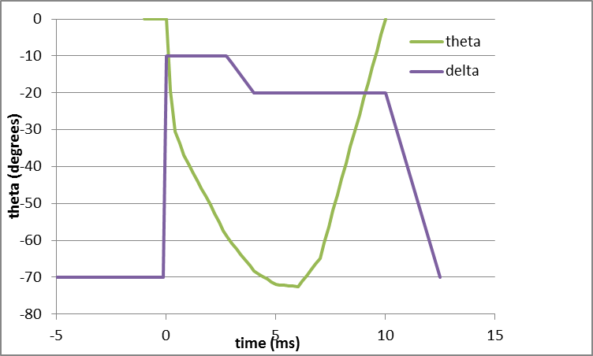
ISIS Dual Harmonic RF Upgrade
Single Harmonic
Dual Harmonic
P Error →
Add more RF cavities. Run at 2 × frequency and reduced voltage compared with fundamental RF systems. Careful phasing. Enlarge stable region to improve trapping and reduce beam loss.
Voltage →
RF Phase →
RF Phase →
0.6
0.5
0.4
V = Vo (sin ωt - δ.sin (2.ωt + θ))
delta
0.3
0.2
0.1
0.0

Slide 8
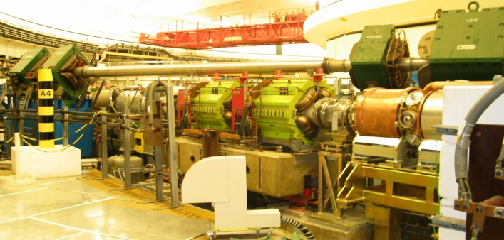
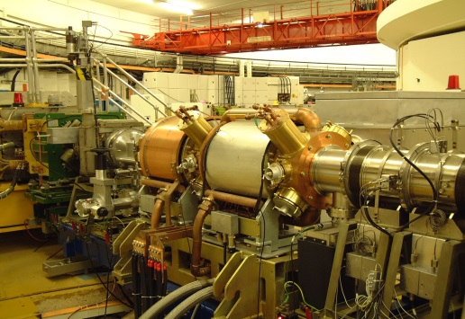
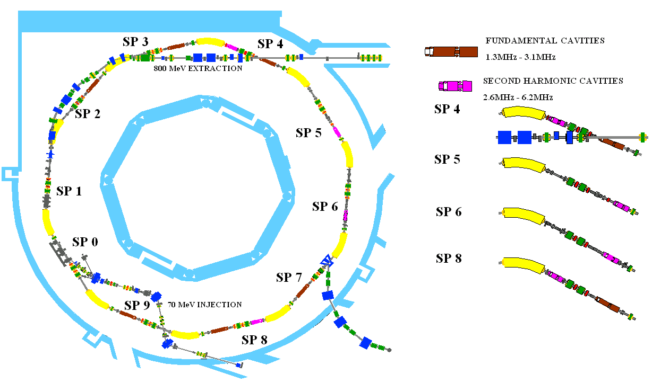
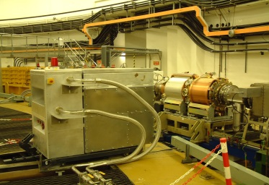
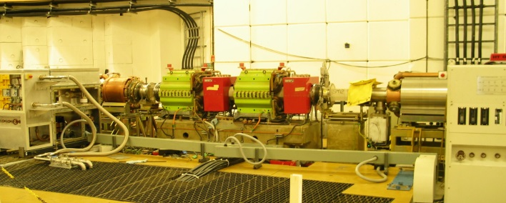
ISIS Dual Harmonic RF Upgrade
Summer 2004
4 2RF cavities installed in ISIS Synchrotron

Slide 9
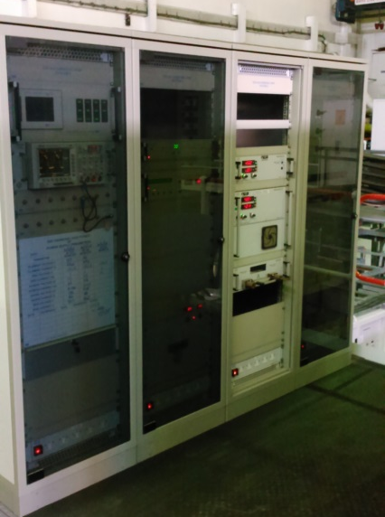
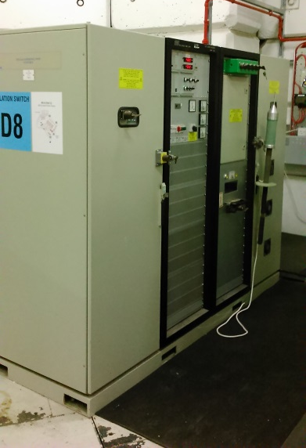
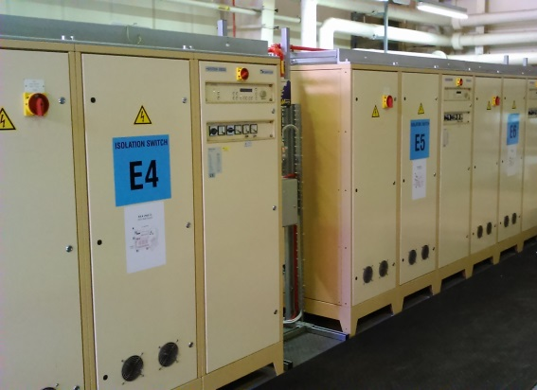
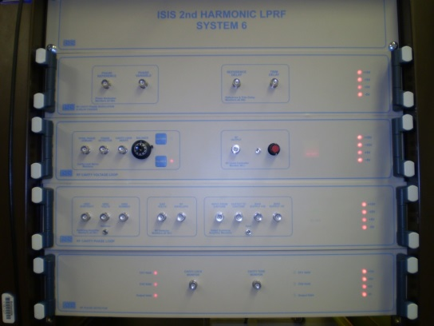
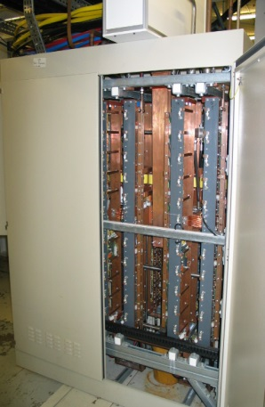
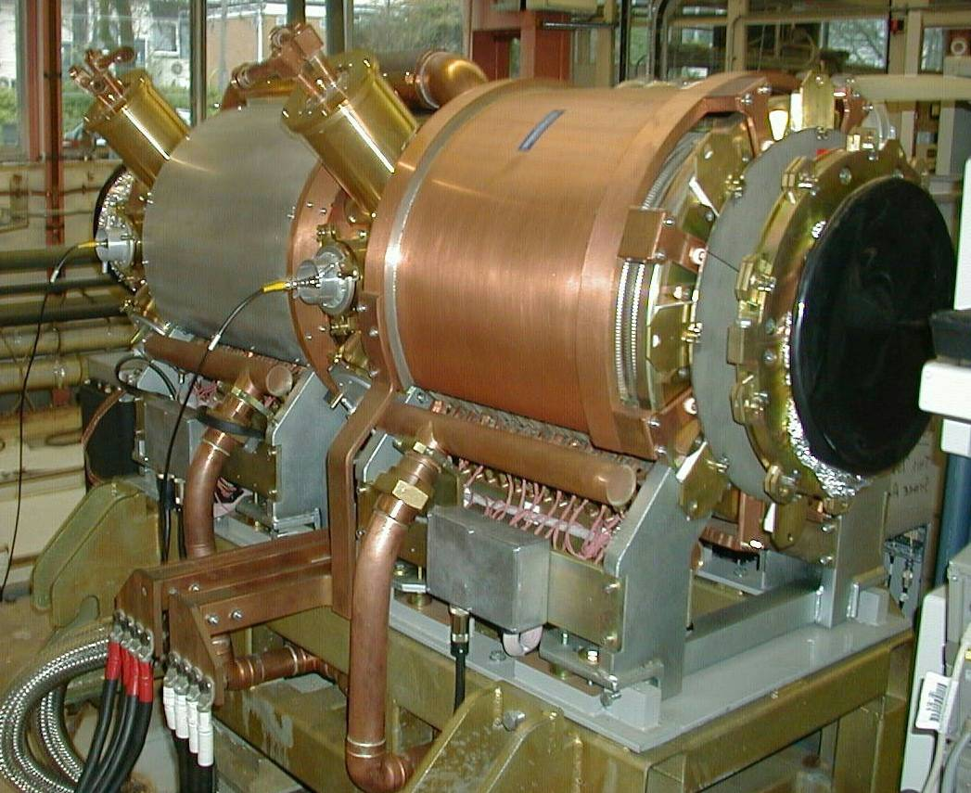
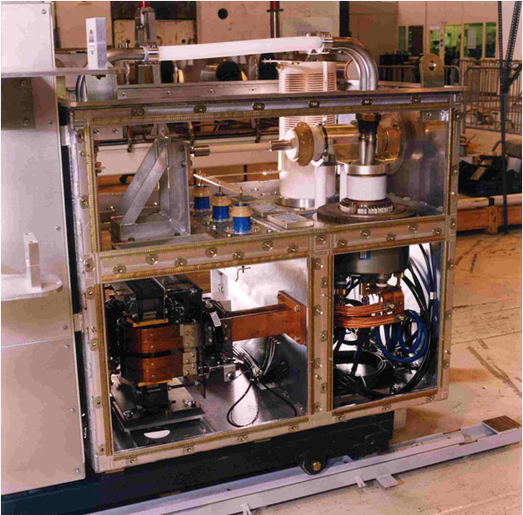
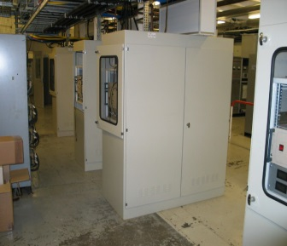
ISIS Dual Harmonic RF Upgrade
Cavity Bias power supply
LPRF control
I/Ls, Screen, DC grid & filament power supplies
Anode power supply
Cavity Bias regulator
Ferrite loaded cavity
Burle 4648 Tetrode based
High power drive Amplifier

Slide 10
ISIS Dual Harmonic RF Upgrade
Initial results June 2005
2RF - Accelerated beam for 1.8 ms
2RF - Cavity gap volts peak ~ 6kV
  95%
  93.5%
2RF - Proton Pulses
Beam intensity and beam loss

Slide 11
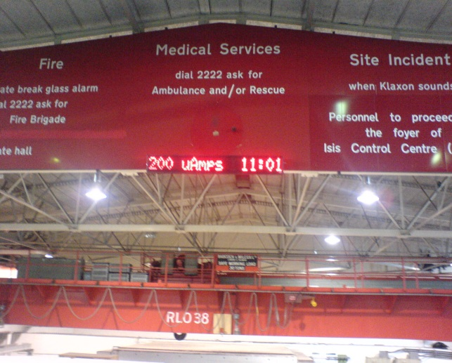
ISIS Dual Harmonic RF Upgrade
By October 2006, 1st 36 day user cycle with DHRF (two 2RF cavities)
DHRF
SHRF
2 cavities running at 70 % peak volts improved trapping efficiency from 93-97 % @ 180 µA.
Increased beam to 200 µA, 13 Dec 06 and ran for ~ ½ day. Beam Loss comparable to 180 µA with no DHRF cavities

Slide 12
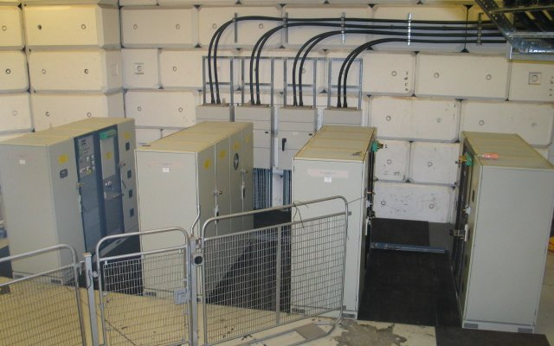
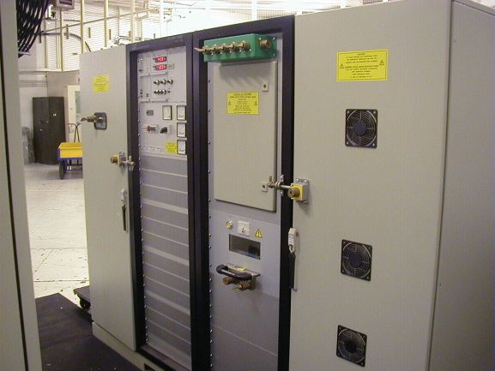
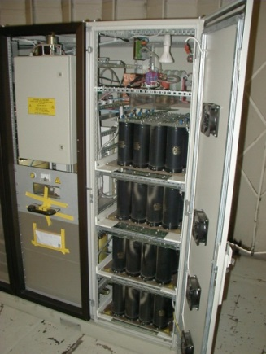
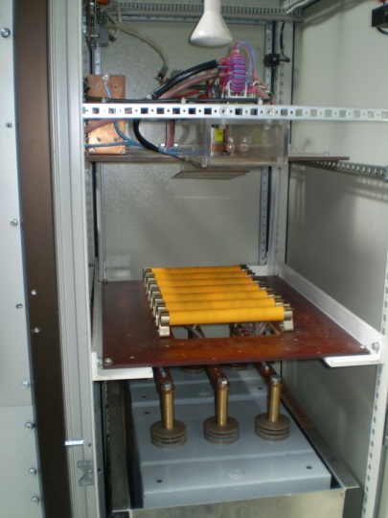
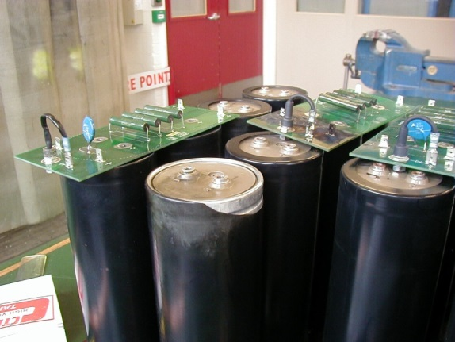
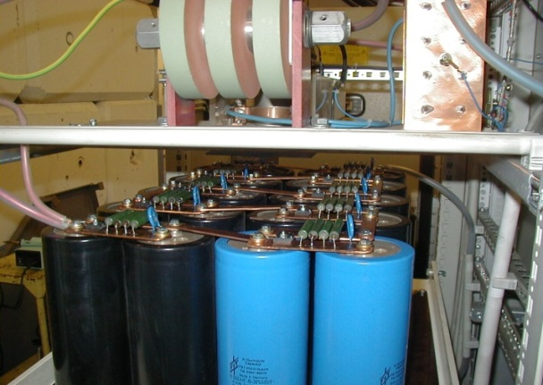
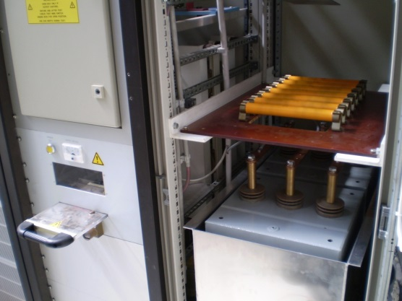
2RF Hardware Issues: Large bangs in APS cabinets and many system trips
ISIS Dual Harmonic RF Upgrade
Replaced Capacitor bank connectors….
… and eventually capacitors

Slide 13
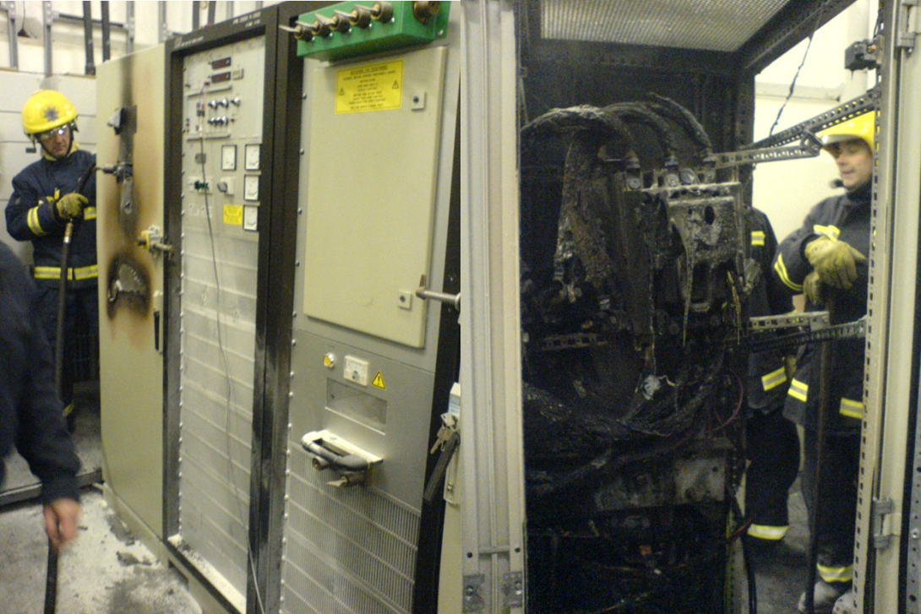
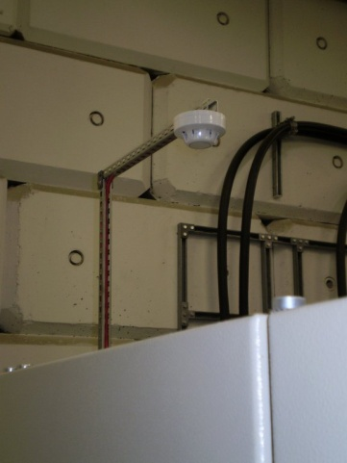
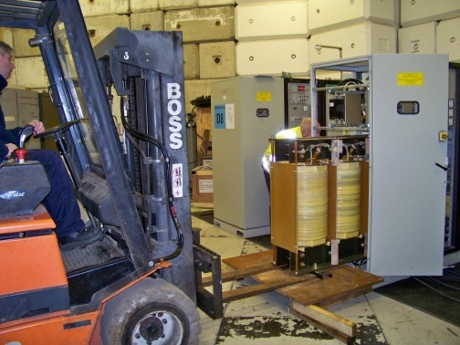
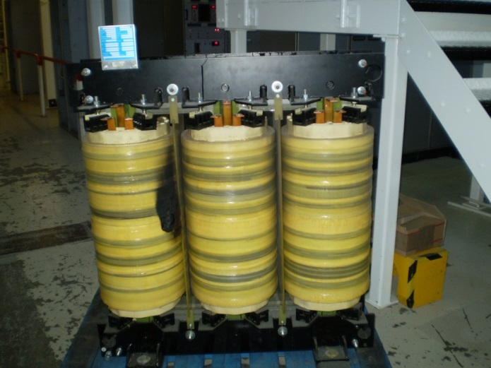
2RF Hardware Issues: Even larger bangs in APS cabinets! (Dec 2006)
ISIS Dual Harmonic RF Upgrade
New Transformers and smoke detectors!
(and Oct
2007!)

Slide 14
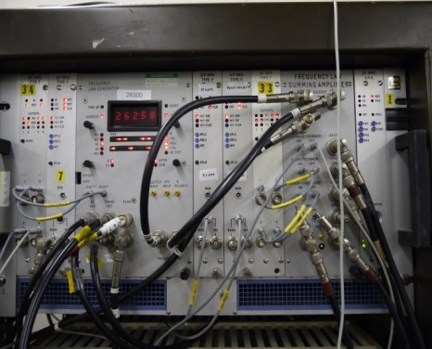



2RF LPRF Hardware issues: Modifications to LPRF units
ISIS Dual Harmonic RF Upgrade
But after several faults on new 2RF units, due to overheating on large horizontal PCBs it worked out the other way around!
Initial plan to use new 2RF units as template for 1RF upgrade.

Slide 15



ISIS Dual Harmonic RF Upgrade
2 × 2RF cavities were run for most of the time during the 10 ISIS user cycles starting with Cycle 2006/3, admittedly with some reliability issues and problems with mid-cycle (~ 5 ms) beam loss.
TS-1 began routine running at 40 pps in Cycle 2008/3 with beam to TS-2 being phased in during Cycles 2008/3 and 2008/4
By the end of Cycle 2008/4 - synchrotron average current 210 µA, with 3x${10}^{10}$protons per pulse in subsequent machine physics shifts.
Late 2013: 4 x 2RF cavity operation becomes routine throughout ISIS user cycles.
4 x 2RF cavity DHRF acceleration - 73% improvement in bunching factor (Oscillations due to Q mismatch as peak bunch height reduced by 20%)
Design delta gapvolts
P-P bunch height
(+ higher delta)

Slide 16



ISIS Dual Harmonic RF Upgrade – Control loops
Beam Phase Loop, Bunch length loop and Radial Loop have attenuation function applied to give variable gain throughout acceleration cycle.
Many trips and APS problems => could only 2 or 3 2RF cavities operational for ISIS user cycles, so introduced “Theta” phase loop to attain demanded phase of total 2RF volts irrespective of which 2RF cavities in use.
2RF Beam comp commissioning + now not used as 2RF content of beam is < 0.25 x 1RF
Multiplier applied to RF Level Control (March 2013) and Cavity tuning loops to help damp beam induced oscillations.
Also lowered liquid resistor values 4kOhms -> 3kOhms on 2RFs to further reduce beam loading - However, downside is it’s difficult to attain 10kVpk on all cavities. But now running on 4 cavities, need lower volts on each, anyway.
multiplier gain function
loop gain measurement
(with above function)
loop gain measurement
(10V dc function)

Slide 17





ISIS RF Obsolescence - 4648 HPD Problems!
Loop Antenna pick-up in HPD Spectra
4648 valve current not meeting specs!
RAM not fitted
RAM fitted to HPD Corner
Lack of performance thought to be due to Parasitic Oscillations ~ 2GHz
Noticed Effect not seen on 1RF HPD – 2 valves in parallel damp each other?
Spectrum of loop pick-up antenna cleaned up with HPD lid removed
  Cavity resonance???
Added RAM to damp oscillations
Still troublesome for higher gain operation – will these HPDs be usable for higher beam currents of ISIS Upgrade?

Slide 18



ISIS RF Obsolescence – TH558 Based HPD Upgrade
New Design to fit in space occupied by existing
One Design for both 1RF and 2RF HPDs
TH558 valve has many advantages
  double the power of the Burle 4648 (if lower gain!)
  multiple users -more secure product lifetime (CSNS, SNS, JPARC etc)
  lower costs
  one valve will drive 1RF cavity
  lower output impedance

Slide 19




RF Obsolescence - R79 RF Test Facility
Offline test facility
Two HPD test bays
  One for valve conditioning
    Always a hot spare
    Re-test “failed” valves
  One for R&D – new HPD etc.
Workshop Area
Spares storage

Slide 20




ISIS RF Obsolescence – Digital LPRF
Bdot
6 x 1RF System
FLG
Static offset
/ antiphase
Modulator
Cavity Lock Phase Mod
Var.
τ Trim
1 RF.
Cav.
Total Accel Volts sum.
BLL
MO
ϕ Det.
BPL
90°
τ Ref.
Rad L
F trim
F
Doubler
Total Accel Volts sum.
θ Det.
θ Phase Mod
Static offset
/ antiphase
ϕ modulator
Cavity lock Phase Mod
Var.
τ Trim
2 RF.
Cav.
90°
ϕ Det.
τ Ref.
4 x 2RF System
Plan to replace existing analogue LPRF with National Instruments FlexRIO FPGA modules in a PXIe crate
“Off-the-shelf” solution quicker than in-house development
1st tests with beam in Dec 2013 Frequency law looked good.
June & August 2014: Combined FLG / MO sends F word over PtoP stream to LOs - ran 195uA beam @50Hz
March 2015: Closed Beam Phase loop and theta loop with IQ demod / CORDIC - But higher latency – cannot use PtoP!!!
May 2015 Revised code using PXI trigger lines for F word broadcast rather than PtoP (PCI express data stream)
Next IQ loop test for one cavity
Then, replace whole system
FLG / MO FPGA module and ADC
Local Oscillator / IQ
& tuning loop FPGA Module and transceiver

Slide 21






ISIS RF Obsolescence – Anode Power Supply Upgrade
1RF - 18kV/15A APS
20kV at 20Amps (Future-proof!)
7 production units in service on 1RF systems. Smaller footprint allows live spare unit in power Hall (and will use patch panel for hot swaps!)
2RF - 20kV/10A APS
1RF APS (Heinzinger) 2009 - January 2015
But for 2RFs need to move to new supplier (JEMA) due to EU procurement rules!

Slide 22


ISIS RF Obsolescence - Bias Power Supply Upgrade
Brentford Cavity Bias Current power supplies replaced 2008

Slide 23





ISIS RF Obsolescence – Bias Regulators (2014 – 2018)
Smaller water-cooled sections, more of them. Isolated-tab FETs, as big as possible. Conservative power ratings with 20 heatsinks housing 120 FETS
Standard 19” cabinet, better accessibility and removal of individual modules (less likely to fail anyway!)
25 kHz bandwidth achieved in trial circuit
Notes:
Use smaller water-cooled sections, more of them.
I have found a water-cooled heatsink in Farnell, made by Aavid. Size is 5” x12” (127 x 305mm).
Use isolated-tab FETs, as big as possible. IXYS IXFN100N50P are a 1kW, 90A, 500V part, in ISOTOP TO227 package. The heatsink will be grounded.
Be conservative with the power ratings. I have chosen to use 120 devices. The Aavid heatsink can take 6, with source resistors also in the ISOTOP package and a 25A fuse mounted on insulated pillars for each transistor. 20 heatsinks will house 120 devices.
The power connections are only –ve supply and o/p, made by 15 x 3mm copper strip.
The heatsinks can mount in a standard 19” cabinet (we have a couple from R8), on some Unistrut or angle; in 2 banks of 10. Accessibility is via the side panels. Water manifolds can be one end of the heatsinks, and electrical connections to busbars at the other end.
A couple of extra heatsinks could house the shunt diodes and shunt resistors that are connected across the cavity. At present the cavity shunt resistance is about 1Ω
Make the water connections by quick release self-sealing connectors and the electrical connections by some short link wires, bolted at both ends. A failed heatsink bank can be quickly swapped out if required.
Control and auxiliary connections made by Molex or similar.
Control circuit for each heatsink, mounted on a PCB fixed to the heatsink.

Slide 24






Low Output Impedance Amplifier Collaboration
Collaboration project at ISIS
  Commenced 1996 Partners: KEK, ARGONNE & RAL
  Aim to develop a Low Output Impedance HPD for the ISIS 2RF system using plate to grid feedback
  First tests with beam due this month
  Class A operation for linear response
  High power dissipation in valves mitigated with grid switching
  Beam tests in 2011 yielded ~40th reduction in cavity impedance and damping of beam oscillations
  November 2012 achieved 10kVpk on LOI driven cavity
  Will use to inform design of feedback on future ISIS HPD amplifier
http://research.kek.jp/group/www-loi/

Slide 25

Conclusions
The Road is long……..
  For a 30 year old machine like ISIS this is a process of continuous change
  2RF Upgrade took a long time to commission
You can’t always get what you want
  Performance of 2RF Anode power supplies not quite as expected!
  Can use past problems to inform future designs
Changes
  Flexibility (of designs and people) is very important
  Operationally: eg need to run last / current ISIS cycles at 700MeV
  Initial drive: higher beam intensities but also equipment reliability important.
Money’s too tight to mention
  Economic climate and Financial timescale can effect machine development
Things can only get better
  Obsolescence planning
  Offline test / tube conditioning facility important
  Spare HPDs and Service plan
Now seeing benefit of keeping spare HPDs in Synchrotron room for quicker fix to HPD faults. Spare rotated in use every
shutdown to enable servicing of each cavity HPD
in turn during ~2 year cycle. Much lower
frequency of faults!

Slide 26
Thankyou!

