Slide 1
Commissioning experience of SNS Ring
By M. Plum
ICFA mini-workshop on beam commissioning for high intensity accelerators, Dongguan
June 8-10, 2015

Slide 2
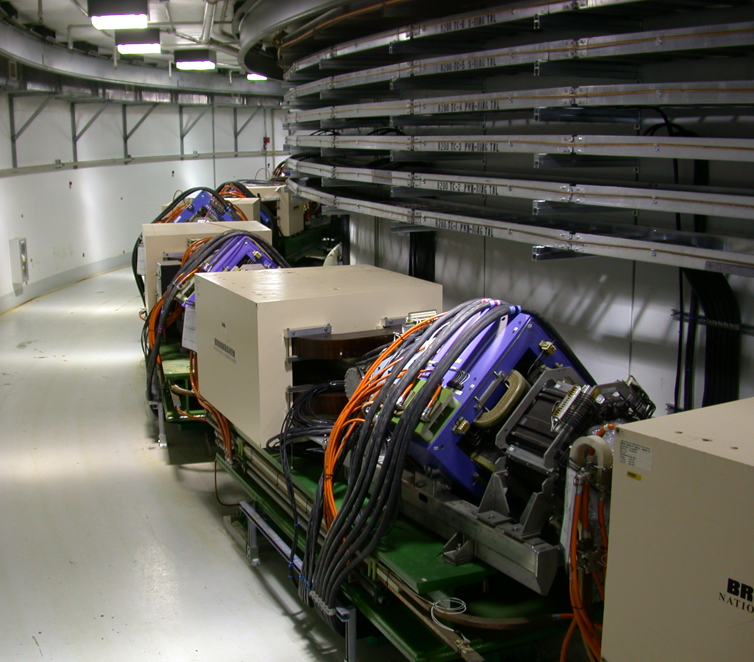
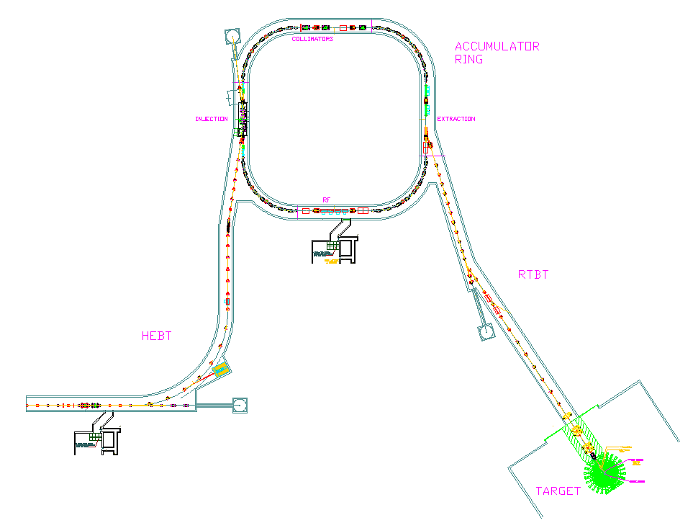
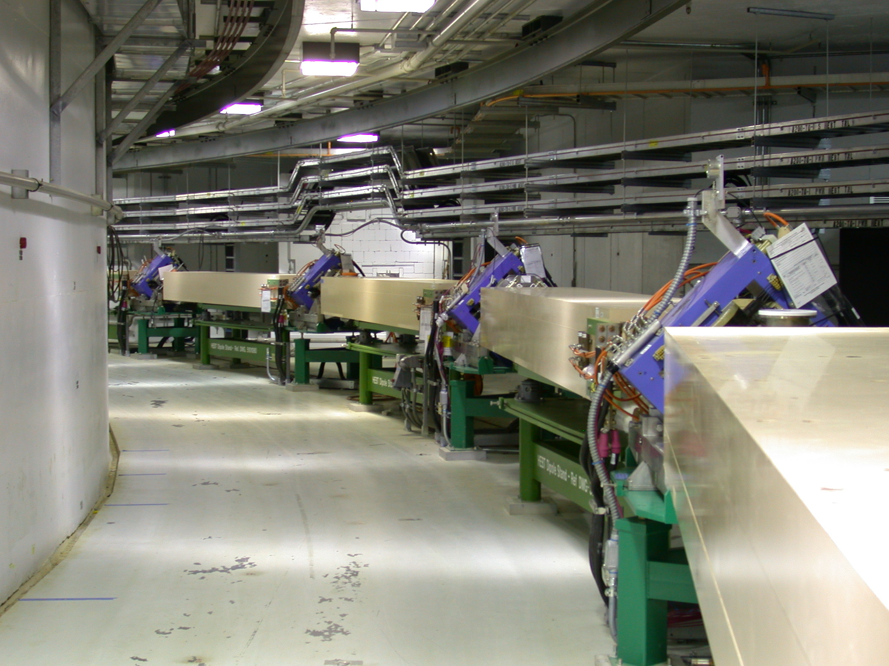
Accumulator Ring and Transport Lines
Circumference 248 m
Energy 1 GeV
f_{rev} 1 MHz
Q_{x}, Q_{y} 6.23, 6.20
Accum turns 1060
Final Intensity 1.5x10¹⁴
Peak Current 52 A
Rep rate 60 Hz
Ring
Injection dump
(150 kW)
Collimation
Injection
Extraction
RF
RTBT
HEBT
Extraction dump
(7.5 kW)
Target
Linac dump
(7.5 kW)
HEBT

Slide 3
The shrinking commissioning time
Early in the project, before the inevitable schedule delays, there was plenty of time reserved for commissioning
July 2002:
  98 days for HEBT, Ring, RTBT
  22 days for RTBT to TARGET
November 2005:
  34 days for HEBT, Ring, and RTBT
  20 days for RTBT to TARGET
Actual (Jan – May 2006)
  32 days for HEBT, Ring, and RTBT
  27 days for RTBT to TARGET

Slide 4
Commissioning Timeline
2002
2003
2004
2005
2006
Front-End
DTL/CCL
DTL Tank 1
SCL
DTL Tanks 1-3
Ring
Target

Slide 5
Ring/RTBT/Target Commissioning Timeline
2006:
  Jan. 12: Received approval for beam to Extraction Dump
  Jan. 13: First beam to Injection Dump
  Jan. 14: First beam circulating in ring
  Jan. 15: Beam circulating in ring for >1000 turns
  Jan. 16: First beam to Extraction Dump
  Jan. 26: Reached 1.26x10¹³ ppp to Extraction Dump
  Feb. 13: End of Ring commissioning run
  April 3-7: Readiness Review for RTBT/Target
  April 27: Received approval for Beam on Target
  April 28: First beam on target and CD4 beam demonstration
  Nov 17: 23.5 kW at 5 Hz to target
2007:
  Mar. 28: 90 kW at 15 Hz
  Apr. 12: First time 30 Hz beam to target
  Aug. 28: First time 60 Hz beam to target
13 days to reach initial commissioning goals

Slide 6
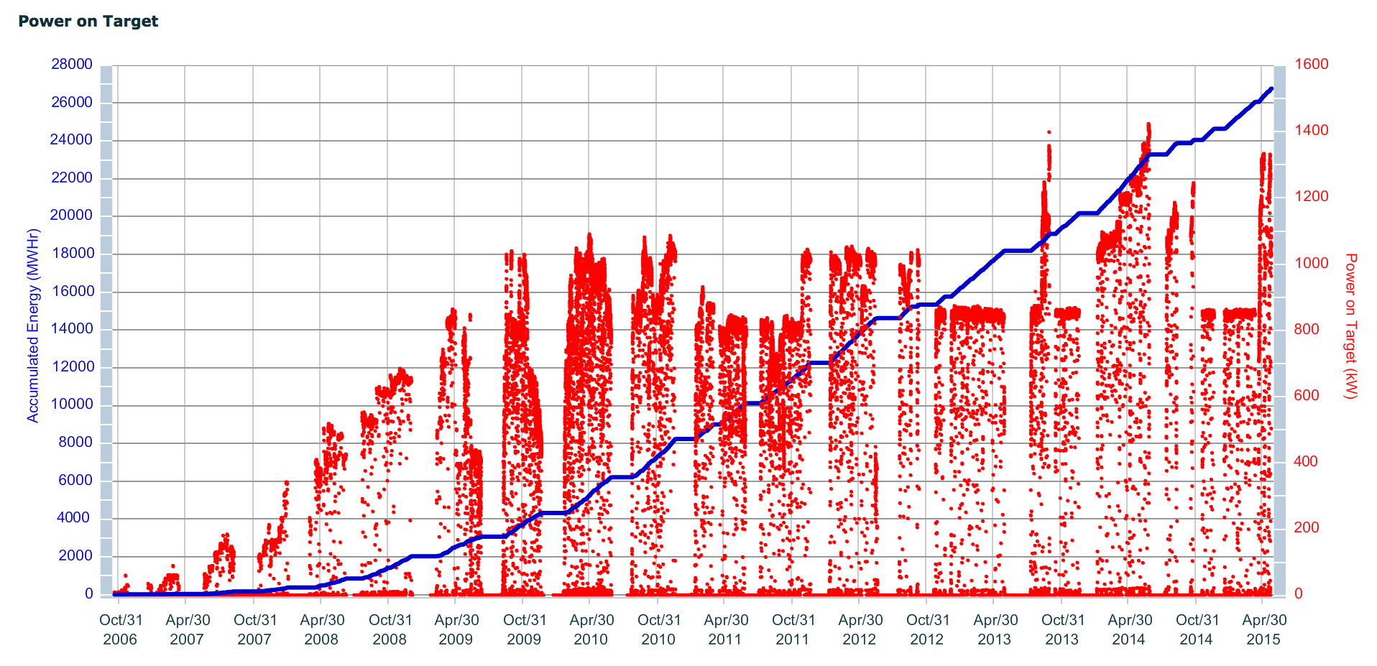
1.4 MW Beam Power at SNS
1 MW, Sept. 2009
1 day operation, June 2014
Power savings
1.4 MW, Sept. 2013
Target issues
1.4 MW
1.0 MW
First neutron production at 1.4 MW: June 29, 2014
Almost 8 years after start of low power operations

Slide 7
Low power commissioning issues
Ring injection chicane did not function as designed
High beam loss in injection dump beam line
Tilted beam on target

Slide 8
Issue: Ring injection chicane
In 2000 a design change was made in the injection chicane magnet bend angles that was not fully accounted for in the ring injection orbit or in the injection dump beam line optics
  One consequence is a large closed orbit distortion, corrected by optimizing the chicane magnet set points and operating nearby dipole corrector magnets near their maximum values
  Another consequence is that we did not have good transmission of the H⁰ and H⁻ waste beams. This led to several modifications of the injection dump beam line.

Slide 9
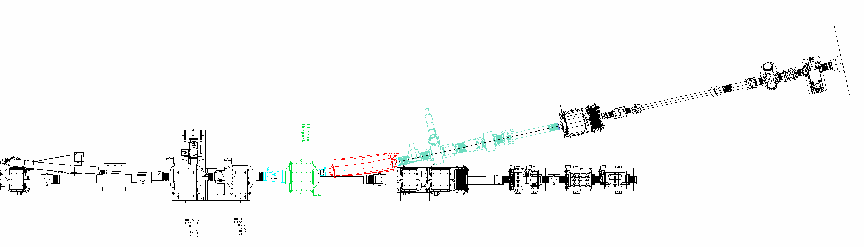
Inj. dump beam line modifications to date
New C-magnet
Increase septum
magnet gap by 2 cm
New WS, BPM,
NCD (high sens. BCM)
Oversize primary stripper foil
Thinner, wider
secondary stripper
foil
Aperture increase, added BPM
Shift 8 cm
beam left
Injection dump
Ring
Electron catcher IR video
(now removed)

Slide 10
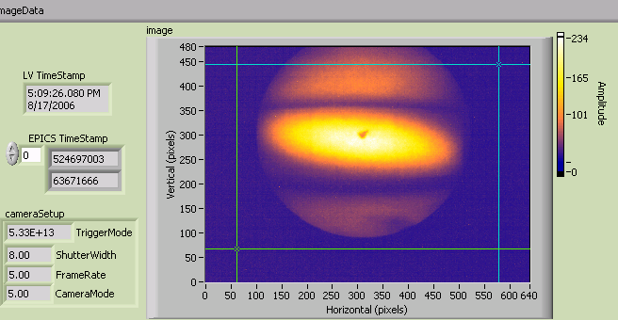
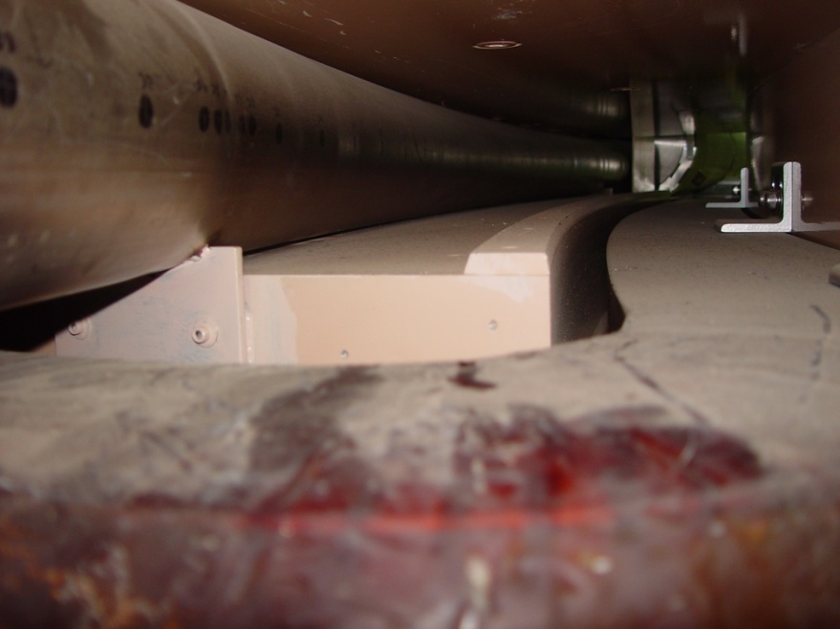
Tilted beam on target
horizontal
vertical
(S. Cousineau)
Tilted beam on the target view screen
RTBT20 wire scanner for 3 different horizontal injection kicker amplitudes
Problem traced to large skew quad component in Lambertson extraction septum magnet. Solution was to replace pole tip shims.

Slide 11
High power commissioning issues
Stripper foil failures, two occasions
Momentum dump
Target failures

Slide 12
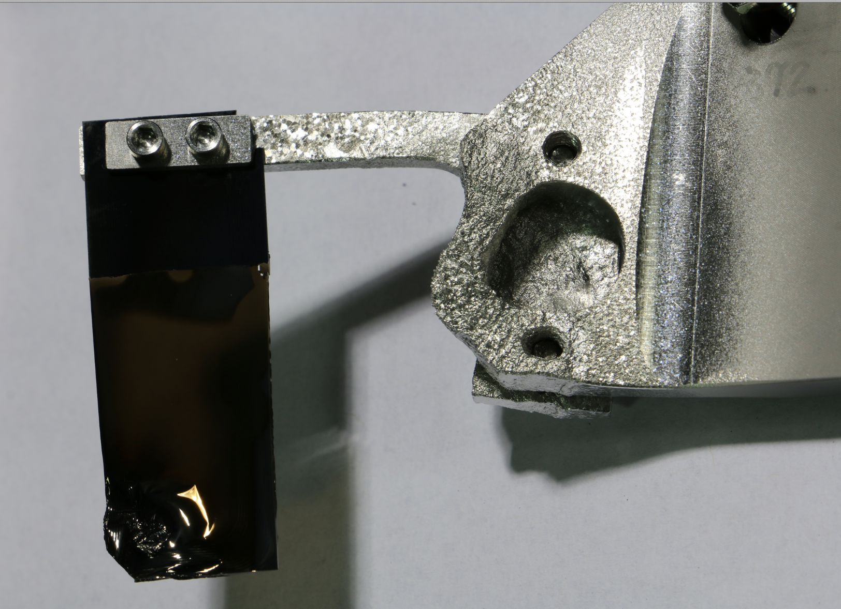
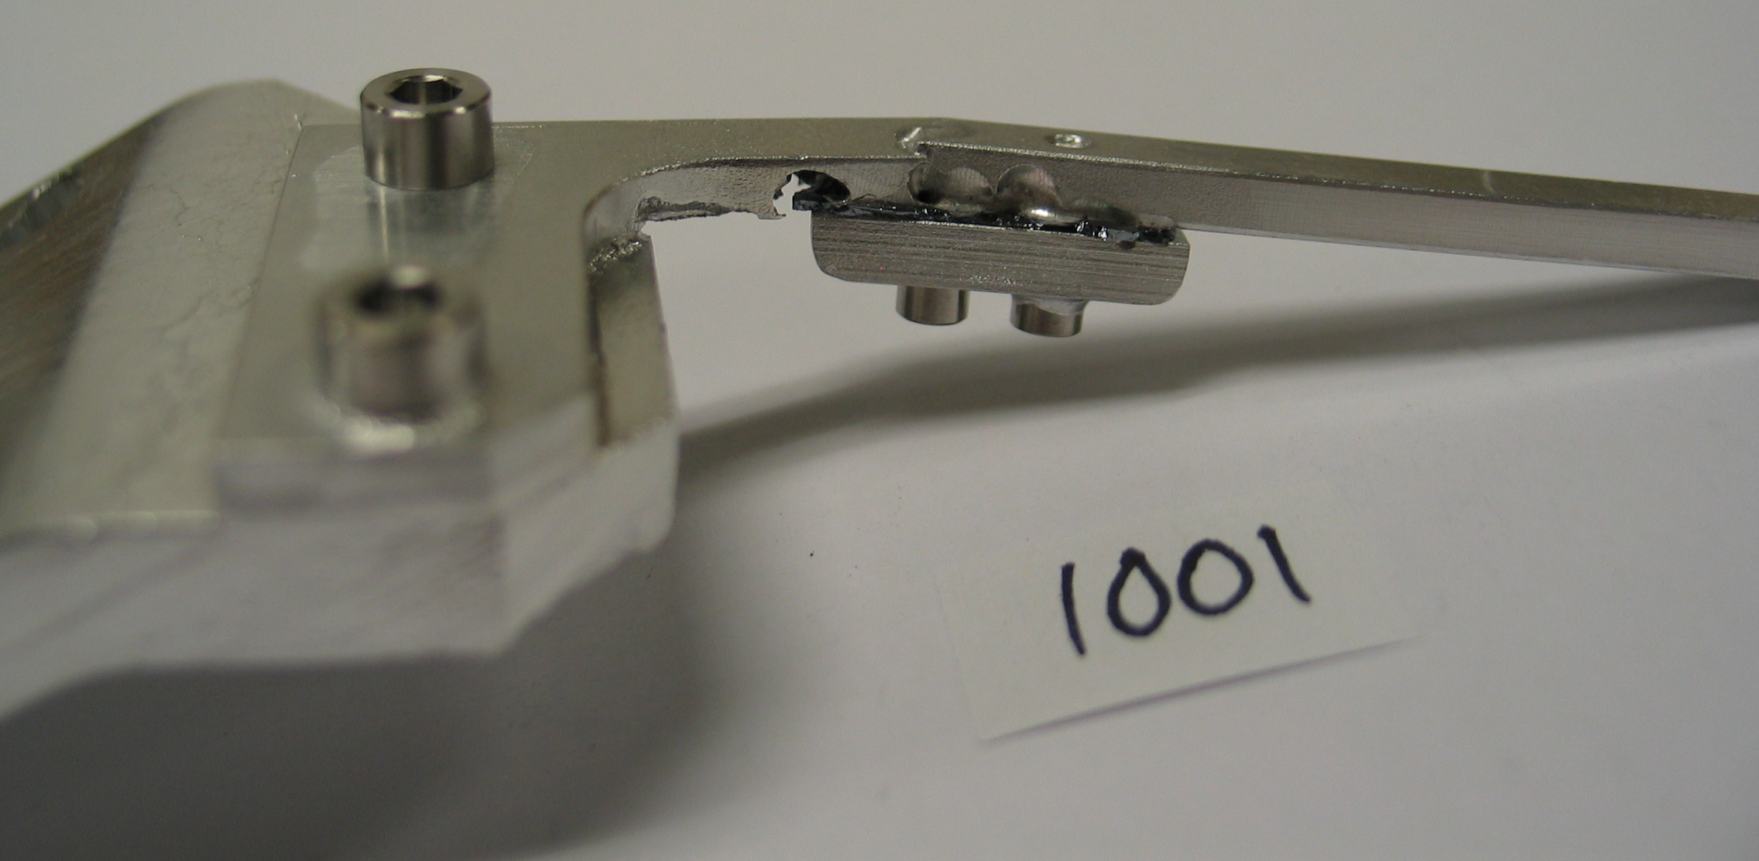
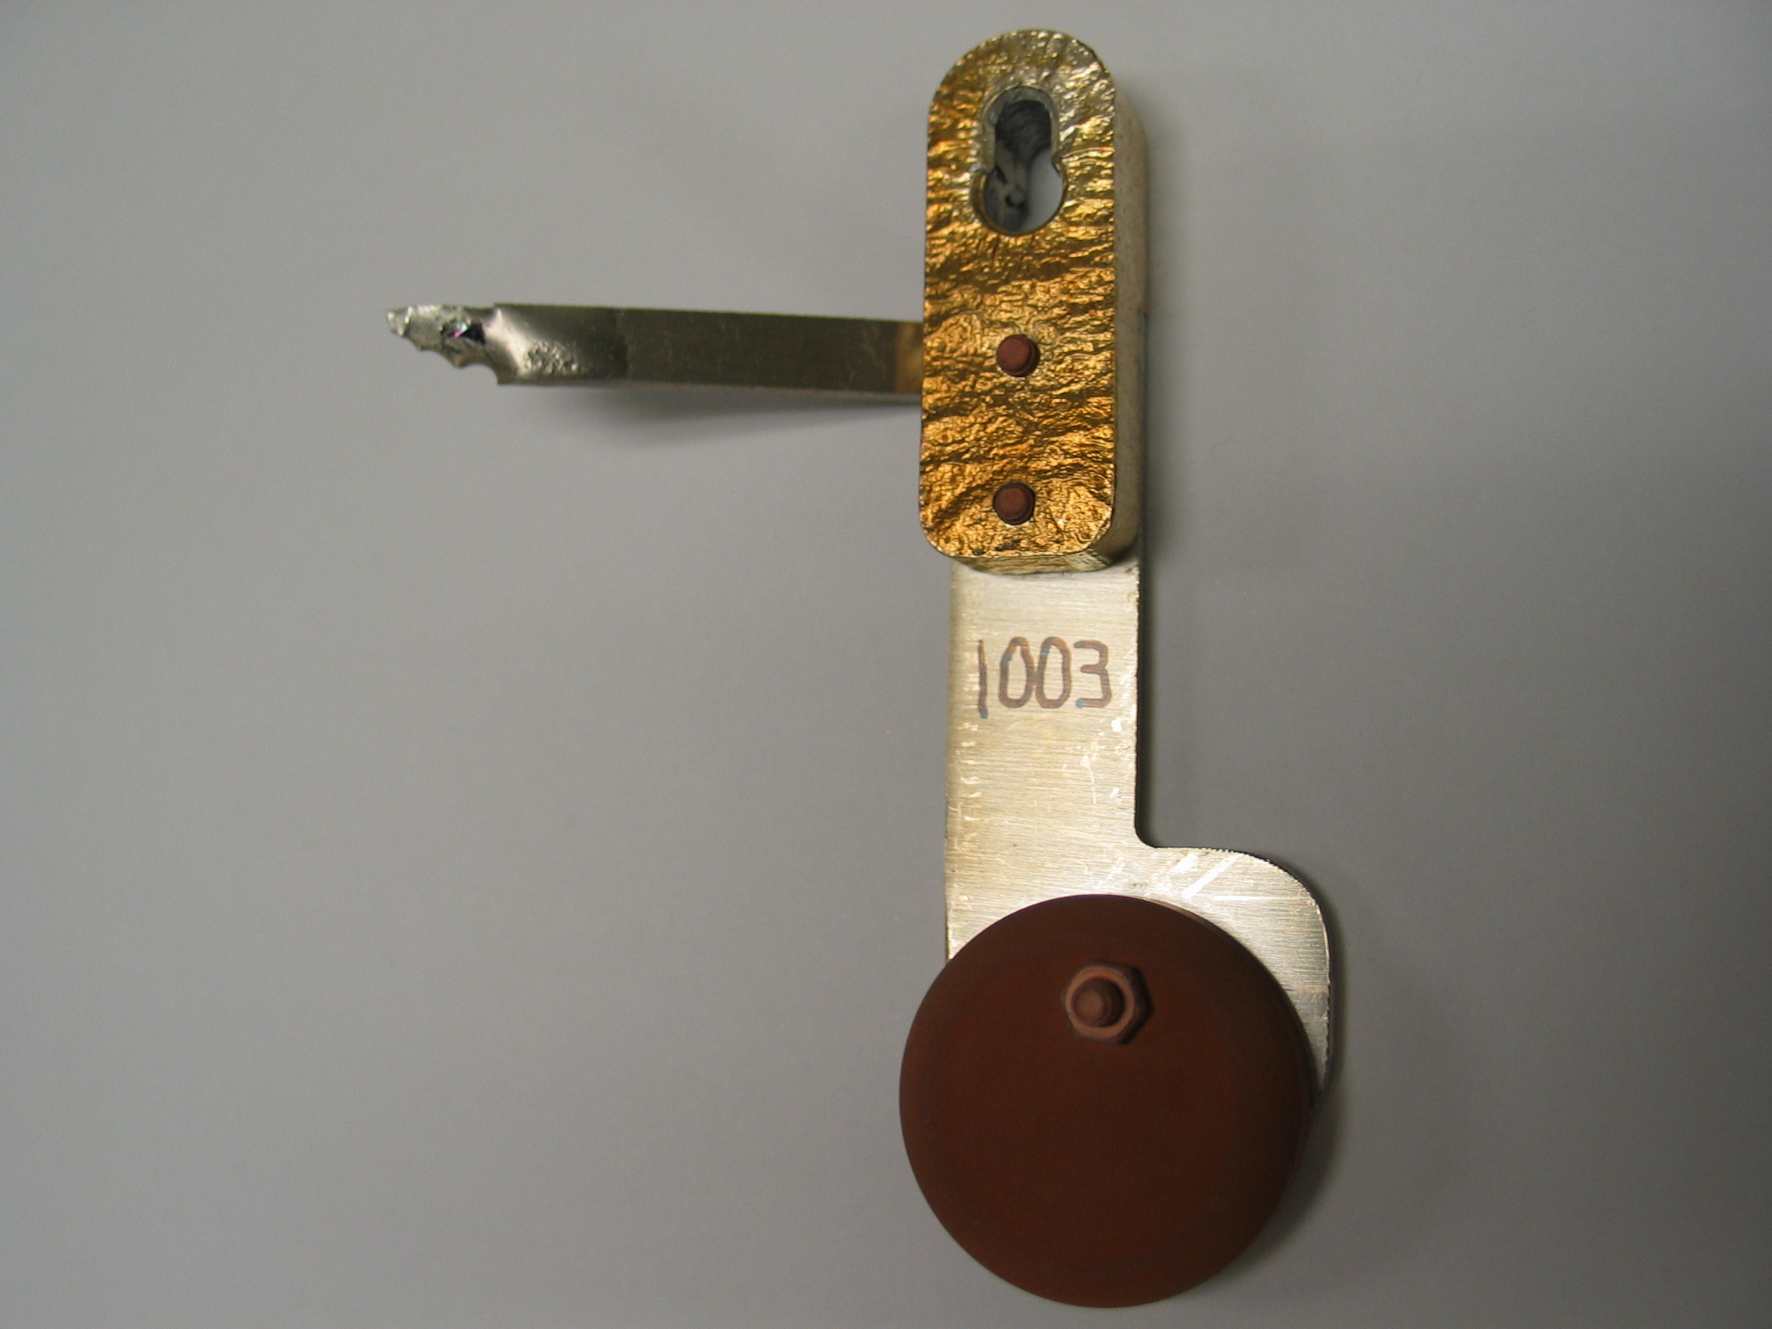
Stripper foil issues at med. & high power
2009 foil bracket failures at ~850 kW. Cured with new foil bracket design, change of material Al to Ti.
2014 foil bracket issue at >1.2 MW. Final solution in progress.
Used for 1.1 to 1.4 MW for 3 months
Arcing damage
Foil was here before it fell off
Bracket softening and distortion due to reflected convoy electrons

Slide 13
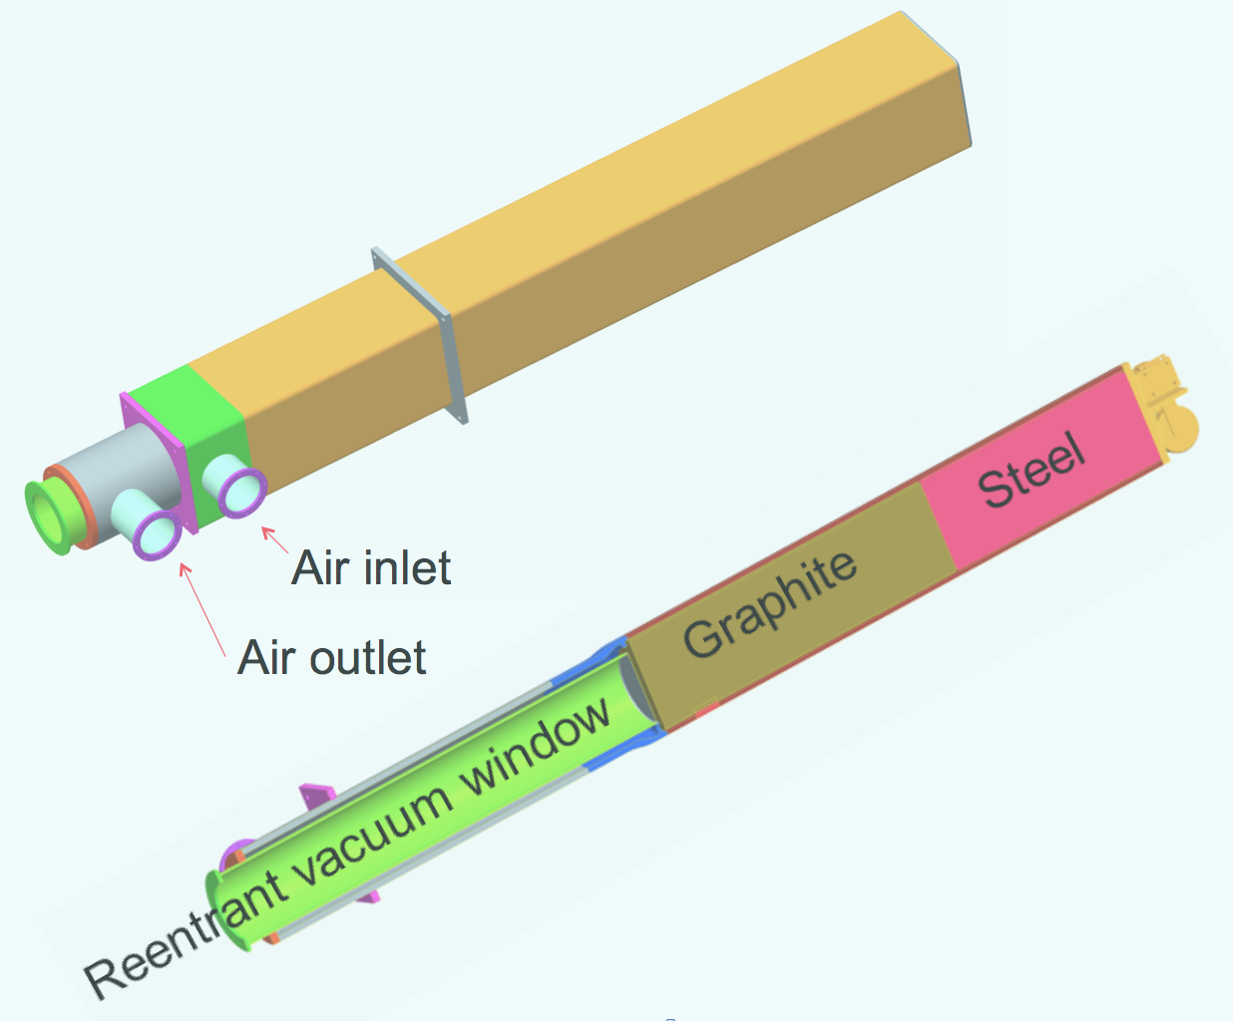
Momentum dump failure
Purpose of momentum scraper / dump is to scrape off high & low momentum tails of beam. Located about halfway along HEBT arc.
Momentum dump failed
April 2008 due to a
combination of too much
beam power (8-10 kW vs.
2 kW rated power) and
inability of system to vent
gas created by radiolysis
(beam passing through
cooling water)
Dump replaced with 5 kW rated air-cooled design

Slide 14
Most important beam instrumentation
Most important / minimum set
  BPMs needed to steer the beam, fine-tune the achromat
  Current monitors to measure beam transmission in transport lines, to measure beam accumulation in ring
  View screen at ring injection to check beam steering and focus
  BLMs for beam loss control, check on beam transmission
  Target imaging system (first temporary view screen mounted to target nose, then permanent coating system developed)
Second most important
  Wire scanners to check transport line optics

Slide 15
Most important applications
Orbit correction app – automates steering in transport lines, only way to correct ring closed orbit
Ring BPM app – measure ring first turn, turn-by-turn, closed orbit (average of ~30 turns), ring tune
Ring injection app – measure and control injected beam position and angle w.r.t. closed orbit, at foil
Energy Manager app – to set magnets to design values for a given beam energy
SCORE – Save COmpare REstore – saves and restores equipment set points
RTBT Wizard – calculates beam size, position, and density on target based on upstream diagnostics
Loss monitor app to display BLMs

Slide 16
Lessons learned
The pace of the commissioning is determined by equipment issues. If all the equipment worked as designed from day one it would only take a few days to commission.
Need to closely involve hardware experts, thoroughly test hardware as much as practically possible before commissioning
Need to prioritize equipment readiness in event of limited resources (e.g. don’t need multipole corrector magnets for initial commissioning)
Low power commissioning is relatively easy. High power operations brings unexpected surprises.

Slide 17
What worked well for us
Thorough magnet measurement program allowed “dialing-in” magnet currents and immediately transporting beam – first shot through HEBT hit view screen in ring injection section
Physics apps were integrated with the on-line model and the control system, and well developed before start of commissioning
Physics apps written by commissioning team members. Allows rapid troubleshooting and development.
Commissioning the machine in 7 stages
Good set of beam instrumentation (lots of beam position, beam profile, and beam loss monitors)

Slide 18
Summary
The first part of SNS Ring commissioning was faster than expected – 3 days to get beam from exit of linac to ring extraction dump
The ramp to high power, reliable operations took longer than expected – 8 years to 1.4 MW demonstration, and we still have more work to deliver 1.4 MW routinely
The pace of commissioning and beam power ramp was determined by the hardware (RF modulators, target, RFQ, ion source)
Accelerator physics worked 24/7, with support from technical experts as needed. Sometimes this was not very efficient because equipment limited the rate of progress.

Slide 19
Thank you for your attention!

Slide 20
Back up slides

Slide 21
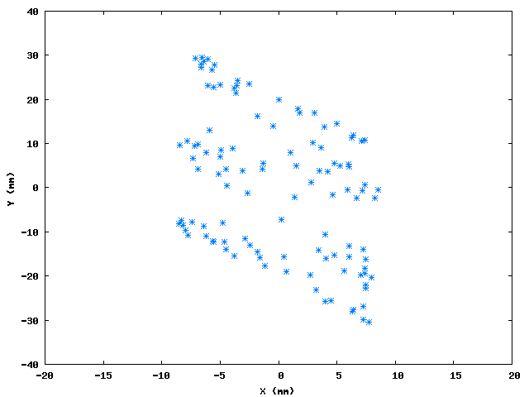
Tilted beam caused by skew quad component in extraction septum magnet
horizontal
vertical
(S. Cousineau)
Tilted beam on the target view screen
RTBT20 wire scanner for 3 different horizontal injection kicker amplitudes
X (mm)
Beam distribution at BPM25 in the extraction line, reconstructed using single minipulse injection and varying extraction time
(S. Cousineau & T. Pelaia)
Y (mm)

Slide 22
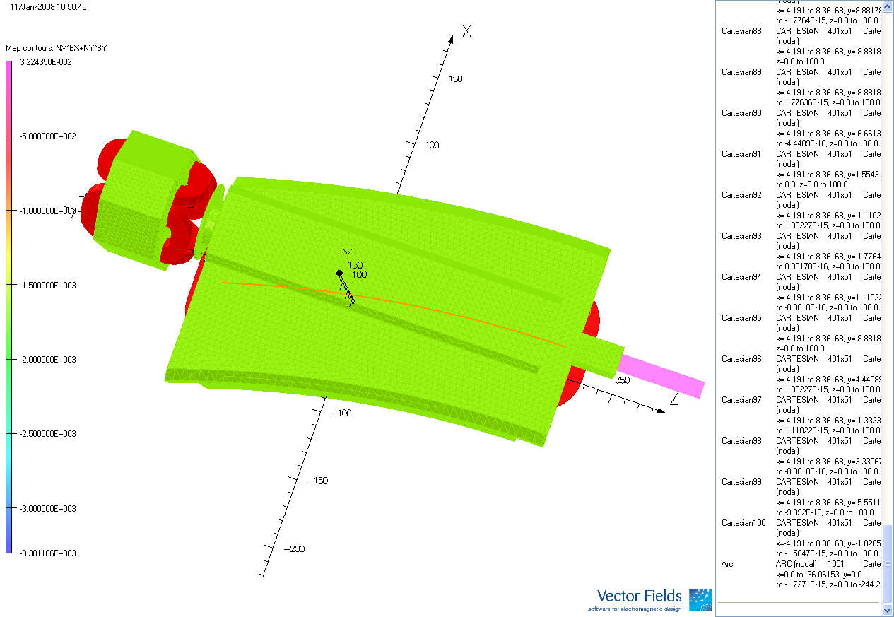
Harmonics calculation
~5% due to proximity of quad
~75% due end effects
Integrated skew quad component 0.26 – 0.28 T at 1 GeV beam energy

Slide 23
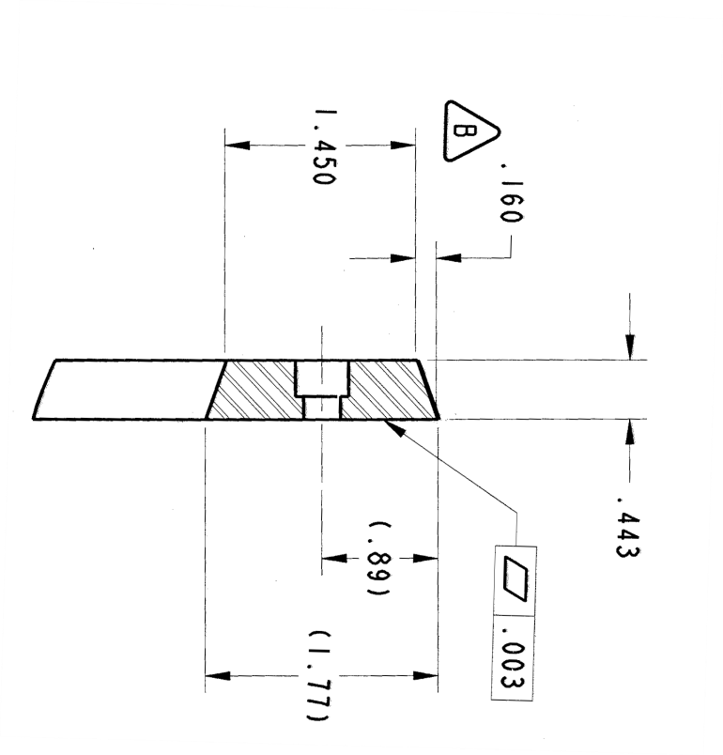
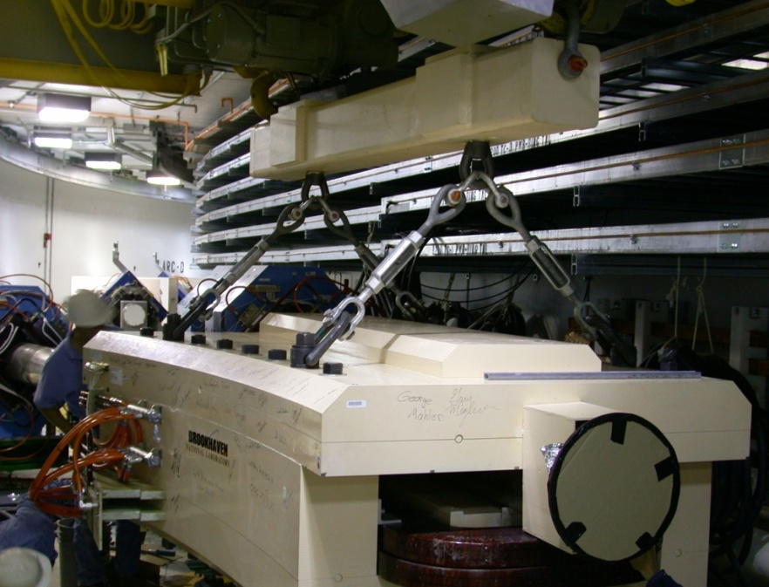
Extraction septum shim replacement
OLD
NEW

Slide 24
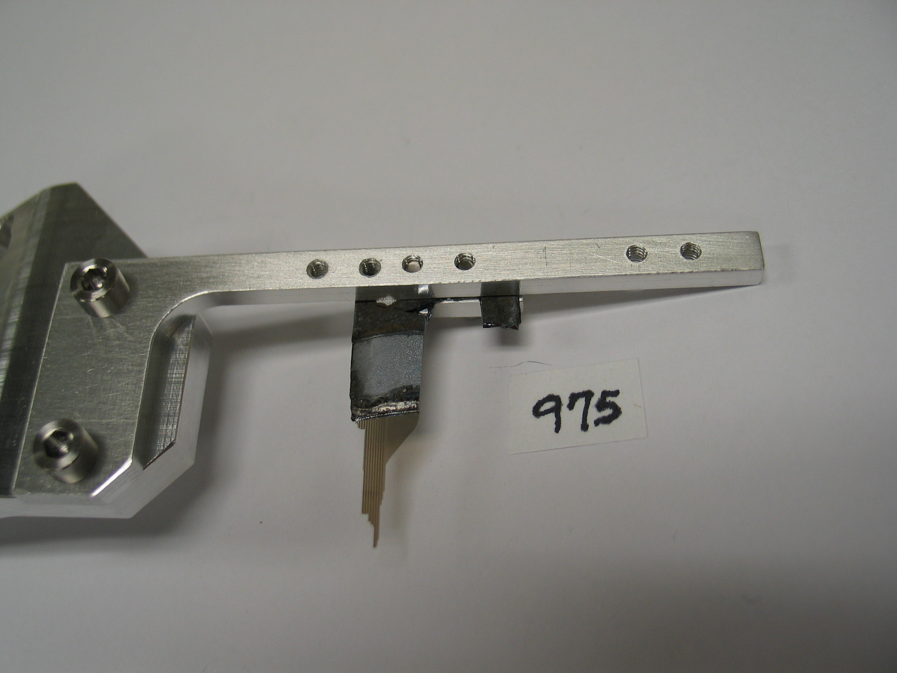
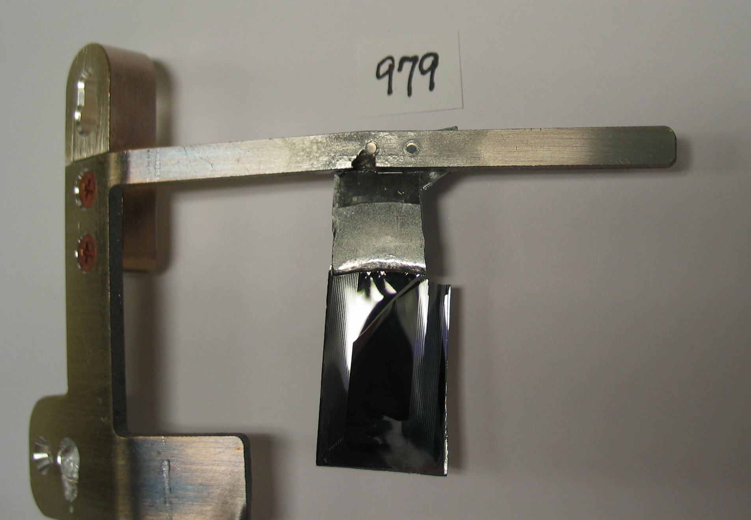
Stripper foil system failure at ~840 kW
(Failed June 15, 2009)
(Failed May 3, 2009)
Material deposition
(Failed May 3, 2009)
(Failed June 12)

