Slide 1
SNS beam loss and control
By M. Plum
ICFA mini-workshop on beam commissioning for high intensity accelerators, Dongguan June 8-10, 2015

Slide 2
Motivation
In high power accelerators, e.g. neutron spallation sources and neutrino production sources, beam loss is one of the biggest issues
Beam loss should be minimized to allow hands on maintenance and to minimize worker dose
Radiation damage to equipment is also a concern
Beam loss minimization is a major driver for the design of high power accelerators
As accelerators become more powerful the allowed fractional beam loss becomes smaller (e.g. 10⁻⁶/m fractional loss of 1 GeV 1 MW proton beam creates ~ 1 mSv dose rate at 30 cm after 4 hours of cool down)
A large fraction of the accelerator physics effort at SNS is dedicated to understanding and reducing the beam loss

Slide 3
H⁻ vs H⁺ beam loss mechanisms
Residual gas stripping
Intra-beam stripping
H⁺ capture and acceleration
Field stripping
Black body radiation stripping
Beam halo/tails (resonances, collective effects, mismatch, etc.)
RF and/or ion source turn on/off transients
Dark current from ion source
H⁻ only

Slide 4
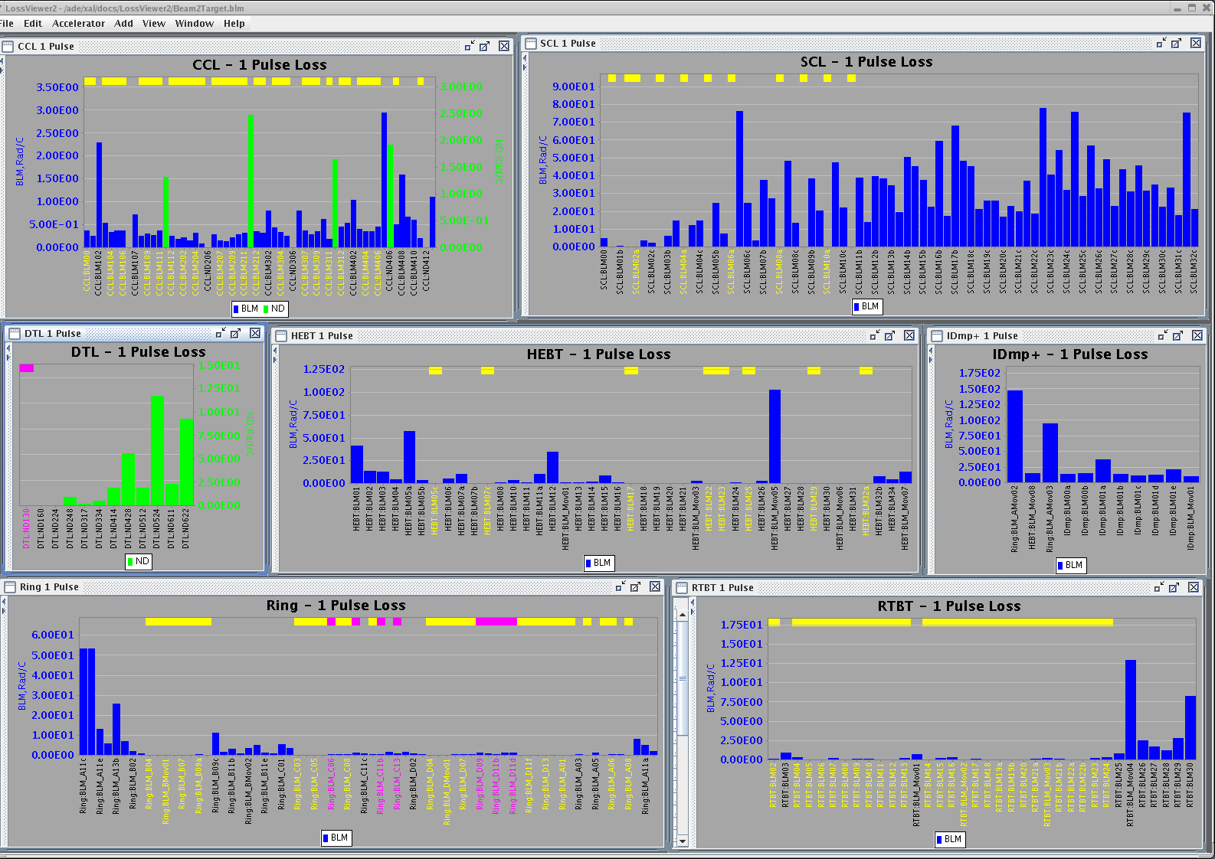
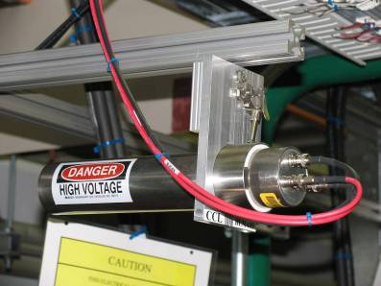
How we measure beam loss
Argon filled ionization chamber detectors (~307)
Scintillation detectors with photomultiplier tubes (~55)
Neutron detectors - especially useful below ~100 MeV (e.g. DTL)
Fast loss detectors
Photo of ionization chamber BLM
Typical BLM display

Slide 5
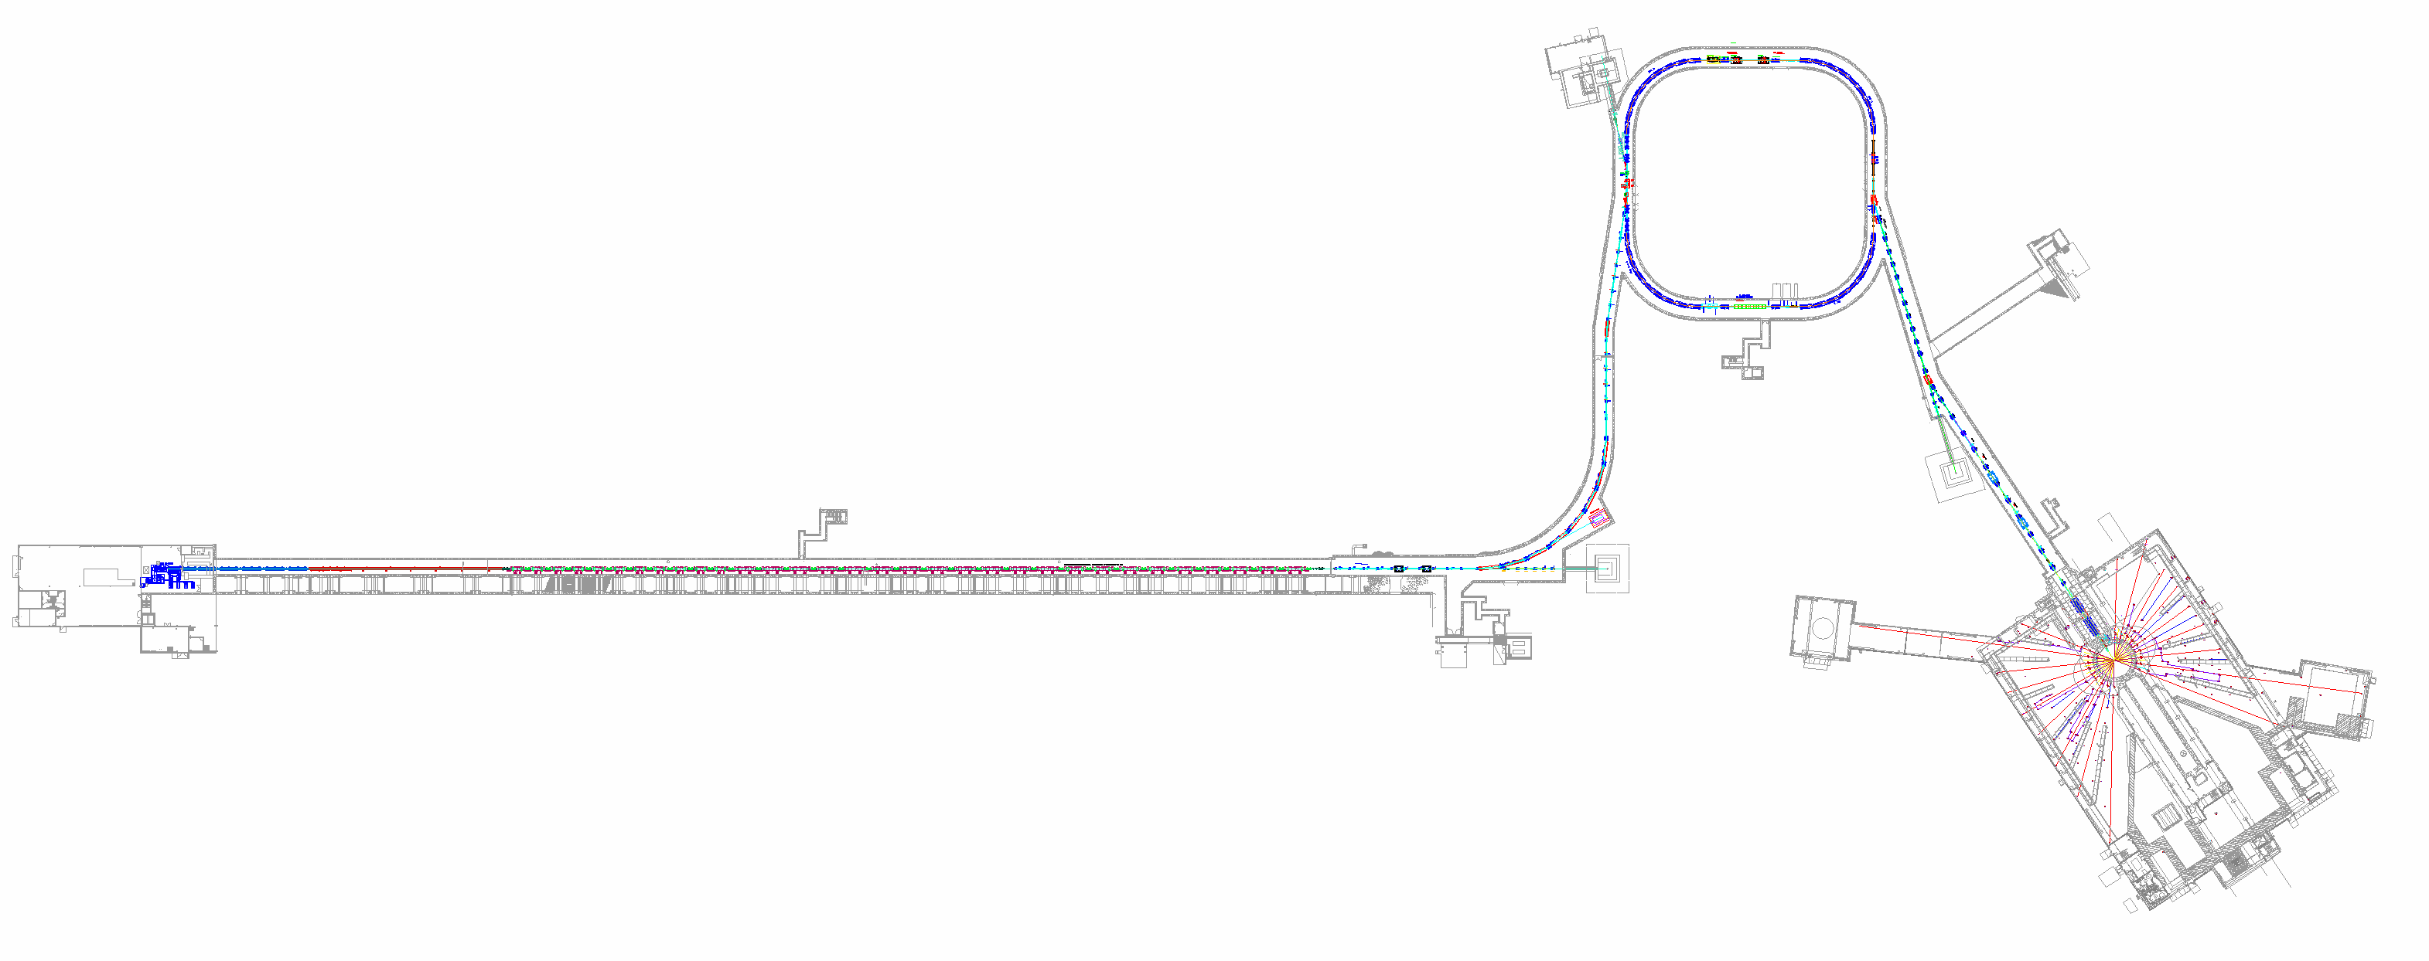
Typical activation levels for 1 MW operations
Causes of beam loss, in approx. order
Stripper foil
Aperture limitation
Residual gas stripping
Extraction inefficiency
Lattice transition
Collimation inefficiency
Intra-beam stripping
Ring collimation 5 – 60
500
Ring extraction
<5
Ring injection 5 – 300
90
40
DTL 1 – 6
CCL 5 – 20
90
RTBT
<5 – 15
SCL 10 – 50
HEBT 5 – 20
50 at CCL4
50 at CM2
150
95
180 LEDP
All numbers are mrem/h at 30 cm from beam line after 1 MW operations followed by ~48 hours of low-power studies
(divide by 100 to get mSv/h)
Notes:
Surveys for 8/May/2012

Slide 6
Beam loss control and mitigation
Scraping – best done at low beam energies
Increase beam size in superconducting linac, to reduce intrabeam stripping
Adjust quadrupole magnet and RF phase setpoints to empirically reduce losses

Slide 7
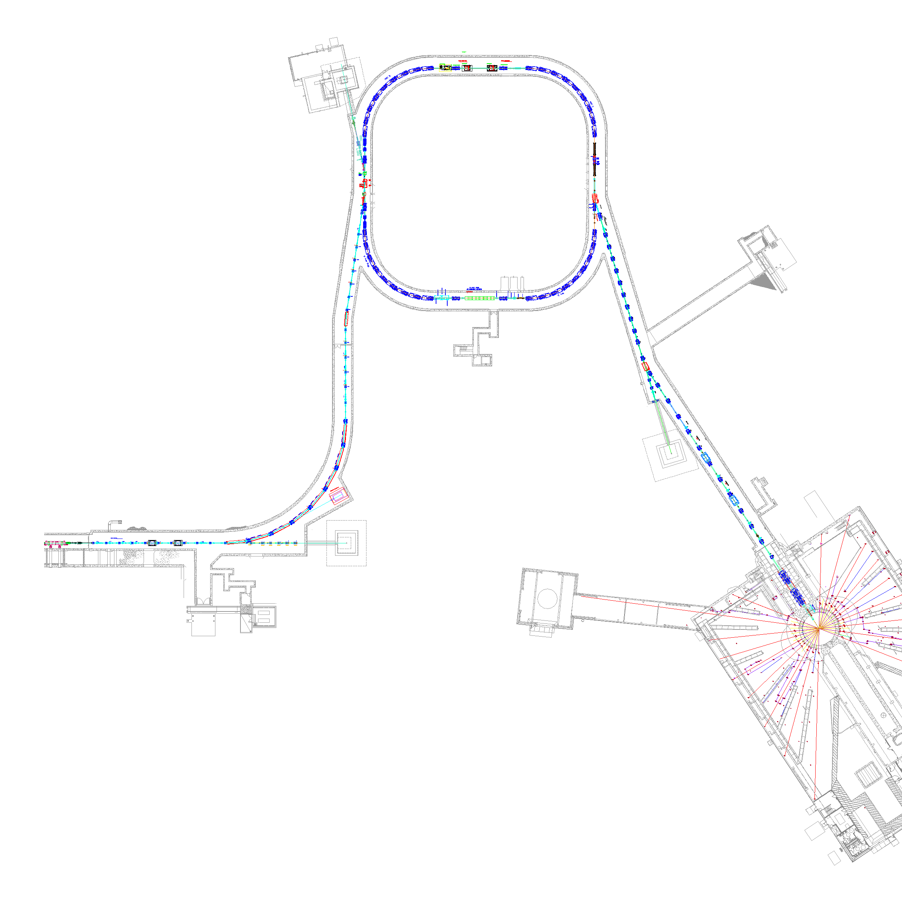
1: Beam loss reduction by scraping
Almost never used
In Ring:
Four scrapers (0, 45, 90, 135 deg.)
Three collimators
Most effective
In MEBT:
Left-right scrapers
Top-bottom added 2013
Occasionally used
Collimators
In HEBT:
Two pairs of left-right scrapers
Two pairs of top-bottom scrapers
Two collimators
Extraction
Injection
RF
RTBT
HEBT
Rarely used
In HEBT:
Left-right (high and low momentum) scrapers
Followed by beam dump

Slide 8
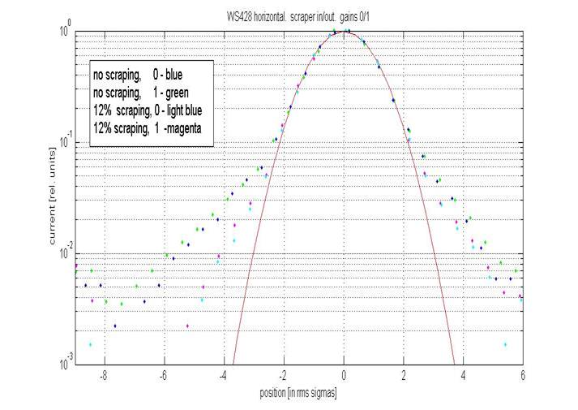
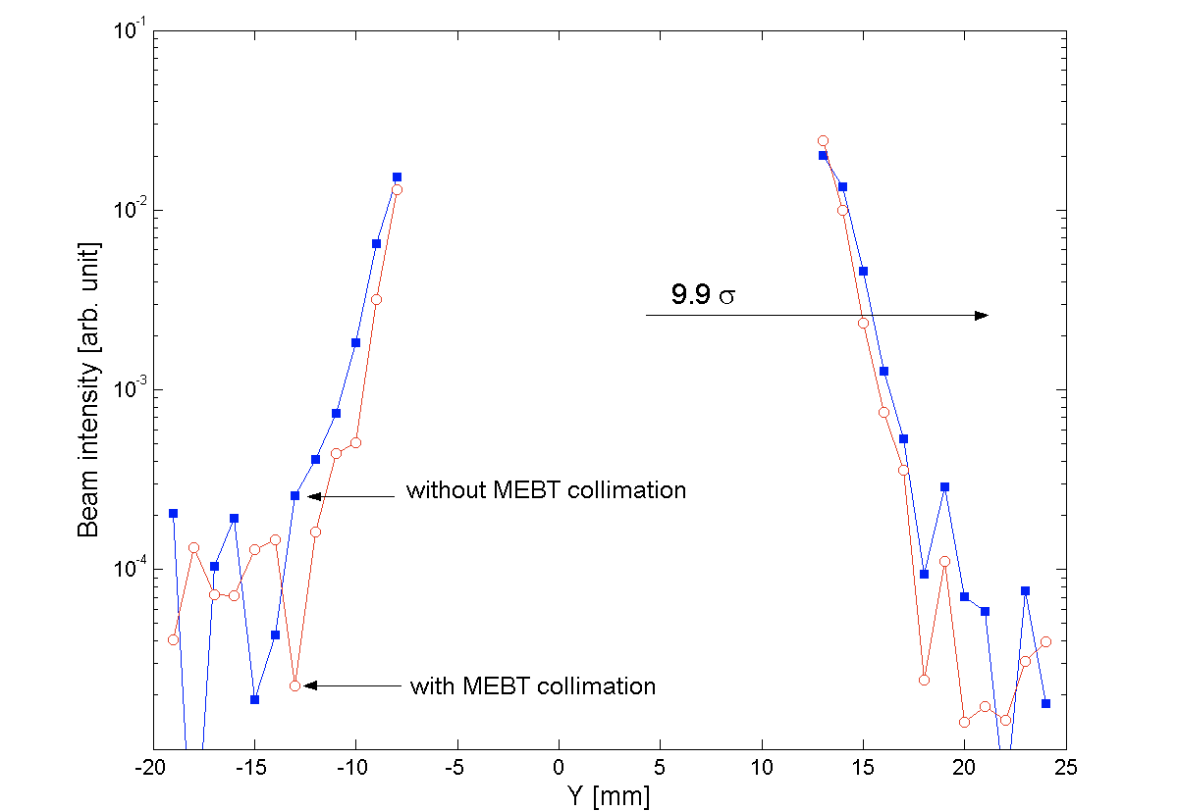
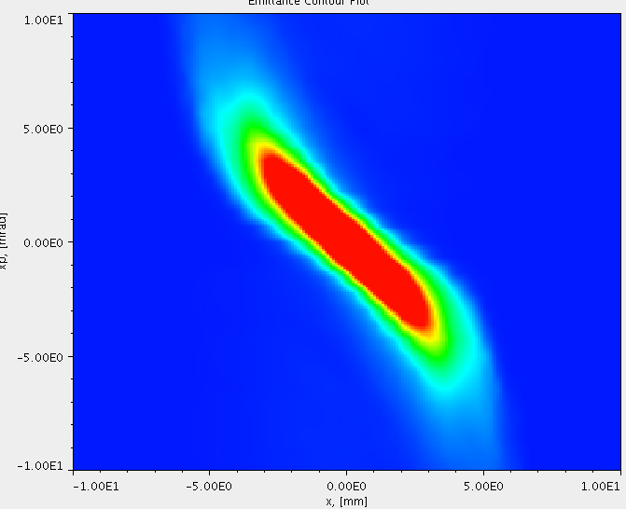
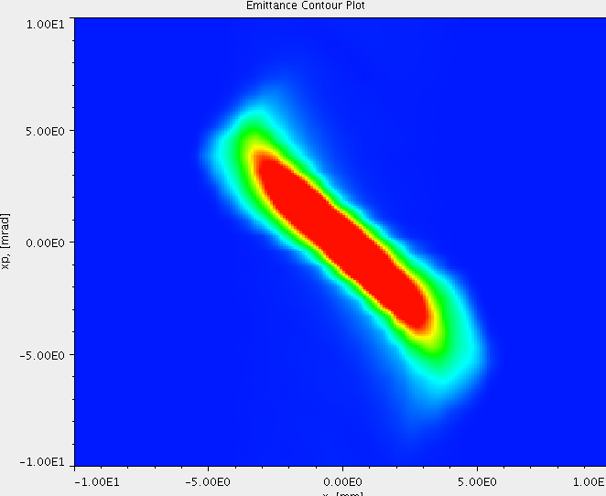
1: MEBT Scraping
DTL profile, log scale
Standard part of production
Reduces linac and injection dump losses by up to ~60%
Effectiveness in loss reduction varies from source to source
No scraping
scraping
Gaussian fit
MEBT Emittance without scraping
MEBT Emittance with scraping
HEBT profile
x’ [mrad]
x’ [mrad]
x [mm]
x [mm]
Courtesy A. Aleksandrov

Slide 9
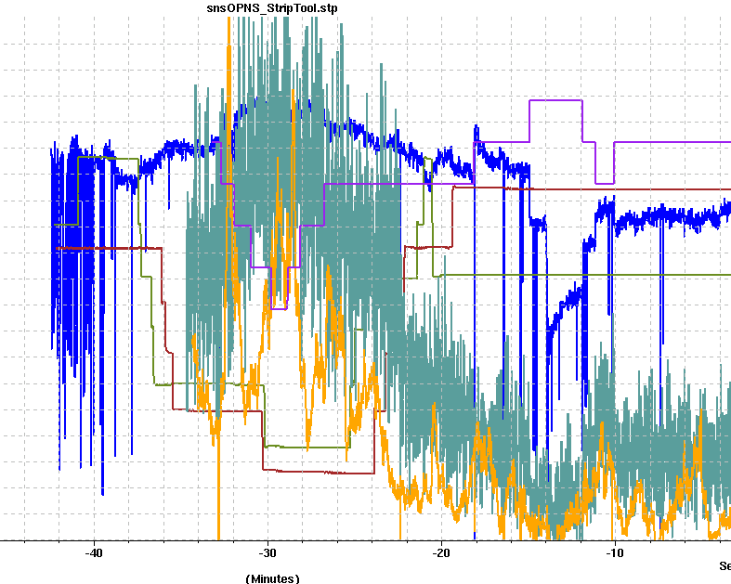
1: Scraping at low beam energy (2.5 MeV)
Scrapers out
Scrapers in
Beam Charge (typically scrape ~3-4% of the beam)
Warm linac beam loss (~55% lower loss at this location)
Ring Injection Dump beam loss (~57% lower loss at this location)
time
The effectiveness of the MEBT scrapers varies with the ion source and the machine lattice
Courtesy J. Galambos

Slide 10
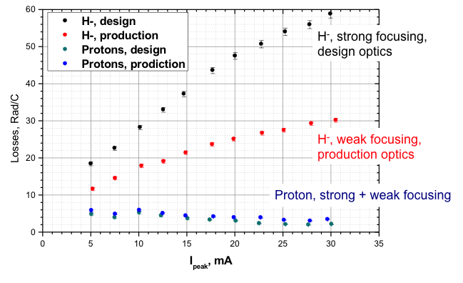
2: Beam loss reduction by increasing the beam size in the SCL
Most of the beam loss in the SCL is due to intra-beam stripping (H⁻ + H⁻ ➔ H⁻ + H⁰ + e)
IBSt reaction rate is proportional to (particle density)²
Quad gradient reduction leads to beam loss reduction
~40%
~50%

Slide 11
3: Beam loss reduction by empirically adjusting magnets and RF phase
Best beam loss is obtained by empirical adjustments to quadrupole gradients and RF cavity phases
The quadrupole changes sometimes result in beam that is transversely mismatched at lattice transitions (e.g. CCL to SCL, SCL to HEBT)
The biggest deviations in RF phase are at the entrance to the SCL
One degree phase changes can approx. double the beam loss at some places
Typical phase changes are 1 to 10 deg

Slide 12
3: Mis-match in the linac and transport line
Low-loss tune is mis-matched at beginning of SCL
These are FODO lattices
The low-loss tune is mis-matched in the SCL and HEBT
Vert. size
Horiz. size
Low loss tune is mis-matched at beginning of HEBT
Vert. size
Horiz. size

Slide 13
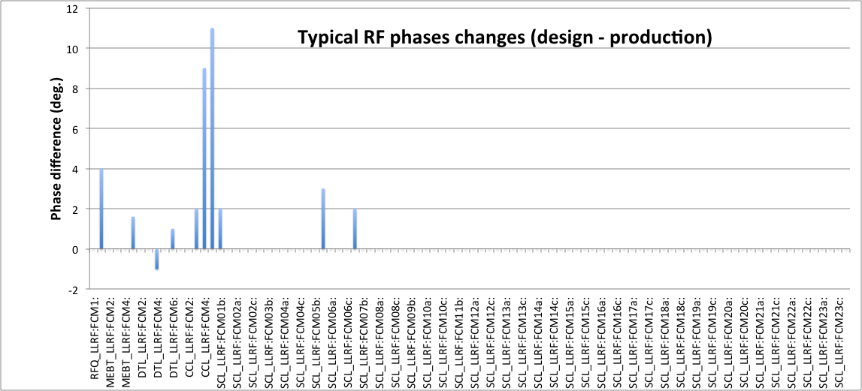
3: Linac RF phases design vs production (2012)
MEBT
DTL
CCL
SCL
Some RF phases must be empirically adjusted to achieve the low-loss tune

Slide 14
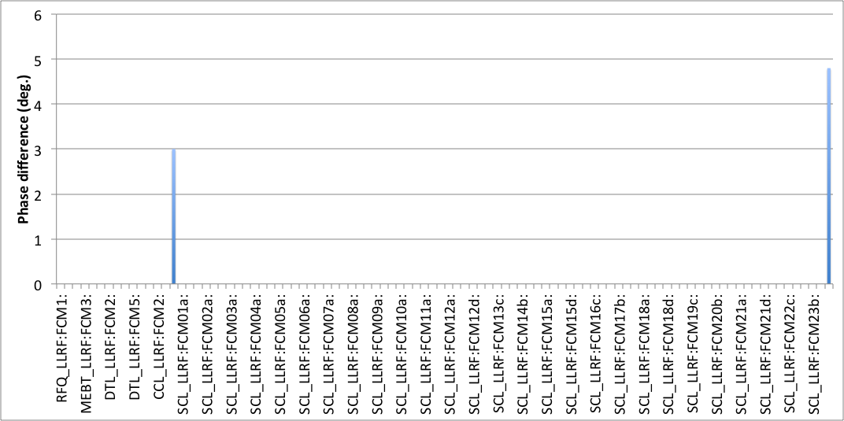
3: Linac RF phases design vs production (2015)
Typical RF phase changes (design – production)
MEBT
DTL
CCL
SCL
Beam energy adjustment
Improvements in automated warm linac phase and amplitude determination have reduced phase changes needed to achieve the low loss tune

Slide 15
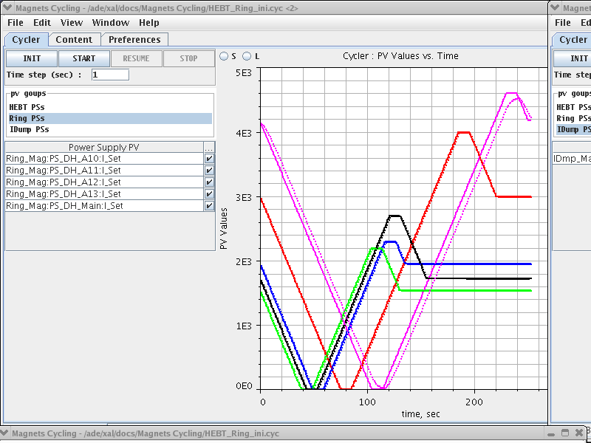
Stability of low loss tune
The low loss tune is very stable
All magnets and RF cavities can be turned off and the beam loss will still be low when they are turned back on
Power supply stability: 10⁻⁴ for ring dipoles, 10⁻³ for quadrupoles, 10⁻² for dipole correctors
Good setpoint reproducibility
Hysteresis cycling is important for the large magnets. Cycling parameters determined empirically.
Klystron gallery temperature stability is important due to sensitivity of LLRF system
Magnet cycling app

Slide 16
Stability of low loss tune (cont.)
Biggest cause of changes during operation:
Stripper foil degradation – foil curls and wrinkles
Extraction kicker timing drifts (upgrade is in progress)
Photo by C. Luck
Photo of used SNS stripper foil

Slide 17
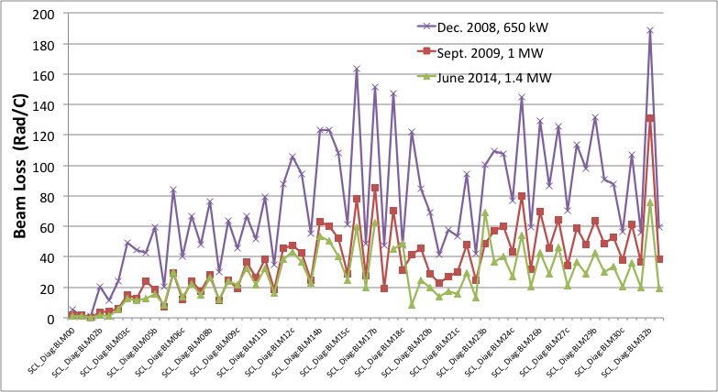
Superconducting Linac beam loss trends
BLMs along the SCL
Big drop in losses with focusing strength reduction in early 2009
Modest benefit since

Slide 18
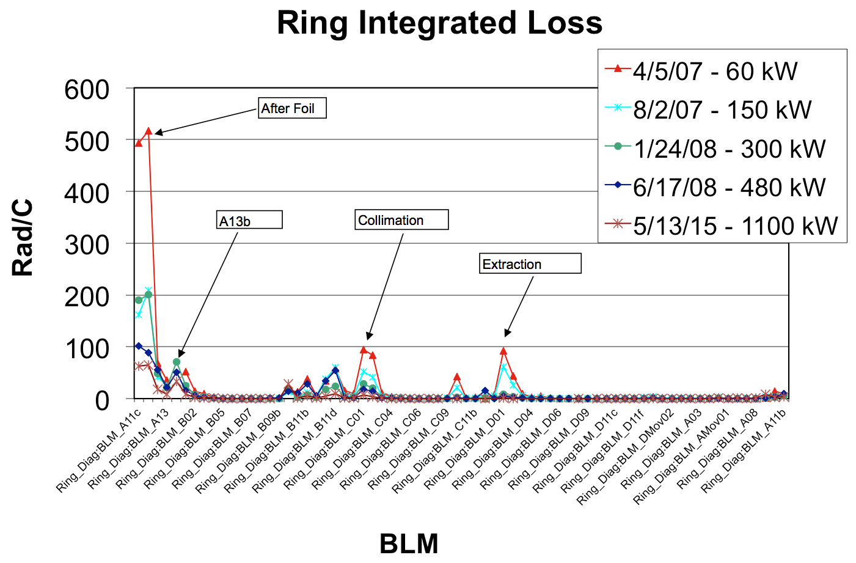
Ring beam loss trends
Ring injection is the primary beam loss area
Estimated total fraction beam loss in ring is 1.9x10⁻⁴

Slide 19
Occasional beam loss (errant beams)
A large amount of beam loss can occasionally occur due to:
RF trips off due to an interlock
Fluctuations in the ion source
Drifts in the RF system (e.g. due to temperature in klystron gallery)
Pulsed magnets miss a pulse or provide only a partial pulse
The integrated beam power lost may be small compared to the continuous beam loss, but the consequences can be large…

Slide 20
Why occasional beam losses are important
Example: damage to superconducting linac (SCL) cavity
Beam hitting RF cavity surface desorbs gas or particulates creating an environment for arcing or low-level discharge
RF cavity performance degrades over time
At SNS, some cavity fields have been lowered, some cavities have been turned off. Lower fields = lower beam energy.
SCL cavities do not trip off with every errant beam pulse, but the probability for a trip increases with time. These trips cause downtime.
At SNS, SCL cavity performance degradation from errant beam can usually be restored
Requires cavity warm up during a long shutdown and then RF conditioning before resuming beam operation

Slide 21
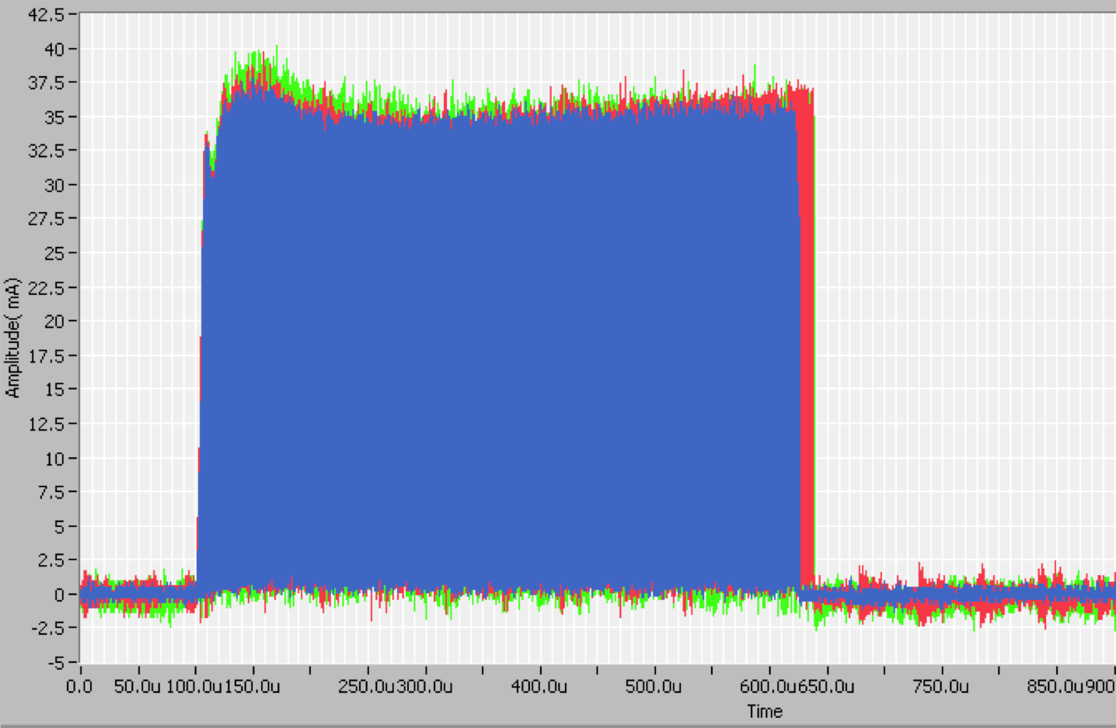
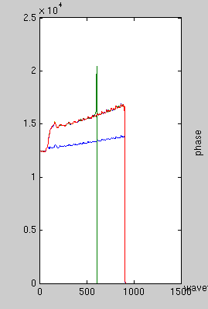
Beam loss due to warm linac RF
Abnormal RF pulse with beam
Normal RF pulse with beam
LLRF output
558 useconds in
CCL
546 useconds in HEBT
12 useconds lost in the SCL
Field
Time (usec)
Normal RF pulse with no beam
(Courtesy C. Peters)

Slide 22
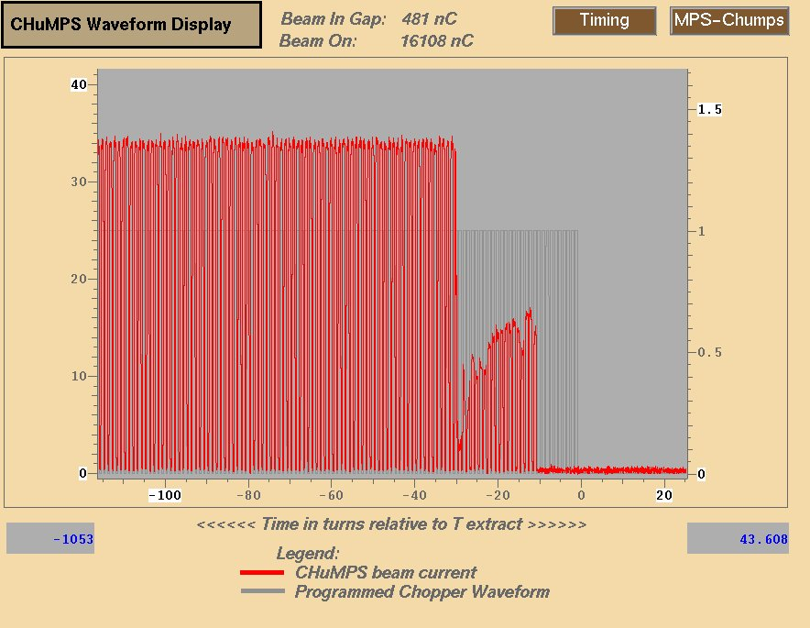
Beam loss due to ion source
Abrupt beam loss caused by sudden changes in the ion source
Fast beam current monitor in MEBT

Slide 23
At SNS, the majority of trips originate in the warm linac
> 90% of BLM trips were due to Warm Linac RF faults
RF faults occur at different times during the pulse
Faults during the RF fill had reproducible times
Faults during the RF flattop were random
Focused on improving warm linac operation
< 10% of BLM trips were due to the Ion source/LEBT
Most ion source induced BLM trips occur during the first week of a new source installation
High voltage arcing

Slide 24
Plans for further improvements
Our goal is to improve our understanding of the accelerator beam dynamics, and our model of the machine, so that the model will accurately determine the low loss tune
Determine if our empirically-determined low loss tune is actually a local minimum – there may be further improvements to be found
Maximize beam size in linac to reduce intra-beam stripping – make best use of available aperture
Consider adding additional scraping between warm and cold linac sections
Minimize and control beam halo formation

Slide 25
Summary
During first years of operation beam losses were improved by empirical tuning, adding scrapers, modifications to ring injection / injection dump
Today losses are stable and reproducible
SNS beam power is not limited by beam losses
The ring injection area has the highest levels of activation, due to the stripper foil
Most beam loss in SCL is caused by intra-beam stripping
Linac losses are linear with beam pulse length
Linac losses are approx. quadratic with beam current (IBSt)

Slide 26
Summary (cont.)
The low-loss tune is not the same as the design tune, can only be found by empirical tuning
Occasional beam loss (errant beams) is mainly due to warm linac RF cavities. We are now working to correct this.
Unexpected results from commissioning:
scraping in MEBT is surprisingly effective
beam loss due to intra-beam stripping
occasional beam loss (errant beams) degrades SC cavities

Slide 27
Thank you for your attention!

Slide 28
Back up slides

Slide 29
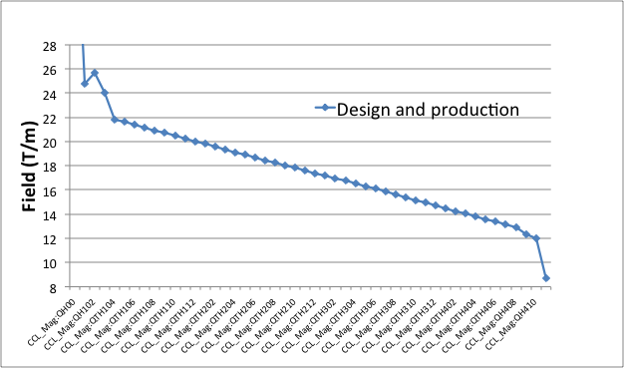
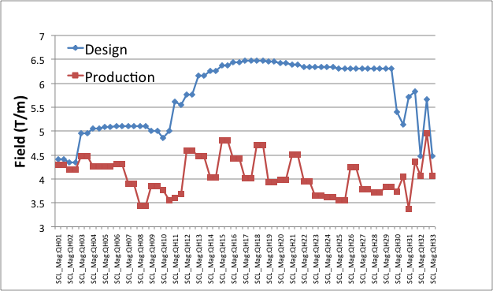
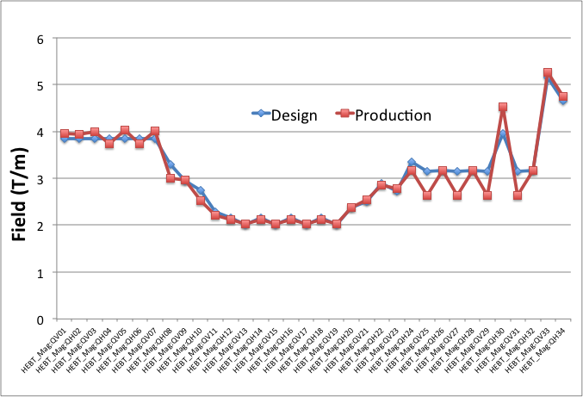
3: SNS Linac Transverse Lattice: Design vs. Operation
CCL quad fields
SCL quad fields
HEBT quad fields
Warm linac CCL quads are equal to design
SCL quads operated much lower than design
HEBT quads operated close to design

Slide 30
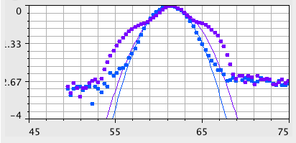
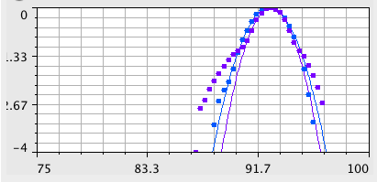
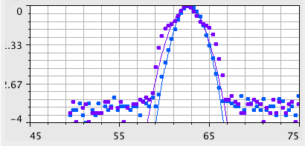
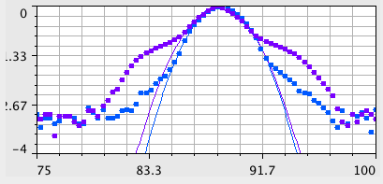
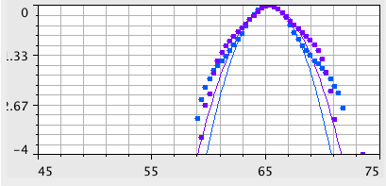
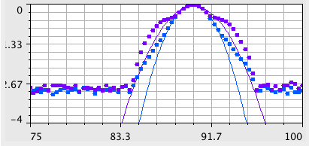
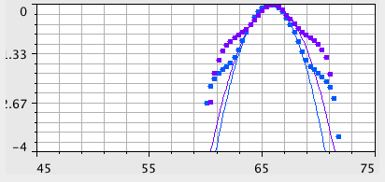
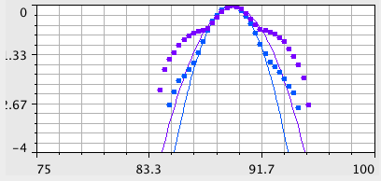
3: Example: beam tails are created in DTL
Horizontal
Mismatched production tune
Better matched beam
Vertical
Start of DTL (7.5 MeV)
Gaussian fits
Semi-log scale
Beam tails improved but still present
End of DTL
(86 MeV)
Courtesy C. Allen
Notes:
3/Jul/2012 data w/ & w/o matching to DTL

Slide 31
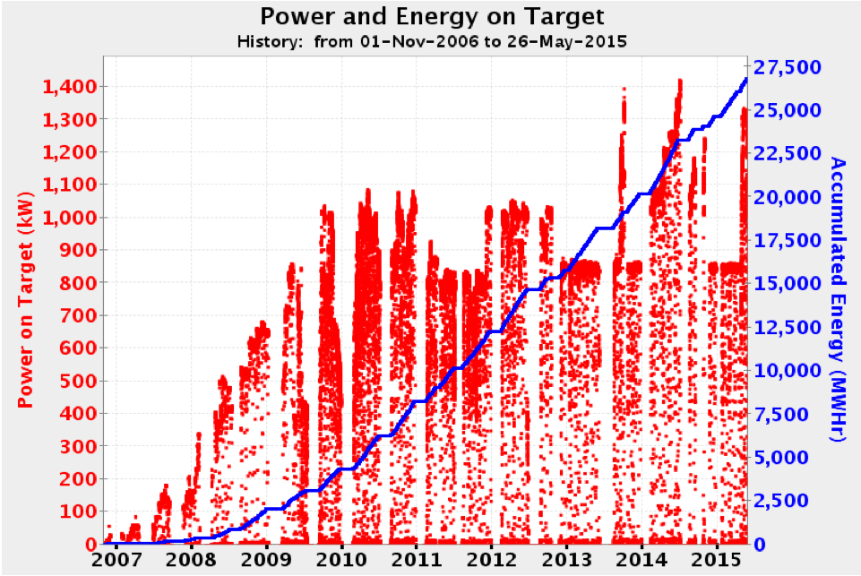
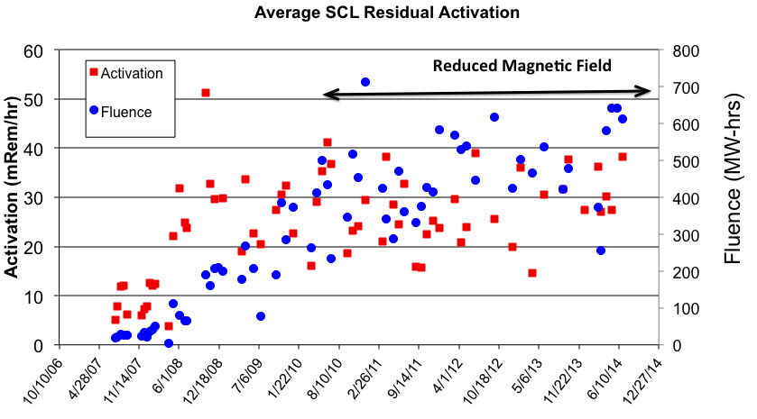
SC Linac Activation vs time (Courtesy C. Peters)
Fairly steady activation level since 2010

Slide 32
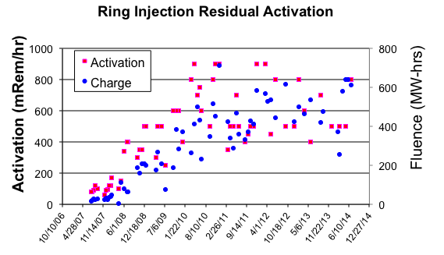
Ring Injection Activation (Peak) (Courtesy C. Peters)
No obvious jump in activation downstream from the foil

Slide 33
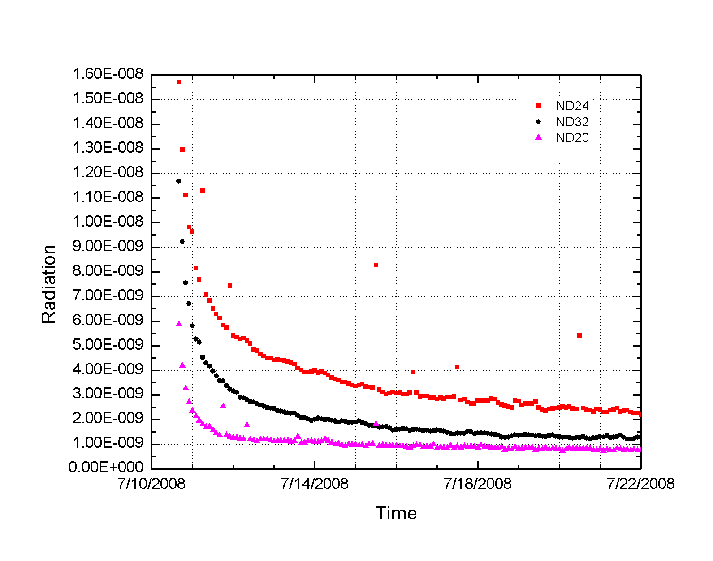
Residual Activation Decay (Zhukov, Assadi, Popova)
Real time measurement of residual activation after shutdown
SCL decays quite fast – model comparisons are underway
Possibly useful information for diagnosing nature of the beam loss

Slide 34
Capturing the occasional beam loss events in the SNS linac
Differential Beam Current Monitor (BCM) systems
Use BCMs in the MEBT, CCL, and HEBT to see how much beam is lost in the SCL
BLM systems
76 ion chamber detectors along the SCL
Automated report system
SCL BLM trip occurs, or BCM system detects abnormal signal
Record BCM waveforms, BLM waveforms, BLM signal level
Send data to a webserver for immediate viewing

Slide 35
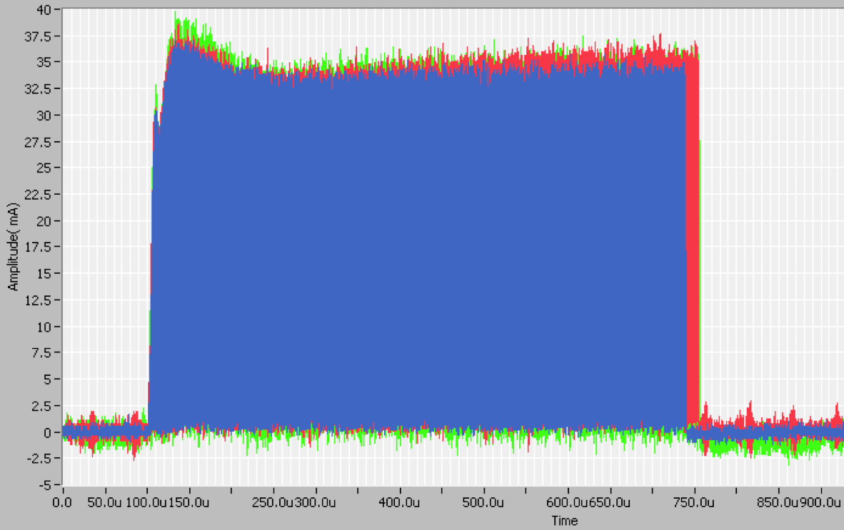
How much beam is lost
16 useconds
End of DTL = 30 J
End of CCL = 66 J
End of SCL = 350 J
Differential BCMs showed different types of faults
Average 15-20 usec of beam lost in the SCL
680 useconds in
CCL
16 useconds lost in the SCL
664 useconds in
HEBT

Slide 36
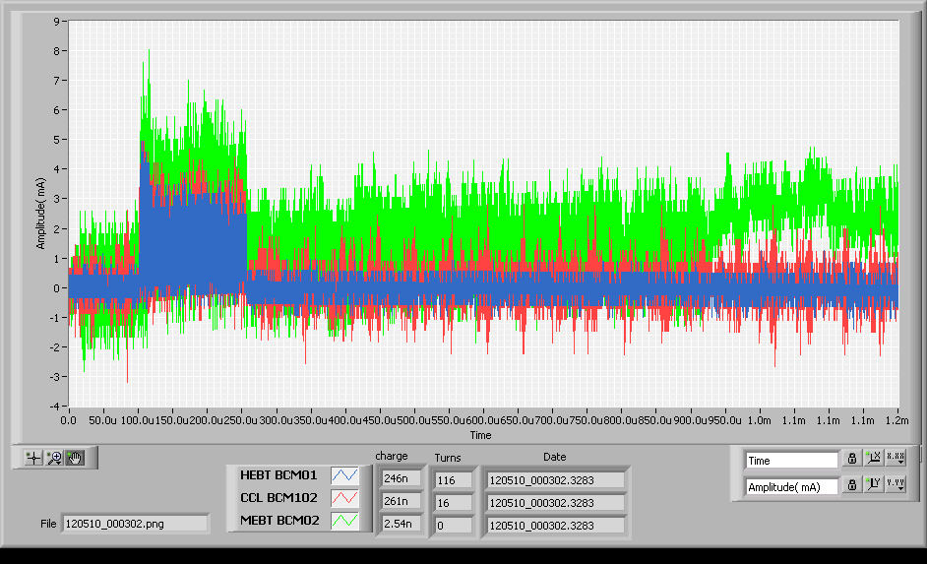
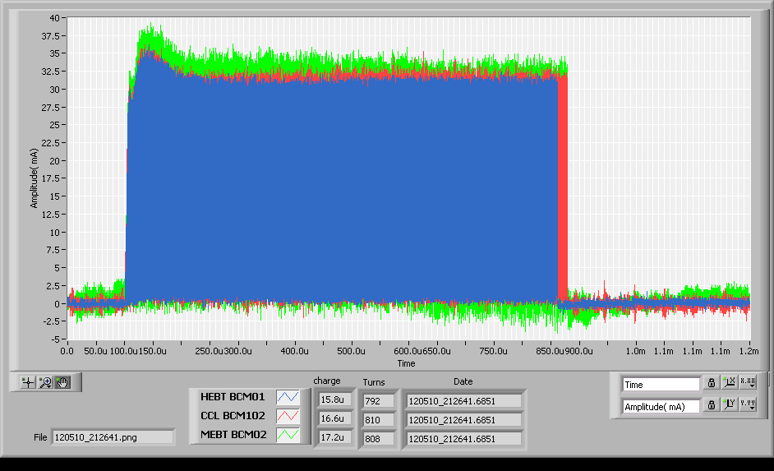
Beam loss due to ion source/LEBT
Low current pulse causes beam loss in SCL
Normal
Normal ion source pulse
~ 33 mA
Abnormal

