Slide 1
CSNS Accelerator Control and Beam Instrumentation
JIN Dapeng, XU Taoguang …
June 9, 2015
jindp@ihep.ac.cn
xutg@ihep.ac.cn

Slide 2
Outline
Overall design and progress of the CSNS accelerator control and beam instrumentation systems
Next to do
Summary
2

Slide 3
Architecture of control system
FPS
Timing
MPS
LAN
3

Slide 4
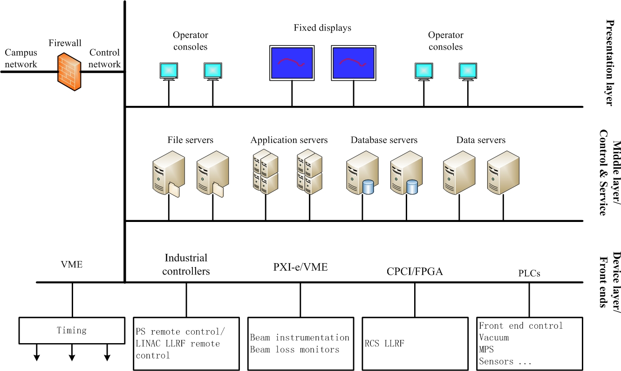
Overall design and progress
Architecture layers.
Global control software : EPICS based.
4

Slide 5
Overall design and progress
Tasks of the control system.
Network based global control backbone.
Timing system.
Machine protection system.
Global data archiving, alarms, and consultation.
Some equipment level controls : front end, vacuum, power supplies remote, LINAC RF remote, injection and extraction, collimators and stripping foils remote …
5

Slide 6
Overall design and progress
Progress of control system
Temporary network for LINAC control and commissioning built and used.
Temporary data archiver settled.
Part of timing system built and used.
Control of front end completed and used.
Vacuum control of front end completed and used.
6

Slide 7
Overall design and progress
Progress of control system
Part of PS remote control built and used.
LLRF remote control built and used.
Part of MPS/FPS (Fast Protection System) built and under test.
Other work goes on smoothly according to the progress of the different equipment.
7

Slide 8
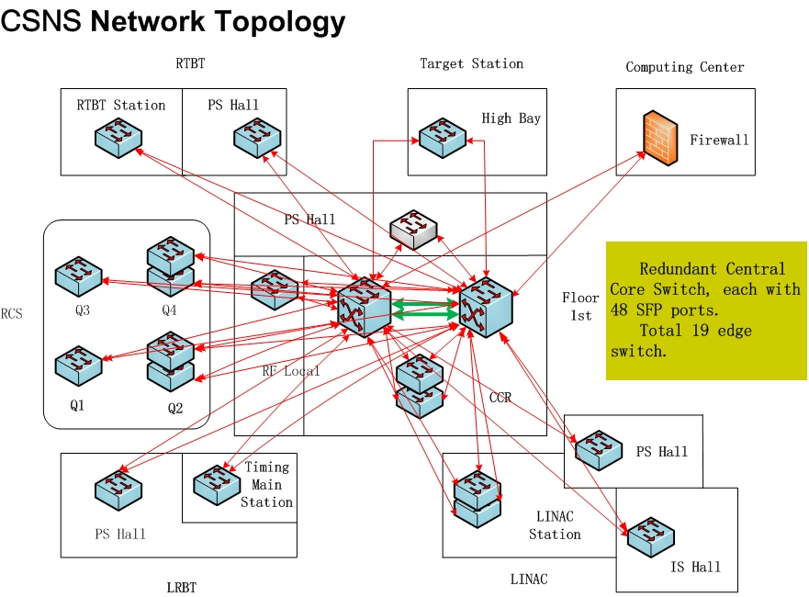
Overall design and progress
Overall network topology.
8

Slide 9
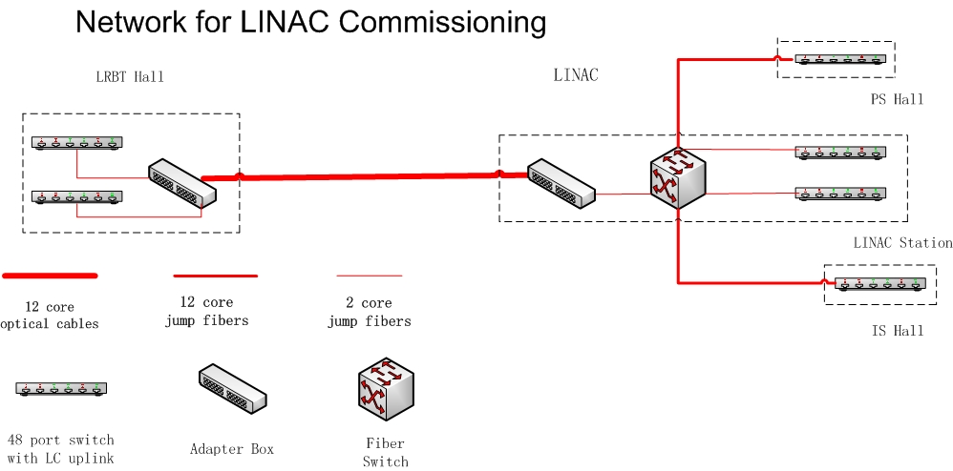
Overall design and progress
Network for LINAC control and commissioning.
9

Slide 10
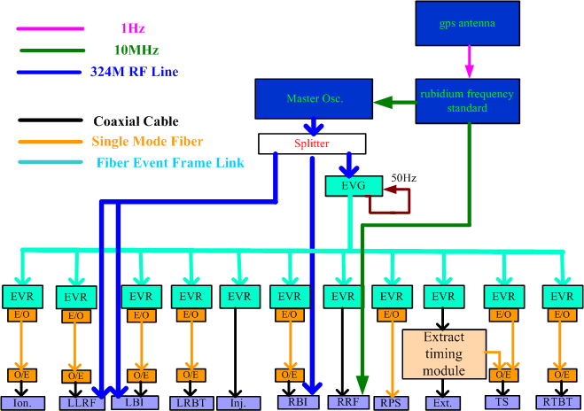
Overall design and progress
Timing system : structure.
Event based.
10

Slide 11
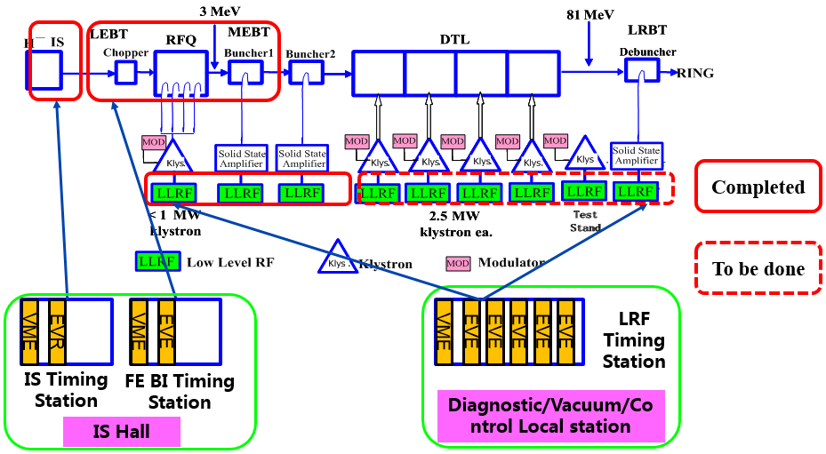
Overall design and progress
Timing system : LINAC.
11

Slide 12
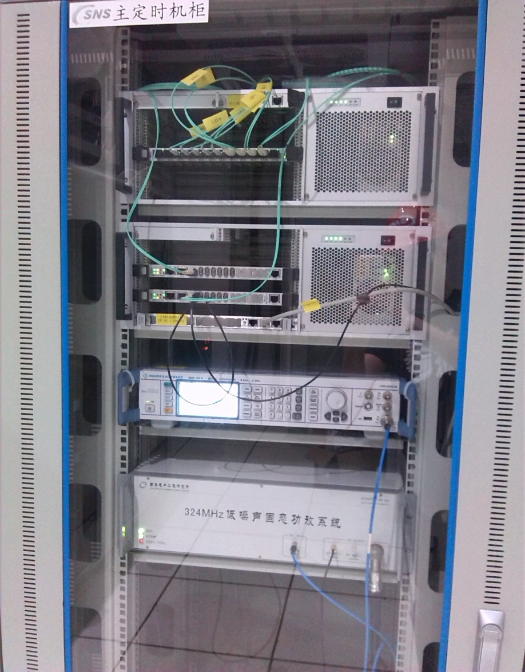
Overall design and progress
Photo of temporary main timing station.
VME FOUT Module
MRF EVG-230 Module
R&S
Signal Generator
Home made
324MHz Power Amplifier
To RF Ref. Line
12

Slide 13
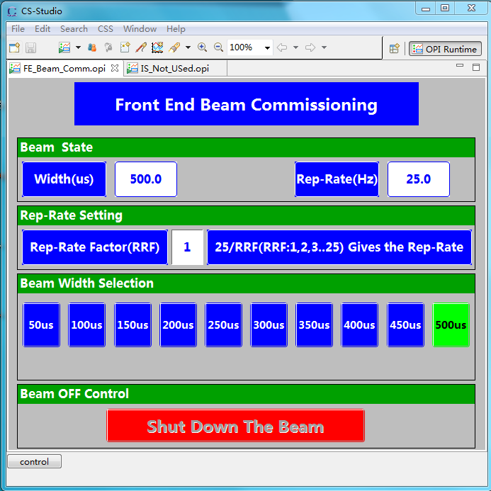
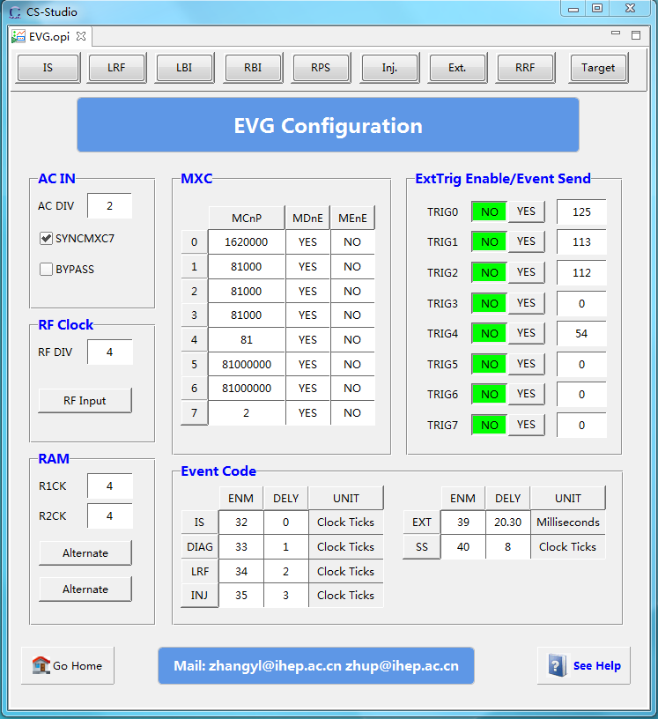
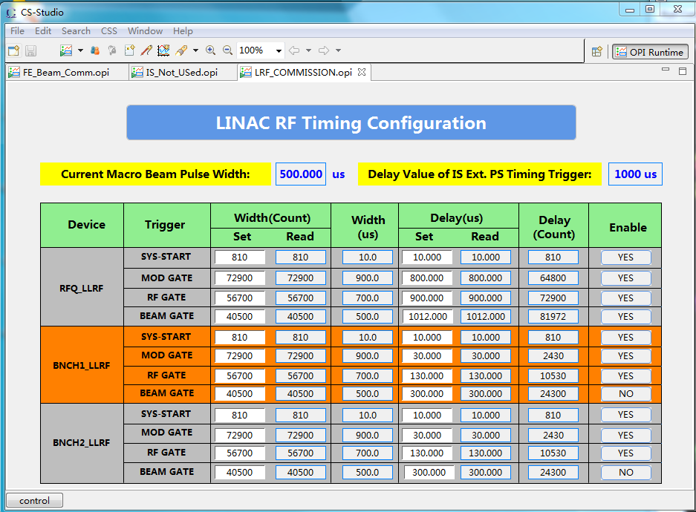
Overall design and progress
Timing system : OPIs.
13

Slide 14
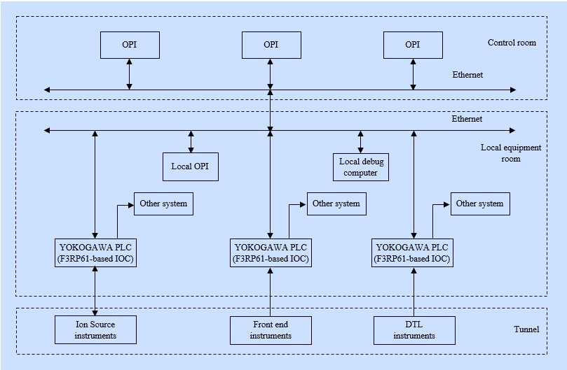
Overall design and progress
Front end control : structure.
14

Slide 15
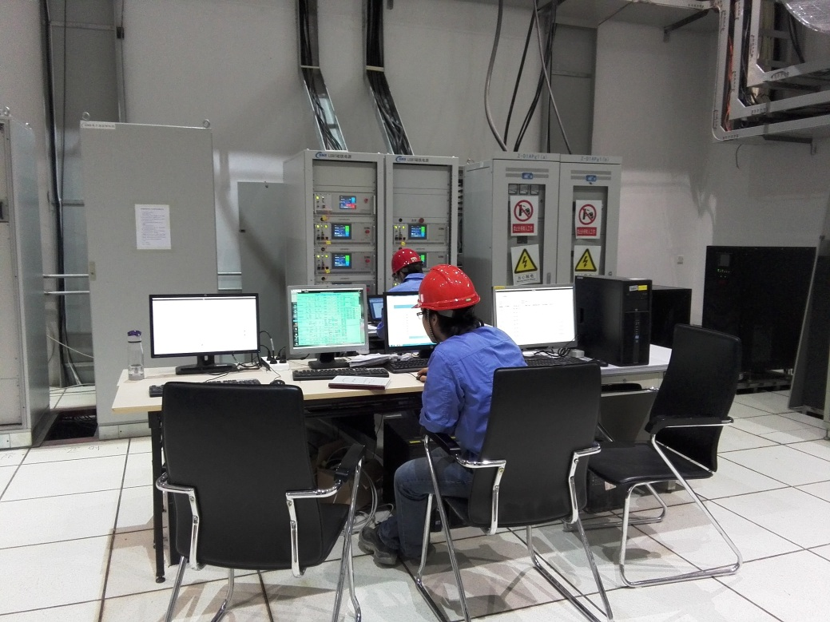
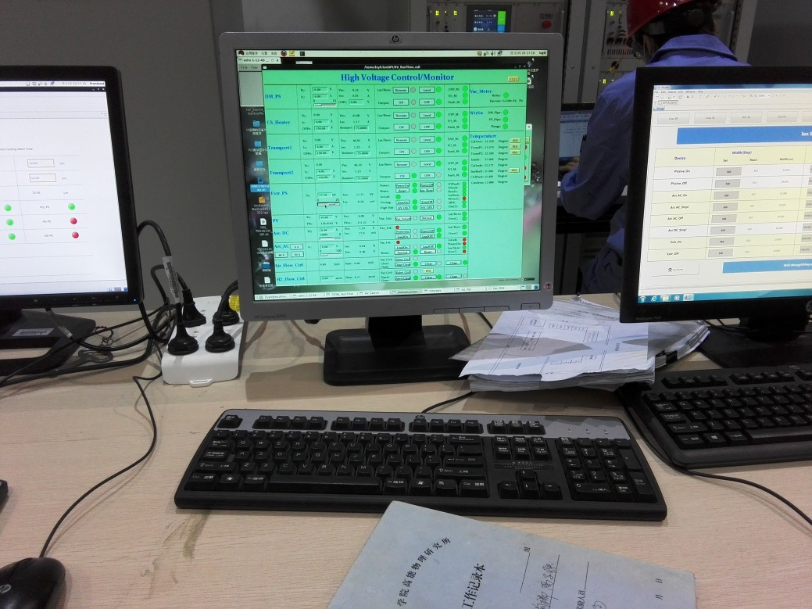
Overall design and progress
Photos of front end control in use. Ion source hall.
15

Slide 16
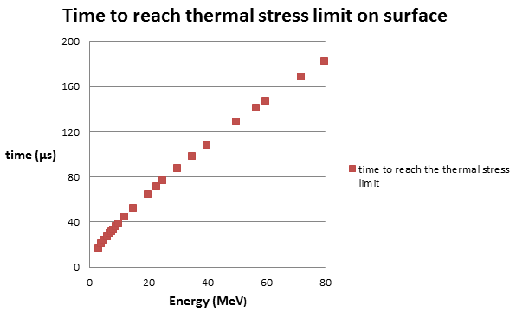
Overall design and progress
Machine protection system.
Requirements for drift tubes, bunchers and de-buncher.
Un-chopped beam, 15mA
Beam size : 0.2cm * 0.2cm RMS
Hitting the components directly
17μs
5μs due to Bragg Peak
10μs if chopped
Critical most cases
16

Slide 17
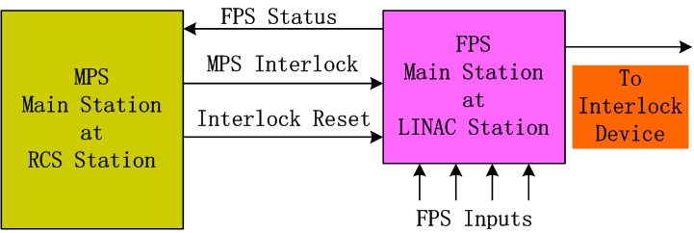
Overall design and progress
Machine protection system : architecture.
17

Slide 18
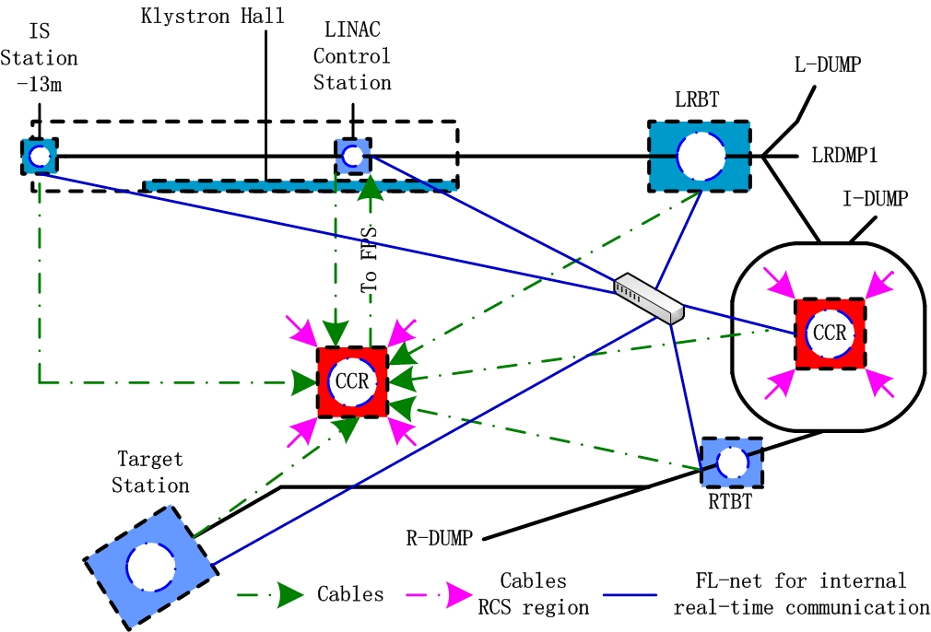
Overall design and progress
Distribution of MPS part (PLC based).
18

Slide 19
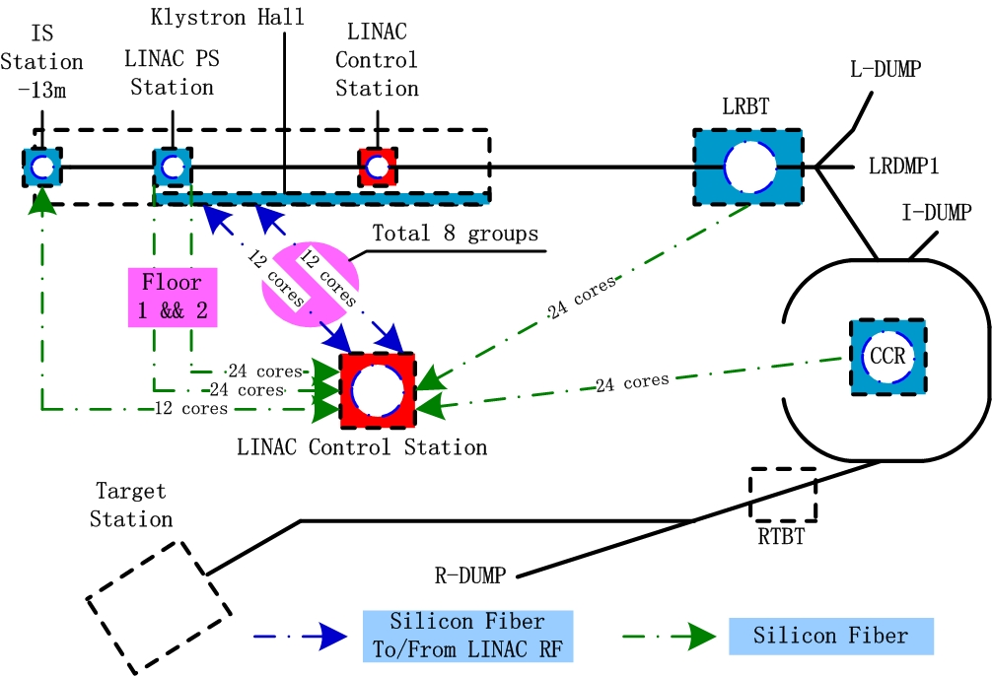
Overall design and progress
Distribution of FPS part (FPGA and high speed serial link based).
19

Slide 20
Overall design and progress
FPS : How to stop the beam and recover
FPS
IS Extraction
Timing
IS HV Control
Below 10kV?
RFQ Power
LLRF Beam
Gate
Interlock
Feedback
Reset
20

Slide 21
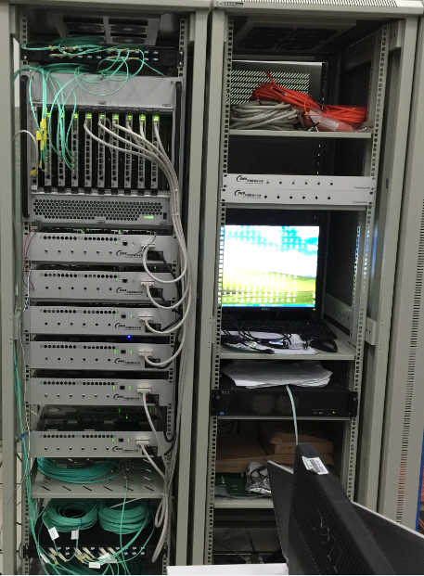
Overall design and progress
Opt. adaptor
FPS Central Station :
Field photo
Opt. transceiver
Main Board
VME
OPI
IS Mother Board
MPS Mother Board
Timing Mother Board
LLRF Mother Board
LLRF Mother Board
BLM Mother Board
21

Slide 22
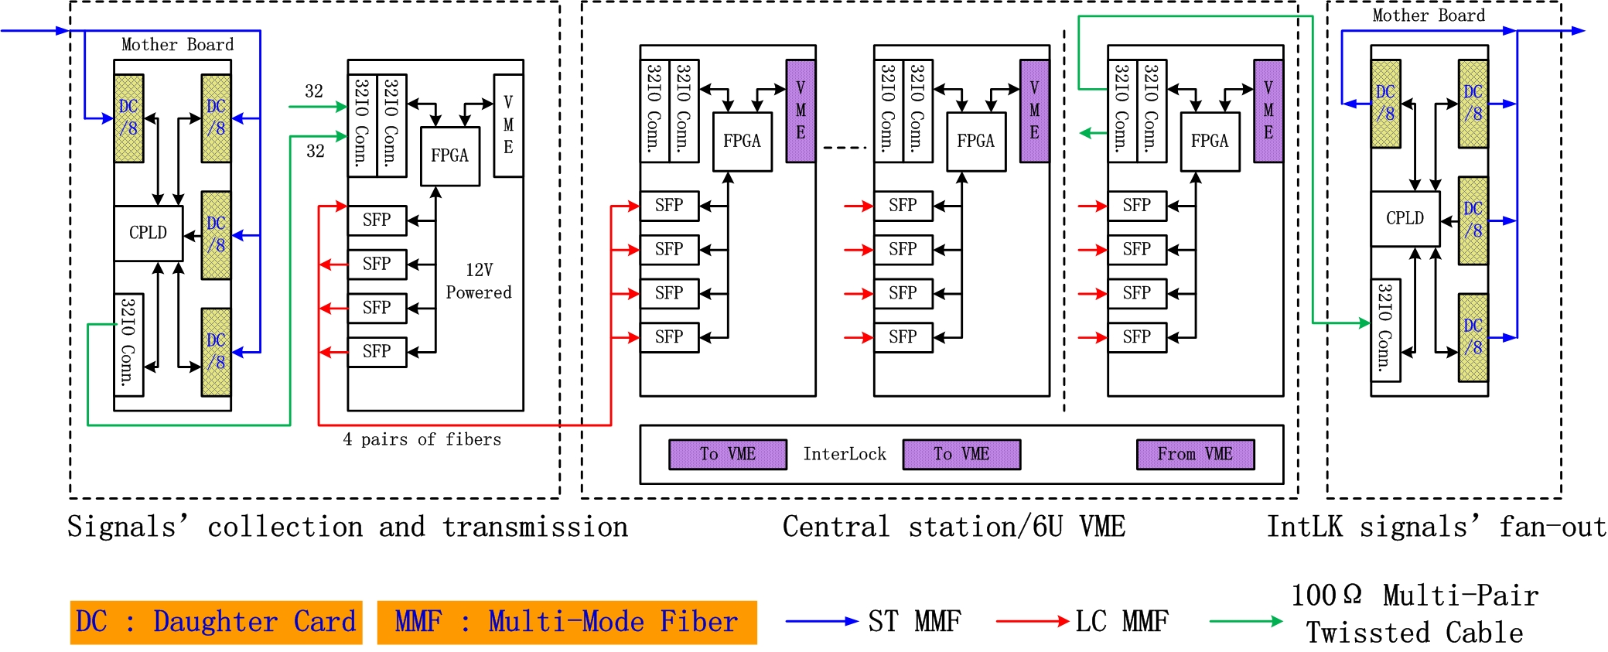
Overall design and progress
FPS : Illustration of connections
Daughter card
Main board
Main board
Mother board
22

Slide 23

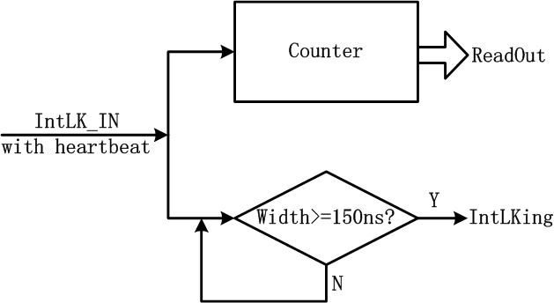
Overall design and progress
Heart-beat functions for real-time safety
Heart-beat signal generation in the CPLD on the daughter card of front end
Heart-beat signal check and counting in the FPGA on the main board at central station
23

Slide 24
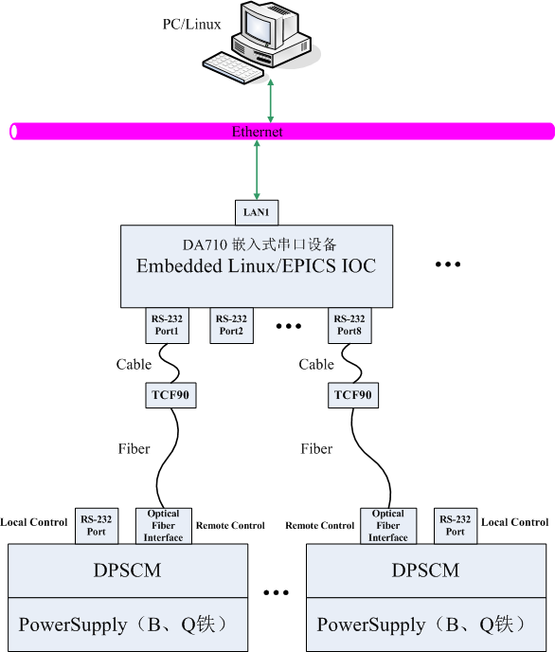
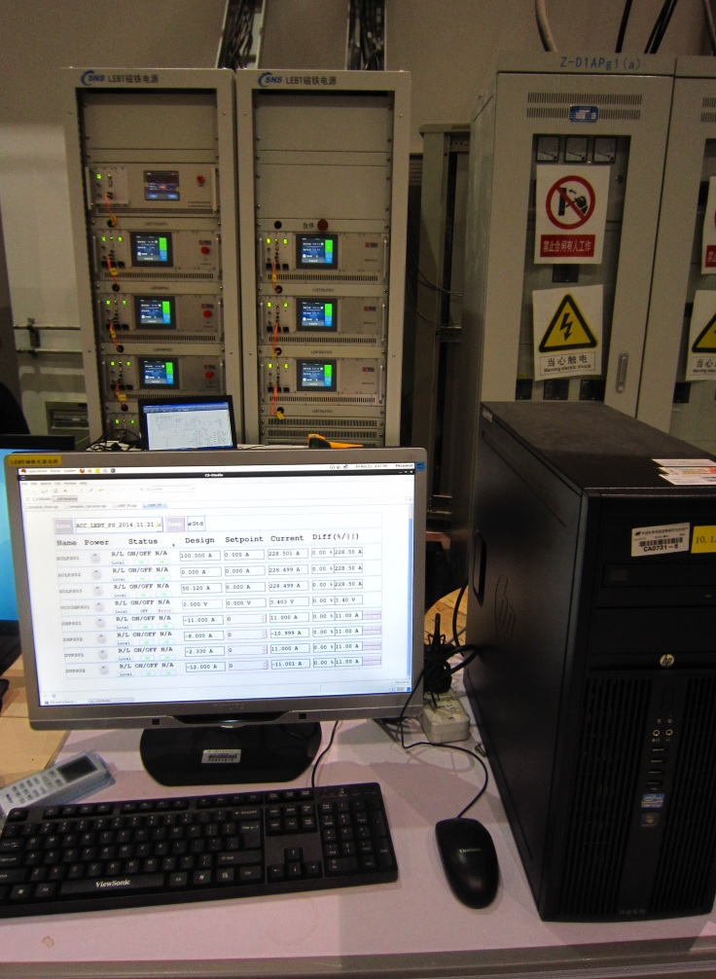
Overall design and progress
Power supplies remote control.
PS cabinets
OPI
24

Slide 25
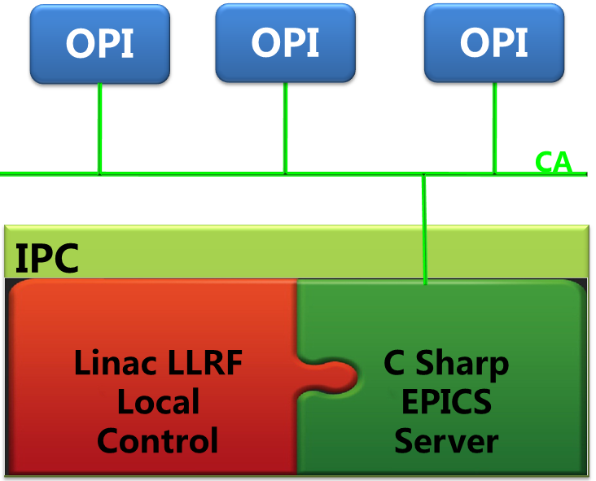
Overall design and progress
LINAC RF remote control. Codes embedded in LINAC LLRF local control with C#.
25

Slide 26
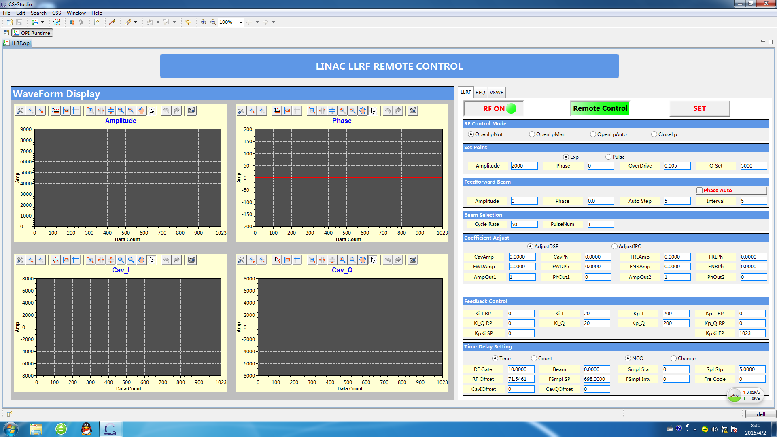
Overall design and progress
LINAC RF remote control : OPI.
26

Slide 27
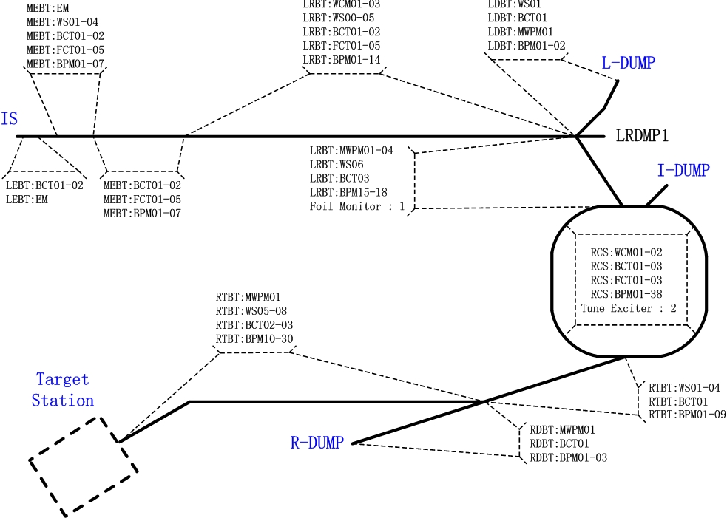
Overall design and progress
Distribution of beam monitoring and measurement devices.
27

Slide 28
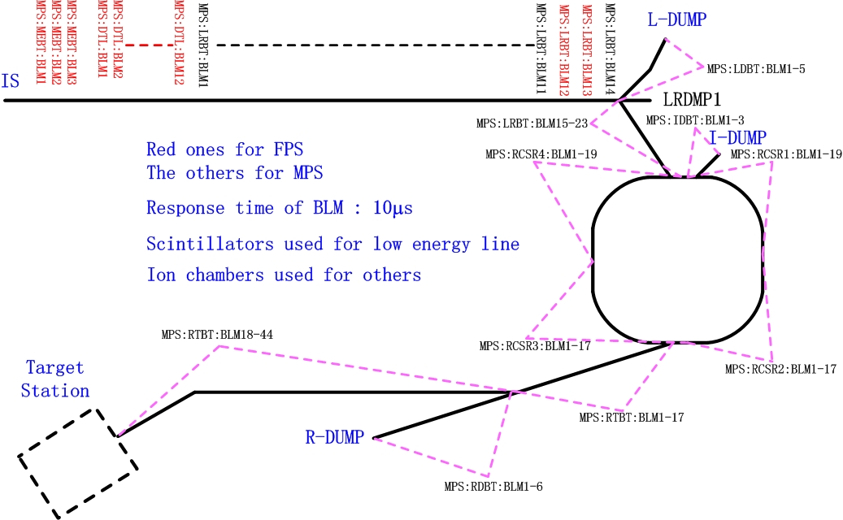
Overall design and progress
Distribution of beam loss monitors.
28

Slide 29
Overall design and progress
Number of beam instrumentation devices along the beam.
 | BCT | BPM | BLM | FBLM | FCT | WS | EM | Foil | MWPM | WCM
LEBT | 2 |  |  |  |  |  | 1
MEBT | 2 | 7 | 3 |  | 5 | 4 | 1
DTL | 2 | 1 | 12 | 1 | 3
DTL temp. | 1 | 1 | 1 |  | 2 | 1 | 1
LRBT | 4 | 20 | 28 | 3 | 5 | 8 |  | 1 | 5 | 3
 | BCT | BPM | BLM | FBLM | FCT | WS | MWPM | WCM | tune exciter
RCS | 3 | 38 | 72 | 9 | 3 |  |  | 2 | 2
RTBT | 4 | 33 | 50 | 2 |  | 8 | 2
29

Slide 30
Overall design and progress
Acquisition and electronics system of beam instrumentation.
Mostly NI PXI-express based with windows and LabView. IOCs in PXI-express controller.
VME/Linux based for BPMs in RCS, IOC in upper server with Windows/Linux + LabView.
Common data will be stored in global Archiver, large size data will be stored in files via NFS for further analysis. Waveform and average value readout for frond end devices with Max 1MHz.
30

Slide 31
Overall design and progress
Till now, the devices for front end (Ion source, LEBT, RFQ, MEBT) have been installed. A Faraday cup is installed for temporary beam dump.
BPM, beam emittance and beam current data have been got. Wire scanner have been put into use.
31

Slide 32
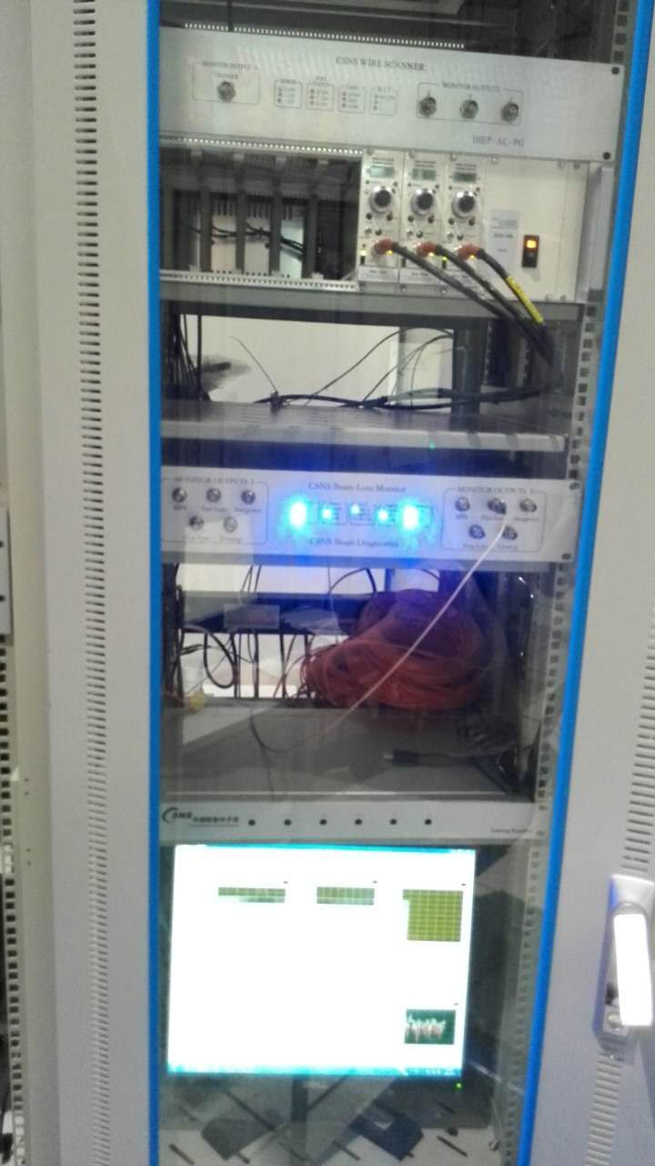
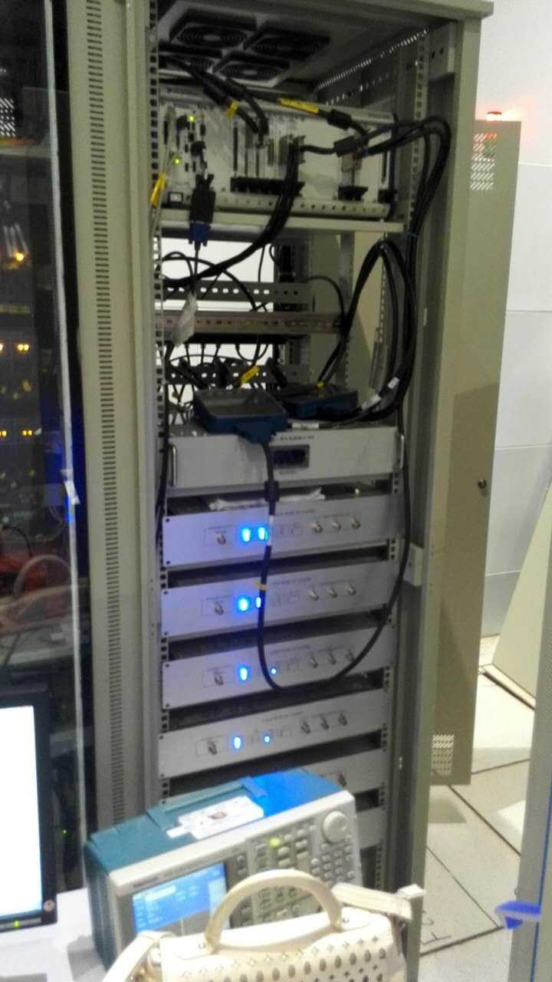
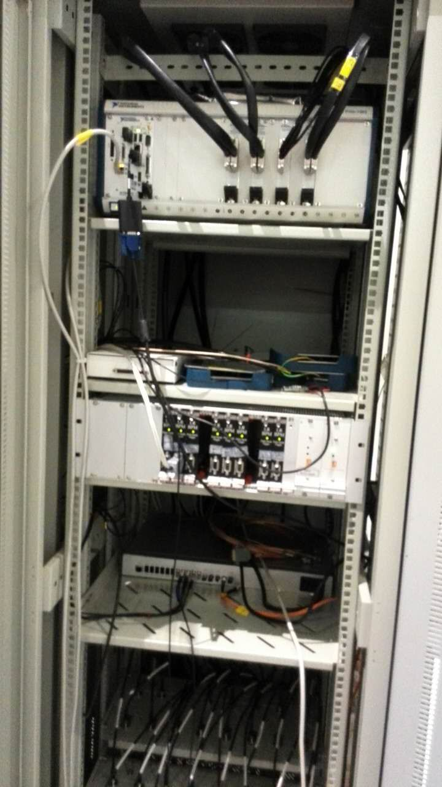
Overall design and progress
Beam instrumentation devices installed in the Ion Source hall.
32

Slide 33
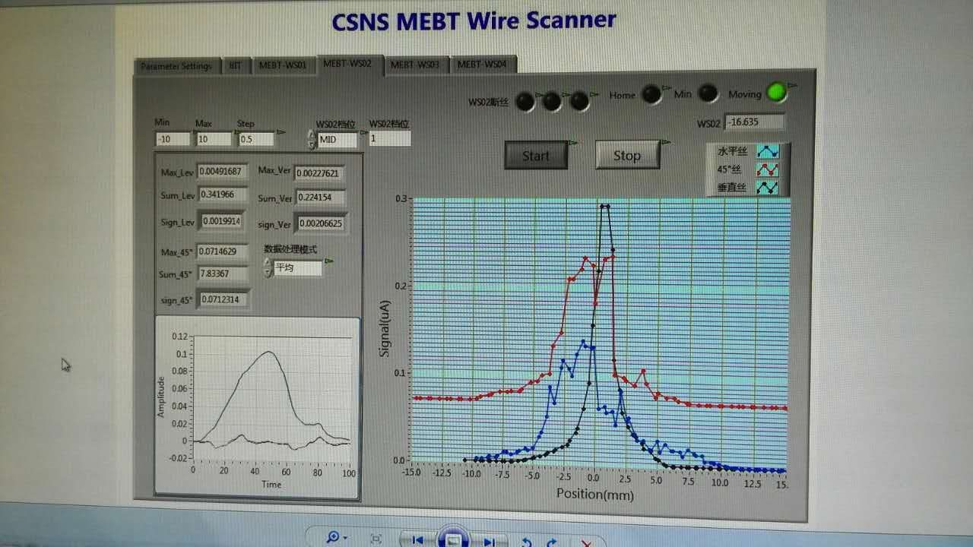
Overall design and progress
Results from the wire scanner.
Wire vertical
Wire 45-degree
Wire horizontal
33

Slide 34
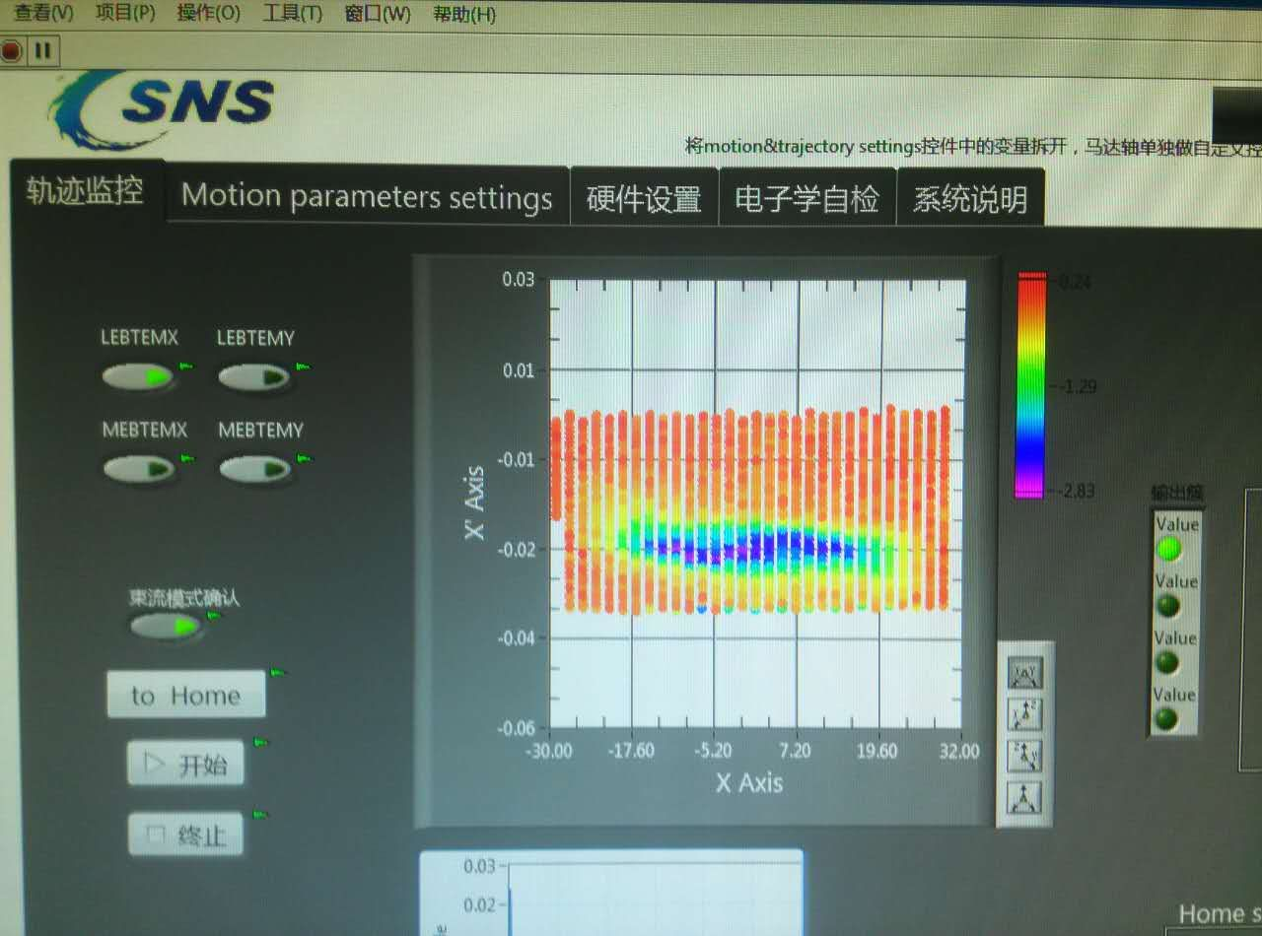
Overall design and progress
Results of emittance measurement.
34

Slide 35
Next to do
Installation and commissioning of devices and equipment after MEBT.
Further debug of the beam instrumentation devices installed to improve performance.
Installation in the Central Control Room will start around this September.
35

Slide 36
Summary
Design and progress of the control and beam instrumentation systems are briefly introduced.
Equipment for the front end have been installed and put into use. All parts run steadily till now.
Much work needs to be done next.
Thanks a lot!
36

