Slide 1
Fermi galactic center excess:
SUSY explanation and its test at LHC run-2
Jin Min Yang
ITP, Beijing
arXiv:1409.8431; 1506.06471
(Cao, Shang, Wu, Yang, Zhang)
雁西湖 2015.8.8

Slide 2
Outline
1 Introduction to dark matter
2 Fermi galactic center excess
Dark matter explanation in SUSY
4 Test at LHC run-2
5 Conclusion

Slide 3
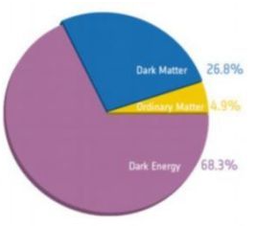
1 Introduction to Dark Matter
So far, we only know dark matter
has gravity interaction
We need to figure out its nature,
e.g., does it have weak interaction ?

Slide 4
Direct detection Indirect detection Collider search

Slide 5


Slide 6
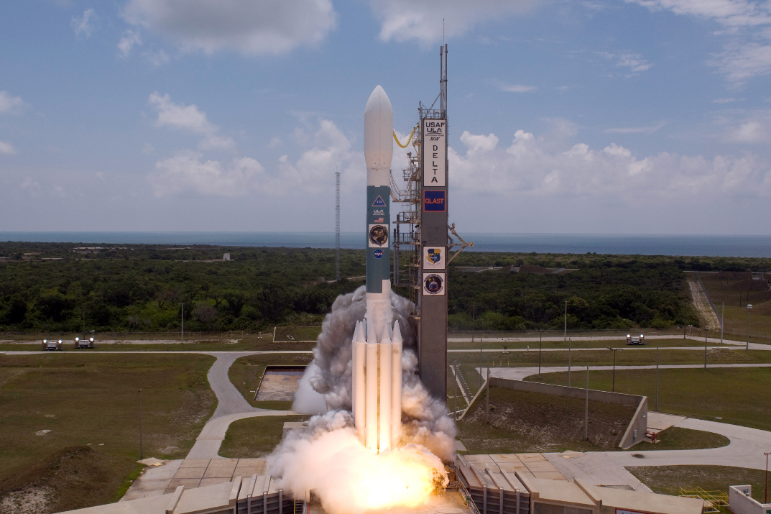

observe a generic connection between LHC Higgs data and electroweak baryogenesis: the particle that contributes to the CP odd hgg or hγγ vertex would provide the CP violating source during a first order phase transition. It is illustrated in the 2HDM that a common complex phase controls the lightest Higgs properties at the LHC, electric dipole moments and the CP violating source for electroweak baryogenesis. We perform a general parametrization of Higgs effective couplings and a global fit to the LHC Higgs data. Current LHC measurements prefer a nonzero phase for tanβ≲1 and EDM constraints still allow an order one phase for tanβ∼1 , which gives sufficient room to generate the correct cosmic baryon asymmetry. We also give some prospects in the direct measurements of CP violation in the Higgs sector at the LHC.
observe a generic connection between LHC Higgs data and electroweak baryogenesis: the particle that contributes to the CP odd hgg or hγγ vertex would provide the CP violating source during a first order phase transition. It is illustrated in the 2HDM that a common complex phase controls the lightest Higgs properties at the LHC, electric dipole moments and the CP violating source for electroweak baryogenesis. We perform a general parametrization of Higgs effective couplings and a global fit to the LHC Higgs data. Current LHC measurements prefer a nonzero phase for tanβ≲1 and EDM constraints still allow an order one phase for tanβ∼1 , which gives sufficient room to generate the correct cosmic baryon asymmetry. We also give some prospects in the direct measurements of CP violation in the Higgs sector at the LHC.
2 Fermi Galactic Center Excess
2.1 Fermi-LAT

Slide 7
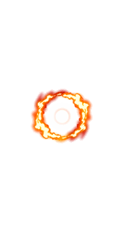

Fermi Gamma-Ray Satellite

Slide 8


The Fermi spacecraft was launched into a near-earth orbit on 11 June 2008. The design life of the mission is 5 years and the goal for mission operations is 10 years.
The LAT is an imaging high-energy gamma-ray telescope covering the energy range from about 20 MeV to more than 300 GeV. Such gamma rays are emitted only in the most extreme conditions, by particles moving very nearly at the speed of light. The LAT's field of view covers about 20% of the sky at any time, and it scans continuously, covering the whole sky every three hours.
The LAT collaboration includes more than 400 scientists at more than 90 universities in 12 countries.

Slide 9
2.2 Fermi Galactic Center Excess

Slide 10


Slide 11
5-year data

Slide 12
Galactic center gamma‐ray excess

Slide 14
Galactic center gamma‐ray excess (more recent)
1409.0042 F. Calore, I. Cholis, C. Weniger

Slide 15
Voice from Fermi Collaboration:

Slide 16
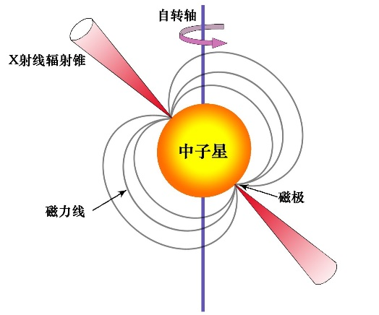
2.3 Dark matter explanation

Slide 17
DM annihilations:

Slide 18
DM annihilations:

Slide 19
However,
recently some tensions with DM interpretation

Slide 20
Dwarf spheroidal galaxy：
Low luminosity galaxies that are companions to Milky Way
Because of the extremely large amounts of dark matter in these objects, they may deserve the title "most dark matter-dominated galaxies"

Slide 23
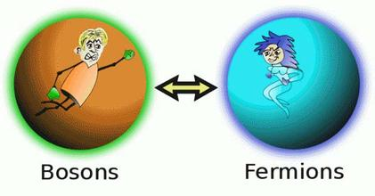
Dark matter explanation in SUSY

Slide 24






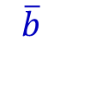
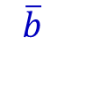


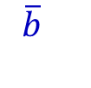



3.1 DM annihilation channel
$$χ$$
$$b$$
$$a_{ }$$
dominant
$$χ$$
$$\overline{b}$$
$$χ$$
$$b$$
Z
p-wave suppression
$$χ$$
$$\overline{b}$$
$$χ$$
$$b$$
$$h$$
p-wave suppression
$$χ$$
$$\overline{b}$$

Slide 25



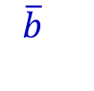


Further, in order to have a large cross section to explain GCE:
$$m_{a}∼2 m_{χ}$$
$$χ$$
$$b$$
$$a_{ }$$
GCE
$$χ$$
$$\overline{b}$$

Slide 26






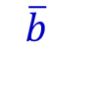
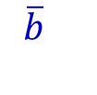


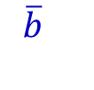



For relic density, we need to consider all channels
(in early universe dark matter velocity is large)
$$χ$$
$$b$$
$$a_{ }$$
dominant
$$χ$$
$$\overline{b}$$
$$χ$$
$$b$$
Z
sub-dominant
$$\overline{b}$$
$$χ$$
$$χ$$
$$b$$
$$h$$
sub-dominant
$$χ$$
$$\overline{b}$$

Slide 27




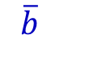


3.2 Incapability of MSSM
$$χ$$
$$b$$
$$a_{ }$$
$$m_{a}∼2 m_{χ}$$
$m_{χ}$ ~ 30-40 GeV
$$χ$$
$$\overline{b}$$

Slide 28
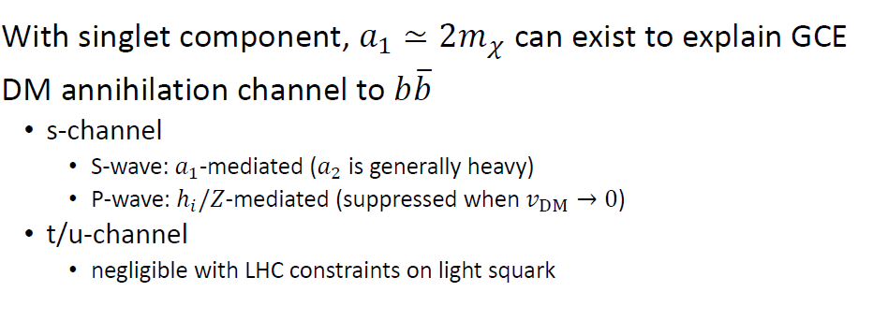
3.3 Capability of NMSSM

Slide 29


Slide 30
early
universe:
V>0
today:

Slide 31
In early universe, Z-contribution is needed
higgsino‐like neutralinos/chargino are moderate/light

Slide 32
Parameter Space Scan
Experimental constraints (each at 2-sigma):
Precision EW data
LEP limits
B-physics
LHC Higgs data
Muon g-2
Dark matter relic density and direct detections
Vaccum stability and purterbativity of couplings

Slide 34
Simulation of 3-lepton signal at LHC-14

Slide 37
4 Test at LHC run-2
Luminosity (${fb}^{−1}$) needed for exclusion (95% CL) at LHC-14

Slide 38
Test at DM direct detections:

Slide 39
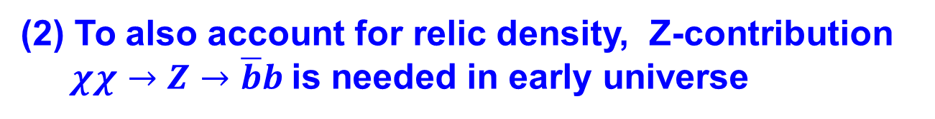

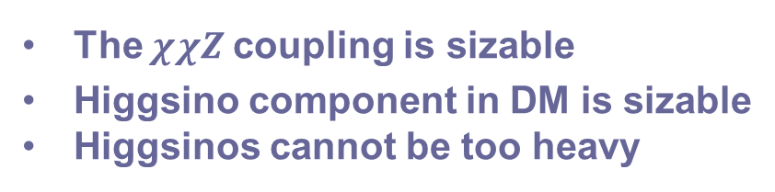
5 Conclusion
GCE can be explained by DM annihilation in NMSSM via $χχ→a_{1}→\overline{b}b$
To also account for relic density, Z-contribution
$χχ→Z→\overline{b}b$is needed in early universe
The $χχZ$coupling is sizable
Higgsino component in DM is sizable
Higgsinos cannot be too heavy
Higgsinos are copiously produced and accessible via tri-lepton signal at the LHC-14
DM-nucleon spin-dependent scattering
cross section is large and accessible at XENON1T

Slide 40
Thanks

