Slide 1

High-Luminosity upgrade of the LHC
Physics and Technology Challenges for the Accelerator and the Experiments
Burkhard Schmidt, CERN

Slide 2
Outline
Lecture I
  Physics Motivation for the HL-LHC
Lecture II
  An overview of the High-Luminosity upgrade of the LHC
Lecture III
  Performance requirements and the upgrades of ATLAS and CMS
Lecture IV
  Flavour Physics and the upgrade of LHCb
Lecture IV
  Heavy-Ion Physics and the ALICE upgrade
Lecture VI
  Challenges and developmets in detector technologies, electronics and computing

Slide 3

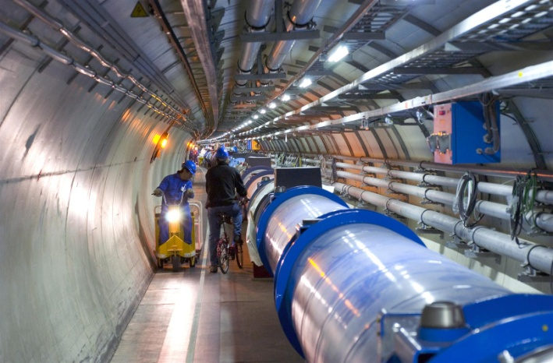
Enter a New Era in Fundamental Science
The Large Hadron Collider – LHC
Start-up of the Large Hadron Collider (LHC), one of the largest and truly global scientific projects ever, is the most exciting turning point in particle physics.
LHC tunnel:
27 km circumference
Germany and CERN | May 2009
Notes:
3

Slide 4
An overview of the High-Luminosity upgrade of the LHC
Why High-luminosity LHC ?
Technical limitations and bottlenecks
Challenges for performance improvement

Slide 5
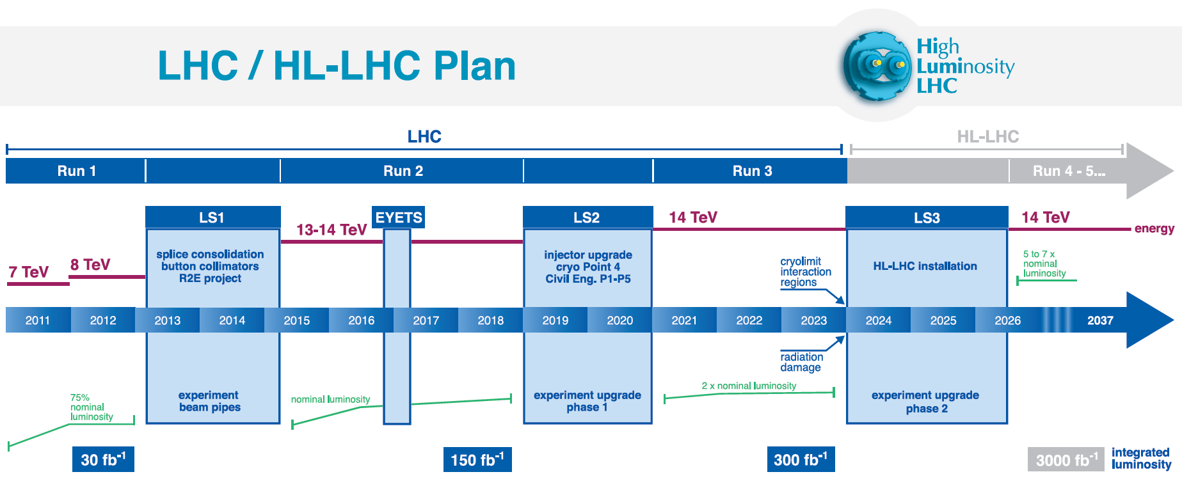
LHC Performance Projection
Run I
Run II
Run III
0.75 10³⁴ cm⁻²s⁻¹
50 ns bunch
high pile up ∼40
1.5 10³⁴ cm⁻²s⁻¹
25 ns bunch
pile up ∼40
1.7-2.2 10³⁴ cm⁻²s⁻¹
25 ns bunch
pile up ∼60
Technical limits for machine and experiments
50 ⇒ 25 ns

Slide 6
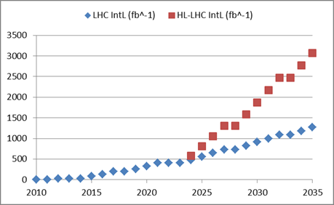

Why High-Luminosity LHC ?
By implementing HL-LHC
Almost a factor 3
By continuous performance improvement and consolidation
Goal of HL-LHC project:
  250 – 300 fb⁻¹ per year
  3000 fb⁻¹ in about 10 years

Slide 7
LHC performance optimization
Luminosity recipe (round beams):
  1) maximize bunch intensities
  2) minimize the beam emittance
3) minimize beam size
4) maximize number of bunches
5) compensate for ‘F’;
6) Improve machine ‘Efficiency’
Injector complex
LHC Inj. Upgrade
triplet aperture
25ns
Crab Cavities
minimize number of unscheduled beam aborts

Slide 8
HL-LHC Performance Goals
Design HL-LHC for virtual luminosity: L > 10 x 10³⁴ cm⁻² s⁻¹
Peak luminosity limitations:
    Event Pileup in detectors
    Debris leaving the experiments and impacting on the
    machine (magnet quench protection @ heat load)
Operate with a leveled peak luminosity: L = 5 x 10³⁴ cm⁻² s⁻¹
Maximize the time spend in physics production:
Machine efficiency
Scheduled physics time
Turnaround time

Slide 9
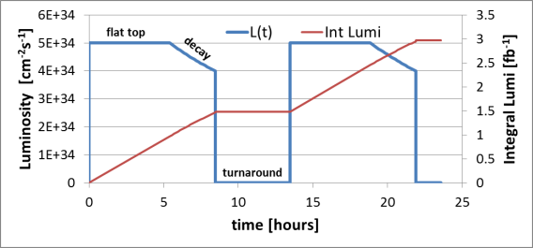
HL-LHC Performance optimization
Luminosity
levelling:
Integrated Luminosity limitations:
    Average Fill length must be larger then levelling time!
    Average Turnaround time must be small wrt fill length
    Number of operation days must be as large as possible
    Overall machine efficiency fraction of physics over scheduled time

Slide 10
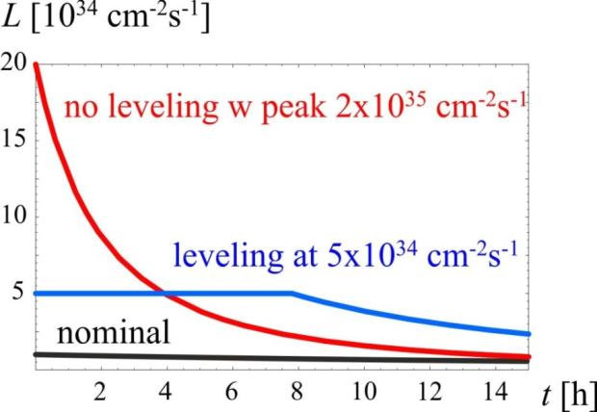
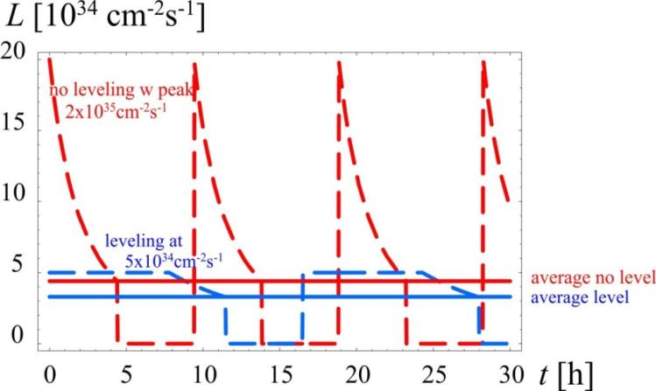
Luminosity Levelling, a key to success
High peak luminosity
Minimize pile-up in experiments and provide “constant” luminosity
Obtain about 3 - 4 fb⁻¹/day (40% stable beams)
About 250 to 300 fb⁻¹/year

Slide 11
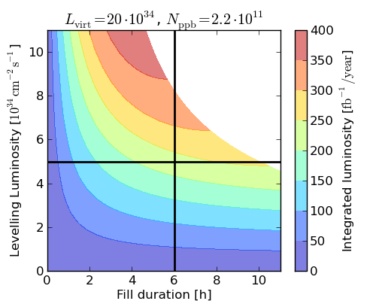
Required Efficiency for HL-LHC ∫Ldt Goal
Estimates are based on standard operation cycle and 160 days of physics production:
η ≥ 35% Physics Efficiency
Average fill length must be > 6h
Maximum levelling time must
be > 8h
High reliability and availability are key goals

Slide 12
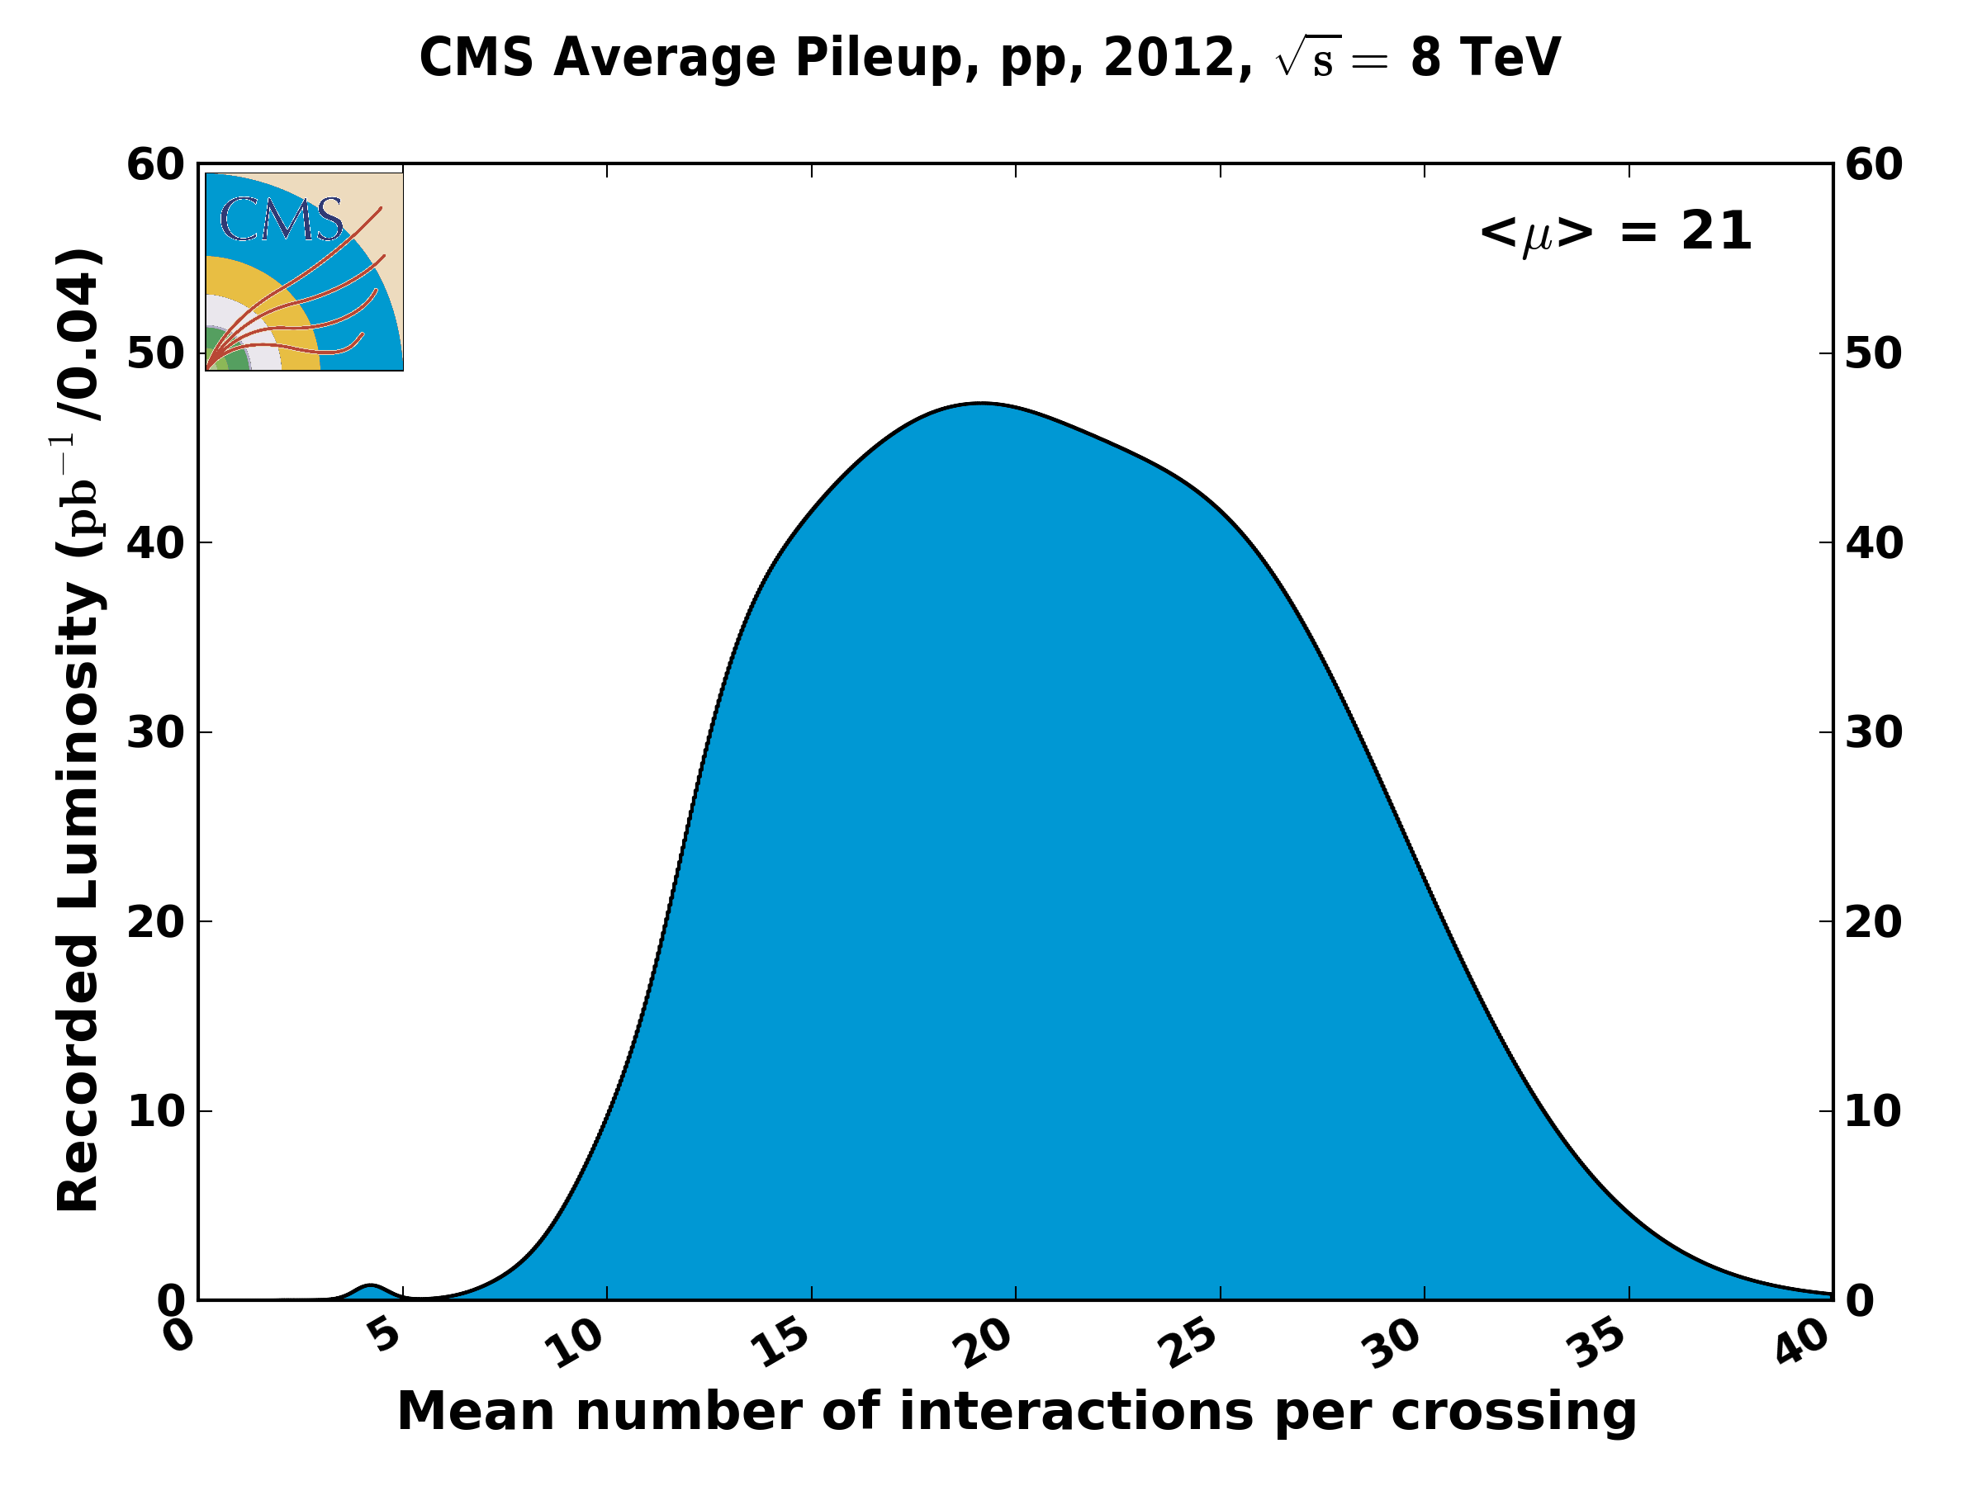
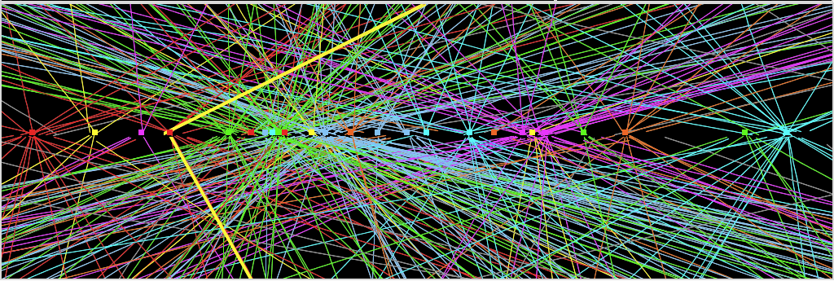
HL-LHC Challenge: Event Pileup Density
Vertex Reconstruction for 0.7 x 10³⁴ cm⁻² s⁻¹ @ 50ns
Z→ μμ event from 2012 data with 25 reconstructed vertices
Z→ μμ
Extrapolating to 5 x 10³⁴ cm⁻² s⁻¹ implies:
< μ > = 280; μ _{peak} > 500 @ 50ns bunch spacing
< μ > = 140; μ _{peak} = 280 @ 25ns bunch spacing

Slide 13
Removing technical bottlenecks

Slide 14
HL-LHC technical bottleneck:
Radiation damage to triplet magnets at 300 fb⁻¹
peak dose longitudinal profile
Cold bore insulation
≈ 35 MGy
30
Q2
27 MGy
7+7 TeV proton interactions
IT quadrupoles
1
]
25
MCBX-1
-
b
MCBX-2
f
0
MQSX
MCBX3 20 MGy
0
20
3
MCTX in MCBX-3
/
MCSOX
y
G
M
15
[
e
s
o
d
10
k
a
e
p
5
0
20
25
30
35
40
45
50
55
distance from IP [m]
Need to replace existing triplet magnets with radiation hard system (shielding!) such that the new magnet coils receive a similar radiation dose at 10 times higher integrated luminosity!

Slide 15
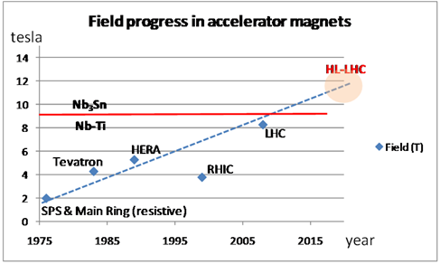
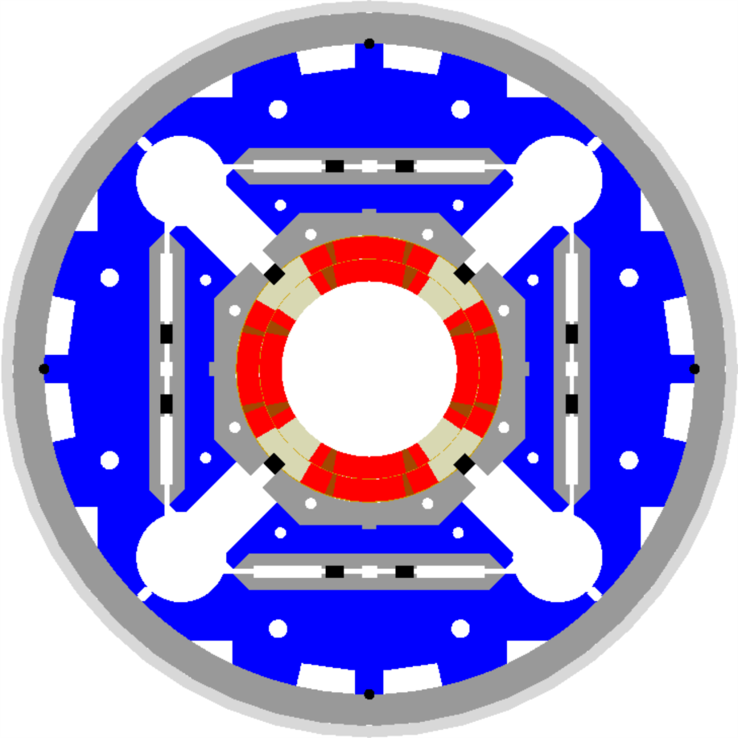
Squeezing the beams: High Field SC Magnets
LHC triplet:
210 T/m, 70 mm bore aperture
  8 T @ coil (limit of NbTi tech.)
HL-LHC triplet:
140 T/m, 150 mm coil aperture
- more focal strength: β*
- crossing angle, shielding
  ca. 12 T @ coil ➔ 30% longer
  Requires Nb₃Sn technology
  ceramic type material (fragile)
    ca. 25 year development for this
    new magnet technology!
  US-LARP – CERN collaboration
  (LHC Acc. Research Program)
US-LARP MQXF magnet design
Based on Nb₃Sn
technology
Notes:
Jc = critical current
NbTi = Niobium Titaninum ; the critical temperature is 10 K.
Nb3Sn = Niobium Tin ; the critical temperature is 18.3 K.

Slide 16

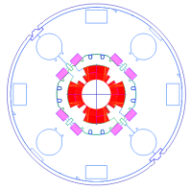
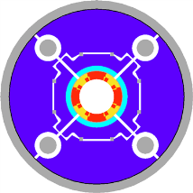

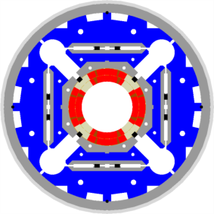

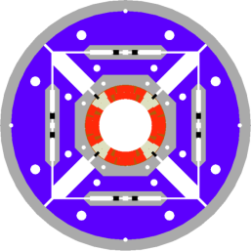
LHC low-β quads: steps in magnet technology from LHC toward HL-LHC
LHC (USA & JP, 5-6 m)
∅70 mm, B_{peak}∼ 8 T
1992-2005
LARP TQS & LQ (4m)
∅90 mm, B_{peak}∼ 11 T
2004-2010
LARP HQ
∅120 mm,B_{peak}∼12T
2008-2014
LARP & CERN MQXF
∅150 mm,
B_{peak}∼ 12.1 T
2013-2020
Superconducting coils

Slide 17
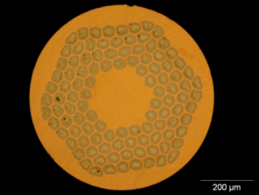
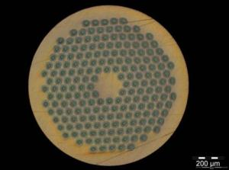
The « new » material : Nb₃Sn
Recent 23.4 T (1 GHz) NMR Magnet for spectroscopy in Nb₃Sn (and Nb-Ti).
15-20 tons/year for NMR and HF solenoids.
  → Experimental MRI is taking off
ITER: 500 tons in 2010-2015!
It is comparable to LHC:
1200 tons of Nb-Ti
HL-LHC will require only 20 tons of Nb₃Sn
HEP ITD (Internal Tin Diffusion):
  High Jc., 3xJc ITER
  Large filament (50 µm), large coupling current...
  Cost is 5 times LHC Nb-Ti
0.7 mm, 108/127 stack RRP from Oxford OST
1 mm, 192 tubes PIT from Bruker EAS
Notes:
NMR = Nuclear Magnetic Resonance ; MRI = Magnetic resonance imaging
This is not a big problem for HL-LHC, requiring 20 tonnes of superconductors, however it is major
problem for HE-LHC ,requiring in total 3000 tonnes of superconductor, more than half in Nb3Sn.
To gauge these figures in the context, LHC has used 1200 tonnes of Nb-Ti, while ITER requires about 500
tonnes of Nb3Sn.
NbTi is normally used in an Aluminium or Copper matrix.

Slide 18
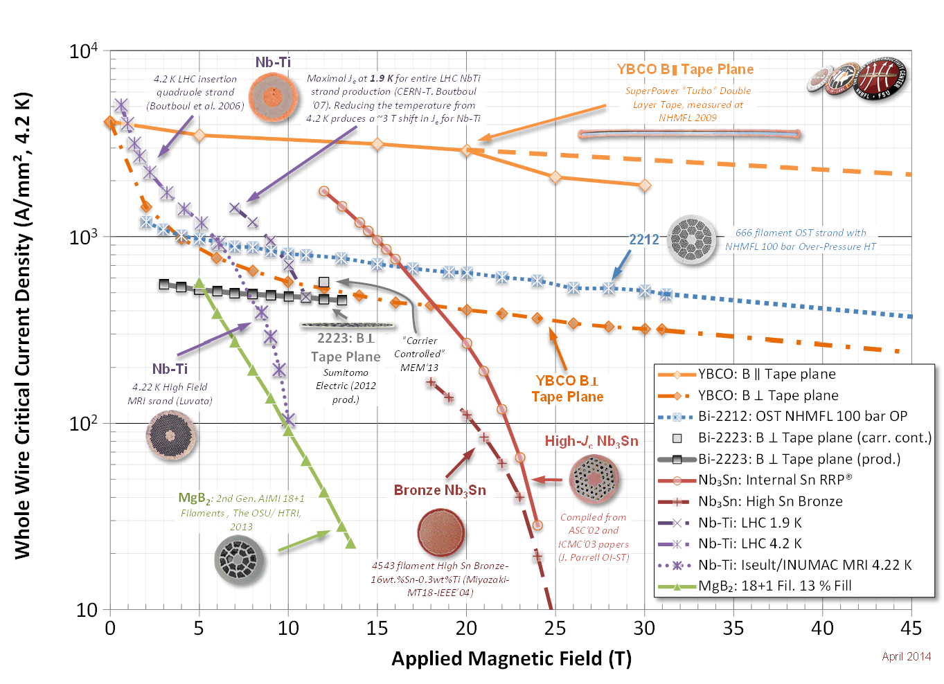
High Field SC Magnets
Notes:
Nb₃Sn is extremely brittle and thus can not be easily drawn into a wire, which is necessary for winding superconducting magnets. To overcome this, wire manufacturers typically draw down composite wires containing ductile precursors. The "internal tin" process includes separate alloys of Nb, Cu and Sn. The "bronze" process contains Nb in a copper-tin bronze matrix. With both processes the strand is typically drawn to final size and coiled into a solenoid or cable before heat treatment. It is only during the heat treatment that the Sn reacts with the Nb to form the brittle, superconducting niobium-tin compound.
HTS have been observed with transition temperatures as high as 138 K (−135 °C).
Magnesium diboride is occasionally referred to as a high-temperature superconductor^{[57]} because its T_{c} value of 39 K

Slide 19
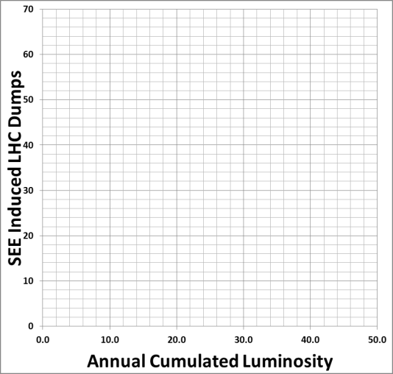
R2E SEU Failure Analysis – Actions
(R2E= Radiation to Electronics ; SEU = Single Event Upset)
2008-2011
  Analyze and mitigate all safety relevant cases and limit global impact
2011-2012
  Focus on equipment with long downtimes; provide shielding
LS1 (2013/2014)
  Relocation of power converters
LS1 – LS2:
  Equipment Upgrades
LS3 -> HL-LHC
  Remove all sensitive equipment from underground installations
~400 h
Downtime
~250 h
Downtime
Improving machine availbility in preparation of upgrade is vital
Relocation
& Shielding
~12 dumps / fb⁻¹
~3 dumps / fb⁻¹
Equipment
Upgrades
LS1 – LS2 Aiming for
<0.5 dumps / fb⁻¹
HL-LHC: < 0.1 dumps / fb⁻¹

Slide 20
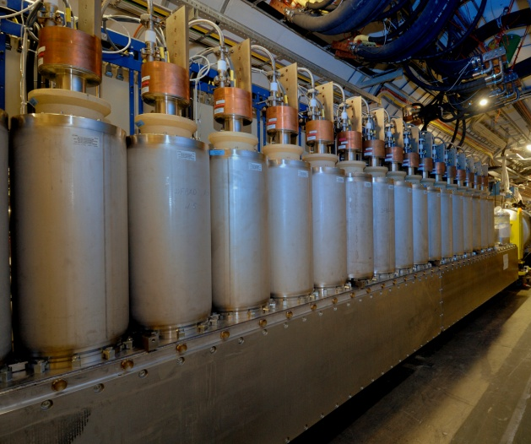
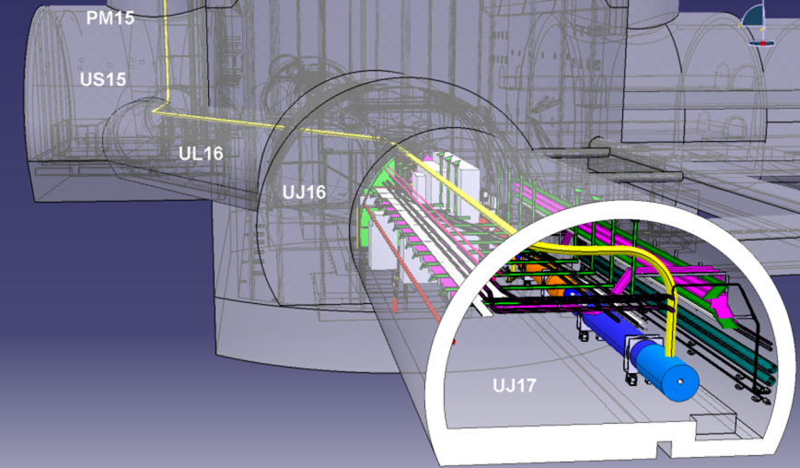
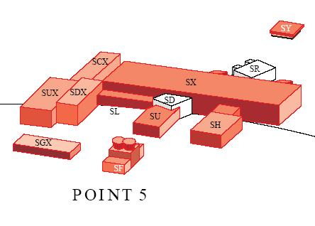
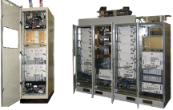
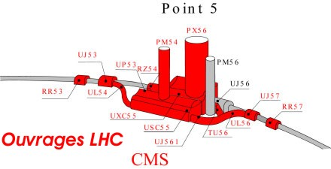
Super-conducting links
allows to move Power Converters and Distribution Feed Boxes
from tunnel to surface
1 pair 700 m 50 kA – LS2
4 pairs 300 m 150 kA (MS)– LS3
4 pairs 300 m 150 kA (IR) – LS3 tens of 6-18 kA CLs pairs in HTS
2×150 kA
Notes:
DFB: These are the beasts that feed the electric currents into the cold mass. This is the transition between room temperature and the super conducting environment.

Slide 21
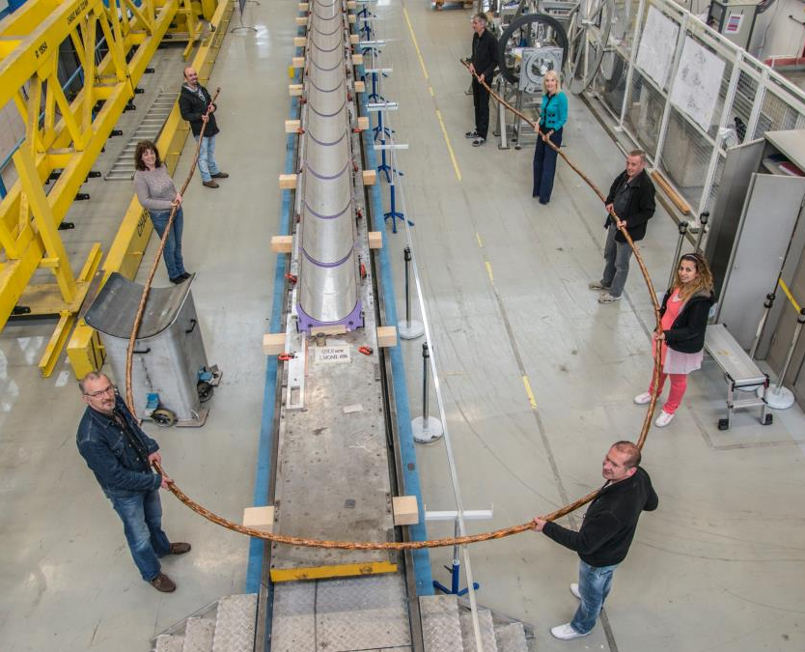
L = 20 m
(25×2) 1 kA @ 25 K, LHC Link P7
Feb 2014: World record for HTS transport current

Slide 22
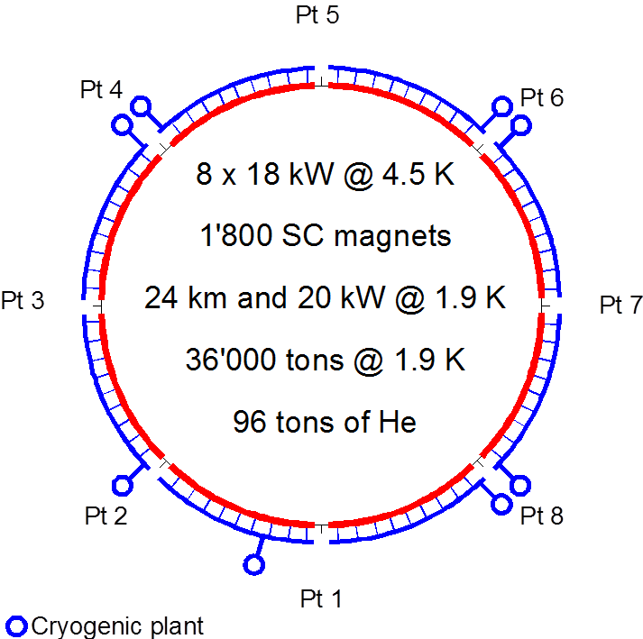
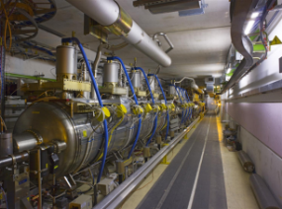
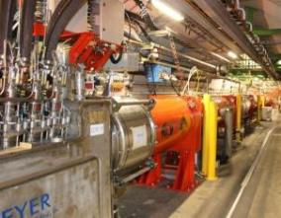
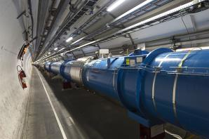
Eliminating Technical Bottlenecks
Cryogenics P4- P1 –P5
IT
IT
RF
RF
New Plant ≥ 6 kW in P4
New 18 kW Plants in P1 and P5
IT
IT
IT
IT
IT
IT

Slide 23
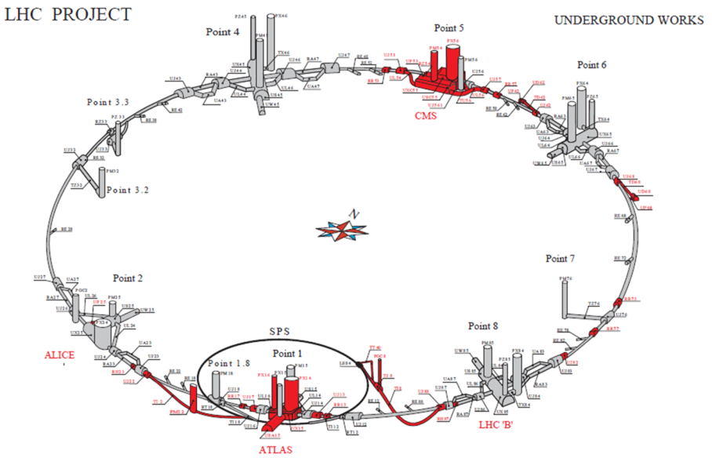
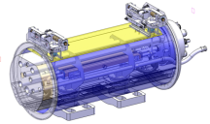
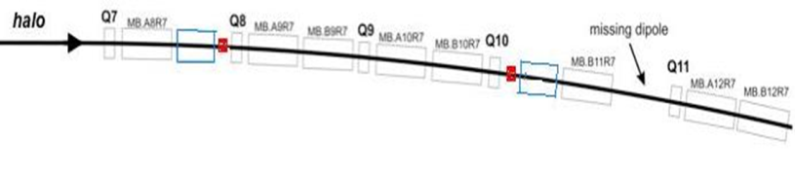
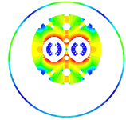


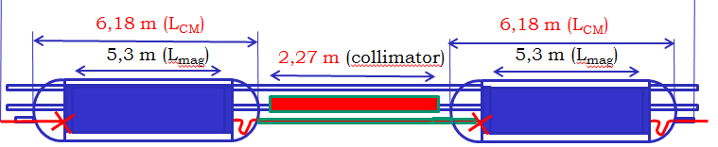
Dispersion Suppressor Collimators
11 T Nb₃Sn

Slide 24
Challenges for performance improvement

Slide 25
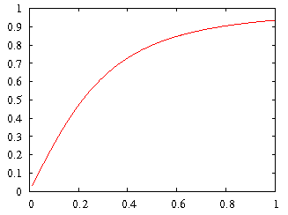
HL-LHC Challenges: Crossing Angle
geometric luminosity
reduction factor:
effective cross section
HL-LHC
large crossing angle:
+ reduction of long range beam-beam interactions
+ reduction of beam-beam tune spread and resonances
- reduction of the mechanical aperture
- increase of effective beam cross section at IP
- reduction of luminous region
- reduction of instantaneous luminosity
➔ inefficient use of beam current!

Slide 26
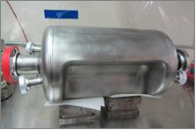
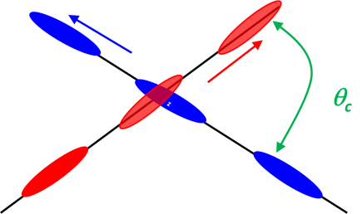
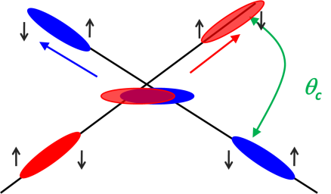
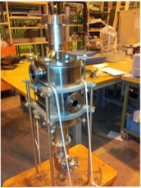
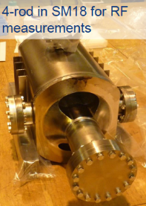
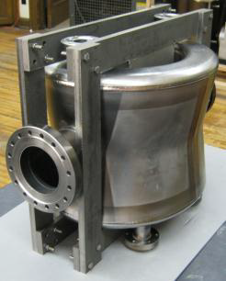
Crab Cavities, Increase “Head on”
Aim: reduce the effect of the crossing angle
Without crabbing
With crabbing
RF-Dipole Nb prototype
Crab cavities are a form of
electromagnetic cavity providing
a transverse deflection to the bunches.
3 proto types available
Cavity tests are on-going
DQWR prototype
17-Jan-2013
Crossing strategy under study to soften pile-up density with interesting potential known as “crab-kissing”
Notes:
Crab cavities are a form of electromagnetic cavity used in particle accelerators to provide a transverse deflection to particle bunches. They can be used to provide rotation to a charged particle bunch by applying a time varying magnetic field. This rotation of the bunch can be used as a diagnostic tool to measure the length of a bunch (the longitudinal dimension is projected into the transverse plane, and imaged) or as a means of increasing the luminosity at an interaction point of a collider if the colliding beams cross each other at an angle (then called crab crossing). They can also be used in order to minimise beam-beam effects, which are important for circular colliders. The KEKB accelerator introduced this technology in its last upgrade.

Slide 27
SPS beam test: a critical step for CC
SPS test is critical: at least one cryomodule before LS2, possibly two, of different cavity type.
A test in LHC P4 is kept as a possibility but it is not in the baseline)
∅ = 84 mm. 2 K
11.6 MV required voltage ;
baseline is 4 cavites/beam-side, ⇒ 2.9MV/cavity

Slide 28
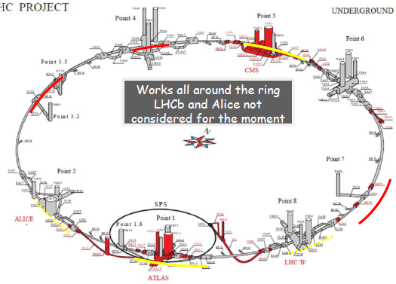
The HL-LHC Project
New IR-quads Nb₃Sn (inner triplets)
  New 11 T Nb₃Sn (short) dipoles
  Collimation upgrade
  Cryogenics upgrade
  Crab Cavities
  Cold powering
  Machine protection
  …
Major intervention on more than 1.2 km of the LHC
Project leadership: L. Rossi and O. Brüning

Slide 29
Baseline parameters of HL for reaching 250 -300 fb⁻¹/year
 | 25 ns | 50 ns
# Bunches | 2808 | 1404
p/bunch [10¹¹] | 2.0 (1.01 A) | 3.3 (0.83 A)
ε_{L} [eV.s] | 2.5 | 2.5
σ_{z} [cm] | 7.5 | 7.5
σ_{δp/p} [10⁻³] | 0.1 | 0.1
γε_{x,y} [μm] | 2.5 | 3.0
β∗ [cm] (baseline) | 15 | 15
X-angle [μrad] | 590 (12.5 σ) | 590 (11.4 σ)
Loss factor | 0.30 | 0.33
Peak lumi [10³⁴] | 6.0 | 7.4
Virtual lumi [10³⁴] | 20.0 | 22.7
T_{leveling} [h] @ 5E34 | 7.8 | 6.8
#Pile up @5E34 | 123 | 247
25 ns is the option
However:
50 ns should be kept as alive because we DO NOT have enough experience on the actual limit (e-clouds, I_{beam}).
Continuous global optimisation with LIU
29

Slide 30
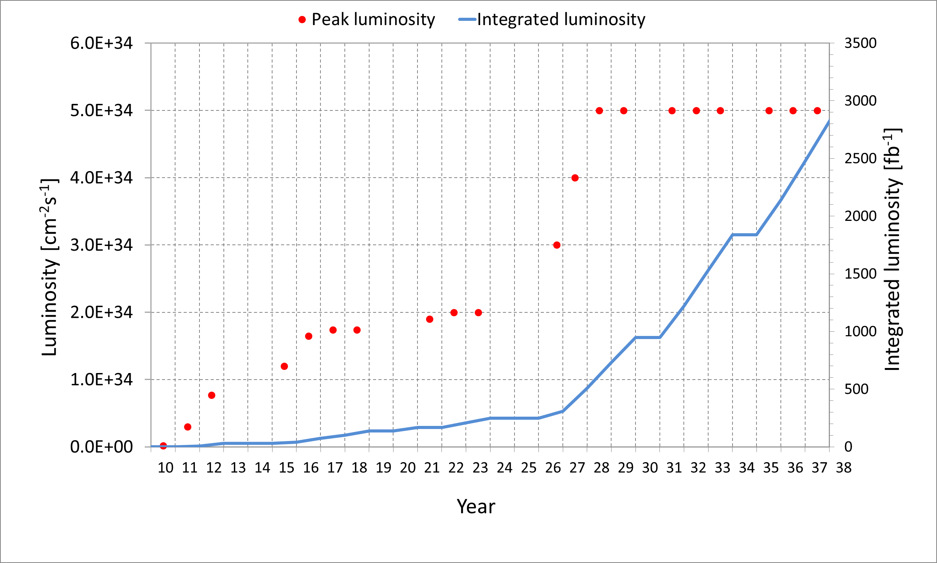
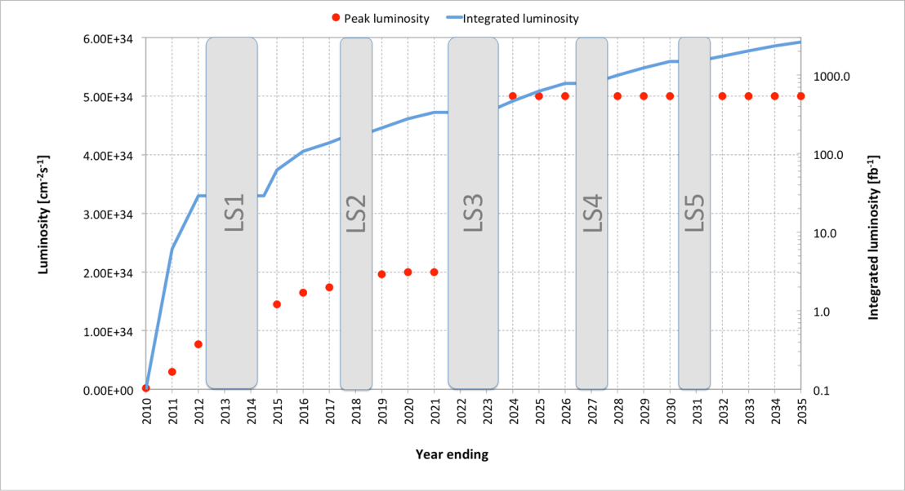
The plan of HL-LHC (baseline)
LS1
LS2
LS2
LS4
LS5
Levelling at 5 10³⁴ cm⁻² s⁻¹: 140 events/crossing in average, at 25 ns; several scenarios under study to limit to 1.0 → 1.3 event/mm
Total integrated luminosity of 3000 fb⁻¹ for p-p by 2035, with LSs taken into account and 1 month for ion physics per year.
30

Slide 31
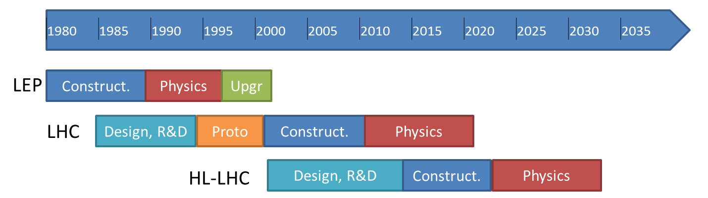
European Strategy for
Particle Physics
“…exploitation of the full potential of the LHC, including the high-luminosity upgrade of the machine and detectors…”
=> High Luminosity LHC project
today
Project
http://cern.ch/hilumilhc

Slide 32
Conclusion part II
  The HL-LHC is an approved project
  A lot of technical and operation challenges :
    Nb₃Sn magnets (accelerator field quality)
    Collimators
    Crab cavities
    Increased availability (machine protection,…)
    …
  Accelerator-experiment interface are central:
    - Bunch spacing, pile-up density, crossing schemes, background, forward detectors, collimation,…

