Slide 1

High-Luminosity upgrade of the LHC
Physics and Technology Challenges for the Accelerator and the Experiments
Burkhard Schmidt, CERN

Slide 2
Outline
Lecture I
  Physics Motivation for the HL-LHC
Lecture II
  An overview of the High-Luminosity upgrade of the LHC
Lecture III
  Performance requirements and the upgrades of ATLAS and CMS
Lecture IV
  Flavour Physics and the upgrade of LHCb
Lecture IV
  Heavy-Ion Physics and the ALICE upgrade
Lecture VI
  Challenges and developments in detector technologies, electronics and computing

Slide 3



Acknowledgements
Most of the material shown in these lectures has been shown at the two ECFA HL-LHC workshops
Aix-les-Bains, France
October 1-3, 2013,
October 21-23, 2014
and the RLIUP workshop,
Archamps, France, October 2013.
Sincere thanks to the many speakers who prepared the material for the above workshops !

Slide 5


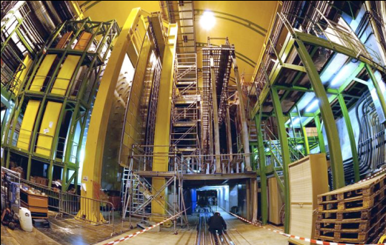
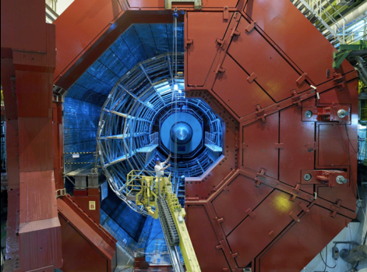
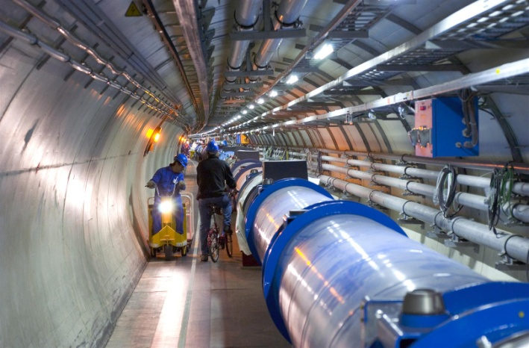

Enter a New Era in Fundamental Science
The Large Hadron Collider – LHC
Start-up of the Large Hadron Collider (LHC), one of the largest and truly global scientific projects ever, is the most exciting turning point in particle physics.
CMS
LHCb
Study of proton and lead collisions
at the TeV scale
ALICE
LHC tunnel:
27 km circumference
ATLAS
Germany and CERN | May 2009
Notes:
5

Slide 6
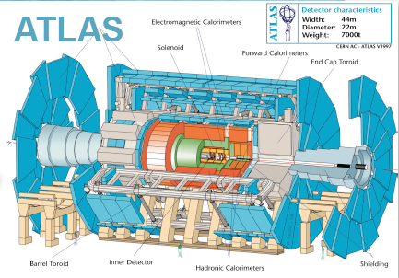
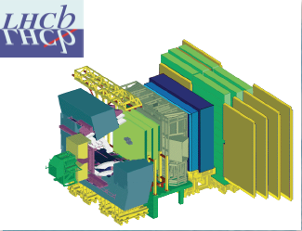
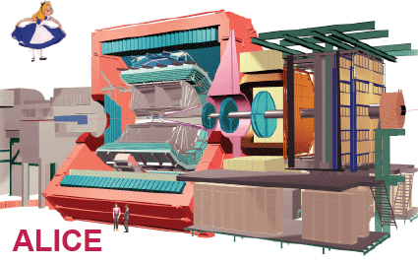
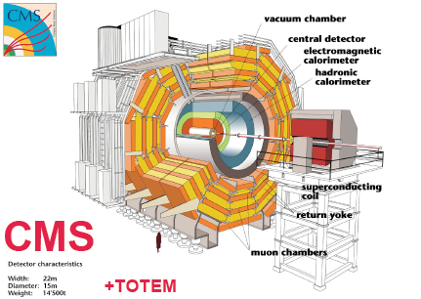
The LHC Detectors
ATLAS
7000 ton
l = 46m
D = 22m
ATLAS and CMS are General Purpose
Detectors (GPD) for data-taking at high
Luminosity.
LHCb is specialized on the study of
particles containing b- and c- quarks
CMS
12500 ton
l = 22m
d = 15m
ALICE Detector is optimized for the
Study of Heavy Ion physik.

Slide 7
Physics Motivation for the HL-LHC
What did we accomplish so far with the LHC ?
What are the outstanding questions ?
How can the HL-LHC address them ?

Slide 8
Three main results from LHC Run-I
  We have consolidated the Standard Model (SM)
    The Standard Model works BEAUTIFULLY …
  We have completed the Standard Model:
    Higgs boson discovery
    Almost 100 years of theoretical and experimental efforts !
  We have NO evidence of new physics
  – at best only some hints …

Slide 9
Consolidation of the Standard Model
  Wealth of measurements at 7-8 TeV at the LHC
The theoretical description of high-Q² processes at the LHC is very good

Slide 10
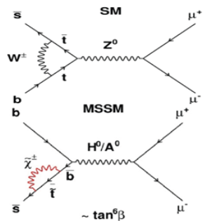
Consolidation of the Standard Model
    Measurements include the very rare B_{s,d} → μμ decay:
      Very rare process: helicity suppressed FCNC
      Small, but well predicted value in SM
      Very sensitive probe to Higgs sector
      of New Physics models
    Standard Model expectations:
      B(B_{s} → μ⁺ μ⁻) = (3.54 ± 0.30) x 10⁻⁹
      B(B_{d} → μ⁺ μ⁻) = (1.0 ± 0.1) x 10⁻¹⁰
[arXiv 1208.0934 and arXiv:1204.1737]

Slide 11
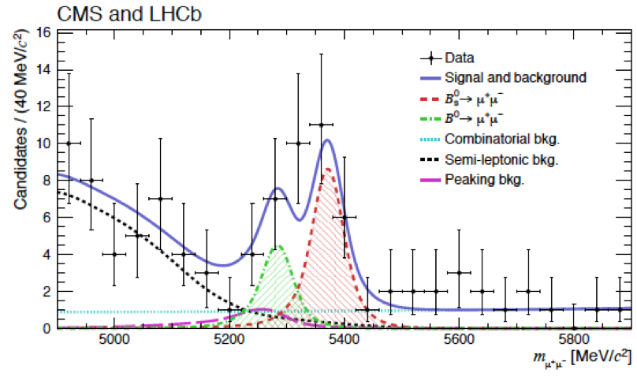
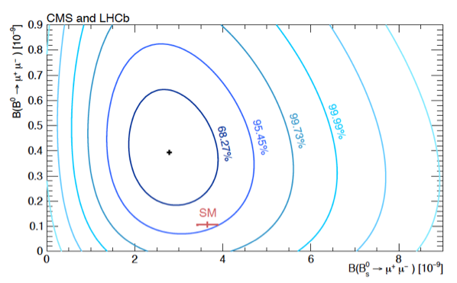
B_{s,d} → μ⁺μ⁻ result
Probability that the decay happens is measured to be
      BR(B⁰_{s}→ μ⁺ μ⁻ ) = 2.8 ^{+0.7} x 10⁻⁹
BR(B⁰_{d}→ μ⁺ μ⁻ ) = 3.9 ^{+1.6} x 10^{-1o}
Significance of B⁰_{s}→ μ⁺ μ⁻ is 6.2 σ
First observation of this decay!
Excess of events at the 3 σ level for B⁰_{d}→ μ⁺ μ⁻ hypothesis with respect to bkg. observed.
Compatible with the SM at 2.2 σ
Joint CMS-LHCb publication: Nature 522, 68–72
_{-0.6}
_{-1.4}
B⁰
B_{s}

Slide 12
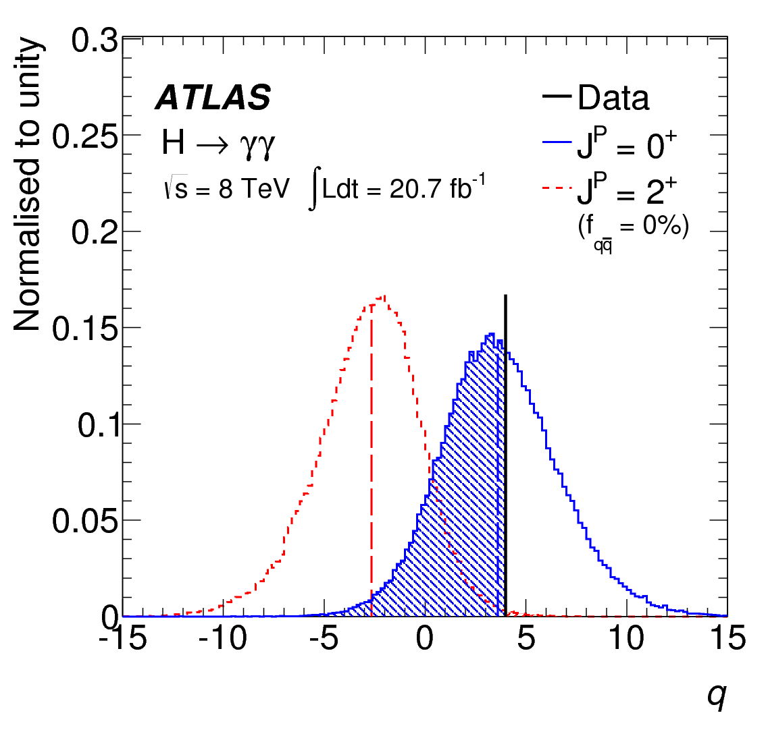
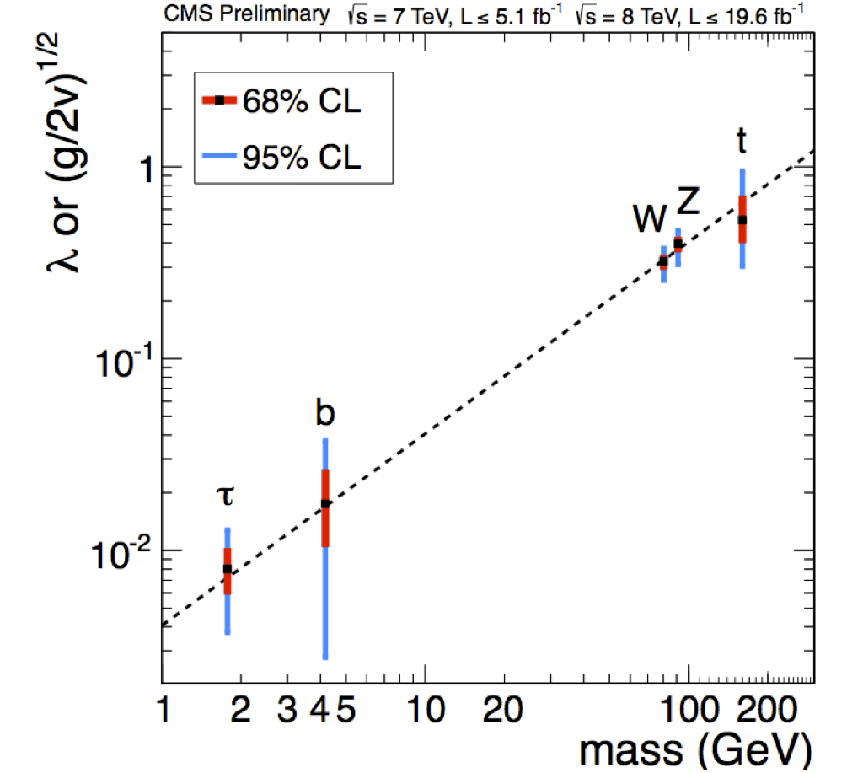
Higgs boson discovery
YES !
Is the new particle the SM Higgs boson ?
The two “Fingerprints” verified by ATLAS and CMS
1. It interacts with other particles (in particular W, Z) with strength proportional to their masses
2. It has spin zero (scalar)
data
Expected
for spin 2
Expected
for spin 0
L (J^{P}=0⁺)/L(J^{P}=2⁺)
Hypothesis Rejection (C.L.)
0⁻ 97.8%
1⁺ 99.97%
1⁻ 99.7%
2⁺ 99.9%
Notes:
To accomplish its job (providing mass): 1

Slide 13
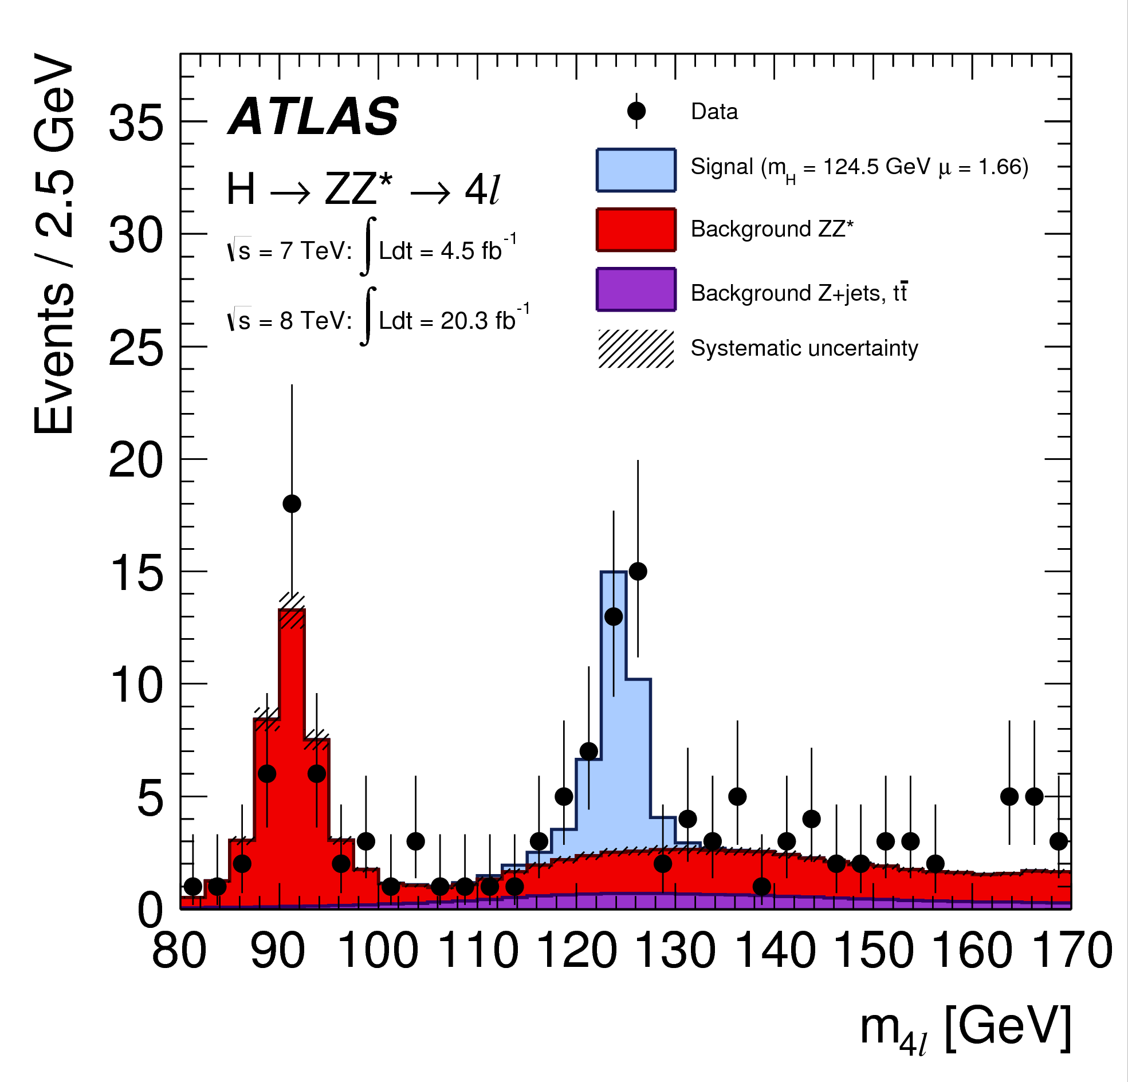
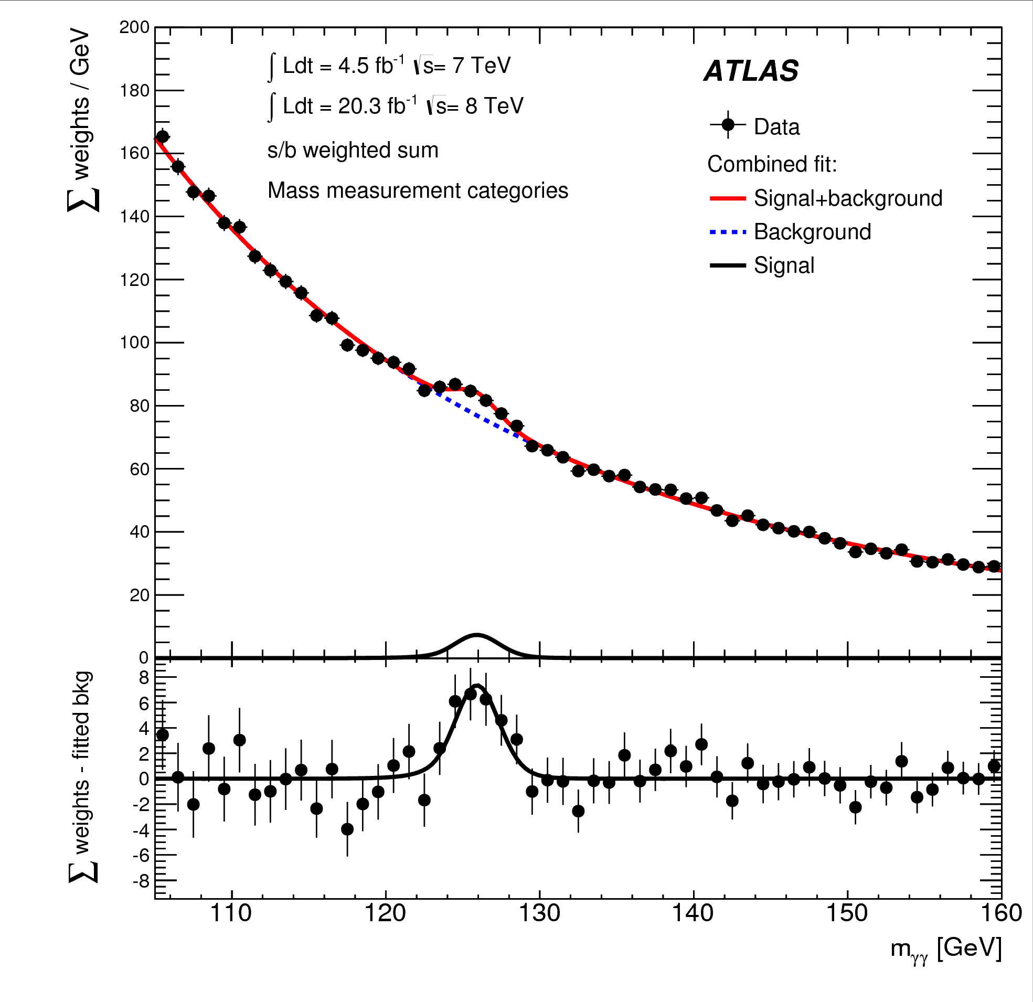
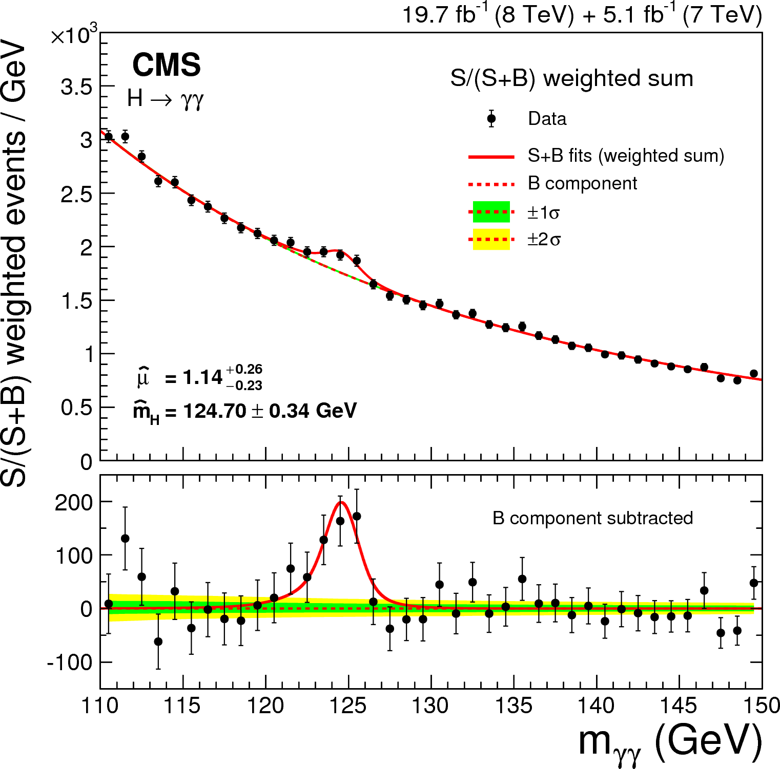
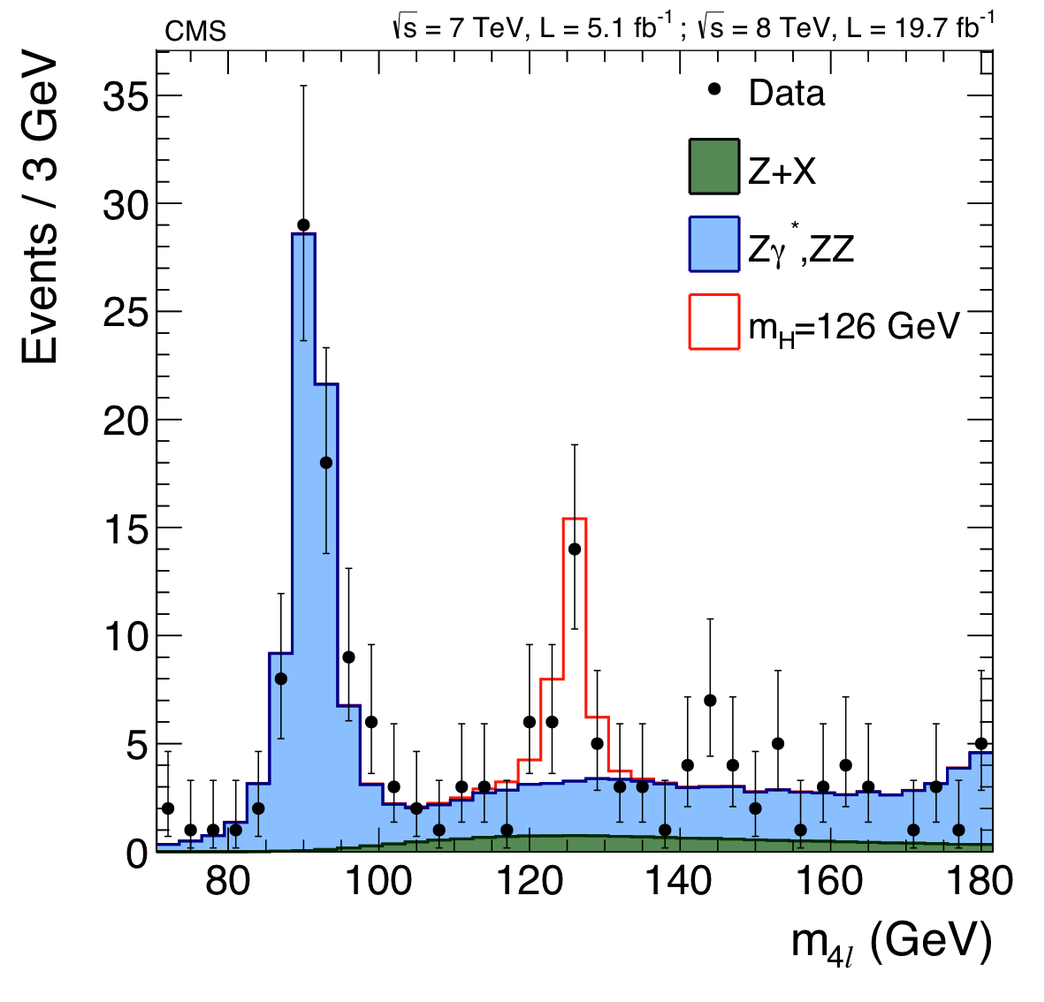
ATLAS+CMS Higgs mass combination
ATLAS H→γγ
ATLAS H→4l
Combination of
ATLAS+CMS mass
measurements in
H → γγ
H → 4l
Shown for the first time at Moriond 2015
CMS H→γγ
CMS H→4l

Slide 14
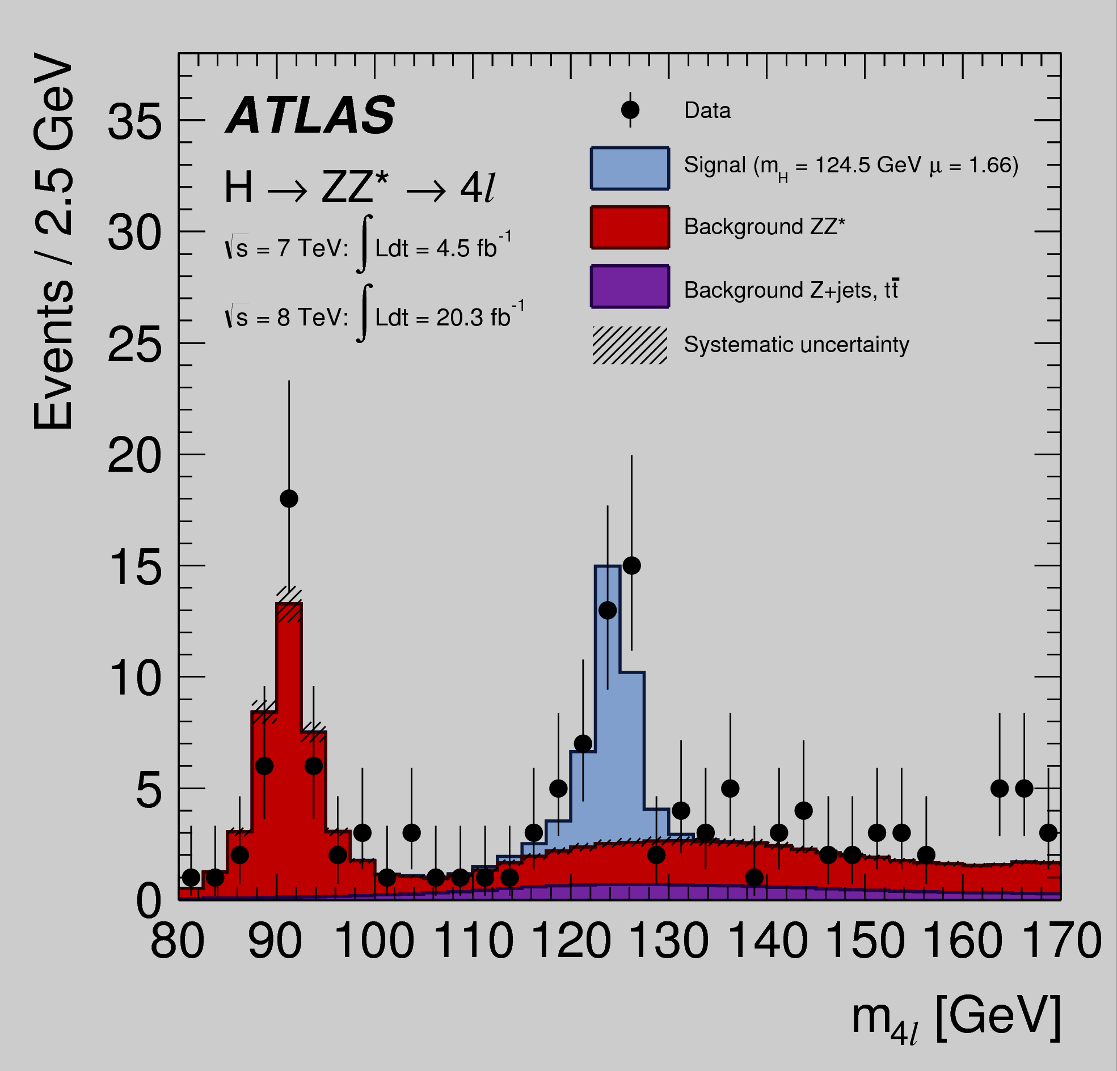
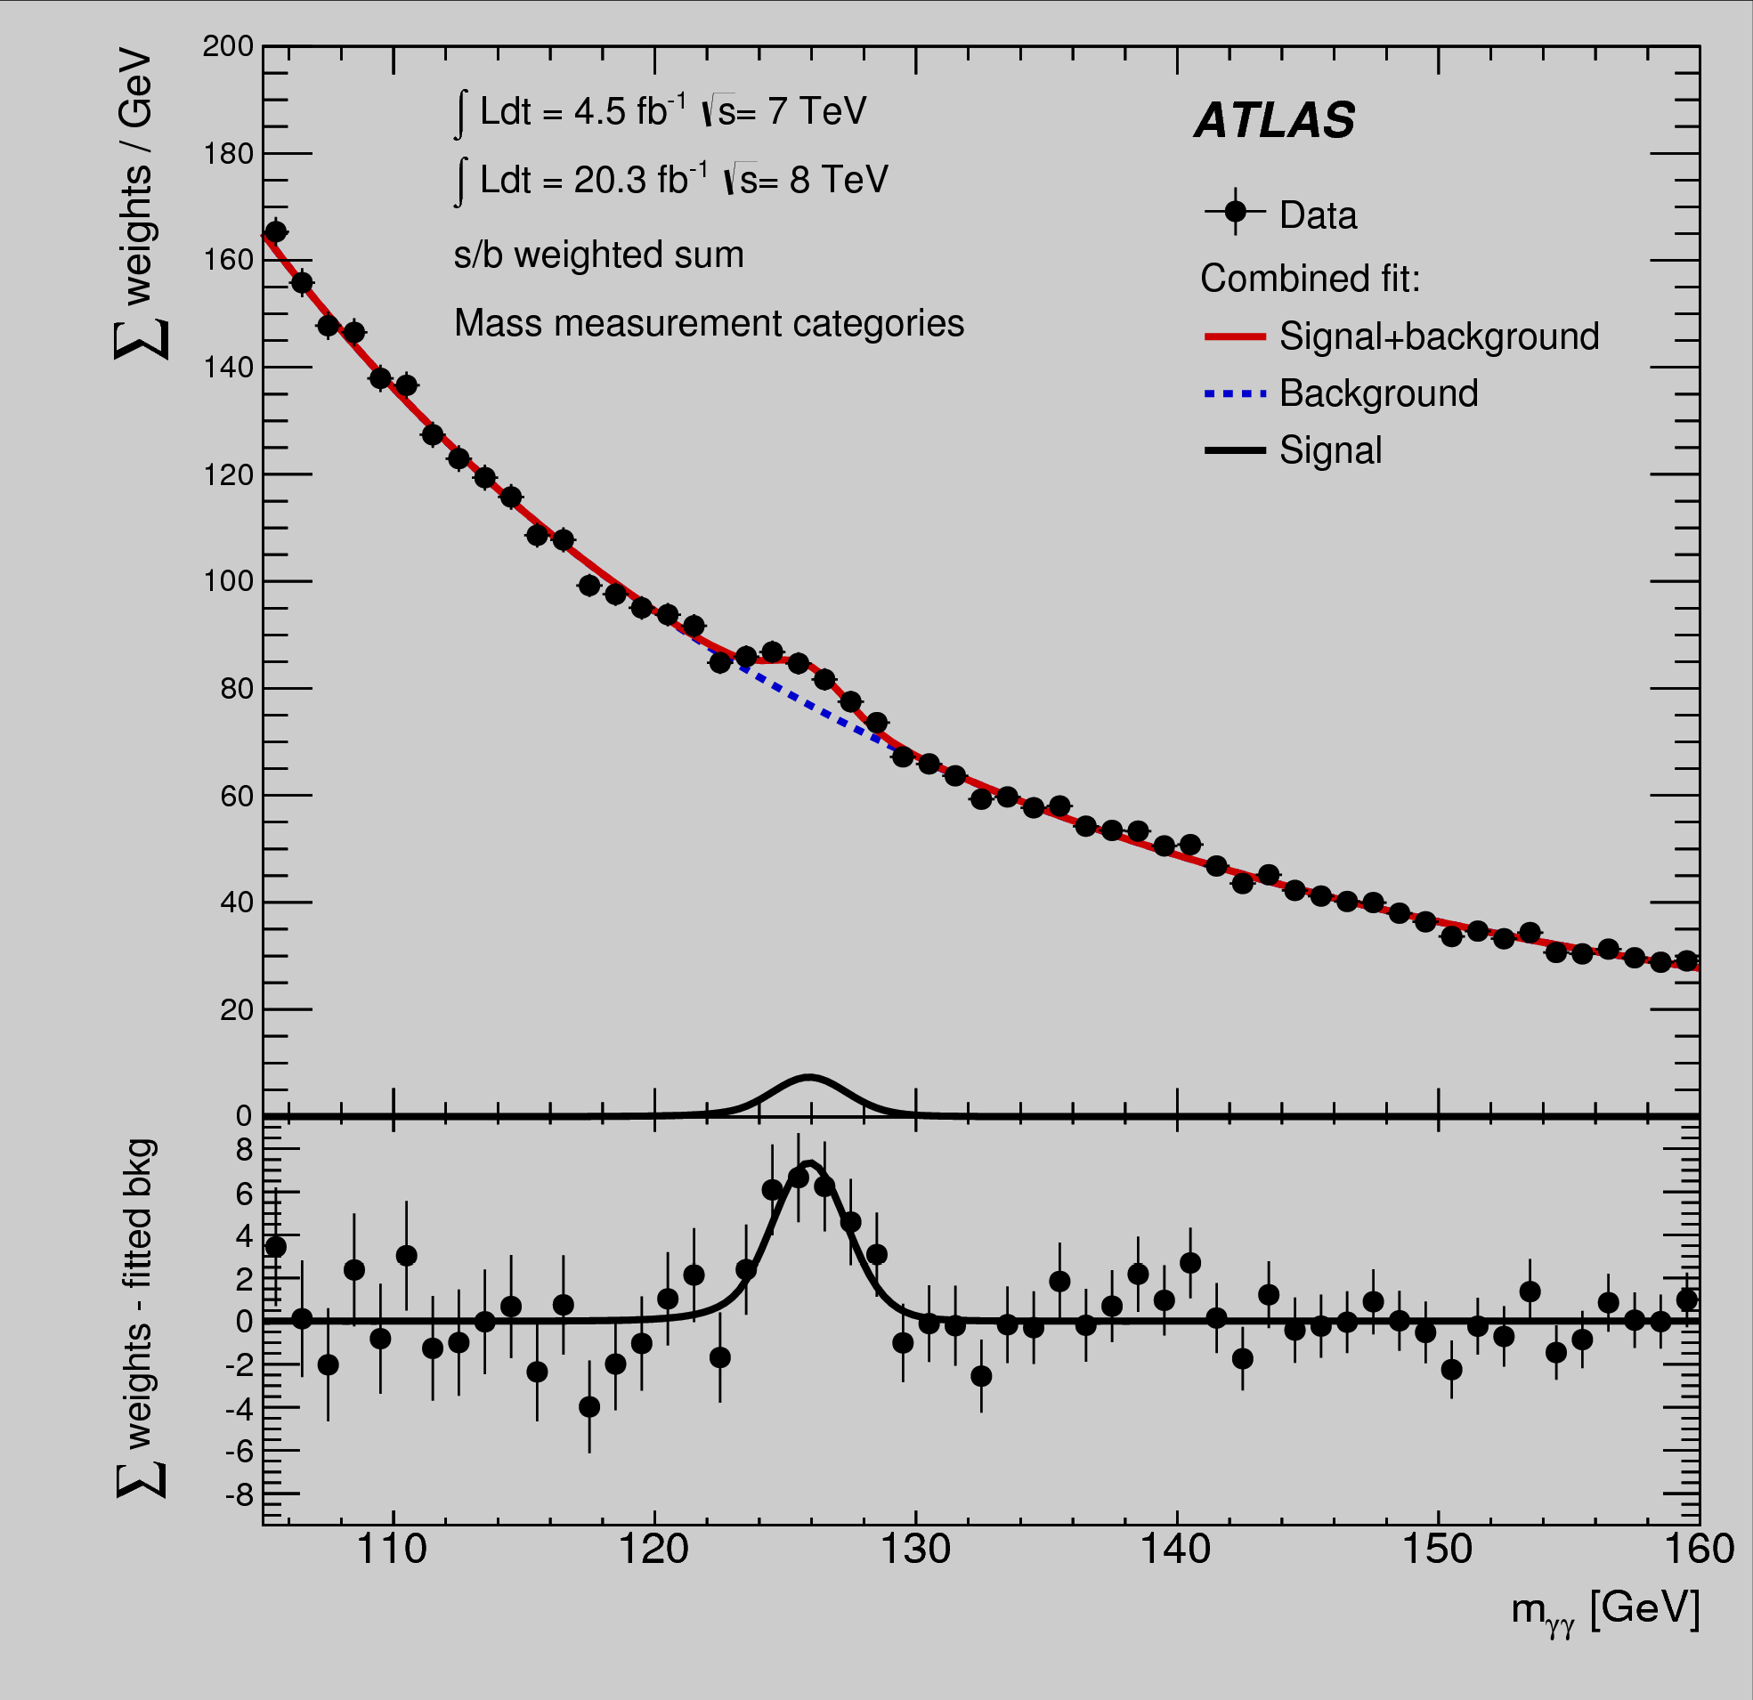
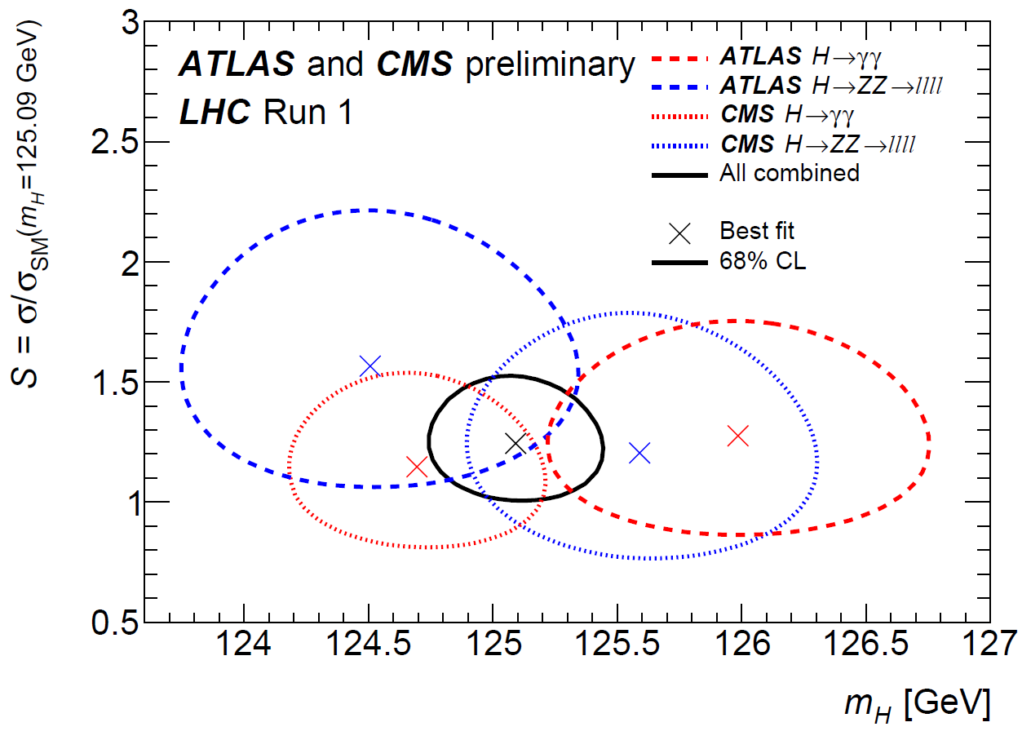
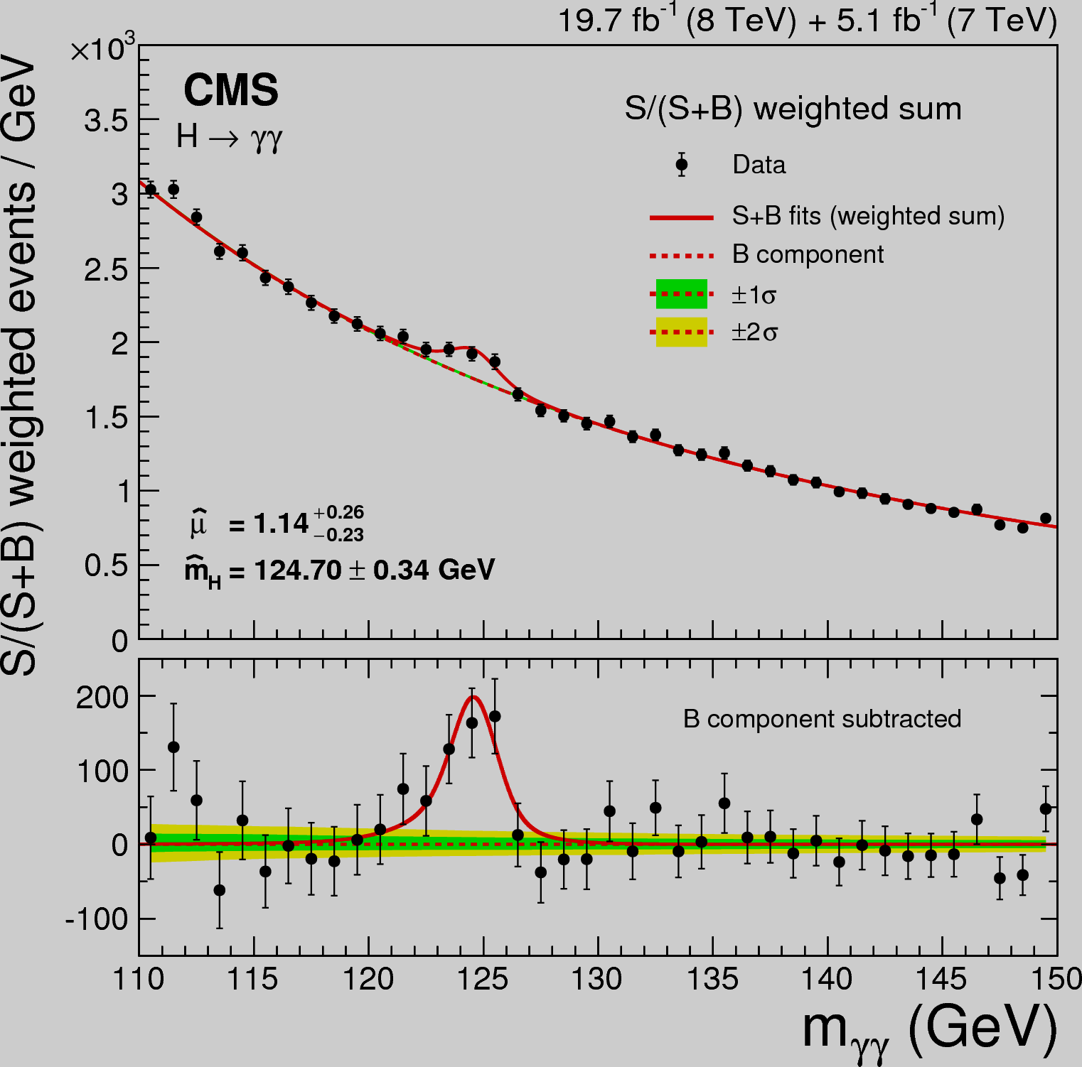
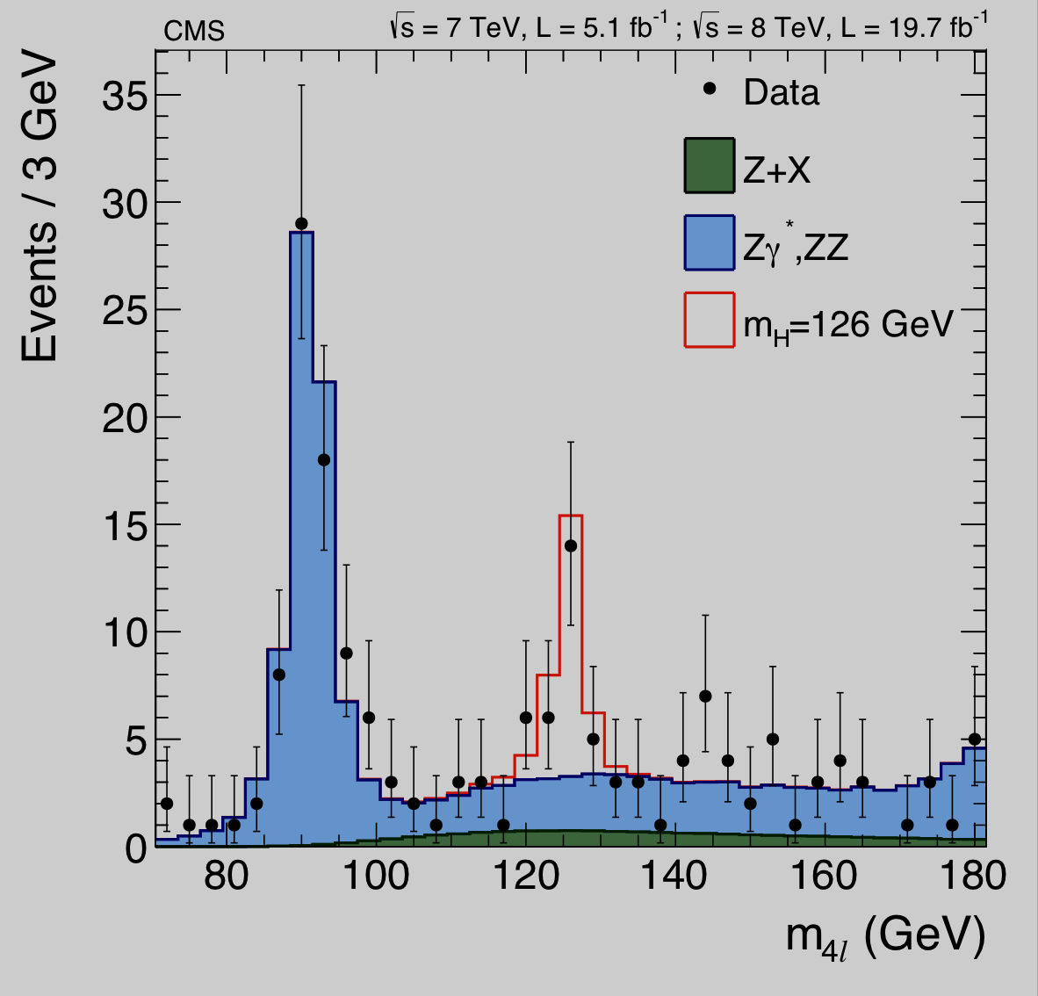
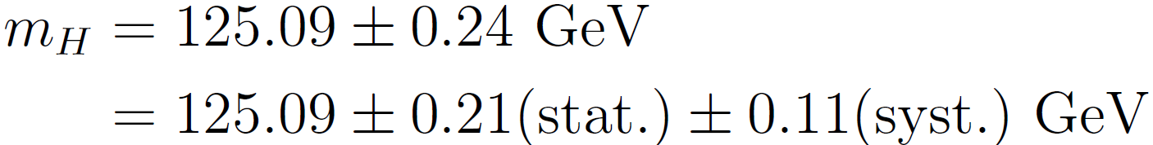
ATLAS+CMS Higgs mass combination
Combination of
ATLAS+CMS mass
measurements
ATLAS H→γγ
ATLAS H→4l
weight ~18%
weight ~19%
CMS H→γγ
weight ~40%
weight ~23%
CMS H→4l
(0.19% precision!)

Slide 15
Are there no deviations from the SM ?
Lepton Universality
B → K∗µ⁺μ⁻ anomaly
P5 exhibits a local tension with
respect to the SM prediction at
a level of 3.7 σ
Compatible with the SM
prediction within 2.6 σ

Slide 16
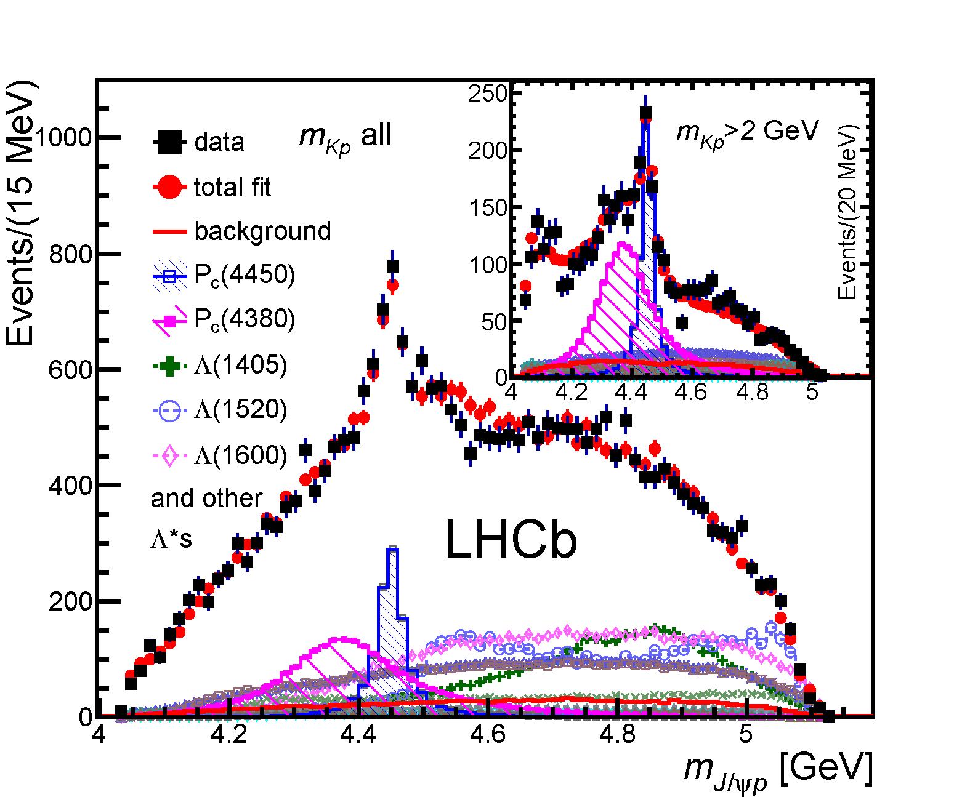
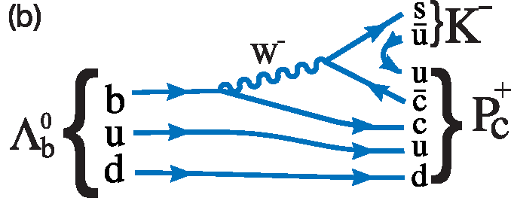
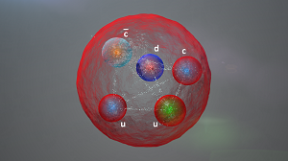
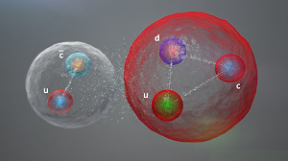
Surprises in Run I : Exotica
Pentaquarks: P_{c}⁺(4450) & P_{c}⁺(4380)
Predicted by Gell-Mann and Zweig in 1964.
Short-lived (~10⁻²³ s) “resonances” whose presence is detected by mass peaks and angular distributions, showing the presence of unique J^{PC} quantum numbers
50 years after Gell-Mann paper now for the first time convincingly seen by LHCb in decays.
“internal mechanism” of quark interactions inside pentaquarks to be understood:
Λ_{b}⁰ → J/ψpK⁻
TetraQuarks: Z(4430)⁺

Slide 17
Are there hints for New Physics ?
Production of a generic X resonance decaying into a di-boson final state
Deviation from a smoothly falling bkg. of the dijet M_{inv} distribution around 2 TeV
Global significance is about 2.5 σ (ATLAS), CMS less than 2σ
These are only hints – more data is needed to clarify the situation

Slide 18
Comparison 8 vs 13 TeV: dijet production rate
Rate to produce dijet
with M_{jj} of 6TeV:
at 8TeV: 50 ab
→ 1 event in 20/fb
at 13 TeV: 100 fb
→ 1 event in 10/pb
fb
100fb: 1ev / 10 pb⁻¹
50ab
In terms of extension of the discovery reach, nothing in the future
of the LHC programme will match the step forward from 8 TeV to 13 TeV
Notes:
To produce

Slide 19
  NO evidence of new physics so far
This is VERY puzzling:
On one hand: the LHC results imply that the SM technically works up to scales much higher than the TeV scale.
Limits on new physics seriously challenge the simplest attempts (e.g. minimal SUSY) to fix its weaknesses
On the other hand: there is strong evidence that the SM must be modified with the introduction of new particles and/or interactions at some energy scale to address fundamental outstanding questions, including the following:
  Why is the Higgs boson so light (so-called “naturalness” or “hierarchy” problem) ?
  What is the nature of the matter-antimatter asymmetry in the Universe ?
  Why is Gravity so weak ?
  And perhaps the most disturbing one …

Slide 20
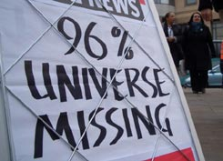
The DARK Universe (96%):
73% Dark Energy
23% Dark Matter
Only 4% is ordinary (visible) matter
DARK …. MATTERS !

Slide 21
Some of the outstanding questions …
Why is the Higgs boson so light (so-called “naturalness” or “hierarchy” problem) ?
What is the nature of the matter-antimatter asymmetry in the Universe ?
Why is Gravity so weak ?
Are there additional (microscopic) dimensions responsible for its “dilution” ?
What is the nature of Dark Matter and Dark Energy ?
…. and the “unknown unknown” …
In addition: The Higgs sector (and Electroweak Symmetry Breaking mechanism): the least known component (experimentally) of the Standard Model
A lot of work needed to understand if it is the minimal mechanism predicted by the SM or something more complex (e.g. more Higgs bosons)
What can the HL-LHC do to address these (and other) questions ?
A LOT: answers to some of the above questions expected at the TeV scale whose exploration JUST started … 3000 fb⁻¹ are crucial in several cases
→ Here only a few examples …

Slide 22
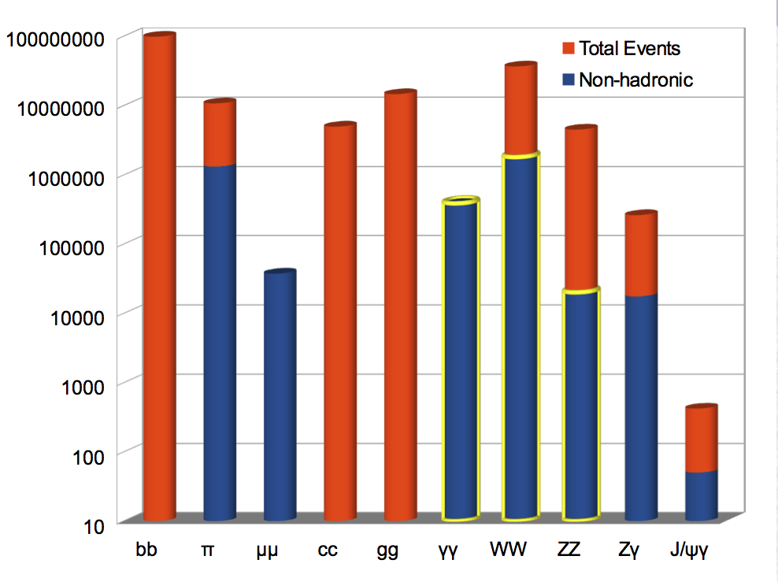
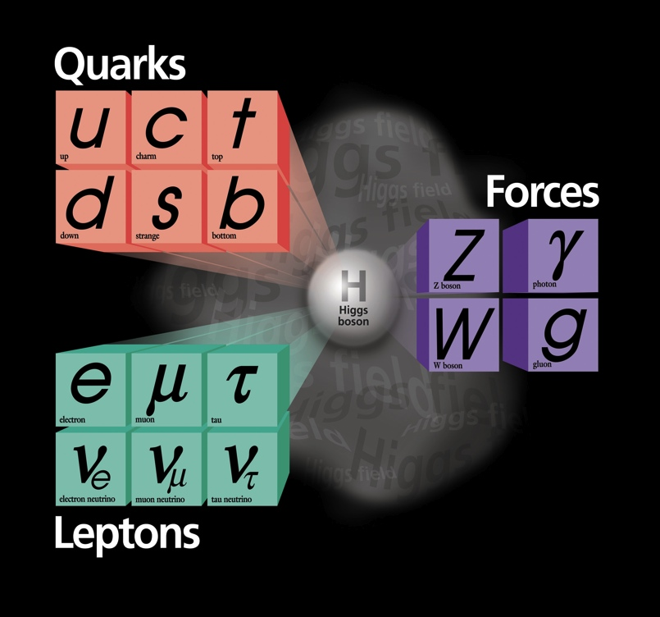
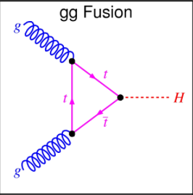
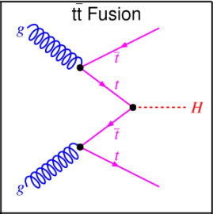
Measurement of Higgs couplings
Measure as many Higgs couplings to
fermions and bosons as precisely as possible
Measure Higgs self-couplings (give access to λ)
Verify that the Higgs boson fixes the SM
problems with W and Z scattering at high E
3000 fb⁻¹
HL-LHC (3000 fb⁻¹), THE Higgs factory:
> 170M Higgs events produced
> 3M useful for precise measurements
more than (or similar to) ILC/CLIC/TLEP
Today ATLAS+CMS have 1400 Higgs events
Observed/measured until now (note: top-Higgs
coupling indirectly through gg-fusion production)
Matter
particles
Force
carriers
Become accessible with 3000 fb⁻¹ : coupling to
muons (H→ μμ) and direct coupling to top quark
(mainly through ttH→ ttγγ)

Slide 23
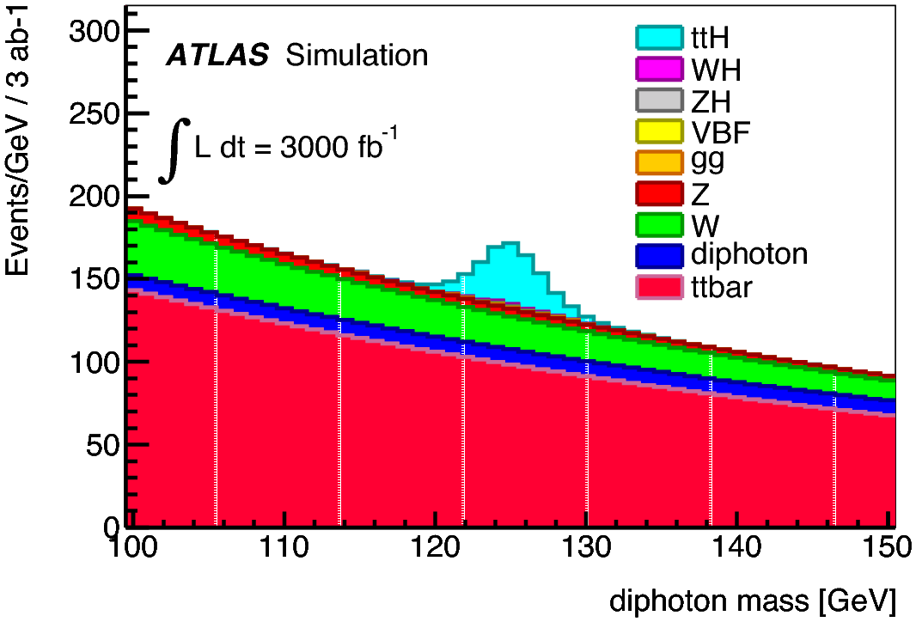
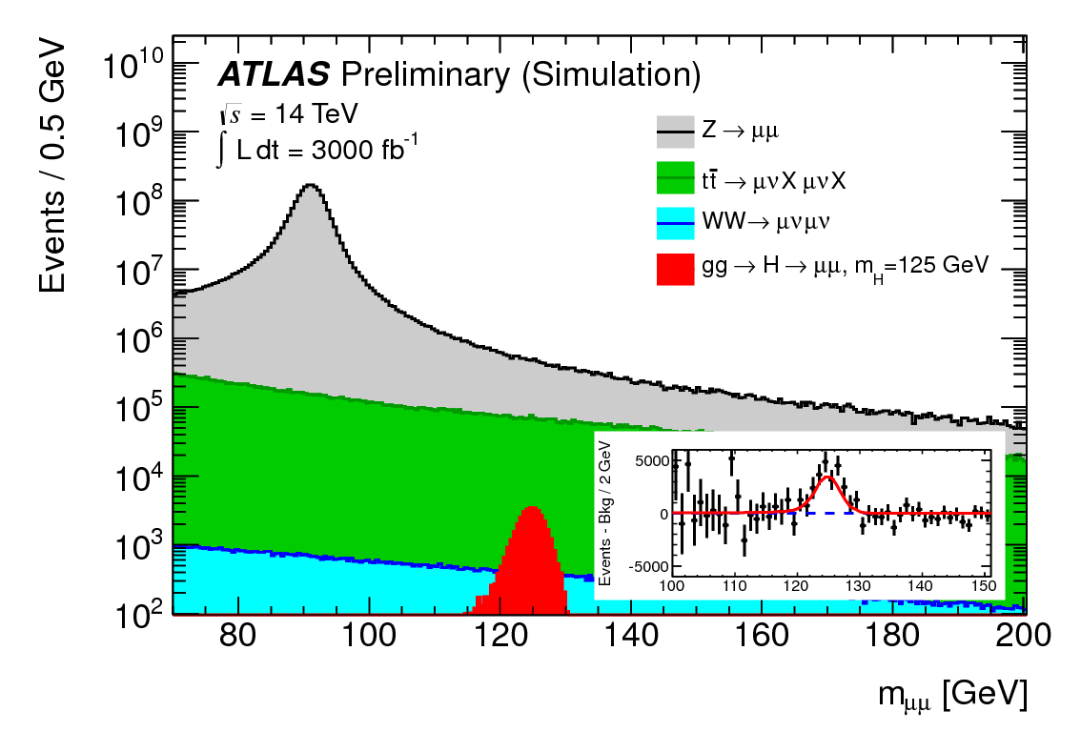
Measurement of Higgs couplings
ttH production with H → γγ
Gives direct access to Higgs-top
coupling (intriguing as top is heavy)
Today’s sensitivity: 6xSM cross-section
With 3000 fb⁻¹ expect 200 signal
events (S/B ~ 0.2) and > 5σ
Higgs-top coupling can be
measured to about 10%
H →μμ
Gives direct access of Higgs couplings
to fermions of the second generation.
Today’s sensitivity: 8xSM cross-section
With 3000 fb⁻¹ expect 17000 signal events
(but: S/B ~ 0.3%) and ~ 7σ significance
Higgs-muon coupling can be
measured to about 10%
Rare processes → sensitive studies only possible with 3000 fb⁻¹

Slide 24
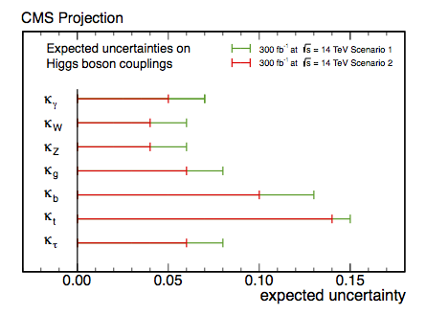
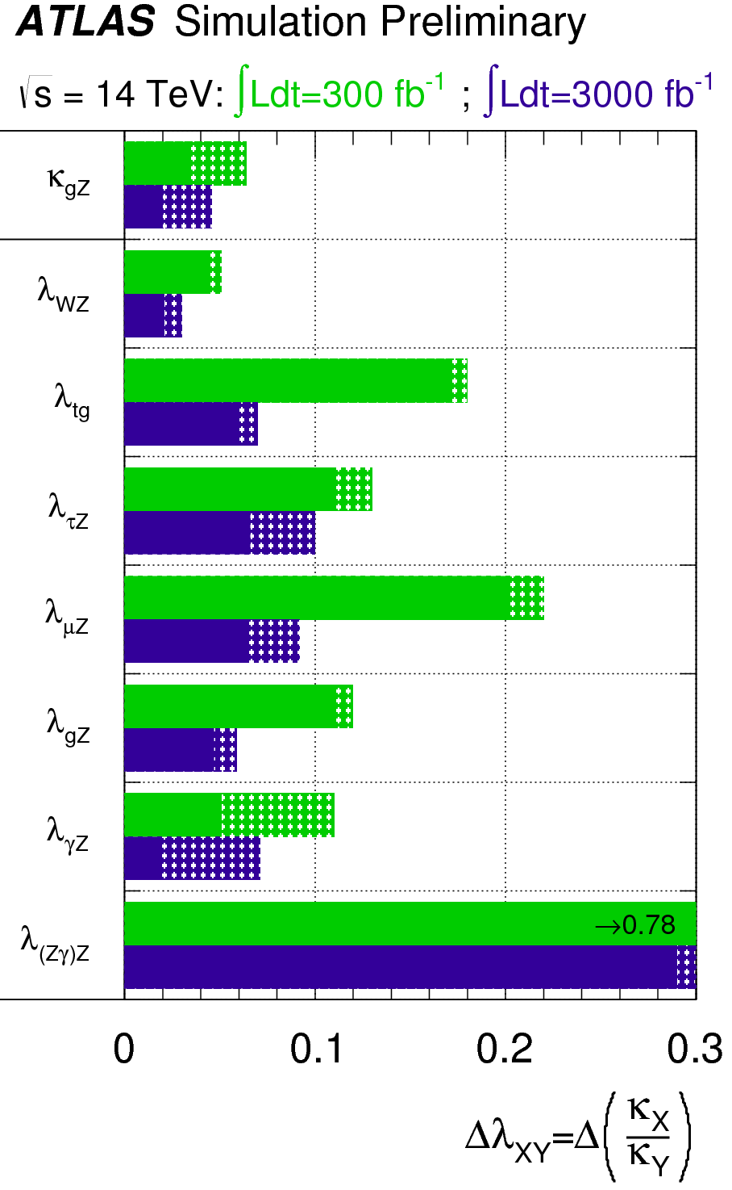
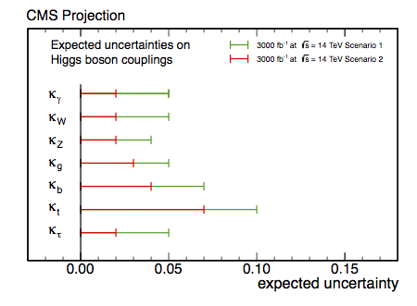
Measurements of Higgs couplings
300 fb⁻¹
Dashed:
theoretical
uncertainty
Scenario 1 (pessimistic): systematic
uncertainties as today
Scenario 2 (optimistic): experimental
uncertainties as 1/√L, theory halved
k_{i}= measured
coupling normalized
to SM prediction
λ_{ij}=k_{i}/k_{j}
3000 fb⁻¹
Main conclusions:
3000 fb⁻¹: typical precision 2-10% per
experiment (except rare modes)
→ 1.5-2x better than with 300 fb⁻¹
Crucial to also reduce theory uncertainties
Notes:
Relative uncertainty on the expected precision for the determination of coupling scale factor ratio lambda_XY in a generic way without assumptions

Slide 25
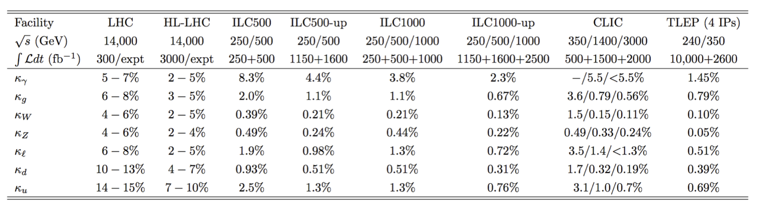
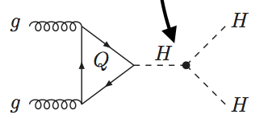
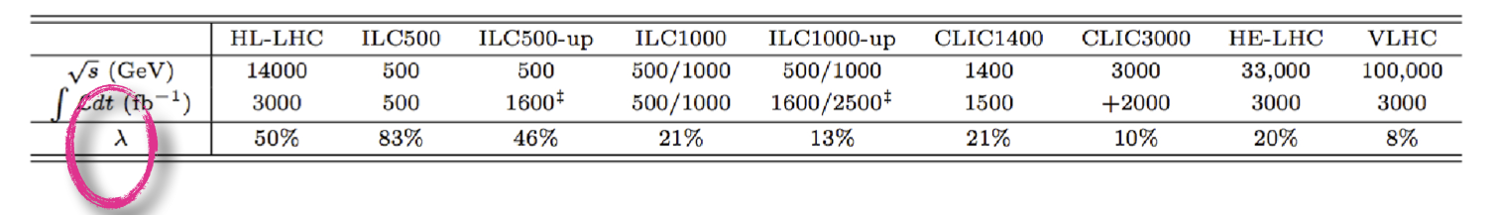
How well can the Higgs couplings be measured ?
Brock/Peskin, Snowmass 2013
HL-LHC: %-level → good sensitivity to BSM physics
ILC/TLEP: sub-percent level
Note: hard to believe that New Physics will manifest itself through tiny effects on Higgs couplings and nothing else …unless very heavy (but then how to interpret the observed deviations ?)
g_{HHH}~ λv
Higgs self-couplings: difficult to measure at any facility (energy is needed …)
30%
HL-LHC studies not completed yet … ~30% precision expected, but need 3000 fb⁻¹

Slide 26
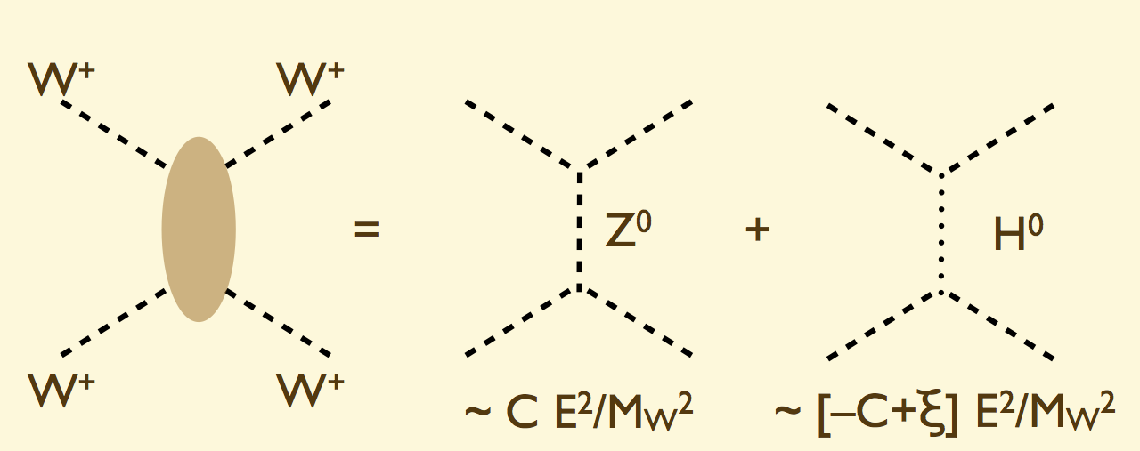
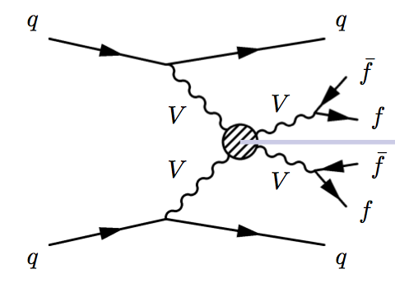
Vector-Boson Scattering
W-, Z-Boson Scattering at large m_{VV} provides insight into EWSB dynamics
First process (Z exchange) becomes unphysical (σ ~ E²) at m_{WW} ~ TeV if no Higgs, i.e. if second process (H exchange) does not exists. In the SM with Higgs: ξ =0
Crucial “closure test” of the SM:
  Verify that Higgs boson accomplishes the job of canceling the divergences
  Does it accomplish it fully or partially ? I.e. is ξ =0 or ξ ≠ 0 ?
  If ξ ≠ 0 → new physics → important to study as many final states as possible (WW, WZ, ZZ) to constrain the new (strong) dynamics
Requires energy and luminosity → first studies possible with design LHC
HL-LHC 3000 fb⁻¹ needed for sensitive measurements of SM cross section or else more complete understanding of new dynamics
M. Mangano
Notes:
If ξ ≠ 0 → new physics (resonant and/or non-resonant deviations)

Slide 27
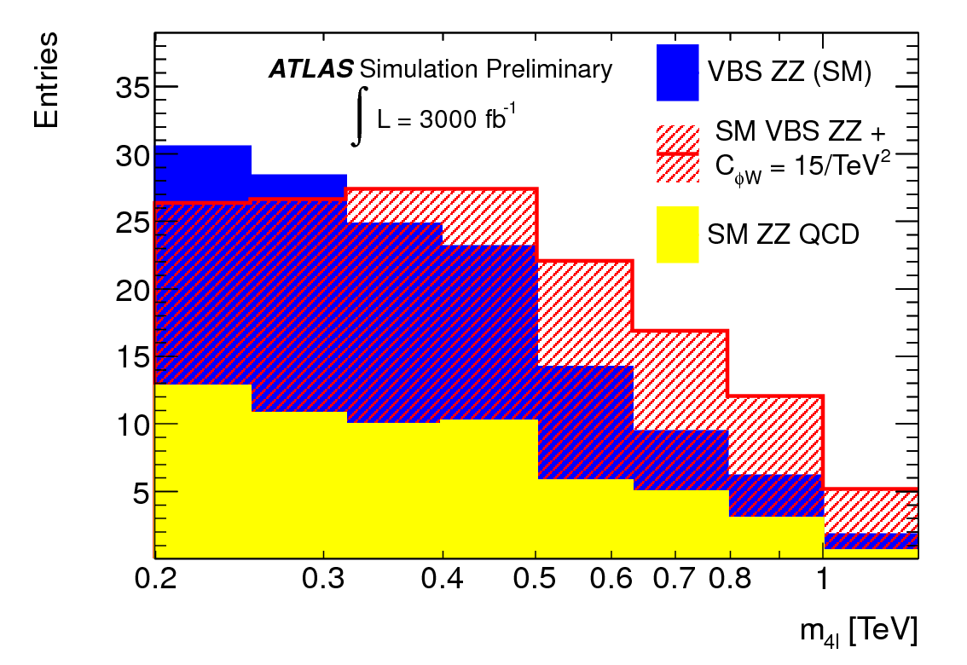
Vector-Boson Scattering
VBS ZZ→ 4l
SM (with Higgs)
New physics
Background
If no new physics: good behaviour of SM cross section (i.e. no divergence thanks to Higgs contribution)
  can be measured to 30% (10%) with 300 (3000) fb⁻¹
If new physics exists: sensitivity increases by factor of ~ 2 (in terms of scale and coupling reach) between 300 and 3000 fb⁻¹
Hl-LHC is crucial for a sensitive study of EWSB dynamics

Slide 28
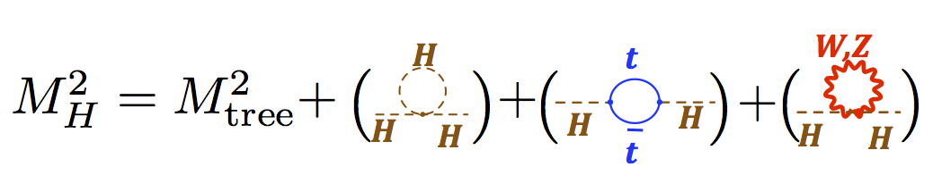
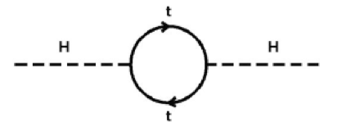
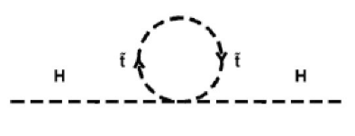
Stability of the Higgs mass
(also known as “naturalness” problem)
In quantum mechanics, the Higgs mass receives radiative corrections, as other particles
Mostly small, except top contribution: ~ m_{t}²Λ²
Λ² = energy scale up to which the SM is valid
(or, equivalently, new physics sets in)
bare
Two solutions:
1) “Naturalness”: Higgs mass stabilized by new physics that cancel the divergences.
E.g. SUSY: the contribution of the super-symmetric partner of the top (stop)
gives rise to the same contribution with opposite sign → cancellation
BUT: cancellation only works if stop mass
not much larger than top mass
this is one of most compelling
motivations for SUSY at the TeV scale
2) “Fine tuning”: the bare mass cancels the radiative corrections → this becomes
more and more ‘tuned’ the higher the scale Λ up to which SM is valid (w/o NP)
E.g. Λ = 10 TeV → M² (rad. corr) = 8265625 GeV²
→ need fine-tuned M_{bare}² = 8281250 GeV² to get M_{H}²= (125 GeV)² = 15262 GeV²
Λ= 10¹⁹ GeV → need fine tuning of M_{bare} to the 33rd digit !! → UNNATURAL

Slide 29
Motivations to search for SUSY
From Naturalness, expect higgsinos (SUSY partners of Higgs bosons) with masses of less than a few hundred GeV
Weakly Interacting Massive Particles (WIMPs) are a popular hypothesis for Dark Matter
  In R-parity conserving SUSY, the lightest neutralino is a potential candidate if it is the Lightest Supersymmetric Particle (LSP)
  Mass near electroweak scale → potentially see at LHC
Electroweak SUSY production may dominate if all strongly-coupled SUSY partners are too heavy to be produced
  No evidence so far of strong SUSY production at the LHC
Notes:
With R-parity being preserved, the lightest supersymmetric particle (LSP) cannot decay. This lightest particle (if it exists) may therefore account for the observed missing mass of the universe that is generally called dark matter

Slide 30
Electroweak SUSY production
Example: χ⁰ χ± production
Direct decays to
W and Z/h + LSP,
(assuming sleptons are heavy)
  Cross-section ranges from 1pb to 1fb, going from masses of 300 to 1100 GeV
The full HL-LHC dataset is needed for high mass sensitivity
Notes:
h = the lightest Higgs boson

Slide 31
Electroweak SUSY production
Use dedicated searches to target different decay modes
  Example: 3ℓ: W(ℓν)Z(ℓℓ)
  Results are interpreted
  using simplified models
Δm = m χ⁰ −m χ⁰
~
²
~
¹
χ⁰
χ± = χ⁰
m
~
¹
Δm = 0
Δm = m_{Z}
m m
~
¹
~
²
On-shell region: bulk of phase space,
concentrate here for projections

Slide 32
Electroweak SUSY production
With 8 TeV results, probe χ⁰ χ± production up to 270-420 GeV in M (χ±)
Wh
WZ
Wh
WZ

Slide 33
Discovery reach with 3000 / fb
Moving to 3000/fb extends the
reach by additional ~300 GeV
Discovery reach extends to
820 GeV, exclusion to 1100 GeV
The most of interesting mass range will be covered !

Slide 34
Conclusions part I
The discovery of the Higgs boson is a giant leap in our understanding of fundamental physics and the structure and evolution of the universe.
After almost 100 years of superb theoretical and experimental work, the Standard Model has been completed.
However, there are many outstanding questions, including:
  Why is the Higgs boson so light (“naturalness” problem) ?
  What is the the nature of the dark part (96% !) of the universe ?
  What is the origin of the matter-antimatter asymmetry ?
  Why is gravity so weak ?
The answers to some of the above questions could well lie at the TeV scale, whose exploration only started.
The STRONG physics case for the HL-LHC with 3000 fb⁻¹ comes from the importance of exploring this scale as much as we can with the highest energy facility we have today.

Slide 35
For the coffee break …
Philosophical/metaphysical questions:
Naturalness is maybe a good concept for us, but …
is it also the case for Nature ?
Anthropic principle:
Of all possible worlds, we live in a fine-tuned one
as otherwise we could not exist !
How much fine-tuning are we ready
to swallow before giving up on
naturalness ?
Notes:
Question for the next high-E machine: how much fine-tuning are we ready to swallow before giving up on naturalness ?

