Slide 1
A Survey of Dark Matter & Some Related Topics in Cosmology/Astrophysics
Bing –Lin Young (楊炳麟)
young@iastate.edu
WHEPS
August 2-10, 2015
Notes:
Crab supernova remnant and Cassiopeia A supernova remnant

Slide 2
Physics of the Dark Universe Frontiers in Particle Astrophysics and Cosmology Physics of the Dark Universe is a new online-only, fully open access journal, started in 2012, offering rapid publication of peer-reviewed, original research articles. View full aims and scope Editor-in-Chief: G. Bertone View full editorial board

Slide 3
Lecture schedule & related matter
Lectures
1:30-3:00 PM, August 4
10:30-12:00 AM, August 5, 7, 8, 9, & 10
Please see me any time you wish or send me an email:
Office:
Email: young@iastate.edu young@iastate.edu
Lectures will be largely in English. Questions can be in English, Chinese, or their mixture.

Slide 4
Progress of lectures
Tuesday, 8/4/2015; pp. 1-46
Wednesday, 8/5/2015; pp. 47-100
Thursday, 8/6/2015; break, no lectures
Friday, 8/7/2015; pp. 101-
Saturday, 8/8/2015; pp.
Sunday, 8/9/2015; pp.
Monday, 8/10/2015; pp.
Changes made after this file was last posted:

Slide 5
Changes made:
August 4 , 2015
Pages 25
August 5, 2015
Pages (Having trouble with pdf and ppt)
August 7, 2015
Pages
August 8, 2015
Pages
August 9, 2015
Pages
August 10, 2015
Pages

Slide 6
Contents:A survey of Dark Matter
Preamble
Introduction
Evidence of dark matter, the beginning
Dark matter candidates
SUSY and WIMP miracles
Searches for DM in general: ground-based labs, in space, in ice, and under water
Searches for DM-light particles
Searches for DM- heavy particles
Current status of dark matter searches: direct and indirect detections
Summary and a glance into the future
A simple conclusion

Slide 7
I. Preamble - Look back, at what it is now, and into the future
Dark matter is not exactly a new story, observed first in 1922 by Kapteyn (Dutch), 1930 by Lundmark (Sweden), 1933 by Zwicky (USA). Most astronomers have believed its existence since the 1980s
It became a very hot topics when particle physicists got interested to connect it with physics beyond the standard model
The WIMP miracle (Lee & Weinberg, 1977) made people thinking that it would be discovered eminently in the early part of the new century.
Dan Hooper of FermiLab made a bet with Kathryn Zurek of Berkeley, both theorists, in 2007. Hooper betted on it being definitely discovered in 2012.

Slide 8
October 2012 Arthur M. Sacler Colloquium, Dark Matter Universe: On the Threshold of Discovery
Michael Turner: Figuring out what is DM matter has become a problem that astrophysicists, cosmologists and particle physicists all want to solve, because DM is central to our understanding of the universe. We now have a compelling hypothesis, namely that dark matter is comprised of WIMPs, particles that don’t radiate light and interact rarely with ordinary matter. After decades of trying to figure out how to test the idea that DM is made up of WIMPs, we have 3 ways to test this hypothesis. Best of all, all 3 methods are closing in on being able to either confirm or falsify the WIMP.

Slide 9
Hooper announced in the 2014 SLAC Summer Institute that he lost the bet
In 2014 SLACS Summer Institute

Slide 10
Goals & desired backgrounds
Goal of lectures: To provide you with some basic knowledge of the current research of DM, and help you do serious study of the subject.
Background: Some introductory particle physics and cosmology will be nice. A very brief introduction to general relativity and some basic materials on cosmology will be provided.
The lectures are most descriptive in nature, technically known as phenomenological.
The heaviest calculation is on the WIMP miracle, i.e., decoupling of massive particles which is a crucial mechanism in the evolution of the universe.

Slide 11
Outline of the lectures
An introductory cosmology primer (very little) plus a little bit particle physics
A survey of dark matter
Big Bang nucleosynthesis: Primordial helium synthesis-quantitative evidence of non-baryonic matter (very little, detail calculation is given in Ch. 10 of the lecture notes.)
Freeze-out of heavy particles, preserving imprints of the early universe, WIMP miracle. (Boltzmann transport equation derived in Ch. 11 of the notes.)
Will not covered CMB anisotropy-general theory of small fluctuation in which the DM has also left its footprint (Ch. 12 of the lecture notes).

Slide 12
Let us start with some quotations
Steve Weinberg: Physics (and astrophysics too) thrives on crisis. We all recall the great progress made while finding a way out of the various crises of the past.
David Schramm: “The study of the very large (cosmology) and the very small (elementary particle) are coming together.
Niels Bohr: Science aims not to understand nature but what we can meaningfully say about it.
Symmetry Magazine: If you use only 5% of the alphabats you will stuck with the letter A. If you have only 5% of the daily diet you can only have a piece of dry toast. (Particle physics works only with 5% of the universe and it is all what we can see!)

Slide 13
References :
Steve Weinberg, Cosmology (2008), good for particle physicists. For most of the topics covered, details given. But it is still a long and hard work to read the book.
Dodelson, Modern Cosmology, more concise than Weinberg;
Kolb and Turner, The Early Universe (1989); V. Mukhanov, Physical Foundation of Cosmology. You can find some other very nice books downloadable from the web, e.g., B. Ryden, Introduction to Cosmology, etc.
arXiv articles
Conference talks for updated information at the time
News releases of important results or articles.
SLAC Summer Institute 2014 lecture slides. TASI 2014, Gelmini’s written talk on Dark Matter.
Various online stuffs, just be careful of what you read.

Slide 14
Interesting videos
Rocky Kolb’s lecture 2012
https://www.youtube.com/watch?v=tip_mqA4WhY
Highly exciting event
http://www.kavlifoundation.org/science-spotlights/astrophysics-closing-in-dark-matter#.VZK6vPlVhBd
Sam Ting’s talk on The AMS Day at CERN
https://cds.cern.ch/record/2009160

Slide 15
Remarks
I claim no great expertise in either dark matter or cosmology. Nobody seems to know what dark matter is and everybody wants to make some sense of it. I want to share with you my ignorance of dark matter, which, hopefully, can help you embark on a journey to its understanding. For this reason I try to present details and cover a lot of grounds
I have borrowed materials from various sources: Weinberg C + other books, arXiv articles, conference talks, the web, and other sources that are available to me. I borrowed a lot of slides and figures from conference talks which I have tried to reference them.

Slide 16
Remarks-continued
But I have not done referencing completely or uniformly. I apologize to authors (a lot of them) who feel that their works should be but have not been acknowledged.
This ppt presentation violates the general principle of conciseness: “do not write complete sentences and do write large”, for the purpose: I hope it still makes sense when it is read later.

Slide 17
II. Introduction
In the 20th century two areas of fundamental science have established their grand theoretical frameworks, after extensive experimental and theoretical efforts, albeit some yet unresolved structural problems.
The very small world of particle physics: The standard model of quarks and leptons, distance size ~ cm, deals with weak, EM, and strong interactions among ordinary matter of quarks, leptons, and associated fields – the visible world.
Tested in terrestrial labs, supposedly to be valid universally.
The final critical piece of the standard model, the Higgs boson has been found and is under detailed scrutiny.
The unsolved structure problems are the hierarchy problem, neutrinos masses, the flavor problem.
The grand challenge: Given the unresolved problems what is theory beyond the standard model, i.e., the physics above the EM symmetry breaking energy scale?

Slide 18
The very large world of the cosmos: the concordance model Λ-CDM, based on a flat geometry, augmented with cold dark matter, distance size ~ cm, deals with all forms of matter and energy which have the gravitational effect.
Now a precision science. N-body simulation has been developed into a useful tool to study theoretical ideas.
Behavior of its energy and matter components are governed by law of terrestrial physics, including particle physics.
The inflationary scenario looks more and more compelling.
Calculation tools are by and large classical, except for some conceptual understanding of certain phenomena.
The grand challenges: The presence of unknown components of the dark sector – dark matter and dark energy, and nailing down inflation.

Slide 19
Look at some aspects of Particle physics and Cosmology
Both based on simple physical principles for their theoretical frameworks and rigorous mathematics for their formulations. Each can be outlined on a couple of pages of paper.
But the theories cannot decide their matter contents which are crucial in the determination of the actual “worlds” they describe.
Neutrino mass and cosmological constant (dark energy), which are surprises in their respective theories, may have been predicted from the beginning-they are not forbidden in their theories.

Slide 20
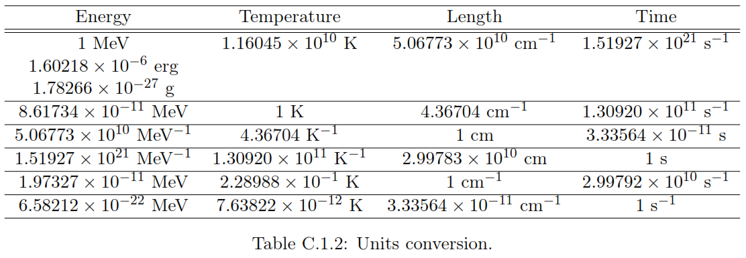
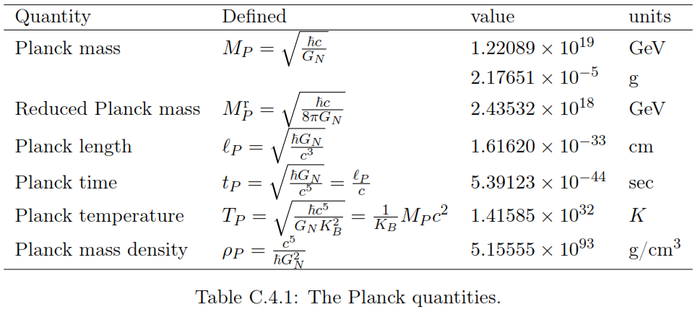
Extended Natural unites
Relationship of various scales: energy, length, time, and temperature
coming from the phase factor

Slide 21
A blurb on particle physics
A non-Abelian gauge field theory with the symmetry structure
A conspicuous feature: Representations of matter fields are assigned to determined the content of the theory. But particle physicists have to find out what exactly the matter fields are.
A symmetry breaking mechanism for the origin of the particle mass. The Higgs has been found as expected.
In a simple approach, the neutrino mass can be realized by introducing a set of right-handed fields, with the possibilities of Majorana masses and sterile neutrinos.
A perturbative calculation tool + renormalization (+lattice gauge theory).

Slide 22
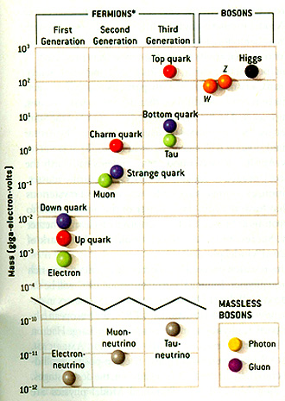
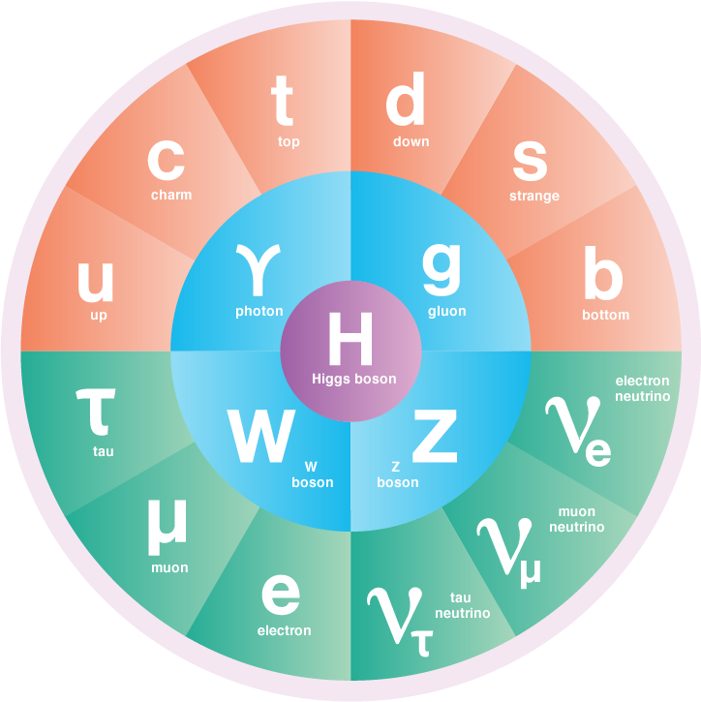
The spectrum: Supposedly, the SM gives a complete classification of matter
Mass hierarchy
Riesselmann, 7/21/2015

Slide 23
Some subtelities:
All massive fermions have a left-handed part and a right-handed counterpart in order to construct the mass terms in a field theory.
All left-handed fermions are SU(2) doublets and all right-handed fermions are SU(2) singlets.
The electric charge is related to the SU(2) ( ) and U(1) ( ) quantum numbers by:
The right-handed neutrinos have zero quantum numbers in the standard model: , there seems to have no reason to include (but not forbid) them in the standard model. Therefore, neutrinos are massless in the standard model. Massive neutrinos is an indication of the physics beyond the standard model.

Slide 24
Mass problem: Fermion mass hierarchy and neutrinos masses
Fermion mass hierarchy 12 orders of magnitude
From neutrino oscillation experiments
At least 2 of the 3 neutrinos have to be massive and the heaviest one is 0.05 eV or greater.
From the March 2013 Planck limit, one mass is less than 0.09 eV the other two are less than 0.07 eV in the normal hierarchy.

Slide 25
II. A brief review of cosmology We give a very brief introduction to general relativity and cosmology.
John Wheeler “Matter tells space how to curve and space tells matter how to move” to link geometry with dynamics.
Einstein field equation
Start with a 4-dimensional space defined by the metric tensor g_{µ𝜈}
The affine connection can be defined:
From which we have the Ricci tensor, purely geometric

Slide 26
Given a physical system characterized by the energy-momentum tensor , the Einstein equation, which links dynamics with the geometry of the space, and forms the starting point of general relativity and cosmology, is
The FLRW metric
We are looking for a homogenous and isotropic space which is the so called “background universe”, in a sense like the free theory of a field theoretic system (but much more complicated, of course). With the Hubble expansion factor a(t) (Hubble scale factor) taken into account, the metric of the space is given by, with the curvature constant :

Slide 27
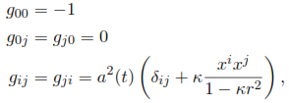
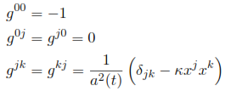
In the natural units, the FLRW line el
Since always goes with , we can scale the spatial coordinate to make if it is not 0.
The line element will be invariant if we scale the Hubble scale factor a(t) and similarly. This says that the Hubble scale factor is not a directly measurable quantity. Physical quantities depends on the ratio of the Hubble scale factor at two times.
The close, open, and flat space are given respectively by
Observationally the space is flat so we will drop the dependence below.

Slide 28
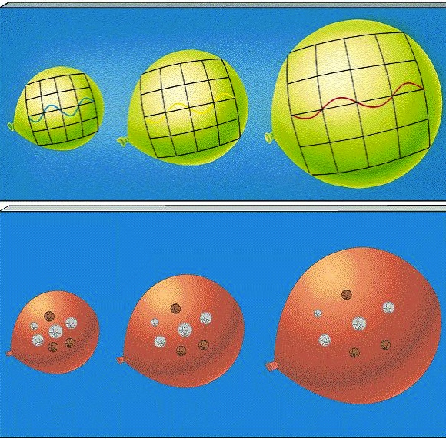
Comoving frame
This coordinate system is
the so-call comoving frame,
in which cosmologic objects
like galaxies are fixed in
the coordinate ,
while the scale factor a(t)
expands in time. So do the
wave lengths of light rays.
Comoving volume: .

Slide 29
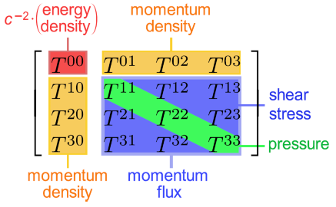
The metric of the flat space becomes much simplified, the FLRW (Friedmann-Lemaitre-Robertson-Walker) metric
Einstein field equation in the FLRW metric
The energy-momentum tensor
P: pressure density
ρ: energy density
Velocity
4-vector

Slide 30
Einstein equation in FLRW
The Ricci and energy-momentum tensors are simple
Equation of state

Slide 31
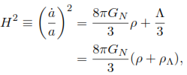
The (00) component of the Einstein equation
The (jk) component
Combining the two gives the important equation for the Hubble expansion rate (Hubble “constant”) , the Friedmann equation for an isotropic, homogeneous, and flat ( ) universe

Slide 32
Cosmological redshift
An important and useful quantity in cosmology is the redshift z which can be described quite simply.
Consider light propagation in an interval dr along the radial direction. FLRW metric null path in flat space
Consider the ratio of 2 time intervals, respectively the periods of the light at the given times:
Taking to be the present time, the scale factor at another time is know by their redshift. The cosmology redshift is not the relativistic Doppler shift.

Slide 33
Thermal dynamics
Thermodynamics governs the average properties of the cosmos. Number density of a particle at equilibrium,
, internal degrees of freedom.
, the chemical potential.
A deviation (perturbation) from H&I ( ), i,.e. CMB anisotropy, for the formation of stars and galaxies.
A conspicuous feature: No matter content is prescribed, except may be the presence of dark energy, but not its size.

Slide 34
A few key points-I
In equilibrium,
For , the highly relativistic case
For , the non-relativistic case (Maxwell-Boltzmann)
g internal degrees of freedom: 2s+1.
Apery’s constant

Slide 35
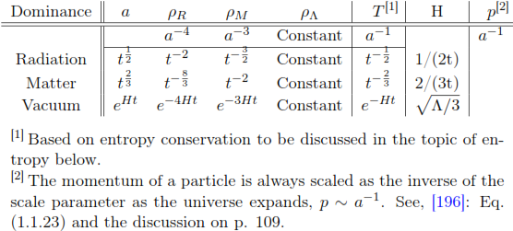
Relationship among dominant energy densities, scale factor, temperature, and cosmic time
Real universe contains a mixture of all types of energy densities.

Slide 36
A few key points-II
Hubble expansion flow: From Einstein field Eq:
, will set K=0.
Reaction rate of individual particles
determines if a particle is in equilibrium or not.
, particle in equilibrium
, particle out of equilibrium, being frozen out.
A conspicuous feature: the energy-mass content determines the time evolution of the universe.

Slide 37
Number Density ratio of massive particles over photons Lee-Weinberg theorem: Equilibrium and decoupling
Relativistic regime
Cosmic dynamics freezes the number density of the massive particle and arrests the exponential decrease
n*a^3=constant
Non-relativistic
Blue dotted, Fermions
Red solid, bosob
More details later

Slide 38
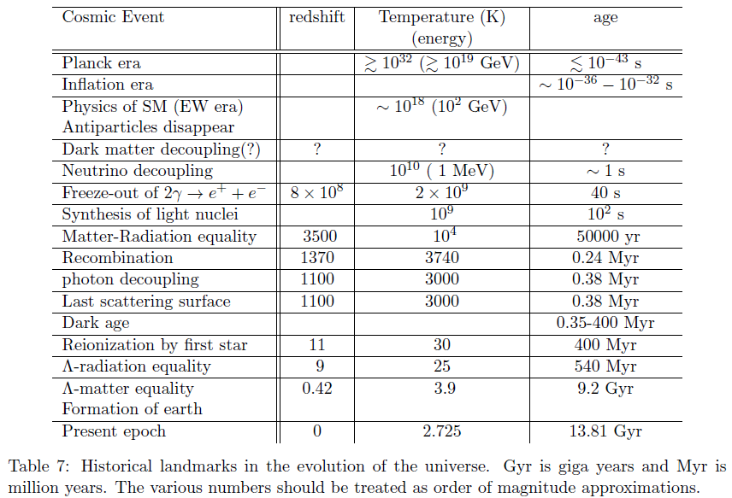
Cosmic history & landmarks
High
uncertainties

Slide 39
Some important epochs in cosmic evolution:
Radiation dominated for cosmic temperature > a few MeV
Matter-radiation equality: T=10⁴ k, t=50000 yr
Last scattering surface: photons decoupled from charged particles & universe became transparent, T=3000 K, t=0.38 Myr
Λ-matter equality, dark energy dominated afterward, T=3.9 K, t=9.2 Gyr
Present epoch, T=2.75 K, t=13.8 Gyr

Slide 40
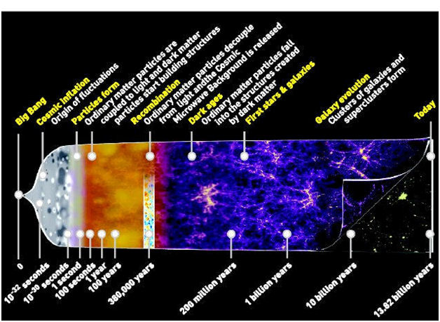
Notes:
Recombination: When the universe at ~400,000 years, becomes cool enough so that ions combine with electron to form neutral atoms. This allows photons to travel freely by release the CMB. But there is no source of light.
Dark ages: The period between the release of the CMB at 380,000 years and the appearance of the fist stars

Slide 42
Particle physics and cosmology operate on very different scales
Different distance scales:
Particle physics ~
Cosmology, tens kpc ~
Difference: 39 orders of magnitude
Different time scales:
Reaction time for EM interactions ~
In the cosmos hundred million years ~
Difference: 32 orders of magnitude
A useful number to remember: 1 yr

Slide 43
Given their sizes of about 32-39 orders of magnitude difference what is the relation between the two?
Note that the conspicuous features of the two theories are complementary to each other and perhaps closely related.
Studies in cosmology/astrophysics, e.g., the inflationary scenario, primordial nucleosynthesis, explanation of many astrophysical phenomena, details of supernova explosions, cosmic rays, etc., are made in the framework of the microscopic particle physics.
So, the elucidation of the Big Bang theory connects the large and small theories. The very large cosmic theory has to use the very small microscopic theory to fill its details.

Slide 44
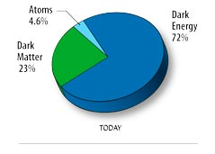
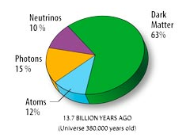
Problem and connection: cosmic composition, large & small connection
Red:
Planck
March
2013
4.9%
Is dark energy the cosmological constant ?
What is dark matter, can it be part of the family of elementary particles?
These are Challenges to both theories, small and large.
68.3%
26.8%
h=0.673
At the last
scattering

Slide 45
Can we understand the dark matter in the framework of particle physics, which is supposedly to include all forms of matter of the universe, and at the same time resolves some problems of particle physics?
Studies in the last couple of decades, with progresses made in both theoretical and experimental developments lead us to believe that such an understanding is not only possible, it is also necessary. DM represents what physics is beyond the standard model.
Take SUSY. SUSY solves the hierarchy problem, but it has a very complicated structure containing a huge number of unknown parameters, seems to be overbearing. If the lightest SUSY particle is also the dark matter, a very different perspective is brought to life for SUSY: the unification of Bosons and Fermions, bringing us the DM, is necessary for what the universe is today.

Slide 46
Particle physics, and physics in general, have provided the needed inputs for the development of cosmology: thermodynamics, nuclear physics, fundamental particles and their interactions, etc. These are established on Earth in terrestrial laboratories.
The existence of dark matter is for cosmology to return the favor to physics, from its perspective in galaxies, and regions of the size of millions of light years, remnants of things of very high energies and early times.
Dark matter reveals the need of a new matter ingredient which is insensitive to terrestrial probes, but nevertheless should be a fundamental part of matter, especially if dark matter is made of WIMPs.
The rest of the lecture is to try to show how this storyline has been developed and where it may possibly lead to.

Slide 47
III. Evidence of dark matter The beginning (a simplified version)
The direct evidence of dark matter comes entirely from observations in astrophysics and cosmology, i.e., large distances and large structures . Data show clearly a large part of the cosmos’ matter component is in some non-luminous form that can escape the identification in terrestrial laboratories.
The conventional story line of the dark matter began with Zwicky’s 1933 paper which announced that extra mass would have to exit in the universe in addition to what were visible.
But the real story is not quite so straightforward.

Slide 48
The Beginning - continued
DM has been observed before Zwicky in 1933.
Earlier observation has been traced to 1922 by Kapteyn (Dutch), then by Lundmark (Sweden) in 1930 in galaxies, Oort (Dutch) in 1932 in Milky Way stars. All observations involving rotation curves implied missing masss.
In his paper Lundmark called the missing mass as “dunkle Materie”, “dark matter” in German.
Zwicky’s work involved the rotation curves of galaxy clusters, extending the missing mass problem to a much larger scale.

Slide 49
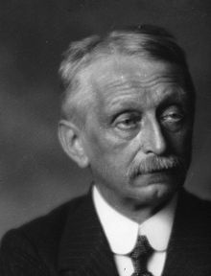
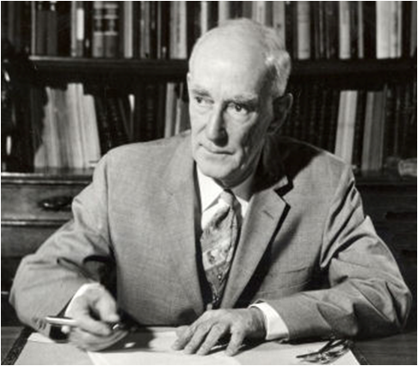
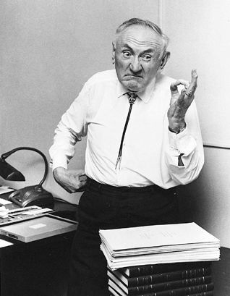
Jacobus Tapteyn
Knut Lundmark
Jan Oort
Fritz Zwicky

Slide 50
The Beginning - continued
For sometime, the astronomical community didn’t pay much attention to these early observations.
In the 1970s Vera Rubin and Kent Ford mapped the motions of stars within galaxies close by, the rotation curve showed that each galaxy required the presence of an enormous amount of dark matter.

Slide 51
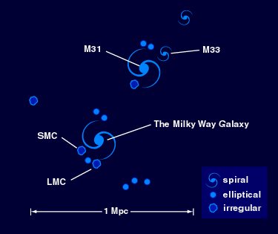
M31:
Andromeda
galaxy: the
Major galaxy
in the local group nearest
to Milky Way
(~2.9 Mlys),
Joe Primack: A brief history of dark matter
http://physics.ucsc.edu/~joel/Ay/214/Jan12-Primack-DM-History.pdf

Slide 52
What the dark matter is and is not
In the past few decades, significant understanding of DM has been made, mostly on what they are not. But we also have a fair amount of information about the DM
It is not baryonic and carries no electric or color charges. It is not composed of particles of the standard model.
It does not (significantly) emit or absorb light, having no direct electromagnetic interaction.

Slide 53
What we know aobut DM
It is mostly cold, non-relativistic, low kinetic energy, does not diffuse in large range in the universe.
It does interact via gravity, showing ubiquitously in many aspects of the detailed properties of large structures of the universe.
We know where it is distributed in the universe. And it is a crucial mater component for the structure of galaxies, cluster, etc.

Slide 54
Synopsis of Direct Evidences

Slide 55
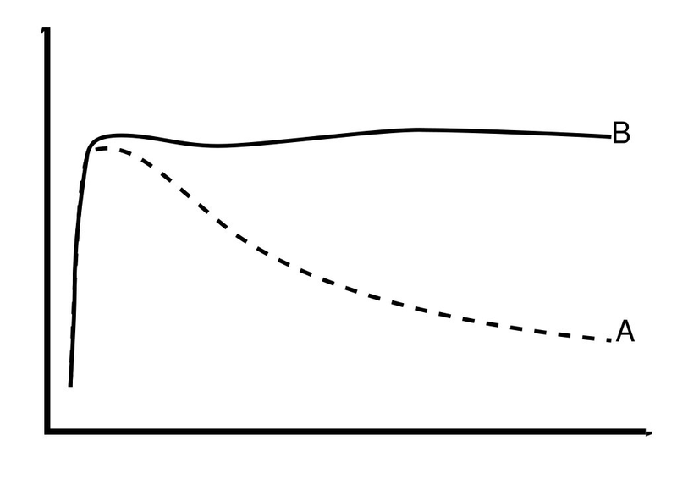
III.A Galactic rotation curves
Galactic rotation curves provide the bulk of the early evidence of dark matter and is the basis of Zwicky’s announcement (1933).
A simple illustration: only mass within r=R is visible:
Rotation velocity
Radius
r
If only were taken into account, would have reached the escape velocity at Then all stars beyond should not be there.
r=R

Slide 56
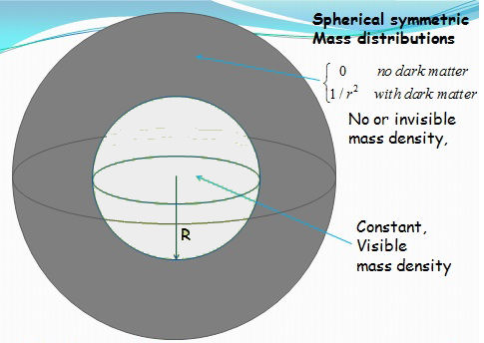
Rotation
curves
visible
A very simple model
invisible
Mass in brigth sphere is visible.
Mass in dark sphere is invisible

Slide 57
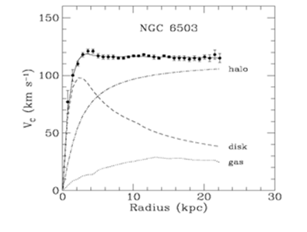
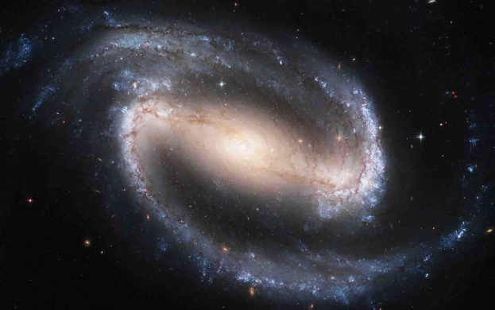
Observation: velocity of stars as a function of the radial distance from the galactic center
NGC is a spiral dwarf galaxy of low visible mass, 17 million light-years from Earth

Slide 58
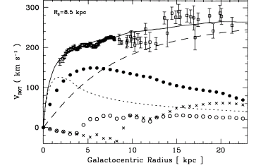
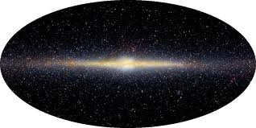
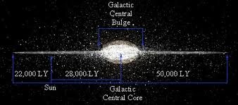
Dark Matter in the Milky Way
R.P.Olling and M.R.Merrifield MNRAS 311, 369- (2000)
sun
Dark Halo
Steller disk
Buldge
The Milky Way (our galaxy) has a large amount of Dark Matter.
KEKPH07-Moriyama: (direct) DM Searches & XMASS Exp.

Slide 59
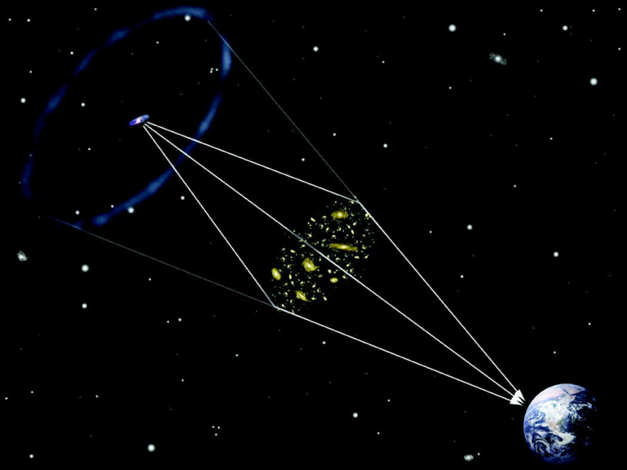
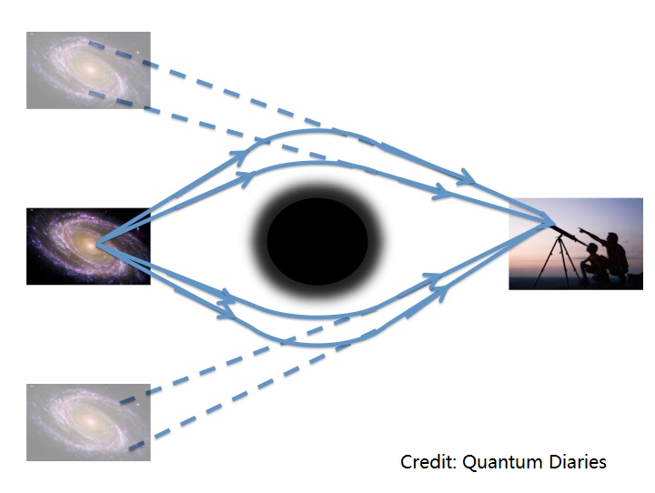
III.B Gravitational lenzing
Gravitational lensing refers to the phenomenon of light bending around a massive object, such as a cluster of galaxies, due to general relativity, providing a strong evidence for DM.
Measuring mass without resorting to dynamics
Providing a unique probe of distribution of matter
A unique calibrator between luminous and DM

Slide 60
Gravitational lensing-a bit of history
Orest Chwolson discussed lensing effect in 1924.
Einstein published the details in 1936. (an interesting story)
http://www.einstein-online.info/spotlights/grav_lensing_history
The effect was confirmed in 1979.
Lensing: A useful tool to measure the distribution of mass such as galaxy surveys. Lensing measures all mass, dark mass as well as luminous matter.
Strong lensing – strong bending of light to form multiple images or arcs. Can be used to study massive objects like clusters.
Weak lensing – not strong enough to form multiple images of arcs, but the source image can be distorted by both being stretched and magnified.
Microlensing – very weak lensing effect but can enhance the brightness of an image which may not be otherwise visible.
Modern simulation makes lensing a very powerful tool.

Slide 61
An exotic idea now has become a major tool for dark matter study.
Einstein published his note no gravitational lensing with a statement:
Of course, there is no hope of observing this phenomenon directly. First, we shall scarcely ever approach closely enough to such a central line. Second, the angle β will defy the resolving power of our instruments.
—Science vol 84 p 506 1936

Slide 62
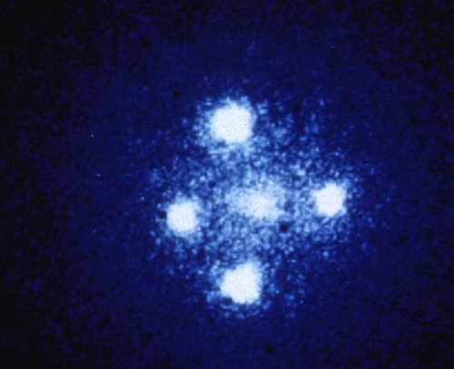
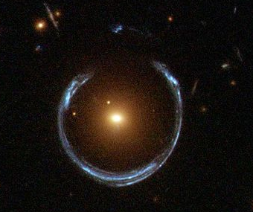
Examples of lensing images
An exotic idea now has become a major tool for dark matter study.
Einstein cross Einstein ring
"Einstein cross" by NASA, ESA, and STScI
4 images of the quasar Pegasus
A Horseshoe “Einstein Ring”
of LRG 3-757 from Hubble
by Lensshoe_hubble.jpg

Slide 63
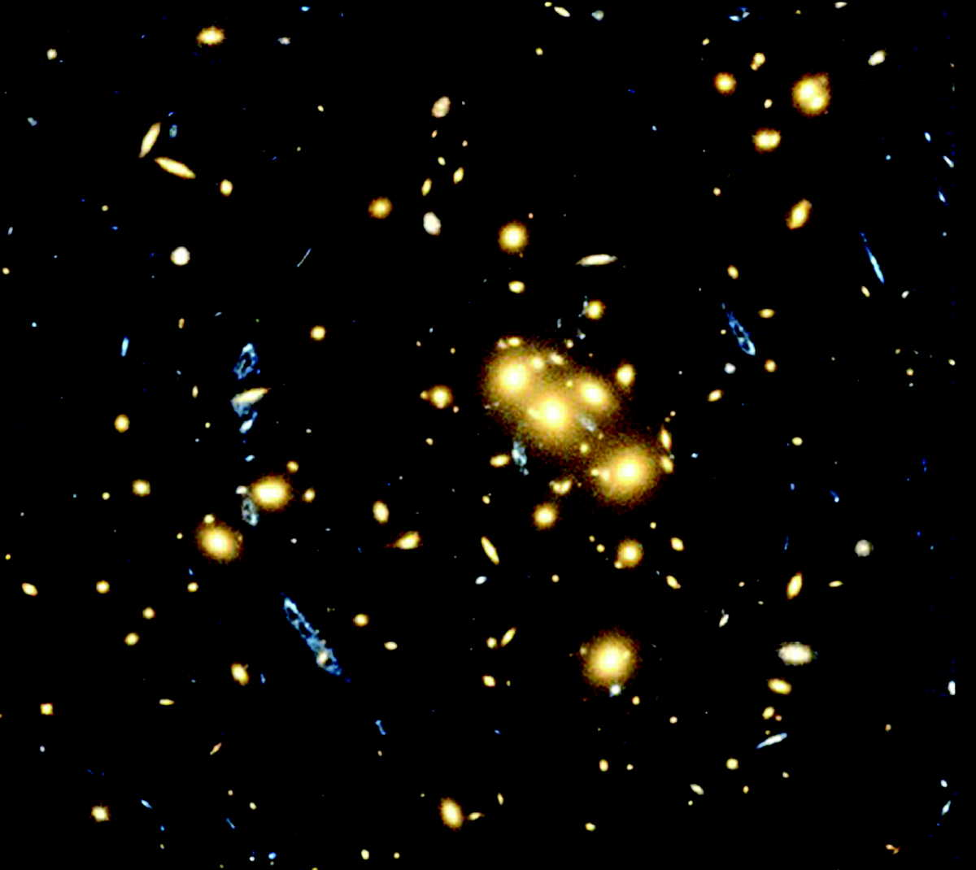
Hubble Lenzing image, foreground is the galaxy cluster CL0024+1654 ( 4 byrs away)
Multiple image of a single galaxy behind the cluster CL0024+1654, formed by the huge mass of dark matter in the cluster which bends the light of the background galaxy

Slide 64
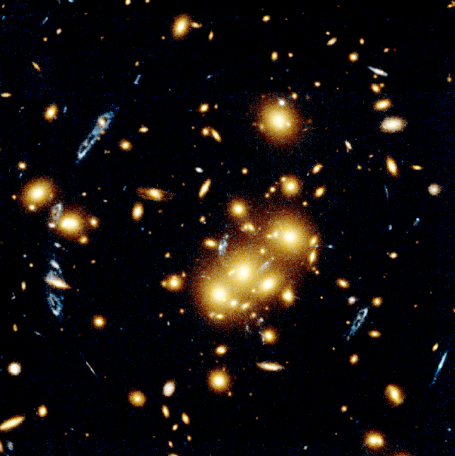
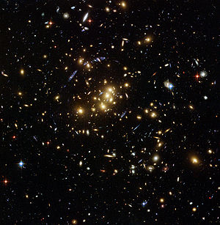
CL 0024+1654
CL 0024+17

Slide 65
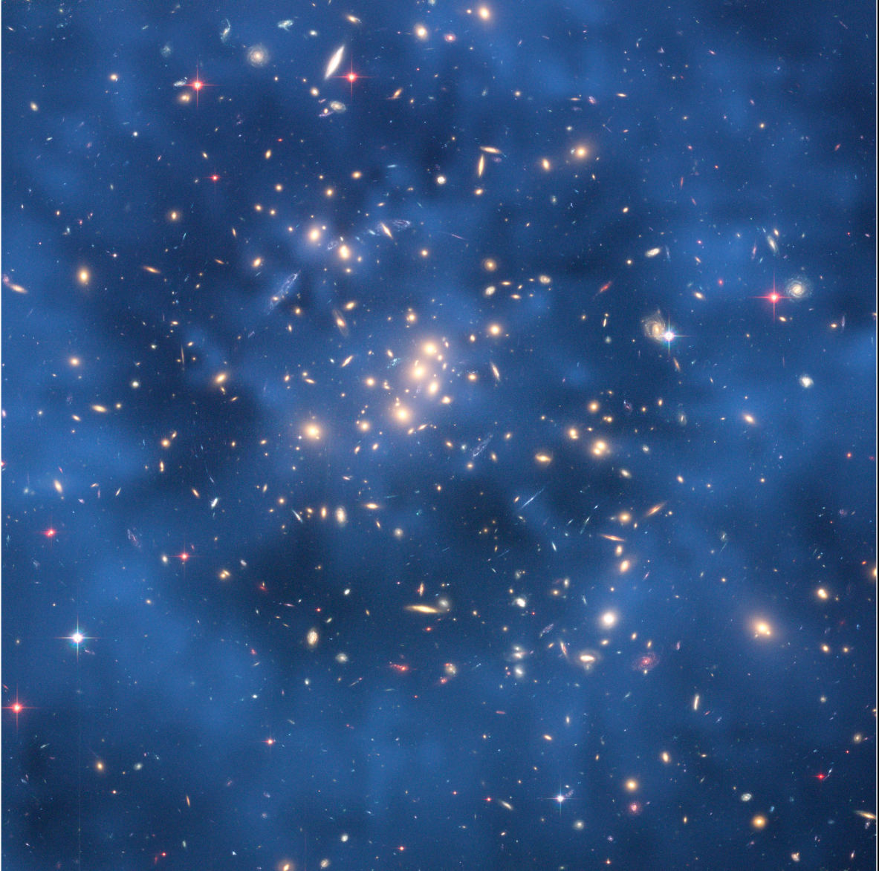
A strong indication of dark matter Foreground: Galaxy cluster CL0024+17
Fussy blue thick ring (2.6 million light years across) is a DM distribution which causes multiple images of a background galaxy.
CL0024+17 consists of tan bright images.
The dark matter ring is caused by the collision of CL0024+17 with another galaxy cluster. The axis of collision is the Earth line of sight. y

Slide 66
Juxtaposing the two images identical points
3/26/2013
Optical image,
without lensing
Superimposing with dark matter, with lensing

Slide 67
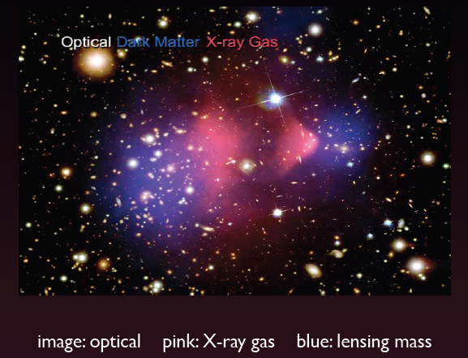
Another strong evidence of dark matter
Foreground: 1E 0657-56
Two galaxy clusters in transit after collision.
The axis of collision is perpendicular to the Earth line of sight.
Blue indicates DM distribution. Bright red color blobs are ordinary matter (X-rays).
Off set of ordinary and dark matter is due to the collision

Slide 68
More detail for 1E 0657-56
Gas peak
Mass peak
Lack of acceleration in DM limits DM self-interactions:
Half dozen more
galaxies collisions
detected

Slide 69
Seems to
Interact
Hsu

Slide 70
Recent developments on lensing Multiple collisions of clusters
arXiv:1503.07675: From Chandra and Hubble ST, 72 cases of collisions of galaxy clusters of both major and minor merges, taking place at different times, of different angles from the Earth line of sight. Existence of DM statistically at 7.6σ.
Stars slid passing through each other, gas clouds greatly slow down due to drag effect, DM also unaffected. Dark matter is none or very weakly interacting each other or with ordinary matter.
DM self interaction at 95% CL, significant improvement over the Bullet Cluster.

Slide 71
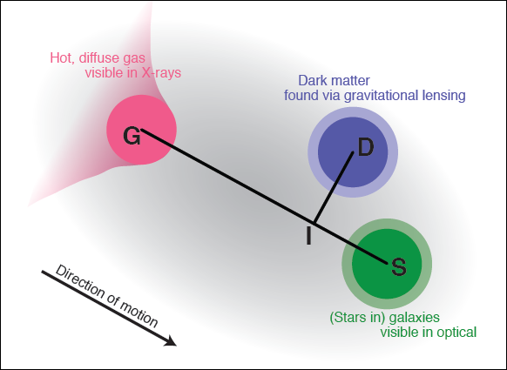
Graphic description of the collision result
Note the different techniques used in identifying different matter components.
arXiv: 1503.07675
unaffected
by collision
Significantly
slowed down
by collision
DM self-interaction:
Unaffected by collision

Slide 72
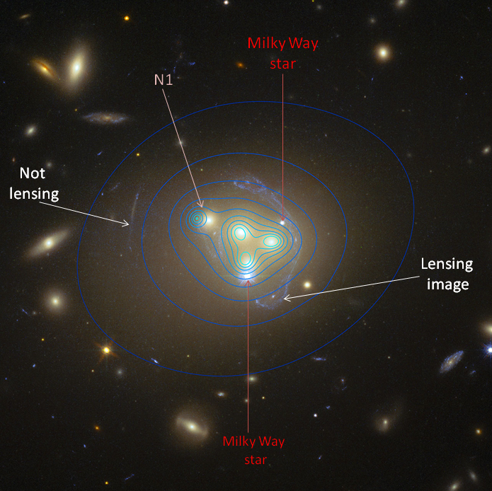
A quartet colliding galaxies-Abell 3827
arXiv:1504.03388, a simultaneous collision of 4 galaxies in Cluster Abell 3927, data from Hubble and ESO VLT tracing out mass lying in the system.
Comparing positions and
distributions of luminous stars
with DM
For galaxy N1 DM clump lags
behind visible parts by 5000 lys,
an off-set not observed before
in single galaxies.
Offset may be understandable
as DM self-interaction.
Notes:
Abell 3827 is a galaxy cluster

Slide 73
Dark matter self interaction observed (?)
Interpreted as DM self-interaction giving
Conflicting with early result? Numerically not.
How do we understand the difference? The two studies are on systems of very different scales, galaxies vs clusters. Cluster collision may not be sensitive to smaller galaxy effect, hence its effect in DM self-interactions.
(from galaxies collision)
(from cluster collisions)

Slide 74
Cosmic map of DM & DM in galaxies
There are a few forms of DM density distributions, e.g.
widely used Navarro, Frenk
and White (NFW) profile
Generalized NFW
profile
Einasto
profile
And others

Slide 75
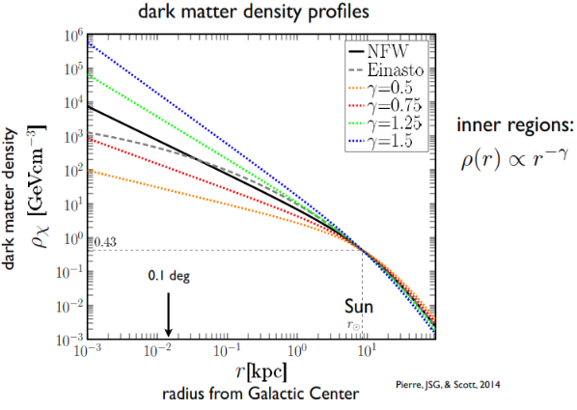
Pierre, Siegal-Gaskins, & Scott, arXiv:1401.7330
Core cusp
Critical density:

Slide 76
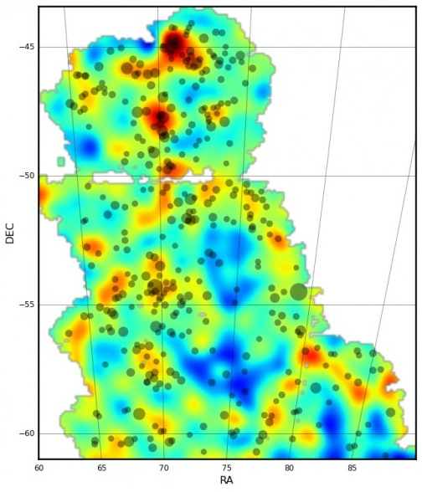
Cosmic map of DM
Weak lensing allows reconstruction
of spatial distribution of normal
and DM by jointly using optical,
X-ray, and lensing imagines.
DES first map of DM
distributions, arXiv:1504.03002
Covered 3% of the area surveyed
Red: highest concentration;
Orange & Yellow: next highest;
Blue: Void;
Circles: Clusters
Notes:
DES: Dark Energy Survey, an optical/near-infrared survey aiming to probe the dynamic of the expansion of the universe and the growth of large scale structure. Collaborations: USA, Brazil, United Kingdom, Germany, Spain, and Switzerland.

Slide 77
III.C Cosmic microwave background (CMB) anisotropy
CMB radiations, discovered in the 1960s, are imbedded in the theoretical formulation of the early universe and forms a part of quantitative cosmology.
CMB anisotropies arise from the inflationary epoch, a unique period of the universe.
CMB is the relic radiation, a nearly uniform and isotropic black body spectrum, of the early universe ~380,000 years after the Big Bang, or about 13.8 billion years ago, when photons are decoupled. It is the oldest light we can see.

Slide 78
CMB anisotropy
CMB carries information of the universe at the time of the last scattering surface when the temperature of the universe was largely uniform and isotropic.
It has a non-uniformity ~ 10⁻⁵ left as the imprint of tiny variations of matter density which has encoded a wealth of cosmological information that can be extracted by studies of the CMB anisotropy.
Smallness of the anisotropy is the result of a linear process. The small matter density fluctuations, originated from the inflationary period of quantum fluctuation, grew by gravity, over a very long time, into observable large-structures.

Slide 79
CMB anisotropy
It provides reliable information on the cosmic composition, the amount of dark energy and matter, and the cosmic geometry, all embodied in the so-called angular power spectrum.
A beautiful theoretical framework parallel to that of HEP has been developed: perturbations theory in metric and densities, and gauge invariance in coordinate transformation. These are of great interest to particle physicists.
Below a quick sketch of the CMB anisotropy is given. Details can be found in Ch. 12 of the lecture notes.

Slide 80
Primordial CMB anisotropy & the power spectrum - a quick sketch
Temperature variation over the sky can be represented by a multipole expansion (see Weinberg C, Sec. 2.6)
Angular power spectrum:
: temperature multipole coefficient;
: temperature partial wave amplitude
For a Gaussian distribution, the temperature anisotropy distributions over two directions is:
Notes:
Gaussian distribution f(x)=a*exp(-(x-b)^2/(2c^2)), i.e., a symmetric bell curve.

Slide 81
Power spectrum
The power spectrum measurements by astronomers are restricted by reality as we have only one universe to observe. What we can do is to make observations at a fixed point on earth and observe different points (θ, ϕ) in the sky.
But how good is this approximation? For Gaussian distributions,
For large ℓ there is very little difference between the real thing and the earth observation.

Slide 82
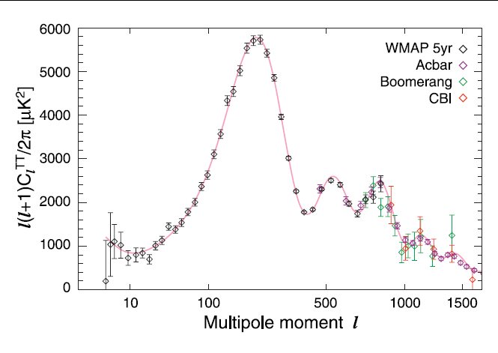
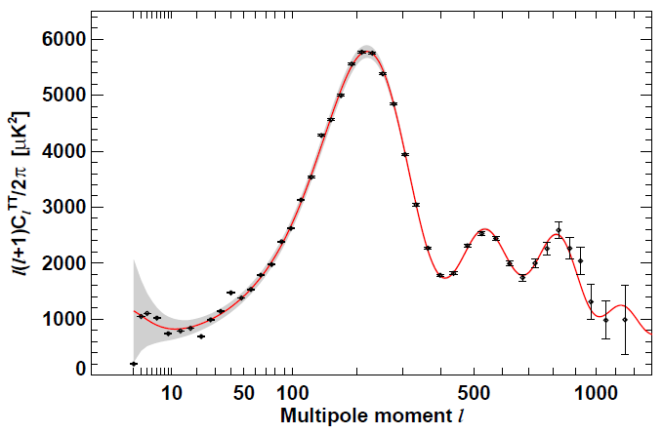
Power spectrum plot of WMAP 7 plus other observations
1st peak is about all matter & energy, determines geometry
WMAP 7yr
3rd peak about dark & ordinary matter
ISW
Rise
2nd peak is about baryons
SW plateau
LS
LSS thickness

Slide 83
Planck
Planck
3/2013

Slide 84
Anisotropy power spectrum
The first peak contains information about the total amount of stuff in the universe: ordinary matter, dark matter, photons, neutrinos, dark energy, and anything else we might not yet know about. The size and location of the peak is related to the geometry of the universe: how flat it is. The peak value and the total matter-energy density is related by . For which says the total density is about the critical density, i.e.,
, so the universe is flat.

Slide 85
Anisotropy power spectrum
The 1st peak covers an area of about of the sky, much larger than the temperature fluctuations we’re seeing (the Sun is 0.5° on the sky!), so it’s not produced by sound waves in the early universe, but by the total energy that drives the expansion.
The second peak tells us exactly how much baryonic matter there is in the universe. It gives a baryonic matter of the order of 5%, agreeing with the value obtained from BBN.
Notes:
Remark: the visible baryonic matter in luminous galaxies and diffused gas is less than 1%. So there is a significant amount of “missing baryons”. There are indications that this “missing baryons” are hot hydrogen gas in inter-galactic regions.)

Slide 86
Anisotropy Power spectrum
The third peak takes into account both the ordinary and dark matter. Combining the 2nd and 3rd peak gives us the amount of dark matter in the universe.
So when the first three peaks are measured, of heights and positions, with good precession, the geometry of the universe, the baryon density, and the total density of non-relativistic matter can be accurately determined

Slide 87
III.D Large scale structures formation requiring a large amount of cold DM
Observations suggest a bottom up approach to structure formation: smallest structures like stars and galaxies are formed first, and a group of galaxies together to form a cluster, then super clusters, walls and filaments, and voids. This picture cannot be realized with the baryonic matter known to exist.
Ordinary baryon matter has too high a temperature and too much pressure to form small structures.

Slide 88
Large scale structures formation requiring a large amount of cold DM
And galaxies are observed to move with sufficiently large velocity that the gravity of visible masses would not be able to hold the individual galaxies to a cluster.
Aside from altering general relativity, the only way to explain the existence of galaxy & clusters is to postulate the existence of a large amount of DM.
Simulation shows that cold DM can act as a compactor for the structure formation to take place .

Slide 89
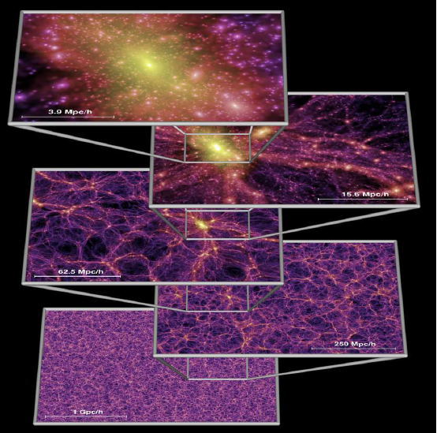
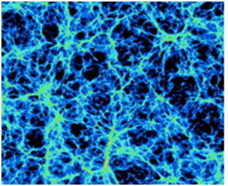
Structure formation simulations with the inclusion of a large quantities of cold dark matter can better reproduce observations.
A 200 Mpc simulation of the DM structure in the universe
(credit: Suvendra Dutta)

Slide 90
III.E Big Bang nucleosynthesis
Big Bang Nucleosynthesis is among the most successful quantitative calculations in cosmology, predicting the abundance of light elements, D, He-3, He-4, and Li-7, synthesized at the end of the first 3 minutes after the Big Bang.
The predictions, which are in good agreement with the primordial abundance inferred from observations, are very impressive in view of the huge differences in ratios of light elements to the hydrogen: ,
, and .
The prediction requires , which gives , i.e., . Other studies gives the total matter fraction .
In earlier time, the only evidence of DM beyond gravity.

Slide 91
Ratio of number of baryons in helium-4 to the total number of baryons
Details of the calculation of Y_{p} is given in Ch. 10. In good approximation, it can be done in analytical calculations plus simple numerical integrations.
The lithium problem?

Slide 92
The lithum problem!
The overabundance prediction of Lithium-7 has been a problem for more than a decade.
Recent update of theoretical inputs in nuclear physics, astrophysics, and cosmology have increased the discrepancy to a 5.3 σ effect.
A pressing, unresolved problem for BBN. Since agreements in D/H, He4/H and CMB are significant, this problem may be due to new physics, for example, axion condensation. There are other explanations. May be a loophole in the computation. No consensus yet.

Slide 93
III.F CDM and the cosmological concordance/ standard model and its challenges
The cosmological standard model (Big Bang cosmology parameterized with cosmological constant + cold dark matter) was proposed in 1982 by 3 independent groups. It has been widely accepted by the 1990s.
https://en.wikipedia.org/wiki/Cold_dark_matter
Spatially flat Six-parameter ΛCDM
Baryon density Ω_{b}
Cold dark matter density Ω_{cdm}
Hubble expansion rate H₀
Scalar spectral index n_{s}
Scalar amplitude A_{s}
Reionization optical depth τ

Slide 94
Challenges to the CDM paradigm
The CDM entering the theory is a pristine entity. Besides being massive, non-relativistic, and interacting weakly with regular particles, it has no other complications.
But CMD so defined has not been found to date by extensive experimental searches.
Theoretically , it faces challenges related to small structures formation of the universe when studied in numerical simulation.
Studies of galaxy collisions suggest that DM may have significant self interactions which may help alleviate the small structure problem.

Slide 95
Challenges to the CDM paradigm
The cusp core problem: Simulations indicate that DM densities of halos of galaxies and clusters are sharply peaked at their centers but high concentration of DM in these cneters are not observed.
The missing satellite problem: CDM predicts the existence of a large amount of substructures. In particular the Milky Way will have more dwarfs or satellite galaxies than observed.
Too-big-to-Fail problem: The CDM predicts the existence of massive satellite galaxies, but this is not supported by observation ether.

Slide 96
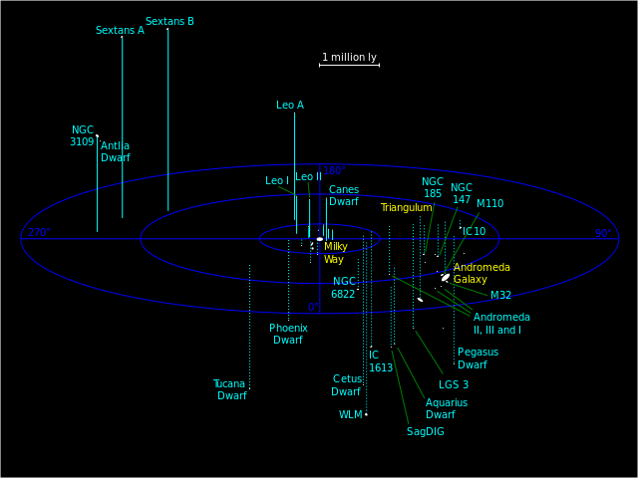
Challenges
to CDM
CDM predicate many
More satellites/dwarf
Galaxies than observed
Has a sharp rise in DM density for r goes to 0, in conflict with observation .

Slide 97
Possible solutions to the Challenges-complicating the DM scenario.
Solution by baryon physics: Overdensity of CDM can be reduced when more complicate baryonic processes are included in the structure formation.
Solution by DM physics-WDM: Warm DM has longer main-free path to be able to erase some of the small structures. But detail consideration shows that the WDM scenario does no do better than CDM.
Solutions by DM physics-SIDM (self interacting DM): DM particles have interactions among themselves. For the cusp problem, the elastic scattering among DM particles can redistribute the DM in the halo center so as to reduce its concentration there.

Slide 98
III.G Brief summary & find a solution
All evidence comes from astrophysical/cosmological observations and theoretical simulations-over huge distance scales (gravity)
Given Einstein’s general relativity, the cosmos observed today, including galaxies, clusters, etc. require the existence of a large amount of non-luminous matter which should be kinematically cold (non-relativistic) (or warm?).
The BBN restricts how much baryonic matter there can be. Again a large amount of the missing mass is needed.
The power spectrum of the CMB anisotropy requires also both baryonic and non-baryonic matters.
The three approaches converge into the conclusion on the existence of DM.

Slide 99
Finding a solution may require a multi-prong approach
Assuming the existence of DM, its effects in many aspects in cosmology/astrophysics can be studied through N-body numerical simulation.
To find out what the DM stuff is made of is anther story: It is a particle physics problem, in which both theoretical and experimental efforts are necessary. The efforts of search and identification involve astro/particle and accelerator experiments.
Interface of the above efforts: if LHC found a new massive neutral particle, detailed studies are needed to see if it has the right properties to be a DM particle.

Slide 100
III. H Alternatives to DM
The DM solutions to the various observational difficulties is based on the strict validity of general relativity and therefore the Newtonian classical gravity to galaxy and cluster scales.
But, Newtonian gravity has only been tested in the solar system. It is natural to consider the possibility of modification of the standard theory of gravity.
A simple modification of Newton’s law called MOND works well for rotation curves. Its generalization to cosmology is the TeVeS. To accommodate all observations some DM is still needed.
For particle physics, MOND types of theories play very little roles.

Slide 101
IV. Dark matter candidates
First, look at the properties of DM as a particle:
It carries no electric charge: no EM interaction.
No evidence in exotic heavy nuclei: no color charges.
It has to be stable against the cosmic time scale so as to survive till today.
It has to have a suitable mass/number density, taking it alone, about 5 time more than the baryon mass density.
Various candidates of DM have been proposed and new ones appear form time to time: stable exotic particles in frameworks beyond the standard model, etc.
DM can be classified in different ways, according to their kinematical properties, particle types, types of theory they fit in, the mass and number densities they have, and how they were produced, etc.

Slide 102
IV.A DM-kinematic types (A)
Classified according to their velocity at the time they are decoupled.
HDM: Hot DM, ultra relativistic, v > 0.95c; moving very fast and having long steaming length, difficult for galaxy formation; candidate, e.g., neutrinos; can’t be a dominant part of DM.
WDM: Warm DM, relativistic, v~0.1c-0.95c, may be ok for galaxy formation, candidate, e.g., sterile neutrino of keV mass; solving small structure difficulties of CDM (?).

Slide 103
DM-kinematic types (B)
CDM: Cold DM, heavy particles, small streaming length to defuse in negligible distance, non-relativistic and decoupled early in cosmic time, v<0.1c; good for large scale structure of the universe; leading to a bottom-up scenario of structure formation; many possible candidates in particle physics, the widely accepted are WIMPs (weakly interacting massive particle). Questions on small scale structures may be solvable.
CDM doesn’t necessary mean heavy. A well-motivated candidate axion is very light, sub meV. They can form condensates to be dark matter.

Slide 104
IV. B DM-Production mechanism
Thermal relics: These are particles existed in the early universe, maintaining thermal equilibrium until their reaction rate drops below the universe expansion rate. Then they decouple and their co-moving density freezes at the required density value.
Non-thermal relics: These are particles produced non-thermally at the early universe, say, from decays of heavier particles, and they have never been in thermal equilibrium. Fine tuning would be required to get the right particle density.

Slide 105
Thermal & non-thermal DM
Number density in a
Comoving volume: na³
Thermal DM: In thermal equilibrium at early universe and evolves according to thermal equilibrium distribution. It freezes out after temperature drops when its reaction rate is smaller than the universe expansion rate. It is then expands freely with density ~ T^3
Number density
Particle number in a co-moving volume: na³
Asymptotic value, having correct density
Temperature
Non-thermal DM: May have a very small density to begin with, its density increases in time from the decay of its parent particle and eventually reaches the required density and then freely expands with the universe, again density ~ T^3

Slide 106
IV.C DM candidates-particle type Various classifications
Started with conventional stuffs
MACHO (MAssive Compact Halo Object): ordinary baryonic types, including brown dwarfs, small dense chunks of heavy elements, etc. Nucleosynthesis requires the fraction of baryonic matter to lies between 14% to 17.% of the matter content, so MACHO cannot be a dominant part of DM.
Black holes: very massive galaxy sized black holes ruled out by gravitational lensing. Small primordial black holes are still a possible part of DM.
Standard model neutrinos: Hot relativistic type, from astrophysical studies, can only be a small part of DM.
Heavy neutrinos: LEP data show that any heavy 4th generation neutrino has to be heavier than 45 GeV, which is too heavy to be stable.

Slide 107
Particles beyond the standard model contained in extension of Standard Model
Sterile neutrinos: Right-handed neutrinos to give mass to ordinary neutrinos; gaining tractions as a candidate of WDM
Axions, axinos, gravitino, etc. All very light; axion is an interesting particle in solving the strong CP problem.
Universal extra dimension (UED): can occur in string and extra dimension theories. The lightest Kluza-Klein particle (KLP) can be a DM candidate.
Sneutrinos: Having sizable production and annihilation cross section, readily produced in high energy colliders to be studied, if it exists. Tevatron searches put it heavier than hundreds of GeV. Such a heavy particle as the lightest SUSY particle is undesirable.
Notes:
In models of UED in which all fields of the SM propagate in the compact extra dimenssion which leads to a tower of particle states. KLP is the first massive state in the KK tower of either the photon or the neutrino.
arXiv:hep-ph/0206071, 0509119: KLP of mass in the TeV scale may be a candidate of DM have $\Omega$ ~ 0.3.

Slide 108
Particles beyond the standard model
Neutralinos: lightest sparticle as a mixture of Higgsinos, photino, and Zino, generally heavy and weakly interacting with ordinary matter.
Together with KLP (lightest Kaluza-Klein particle), they are favorable candidates of DM and referred to as weakly interacting massive particles (WIMPs).

Slide 109
More exotic particles
Superwimps: This is a class of particles which are decay product of WIMPS. They have very little interactions other than gravitational force. They are lighter but can be studied at LHC, candidate: gravitino (Jonathon Feng, et al.)
Wimpzilla: very massive Non-thermal relics, 10¹² - 10¹⁶ GeV.
Q-balls: a type of non-topological soliton, a finite-sized "blob" containing a large number of particles. The blob is stable against fission into smaller blobs, and against "evaporation" via emission of individual particles, due to the attractive interaction, the blob is the lowest-energy configuration of this collection of particles.
Notes:
Q-ball refers to a type of non-topological soliton. A soliton is a localized field configuration that is stable—it cannot spread out and dissipate. In the case of a non-topological soliton, the stability is guaranteed by a conserved charge: the soliton has lower energy per unit charge than any other configuration. (In physics, charge is often represented by the letter "Q", and the soliton is spherically symmetric, hence the name.)
In quantum field theory, a non-topological soliton (NTS) is a field configuration possessing, contrary to a topological one, a conserved Noether charge and stable against transformation into usual particles of this field for the following reason. For fixed charge Q, the mass sum of Q free particles exceeds the energy (mass) of the NTS so that the latter is energetically favorable to exist.

Slide 110
A note on superWIMPs
3/28/2013
If WIMP, such as neutralinos, is the NLSP and it decays, then what? Jonathan Feng et al (SUGRA20, 2003): superWIMPs.
The mechanism: WIMP freezes out in early universe as before with the right , then later decays into superWIMPs, e.g., gravitino, and preserves most of the DM characters of WIMPs, e.g., .
This is to “escape the tyranny of neutralino like DM”. SuperWIMPs have only gravitational interaction and naturally the desired thermal relic. SuperWIMPs are inaccessible to all conventional searches, but have many other consequences, in, e.g., BBN, CMB spectrum, and as decay product of many sparticles. Special detector can be designed to study it indirectly. It may be a way out of the recent XENON100 upper limit.

Slide 111
Another
Number density vs
Can be studied in particle physics
Can be readily studied in particle physics exps.
Difficult to study these very small & huge cases.
Pospelov TAUP2011

Slide 112
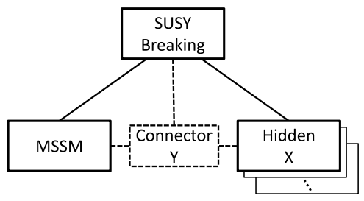
Broader characterization Dark sector/Hidden section
DM candidates discussed so far are traditional, related to the standard model, e.g. the dark energy and dark matter were proposed to have very simple properties just to argument the inadequacy of the baryon matter.
But we have to confront the fact that broad experimental searches have turned up empty handed, while possible candidates are in the low mass region, and DM self-interaction maybe required,
So theoretical attentions have
turned to new schemes with
theories of very different
structures and easier to
build new models: Hidden sector.
SUSY as an illustration
Feng & Kumar, 0803.4196

Slide 113
Hidden sector/Dark sector
Presently the literature is confusing. The terms dark sector, hidden sector, and even secluded sector have been used sometime for the same object. My inclination to settle the terminology as follows:
First a question: Why the dark section has to be so simple if 5% is already being so complicated? So the dark sector can be very complicated too. A whole elaborated new physical sector of dark particles may exit.
Hidden sector: Hidden sector is generally used in particle physics to refer to the existence of hidden gauge symmetries that complement the gauge symmetry of the Standard model. So the dark sector consists of the hidden sector, plus gravity and maybe a fifth (weak) force which as portals to connect the two sectors. Hidden sector which may be a complete physical theory by itself form a realization of dark sector.
So the physical world consists of parallel sectors, our sector and the hidden sector connected by the portal.

Slide 114
Some models
WIMPless DM: Examples of hidden sector theory, models emerging from SUSY breaking. The DM is composed of particles having correct thermal relic density, not restricted to weak scaled masses in the absence of WIMPs, ranging from 10 MeV to 10 TeV.
Dark photon: A new U(1) gauge field ( ). In the general form, dark photon can be massless or massive. It may couple to the standard model hypercharge ( ) by kinematic mixing and hence experimentally detectable.

Slide 115
Some more examples M. Graham, SLAC SS 2012

Slide 116
SIDM/SIMP
SIDM/SIMP stands for strongly interacting dark matter. Motivated by the observational evidence that from quartet galaxy collision which set a lower bound for the cross section of dark matter self-interaction. The dark sector has very little interaction with the visible sector. To freeze out to the desirable dark matter density, the 3 -> 2 scattering is used to reduce the particle number to the asymptotic value, equivalent to the WIMP miracle. There is a hidden sector in this type of theories (arXiv:1411.3727).

Slide 117
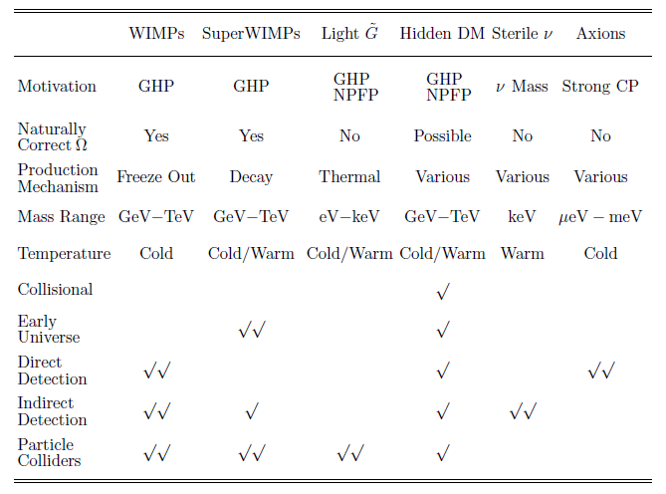
IV.D Summary of dark matter candidates physical problems they address to & their detection
Gauge hierarchy problem
New physics flavor problem
, if the macroscopic and microscopic theories are closely related.
Jonathan Feng
ARA 48 (2010) 495

Slide 118
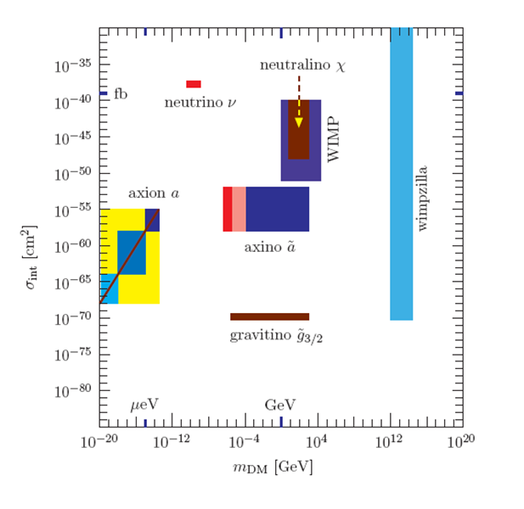
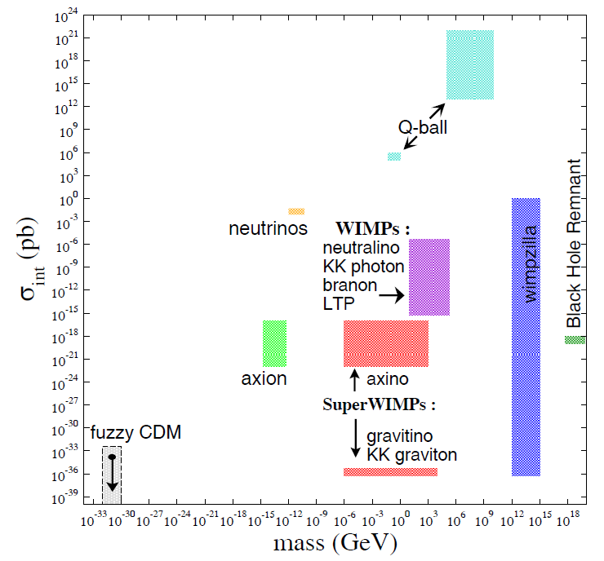
IV.E Summary of mass and cross section ranges of DM candidates Estimates by Different authors are not the same.
Roszkowski
WIMPs
K.-E. Park

Slide 119
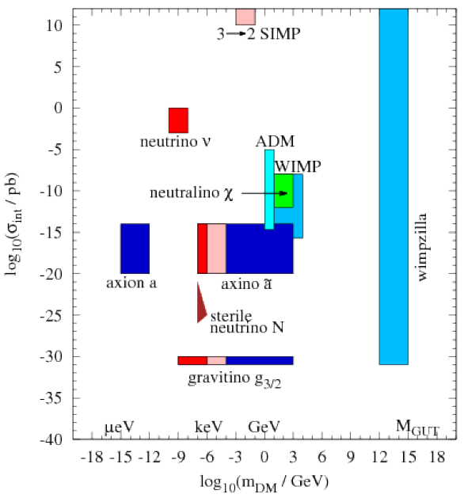
A newer plot
ADM: Asymmetric Dark Matter
to tie with the baryon asymmetry.
SIMP: Strongly Interacting Massive Particles,
Both have their own miracles.

Slide 120
Mass bounds
Unitarity upper bound: From partial wave unitarity of the S-matrix, M_{dm} < 115 TeV for thermal DM particles. But there is also a smaller bound of 30 TeV. Not valid for non-thermal DM.
Tremaine-Gunn lower bound: From phase-space density argument for dominated fermionic dark matter particles due to Pauli exclusion principle.
For the local group dwarf galaxies the bound is a few eV for neutrino if it dominates the DM.
http://ned.ipac.caltech.edu/level5/March02/Bertschinger/Bert3_1.html

Slide 121
IV.E What is a good DM candidate?
Astrophysically, has to have a correct density
Theoretically: A good candidate is the one which is well-motivated and can help address problems in particle physics; such as SUSY particles like WIMP, axion, gravitino, etc.: problems in particle physics: gauge hierarchy, new flavor, neutrino mass, and strong CP.
Experimentally: not too much less than the weak interaction cross section, having a reasonable large cosmic density, producing signals not too impossible to identify.

Slide 122
Some well-motivated “good” candidates
Axions (a): A resolution for the strong CP-problem, produced non-thermally, very light, part of CDM. Large mass regions already excluded.
Sterile neutrinos: SU(2)XU(1) giving mass to ordinary neutrinos, KeV mass warm DM, can alleviate the cusp/core problem of CDM.
WIMP: particles of mass 10 GeV to a few TeV, having weak interaction cross sections involving ordinary particles. For thermal WIMPs in thermal and chemical equilibrium in early universe, being a part of the fundamental particles, reliable calculations can be made. WIMP miracle
Primordial black holes: black holes created in the BBN era or after will not be counted in baryon density, unless created pre-BBN which are included as part of DM.

Slide 123
IV.F Alternative to DM
The DM approach to solutions of rotation curve is based on the validity of (1) general theory of relativity and (2) standard theory of gravity, which have been tested in the scale of solar system not in much larger galactic and extragalactic scales.
Hence the possibility of modifying either or both cannot be ruled out.
MOND (Modified Newton Dynamics): Rotation curves are results of Newtonian gravity, so why not modify it. MOND can successfully explain observed galactic rotation curves. But MOND is non-relativistic

Slide 124
DM is more attractive
An extension of MOND is the TeVeS (tensor-vector-scalar) theory which can deal with topics of cosmology, such as structure formation, lensing effect, etc. The overall evaluation of the MOND/TeVeS theory is that it still needs some component of dark matter.
There are other approaches such as MOG (MOdified Gravity).
From the view point of particle physicists, DM is the most attractive approach, providing a paradigm of solving problems of both cosmology and particle physics, making a close connection of the two.

Slide 125
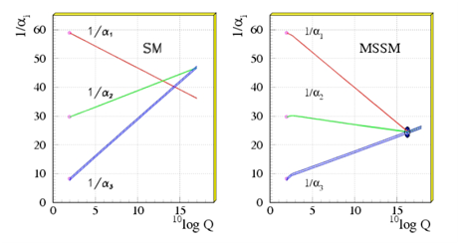
V. SUSY and the WIMP miracle
On broad theoretical considerations, WIMPs are the most desirable DM candidates.
Densities of DM and baryon matter are the same order , Ω_{dm}/Ω_{b}=5.5, suggesting a relationship between the two.
WIMP being DM has the merit of solving outstanding problems in both areas simultaneously.
SUSY neutralinos are particularly attractive: providing the DM, solving the
hierarchy problem,
and allowing coupling
constant unification
for an eventual grand
unified theory.
Miracle #1?

Slide 126
Thermal WIMPs in cosmic evolution-a description of the approach
WIMPs and ordinary particles are in thermal and chemical equilibrium through scattering and annihilation processes:
: DM particle, : ordinary particles.
In thermal equilibrium, density of WIMP is given by
: Fermi/Bose distribution function
g is the number of degrees of freedom, i.e., the number of spin states of the DM particle, .

Slide 127
Behavior of thermal WIMPs in early universe
High energies,
Low energies,

Slide 128
Behavior of WIMP in early universe
For DM is in equilibrium, , and it expands with the universe. For WIMPs density would become exponentially suppressed
due to annihilation. If this equilibrium situation continues, the density of the DM would be negligibly small today.
Fortunately the cosmic dynamics intervenes. As the WIMP density becomes sufficiently small, when the universe continues to expand, WIMP particles can no longer find one another to annihilate and the disappearance of the DM particles is halted, the WIMPs expand together with the universe and the WIMP density again goes like .

Slide 129
Freeze-out: In this way, the WIMP particle, which decouples with the rest of the particles in the universe, expands freely with the universe, as long as they don’t disappear by decays. Then, n_{χ}T³ = const.,
as if the WIMP were in a state of equilibrium similar to the case of a relativistic particle .
The condition for decoupling: the annihilation rate becomes smaller than the universe expansion rate:
Will demonstrate this decoupling below. A detailed derivation of decoupling (freeze out), including a derivation of the Boltzmann transport equation, is given in Ch. 10.

Slide 130
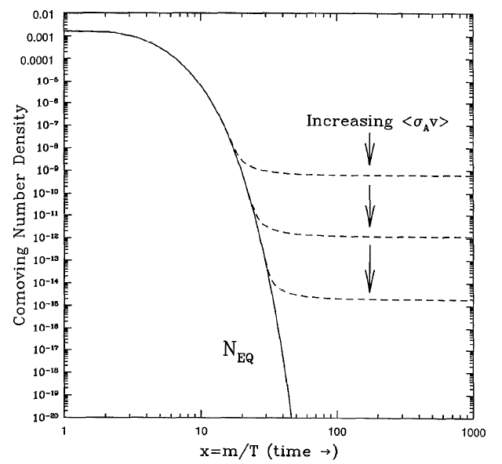
Particle decoupling – origin of species a cartoon illustration
n_{χ} (T).a³
Relativistic decoupling
Proof of decoupling given later, details in Ch. 10.
Solution of the Boltzmann transport equation
Decoupled particle density follows the dashed curve. The asymptotic density deceases with increase of annihilation rate.
Solid curve: particle stays in equilibrium

Slide 131
calculation
Serpico: TAUP2011

Slide 132
The WIMP miracle-thermal relics, a schetch
Boltzmann Transport Equation (BTE)
DM annihilation rate
Recall: a~1/T: Hubble expansion scale factor
co-moving volume
Meaning
of terms
BTE derived in Ch. 11
σ_{ann}: DM annihilation
cross section
V: relative velocity of
nuclear target and DM

Slide 133
WIMP miracle
Evolution of total number in a co-moving volume
Equivalent but physical more transparent:
const. no. in a comoving
volume if in equilibrium
negative feedback
“Annihilation rate divided by
expansion rate” determines
the rate of change of Y.
Freeze-out temp
Radiation dominated

Slide 134
Hot relics
Particles freeze out when still relativistic (x_{f} <2)
Needed expressions
m/T=2
m/T=2, both relativistic
& non-relativistic approx.
are good within a factor 2.

Slide 135
Hot relics
The asymptotic value is the equilibrium value at x_{f} .
Contribution from neutrino
Current data PDG 2014

Slide 136
Remark on neutrino relics
Particles freeze out when still relativistic which happens for neutrinos.
Determine the freezing temperature
Assume radiation dominance at the decoupling
Plus the cross section expression
See Sec. 9.5,Ch. 9

Slide 137
Cold relics-the WIMP miracle
Rewrite the Boltzmann Transport Equation (BTE)
Approximate as a
constant.
Focus on time after
freeze out , so
can be ignored in
comparison with .
Assuming radiation
Dominance at decoupling

Slide 138
The WIMP miracle
Rewrite approximate BTE
Integrate the equation from to obtain
Freeze out density: multiplying by S₁ at T₁ which is much larger than T₀ (present time) but Y already reaches asymptotic value.

Slide 139
The WIMP miricle
Estimate: x_{f} ~ 10, g* ~ 100, (a₁T₁)/(a₀T₀)~1/30 :
Finally
Pb=10⁻³⁶ cm²
a: s-wave
b: p-wave

Slide 140
Reaction channels and degrees of freedom

Slide 141
State the WIMP miracle again
Decoupling takes place at about and the WIMP density to critical density ratio becomes
For we need , for cold dark matter, the annihilation cross section is the order of pico barn (pb);
which is about the weak interaction cross section. This makes DM not only measurable but also can possibly be fitted into an extended theory of the standard model. This is dubbed as the WIMP miracle. (Miracle #2).

Slide 142
Remark: Thermal & non-thermal DM
Thermal DM: In thermal equilibrium at early universe and evolves according to thermal equilibrium distribution. It freezes out after temperature drops when its reaction rate is smaller than the universe expansion rate. It is then expands freely with number density ~ T^3
Number density
Asymptotic value
Temperature
Non-thermal DM: May have a very small density to begin with, its density increases in time from the decay of its parent particle and eventually reaches the required density and then freely expands with the universe, again density ~ T^3

Slide 143
More on solving the BTE
The freeze out of massive particles is an important cosmological mechanism to preserve some of the matter species in the universe. So it is also called “the origin of species” by Turner and Kolb.
The BTE is a first order nonlinear differential, called the Riccati equation
There is no general solution to the Riccate equation. It can be solve numerically.

Slide 144
Derivation of the WIMP miracle Decoupling of heavy particles (II)
See
Notes
Fig.
11.4.1,
Ch. 11

Slide 145
Test of boundary condition
Insensitive to
Boundary
condition
Boundary conditions at x=0.01
Y(0.01)=0.008, 0.1827, 0.8
Y(0.01)=0.1827 is the right condition, i.e,
Irrespective of the boundary
condition, Y(x) is driven back
to the correct solution.

Slide 146
Comparison of results on freeze-out
Decouple of neutrinos
and reheating
of hotons

Slide 147
VI. Searches for DM in ground-based labs, in space, in Ice, & under water
DM drives the dynamics of galaxies and clusters, and generate the growth of structures.
Observations of DM’s actions in contexts outside of gravity are necessary for gaining a fundamental understanding of what DM particles are.
The halo of our galaxy, the Milky Way, is expected to filled with DM particles which may occasionally collide with ordinary particles or annihilate into them. These serve as a base for the detection of DM in the terrestrial environment, in all direct searches.
Numerous experiments have been proposed, online/ construction/planning, to search for DM. Most require very strong background suppression. This means they have to be performed in underground labs, under water, or in ice. Some are cryogenic experiments.

Slide 148
Survey of the DM Landscape

Slide 149
Another
Number density vs
Can be studied in particle physics
Can be readily studied in particle physics exps.
Difficult to study these very small & huge cases.
Pospelov TAUP2011

Slide 150
Say, in WIMP detections as an example:
This is what most searches target on.
Detection of each types of DM particle has their own requirements.
Pospelov TAUP 2011

Slide 151
The universe is a busy place The grand unified photon spectrum
The grand photon spectrum is just one example of background.
There are many other possible backgrounds

Slide 152
VI.A approaches to Dark Matter searches Many experiments in worldwide locations
Gravitational effects: So far almost all evidences of dark matter are from gravitational effects: rotation curve, lensing, structure formation N-body simulation.
Direct searches: DM particles in the solar system (local) collide elastically with laboratory nucleus.
Indirect searches: DM particles annihilation produces standard model particles. Sources of interactions can come from a number of places in the Galaxy or nearby spaces (remote). Look for anomalies in cosmic rays.
Accelerator production: Production of WIMPs with the DM characteristics, detailed study of DM properties, find out how to fit DM in particle physics framework.

Slide 153
Let us remind ourselves:
Keep open minded for new possibilities and there are many: dark sector DM, SIMP, etc.
Major undertaking to find and identify them.
Primordial black hole
WIMP

Slide 154
Some theoretical bounds on DM mass
Unitarity bound: < 340 TeV for thermal particles
Lee-Weinberg bound : WIMPs or like particles
10 GeV to 1 TeV mass
Tremaine-Gunn bound, Sterile neutrinos > a few KeV.

Slide 155
annihilation
Conforming
DM particle
is a very
complicate
process
elastic scattering
Pair productions
Serpico: TAUP2011

Slide 156
Some
Exps
Cirelli LP2011
Just some examples
Cirelli LP2011

Slide 157
VI.B Cartoon - The Galactic (Milky Way) Environment where DM may concentrate
Dark matter
distribution
Milky Way:
Diameter :100 kly; Thickness: 1 kly
# of stars: 200-400 billion
Solar DM density: 0.4 GeV/cm³
Important galactic
locations where higher DM distribution expected
Notes:
OB stars are hot, massive stars of spectral types O or early-type B that form in loosely organized groups called OB associations. They are short lived, and thus do not move very far from where they formed within their life. During their lifetime, they will emit much ultraviolet radiation. This radiation rapidly ionizes the surrounding interstellar gas of the giant molecular cloud, forming an H II region or Strömgren sphere.

Slide 158
The local group-Sources of DM
Total 54
galaxies:
3 major
(in yellow)
Plus dwarfs
Satellite
Dwarfs:
Dia:0.3-5 kly
Mostly
discovered in
recent decades
MW may be
the most
massive for
its dark matter
content.

Slide 159
Relevant data about DM in MW
Local galactic DM density: compared with
DM velocity , cold, non-relativistic at the onset of the galaxy formation.
Higher concentration of DM expected: at galactic center, in satellite dwarf galaxies, & in the sun.
DM particles must be:
Stable against cosmic time billion years.
Interacting weakly with ordinary matter
Having the right relic density (?).
Likely candidates: primordial black holes, axions, sterile neutrinos, WIMP, etc.

Slide 160
Short note on Galactic dark matter density profile
The galactic dark matter halo distribution often uses the Navarro-Frenk-White profile
or the Einasto profile
A recent semi-empirical catalog of early-type (elliptical & lenticular) galaxy halo found the above dissipationless characterization inadequate.
Dark matter direct search experiments are concerned with local dark matter density which is about 0.4 GeV/cm^3, or about 40000 DM particles per m³ for 10 GeV DM particles.

Slide 161
VI.C UL &
3220 m rock or ~10,000 MWE

Slide 162
Notes:
No. 26 Andes Underground Lab is still a proposal. If approved it is the only UL in the south hemisphere.

Slide 163
Show names of ULs

Slide 164
(not updated)
JingPin
CDEX
Show exps in ULs (incomplete)
CJPL is not included
Also note the error

Slide 165
World deep underground laboratories
Credit:
Prof.
程建平 Tsinghua Univ.
Sanfort (美国)
Less than 40 muons
/m2/yr
Proposal denied

Slide 166
Presently
Out!

Slide 167
Comparison of worldwide major ULs
Credit:
Prof.
程建平 Tsinghua Univ.

Slide 168
Underground Lab, depth & background
The deepest ocean is 10,924 m in the Marian Trench near Guam
Everest ~ 8848 m
1 m rock~ 2.65 MWE

Slide 169
VI.D World wide DM experiments
Partially
Updated
from
Xenon
Homepage
Some may not
Be active,
Some are
Combined.
Need updated.
List to show
that there
exit numerous
experimnts.

Slide 170
Experiments with (significant) results
Direct search
Indirect search
CDMS
COUPP
CoGeNT
CRESST
DAMA/LIBRA
EDELWEISS
KIMS
PICASSO
SIMPLE
XENON
ZPLIN III
LUX
PANDAX
CDEX, …
AMS-02
ATIC
EGRET
FermiLAT
HESS
IceCube
INTEGRAL
PAMELA, …
Blue: positive results claimed

Slide 171
VII. Searches for DM- light particle candidates
The search for dark matter has to be carried out in all possible reasonable approaches, in the absence of a compelling indication about what the DM particle could be.
Because of the plethora of possible candidates and their different properties, various technologies are applied for searches.
For the same reasons there are many different experiments to try to cover all the grounds.
We start with the search for light candidates

Slide 172
VII.A Light DM candidate: axions
The axion is a pseudo Nambu Goldstone boson of the Peccei-Quinn U(1) symmetry, a solution for the strong CP problem.
Axion, mixing with and , has effective couplings to ordinary particles. A prominent one is the axion-two-photon coupling: . Through the Primakoff effect, the axion-photon conversion can take place near a heavy nucleus by the axion-gamma-gamma coupling.

Slide 173
Axion effective coupling
Effective Lagrangian
Axion decay constant
Model dependent
Gamma to
Axion
conversion
Axion to
Gamma
conversion
X

Slide 174
Most of the mass regions have been excluded

Slide 175
The most recent results
Cooling stars and SN1987A excluded f_{a} < 10⁹
Future lab tests can also probe
f_{a} < 10⁹ and
f_{a} > 10¹²
To probe the intermediate region is challenging.
Helioscopes: CAST and others
Telescope/EBL: FermiLAT and Chandra X-ray
EBL: extra galactic light

Slide 176
VII.B Light DM candidate: KeV sterile neutrinos
Massive neutrinos require the existence of right-handed (beyond the standard model) neutrinos which are sterile neutrinos and can be a candidate of DM.
A simple model to include right-handed neutrinos is the so-called (neutrino minimal standard model) which has 3 right-handed neutrinos. This adds 18 more parameters to the standard model:
3 Dirac masses for the ordinary neutrinos
3 Majorana masses, one is KeV and two are multi-GeV.
6 mixing angles and 6 CP phases.

Slide 177
KeV sterile neutrino
The KeV sterile neutrino will be a warm DM, avoiding the overabundance of dwarf galaxies.
Production and decay of
Production:
Decay:
The age of the universe is , a keV sterile neutrino is needed, also satisfy the Tremaine-Gunn bound.
Astrophysical searches for keV neutrinos has excluded a large mass region

Slide 178
Region of exclusion of keV sterile neutrinos

Slide 179
A possible candidate of 7 KeV sterile neutrino
A previously unknown weak x-ray line at E~3.5 KeV has been identified from the Andromeda galaxy and the Perseus galaxy cluster which are dominated by DM. The line has the tendency to become stronger toward the centers of the objects. The line is absent in deep blank sky.
It is interpreted to come from the decay of a sterile neutrino (2014.2301 & 2014.4119)
It gives a very small mixing angle in .
More data are needed to firm up the situation.
Notes:
Perseus cluster is Abell 426

Slide 181
VIII. Searches for DM-WIMPs
The majority of the dark matter searches are for WIMPs like SUSY particles
Mass: ~10 GeV to TeV.
Cross section in the weak interaction range ~ pb.
This is based on the decoupling calculation given on slide #139
Given the observational value , with the annihilation cross sect is the order of pb.
By crossing, the scattering and pair creation cross sections are also the order of pb, all weak interaction cross sections.

Slide 182
Searches for DM-WIMPs
Search processes have to be carried out in terrestrial experiments, divided into direct and indirect detections in underground labs , or detectors in satellites, underwater, or in ice.
Direct detections are looking for elastic scatterings of WIMPs with a heavy nucleus in underground labs, measuring the DM halo density in the Earth orbit.
Indirect detection are searching for annihilations of WIMPs into ordinary particles to be detected in space labs on satellite, in ice, or under water, measuring galactic DM distribution.

Slide 183
VIII.A Direct Detections DM-nucleus elastic scattering
The reaction: is a heavy nucleus.
The detection rate per nuclei: ; WIMP number density, velocity.
Detector technologies: detection & discrimination
Liquid scintillation PMT-sensitive light detection.
Non-PMT cryogenic, phonons and energy deposit.
Ionization, etc.
Low detection rate due to low cross sections and galactic low WIMPs density, experiments are in deep underground to suppress cosmic ray background. Cryogenic detector at extremely low temperature to suppress thermal backgrounds in order to detect tiny energy deposition.
A number of experiments completed, ongoing, or in construction.

Slide 184
More on basic principle of direct detection
Elastic scatter of DM produces a recoil of the target nucleus.
Earth motion with respect to the galactic system induces a typical asymmetry signature in the direction of the recoil spectrum, resulting in an annual modulation, Details of the modulation depend on the DM halo model. This is the technique used by the DAMA and CoGeNT collaborations.
Many other experiments rely on detecting energy deposition of the target nucleus when scattered by a DM particle, requiring sophisticated background rejection.

Slide 185
Cartoon on Terrestrial lab setting for cosmic detections-annual modulation
Maxwell velocity distribution for WIMPs in galaxy.
Solar system moves in galaxy ~ 232 km/s.
Earth moves in orbit~30 km/s
Faster
Slower
Relative velocity produces
an annual modulation

Slide 186
Cartoon on Terrestrial lab setting for cosmic detections-annual modulation
Faster
In June
Faster
In June
Maxwell velocity distribution for WIMPs in galaxy.
Solar system moves in galaxy ~ 232 km/s.
Earth moves in orbit~30 km/s
Slower
In Dec
Relative velocity produces
an annual modulation
Slower

Slide 187
Cartoon of direct detection of DM- energy deposition
Nucleus recoil energy is very small:
For WIMP of 100 GeV

Slide 188
Scattering cross sections
There are two classes of cross sections:
Spin independent cross section: has a coherent enhancement factor proportional to the mass number squared A, so the cross section is proportional to .
Spin dependent cross section dose not have the coherence factor and is proportional to the mass number A.
As a result the spin independent case can set a more stringent limit on DM candidate.
The recoil energy is maximal for .

Slide 189
Detector technologies for
Nucleus recoils
Cryogenic
PMT
superconductivity

Slide 190
Direct Detection experiments and technologies
SIMPLE
KIMS

Slide 192
Jining Lab:
PANDA-X,
CDMX/TEXONO
Credit? Taken from the web.

Slide 193
Some Direct search Experiments & Acronyms
CoGeNT: CoGeNT Dark Matter Exp.
PICASSO: Project In Canada to Search for Supersymmetric Object, (SNO Lab)
COUPP: Chicagoland Observatory for Undergroud Particle Physics, MINO detector, (Soudan)
DRIFT: Directional Recoil Identification From Tracks (Boulby Mine, UK)
CDMS: Cryogenic Dark Matter Search (Soudan)
EDELWEISS: 4 kg cryogenic germanium detector (Modane Underground Lab, France)
CRESST II: Cryogenic Rare Event Search with Superconducting Thermometers (Gran Sasso)
EURECA: Merge of EDELWEISS and CRESST, cryogenic bolometer, cross section down to 10E-10 pb, detection of phonon ionization and scintillation from Ge and CaWO4/MoWO4 crystals with a target mass of up to one tonne (Modane, France).

Slide 194
Some Direct search Experiments Acronyms
DAMA: Dark Mater search exp., DAMA/Nal and DAMD/LIBRA (Gran Sasso)
XMASS- three in one:Xenon detector for weakly interacting massive particles, Xenon massive detector for solar neutrinos, Xenon neutrino mass detector (Kamioka)
DEAP/CLEAN: Dark Matter Experiment using Argon Pulse-shape discrimination (SNOLAB)
XENON: The xenon Dark Matter Project, WIMP mass~100 GeV (Gran Sasso)
LUX: Large Underground Xenon (Sanford Underground Lab)
WArP: Wimp dark matter with liquid Argone Program (Gran Sasso)
ArDM: Argon Dark Matter, 1 ton liquid argone, 100 events/day, or 0.01 event/day for cross section 10E-6 pb to 10E-10 pb (Canfranc Underground lab, Spain)
ZEPLIN: Liquid Xe based program (Boulby, UK)

Slide 195
Direct Detection experiments in Asia
CDMX/TEXONO: China Dark Matter Experiment (CJPL), very low threshold (200 eV)
PAND-X: Dark Matter Search with LXe detector (CJPL), liquid Xenon, low mass WIMP search.
KIMS: Korean Invisible Mass Search (YangYang) (Collaboration from China: Tsinghua, IHEP)
XMASS (Kamioka, Japan)

Slide 196
A large collaboration in USA, evolution history
Dedication
&
Patience
Wrong business
if look for instant gratification or a Quick reward
CDMS
20-year span
Rau TAUP2011

Slide 197
VIII.B Indirect detections-DM annihilation
Indirect detections of DM are studies of anomalous events in cosmic rays.
Signals can be originated in the sun, inside or outside of the galaxy, far from detector.
Detectors are satellite-based, in deep water or ice.
Neutralinos-like WIMPs can annihilate into ordinary particles-antiparticle pairs, e.g.,
Annihilation rate

Slide 199
Example: to look for photons
Serpico: TAUP2011

Slide 200
Example-Fermi Large Area Telescope (originally called GLAST)
FermiLAT is an example of a major indirect search exp.
It detects gammas, & cosmic electrons & positrons.

Slide 201
Indirect search experiments Detectors are usually referred to as telescopes, look for signals usually having low background
Antimatter telescope:
AMS, PAMELA (Payload for Antimatter Matter Exploration and Light Nuclei Astrophysics), MASS (Matter Antimatter Space Spectrometer), , HESS (High Energy Stereoscopic System), Fermi, ATIC.
High energy gamma rays:
FermiLAT, VERITAS, Whipple GC, HESS, EGRET (Energetic Gamma Ray Exp. Tele), MAGIC, etc
Neutrino telescope: DM annihilation to produce high energy neutrinos,
AMMENDA, IceCube, ANTARES, Super-Kamiokande

Slide 202
VIII.C Accelerator production of DM particle
If DM particles are produced in early universe and somehow related to regular particles, they should also be produced in high energy accelerators together with related ordinary particles, offering a possibility to study the physics of dark matter particles.
Searches for exotic particles have been conducted in high energy accelerators LEP and Tevatron without any success. Only limits have been established.
LHC may have enough energy/intensity to produce them.
LHC is designed to run at 14 TeV total energy with luminosity (for comparison, the Tevatron luminosity is ). LHC can produce 1.6 pair per second ( a fully year running). There is a plan to increase the luminosity to by 2018.

Slide 203
Accelerator production of DM
DM candidates are potentially present in almost all extensions of standard model.
In SUSY with R-parity conservation, neutralinos are logically candidates of DM. Other possibilities, e.g., gravitinos, are also possible.
The ongoing LHC and future ILC, designed to probe new physics, can explore these DM possibilities and make a closer connection between particle physics and cosmology/astrophysics.
Reconstruction of particle physics properties and model of DM open a window to the early universe to look at the detailed nature of the universe and therefore cosmology.

Slide 204
Production of WIMPs at LHC
The dominant mechanism for the production of neutralino is the parton processes:
Being the lightest SUSY particle, the neutralino ( ) will be the end product of all sparticles:
For a mass of the order of a few hundred of GeV, neutralinos is estimated to be produced per integrated luminosity, while the number of ordinary particles produced is about .
LHC can be regarded as a (minor) neutralino factory.
squarks
gluino
ordinary particles

Slide 205
Signal of WIMP (neutralinos) at LHC
Being neutral, weakly interacting, and stable, neutralinos behave like heavy neutrinos, leaving very little traces behind after they were produced and left the detector.
Since they are heavy, they can
carry away a significant fraction
of the total energy with them.
If they have a reasonable amount
of transverse momentum, their
signature is missing transverse
energy.
There are no other signatures. To verify that they are indeed the lightest SUSY particles, say, in MSSM, it is necessary to verify the other features of MSSM.
Beam: perpendicular to page

Slide 206
CMS simulation of production of a SUSY DM particle

Slide 207
An explicit event of missing transverse energy
CDF (Fermilab) most Higgs-like Event: Two jets J1 & J2 Plus missing transverse Energies (MET)
FermiLab Today Jan. 1, 2008

Slide 208
CDF simulation of the production of a pair of DM particles

Slide 209
IX. Current status of DM searches- direct & indirect searches
Will summarize below some of the main results of both the direct and indirect detections.
No smoking gun of convincing signals have been found.
Some of the experiments are in tension with one another. The experimental situation is in a state of confusion, an indication that we don’t yet have a good idea of what DM particles are.
The LHC has not found any signals of particles beyond the standard model and therefore no candidates for DM.

Slide 210
IX.A A brief summary of the status of direct detections (DS)
Experiments claimed DM signals
DAMA/LIBRA,
CoGeNT,
CRESST,
CDMSII-Si
Experiments of high statistics setting only limits
SuperCDMS,
XENON100,
LUX, etc.
Data of these two groups of experiments are in tension, but may not be in absolute conflict.

Slide 211
Claims of positive signals: DAMA, CoGeNT, & CRESST, CDMSII-Si: DM in Milky Way halo or subtle background?
For close to two decades, since 1997 DAMA (Gran Sasso) has claimed DM signals by observing nuclei recoils which show annual modulation of nuclei recoil. But no signal & background distinction made otherwise.
In May 2011 CoGeNT (Soudan), like DAMA, has also observed seasonal fluctuations in their data.

Slide 212
DM in Milky Way halo or subtle background?
On Sept 2011, the cryogenic CRESST (Gran Sasso) announced possible signal of DM. Collisions of target nucleus generated very small amount of heat and light. DM collisions generate similar amount of heat as ordinary collisions, but less light. Based on two years worth of data, 67 signals observed but only 50 are attributed to background.
CDMSII-Si announced the observation of possible DM candidate in 2014.
All four groups point to the existence of WIMPs of similar but not “identical” low masses and sub-pb cross sections.

Slide 213
DAMA/LIBR-some details
DAMA/LIBRA, formerly DAMA/NaI, located in Gran Sasso 1400 m underground and one of the earliest WIMP detectors, is based on highly radiopure scintillators.
Uses the novel approach of annual modulation in the velocity of Earth relative to the DM.
Counting rates of DAMA/LIBRA shows a yearly modulation consistently for 5200 days’ (13.7 yrs) running. Data of the most recent 1400 days or close to 4 years, from DAMA/LIBRA, have relatively small error bars.

Slide 214
DAMA/NaI & DAMA/LIBRA modulation data

Slide 215
CoGeNT (Coherent Germanium Neutrino Technology)
PRL 107 (2011) 141301
Region of Interest
Annual modulation
KeVee
Notes:
KeVee is an energy units: It is the energy of an event if it were due to the recoil of an electron.

Slide 216
CoGeNT data analyzed independenly by Kopp, Lisanti, & Weiner (arXiv:1107.1707)
The authors confirmed the annual modulation in CoGeNT
KeVee is the energy of an event if
it were due to an electron recoil.
The authors do not belong to
the CoGeNt Collaboration.

Slide 217
CRESST (Cryogenic Rare Event Search with Superconducting Thermometers, Gran Sasso)
WIMP safe minimal mass 12 GeV
CRESST:
Two regions
12 GeV,
25 GeV,
Caveat:
Some background
problem may not
be addressed
adequately.
Comment on
XENON100 &
CDMS-II:
WIMP safe minimal mass is 12 GeV
arXiv:1109.0702

Slide 218
CRESST
WIMP safe mimimal mass 12 GeV
WIMP direct detection via their scattering off nuclear target.
Signal: nuclear recoil
Petricca: TAUP2011

Slide 219
CDMS PRL 112 241302 (arXiv:1402.7137)
From
Cushman,
Talk at
2014
SLACSI

Slide 220
Remark:
At low WIMP mass, the data analysis of a direct search experiment becomes highly sensitive to the details of the physical situation and the detector sensitivity.
Drees & Gerbier (arXiv 1204.2373) define a WIMP safe minimal mass below which “the interpretation of a given direct detection experiment depends strongly on the tail of WIMP velocity distribution and the experimental energy resolution”.
Consequently the conflicts among experiments in the low mass region could be resolved by knowing the details relevant to this region.
In the case of XENON, the detector energy resolution is degraded for low WIMP mass.

Slide 221
Earlier information: Dark Attack conference, July 15-20, 2012
XENON 100
updated.
Analysis is
somewhat
different
from
Drees & Gerbier.
SUSY
Parameter
space

Slide 222
Spin dependent DS
Drees &Gerbier, aarXiv 1204.2373,
PDG Mini-Review 2012

Slide 223
Some other earlier results
April 16, 2013
Spin
dependent
Spin
in-dependent
Munoz TAUP2011

Slide 224
Resolving conflicts among exps examples of relevant works
Isospin violation coupling (IVDM): dark matter couplings to proton and neutron are different, Feng et al., 1102.4331: can make DAMA and CoGeNT to agree and consistent with XENON.
Yu-Feng Zhou 1212.0243: Analysis including CRESST and SIMPLE and indirect measurement BESS-Polar II (measured spectrum consist with secondary production) severely constrains the IVDM (isopin violated) scenario.
Fitzpatrick: 1211.2818: Constructed an effective theory and its parameter space for DM interactions and identified the parameter spaces for various experiments. One conclusion: No elastically scattering dark matter explanation of DAMA is consistent with all other experiments at 90%.
Arian 1210.4011:Making Bayesian statistic analysis to quantify the conflicts among experiments.

Slide 225
CDMS II April 15, 2013 (USA)
Maximum likehood
Point for the WIMP signal interpretation
CDMS II
germanium
CDMS-II
Silicon
CoGeNT
Presentation
At the APS
April 2013
Meeting, by
Kelvin
McCarthy,
MIT
present
analysis
XENON
3-sigma
effect, not
a discovery
Yet. More
Data needed.
68%
90%
Present analysis
Interpreted as
WIMP signal
Notes:
For a discussion of statistics related to these CDMS-II events see Hank Campbell

Slide 226
Drees & Gerbier:rpp 2014
Current status of direct searches
Signals are in tension with high statistics bounds.
A possible way out is to argue that they use different types of detectors.

Slide 227
IX.B A brief summary of the status of indirect detections (ID)
WIMPs can annihilate into ordinary particles-antiparticle pairs,

Slide 229
Critiques of various indirect search experiments

Slide 230
Focus of indirect detections (ID)
Indirect searches have to focus on a certain channels in the annihilation final states, can be helpful in beating the backgrounds:
Search for charged particles are focused on antiparticles: , etc., which are much less abundant than the corresponding particles.
Searches for neutral particles, photons (gamma rays, x-rays, and synchrotron radiations) and neutrinos, are focused in areas where the DM signals are maximized relative to astro-noises.

Slide 231
Indirect detection
Excellent performance of early experiments: PEMALA, FERMI, and HESS have helped drive the study into a data driven era. (review of earlier data: Cirelli, arXiv:1201.1454 [hep-ph].)
AMS-02 has recently provided the best data for charged particles, with unprecedented statistics and extends data of PAMELA and FermiLAT to much higher energy.

Slide 232
IX.B.1 Charge particles
Look for anomalous cosmic ray distributions in the positron fractions and antiproton- proton ratio .
The major experimental collaborations are PAMELA and AMS-02, and also FermiLAT, HESS, ATIC, CREAM, BESS, etc.
In the presence of WIMPs the distributions of positron fraction and antiproton-proton ratios depend on the WIMP mass, annihilation/decay channels.
Notes:
Acronyms: PAMELA: Payload for Antimatter Matter Exploration and Light-nuclei
AMS: Alpha Magnetic Spectrometer
FermiLAT: Fermi Large Area Telescope
HESS: High Energy Stereoscopic System
ATIC: Advanced Thin Ionization Calorimeter
CREAM: Cosmic Ray Energetics and Mass
BESS: Balloon-Borne Experiment with Superconducting Calorimeter
GLAST: Gamma-Ray Large Area Space Telescope

Slide 233
Acronyms
PAMELA: Payload for Antimatter Matter
Exploration and Light-nuclei
AMS: Alpha Magnetic Spectrometer
FermiLAT: Fermi Large Area Telescope
HESS: High Energy Stereoscopic System
ATIC: Advanced Thin Ionization Calorimeter
CREAM: Cosmic Ray Energetics and Mass
BESS: Balloon-Borne Experiment with
Superconducting Calorimeter
GLAST: Gamma-Ray Large Area Space Telescope
(Former FermiLAT)

Slide 234
Illustration: Charged particle distributions with/without WIMPs
According to simulation, the distributions of positron and anti-proton ratios in the presence and absence of WIMPs took the forms:
Figures from Sam Ting’s talk at the AMS day @ CERN, April 2015.

Slide 235
For contrast Prior to AMS-02 precision data
PAMELA: a steep increase in the positron fraction in in in the 10 to 100 GeV region, agreeing with earlier results from HEAT and AMS-01.
Fermi has confirm the PAMELA findings and extend the positron enhancement energy range to 200 GeV.
PAMELA and Fermi do not show any enhancement in the anti-proton data.
Balloon experiments ATIC-2 and PPB-BETS reported a peak in in the 500 to 800 GeV ranges. Fermi confirmed an enhancement but not a peak.

Slide 236
Earlier results fitted with a massive particle
Mass: TeV order
Interaction cross section: several orders higher
than expected.
Bench mark cross section:
Leptophilic: couple to leptons
Baryophobic: not couple to baryons

Slide 237
Explanation of the earlier data
An astrophysical explanation of the excess positrons can not be excluded. But a dark matter explanation should be attempted.
For a dark matter explanation, the dark matter particle has to have a mass of the TeV order in order to fit the positron energy spectrum.
The dark matter has to be leptophilic or baryophobic, so that the annihilation exclusively into leptons, not quarks.
To explain the rapid rise in energy in the positron spectrum, the annihilation cross section has to be several orders of magnitude larger than required for a thermal relic. This is in significant tension with results of direct searches and with theory.

Slide 238
Most recent data from AMS-02
AMS (Alpha Magnetic Spectrometer) is a unique experiment, detector housed in the International space station, 15 years in the making, proposed in 1996 and launched in May 16, 2011.
It has accumulated close to 68 billion cosmic ray events. On NASA-AMS webpage it keeps the cosmic ray counting: AMS-NASA (ams.nasa.gov).
AMS-02 published their positron spectrum in PRL (PRL 110 (2013) 141102, April 3, 2013).
See the more accessible related PRL highlight article Viewpoint article
Figures below taken from Sam Ting AMS day talk.

Slide 239
Alpha Magnetic Spectrometer (AMS) in the International Space Station (ISS)

Slide 241
How to understand the positron results
Both figures taken from a PRL Viewpoint article
Viewpoint article
Cartoon shows that events can
Be generated far away from the
Detector. (SNR=supernova remnent)
Structure
around
100 GeV
Expected background

Slide 242
Understand AMS-02 Anti-proton data
The old data, having large uncertainties and limited energy range, can be interpreted as agreeing with the expected background. The new AMS data show clearly a flat energy distribution for energy greater than 20 GeV to 300 GeV.
Geisen et al. (arXiv:1504.04276): No unambiguous evidence of excess over astrophysical sources. The excess can be explained as contributions from astrophysical sources.
Hamaguchi et al., (arXiv:1505.15937): flat distribution may come from a DM of more a few TeV with the thermal annihilation cross section .

Slide 243
Understand AMS-02 Positron data
Kopp (arXiv:1304.1184): The observed positron spectrum is difficult to explain: pulsars (fast rotating neutron stars) with strong magnetic field, or/and dark matter annihilation/decay.
Difficult for the dark matter scenario: requiring large annihilation cross section, hard to have with thermal freeze-out, requiring companying diffuse photons of microwave, x-ray, and gamma ray, but which have not been observed.
More recently, Mauro, et al. (aeXiv:1507.07001): observed positron excess can be understood as from astrophysical sources. But DM can improve fittings.

Slide 244
IX.B.2 ID searches-photons, photon signature of DM annihilation/decay
Prompt photons: monochromatic, from DM annihilation into a pair photons or DM decay (very low background, smoking gun).
Diffuse of continuous energy distribution: Due to complicated processes of secondary photons production, such as production during hadronization, internal bremstrahlung during charged particle production.
Several experiments running, FermiLAT (space telescope) and ground based detectors: HESS, VERITAS, etc.
Events will follow the DM distribution pattern.

Slide 245
Diffuse gamma ray
FermiLAT also searched for dark matter in dwarf galaxies which are dark matter dominated objects.
Combined analysis of 24 months’ observation on 10 dwarf satellites, no evidence of DM candidates has shown up. The observed diffuse gamma spectrum agrees with the prediction of the diffuse galactic gamma-ray emission models in which diffuse gamma rays are produced by cosmic rays interaction with interstellar gas and radiation fields.
This observation sets bounds on the DM parameter space

Slide 246
Prompt gamma line 130 GeV prompt photon line
3 independent analyses claimed to have uncovered a prompt photon line from the combined public data of FermiLAT observations on 10 satellite galaxies of the Milky Way over 43 months , which implies a dark matter particle
This is a large cross section and may be in conflict with the bound of XENON 100.
Recent FermiLAT 2015 data do not shown any enhancement at 130 GeV, which significantly weakens the possibility of such a prompt photon line.

Slide 247
Observation of the Galactic center Tantalizing signalls
The Galactic center is predicted to have high concentration in DM, but it is also a complicated system to search for DM.
An independent group claimed to found a certain structure in the FermiLAT data, confirmed by 2 other groups, which can be interpreted as DM (Hooper & Linder, arXiv:1110.0006). A more recent updated analysis found the dark matter interpretation of the feature to be compelling:

Slide 248
The 511 KeV annihilation emission
Celestial gamma line 511 KeV has been observed since 1972 in balloon experiments, which was confirmed by much more sophistic detector such as the INTEGRAL (0906.1503).
The emission is resulted from positron-electron annihilation around the galactic center, a 50-sigma effect.
Standard astrophysics mechanism cannot easily explain the signal (type Ia SN is still possible) . This inspired a number of dark matter models which produce extra positrons through dark matter scattering or decay.
For reviews: 1009.4620 & 1301.0819.

Slide 249
IX.B.3 ID search-neutrinos
DM annihilation into is a good signal for its parent particles. Advantages:
Neutrinos have very long mean free path, they can be detected a very long distance away from their production point into a controlled environment of earth labs underground, deep water, or in ice.
Very large and well-understood detectors are available.
Upward neutrino have the whole earth as the shield from cosmic ray background.
The background is mostly just
neutrinos themselves, such as
atmospheric neutrinos.

Slide 250
Indirect detection-neutrinos
Online detectors: Super-K, IceCue, and ANTARES, targeting at different DM mass range:
Indirect detection rely on annihilation processes, searches are made in specific final states.
Presently no signals have been observed and some of the limits set are comparable to direct detections.
Below are some examples of early limits.

Slide 251
Some early data S-K and some DS for Spin-Independent
S-K looks for different final states
Early 2011 data

Slide 252
S-K and some DS for Spin-Dependent
S-k can look for different channel of final states
Early 2011 data

Slide 253
Most recent data from IceCube PRL 110 (13)131302
Spin
independent
Spin
dependent

Slide 254
Recent status in conjunction with direct searches results
Indirect searches provide tighter
constraints for low mass WIMPs

Slide 255
Comparison of 4 Icecube measurements with other indirect searches.
The grey shaded region is the DM interpretation of PAMELA positron.
Green shaded area Fermi excess, .
Figure adopted from 1505.07259.

Slide 256
Indirect search-anti-deuteron
The anti-deuteron, which may appear as a secondary particle from WIMP annihilation, has been proposed as a promising signal of DM.
The mechanism is the coalescence of an anti-proton and anti-neutron in the annihilation of WIMPs.
The anti-deuteron so produced will have very little kinetic energies, about a fraction of a GeV, while the cosmic background from spallations occurs in high energy cosmic ray protons.
Presently there are upper bound from BESS.

Slide 257
A quick glance of ID
AMS-02
Fermi
Cirelli LP2011

Slide 258
X. summary & a glance into the future
Both direct detection and indirect detection exps are very productive, having a number of hints of signals and challenges of seemingly conflicting results.
In direct detections, the claims of signals are in the low mass regions which seemed to be ruled out by other experiments. Theorists are getting into the action to better understand the conflicts and to see if there are ways out.
In indirect detections, the anomalous high energy positron spectrum and the apparent gamma lines are hints of something new. But they are difficult to understand in the common framework of dark matter.
Obviously more data are required which means to put the burden of responsibility on the experimental side of the endeavor.

Slide 259
Bergstrom arXiv: 1205.4882
SUMMARY
Recent
Experimental
Claims for
Possible
Dark matter
Detection
&
Comments on
Their present
Status.

Slide 260
Moore’s law of DM direct detection
Look into the future
(Gordon E.
Moore)
Moore’s Law of
Computing
Hardware:
# of transitors
on integrated
circuits doubled
approximately
every 2 years
Adopted from
L. Hsu’s talk
at ICHEP 2012

Slide 261
In direct detection exps
In the near future some of the modest efforts will join force to build much large detectors and some detector will updated to increase their sensitivities to be able to reach into much lower cross sections:
EURECA (European effort), joining force between CRESST and Edelweiss, will be sensitive to low mass WIMPs. A welcome trend.
XENON-1t
CLEAN, etc.
A world-wide to check DAMA

Slide 262
To check possible
seasonal variation
in cosmic ray.
In progress
To check possible
Seasonal variation
In cosmic ray

Slide 263
Comparison CLEAN & XENON-1t (?)

Slide 264
CF1 Snowmass arXiv:1310.8327
Note:
similar
updated
plots
exist
to
cover
most
area
above
NCS
Notes:
The neutrino-nucleus elasti scattering and the WINP-nucleus elastic scattering are similar

Slide 265
Compared with Currently covered area

Slide 266
Indirect detection
Indirect detections have great potentials in all the particle channels that can be searched for. Let us just mention AMS-02. It has just run for less than two years and has already produced very interesting data with small error bar. If the trend continues, it will bring us precision data from the sky.

Slide 267
On the theory side Some very brief comment-I
Supersymmetry largely motivated the search for WIMPs which are expected to be in the multi-GeV mass range. But the absence of any signals from all collider exps performed to date is discouraging. The low mass value of the Higgs discovered at LHC disfavors the simple CMSSM. The allowed SUSY parameter space has been reduced by DM direct detection exps .
It is not clear what will happen to SUSY. The next phase LHC proton running at 13.5 TeV, starting in 2015, will give SUSY more rigorous tests.
Some relevant references: lectures given at the 2012 European School of HEP, arXiv:1211.3718; 1212.2548.

Slide 268
On the theory side Some very brief comment-II
Because of status of SUSY and the claimed signal of possibility low mass for dark matter candidate, more attention is given toward lighter dark matter mass in the 10 GeV range. New models of dark matter are under consideration. Some examples:
Asymmetric dark matter (ADM). This model is to relate the dark matter to baryon asymmetry of ordinary particles, see Kaplan 0901.4117 and its citation list for further work on ADM.
For review of light mass dark matter, see the talk give by Gondolo at the UCLA Dark Matter 2012 https://hepconf.physics.ucla.edu/dm12/agenda.html
Dark sector, the dark matter is far more complicate than a single entity as conventionally assumed. see Arkani-Hamed et al., arXiv 0810.0713 and its citation list.

Slide 269
Looking more widely?
The experimental focus has mostly been on WIMPs for which more and more mass~cross section regions are excluded by XENON100, LUX and others.
At the same time the cold dark matter seems to encounter some problem with small structures and some warm dark matter like the 3keV sterile neutrinos may need to be included.
There has been a lot theoretical work done on sterile neutrinos. It may be the time to think about how to search for them systematically.

Slide 270
XI. A simple conclusion
Dark matter posts a welcome challenge to particle physics (and cosmology/astrophysics). The number of experimental studies is more than those devoted to neutrinos a decade ago and the stake and challenge are also higher.
Presently the challenge is data driven.
Theorists can contribute in better understanding the data in connection with theoretical models, to gain new insights, and propose new model if needed.
The elucidation of properties of the dark matter and finding out what particle physics framework DM belongs to will turn a new page for fundamental sciences.

Slide 271
To solve with many a puzzle pieces
Terrestrial physics
Normal particles
The very large Universe
cosmology
Dark matter &
Dark energy
The very small
Terrestrial
Particle physics
耿耿星河欲曙天，升天入地求之遍。
上穷碧落下黄泉，两处茫茫皆不见。

Slide 272
Acknowledgement and remarks http://indico.ihep.ac.cn/event/4869/contribution/7 http://indico.ihep.ac.cn/event/4869/contribution/10
The written up lecture notes will be modified and updated at the website listed above where the ppt lectures will be stored too.
I welcome your feedback on the lecture notes. Please contact me at young@iastate.edu.
Thanks to Prof. Rong-Gen Cai for his invitation to participate in the first WHEPS program .
Thanks to the Local Committee for the kind hospitality they have provided to me.
謝謝

Slide 273
Remark: The CDM problem vs WDM
It is often referred that the standard model of the Big Bang cosmology is the cold dark matter with dark energy, abbreviated as, .
It has been pointed out, that CDM has difficulties with small structure of the universe, such as the prediction of cusped profiles and the overabundance of substructures, such as many satellite dwarf galaxies.
These difficulties, as it was claimed, can be solved with WDM, such as sterile neutrinos (~3 KeV).
A series of workshop has been dedicated to the study of WDM, see, the latest http://chalonge.obspm.fr/Cias_Meudon2014.html
Small structure problem may be solved in other approaches.

Slide 274
What evidence do we have? First a quick summary, then more details follow
Indirect evidence: non-gravitational
Too little baryonic (the standard model) matter
Big Bang nucleosynthesis, the calculation of the production of light nuclear elements, shows that about 5% of the universe is in the form of the baryonic matter. Something else of non-baryonic in nature has to exit to make up the rest of the universe.

Slide 275
Hot relics
Particles freeze out when still relativistic (x_{f} <2)
Needed expressions
m/T=2
m/T=2, both relativistic
& non-relativistic approx.
are good within a factor 2.

