Slide 1

High-Luminosity upgrade of the LHC
Physics and Technology Challenges for the Accelerator and the Experiments
Burkhard Schmidt, CERN

Slide 2
Outline
Lecture I
  Physics Motivation for the HL-LHC
Lecture II
  An overview of the High-Luminosity upgrade of the LHC
Lecture III
  Performance requirements and the upgrades of ATLAS and CMS
Lecture IV
  Flavour Physics and the upgrade of LHCb
Lecture IV
  Heavy-Ion Physics and the ALICE upgrade
Lecture VI
  Challenges and developmets in detector technologies, electronics and computing

Slide 3
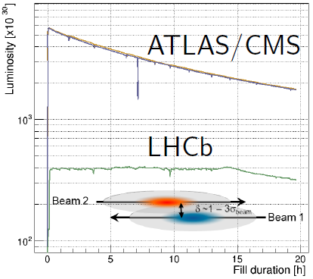
Expected LHCb luminosity evolution
2011 2012 2013 2014 2015 2016 2017 2018 2019 2020 2021 2022 2023 2024 2025 2026
LHC Run I LS1 LHC Run II LS 2 LHC Run III LS3 LHC Run IV
pp runs with LHC splice pp runs with LHC injector pp runs with HL-LHC prep
- 50ns bunch spacing consoli- - 25ns bunch spacing, upgrade - 25ns b.spacing GPD phase 2
- E_{CM} 7TeV and 8 TeV dation - E_{CM} 13 TeV LHCb - E_{CM} 14 TeV upgrades
LHCb L~4x10³²/cm²/s LHCb L>4x10³²/cm²/s upgrade L > 1x10³³/cm²/s L=2x10³³/cm²/s
LHCb ∫L ~3/fb LHCb ∫L >5/fb LHCb ∫L > 15/fb ∫L > 23/fb
LHCb up to 2018 → ~ 8 fb⁻¹:
find or rule-out large sources of flavour symmetry breaking at the TeV scale
~
LHCb upgrade → ≥ 50 fb⁻¹:
increase precision on quark flavour physics observables
aim at experimental sensitivities comparable to theoretical uncertainties

Slide 4
Flavour Physics and
LHCb upgrade plans
Flavour Physics at the LHC
Performance requirements and physics reach for the LHCb upgrade
Overview of the Trigger and Detector upgrades

Slide 5
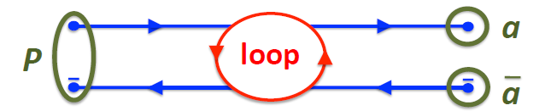
Reminder about Physics at the LHC
Precision measurements of Standard Model (SM) processes, including the Higgs Boson sector.
Search for Physics Beyond the SM (BSM) and Dark Matter candidates in high energy collisions. Two ways:
  Detect the existence of such particles directly (on-shell).
  Discover the indirect effects of new states via their virtual production in loop diagrams.
  Sensitive far beyond direct particle production reach

Slide 6
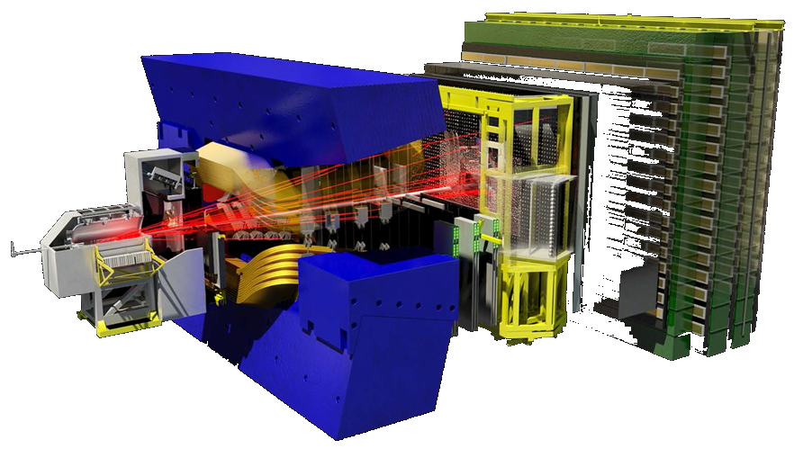
Flavour Physics with LHCb
Study CP violation and rare decays in the b and c-quark sectors
Search for deviations from the SM due to virtual contributions of new heavy particles in loop diagrams
Sensitive to new particles above the TeV scale not accessible to direct searches
RICH detectors
K/π/p separation
Vertex Detector
reconstruct vertices
decay time resolution: 45 fs
IP resolution: 20 μm
Muon system
μ identification
Tracking system
momentum resolution
Δp/p = 0.4%–0.6%
Calorimeters
energy measurement
e/γ identification
Dipole Magnet
bending power: 4 Tm

Slide 7
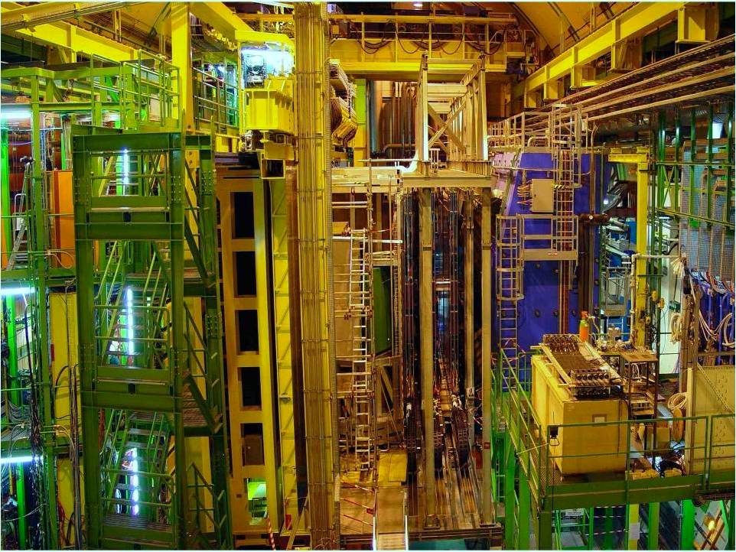

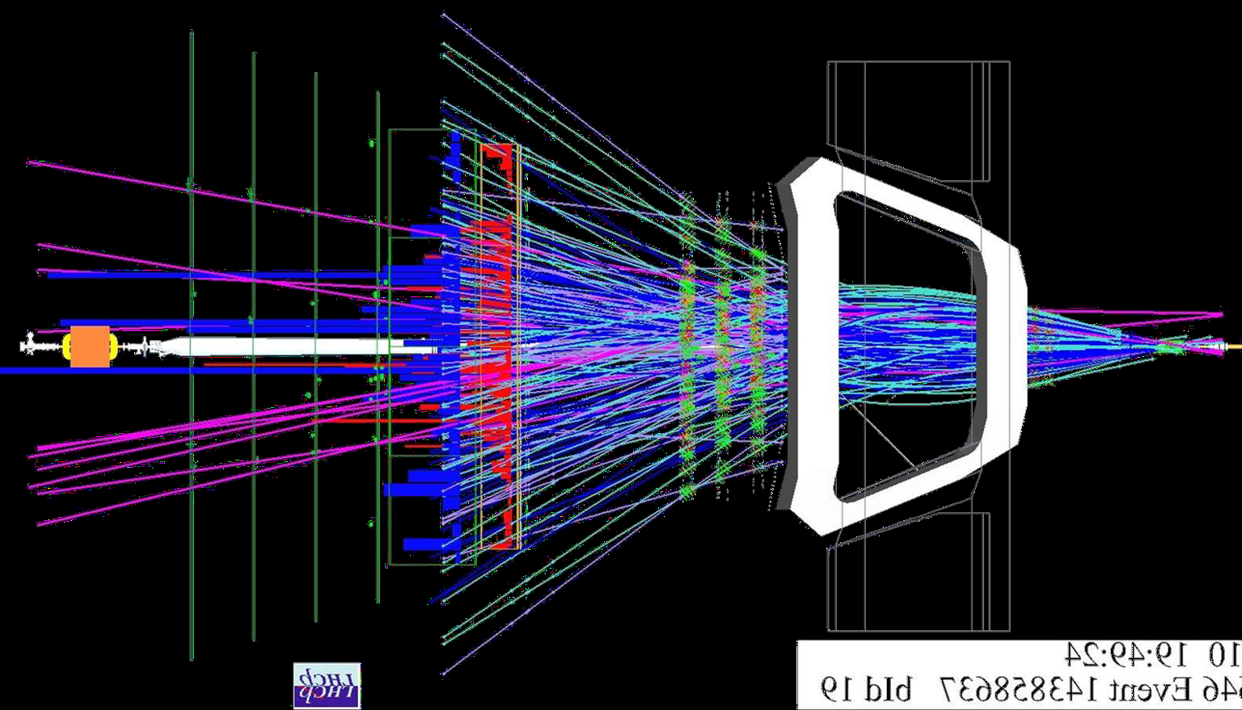
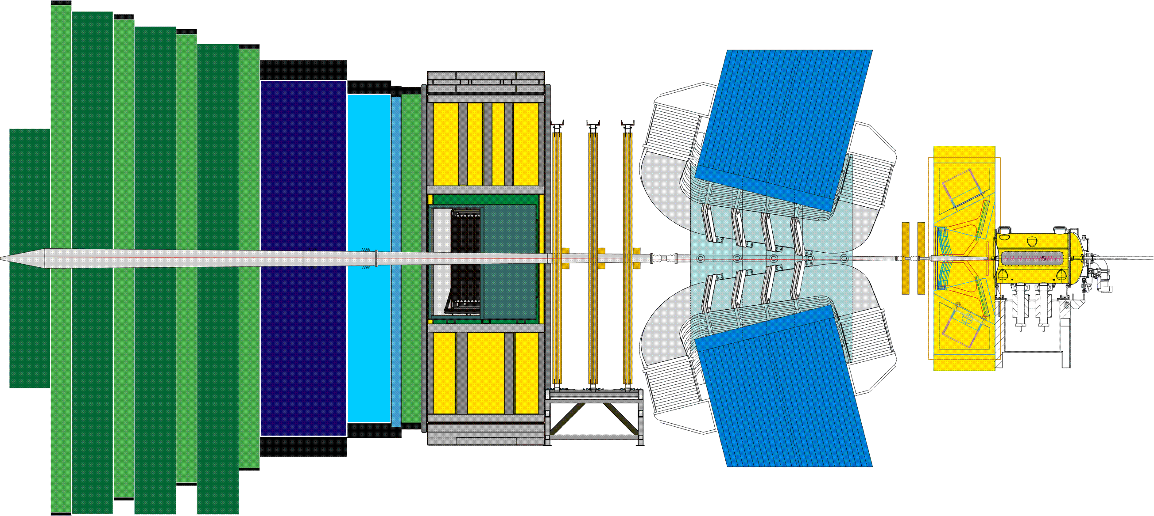
The LHCb Detector
Muon System
RICH Detectors
Vertex Locator
Interaction
Point
Calorimeters
Tracking System
23 sep 2010 19:49:24
Run 79646 Event 143858637

Slide 8
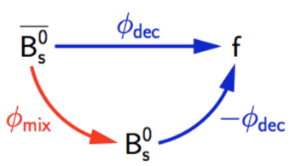
CP violation in the interference between decay and mixing
CP violating phase Φ_{s}= Φ_{mix} - 2Φ_{dec} in interference between decay and mixing in B_{s} decays.
Φ_{s} is expected to be very small
in the Standard Model:
Φ_{s} (SM) = -36.3 ± 16.0 mrad
  [Phys. Rev D84 (2011) 033055]
It will be difficult to measure it with this precision.
However, good channel to look for deviations from the SM

Slide 9
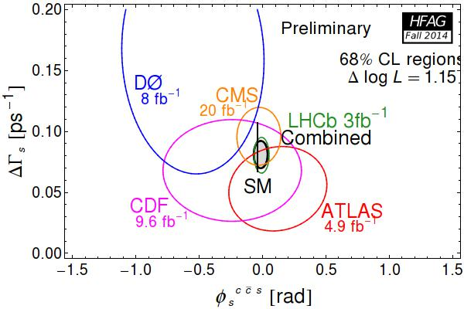
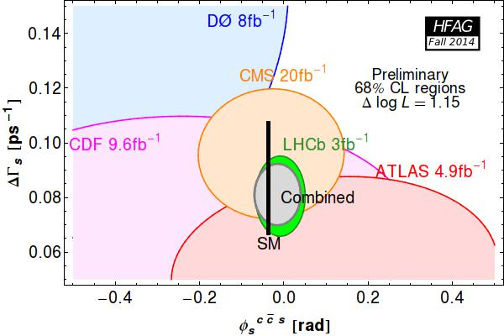
Combination of measurements
Zoom:
World average : Φ_{s} = -15 ± 36 mrad
Present uncertainty dominated by LHCb (Φ_{s} = -10 ± 40 mrad)
      No signs of discrepancy with SM expectations

Slide 10
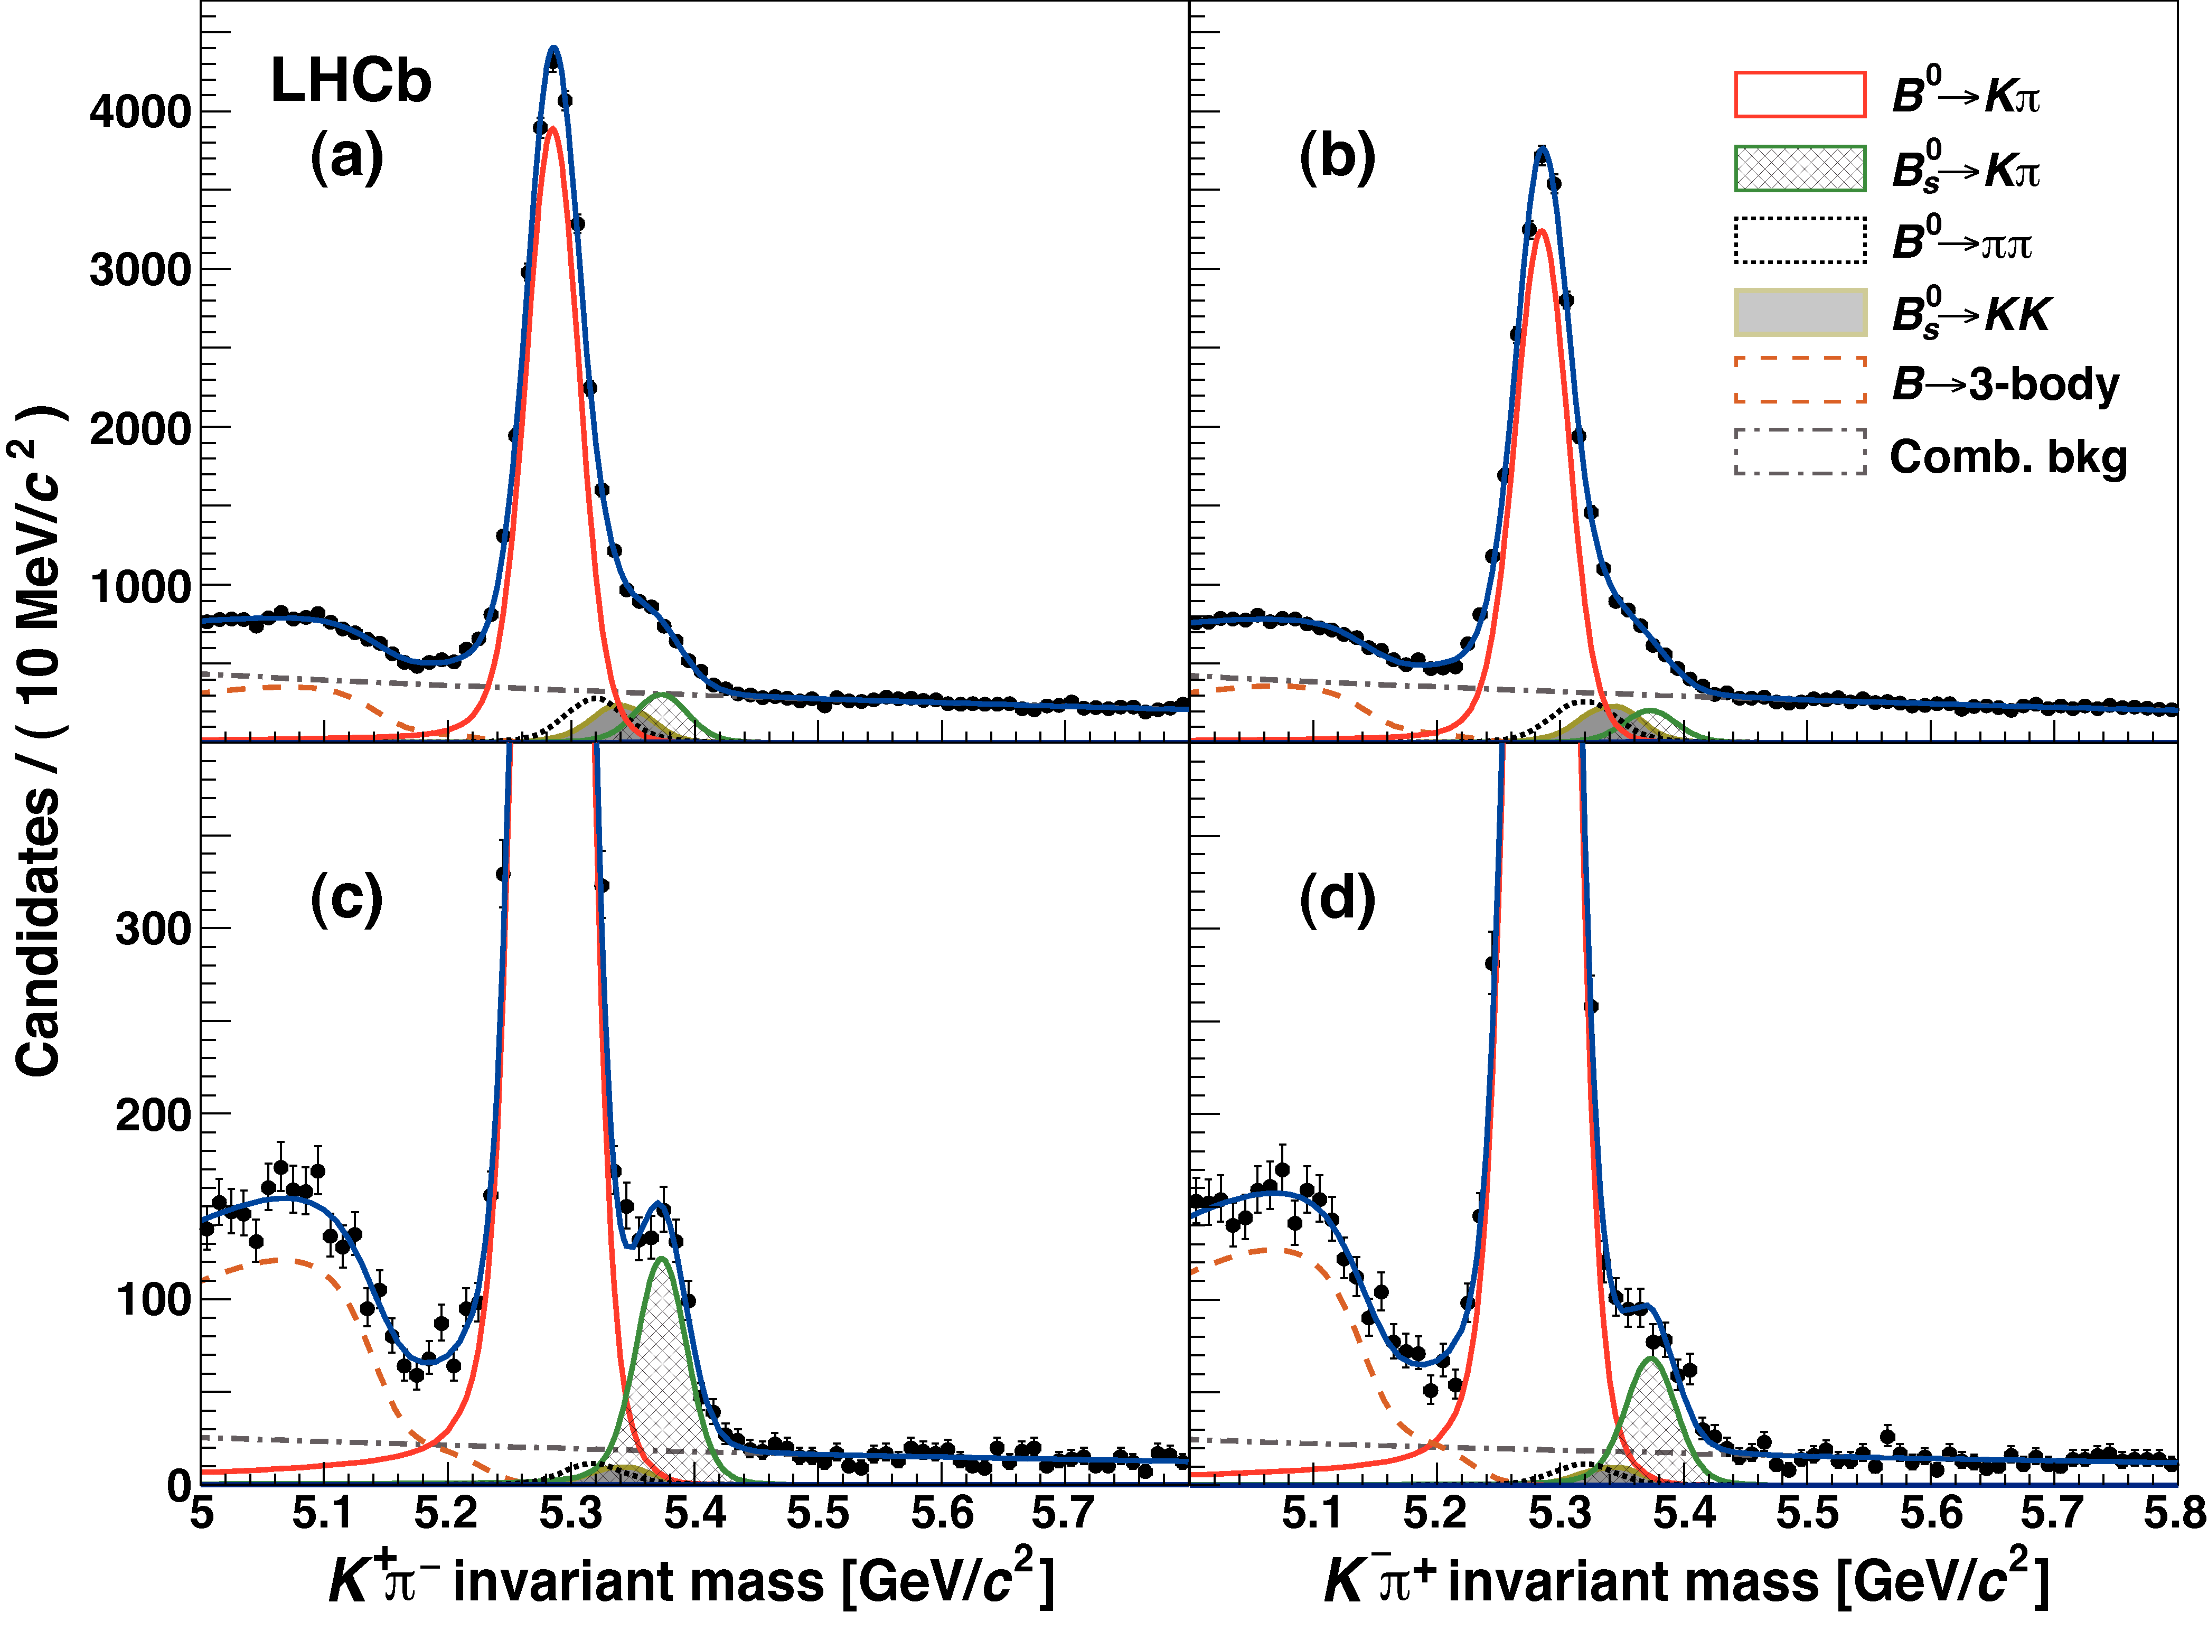
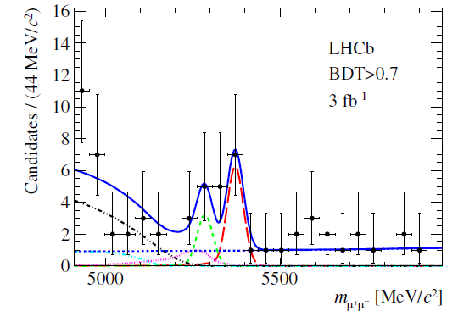
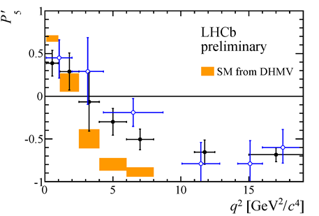
Some highlights of LHCb results
B_{S}⁰ → µ⁺µ ̶
PRL 111 (2013) 101805
1 fb⁻¹
JHEP 1308 (2013) 131
B⁰ → K*⁰μ⁺μ⁻
q₀² = 4.9 ± 0.9 GeV²/c⁴
Notes:
CP violating phase φs in Bs mixing
Zero crossing point of the Fwd Bwd asymmetry in B0→K*μ+μ- decays.

Slide 11
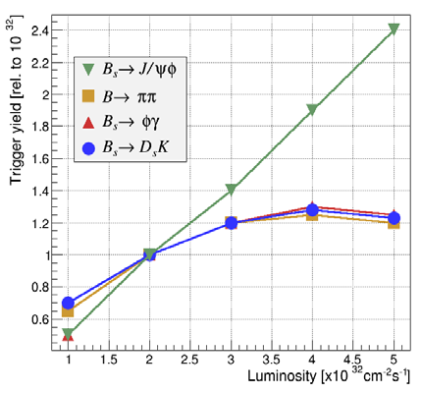
LHCb data-taking perspectives
Until 2018:
Running at 4x10³² cm⁻²s⁻¹ LHCb can collect ~ 1.5/fb per year
By 2018 we should have ~8/fb on tape or ~3x the Run I sample in terms of physics yields
Understanding New Physics phenomena will need more statistics
From 2020:
Run at 1-2 x10³³ cm⁻²s⁻¹ and collect 4-8/fb per year
To profit of an increase in luminosity, it is required to overcome the current hardware limitation of 1 MHz LO-trigger
LHCb 2012
At present:
Final states with muons → Linear gain
Hadronic final states → Yield flattens out
(E_{T} cut must be raised to stay within 1 MHz RO limit)
Information has to be introduced that is more discriminating than E_{T}.

Slide 12
Motivation for the LHCb upgrade
Present experimental status:
flavour changing processes are consistent with the CKM mechanism
large sources of flavour symmetry breaking are excluded at the TeV scale
the flavour structure of NP would be very peculiar at the TeV scale (MFV)
Why is the LHCb upgrade important:
measurable deviations from the SM are still expected, but should be small
need to go to high precision measurements to probe clean observables
→ LHCb upgrade essential to increase statistical precision significantly
Quark flavour physics main component, but physics program includes also:
  Lepton flavour physics
  Electroweak physics
  Exotic searches
  Heavy-ion physics
→ Reinforce LHCb as general purpose forward detector

Slide 13
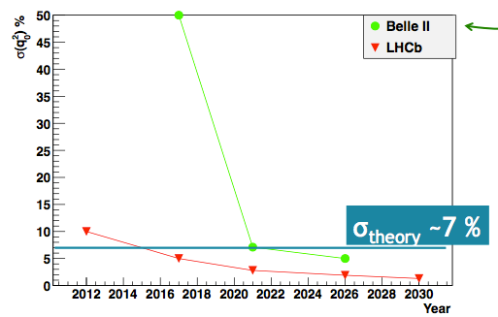
LHCb upgrade - expected precision
B_{s} mixing phase 𝜙_{s} from J/ψ 𝜙
q₀ from B→K*ll
CKM angle 𝛾 from trees
σ (BR(B_{s}→ µ⁺ µ⁻)/ BR(B_{d}→ µ⁺ µ⁻)

Slide 14
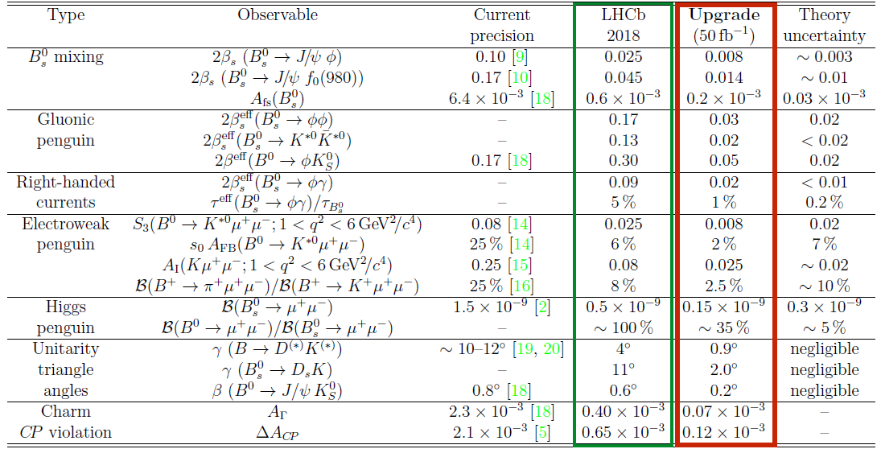
LHCb statistical sensitivity to flavour observables
Framework TDR for the LHCb Upgrade
CERN-LHCC-2012-007
Getting close to the theoretical uncertainties 8 fb⁻¹ up to 2018
≥ 50 fb⁻¹ for the upgrade
Notes:
Expected statistical uncertainties on a few selected physics channels before and after the upgrade, compared to theory.
CP violating observables, rare decays and fundamental parameters of the CKM unitary triangle.

Slide 15



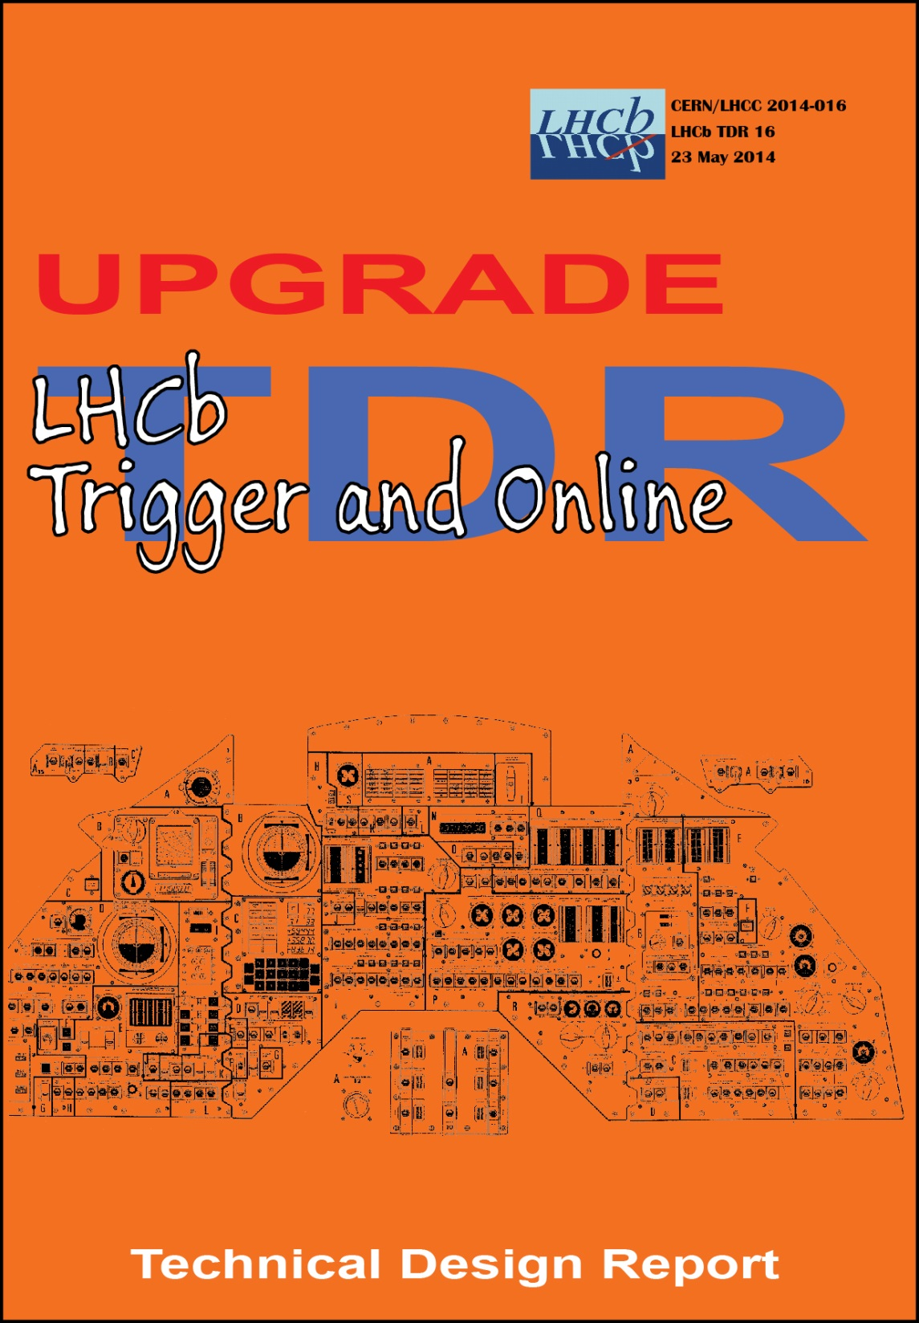
LHCb Upgrade TDRs
CERN-LHCC-2013-021
CERN-LHCC-2013-022
CERN-LHCC-2014-001
CERN-LHCC-2014-016
All TDRs have been approved by the CERN Research Board,
after having been recommended for approval by the LHCC.

Slide 16
LHCb Trigger Evolution
Valuable experience has been gained during Run I
A significantly improved trigger is used in Run II, testing concepts that will be used for the upgrade

Slide 17
Detector upgrade to 40 MHz R/O
upgrade ALL sub-systems to 40 MHz Front-End (FE) electronics
replace complete sub-systems with embedded FE electronics
adapt sub-systems to increased occupancies due to higher luminosity
keep excellent performance of sub-systems with 5 times higher luminosity
Calorimeters
Replace R/O
New VELO
(Vertex Locator)
IP
RICH Detectors:
Replace photodetectors and change RICH1 optics
New Tracking System
Muon System
Replace ODE

Slide 18
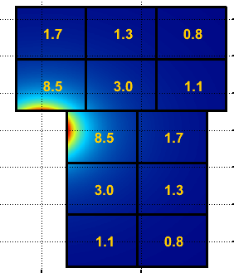
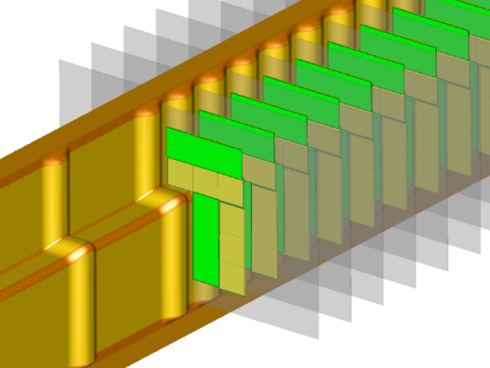
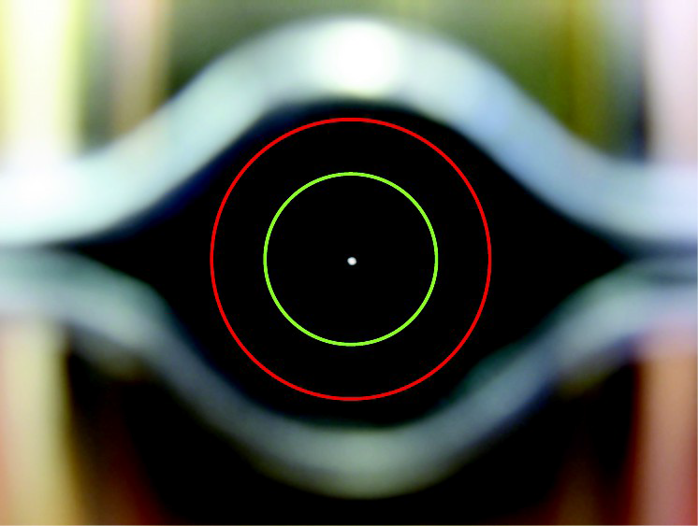
VELO upgrade
Upgrade challenge:
withstand increased radiation
(highly non-uniform radiation of up to 8∙10¹⁵ n_{eq}/cm² for 50 fb⁻¹)
handle high data volume
keep (improve) current performance
  lower materiel budget
  enlarge acceptance
Technical choices :
55x55 µm² pixel sensors with micro channel CO₂ cooling
40 MHz VELOPIX (130 nm technology )
replace RF-foil between detector and beam vacuum
  reduce thickness from 300 μm → ≤ 250 μm
move closer to the beam
  reduce inner aperture from 5.5 mm → 3.5 mm
tracks/chip/event at L=2∙10³³ cm⁻²s⁻¹
current inner aperture 5.5 mm
RF-foil
new aperture 3.5 mm
Notes:
8.5 tracks/chip/event correspond to a data-rate of 15 Gbit/s (no buffering).

Slide 19
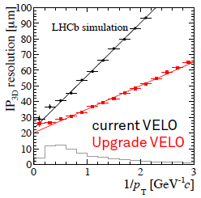
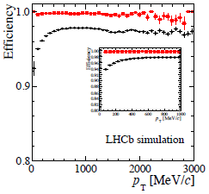
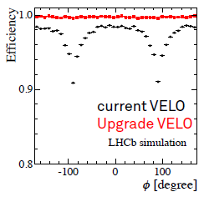
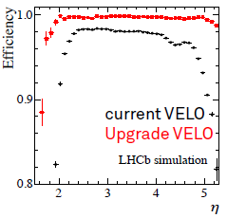
VELO upgrade performance
better impact parameter resolution due to reduced material budget
reduced ghost rate
improved efficiency over p_{T}, 𝜙, 𝜂
3D IP resolution at
L = 2∙10³³ cm⁻²s⁻¹
note: full GEANT Monte Carlo with standard LHCb simulation framework

Slide 20
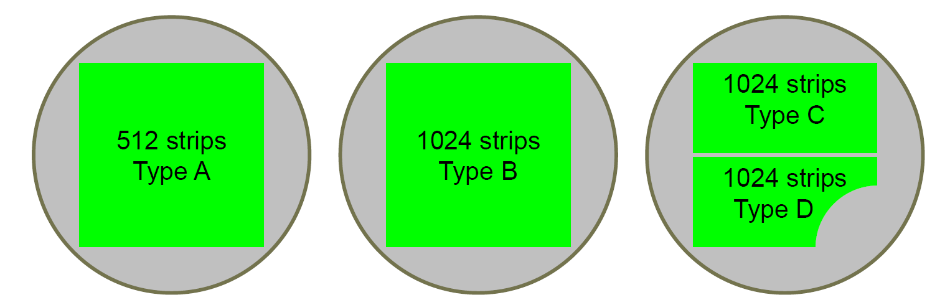
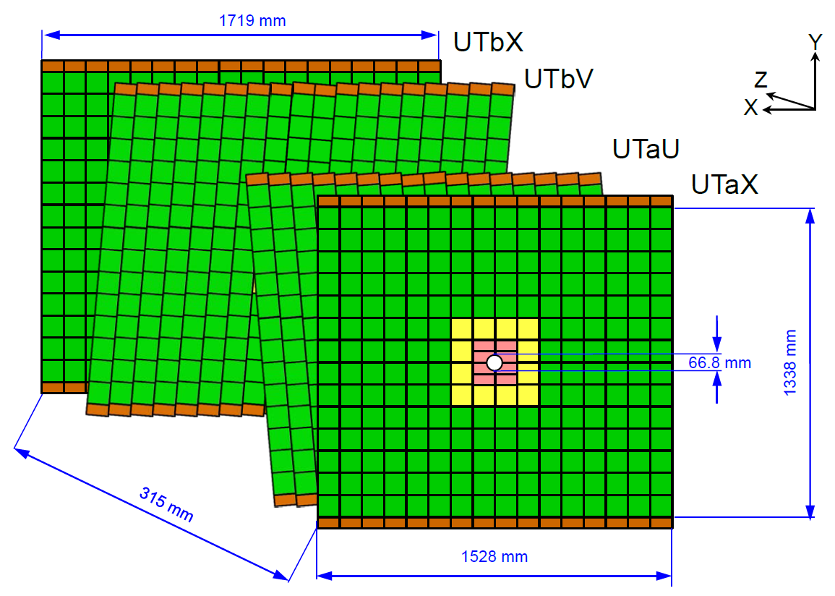
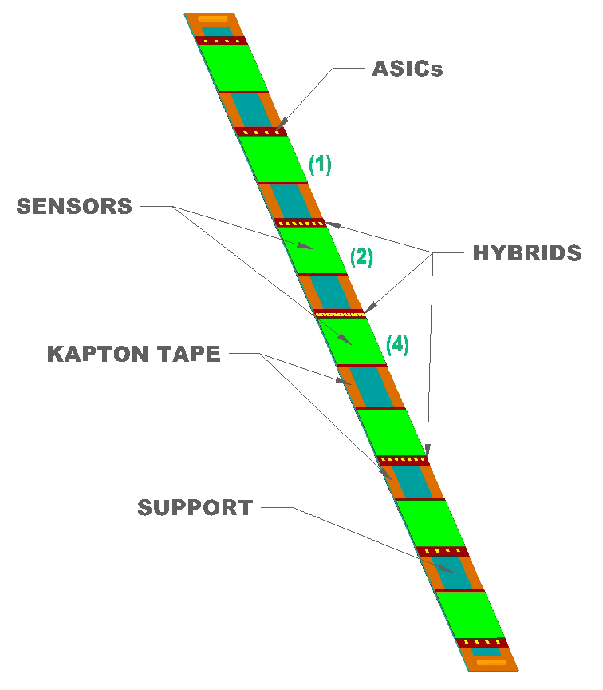
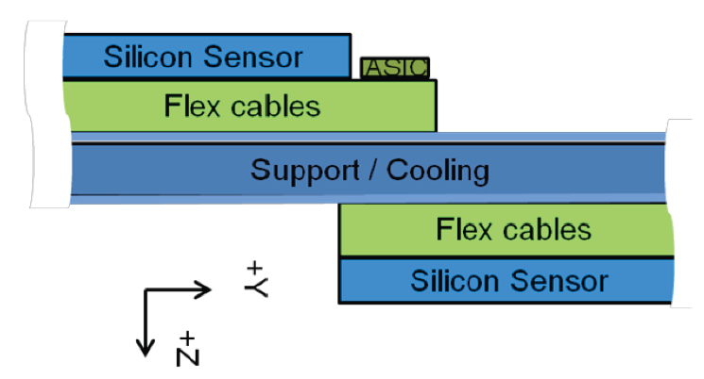
TT upgrade: Upstream Tracker (UT)
silicon strip detector
adapt segmentation to varying occupancies (out → in-side):
outer
middle
inner
98 → 49 mm long strips
190 → 95 µm pitch
p⁺-in-n → n⁺-in-p
40MHz silicon strip R/O → SALT chip
GBT
KAPTON TAPE
SUPPORT
GBT
40MHz silicon strip R/O → SALT chip

Slide 21
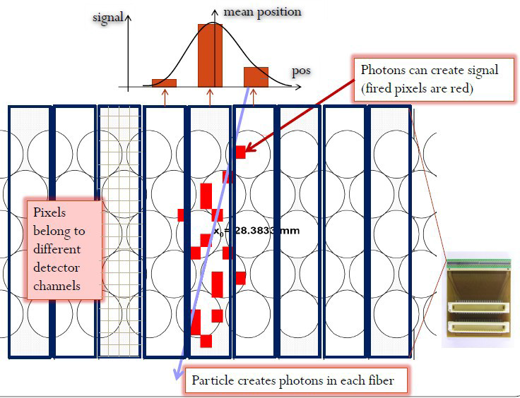
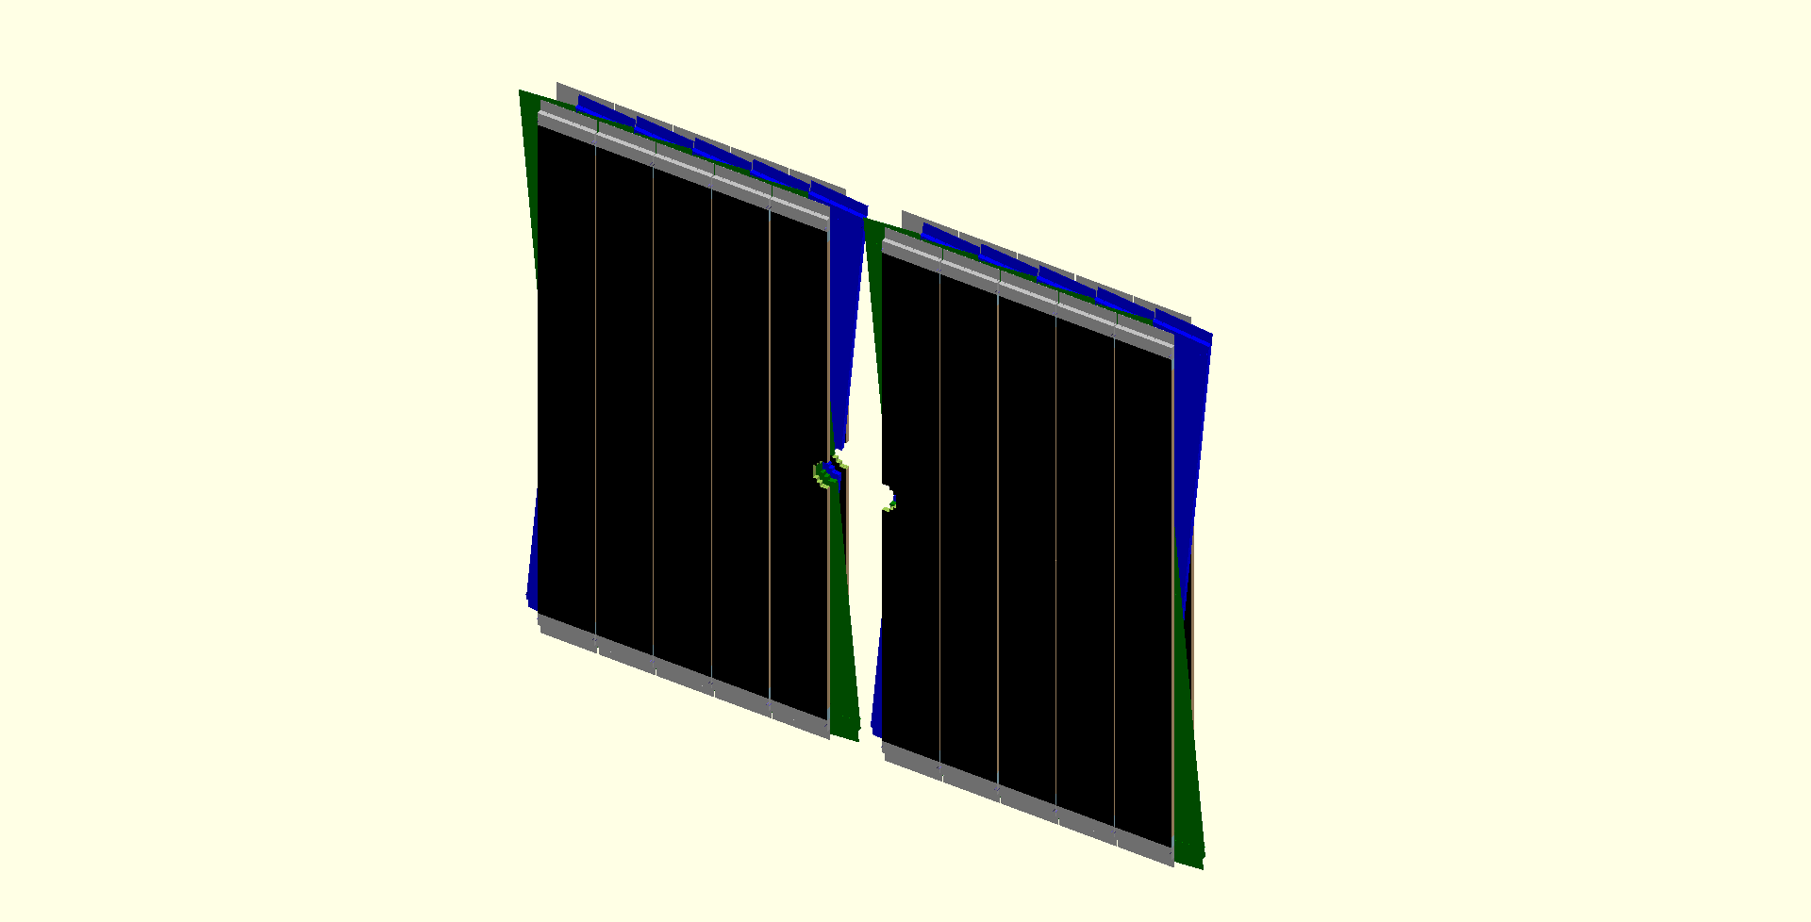
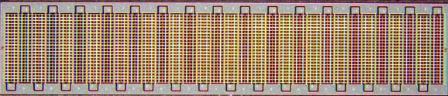
T-stations upgrade: Fibre Tracker
3 stations of X-U-V-X (±5º stereo angle) scintillating fibre planes
every plane made of 5 layers of Ø=250 µm fibres, 2.5 m long
40 MHz readout and Silicon PMs at periphery
Scint.-fibre mat (5-6 layers)
SiPM readout
2 x ~ 2.5 m
fibre ends
mirrored
1.25 mm
SiPM readout
1 SiPM channel
SiPM array
2 x ~3 m
Benefits of SciFi concept:
a single technology to operate
uniform material budget
SiPM + infrastructure outside accept.
x-position resolution of 50 – 75 µm
fast pattern recognition for HLT
Challenges: radiation environment
ionization damage to fibres → tested ok
neutron damage to SiPM → operate at -40ºC
large size – high precision, O(10’000 km) of fibres
Notes:
Photons create signal, fired pixels are red

Slide 22
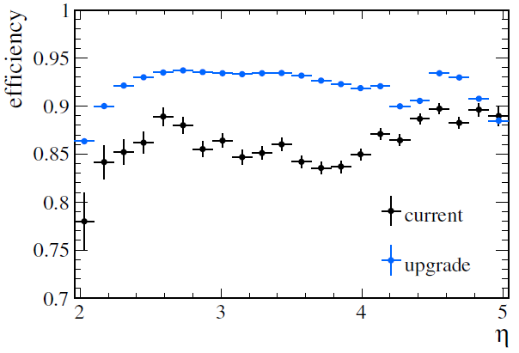
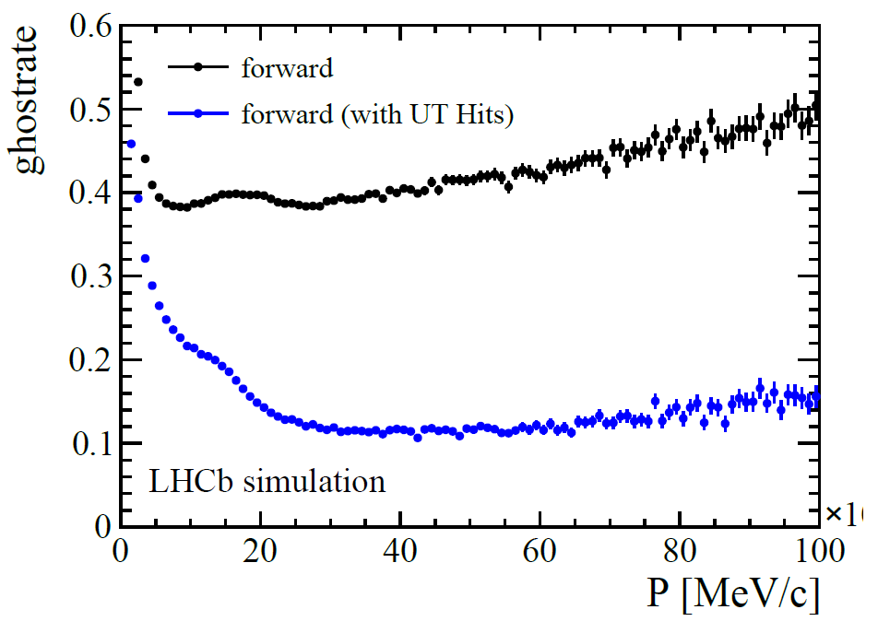
Tracking performance
Efficiency for B_{s} → ΦΦ events:
upgrade conditions,
current and upgraded T-stations
Ghost rate for B_{s} → ΦΦ events:
long tracks without UT and
with UT (≥ 3hits)
OT
IT
SciFi
without UT
with UT
improve tracking performance at upgrade luminosity with Fibre Tracker
reduce significantly the ghost rate using the Upstream Tracker information
Notes:
Left plot illustrates the superior performance of the SciFi Tracker compared to the OT.
Adding UT hits has the advantage that the momentum resolution improves significantly.
Moreover, the requirement to have at least three UT hits reduces the ghost rate while keeping the efficiency.

Slide 23
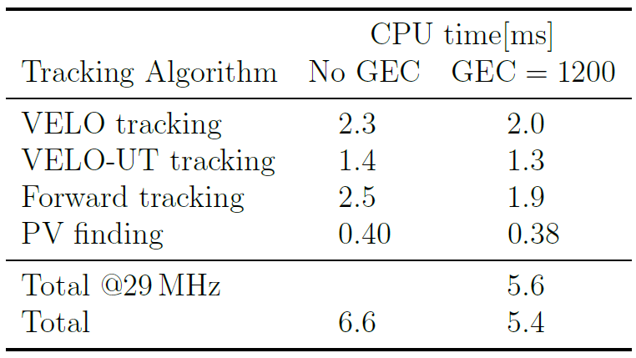
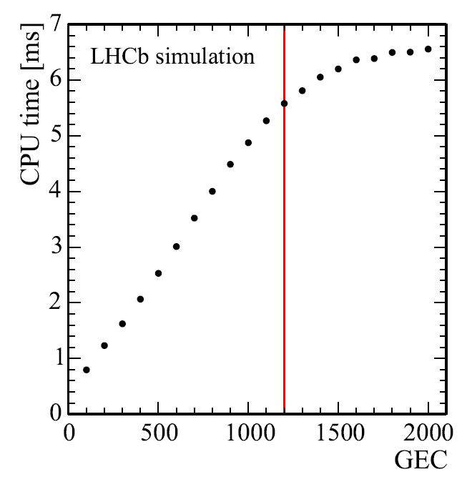
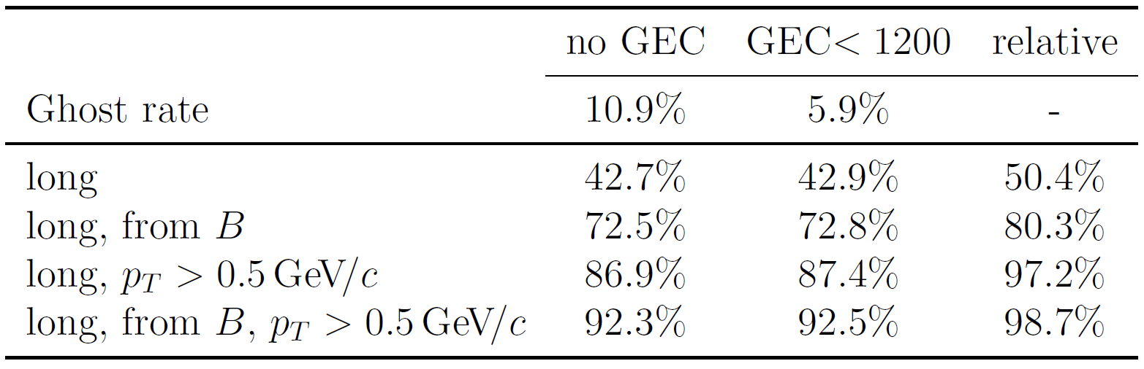
Tracking algorithm for the Trigger
Expected CPU budget with upgraded Event Filter Farm:
~13 ms (10 x current CPU farm)
Performance of HLT tracking with upgraded VELO, UT and FT:
GEC (Global Event Cut) → multiplicity cut to remove pathological events (e.g. hit multiplicity of sub-detector)
ms
→ leaves ~ 6-7 ms for a trigger decision
→ high efficiency (even with GEC)
Notes:
Bottom table: track finding efficiencies.
B-daughter tracks have pT more than 500MeV.
Relative means relative to offline.

Slide 24
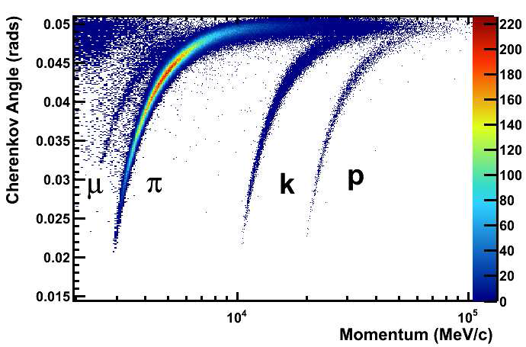
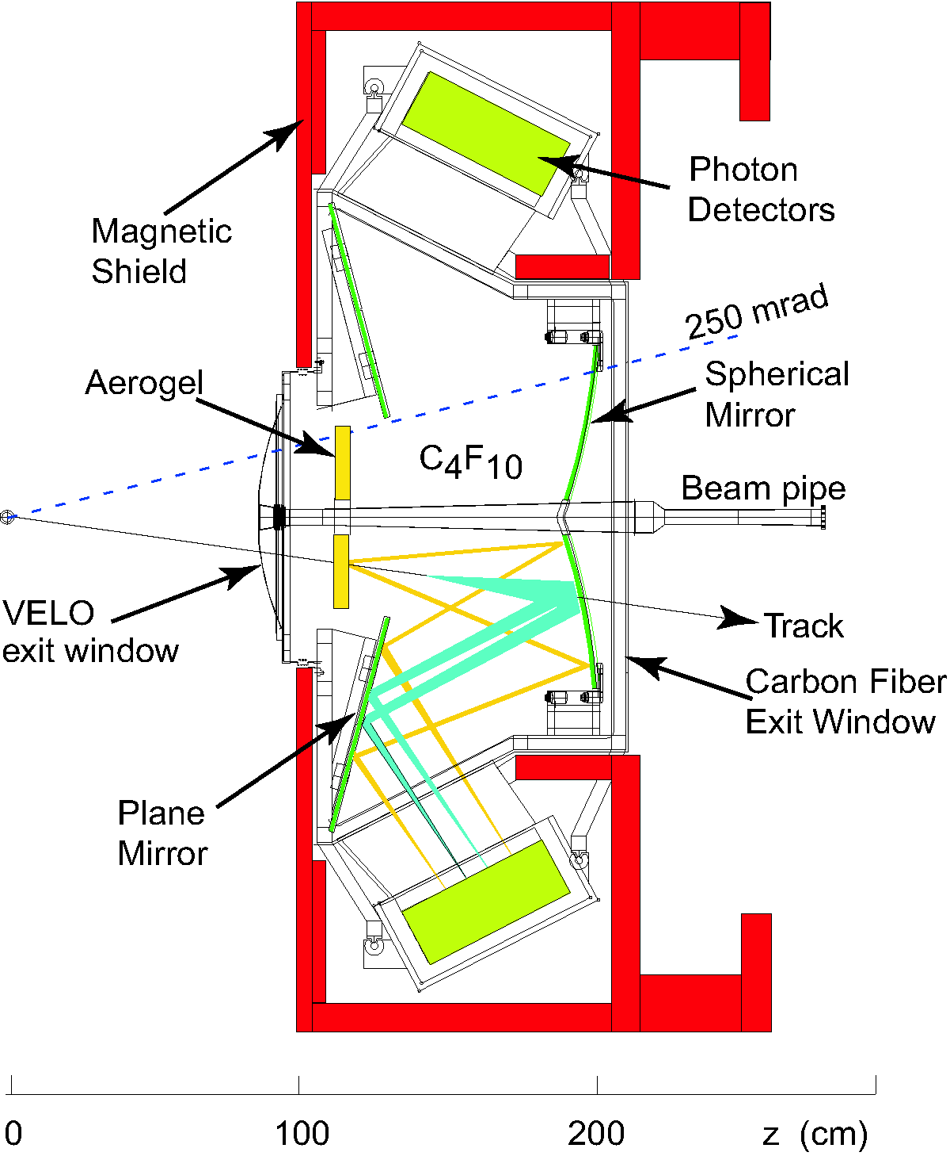
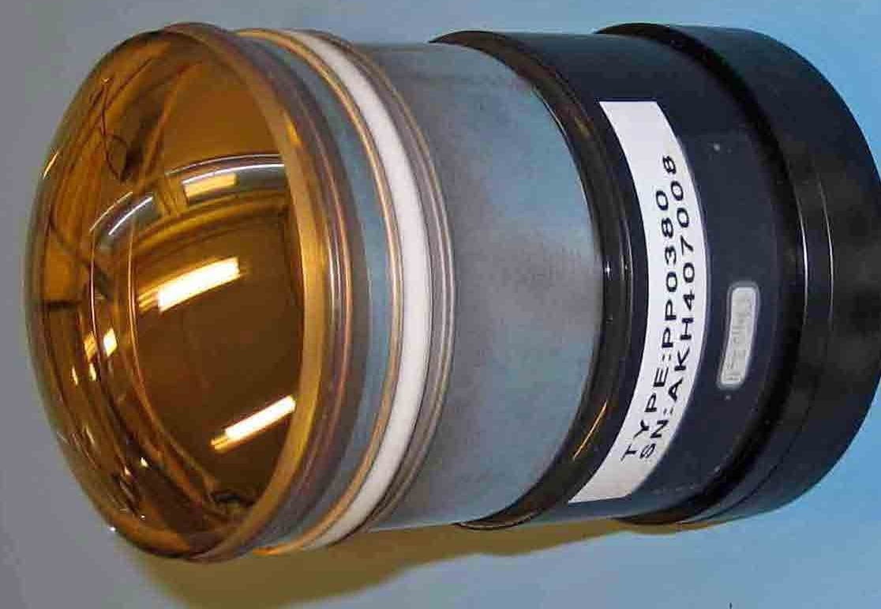
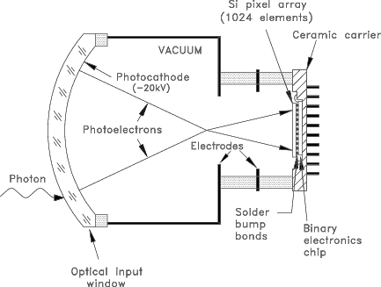
RICH upgrade
Particles traversing radiator produce Cherenkov light on an array of photon detectors located outside the acceptance
Maintain excellent charged particle ID
RICH 1 optimized to reduce hit occupancy
RICH 1
C₄F₁₀
Eur. Phys. J. C (2013) 73:2431
Replace RICH photon detector:
MaPMT
Hybrid Photon Detector
HPDs
with embedded 1 MHz R/O chip
Notes:
Reconstructed Cherenkov angle as a function of track momentum in the C4F10 radiator

Slide 25
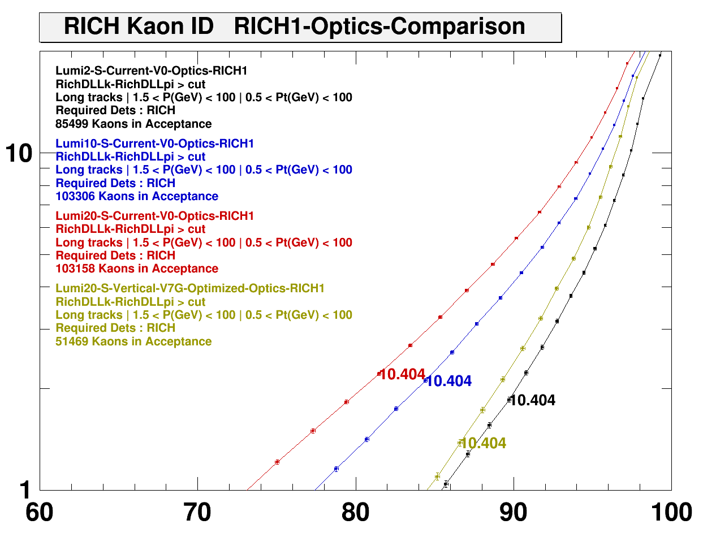
RICH upgrade performance
as function of luminosity
Current RICH1
2∙10³² cm⁻²s⁻¹
10∙10³² cm⁻²s⁻¹
20∙10³² cm⁻²s⁻¹
RICH1 upgrade
20∙10³² cm⁻²s⁻¹
Pion misidentification efficiency [%]
note:
full GEANT MC with standard LHCb simulation framework
Kaon identification efficiency [%]

Slide 26
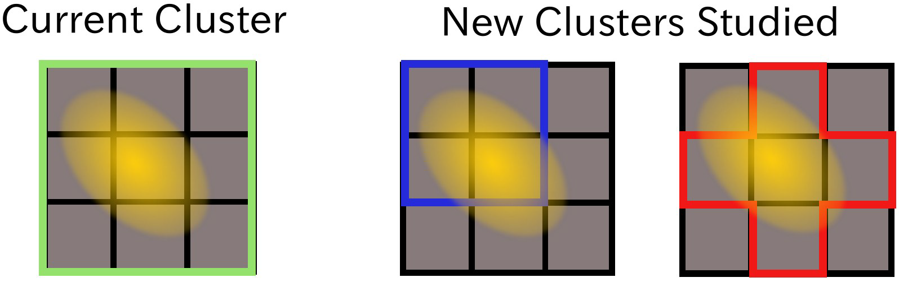
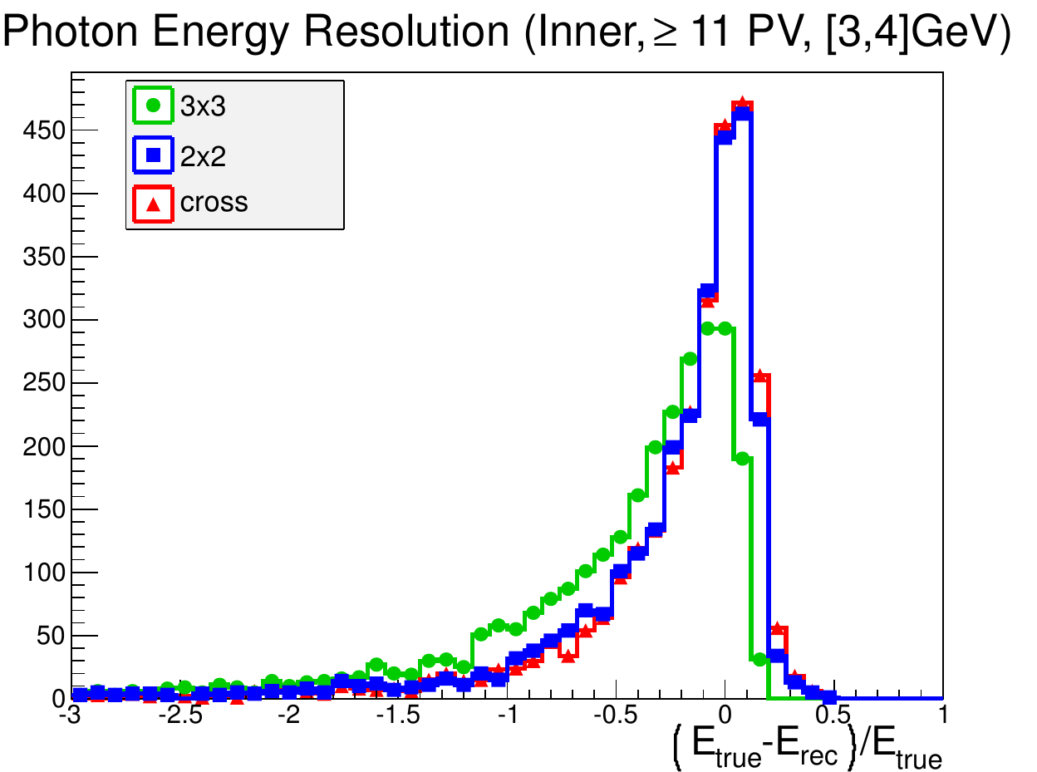
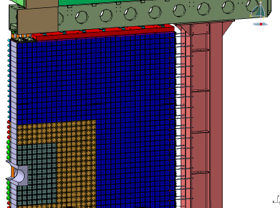
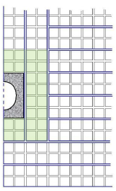
Calorimeter upgrade
40 MHz readout electronics:
reduce photomultiplier gain
adopt electronics
Impact of pile-up on the energy /
position measurement:
Change the reconstruction and define
smaller clusters
Radiation damage on detectors:
Preshower and SPD removed
HCAL modules ok up to ~50 fb⁻¹
irradiation tests show that most exposed ECAL modules resist up to ~20 fb⁻¹ → LS3
Innermost ECAL modules around beam-pipe can be replaced

Slide 27
Muon System upgrade
Modifications due to higher luminosity and 40 MHz readout:
  remove M1 due to too high occupancies
  additional shielding behind HCAL to reduce the rate in the inner region of M2
  keep on-detector electronics (CARIOCA); already at 40 MHz readout
  new off-detector electronics for an efficient readout via PCIe40 R/O boards
on-detector electronics
off-detector electronics

Slide 28
Conclusion Lecture IV
LHCb is producing world best measurements in the b- and c-quark sector due to its excellent detector performance.
By 2018 with ~8 fb⁻¹ LHCb will find or rule-out large sources of flavour symmetry breaking at the TeV scale.
The LHCb upgrade is mandatory to reach experimental precisions of the order of the theoretical uncertainties.
An efficient and selective software trigger with access to the full detector information at every 25 ns bunch crossing will allow to collect the necessary ≥50 fb⁻¹ within ~10 years.
The LHCb upgrade is fully approved, with the last TDR under review.
The detector upgrade to 40 MHz readout sustaining a levelled luminosity of 2 x 10³³ cm⁻²s⁻¹ at 25 ns bunch spacing is under preparation, to be operational at the beginning of 2021.

