Slide 1

High-Luminosity upgrade of the LHC
Physics and Technology Challenges for the Accelerator and the Experiments
Burkhard Schmidt, CERN

Slide 2
Outline
Lecture I
  Physics Motivation for the HL-LHC
Lecture II
  An overview of the High-Luminosity upgrade of the LHC
Lecture III
  Performance requirements and the upgrades of ATLAS and CMS
Lecture IV
  Flavour Physics and the upgrade of LHCb
Lecture IV
  Heavy-Ion Physics and the ALICE upgrade
Lecture VI
  Challenges and developmets in detector technologies, electronics and computing

Slide 3
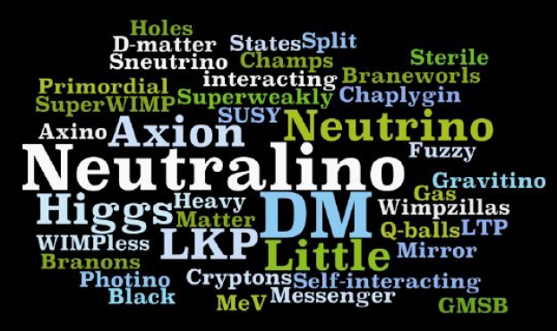
Fundamental questions in Particle Physics
Why is the Higgs boson so light ?
(so-called “naturalness” or “hierarchy” problem) ?
What is the nature of the matter-antimatter
asymmetry in the Universe ?
Why is Gravity so weak ?
Are there additional (microscopic) dimensions
responsible for its “dilution” ?
What is the nature of Dark Matter and Dark Energy ?
The answers to some of the above questions could well lie at the TeV scale whose exploration only started … 3000 fb⁻¹ are crucial in several cases
The Higgs sector (and Electroweak Symmetry Breaking mechanism):
the least known component (experimentally) of the Standard Model
A lot of work needed to understand if it is the minimal mechanism predicted by the SM
The STRONG physics case for the HL-LHC with 3000 fb⁻¹ comes from the importance of exploring the TeV scale as much as we can with the highest-Energy facility we have today.

Slide 4
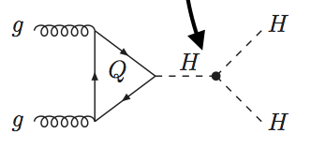
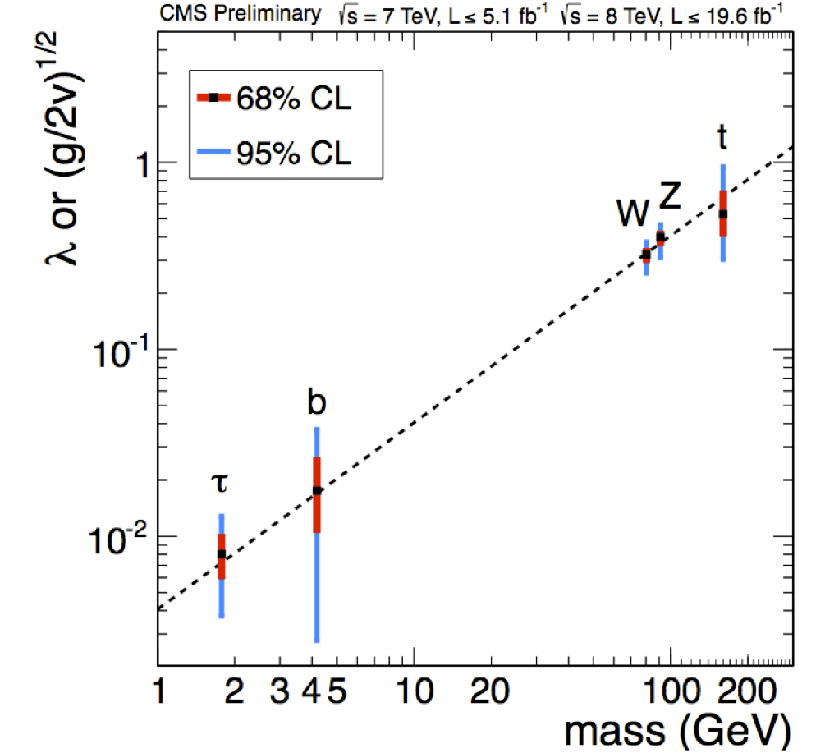
Physics reach at 3000 / fb
Gain precision on Higgs-couplings
Measure Higgs-self couplings
And of course:
  Precision measurement of SM rare processes
  Access to small cross section SUSY processes

Slide 5
HL-LHC luminosity goals
Estimate based on expected bunch intensities and virtual peak luminosities,
  160 days of physics production
  η ≥ 35% machine efficiency (luminosity production)
“Ultimate” levelling:
  7.5 x 10³⁴ (Hz/cm²)
  ~200 PU
“Nominal” levelling:
  5 x 10³⁴ (Hz/cm²)
  ~140 PU

Slide 6
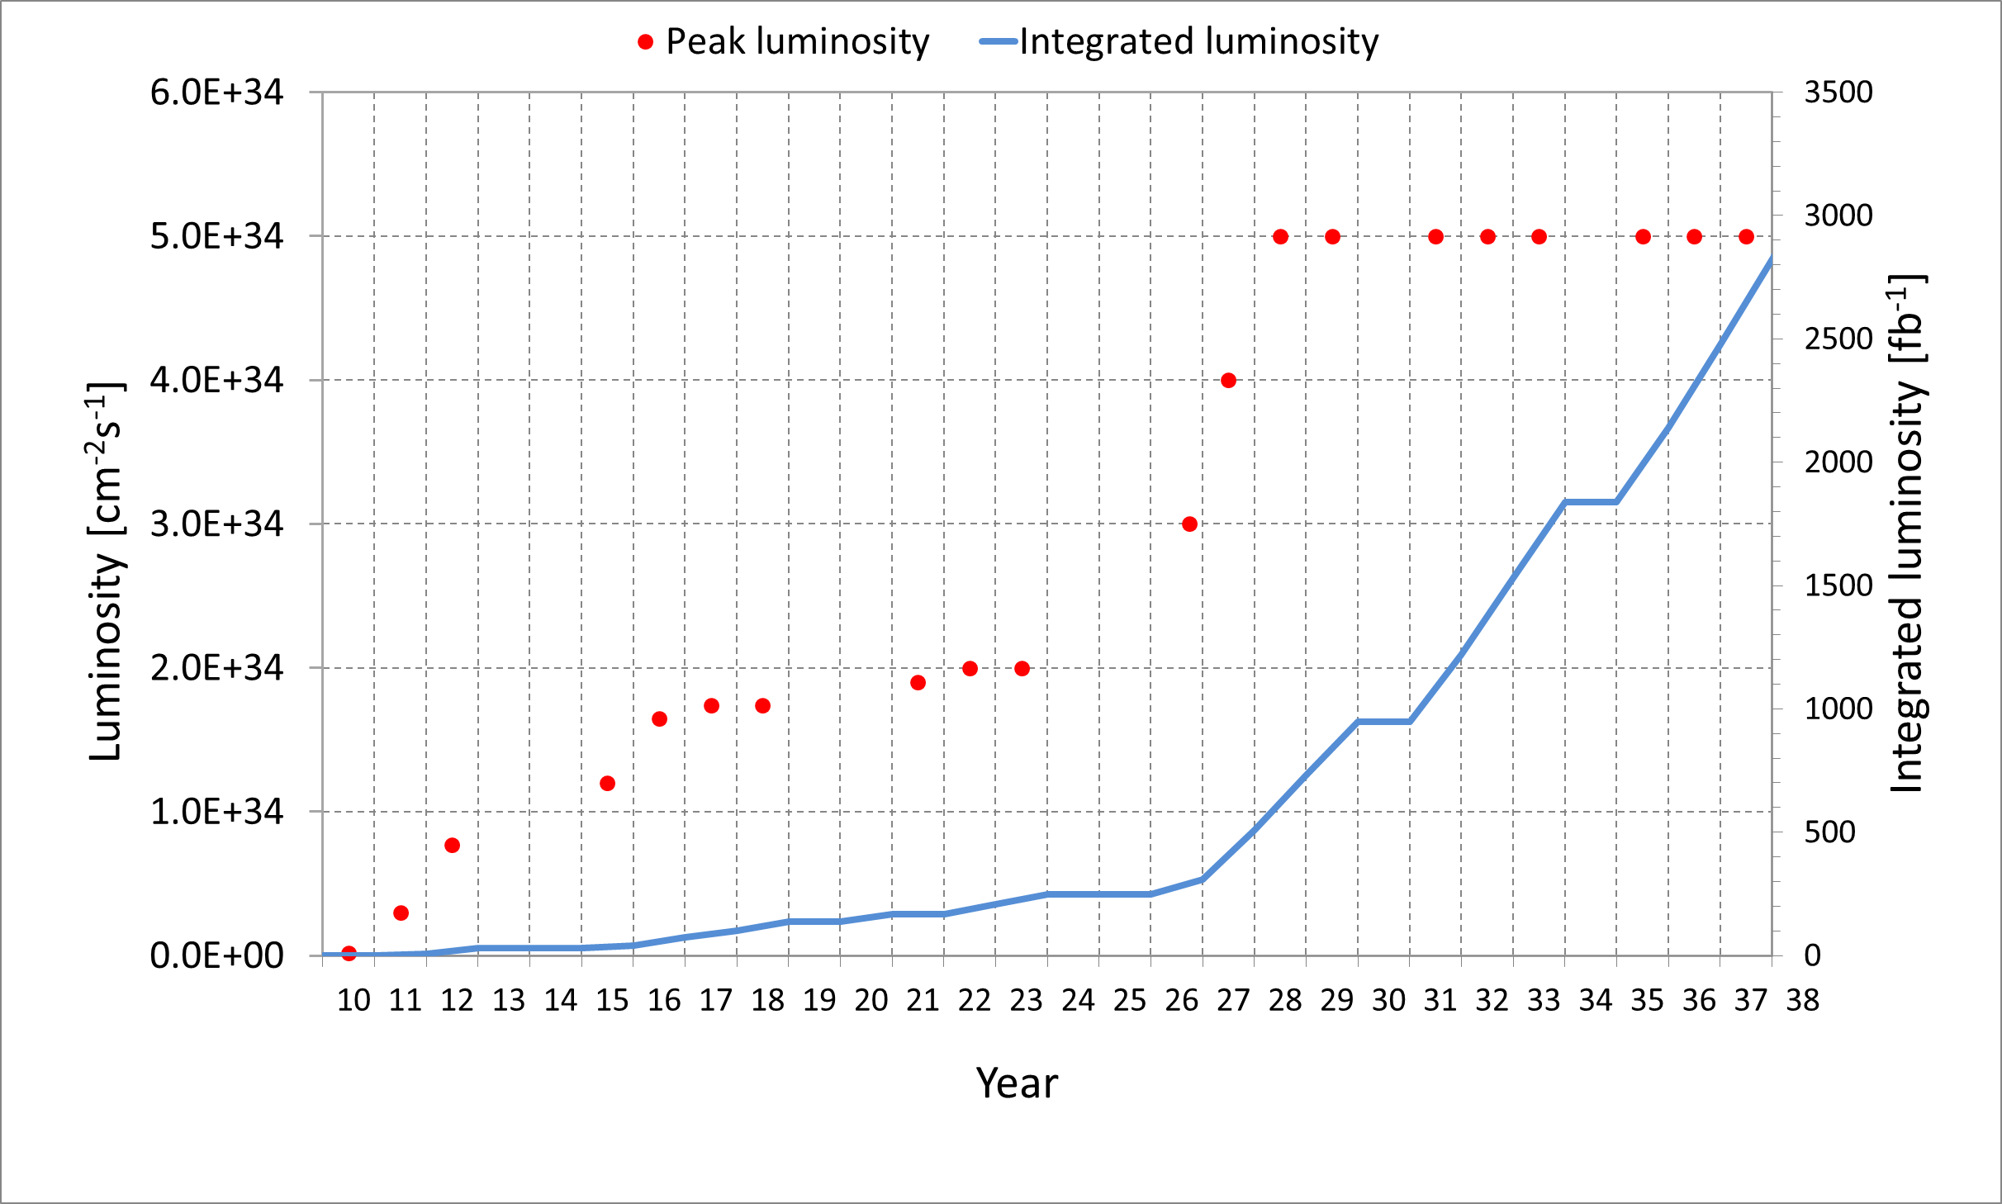
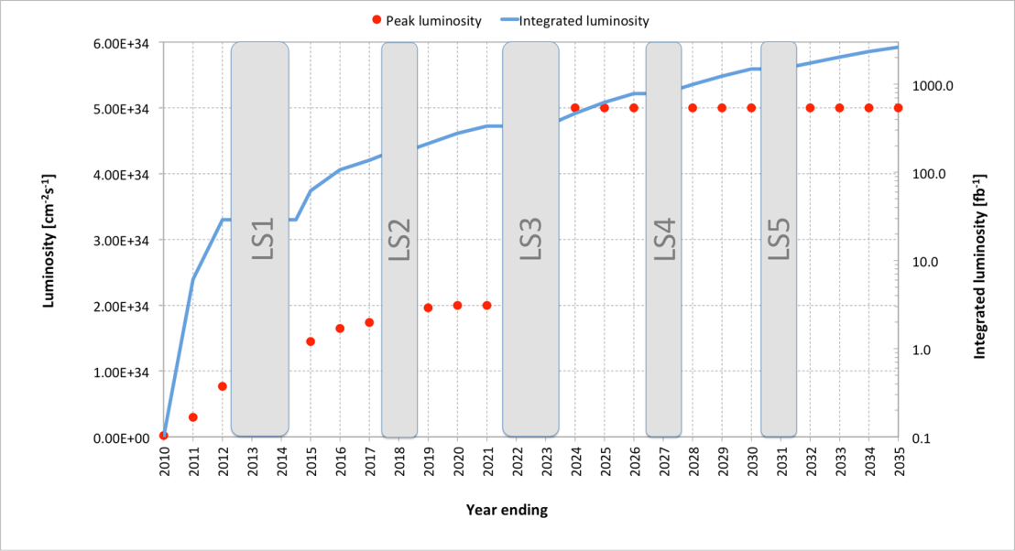
Long Term LHC Schedule
PHASE I Upgrade
ALICE, LHCb major upgrade
ATLAS, CMS ‚minor‘ upgrade
- LHC Injector Upgrade
- Heavy IonLuminosity
from 10²⁷ to 7 x 10²⁷
LS1
LS3
LS2
LS4
LS5
PHASE II Upgrade
ATLAS, CMS major upgrade
HL-LHC, pp luminosity
from 2 x 10³⁴ (peak) to 5 x 10³⁴ (levelled)

Slide 7
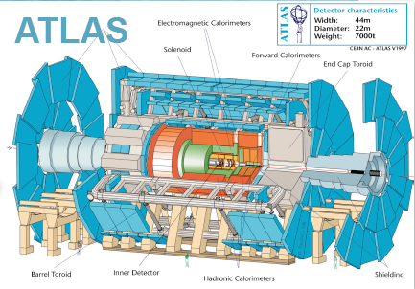
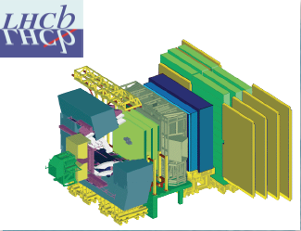
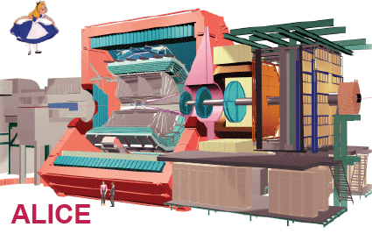
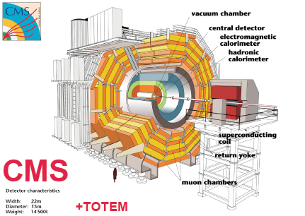
The LHC Detectors
ATLAS
7000 ton
l = 46m
D = 22m
ATLAS and CMS are General Purpose
Detectors (GPD) for data-taking at high
Luminosity.
LHCb is specialized on the study of
particles containing b- and c- quarks
CMS
12500 ton
l = 22m
d = 15m
ALICE Detector is optimized for the
Study of Heavy Ion physics.

Slide 8
CMS upgrade plans

Slide 9
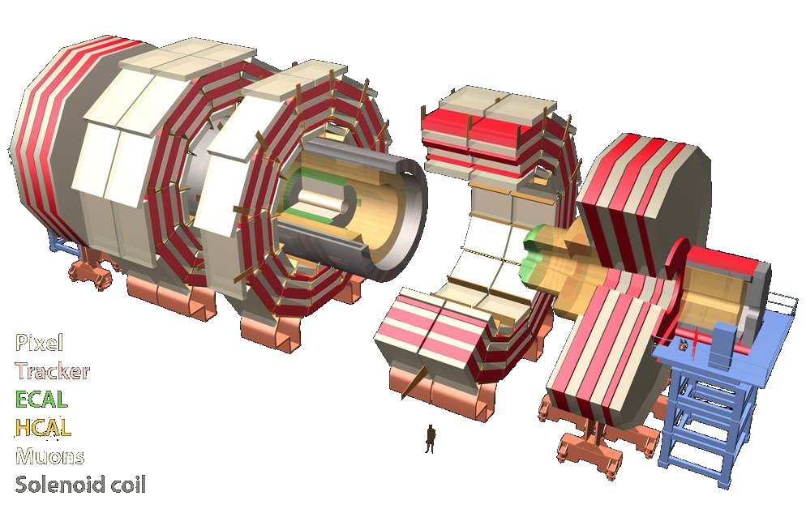
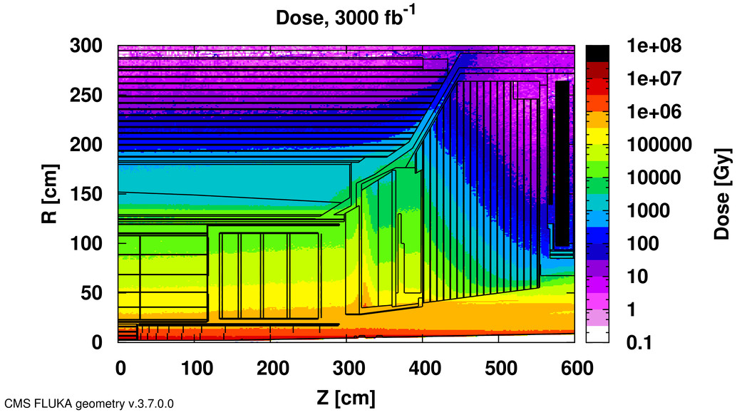
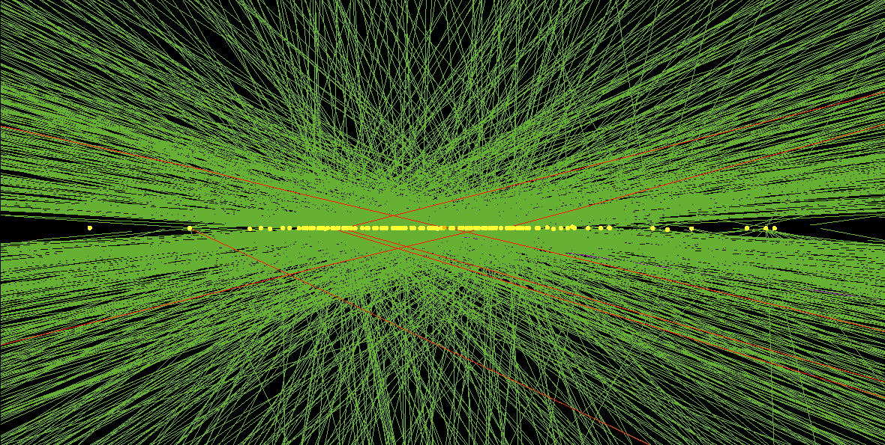
The HL-LHC – a challenging environment
Radiation
  Ionizing dose
  Neutron fluences up to 2 x 10¹⁶ n/cm² in pixels
Pileup
  140 average simultaneous interactions (many events with > 180)
Simulated Event Display at 140 PU (102 Vertices)

Slide 10
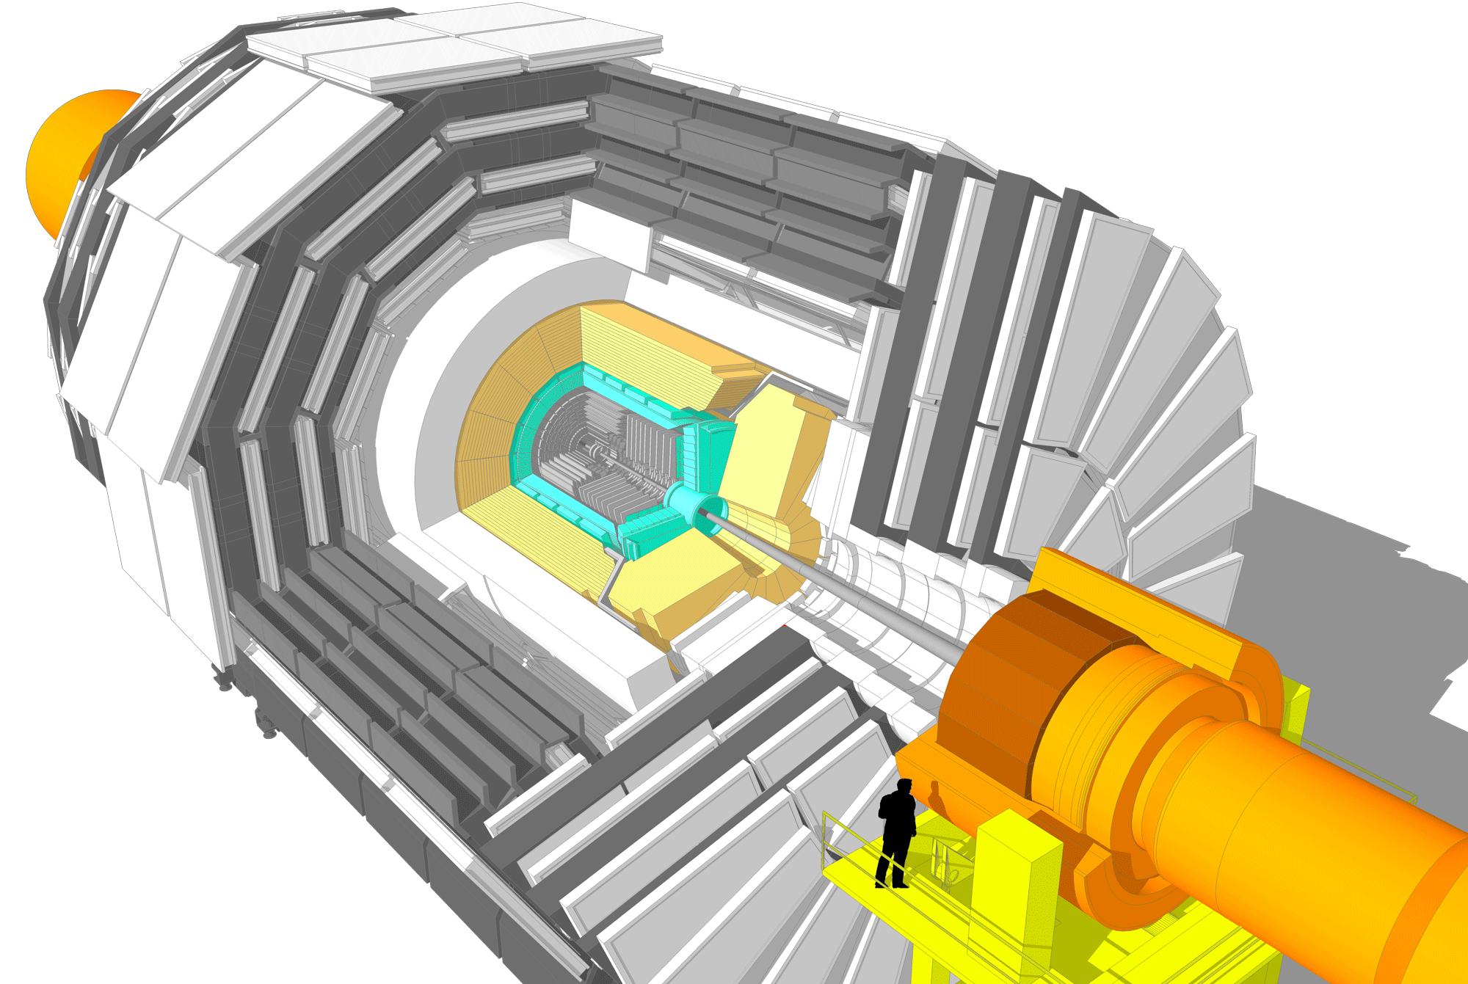
CMS upgrade plans
New Tracker
Radiation tolerant - high granularity - less material
Tracks in hardware trigger (L1)
Coverage up to η ∼ 4
Muon System
Replace DT FE electronics
Complete RPC coverage in forward region (new GEM/RPC technology)
Investigate Muon-tagging up to η ∼ 3
New Endcap Calorimeters
Radiation tolerant
High granularity
Barrel ECAL
Replace FE electronics
Cool detector/APDs
Trigger/DAQ
L1 (hardware) with tracks
and rate up ∼ 750 kHz
L1 Latency 12.5 µs
HLT output rate 7.5 kHz
Other R&D
Fast-timing for in-time pileup suppression
Pixel trigger

Slide 11
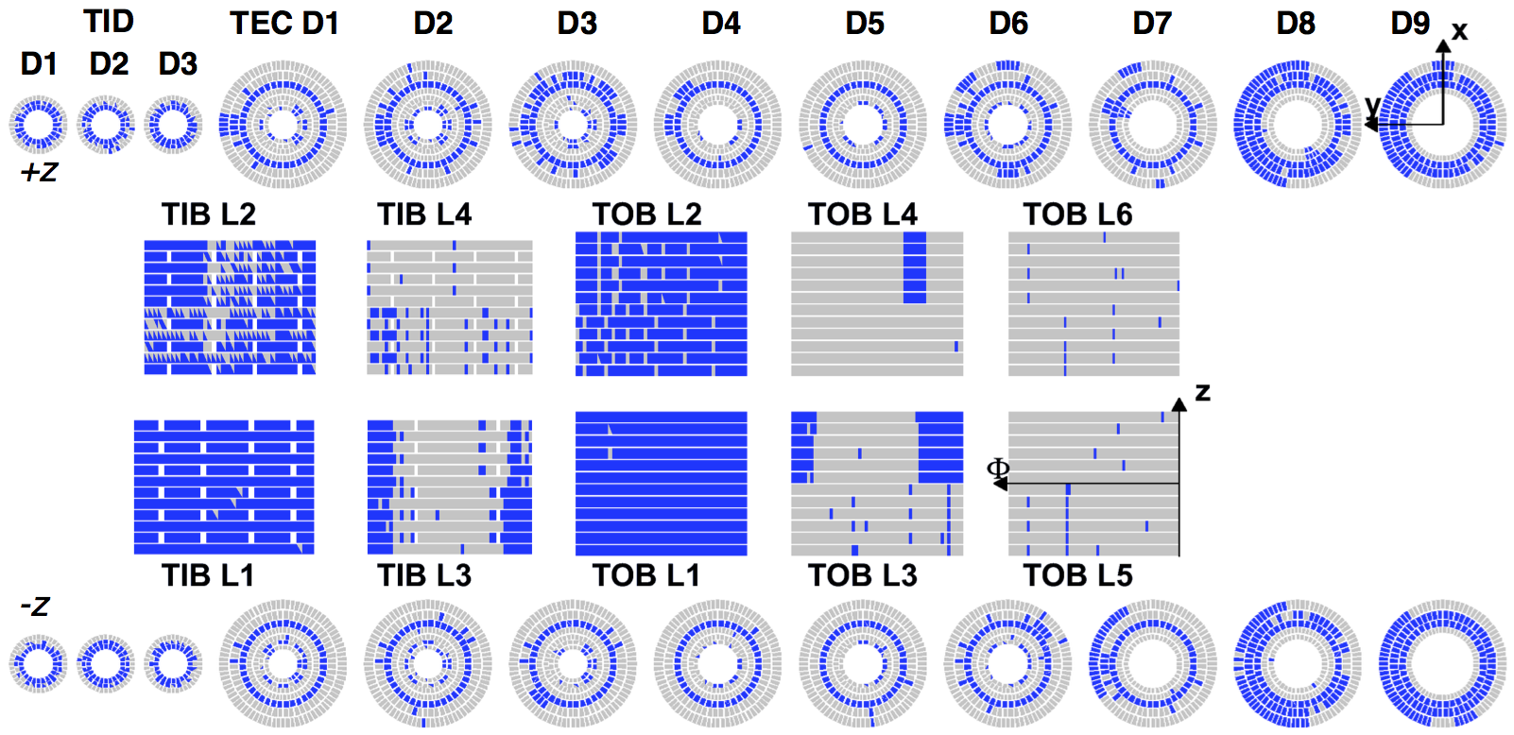
Tracker Upgrade
Tracker replacement is necessary due
to efficiency loss and fake-rate increase
Blue tracker modules are inactive after 1000 fb⁻¹ due to very high leakage currents induced by neutron fluence.

Slide 12
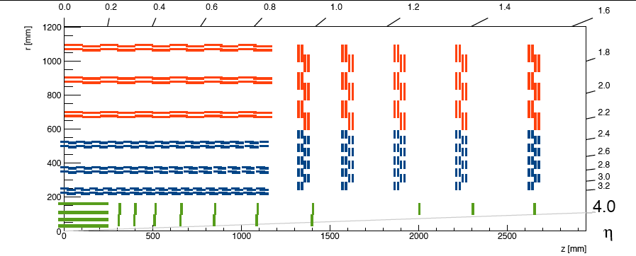
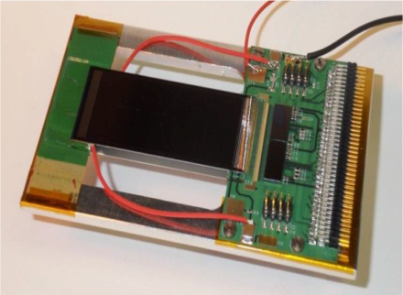
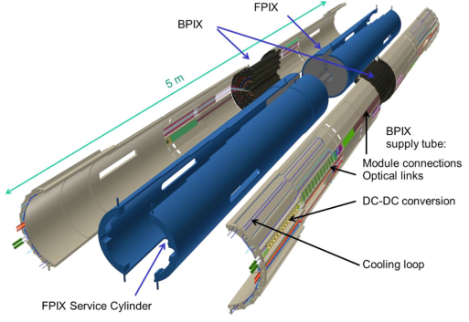
Conceptual design for the CMS tracker
Strip Modules
90 µm pitch/5 cm length
All-silicon tracker with three sections
and trigger-stub capability
Inner Pixel
Covers up to η=4.0
Strip/Pixel Modules
100 µm pitch/2.5 cm length
100 µm x 1.5 mm “macropixels”

Slide 13
Outer Tracker modules
Design optimization
  2S modules: 35-40 g
Material budget:
  Tracker weight ½ of current
  Gain of a factor 2 to 3 on photon conversion rates depending on η
Current Tracker
New ‘flat’
New ‘tilted’
Phase I pixel

Slide 14
Tracking performance
Track efficiency:
  for Phase-2 @200 PU similar to Phase-1 @50 PU
  improved η coverage
Fake rate:
  tolerable increase at 200 PU
Improved momentum resolution
  smaller pitch
  less material

Slide 15
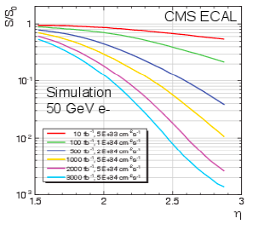
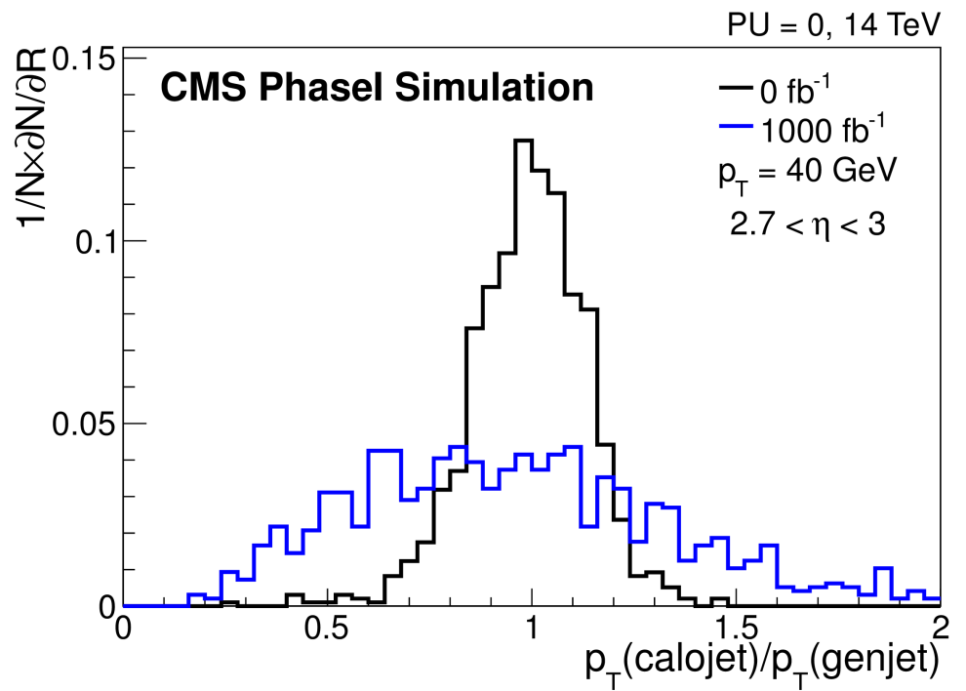
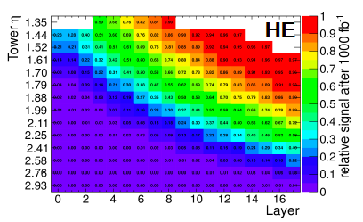
Replacement of the endcap calorimeters
Very significant signal degradation at high η
  Particularly important region for VBF Higgs and VBS measurements
Two concepts have been studied for endcap calorimetry in Phase 2

Slide 16
Selected Technologies for Calorimetry
High Granularity Silicon based sampling calorimeter, allowing a 3D shower measurement (particle flow)
  Electromagnetic: 26 X₀ , 1.5 λ , 28 layers Silicon-W/Cu absorber
  Front Hadronic: 3.5 λ , 12 layers of Silicon-Brass
Back hadronic : 5 λ , 12 layers of Scintillator –Brass (2 depth readout)
EE: 380 m², 4.3 MCh
13.9 k modules, 16 t
FH: 209 m², 1.8 MCh
7.6 k modules, 36.5 t
Si-operation at -30ºC,
total cooling power 125kW
BH: 428 m², 5184 SiPM

Slide 17
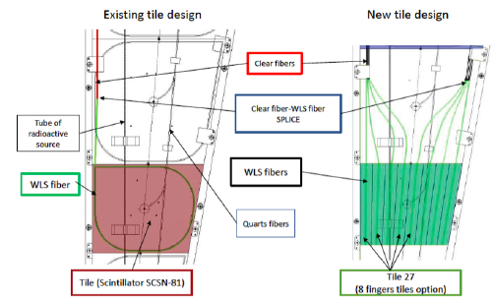
Back-Hadron Endcap Calorimeter
Development of radiation tolerant plastic-scintillator calorimeter
  Change layout of tile calorimeter using WLS fibres to shorten the light path length
  Doubly-doped plastic scintillator with x 2 light yield after irradiation
  WLS fibres with quartz capillaries
Also increased granularity: x 2 in φ and x 1.3 η
Notes:
Targeted R&D program underway to meet the challenges of replacing the CMS End-cap modules

Slide 18
Calorimeter performance
Shower profile simulation: containment & fraction of energy vs layer number
  Moliere radius is ≃ 28 mm (2mm air gap), but showers are very narrow in the first 10-15 layers for mitigation of PU effect
Intrinsic energy resolution:
  Stochastic term is 20-24 % (for 300- 100μm sensor thickness)

Slide 19
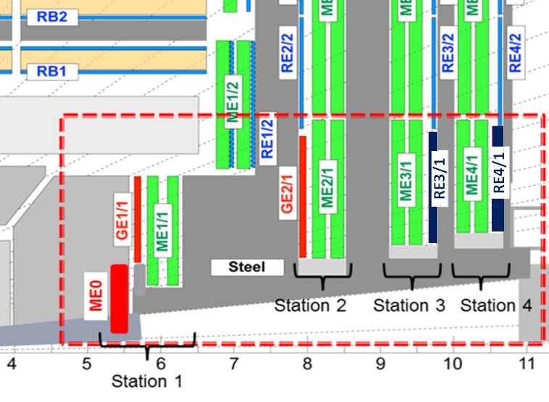
CMS Muon System upgrade
- Extend coverage at high rapidity
- Meet the trigger rate and latency requirements of the track trigger
Improvements of existing detectors
  Electronics: DT minicrates, CSC inner MEx/1 readout
    Both are needed for compliance with trigger upgrade
Forward 1.6<|η|<2.4 upgrades
  L1 trigger rate reduction,
  GEMs: GE1/1 and GE2/1
  iRPCs: RE3/1 and RE4/1
    Operation in higher rate
Very forward extension
  Extend muon tagging
  MEO with GEMs
  6 layer stub
  Baseline 2.0<|η|<3.0

Slide 20
Overall performance improvement
Example: Higgs physics:
With aged Phase 1 tracker huge efficiency loss for H→ ZZ→ 4l
Phase 2 upgrade restores efficiency and increases acceptance by 20%

Slide 21
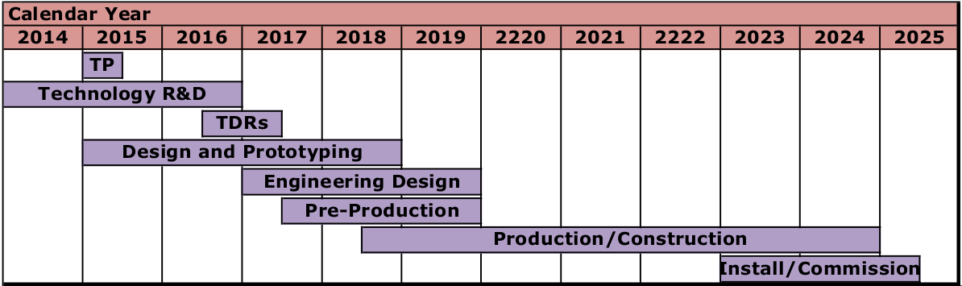
Roadmap for CMS Detector Upgrade
The next two years are important for technology R&D leading up to the technical design reports for major subsystems → more tomorrow
CMS HL-LHC Technical Proposal is being completed now with full-simulation physics studies
CMS will complete Technical Design Reports on the key upgrades in 2017

Slide 22
ATLAS upgrade plans

Slide 23
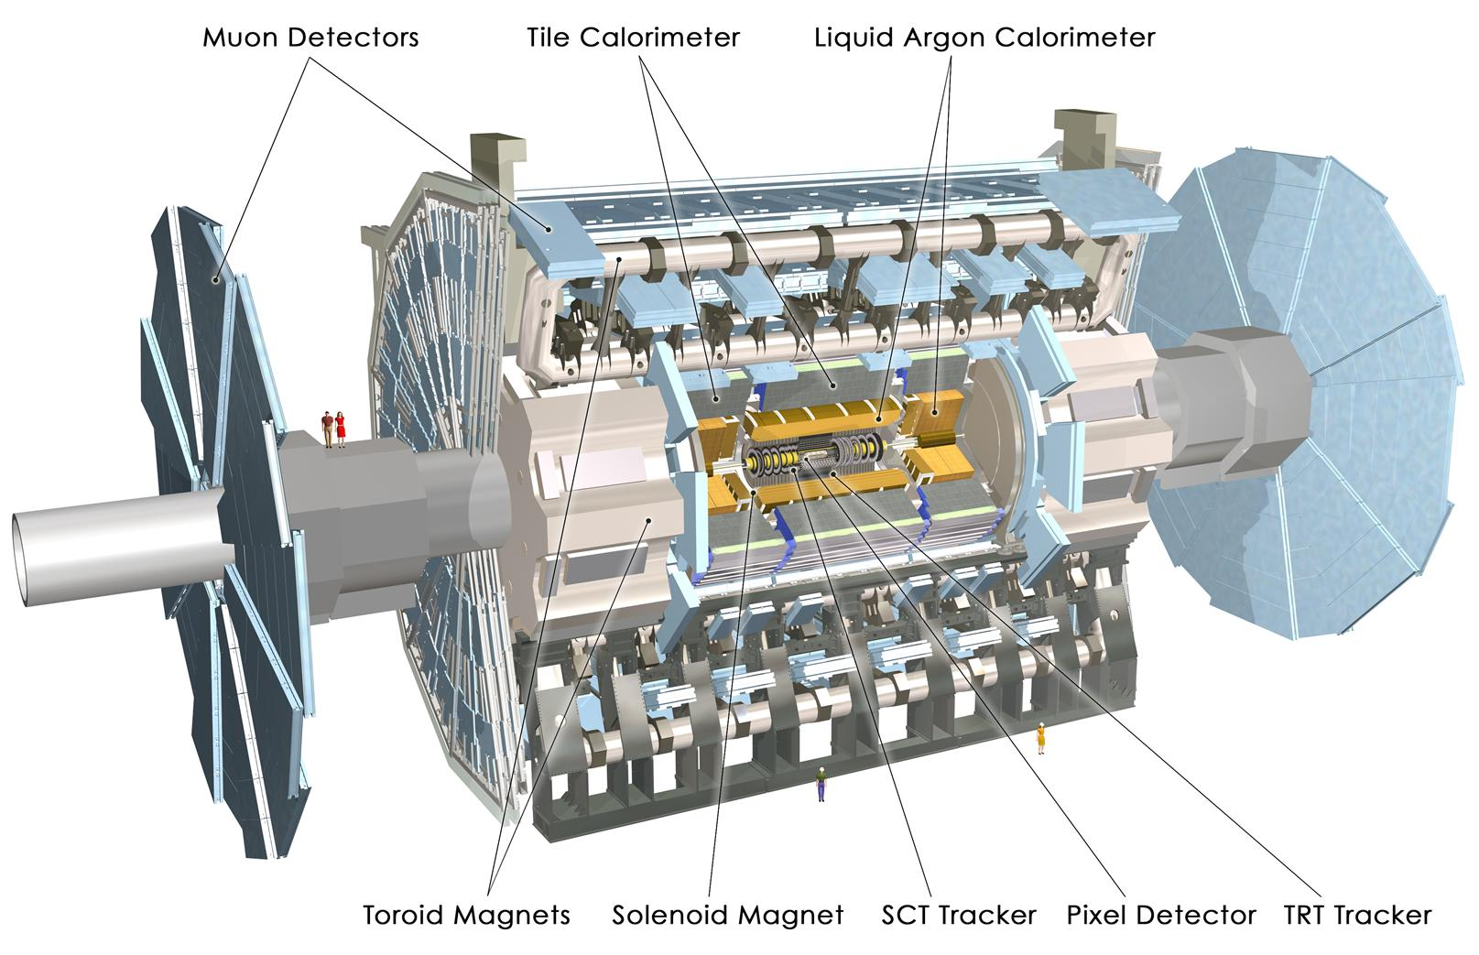
The ATLAS Detector
Muon Detector
Tile Calorimeter
Liquid Argon calorimeter
Inner Detector (ID)
Tracking
Silicon Pixels 50 x 400 mm²
Silicon Strips (SCT)
80 mm stereo
Transition Radiation Tracker (TRT) up to 36 points/track
2T Solenoid Magnet
Toroid Magnet
Solenoid Magnet
SCT
Pixel Detector
TRT

Slide 24
The ATLAS Detector
Muon Detector
Tile Calorimeter
Liquid Argon calorimeter
Calorimeter system
EM and Hadronic energy
Liquid Ar (LAr) EM barrel and end-cap
LAr Hadronic end-cap
Tile calorimeter
(Fe – scintillator)
hadronic barrel
Toroid Magnet
Solenoid Magnet
SCT
Pixel Detector
TRT

Slide 25
The ATLAS Detector
Muon Detector
Tile Calorimeter
Liquid Argon calorimeter
Muon spectrometer
m tracking
Precision tracking
MDT (Monit. drift tubes)
CSC (Cathode Strip Ch.)
Trigger chambers
RPC (Resist. Plate Ch.)
TGC (Thin Gap Ch.)
Toroid Magnet
Toroid Magnet
Solenoid Magnet
SCT
Pixel Detector
TRT

Slide 26
The ATLAS Detector
Muon Detector
Tile Calorimeter
Liquid Argon calorimeter
Trigger system (Run 2)
L1 – hardware
output rate: 100 kHz latency: < 2.5 ms
HLT – software
output rate: 1 kHz
proc. time: ~ 550 ms
Toroid Magnet
Solenoid Magnet
SCT
Pixel Detector
TRT

Slide 27
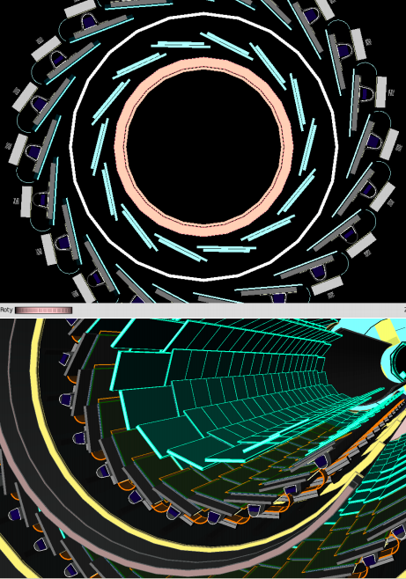
Phase-O upgrade (LS-1)
Insertable B-Layer
  Installation and commissioning of IBL in the pixel detector in summer 2014
  Will stay until Phase-II
w/ IBL
w/o IBL
b-tagging rejection vs pile-up
Notes:
Just one slide with a picture of IBL and one plot of performance improvement due to IBL

Slide 28


The ATLAS upgrade programme
TDRs approved by the
CERN Research Board
New Small Wheel
Fast Track Trigger
Trigger/DAQ
LAr Trigger

Slide 29
Muons: New Small Wheel
Consequences of luminosity rising beyond design values for forward muon wheels
  degradation of the tracking performance (efficiency / resolution)
  L1 muon trigger bandwidth exceeded unless thresholds are raised
Replace Muon Small Wheels with New Muon Small Wheels
  improved tracking and
  trigger capabilities
  position resolution < 100 μm
  IP-pointing segment in NSW
  with σ_{θ}~ 1 mrad
  Meets Phase-II requirements
    compatible with <µ>=200,
    up to L~7x10³⁴ cm⁻²s⁻¹
  Technology: MicroMegas
  and sTGCs
New Small Wheel
covers 1.3<|η|<2.7

Slide 30
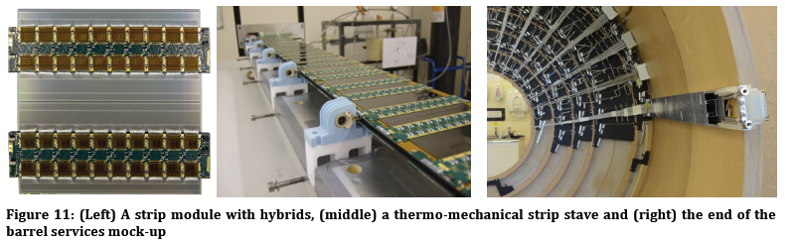
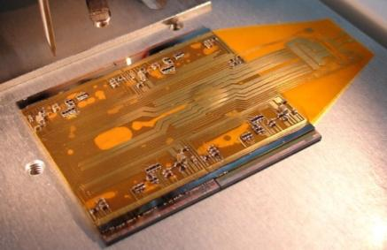
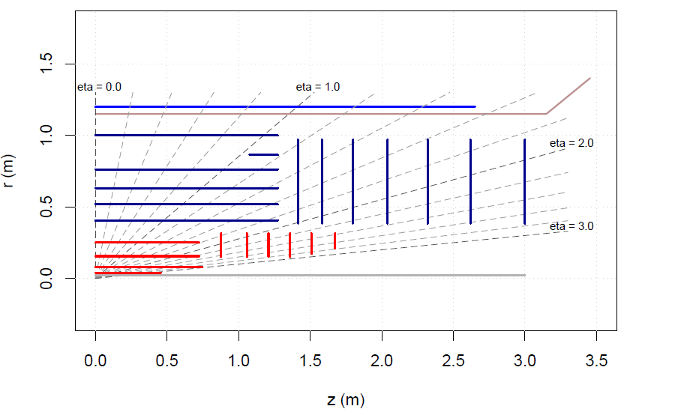
New Tracking detector
Current Inner Detector (ID)
  Designed to operate for 10 years at L=1x10³⁴ cm⁻²s⁻¹
  with <μ>=23, @25ns, L1=100kHz
Limiting factors at HL-LHC
  Bandwidth saturation (Pixels, SCT)
  Too high occupancies (TRT, SCT)
  Radiation damage (Pixels (SCT) designed for 400 (700) fb⁻¹)
Microstrip Stave Prototype
Quad Pixel Module Prototype
LoI layout new (all Si) ATLAS Inner Tracker for HL-LHC
Barrel Strips
Forward Strips
Solenoid
New 130nm prototype strip ASICs in production
incorporates L0/L1 logic
Sensors compatible with 256 channel ASIC being delivered
Barrel pixel
Forward pixel

Slide 31
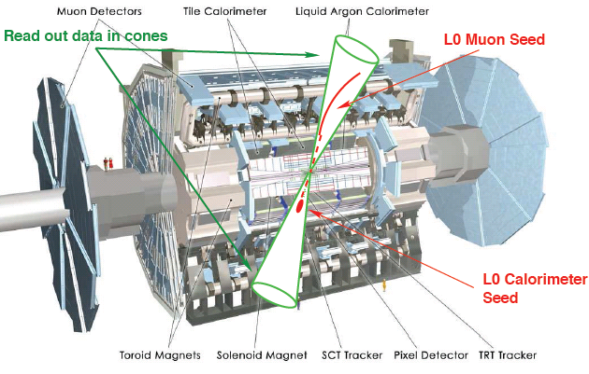
ATLAS L1Track Trigger
Adding tracking information at Level-1 (L1)
  Move part of High Level Trigger (HLT) reconstruction into L1
  Goal: keep thresholds on p_{T} of triggering leptons and L1 trigger rates low
Triggering sequence
  L0 trigger (Calo/Muon)
  reduces rate within ~6 μs
  to ≳ 500 kHz and defines
  RoIs
  L1 track trigger extracts
  tracking info inside RoIs
  from detector FEs
Challenge
  Finish processing within
  the latency constraints

Slide 32
ATLAS Calorimeter electronics
Tile Calorimeters
  No change to detector needed
  Full replacement of FE and BE electronics
    New read-out architecture: Full digitisation of data at 40MHz and transmission to off-detector system, digital information to L1/L0 trigger
LAr Calorimeter
  Replace FE and BE electronics
    Aging, radiation limits
    40 MHz digitisation, inputs to L0/L1
    Natural evolution of Phase-I trigger boards
Replace Forward calorimeter (FCal)
  Install new sFCAL in cryostat or miniFCAL in front of cryostat if significant degradation in current FCAL

Slide 33
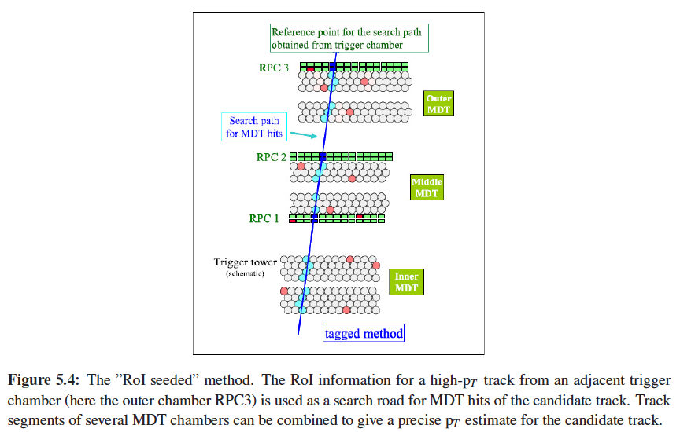
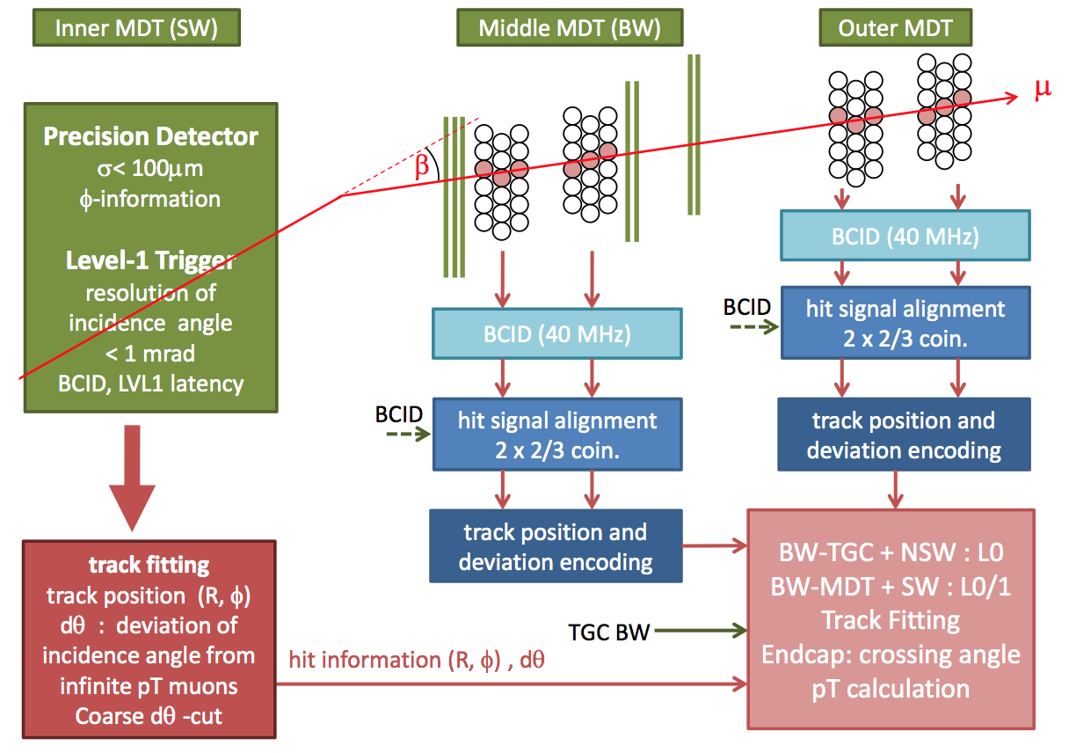
ATLAS Muon system upgrade
Upgrade FE electronics
  accommodate L0/L1 scheme parameters
Improve L1 p_{T} resolution
  Use MDT information possibly seeded by trigger chambers ROIs (RPC/TGC)
NSW
RoI of high-p_{T} track used as a search road for MDT hits of the candidate track
Combine track segments of several MDTs to give precise p_{T} estimate
  Match angle measurement in end-cap MDTs to precision measurement in NSW

Slide 34
Conclusion Lecture III
ATLAS and CMS upgrades for the HL-LHC era are driven by achieving the physics promise of the large HL-LHC data set while surviving the challenging HL-LHC environment
  Very high radiation doses and pileup values
The experiments have a coherent plan for meeting these challenges with a set of upgrades to many of major detector elements.
More on common R&D tomorrow’s lecture

