Slide 1

High-Luminosity upgrade of the LHC
Physics and Technology Challenges for the Accelerator and the Experiments
Burkhard.Schmidt@cern.ch

Slide 2
Outline
Lecture I
  Physics Motivation for the HL-LHC
Lecture II
  An overview of the High-Luminosity upgrade of the LHC
Lecture III
  Performance requirements and the upgrades of ATLAS and CMS
Lecture IV
  Flavour Physics and the upgrade of LHCb
Lecture IV
  Heavy-Ion Physics and the ALICE upgrade
Lecture VI
  Challenges and developmets in detector technologies, electronics and computing

Slide 3
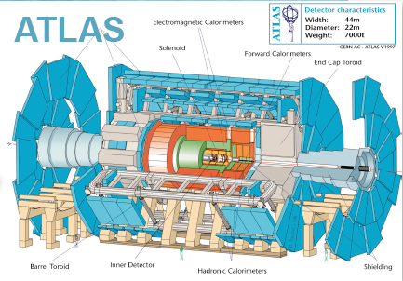
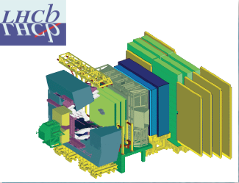
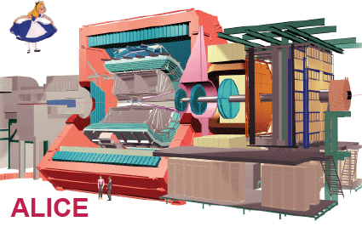
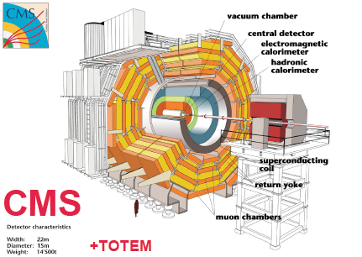
The LHC Detectors
ATLAS
7000 ton
l = 46m
D = 22m
ATLAS and CMS are General Purpose
Detectors (GPD) for data-taking at high
Luminosity.
LHCb is specialized on the study of
particles containing b- and c- quarks
CMS
12500 ton
l = 22m
d = 15m
ALICE Detector is optimized for the
study of Heavy Ion physics.

Slide 4
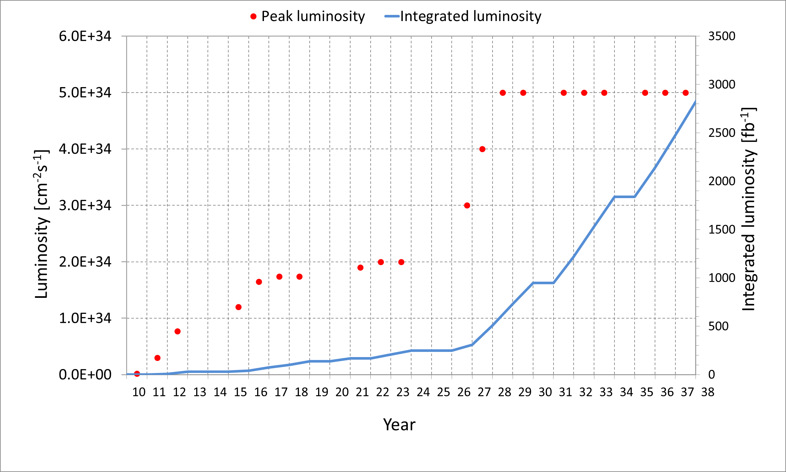
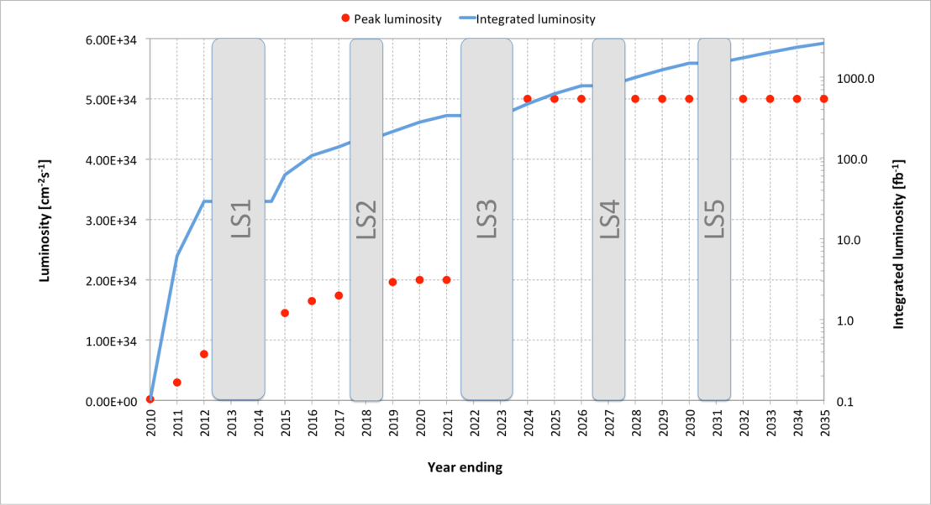
Long Term LHC Schedule
PHASE I Upgrade
ALICE, LHCb major upgrade
ATLAS, CMS ‚minor‘ upgrade
- LHC Injector Upgrade
- Heavy IonLuminosity
from 10²⁷ to 7 x 10²⁷
LS1
LS3
LS2
LS4
LS5
PHASE II Upgrade
ATLAS, CMS major upgrade
HL-LHC, pp luminosity
from 2 x 10³⁵ (peak) to 5 x 10³⁴ (levelled)

Slide 5
Heavy Ion (HI) Physics
Selected results from LHC Run I and prospect for the HL-HI-LHC
Performance requirements and overview of the ALICE Detector upgrade
Notes:
QCD phase diagram

Slide 6
Relativistic Heavy-Ion Collisions
QCD Phase Diagram
QCD leads to new states of matter, when temperature and densities exceed the values beyond which quarks and gluons are confined inside hadrons
QGP is a state of matter without color confinement that exhibits collective effects.

Slide 7
HI collisions at the LHC are unique
The net baryon density at mid-rapidity is small (μ_{B}≈0), corresponding to the conditions in the early universe
The initial temperature and energy density are the highest achievable in the laboratory
The collision energy provides abundant production of hard probes
First principle methods (pQCD, Lattice GaugeTheory) applicable
Some of the outstanding questions to be addressed
What is the nature of matter at ultra-high temperature and density?
Which are their microscopic degrees of freedom and excitations?
Which are the macroscopic transport properties and equation of state?
How did their properties influence the evolution of the early universe?
What is the relation between strongly coupled QGP and asymptotically free QCD?

Slide 8
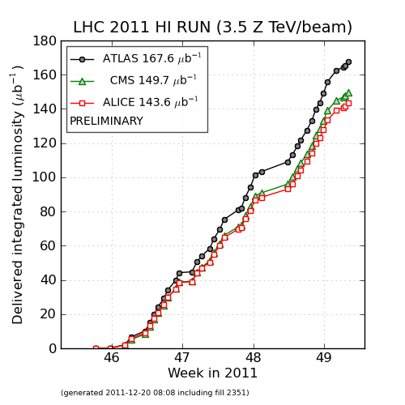
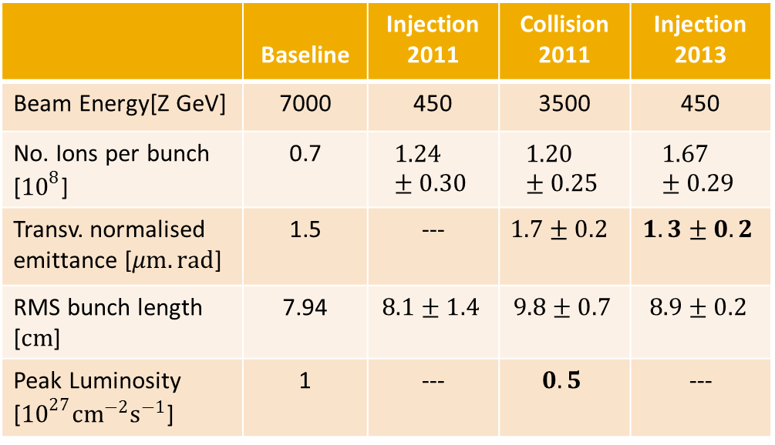
Heavy-Ion running at the LHC (Run I)
 | Baseline | Injection 2011 | Collision 2011 | Injection 2013
Beam Energy[Z GeV] | 7000 | 450 | 3500 | 450
No. Ions per bunch [${10}^{8}$] | 0.7 | $$1.24±0.30$$ | $$1.20±0.25$$ | $$1.67±0.29$$
Transv. normalised emittance [$μm.rad$] | 1.5 | --- | $$1.7±0.2$$ | $$1. 3±0.2$$
RMS bunch length [$cm$] | 7.94 | $$8.1±1.4$$ | $$9.8±0.7$$ | $$8.9±0.2$$
Peak Luminosity [${10}^{27}{cm}^{−2}s^{−1}$] | 1 | --- | $$0.5$$ | ---
Design performance achieved, p-Pb in 2013 was not part of the baseline ...
Major results by ALICE, ATLAS and CMS:
Jets and jet quenching
Electroweak probes
Upsilon spectroscopy and quarkonium suppression
Heavy flavour R_{AA} , v₂ ; bulk properties
Notes:
Elliptic flow is strong evidence for the existence of quark–gluon plasma, and has been described as one of the most important observations measured at RHIC.
Elliptic flow describes the azimuthal momentum space anisotropy of particle emission from non-central heavy-ion collisions in the plane transverse to the beam direction, and is defined as the second harmonic coefficient of the azimuthal Fourier decomposition of the momentum distribution.^{[4]} Elliptic flow is a fundamental observable since it directly reflects the initial spatial anisotropy, of the nuclear overlap region in the transverse plane, directly translated into to the observed momentum distribution of identified particles.

Slide 9
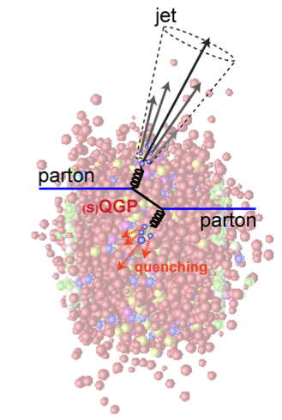
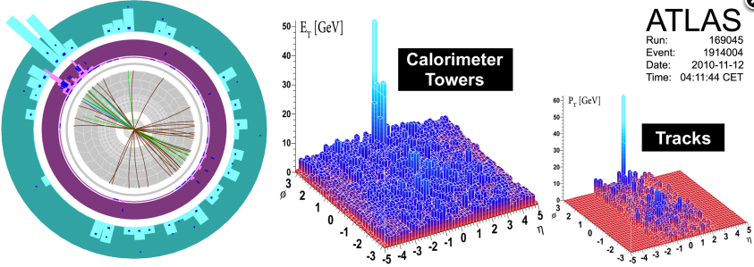
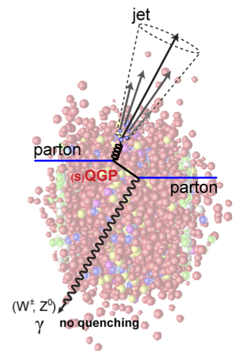
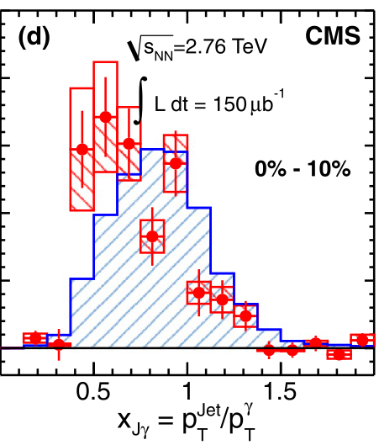
Jet quenching
Pb-Pb events with large di-jet imbalance
γ/Ζ-jet correlations are a powerful tool:
  γ/Ζ-boson escape unaffected
  by the QCD medium
  E^{γ/Ζ} = E^{Jet} !
  → Initial E^{jet} can be measured
  First measurement of γ-jet
  p_{T} imbalance p_{T}^{Jet}/p_{T}^{γ}
Direct observation
of in-medium parton
energy loss is a probe
of the QGP density.
CMS, PLB718 (2013) 773

Slide 10
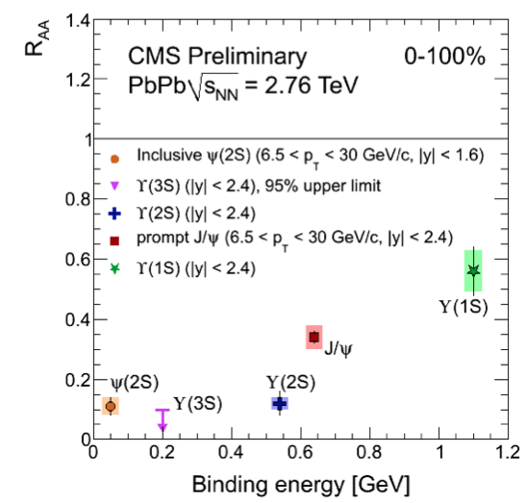
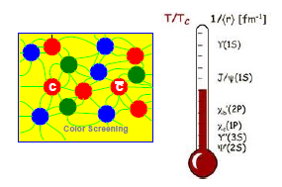
Quarkonia production / suppression
Heavy quark pairs produced in the initial hard partonic collisions
Suppressed by Debye color screening:
  Color charge of one quark masked by surrounding quarks.
  Prevents qq binding in the QGP.
Quarkonium sequential dissociation:
  direct probe of deconfinement and of the medium temperature
  First hint of sequential pattern
HL-HI-HLC: high statistics (10/nb):
E.g. CMS
precise multi-differential measurements
ϒ(1s) | ϒ(2s) | ϒ(3s)
270k | 40k | 7k

Slide 11
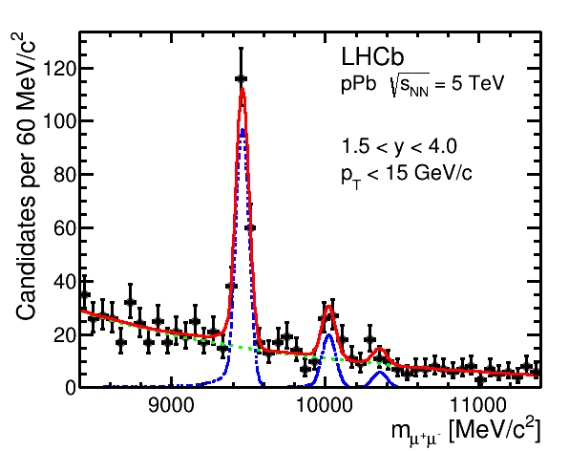
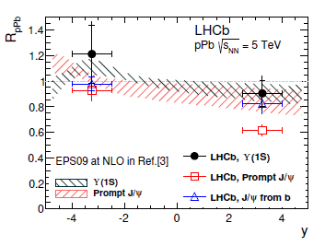

Quarkonium suppression
Quarkonium Suppression has also been observed in pA, where the energy density is much lower and the QGP is not present:
Heavy flavour / quarkonium production is an important probe to disentangle QGP effects from Cold-Nuclear-Matter (CNM) effects
The nuclear attenuation factor R_{pA} tests modeling of cold nuclear effects:

Slide 12
HL-HI Physics Programme
Jets: characterization of energy loss mechanism both as a testing ground for the multi-particle aspects of QCD and as a probe of the medium density
  Differential studies of jets, b-jets, di-jets, γ/Z-jet at very high pT (ATLAS, CMS)
  Flavour-dependent in-medium fragmentation functions (ALICE)
Heavy flavour: characterization of mass dependence of energy loss, thermalization and hadronization of HQ as probe of the medium transport properties
  Low-pT production and elliptic flow of several HF hadron species (ALICE, LHCb)
  B and b-jets (ATLAS , CMS, LHCb)
Quarkonium: precision study of quarkonium dissociation pattern and regeneration, as probes of deconfinement and of the medium temperature
  Low-pT charmonia and elliptic flow (ALICE and LHCb)
  Multi-differential studies of Υ states (ATLAS, CMS and LHCb)
Low-mass di-leptons: thermal radiation γ (→e+e-) to map temperature during system evolution; modification of ρ meson spectral function as a probe of the chiral symmetry restoration
  (Very) low-pT and low-mass di-electrons and di-muons (ALICE)

Slide 13
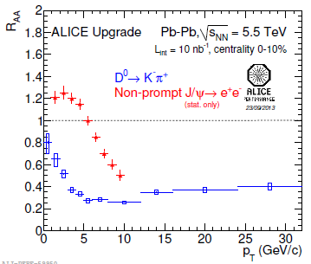
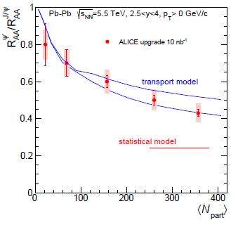


HL-HI performance expectation
Nuclear Modification Factors of c and b:
Pin down quark mass dependence of parton energy loss
Investigate transport of heavy quarks in the QGP
Prompt D⁰ and Non-prompt J/ψ R_{AA}
Explore new probe of deconfinement:
Understand the underlying mechanism that binds deconfined heavy quark pairs
Discriminates between models of dissociation and regeneration (competing effects)
c/b mass

Slide 14
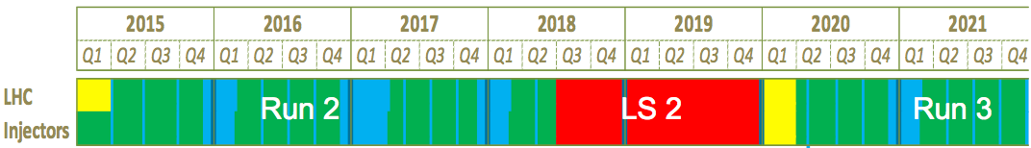
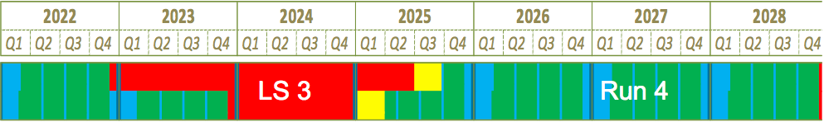
Timeline of future HI running at the LHC
Run 2:
  Pb-Pb ~1/nb or more, at √sNN ~ 5 TeV
  p-Pb (at increased luminosity)
  pp reference at Pb-Pb energy (5 TeV)
Runs 3+4 (HL-HI-LHC ):
  Experiments request for Pb-Pb: >10/nb (ALICE: 10/nb at 0.5T + 3/nb at 0.2T)
  A luminosity increase to 6 x 10²⁷ /cm²/s is expected after LS2
  Lighter nuclei (e.g. Ar): a possibility to be considered after LS2
    Study system size dependence and onset of QGP effects
    Larger instantaneous luminosity compensates the reduced yields for hard processes (which scale with A², e.g. Ar-Ar/Pb-Pb = 1/27)
HL-HI-LHC:
  focus on rare probes, their coupling with QGP medium and their (medium-modified) hadronization process

Slide 15

ALICE Upgrade Strategy
Goal:
High precision measurements of rare probes at low p_{T,} which cannot be selected with a trigger.
Target a recorded Pb-Pb luminosity ≥ 10 nb⁻¹  8 x 10¹⁰ events to gain a factor 100 in statistics over the Run1+Run2 programme and significant improvement of vertexing and tracking capabilities.
Detector:
Read out all Pb-Pb interactions at a maximum rate of 50kHz (i.e. L = 6 x 10²⁷ cm⁻¹s⁻¹) upon a minimum bias trigger
Perform online data reduction based on reconstruction of clusters and tracks
Improve vertexing and tracking at low p_{T} ➔ New Inner Tracking System (ITS)

Slide 16
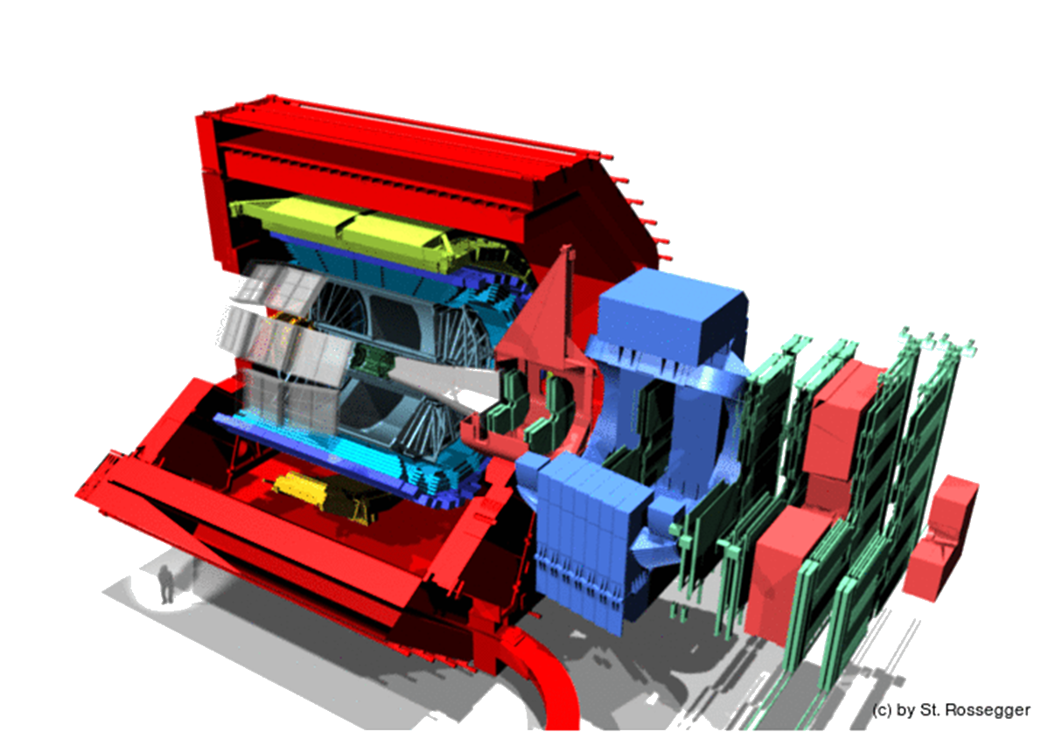
ALICE Upgrade Overview
Muon Forward Tracker (MFT)
new Si tracker
Improved MUON pointing precision
New Inner Tracking System (ITS)
improved pointing precision
less material
→ thinnest tracker at the LHC
MUON ARM continuous
readout electronics
Time Projection Chamber (TPC)
New Micropattern gas detector technology
continuous readout
New Central Trigger Processor (CTP)
Data Acquisition (DAQ)/ High Level Trigger (HLT)
new architecture
on line tracking & data compression
50kHz Pbb event rate
TOF, TRD
Faster readout
New Trigger
Detectors (FIT)

Slide 17




ALICE upgrade in LS2
The ALICE LS2 upgrade is detailed in 5 Technical Design Reports
ITS
Readout and Trigger System
TPC
MFT
→ all approved
Online Offline System
→ now under review

Slide 18
ALICE Upgrade Overview
Muon Forward Tracker (MFT)
new Si tracker
Improved MUON pointing precision
New Inner Tracking System (ITS)
improved pointing precision
less material
→ thinnest tracker at the LHC
MUON ARM continuous
readout electronics
Time Projection Chamber (TPC)
New Micropattern gas detector technology
continuous readout
New Central Trigger Processor (CTP)
Data Acquisition (DAQ)/ High Level Trigger (HLT)
new architecture
on line tracking & data compression
50kHz Pbb event rate
TOF, TRD
Faster readout
New Trigger
Detectors (FIT)

Slide 19
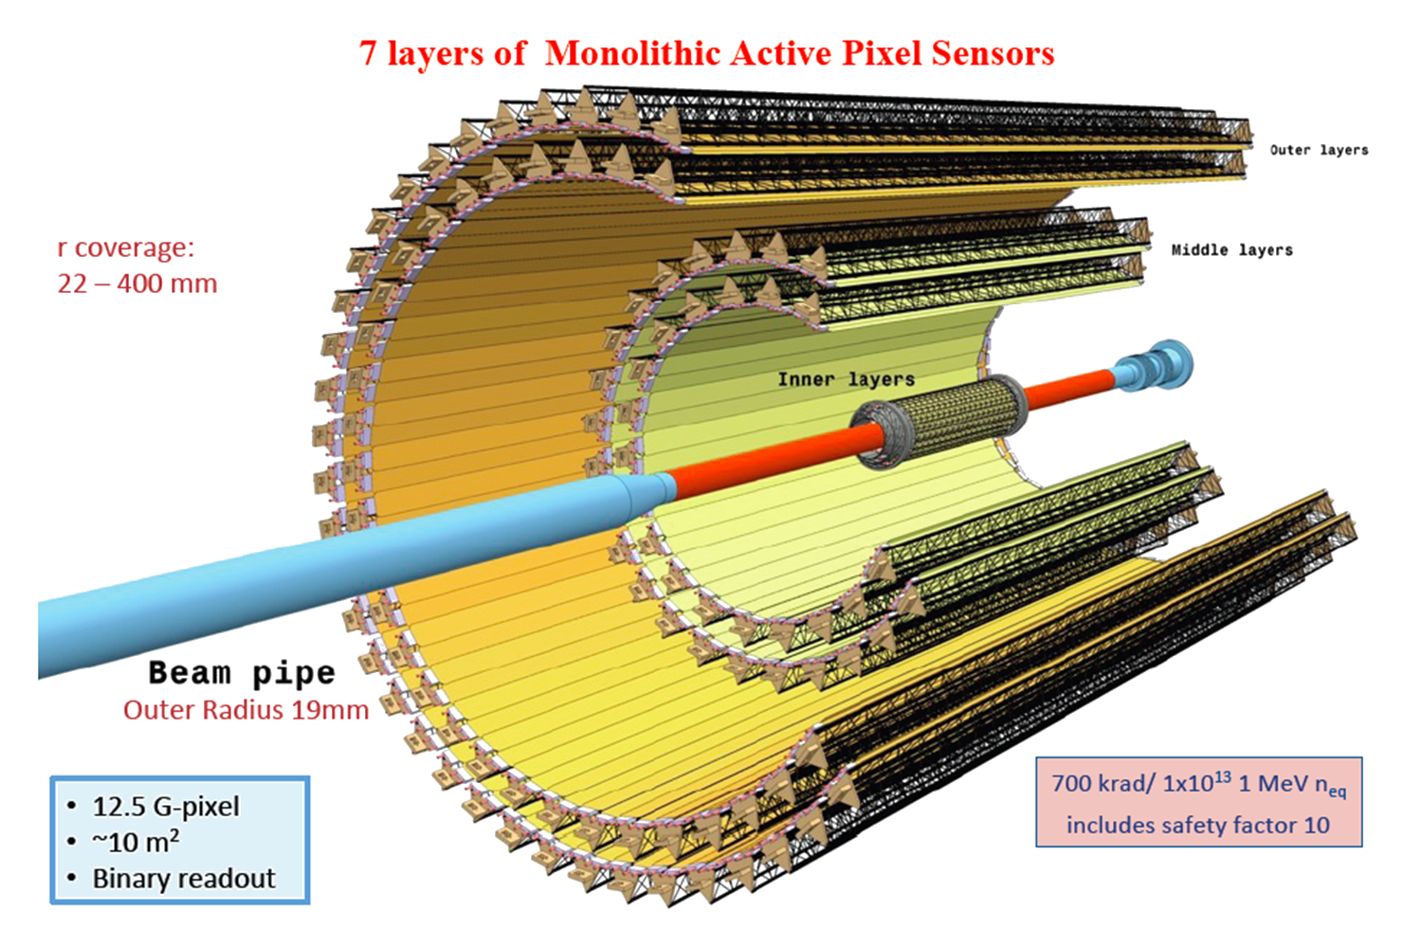
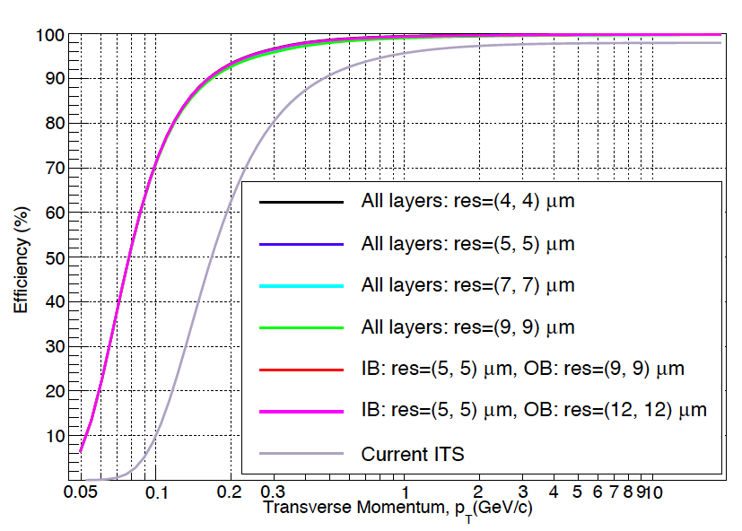
ALICE ITS upgrade
7 layers of Monolithic Active Pixel Sensors
r-coverage
22- 400mm
700 krad or
1x10¹³ 1 MeV n_{eq}
includes safety factor 10
12.5 G-Pixels
~10m²
Binary readout

Slide 20
ALICE Upgrade Overview
Muon Forward Tracker (MFT)
new Si tracker
Improved MUON pointing precision
New Inner Tracking System (ITS)
improved pointing precision
less material
→ thinnest tracker at the LHC
MUON ARM continuous
readout electronics
Time Projection Chamber (TPC)
New Micropattern gas detector technology
continuous readout
New Central Trigger Processor (CTP)
Data Acquisition (DAQ)/ High Level Trigger (HLT)
new architecture
on line tracking & data compression
50kHz Pbb event rate
TOF, TRD
Faster readout
New Trigger
Detectors (FIT)

Slide 21
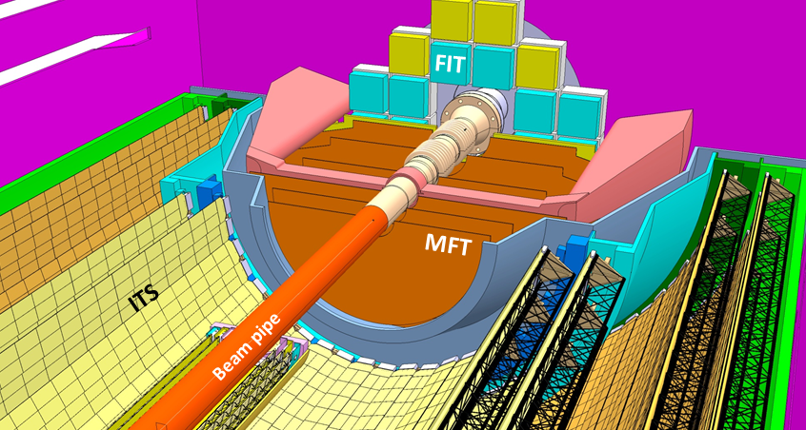
Muon Forward Tracker (MFT)
Measure muon tracks in the ALICE muon spectrometer acceptance with high precision vertexing before the large absorber.
A silicon pixel tracker complementing the acceptance of the ALICE upgraded ITS and covering most of the acceptance of the muon spectrometer 2.5<η<3.6.
Placed inside the ITS outer barrel, between the ITS inner barrel and the absorber and surrounding the ALICE vacuum beam-pipe.
Common Silicon Sensor with ITS (15 mm x 30 mm)

Slide 22
ALICE Upgrade Overview
Muon Forward Tracker (MFT)
new Si tracker
Improved MUON pointing precision
New Inner Tracking System (ITS)
improved pointing precision
less material
→ thinnest tracker at the LHC
MUON ARM continuous
readout electronics
Time Projection Chamber (TPC)
New Micropattern gas detector technology
continuous readout
New Central Trigger Processor (CTP)
Data Acquisition (DAQ)/ High Level Trigger (HLT)
new architecture
on line tracking & data compression
50kHz Pbb event rate
TOF, TRD
Faster readout
New Trigger
Detectors (FIT)

Slide 23
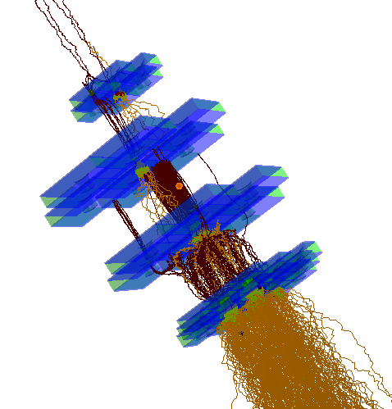
TPC Upgrade
With an average of 5 PbPb collisions inside the drift time of 100us, the classic gating of TPC wire chambers does not work.
Replace wire chambers with
4-GEM or Micromega+2 GEM
Specified to have <20 Ions flowing back into the TPC volume for every primary electron being amplified, i.e. ion back flow (IBF) of <1% for a gas gain of 2000
Exploded view of a GEM IROC

Slide 24
ALICE Upgrade Overview
Muon Forward Tracker (MFT)
new Si tracker
Improved MUON pointing precision
New Inner Tracking System (ITS)
improved pointing precision
less material
→ thinnest tracker at the LHC
MUON ARM continuous
readout electronics
Time Projection Chamber (TPC)
New Micropattern gas detector technology
continuous readout
New Central Trigger Processor (CTP)
Data Acquisition (DAQ)/ High Level Trigger (HLT)
new architecture
on line tracking & data compression
50kHz Pbb event rate
TOF, TRD
Faster readout
New Trigger
Detectors (FIT)

Slide 25
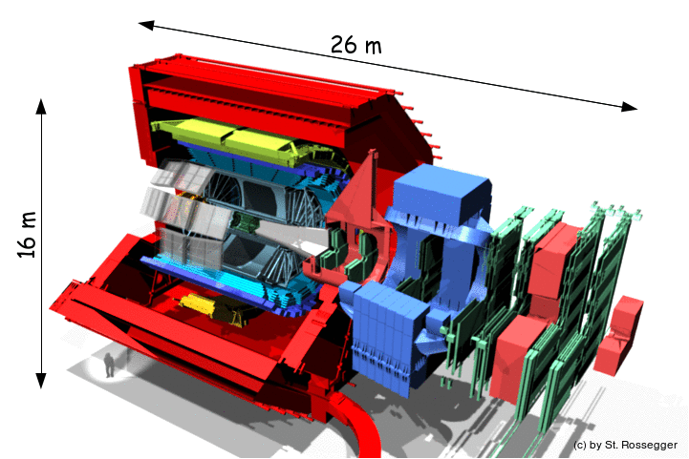
ALICE & LHCb in 2018
4 TByte/s into PC farm
50 kHz
1 TByte/s into PC farm
Reconstruction
+
Compression
O² (Online Offline)
System
Storage
75 GB/s
(PEAK OUTPUT)

Slide 26
Conclusion Lecture V
LHC offers unique opportunities to study QCD matter at μ_{B}=0 in heavy-in collisions via hard and electroweak probes.
The currently approved HI program (1 nb⁻¹) provides an essential step towards an era of precision measurements.
Full exploitation of the physics potential of the LHC and of the complementarity of the experiments requires extension to 10 nb⁻¹, which implies a heavy-ion programme at the LHC beyond LS3.
ALICE is preparing a major upgrade for LS2
  R&D on ITS MAPs, TPC Micropattern Detectors, Online-Offline System etc. is in full swing with conclusion during 2015
  Construction starting in 2015/2016

