Slide 1

High-Luminosity upgrade of the LHC
Physics and Technology Challenges for the Accelerator and the Experiments
Burkhard.Schmidt@cern.ch

Slide 2
Outline
Lecture I
  Physics Motivation for the HL-LHC
Lecture II
  An overview of the High-Luminosity upgrade of the LHC
Lecture III
  Performance requirements and the upgrades of ATLAS and CMS
Lecture IV
  Flavour Physics and the upgrade of LHCb
Lecture IV
  Heavy-Ion Physics and the ALICE upgrade
Lecture VI
  Challenges and developments in detector technologies, electronics and computing

Slide 3
Research and Development on Technologies
Systems
R&D collaborations and Groups
Tracking Systems
Calorimetry
Muon Systems
Electronics and Readout Systems
Trigger/DAQ/ Offline/ Computing
RD 50 collaboration (rad. hard semiconductors)
Cooling: PH-DT and ext. collaborators
RD52 collaboration (Dual-Readout Calorimetry)
CALICE collaboration (Calo. for linear coll.)
RD 51 collaboration
Micro-Pattern Gas Detectors Technologies
Common Electronics Projects, ACES
RD 53 collaboration (Dev. of Pixel Readout IC)
TDAQ teams of the experiments
PH-SFT group and ext. collaborators

Slide 4
Solid state
Tracking Systems
Solid state detectors are the baseline technology for very high granularity tracking system:
  Low detector mass (radiation length)
  Radiation resistent devices have been developed, maintaining good detector performance
Technical solutions for ALICE, LHCb and the outer radius (strips/strixel) of ATLAS and CMS have been established and R&D efforts are in advanced stages.
R&D for the pixel detectors is still intensive with several solutions on the horizon.
Diamond Sensors only for special applications in the HL-LHC (very small areas)

Slide 5
Tracking System Upgrades
ALICE and LHCb:
New trackers have to cope with much higher event rates.
ATLAS and CMS Outer Trackers:
Large procurement (2×~200 m²) with the same timeline
  Difficult to find vendors with suitable production capacity and quality
  Possibility of production on 8” wafers needs to be explored
Requires dedicated R&D – and may bring substantial financial saving
ATLAS and CMS pixels:
Radiation will increase to > 10¹⁶ neq cm⁻²
  common activities to develop radiation hard sensors within the RD50 collaboration
  Operational requirements more demanding
High pile-up requires enhanced functionalities
Upgrades | Area | Baseline sensor type
ALICE ITS | 12 m² | CMOS
LHCb VELO | 0.15 m² | n-in-p/n
LHCb UT | 5 m² | n-in-p
ATLAS Strips | 193 m² | n-in-p
CMS Strips | 218 m² | n-in-p
ATLAS Pixels | 8.2 m² | n-in-n or 3D
CMS Pixels | 4.6 m² | n-in-p or 3D
  Main goal of tracker upgrades:
  Achieve enhanced radiation tolerance
  and improved performance.

Slide 6
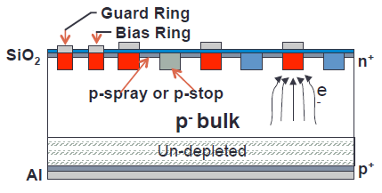
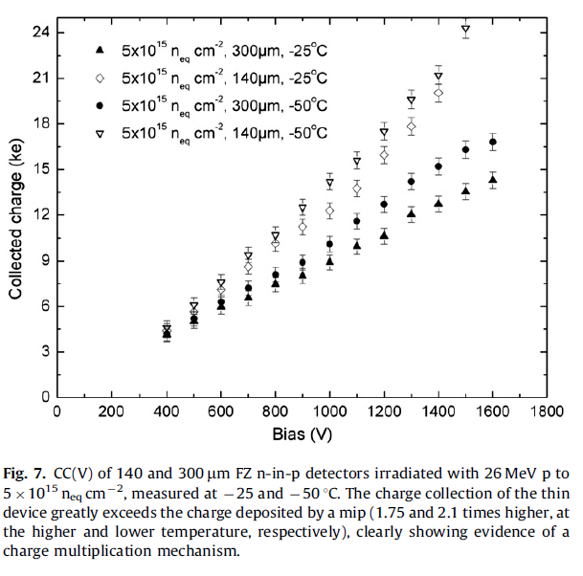
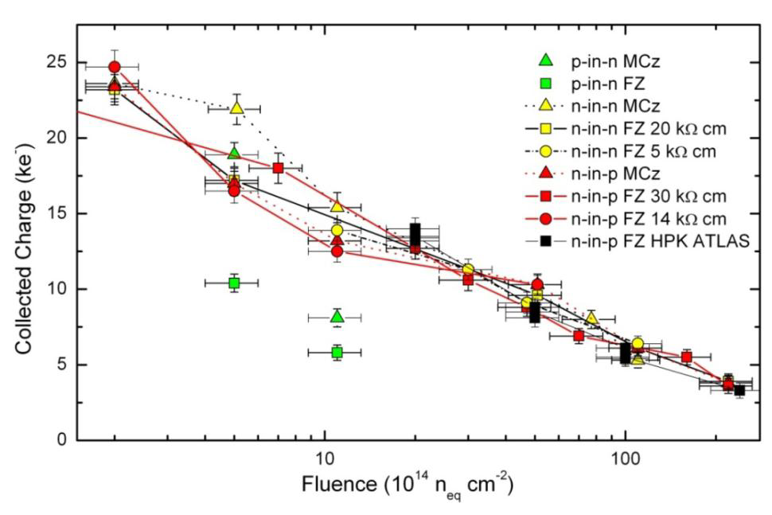
Sensor R&D: Planar Sensors
Planar sensor R&D:
Improved radiation hardness
  Use of n-in-p sensors, which deplete from the segmented side. Under-depleted operation possible.
  Optimization of sensor thickness to reduce leakage current (and material) (LHCb VELO 200μm sensors)
  Optimization of design, e.g. bias structures, isolation
Development of slim-edge and edgeless sensors
  Reduced edge allows for better overlap with less material
  Several techniques under study
Notes:
Fz= float-zone,
MCz = magnetic Czochralski

Slide 7
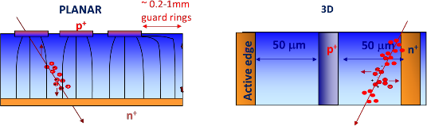
Sensor R&D: 3D sensors
Both electrode types are processed inside the detector bulk
Max. drift and depletion distance set by electrode spacing
Allows reduced collection time and depletion voltage
Potentially the option with highest radiation hardness
Production time and complexity to be investigated for larger scale production
Advantages of 3D:
  Short drift path,
  Higher fields at same V_{bias}
Could be the optimal choice for inner regions of ATLAS and CMS pixel detectors
Used in ATLAS IBL

Slide 8
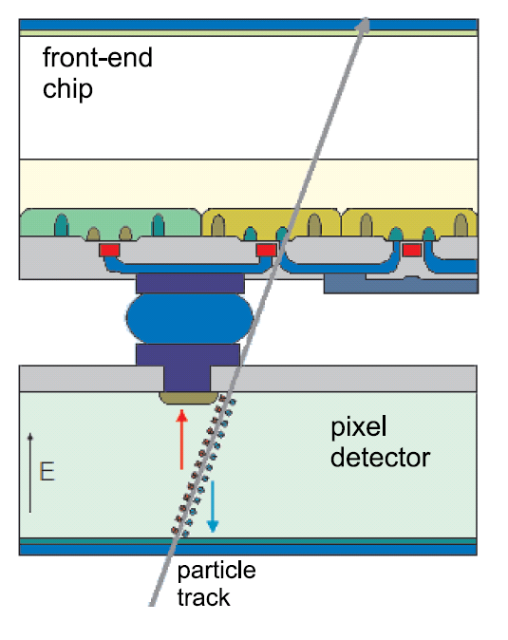
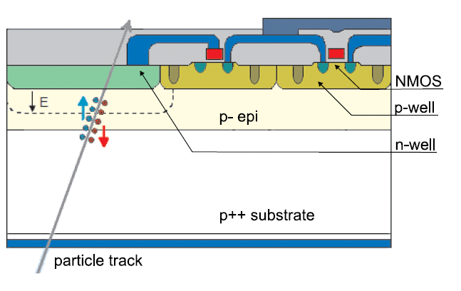
Sensor R&D : MAPS on CMOS process
MAPS=Monolithic Active Pixel System
Combine sensor and electronics in one chip
Hybrid Pixel Detector Monolithic Pixel Detector
Notes:
- MAPS: monolithic active pixel system
- Noise cut in units of sigma

Slide 9
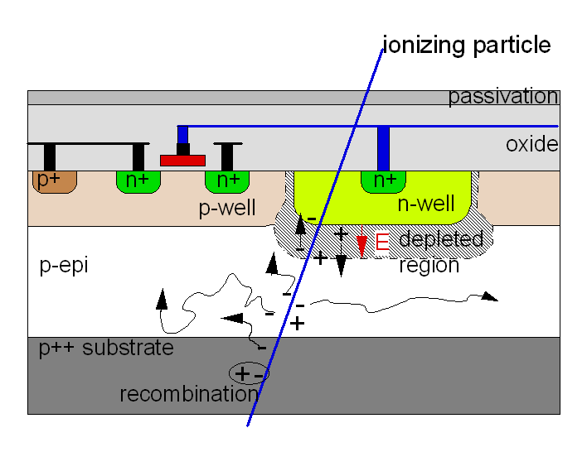
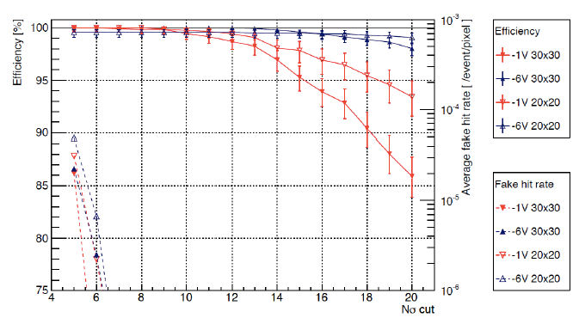
Sensor R&D : MAPS on CMOS process
Combine sensor and electronics in one chip
No interconnection needed
Small cell size – high granularity
Very low material budget
Limited radiation tolerance: ~10¹³ neq cm⁻²
Readout time ~100 μs (rolling shutter architecture)
Fake hit rate due to diffusion of charge carriers
Critical issues have been addressed for ALICE ITS upgrade
monolithic pixels have been chosen as baseline
Ongoing R&D :
Moving to smaller CMOS node to improve
radiation tolerance
Optimization of architectures – higher speed: < 1 μs
CMOS process with deep p-well shielding of the
collection diode for more complex electronics
→ Reduce fake hit rate
After irradiation
with 10¹³ neq cm⁻²
Notes:
- MAPS: monolithic active pixel system
- Noise cut in units of sigma

Slide 10
Mechanics and Cooling
The high power dissipation in HL-LHC detectors makes the thermal management challenging for the LHC detector upgrade.
Design of mechanical structures needs to be strongly coupled with the cooling system
Silicon trackers are the detectors where the tensions from diverging requirements are strongest:
  low temperature – large thermal power
  low material budget – high stability – long-term reliability.
Use of state-of-the-art technologies

Slide 11
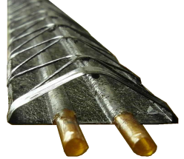
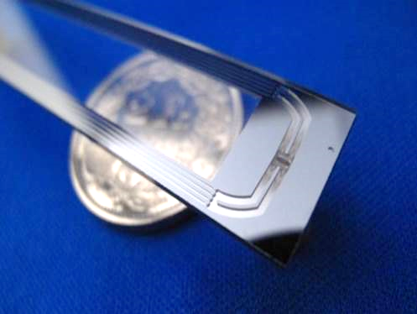
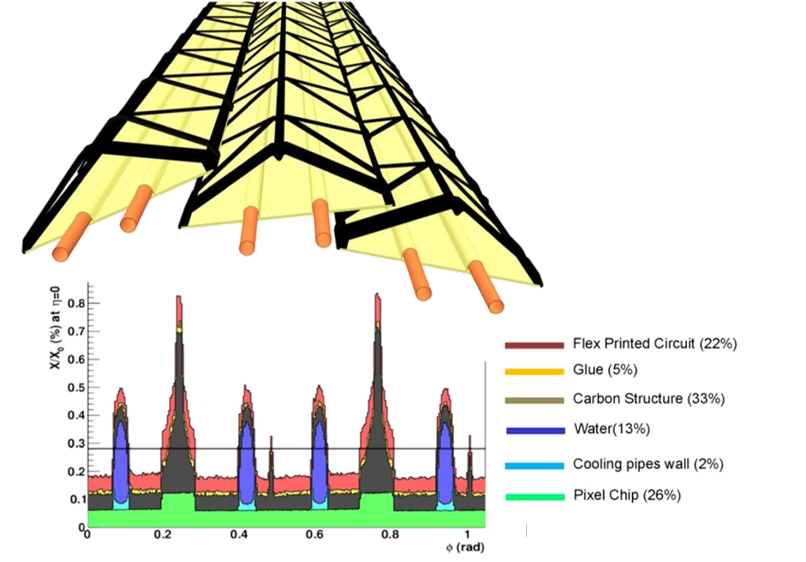
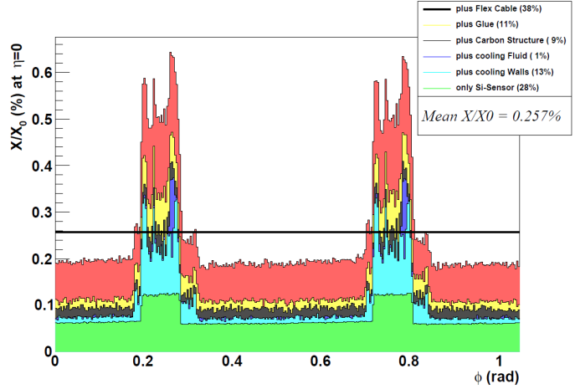
Lightweight Structures
Example: ALICE Inner Tracking System Upgrade
Radiation length X_{o} minimized through the use of a Carbon Fibre Structure
An average X₀ for a detector layer of X/X₀< 0.3% can be obtained,
including: Structure, Pixel Chip, Flex Printed Circuit, Coolant
An alternative desing using microchannel cooling under study
With micro-channel cooling
11

Slide 12
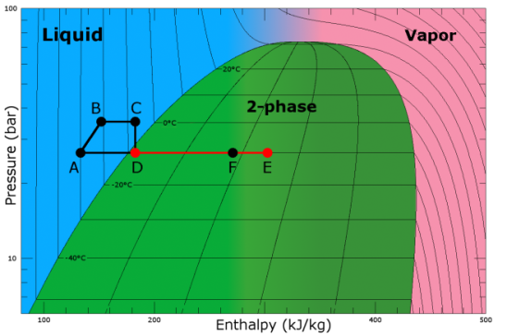
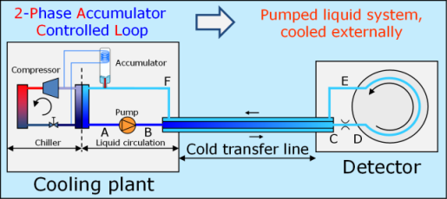
Thermal Management: CO₂ cooling
Several advantages brought in by CO₂ refrigeration (compared to standard freon like fluids) recently led the LHC experiments to select this fluid for the thermal management of cold-operated semiconductor detectors:
DETECTOR
High heat transfer capability
T stability due to high P
Smaller pipes
  Reduced insulation
  Reduced material budget
INFRASTRUCTURE
Smaller pumps
Lower installation costs
More economical operation
Lower energy consumption
Reduced carbon footprint (environmentally friend)
‒50˚C
‒40˚C
‒30˚C
‒20˚C
‒10˚C
0˚C
+10˚C
+20˚C
+30˚C
Selected thermodynamic cycle: “2PACL”.
Special case of “2-phase pumped cycles”, increasingly used in industry for high power electronics application.
Main advantages of these cycles:
Absence of compressor;
Absence of active components in the detector loop;
High thermal stability in operation;
Simple regulation required.
70 bar
+30˚C
60 bar
+20˚C
50 bar
+10˚C
40 bar
0˚C
30 bar
20 bar
‒20˚C
‒30˚C
10 bar
‒40˚C
‒50˚C

Slide 13
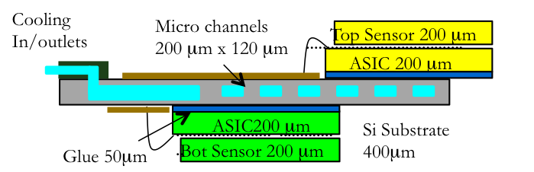
Thermal management
On-detector thermal management
requires novel materials and solutions
to achieve better performance and
higher radiation tolerance
    “known solutions” need to be re-qualified
    Novel solutions for small areas:
    micro-channel cooling, very compact
CO₂ cooling is the chosen technology
    Positive experience with LHCb VELO
    ATLAS IBL and CMS Pixel cooling systems
    have been constructed
    Large step forward needed for the ATLAS/CMS phase-2 trackers
LHCb VELO upgrade
 | Temp [ºC] | Cooling power [kW]
LHCb VELO | -25 | 1
CMS pixels | -30 | 15
ATLAS/CMS Trackers | -35 | 100
Centralized development for the cooling plants is a must
Organization already in place, centered at CERN in PH-DT.

Slide 14
Future CO₂ cooling plants at the LHC
2014
CMS Pix-Ph1:
2 x 15 kW independent plants for 2 detectors
Temporary swapping back-up possibility
T = -25 ˚C
ATLAS IBL:
1+1 plants with swapping possibility
Each unit 3.3 kW @ -35 ˚C
LS2 (2019)
LS3 (2023)
(preliminary ideas)
LHCb Velo + UT:
2 x 7 kW independent plants for 2 detectors
Temporary swapping back-up possibility
T < -30 ˚C
Plants installation in EYETS 2016/17
ATLAS ITK :
5+1 plants with swapping possibility
Each unit 30 kW @ -35 ˚C
Very large CO₂ volumes!
CMS TRACKER & HGCal:
(3+1) + (4+1) plants with swapping possibility
Each unit 45 kW @ < -30 ˚C
Very large CO₂ volumes!
Additional unit for partial detector tests on surface
CO₂ plant capacity: tens of kg
Consolidation of studies on:
Long vertical evaporators
Balancing of large number of loops
Plant swapping philosophy and control
Applied R&D on:
Dynamic modeling and simulation
Accumulation / Transfer lines
30-45 kW units
Smooth plant swapping (spare!)
Technical efforts on:
Space and infrastructure definition
Hardware components
Consolidation of technology +
Lessons from ATLAS & CMS operation +
Dedicated studies on:
Long vertical evaporators
Balancing of mchannel loops
Refined evaporating line models
CO₂ plant capacity : hundreds of kg (to be defined)

Slide 15
Scintillator-based
Detector Developments
Planned for LHCb tracking system and
CMS calorimeter system upgrades

Slide 16
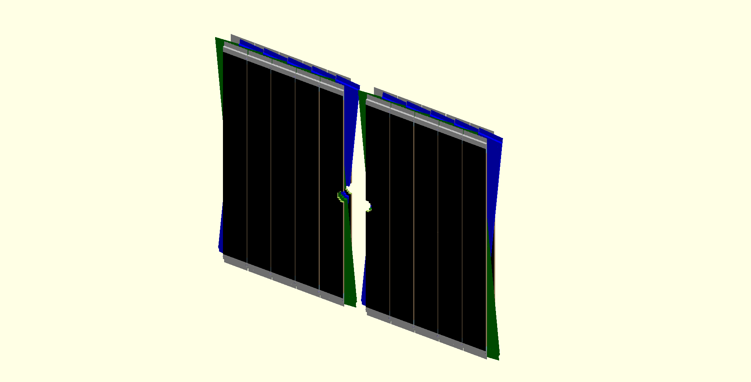
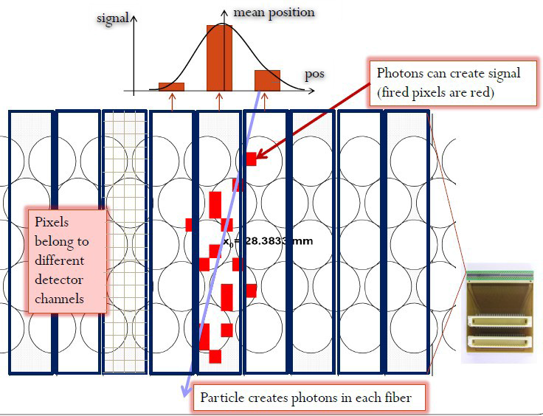
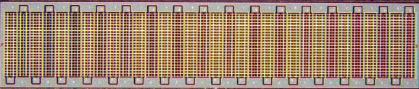
Scintillating Fibre Tracker for LHCb
3 stations of X-U-V-X (±5º stereo angle) scintillating fibre planes
every plane made of 5 layers of Ø=250 µm fibres, 2.5 m long
40 MHz readout and Silicon PMs at periphery
SiPM readout
Scint.-fibre mat (5-6 layers)
2 x ~ 2.5 m
fibre ends
mirrored
1.25 mm
SiPM readout
1 SiPM channel
SiPM array
2 x ~3 m
Notes:
Photons create signal, fired pixels are red

Slide 17
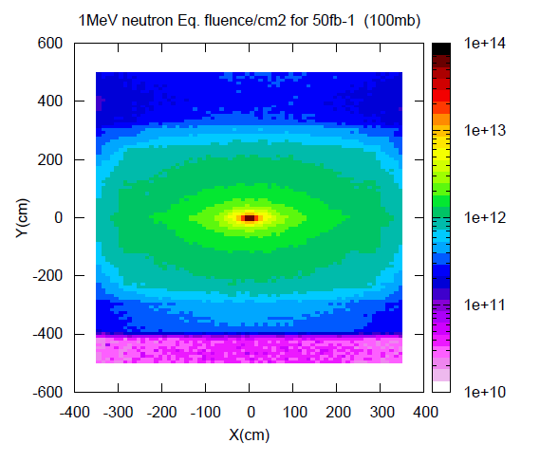
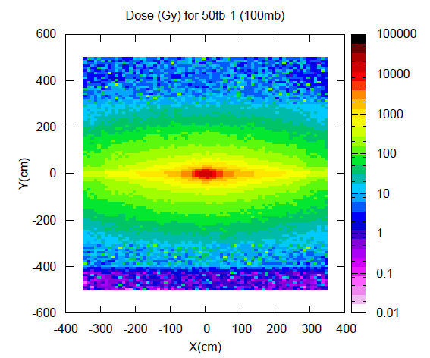
Main requirements on the SciFi tracker
LHCb FLUKA simulation
Performance requirements
high hit efficiency (~99%)
low noise cluster rate (<10% of signal )
σ_{x} < 100μm (bending plane)
X/X0 ≤ 1% per detection layer
Constraints
40MHz readout
geometrical coverage: 6(x) x 5(y) m²
  - large size – high precision, O(10’000 km) of fibres
radiation environment:
      ≤ 10¹² 1MeV n_{eq} / cm² and ≤ 80Gy
      at the location of the photo-detectors
      ≤ 35kGy peak dose for the scintillating fibres
→low temperature operation of photodetectors

Slide 18
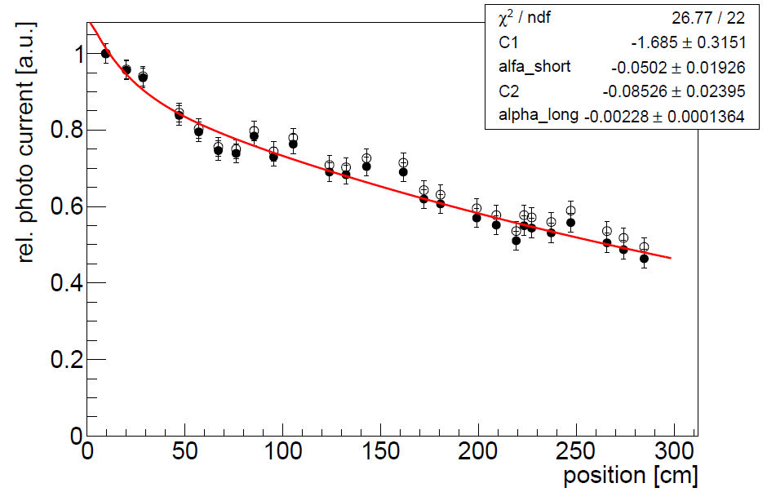
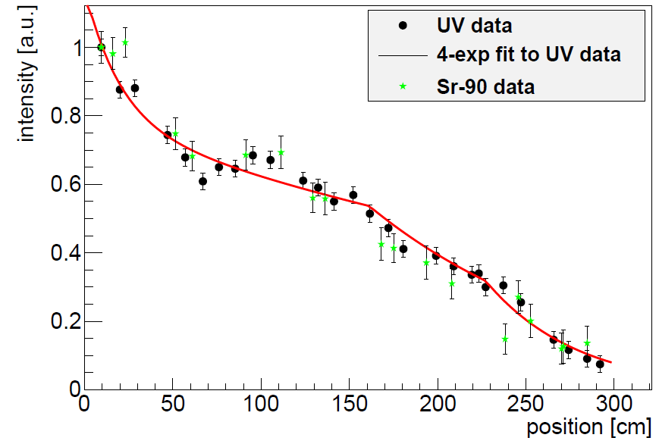
Radiation damage to scintillating fibres
Complex subject. Literature relatively poor and contradictory
Irradiation tests under conditions close to the ones met in the experiment are needed
Ionising radiation degrades transparency of polystyrene core (shorter att. length), but doesn't affect scintillation + WLS mechanism.
Example: LHCb irradiation test (2012)
  3 m long SCSF-78 fibres (Ø 0.25 mm), embedded in glue (EPOTEK H301-2)
  irradiated at CERN PS with 24 GeV protons (+ background of 5·10¹² n/cm²)
before irradiation
after irradiation
Λ_{l} = 126 cm
Λ_{l} = 439 cm
Λ_{l} = 422 cm
Λ_{l} = 52 cm
0 kGy
3 kGy
at 6.25 Gy/s
22 kGy
at 1.4 Gy/s

Slide 19
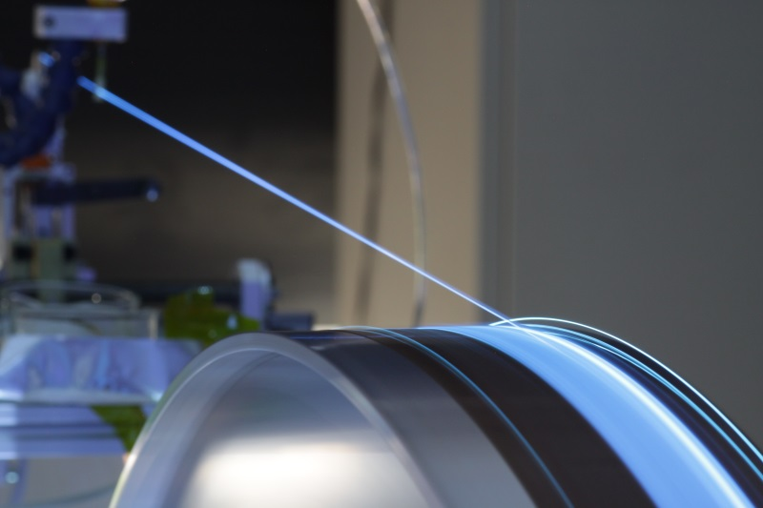
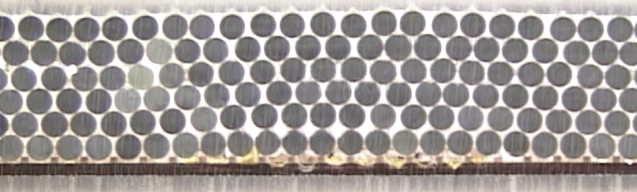
Geometrical precision of Fibre mats
Fibre mats are produced by winding fibres, layer by layer, on a fine-pitch threaded wheel
After partial polymerisation, the mat is cut and fattened for full polymerisation.
addition of very fluid epoxy glue, TiO2 loaded
feeder
~ Ø 900mm
~ 150 mm
~ 2800 mm
p = 270 μm
Fibre winding
Dedicated machine, in-house production
~150 mm

Slide 20
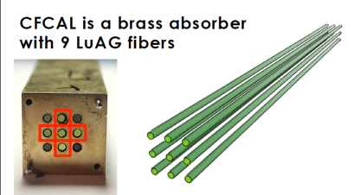
Integrated ECAL/HCAL R&D
High granularity Particle flow / Imaging Calorimetry (CALICE)
  high segmentation (transv.and longit.) to measure shower topology
Challenges and R&D:
  large number of channels (~ 10⁷)
  compact and inexpensive electronics, low power 40 MHz ADC, cooling
  development of high speed data links (10 Gbps) to transport large volumes of data
Dual ReadOut with Cerenkov/Scint. sampling detector (DREAM, RD52)
Ongoing R&D:
  Quartz fibers:
    Cerenkov radiator for Dual Readout
    Doped Quartz fibers for scintillation signal in Dual Readout Calorimeter
  Crystal fibers:
    doped inorganic crystal fibers, e.g. LuAG for scintillation light detection
    Undoped LuAG for Cerenkov light detection
Notes:
Cerenkov light Quartz fibres to sample EM part of the shower.
Scintillation signal to sample all components.

Slide 21
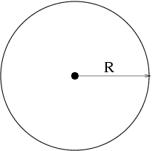


Gaseous Detector Systems
Widely used at the LHC experiments, especially for the large areas needed for the muon detection
Most of these systems belong to one of the three following configurations:
  Drift tubes
  MWPC (Multi Wire Proportional Chambers)
  RPC (Resistive Plate Chambers)
They are well known devices for many years …
… but several aspects have improved dramatically
  Readout electronics (integration, radiation resistance)
  Understanding and optimization of detector physics effects
  Improvement in ageing characteristics due to special gases
Geiger- Müller (1908), 1928
Drift Tube (1968)
G. Charpak, 1968
R. Santonico, 1980

Slide 22
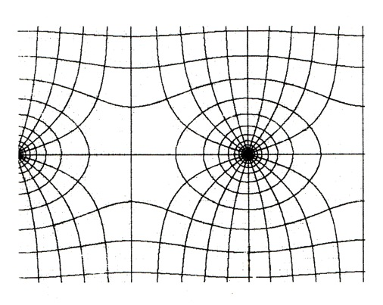
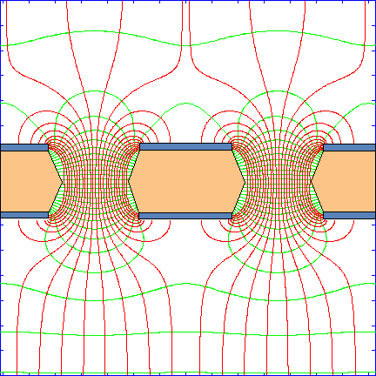
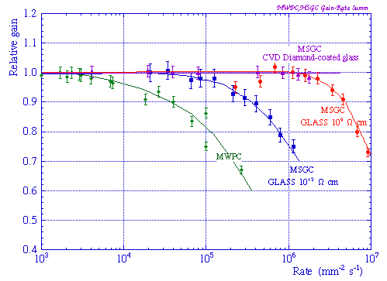
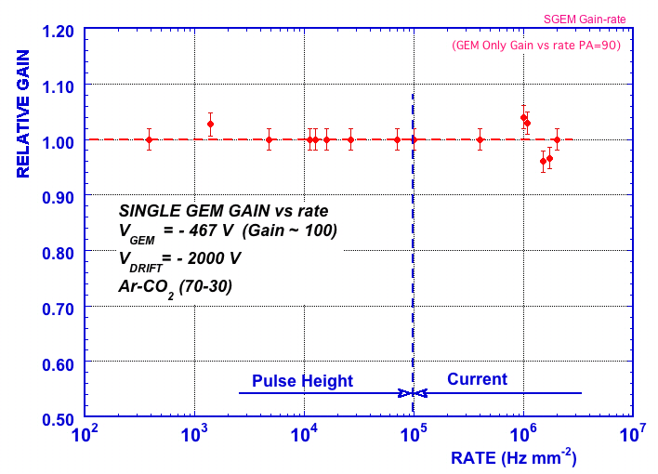
Micro Pattern Gas detectors
Limitations of wire-based chambers:
Resolution: reduction of wire spacing <1 mm difficult
Rate capability: limited by build-up of positive
space-charge around anode
Gas Electron Multiplier (GEM)
e⁻
~ 100 ns
I⁺
~ 100 µs
Reduction of cell size
by a factor of 10

Slide 23
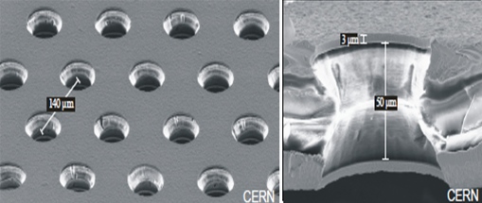
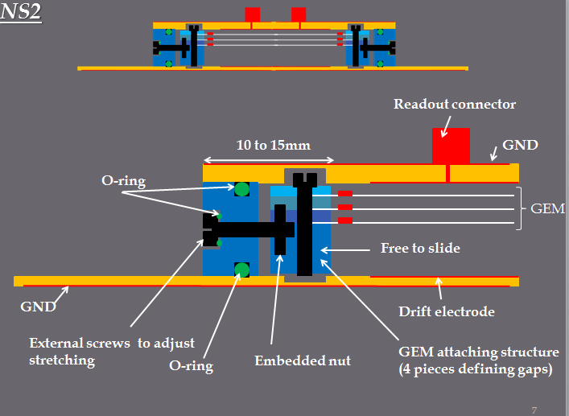
GEM Detector R&D
Triple GEM detectors have been used successfully in LHCb
(after ~10 years of R&D)
Main challenge now :
  build large systems (CMS and ALICE)
  larger foils, made with single sided etching technique
Industrialize production
Ongoing R&D:
Performance studies
  time and space resolution
Longevity
  ageing tests at GIF and GIF++
Stretching of foils without spacers
  Allows reopening of chambers
 | Detector surface | Foil Area
LHCb Muon system (now) | 0.6 m² | 4 m²
ALICE TPC | 32 m² | 130 m²
CMS Muon system | 335 m² | 1100 m²

Slide 24
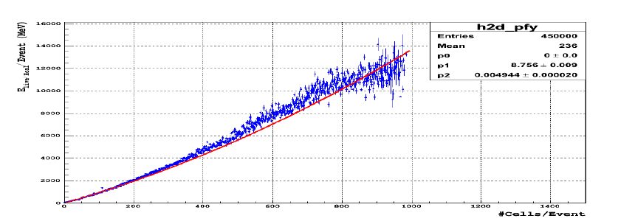
New GEM detector applications
ALICE TPC:
Replace wire chambers with quadruple-GEMs
MWPC not compatible with 50 kHz operation because of ion backflow in the field cage
Choice of quadruple-GEM detectors to minimize ion backflow ( < 1 % )
GEM
GEMs for calorimetry:
Digital calorimetry approach:
  Cell is either ON or OFF
High granularity for charged particle tracking
  1x1 cm² cells proposed
Requires development of Particle Flow algorithm
Good correlation between particle energy
and numbers of cells hits

Slide 25
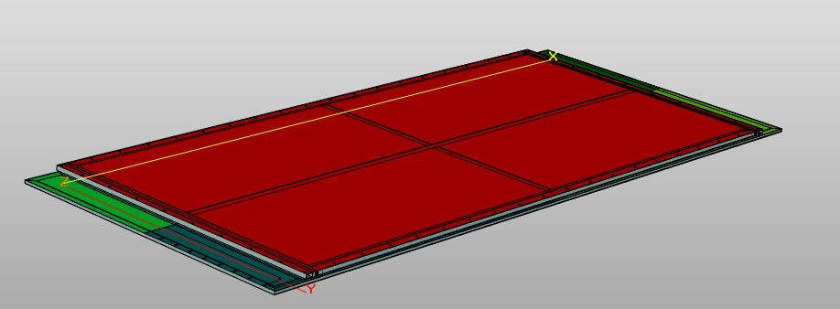
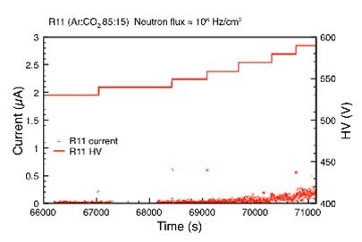
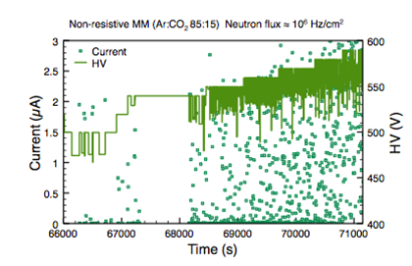
Micromega Detector R&D
Micromegas have been chosen as precision measurement and trigger detectors of the New Small Wheels of ATLAS
First large system based on Micromegas
  Detector dimensions: 1.5–2.5 m²
  A total of ~1200 m² of detection layers
  ‘Floating mesh’ technique used for chamber construction
Breakthroughs and on-going R&D:
Resistive strips to reduce discharges
µTPC operation mode to get good spatial resolution for inclined tracks
3D view of the first large (1 x 2.4 m²) MM chamber

Slide 26
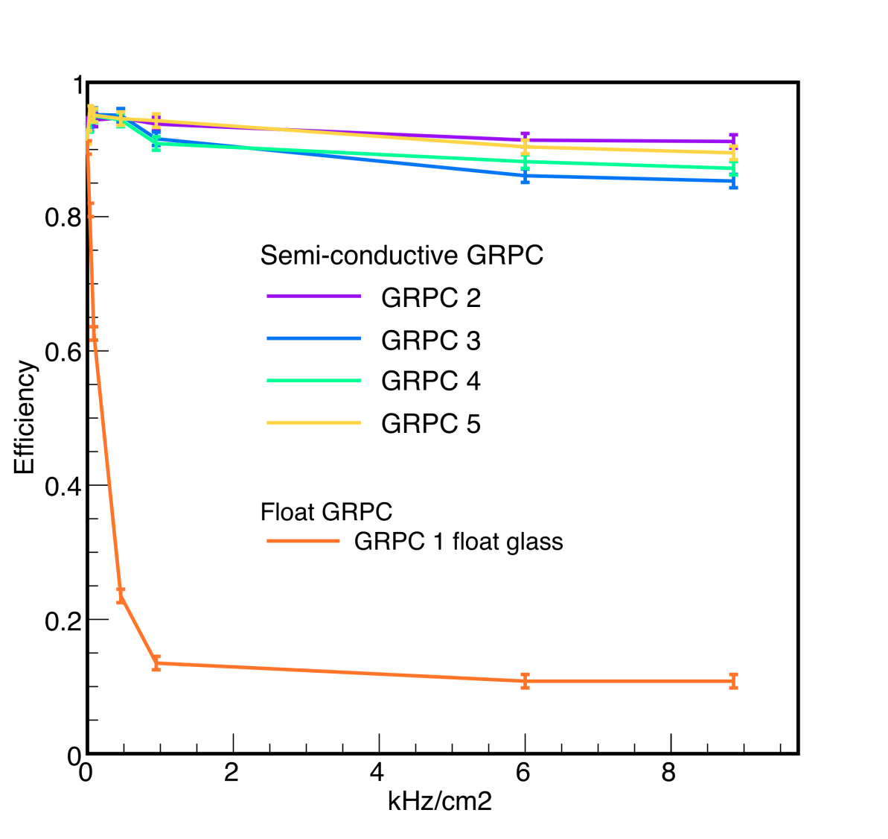
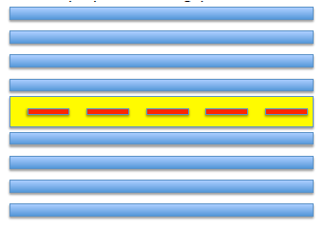
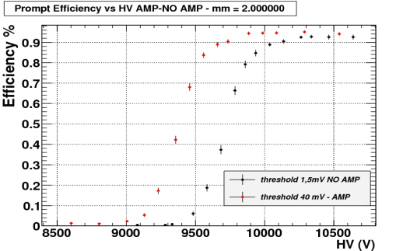
R&D to Improve RPC (iRPC)
Main goal: Improve rate capability
Reduce the electrode resistivity
  “low” resisitivity (10¹⁰ Ωcm) glass (lowest resistivity usable 10⁷Ωcm)
  Needs important R&D on electrode materials
Change the detector configuration
  Go to ‘double-triple gap’ option
    Improves the ratio:
    induced signal/charge in the gap
    Rate capability ~ 30 kHz/cm²
    Time resolution 20-30 ps
Change the operating conditions
  reduces the charge/avalanche,
  part of the needed amplification transferred from gas to FE electronics
  Needs an improved detector shielding against electronic noise
Improved electronics
“Standard” electronics

Slide 27
Electronics

Slide 28
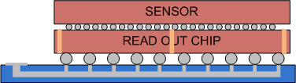
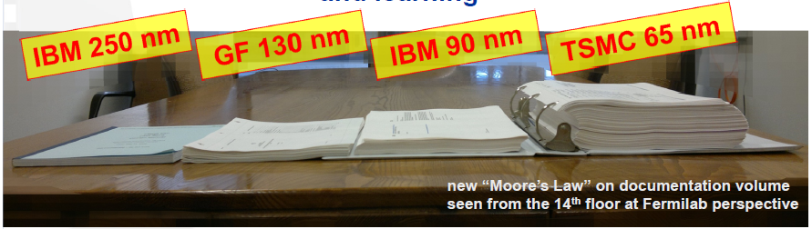
IC designs and HD interconnects
On-detector electronics 100% custom made with highly specialized complex ASICs that must work reliably in unprecedented hostile radiation environments for many years.
ASICs in 130 nm – good progress already, but still a lot of work ahead
ASICs in 65 nm new for HEP – huge amount of work, including special radiation qualification for extreme conditions (ATLAS/CMS pixels)
Must be a collaborative effort –
RD53 established
Increased channel densities makes High Density Interconnect (HDI) technologies increasingly critical
High density interconnects:
  hybrid substrates, bump-bonding, Through Silicon Vias (TSV)…
Investigate and qualify vendors with suitable products, interested in our volumes and budgets
Often project-specific. Share information and experience.
Use of TSV
Notes:
TSV instead of wire bonds

Slide 29
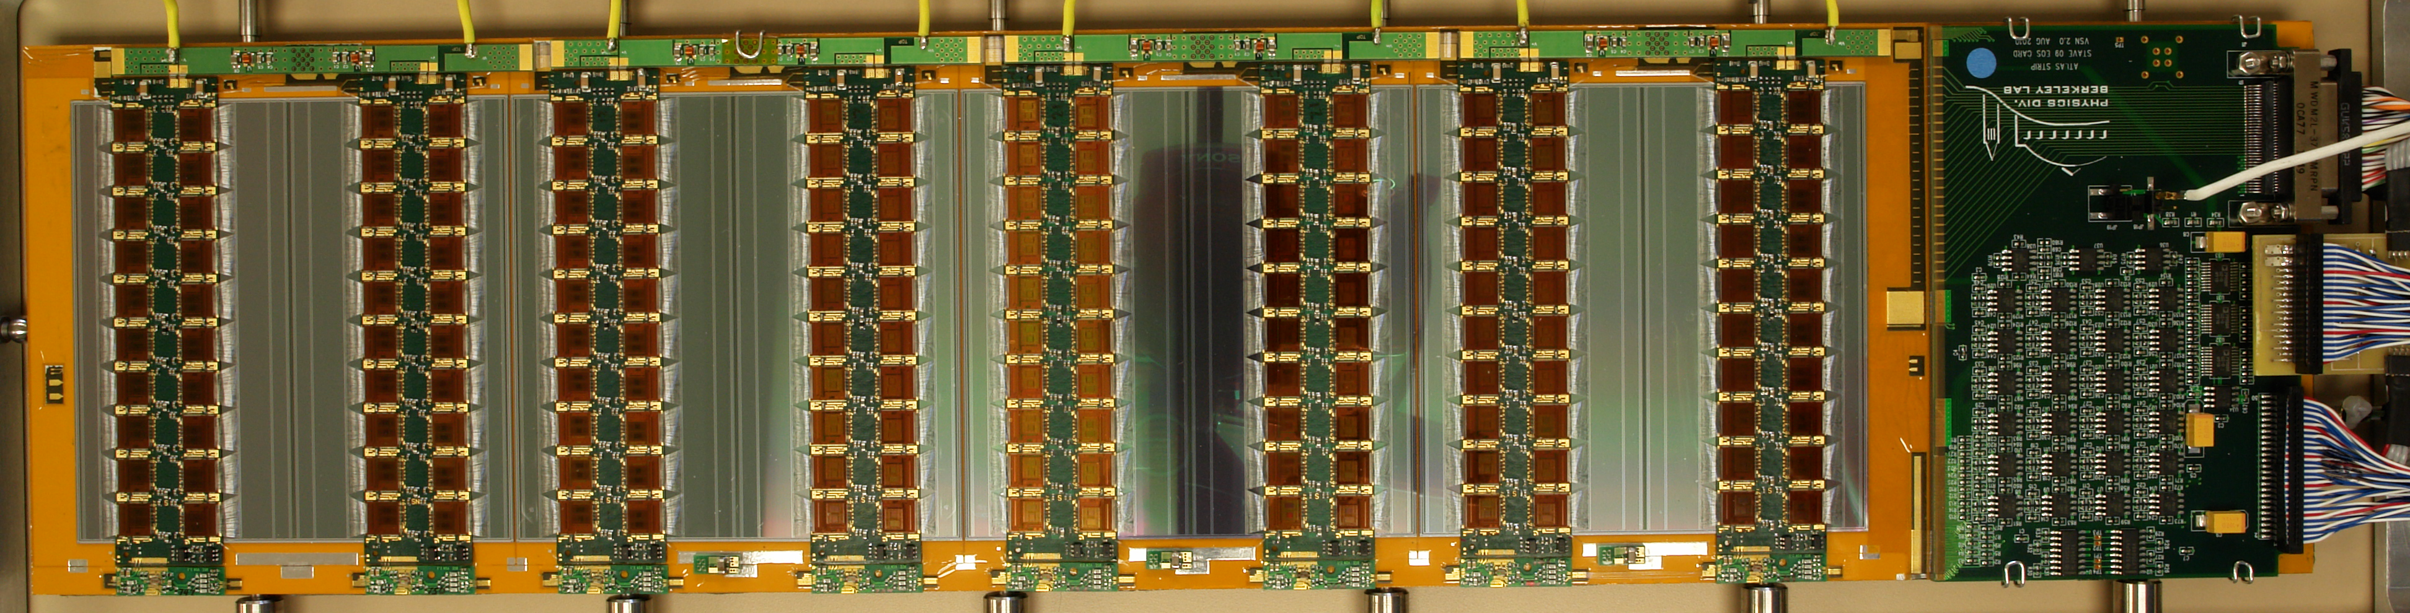
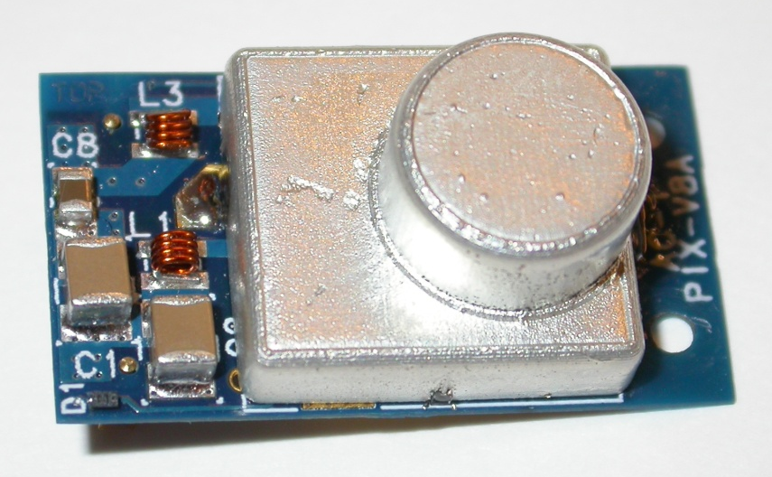
Power Distribution R&D
Two main power strategies being explored for the HL-LHC
  Serial Powering
  DC-DC Buck converters
In addition
  Switched capacitor DC-DC
Necessary to continue work on all
  Overall efficiencies of > 80% can be obtained
Continued support is needed to deliver suitable parts in time
  Bulk supplies
  Evaluation of larger Serially Powered systems
  Low mass DC-DC Buck Converters with increased radiation tolerance
  Identification of “HV” switch transistors for sensor bias applications
Example Serial Powering:
  ATLAS Strip staves
Ex. DC-DC buck converter
  CMS Pixel upgrade
OV
2.5V
5V
7.5V
10V

Slide 30
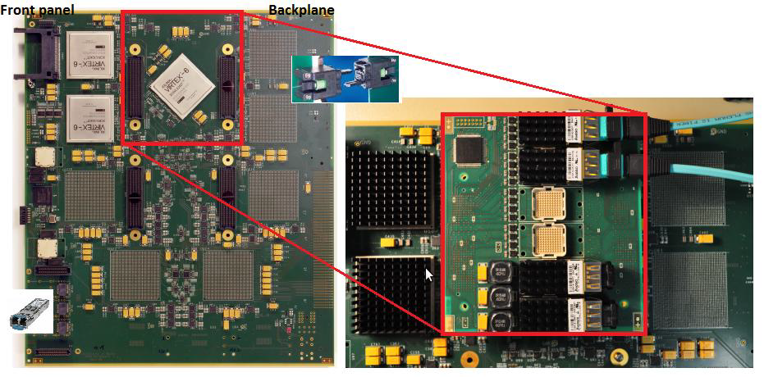
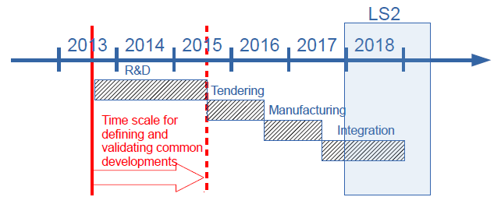
Modular Electronics
xTCA and its sub-standards:
  ATCA (2002): ATLAS, LHCb, ILC, …
  μTCA (2006): CMS, XFEL
  favoured candidate as successor of VME
  Tight roadmap to define and test common developments
Next steps:
Manpower and tools needed to develop common solutions and support them
Raising the competence of developers community will take time
Many coordinating actions already started, but lots to be done
xTCA Interest Group should play a major role
Example: ATLAS Calorimeter Trigger Topological Processor Card
Alternatively development of high bandwidth system based on PCIx cards in “commodity” PCs to interface detector specific front-end to DAQ systems on a switched-network.
Notes:
Advanced Telecommunications Computing Architecture ATCA

Slide 31
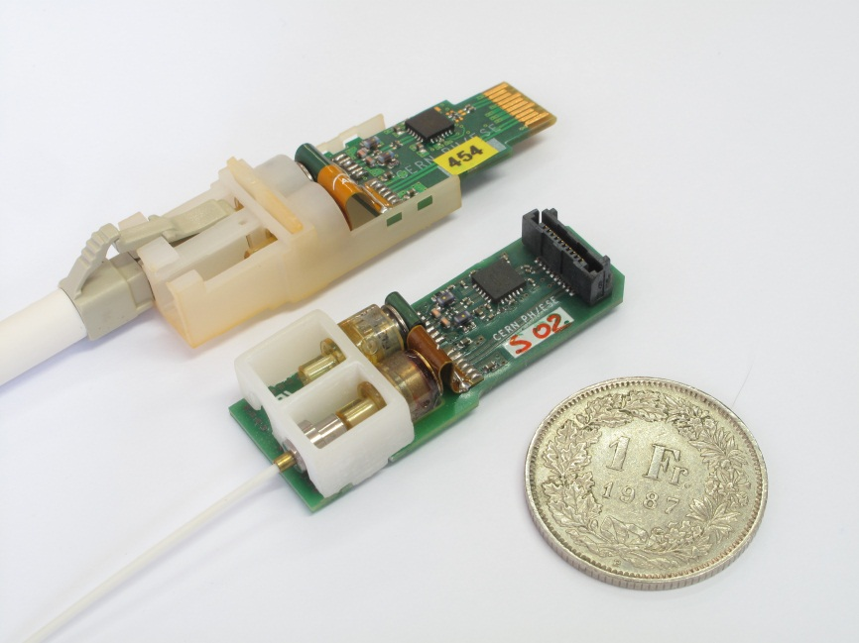
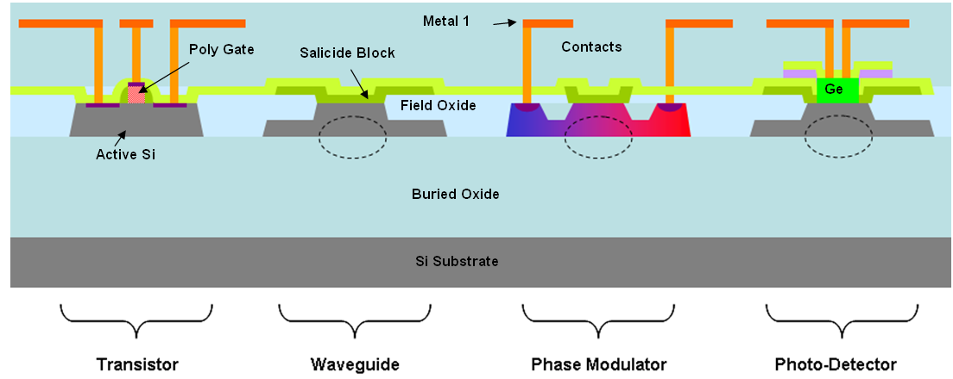
High speed Link R&D
High speed links (≳10 Gbps) are the umbilical cords of the experiments
Meeting the HL-LHC challenge requires:
  Qualifying new technologies and components
  Designing electronics, interconnects, packages and perhaps even optoelectronics
  Maintaining expertise, tools and facilities
  Investing heavily with a few selected industrial partners
Development time remains very long (~6y) in comparison to industry.
HL-LHC environment is unique and requires specific R&D and qualification procedures.
  Shrinking of GBT package size to smaller footprint
  Exploratory Project on Si-photonics for HEP applications
VTRx
SF-VTRx

Slide 32
Trigger / DAQ / Offline / Computing

Slide 33
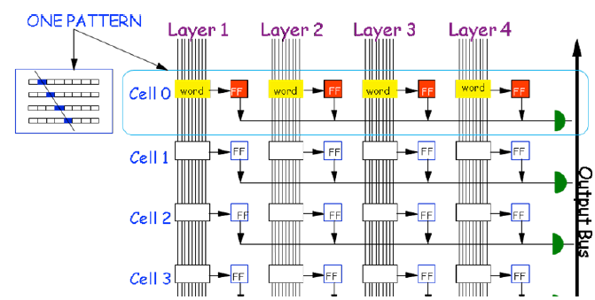
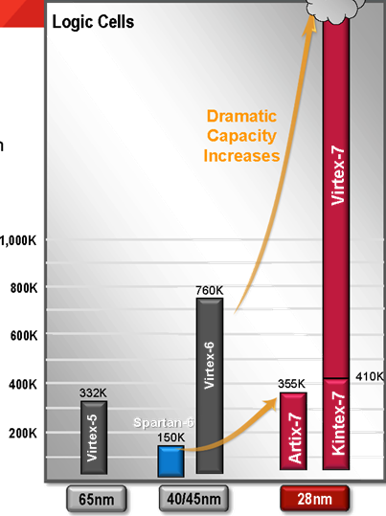
Trigger Developments
Tracking Triggers
  ATLAS: L1 trigger at 500KHz within 20 μs; ‘pull path’
  CMS: L1 trigger at 40MHz within 10-20μs; ‘push path’
Challenges:
  Complex pattern recognition over very large channel counts with short latency and no dead time (clock/event pipelined).
  Highly challenging connectivity and processing problem
Tools:
Pattern Recognition Associative Memory (PRAM)
    Match and majority logic to associate hits in different detector layers to a set of pre-determined hit patterns
    highly flexible/configurable
  Challenges:
    Increase pattern density by 2 orders of magnitude
    Increase speed x 3 (latency)
FPGAs:
  Challenges:
    Latest generation FPGAs create complex placement issues
    Embedded Processors, moving tasks from FPGA to SW design
Associative memories for pattern matching
2.000k Logical Cells
Notes:
ATLAS: Region of Interest Trigger. ‘pull path’
CMS: Self Seeded Trigger. ‘push path’

Slide 34
Trigger / DAQ Overview
 | ALICE | LHCb | CMS | ATLAS
Hardware trigger | No | No | Yes | Yes
Software trigger input Rate | 50 kHz Pb-Pb 200 kHz p-Pb | 30 MHz | 500/750 kHz for PU 140/200 | 400 kHz
Baseline processing Architecture | CPU/GPU/FPGA Cloud&Grid | CPU farm (+coprocessors) | CPU farm (+coprocessors) | CPU farm (+coprocessors)
Software trigger output rate | 50 kHz Pb-Pb 200 kHz p-Pb | 20-100 kHz | 5-7.5 kHz | 5-10 kHz

Slide 35
Trends in HLT & DAQ
Event building architectures for
cost effective large bandwidth
networks are required
  Profit from progress in PC evolution for PC server architecture
Tools:
HLT Specialized Track Processing
  Various options, e.g. GPU.
    Depends on resources available, CPU and link speed
Use of New Processors in HLT
  ARM, Nvidia Tesla (GPU), Xeon Phi…
HLT on the Cloud
  e.g. share resources between HLT & Tier-O
Merging of HLT & offline software development
 | Event size [kB] | L1 Rate [kHz] | Bandwidth [Gb/s] | Year [CE]
ALICE | 20000 | 50 | 1000 | 2020
ATLAS | 4000 | 400 | 1600 | 2025
CMS | 4000 | 750 | 3000 | 2025
LHCb | 100 | 30000 | 3000 | 2020

Slide 36
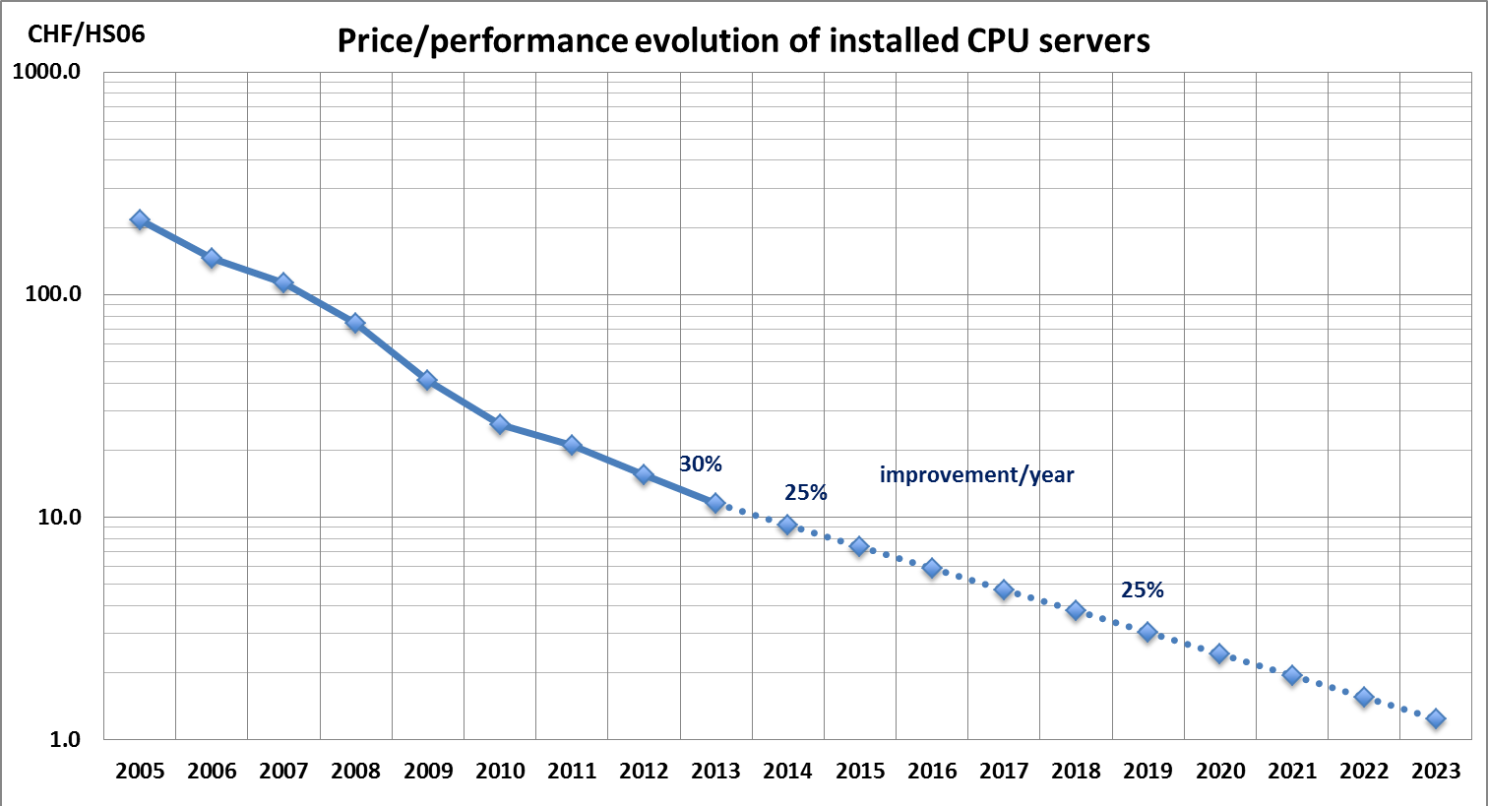

Technology Trends in TDAQ & Computing
HEP profit from industrial developments
We expect current performance rates (and price performance improvements) will hold at least until 2020
  25% performance improvement per year in computing at constant cost.
  Only if our efficiency in using the resources
  remains constant as well!
  Local area network and link technology show a similar trend as processors.
  20% price-drop per year at constant capacity expected for disk-storage.
Far beyond LS2 the technical challenges for further evolution seem daunting.
Nevertheless, the proven ingenuity and creativity of IT justifies cautious optimism.

Slide 37


Trends in Computing
Resources needed for Computing at the HL-LHC are large – but not unprecedented.
Development of the WLCG was a great success.
Experiments are proposing to build very large computing online facilities that could be potentially used for offline computing.
Virtualization and Clouds may help
  reducing the complexity of the Grid middleware
  fully utilizing resources.
Cloud federation may be a way to build our next Grid
Virtualization is the key
technology behind the Cloud

Slide 38


Software Trends
Future evolution of processors: many cores with less memory per core, more sophisticated processor instructions (micro-parallelism),
  Parallel framework to distribute algorithms to cores
  Optimization of software to use high level processor instructions
LHC experiments software has more than 15 million lines of code, written by more than 3000 people
A whole community to involve, starting essentially now
Revisiting code is a good opportunity to share effort and software
We can do much more: http://concurrency.web.cern.ch
Concurrent event-processing
Notes:
performance gap between sequential applications and those tuned to utilize parallel capabilities of modern CPUs

Slide 39
Conclusion Lecture VI
The radiation environment in which the experiments have to operate reliably poses an always greater challenge.
Work in the R&D collaborations has been very beneficial for the advancement of many detector technologies.
There is an increasing integration of the sensors, its electronics and detector cooling in the case of Tracking Systems.
Technologies for ASIC design are increasingly complicated to use. Significant R&D manpower and resources are needed at an early stage.
The challenges in terms of computing and software design should not be underestimated. Common developments across the experiments are important.

Slide 40
The High-luminosity LHC is an exciting project at
the high-energy frontier of particle physics with
an enormous physics potential.
The challenges to realize the project on the side of the
accelerator and the experiment are great, but manageable…
…with many possibilities to contribute.

Slide 41

Is this a sun-rise or a sun-set?
Thank you for your attention !
… and for organizing the meeting in a nice place and inviting me to join !

