Slide 1
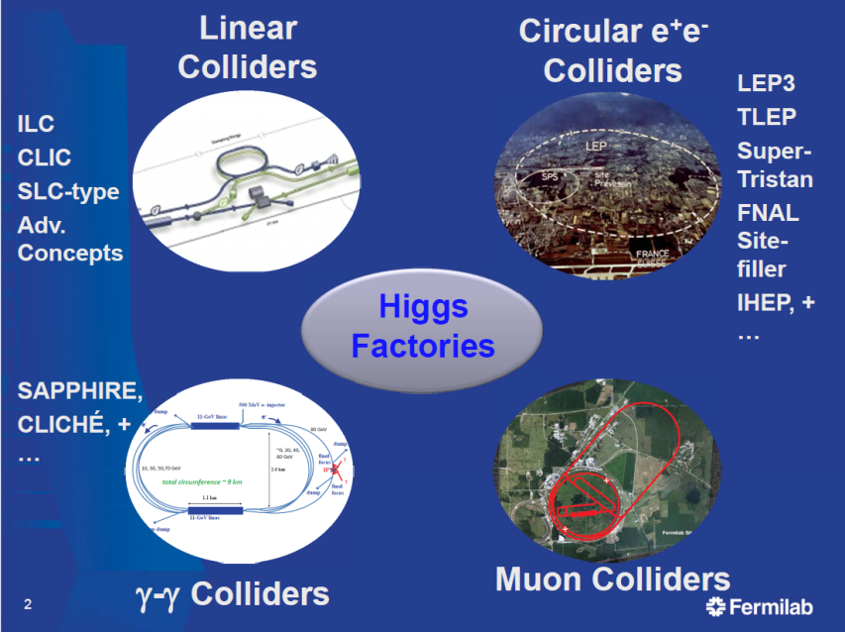
Future High Energy lepton colliders --2
LEP
CEPC
FCC-ee

Slide 2
WHY DO WE NEED FUTURE e+e- COLLIDERS ?
WHICH ONE IS BEST SUITED FOR THE NEEDS OF PHYSICS?
Lets have a quick look today at the physics landscape
Then we will discuss the accelerators themselves
and talk about Higgs Factories
Tomorrow we will discuss precision measurements
and (heavy) neutrino physics, and conclude

Slide 3
Why do we need a new machine after and in addition to HL-LHC?
YESTERDAY
1. the Higgs boson itself
σ_{i→f} ^{observed} ∝ σ_{prod} (g_{Hi} )²(g_{Hf})² difficult to extract the couplings because
Γ_{H} σ_{prod} uncertain and Γ_{H} is unknown
2. There might be other Higgs bosons or other generation of masses
which modifiy the properties of the Higgs (126) by small amounts
-> want to measure H properties as well as possible (10⁻³)
3. New physics with small couplings is difficult to see at the LHC
4. Precision measurements are limited at LHC,
yet precision measurements at LEP were used to predict
the top quark and Higgs boson masses
Can we improve the measurements by large factors?
5. In the following we will examine what we can learn from a next e+e- collider
TODAY

Slide 4
Before we start let us look at some pretty events in e+e- collisions
from a REAL experiment (ALEPH 1989-200)

Slide 5
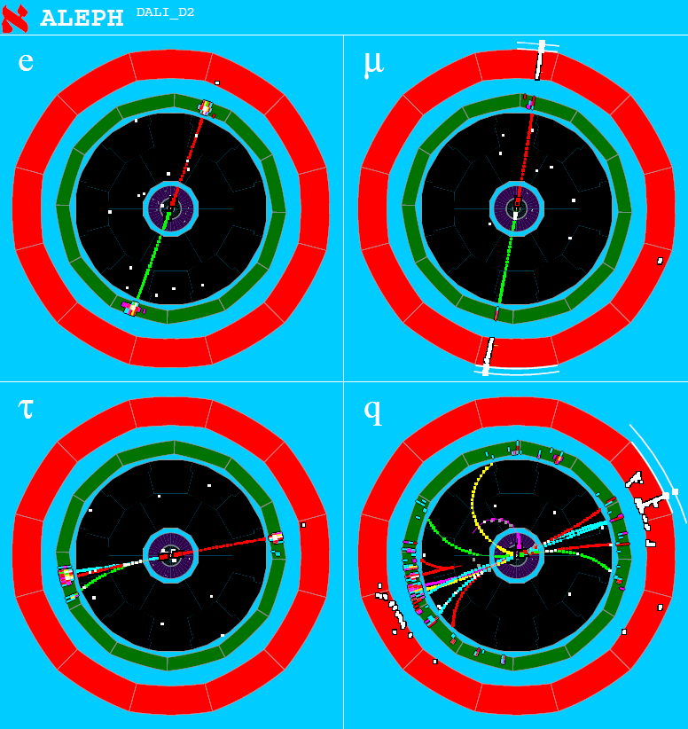
Z decays

Slide 6
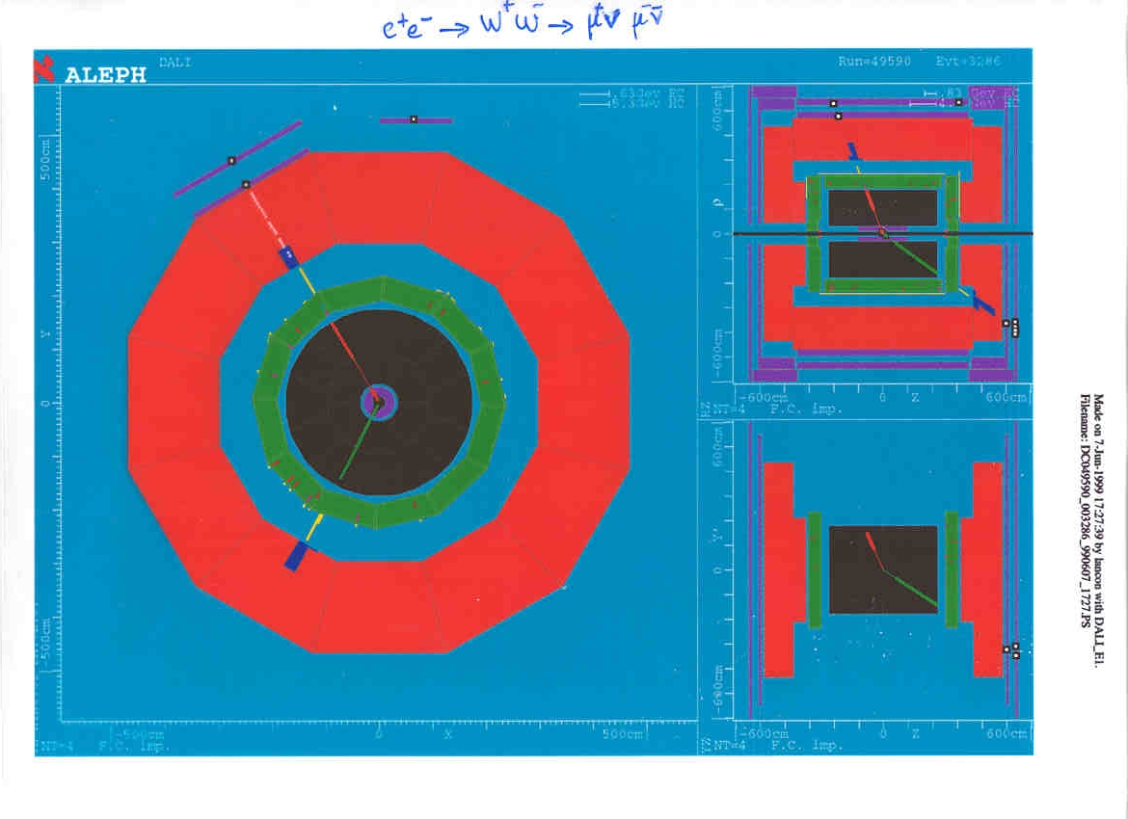

Slide 7
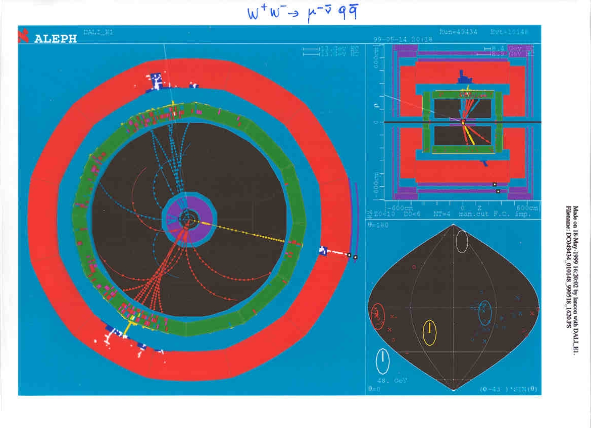

Slide 8
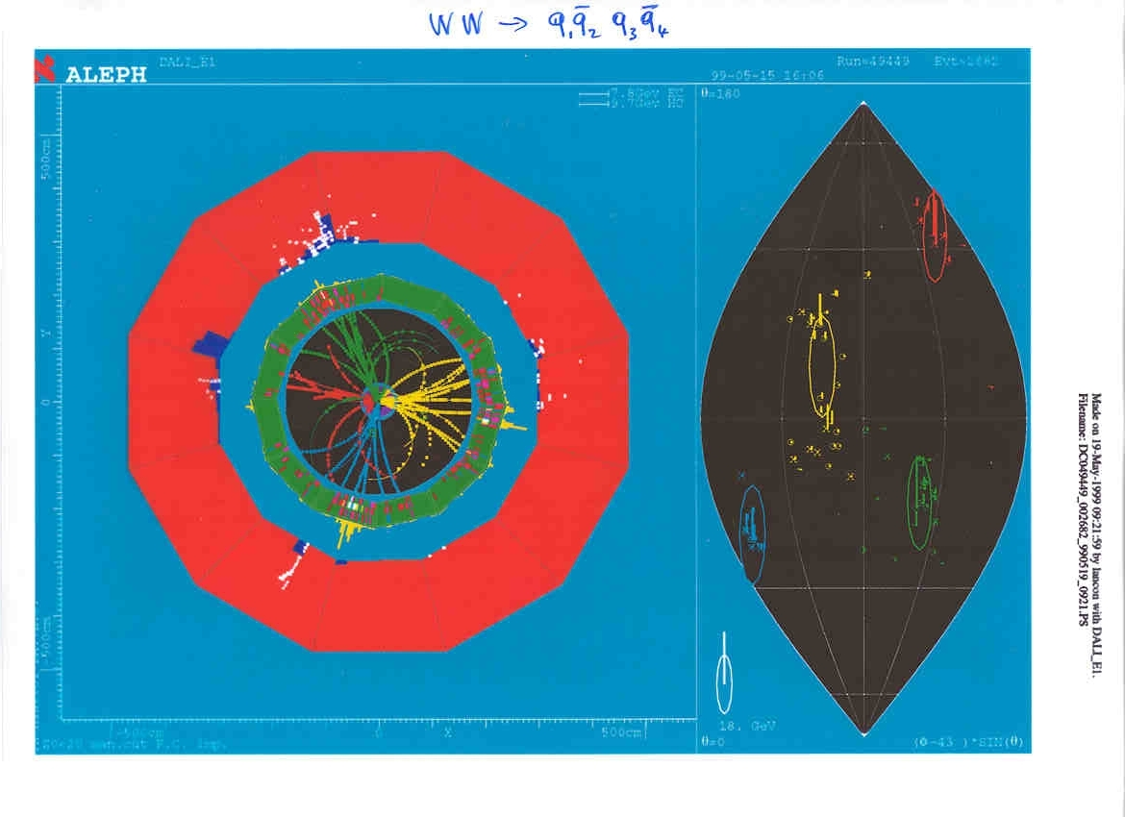

Slide 9
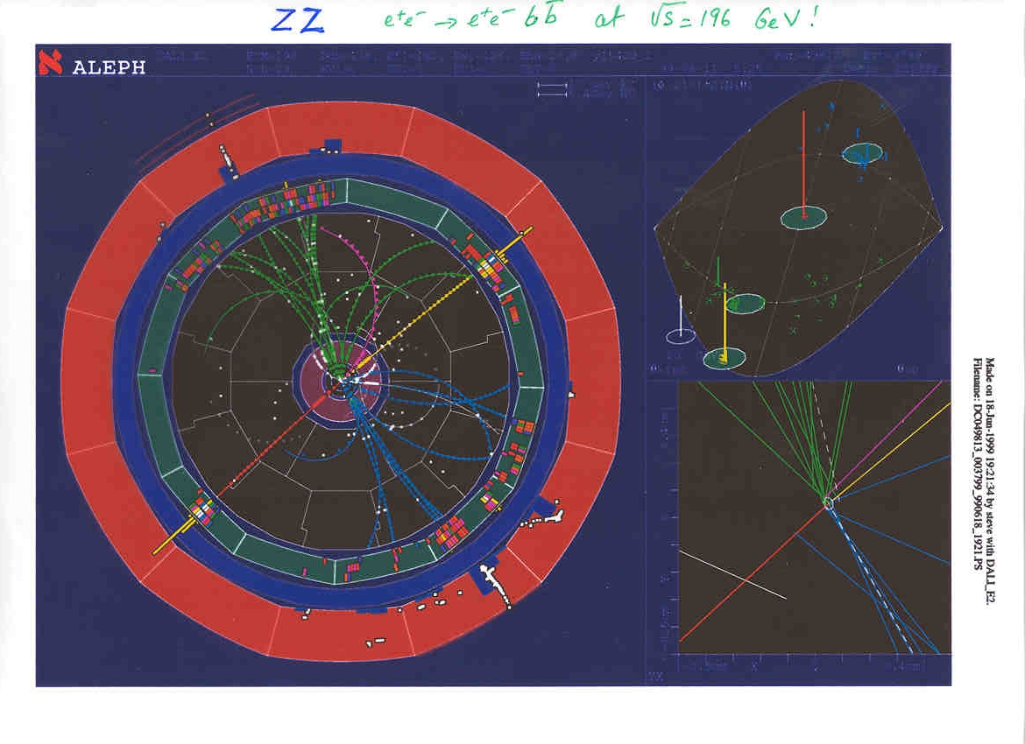

Slide 10
ELECTROWEAK PRECISION TESTS (EWPT)
The standard model is entirely defined by
--1 The 3 coupling constants α_{QED} , α_{W} = α_{QED} /sin²θ_{W} , α_{s}
--2 The structure of the theory and the particle content
--3 The particle masses, all related to the Higgs boson v.e.v. <v>
--4 The mixing angles (CKM and neutrinos, are all known)
Any deviation from the SM is proof of new physics
NB Instead of sin²θ_{W} and <v>,
use m_{Z} and G_{F} ,
which are very well measured
Due to the non-abelian Gauge theory, High Energy Electroweak observables
offer sensitivity to electroweakly coupled new particles ...
-- if they are nearby in Energy scale
or
-- if they violate symmetries of the Standard Model (in which case, no «decoupling»)
Higgs boson and top-bottom mass splitting constitute such symmetry violations
Now that the m_{H} and m_{top} are known, all of this is completely defined!

Slide 11
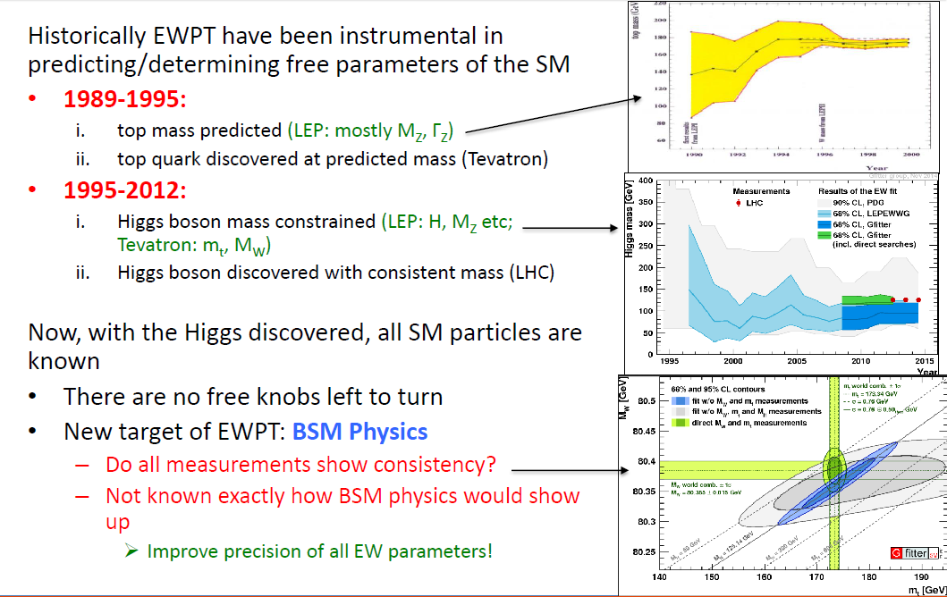

Slide 12
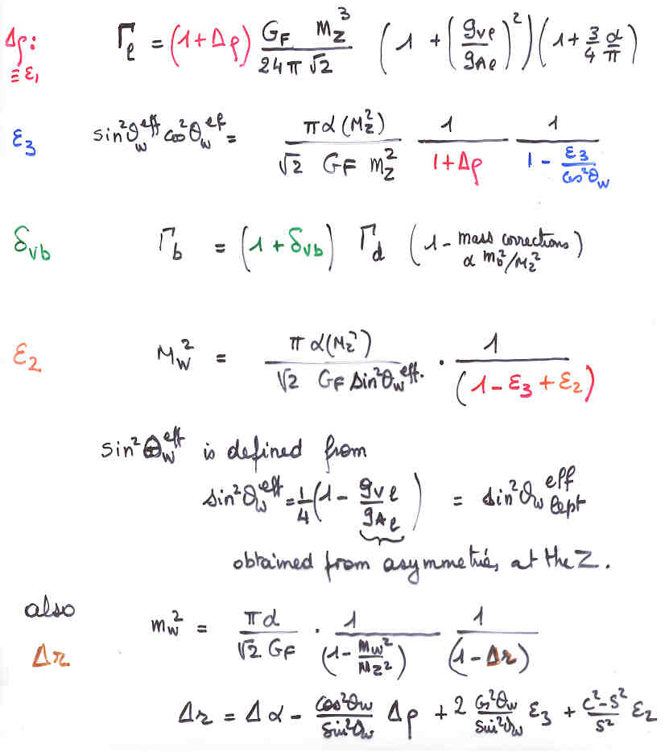
EWRCs
Input G_{F} m_{Z} α_{QED}
Radiative corrections affect the
relationship between the
input quantities and the others.
at first order:
Δρ = α /π (m_{top}/m_{Z})²
- α /4π log (m_{h}/m_{Z})²
ε₃ = cos²θ_{w} α /9π log (m_{h}/m_{Z})²
δ_{νb} =20/13 α /π (m_{top}/m_{Z})²
complete formulae at 2d order
including strong corrections
are available in fitting codes
e.g. ZFITTER , GFITTER

Slide 13
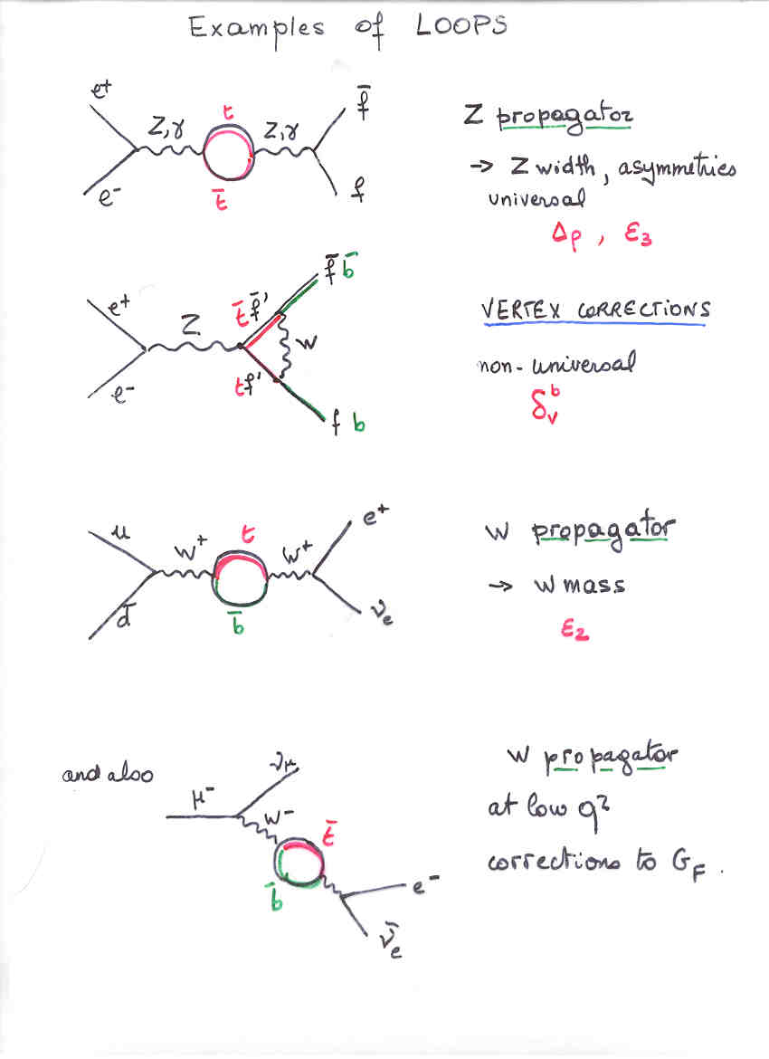

Slide 14

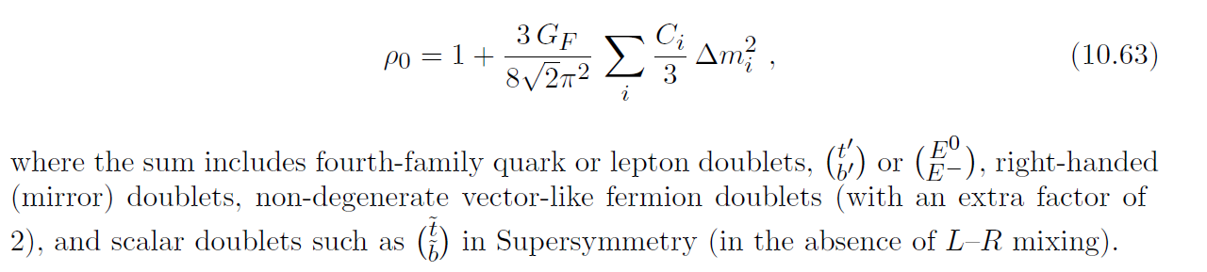
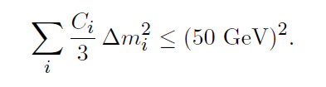
Example (from Langacker, Erler PDG 2014)
Δρ =ε₁=α(M_{Z}) . T
ε₃=4 sin²θ_{W} α(M_{Z}) . S
From the EW fit
Δρ = 0. 0004 +- 0.00024
-- is consistent with 0 at 1.7σ (0= SM)
-- is sensitive to non conventional Higgs bosons (e.g. in SU(2) triplet with ‘funny v.e.v.s)
-- is sensitive to Isospin violation such as m_{t} ≠ m_{b}
Measurement implies
The larger possible mass splitting of an SU(2) doublet is 50 GeV
no matter what its mass is.

Slide 15
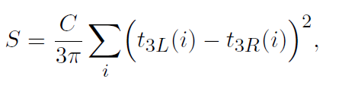
Similarly
Would be sensitive to a doublet of new fermions where Left and Right have different masses etc… (neutrinos are already included)
Note that often EW radiative corrections do not decouple with mass => a very powerful tool of investigation
Δρ = α /π (m_{top}/m_{Z})² - α /4π log (m_{h}/m_{Z})²
ε₃ = cos²θ_{w} α /9π log (m_{h}/m_{Z})²
δ_{νb} =20/13 α /π (m_{top}/m_{Z})²

Slide 16
NB Instead of sin²θ_{W} and <v>,
use M_{Z} and G_{F} ,
which are very well measured
The main players
Inputs:
G_{F} = 1.1663787(6) × 10⁻⁵ /GeV² from muon life time 6 10⁻⁷
M_{Z} = 91.1876 ± 0.0021 GeV Z line shape 2 10⁻⁵
α = 1/137.035999074(44) electron g-2 3 10⁻¹⁰
EW observables sensitive to new physics:
M_{W} = 80.385 ± 0.015 LEP, Tevatron 2 10⁻⁴
sin²θ_{W}^{eff =} 0.23153 ± 0.00016 WA Z pole asymmetries 7 10⁻⁴
+ Γ Rb etc...
Nuisance paramenters:
α (M_{Z}) =1/127.944(14) hadronic corrections 1.1 10⁻⁴
to running alpha
α_{S} (M_{Z}) =0.1187(17) strong coupling constant 1.7 10⁻²
m_{top} = 173.34 ± 0.76 GeV from LHC+Tevatron 4 10⁻³
combination
m_{H} = 125.09±0.21 (stat.)±0.11 (syst.) GeV/c² (CMS+ATLAS) 2 10⁻³

Slide 17
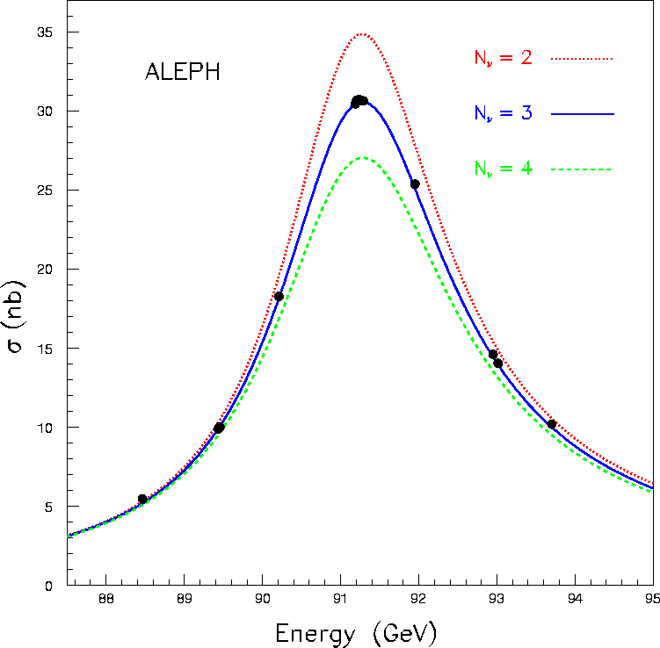
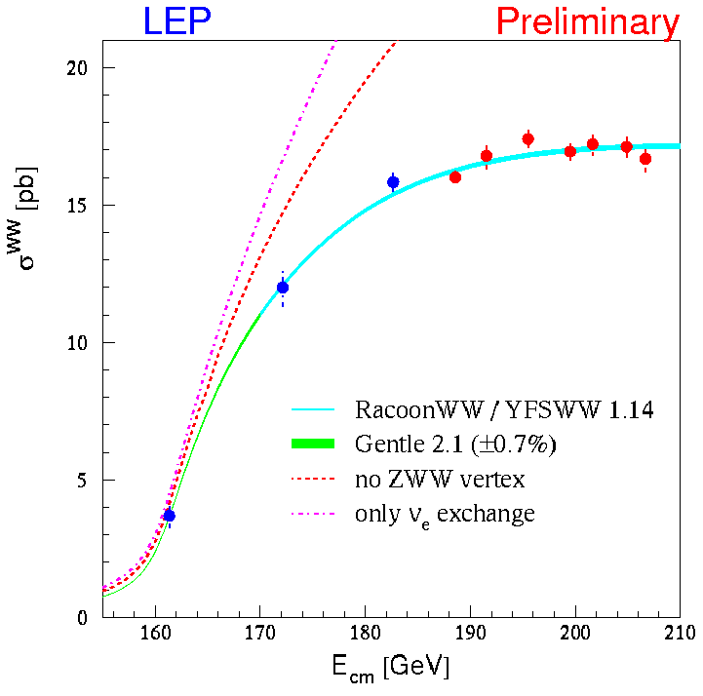
Precision Electroweak Observables
LEP1
LEP2
Heavy Flavour
Rates

Slide 18
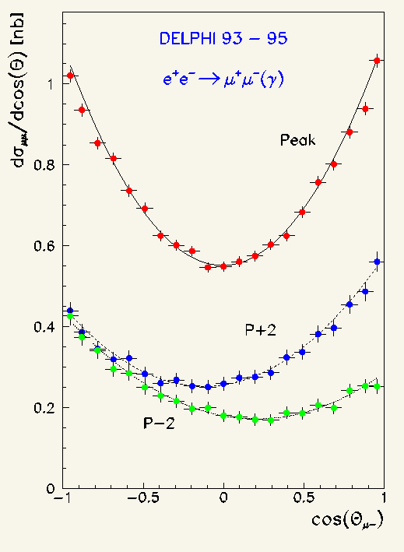
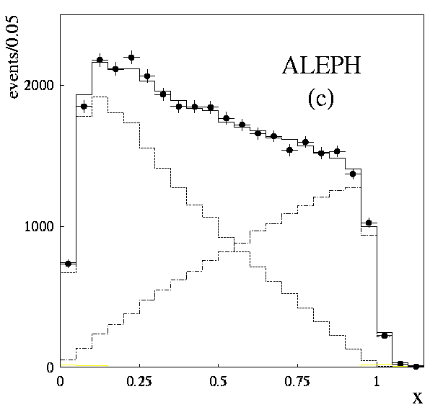
Precision Electroweak Observables (II)
Precision
of the
Detectors
LEP
eff
1-4|Q_{i}|sin²θ_{W}
eff
e.g.
Precise
Energy
sin²θ_{W}
Z→μ⁺μ⁻
High Luminosity
to
5.10⁻⁴
+ b-Tagging
τ-selection
...
m_{W}
...
Polarized Beam
(SLC only)
Consistency
Checks!
τ→πν_{τ}
eff
sin²θ_{W} = 1 – m_{W}²/m_{Z}²(1+Δρ)

Slide 19
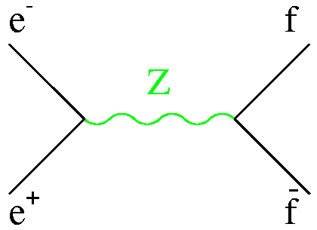
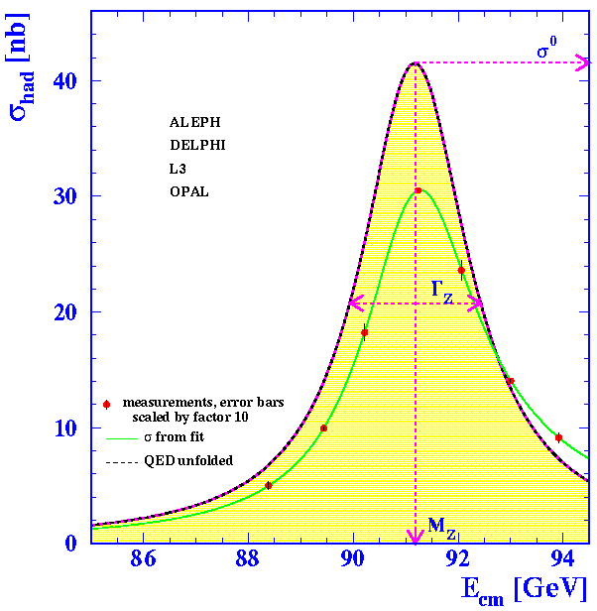
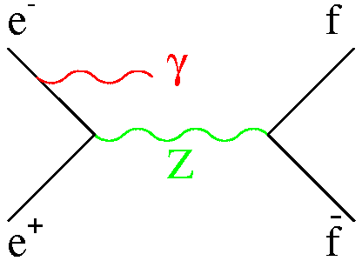
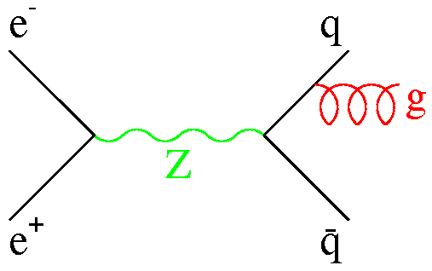
The Z Lineshape at LEP
At tree-level:
∝ (1+Δρ)
Measure σ and s
Correct for QED and QCD
-30% for σ⁰
+200 MeV for m_{Z}
+4% for Γ_{qq}
Fit for the Z parameters
(mass, total width, peak cross
section and partial widths)
√s =

Slide 20
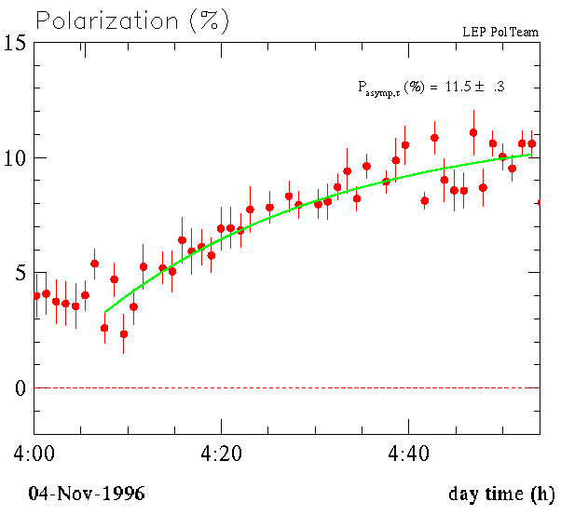
Measurement of the LEP Beam Energy (I)
Approximation: LEP is a circular ring
immersed in a uniform magnetic field:
1) The electrons get transversally polarized
(i.e., their spin tends to align with B), but
B_{dipole}
Process very sensitive to imperfections
(→ slow, typically hours, and limited
to o(10%) polarization)
Process very sensitive to beam-beam
interactions (→ one beam, no polarization
in collisions)
→
p
e⁻
R
LEP
(L = 2πR = 27km)
E ∼ p = e B R = (e/2π) B L
In real life:
B non-uniform, ring not circular
To be
measured

Slide 21
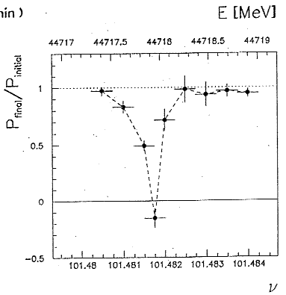
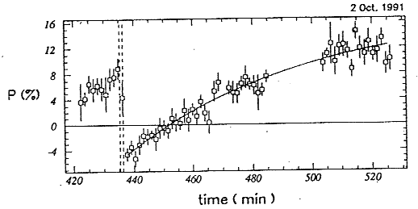
Measurement of the LEP Beam Energy (II)
2) The spin precesses around B with
a frequency proportional to B.
The number of revolutions
for each LEP turn is thus
proportional to B L (in fact,
to ∫ B dl, and then to E_{beam})
3) Measure ν_{s} :
0
B
B_{x}: oscillating field with
frequency ν, in one point.
1
2
3
-B_{x}
B_{x}
Vary ν until Polarization = 0
101.5 Peak-2
103.5 Peak
105.5 Peak+2
1993
Precision
∼ 2×10⁻⁶
ΔE_{beam} ∼ 100 keV !

Slide 22
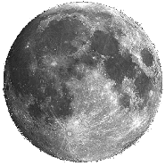

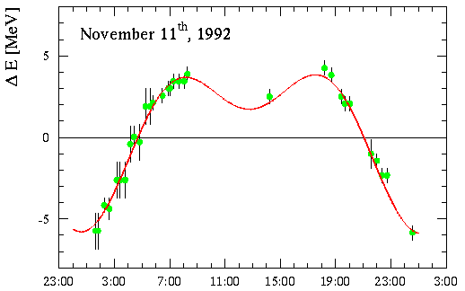
Measurement of the LEP Beam Energy (III)
A dispersion of 10 MeV is observed (>> 100 keV)
in the same machine conditions. Correlation with
the moon found on 1992, Nov 11th:
At midnight, the electrons see
less magnetic field, E is smaller;
At noon, they see more magnetic
field, and E is larger.
LEP at midnight
Longer by 300 μm
LEP at noon
Shorter by 300 μm
→ S
→ U
→ N
Prediction and data
fit perfectly …
However, the electron orbit length
is fixed by the RF frequency:
L = c × Δt

Slide 23
Measurement of the LEP Beam Energy (IV)
B_{dipole}
RF frequency:
352 254 170 Hz
(±1 Hz)
Electron orbit fixed by RF

Slide 24
QUAD
Dipole
Dipole
QUAD
⊗
⊗
IF the length of the
electron trajectory
= length of magnetic
channel
B=B₀
E=E₀
Beam Orbit
Monitors (BOM)
⊗
⊗
QUAD
QUAD

Slide 25
QUAD
Dipole
QUAD
Dipole
Ground expands
(tide etc..)
⊗
⊗
If the length of the
electron trajectory
< length of magnetic
channel
B<B₀
E<E₀
Beam Orbit
Monitors (BOM)
⊗
⊗
QUAD
QUAD

Slide 26
QUAD
Dipole
QUAD
Dipole
Ground shrinks
(tide etc..)
⊗
⊗
If the length of the
electron trajectory
> length of magnetic
channel
B > B₀
E > E₀
⊗
⊗
QUAD
QUAD

Slide 27
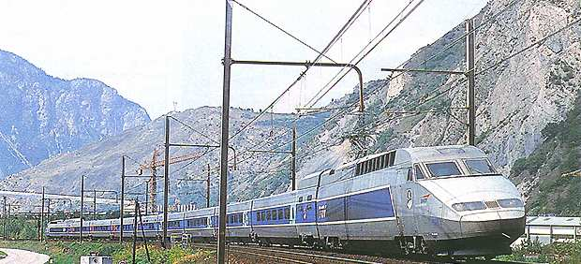
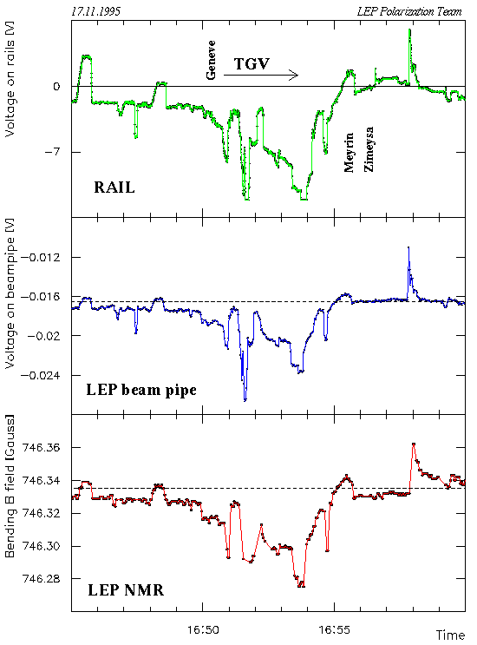
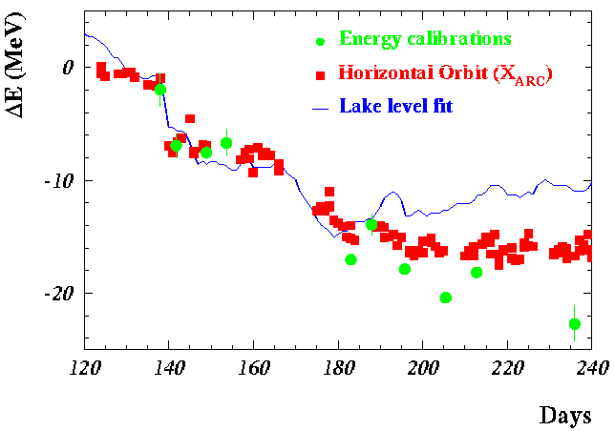
Measurement of the LEP Beam Energy (V)
Other 10 MeV-ish effects understood even later:
Effect of the rain: water pressure in the
mountains change LEP circumference;
(controlled with the BOM’s)
Effect of the TGV: currents induced on the
LEP beam pipe change the magnetic field
(controlled by 16 NMR probes)
Understood after one-day strike
Understood after three rainy months
Now: ΔE_{beam} < 2 MeV

Slide 28
TERA-Z, Oku-W, Megatops
Precision tests of the
closure of the Standard Model

Slide 29
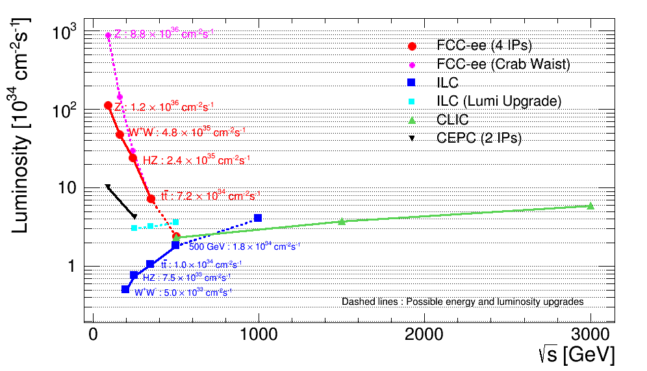
Overlap in Higgs/top region, but differences and complementarities
between linear and circular machines:
Circ: High luminosity, experimental environment (up to 4 IP), E_{CM} calibration
Linear: higher energy reach, longitudinal beam polarization

Slide 30
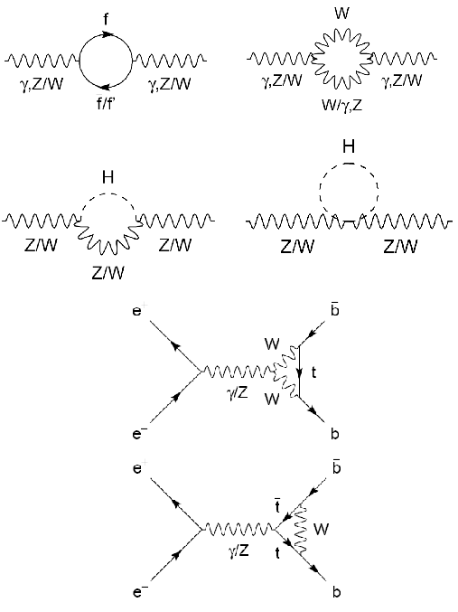
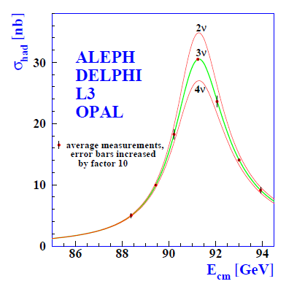
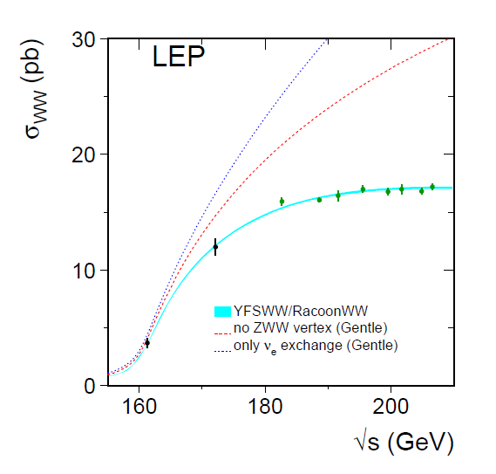
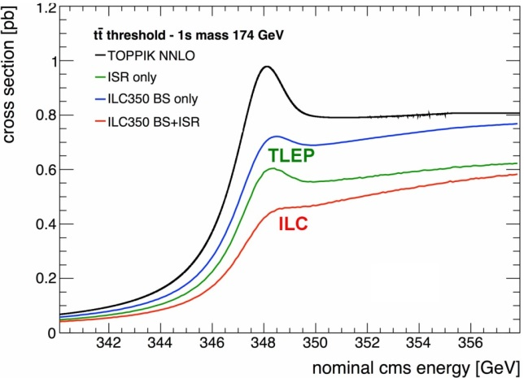
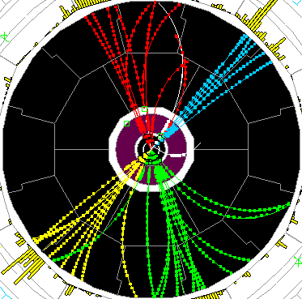
Precision tests of EWSB
Z pole ssymmetries, lineshape
WW threshold scan
tt threshold scan
-
TLEP : Repeat the LEP1 physics programme every 15 mn
Transverse polarization up to the WW threshold
  Exquisite beam energy determination (10 keV)
Longitudinal polarization at the Z pole
        Measure sin²θ_{W} to 2.10⁻⁶ from A_{LR}
        Statistics, statistics: 10¹⁰ tau pairs, 10¹¹ bb pairs, QCD and QED studies etc…

Slide 31
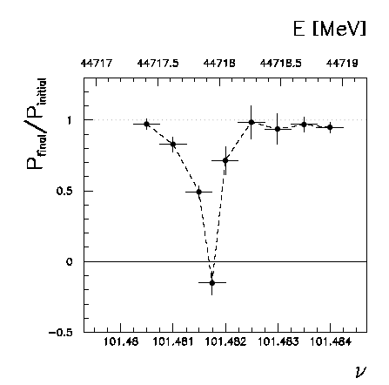
Beam polarization and E-calibration @ FCC-ee
Precise meast of E_{beam} by resonant depolarization
~100 keV each time the meast is made LEP→
At LEP transverse polarization was achieved routinely at Z peak.
instrumental in 10⁻³ measurement of the Z width in 1993
led to prediction of top quark mass (179+- 20 GeV) in Mar’94
Polarization in collisions was observed (40% at BBTS = 0.04) →
At LEP beam energy spread destroyed polarization above 61 GeV
σ_{E} ∝ E²/√ρ ➔ At TLEP transverse polarization up to at least 81 GeV (WW threshold)
to go to higher energies requires spin rotators and siberian snake (see spares)
TLEP: use ‘single’ bunches to measure the beam energy continuously
→no interpolation errors due to tides, ground motion or trains etc…
<< 100 keV beam energy calibration around Z peak and W pair threshold.
Δm_{Z} ~0.1 MeV, ΔΓ_{Z} ~0.1 MeV, Δm_{W} ~ 0.5 MeV

Slide 32
Improvement in α_{QED} (m_{Z})
QED ⊂ SM are Quantum Field Theories
Renormalization → Running Coupling Constants
QED: photon propagator → Vacuum polarization → charge screening
Define the effective QED coupling as:
where is the fine structure constant, experimentally known to better than 4×10⁻⁹
is the contribution of vacuum polarization on the photon propagator, due to fermion loops
In the approximation of light fermions the leading contribution is:
The Leptonic contributions are calculable to very high precision
The Quark contributions involve quark masses and hadronic physics at low momentum scales, not calculable with only perturbative QCD.
Notes:
The effective coupling is an essential ingredient for many predictions: Δα≈6% at the Z-peak and ≈2% at the scale of LEP luminosity

Slide 33
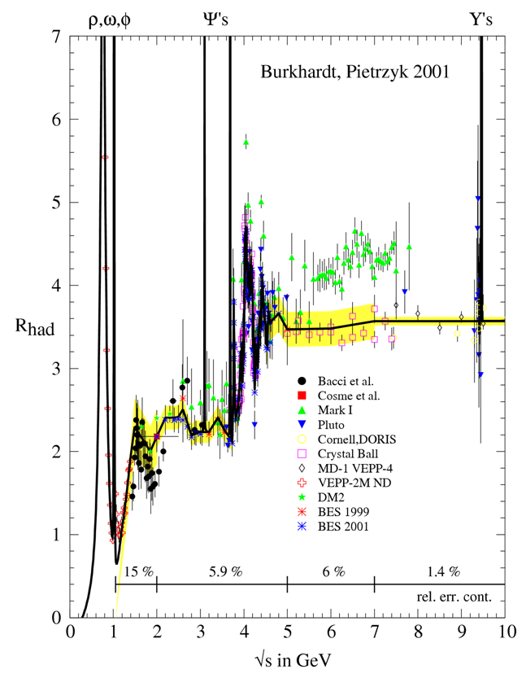
Δα_{had}
Optical Theorem, Dispersion Relations
Classic approach: parameterization of measured σ(e⁺e⁻→hadrons) at low energies plus pQCD above resonances
Alternative theory-driven approaches:
pQCD applied above ≈2 GeV
pQCD in the space-like domain (via Adler function) where Δα is smooth
H.Burkhardt, B.Pietrzyk, Phys. Lett. B 513 (2001) 46
Δα⁽⁵⁾_{had}(m_{Z}²) = 0.02761±0.0036
error on Δα⁽⁵⁾_{had}(m_{Z}²) dominated by experimental errors in the energy range 1-5 GeV One of the dominant uncertainties in the EW fits constraining the Higgs mass
popular parameterization, for s>10² GeV² or s<0
could be further improved by measurements at BEPC!

Slide 34
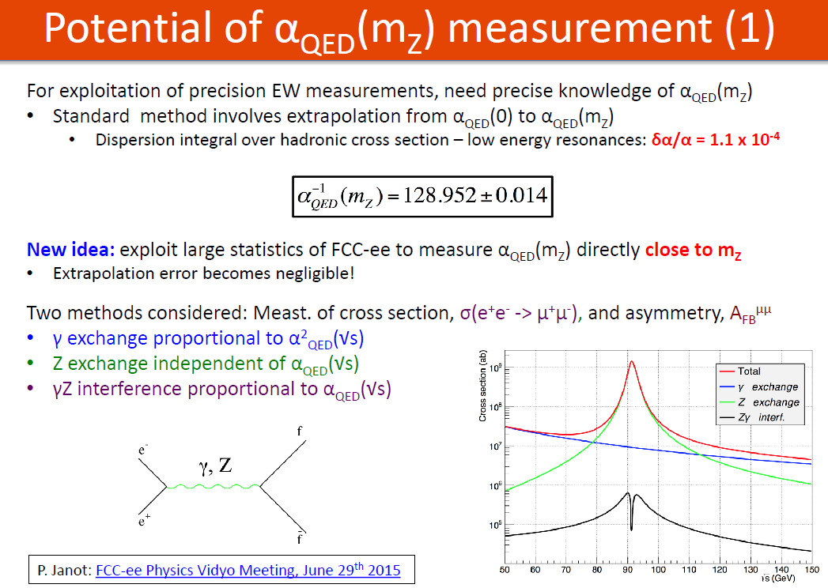

Slide 35
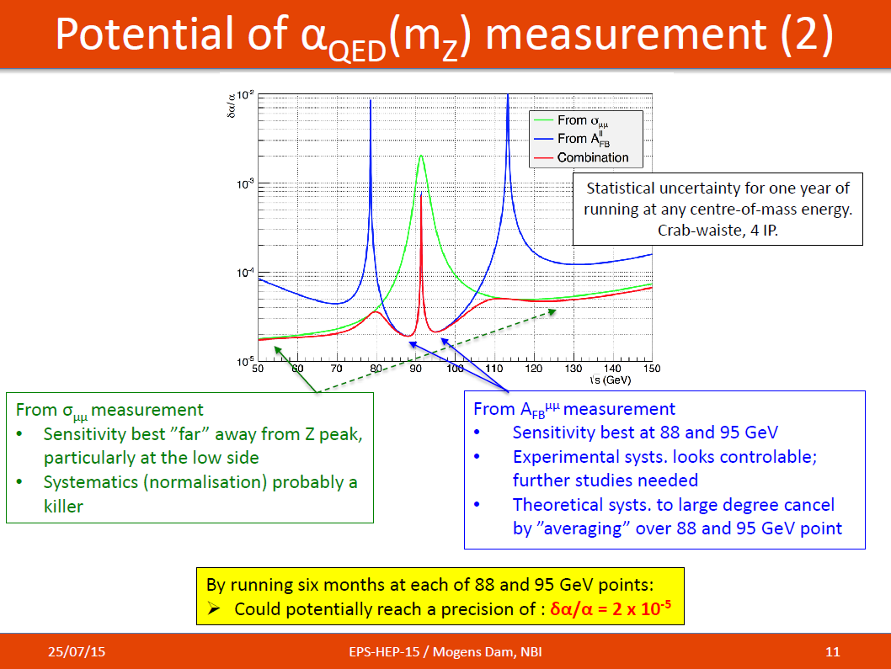

Slide 36
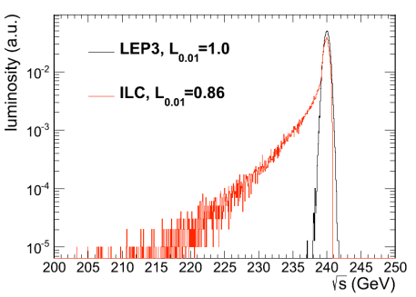

BEAMSTRAHLUNG
Luminosity E spectrum
Effect on top threshold
➔
Beamstrahlung @TLEP is benign: particles are either lost or recycled on a synchrotron oscillation
➔ some increase of energy spread
but no change of average energy
Little EM background in the experiment.

Slide 37
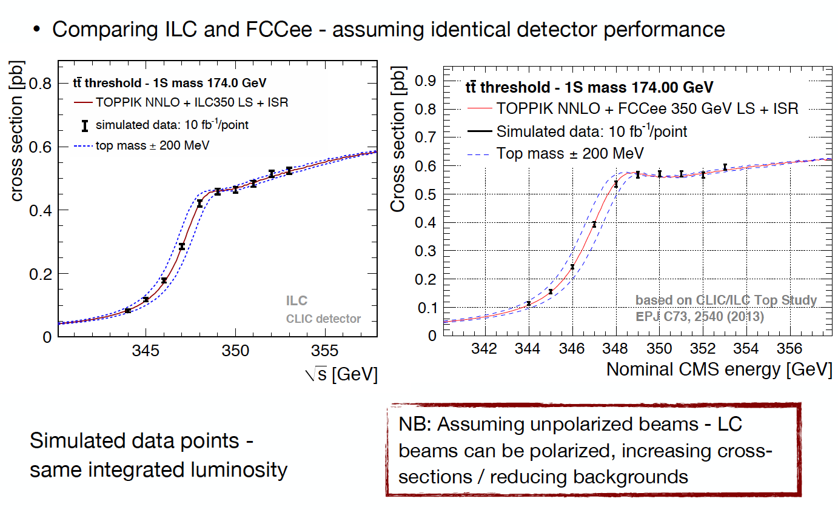
350 GeV: the top mass
Advantage of a very low level of beamstrahlung in circular machines
Could potentially reach 10 MeV uncertainty (stat) on m_{top}
From Frank Simon, presented at 7th TLEP-FCC-ee workshop, CERN, June 2014

Slide 38
A Sample of Essential Quantities:
X | Physics | Present precision |  | TLEP stat Syst Precision | TLEP key | Challenge
M_{Z} MeV/c2 | Input | 91187.5 ±2.1 | Z Line shape scan | 0.005 MeV <±0.1 MeV | E_cal | QED corrections
Γ_{Z} MeV/c2 | Δρ (T) (no Δα!) | 2495.2 ±2.3 | Z Line shape scan | 0.008 MeV <±0.1 MeV | E_cal | QED corrections
R_{l} | α_{s ,} δ_{b} | 20.767 ± 0.025 | Z Peak | 0.0001 ± 0.002 - 0.0002 | Statistics | QED corrections
N_{ν} | Unitarity of PMNS, sterile ν’s | 2.984 ±0.008 | Z Peak Z+γ(161 GeV) | 0.00008 ±0.004 0.0004-0.001 | ->lumi meast Statistics | QED corrections to Bhabha scat.
R_{b} | δ_{b} | 0.21629 ±0.00066 | Z Peak | 0.000003 ±0.000020 - 60 | Statistics, small IP | Hemisphere correlations
A_{LR} | Δρ, ε_{3 ,}Δα (T, S ) | 0.1514 ±0.0022 | Z peak, polarized | ±0.000015 | 4 bunch scheme | Design experiment
M_{W} MeV/c2 | Δρ, ε_{3 ,} ε_{2,} Δα (T, S, U) | 80385 ± 15 | Threshold (161 GeV) | 0.3 MeV <1 MeV | E_cal & Statistics | QED corections
m_{top} MeV/c2 | Input | 173200 ± 900 | Threshold scan | 10 MeV | E_cal & Statistics | Theory limit at 100 MeV?

Slide 39
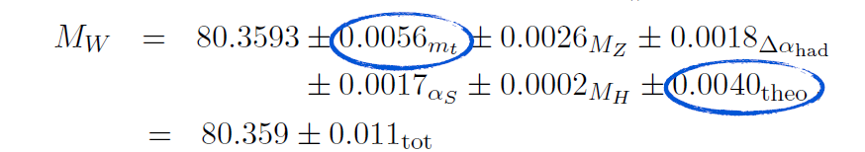
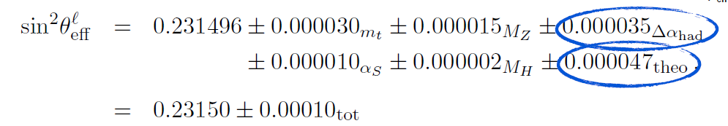
Theoretical limitations
FCC-ee
R. Kogler, Moriond EW 2013
SM predictions (using other input)
0.0002
0.0001
0.0002?
0.0003
0.00025?
0.0000
0.0000015
0.000001
0.000007?
0.000001
0.0000014?
0.000000
Experimental errors at FCC-ee will be 20-100 times smaller than the present errors.
BUT can be typically 10 -30 times smaller than present level of theory errors
Will require significant theoretical effort and additional measurements!
Radiative correction workshop 13-14 July 2015 stressed the need for 3 loop calculations for the future!

Slide 40
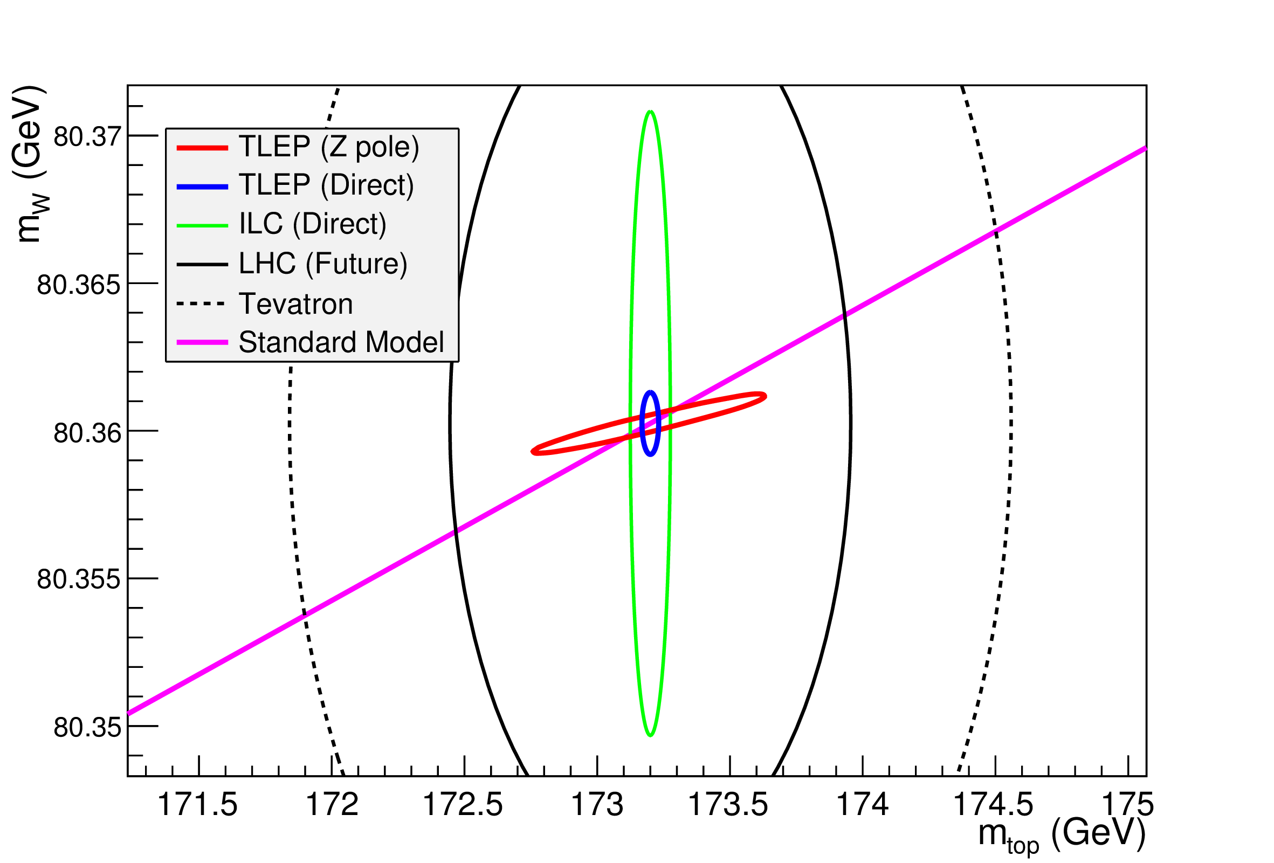
NB without TLEP the SM line would have a 2.2 MeV width
in other words .... Δ(Δρ)= ± 10⁻⁵ + several tests of same precision

Slide 41
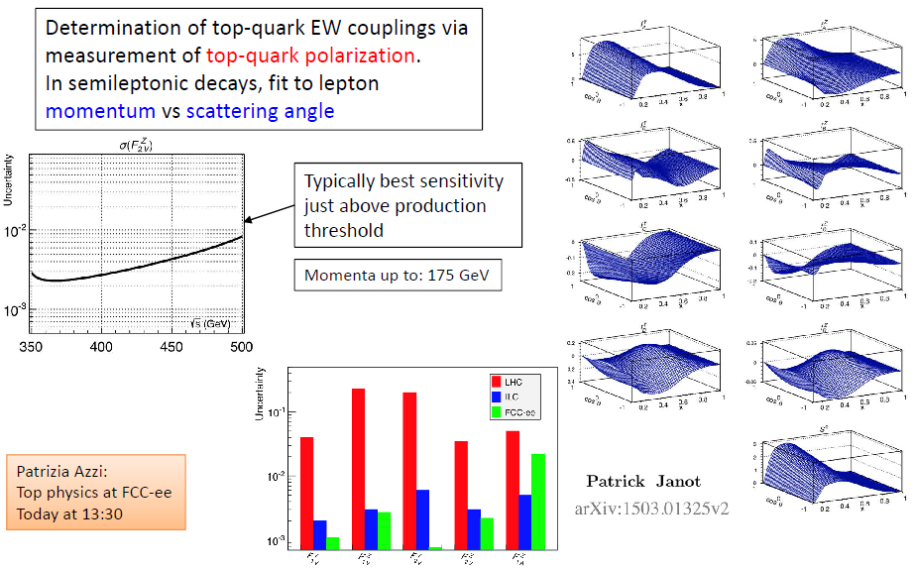

Slide 42

Nima
At higher masses -- or at smaller couplings?

Slide 43
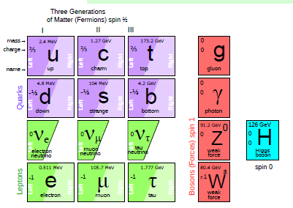
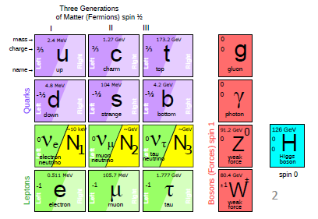
THE STANDARD MODEL IS COMPLETE .....
But at least 3 pieces are still missing
neutrinos have mass...
and this very probably implies new degrees of freedom
➔ Right-Handed, Almost «Sterile» (very small couplings) Neutrinos
completely unknown masses (meV to ZeV), nearly impossile to find.
.... but could perhaps explain all: DM, BAU,ν-masses

Slide 44
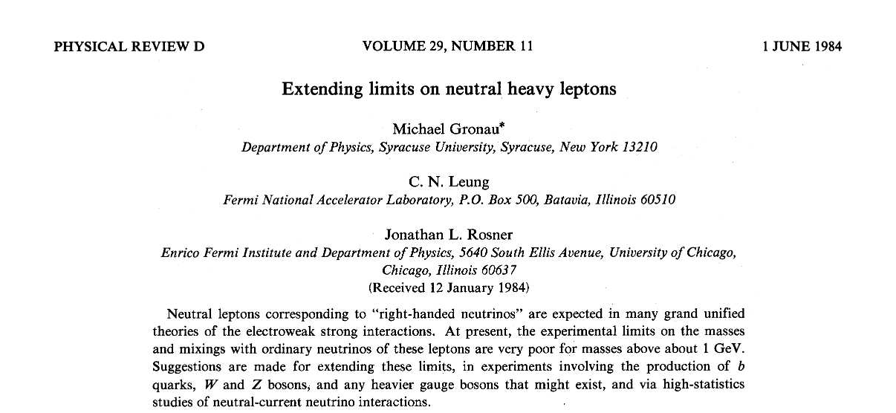
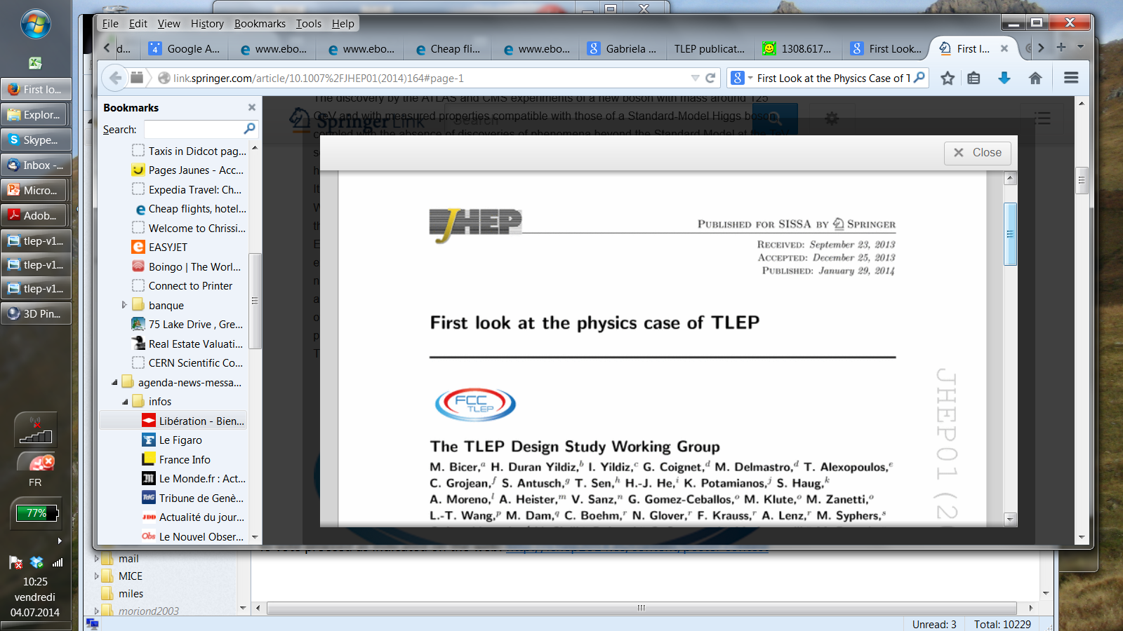
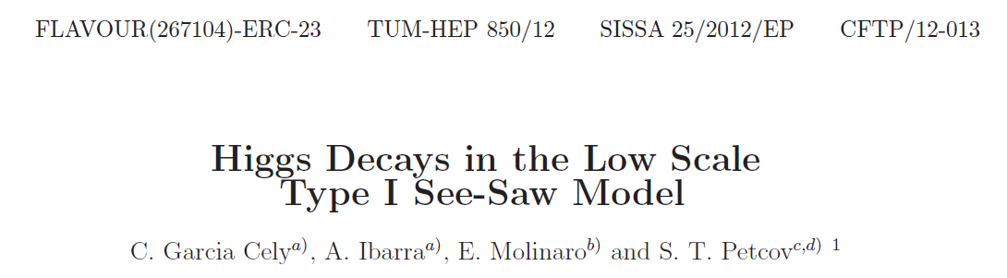
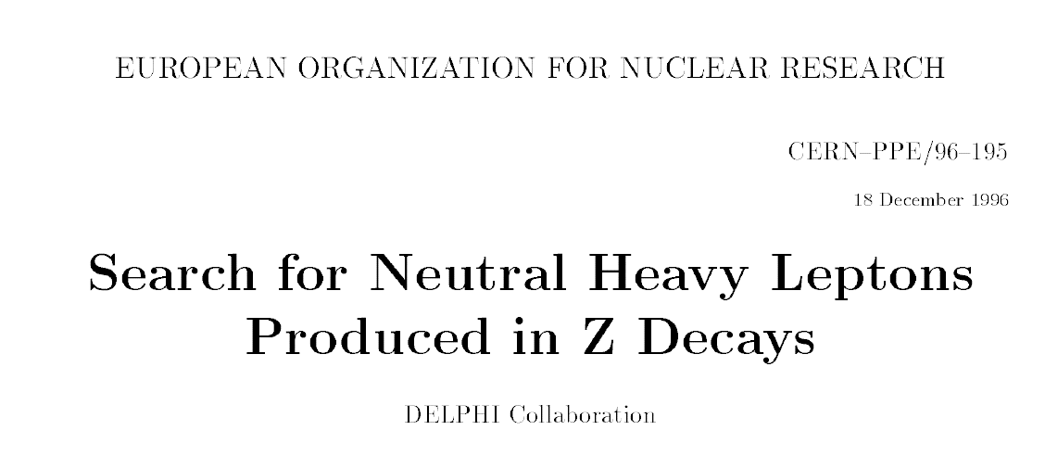




some REFERENCES
arxiv:1308.6176
arxiv:1208.3654
FCC design study and FCC-ee http://cern.ch/fcc-ee
and presentations at FCC-ee physics workshops
http://indico.cern.ch/category/5684/
Phys.Lett.B631:151-156,2005
arXiv:hep-ph/0503065

Slide 45









Electroweak eigenstates
$$\left({e \atop v_{e}}\right)$$
$$\left({ \atop v_{μ}}\right)$$
$$\left({ \atop v_{τ}}\right)$$
$$\left(e\right)$$
$$\left(\right)$$
$$\left(\right)$$
Q= -1
R
R
R
L
L
L
$$\left(_{e}\right)$$
$$\left(_{μ}\right)$$
$$\left(_{τ}\right)$$
Q= 0
R
R
R
I = 1/2
I = 0
Right handed neutrinos
are singlets
no weak interaction
no EM interaction
no strong interaction
can’t produce them
can’t detect them
-- so why bother? --

Slide 46


Adding masses to the Standard model neutrino 'simply' by adding a Dirac mass term (Yukawa coupling)
implies adding a right-handed neutrino (new particle)
No SM symmetry prevents adding then a term like
and this simply means that a neutrino turns into a antineutrino
(the charge conjugate of a right handed antineutrino is a left handed neutrino!)
It is perfectly conceivable (‘natural’?) that both terms are present ➔ ‘see-saw’
B. Kayser, the physics of massive neutrinos (1989)

Slide 47


Mass eigenstates
See-saw in a general way :
M_{R} ≠ 0
m_{D} ≠ 0
Dirac + Majorana
mass terms
see-saw
M_{R} = 0
m_{D} ≠ 0
Dirac only, (like e- vs e+):
ν_{L} ν_{R} ‾ν_{R} ‾ν_{L}
½ 0 ½ 0
4 states of equal masses
M_{R} ≠ 0
m_{D} = 0
Majorana only
ν_{L} ‾ν_{R}
½ ½
2 states of equal masses
M_{R} > m_{D} ≠ 0
Dirac + Majorana
ν_{L} N_{R} ‾ν_{R} ‾N_{L}
½ 0 ½ 0
4 states , 2 mass levels
m
m
m
I_{weak}=
dominantly:
I_{weak}=
I_{weak}=
Some have I=1/2 (active)
Some have I=0 (sterile)
All have I=1/2 (active)
m₁ have ~I=1/2 (~active)
m₂ have ~I=0 (~sterile)

Slide 48

There even exists a scenario that claims to explain everything: the νMSM
Shaposhnikov et al
TeV
N₂, N₃
can generate Baryon Asymmetry of Universe
if m_{N2,N3} > 140 MeV
GeV
MeV
constrained:
mass: 1-50 keV
mixing :
10⁻⁷ to 10⁻¹³
N₁
keV
eV
decay time:
τ_{N1} > τ_{Universe}
ν₃
ν₂
N₁→ v γ
meV
ν₁
soon excluded?

Slide 49






Manifestations of right handed neutrinos
$v$ = light mass eigenstate
N = heavy mass eigenstate
≠ $vL$ , active neutrino
which couples to weak inter.
and ≠ N_{R}, which does’nt.
one family see-saw :
θ ≈ (m_{D}/M)
$mv$ ≈ $\frac{mD2}{M}$
m_{N} ≈ M
|U|² ∝ θ² ≈ $mv$/ m_{N}
_{can be larger with 3} _{families}
$v= vL$ cosθ - ${Nc}_{R }^{} sin$θ
$N=N_{R}^{} \text{cos}\text{θ}+ vL$ ^{c} sinθ
what is produced in W, Z decays is:
$vL= v$ cosθ + $N_{ }^{}sin$θ
-- mixing with active neutrinos leads to various observable consequences
-- if very light (eV) , possible effect on neutrino oscillations (short baseline)
-- if in keV region (dark matter), monochromatic photons from galaxies with E=m_{N}/2
-- possibly measurable effects at High Energy
If N is heavy it will decay in the detector (not invisible)
➔ PMNS matrix unitarity violation and deficit in Z «invisible» width
➔ Higgs, W, Z exotic decays H→ ν_{i}‾Ν_{i} and Z→ ν_{i}‾Ν_{i} , W-> l_{i} ‾Ν_{i}
➔ also in charm and b decays via W*-> l_{i} ‾Ν_{i}
➔ violation of unitarity and lepton universality in Z, W or τ decays
-- etc... etc...
-- Couplings are small ($mv$/ m_{N}) (but who knows?) and generally out of reach of hadron colliders (but this deserves to be revisited for detached vertices @LHC, HL-LHC, FCC-hh)

Slide 50
Indirect effects
-- neutrino Majorana mass term can lead to lepton number violating processes
by virtual neutrino exchange and to flavour violation
-- neutrinoless double beta decay (the most powerful one)
-- FCNC (μ→eγ) etc...
-- at a Z factory : Z→ τμ Z→ τe Z-> ττ , τ → μγ τ → eγ etc...

Slide 51

Indirect constraints from lepton flavour violation are weak
arxiv:1208.3654
LEP2 limits (DELPHI)
LEP1 limits (DELPHI)
(projected)

Slide 52

At the end of LEP:
Phys.Rept.427:257-454,2006
N_{ν} = 2.984 ±0.008
- 2 σ :^) !!
This is determined from the Z line shape scan
and dominated by the measurement of the
hadronic cross-section at the Z peak maximum ➔
The dominant systematic error is the theoretical
uncertainty on the Bhabha cross-section (0.06%)
which represents an error of ±0.0046 on N_{ν}
Improving on N_{ν} by more than a factor 2 would require a large effort
to improve on the Bhabha cross-section calculation!

Slide 53



Slide 54



Neutrino counting at TLEP
given the very high luminosity, the following measurement can be performed

Slide 55



Higgs factory
(constrained fit
including ‘exotic’)
4 IPs
(2 IPs)
2 10⁶ ZH events in 5 years
«A tagged Higgs beam».
sensitive to new physics in loops
incl. invisible = (dark matter?)
NB will improve with inclusion of
ZH-> qq H tagging
➔ total width
HHH (best at FCC-hh)
Htt (best at FCC-hh)
<1%
28%
13%
from HZ thresh
from tt thresh

Slide 56

Lepton flavour violating Z decays with 10¹³ Z decays
A. Abada et al, arXiv:1412.6322 Indirect searches for sterile neutrinos at a high-luminosity Z-factory A. Abada, V. De Romeri, S. Monteil, J. Orloff, A. M. Teixeira

Slide 57



RHASnu’s production in Z decays
Production:
multiply by 2 for anti neutrino and add contributions of 3 neutrino species (with different |U|² )
Decay
Decay length:
cm
NB CC decay always leads to
≥ 2 charged tracks
Backgrounds : four fermion: e+e- → W*⁺ W*⁻ e+e- → Z*(vv) + (Z/γ)*

Slide 58

Order-of-magnitude extrapolation of existing limits
4 10⁶ Z decays
BAU
maybe achievable with
10¹⁰ ⁻ 10¹³ Z decays?
see-saw

Slide 59

Search for heavy neutral leptons
search e⁺ e⁻→ v N
N→ v(γ/Z)*_{→ monojet}
Find: one event
in 4x10⁶Z:
e⁺e⁻
e⁺
γ*
Z*
e⁻

Slide 60

Decay length
Interesting region
|U|² ~ 10⁻⁹ to 10⁻¹² @ 50 GeV
L=1mm
L=1m
L=10m
~1 evt with 10¹³Zs
20 50 100
heavy neutrino mass ~ M
a large part of the interesting region will lead to detached vertices
... ➔very strong reduction of background!
μ⁺
N
W⁻→qq
Exact reach domain will depend on detector size
and details of displaced vertex efficiency & background
ν

Slide 61




Slide 62

N_{Z} = 10¹² 1mm<L<1m
region of interest
FCC-ee sensitivity
A.B, Elena Graverini, Nicola Serra, Misha Shaposhnikov

Slide 63



N_{Z} = 10¹² 1mm<L<1m
N_{Z} = 10¹³ 100$m$ <L<5m
region of interest
FCC-ee sensitivity

Slide 64


N_{Z} = 10¹² 1mm<L<1m
N_{Z} = 10¹³ 100$m$ <L<5m
region of interest
FCC-ee sensitivity

Slide 65

SHIP
N_{Z} = 10¹² 1mm<L<1m
N_{Z} = 10¹³ 100$m$ <L<5m
region of interest
FCC-ee sensitivity
NB very large detector caverns for FCC-hh may allow very large FCC-ee detector (R=15m?)
leading to improved reach at lower masses.

Slide 66



-- also search for same sign muons or electrons at the LHC
(e.g. CMS: )
ATLAS arXiv:1203.5420.
CMS arXiv:1207.6079.
arXiv:1501.05566
7 GeV run
papers on 8 GeV run
in preparation
limits at |U|² ~ 10⁻²⁻⁵ level

Slide 67

Preliminary projection for LHC (P. Mermod, very preliminary)

Slide 68
Comment/Outlook for FCC-hh
We have seen that the Z factory offers a clean method
for detection of Heavy Right-Handed neutrinos
Ws are less abundant at the lepton colliders
At the 100 TeV hadron machine the W is the dominant particle.
There is a lot of /pile-up/backgrounds/lifetime/trigger issues which need to be investigated.
BUT.... in the regime of long lived HNLs the simultaneous presence of
-- the initial lepton from W decays
-- the detached vertex with kinematically constrained decay
allows for a significant background reduction.
But it allows also a characterization both in flavour and charge of the produced neutrino, thus
information of the flavour sensitive mixing angles and a test of the fermion violating nature
of the intermediate (Majorana) particle.
VERY interesting...

Slide 69
CONCLUSIONS
The discovery of the Higgs Boson at the LHC has opened a new era for Physics:
We have a very powerful theory of particles which reproduces /predicts very well
all measurements and observations done so far.
We know that it need to be modified/augmented but we do not know in which
way, at which energy and with which coupling to the known particles.
For studies of the HIggs boson, as well as for precise measurements of the other
known heavy particles in the Standard model, the search for the right-handed
partners of the neutrinos will be part of the essential program in the next decades.
A high energy e+e- collider seems to be the natural choice.
Linear or circular will depend on the presence of accessible new physics at the LHC
In any case the circular option (CEPC/SPPC or FCC-ee/hh) offers the deepest and most
powerful combination that we know how to make today.
We may be at the threshold of a 60-years long adventure!

Slide 70
Recommendations concerning Higgs Factories
European Strategy:
There is a strong scientific case for an electron-positron collider, complementary to the LHC, that can study the properties of the Higgs boson and other particles with unprecedented precision and whose energy can be upgraded.
(AB up to which energy?)
US P5 Report
An e+e- collider can provide the next outstanding opportunity [after LHC/HL-LHC]
to investigate the properties of the Higgs in detail. [...] the physics case is extremely strong.
LINEAR or CIRCULAR?
At the time of the definition of these strategies, ILC was proposed by Japanese physicists to their governments and welcoming statements were added. Situation has been reviewed in Japan since: → wait for results from LHC13. Issues of physics, manpower, cost, spinoffs, have been raised. Japanese community is also pushing very strongly for HyperK.

