Slide 1
Through process quality control of HTS magnets - from tapes to coils
P. Song
C. Gu, T. Qu, L. Lai, Y. Li, Z. Han
Tsinghua Univ.
2015/06/16

Slide 2
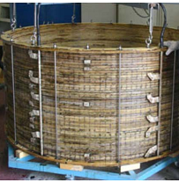
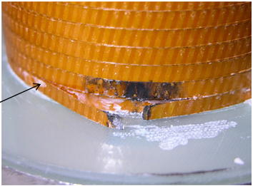
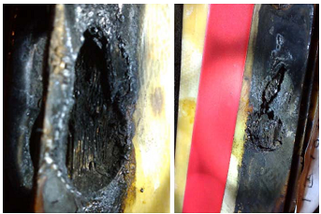
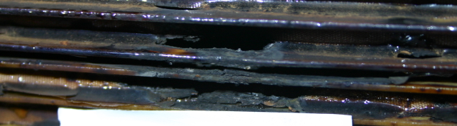
Safety Problem of HTS magnets
Through process quality control of HTS magnets: from tapes to coils
Terrible accident: HTS magnet quenched, then burned out !
Quench
Burn out
HTS magnet
What may cause quench:
Thermal disturbance
Transient current shock
Incorrect operation
……
The defects in the coil are the main origin of quench.
Notes:
For a running HTS magnet, if the HTS magnet encountered some faults, like thermal disturbance, transient current shock or incorrect running operation that leading to over flow,
the defects in the magnet might produce much heat, the temperature increased greatly, and then caused the magnet quench, even worse the HTS magnet might burn out, just like the right pictures shows. The HTS tape completely broke at the burning point.

Slide 3
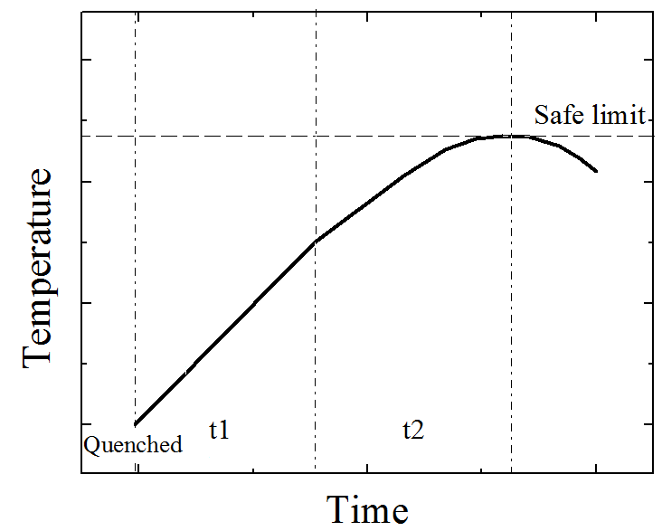
Quench behavior and protection of HTS
Through process quality control of HTS magnets: from tapes to coils
NZPV slow (10⁻²-10⁻³ m/s along the tape), two to three orders of magnitude slower than LTS
High temperature locally, higher T_{max} for the same voltage detected ($V∼\int{Tdx}$)
Less operation time, tougher detection challenge
Need more improvements
Time-budget for energy releasing
HTS
LTS
T
T
Safe limit
Protective action
length
length
Temperature distribution of HTS and LTS when quench detected
Notes:
The HTS quench behavior is different from the LTS. The normal zone propagation velocity of HTS is at least two orders of magnitude slower than LTS. It means that the HTS quench behavior is localized. For the same quench detection system, when the quench signal is detected, the normal zone of LTS is long and the peak temperature is relatively low, but the normal zone of HTS is short and the peak temperature is relatively high, maybe be higher than the safe limit that will lead to unrecoverable degradation, or even burn out.
When quench happens, It is better to take protective action as early as possible. However, restricted by the detection resolution, it is hard to detect HTS quench early enough, thus the time-budget for energy releasing is quite small. So the HTS quench protection has many challenges and need more improvements.

Slide 4
Two alternatives of magnet protection
Through process quality control of HTS magnets: from tapes to coils
Design:
safety margin
Tape type choice
Tape test:
Defects examine
properties test
Coil winding:
Tension, insulation, impregnation resin
Coil test:
Defects examine
properties test
Before the assemble
Quality Control
Our interest!
Magnet running
After the assemble
Quench Protection
Assessment of the disturbance to determine whether quench
Detect a disturbance of voltage measurement
Take protective action and release energy
Notes:
In order to protect the HTS magnet, despite of the quench protection, our research group pay lots of attention to through process quality control of the magnet before assembly, from design stage to tape test, coil winding and finally the coil test, to guarantee the magnet safety from source.
( For example, in design stage, we can set a safety margin of the working current. Considering magnetic and mechanical properties, in different position of the HTS magnet we can apply different types of HTS tapes to optimize the performance. Then at tape and coil level, we will do a series of tests to check the defects and remove them.)

Slide 5
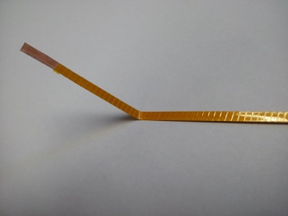
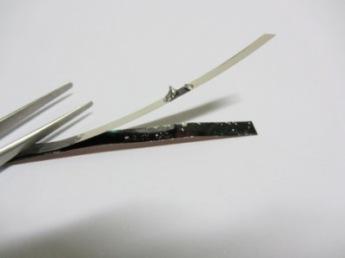
The sources of defects
Through process quality control of HTS magnets: from tapes to coils
What process or situation may bring in defects?
Tape manufacture
Instability of the manufacture techniques
improper operation
hidden soldering point
Coil Winding
Careless operation leading to tape bending
unexpected insulation break
Various stress during the magnet running
Thermal stress
electromagnetic stress
delamination
Tape users are not able to control the tape manufacturing process, so the tape examination is important for checking defects.
Notes:
At the HTS tape manufacture process, coil winding process or the HTS magnet running period, there are many cases that will bring in defects. For example, at tape manufacturing process, the instability of the manufacture techniques, improper operation may cause defects. At some situations, there are some hidden soldering points in the long tape, but the users don’t know, and the tape supplier also didn’t tell the users. These soldering point may produce heat during the HTS magnet running.
At coil winding process, careless operation may lead to tape bending sharply, or may cause unexpected insulation break. After assemble of the HTS magnet and during the magnet running period, the thermal stress, electromagnetic stress, especially the delamination would lead to unrecoverable defects. In fact, the tape users are probably not able to control the manufacturing process, so it is important to examine the whole tape to check defects before winding the coil.

Slide 6
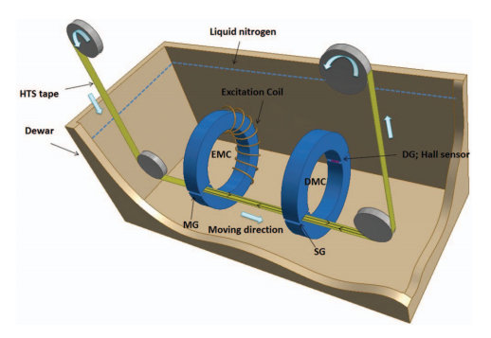
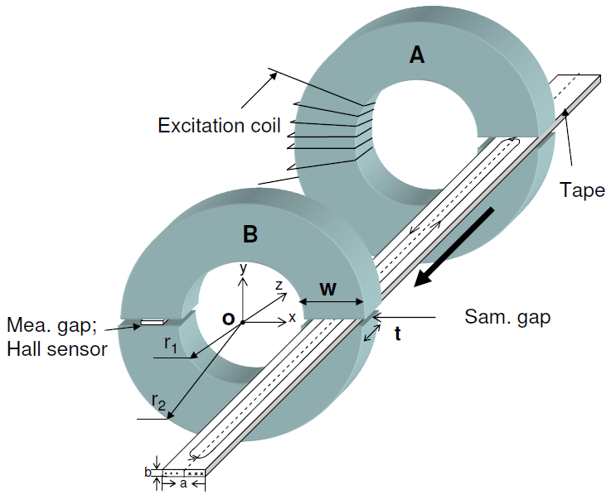
HTS tapes Continuous I_{c} measurement
Through process quality control of HTS magnets: from tapes to coils
The tape residual current is excited through the magnet circuit gap
Tape movement direction
Compared with other magnetic measurement methods:
The tape is in gap of the magnetic circuit, the magnetic flux density is not related to the location.
Solve the problem of measurement accuracy in principle, which makes the high-speed continuous measurement possible.
The magnetic moment of residual current is detected in this gap
Notes:
To check the defects, we need to test the uniformity of the whole tape. Despite of the traditional four-probe measurement, we have developed a long tape continuous Ic measurement system that based on magnetic circuit. In this measurement process, the HTS tape passes through two slits of magnetic circuits. Firstly the tape passes through the excitation magnetic circuit, the magnetic field in the gap would excite a residual current on the HTS tape. Then the HTS tape passes through the detection magnetic circuit. The hall sensor in this magnetic circuit can detect the magnetic flux density of the residual current on the tape. According to the properties of HTS material, that magnetic flux density is related to the critical current density at that point. Therefore from the voltage signal of the hall sensor we can obtain the critical current information about the detected point of the tape.
Compared with other magnetic measurement method, this method has some advantages. The tape is in the gap of the magnetic circuit, so the magnetic flux density in the gap is not related to the tape’s position in the gap. Even the tape vibrates slightly during measurement, this method can still detect the magnetic signal accurately. Thus this method solve the problem of measurement accuracy in principle, which makes the high-speed continuous measurement possible.

Slide 7
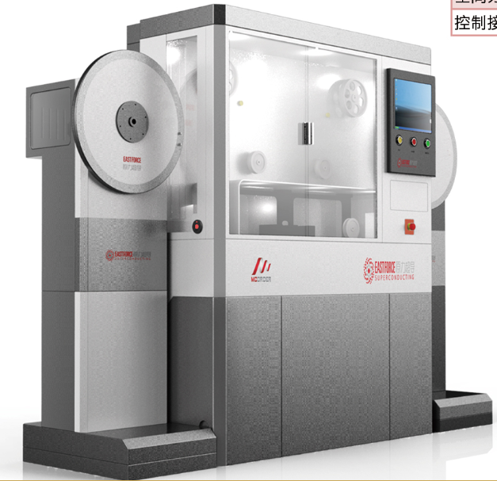
HTS tapes Continuous I_{c} measurement - MCorder
Through process quality control of HTS magnets: from tapes to coils
Item | data
Temperature | 77 K (1atm)
Measuring speed(m/hr) | 10 - 500
Tension on tape (N) | 5 – 10
Tape type | BSCCO, YBCO
Tape length(m) | 1000
Tape width | 2 - 15
Current range(A) | 1- 800
Current resolution | < 0.6 A
Signal to noise ratio | > 54 dB
Repeatability | > 98.5%
Spatial resolution(mm) | 1 - 2
It has served in:
Notes:
This continuous Ic measurement system has become a product named Mcorder, as the left picture shows. The measuring speed can be as high as 500 m/hr, and the repeatability is larger than 98.5%. These data represents the best performance among the similar kinds of measurement system.
It can measure nearly all types of BSCCO and ReBCO tapes in the world. Now it has served in many HTS research organizations, like Shanghai Superconductor Technology Co., InnoST Co., Dongfang Electric, and so on, and received a good reputation.

Slide 8
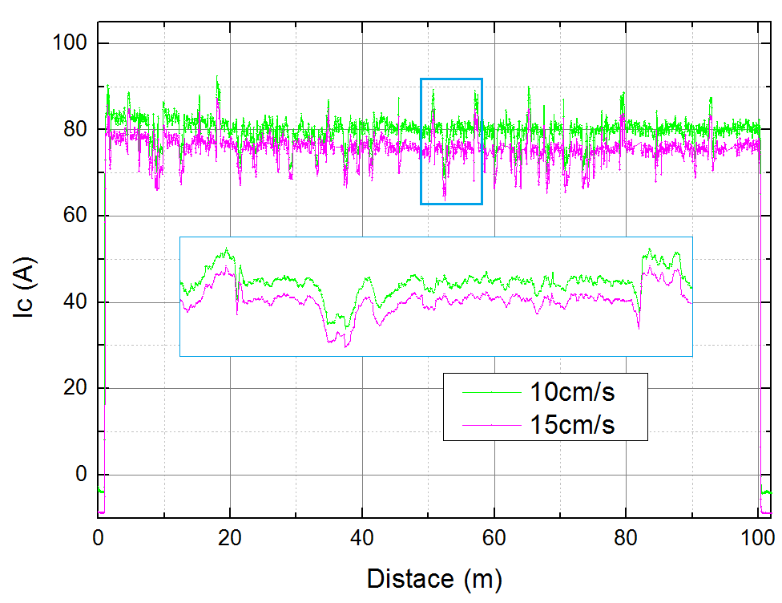
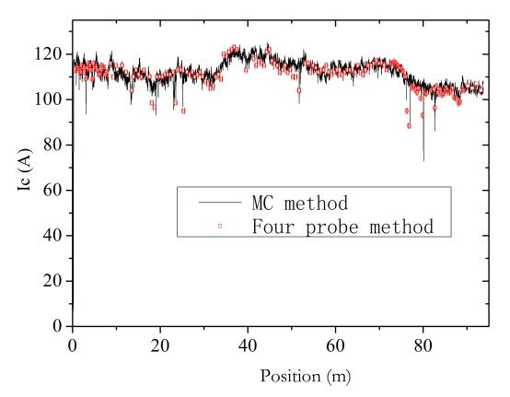
HTS tapes Continuous I_{c} measurement - MCorder
Through process quality control of HTS magnets: from tapes to coils
High speed, high repeatability
High accuracy
The measurement result of YBCO(IBAD) tape at different speeds.
The continuous measurement result of Bi-2223 tape vs. four-probe I_{c} measurement result
Notes:
The left figure shows the measurement result of a YBCO tape at different speeds. At two different measuring speeds of 10cm/s and 15cm/s, the two result data are almost the same. The tiny difference of the magnitude is caused by the difference of the excited residual current.
In order to confirm the reliability of the magnetic circuit method, we specially compared the continuous measurement data with four-probe method data. Like the right figure shows, the four-probe method result are almost coincide with the magnetic circuit method, which prove that magnetic circuit method is reliable.

Slide 9
HTS tapes Continuous I_{c} measurement - MCorder
Through process quality control of HTS magnets: from tapes to coils
Possible to find all local defects via Continuous I_{c} measurements, and remove them
Notes:
Using the Mcorder system we can not only get the information about the current performance and uniformity of the long HTS tape, but also can find the hidden defects on the tape. Here is an example. As the left figure shows, there is a significant current reduction at some point.
After that we unfold the whole tape, at the certain point an obvious mechanical hurt was found. So before the winding process, the defects in the tape can be checked and removed.

Slide 10
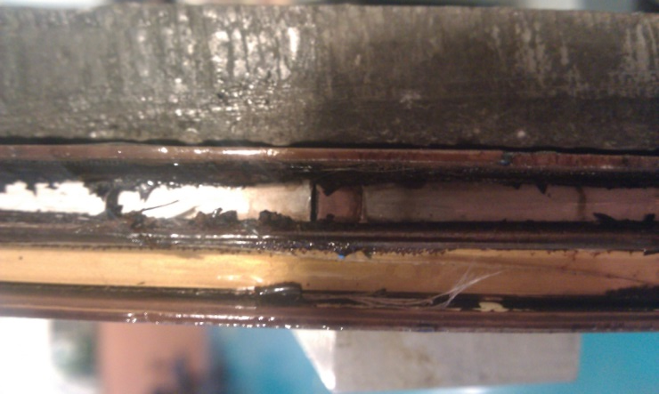
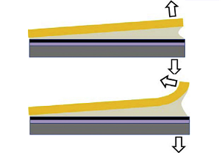
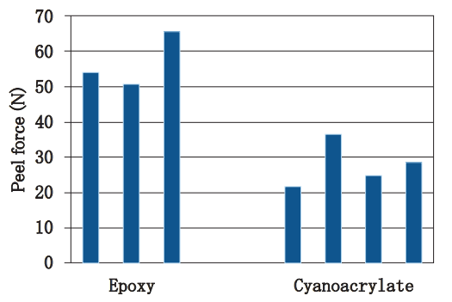
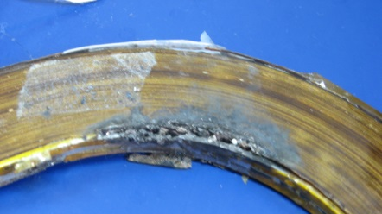
Quality control of coil winding process
Through process quality control of HTS magnets: from tapes to coils
cleavage
peel
Over-tension caused the HTS tape break
Unexpected insulation damage caused burn-out
Use different impregnation material to reduce peel force
Notes:
During the HTS coil winding process, the winding tension, the impregnation epoxy choice and the insulation treatment should be controlled properly, otherwise these processes may bring in defects, even more seriously the tape would break or the coil burn out, like the left figure shows.
Especially for the YBCO coil, as the cleavage or peel stress are much smaller than the transverse tensile stress, the impregnation epoxy may cause the YBCO tape delamination which will also reduce the critical current greatly. Reinforcing the YBCO tape or changing the impregnation material which has lower bonding strength can obviously prevent the delamination.

Slide 11
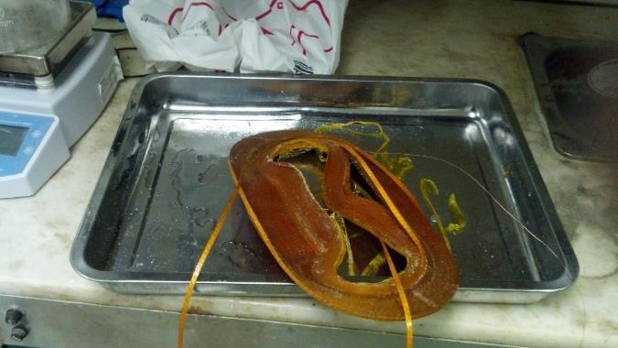
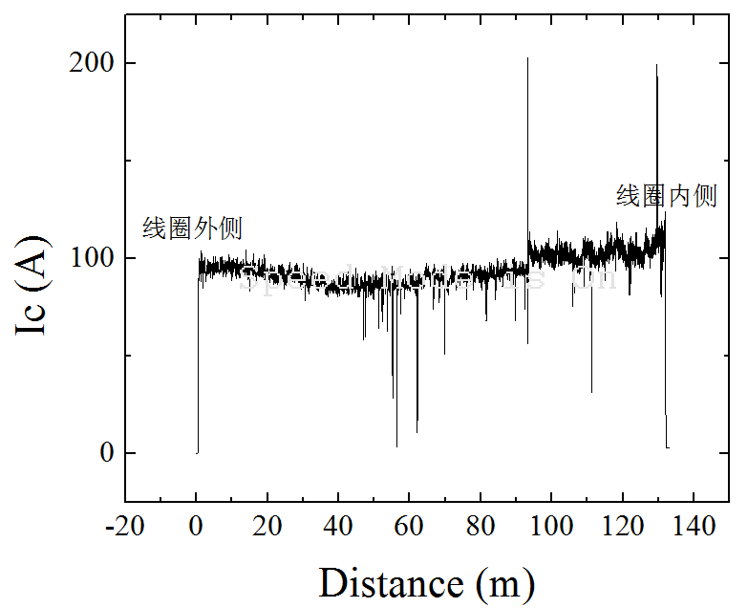
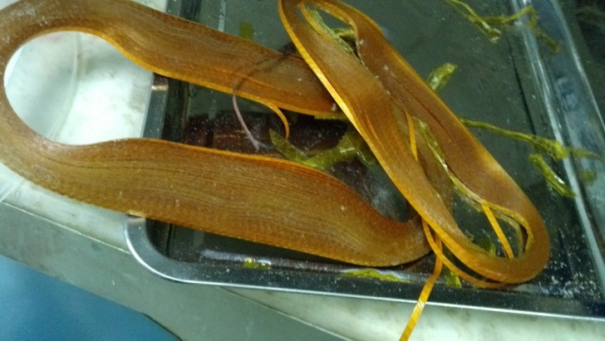
An example – disassembly of a YBCO coil
Through process quality control of HTS magnets: from tapes to coils
Soldering points
defects
The continuous measurement result of the tape disassembled from the failed race-track YBCO coil
Disassemble a failed race-track YBCO coil
Notes:
Once we disassembled a failed race-track YBCO coil, dissolved the impregnation epoxy and removed the coil framework, then used Mcorder to check the long tape’s uniformity. From measurement result, we can found two soldering points and some defects in the coil which didn’t exist before the coil winding.
These defects may caused by over stress and delamination because this tape was not reinforced. So before winding, the winding techniques and processes should be chosen carefully.

Slide 12
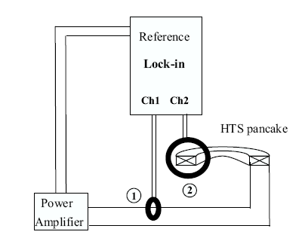
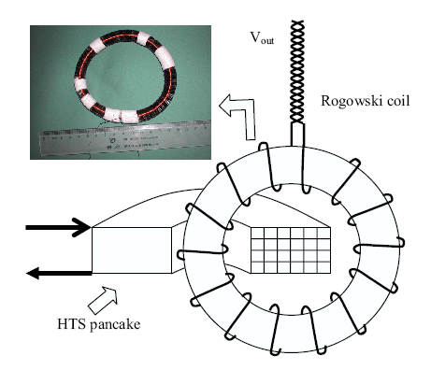
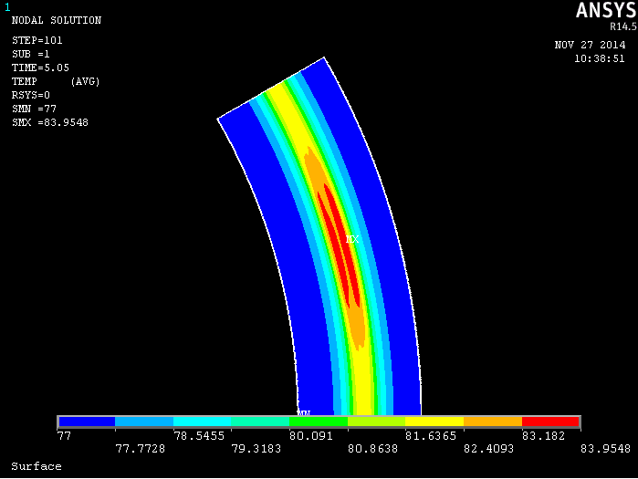
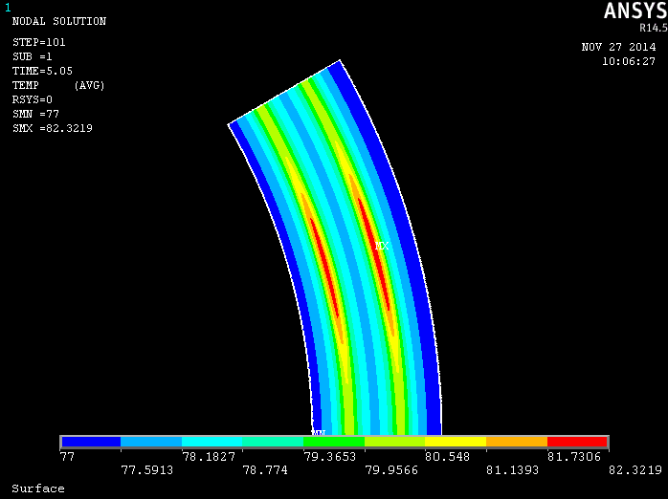
Insulation and defects test of the coil
Through process quality control of HTS magnets: from tapes to coils
Detection of insulation break in the coil, using lock-in at ac situation.
High accuracy
High repeatability
Developing the temperature measuring method to check the defects in the coil.
FEM simulation and experiment
Notes:
At the final stage of the HTS coil manufacturing process, we are developing some methods to detect the insulation breaks and defects of the coil. Now the insulation break can be detected accurately by using lock-in device at ac situation.
And we are trying to build a temperature measuring method using temperature sensor array to detect the defects in the coil when the coil carries a critical current. Some FEM simulation work and experiments have started.

Slide 13
Conclusion
Through process quality control of HTS magnets: from tapes to coils
To guarantee the safely running of the HTS magnet, the through process quality control of HTS magnet should be taken.
We developed a continuous tape measurement system to check the uniformity of the long tape, to get rid of the defects from source.
At coil winding stage, some winding techniques and processes should be considered carefully, like the winding tension, insulation treatment and impregnation material.
The detection methods of insulation break and defects of the coil are developing.

Slide 14
Reference
Through process quality control of HTS magnets: from tapes to coils
J. Schwartz, Quench in high temperature superconductor magnets.
Chen Gu, et, al. Contactless measurement of critical current of high temperature superconductor tape by magnetic circuit. The Review of scientific instruments: 08/2010; 81(8):085105.
S N Zou, et, al. Continuous critical current measurement of high-temperature superconductor tapes with magnetic substrates using magnetic-circuit method. The Review of scientific instruments: 10/2013; 84(10):105106.
D X Ma, et, al. Degradation analysis of REBCO coils. Supercond. Sci. Technol. 27 (2014) 085014 (8pp)
Carmine Senatore, et, al. Progresses and challenges in the development of high-field solenoidal magnets based on RE123 coated conductors. Supercond. Sci. Technol. 27 (2014) 103001 (26pp)
Katsutoshi MIZUNO, et, al. An innovative superconducting coil fabrication method with YBCO coated conductor.
J. B. Cui, et, al. Safety Considerations in the Design, Fabrication, Testing, and Operation of the DC Bias Coil of a Saturated Iron-Core Superconducting Fault Current Limiter. IEEE TRANS. APPL. SUPERCOND. , VOL. 23, NO. 3, JUNE 2013 5600704

Slide 15
Thank you for attention

Slide 16
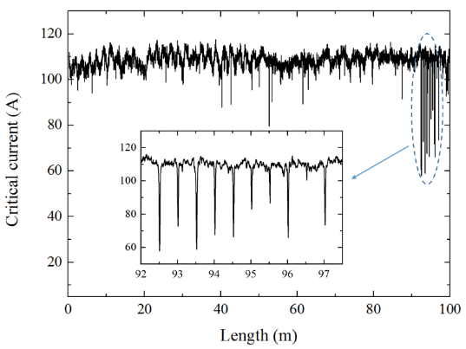
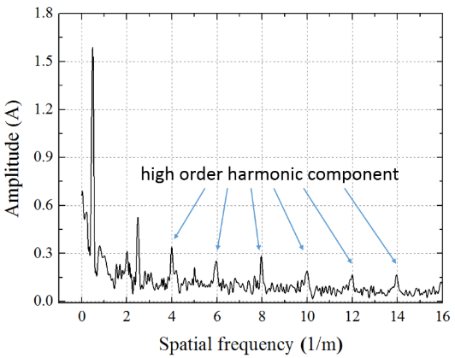
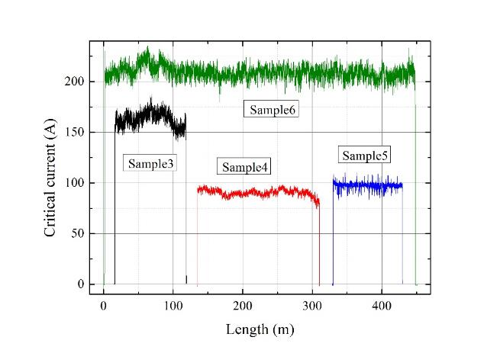
Continuous tape measurement
傅里叶变换
Sample | 1 | 2 | 3 | 4 | 5 | 6
Length (m) | 95 | 100 | 102 | 175 | 100 | 446
I_{mean}(A) | 112.2 | 108.6 | 163.3 | 90.3 | 97.3 | 209.4
σ_{Ic} / I_{mean}(%) | 4.5 | 3.1 | 4.5 | 3.5 | 3.5 | 3.0
I_{min} | 73.8 | 60.8 | 49.4 | 74.1 | 83.4 | 180.4
Δ(0.9) (%) | 0.74 | 0.55 | 0.98 | 1.10 | 1.25 | 0.05
Δ(0.85) (%) | 0.08 | 0.29 | 0.05 | 0.06 | 0 | 0

