Slide 2
I Introduction
II 2G HTS Wires
Contents
III Autonomous Production
IV Strategies

Slide 3
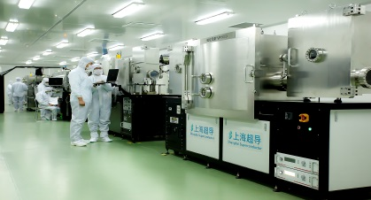
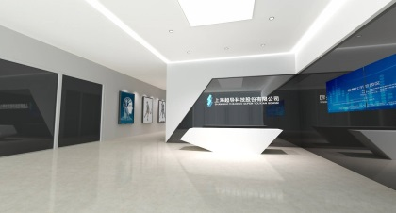
INTRODUCTION
Corporate Introduction
Strategic High-tech Enterprise Established in 2011
Started with R&D of 2G High Temperature Superconductors
Milestones
2007
Developed strategic blueprint for the commercialization of 2G HTS
2011
Shanghai Superconductor Technology Co., Ltd. established
July 2014
Start to manufacture 1000-metre length level 2G HTS wire in China
2010
Successfully fabricated the first 100-metre 2G HTS wire (193 A) in China
Dec 2013
Realized autonomous manufacturing of the entire production line of 2G HTS
Mar 2015
New headquarter at Zhangjiang Hi-tech Park put into service

Slide 4
INTRODUCTION
Our People
Over 100 Employees
40% with Master Degree or Above
Graduate Profiles
Key Scientists & Researchers
Dr. Zhiyong Hong
Associated Professor
Executive Director
Dr. Zhiwei Zhang
Teaching Assistant
Research Fellow
Dr. Xiang Wu
Research Fellow
Dr. Fengfeng Sheng
Research Fellow
Dr. Guangyu Jiang
Research Fellow
Prof. Yijie Li
Distinguished Professor
Chief Scientist
Prof. Zhijian Jin
IEEE Member
Ex-employee of CERN
Dr. Linpeng Yao
Research Fellow
Dr. Yue Zhao
Research Fellow
Dr. Wei Wu
Research Fellow
From Overseas:
University of Cambridge
University of Oxford
Imperial College London
Swiss Federal Institute of Technology
Technical University of Denmark
University of Michigan
Nanyang Technological University
From Natives:
Chinese Academy of Sciences
Tsinghua University
Shanghai Jiao Tong University
Fudan University
Zhejiang University
Notes:
There is also a parallel timeline for our micro- and nanotechnology
2001-2011年，基础研究阶段，解决从实验室研究成果向产业化转移所必需克服的镀膜工艺的稳定性、重复性和可靠性等技术难点，其中于2010年依托上海交大李贻杰教授团队在国内首次突破百米级（193A）二代超导带材
2012-2015年，产业化开发阶段，研制成功公里级第二代高温超导带材各层制备工艺，并建成公里级生产线并运行投产

Slide 5
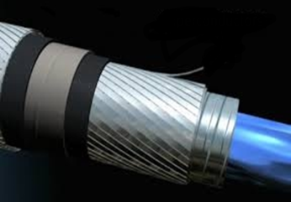
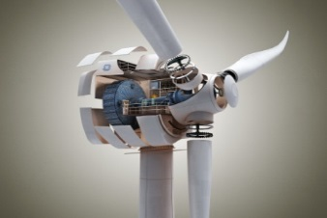
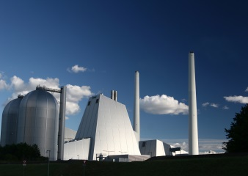
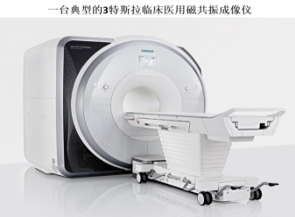
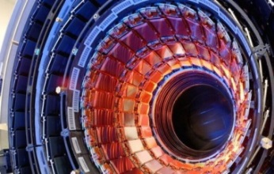
INTRODUCTION
Electric Power
Research Centre & Facilities
Research Institute of Superconductivity @ Shanghai Jiaotong University
An institute with independent personnel authority, financial authority and PhD enrollment quota
Brought together a group of top-tier researchers from home and abroad
Continuous R&D to guarantee the most advanced technologies and process world-wide for 2G HTS wire production
Energy Saving
Environmental
Protection
Health Care
Scientific Research

Slide 6
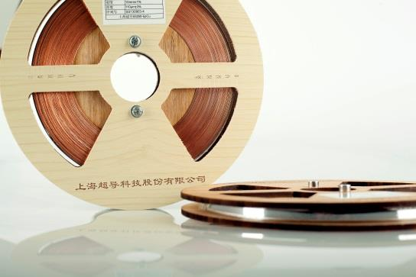
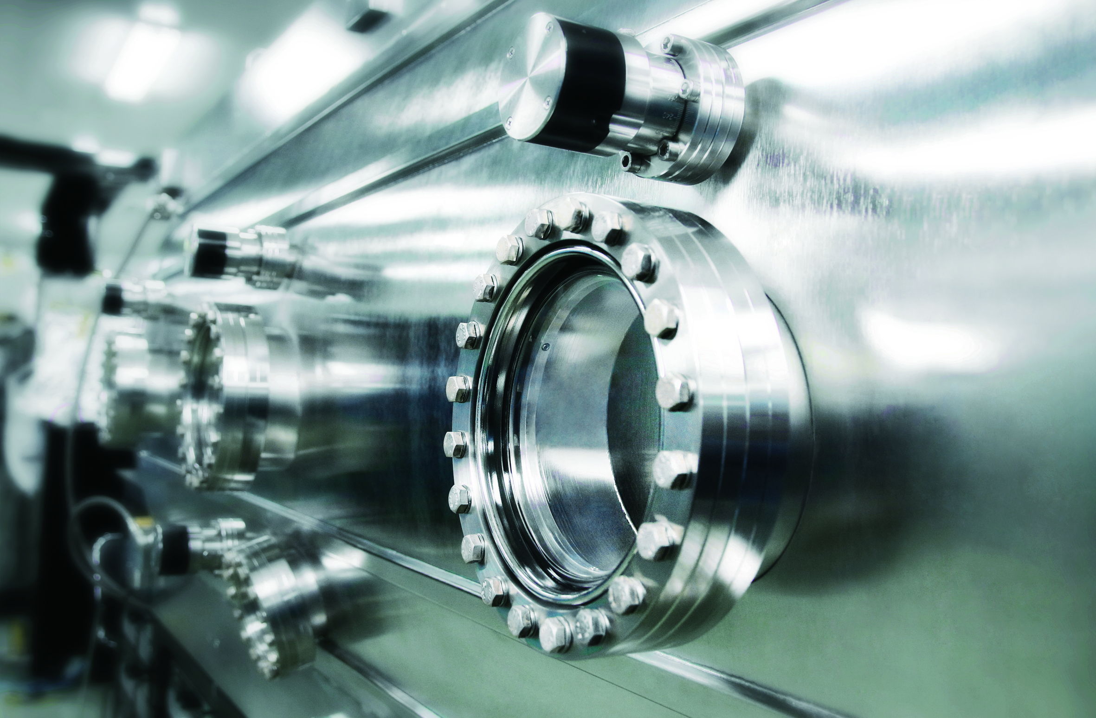
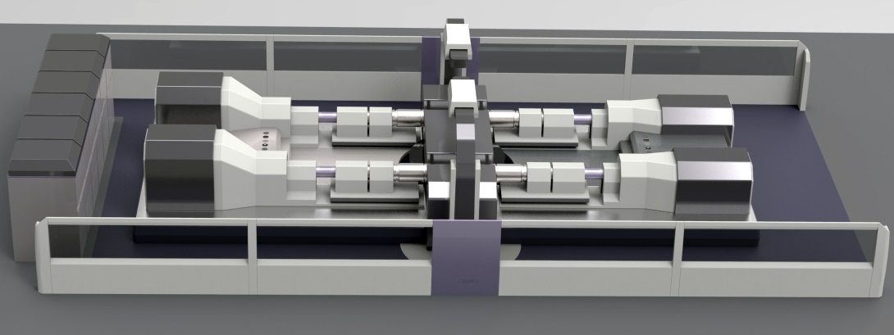
INTRODUCTION
Major Markets & Products
Business Area
Investment (RMB)
2G HTS Materials & Wires
200 Million
Vacuum Deposition Equipment
100 Million
Superconducting Induction Heater
50 Million
Micro- and Nanotechnology Products
120 Million
Aviation Materials Testing Service
50 Million

Slide 7
INTRODUCTION
Research Funding in the area of Superconductivity
2007–2009 A total of RMB 25 Million granted by Central Government, Shanghai
Government and Shanghai Jiaotong University
2010–2011 A total of RMB 45 Million granted by ITER, State Government
and Shanghai Local Government
2012–2013 RMB 20 Million granted by Shanghai Government
RMB 100 Million granted by Shanghai Strategic New Industries Project
2014–2015 RMB 10 Million granted by Shanghai Government

Slide 8
I Introduction
II 2G HTS Wires
Contents
III Autonomous Production
IV Strategies

Slide 9
2G High Temperature Superconducting Wires
Excellent High Field Performance at Low Temperatures
Critical current of 1000 A/cm (width) at 4.2K and 9T
Measurement passed third party verification by Chinese Academy of Sciences
“Created in China”
World-leading Critical Current Density
Critical current density of 5 MA/cm² at 77K, self-field (amongst the top few in the world)
Advanced Low Resistance Superconducting Wire Joint
Total resistance of a single joint can be as low as 2.3 nΩ (resistance evenly distributed in a few meters lenght)
Lowest ever achieved for commercial wires
Highly reversible in the event of over current
Stable Magnetic Coil Winding Performance
Special lamination technique to deal with peeling effect (Ic degradation after applying epoxy)
High tensile strength and critical delamination stress
Al₂O₃
Blocking Layer
Y₂O₃
Buffer Layer
YBCO Superconducting Layer
Cu
Stabilizing Layer
Hastelloy Substrate
MgO
Seed Layer
CeO₂
Cap Layer
Ag
Overlayer

Slide 10
2G High Temperature Superconducting Wires
Existing Clients
CAS Institute of Electrical Engineering
CAS Institute of High Energy Physics
Tsinghua University
Twente University
North China Electric Power University
Cambridge University
Baosteel Group
Bath University
China Southern Power Grid
Bologna University
Dongfang Electric Corporation
Xinan Jiaotong University

Slide 11
I Introduction
II 2G HTS Wires
Contents
III Autonomous Production
IV Strategies

Slide 12
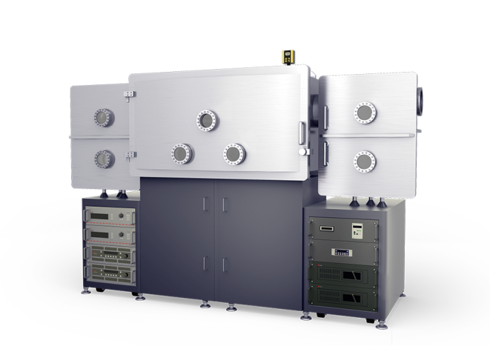
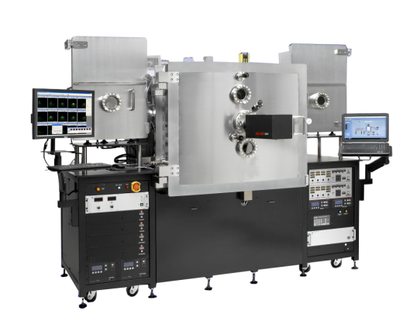
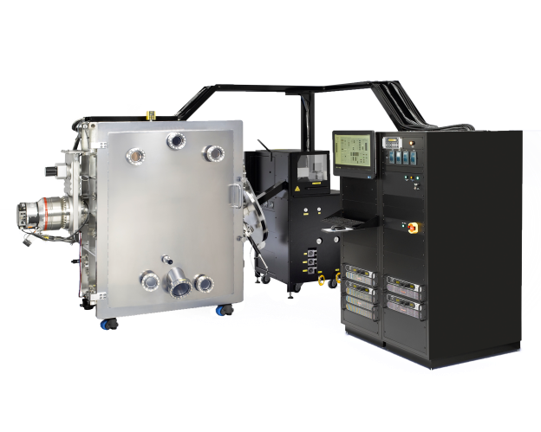
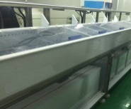
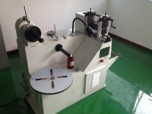
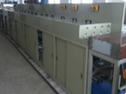
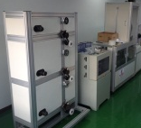
Autonomous Production Line
RF Sputtering Deposition
Ion Beam Assisted Deposition
High Temperature
RF-Sputtering
Deposition
Pulsed Laser Deposition
DC Sputtering Deposition
Polishing
Slitting
Electroplating
Lamination
YBCO Superconducting Layer
Cu Stabilizing Layer
Hastelloy Substrate
Al₂O₃
Y₂O₃
MgO Seed Layer
CeO₂ Cap Layer
Ag Overlayer
Amorphous Layer
From fabrication of sputtering targets to repair and maintenance
The first and only autonomous 2G HTS wires production line in China
A decade of process exploration precedes world-leading wire performance
Capable of mass-producing high quality 2G HTS wires
Currently the world’s only supplier of turn-key 2G HTS wires production line

Slide 13
I Introduction
II 2G HTS Wires
Contents
III Autonomous Production
IV Strategies

Slide 14
Future Strategies
Currently there are far from enough suppliers of 2G HTS for the CEPC-SPPC Project
The collider needs about houdreds superconducting magnets per km
To expand 2G HTS wire production by supplying production line and facilities
To create a huge platform of common interest
Each magnet requires around 20km of superconducting wires
The entire project requires X00,000 km 2G HTS wires

Slide 15
Future Strategies
Focusing on Core Competencies & Advantages
Always on the cutting edge of technologies through our own R&D
Export-ready production line with mature technology
Large number of strategic and business partners
New strategies to develop and restructure high-end manufacturing
Mastery of engineering and processes of mass wire production
Ever developing and improving market environment in China

Slide 16
Future Strategies
Business Model
Status quo of most high-end manufacturing companies in China
Status quo of Shanghai Superconductor
Immature market and mismatch between supply and demand
Heavily relied upon imports
Huge capital requirement for manufacturing facilities and immense debt
Continuous drain of resources
Lack of original research and development
Shared
Outsourcing and hence expansion of manufacturing processes
Integration of resources and geopolitics
Focus on market and research
Invigorating the
2G HTS industry by continuous breakthroughs and innovations
Market
Market
Partner
Equipment
& Facilities
Manufacturing
Manufacturing
Partner
Technical
Know-how
Partner
R&D
R&D
Support

Slide 17
Future Strategies
Business Model
An Open & Win-Win Platform for Everyone
Rationale
In light of the massive demand for 2G HTS we need to duplicate production lines by means of strategic corporation with business partners
Equipment Manufacturers
Vacuum
PVD
SPD
Responsibility
2G HTS Material Suppliers
MOCVD
To open up and supply not only the entire production line but also processes and high value-added services
IBAD
PLD
Partner
Partner
Application
Suppliers
Cryogenic
Revolution
Cable
Partner
We envision explosive development of 2G HTS and a increasingly market-oriented and internationalized industry
Magnet

Slide 18
Thank you

