Slide 1
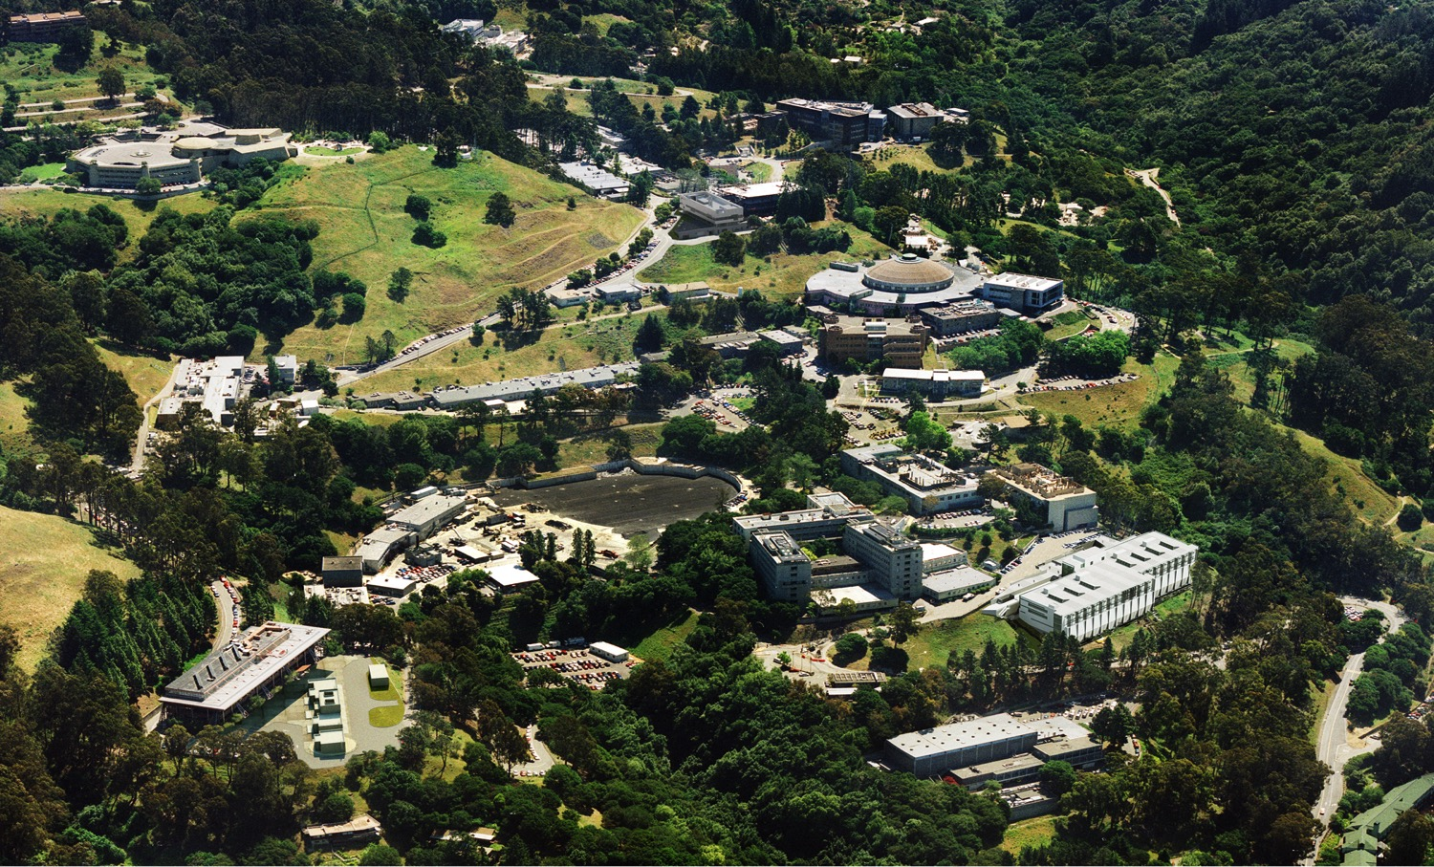
CCT Magnet Development at LBNL
Daniel R. Dietderich
Superconducting Magnet Program
ICFA Mini Workshop on High Field Magnets for Future pp Colliders
Shanghai Jiao Tong University, Xuhui Campus
June 14-17, 2015

Slide 2
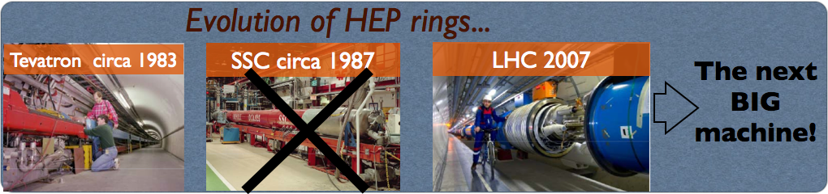
P5/HEPAP subpanel report on Accelerator R&D identifies the importance of Magnet Technology
Recommendation 5: “Participate in international design studies for a very high-energy proton-proton collider in order to realize this Next Step in hadron collider facilities for exploration of the Energy Frontier. Vigorously pursue major cost reductions by investing in magnet development and in the most promising superconducting materials, targeting potential breakthroughs in cost-performance.”
ATAP modeling activities are in-line with the recommendations.

Slide 3
We have identified a focused set of Grand Challenge questions addressing the P5/HEPAP subpanel report concerns
Achieve a field of 16T in a bore of at least 50mm by focusing on simple, manufacturable designs
Understand training of Nb₃Sn magnets and develop ways to reduce or eliminate it
Produce an HTS (Bi-2212/YBCO) insert with a self-field of > 4T and measure the field quality
Reduce cost and improve performance of Nb₃Sn
  Increase the current density by 30% with a scalable sub-element structure
  Aim for a cost per kg the same as NbTi
Develop HTS conductor
  Reduce silver (i.e. increase Bi-2212 content) or replace silver
  Increase J_{c}/J_{e}
  Focus on magnets as technology drivers to generate larger market for cost reduction (Stewardship activity) as a collateral benefit to the program.
ATAP SMP is uniquely qualified to address these challenges.

Slide 4
A SMP Program has been developed to efficiently and effectively address the Grand Challenges
Designing, fabricating and testing high field dipoles of Nb₃Sn and HTS
A program to develop and assess the viability of high temperature superconductors, both Bi-2212 and ReBCO for applications to HEP
An ancillary program of subscale studies to investigate training, materials such as insulation and epoxies, quench protection, etc.
A strong DOE Conductor Development Program to reduce cost and improve performance of superconductors.
Each of these elements are crucial to a successful program that will meet the required goals.

Slide 5
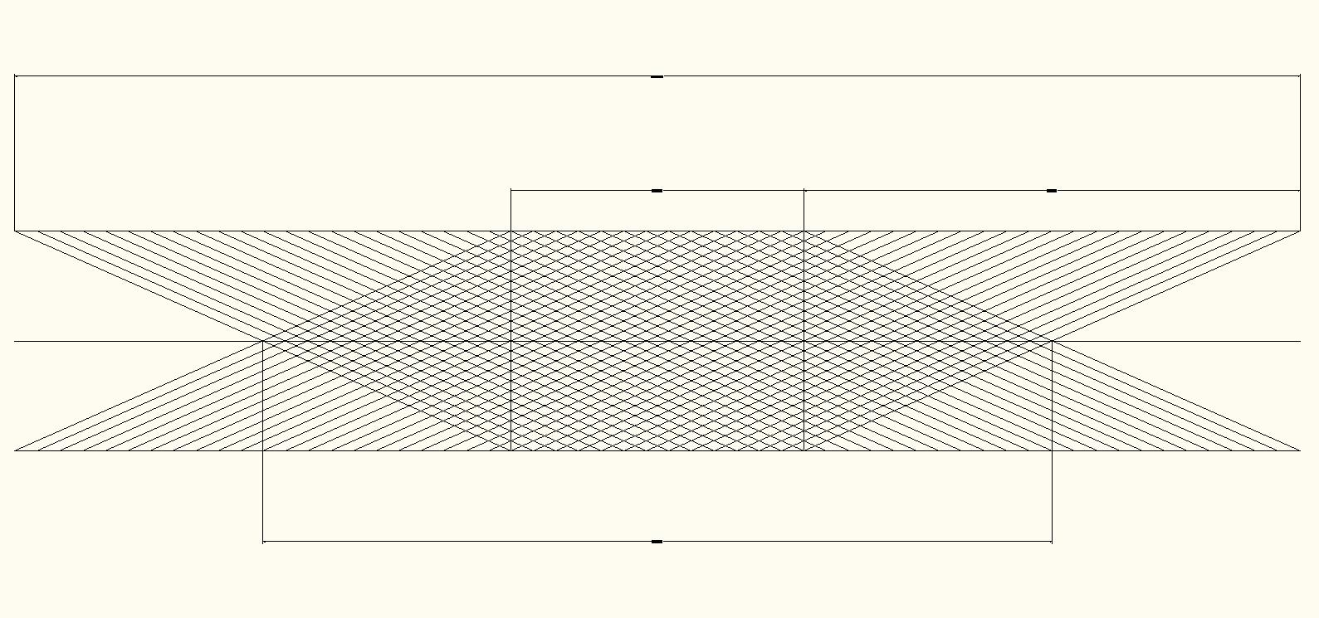
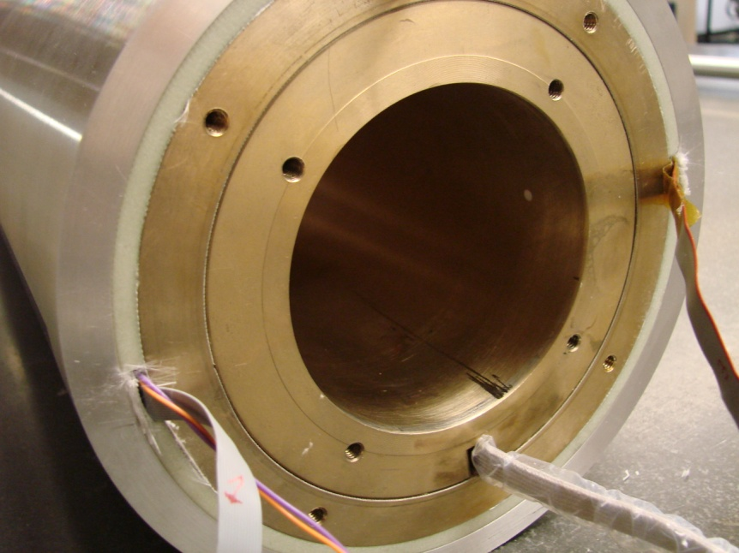
CCT: Path to Fields > 18T
Superconducting Magnet Program
New application for Canted-Cosine-Theta (CCT)
Canted solenoids generate “near perfect” accelerator fields – dipole, quads
Stresses > 200 MPa expected at the mid-plane in CosΘ dipoles at 20T
Ribs in CCT intercept Lorentz forces from each cable and prevents stress accumulation on cables
Successful proof of principle with 2 coils of NbTi that achieved ~4.5T

Slide 6
CCT Background Slide
Paper by D.I. Meyer and R. Flasck in 1970
(D.I. Meyer, and R. Flasck “A new configuration for a dipole magnet for use in high energy physics application”,
Nucl. Instr.and Methods 80, pp. 339-341, 1970.)
Renewed interest during the past decade

Slide 7
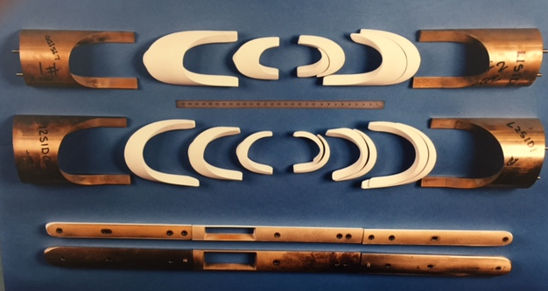
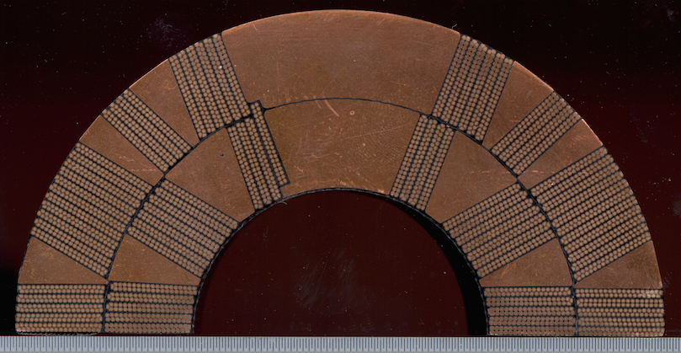
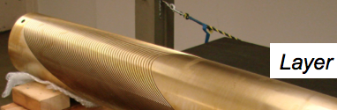
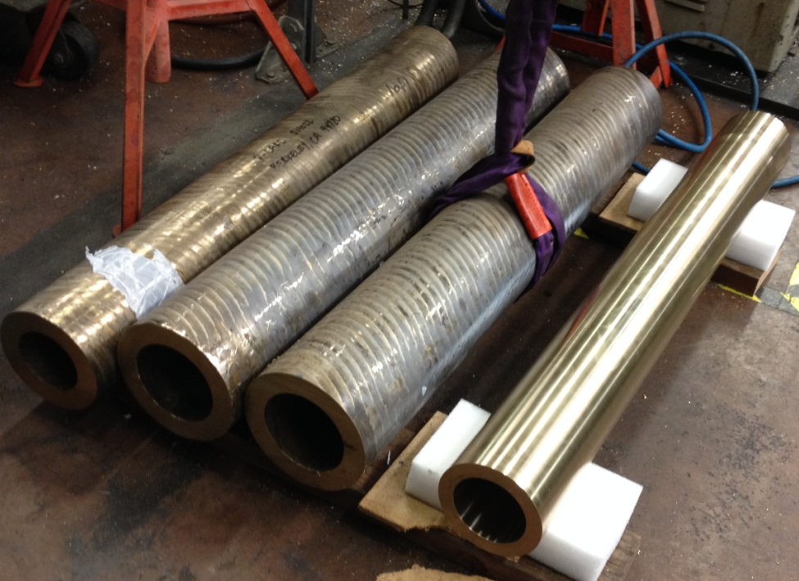
LBNL’s D20 Dipole and CCT Coil Parts
Parts for D20 13.6 T (1.9K) for 4 layers 2 coils – End spacers coated with alumina, wedges not shown, end shoes, and pole pieces
Cross section of D20
Layers 1 & 2
Parts for CCT 4 layers,
4 tubes -- No pole pieces, no end spacers, no wedges, no end shoes

Slide 8
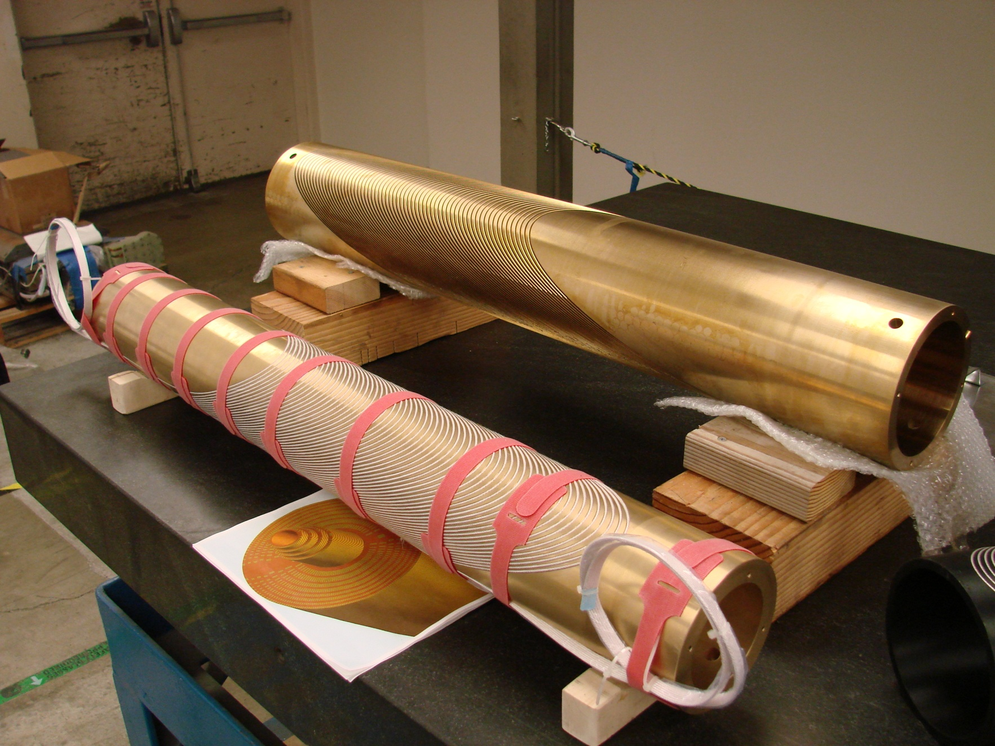
The Canted-Cosine-Theta (CCT2)
Layer 2
4 Layers
4 Bronze tubes
Possibly a simpler assembly
Layer 1
Field Quality incorporated into grooves
Mandrels integrate windings and structure
Poles (i.e. tubes) are part of the reaction and impregnation tooling
CCT2 – a 5T limit 2 layer NbTi 90 mm clear bore

Slide 9
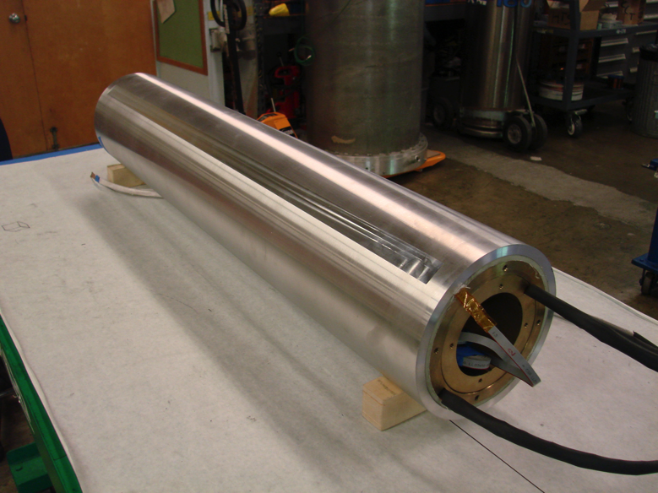
We are working aggressively to investigate the potential of the CCT for high field accelerator magnets
CCT2 with NbTi
First results: Data reduction and analysis ongoing
First test campaign magnet went to ~9,000 A (4.5T)
No room temperature preload used – only preload from cool-down
Validation of fabrication processes - ready for much higher field!

Slide 10
CCT2 training
90.4% I_{ss}
Inner Layer
~9,000 A
Outer Layer
Outer Layer

Slide 11
First CCT results show excellent promise,
but lots of work to do
First results: Data reduction and analysis ongoing
Static harmonics: excellent agreement with calculation
Diagnostics of acoustic sensors and quench antenna arrays performed ????

Slide 12
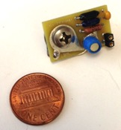
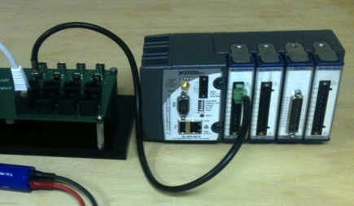
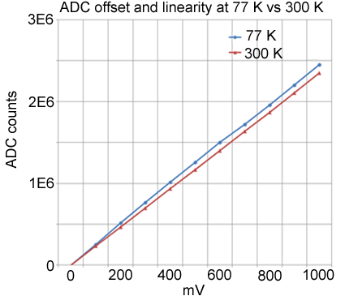

Magnet Instrumentation and Diagnostics
Digital 16-channel FPGA-based quench detection system
6-channel acoustic quench diagnostics system
0-300 kHz bandwidth and 300 -1.9 K operation
Improved accuracy of quench localization
Improved redundancy
Precise and flexible control of detection thresholds and protection delays
PC board-based stackable quench antenna arrays with 1 inch spatial resolution
Localizing quenches and measuring quench propagation velocity with ultimate precision, also enabling full quench diagnostics where voltage taps are unavailable (CCT)
Cryogenic DAQ instrumentation
  Proof-of-principle with CCT test
  Implemented by end of 2015
CLIQ system (June 2015)
The most efficient “bulk heating” quench protection technique
Essential for reducing quench integrals in high-field magnet tests where surface heaters are not implemented or inefficient
Drastically reduces number of wires coming out of the cryostat, improves reliability and reduces operational costs
A platform for implementing future sensors and diagnostics
By M. Turqueti

Slide 13
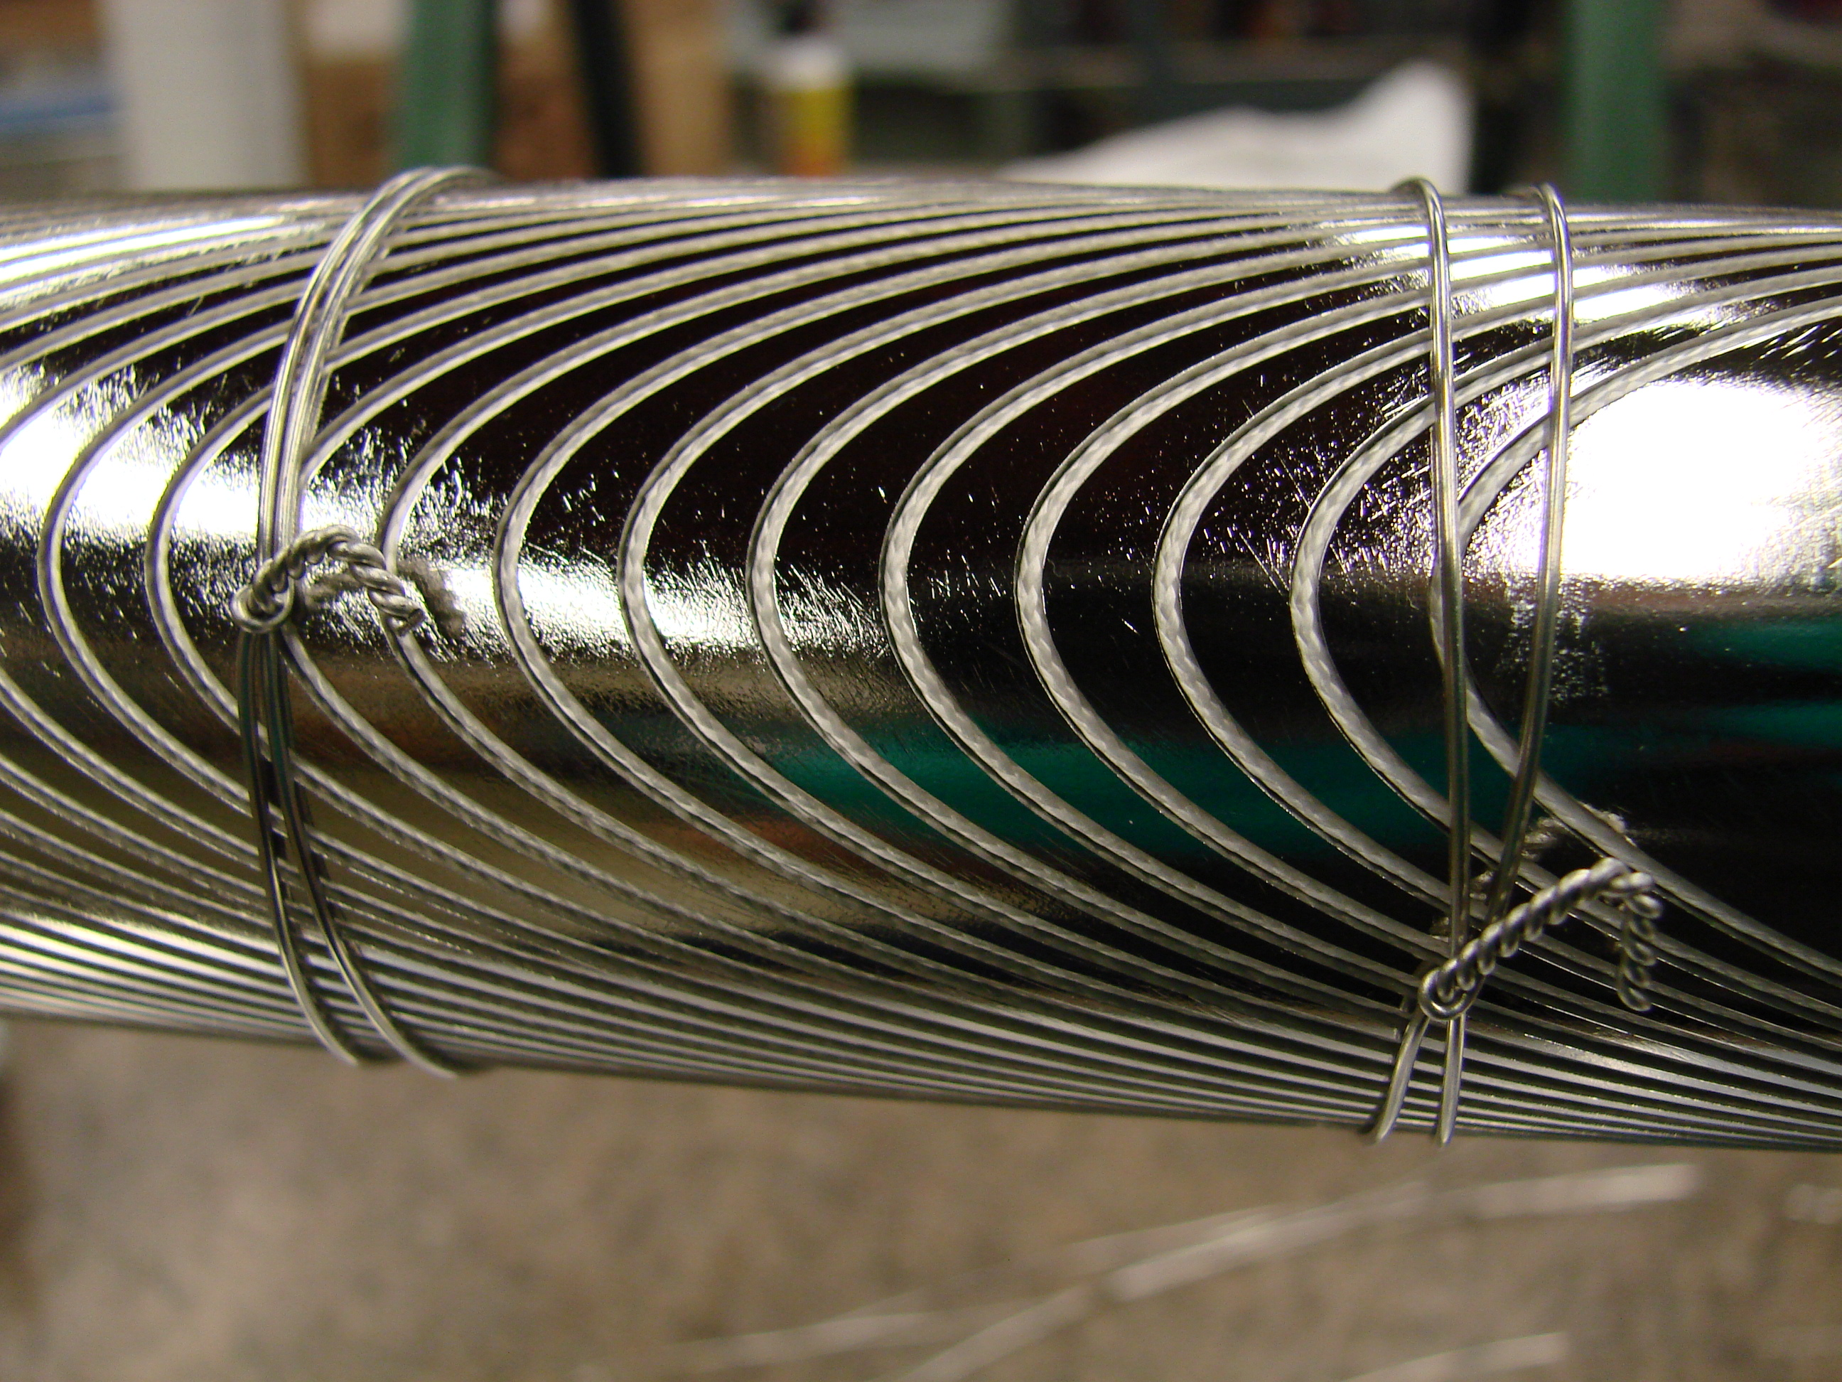
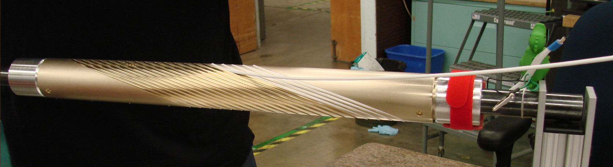
Bi-2212 CCT Effort
BIN1 – Single wire coils for process development with Inconel
BIN2 – 6 around 1 cable with Bronze
BIN3 – Rutherford cable – Next step

Slide 14
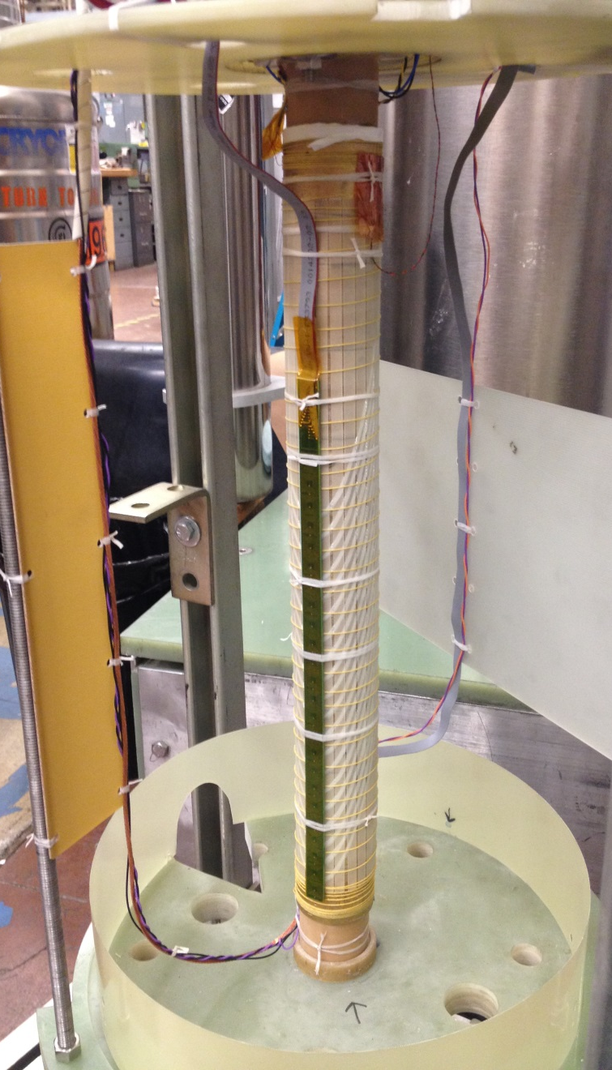
BIN2 coil with 6 around 1 cable (Bi-2212)
Instrumentation wiring
G10 strips covering the coil surface and wrapped with Kevlar string (yellow) to counteract the Lorentz force on the conductor (20 N/cm in the mid-plane)
BIN2 inner layer
Quench antenna covering the magnet pole area. Another one on the opposite side (not shown)
NbTi Rutherford cable current leads

Slide 15
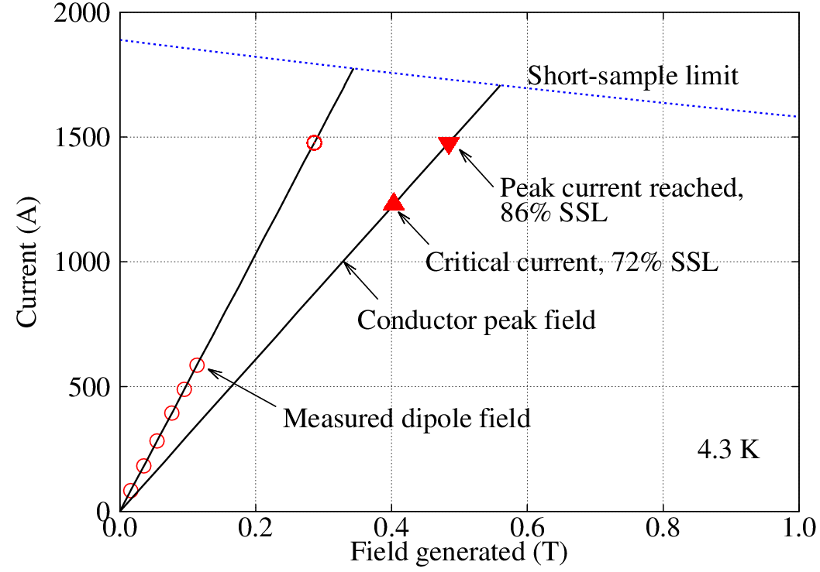
Coil reached > 72% of conductor limit
Performance consistent with previous LBL subscale coils heat treated at 1 bar
  I_{c} = 1230 A (0.1 μV/cm), n = 15
  > 72% of short-sample limit
  J_{e} = 350 A/mm²
Cycled to 1400 A for a few times without degradation
Excellent agreement between the measured dipole fields and calculation
Measurement of field quality is planned for the next test
Notes:
Red: measurements
Black lines: calculated load lines
Short-sample: 1708 A

Slide 16
SMP Drivers
Alignment with P5
“Going much further, however, requires changing the capability-cost curve of accelerators , which can only happen with an aggressive, sustained, and imaginative R&D program.”
“Primary goal, . . . . build the future-generation accelerators at dramatically lower cost. For, example, the primary enabling technology for pp colliders is high-field accelerator magnets, . . .”
“Strengthen national laboratory-university R&D partnerships, leveraging their diverse expertise and facilities.”
Development for 18 T magnet with best magnet concept – Future Circular Collider (FCC)
    Consider both Nb₃Sn and HTS conductors
Faster, Better, Cheaper may apply to CCT

Slide 17
Conclusion
SMP has a strong program aligned with the P5 subpanel
    Focused accelerator magnet Grand Challenges have been identified…
    A program has been defined to effectively and efficiently address them
SMP is aggressively pursuing the novel CCT concept
    Need to develop, test, and challenge the approach to determine feasibility
    First results with NbTi conductor are very promising
    Plan to proceed quickly towards higher fields with Nb₃Sn conductor
LBNL is very active in important DOE projects and initiatives
    Critical roles in LARP/HiLumi
    Advancing superconducting technology for FRIB
    Introduced novel superconducting gantry magnets⇒Stewardship award

Slide 18
Extra Slides

