Slide 1
2015 Technology and Manufacturing Innovations at SuperPower
Guilin Cui
Furukawa Electric Co.,Ltd
Beijing

Slide 2
Outline
SP overview
Electrical properties (IcBT)
Mechanical properties
New initiatives on-going
Applications cases

Slide 3




SuperPower’s history as a 2G HTS industry leader
2000-2006: The Intermagnetics Years
  SuperPower formed from the Technology Development Organization of Intermagnetics
  2G HTS technology development
  Production scale-up
  Demonstration projects – energy focus
2006-2012: The Philips Years
  Transition from scale-up to commercialization
  Exploration of a wide range of commercial markets
  Buildup of a broad customer base
From 2012 onward: The Furukawa Years
  Continuous manufacturing improvements over established baseline capabilities … to address market needs
  Steady expansion of production to meet market requirements
  Focus on long-term sustainability in a slowly evolving market

Slide 4






One Furukawa: offering both LTS and HTS solutions
Three core materials across five business segments
Photonics
Metals
Telecommunications
Metal
Polymer
Light Metals
Energy/Industrial Products:
CORPORATE PHILOSOPHY
Drawing on more than a century of expertise in the development and fabrication of advanced materials,
we will contribute to the realization of a sustainable society through continuous technological innovation.
Electronics/Automotive
Systems

Slide 5
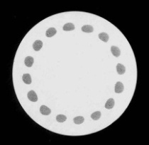
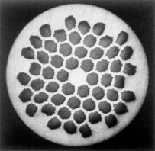
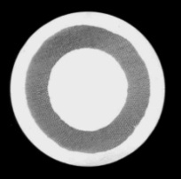
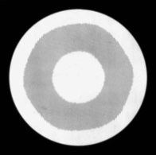
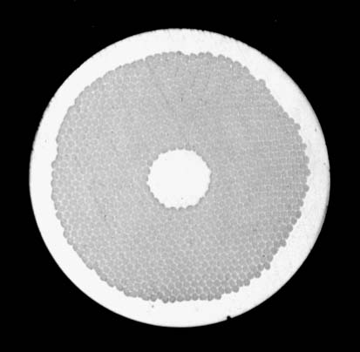
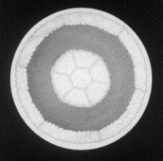
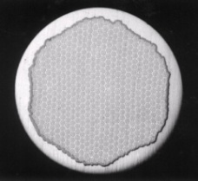
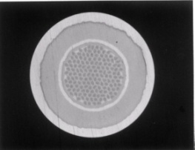

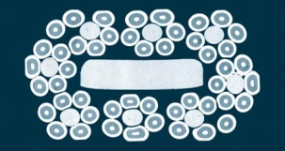
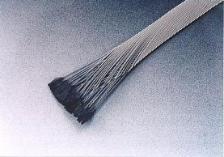
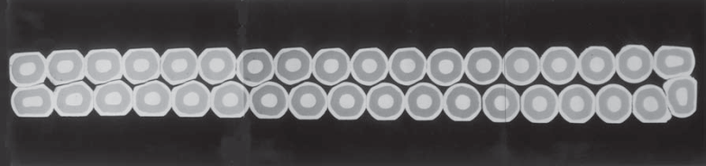
Furukawa has a long history in LTS
CUSTOMIZATION
Various conductor designs satisfy customer demands
NbTi wire with various Cu ratio & filament sizes
HIGH TECHNOLOGY
Sophisticated metal composite technology
Low ac loss NbTi wire
Al-stabilized NbTi wire
High Jc Nb₃Sn wire
High strength Nb₃Sn wire
HIGH QUALITY
High-precision cabling technology
Al-stabilized NbTi Rutherford cable
NbTi Rutherford cable with cored bar
NbTi Rutherford cable with high-precision

Slide 6
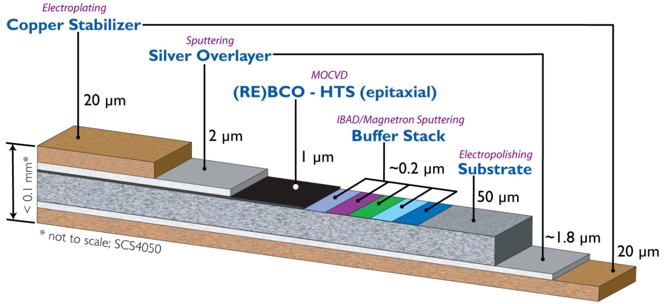
Typical architecture of SuperPower’s wire
Series of width : 2mm, 4mm, 6mm, 12mm

Slide 7

Today’s properties for the customers
High I_{c} : >450A standard (12 mm width; 77K, 0T)
Uniform I_{c} over long lengths: STDEV +/- 10%
  Good, repeatable bandwidth
  Good 2D uniformity (across width)
High engineering current density:
  Very thin substrates and stabilizers
Chemistry:
  Currently two formulations
    AP (Advanced Pinning) – enhanced performance for in-magnetic field applications
    CF (Cable Formulation) – 77K, low fields (cable, FCL, transformer)
Flexible, robust architecture:
  Multiple widths and thicknesses (substrate, stabilizers)
Superior mechanical properties:
  Yield strength 550 MPa and higher with superalloy-based coated conductors
  Excellent joints and solderability

Slide 8
Recent step wise improvements to meet market challenges
High - Critical current
  Recent advances in processing have significantly increased the base I_{c} (77K, sf) of SP 2G HTS tapes into the 400-600 A/cm-w range
Long - Piece length
  Recent advances in processing have also increased the stable production piece length of SP 2G HTS tapes >500m
Large - Current density
  SP 2G HTS tapes have the highest conductor Jc’s in the industry
  New initiatives will maintain this performance advantage
    Thinner substrates (>30% Jc improvements)
    Improved lift factors (2x +) with enhanced pinning
Efforts in Pricing
  Improved yields improve costs
  Review of pricing structure to facilitate competitive pricing

Slide 9
IcBT improvements achieved
- Ic (standard vs enhanced 7.5%)
- Anisotropy

Slide 10
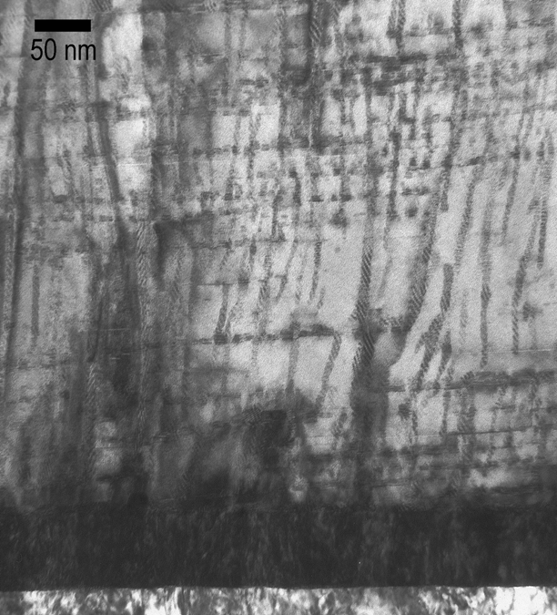
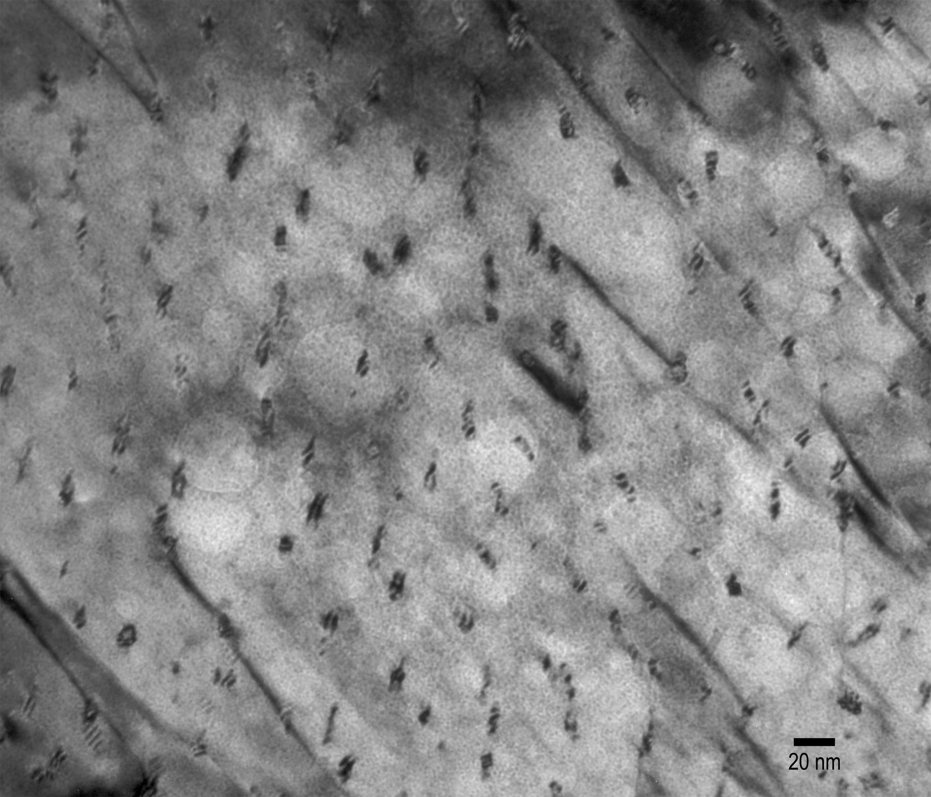
Microstructure of production MOCVD HTS wires with standard 7.5% Zr doping
5 nm sized, few hundred nanometer long BZO nanocolumns with ~ 35 nm spacing created during in situ MOCVD process with 7.5% Zr

Slide 11
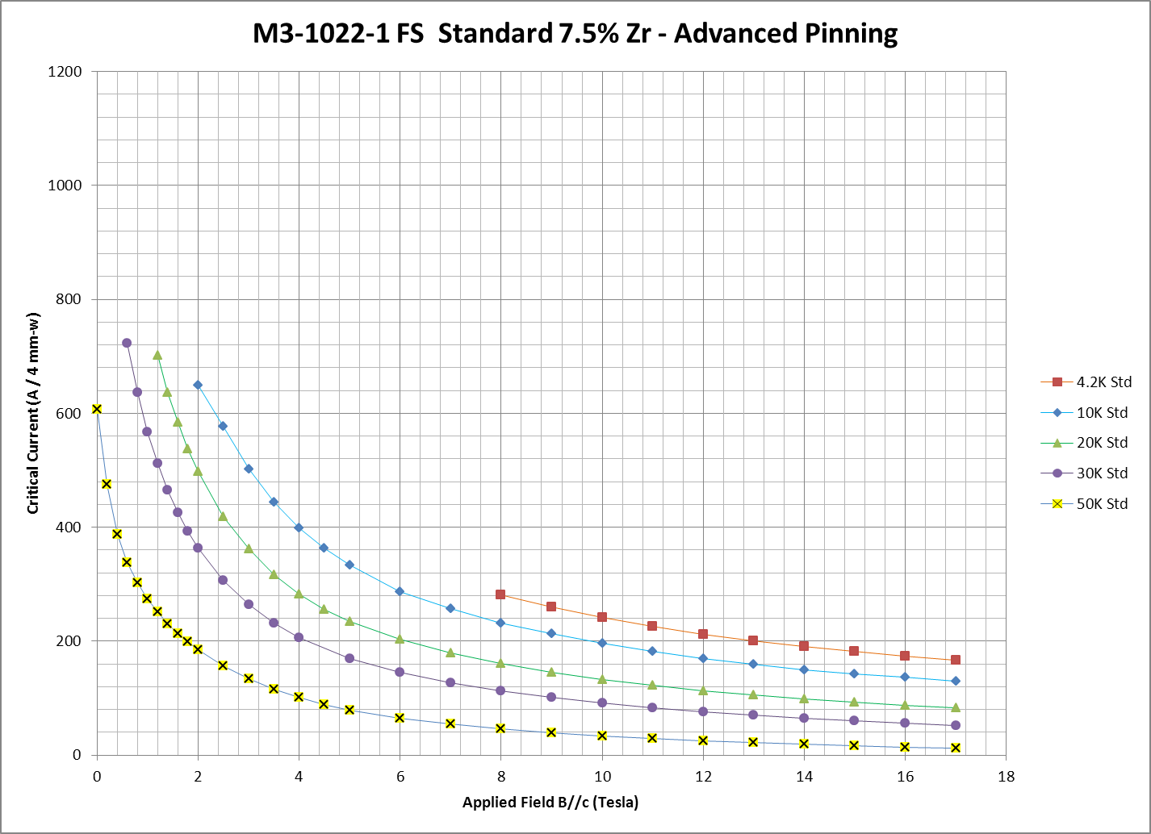
Ic vs. field: standard 7.5% Zr AP
4 mm-w
Measurements made at Tohoku University

Slide 12
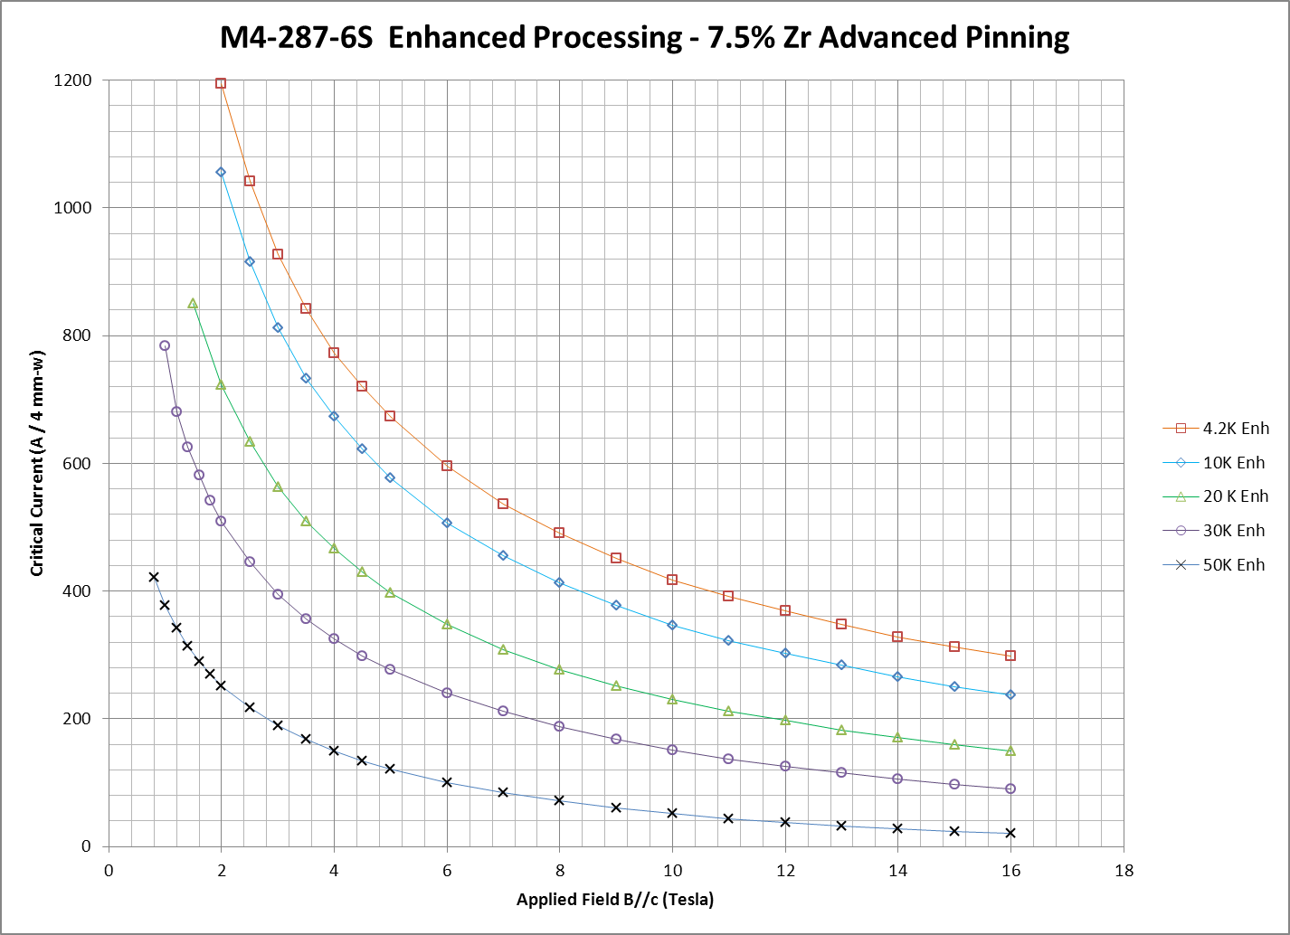
Ic vs. field: enhanced 7.5% Zr AP
4 mm-w
Measurements made at Tohoku University

Slide 13
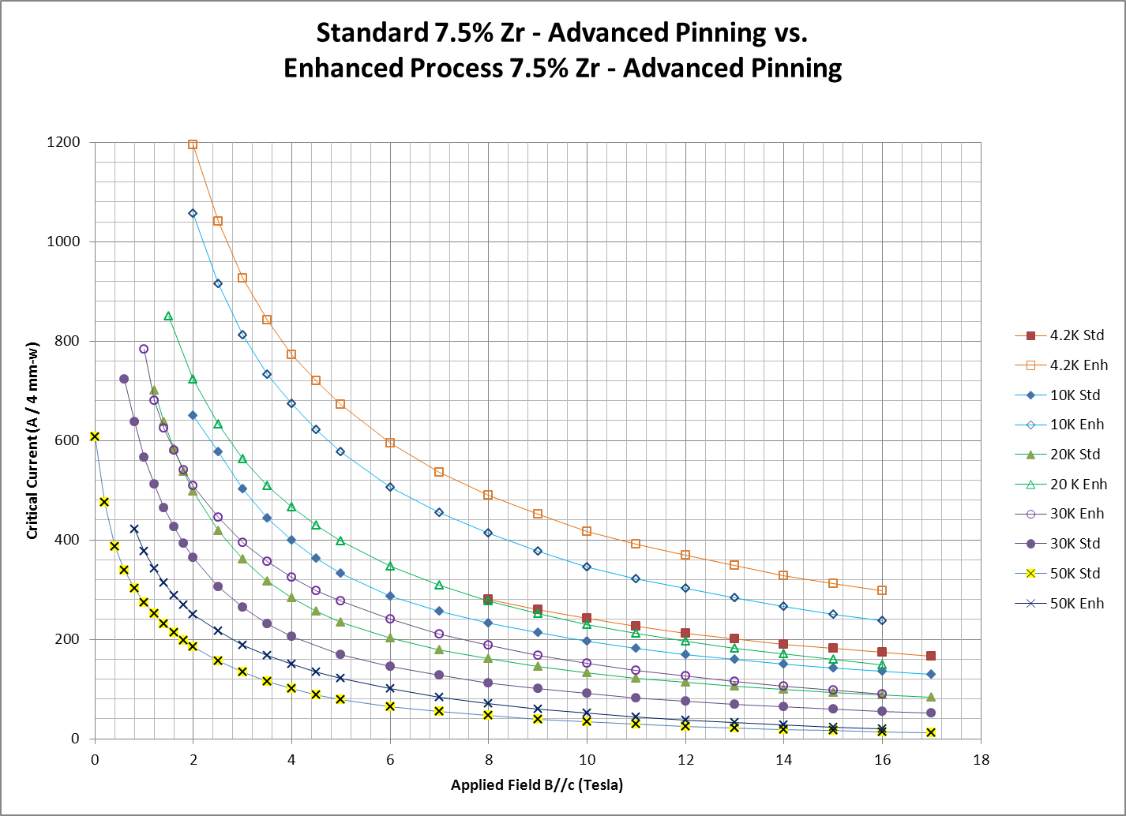
Ic comparison: standard vs. enhanced
4 mm-w
Measurements made at Tohoku University

Slide 14
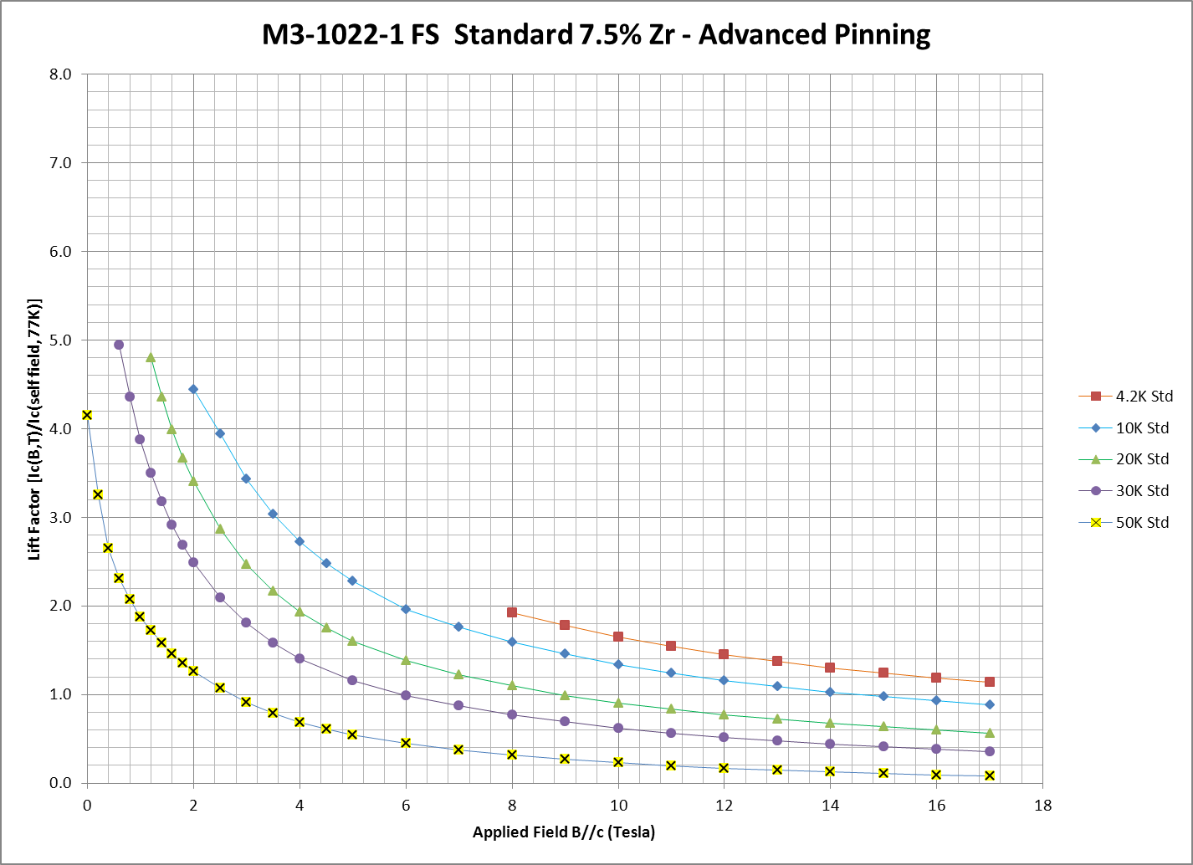
Lift factor (another perspective) : std 7.5% Zr AP
Measurements made at Tohoku University

Slide 15
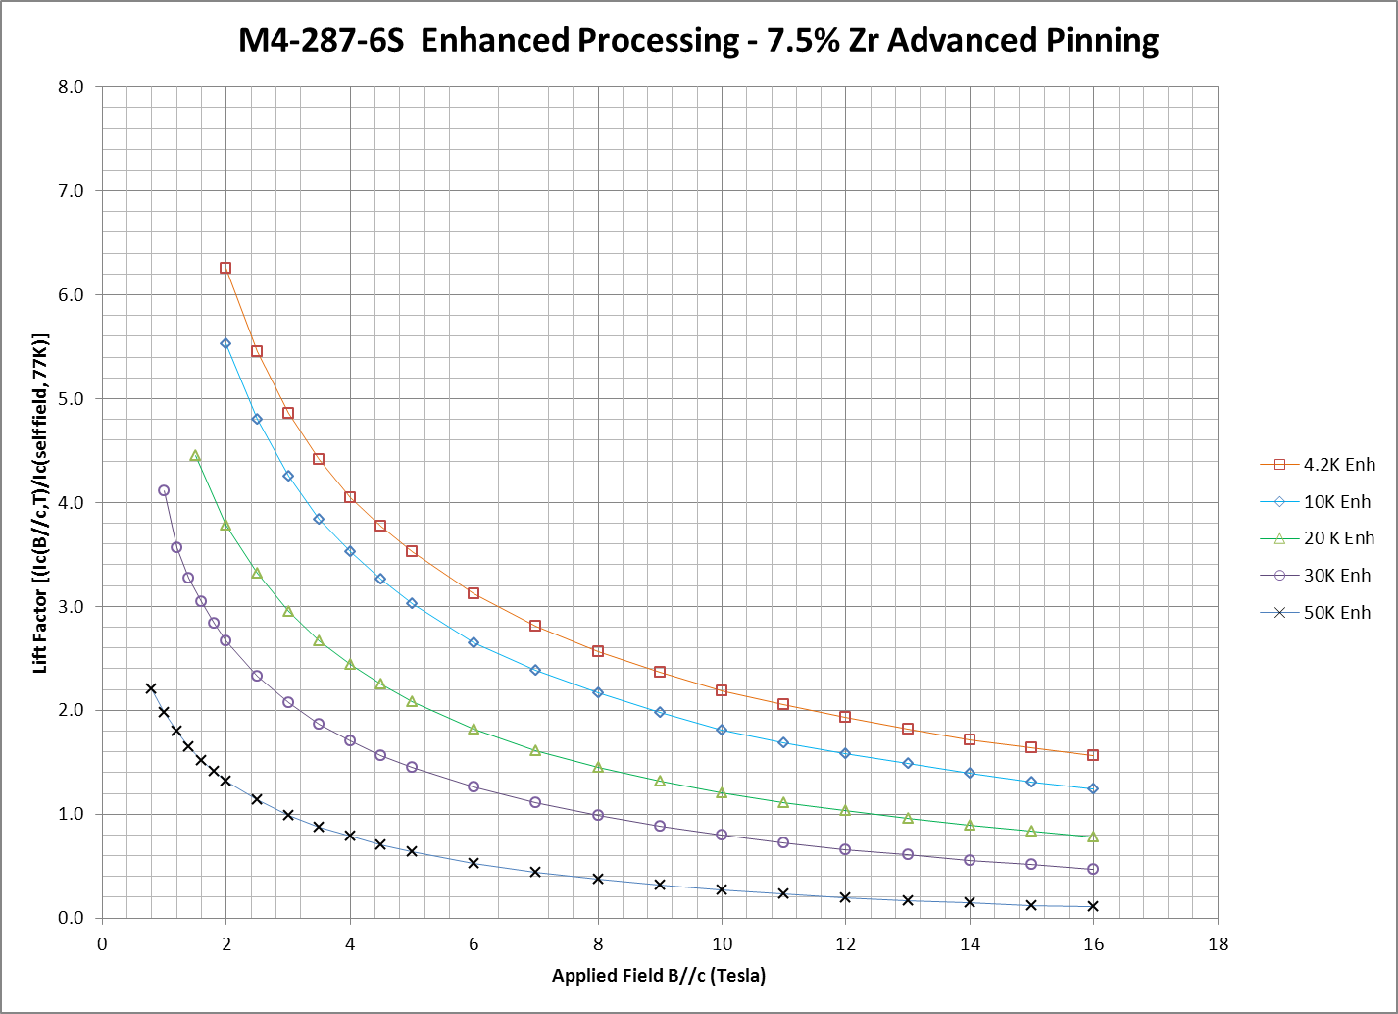
Lift factor (another perspective ): enhanced 7.5% Zr AP
Measurements made at Tohoku University

Slide 16
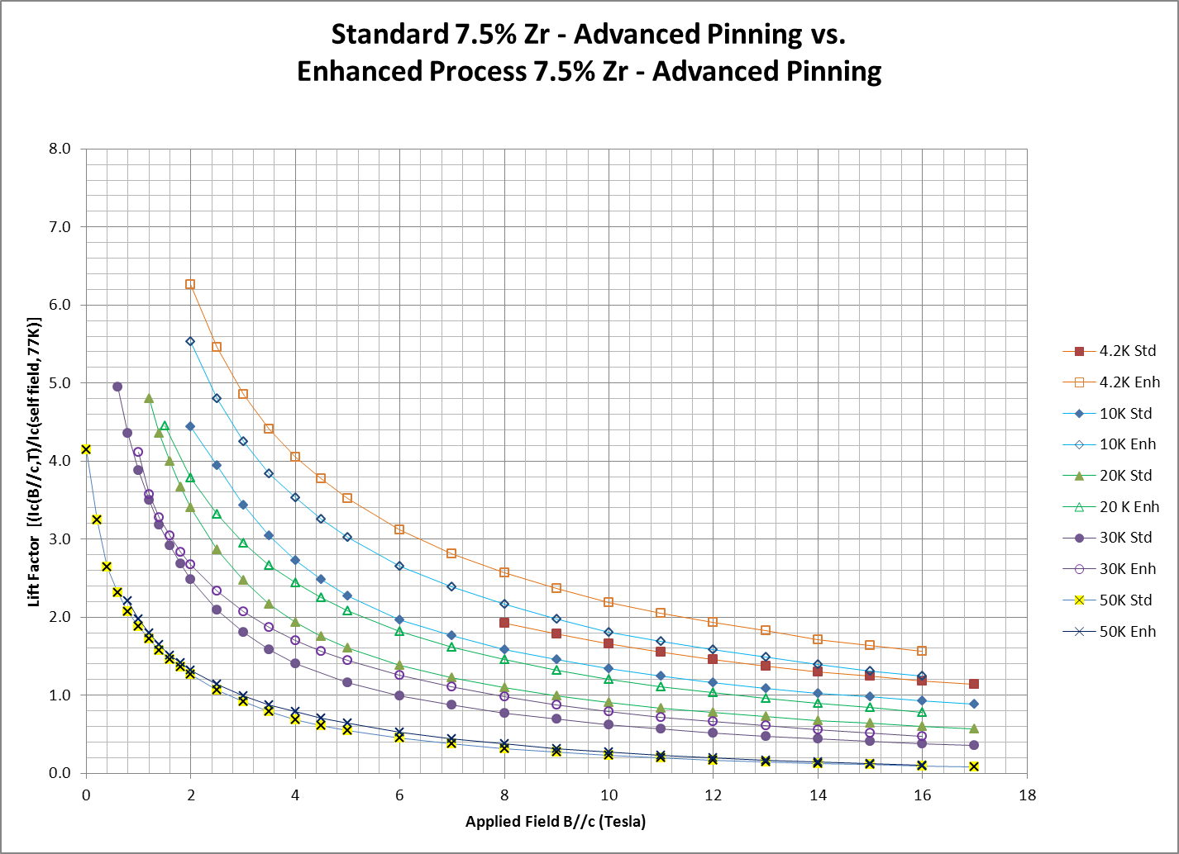
Lift factor comparison: standard vs. enhanced
Measurements made at Tohoku University

Slide 17
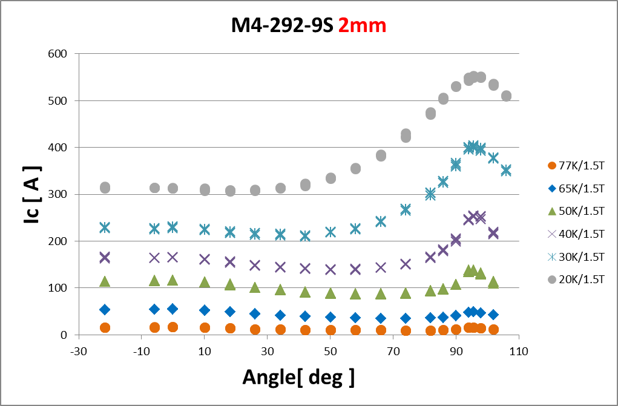
IcBT typical data of Anisotropy (1.5T)

Slide 18
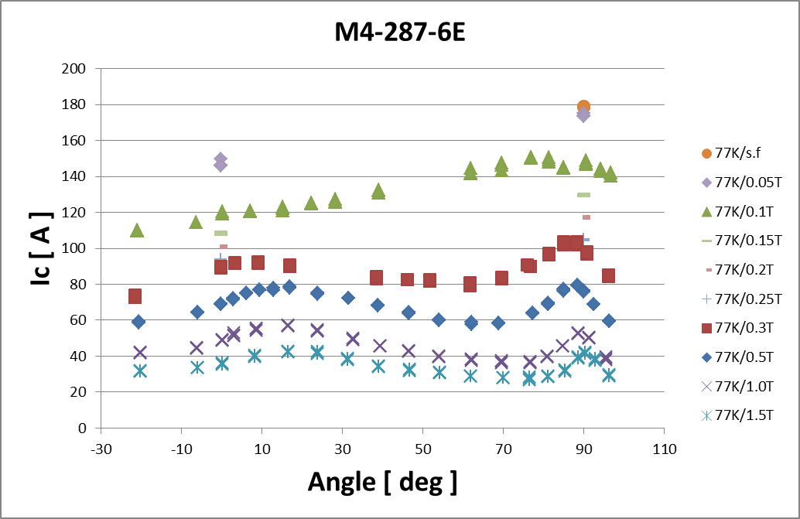

IcBT typical data of anisotropy (77K)
4 mm-w

Slide 19
Mechanical properties

Slide 20
Comprehensive testing capabilities for mechanical and electromechanical properties
Axial tensile test at room temperature or at 77K (with I_{c})
Measurement of elastic modulus and yield stress
Determination of critical stress and irreversible stress (strain)
Measurement of delamination strength – various testing methods
Peel test: at room temperature and with varying peeling angle
Pin-pull (c-axis tensile) test: at room temperature
Anvil (c-axis tensile) test: at room temperature or at 77K (with I_{c})
Transverse (c-axis) compressive test at 77K (with I_{c})
Measurement of critical compressive stress
Torsion-tension test at 77K (with I_{c})
Measurement of critical tensile stress under twist

Slide 21
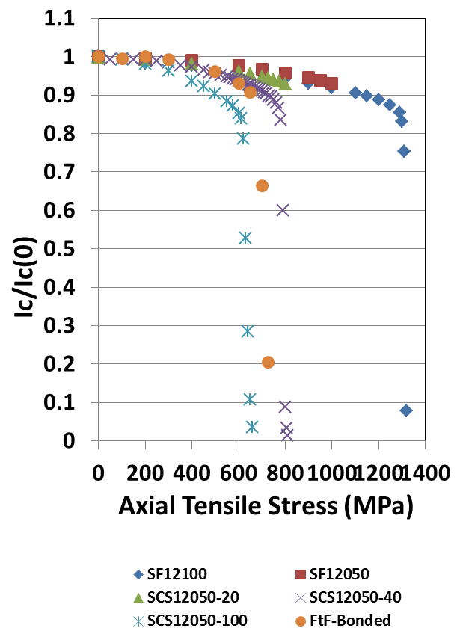
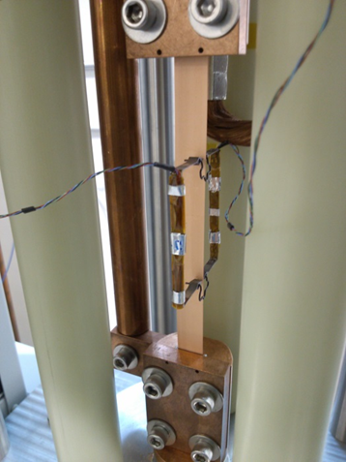
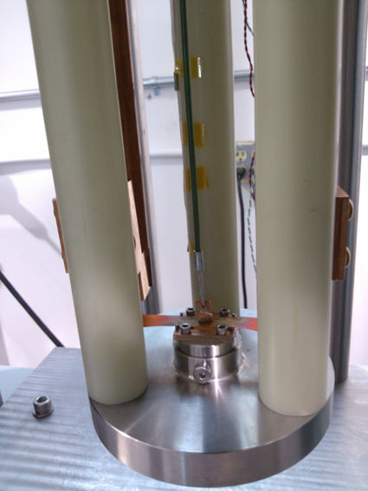
Studies on mechanical/electromechanical properties
Mechanical behaviors under various stress conditions at RT and/or 77K
Electromechanical testing for stress (strain) dependence of I_{c} at 77K
Electromechanical strength determined by critical stress with 95% I_{c} retention
Axial tensile
RT or 77K w/ I_{c}
Transverse tensile
Stud method
RT or 77K w/ I_{c}
Normalized I_{c} vs. axial tensile stress for
Fixture for mechanical/electromechanical testing

Slide 22

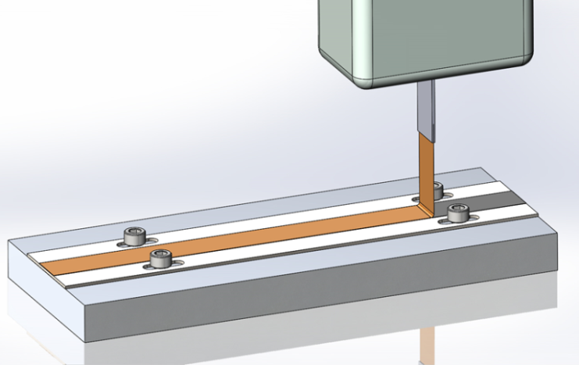
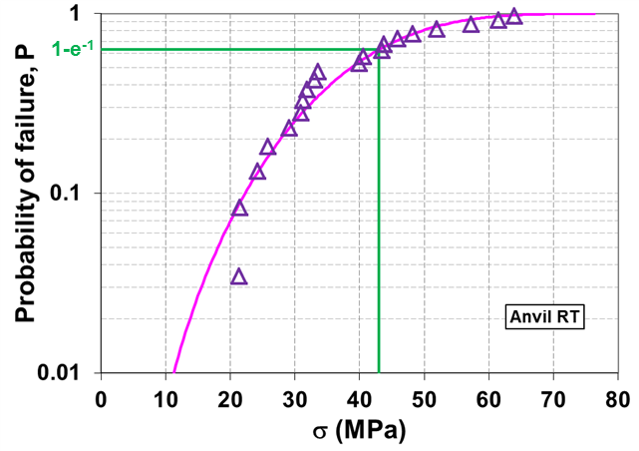
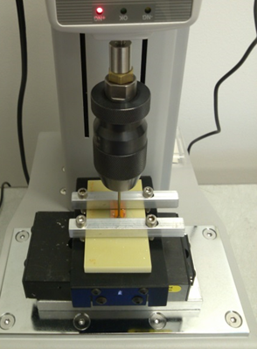
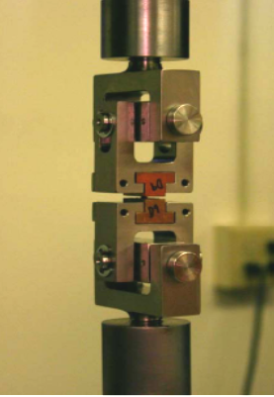
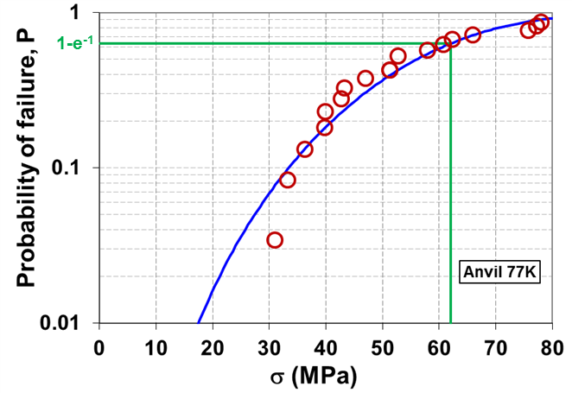
Studies on mechanical/electromechanical properties
90° Peel test, RT
Transverse tensile
Pin-pull method
RT
Transverse tensile
Anvil method
RT or 77K
Weibull analysis results – anvil test

Slide 23
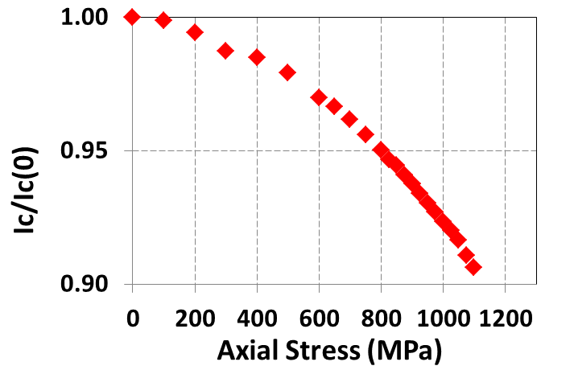
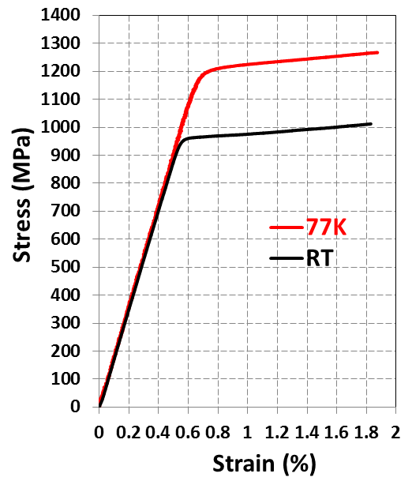
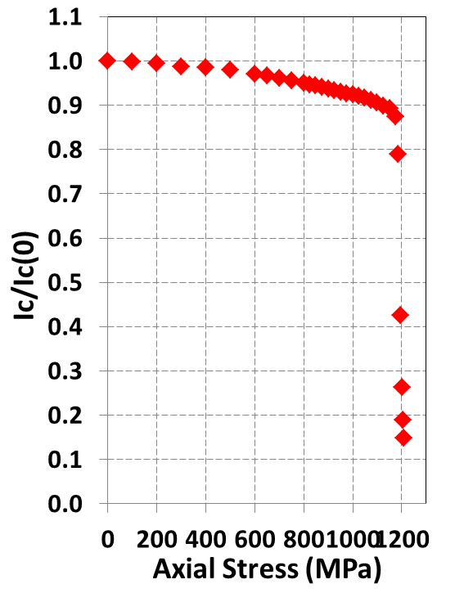
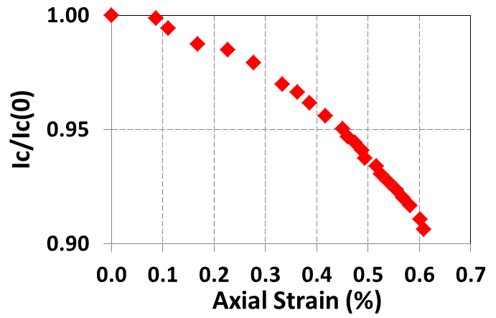
Tensile property of wire without stabilizer
Tensile stress-strain relationship (RT & 77K) and I_{c} vs. tensile stress relationship (77K) measured on tape without Ag and Cu (processed up to (RE)BCO only. Hastelloy substrate thickness = 50 μm)
σ_{c,0.95}≈800MPa, ε_{c,0.95}≈0.45%
77K

Slide 24
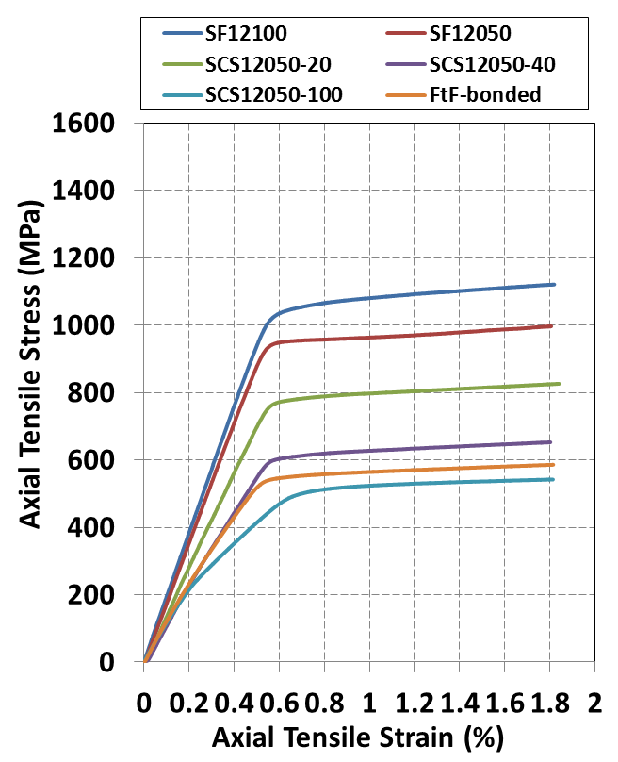
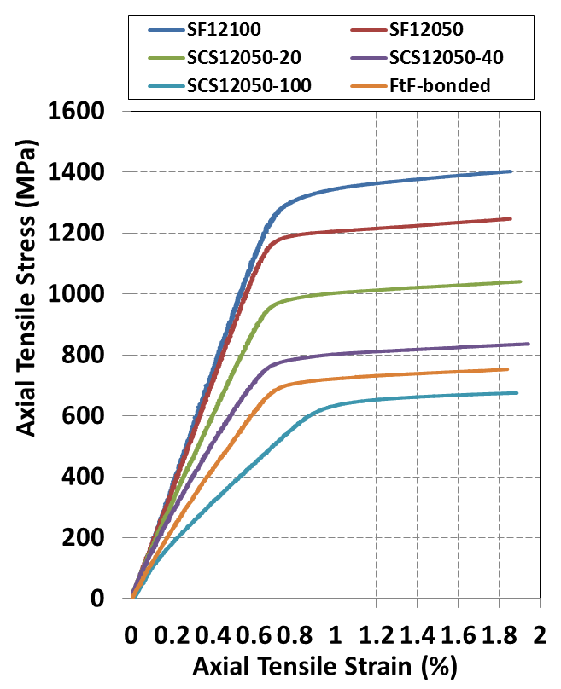
Tensile property of various wires
Tensile stress-strain relationship measured at RT and 77K
RT
77K

Slide 25
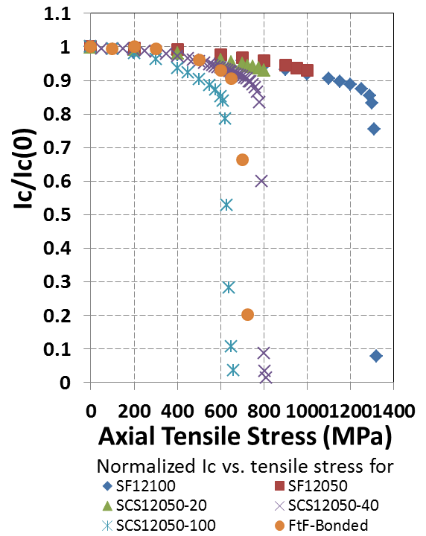
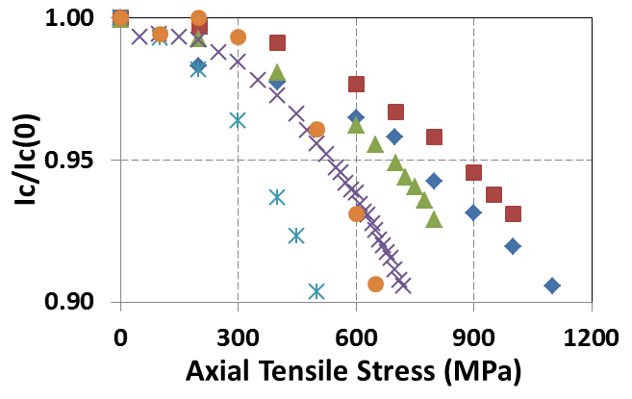
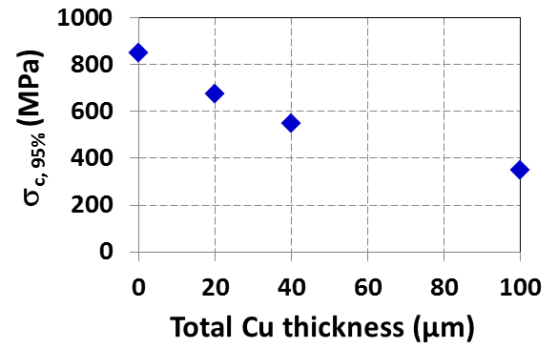
Tensile property of various wires
I_{c} vs. tensile stress relationship at 77K
For wires on 50μm Hastelloy Substrate

Slide 26
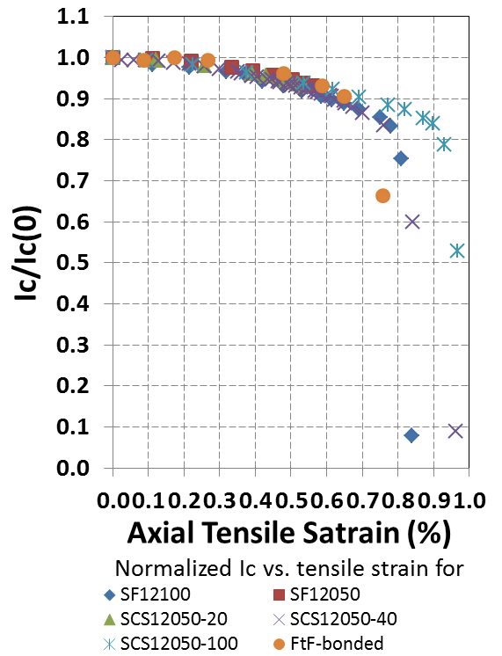
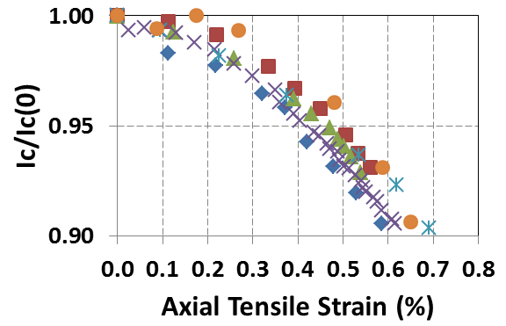
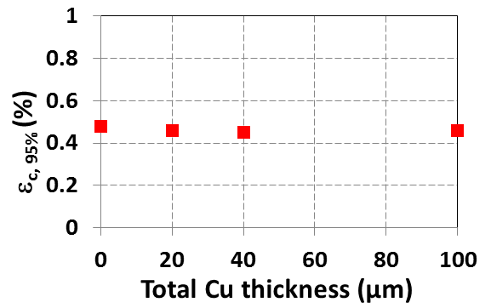
Tensile property of various wires
I_{c} vs. tensile strain relationship at 77K
0.45%
For wires on 50μm Hastelloy Substrate

Slide 27
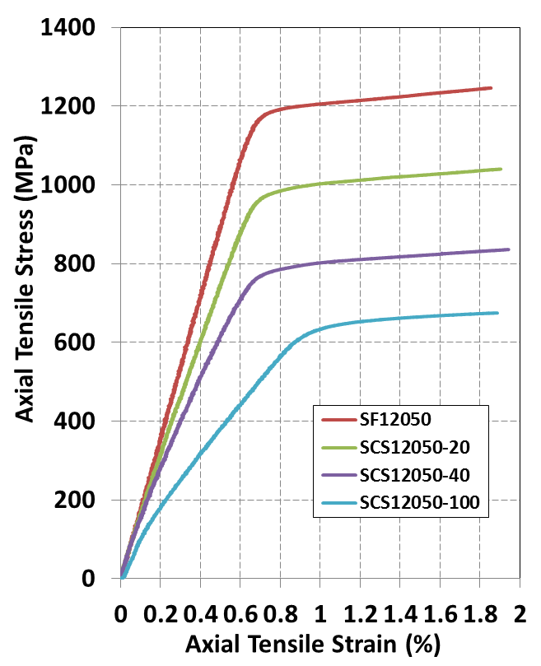
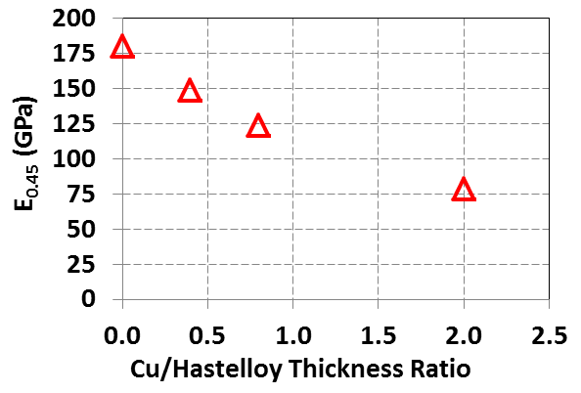
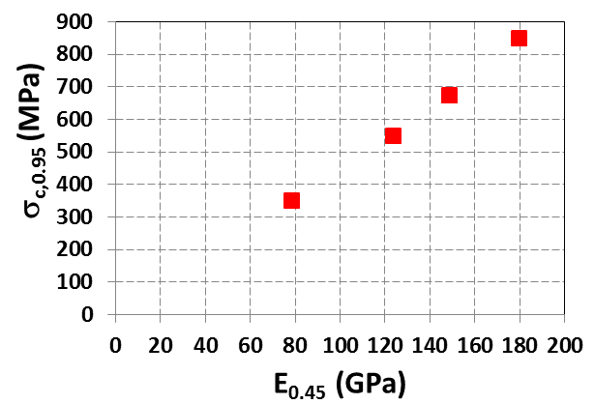
Effect of Cu/Substrate thickness ratio on σ_{c,0.95}
Comparison of four wires on 50 μm thick substrate
E_{0.45,} which is the chord modulus in between 0% and 0.45% strain, depends on Cu/substrate thickness ratio
While ε_{c,0.95} is a constant of about 0.45%, σ_{c, 0.95} depends on E_{0.45}
0.45%
77K

Slide 28
New initiatives

Slide 29
New Initiatives being transitioned from R&D to production
15% Zr additions
30 micron substrate
Bonded tapes
Insulation options

Slide 30
15% Zr additions

Slide 31
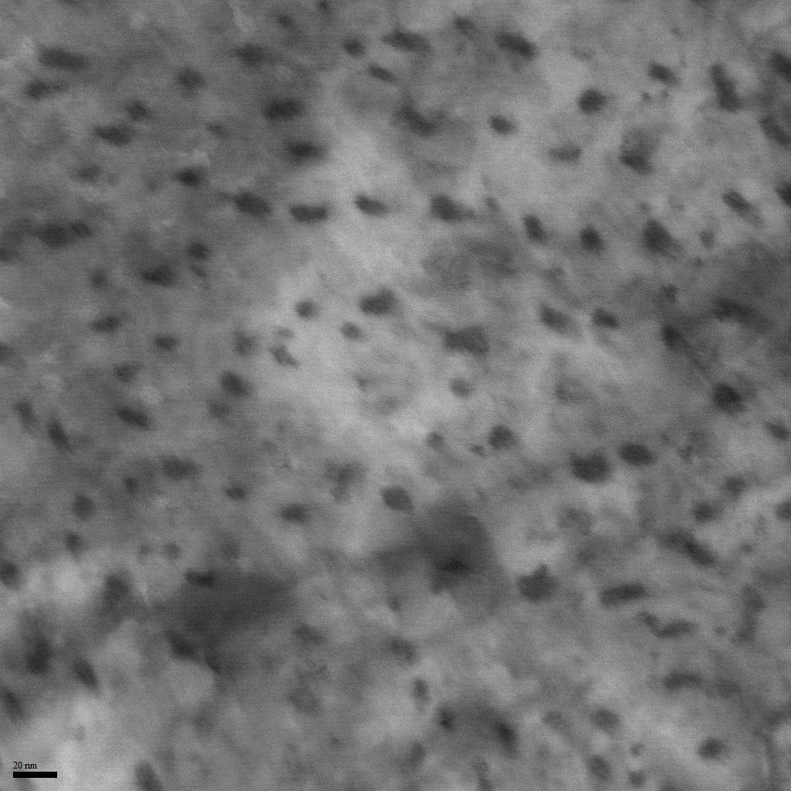
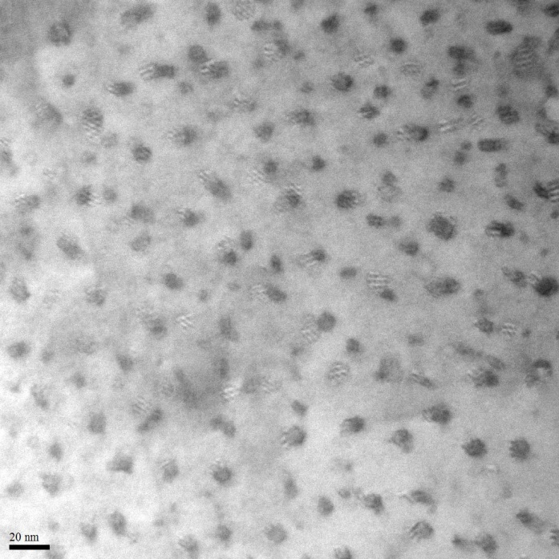
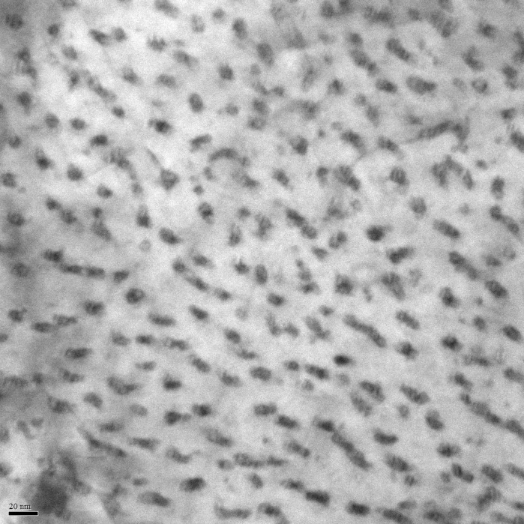
TEM analysis for enhanced Zr doping
Zr = 7.5%
Zr = 11.5%
Zr = 15%
Size : 4.4~6.2nm
Distance : 20.8~26.8nm
Size : 4.4~5.6nm
Distance : 16~20.7nm
Size : 4.4~5.6nm
Distance : 12.8~18.3nm
Notes:
I will show you the TEM images for Zr enhanced samples.
This image is plan view of current production as Zr=7.5%.
The BZO pin size is … and the distance between BZO rods is ….
And when we increase the Zr doping ratio, 11.5%, 15%.
The BZO density increases with increasing the Zr doping ratio.

Slide 32
Trend of BZO rod
The BZO rod size is almost in the same range
Distance of BZO rods decreases with increasing Zr doping ratio
Notes:
So we plot them to confirm the Zr doping efficiency.
The trend of BZO size slightly becomes small in this graph, but the dispersion at 7.5% is larger than others.
And we focused on the smallest size, they are almost same in whole doping level.
So we guess BZO rods keep same size in our current growth condition, even if we increase the doping ratio.
The other hand, the BZO distance becomes smaller, with increasing the Zr doping ratio.
In this doping range, the Zr becomes BZO rods well.

Slide 33
In-field performance at 30K/2T
Enhanced Zr doping samples promise high I_{c} performance
Notes:
We compared the in-filed performance between Zr=7.5% and 15% doping.
The Zr=7.5% sample is current production samples.
In the whole range, Zr=15% samples shows high performance.
So enhanced Zr doping samples promise the high Ic performance.

Slide 34
Ic-B performance at various temperature
B//c
Motors & generators
HF inserts/
HEP magnets
4.2K
20K
Maglev
50K
77K
17T
Zr enhanced sample show high I_{c} performance under 50K
Notes:
We compared the Ic-B performance at magnetic field parallel to c.
At 77K, Ic performance of 7.5% is higher than that of 15%.
How ever, under 50K, the performance switched, and 15% is higher than 7.5%.
In this time, we haven’t enough data to discuss about where is the turning point.

Slide 35
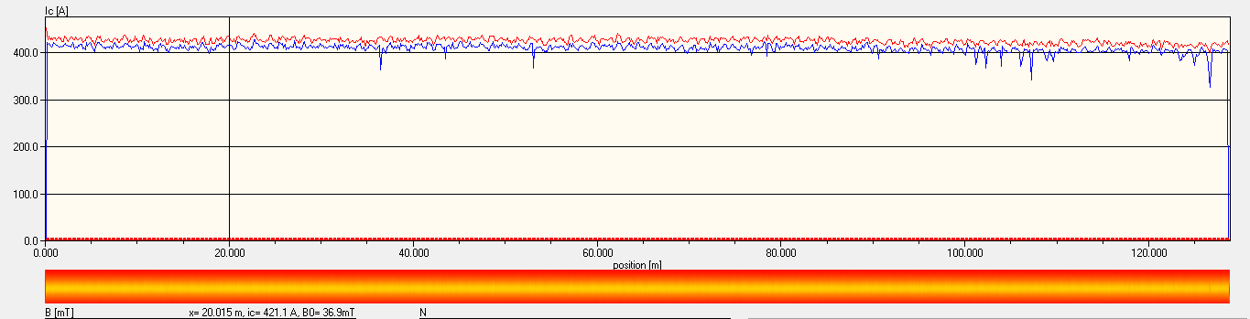
I_{c} performance with Zr = 15%
130m length with Zr = 15%
I_{c} ~400A at 77K/sf
Notes:
We made some medium length tapes.
So this is the tapestar data with Zr=15% doping.
The Ic is almost uniform and the value is about 400A at 77K/s.f.
And we measured in-field performance at 30K/3T.
The Ic is over 1100A/cmW.

Slide 36
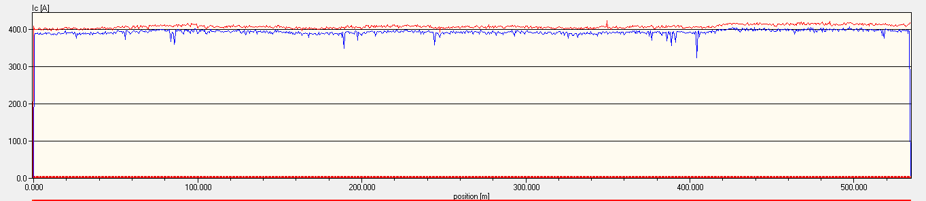
Long tapes with Zr = 15%
Further work is underway before official release of Zr enhanced wires
  Repeatability of I_{c} performance at 20~50K and 2T thru 5T
  Dispersion of I_{c} performance
  Mechanical property
Notes:
And we made a long tape over 500m.
Before we release Zr enhanced wires, further work is underway.
For example, repeatability….

Slide 37
30 micron substrate

Slide 38

Improved Je (engineering current density) wire with thinner substrate
Existing products based on either 50 or 100 μm Hastelloy® substrate
For wire with 50 μm substrate and 40 μm Cu, the total thickness is ~ 0.095 mm
Wires with thinner substrates (38, 30 and 25 μm) are being developed
  For standard Cu thickness of 40 μm total on a 30 μm Hastelloy® substrate, conductor thickness is reduced to ~75 μm
  This implies a 27% increase in current density
Baseline wire is on 50μm substrate and with 40μm Cu

Slide 39

Tensile testing of thinner substrate
RT tensile testing of 30μm thick substrate
Yield stress (σ_{0.2}) and elastic modulus (E) measured and compared with 50μm thick substrate
Vendor Specification Properties
50μm
30μm
Measured Properties
50μm
50μm
30μm-CD3
30μm-D1
30μm-MC2
30μm-MC4
30μm
30μm
30μm
30μm

Slide 40
Bonded tapes

Slide 41

Bonded tapes tailored for various applications
Bonded tape provide benefits with higher I_{c}, higher mechanical strength, tailored normal state resistivity, and/or improved stability
A fully automated system has been built for fabrication of multiple tape bonded wire
Variation in architecture – material and number of tapes, orientation
Alignment & pre-clean
Post clean
X-ray
inspection
Payoffs
Take-up
Bonding station

Slide 42

Examples:
One 2G tape bonded with one CuNi alloy tape (up to 1 mm thick) – conductor with high mechanical strength and tailored normal state resistivity for FCL transformer

Slide 43


Examples (continued)
Two 2G tapes bonded with one Cu tape in-between – conductor with high I_{c} and improved stability for accelerator magnets
E-I characteristics (77K, sf) of a composite wire bonded with two 2G tapes with one Cu tape in-between

Slide 44
Insulation options

Slide 45


New 2G HTS conductor insulations are being developed to meet customer requests
Current option is a wrapped Kapton®/Polyimide insulation
  Either overlapped (30-50%) or butt wrapped
  12.7 to 25.4μm thick with 15μm adhesive
Evaluating Polyimide Electro-Deposited Conductor [PIED], developed by RIKEN, as alternative insulation
  Thicknesses of 20μm and below are being evaluated
  Epoxied coils tested to date using this insulation show excellent results & resistance to delamination
PIED insulation

Slide 46
Some applications

Slide 47






SP 2G HTS is used in several cable configurations
Roebel Cable
Fabricated by winding mechanically punctured meandering tapes – high I_{c}(~nkA) and low AC loss
Uniformity across width and mechanical strength
W. Goldacker et al, IEEE TAS , 17(2007)3398
CORC (Conductor on Round Core) Cable
Fabricated by winding multiple wires in a helical way around a small former – high I_{c}(~nkA)
High Je and mechanical strength
D C van der Laan et al, SUST , 24(2011)042001
Twisted Stacked-Tape Cable (TSTC)
Fabricated by stacking multiple tapes together and twisting at a pitch length – high I_{c}(~nkA)
Mechanical strength
M. Takayasu et al, SUST , 25(2012)014011

Slide 48


Latest news release (June.10th )
SP’s recent advances in pinning structure, thinner substrates and other improvements will form the basis for the MagLab's next generation of magnets.

Slide 49
Offering improved services to our customers
Up to 50% price reduction and delivery lead time compared 2013/2014 depending on application
Upgraded Quick Ship list with greater variety
Longer piece lengths, higher I_{c} & greater product varieties

Slide 50
Summary
SP offers the best IcBT performance in the industry
SP establish a series of mechanical testing facilities in order to better understand and continuously improve the materials
SP is engaging to make more initiatives including 15% Zr doping, thinner substrate, bonded wires and insulation options.
Continue to lower the cost and speed up the response to the custoemrs

