Slide 1
Openstack introduction
Cloud Technology Group
2015-9-11

Slide 2
Outline
0.IhepCloud
1.About Openstack
2.Virtualization network design
3.Fast install Openstack
4.Openstack usage

Slide 3
IhepCloud Introduction

Slide 4
HPC Virtulization in IHEP
The Goal
  Build by Openstack platform
  Virtualize computing resources,
    Service local HPC Only user is virtualized scheduler
    Service user such as UI or TEST
  Dynamically launch virtual machines based on physics job
    Suitable image
    Individual OS and physics resource
  Accounting and resource exchanging
    Resource provider
    Resource user
    Earn or consume integral

Slide 5
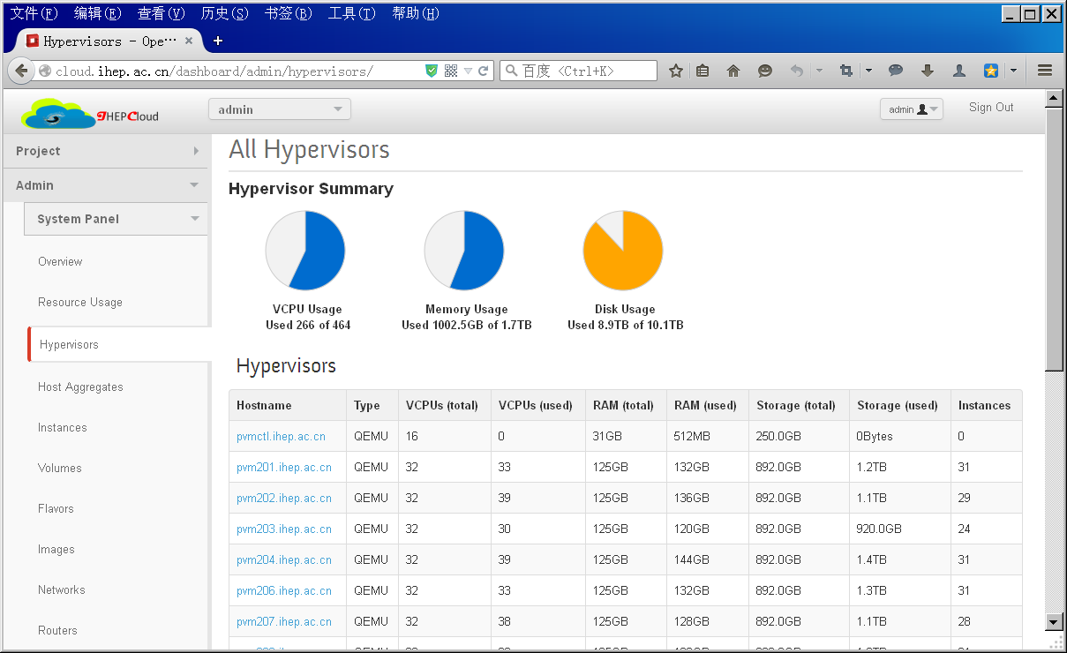
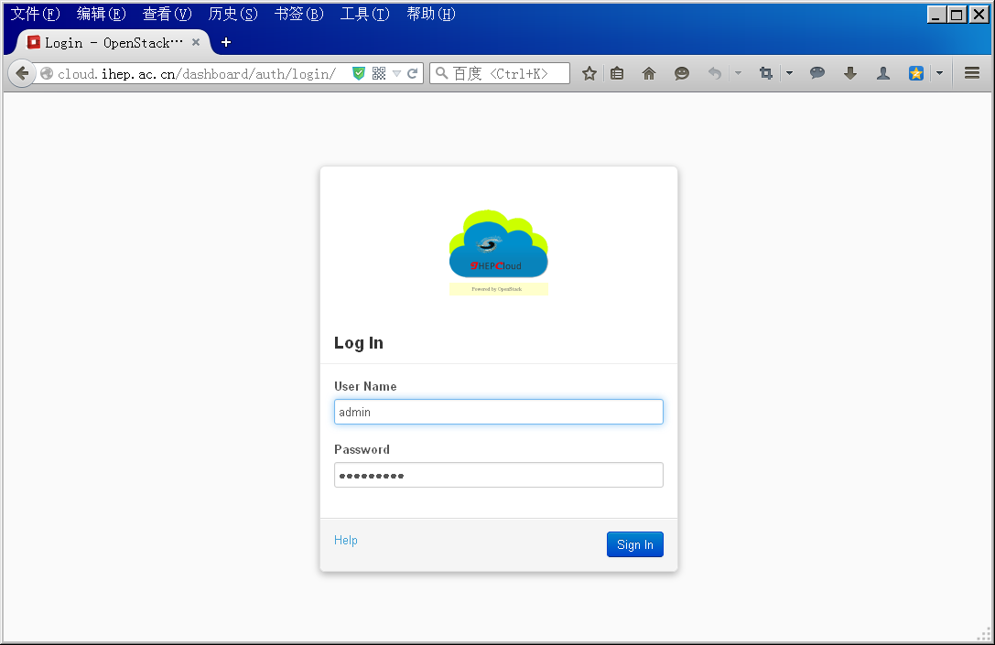
IhepCloud
IhepCloud online
  Online in Nov.2014 (Spread in small scale and no advertisement)
  Platform Openstack Icehouse
  Resources 464 Vcpu, 1.7TB Ram, 10.1TB Storage
  Users 100
IhepCloud features
  Provide SL5.5, 5.8 and 6.5 UI and WN VM for local HPC
  Provide SL6.5, SL7.0 and Win7 for testing
  Multi-tenants login with mail account
  NETDB component info synchronization
    Push info to DNS Valid IP and Valid domain for each VM
    Push info to Nagios and Puppet Simple monitor
    automatic configuration by puppet

Slide 6
Problems
Large Scale
  Avoid risk
  Cells or ?
  Distributed and Loose coupling architecture
Accounting
  Code Is developing
Monitor
  No effective plan Nagios\ganglia or …
Customized dashboard
  Conceal network and virtual volumes
  show accounting info

Slide 7
About Openstack

Slide 8

About Openstack
Openstack
  Open source and free
  OpenStack NASA and Rackspace 2010-?
  Project goals：
  Open source of software for creating private and public clouds
  Versions
  Under development Mitaka, Liberty
  Stable Kilo、Juno、
  EOL Icehouse, Havana, Grizzly, Folsom, Essex, Diablo, Cactus. Bexar, Austin
  Features：
  resources scheduling and vm management
  virtualization network / SDN L2/L3
  multi-tenants individual resources quota\network\accounting\dashboard
  storage interface cinder/swift
  Application Trove/Sahara

Slide 9
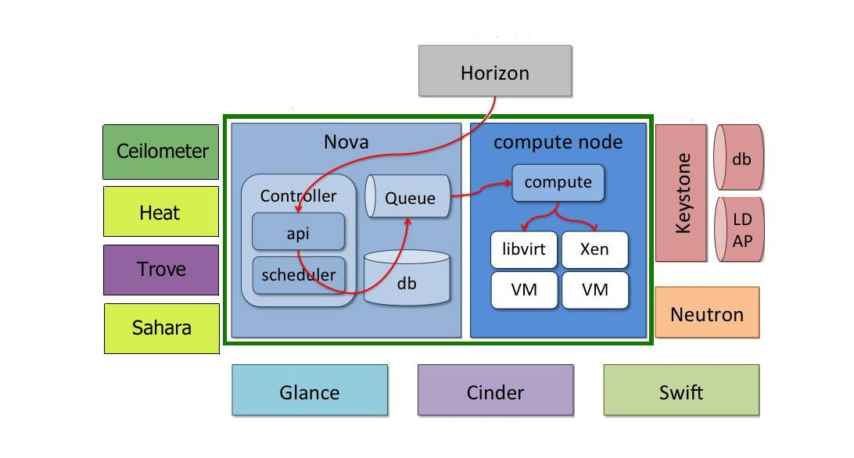
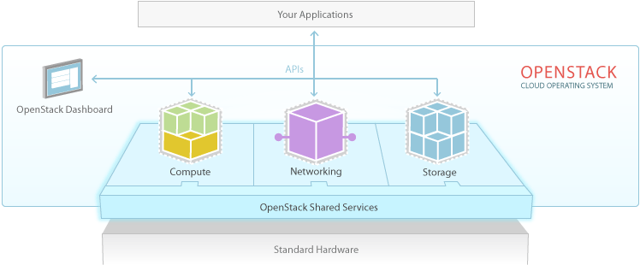
Openstack Architecture

Slide 10
Virtualization network design

Slide 11
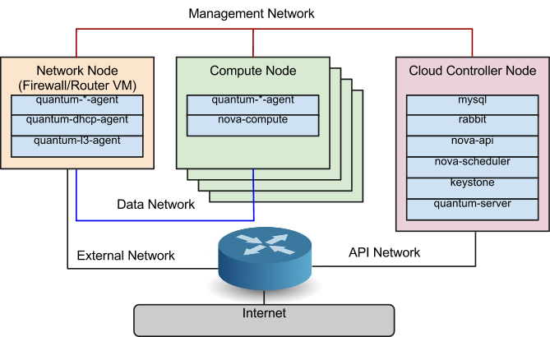
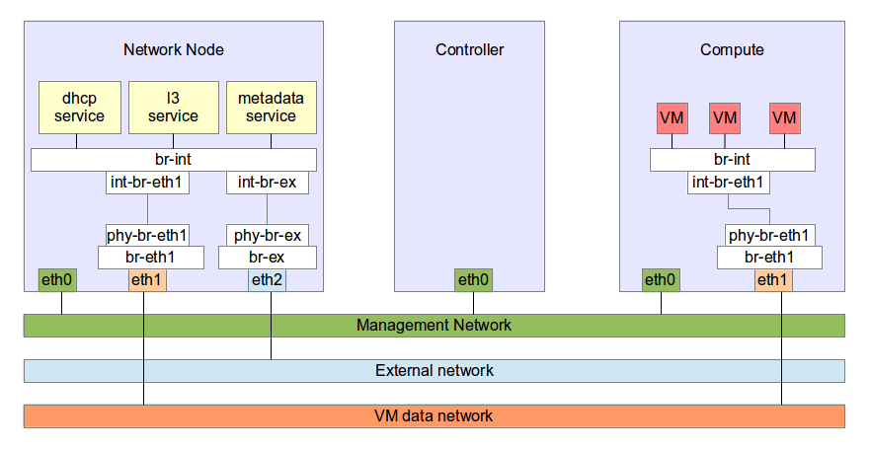
Openstack network
Openstack concept
Scenario 1
  Management network rabbitmq/mysql/mongodb
  Data network instance L2/L3
  External network floating ip
  API network API communication
Scenario 2
  Tenant network
    Flat
    Vlan
    Gre/vxlan
  Providor network

Slide 12
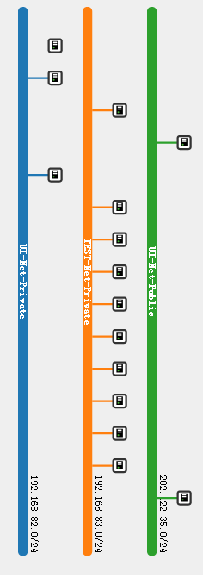
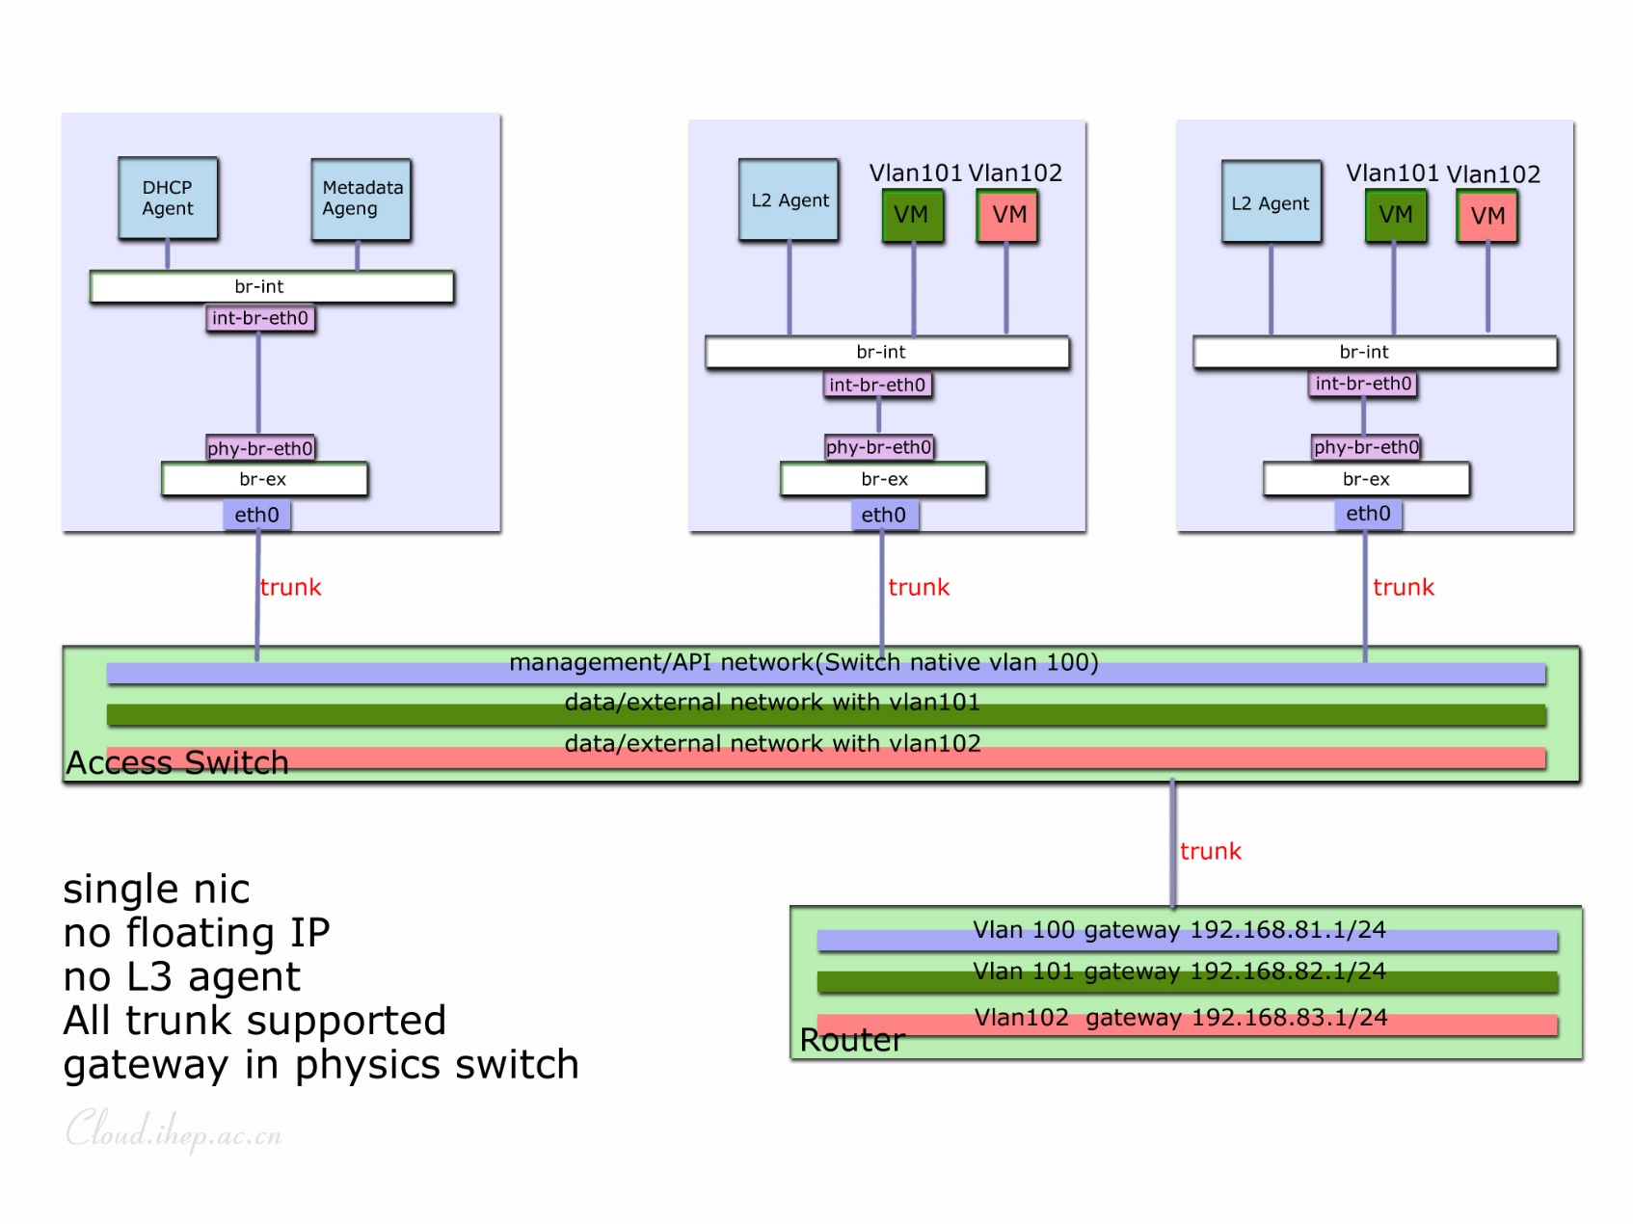
Network design
Flat mode
  Single ip segment
  Hypervisor and VM in same segment
Vlan mode
  Tenant network
  Vlan mode Neutron + OVS
  Physics Switch
  802.1Q supported or individual NIC
IhepCloud mode ☺
  External and Data network combine into one network
  Vlan mode with only one NIC
  Switch support 802.1Q
  Sec group open all rules TCP/UDP/ICMP/IGMP except DHCP
  Gateway in physics switch

Slide 13
Automatic install

Slide 14
RDO
RDO automatic install Tool
Radhat Tool for Openstack
Characters
  Controller include glance\cinder\ceilometer
  Network node neutron\OVS
  Compute node nova-compute
Install steps
  OS install and rpm dependency check
  Environment modify
    Selinux\NetworkManager\DNS\Hosts\cinder LVM\NIC\...
  Yum sources (local yum sources is faster)
  Answer file configuration
  installation

Slide 15
Answer file
My.conf
  Basic
    CONFIG_DEFAULT_PASSWORD=
    CONFIG_NTP_SERVERS=ntp.ihep.ac.cn
    EXCLUDE_SERVERS=
    CONFIG_COMPUTE_HOSTS=192.168.nnn.mmm
    CONFIG_NETWORK_HOSTS=192.168.nnn.mmm
    CONFIG_COMPUTE_HOSTS=192.168nnn.001,192.168.nnn,002,…
    CONFIG_USE_EPEL=y
    CONFIG_PROVISION_DEMO=n
    CONFIG_NOVA_SCHED_CPU_ALLOC_RATIO=
    CONFIG_NOVA_SCHED_RAM_ALLOC_RATIO=
  Network configuration OVS+vlan
    CONFIG_NEUTRON_L2_PLUGIN=openvswitch
    ['logger', 'test', 'linuxbridge', 'openvswitch', 'hyperv', 'ncs', 'arista', 'cisco_nexus', 'l2population']
    CONFIG_NEUTRON_L3_EXT_BRIDGE=br-ex CONFIG_NEUTRON_ML2_TYPE_DRIVERS=vlan
    ['local', 'vlan', 'gre', 'vxlan']
    CONFIG_NEUTRON_ML2_TENANT_NETWORK_TYPES=vlan
    ['local', 'vlan', 'gre', 'vxlan']
    CONFIG_NEUTRON_ML2_VLAN_RANGES=phy1:vlanid:vlanid
    CONFIG_NEUTRON_LB_INTERFACE_MAPPINGS=phy1:eth0
    CONFIG_NEUTRON_OVS_BRIDGE_MAPPINGS=phy1:br-ex

Slide 16
Openstack Usage

Slide 17
configuration
Disk capacity
  Instances cache
  /var/lib/nova/instances/_base
  Nova and neutron Log
  /var/log/nova/
  /var/log/neutron/
Change Directory location
ln –s /home/opstk/nova /var/lib/nova
chown nova:nova /home/opstk/nova
ln –s /home/opsntk/neutron /var/lib/nova
chown neutron:neutron /home/opstk/neutron

Slide 18
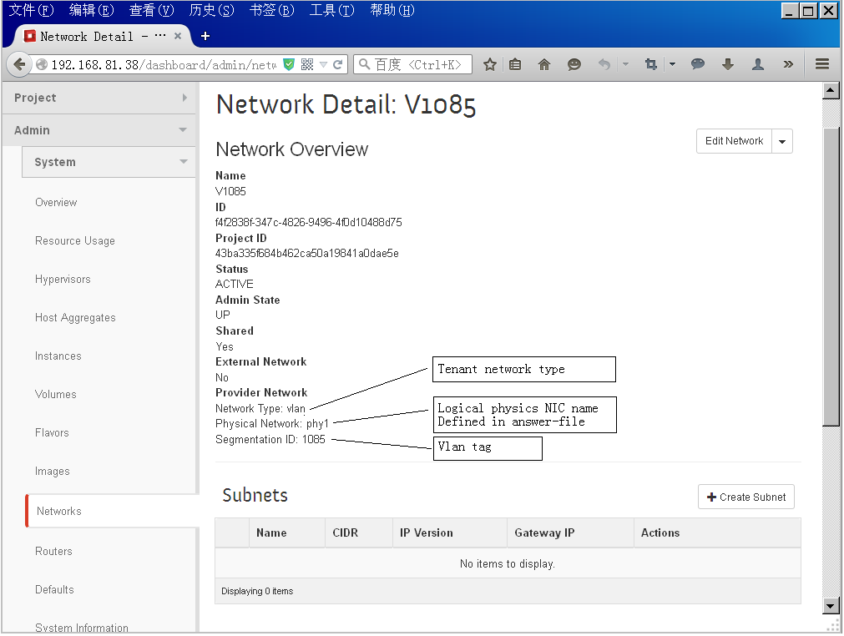
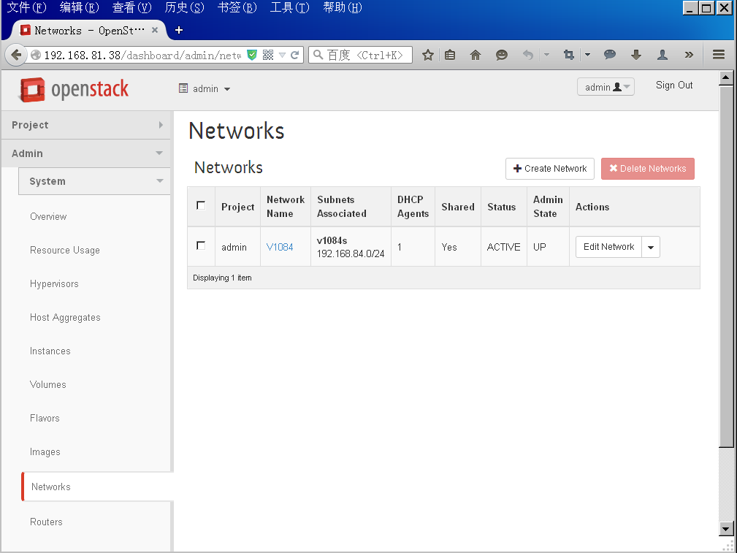
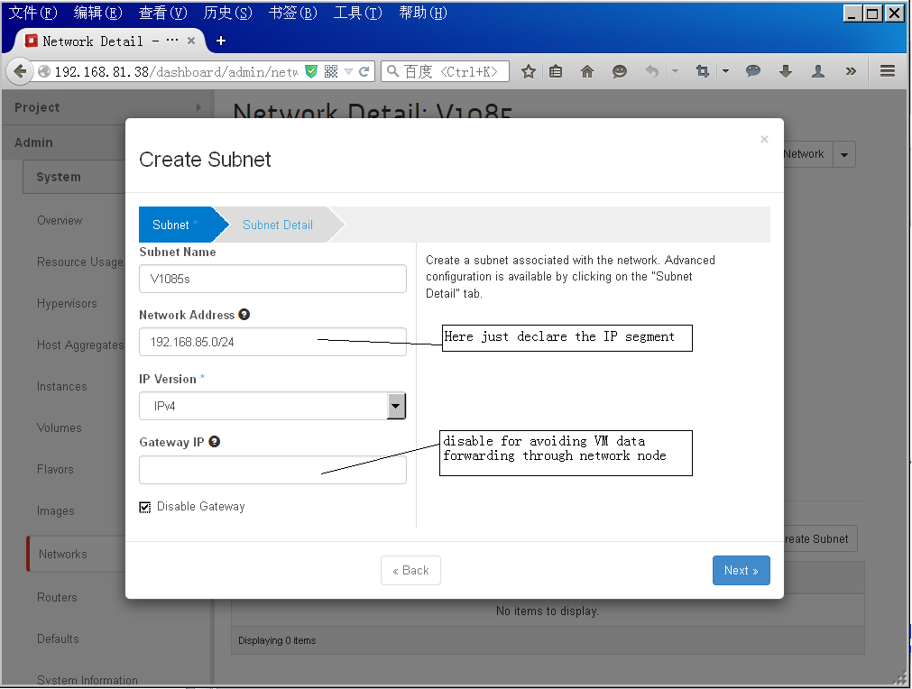
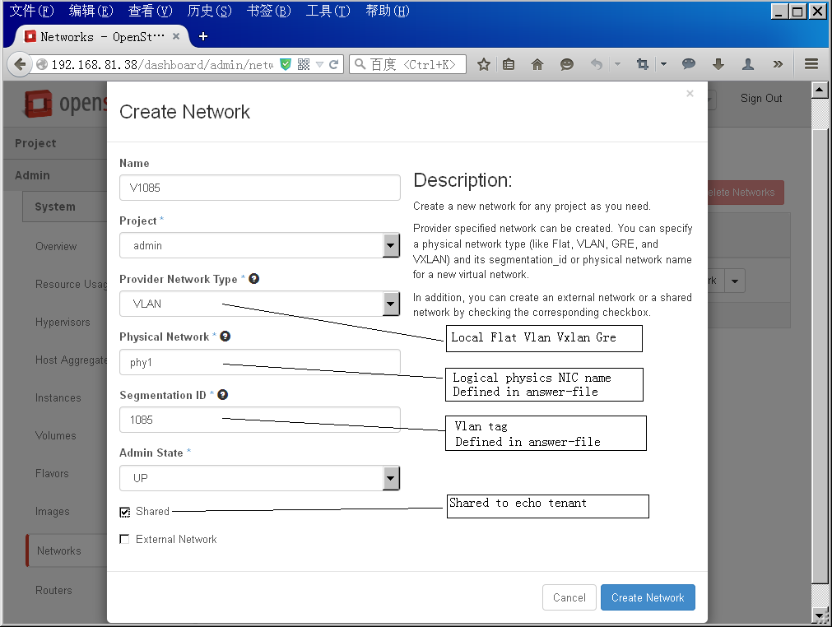
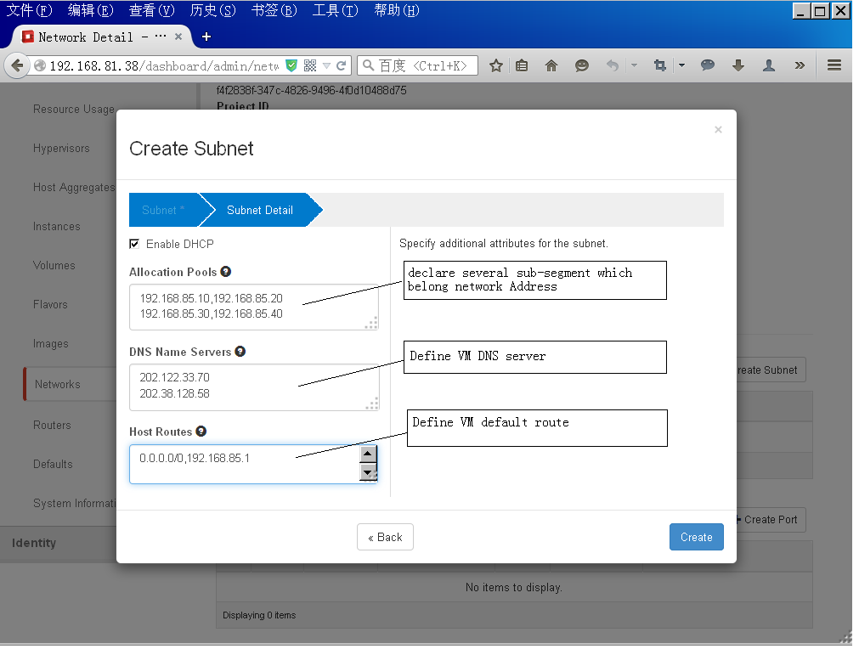
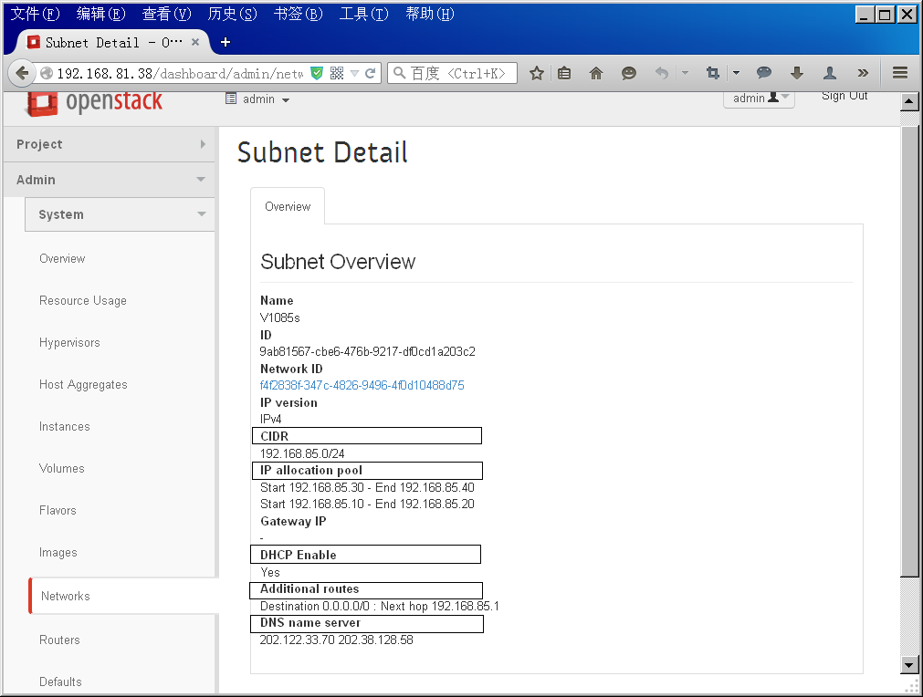
configuration
Network configuration
  Check configuration /etc/neutron/plugin.ini
  network_vlan_ranges =phy1:1084:1090
  Create from dashboard
  Create network and subnet

Slide 19
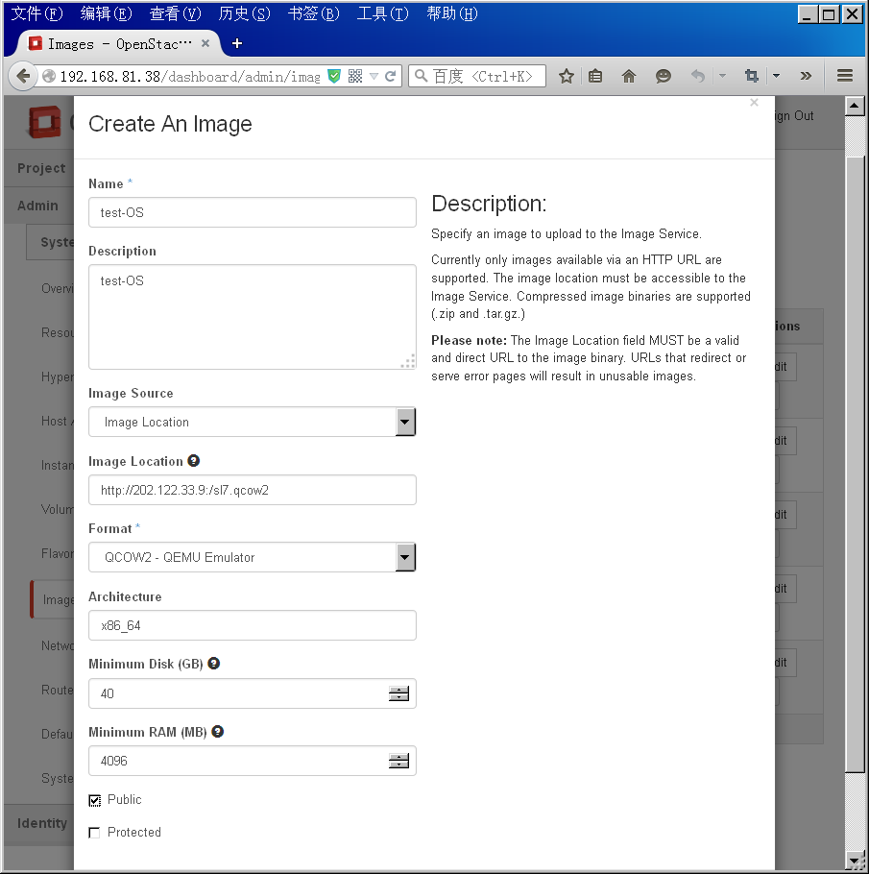
configuration
Create Image
  qemu-img create –f qcow2 w2012srv.qcow2 40G
  2. /usr/libexec/qemu-kvm -name w2012srv -cpu qemu64 -smp 2 -m 8000
  -boot d
  -drive file=/home/nuctech/w2012srv.qcow2,if=virtio,index=1
  -cdrom /home/nuctech/virtio-win-0.1.96.iso
  -net nic,name=tap0,model=virtio -net bridge,name=tap0,br=br0
  -vnc :9
  3. Use tightVNC configuration this VM
Import image
  1.Glance image-create --is-public true --disk-format qcow2 --container-format bare --name "SL65-64-WN" --file /home/wl02.qcow2 --owner f838761e67da4bf3b2f4d055ffa21a7e
  2.By dashboard

Slide 20
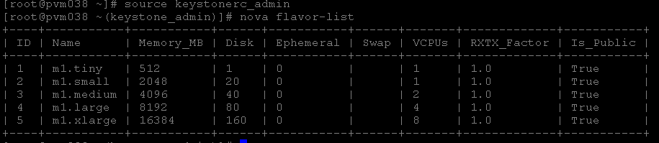
configuration
Flavors
  Define Vcpu\Ram\DISK resource quota for echo VM

Slide 21
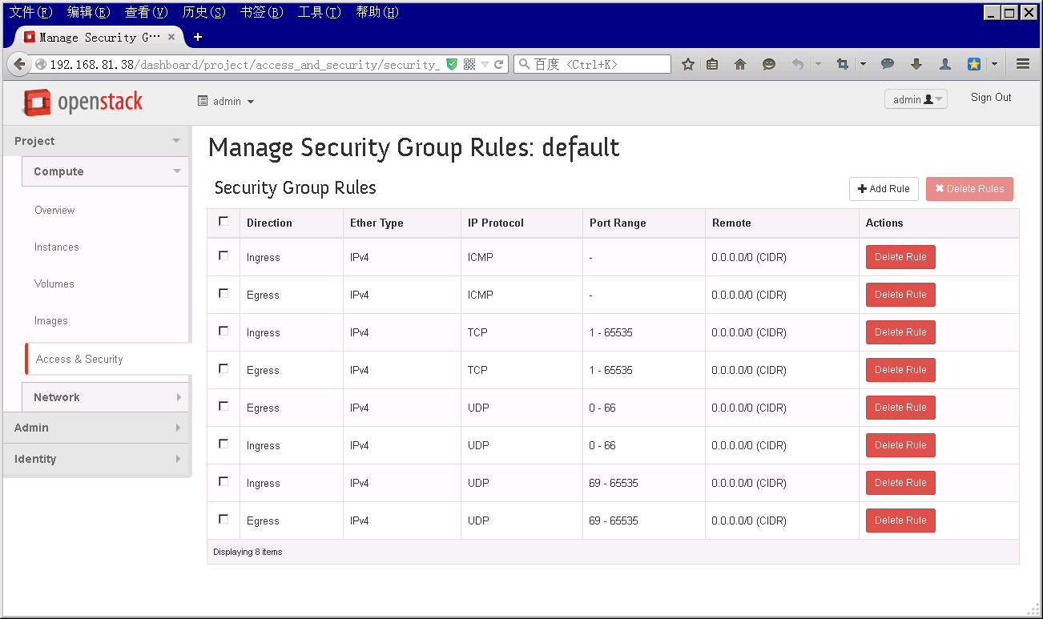
configuration
Security Group
  Tenant rules based on Iptables
  Isolate boardcast domain for each tenant
IhepCloud mode
  Openstack all rules except DHCP
  NETDB component automatic update all tenant rules

Slide 22
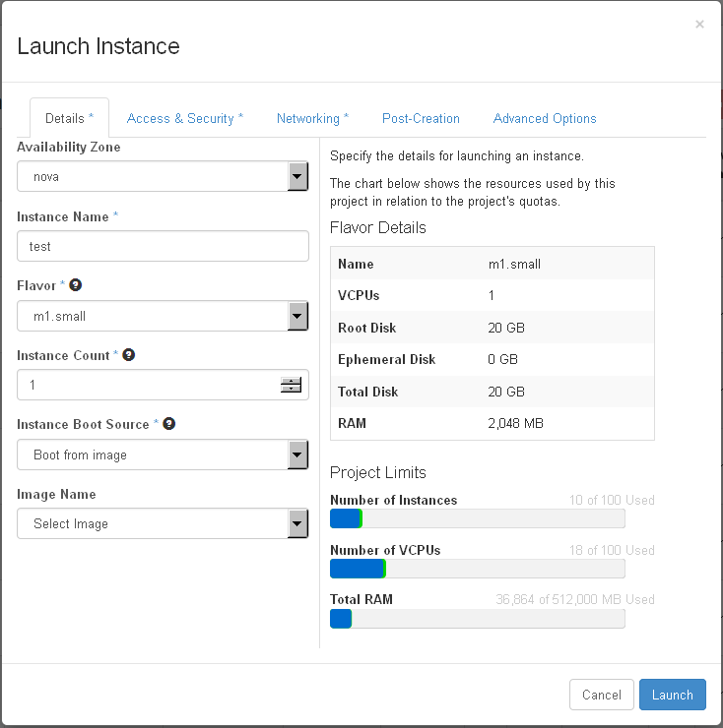
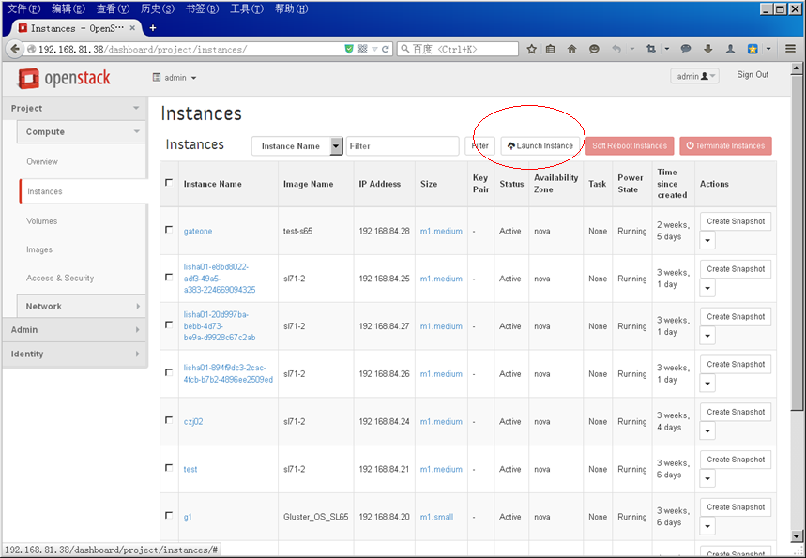
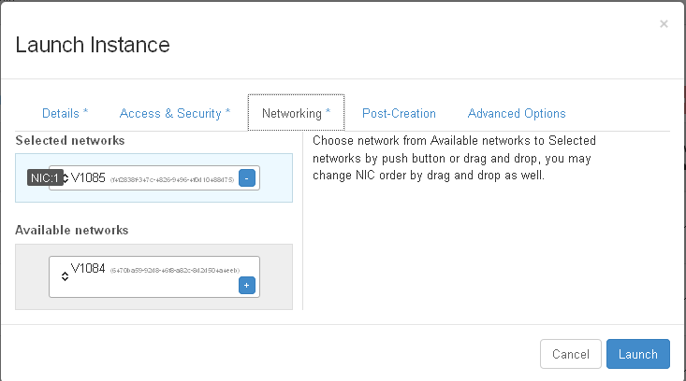
Launch a VM
Dashboard
  Choose flavor
  Choose image or snapshot
  Choose security/ key pair
  Choose networking
  …

Slide 23
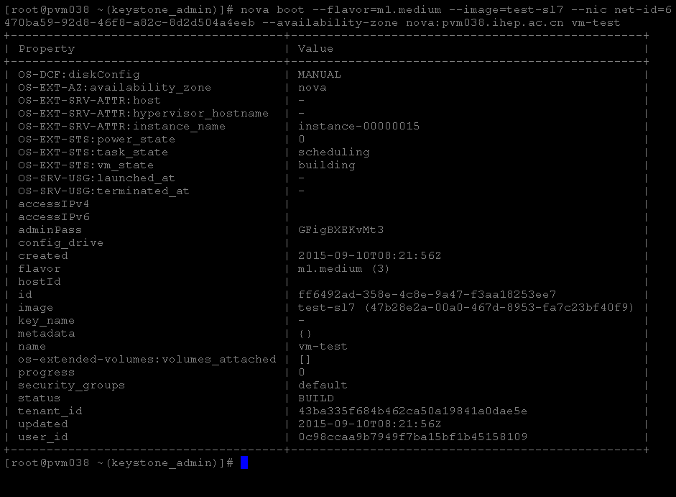
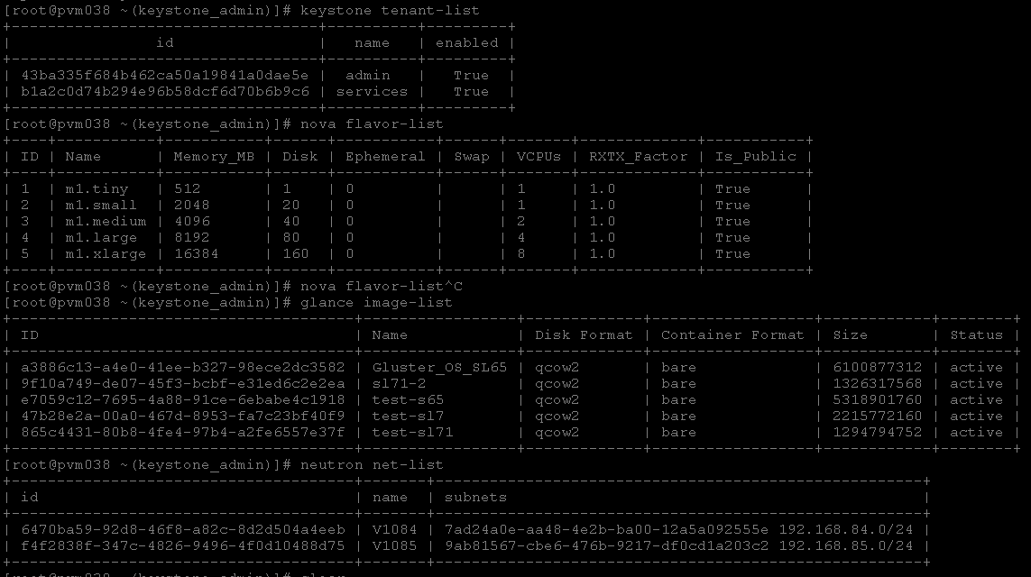
Launch a VM
CLI
  Configure environment source keystonerc_admin
  Get tenant ID keystone tenant-list
  Get image name glance image-list
  Get flavor name nova flavor-list
  Get net ID neutron net-list
  Boot VM
  nova boot
  --flavor=c1-m4-10 1
  --image=test
  --nic net-id=052f2df5-ba95-4578-bd08-903df34fd28c
  --availability-zone nova: hypervisor.domain
  Vm-name

Slide 24
Thanks！

