Slide 1
Virtualization Overview
Jianhai Chen (陈建海)
chenjh919@zju.edu.cn
+86 13958011808
Intelligence Computing and System Lab
College of Computer Science
Zhejiang University
Hangzhou, Zhejiang, P.R. China
2015/09/07
Notes:
Good morning everyone! I am glad to be here as a summer school teacher.
Thanks professor Zhang Xiaomei, and everyone of the summer school for giving me this opportunity to talk about virtualization technology.
I am Jianhai Chen, a computer teacher from college of computer science of Zhejiang university. I am also a leader of virtualization research group in our lab. I have been doing research at virtualization and using virtualization technology for many years. So today in this lesson I will share with everyone some of my views and using experience of virtualization technology.

Slide 2
Agenda
Introduction
Virtualization Technologies
  CPU
  Memory
  IO
Commercial virtualization tools
Problems in using virtualization
  How to create and handle VM images
  Virtual network concepts and configuration
Summary
Notes:
In last section, we can think that cloud computing system presents a platform to manage virtual machines to run applications for provisioning services. But the virtual machine is realized by the virtualization technology.
In this lesson I will introduce virtualization according to four aspects.
At first, I introduce some basic virtualization concepts.
At second, I briefly introduce some key techniques to implement virtualization technology in CPU, memory and IO.
At third, I introduce some commonly used virtualization tools.
At last, I introduce two common problems about VM image creation and virtual network configuration.
首先，介绍一些虚拟化技术有关的概念与架构。
其次，介绍一下虚拟化实现的关键技术，CPU，内存和IO是如何实现的。
再次，介绍一下常用的虚拟化工具。
最后，介绍关于镜像方面的制作管理方法和网络配置问题。
BESIII scientific application can run within a VM.
Stefano.bagnasco@to.infn.it

Slide 3

What is virtualization
Virtualization is a term that (wikipedia)
  refers to the abstraction of computer resources, or the act of creating a virtual (rather than actual) version of something, including virtual computer hardware platforms, operating systems, storage devices, and computer network resources.
Virtualized computer resources
abstraction
virtualization
Physical computer resources
https://en.wikipedia.org/wiki/Virtualization
Notes:
We introduce the definition of Wikipedia.
Virtualization is a term that (wikipedia) refers to the abstraction of computer resources, or the act of creating a virtual (rather than actual) version of something in computing, including virtual computer hardware platforms, operating systems, storage devices, and computer network resources.
虚拟化技术最早出现在1960年代，IBM 主机。然而，之后的30多年来没有大规模研究和应用。
后来2000年之后，随着硬件规模的发展扩大，数据中心资源浪费严重，虚拟化再次引起注意。各种虚拟化产品依次出现。
1999年VMWARE,2003年XEN,2007年KVM
2007年，INTEL CPU 支持VT, AMD CPU支持 VT
…
今天的VMM
多大数十种

Slide 4
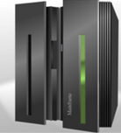
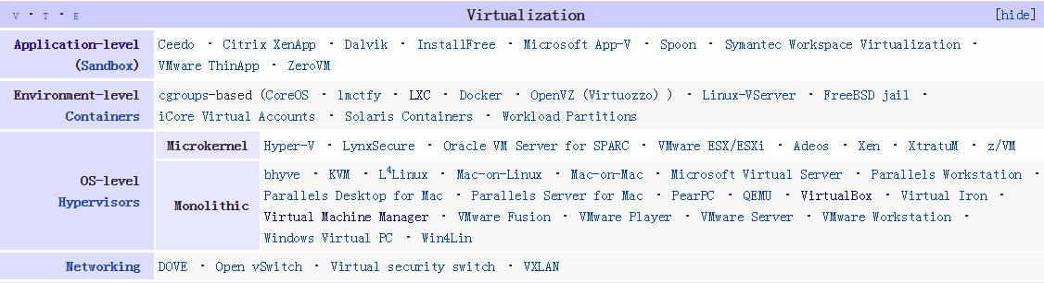

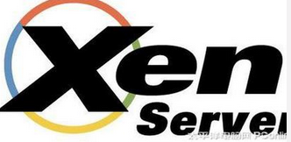
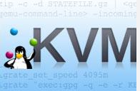
History
In the 1960s
  Firstly appeared in IBM mainframe computer OS.
  Used as a method of dividing system resources between different applications.
Since then, before 1999
  the development of virtualization was almost at a standstill about 30 years.
1999-, develop to climax
  Vmware, the first virtual platform for Intel x86-32 architecture computers.
  2003, UCCL, Xen, the first open-source, drive more academia research on virtualization.
  2007, KVM, a linux OS kernel-based VM
  2007, hardware support: Intel VT, AMD-V
  Now ~50 virtualization tools or types
Notes:
Virtualization has a history of 50 years. It firstly appeared in IBM mainframe computer OS in the 1960s, used as a method of logically dividing the system resources of mainframe computers between different applications. Since then, the meaning of the term virtualization has broadened.
About 30 years before 1999, the interest to virtualization was decreased and the development of virtualization was almost at a standstill. Until in 1999 VMware Inc. presented Vmware virtual platform for x86-32 architecture, a common architecture used in most computers.
In 2003, the University of Cambridge Computer Laboratory designed Xen, an open-source virtualization, causing the climax of academia research on virtualization.
Afterwards, more virtualization productions are developed, such as KVM, Linux OS supports virtualization, Kernel-based VM(KVM) in 2007. At the same time, Intel and AMD provided the hardware support to virtualization, such as Intel (VT): VT-x,VT-d, VT-I; and AMD: AMD-V, Pacifica. Nowadays, the commercial virtualization tools has been about 50 types. The virtualization has become a crucial technology in cloud computing.

Slide 5
Virtualization technology types
Hardware virtualization
Software virtualization
Other virtualization
  Desktop virtualization
  Nested virtualization
Notes:
We introduce four types of virtualization according to virtualization technology types.

Slide 6
Hardware virtualization (HV)
Hardware virtualization (most fundamental)
  or platform virtualization refers to the creation of a virtual machine (VM) that acts like a real computer with an operating system (OS).
  Software executed on these VMs is separated from the underlying hardware resources.
    Host with Microsoft Windows → VM → Ubuntu linux OS;
Guest machine
Concepts
  Host/guest
  Hypervisor or Virtual Machine Manager (VMM)
Hypervisor
Host machine
Notes:
Hardware virtualization or platform virtualization is the most fundamental virtualization. It refers to the creation of a virtual machine (VM) that acts like a real computer with an operating system (OS). Software executed on these VMs is separated from the underlying hardware resources.
For example, a computer that is running Microsoft Windows may host a virtual machine that looks like a computer with the Ubuntu Linux operating system; Ubuntu-based software can be run on the virtual machine.
In hardware virtualization, the host machine is the actual machine on which the virtualization takes place, and the guest machine is the virtual machine.
The words host and guest are used to distinguish the software that runs on the physical machine from the software that runs on the virtual machine.
The software that creates or manages a virtual machine on the host hardware is called a hypervisor or Virtual Machine Manager or Monitor.

Slide 7
Virtual machine monitor (VMM)
VMM transforms the single machine interface into the illusion of many interfaces. Each of these interfaces (virtual machines) is an efficient replica of the original computer system, complete with all of the processor instructions.
Robert P. Goldberg.
Notes:
In virtualization, a virtual machine monitor (VMM), also called as Hypervisor, is added to the traditional computer architecture. VMM transforms the single machine interface into the illusion of many. Each of these interfaces (virtual machines) is an efficient replica of the original computer system, complete with all of the processor instructions.

Slide 8
Two Hypervisor (VMM) Types
Vmware Esx server
Xen ctrix server
VMware Esx workstation
Xenserver
Notes:
In Hypervisor type I, VMM can be directly installed among hardware without OS. Vmware Esx server
In Hypervisor type II, VMM need to installed among OS. E.g VMware Esx workstation.

Slide 9
What does a VM look like
Without VMs: Single OS owns all hardware resources
With VMs: Multi-OSes share hardware resources
A virtual machine is implemented by adding software to an execution platform to give it the appearance of a different platform, or for that matter, to give the appearance of multiple platforms.
Notes:
Without VMs: single OS owns all hardware resources while with VMs: Multi-OSes share hardware resources through VMM.
A virtual machine is implemented by adding software to an execution platform to give it the appearance of a different platform, or for that matter, to give the appearance of multiple platforms.

Slide 10
Essential characteristics of VMM
Equivalence
  Essentially identical virtual platform, except
    Differences caused by the availability of system resources
      E.g. amount of memory available to VM
    Differences caused by timing dependencies.
Isolation, or resource control
  VMM is in complete control of system resources
    VM can’t access any resources not explicitly allocated to it
    VMM may regain control of resources already allocated
Efficiency
  At worst only minor decreases in speed
  Rules out traditional emulators and complete software interpreters (simulators)
Source from Gerald J. Popek & Robert P. Goldberg, “Formal Requirements for Virtualizable Third Generation Architectures”
Notes:
From the perspective of design, three essential characteristics of VMM: equivalence, isolation and efficiency should be taken into consideration.
Equivalence: the virtual platform must be equivalent to the physical platform except …
2)The isolation or resource control must guarantee that
VMM is in complete control of system resources: VM can’t access any resources not explicitly allocated to it. VMM may regain control of resources already allocated.
3)The efficiency depends on only minor decreases in speed at worst and rules out traditional emulators and complete software interpreters(simulators).

Slide 11
Types of hardware virtualization
Full virtualization
  almost complete simulation of the actual hardware to allow software to run an unmodified guest OS.
  Hardware-assisted virtualization
  Binary Translation etc.
Partial virtualization
  some but not all of the target environment attributes are simulated.
    As a result, some guest programs may need modifications to run in such virtual environments.
Paravirtualization
  Modify guest OS to cooperatively work with hypervisor to solve virtualization issues or for performance.
Hardware-assisted virtualization
  is a way of improving overall efficiency of virtualization.
    CPUs provide support for virtualization in hardware
    other hardware components that help improve the performance of a guest environment.
Notes:
Full virtualization: presents almost complete simulation of the actual hardware to allow software to run an unmodified guest OS.
Partial virtualization: some but not all of the target environment attributes are simulated.
As a result, some guest programs may need modifications to run in such virtual environments.
Paravirtualization: a hardware environment is not simulated and modify the guest specifically to enable that the guest programs are executed in their own isolated domains, as if they are running on a separate system.
Hardware-assisted virtualization: is a way of improving overall efficiency of virtualization.
It involves CPUs that provide support for virtualization in hardware and other hardware components that help improve the performance of a guest environment.

Slide 12
Software virtualization
Operating system-level virtualization
  hosting of multiple virtualized environments within a single OS instance.
  An OS allows for multiple isolated user-space instances (based on cgroup)
  Often called containers
Application virtualization and workspace virtualization
  the hosting of individual applications in an environment separated from the underlying OS.
  Application virtualization is closely associated with the concept of portable applications.
Service virtualization
  emulating the behavior of dependent (e.g., third-party, evolving, or not implemented) system components that are needed to exercise an application under test (AUT) for development or testing purposes.
Notes:
Operating system-level virtualization is hosting of multiple virtualized environments within a single OS instance.
Application virtualization and workspace virtualization is the hosting of individual applications in an environment separated from the underlying OS. Application virtualization is closely associated with the concept of portable applications.
Service virtualization is emulating the behavior of dependent (e.g., third-party, evolving, or not implemented) system components that are needed to exercise an application under test (AUT) for development or testing purposes.

Slide 13
Desktop virtualization
Desktop virtualization
  is the concept of separating the logical desktop from the physical machine.
    One form of DV is virtual desktop infrastructure (VDI).
    it can be thought of as a more advanced form of hardware virtualization.
  Is used to support desktop office.
Notes:
Desktop virtualization is the concept of separating the logical desktop from the physical machine.
It is popular
One form of desktop virtualization, virtual desktop infrastructure (VDI), can be thought of as a more advanced form of hardware virtualization. Rather than interacting with a host computer directly via a keyboard, mouse, and monitor, the user interacts with the host computer using another desktop computer or a mobile device by means of a network connection, such as a LAN, Wireless LANor even the Internet. In addition, the host computer in this scenario becomes a server computer capable of hosting multiple virtual machines at the same time for multiple users.^{[4]}

Slide 14
Nested virtualization
Nested virtualization
  refers to the ability of running a virtual machine within another, having this general concept extendable to an arbitrary depth.
  Can be used to deploy a cloud platform in VMs.
VM
VM
Notes:
If you want to practice installing a cloud platform in VM then it needs nested virtualization.
如果你要在虚拟机中练习搭建云平台的实践，则需要虚拟机中能够安装虚拟机。

Slide 15
Agenda
Introduction
Virtualization Technologies
  CPU
  Memory
  IO
Commercial virtualization tools
Problems in using virtualization
  How to create and handle VM images
  Virtual network concepts and configuration
Summary
Notes:
How to realize the virtualization technologies? We briefly introduce some of the design and implementation of CPU, memory and IO virtualization technologies.

Slide 16
Virtual Platform
Simulates a hardware platform and all its software platforms.
Hardware platform
  CPU, Memory,I/O
Software platforms/components layer
  BIOS
  OS
  Run time library
  Applications
Notes:
After virtualization, we have a virtual platform. The virtual platform should simulate a hardware platform and all its software platforms. The hardware includes CPU, memory and IO. The software targets to software platforms or components layer, including BIOS, OS, runtime library and applications.
一个虚拟平台必须模拟一个硬件平台和所有相关的软件平台。
模拟硬件需要实现CPU、MEM、IO。
软件模拟需要实现BIOS，OS， Run time library和application.

Slide 17
Agenda
Introduction
Virtualization Technologies
  CPU
  Memory
  IO
Commercial virtualization tools
Problems in using virtualization
  How to create and handle VM images
  Virtual network concepts and configuration
Summary
Notes:
How to realize CPU virtualization.

Slide 18
Instruction and application program
CPU is responsible for running applications.
CPU includes an instruction set system.
An instruction
  is a basic command of computer CPU operation.
An application program
  is compiled into a binary code initially.
  is a set of sequence instructions.
The running of application denotes
  CPU run a set of instructions according to a special order.
Notes:
What is CPU?
In computer system, CPU is

Slide 19
For Example：2+3=5
Memory
2
2
3
3
Write
Write
Input
Read
Read
Output
2
ALU
3
+
5
CPU
command：input 3
Add
command：Input 2
Controller
Out
Notes:
This is an example of application program to complete a computing task with 2+3.
To show how to realize a simple computing task with 2+3 for a computer.
The 2+3 program will have a set of instructions ordered.
The instruction simulation or virtualization is the most central work of virtualization.

Slide 20
Program with instructions
Input 2
Write 2 to memory
Input 3
Write 3 to memory
Read 2
Read 3
Add 2 and 3
Output 5

Slide 21
CPU virtualization
How to virtualize CPU resource?
  VM is set one or more vCPUs and each vCPU is allocated to run applications of Guest OS.
  Each application program is denoted by an ordered set of instructions and finally executed by physical CPU.
  During the running of application, app instructions will firstly submitted to vCPU, then the vCPUs are mapped to or allocated with physical CPU to run instructions through VMM.
VM₀
VM_{n}
APP (Instructions )
APP (Instructions )
vCPU
vCPU
…...
vCPU
VMs
MAP / allocate
VMM
CPU
CPU
……
CPU
PM
Notes:
So questions are:
How to simulate the cpu instructions. How to schedule PCPU to execute the Vcpu instructions.
Let’s start getting the instruction system of CPU because all hardware resource management is implemented by the instruction.
The operating system controls and manages resources by executing some instructions to complete the application program tasks. One application program denotes a set of instructions. The guest OS running an application by running these instructions by CPU. Some instructions can only be executed by root user. These instructions are privileged instructions. We call some privileged instructions as sensitive instructions. The ISA virtualization must control sensitive instructions.
The non-privileged instruction can be directly executed in guest OS and some sensitive instructions can not be executed in GOS. And the GOS will send the process of sensitive instructions to VMM and VMM sends to the PCPU to run.
虚拟机CPU称为vCPU。
CPU是一个执行程序指令的部件。在操作系统中，一个程序就是一组指令的有序集合， 因此CPU执行程序就是执行一组有序的指令。
在客户机OS中，程序的执行就是将一组有序指令交给了vCPU执行，VCPU又不是真的CPU，需要VMM调度具体的CPU来执行。
CPU虚拟化需要解决由各个VCPU提交过来的指令请求，如何调度CPU来执行。
CPU is a component of executing program instructions. In OS, one program is an ordered set of instructions. So the program execution of CPU is equal to executing a set of ordered instructions.

Slide 22
CPU virtualization approaches
Binary Translation (BT)
  Translate guest OS binary on the fly to solve virtualization issue
Paravirtualization (PV)
Hardware-assisted virtualization
Notes:
The key implementation of CPU virtualization is the instruction virtualization.
There are three methods.
Binary Translation.
Paravirtualization
Hardware-assisted virtualization
Intel® VT for Intel® 64 (VT-x) and AMD-V technology
VMX Transitions.

Slide 23
1)Binary Translation (BT)
Translate guest OS binary
  OS binary is still visible to guest, but the executed guest code is actually in translation cache.
  Need to steal guest address space to hold the translated cache.
    be able to run unmodified guest OS
All the instructions are virtualized for translation.
  Frequent translations impact on performance
  Benefit: not modify guest OS
Guest Operating System
binary
Translated by VMM
Physical instructions
Notes:
整个操作系统看做一个应用程序的二进制，所有的代码指令被翻译成物理CPU可识别的指令。
The guest OS is viewed as an application program binary. The all program codes denote a set of virtual instructions and are translated into real instructions of PCPU by VMM in runtime.
所有的操作指令必须先翻译再被执行，造成很大开销.
All the virtualized instructions must be translated for execution. The large quantity of translation operations reduce performance.

Slide 24
2)Paravirtualization (PV)
Modify guest OS source to cooperatively work with hypervisor for performance, simplicity etc.
  Hypercall to request for hypervisor service
    Share the global resource
  Event channel to receive asynchronous notification from hypervisor
  Share memory for massive information communication
  Virtio for directly access IO device
Widely used in device driver by commercial VMMs
  Vmware
  Xen/KVM
  Hyper-V
Notes:
Modifying guest OS source to cooperatively work with hypervisor for performance, simplicity etc.
The implementation approaches include hypercall, event channel, share memory and virtio.
通过修改VM的OS内核，增加一些特殊支持超级调用，使得一些特殊指令能够直接被PM操作系统运行而不进入VMM。比如，IO访问支持。
virtio技术

Slide 25
3)Hardware-assisted virtualization
Hardware extension
  Intel® Virtualization Technology (Intel® VT)
  AMD-V
Hardware support to enable run
  Guest OS runs in de-privileged mode to execute instructions
  Guest access to privileged resources triggers exit from VM to VMM
Be able to run unmodified guest OS
Notes:
Some sensitive instructions can be directly captured and executed by hardware extension.
This needs to improve hardware support that VM can.
The hardware can directly access the some instructions of guest OS.

Slide 26
Agenda
Introduction
Virtualization Technologies
  CPU
  Memory
  IO
Commercial virtualization tools
Problems in using virtualization
  How to create and handle VM images
  Virtual network concepts and configuration
Summary
Notes:
内存是如何被虚拟化的？首先需要了解操作系统内存工作原理。
操作系统中的MMU，是负责内存管理的部件。
计算机的内存被分段和分页进行管理，每个页标识为一个地址，所有地址构成一个地址空间。操作系统访问数据要遍历内存空间。
为了保证访问效率，操作系统设计要求一些内存地址是连续的。
虚拟化之后，虚拟机GuestOS看到的连续内存是虚拟化的内存（vMemory），会对应到实际的物理机实际内存，是不连续的。
这要求管理一张虚拟机OS的内存地址（逻辑地址）和物理机实际内存地址的对照表。

Slide 27
Memory virtualization
In OS, memory management has the rules
  OS expect to see physical memory starting from 0
    BIOS/Legacy OS are designed to boot from address low 1M
  OS expect to see contiguous memory in address space
    OS kernel requires minimal contiguous low memory
      OS, such as Linux, requires minimal contiguous low memory
    OS components may require certain level of contiguous memory
      For example, DMA pages, identical mapped kernel data structure…
    Efficient page frame management
      Less management overhead
    Efficient TLB (Translation lookaside buffer)
      Super page TLB
Notes:
Now, let’s see that how to realize the memory virtualization.
As a guest OS, it must ensure that
In general, all the linux OS expect to see physical memory starting from 0. The BIOS OS are designed to boot from address low 1M (mega byte).
OS expect to see contiguous memory in address space.
So VMM has to remap guest physical address to host physical address.
A translation lookaside buffer (TLB) is a cache that memory management hardware uses to improve virtual address translation speed.^{[1]} The majority of desktop, laptop, and server processors includes one or more TLBs in the memory management hardware, and it is nearly always present in any hardware that utilizes paged orsegmented virtual memory.

Slide 28
Physical page frame redirection
Notes:
For example, we consider four VMs run in one PM. The VM guest OS has a special contiguous memory page address.
Each page with a logical address of VM is corresponding to a PM page address.
After the redirection, the VM guest memory pages are remapped to real PM memory with noncontiguous address.

Slide 29
Page frame allocation
Partitioning
  Simple and high performance
  $ to buy more memory
Contents based sharing
  Pages with same contents can share the physical frame
    Such as zero page, guest code pages etc.
    Can improve memory usage
Ballooning
  A VMM-aware balloon driver running in guest OS to dynamically allocate memory from OS and release them to VMM, and vice versa
Host swapping
  The physical frames for guest pages may be swapped out
Shadow page table
  Guest memory <--→ physical machine memory
Notes:
The VMM implements the page frame allocation. The primary solutions are as follows.
At first, we can partition a special amount of memory pages for each VM. This requires more $ to buy more memory.
At second, contents based sharing, pages with same contents can share the physical frame such as zero page, guest code pages etc.
Ballooning solution is used in many VMMs. A VMM-aware balloon driver running in guest OS to dynamically allocate memory from OS and release them to VMM, and vice versa.
The last solution is host swaping. The physical frames for guest pages may be swapped out.
Another conception is the shadow page table.
It is a memory address mapping table, a mapping from guest page address to the physical page address.
When a guest OS requires to access a special page, it firstly has a page address based on the guest OS. It is a virtual address.
Not a physical memory address. It firstly access the shadow page table to determine the real physical address. If the mapping is not in the shadow page table, then trigger a page miss interrupt to look for the real address from the physical memory.

Slide 30
Ballooning
Notes:
The ballooning method implements VMM a dynamical memory allocation solution by a balloon driver program .
The allocation operation is like a balloon which can become big or small.
All VMs initially are allocated with a special size of memory. When a VM running application needs more memory, the VM will do ballooning in method to obtain some idle memory pages from other adjacent VMs. Then, the size of memory of this VM becomes bigger. Conversely, when the other VMs need more memory pages, the VM can also do balloon out to release some memory pages for other VMs. All memory allocation operations are completed dynamically.
每个VM首先分配指定大小的内存，随着应用的运行，内存需求会变大，在用完本地分配的内存之后，气泡就会变大，从其他VM中获取有用的内存。
当内存用完后，通过balloon out会释放内存使自己变小。

Slide 31
Agenda
Introduction
Virtualization Technologies
  CPU
  Memory
  IO
Commercial virtualization tools
Two problems in using virtualization
  How to create and handle VM images
  Virtual network concepts and configuration
Summary
Notes:
IO虚拟化是怎么做到的？操作系统管理IO设备是通过管理IO设备驱动程序进行的。

Slide 32
IO virtualization
Device interface
Software Emulation
Paravirtualization
Direct assignment
Notes:
IO虚拟化是怎么做到的？操作系统管理IO设备是通过管理IO设备驱动程序进行的。

Slide 33
Device interface
Driver
program
Interaction between device and driver:
  Driver programs device through register access
  Device notifies driver through interrupt
  Device could DMA for massive data movement
I/O Virtualization requires the hypervisor to present guest a complete device interface
  Presenting an existing interface
    Software Emulation
    Direct assignment
  Presenting a brand new interface
    Paravirtualization
Notes:
IO虚拟化是怎么做到的？操作系统管理IO设备是通过管理IO设备驱动程序进行的。
OS has a device interface model. For each device, there is a device driver program.
CPU controls, manages and interacts all devices in OS by the driver program.
1)Driver programs drive device operation through register access
2)Device notifies driver through interrupt
3)Device could DMA for massive data movement
IO virt. Requres the vmm to present guest a complete device interface.
The following three approaches can be used to implement the IO virtualization.
1) Presenting an existing interface
Software Emulation
Direct assignment
2)Presenting a brand new interface
Paravirtualization
In OS, CPU与设备之间的交互接口如图所示。所有IO设备通过设备驱动与CPU交互。
驱动程序通过寄存器访问来驱动设备。
设备通过中断通知驱动。
设备也可以直接通过DMA共享内存实现较大的数据移动。

Slide 34
Software Emulation
Guest runs native device driver, e.g. NE2000
  I/O access is trap-and-emulated by device model in hypervisor
    Translation for MMIO is zapped
  Virtual Interrupt is signaled by device model per se’mantics
Excessive trap and emulation
Notes:
In this approach, the guest OS has a native device driver, e.g. NE2000. The hypervisor has a device model.
I/O access is trap-and-emulated by device model. Virtual interrupt is signaled by device model per semantics.
When app sends an IO operation request to native driver, the request will be trap, then exit VM and be emulated by the device model. The model generates an IRQ which is sent back to the VM as a virtual interrupt. Finally the IO operation complete.
So each IO access operation will intervene the hypervisor one time, and obviously excessive trap and emulation will seriously impact the IO performance.
软件模拟方法：在虚拟机的OS中具有一个原始的设备驱动，在VMM中有一个设备模型对驱动进行仿真模拟。
每一次IO访问，应用程序向驱动发出一次IO操作请求，会从VM中出来陷入到VMM，被设备模型仿真模拟，
并产生一个中断请求，返回到VM, (VMM-in)，完成具体的IO操作。因此，每一次IO操作总是会干扰VMM一次。
如果IO操作很频繁，则会过度干扰VMM造成性能下降。

Slide 35
Paravirtualization
A new front-end driver (FE driver) is run in guest
  Optimized request through hypercall
Hypervisor runs a back-end driver (BE driver) to service request from FE driver
  Notify guest for processing
Shared memory is used for massive data communication
  To reduce guest/hypervisor boundary crossing
  E.g. Xen VNIF, KVM Virtio-Net
Notes:
The Paravirtualization aims at reducing the runtime hypervisor intervention.
It modifies the guest OS to present a new device model. The guest OS runs a new front-end driver optimizing request through hypercall.
The Hypervisor runs a back-end driver. The front-end driver communicates with the back-end driver and use shared memory for massive data communication. Then the runtime hypervisor intervention is largely reduced.
通过超级调用直接进行IO操作交互处理。不用陷入到VMM，然后返回。

Slide 36
Direct assignment
Guest runs native driver
I/O is written through
  Translation for MMIO is presented
Interrupt
  Physical interrupt is captured by hypervisor (pIRQ)
  Virtual interrupt is signaled for guest (vIRQ)
  Remapping from pIRQ->vIRQin hypervisor
Notes:
通过虚拟机直接访问IO设备。
The direct assignment is implemented by hardware that enables that guest runs native driver and IO operation is written through.
It uses a new method to process interrupt: Physical interrupt is captured by hypervisor (pIRQ). Virtual interrupt is signaled for guest (vIRQ). Remapping from pIRQ->vIRQin hypervisor.

Slide 37
Agenda
Introduction
Virtualization Technologies
  CPU
  Memory
  IO
Commercial virtualization tools
Problems in using virtualization
  How to create and handle VM images
  Virtual network concepts and configuration
Summary

Slide 38
Commercial virtualization tools
Xen
KVM/Qemu
Vmware
virtualbox
LXC & Docker
……
Notes:
We focus on the following five virtualization tools.

Slide 39
Xen
Produced in 2003.
Open-source virtualization tool
The University of Cambridge Computer Laboratory developed the first versions of Xen
Xen is currently available for the IA-32, x86-64 and ARM instruction sets.
Xen supports five different approaches to running the guest operating system:
  HVM (hardware virtual machine),
  HVM with PV drivers,
  PVHVM (HVM with PVHVM drivers),
  PVH (PV in an HVM container) and PV (paravirtualization)

Slide 40
KVM
Produced in 2007.
KVM (Kernel-based Virtual Machine)
  is a virtualization infrastructure for the Linux kernel that turns it into a hypervisor.
  supports x86 processors
Paravirtualization support for certain devices
  is available for Linux, OpenBSD, FreeBSD, NetBSD, Plan 9 and Windows guests using the Virt-IO API.
  This supports a para virtual Ethernet card, a para virtual disk I/O controller, a balloon device for adjusting guest memory usage, and a VGA graphics interface using SPICE or VMware drivers.

Slide 41
Qemu
QEMU (short for Quick Emulator)
  is a free and open-source hosted hypervisor that performs hardware virtualization (not to be confused with hardware-assisted virtualization).
QEMU is a hosted virtual machine monitor
  It emulates CPUs through dynamic binary translation and provides a set of device models, enabling it to run a variety of unmodified guest operating systems.
  It also can be used together with KVM in order to run virtual machines at near-native speed (requiring hardware virtualization extensions (VT-x) on x86 machines).
  QEMU can also be used purely for CPU emulation for user-level processes, allowing applications compiled for one architecture to be run on another.

Slide 42
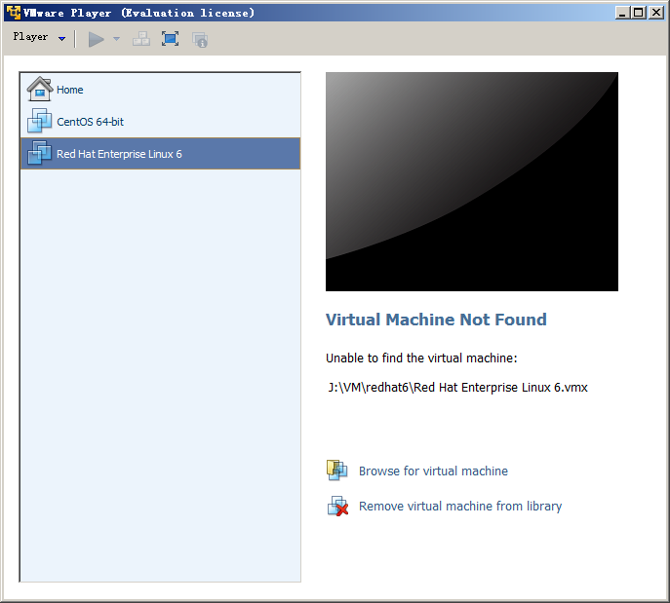
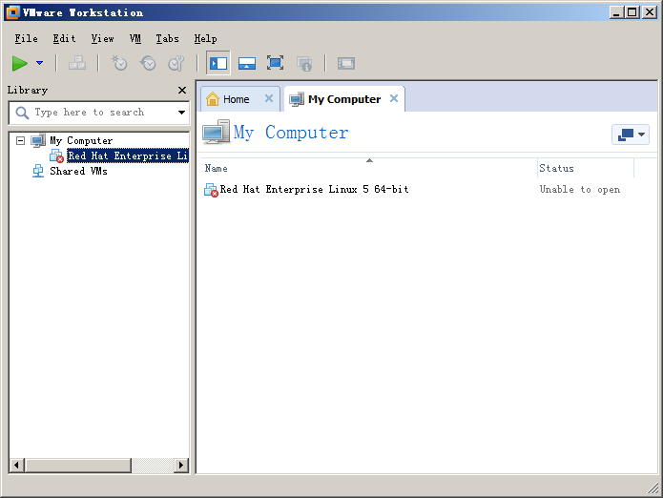
VMware
Produced in 1999. VMware Inc. product. It is non-open source.
  VMware's desktop software runs on Microsoft Windows, Linux, and Mac OS X.
  Its enterprise software hypervisors for servers, VMware ESX and VMware ESXi, are bare-metal hypervisors that run directly on server hardware without requiring an additional underlying operating system.
Desktop software
  VMware workstation, VMware Fusion
  VMware player: is freeware for non-commercial use
Server software
  VMware vSphere
  VMware server

Slide 43
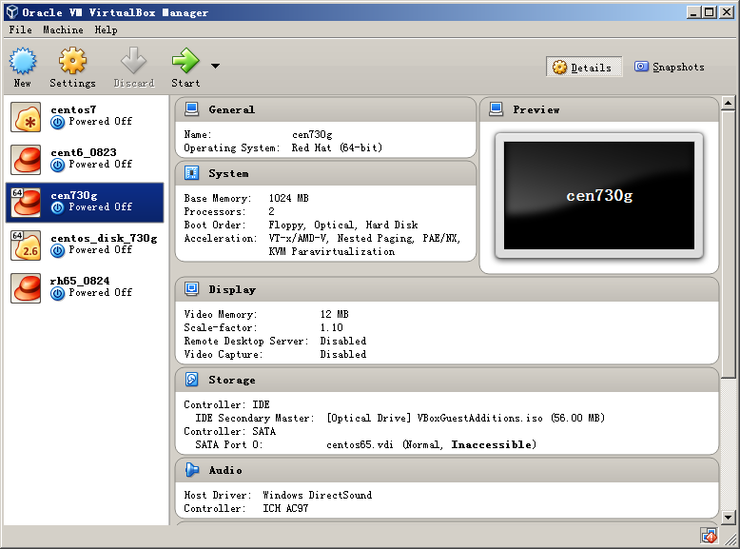
virtualbox
is a hypervisor for x86 computers from Oracle Corporation.
VirtualBox may be installed on a number of host operating systems, including: Linux, OS X, Windows Vista, Solaris, and OpenSolaris.
Support Software-based virtualization and Hardware-assisted virtualization

Slide 44
LXC (linux container) and Docker
LXC (Linux Containers)
  is an operating-system-level virtualization environment for running multiple isolated Linux systems (containers) on a single Linux control host.
  The Linux kernel provides the cgroups functionality that allows limitation and prioritization of resources (CPU, memory, block I/O, network, etc.)
Docker
  a project automating deployment of applications inside software containers
  can also use LXC as one of its execution drivers, enabling image management and providing deployment services.

Slide 45
Agenda
Introduction
Virtualization Technologies
  CPU
  Memory
  IO
Commercial virtualization tools
Problems in using virtualization
  How to create and handle VM images
  Virtual network concepts and configuration
Summary
Notes:
Use the virtualization tools to create and handle VM images.

Slide 46
Libvirt – API for managing VMs
is an open source API, daemon and management tool for managing platform virtualization.
  itself is a C library.
  Others, Python, Perl, OCaml, Ruby, Java, and PHP.
  widely used in the orchestration layer of hypervisors in the development of a cloud-based solution.
can be used to manage
  KVM, Xen, VMware ESX, QEMU and other virtualization technologies.
Two User Interfaces
  Graphical Interface: virt-manager
  Command line interface: virsh
Warnke, Robert; Ritzau, Thomas. qemu-kvm & libvirt (in German)
https://en.wikipedia.org/wiki/Libvirt
Notes:
The most important tool is libvirt. It is an open source API, daemon and management tool for managing platform virtualization.
itself is a C library. Others, Python, Perl, OCaml, Ruby, Java, and PHP. Is widely used in the orchestration layer of hypervisors in the development of a cloud-based solution.
Can be used to manage images of KVM, Xen, VMware ESX, QEMU and other virtualization technologies.
There two user interfaces. Graphical interface: virt-manager and command line interface: virsh.

Slide 47
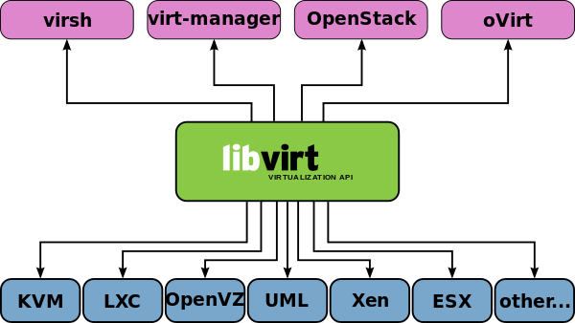
libvirt
libvirt supports several Hypervisors and is supported by several management solutions
Notes:
公共的API，提供了统一管理虚拟机的接口。API。
libvirt supports several Hypervisors and is supported by several management solutions

Slide 48
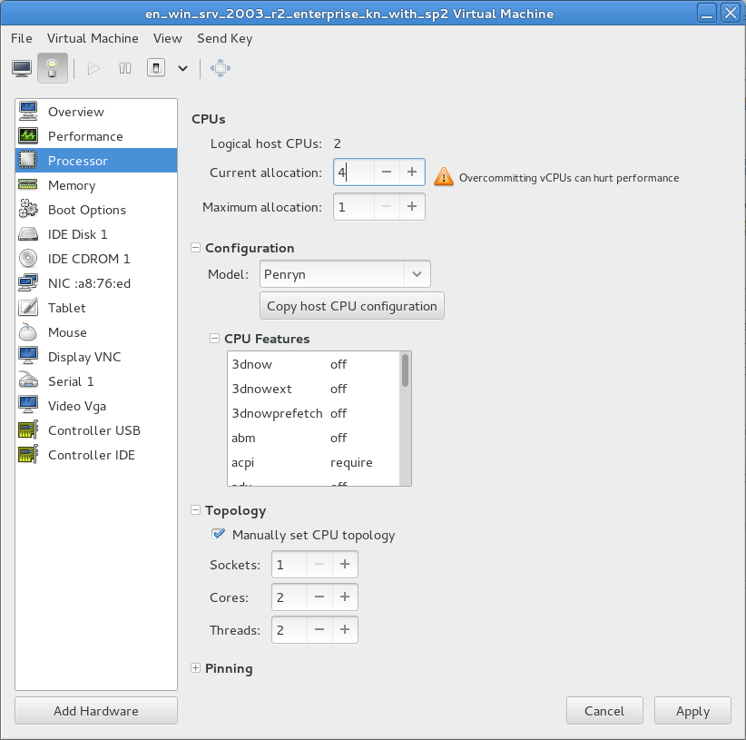
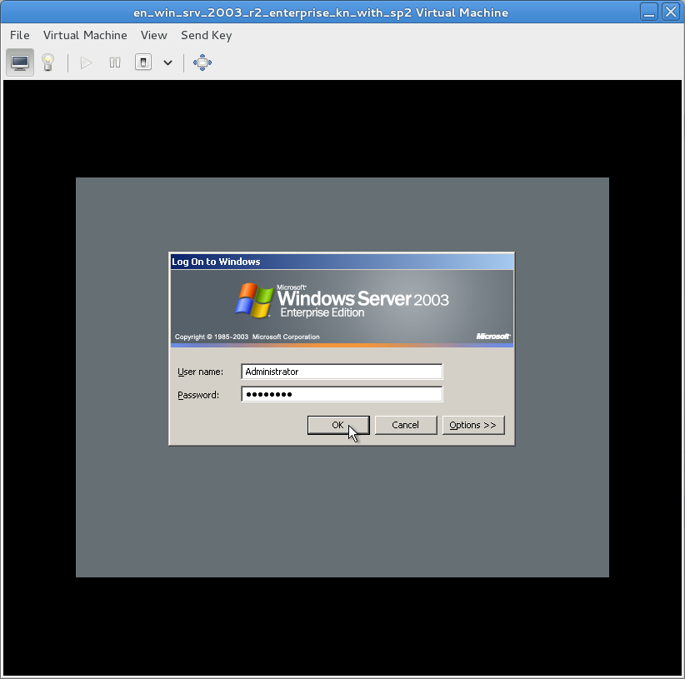
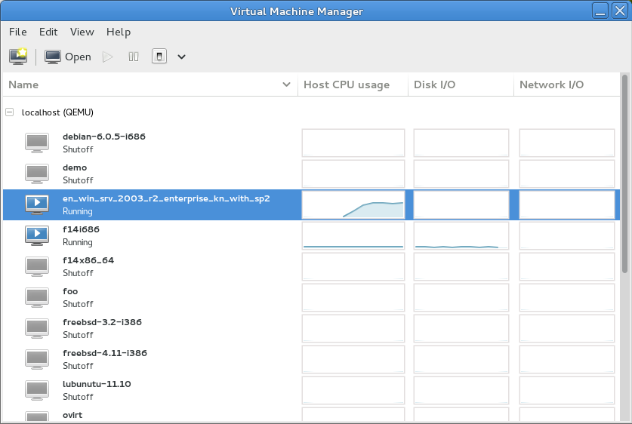
virt-manager
http://virt-manager.org/
Virtual Machine Manager
  is a desktop-driven virtual machine manager with which users can manage virtual machines (VMs)
Functions
  create, edit, start and stop VMs
virt-manager’s supporting tools
  virt-install tool
  virt-clone tool
  virt-viewer application
Notes:
About virt-manager’s supporting tools
The virt-install tool is a command line tool which provides an easy way to provision operating systems into virtual machines.
The virt-clone tool is a command line tool for cloning existing inactive guests. It copies the disk images, and defines a config with new name, UUID and MAC address pointing to the copied disks.
The virt-viewer application is a lightweight interface for interacting with the graphical display of virtualized guest OS. It can display VNC or SPICE, and uses libvirt to lookup the graphical connection details.

Slide 49
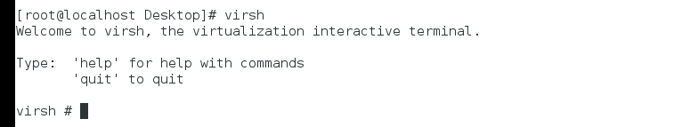
virsh
http://blog.csdn.net/bravezhe/article/details/8465678
The virsh is used to manage domains. You must run the commands as the root user or by assuming the appropriate role account on the host operating system. The commands cannot be run in the guest domain.
Common used commands:
  virsh create #1: start a VM
    virsh create vm01.xml
  virsh destroy #1
  virsh list
    list all the running VMs
  virsh console: connect to a VM
  virsh reboot #1
  virsh shutdown #1
  …
Notes:
The virsh is used to manage domains. You must run the commands as the root user or by assuming the appropriate role account on the host operating system. The commands cannot be run in the guest domain.

Slide 50
VM image file
VM Image file stores all contents of a VM.
Two modes: mirror and sparse mode
  The mirror mode image stores all byte data, includes invalid data for users. Raw format is a mirror mode image.
  The sparse mode image stores the user or system valid data, only occupy a special necessary size of storage space. The qcow2 and vmdk are sparse mode file formats.
File format
  General image: qcow, qcow2 & raw
  Commercial image: vmdk, vdi, …
    Each commercial virtualization has its own image format.

Slide 51
Choosing Image format
raw format (KVM/Xen)
  (linux default) the raw format is a plain binary image of the disc image, and is very portable.
  On file systems that support sparse files, images in this format only use the space actually used by the data recorded in them.
qcow2 (QEMU copy-on-write)
  QEMU copy-on-write format with a range of special features, including the ability to take multiple snapshots, smaller images on file-systems that don’t support sparse files, optional AES encryption, and optional zlib compression.
Other
  vmdk: VMWare file format
  vdi: virtualbox file format
Image File format convert
  In general a commercial VMM can convert its format file to the raw formant
Notes:
raw format (KVM/Xen):
(linux default) the raw format is a plain binary image of the disc image, and is very portable.
On file systems that support sparse files, images in this format only use the space actually used by the data recorded in them.
raw format (KVM/Xen)
(linux default) the raw format is a plain binary image of the disc image, and is very portable.
On file systems that support sparse files, images in this format only use the space actually used by the data recorded in them.
Other
vmdk: VMWare file format
vdi: virtualbox file format
Image File format convert
A commercial VMM can convert its format file to the standard raw formant.

Slide 52
Agenda
Introduction
Virtualization Technologies
  CPU
  Memory
  IO
Commercial virtualization tools
Problems in using virtualization
  How to create and handle VM images
  Virtual network concepts and configuration
Summary
Notes:
Virtualization has been widely used in modern data centers, grids and clouds.
This lesson convers some general concepts about virtualization, a simple introduction of the design and implementation challenges of virtualization technology, some commonly used virtualization tools and some difficulties in practical using virtualization. I have made much communication and discussion with professor zhangxiaomei about the lesson content during the period of preparation.

Slide 53
Network Communication between VMs
Application
Application
Communication
VM1
VM2
VM1
VM2
Disperse placement (DP)
Colocation-placement (CP)
PM1
HW
PM2
HW
VM1
VM2
PM
Hardware(HW)
VM1
VM2
VMM
VMM
VMM
Virtual Network
Network
Pass through vNIC
but not NIC
Through NIC
Notes:
The network communication between VM1 and VM2 which are disperse placed onto distinct PMs will pass through the network interface card of PMs.
The network communication between VM1 and VM2 which are colocation placed onto the same PM will not pass through the network interface card of PMs but vNIC.

Slide 54
Virtual network concepts
Physical network
  NIC, switch
Virtual Network
  vNIC, vSwitch
Virtual network devices
  TAP/TUN
  Linux Bridge
http://www.ibm.com/developerworks/cn/linux/1310_xiawc_networkdevice/
https://www.vmware.com/support/ws55/doc/ws_net_basics.html
http://blog.csdn.net/tantexian/article/details/45395075
Notes:
参考资料：
http://www.ibm.com/developerworks/cn/linux/1310_xiawc_networkdevice/
网络设备虚拟化
https://www.vmware.com/support/ws55/doc/ws_net_basics.html
3种虚拟网络模式
http://blog.csdn.net/tantexian/article/details/45395075
Neutron的网络拓扑图

Slide 55
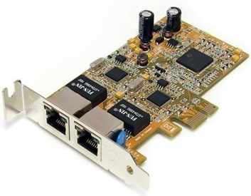
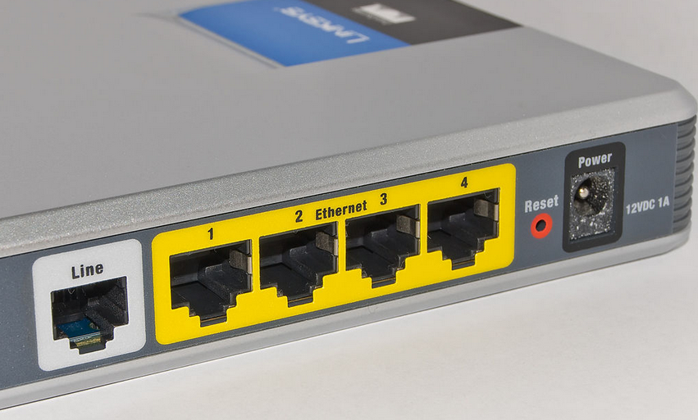
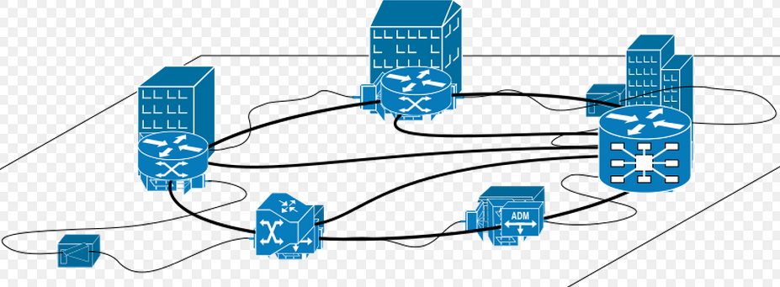
Physical network
Many computers with distinct geolocations are connected together, creating a physical network.
Network connection needs network devices.
  Network interface controller(NIC)
    A computer or server must be network-capable with a working NIC or a network card installed.
    The NIC enables the computer to interact with a network.
  Switch and local area network (LAN)
    Computers are usually connected to a device called a switch, which creates a local area network (LAN).
    Switches are responsible for intelligently routing this network traffic to the appropriate destination.
  Network protocol: TCP/IP
Notes:
To connect to a network, a computer must be network-capable, namely, must installed a working network interface controller (NIC), also known as a network card or network adapter. The NIC enables the computer to interact with a network.
Many computers must use switch to connect together.
Multiple computers interconnecting requires a network device, called switch.
In most business environments, computers are usually connected to a device called a switch, which creates a local area network (LAN).
Switches are responsible for intelligently routing this network traffic to the appropriate destination.
The network communication must need protocols such as TCP/IP.

Slide 56
Virtual network
In virtualization network devices are virtualized, such as vNIC and vSwitch.
Many VMs connected together with virtual network devices creates a virtual network.
  Virtual network interface card (vNIC)
    Hypervisor can create one or more vNICs for each VM.
    The vNIC provides the networking capabilities of the VM.
    Each vNIC is identical to a physical NIC.
  Virtual Switch(vSwitch)
    Switch also can be virtualized as a virtual switch.
    Each vNIC is connected to the vSwitch port, and these vSwitch access external physical network through the physical NIC of Physical Server.
  e.g., TAP/TUN
Notes:
1)Similar as physical network, many VMs can be connected together by virtual network devices, creating a virtual network
2)For each VM, the connection to network is by the virtual network card. Hypervisor can create one or more vNICs for each VM and each vNIC is identical to a physical NIC.
3)Switch can also be virtualized as a virtual switch. Each vNIC is connected to the vSwitch port, and these vSwitch access external physical network through the physical NIC of Physical Server.
虚拟机的网络功能由虚拟网卡(vNIC)提供，Hypervisor可以为每个虚拟机创建一个或多个vNIC，站在虚拟机的角度，这些vNIC等同于物理的网卡。为了实现与传统物理网络等同的网络结构，与NIC一样Switch也被虚拟化为虚拟交换机(vSwitch)，各个vNIC链接在vSwitch的端口上，最后这些vSwitch通过物理Server的物理网卡访问外部的物理网络。

Slide 57
TAP/TUN
TAP / TUN
  is a pair of virtual network devices based on Linux kernel implementation.
  is widely used to realize the connection between the VM and PM.
TAP
  is equivalent to an Ethernet device, which operates the second-layer packets such as Ethernet data frames. (can see in linux by ifconfig)
TUN
  simulates the network layer devices, and operate the third layer packet such as IP data packets. ➔router or switch (vSwitch)
Notes:
In order to realize the connection between the VM and PM, it is required a virtual network device to connect.
These virtual network devices are all implemented in software and provide the software on operating system with the same function as hardware on the network.
网络设备的虚拟化
TAP/TUN是Linux内核实现的一对虚拟网络设备，这些虚拟的网络设备全部用软件实现，并向运行于操作系统上的软件提供与硬件的网络设备完全相同的功能。
TAP 等同于一个以太网设备，它操作第二层数据包如以太网数据帧。TUN模拟了网络层设备，操作第三层数据包比如IP数据封包。Linux内核通过TUN/TAP设备向绑定该设备的用户空间的程序发送数据，反之，用户空间的程序也可以像操作硬件网络设备那样，通过TUN/TAP设备发送数据。
基于TAP驱动，即可以实现虚拟网卡的功能，虚拟机的每个vNIC都与Hypervisor中的一个TAP设备相连。当一个TAP设备被创建时，在Linux设备文件目录下将会生成一个对应的字符设备文件，用户程序可以像打开普通文件一样打开这个文件进行读写。

Slide 58
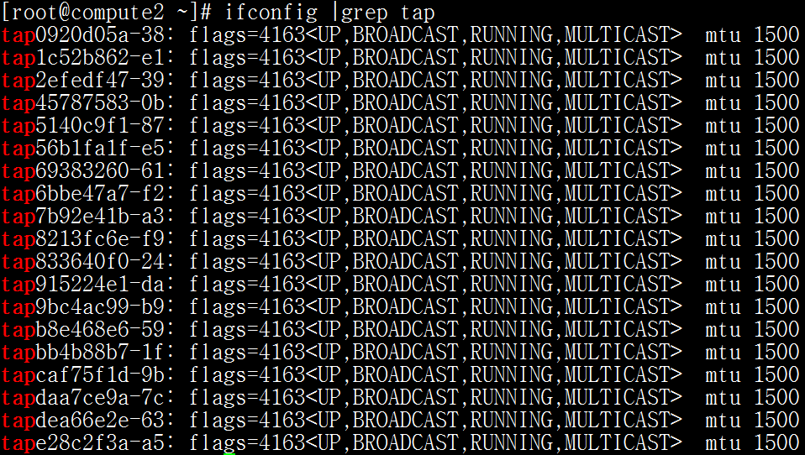
Tap devices in KVM machine
One VM has a tap device

Slide 59
Linux bridge
Linux Bridge
  is a virtual network device working on the second layer
  has the functions similar to the physical switches.
Bridge can
  bind other Linux network device as a slave device, and virtualize the slave device as a port.
VM
OS
vNIC
bridge
PM(host)
NIC
Notes:
网络设备的虚拟化
Linux Bridge(网桥)是工作于二层的虚拟网络设备，功能类似与物理的交换价。
Bridge可以绑定其他Linux网络设备作为从设备，并将这些从设备虚拟化为端口，当一个从设备被绑定到Bridge上时，就相当于真实网络中的交换机端口插入了一个连接有终端的网线。

Slide 60
Network configuration
Networking modes
Example of virtual network configuration

Slide 61
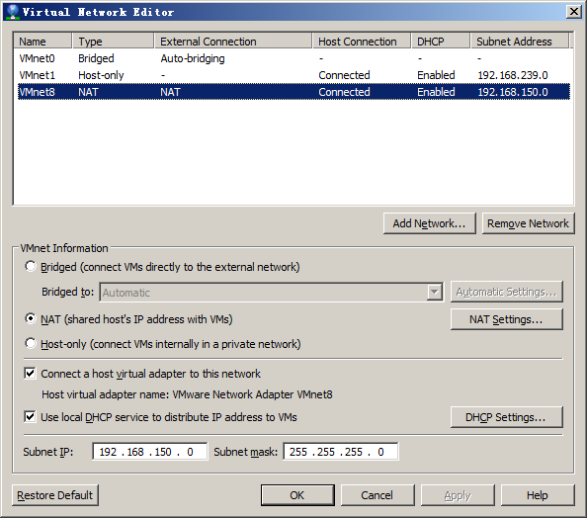
Networking modes
Network address translation (NAT) configures your VM to share the IP and MAC addresses of the host.
  The VM and the host share a single network identity that is not visible outside the network.
  NAT can be useful when you are allowed a single IP address or MAC address by your network administrator.
  You might also use NAT to configure separate VMs for handling http and ftp requests, with both VMs running off the same IP address or domain.
Host-only networking configures your VM to allow network access only to the host.
  This can be useful when you want a secure VM that is connected to the host network, but available only through the host machine.
Bridged networking configures your VM as a unique identity on the network, separate and unrelated to its host.
Notes:
There are three modes you can configure a VM for virtual networking.
The first is NAT. It configures your VM to share the IP and MAC address of the host.
So if the host can link to an outside network, then the VM can also link to an outside network.
在实际使用中，经常需要让一个虚拟机作为一个单独的服务器，拥有一个能被外网访问的IP地址，这时，需要将虚拟机网络连接模式设置为网桥模式。
In practical application, we usually need a VM as a special server machine with a special IP address which can be accessed by outer network.
Then we should use the bridge networking mode to configure the VM network.
Next, I present an example to show how to configure the network with bridge networking mode.

Slide 62
Example of bridge networking
Hardware environment:
  A host is running centos with virtualization KVM.
    A VM is required to configure the virtual network in bridge mode.
    The host is required to configure a bridge and bind the NIC to this bridge.
Configuration steps
  Step1. modify ifcfg-ethX in host
  Step2. create a new bridge in host
  Step3. modify VM configure file (.xml) in host
  Step4. Connect VM and configure VM network

Slide 63
Step1: modify ifcfg-ethX
1. Modify /etc/sysconfig/network-scripts/ifcfg-ethX. e.g.
  vi /etc/sysconfig/network-scripts/ifcfg-eth0
  -----------------------------------------------------------
  DEVICE=“eth0”
  NM_CONTROLLED=“no”
  ONBOOT=“yes”
  TYPE=Ethernet
  BOOTPROTO=none
  BRIDGE=“br0” #Add this line bind br0
  NAME="System eth0"
  HWADDR=44:37:E6:4A:62:AD
-------------------------------------------
(In host machine)

Slide 64
Step2: create a new bridge in host
Add a new file, /etc/sysconfig/network-scripts/ifcfg-br0.
#---------------------------------------------
DEVICE=“br0”
ONBOOT=“yes”
TYPE=“Bridge” #it’s bridge
BOOTPROTO=static
IPADDR=10.0.112.39 #ip addr.
NETMASK=255.255.255.0 #netmask
GATEWAY=10.0.112.1 #gateway
DEFROUTE=yes
#------------------------------------------------------------------
And restart network device and check bridge interface info.
#service network restart #restart network service
#brctl show #show bridge list
bridge name bridge id STP enabled interfaces
br0 8000.4437e64a62ad no eth0 #bind eth0
Notes:
添加/etc/sysconfig/network-scripts/ifcfg-br0的配置文件，比如
DEVICE=“br0”
ONBOOT=“yes”
TYPE=“Bridge”
BOOTPROTO=static
IPADDR=10.0.112.39 #ip 地址
NETMASK=255.255.255.0 #掩码
GATEWAY=10.0.112.1 #网管
DEFROUTE=yes
重启网络，校验桥接接口
#service network restart
#brctl show
bridge name bridge id STP enabled interfaces
br0 8000.4437e64a62ad no eth0

Slide 65
Step3. Modify VM configure file (.xml)
Add the following code to VM configure file XXX.xml:
<devices>
<interface type='bridge'>
<source bridge='br0'/>
<target dev='vnet0'/>
<mac address="00:11:22:33:44:55"/>
</interface>
</device>
Boot the VM to check network link valid or not.
#virsh create XXX.xml
#brctl show
bridge name bridge id STP enabled interfaces
br0 0.4437e64a62ad no eth0 vnet0
Notes:
虚拟网络模式
2.修改虚拟机配置文件，增加如下内容
<devices>
<interface type='bridge'>
<source bridge='br0'/>
<target dev='vnet0'/>
<mac address="00:11:22:33:44:55"/>
</interface>
</device>
启动虚拟机，验证网口接口是否正常
#virsh create XXX.xml
#brctl show
bridge name bridge id STP enabled interfaces
br0 0.4437e64a62ad no eth0 vnet0

Slide 66
Step4. Connect VM and configure VM network
Use vnc to connect VM. Firstly use virsh dumpxml to view the vnc interface number. Then use virt-viewer to connect to the VM.
virt-viewer localhost:5901
Login the VM and complete the network configuration. The operation in VM is the same as physical machine.
Notes:
虚拟网络模式
3.使用vnc连接虚拟机，进行网络配置
使用virt-viewer通过vnc端口连接虚拟机，如果在配置文件中虚拟机使用自动分配vnc端口，则可以使用virsh dumpxml查看虚拟机运行时vnc端口号
#virt-viewer localhost:5901
登陆后进行虚拟机的网络配置(和物理机的网络配置相同)

Slide 67
Summary
What is virtualization
Virtualization technology implementation principles
  CPU, Memory, IO virtualization
Virtualization tools
  KVM, Xen, Docker
Two problems in practical application
  Manage VM images
  Virtual network concepts

Slide 68
End
Thank You!

