Slide 1
Cloud Standard API and Contextualization
Xianghu Zhao
IHEP Computing Center
2015 BESIIICGEM Cloud Computing Summer School

Slide 2
Content
Cloud Standard API
OCCI
EC2
Other Approaches
Contextualization
Cloud-init

Slide 3
Cloud Standard API

Slide 4
Cloud API
Cloud API (Application Programming Interfaces)
API through network
Almost all based on the HTTP protocol
Independent on programming language
RESTful / XML-RPC / SOAP / …
Web portal and command lines running upon cloud API
Cloud SDK (Software Development Kit)
Provide easy access to cloud API
Implementations for multiple programming languages

Slide 5
Cloud Provider Specific API
Specific for certain cloud manager
Each cloud manager usually has its own API
OpenNebula
OCA (XML-RPC)
OpenStack
Nova API
May provided several SDKs for different programming languages

Slide 6
Cloud Standard API
All clouds are providing similar functionalities
It is possible to use a unique way to manage different cloud types
Cross-platform
Control different cloud types with the same interface
Easier to deal with cloud bursting and federation

Slide 7
Weakness of Cloud Standard API
Not full-featured API for a specified cloud
General design
Need extra configuration or installation for the cloud
Configuration
Installation of some intermediate services

Slide 8
OCCI

Slide 9
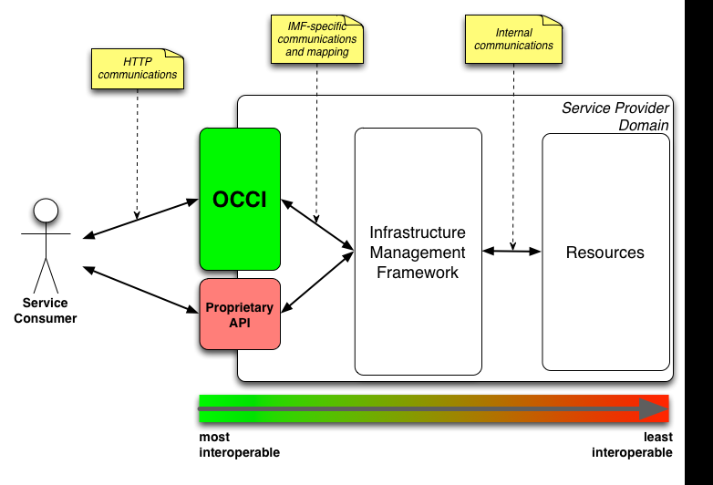
Introduction to OCCI
Open Cloud Computing Interface
Protocol and API for management of cloud service resources
OCCI is an open specification
Need implementations to put it into practice
Used as the second API for clouds

Slide 10
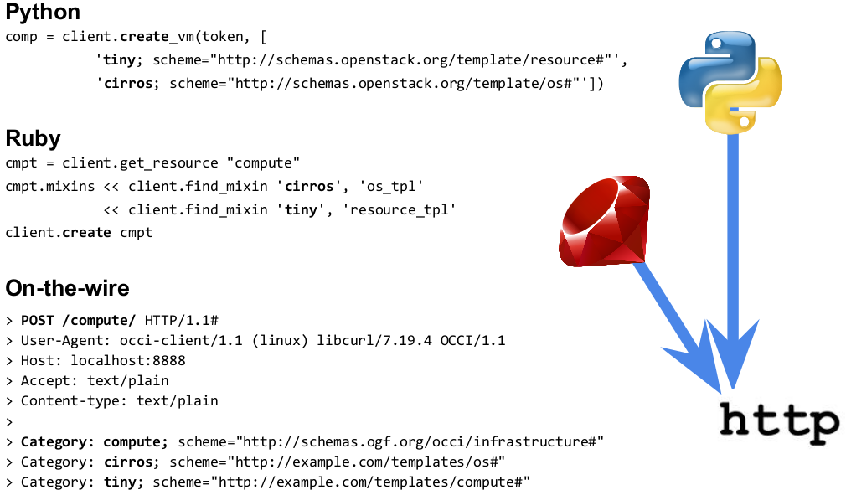
OCCI in Action

Slide 11
rOCCI
rOCCI is a modular Framework for OCCI written in ruby
Current supported backends
OpenNebula
EC2
Contain 4 parts
rOCCI-core
rOCCI-api
rOCCI-cli
rOCCI-server

Slide 12
Adding OCCI support for OpenNebula
Install rOCCI-server for OpenNebula
rOCCI-server is actually a web service
Based on Ruby on Rails framework
rOCCI-server Could be located on any place
Virtual machine is also OK
Configure the web server
apache / nginx / …
Installation details
https://wiki.egi.eu/wiki/rOCCI:ROCCI-server_Admin_Guide

Slide 13
rOCCI Command Line
rOCCI-cli is a ready-to-use shell client for OCCI enabled services
Provide full features to access rOCCI server
Installation
Need Ruby >= 1.9.3
gem install occi-cli

Slide 14
rOCCI-cli Examples
List all images
occi --endpoint https://<ENDPOINT>:<PORT>/ --action list --resource os_tpl --auth x509
List all resource types (CPU, Memory, …)
occi --endpoint https://<ENDPOINT>:<PORT>/ --action list --resource resource_tpl --auth x509

Slide 15
rOCCI-cli Examples
List all VM instances
occi --endpoint https://<ENDPOINT>:<PORT>/ --action list --resource compute --auth x509
Create a new VM instances
occi --endpoint https://<ENDPOINT>:<PORT>/ --action describe --resource compute --auth x509
Detail information about the VM instance
occi --endpoint https://<ENDPOINT>:<PORT>/ --action describe --resource /compute/<OCCI_ID> --auth x509

Slide 16
EC2

Slide 17
Introduction to EC2 API
EC2 API is original used for management of Amazon EC2
Became a kind of standard by the powerful influence of AWS in cloud computing
It is supported by many cloud managers

Slide 18
Tools for EC2 API
Amazon EC2 command line tools
EC2 official tools written in java
euca2ools
Compatible with Amazon EC2 and IAM APIs
econe tools provided by OpenNebula
Suitable for testing the OpenNebula econe service

Slide 19
Configure EC2 in OpenNebula
Modify the configuration file /etc/one/econe.conf
Start econe service
Econe-server start
EC2_ACCESS_KEY is the user name
EC2_SECRET_KEY is the SHA1 hashed password
oneuser show user-name
Detailed configuration
http://docs.opennebula.org/4.8/advanced_administration/public_cloud/ec2qcg.html

Slide 20
econe Examples
Common environments for econe commands
EC2_URL
EC2_ACCESS_KEY
EC2_SECRET_KEY
Image

Slide 21
econe Examples
Instance

Slide 22
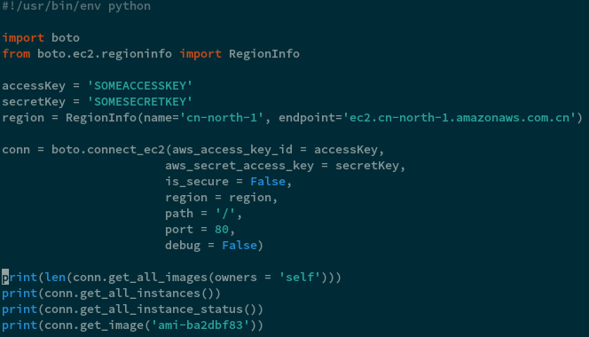
EC2 SDK Example

Slide 23
Other Approaches

Slide 24
Unified API from Client
Interacting with many cloud service providers using a unified API
Provide different drivers for many clouds
Do not need to change anything from the cloud side
Related projects
Apache Libcloud (python)
Fog (ruby)
Apache Deltacloud
Libcloud REST
…

Slide 25
Libcloud
Driver could be change to accommodate different clouds

Slide 26
Deltacloud

Slide 27
There is No Silver Bullet for Cloud API
There are still many standards
Choose the one fits your needs best
Supported cloud types
The way to manage the cloud
Need for cloud specific features

Slide 28
Contextualization

Slide 29
What is Contextualizaton
Contextualization provides boot time customization for cloud and virtualization instances.
Service runs early during boot, retrieves user data from an external provider and performs actions
Could build various VM instances with the same image

Slide 30
Contextualization Methods
Amiconfig
User-data
HEPIX
Cloud-init
Vmcontext in OpenNebula
…

Slide 31
Cloud-init
Supported user data formats:
Shell scripts (starts with #!)
Cloud config files (starts with #cloud-config)
Standard YAML syntax available for many common configuration operations.
MIME multipart archive.
Custom part handling also available.
Modular and highly configurable.

Slide 32
Cloud-init Modules
cloud-init has modules for handling:
Disk configuration
Command execution
Creating users and groups
Package management
Writing content files
Bootstrapping Chef/Puppet
Additional modules can be written in Python if desired.

Slide 33
Data Categories
meta-data is provided by the cloud platform.
user-data is a chunk of arbitrary data the user provides.
Retrieved from data source and saved to /var/lib/cloud/

Slide 34
What can cloud-init Do
You may already be using it!
Injects SSH keys.
Grows root filesystems.
Other module support tasks such as
Setting the hostname.
Setting the root password.
Setting locale and time zone.
Running custom scripts.

Slide 35
Examples
User-data Examples
Upgrading and installing packages:
#cloud­config
package_upgrade: true
packages:
-­ git
­- screen
­- vim­enhanced

Slide 36
Examples
Run an arbitrary command:
#cloud­config
runcmd:
-­ rhnreg_ks ­­activationkey=3753...
Or:
#!/bin/bash
rhnreg_ks ­­activationkey=3753...

Slide 37
Enable Cloud-init in Image
Use cloud-init enabled image
Install cloud-init package via yum in the guest OS
Enable EPEL repository
yum install cloud-init
Make new image from the above instance

Slide 38
How does it work - OpenStack / EC2
Accesses metadata service at
http://169.254.169.254/latest/meta-data
http://169.254.169.254/latest/user-data
NAT rules on your network controller make this work.
Service provided by nova-api (accessed via per-router neutron-metadata-proxy when using Neutron).

Slide 39
How does it work - OpenNebula
Try to find the CONTEXT ISO disk created by OpenNebula
Find the context.sh file in the ISO image
Configure the network with the variables
Get the USER_DATA and run it as cloud-init script

Slide 40
Cloud-init for OpenNebula
Need a little modification of configuration
Use the OpenNebula data source
Edit /etc/cloud/cloud.cfg in VM and add:

Slide 41
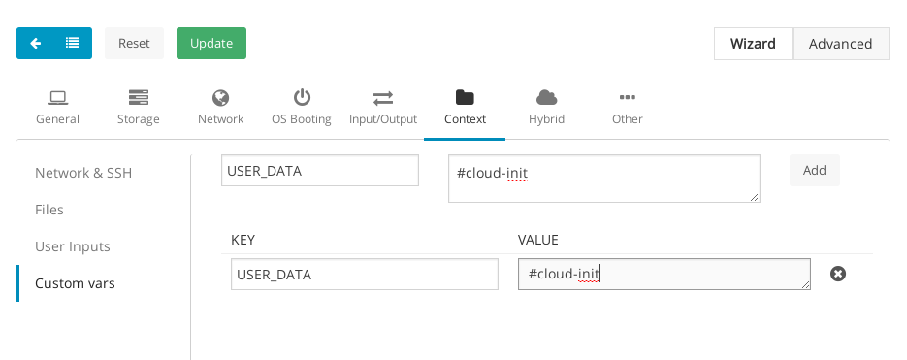
Set USER_DATA

Slide 42
Thanks

