Slide 1


江门实验探测超新星中微子
周 顺
中科院高能所理论室
JUNO中微子天文和天体物理学研讨会
北京, 2015-7-10

Slide 2
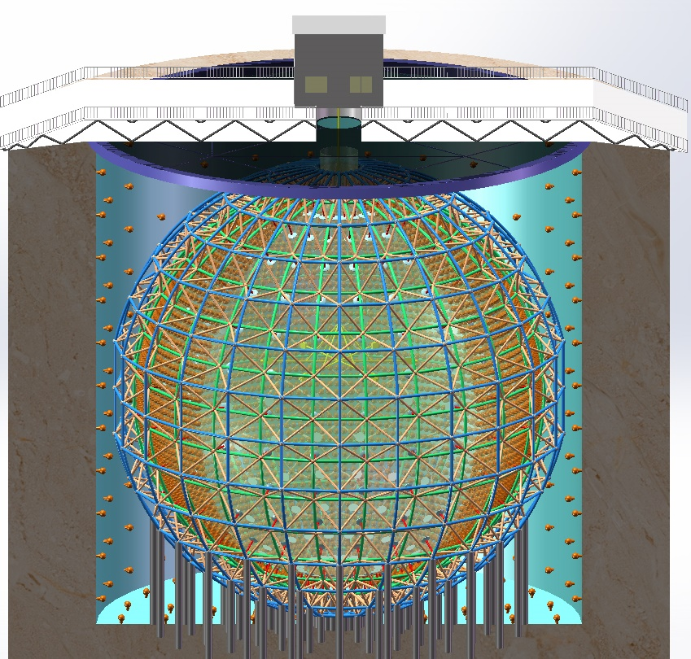
The JUNO Experiment
Jiangmen Underground Neutrino Observatory (JUNO), a multiple-purpose neutrino experiment, approved in Feb. 2013, ~ 300 M$.
20 kton LS detector
3% energy resolution
700 m underground
Rich Physics Possibilities
  Reactor Neutrinos
  for neutrino mass hierarchy & precision measurement of oscillation parameters
  Supernova Neutrino Burst
  Diffuse Supernova Neutrino Background
  Geoneutrinos
  Solar Neutrinos
  Atmospheric Neutrinos
  Proton Decays
  Exotic Searches
Talks by Y.F. Wang at ICFA Seminar 2008, Neutel 2011; by J. Cao at Neutel 2009, NuTurn 2012, NeuTel 2015 ; Papers by L. Zhan, Y.F. Wang, J. Cao, L.J. Wen, PRD78:111103, 2008; PRD79:073007,2009; Y.F. Li, J. Cao, Y.F. Wang, L. Zhan, PRD 88: 013008, 2013.

Slide 3
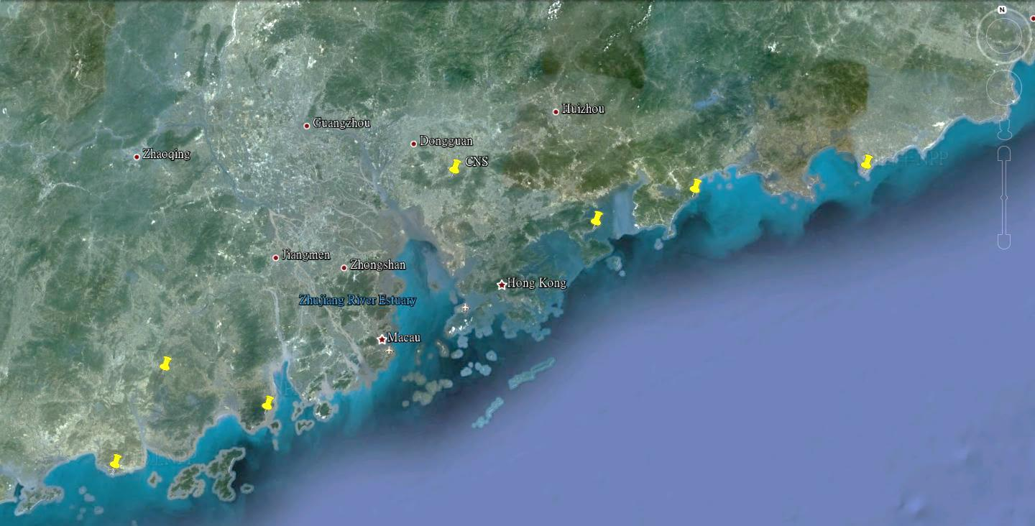

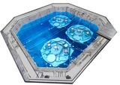
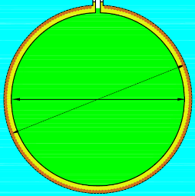
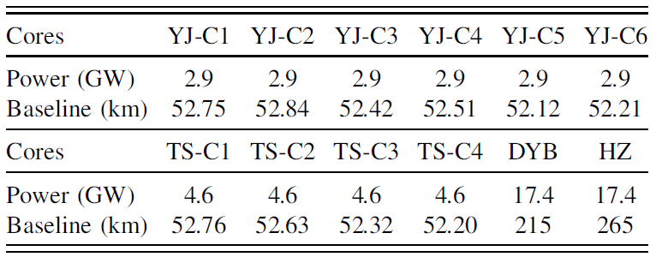
Location of JUNO
NPP | Daya Bay | Huizhou | Lufeng | Yangjiang | Taishan
Status | Operational | Planned | Planned | Under construction | Under construction
Power | 17.4 GW | 17.4 GW | 17.4 GW | 17.4 GW | 18.4 GW
by 2020: 26.6 GW
Overburden ~ 700 m
Previous site candidate
Guang Zhou
Kaiping,
Jiangmen City,
Guangdong Province
2.5 h drive
Lufeng
NPP
Shen Zhen
Huizhou
NPP
Zhu Hai
Daya Bay NPP
Hong Kong
53 km
Macau
53 km
Taishan NPP
Yangjiang NPP

Slide 4
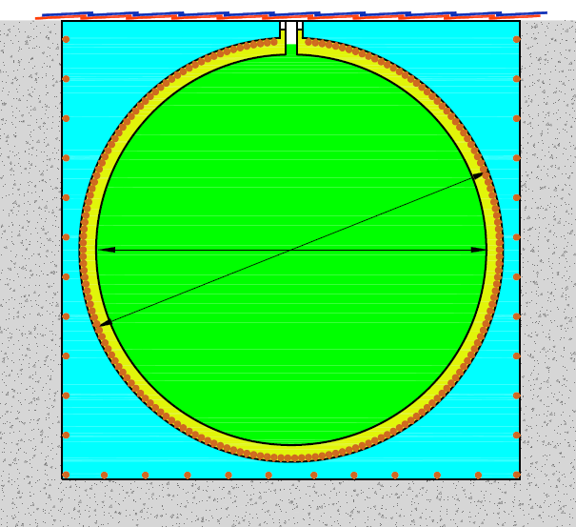
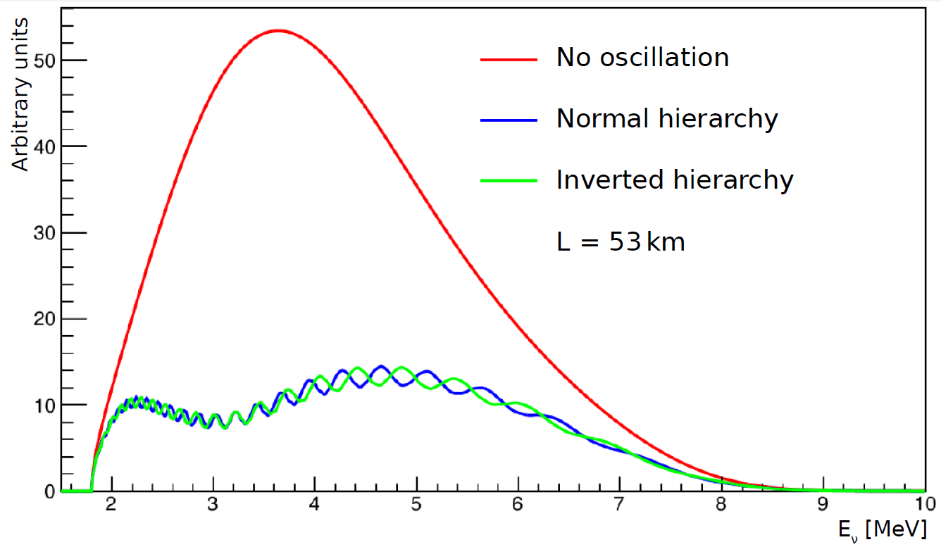





High-precision, Giant LS detector
Muon tracker
Steel Tank
20 kt LS
$$m_{3}>m_{2}>m_{1}$$
coverage: ~77%
~18000 20” PMTs
~20 kt water
$$m_{2}>m_{1}>m_{3}$$
Prompt signal:
$$e^{+}e^{−}⟶2γ$$
Acrylic tank: Φ∼35.4m
Stainless Steel tank: Φ∼39.0m
${\overline{ν}}_{e}+p⟶n+e^{+}$
~6kt MO
JUNO
Delayed capture on H;
2.2 MeV γ
~1500 20” VETO PMTs
5m
 | KamLAND | BOREXINO | JUNO
LS mass | 1 kt | 0.5 kt | 20 kt
Energy Resolution | 6%/$\sqrt{E}$ | 5%/$\sqrt{E}$ | 3%/$\sqrt{E}$
Light yield | 250 p.e./MeV | 511 p.e./MeV | 1200 p.e./MeV
Run for 6 yrs | Relative | Absolute Δm²
Statistics | 4σ | 5σ
Realistic | 3σ | 4σ

Slide 5
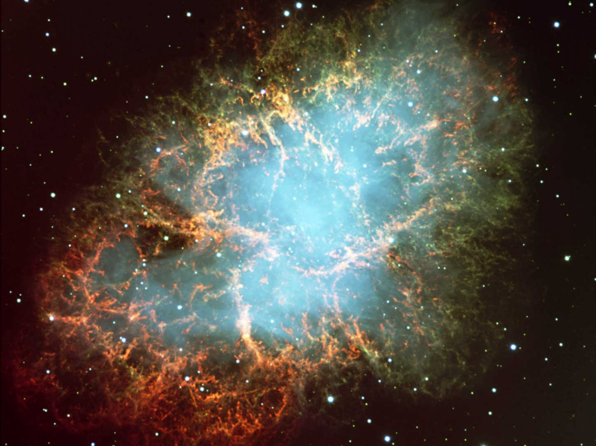
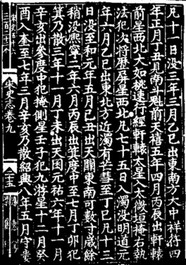
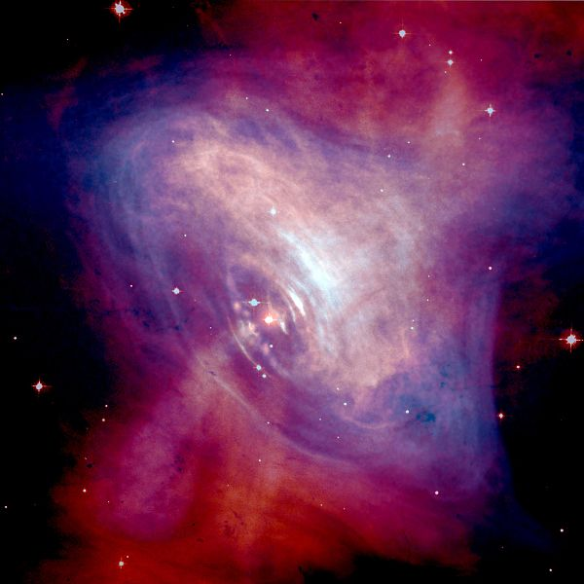
Galactic SN 1054
Distance: 6500 light years (2 kpc)
Center: Neutron Star ( R~30 km)
Progenitor : M ~ 10 solar masses
Red：Optical (Hubble)
Blue：X-Ray (Chandra)

Slide 6
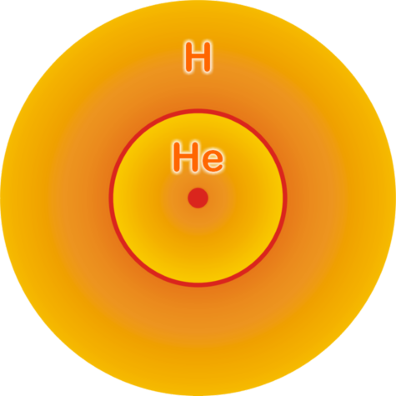
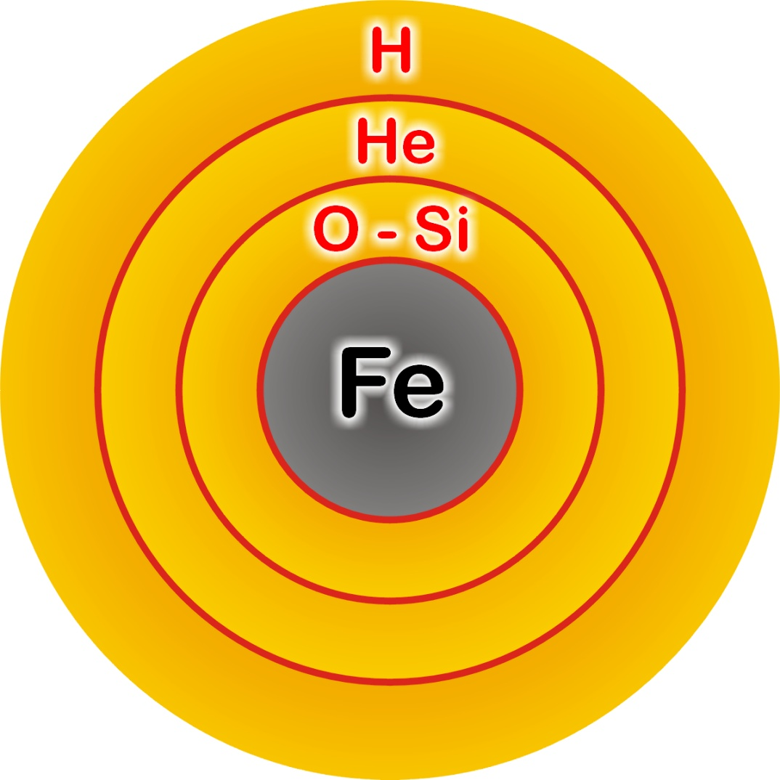
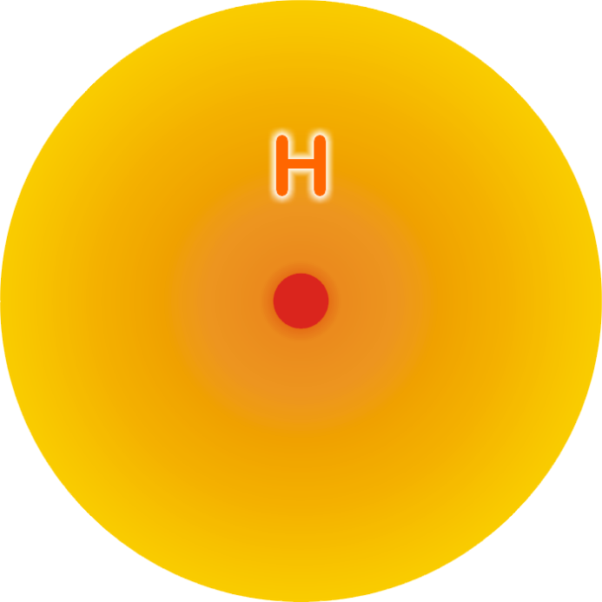


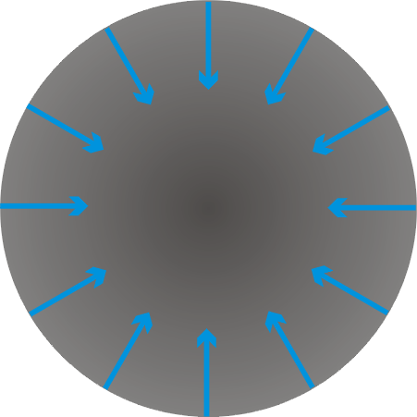
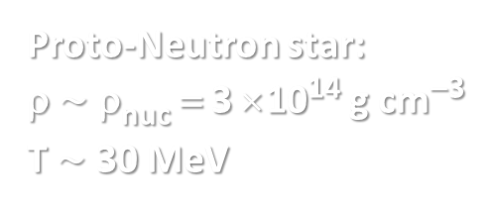
Stellar Collapse and SN Explosion
Grav. binding energy E_{b}≈3 × 10⁵³ erg
99% Neutrinos
1% Kinetic energy of explosion
(1% of this into cosmic rays)
0.01% Photons, outshine host galaxy
Main-sequence star
Helium-burning star
Hydrogen
Burning
Helium
Burning
Hydrogen
Burning
> 8 Solar Masses
Collapse→Bounce
Shock wave halted
ν energy deposited
Final SN explosion
Degenerate iron core:
ρ ≈ 10⁹ g cm⁻³
T ≈ 10¹⁰ K
M_{Fe} ≈ 1.5 M_{sun}
R_{Fe} ≈ 8000 km
Proto-Neutron star:
ρ $\sim$ ρ_{nuc} = 3 × 10¹⁴ g cm⁻³
T $\sim$ 30 MeV

Slide 7
Why No Prompt Explosion?
0.1 M_{sun} of iron has a
nuclear binding energy
≈ 1.7 × 10⁵¹ erg
Comparable to
explosion energy
Undissociated Iron
Collapsed Core
Shock Wave
Dissociated
Material
(n, p, e, ν)
Shock wave forms
within the iron core
Dissipates its energy
by dissociating the
remaining layer of iron

Slide 8
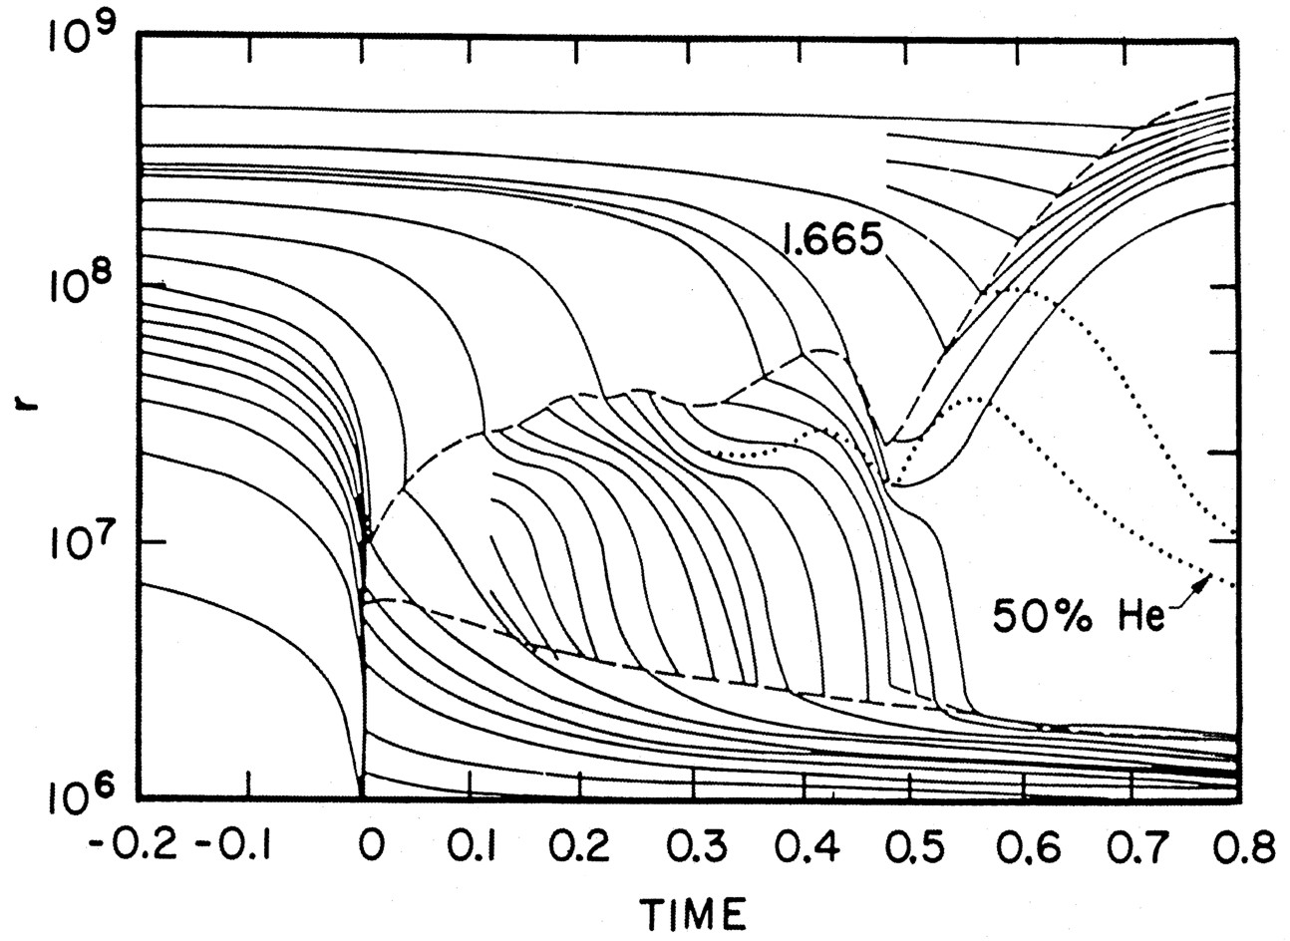
Delayed Explosion
Wilson, Proc. Univ. Illinois Meeting on Num. Astrophys. (1982)
Bethe & Wilson, ApJ 295 (1985) 14

Slide 9
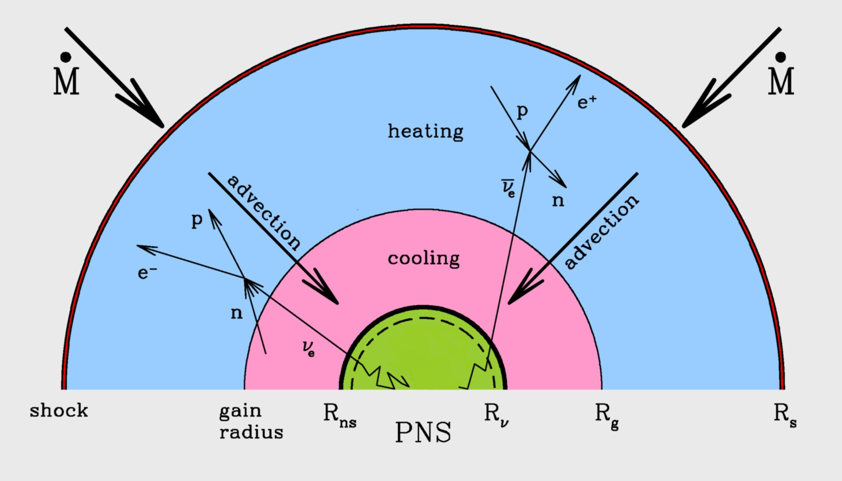
Neutrinos to Rescue
Neutrino heating
increases pressure
behind shock front
Janka, astro-ph/0008432

Slide 10
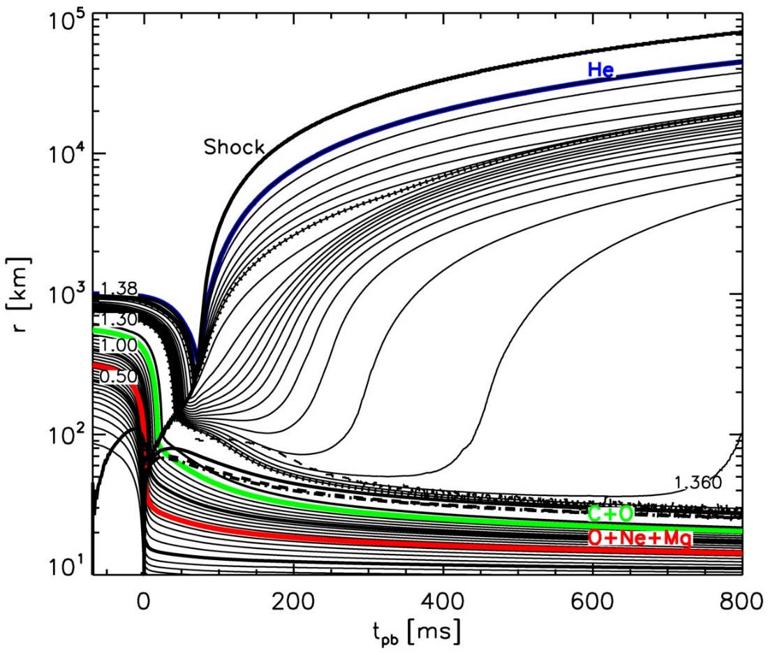
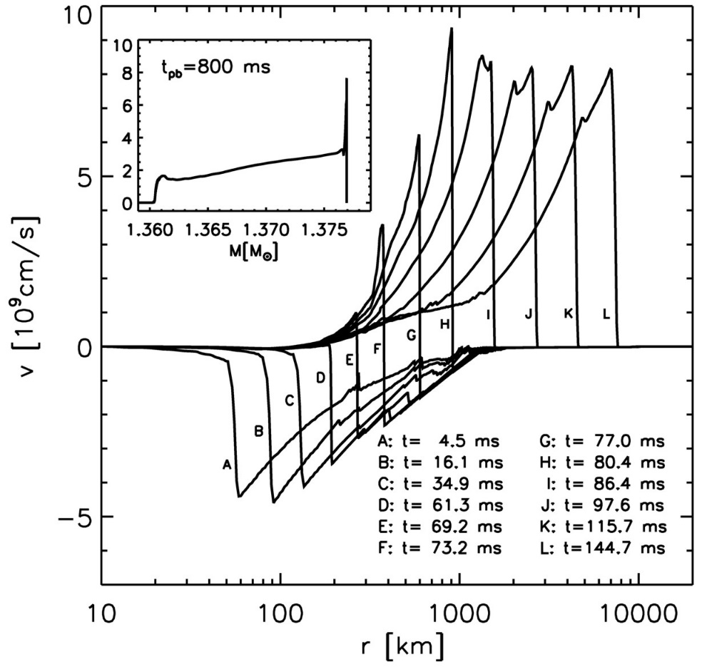
Exploding Models (8–10 Solar Masses)
Kitaura, Janka & Hillebrandt: “Explosions of O-Ne-Mg cores, the Crab supernova,
and subluminous type II-P supernovae”, astro-ph/0512065

Slide 11
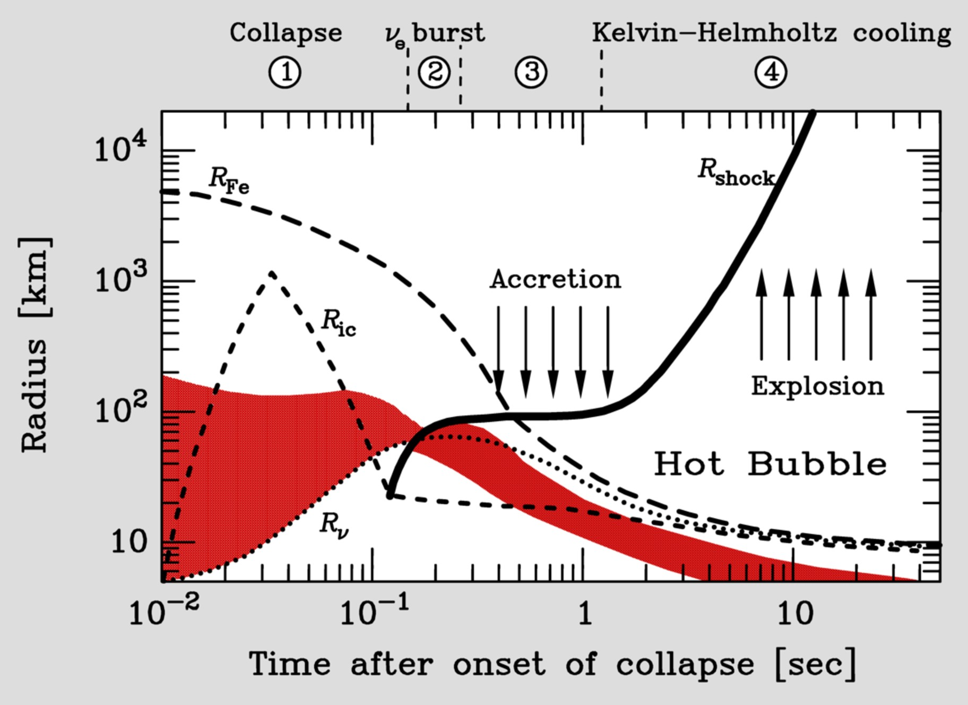
Supernova Delayed Explosion Scenario

Slide 12
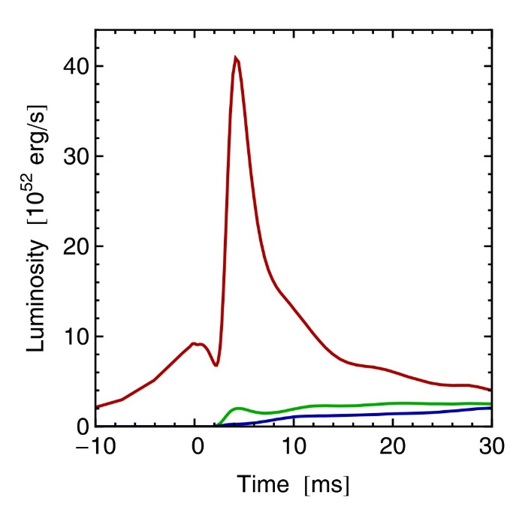
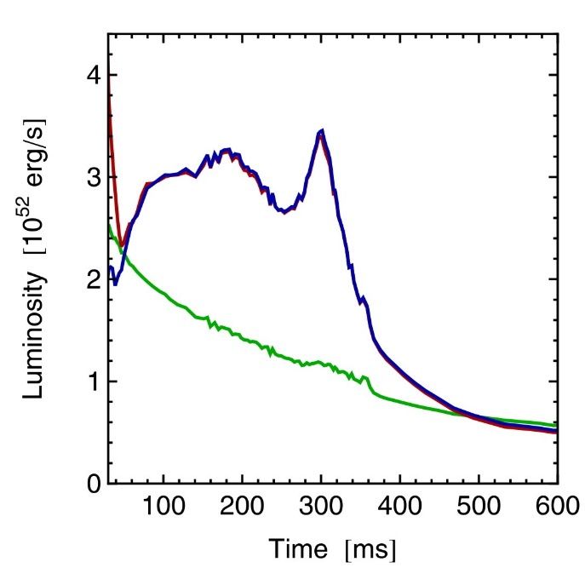
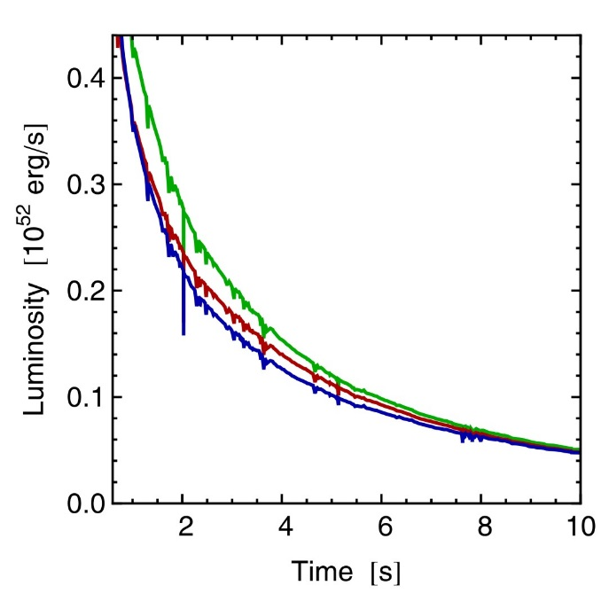








Three Phases of Neutrino Emission
Prompt ν_{e} burst
Accretion
Cooling
$$ν_{e}$$
$$ν_{e}$$
$${\overline{ν}}_{e}$$
$$ν_{x}$$
$$ν_{x}$$
$$ν_{e}$$
$${\overline{ν}}_{e}$$
Shock breakout
De-leptonization of
outer core layers
Shock stalls $\sim$ 150 km
Neutrinos powered by
infalling matter
Cooling on neutrino
diffusion time scale
Spherically symmetric model (10.8 M⊙) with Boltzmann neutrino transport
Explosion manually triggered by enhanced CC interaction rate
Fischer et al. (Basel group), A&A 517:A80, 2010 [arxiv:0908.1871]

Slide 13
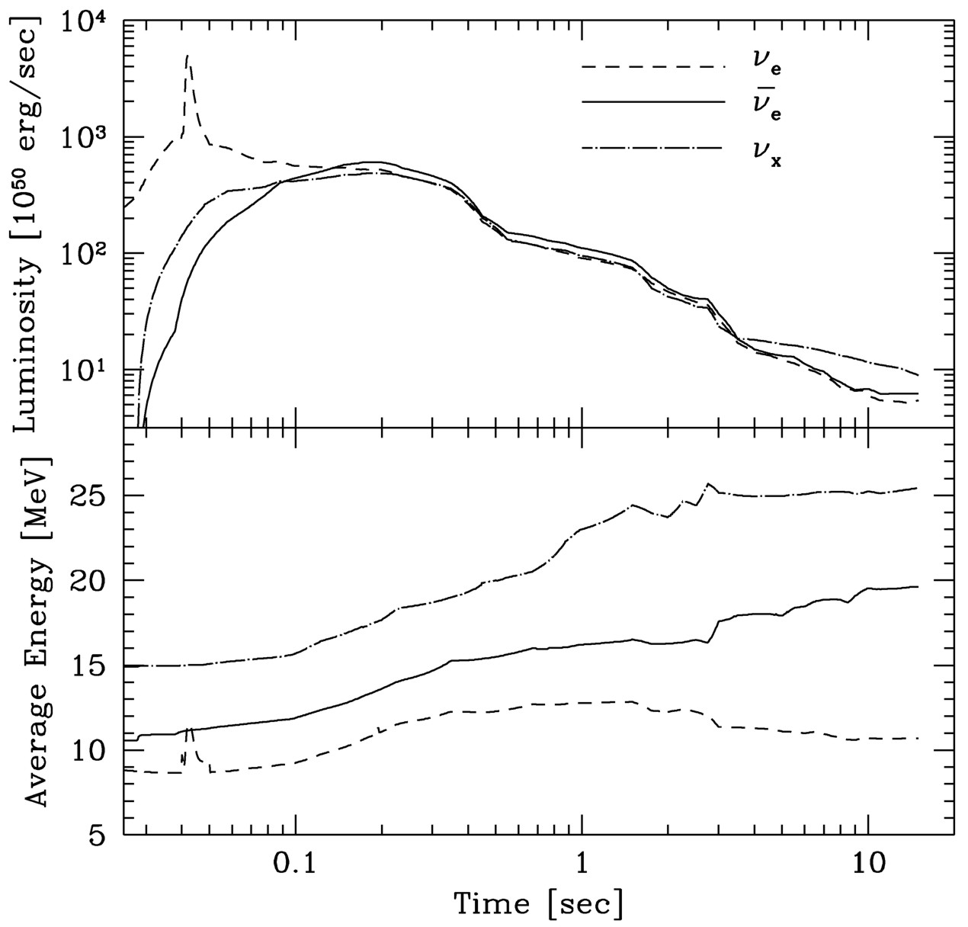
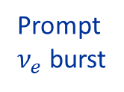



Livermore Fluxes and Spectra
Schematic transport of
ν_{μ} and ν_{τ}
Incomplete microphysics
Crude numerics to couple
neutrino transport with
hydro code
Prompt
$ν_{e}$ burst
$$ν_{x}$$
$${\overline{ν}}_{e}$$
$$ν_{e}$$
Livermore numerical model
ApJ 496 (1998) 216

Slide 14
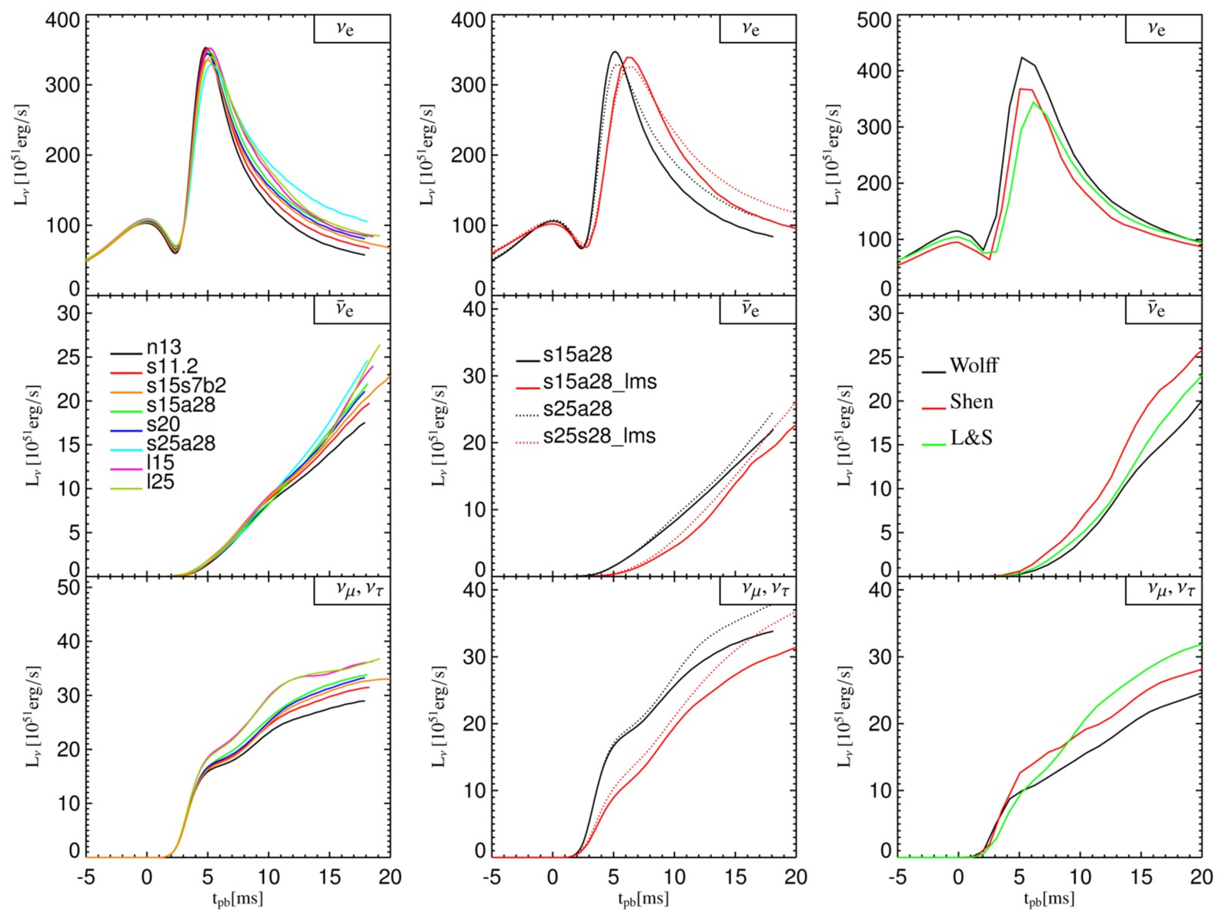
Neutronization Burst as a Standard Candle
Different Mass
Neutrino Transport
Nuclear EoS
If mixing scenario
is known, can
determine SN
distance
(better than 5-10%)
Kachelriess, Tomàs,
Buras, Janka,
Marek & Rampp,
astro-ph/0412082

Slide 15

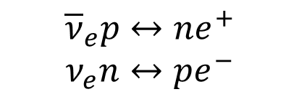



Supernova Neutrino Spectra Formation
Electron flavor ($ν_{e}$ and ${\overline{ν}}_{e}$)
Free
streaming
$${\overline{ν}}_{e}p↔ne^{+}$$
$$ν_{e}n↔pe^{−}$$
T_{flux}∼ T_{NS}
Thermal Equilibrium
Neutrino sphere (T_{NS})
Other flavors ($ν_{μ}$, ${\overline{ν}}_{μ}$, $ν_{τ}$, ${\overline{ν}}_{τ}$)
$$νN↔Nν$$
$$νe↔νe$$
$$NN↔NNν\overline{ν}$$
$$e^{+}e^{−}↔ν\overline{ν}$$
$$ν_{e}{\overline{ν}}_{e}↔ν_{μ}{\overline{ν}}_{μ}$$
Scattering Atmosphere
$$νN→Nν$$
T_{flux}∼ 0.6T_{ES}
Free
streaming
Diffusion
Energy sphere (T_{ES})
Transport sphere
Raffelt (astro-ph/0105250), Keil, Raffelt & Janka (astro-ph/0208035)

Slide 16
Parametrizations of Neutrino Spectra
Keil, Raffelt & Janka, astro-ph/0208035
Modified MB
Fermi-Dirac
MB
MB

Slide 17
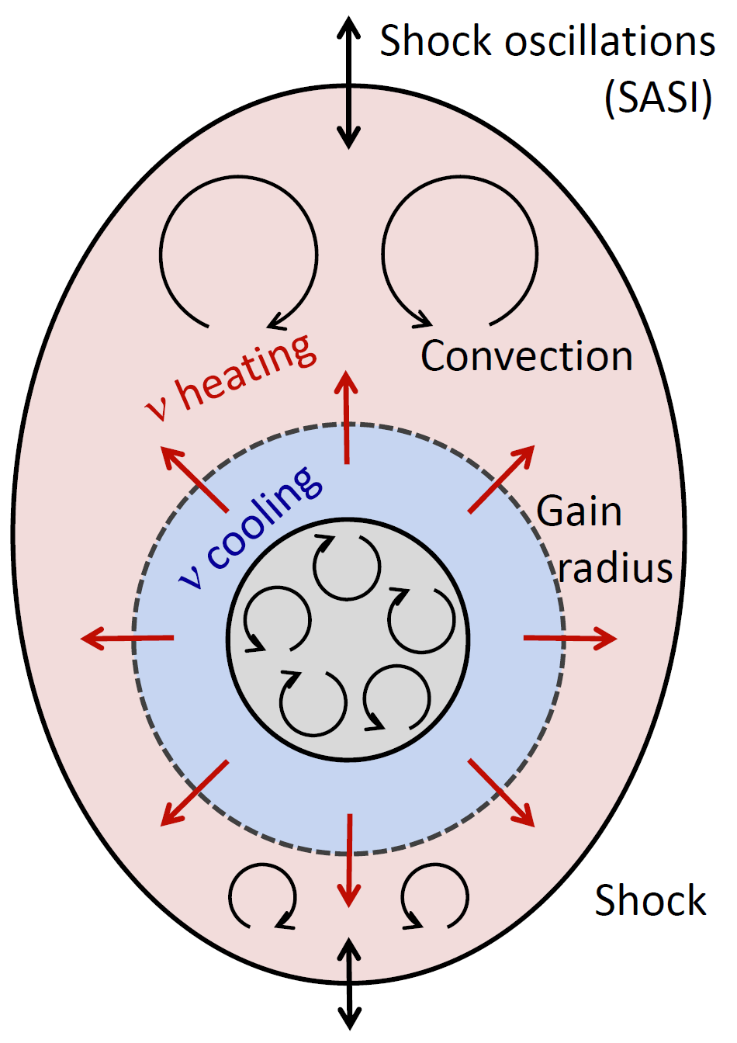
Explosion Mechanism：Neutrino-driven Explosion
The prompt shock halted at 150 km,
by disintegrating heavy nuclei
Neutrinos deposit their energies via
interaction with matter; 1 % neutrino
energy leads to successful explosion
Simulations in 1D & 2D for different
progenitor masses observe explosions
3D simulation has just begun; but no
clear picture (resolution, progenitors)
for a review, Janka, 1211.1378

Slide 18
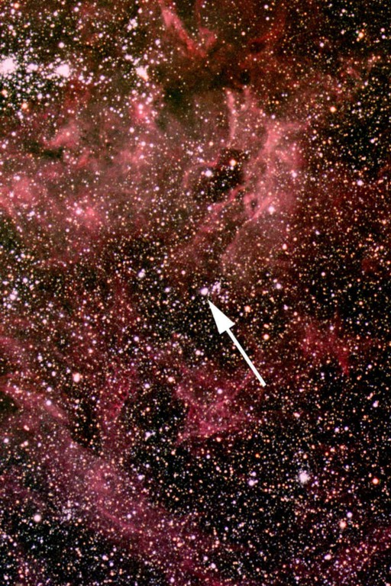
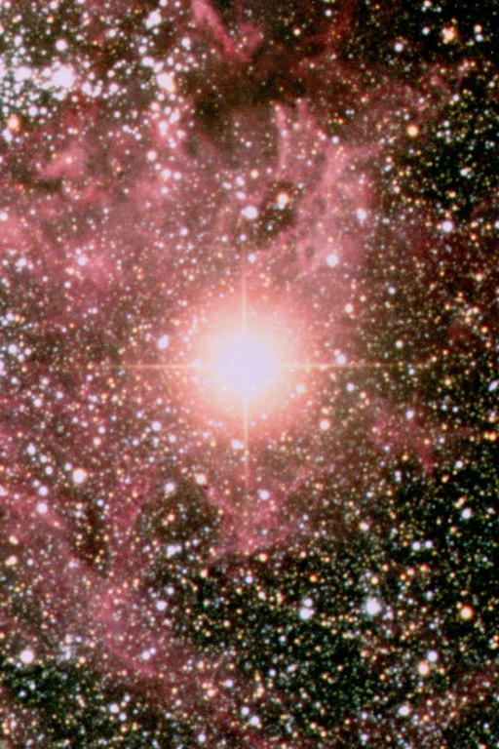
Large Magellanic Cloud SN 1987A
Sanduleak - 69 202
Supernova 1987A
23 February 1987
Distance：165 000 light yrs (50 kpc)
Center：Neutron Star
(expected, but not found)
Progenitor： M ~ 18 solar masses

Slide 19
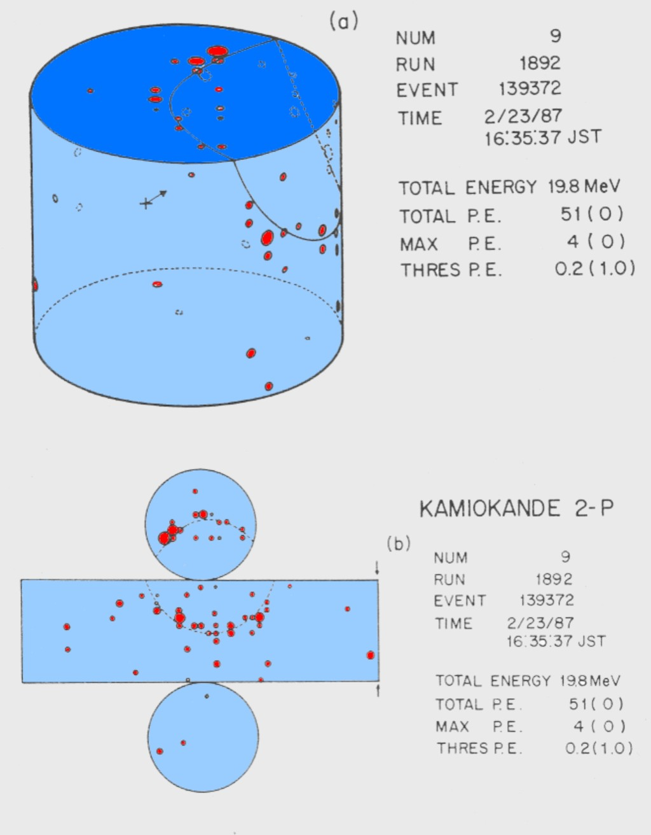
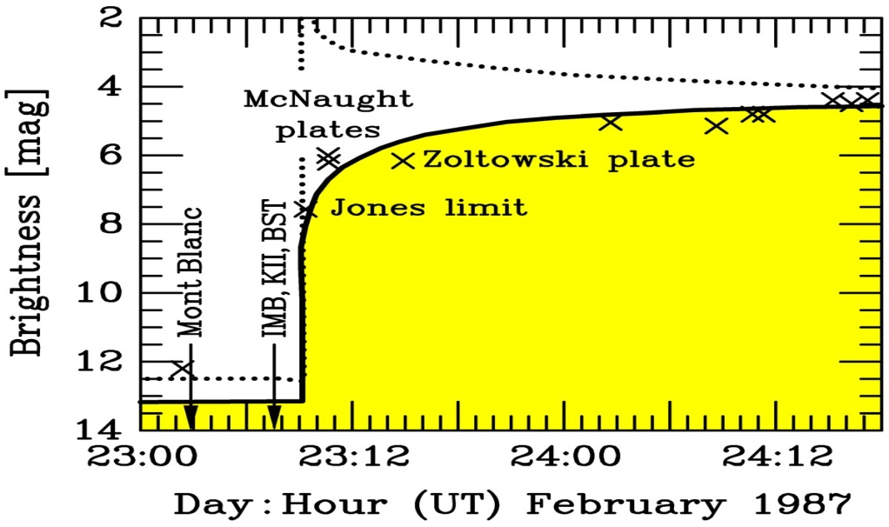
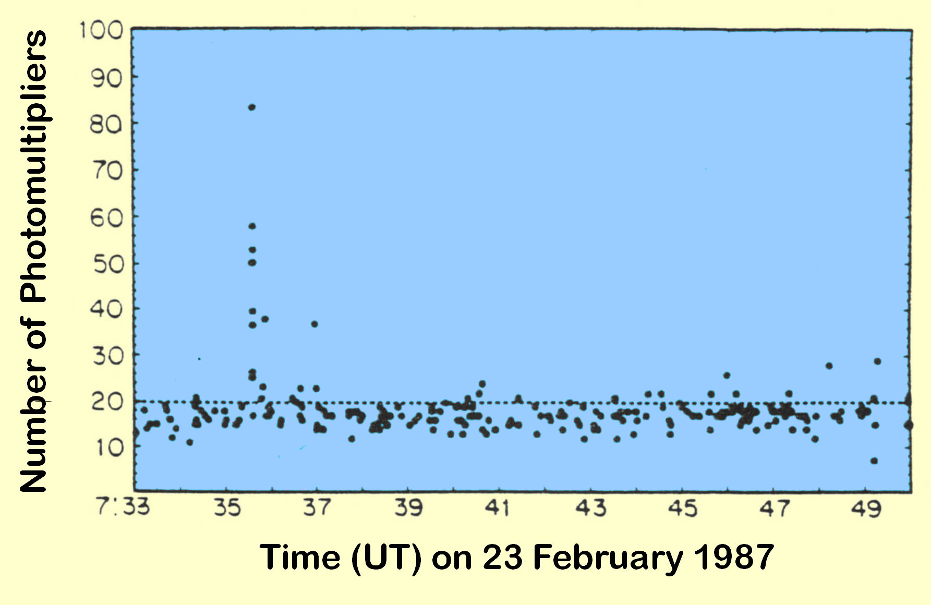
Supernova Neutrinos: SN 1987A
Arnett et al.,
ARAA 27 (1989)
Hirata et al., PRD 38 (1988) 448

Slide 20
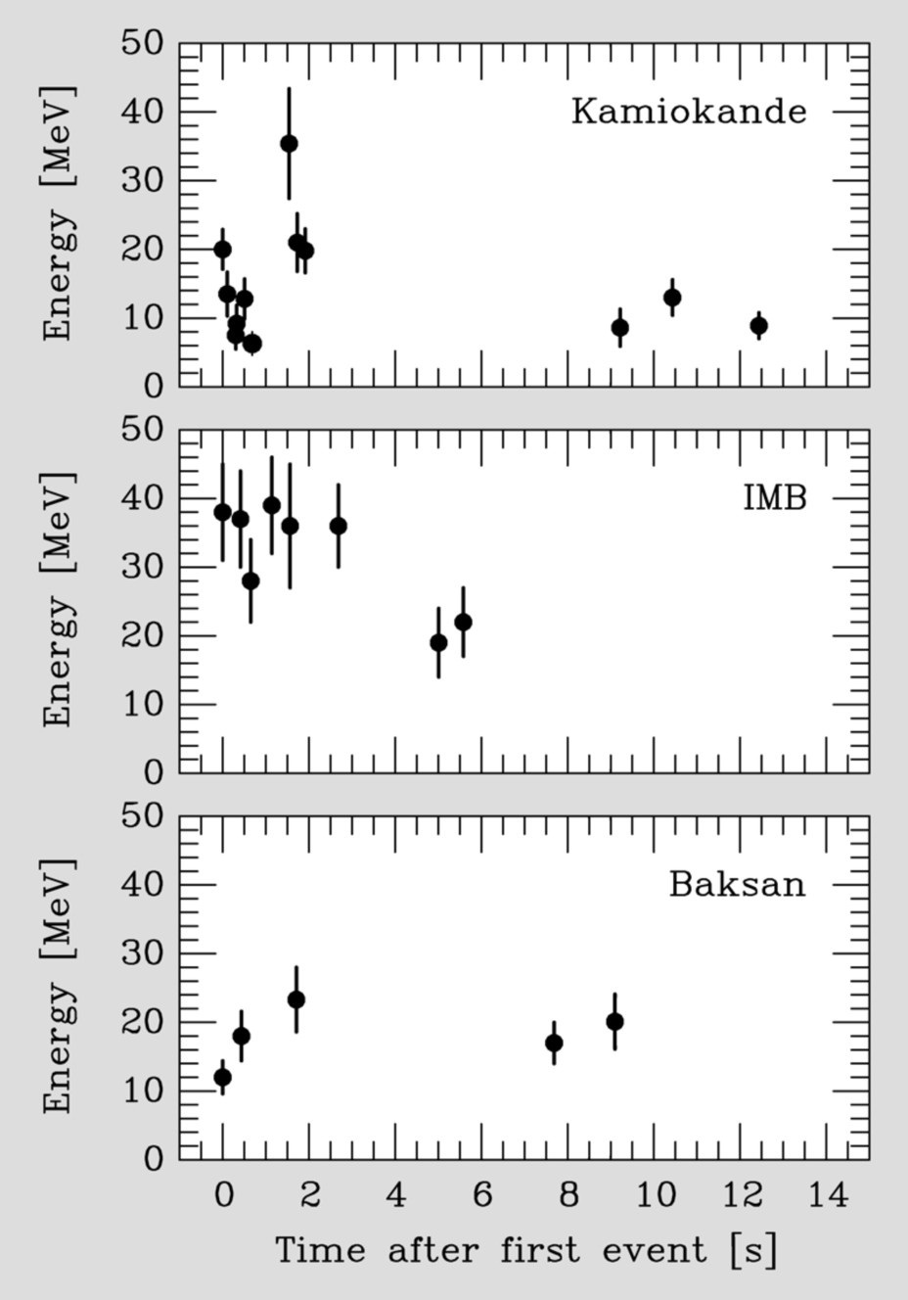
Supernova Neutrinos: SN 1987A
Kamiokande-II (Japan):
Water Cherenkov (2,140 ton)
Clock Uncertainty ± 1 min
Irvine-Michigan-Brookhaven (US):
Water Cherenkov (6,800 ton)
Clock Uncertainty ±50 ms
Baksan LST (Soviet Union):
Liquid Scintillator (200 ton)
Clock Uncertainty +2/-54 s
Mont Blanc: 5 events, 5 h earlier

Slide 21
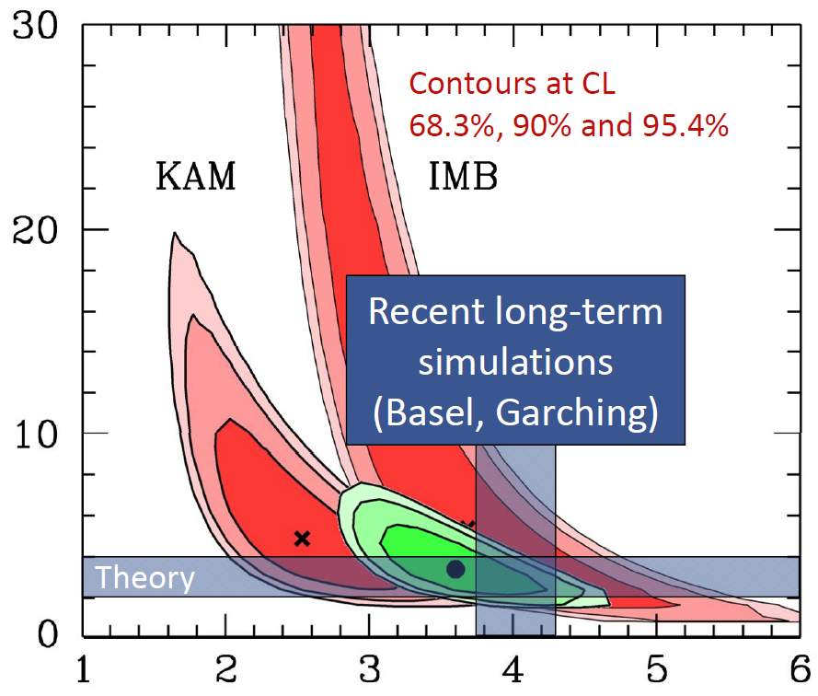
Supernova Neutrinos: SN 1987A
Assumptions:
Thermal
Equipart.
Jegerlehner, Neubig & Raffelt
astro-ph/9601111
Conclusions:
Collapse
Ave.Ener.
Duration
E_{b} [10⁵³ ergs]
Problems：
24 events
by chance
Spectral anti-ν_{e} Temperature [MeV]

Slide 22

SN ν Detection: present and future experiments
MiniBooNE
(200)
LVD (400)
Borexino (100)
Baksan
(100)
Super-Kamiokande (10⁴)
KamLAND (400)
SN @10 kpc
Daya Bay (100)
JUNO (10⁴)
Water/Ice
Cherenkov
Liquid
Scintillator
IceCube (10⁶)

Slide 23
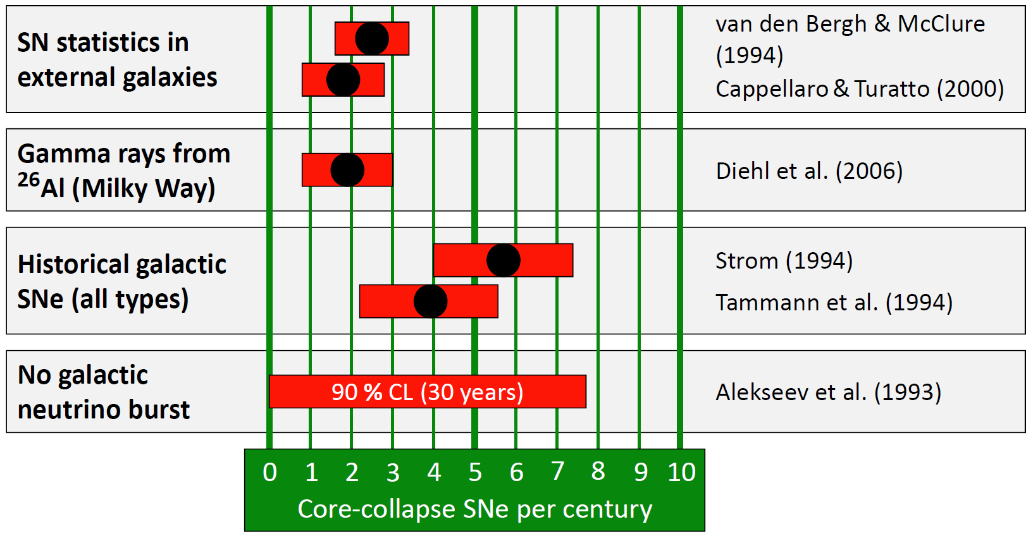
Key Problem: where and when?
© Raffelt
(1) Estimate from SN statistics in other galaxies; (2) Only massive stars produce ²⁶Al (with a half-life 7.2 × 10⁵ years); (3) Historical SNe in the Milky Way; (4) No neutrino bursts observed by Baksan since June 1980

Slide 24
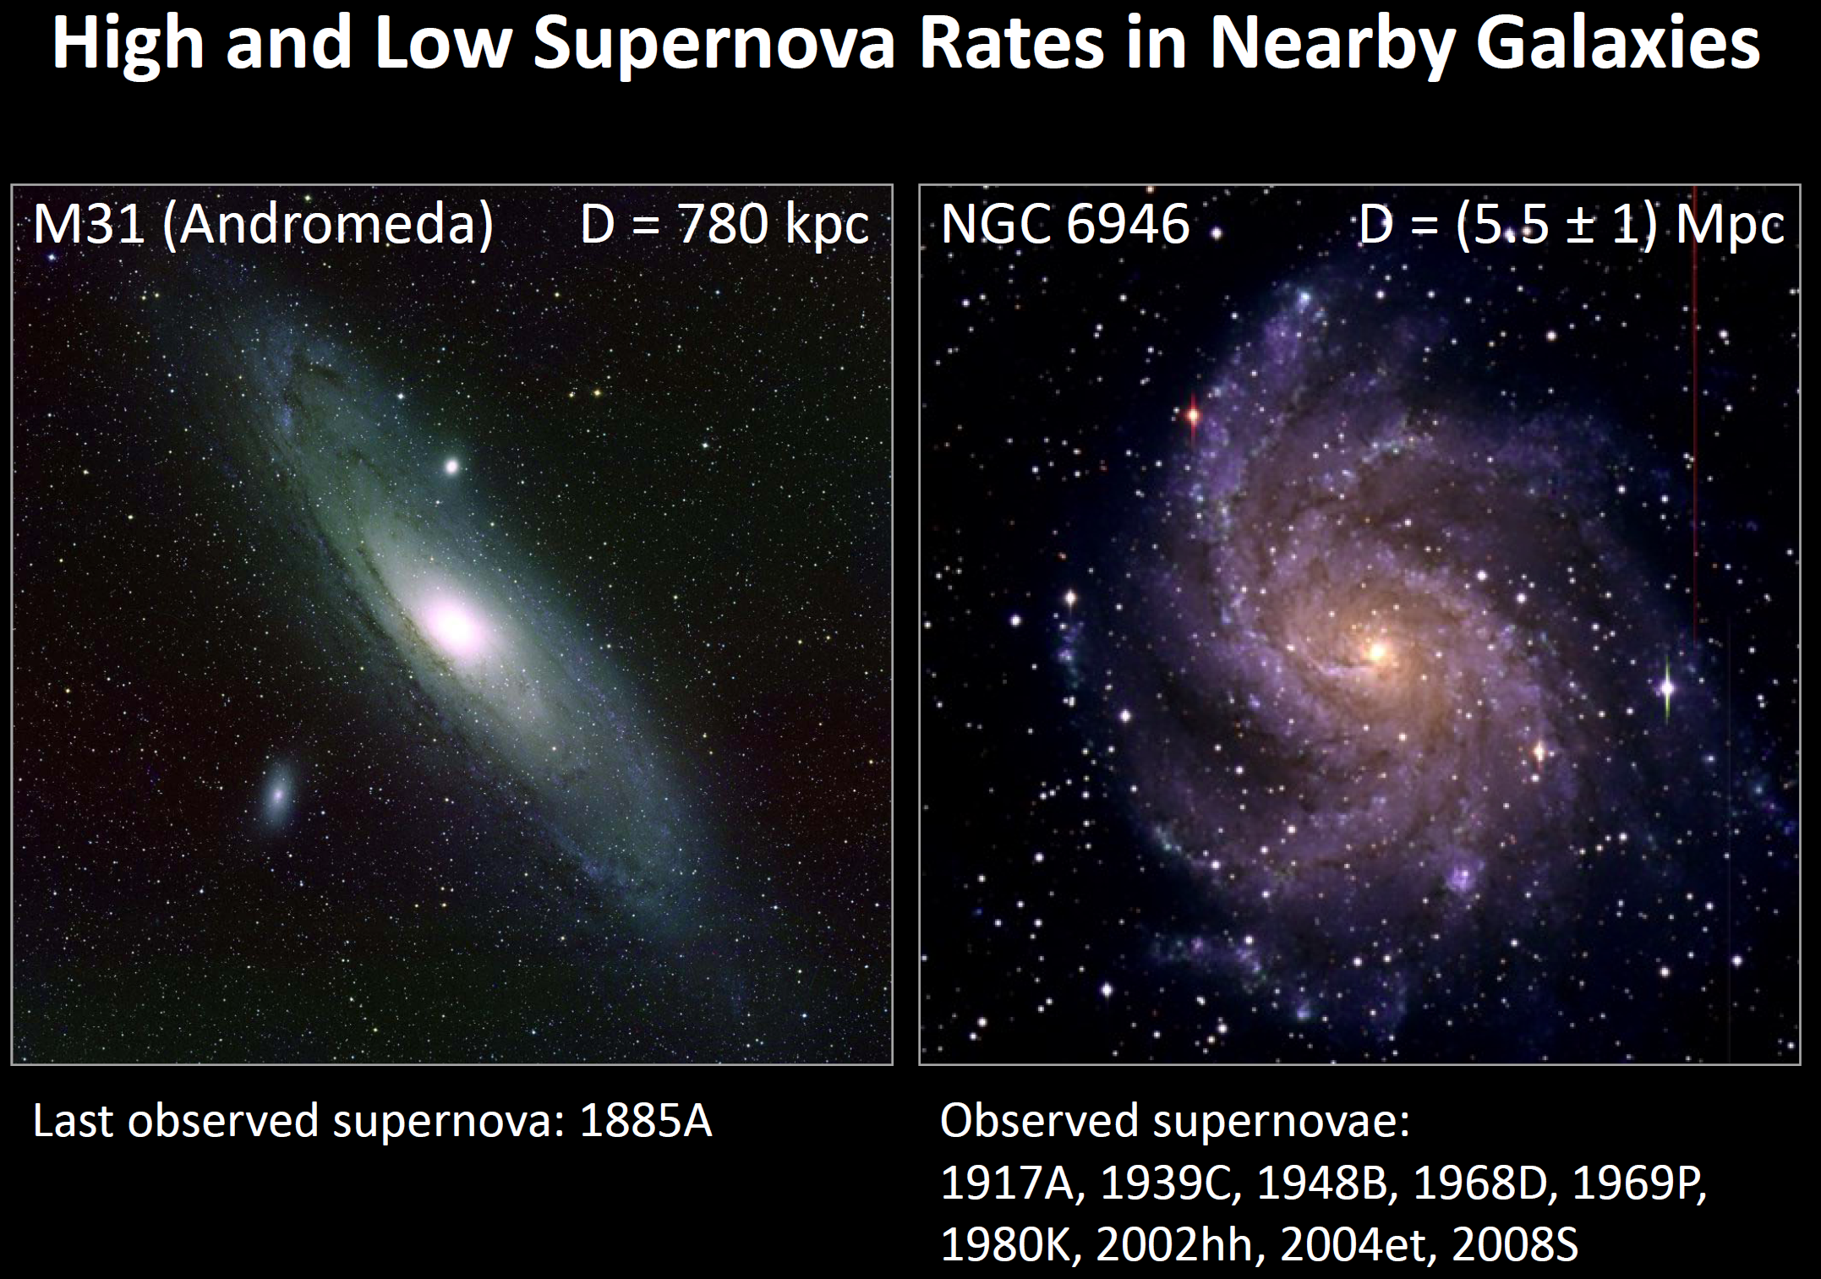
Key Problem: where and when?

Slide 25
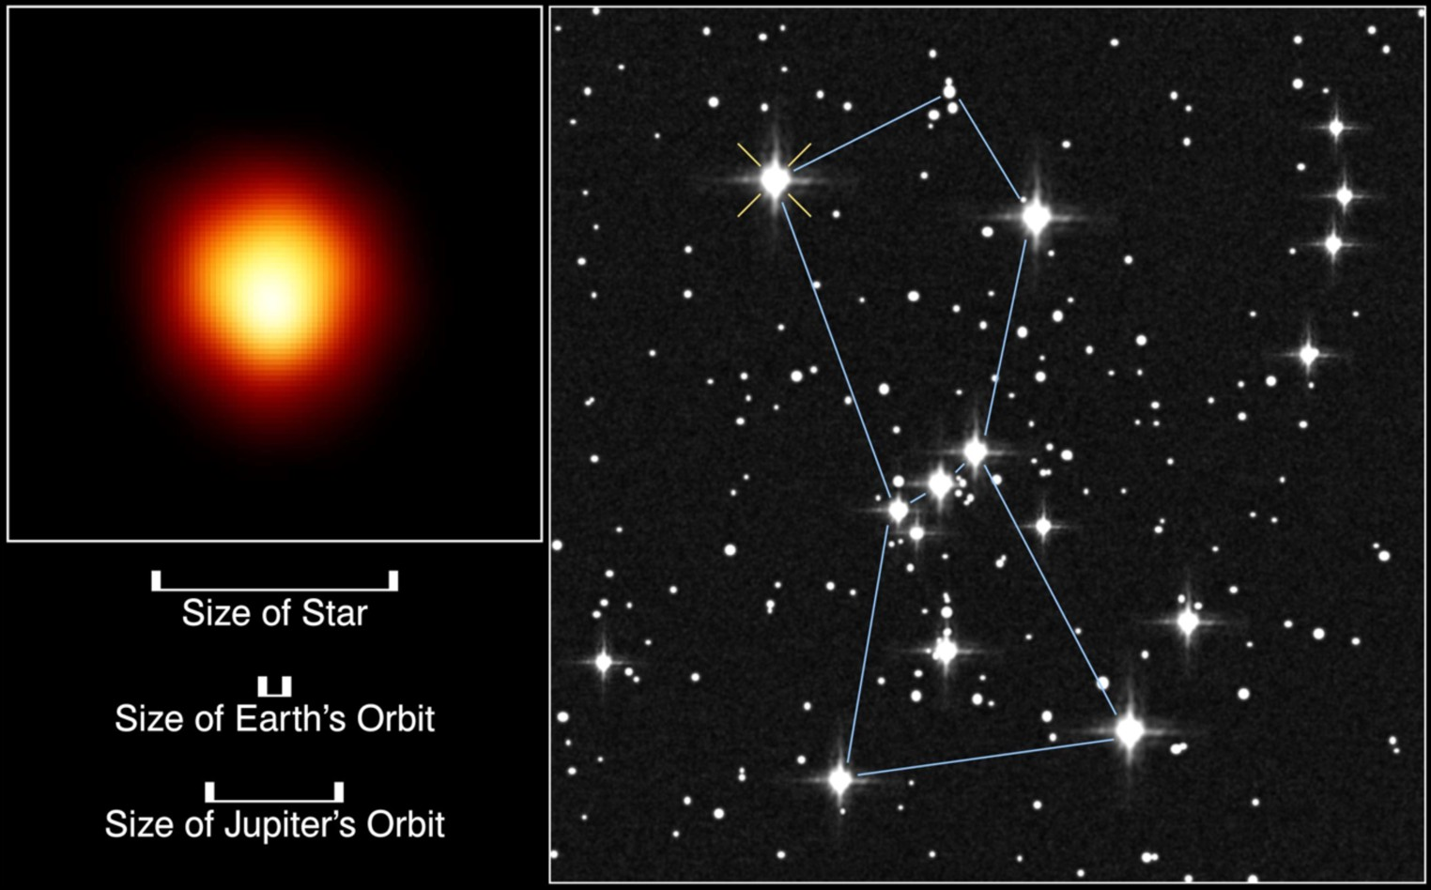
SN Candidate: The Red Supergiant Betelgeuse (Alpha Orionis）
Distance: 642 ly (197 pc)
Type：Red Supergiant
Mass：~ 18 solar masses
Expected to end its life as SN explosion
@ JUNO: 2 ×10⁷ events

Slide 26







Burning Phases of a 15 Solar-Mass Star
Pre-SN Neutrinos
L_{γ} [10⁴ L_{sun}]
Burning Phase
T_{c}
[keV]
ρ_{c}
[g/cm³]
L_{ν}/L_{γ}
Duration
[years]
Hydrogen
3
5.9
2.1
-
1.2 ×10⁷
Helium
14
1.3×10³
6.0
1.7 ×10⁻⁵
1.3 ×10⁶
Carbon
53
1.7×10⁵
8.6
1.0
6.3 ×10³
Neon
110
1.6×10⁷
9.6
1.8 ×10³
7.0
Oxygen
160
9.7×10⁷
9.6
2.1 ×10⁴
1.7
Silicon
270
2.3×10⁸
9.6
9.2 ×10⁵
6 days
Detection of ${\overline{ν}}_{e}$ a massive star before SN explosion
For M = 20 solar masses, D = 0.2 kpc (Betelgeuse), and in the energy range 1 MeV < E_{ν} < 2.6 MeV
per day | Reactor | Geo. | Pre-SN
# of events | 3 | 0.1 | 10
Gang Guo’s talk

Slide 27
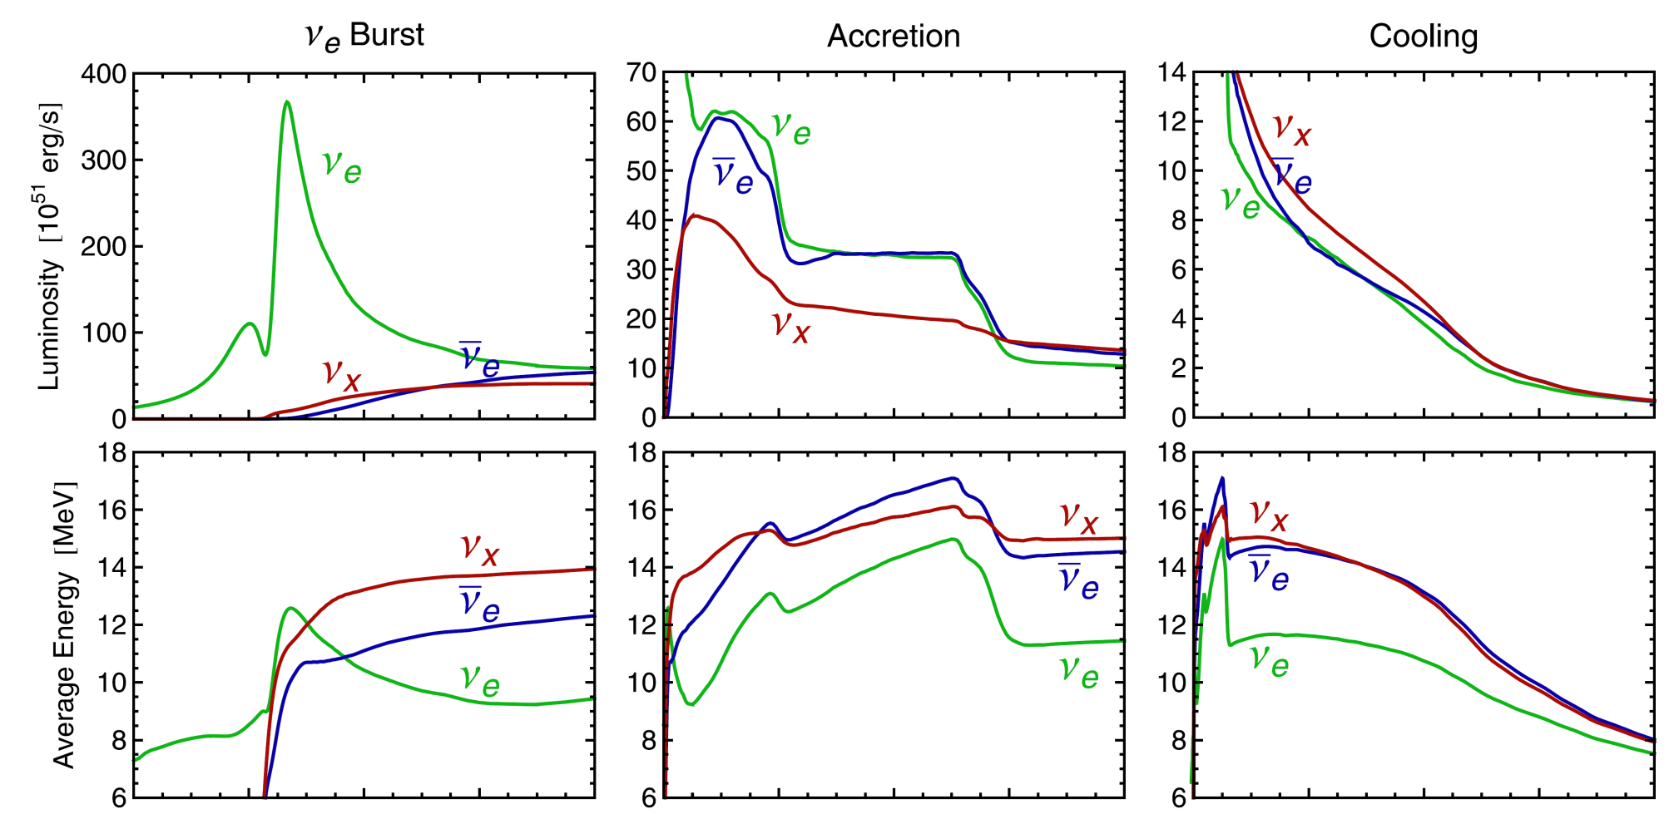
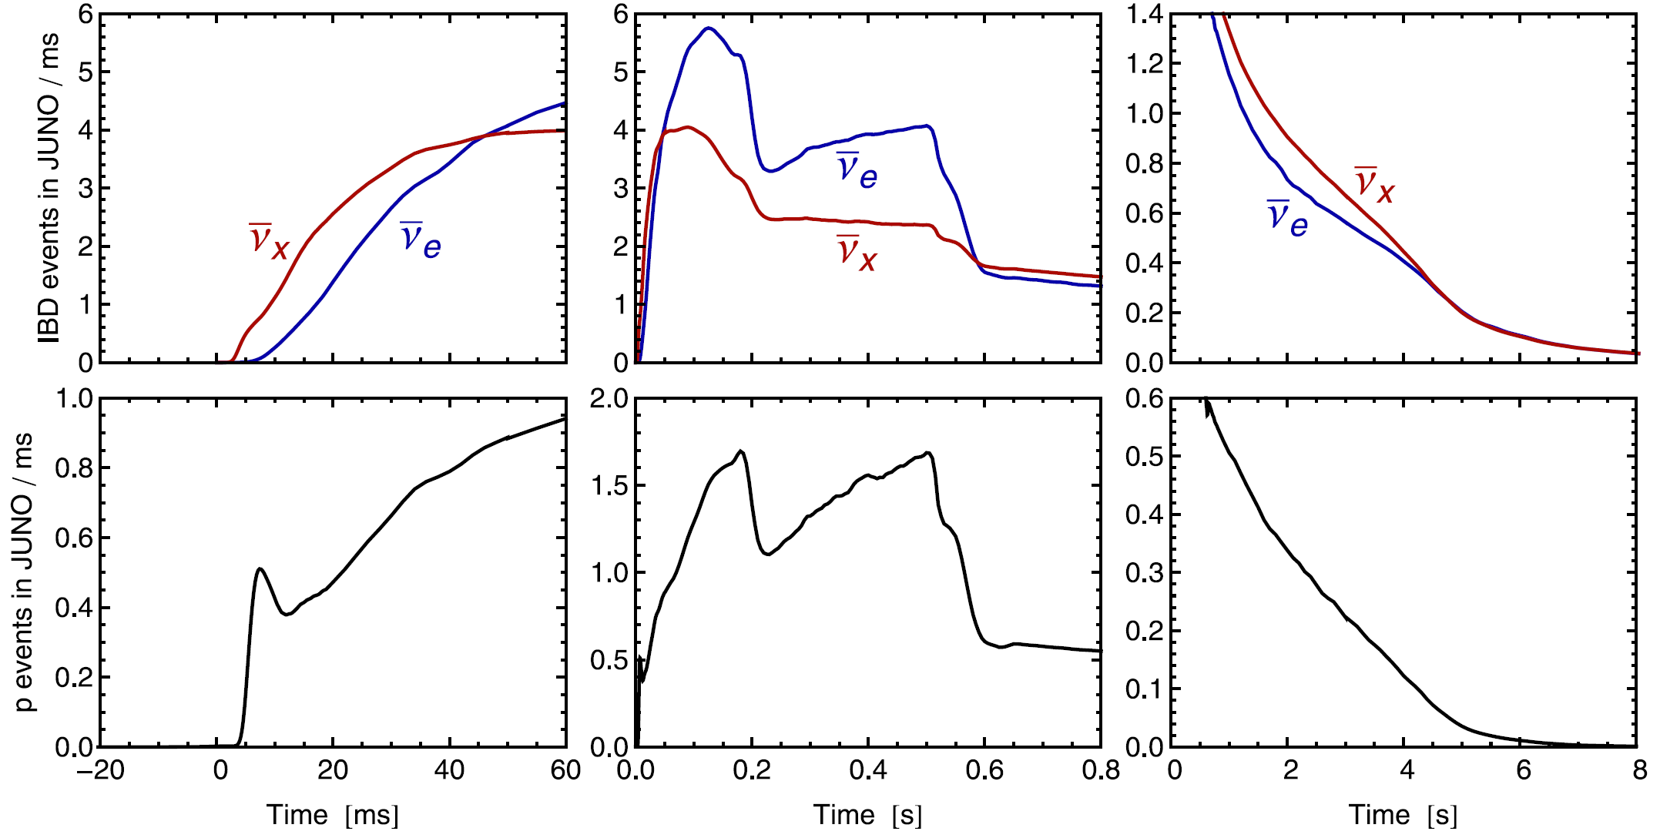
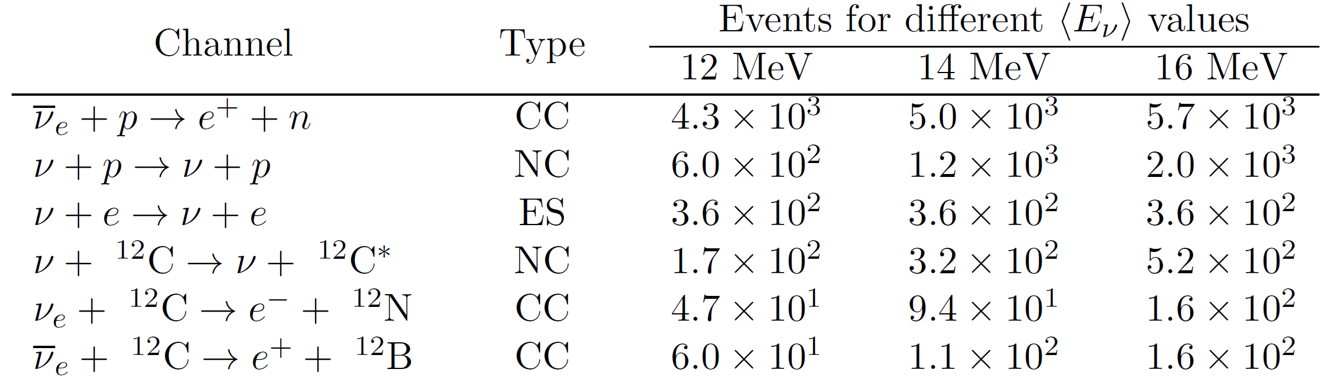

Galactic SN Neutrinos
See, Janka, 1211.1378
Detect ${\overline{ν}}_{e},ν_{e},ν_{x}$ from a galactic SN @ 10 kpc
real-time meas. of three-phase ν signals
distinguish between different ν flavors
reconstruct ν energies and luminosities
almost background free due to time info

Slide 28






Detection of SN Neutrinos at JUNO
$Inverse beta decay \left(IBD\right){ \overline{ν}}_{e}+p⟶n+e^{+}$
Spectra
$${\overline{ν}}_{e}$$
Precision of 1%
Prompt signal：$2γ$
p
$$e^{−}$$
$$n$$
$$e^{+}$$
p
Delayed signal：
$$2.2 MeV γ$$
5000 IBD events, golden channel for SN neutrino observations
Coincidence of prompt and delayed signals: least background
Dominant channel for electron anti-ν, good reconstruction of E_{ν}

Slide 29


Detection of SN Neutrinos at JUNO
$$Elastic ν−p Scattering \left(pES\right) ν +p⟶ν+p$$
$$ν$$
$$Elastic ν−e Scattering \left(eES\right) ν_{e} +e⟶ν_{e}+e$$
p
$$ν$$
recoil energy
2000 pES events, dominant channel for muon & tau neutrinos
Low threshold for visible energy: nominal value = 0.2 MeV
reconstruction of neutrino energy spectrum: high-energy tail

Slide 30
Detection of SN Neutrinos at JUNO
Impact of neutrino flavor conversions

Slide 31
Detection of SN Neutrinos at JUNO
Global analysis of all channels

Slide 32
Neutrino Mass Bound @ JUNO
Time delay of massive neutrinos
Jia-Shu Lu’s talk
3000 simulations
for JUNO
J.S. Lu et al., JCAP 15’, 1412.7418

Slide 33

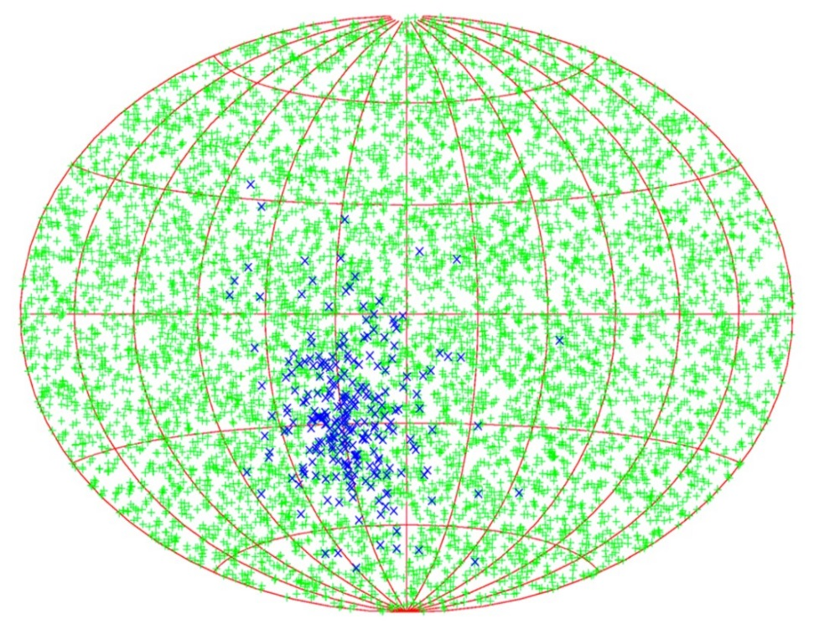
Galactic SN Neutrinos
For Optical Observations：SuperNova Early Warning System (SNEWS)
Zhe Wang’s talk
Tomàs et al., hep-ph/0307050
Beacom & Vogel, astro-ph/9811350
http://snews.bnl.gov/
Daya Bay
Super-K
IceCube
n-tagging efficiency
95% CL half-cone
opening angle
LVD
Borexino
None
90 %
Neutrinos arrive several hours before
photons; to alert astronomers several
hours in advance
7.8°
3.2°
SK
Alert @BNL
Locating a galactic SN @ 10 kpc
Stat. recon. e⁺-n correlation: 8.1°@JUNO

Slide 34
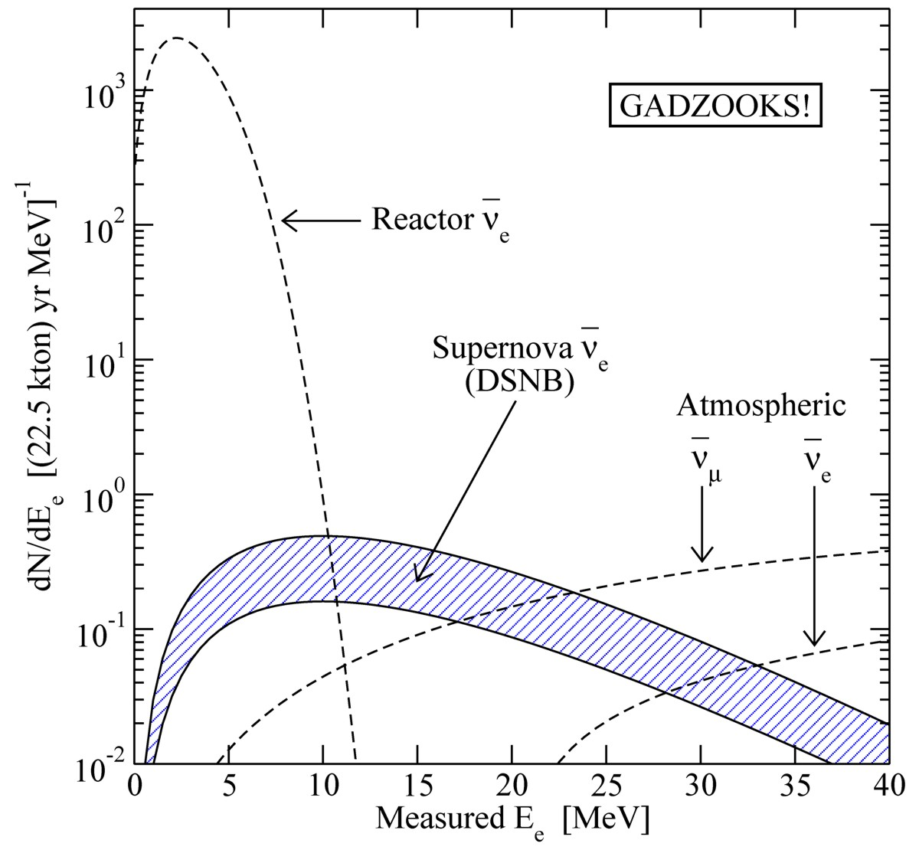

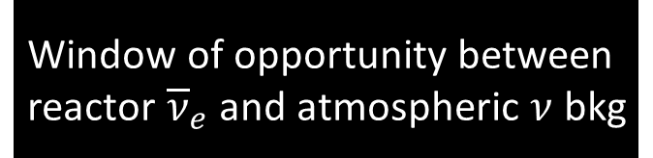
Diffuse Supernova Neutrino Background (DSNB)
• Approx. 10 core collapses/sec
in the visible universe
• Emitted $ν$ energy density
∼ extra galactic background light
∼ 10% of CMB density
• Detectable ${\overline{ν}}_{e}$ flux at Earth
$∼10 {\text{cm}}^{−2} {\text{s}}^{−1}$
mostly from redshift $z∼1$
• Confirm star-formation rate
• Nu emission from average core
collapse & black-hole formation
• Pushing frontiers of neutrino
astronomy to cosmic distances!
Beacom & Vagins,
PRL 93:171101,2004
Window of opportunity between
reactor ${\overline{ν}}_{e}$and atmospheric $ν$ bkg

Slide 35
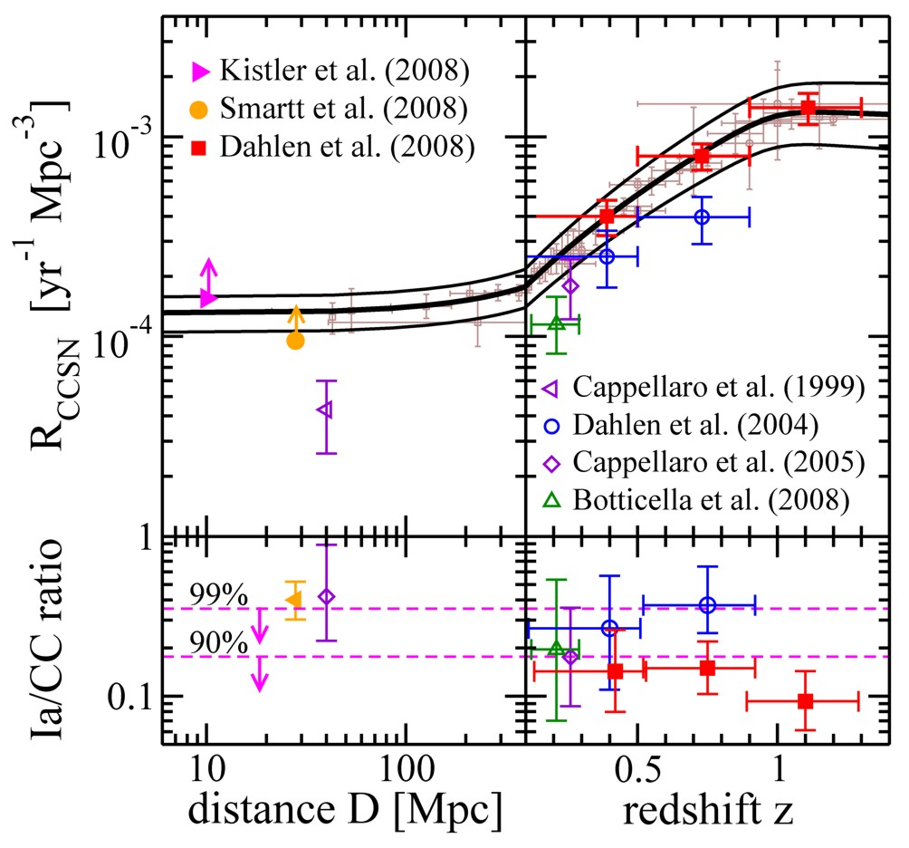
Redshift Dependence of Cosmic Supernova Rate
Core-collapse
rate depending
on redshift
Relative rate
of type Ia
Horiuchi, Beacom & Dwek, arXiv:0812.3157v3

Slide 36
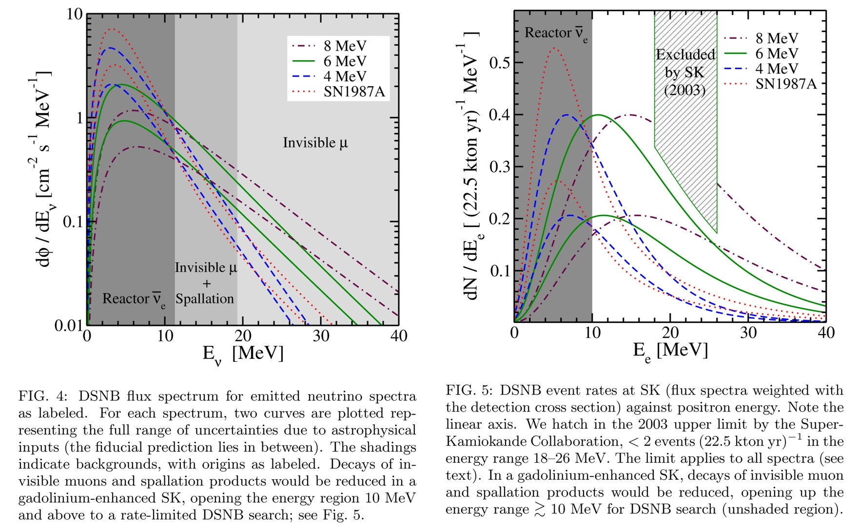
Realistic DSNB Estimate
Horiuchi, Beacom & Dwek, arXiv:0812.3157v3

Slide 37
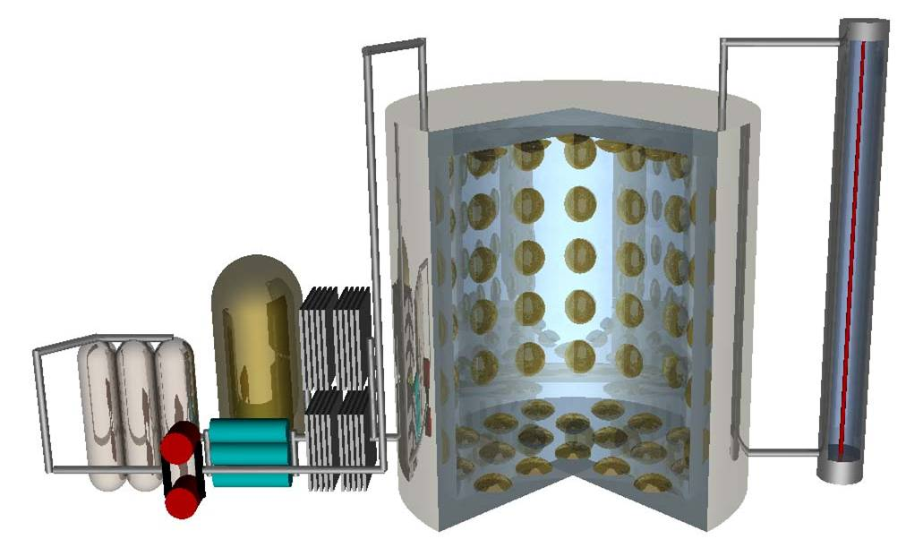
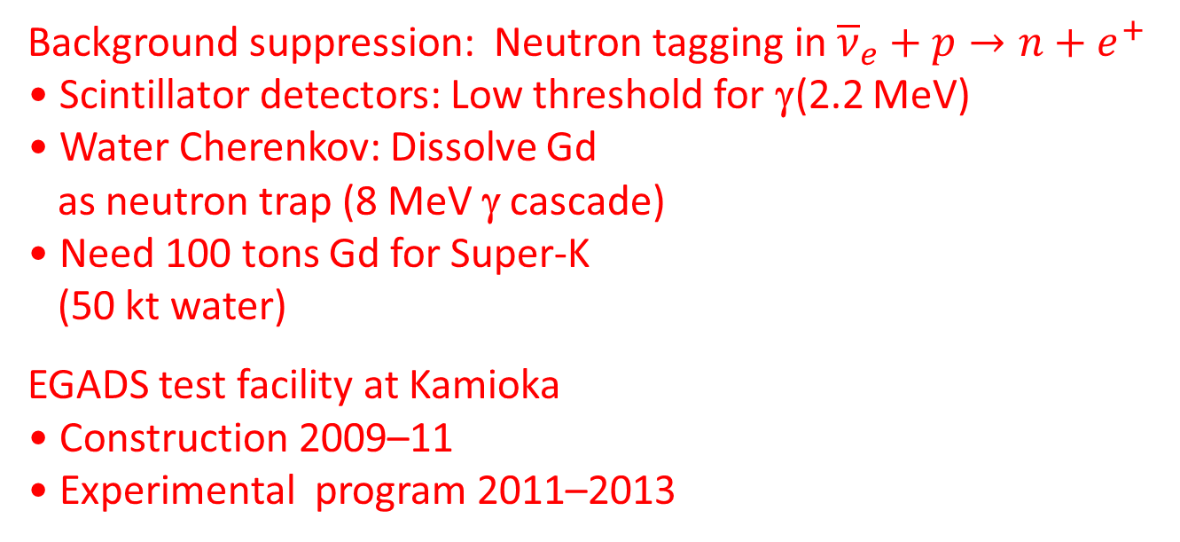
Neutron Tagging in Super-K with Gadolinium
Background suppression: Neutron tagging in ${\overline{ν}}_{e}+p→n+e^{+}$
• Scintillator detectors: Low threshold for γ(2.2 MeV)
• Water Cherenkov: Dissolve Gd
as neutron trap (8 MeV γ cascade)
• Need 100 tons Gd for Super-K
(50 kt water)
EGADS test facility at Kamioka
• Construction 2009–11
• Experimental program 2011–2013
Mark Vagins
Neutrino 2010
Selective water & Gd
filtration system
200 ton
water tank
Transparency
measurement

Slide 38
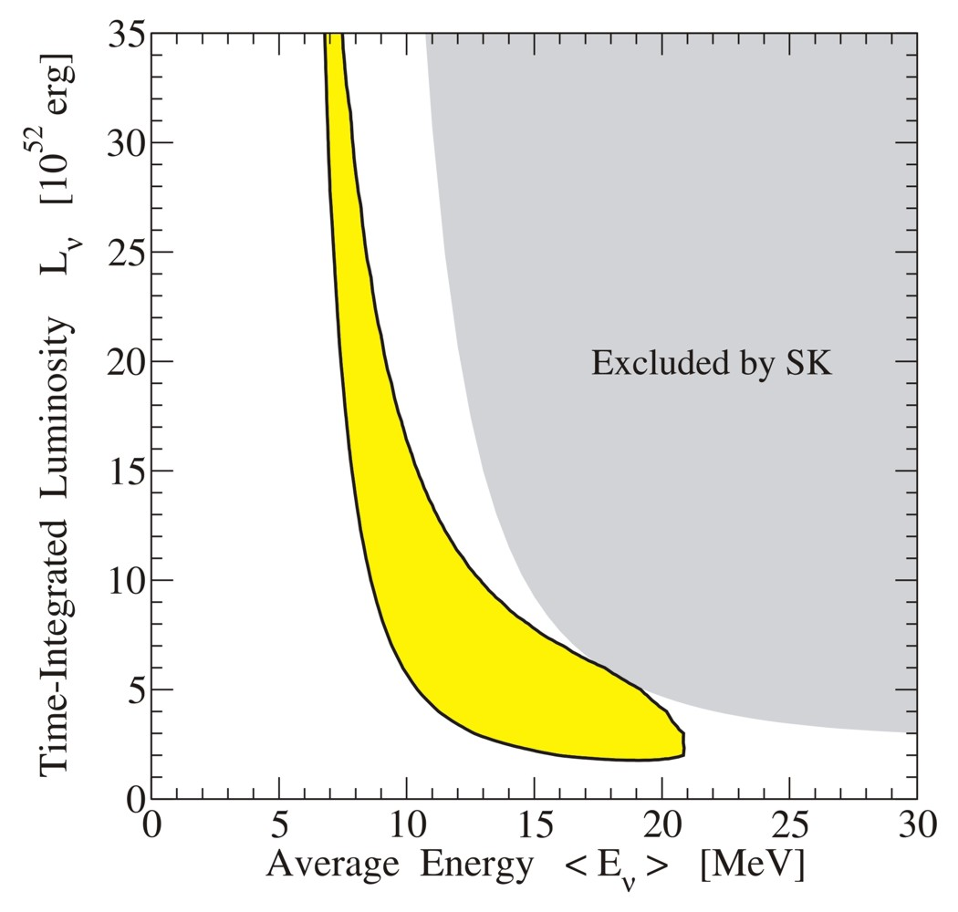
Average spectral properties from DSNB
90% CL sensitivity to
average SN spectrum
from DSNB after 5 years
of Gd enhanced Super-K
Adapted from Yüksel, Ando & Beacom, astro-ph/0509297

Slide 39

Neutrinos from all the SNe in our Universe
Diffuse SN Background (DSNB)
# of SNe per yr per Mpc³(un. SFR, IMF)
Cosmological evolution
ν spectrum
90% CL exclusion curves
(the upper-right regions)
if no detection for 10 yrs
Observation window: 11 MeV < E_{ν} < 30 MeV
PSD techniques for NC atmospheric ν
Fast neutrons: r < 16.8 m (equiv. 17 kt mass)
$$⋆$$

Slide 40
Summary and Outlook
Neutrinos from next nearby supernova cannot be missed (a once-in-a-lifetime opportunity!)
Physics opportunities with SN neutrinos: stellar collapse, explosion mechanism, collective flavor conversion, matter effects, neutrino mass ordering, absolute neutrino mass,…
10⁴ neutrino events @ JUNO for a typical galactic SN; to improve neutrino mass bound, reconstruct neutrino spectra; A lot of theoretical works to do while waiting for a real SN

