Slide 1
超新星不对称与中微子
王力帆
紫金山天文台
and
Texas A&M University

Slide 2
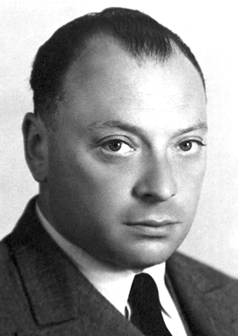
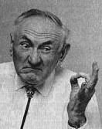
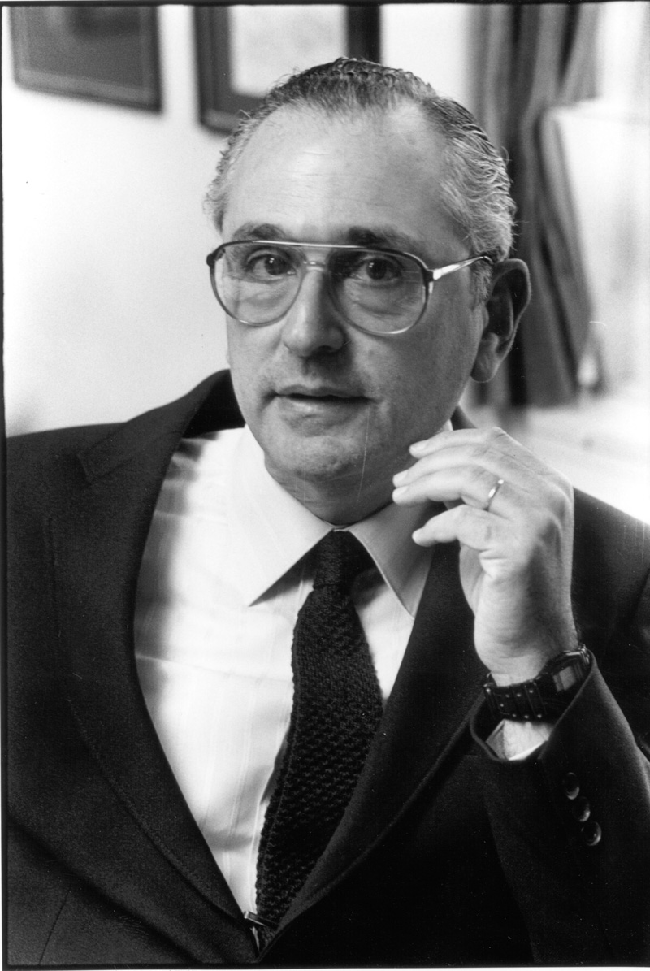
Physics of Supernovae
Pauli (1934) – Neutrino postulation
Bethe & Peierls (1934) - If [there are no new forces] – one can conclude that there is no practically possible way of observing the neutrino
Baade & Zwicky (1934) – stars collapsing into neutron stars
“With all reserve we advance the view that a super-nova represents the transition of an ordinary star into a neutron star, consisting mainly of neutrons. Such a star may possess a very small radius and an extremely high density”
Supernovae, neutron stars, cosmic rays
Reines & Cowan (1956) – neutrinos detected, using a nuclear reactor; Reines, Nobel Prize 1995 (Cowan died in 1974)
Bahcall (1964) - Only neutrinos, with their extremely small interaction cross sections, can enable us to see into the interior of a star...
Colgate & White (1966), Wilson (1985), Colegate & White (1985) – delayed neutrino mechanism – neutrino heating revives stalled shock thereby exploding the star
1987 - nearby Supernova 1987A; Davis and Koshiba, 2002 Nobel Prize

Slide 3
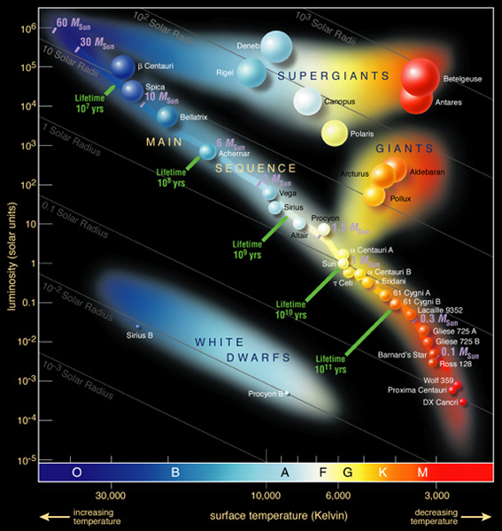

Slide 4
Core-Collapse, Does it Work?
Multi-Dimensional Simulation
To Explode or, Not
1-D: Most do not explode, except an 8.8 Mo model
2-D: similar to 1-D
3-D: Some found it makes it easier (e.g. Mezzacappa group), some found it harder (e.g. Janka group)
Instability, Asymmetry
Explosions of ~ 0.3 – 0.9 foe (Mezzacappa et al.)
10foe? (Do not exists in theory)
Rotation (some say it is not important)
Magnetic Field (Le Blanc & Wilson mechanism; Wheeler et al. 2000) – related to rotation

Slide 5
No current simulation has produced a successful 10⁵¹ erg supernova.

Slide 6
Asymmetric Supernovae - Paradigm Shift?
Polarimetry
Neutron Star Kick
SN 1987A
Do Jets occur in SNe?

Slide 7
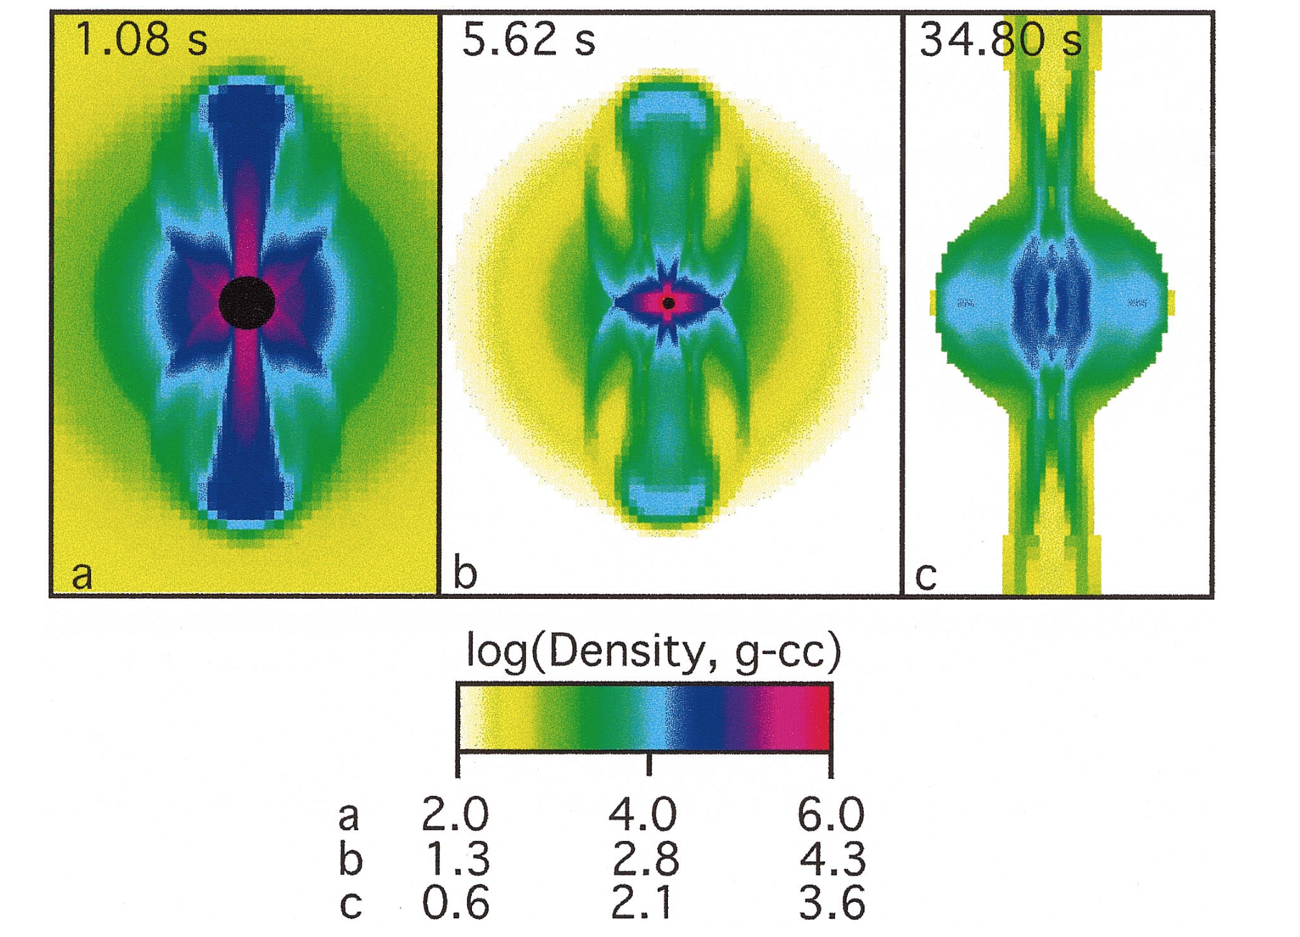
One simple model
Jets: Relativistic – GRB
….
…
..
.
Jets: Supersonic – Normal SNe?
Khokhlov et al. 1999
Supersonic jets
Magnetorotational
Does not depend on neutrino
Angular momentum barrier
Jittering-Jet (Papish & Soker 2011, 2014)

Slide 8
What Can a Jet Do?
A GRB
An Explosion?
Beamed Neutrino?
Boosted energy
Boosted luminosity/Beaming

Slide 9
Observations
SN 1987A
Pulasar kick
Polarimetry

Slide 10
SN 1987A
Bocchum event (Hanuschik et al. 1988)
CSM Ring (Wang et al. 1991)
HST Imaging and Kinematics (Wang et al. 1996)
VLT SIFONI Data (Larsson et al. 2013)
ALMA …

Slide 11
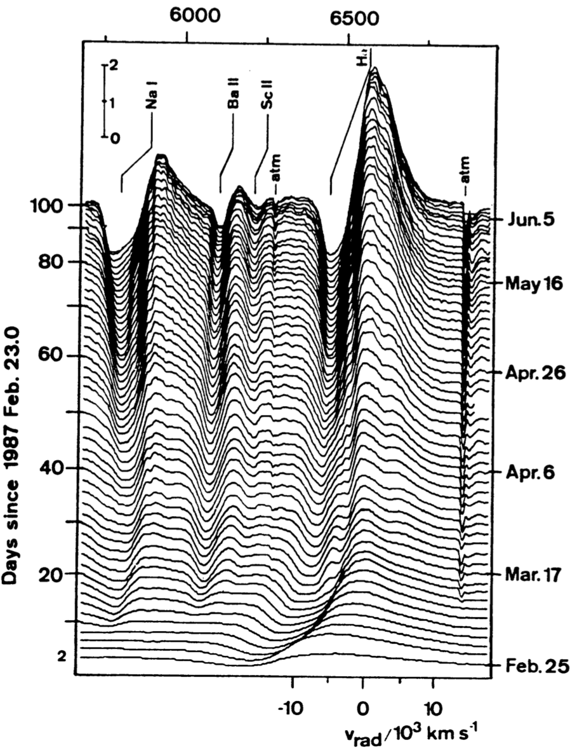

Slide 12
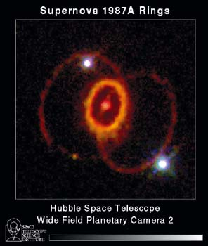
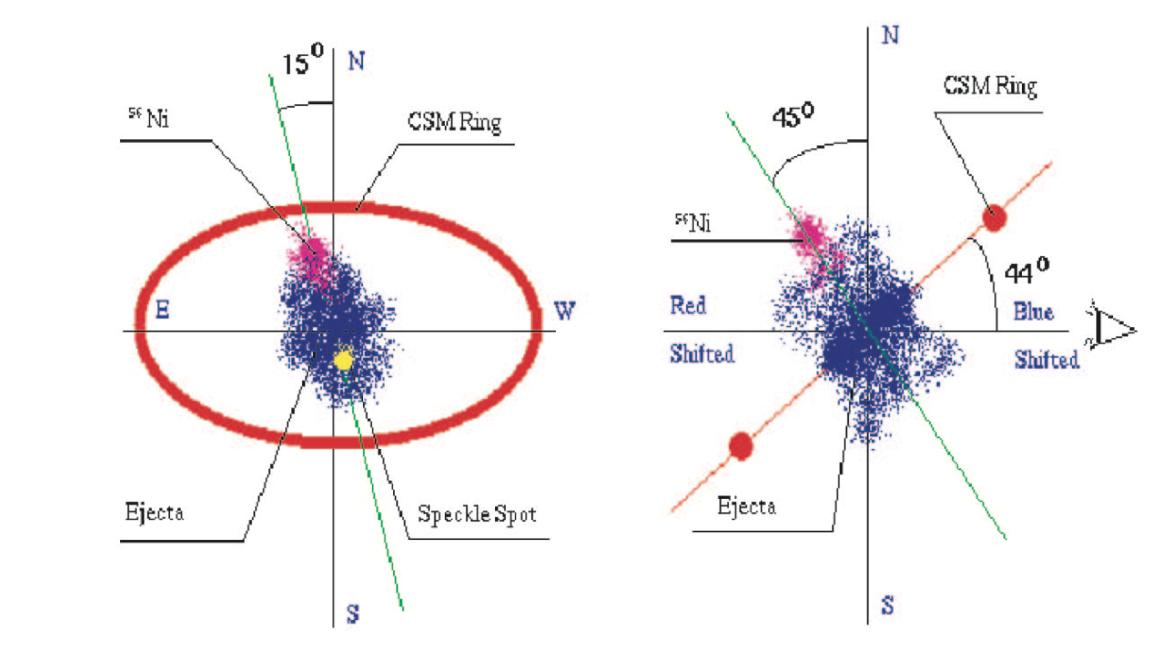
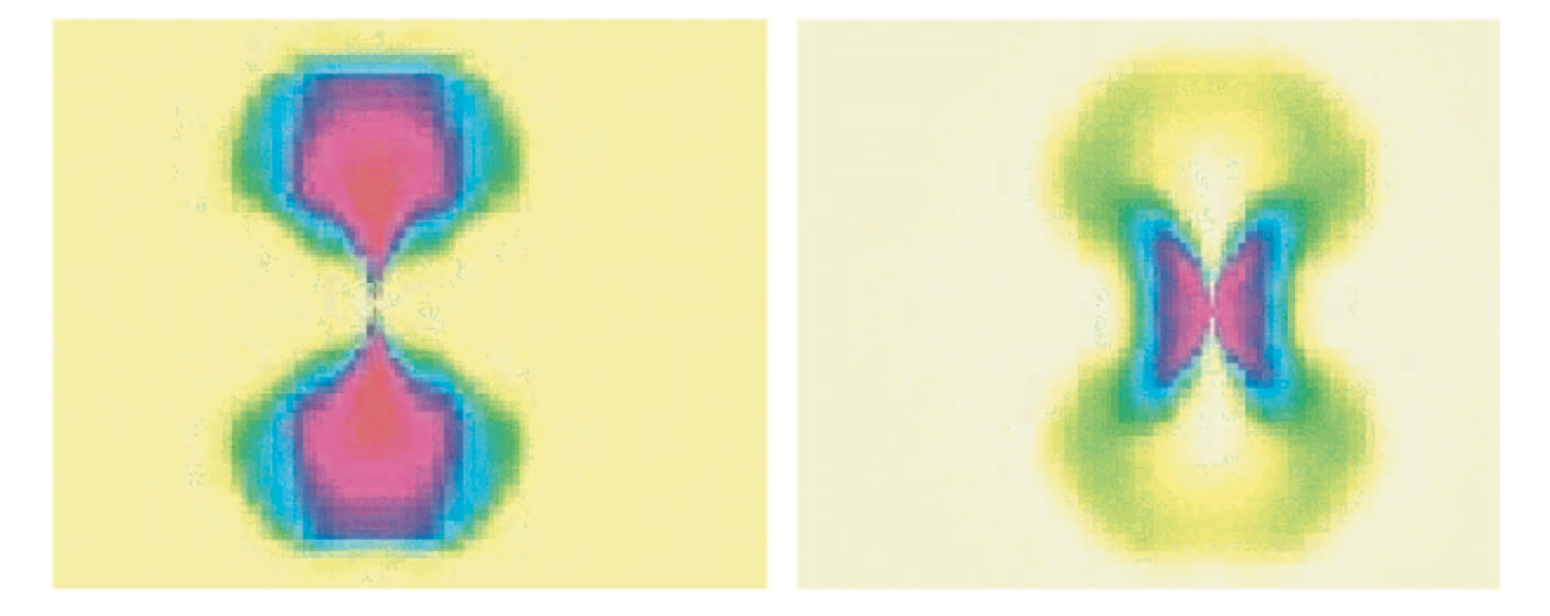
Wang et al. 2002

Slide 13
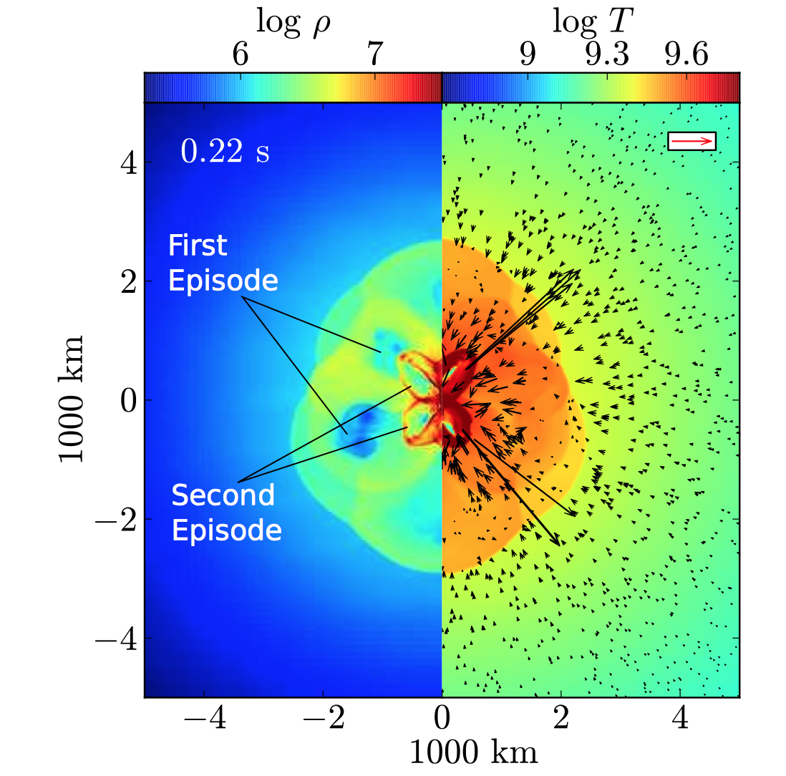

Slide 14
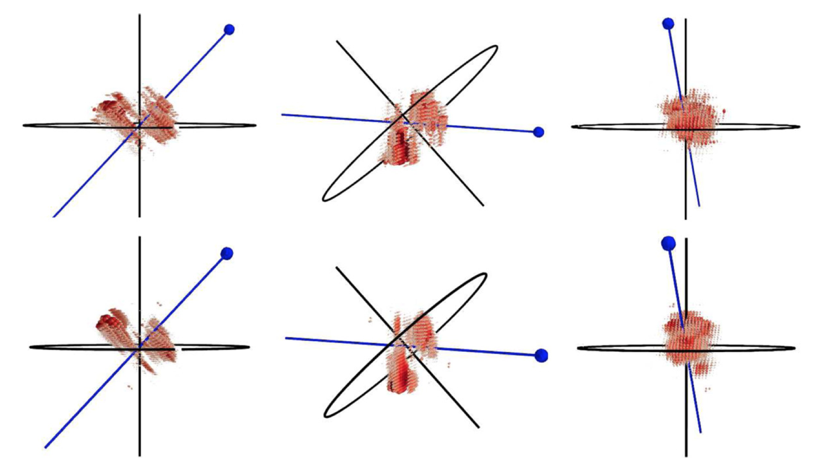
Nice jet, but the new data do not agree …

Slide 15
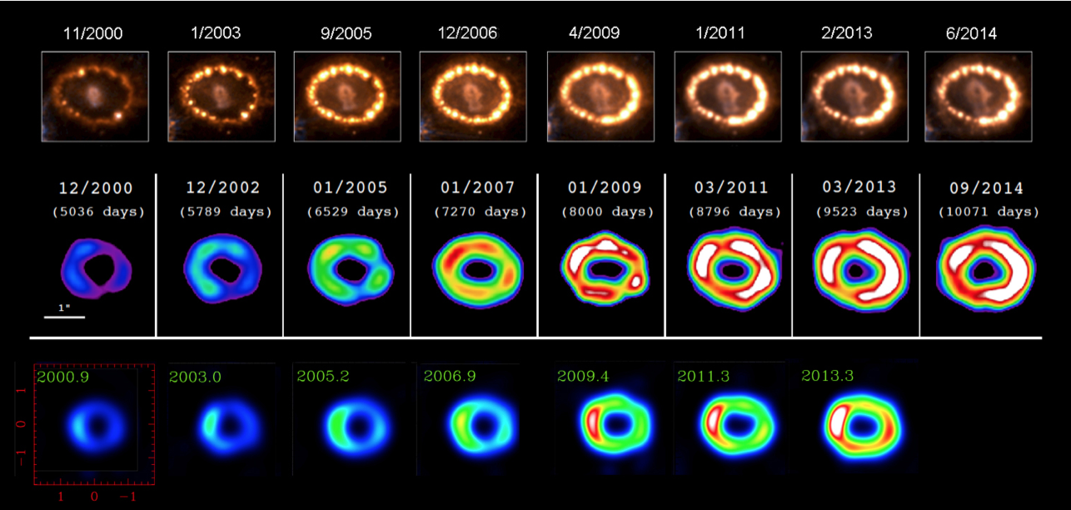
Notes:
Evolution of SN1987A and its Equatorial Ring. Top row -- Optical (Fransson et al 2015). The brightness of the ring has been reduced by a factor of 20 to make it possible to see faint emission from the supernova debris and beyond the ring; Middle row – 0.5 – 3 keV X-rays (Frank et al 2015); Bottom row – 9 GHz (Ng, Zanardo et al. (2013)

Slide 16
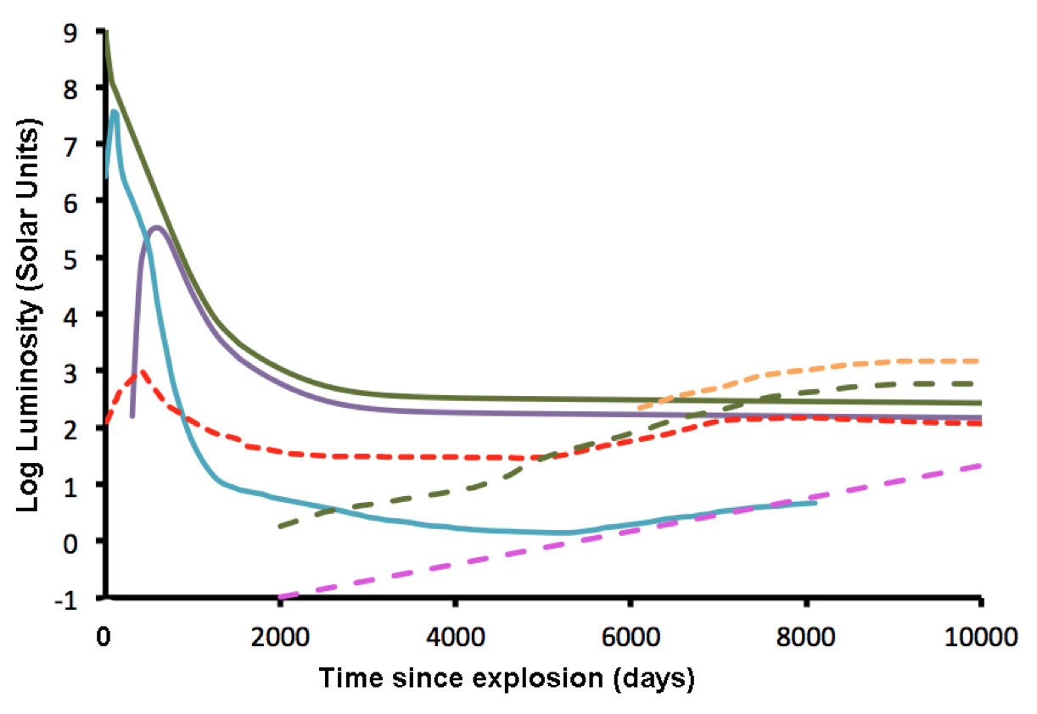
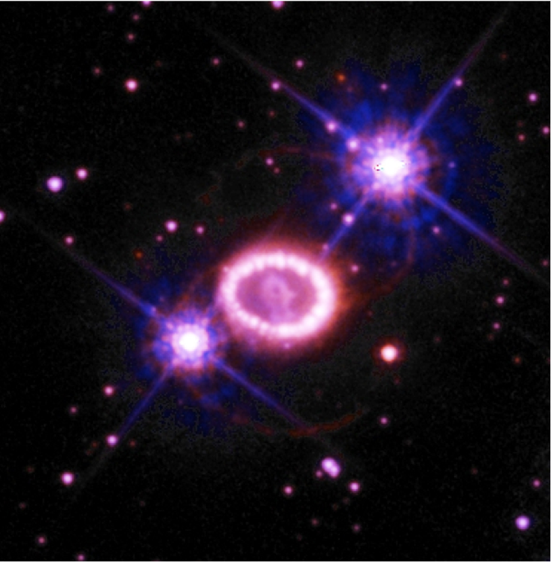
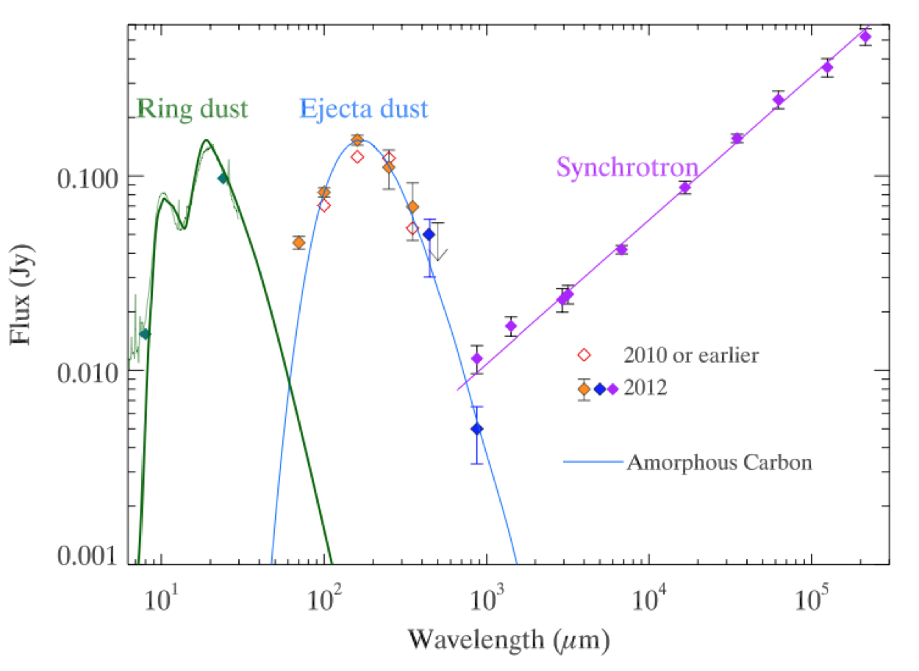
Really?
Green – Radioactive deposition
Violet – Far-Infrared
Cyan – Optical
McCray, in prep
Notes:
SN1987A Light Curves. Solid curves are debris: Green – Radioactive deposition (Fransson \& Kozma 2002; Jerkstrand et al 2011; Boggs et al 2015); Violet – Far-Infrared (McCray 1993; Matsuura et al 2015); Cyan – Optical (McCray 1993; Larsson et al 2011; Jerkstrand et al 2011). Dashed curves are equatorial ring: Pink – Radio (3–20 cm) (Manchester et al. 2002; Zanardo et al. 2010, 2014; Ng et al. 2013); Green –X-rays (0.5 – 3 keV) (Hasinger, Aschenbach & Trumper 1996; Burrows et al 2000; Frank et al 2015); Red – Optical (Lundqvist \& Fransson 1996; Mattila et al 2010; Fransson et al 2015); Gold – Near Infrared (5 – 30 microns) (Dwek et al 2008, 2010).

Slide 17
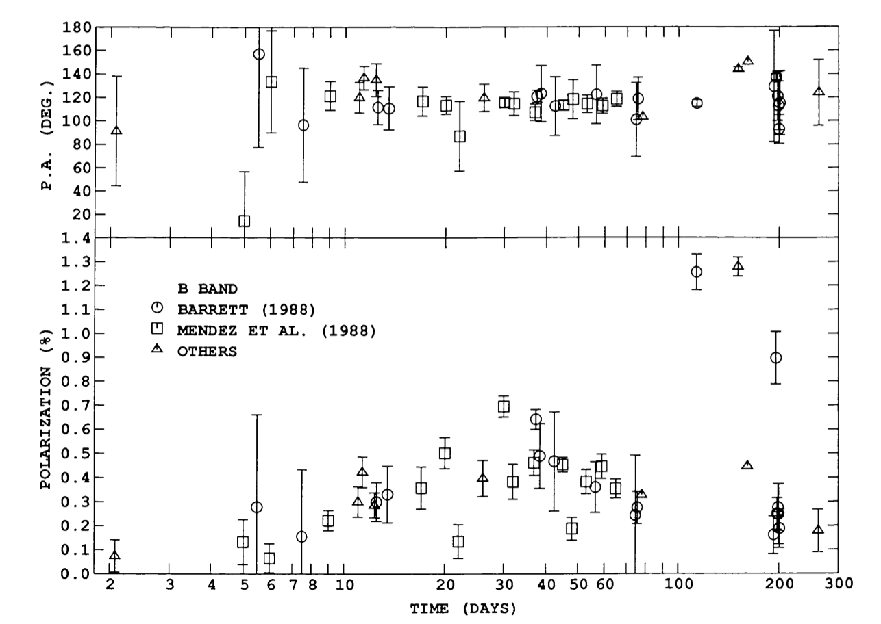
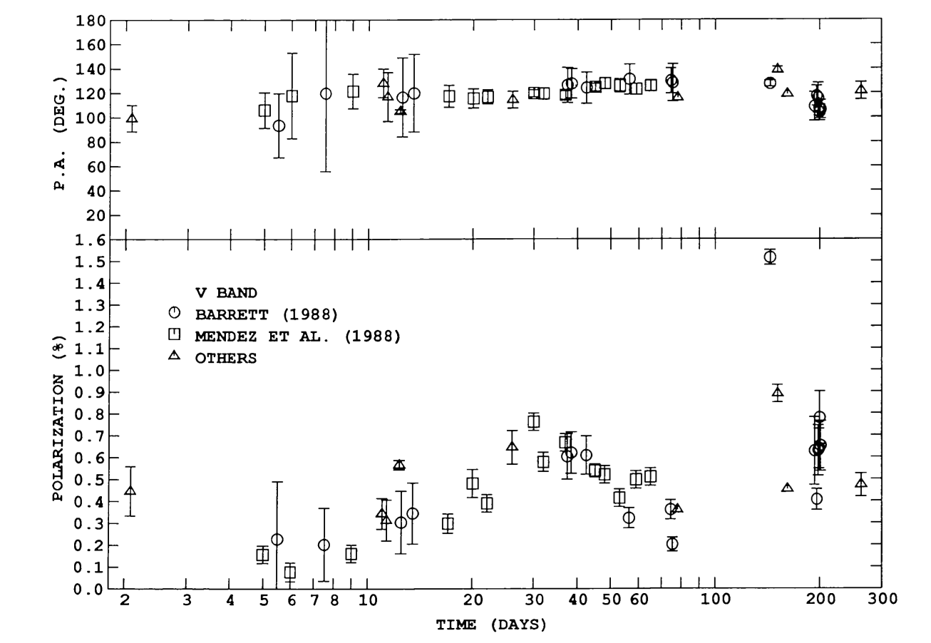
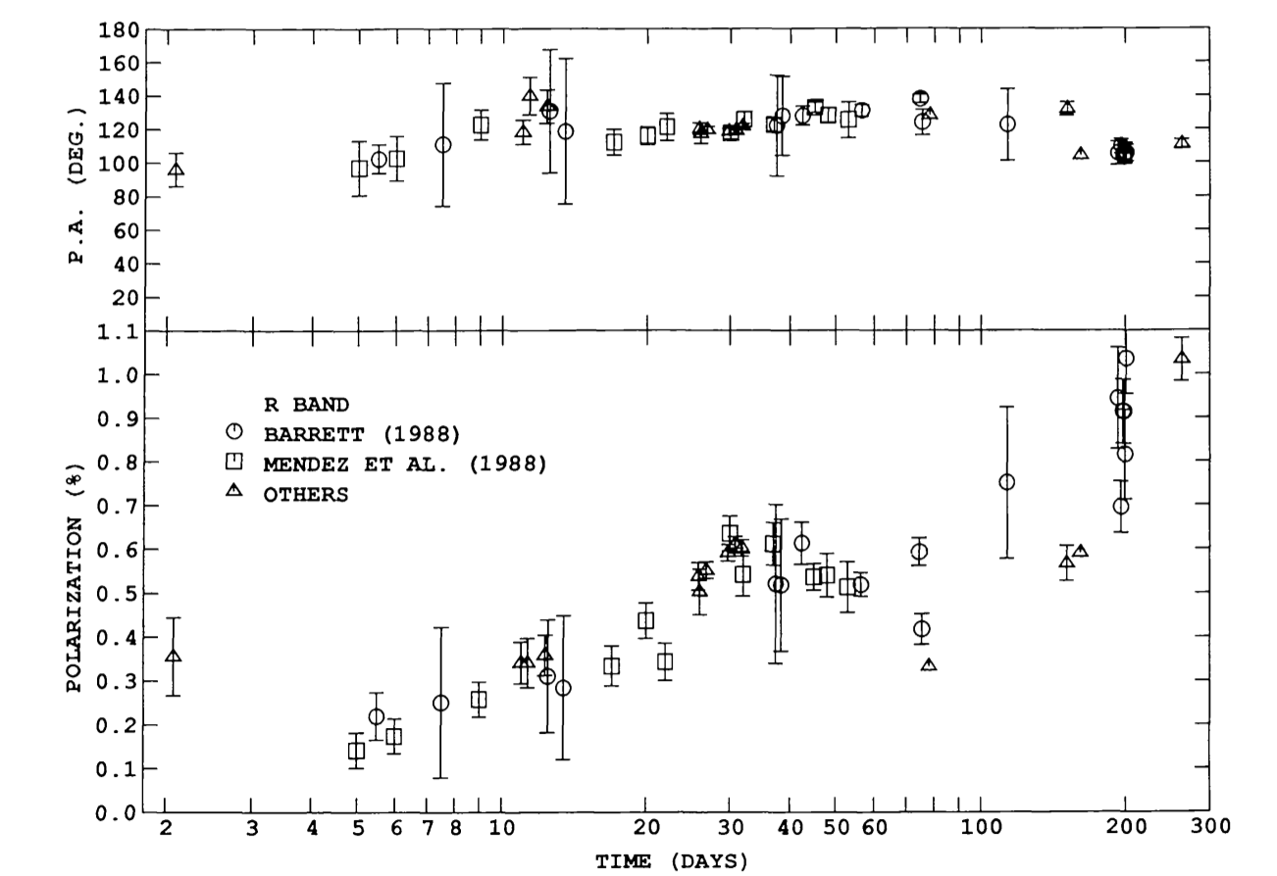
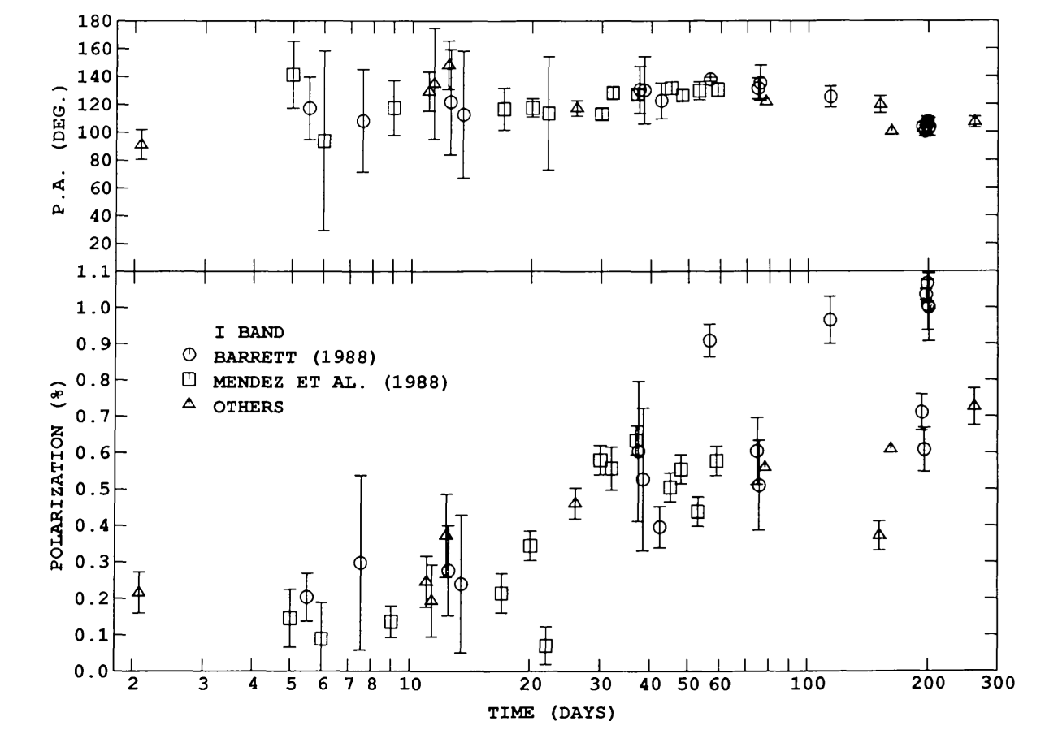
Polarimetry

Slide 18
Asymmetry Creates Polarization
Photosphere
e⁻
Ca II
e⁻
e⁻
e⁻
e⁻
e⁻
e⁻
e⁻
e⁻
e⁻
e⁻
e⁻
e⁻
Line forming, scattering atmosphere
Distorted Photosphere:
Continuum/line Polarization
Spherical Photosphere
Spectral line polarization only

Slide 19
The Concept of Dominant Axis
I₉₀
(N)
U
I₁₃₅
I₄₅
I₀
(E)
Q
Q = (I₀-I₉₀)/(I₀+I₉₀)
U = (I₄₅-I₁₃₅)/(I₄₅+I₁₃₅)
I₉₀(N)
I₁₃₅
U
I₄₅
I₀(E)
Q

Slide 20
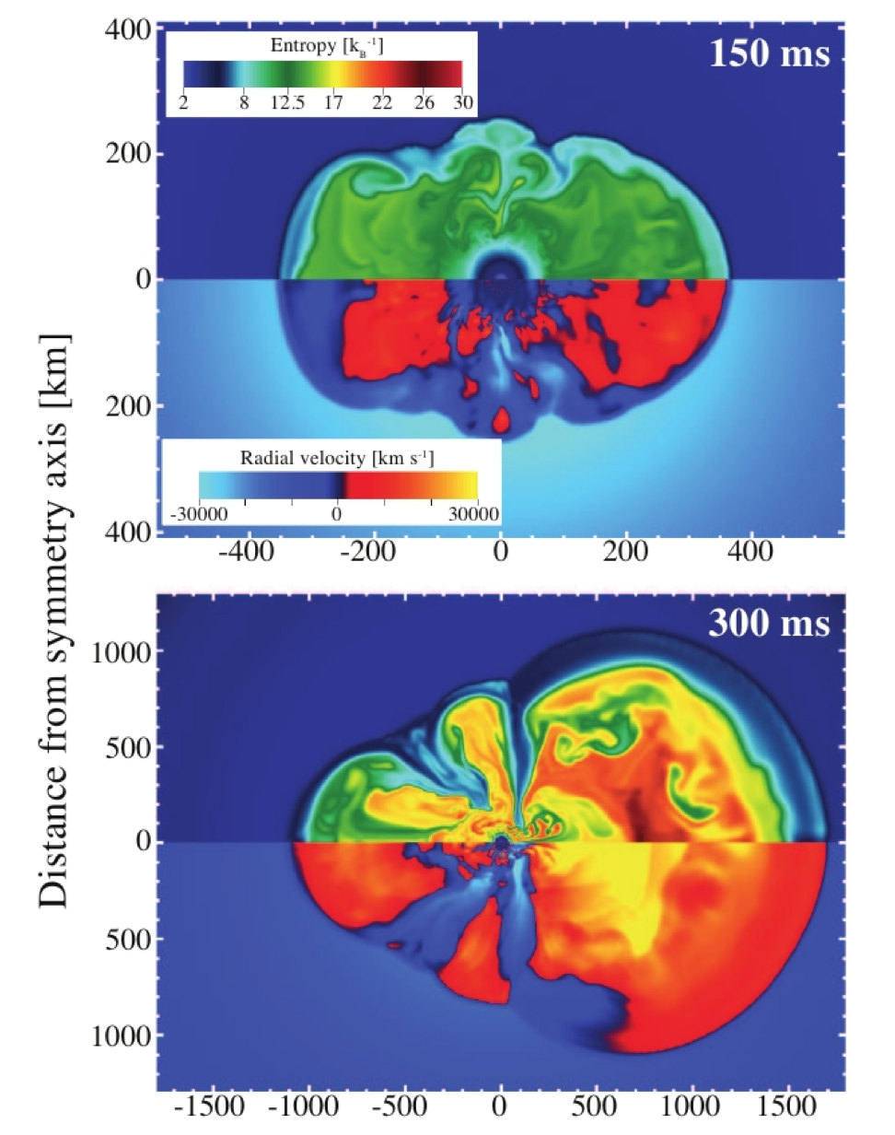
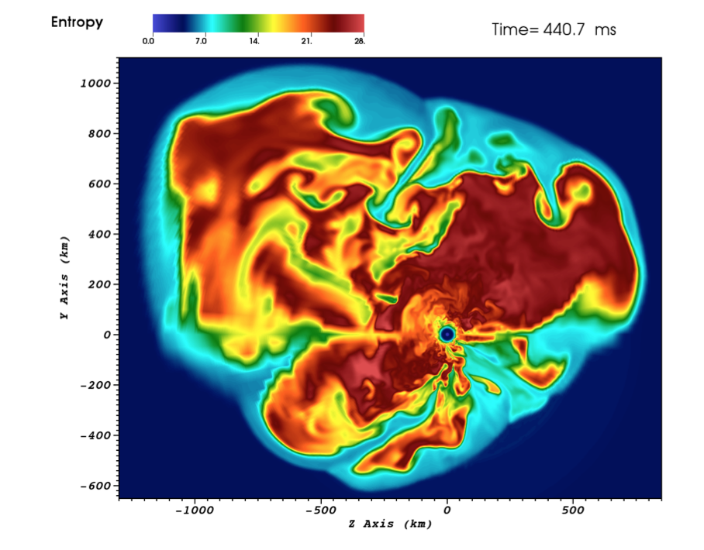
2-D vs 3-D?
If we maintain that CCSNe are neutrino-driven, it may be logical to assume that we are missing something essential in the neutrino sector. Mezzacappa et al. 2015

Slide 21
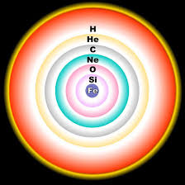
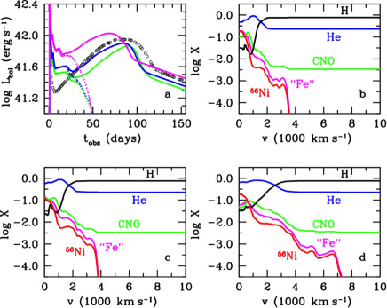
3-D, 2-D, or 1-D?

Slide 22
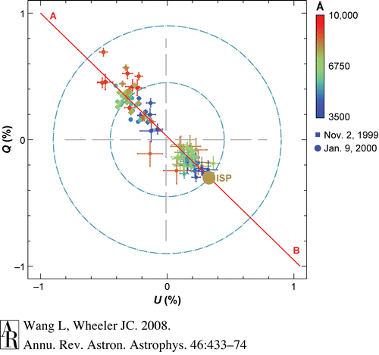

Slide 23
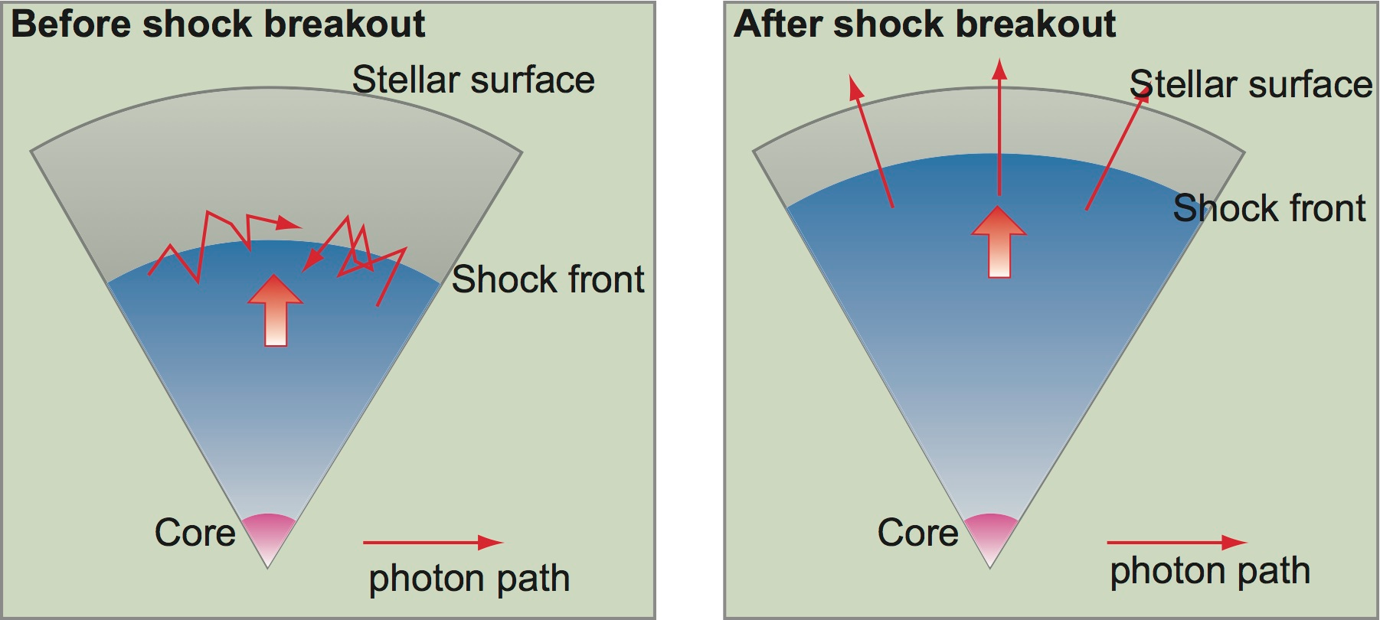
Observational Constraints - What can JUNO do?
Shock Breakout

Slide 25
It takes 20 min – 2 hours for the shock to breakout of the surface of the star
Enough time to alert ground-based optical network

Slide 26
Optical Followup
XIAN – (York, Wang, et al. 2008)
eXtreme Imaging Antarctic Network
大视场望远镜阵 － 紫台

Slide 27
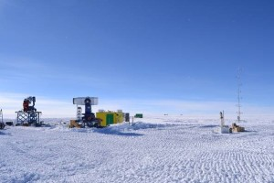
XIAN
-AST3

Slide 28
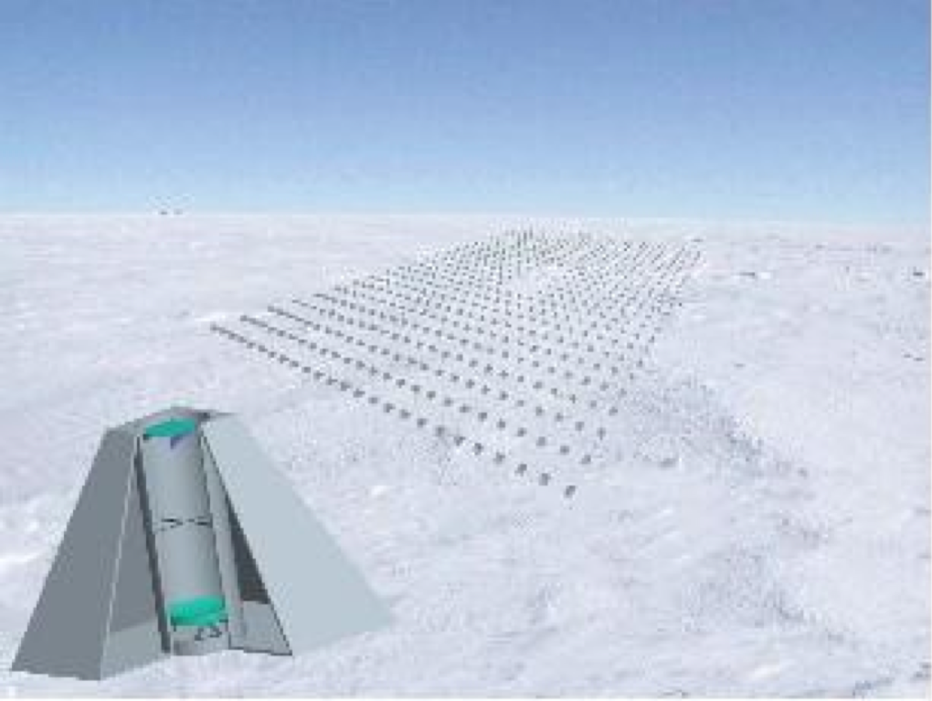

Slide 30
Optical Followup
大视场望远镜阵 － 紫台
新疆、红河、姚安
共~20000平方度
30cm aperture
在第1秒发现银河系超新星的概率：1/3*10000.／40000. ＊0.7 ＝ 5%
在第2天发现银河系超新星的概率：18000.／40000.＊0.7 ＝ 30%
17 mag in 10 min

Slide 31
Follow up observations
AST3 can follow any candidates during Austral winter
Small telescope networks (LCOGT etc)
LSST
ASKAP (Radio; SKA Prototype)

Slide 32
But they would not work …
The progenitor stars are very small in size
The shock breakouts are very hot
AST3, XIAN, PANSTARRs, LSST etc, are unlikely to catch the initial burst in the wavelength you want to observe – Gamma; X-ray; UV
Swift?

Slide 33
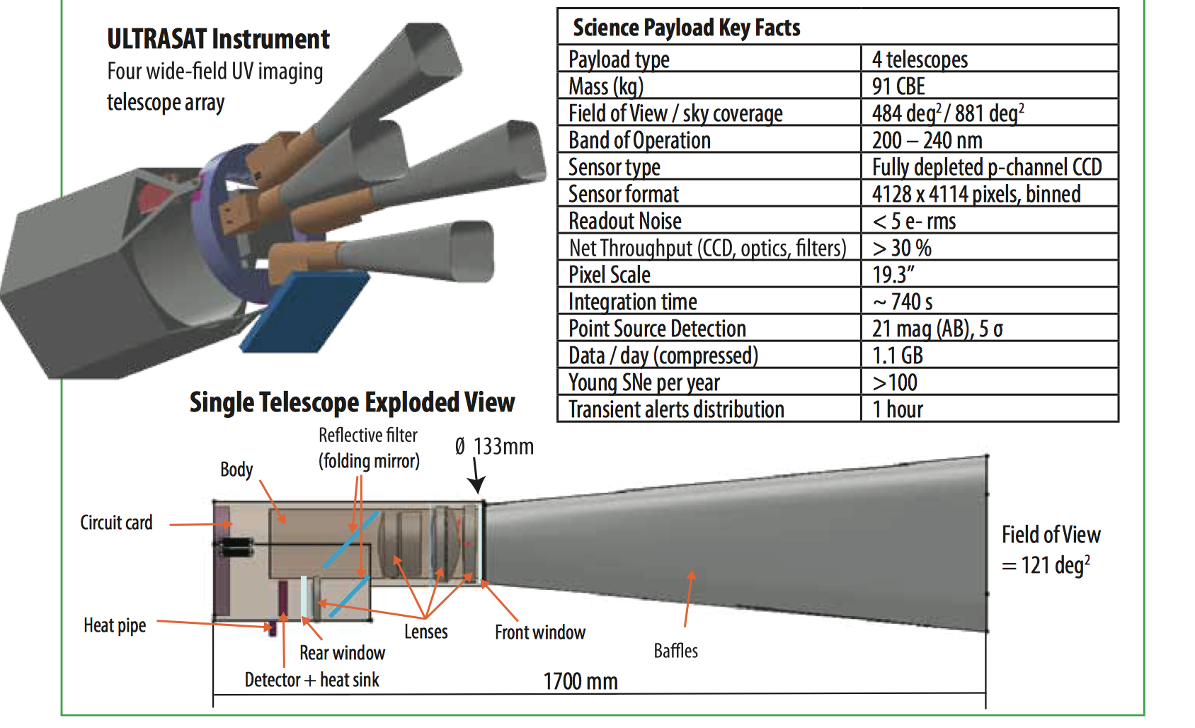
UV in Space

Slide 34
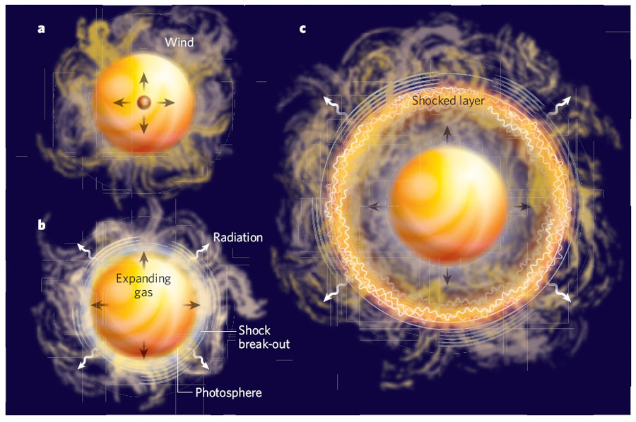
Optical Followup
Neutrino Trigger – Wide field rapid follow up
For Supergiant (Type IIp) – up to 2 hour
For WR Stars (Type Ib/c) – ~ 10 minutes
Chevalier 2008

Slide 35
Summary
Neutrino detection is critical for supernova physics
Supernova physics may be missing some important physics, about neutrinos or about driving mechanisms
In the future, optical follow up can be done within minutes after JUNO trigger, but the best observing window is not in the optical
UV observations reveals the surface of the stars, and the temperatures of the shock breakout
Soft X-ray? (Shock breakout; Blue Supergiant such as of SN 1987A; CSM interaction)
Gamma? (Radioactive decay)

