Slide 1
江门中微子实验探测太阳中微子
李玉峰
中科院高能所
JUNO中微子天文和天体物理学研讨会
2015-7-11

Slide 2
Outline
(1) Basics of solar neutrinos:
Neutrino production, oscillation, and detection
(2) Status of past solar neutrino measurements
(3) Future solar neutrino detection at JUNO
(4) Opportunity for particle and solar physics
test of MSW effect, solar abundance problem,
luminosity tests

Slide 3
Solar energy production
Sun: low-mass H-burning (main-sequence) star
Powered by nuclear fusion reaction
Core temperature:
1.5x10⁷ K (~keV)
quantum tunnel effect
(Gamow)
Filter of stable burning
Notes:
要发生热核聚变反应，需要原子核之间的距离足够小，但是原子核之间的库伦排斥势成为其相互靠近的阻力

Slide 4
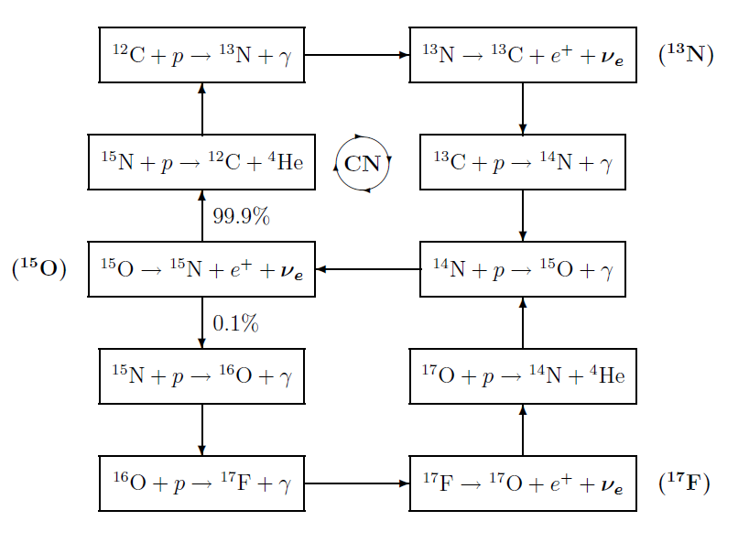
Solar neutrino production
pp chain (99%) vs. CNO cycle (1%) (H. Bethe 1930s)
He3 + p →hep nus (<18.77 MeV)：with the probability 2x10⁻⁷
Notes:
1950年代，He3+He4燃烧的截面在比原来大1000倍，因此直接打开
温度依赖不同，所以B8中微子的测量可以验证太阳核心温度到1%
He 和质子的反应 产生最好18.77MeV的hep中微子，

Slide 5
Standard solar models
SSM: Constructed with best available physics and input data (Bacall et. al. from 1962)
(1) local hydrostatic equilibrium
(2) Equation of state: ideal gas
(2) hydrogen burning: pp chain, CNO cycle
low energy cross section
(3) energy transport by radiation and convection
opacity
(4) boundary conditions
mass, radius, luminosity

Slide 6
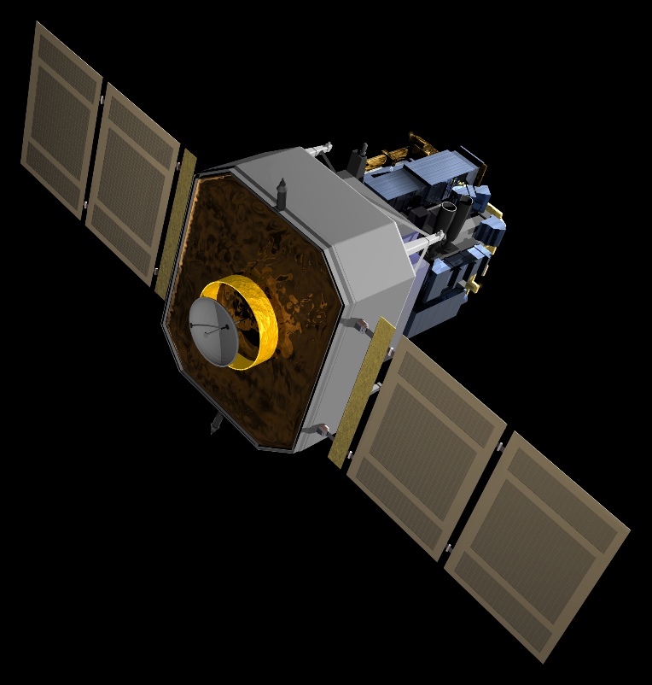
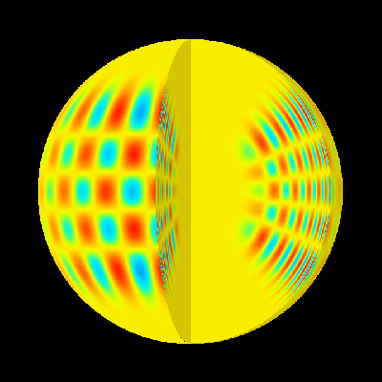
Helioseismology 日震学
Science that study the wave oscillations of the Sun
Doppler shifts of photospheric absorption lines
Give the sound speed and matter density of the interior of the Sun
Solar and
Heliospheric
Observatory
(SOHO)
Launched
1995.12

Slide 7
Neutrino flux and spectrum

Slide 8
MSW effect (inside the Sun)
ν
source
detector
Vacuum
oscillations
P(averged over oscillations)
1
2
1 - sin²2θ
Adiabatic
edge
Non-adiabatic
conversion
sin²θ
E
Resonance
at the highest
density
Non-oscillatory
adiabatic conversion
ν(0) = ν_{e} = ν_{2m} ν₂
P = |< ν_{e}| ν₂ >|² = sin²θ
adiabaticity

Slide 9
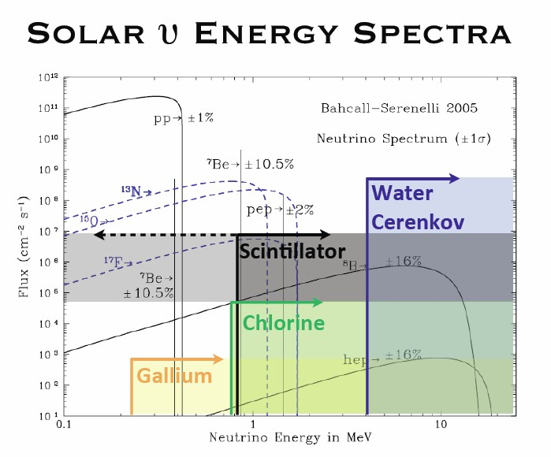
Detection methods
Detection of neutrinos rather than antineutrinos
theoretical energy threshold vs.
Experimental energy threshold

Slide 10
Status of solar neutrino measurement

Slide 11
Solar Neutrino Problem solved in 2002
What we have from past measurements

Slide 12
What we have from past measurements
1201.6311
1403.4575
Validated predictions for both the vacuum- and matter-dominated regions.
No evidence for the transition range.

Slide 13
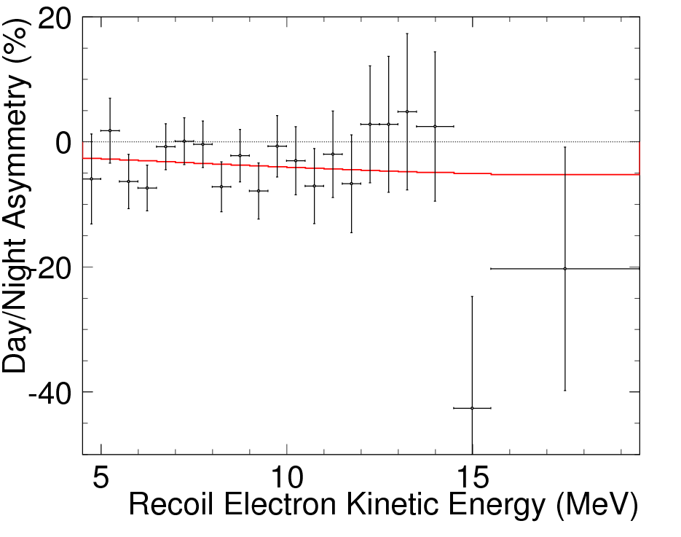
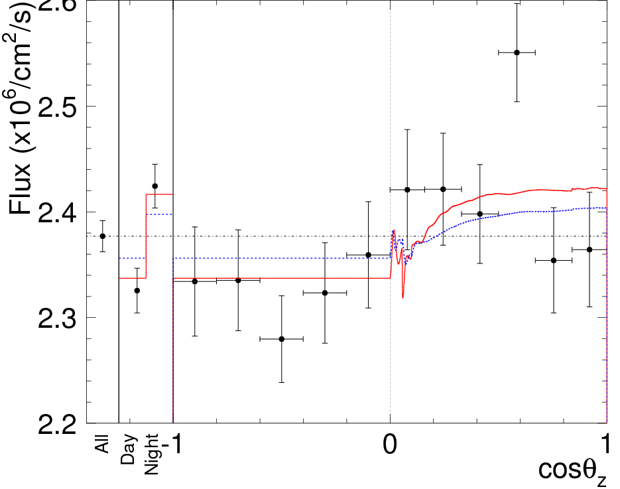
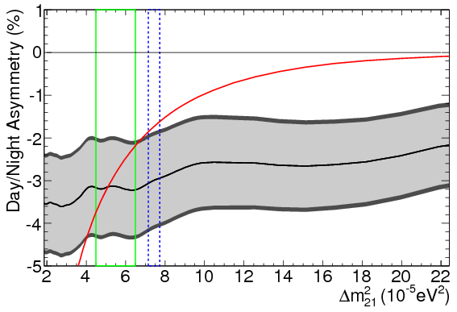
What we have from past measurements
Day-night asymmetry:
First Indication of Terrestrial Matter Effects on Solar Neutrino Oscillation
Super-Kamiokande: arXiv:1312.5176

Slide 14
What we have from past measurements
KamLAND
provided a model-independent test of the solar LMA-MSW parameter space.
Solar: theta(12)
KamLAND: Δm²₂₁
1303.4667

Slide 15
Solar nu measurement at JUNO
Using the elastic electron-scattering: singles events
Pros: large target mass (20 kt), better energy resolution (3%)
Cons: relatively small overburden, uncertain radio impurity
Prospects:
Low energy: Be7 and pp nus
High energy: B8 nus

Slide 16
Low energy: Assumptions
Take around 50% (10 kt) FV as the target mass.
External backgrounds neglected with a 5 m cut.
Only the internal background.
Only beta/gamma background (PSD for alpha)
No energy nonlinearity

Slide 17
The expected cosmogenic C11, C12 rates are scaled from
KamLAND taking account of the muon energy and rate.
Solar neutrino signal calculated from BP05(OP), without any cut of energy threshold.

Slide 18
Baseline assumption

Slide 19
Ideal assumption

Slide 20
Preliminary fitting
Rate uncertainties: U238: 4%,Th232: 8%,K40: 15%, Kr85: 30%, Bi210 (Pb210): free-floating.
Without shape uncertainty
Need add the theta(12) uncertainty and systematics

Slide 21
Comparison
Borexino:
Be7 nus: (4.43+_0.22) x 10⁹ cm⁻² s⁻¹
5%, largely from stat. and theta(12) errs
pp nus: (6.0+_0.8) x 10¹⁰ cm⁻² s⁻¹
13%, dominate by stat. errs (9%)
JUNO:
B7: stat. err <1%, theta(12) errs from reactors
Key systematics: Bi210, Kr85, energy scale etc.
pp: stat. err <1% (due to separation of C14 and pp)
Key systematics: C14 pileup, energy scale, etc.

Slide 22
High energy: B8 nus
Above 5 MeV, long lifetime cosmogenic isotopes dominates.
Need three-fold Coincidence to reduce these background.
<5 MeV, Tl208 from Th232

Slide 23
What can be done with these measurements
B8 nus: test the transition between vacuum and matter oscillations.→ low energy threshold.
Be7 nus: accurate measurement, help to the solar abundance problem
pp nus: high statistics measurement, test solar luminosity at the percent level.

Slide 24
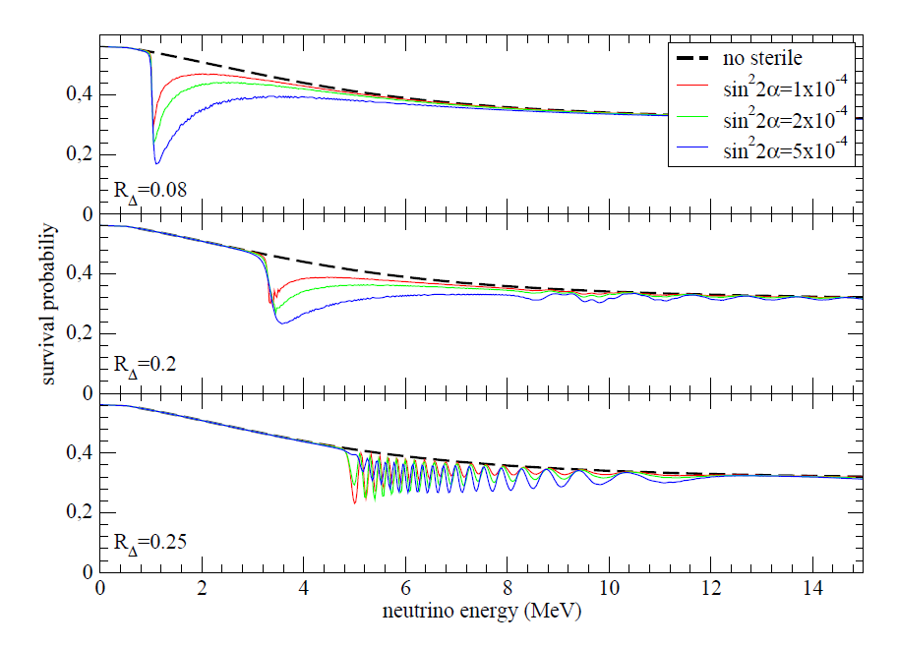
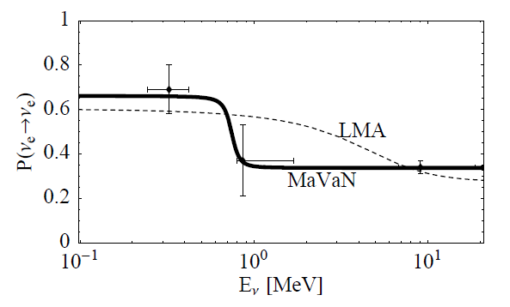
Sub-dominate structure: new physics

Slide 25
Solar abundance problem
A disagreement between SSMs
that are optimized to agree with interior properties deduced from our best analyses of helioseismology (high Z),
and those optimized to agree with surface properties deduced from the most complete 3D analyses of photo absorption lines (low Z).

Slide 26
Helioseismology vs. new SSM
0910.3690, Serenelli

Slide 27
Neutrino as the discriminator

Slide 28
Degeneracy Serenelli et. al.

Slide 29
Break with CNO nus

Slide 30
Conclusion
JUNO can have interesting contributions to solar neutrinos if better radio purity can be achieved.
pp nus, Be7 nus, B8 nus
Test of MSW effects using the low energy threshold B8 nus.
Precision Be7 nus help to solve the abundance problem.
CNO nus, not possible due to the relative small overburden.

Slide 31
谢谢

