Slide 1
Primary study on DA optimization of the main ring
H. Geng, Y. Zhang, G. Xu, Y. Wang, D. Wang
CEPC Accelerator Physics Group meeting
10th, July 2015

Slide 2
Contents
Primary results of different working points
DA with 1000 turns
DA results with 6 families of sextupoles
Summary

Slide 3
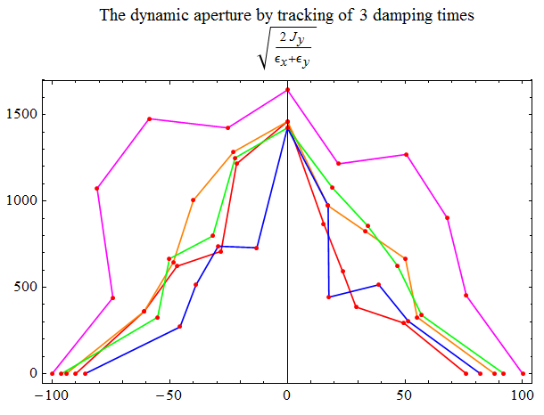
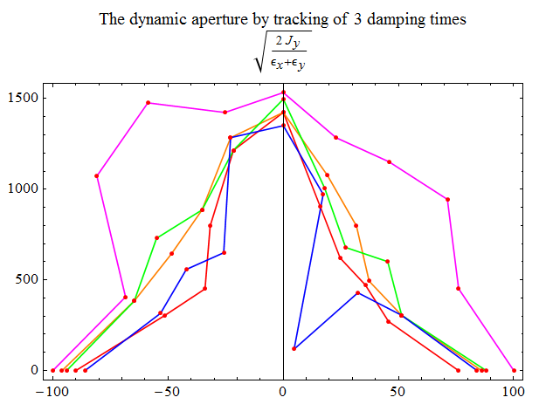
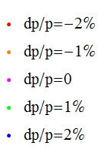
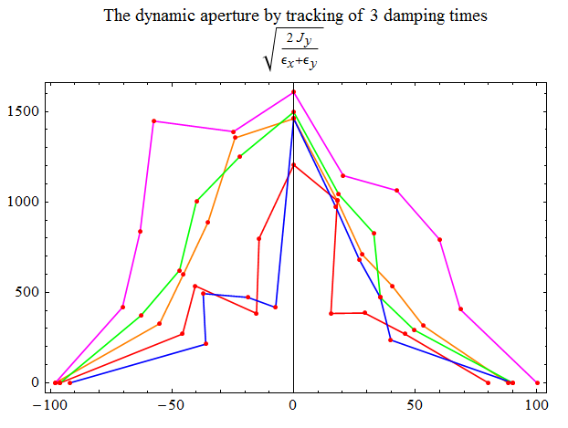
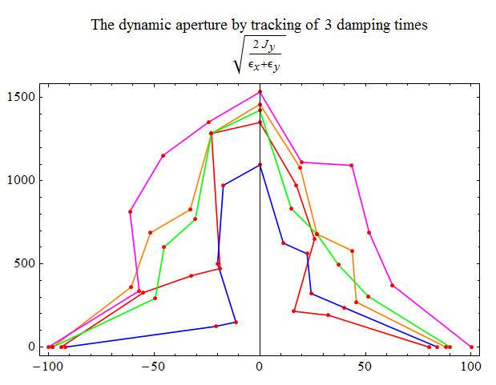
Different working points
.08/.22
.12/.25
.16/.29
.20/.33

Slide 4
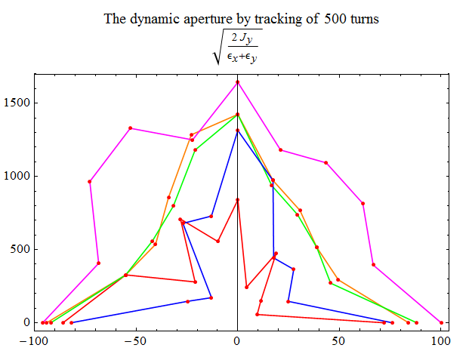
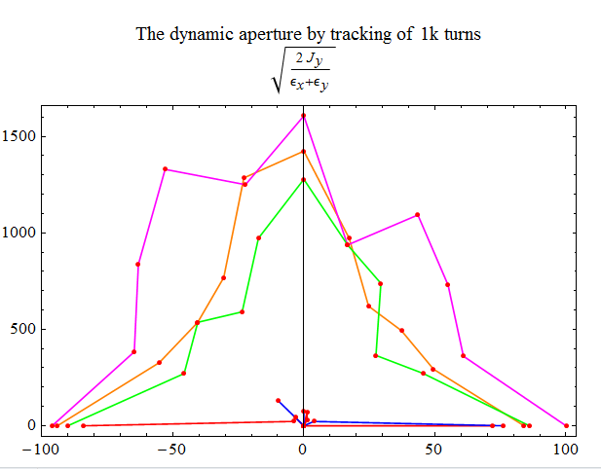
DA tracking with 1000 turns (.08/.22)
240 turns
500 turns
1k turns

Slide 5
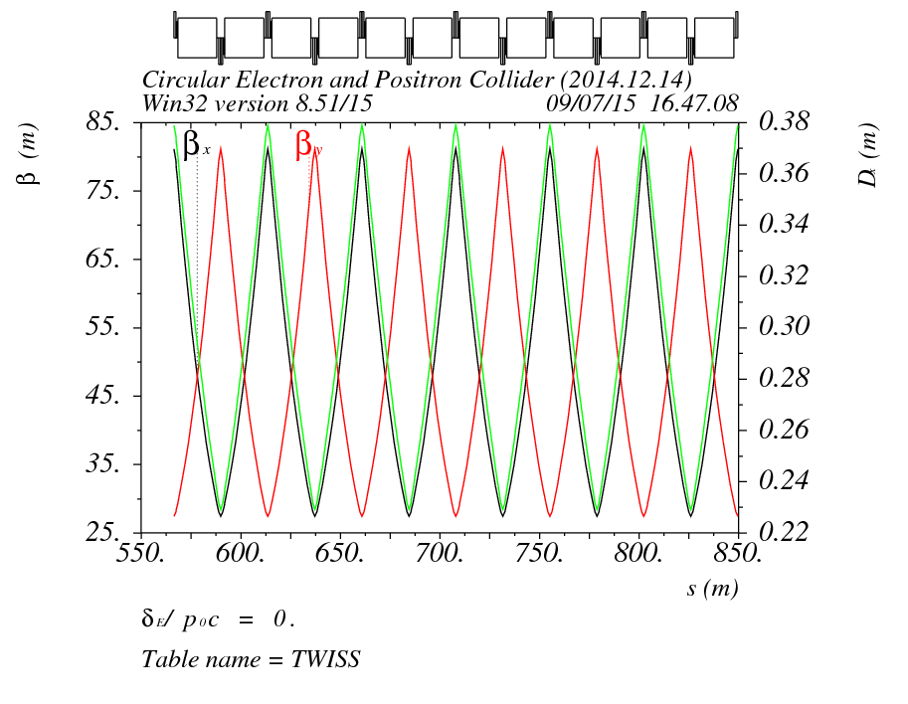
6 families of sextupoles

Slide 6
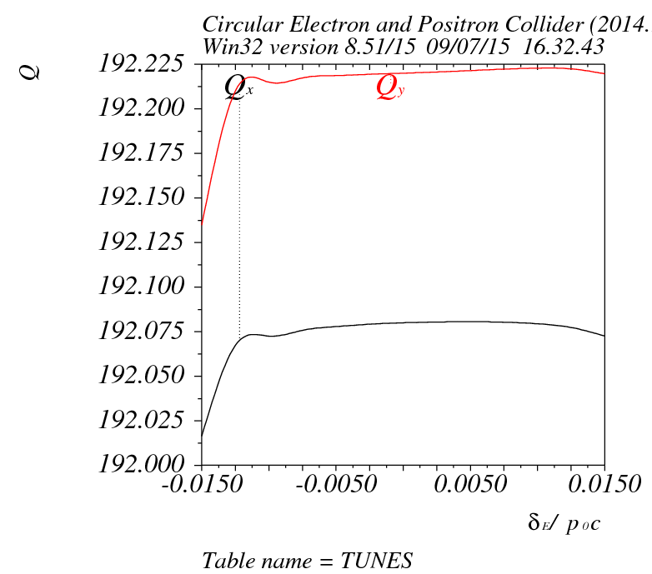
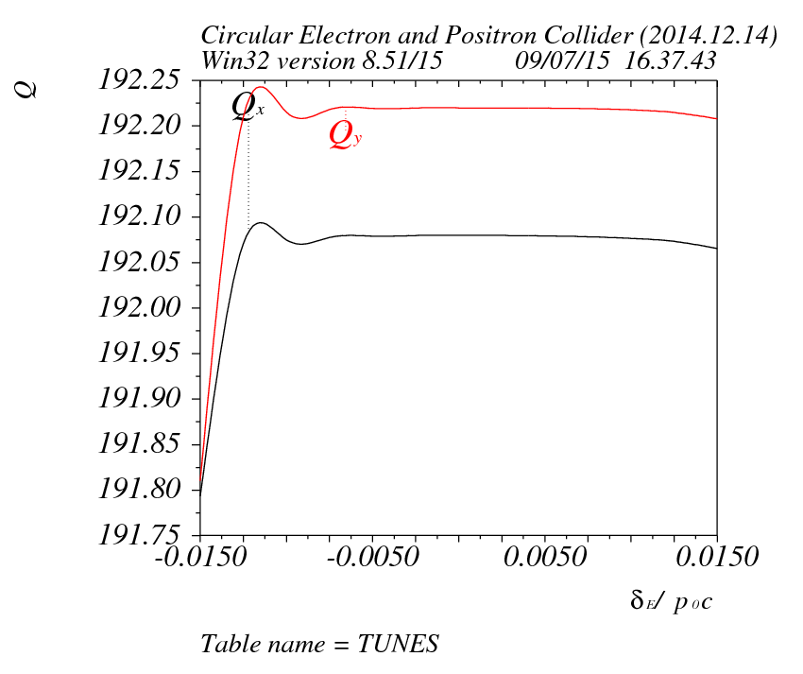
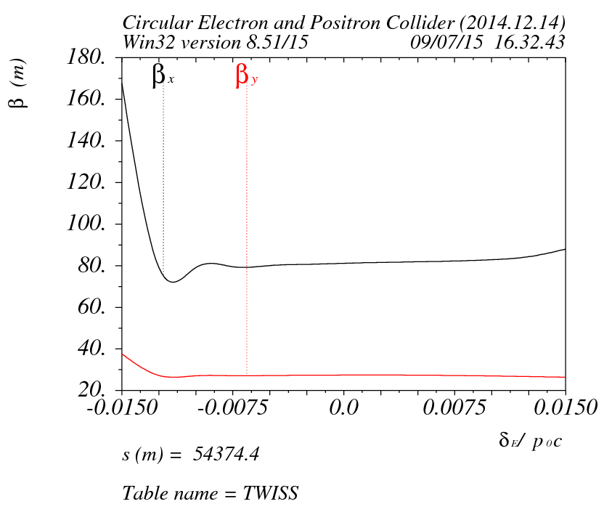
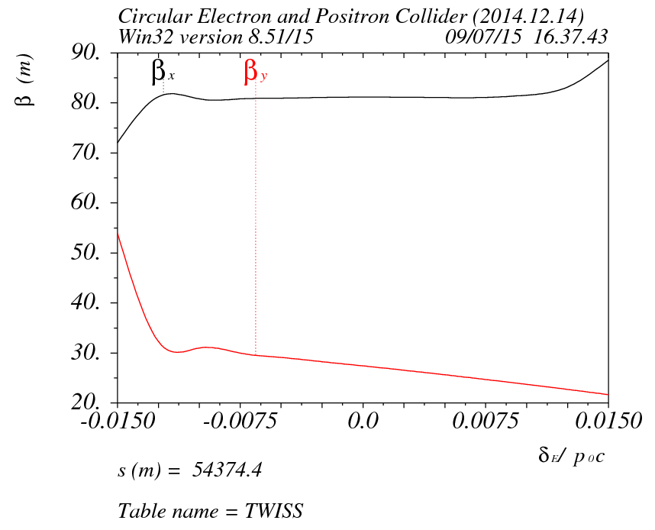
DA with 6 families of sextupoles

Slide 7
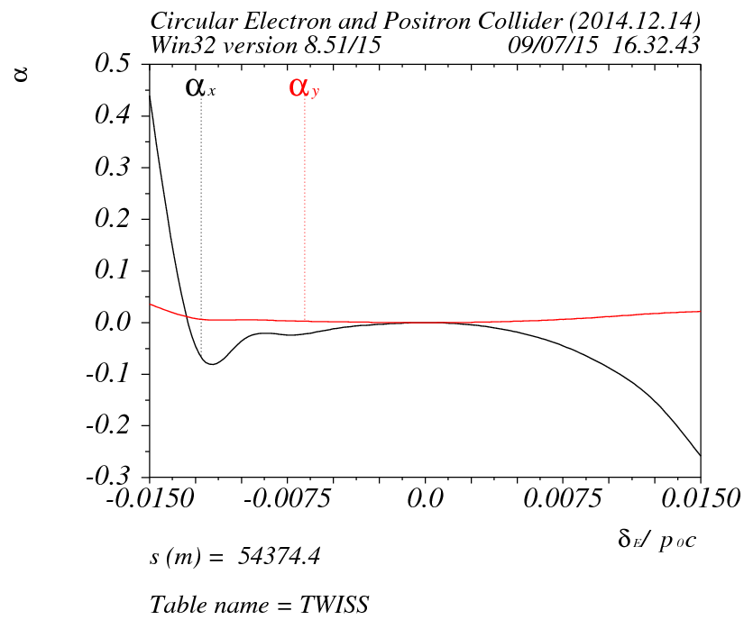
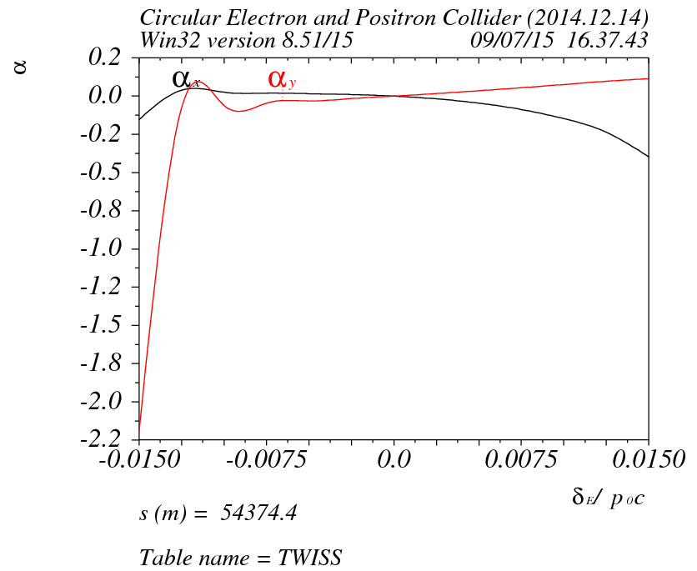
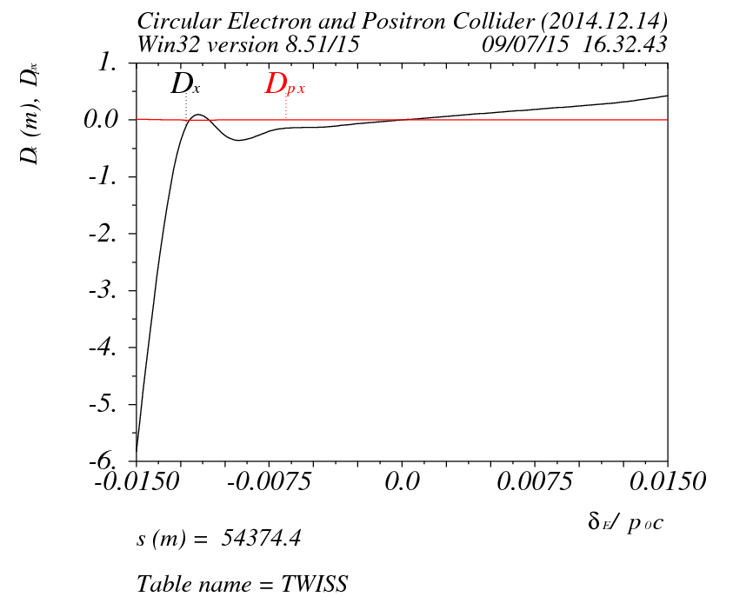
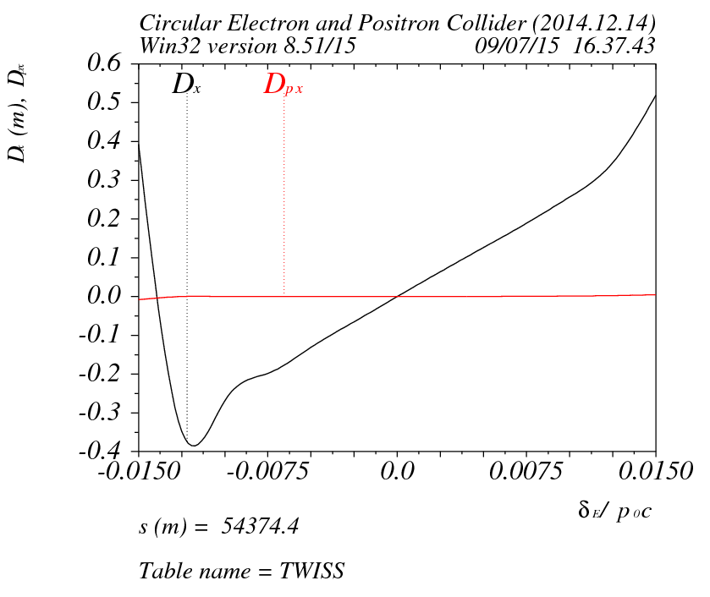
DA with 6 families of sextupoles

Slide 8
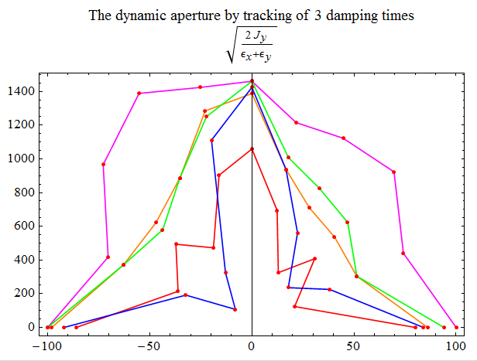
DA with 6 families of sextupoles

Slide 9
Summary
Working points (.08/.22) seem not be the reason for small DA
DA is different as # of turns changes, is it because DynamicApertureSurvey has no damping ?
6 families of sextupole seems not enough
….

Slide 10
backup

Slide 11
DA with 2 families of sextupoles

Slide 12
