Slide 1
Introduction of beam-beam compensation
Guo Yuanyuan
2015.7.10

Slide 2
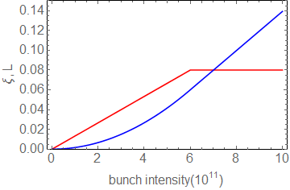

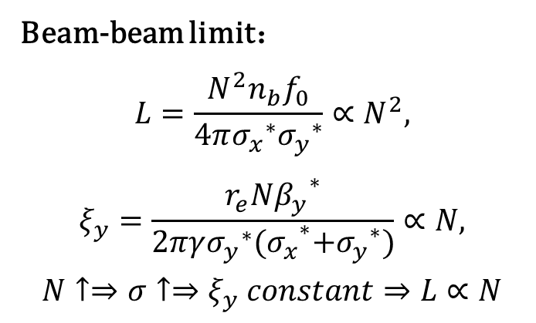



Motivation
Beam- beam effects a main factor limiting the luminosity of collider
Beam-beam limit：
$$L=\frac{N^{2}n_{b}f_{0}}{4π{σ_{x}}^{∗}{σ_{y}}^{∗}}∝N^{2},$$
$$ξ_{y}=\frac{r_{e}N{β_{y}}^{∗}}{2πγ{{{σ_{y}}^{∗}(σ}_{x}}^{∗}{{+σ}_{y}}^{∗})}∝N,$$
$$N↑⇒σ↑⇒ξ_{y} constant⇒L∝N$$
$$L∝N$$
$$ξ=const$$
$$ξ∝N$$
$$L∝N^{2}$$
So we need some beam-beam compensation schemes to alleviate the limitation
Notes:
When the beam-beam effect is weak,

Slide 3
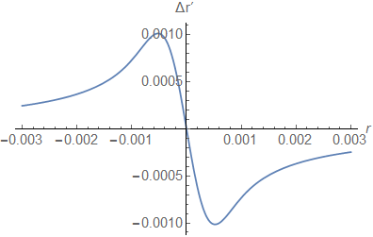
Beam-beam force
For small amplitude: linear force
For large amplitude: nonlinear force
Amplitude dependence of beam-beam kick is fundamentally different from magnets
Another beam can produce same kick of opposite sign
Notes:
Quadrupoles focus in only one plane while the beam-beam force focus in both planes

Slide 4
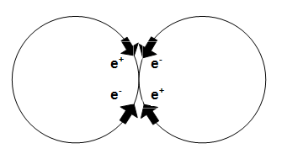
Beam-beam compensation
Direct space charge compensation
Four beams(e⁺e⁻e⁺e⁻) compensation scheme was tested in DCI
The net incoherent beam-beam force is 0.
Strong coherent beam-beam instabilities
Notes:
This figure shows the four beam compensation in storage rings ,each bunch in four beams has exactly the same intensity and distribution ,and they collide in one collision point, so the net beam-beam force is zero.

Slide 5
Indirect space charge compensation
head-on beam-beam compensation
for Tevetron-> Electron lens
Long-range beam-beam compensation
for LHC->current carrying wires
Notes:
In storage rings, a relatively low energy beam with a matched profile collide with the circulating beam once per turn. In hardron colliders ,the compensation can be achieved by colliding positively charged beams with negatively charged low energy electron beam, the device which provide electron beam is called electron lens.
2 beams coherent instability is not a issue with electron lenses
Head-on beam-beam compensation with electron beams was first proposed by Tevatron,this idea is to introduce a low energy electron beam to collide head0on with the opposing proton beam

Slide 6
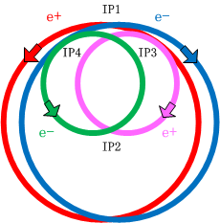
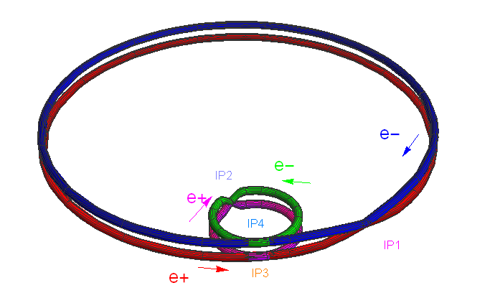
Head-on beam-beam compensation
Two types of beam-beam compensation scheme
Notes:
For the head-on BBC,Here we proposed two types of BBC schemes .two large ring are electron-positron collider ,and we introduce another two rings to compensate

Slide 7
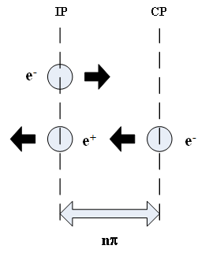
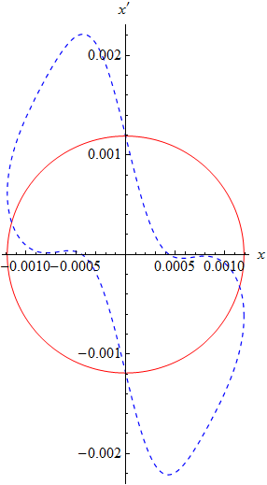
Head-on beam-beam compensation
Incoherent model
Transverse beam-beam kick at IP:
Beam-beam tune shift：
Transverse beam-beam kick at CP:
Beam-beam tune shift
Notes:
以圆束团为例来说明正对撞束束补偿的原理，这个是对撞补偿过程的示意图，这个图显示了对撞补偿过程中束流横向相图的变化过程。对于初始横向空间电荷分布为高斯分布的圆束团，它的横向归一化相图为圆形。负电子束团在对撞点IP处穿越与其相向运动的正电子束团时，粒子受到的横向的束束冲击为，这里的负号表示带异性电荷的粒子间的相互作用。同时束束作用力会导致非相干的束束频移且此时束束频移为正。负电子束团中的粒子受到束束冲击后，粒子动量受到影响，此时的横向归一化相图如图 4‑2(b)中虚线图形所示，可以看出归一化相图发生变化，由束团横向分布偏离了初始的高斯分布。负电子束团传输一段距离到达补偿点时，再与补偿束中的高斯分布的负电子束团对撞，受到补偿束的束束作用的横向冲击为，此时同性电荷的束流对撞的束束作用力会产生负的束束频移。由束流在对撞点和补偿点受到的作用力以及产生的束束频移的关系，可以得出实现完全补偿的条件。

Slide 8
Exact compensation if:
—the compensation beam and the circulating beam has the same intensity and distribution, so they can produce the same amplitude dependent force.
—same bunch length, so the beam-beam force is same along the bunch.
—same beta function at IP and CP, so the same beam-beam tune shift.
—the phase advance between IP and CP is a multiple of π in both transverse planes.
—same bunch space.
—no nonlinearities between the two collisions.
Notes:
The head-on beam-beam effect can be canceled exactly if the following conditions are met:
1.the compensation bunch and the circulating bunch has the same intensity and distribution,so they can produce the same amplitude dependent force.
2. Has the same bunch length
3.

Slide 9
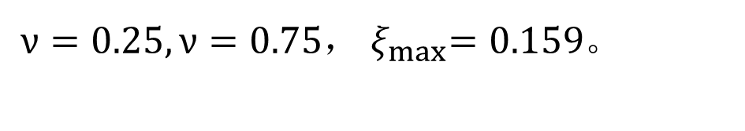
Coherent model
$ν=0.25,ν=0.75$，${ ξ}_{max}=0.159$。
Notes:
With limit of strong conherent beam-beam effect, the four-ring schemes are not beneficial very much ,so we improve the scheme

Slide 10
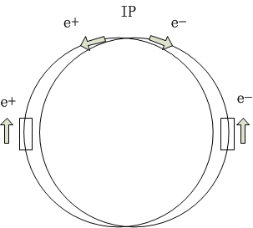
ERL
Avoid the coherent beam-beam effects
Avoid energy loss
Notes:
We use ERL to produce the low energy electron, the electron beam is single-pass, so avoid the coherent ,

Slide 11
Distribution before and after beam-beam compensation
Notes:
The initial distribution of the beam is gaussian distribution ,the distribution of x is not changed during the collision,and the distribution of xp is changed with the beam-beam effect, with the BBC, the distributuion of xp will always be the initial gaussian dis.

Slide 12
Beam-beam compensation reduce the beam-beam tune spread
Tune footprint w/o and with compensation
Notes:
Cross the resonance

Slide 13
Beam-beam compensation can improve the beam lifetime effectively
bunch current and so the luminosity will increase very much with the beam-beam compensation
Notes:
Therefore bunch current and so the luminosity will increase very much with the BBC

