Slide 1


CEPC bunch train scheme study
XIAO Ming, GAO Jie, WANG Yi-Wei, WANG Dou, BAI Sha
July 6,2015

Slide 2
outline
_
Motivation
Separator system study for bunch train scheme
Primary idea (lattice design)
What to do next

Slide 3
Motivation
_
The CEPC (circular electron positron collider) is one of the largest plans in high energy physics study at China, which would serve as Higgs Factory firstly and then upgrade to a 70-100TeV Super Proton-Proton Collider(SPPC) in the same tunnel.
The synchrotron radiation power of CEPC is as high as 50MW and its goal is to deliver a peak luminosity greater than 1×10³⁴cm⁻²s⁻¹ per IP. The baseline design is a single beam-pipe electron positron collider, which has to adopt pretzel orbit scheme. And it is not suitable to serve as a high luminosity Z factory.

Slide 4
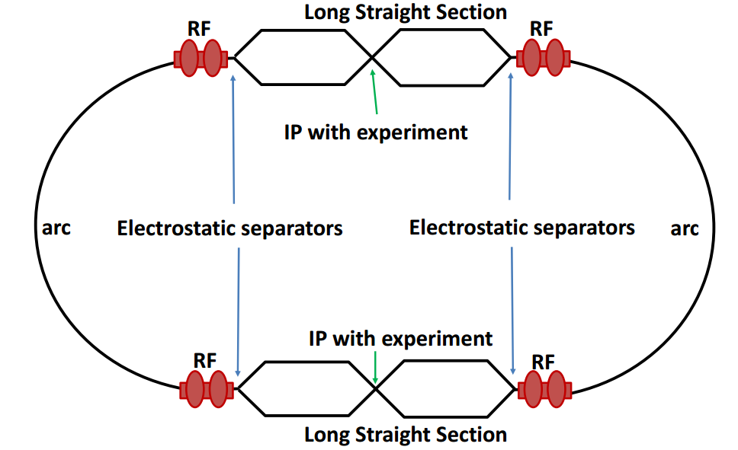
Local double beam pipe
_
Advantages
No pretzel
More bunches
Challenges
Crossing angle & crab waist design.
Electron cloud issues.
Bunch train operation introduces an uneven load to the RF
system.

Slide 5
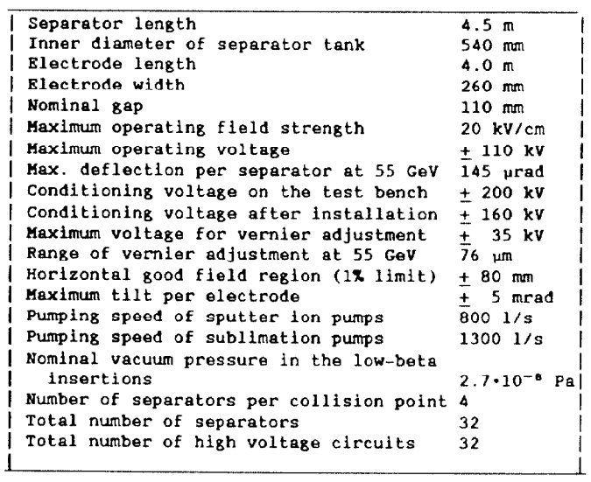
Separator system study for bunch train scheme
_
The main design parameters of the separator system of LEP are given in right Table.
For CEPC 120GeV beam:
Max. deflection per separator is 66μrad.
12 of these LEP separators and 100m drift space would provide 60mm*2 deflection.

Slide 6
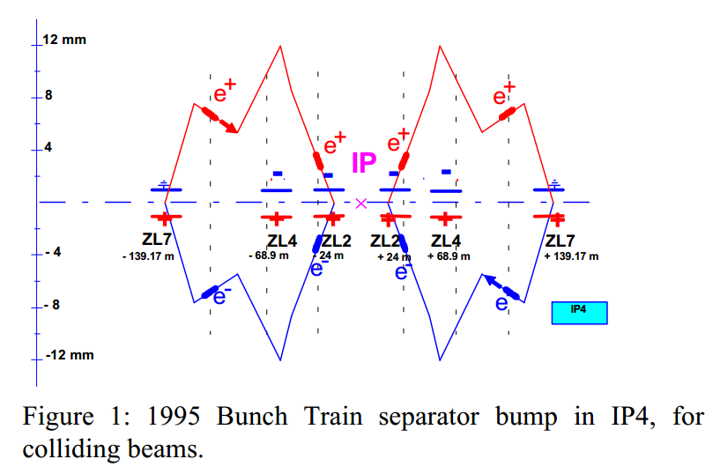
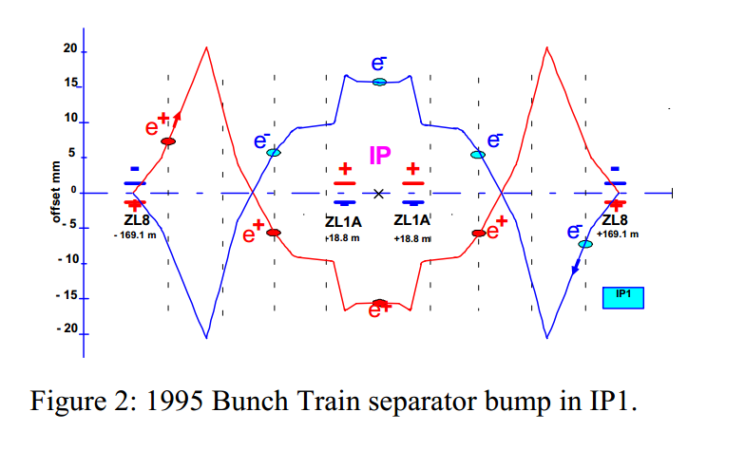
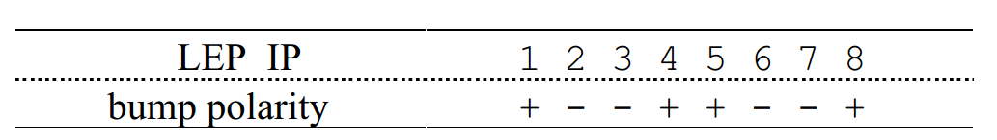
Separator Layouts of LEP
_
Two of the bumps should be positive and two negative.
This combination minimizes
both the vertical offsets and slope in the collision of the
bunches of a given train, minimizes the residual vertical dispersion and maximizes the possible luminosity.
Direction of separator Bunch Train bumps

Slide 7
Primary idea
_
At the very beginning, we take the parameters design from CEPC pre-CDR [1]. We assume the local double section is about 10% of the whole ring.
Here we temporarily choose 120 FODO cells length (47.2m*120=5660m) to achieve a bunch train scheme, which would need another 1.416km on each side of IP.
Parameters | Value | Unit
Circumference | 54374 | m
Length of one FODO cell | 47.2 | m
Harmonic number | 118800
One bucket length in the ring | 0.46 | m
Bucket number in 30 FODO cells | 3094
Bucket intervals per bunch | 120

Slide 8
Lattice design
_
At the first stage, we just insert a set of lattice to separator the two beams on the base of CEPC baseline lattice design from the Pre-CDR. And we have compared two situations by using different number of separators.
parameters | value |  | Unit
No. of Separator at each side | 15 | 30
Circumference | 58.713 | 59.018 | km
Double beam pipe length | 1273.6 | 1349.8 | m
β_{x} at IP | 0.45 | 0.2 | m
β_{y} at IP | 0.002 | 0.002 | m
betax(max) | 3775.73 | 905.42 | m
betay(max) | 9483.74 | 9359.27 | m

Slide 9
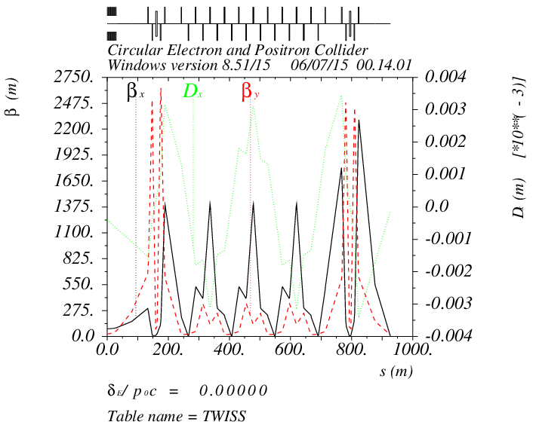
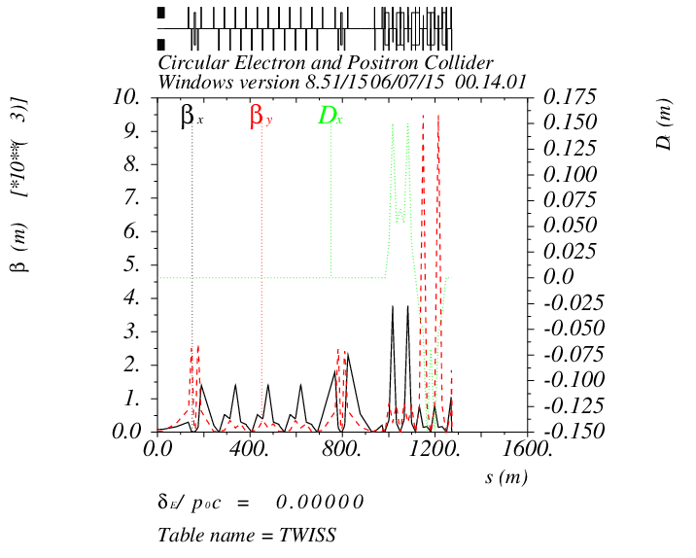
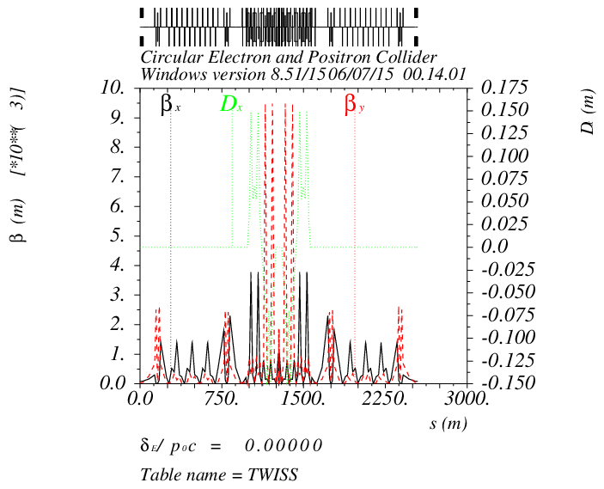
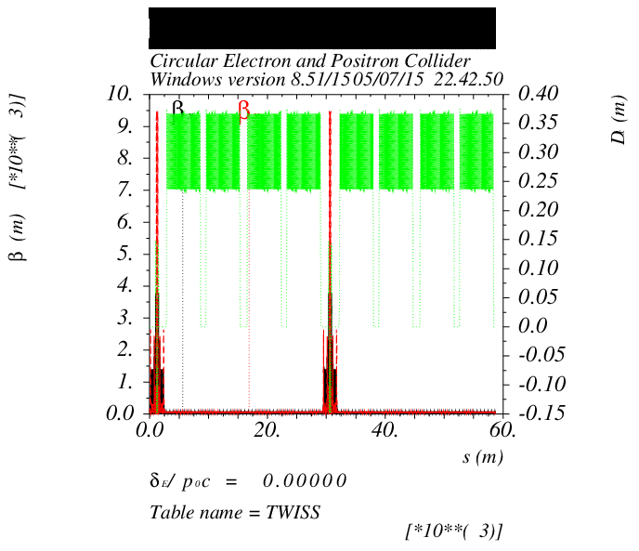
15 Separators

Slide 10
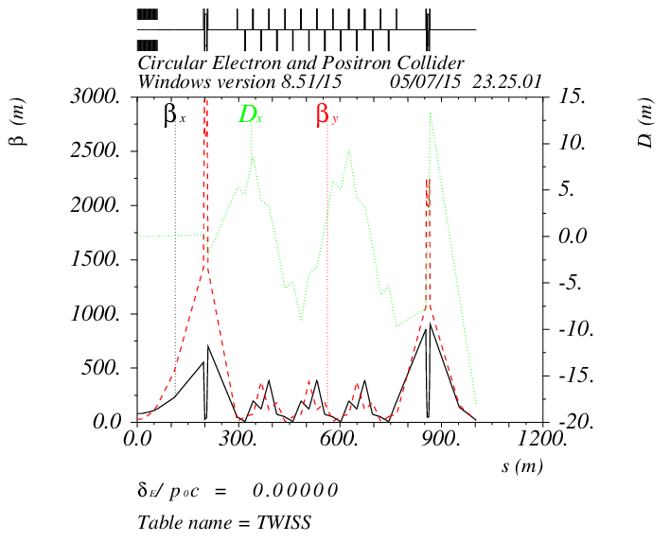
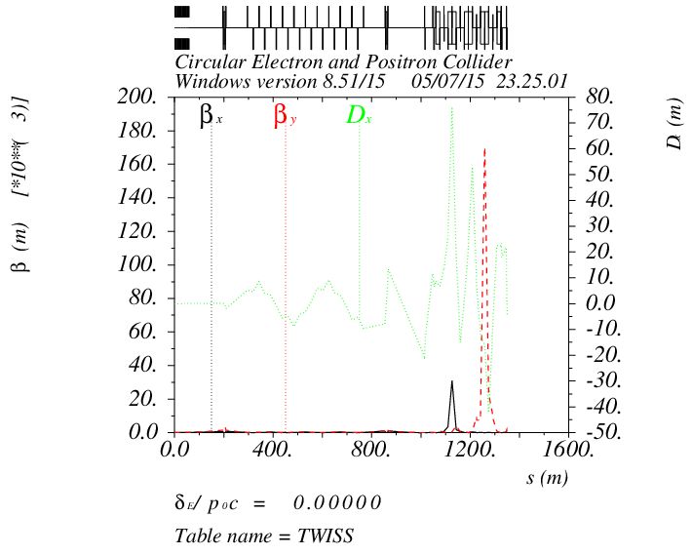
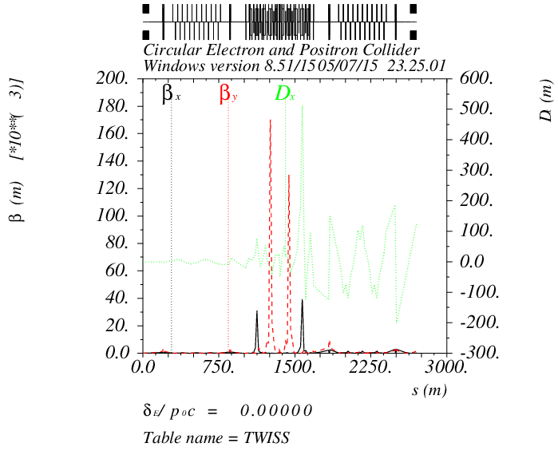
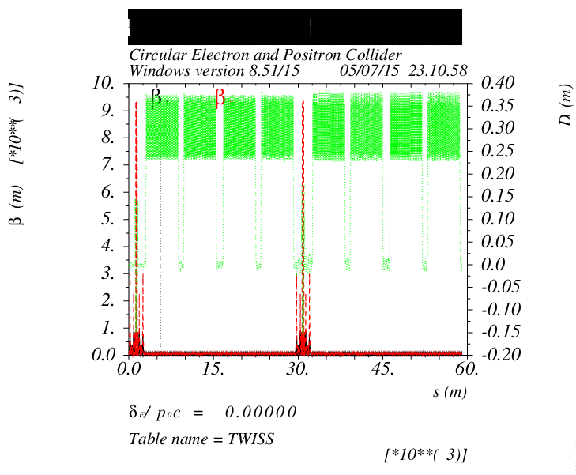
30 Separators

Slide 11
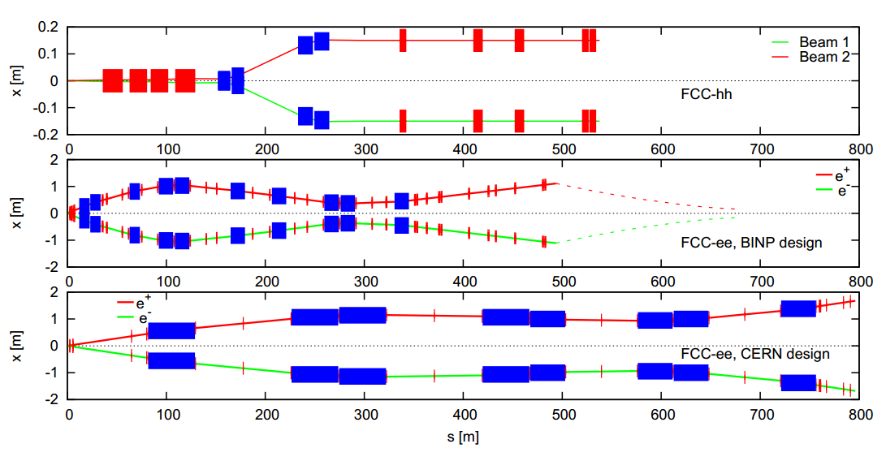
FCC-ee final focus
_
tunnel diameter of both FCC-ee designs ≈ 2m → reasonable
CERN design far too long, even for longer FCC-hh, BINP design might work out

Slide 12
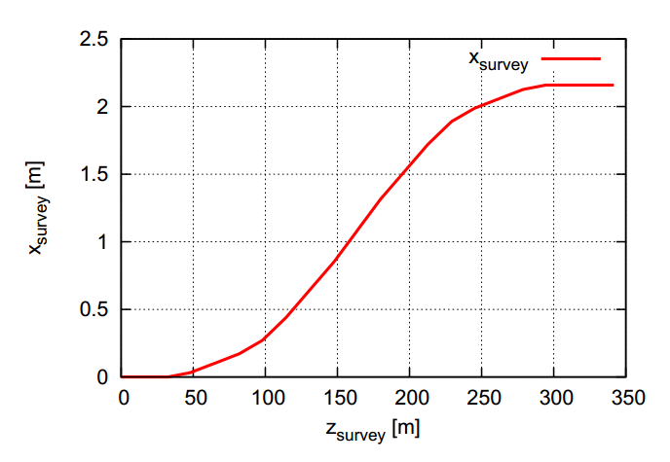
CEPC final focus
_
Dipole bending angle ≈ 4mrad
If we choose the crossing angle is 30mrad, the max. deflection is ≈ 4m*2
Betay=1.2mm

Slide 13
Max deflection:
15 SEP vs. 30 SEP
_
The max. deflection of 15 SEP is less than 0.2m while the 30 SEP is about 1m. (FFS not included)
Dipole bending angle ≈ 4mrad

Slide 14
What to do next and problems?
_
Local double beam pipe lattice design
New layouts of separator system
deflection
New final focus section might be taken into consideration
crossing angle (30mrad or smaller)
Crab waist?
New MDI design

Slide 15
Reference
_
[1] CEPC-SPPC Preliminary Conceptual Design Report, The CEPC-SPPC Study Group, IHEP-CEPC-DR-2015-01.
[2] J. Gao, IHEP-AC-Note-2013-012.
[3] M. Koratzinos, F. Zimmermann, “MITIGATING PERFORMANCE LIMITATIONS OF SINGLE BEAM-PIPE CIRCULAR e+e- COLLIDERS”, IPAC15, Richmond, TUPTY058.
[4]W. Kalbreier, et al, “Layout, design and construction of the electrostatic separation system of the LEP e+e- collider”, CERN, Geneva, Switzerland.
[5] B. Balhan, et al, “MODIFICATION OF THE LEP ELECTROSTATIC SEPARATOR SYSTEMS FOR
OPERATION WITH BUNCH TRAINS”, CERN, CH-1211 Geneva
[6] R. Martin, et al, “Status of the FCC-ee interaction region design”, HF2014 Workshop, Beijing, China, 9-12 October, 2014

Slide 16
Thank you!

