Slide 1
FFS lattices with L*=1.5m
Yiwei Wang, Dou Wang, Sha Bai
16 July 2015, CEPC AP meeting, C407

Slide 2
Outline
Generic final focus system
High order correction
CEPC FFS lattices with L*=1.5m
Summary

Slide 3
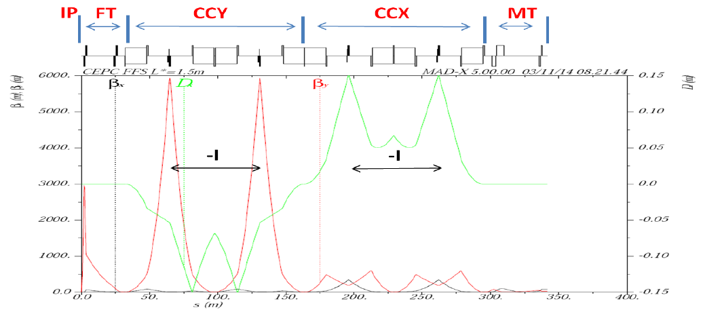
Generic final focus system
Linear latice design
FT:
4 quads
βy*, L*, d, Btip
CCS:
8 FODO cells
Ltot, βymax, ΔU/U, Δε/ε
MT:
4 quads
Primary nonlinear correction
1st order ξ
2nd order geo. aberr.

Slide 4
High order correction
High order ξ
geo. aberr. from finite length sext.
break down of –I matrix
2nd order dispersion
…

Slide 5
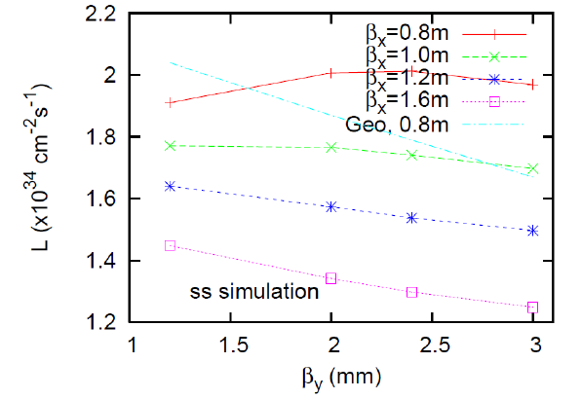
CEPC FFS lattices L*=1.5m
Typical versions
1.2mm
FFS_1.2mm_v0_Sep_2014 (150m), FFS_1.2mm_v0_Sep_2014(350m)
3.0mm
FFS_3.0mm_v0_Feb_2015(350m), FFS_3.0mm_v1_Mar_2015(315m), FFS_3.0mm_v2_Jul_2015_tmp(315m), FFS_3.0mm_v1_Apr_2015(390m)
by Ohmi kazuhito
Bunch lengthing inclued in the beam-beam simulation

Slide 6
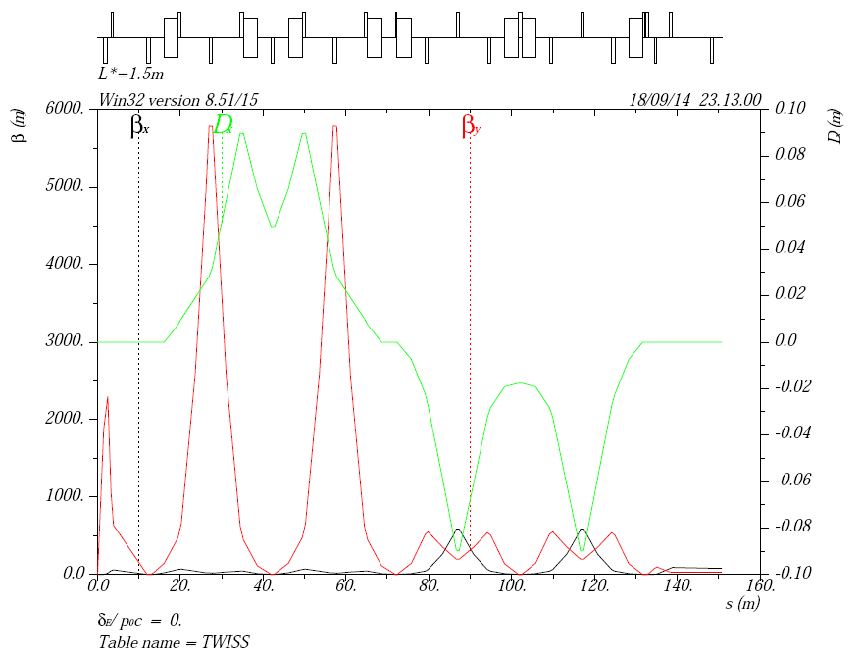
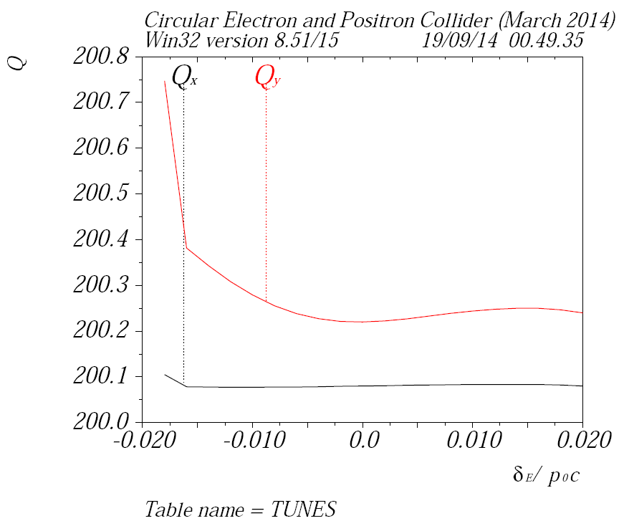
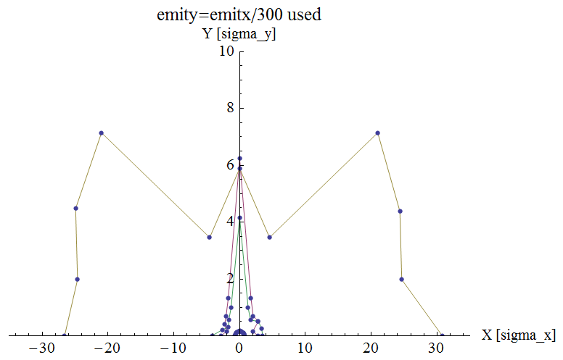
FFS_1.2mm_v0_Sep_2014
Version | Date | author | FT | CCS | MT | Natural chromaticity (incl. FODO) | Primary nonlinear corerction | High order correction | Dynamic aperture with FFS only | Dynamic aperture with whole ring | To be done | Remark
FFS_1.2mm_v0_Sep_2014 (150m) | 2014/9 | Yiwei Wang | 2 quads βy*=1.2mm L*=1.5m d=0.75m R=20mm Btip=8.2T | Ltot=120m βymax=6000m ΔU/U=18% Δε/ε=17% | 4 quads | ξx=-88.3/4 ξy=-1341.9/4 | 1st order ξ, 2nd order geo. aberr. |  |  | with ARC_STRh_5FODO_Sep_2014 0%: (25σx, 6σy) 1.5%: (1σx, 1σy) |  | Based on Yunhai Cai’s design

Slide 7
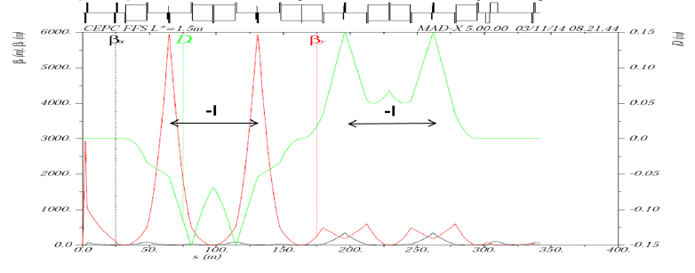
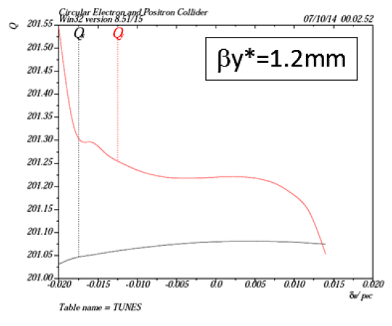
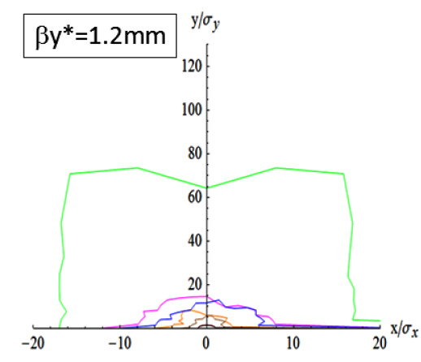
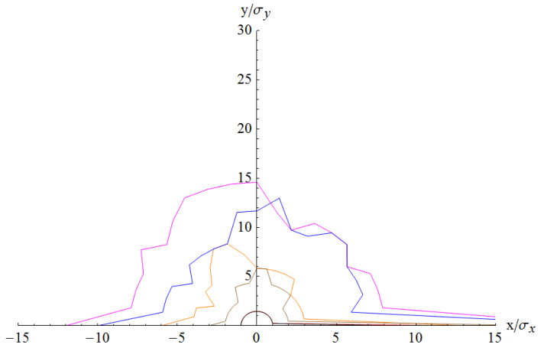
FFS_1.2mm_v1_2_Oct_2014
Version | Date | author | FT | CCS | MT | Natural chromaticity (incl. FODO) | Primary nonlinear corerction | High order correction | Dynamic aperture with FFS only | Dynamic aperture with whole ring | To be done | Remark
FFS_1.2mm_v1_2_Oct_2014 (350m) | 2014/10 | Yiwei Wang | 4 quads βy*=1.2mm L*=1.5m d=0.5m R=21mm Btip=6.3T | Ltot=264m βymax=6000m ΔU/U=3.3% Δε/ε=-2.5% | 4 quads | ξx=-36.8/4 ξy= -923.7/4 | 1st order ξ, 2nd order geo. aberr. | High order ξ (tune phase), 3rd order geo. aberr. from finite length sext. |  | with ARC_STRh_5FODO_STRIPh_8FODO_Oct_2014 0%: (17σx, 70σy) 1.5%: (1.5σx, 1σy) |  | For pre-CDR Help from Yunhai Cai, Anton

Slide 8
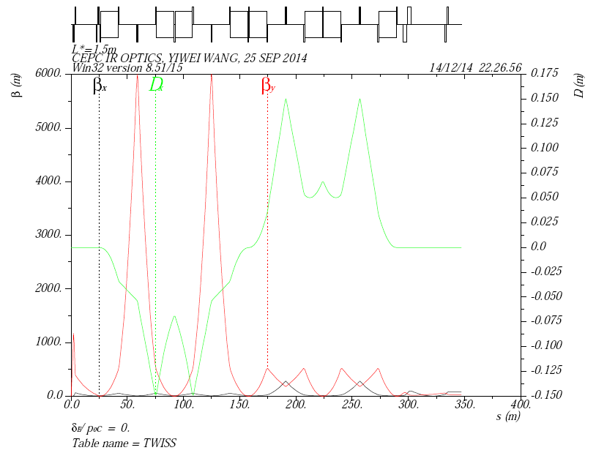
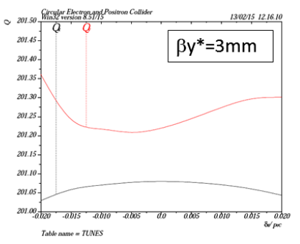
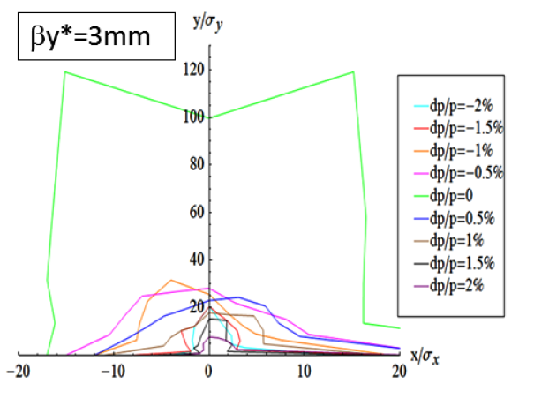
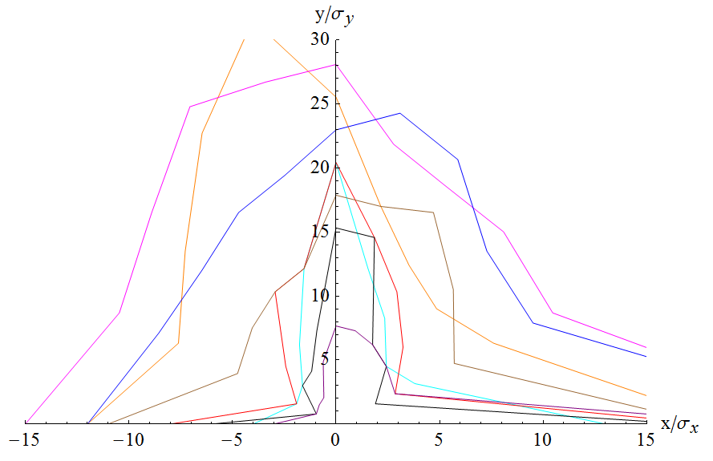
FFS_3.0mm_v0_Feb_2015
Version | Date | author | FT | CCS | MT | Natural chromaticity (incl. FODO) | Primary nonlinear corerction | High order correction | Dynamic aperture with FFS only | Dynamic aperture with whole ring | To be done | Remark
FFS_3.0mm_v0_Feb_2015 (350m) | 2015/2 | Yiwei Wang | 4 quads βy*=3.0mm L*=1.5m d=0.5m R=16mm Btip=4.7T | Ltot=264m βymax=6000m ΔU/U=3.3% Δε/ε=-2.5% | 4 quads | ξx= -36.9/4 ξy= -565.2/4 | 1st order ξ, 2nd order geo. aberr. | High order ξ (tune phase), 3rd order geo. aberr. from finite length sext. |  | with ARC_STRh_5FODO_STRIPh_8FODO_Oct_2014 0%: (17σx, 100σy) 2%: (1.5σx, 13.5σy) |  | For pre-CDR

Slide 9
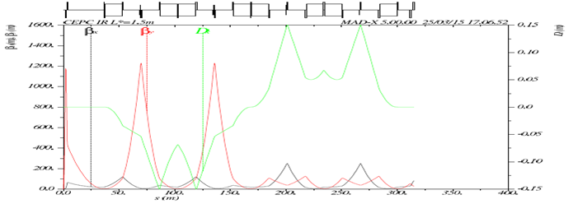
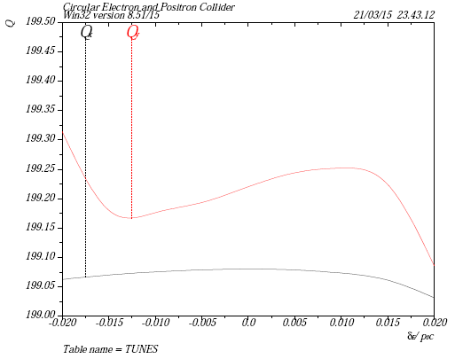
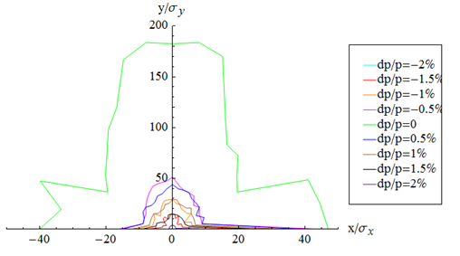
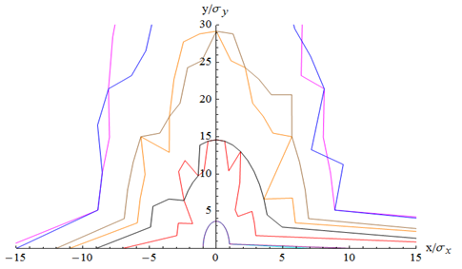
FFS_3.0mm_v1_Mar_2015
Version | Date | author | FT | CCS | MT | Natural chromaticity (incl. FODO) | Primary nonlinear corerction | High order correction | Dynamic aperture with FFS only | Dynamic aperture with whole ring | To be done | Remark
FFS_3.0mm_v1_Mar_2015 (315m) | 2015/3 | Yiwei Wang | 2 quads βy*=3.0mm L*=1.5m d=0.5m R=16mm Btip=4.7T | Ltot=264m βymax=1200m ΔU/U=3.3% Δε/ε=-2.5% | 2 quads | ξx=-24.1/4 ξy=-306.9/4 | reduce ξ contribution from CCS, 1st order ξ, 2nd order geo. aberr. | High order ξ (tune phase), 3rd order geo. aberr. from finite length sext. |  | with ARC_STRh_5FODO_STRIPh_8FODO_Oct_2014 0%: (40σx, 180σy) 2%: (1σx, 3.5σy) much more symetric |  | Comments from the reviewers

Slide 10
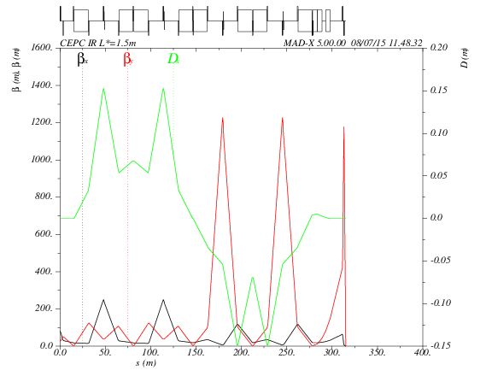
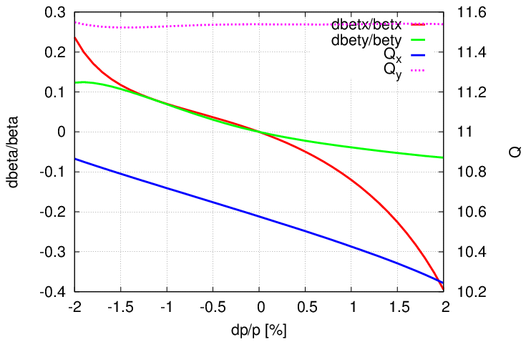
FFS_3.0mm_v2_Jul_2015_tmp
Version | Date | author | FT | CCS | MT | Natural chromaticity (incl. FODO) | Primary nonlinear corerction | High order correction | Dynamic aperture with FFS only | Dynamic aperture with whole ring | To be done | Remark
FFS_3.0mm_v2_Jul_2015_tmp (315m) | 2015/7 | Yiwei Wang | 2 quads βy*=3.0mm L*=1.5m d=0.5m R=16mm Btip=4.7T | Ltot=264m βymax=1200m ΔU/U=3.3% Δε/ε=-2.5% | 2 quads | ξx=-28.6/4 ξy=-306.3/4 | reduce ξ contribution from CCS, 1st order ξ, 2nd order geo. aberr. | High order ξ (tune phase+additional sext.), 3rd order geo. aberr. from finite length sext. |  | TBD | an ARC with optimised dQ/dJ | Idea from Brickmann’s paper and Marica’s comments

Slide 11
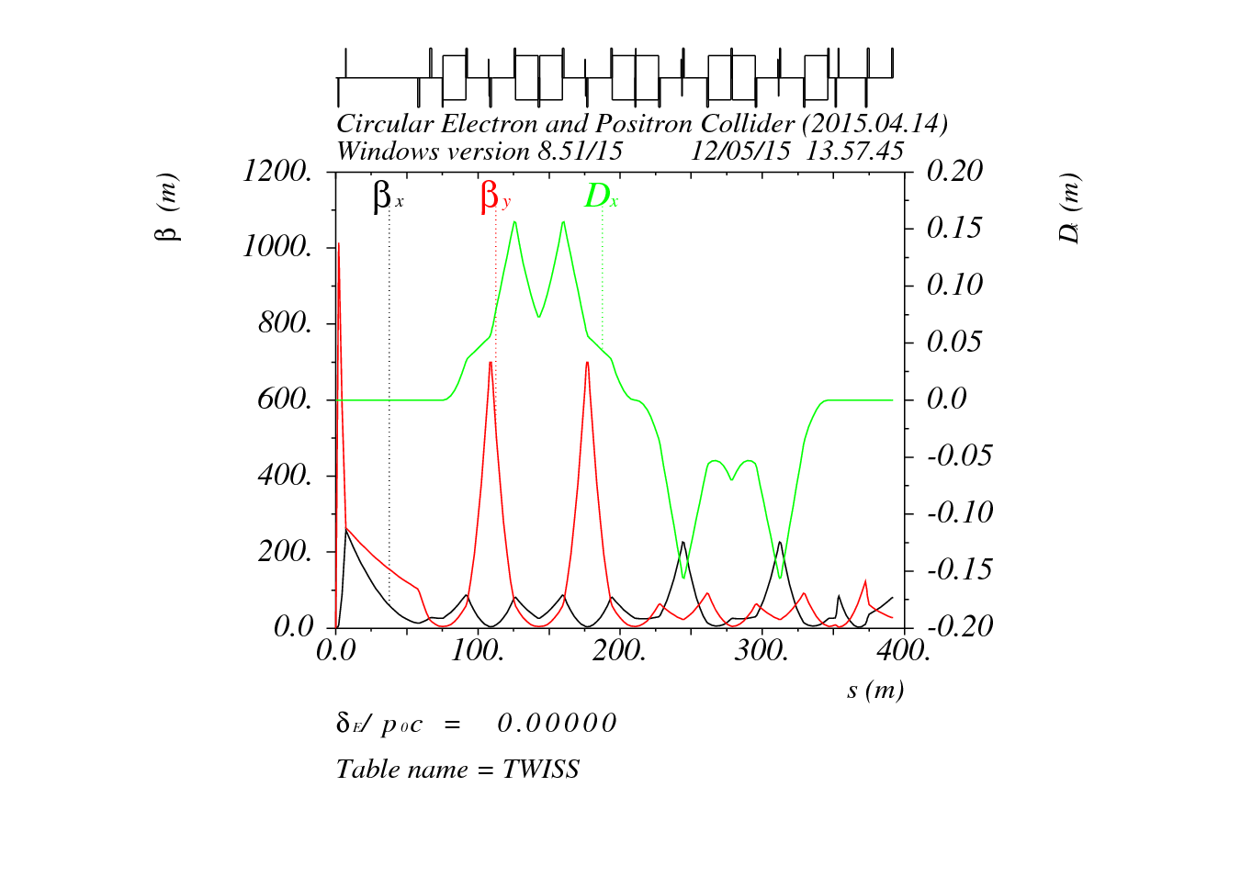
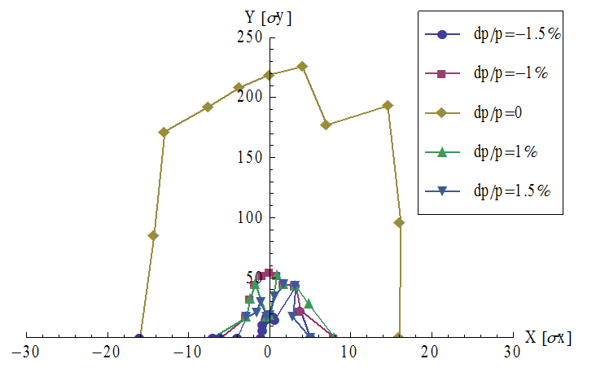
FFS_3.0mm_v1_Apr_2015
Version | Date | author | FT | CCS | MT | Natural chromaticity (incl. FODO) | Primary nonlinear corerction | High order correction | Dynamic aperture with FFS only | Dynamic aperture with whole ring | To be done | Remark
FFS_3.0mm_v1_Apr_2015 (390m) | 2015/4 | Dou Wang | 4 quads βy*=3.0mm L*=1.5m d=4.8m R=15mm Btip=7.2T | Ltot=272m βymax=700m ΔU/U=3.3% Δε/ε=-2.5% | 5 quads |  | reduce ξ contribution from CCS, 1st order ξ, 2nd order geo. aberr. | High order ξ (tune phase), 3rd order geo. aberr. from finite length sext |  | with ARC_STRh_5FODO_STRIPh_8FODO_Oct_2014 0%: (16σx, 220σy) 2%: 0 |  | Comments from the reviewers

Slide 12
Version | Date | author | FT | CCS | MT | Natural chromaticity (incl. FODO) | Primary nonlinear corerction | High order correction | Dynamic aperture with FFS only | Dynamic aperture with whole ring | To be done | Remark
FFS_1.2mm_v0_Sep_2014 (150m) | 2014/9 | Yiwei Wang | 2 quads βy*=1.2mm L*=1.5m d=0.75m R=20mm Btip=8.2T | Ltot=120m βymax=6000m ΔU/U=18% Δε/ε=17% | 4 quads | ξx=-88.3/4 ξy=-1341.9/4 | 1st order ξ, 2nd order geo. aberr. |  |  | with ARC_STRh_5FODO_Sep_2014 0%: (25σx, 6σy) 1.5%: (1σx, 1σy) |  | Based on Yunhai Cai’s design
FFS_1.2mm_v1_2_Oct_2014 (350m) | 2014/10 | Yiwei Wang | 4 quads βy*=1.2mm L*=1.5m d=0.5m R=21mm Btip=6.3T | Ltot=264m βymax=6000m ΔU/U=3.3% Δε/ε=-2.5% | 4 quads | ξx=-36.8/4 ξy= -923.7/4 | 1st order ξ, 2nd order geo. aberr. | High order ξ (tune phase), 3rd order geo. aberr. from finite length sext. |  | with ARC_STRh_5FODO_STRIPh_8FODO_Oct_2014 0%: (17σx, 70σy) 1.5%: (1.5σx, 1σy) |  | For pre-CDR Help from Yunhai Cai, Anton
FFS_3.0mm_v0_Feb_2015 (350m) | 2015/2 | Yiwei Wang | 4 quads βy*=3.0mm L*=1.5m d=0.5m R=16mm Btip=4.7T | Ltot=264m βymax=6000m ΔU/U=3.3% Δε/ε=-2.5% | 4 quads | ξx= -36.9/4 ξy= -565.2/4 | 1st order ξ, 2nd order geo. aberr. | High order ξ (tune phase), 3rd order geo. aberr. from finite length sext. |  | with ARC_STRh_5FODO_STRIPh_8FODO_Oct_2014 0%: (17σx, 100σy) 2%: (1.5σx, 13.5σy) |  | For pre-CDR
FFS_3.0mm_v1_Mar_2015 (315m) | 2015/3 | Yiwei Wang | 2 quads βy*=3.0mm L*=1.5m d=0.5m R=16mm Btip=4.7T | Ltot=264m βymax=1200m ΔU/U=3.3% Δε/ε=-2.5% | 2 quads | ξx=-24.1/4 ξy=-306.9/4 | reduce ξ contribution from CCS, 1st order ξ, 2nd order geo. aberr. | High order ξ (tune phase), 3rd order geo. aberr. from finite length sext. |  | with ARC_STRh_5FODO_STRIPh_8FODO_Oct_2014 0%: (40σx, 180σy) 2%: (1σx, 3.5σy) much more symetric |  | Comments from the reviewers
FFS_3.0mm_v2_Jul_2015_tmp (315m) | 2015/7 | Yiwei Wang | 2 quads βy*=3.0mm L*=1.5m d=0.5m R=16mm Btip=4.7T | Ltot=264m βymax=1200m ΔU/U=3.3% Δε/ε=-2.5% | 2 quads | ξx=-28.6/4 ξy=-306.3/4 | reduce ξ contribution from CCS, 1st order ξ, 2nd order geo. aberr. | High order ξ (tune phase+additional sext.), 3rd order geo. aberr. from finite length sext. |  | TBD | an ARC with optimised dQ/dJ | Idea from Brickmann’s paper and Marica’s comments
FFS_3.0mm_v1_Apr_2015 (390m) | 2015/4 | Dou Wang | 4 quads βy*=3.0mm L*=1.5m d=4.8m R=15mm Btip=7.2T | Ltot=272m βymax=700m ΔU/U=3.3% Δε/ε=-2.5% | 5 quads |  | reduce ξ contribution from CCS, 1st order ξ, 2nd order geo. aberr. | High order ξ (tune phase), 3rd order geo. aberr. from finite length sext |  | with ARC_STRh_5FODO_STRIPh_8FODO_Oct_2014 0%: (16σx, 220σy) 2%: 0 |  | Comments from the reviewers

Slide 13
Summary
Growth of the emittance and synchrotron ration due to the insertions of the IRs has been reduced to a reasonable value for lattices after the lattice “FFS_1.2mm_v0_Sep_2014”.
Chromticity contribution from CCS should be neglectable compared with the one from FD.
The momentum acceptance has been extended to 2% when βy* increased from 1.2mm to 3.0 mm.
Pairs of weak sextupoles beside the main ones effectively correct the finite length effect.
Tuning phases between the FD and sextupoles and additional sextupoles effectively correct the high order chromaticity.
Break down of –I matrix, 2nd order dispersion and maybe other aberration should be corrected to further increase the DA for dp/p=2%.

