Slide 1
Neutrinos as a Cosmic Messenger
Shun Zhou (周顺)
IHEP, Beijing
Seminar @ Experimental Physics Division, IHEP, 2015-7-24

Slide 2
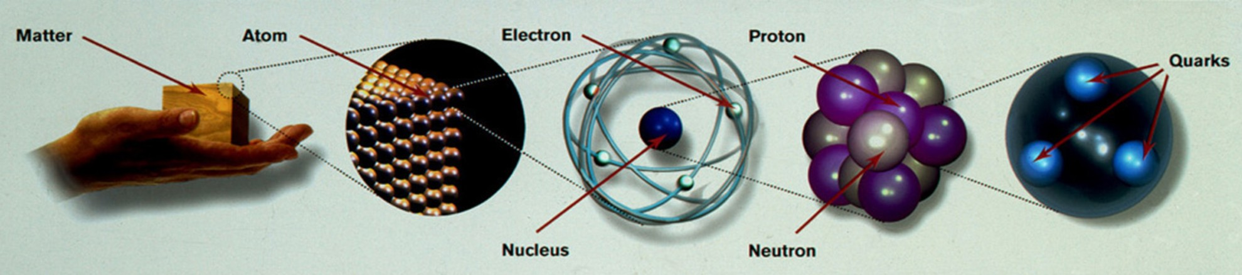
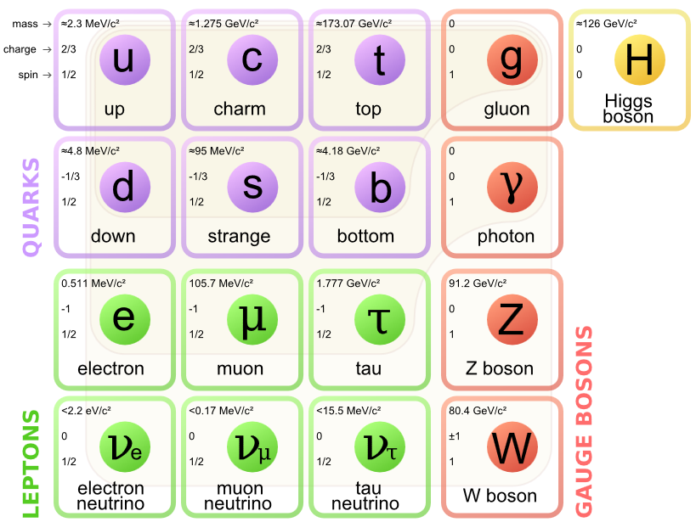
Standard Model of
Elementary Particles
Three generations of quarks and
leptons-building blocks of matter
Gauge bosons as force carriers
Strong Interaction (8 gluons)
Electromagnetic Interaction (γ)
Weak Interaction (W and Z)
Gravitation (Graviton?)
Neutrinos are massive particles-
beyond the Standard Model
1

Slide 3
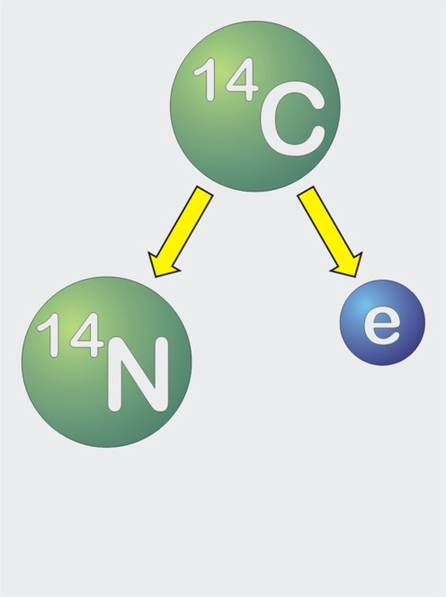
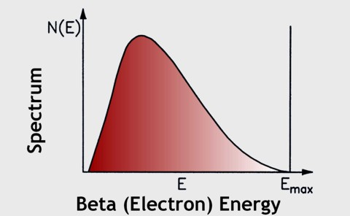
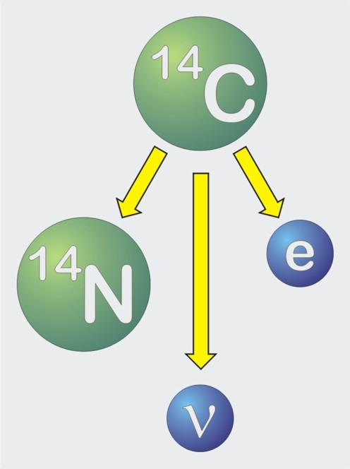
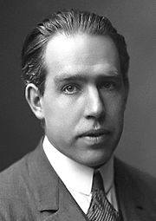
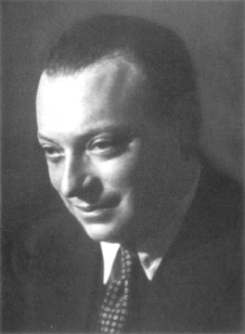
Pauli’s Neutrino Hypothesis
“Neutrino”
(E. Fermi,
1933)
“Neutron”
(1930)
?
Niels Bohr
(1885-1962)
Nobel Prize 1922
Energy not
conserved in
the quantum
domain?
Wolfgang Pauli
(1900–1958)
Nobel Prize 1945
there exist in the
nuclei electrically
neutral particles,
that I call neutrons
2

Slide 4
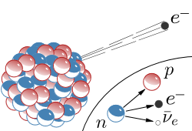
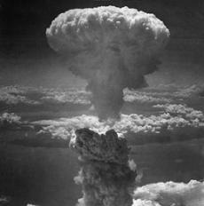
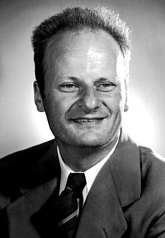
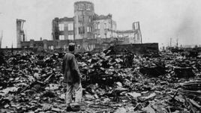
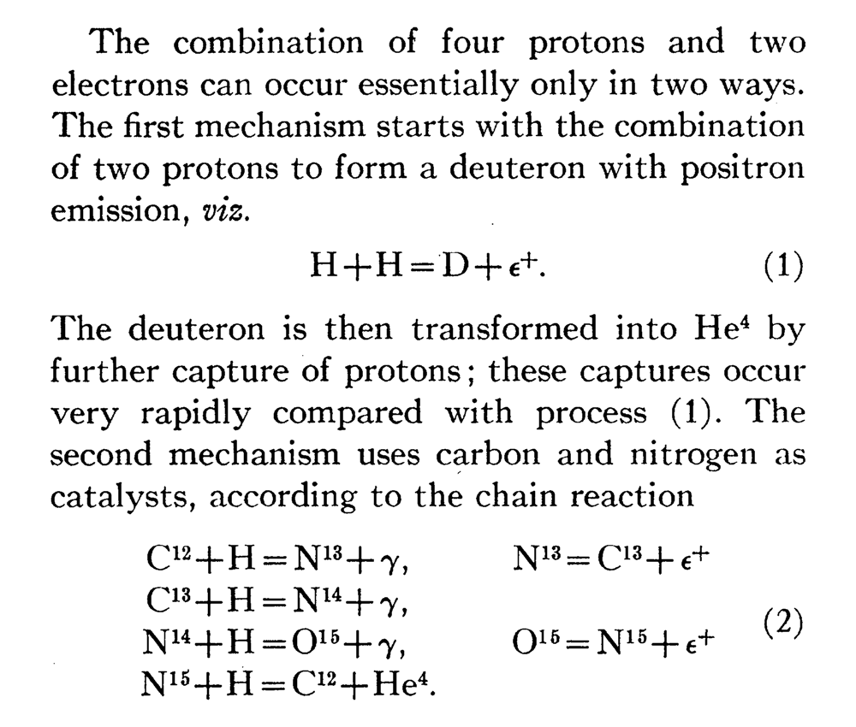
Detecting Neutrinos from Nuclear Explosions?
Bethe and Peierls (1934)
“It is therefore absolutely impossible to observe the processes of this kind with the neutrinos created in nuclear transformations.”
No neutrinos in Bethe’s
classic paper on nuclear
reactions in stars (1939)
Hans A. Bethe
(1906–2005)
Nobel Prize 1967
Reines to Fermi (1951): neutrino detector near ‘A-bombs’?
3
Notes:
The

Slide 5
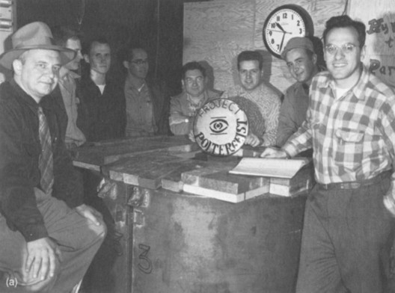
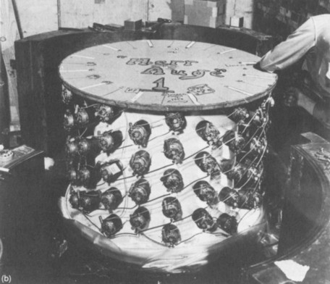

Discovery of Reactor Neutrinos 1954-1956
Clyde Cowan
(1919 – 1974)
Fred Reines
(1918 – 1998)
Nobel Prize 1995
Neutrino Detector
Gave up
‘A-bombs’
Hanford
Nuclear
Reactor
three Gammas
5 μs delay of γ
from n capture
on Cadmium
time coincidence
n
Cd
γ
p
γ
e⁺
e⁻
γ
4

Slide 6
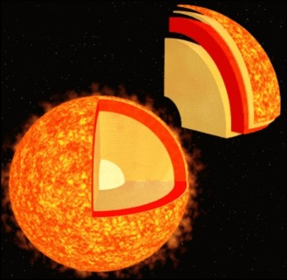
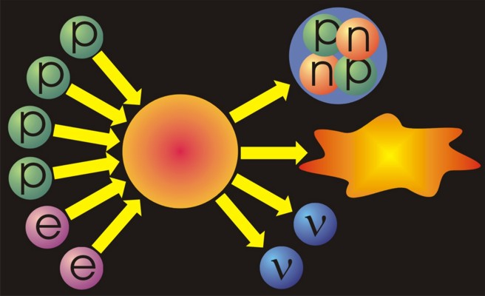
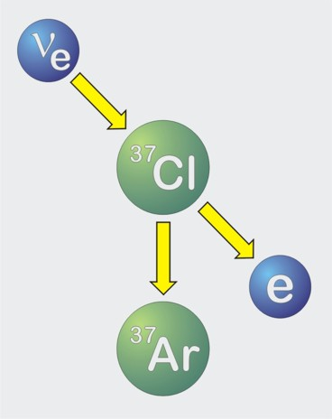
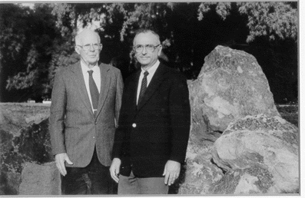
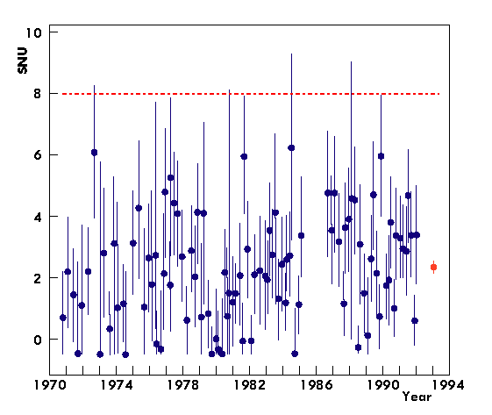
Discovery of Solar Neutrinos (1968)
Helium
Reaction-
chains
Energy
26.7 MeV
Homestake Experiment
R. Davis
J. Bahcall
3

Slide 7

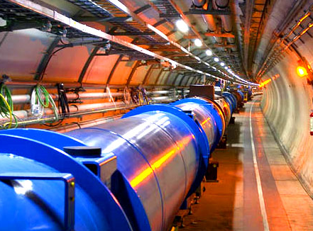
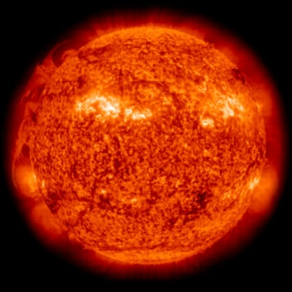
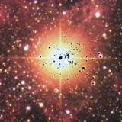
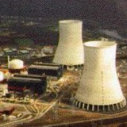
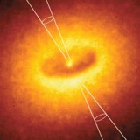

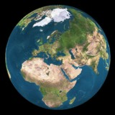
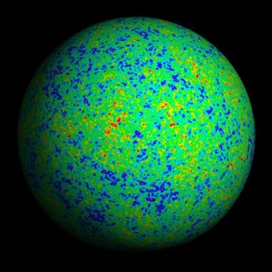
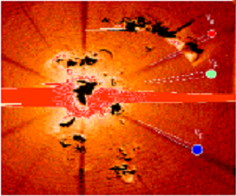
Neutrino Sources in Nature
Nuclear Fusion
in the Sun
✓
✓
Supernova Explosion
SN 1987A
Particle Accelerators
Nuclear Reactors
✓
✓
Cosmic Accelerators ?
3 UHE neutrino events
@ IceCube
Cosmic rays
@ the Earth
Atmosphere
✓
Big Bang
(Indirect
Evidence)
Natural radioactivity
in the Earth Crust
✓
6

Slide 8

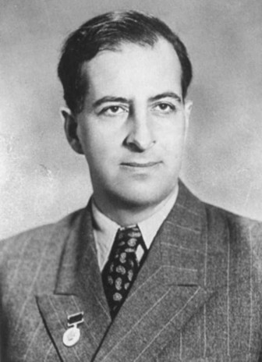

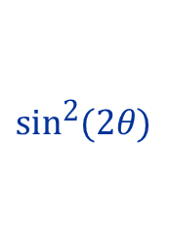
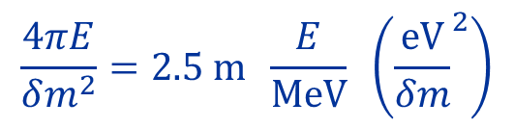
Neutrino Flavor Oscillations
Two-flavor mixing
Pontecorvo, 1957; Maki, Nakagawa, Sakata, 1962
Bruno Pontecorvo
(1913–1993)
Invented ν oscillations
z
Neutrino Oscillations:
quantum phenomena of
massive neutrinos at the
macroscopic distances
Oscillation
Length
7

Slide 9
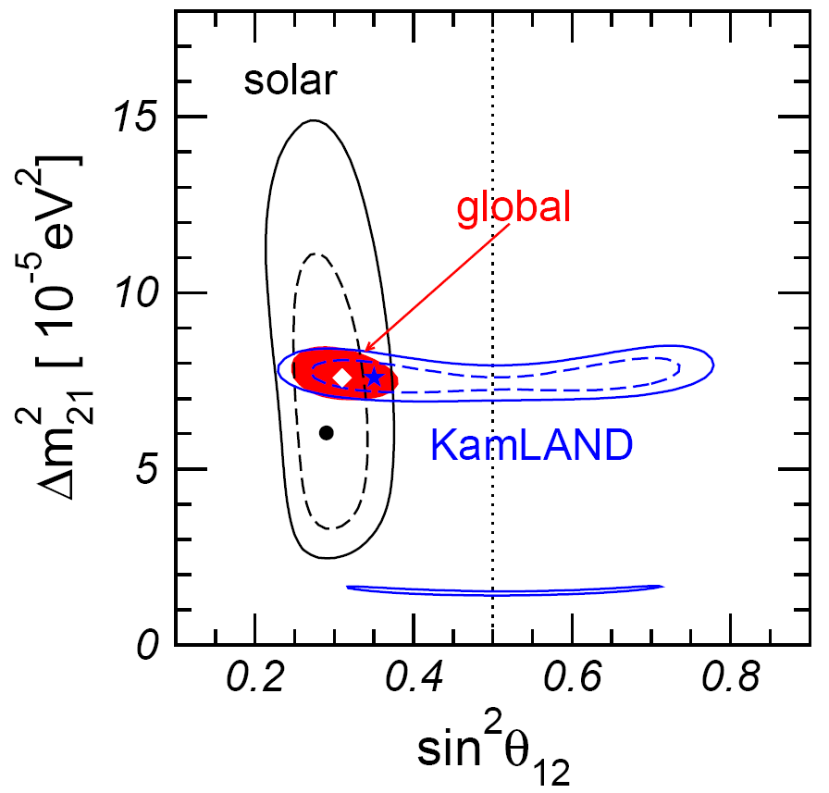
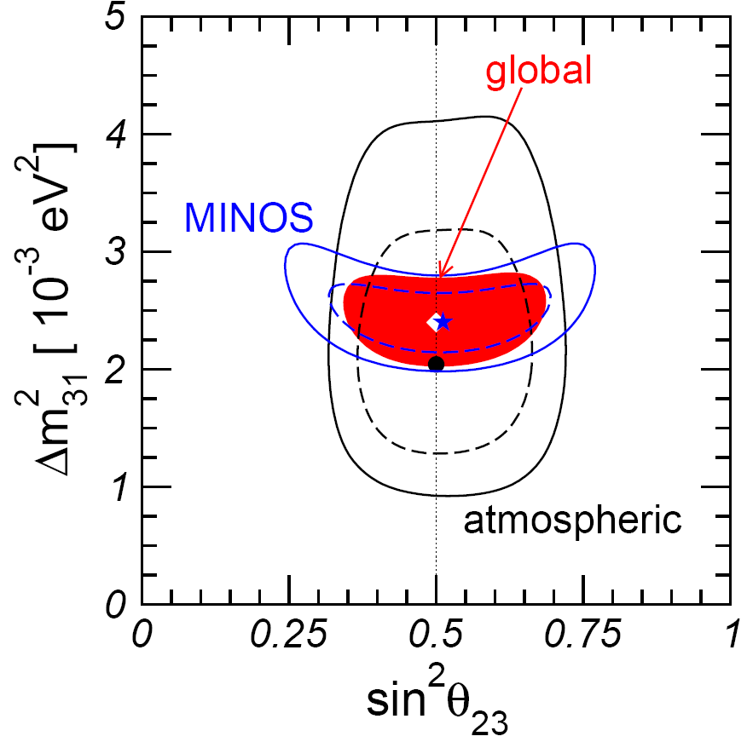
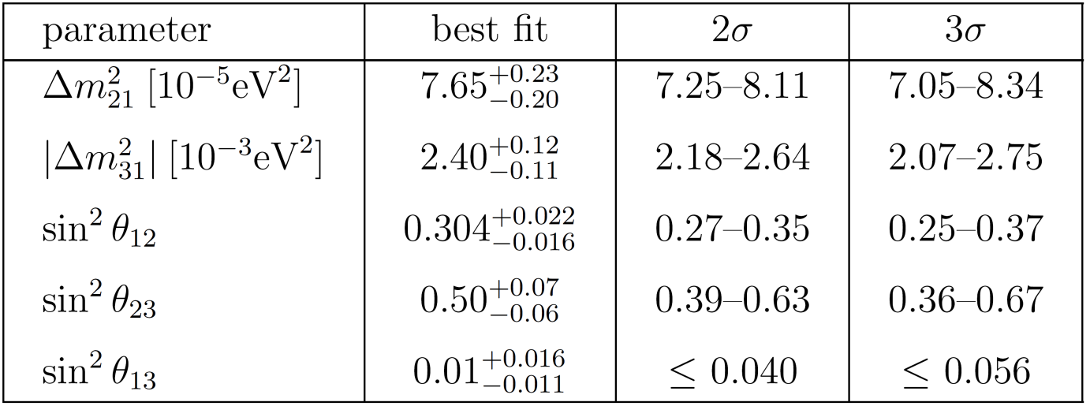
What we have learned about neutrinos
Global Analysis of Neutrino Oscillation Experiments
Schwetz et al., NJP 2008
No direct evidence for a nonzero θ13
0.9σ
θ₁₂=33.5º, θ₂₃=45º, θ₁₃=5.7º
8

Slide 10
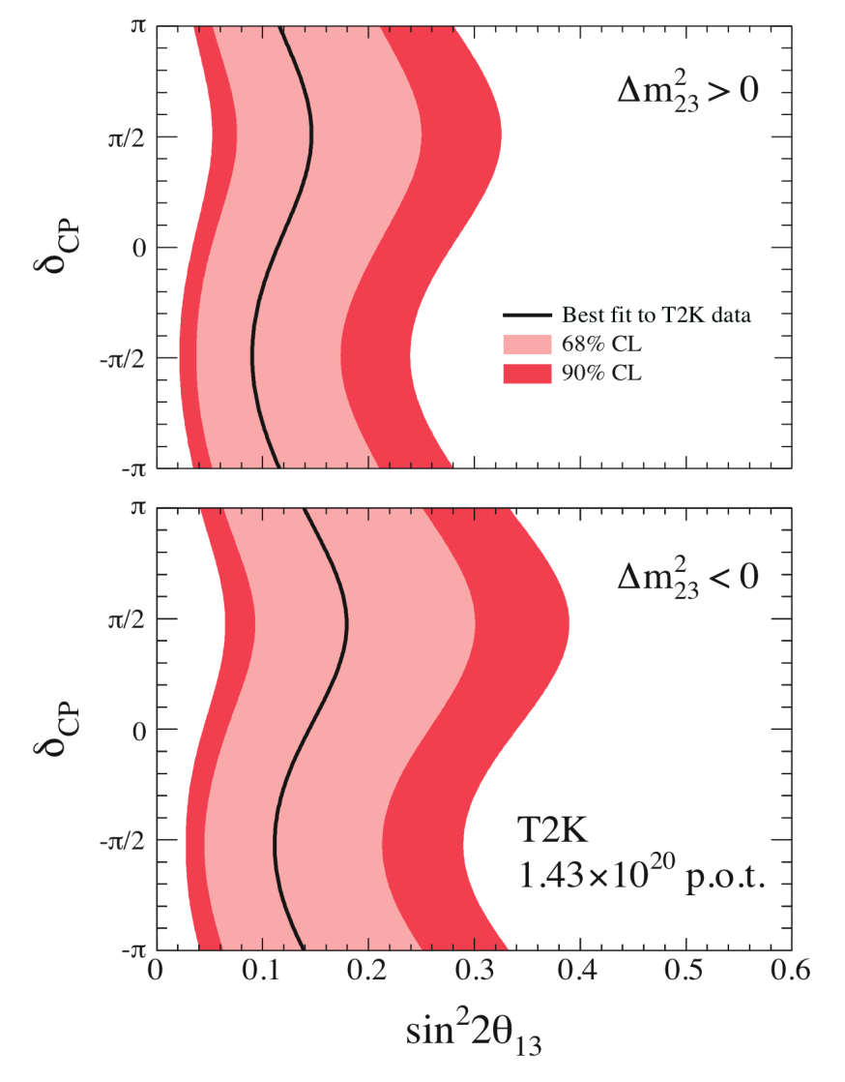
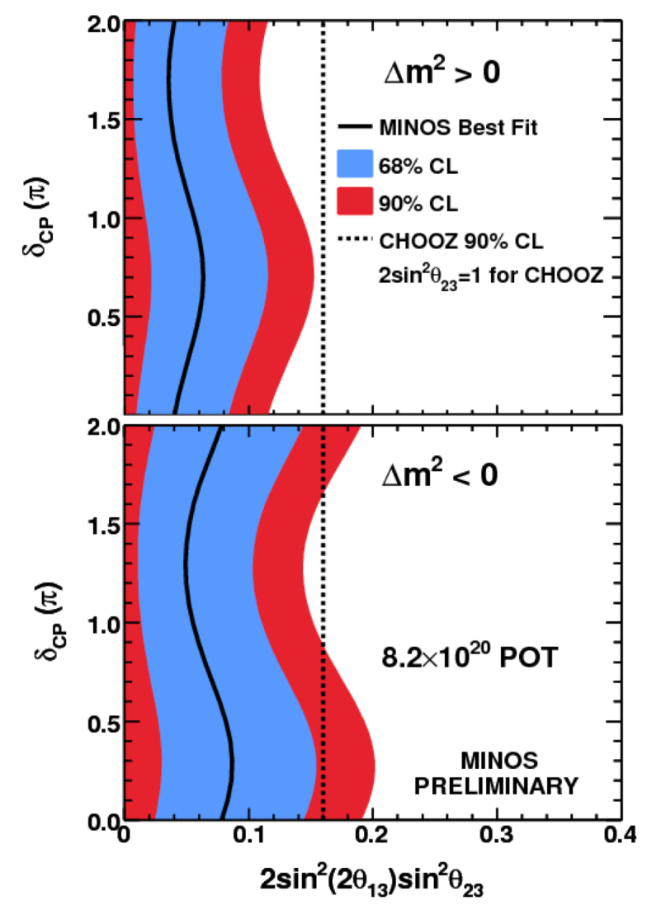
What we have learned about neutrinos
June 2011 breakthrough: Appearance results from T2K and MINOS
T2K
MINOS
2.5σ
1.7σ
9

Slide 11
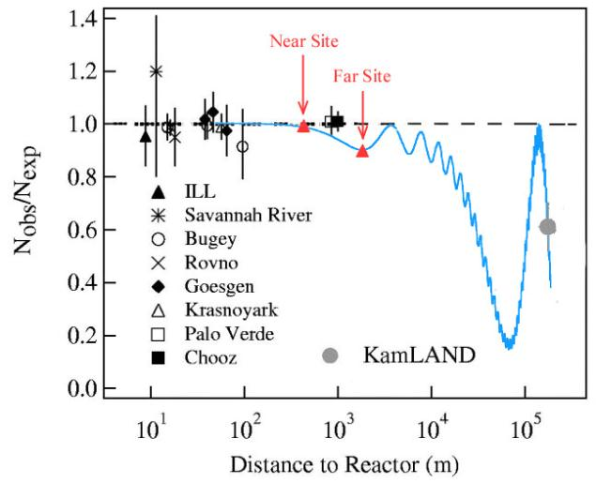
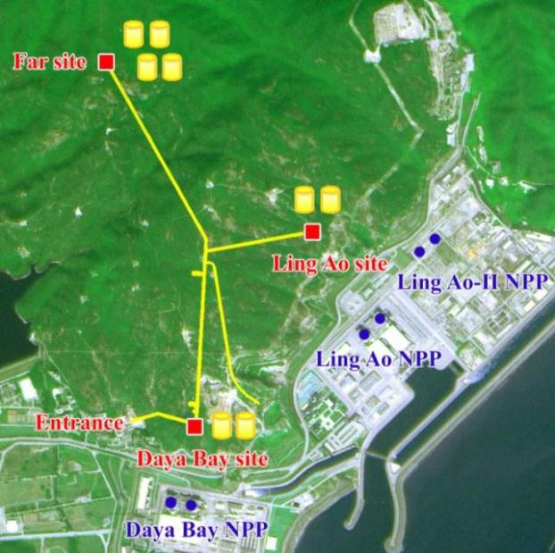
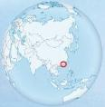
What we have learned about neutrinos
4MeV ͞ν_{e}
Dec. 2011
Double Chooz (far detector):
Daya Bay (near + far detectors):
RENO (near + far detectors):
sin² θ₁₃ = 0.022 ± 0.013
sin² θ₁₃ = 0.024 ± 0.004
sin² θ₁₃ = 0.029 ± 0.006
1.7σ
Mar. 2012
5.2σ
Apr. 2012
4.9σ
10

Slide 12
Neutrino Oscillations
Probability ν_{e} → ν_{μ}
sin²(2θ)
Pontecorvo-Maki-Nakagawa-Sakata Matrix
z
Oscillation
Length
Standard Parametrization
3-flavor
Mixing
Atmospheric
Accelerator
Reactor
Accelerator
Solar
Reactor
0νββ?
θ₂₃ ~ 45°
θ₁₃ ~ 9°
θ₁₂ ~ 34°
11

Slide 13
Current Status of Neutrino Mixing Parameters
Gonzalez-Garcia et al., 1409.5439
Open Questions
Normal/Inverted Mass Ordering
Leptonic CP-Violating Phase (δ)
Dirac or Majorana Neutrinos
Absolute Neutrino Mass Scale
Origin of Masses and Mixing
Extra (Sterile) Neutrino Species
Neutrino Mass Ordering
Medium-baseline Reactor: JUNO, RENO-50
Long-baseline Accelerator: T2K, NOνA
Atm. Neutrinos: PINGU, ORCA，INO, Hyper-K
Second Step
Leptonic CP Violation
Long-baseline: LBNF/DUNE
Neutrino Super-B: ESSνSB, MOMENT
ν Factory & Beta-Beams
First Step
Non-oscillation experiments: Tritium β decays (KATRIN), 0νββ (¹³⁶Xe, ⁷⁶Ge), Cosmology, ……
12

Slide 14


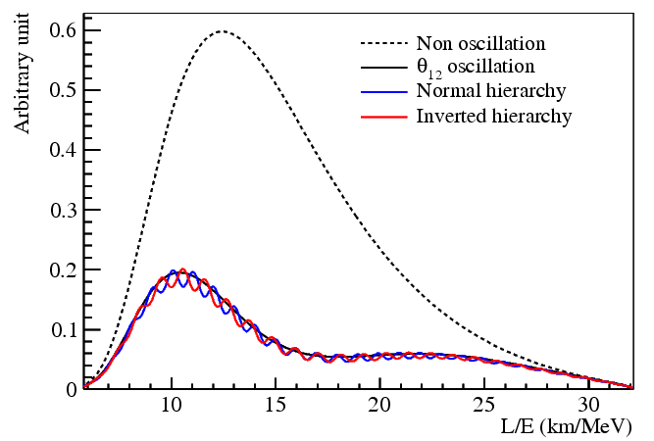
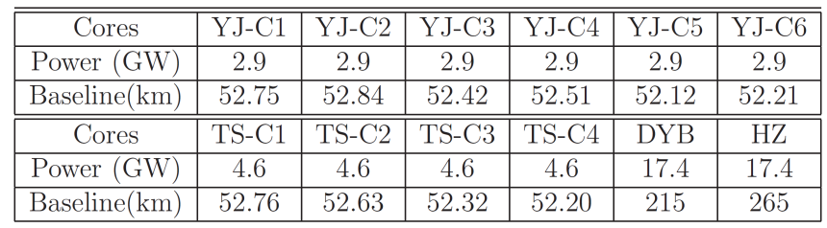

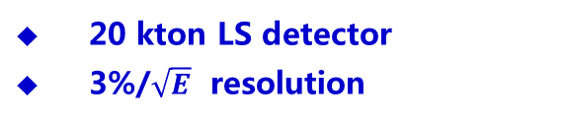
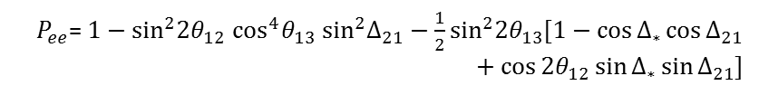


Neutrino Mass Ordering: JUNO & RENO-50
Daya Bay
60 km
JUNO
© Jun Cao, NeuTel 2015
20 kton LS detector
3%/$\sqrt{E}$ resolution
Oscillation Probability:
$P_{ee}$= 1 $−$ $\sin^{2}2θ_{12}$ $\cos^{4}θ_{13}$ $\sin^{2}Δ_{21}−\frac{1}{2}\sin^{2}2θ_{13}$[1 $−$ $\cos{Δ_{∗}}cos{Δ_{21}}$ + $\cos{{2θ}_{12}\sin{Δ_{∗}}}sin{Δ_{21}}$]
JUNO: Jiangmen, Guangdong
3σ ~4σ in 6 years
$$Δ_{ji}=\frac{\left(m\begin{matrix}2 \\ j\end{matrix}−m\begin{matrix}2 \\ i\end{matrix}\right)L}{4E}$$
$$m_{3}>m_{2}>m_{1}$$
$$m_{2}>m_{1}>m_{3}$$
$Δ_{∗}=Δ_{31}$ +${ Δ}_{32}$
Li et al., 1303.6733
13

Slide 15
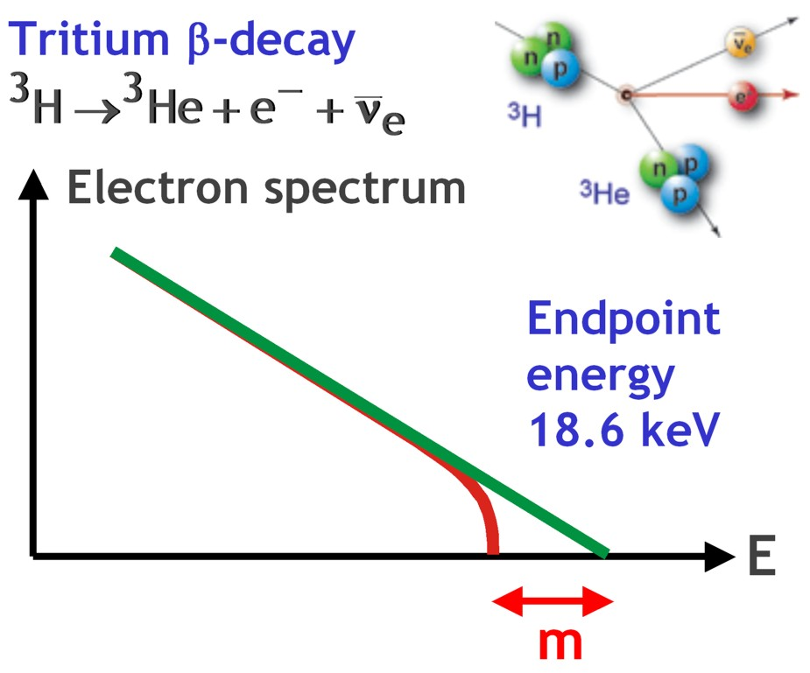
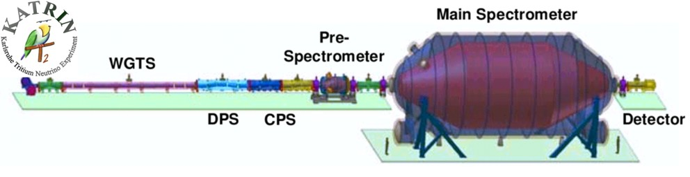
Tritium Beta Decay: Absolute Neutrino Masses
Sensitive to common mass scale m
for all flavors because of small mass
differences from oscillations
Best limit from Mainz and Troitsk
m < 2.2 eV (95% CL)
KATRIN can reach 0.2 eV
Under construction
Data taking to begin 2015/16
http://www.katrin.kit.edu
14

Slide 16
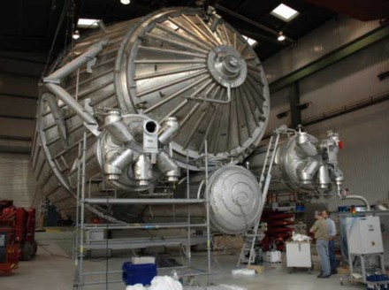
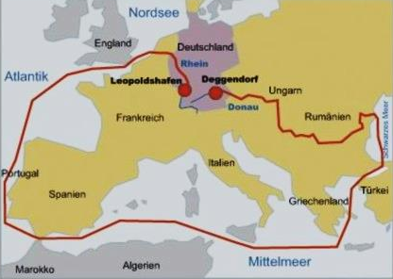
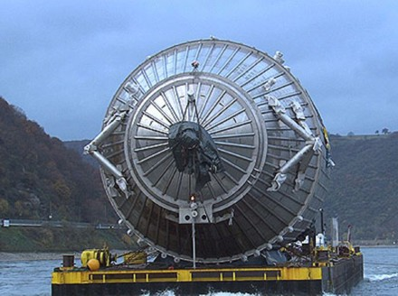
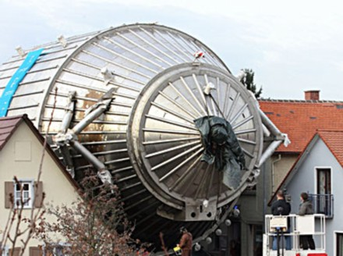
KATRIN: So Near, and Yet So Far
15

Slide 17
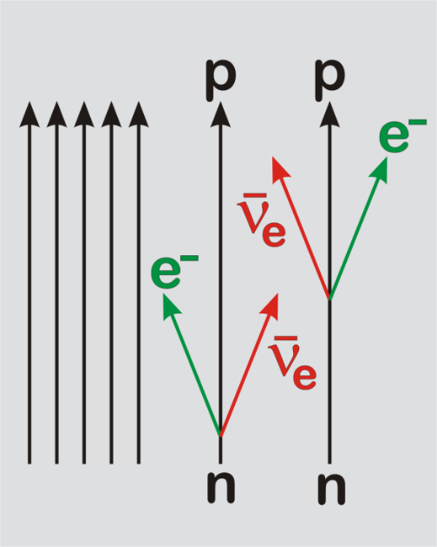
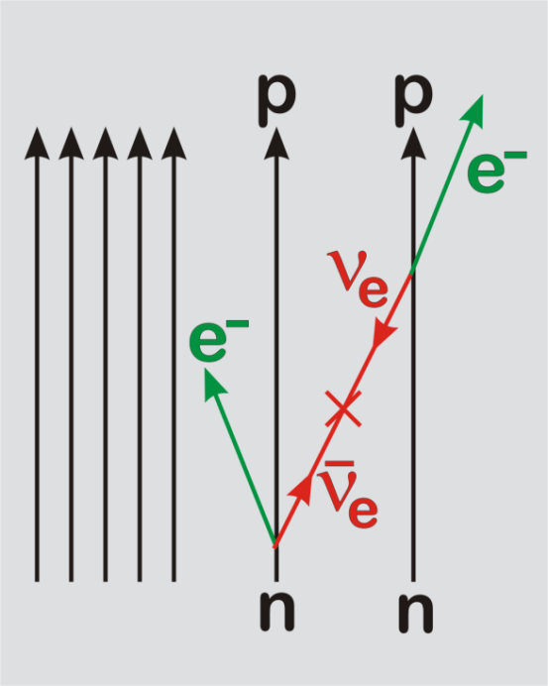




Neutrinoless Double-Beta Decay: Majorana vs. Dirac
Some nuclei decay only by
the ββ mode, e.g. Ge-76
⁷⁶As
2⁻
⁷⁶Ge
0⁺
⁷⁶Se
2⁺
0⁺
Standard 2ν mode
0ν mode, enabled
by Majorana mass
Measured
quantity
Best limit
from ⁷⁶Ge
16

Slide 18

Cosmological Limit on Neutrino Masses
Cosmic background neutrinos: 112 neutrinos and anti-neutrinos per
flavor per cubic centimeter, next to relic photons from the Big Bang
CMB alone constraining Σm_{ν}
CMB + BAO constraining Σm_{ν} + N_{eff}
CMB + BAO limit: Σm_{ν} < 0.23 eV (95% CL)
Ade et al. (Planck Collaboration), arXiv:1303.5076 & 1502.01589
17

Slide 19








Seesaw Models of Neutrino Masses
Charged Leptons
Neutrinos
Dirac masses
from coupling
to standard
Higgs field Φ
Heavy
Majorana
masses
M_{j} > 10¹⁰ GeV
Lagrangian for
particle masses
$$ℒ_{mass}=$$
$$− \overline{ℓ_{L}}Y_{l}ΦE_{R}− \overline{ℓ_{L}}Y_{ν}ΦN_{R}$$
$$−\frac{1}{2} \overline{N\begin{matrix}C \\ R\end{matrix}}MN_{R}$$
$$\frac{Y\begin{matrix}2 \\ ν\end{matrix}{\left\langle Φ\right\rangle }^{2}}{M}$$
Light Majorana mass
$$\left(\begin{matrix}\overline{ν_{L}} & \overline{N\begin{matrix}C \\ R\end{matrix}}\end{matrix}\right)\left(\begin{matrix}0 & Y_{ν}\left\langle Φ\right\rangle \\ Y_{ν}\left\langle Φ\right\rangle & M\end{matrix}\right)\left(\begin{matrix}ν\begin{matrix}C \\ L\end{matrix} \\ N_{R}\end{matrix}\right)$$
$$\left(\begin{matrix}\overline{ν_{L}} & \overline{N\begin{matrix}C \\ R\end{matrix}}\end{matrix}\right)\left(\begin{matrix}\frac{Y\begin{matrix}2 \\ ν\end{matrix}{\left\langle Φ\right\rangle }^{2}}{M} & 0 \\ 0 & M\end{matrix}\right)\left(\begin{matrix}ν\begin{matrix}C \\ L\end{matrix} \\ N_{R}\end{matrix}\right)$$
Diagonalize
18

Slide 20

Seesaw Models of Neutrino Masses
ν
ℓ±
N
Heavy
right-handed
neutrinos
Charged
leptons
Ordinary
neutrinos
Light Majorana mass
$$\left(\begin{matrix}\overline{ν_{L}} & \overline{N\begin{matrix}C \\ R\end{matrix}}\end{matrix}\right)\left(\begin{matrix}\frac{Y\begin{matrix}2 \\ ν\end{matrix}{\left\langle Φ\right\rangle }^{2}}{M} & 0 \\ 0 & M\end{matrix}\right)\left(\begin{matrix}ν\begin{matrix}C \\ L\end{matrix} \\ N_{R}\end{matrix}\right)$$
10¹⁰ GeV
1 GeV
10⁻¹⁰ GeV
19

Slide 21


Seesaw Models and Leptogenesis
M. Fukugita & T. Yanagida:
Baryogenesis without Grand Unification
Phys. Lett. B 174 (1986) 45
Equilibrium
abundance of
heavy Majorana
neutrinos
In see-saw models for neutrino masses,
out-of-equilibrium decays of RH heavy
Majorana neutrinos provide source for
CP- and L-violation
Real abundance
determined by decay rate
CP-violating decays by interference of
tree-level with one-loop diagram
Created
lepton-number
abundance
B = L = 0 early on
Thermal freeze-out of heavy Majorana neutrinos
Out-of-equilibrium CP-violating decay creates net L
Shift L excess into B by sphaleron effects
Cosmological Matter-antimatter
Asymmetry
20

Slide 22




Detection of pp Neutrinos from the Sun
Borexino Collaboration
Nature 512 (2014) 383
21

Slide 23



Galactic SN 1054
Distance: 6500 light years (2 kpc)
Center: Neutron Star ( R~30 km)
Progenitor : M ~ 10 solar masses
Red：Optical (Hubble)
Blue：X-Ray (Chandra)
22

Slide 24


Stellar Collapse and SN Explosion
© Raffelt
Main-sequence star
Helium-burning star
Hydrogen Burning
Helium
Burning
Hydrogen
Burning
23

Slide 25


Stellar Collapse and SN Explosion
© Raffelt
Onion structure
Collapse (implosion)
Degenerate iron core:
ρ ≈ 10⁹ g cm⁻³
T ≈ 10¹⁰ K
M_{Fe} ≈ 1.5 M_{sun}
R_{Fe} ≈ 8000 km
24

Slide 26




Stellar Collapse and SN Explosion
© Raffelt
Neutrino-driven Explosion
Newborn Neutron Star
$\sim$ 50 km
Proto-Neutron Star
ρ ≈ 3x10¹⁴ g cm⁻³
T ≈ 30 MeV
25

Slide 27
Stellar Collapse and SN Explosion
© Raffelt
Newborn Neutron Star
Gravitational binding energy
E_{b} ≈ 3 × 10⁵³ erg ≈ 17% M_{SUN} c²
$\sim$ 50 km
This shows up as
99% Neutrinos
1% Kinetic energy of explosion
(1% of this into cosmic rays)
0.01% Photons, outshine host galaxy
Neutrino cooling
by diffusion
Neutrino luminosity
L_{ν} ≈ 3 × 10⁵³ erg / 3 sec
≈ 3 × 10¹⁹ L_{SUN}
While it lasts, outshines the entire
visible universe
Proto-Neutron Star
ρ ≈ 3x10¹⁴ g cm⁻³
T ≈ 30 MeV
26

Slide 28




Supernova Neutrinos: Theoretical Predictions
Kitaura, Janka & Hillebrandt
astro-ph/0512065
Raffelt, 1996
27

Slide 29


Large Magellanic Cloud SN 1987A
Sanduleak - 69 202
Supernova 1987A
23 February 1987
Distance：165 000 light yrs (50 kpc)
Center：Neutron Star
(expected, but not found)
Progenitor： M ~ 18 solar masses
28

Slide 30



Supernova Neutrinos: SN 1987A
Arnett et al.,
ARAA 27 (1989)
Hirata et al., PRD 38 (1988) 448
29

Slide 31

Supernova Neutrinos: SN 1987A
Kamiokande-II (Japan):
Water Cherenkov (2,140 ton)
Clock Uncertainty ± 1 min
Irvine-Michigan-Brookhaven (US):
Water Cherenkov (6,800 ton)
Clock Uncertainty ±50 ms
Baksan LST (Soviet Union):
Liquid Scintillator (200 ton)
Clock Uncertainty +2/-54 s
Mont Blanc: 5 events, 5 h earlier
30

Slide 32

Supernova Neutrinos: SN 1987A
Assumptions:
Thermal
Equipart.
Jegerlehner, Neubig & Raffelt
astro-ph/9601111
Conclusions:
Collapse
Ave.Ener.
Duration
E_{b} [10⁵³ ergs]
Problems：
24 events
by chance
Spectral anti-ν_{e} Temperature [MeV]
31

Slide 33

Supernova Neutrinos: Astrophysics & Astronomy
Explosion Mechanism：Neutrino-driven Explosion
The prompt shock halted at 150 km,
by disintegrating heavy nuclei
© Raffelt
Neutrinos deposit their energies via
interaction with matter; 1 % neutrino
energy leads to successful explosion
Simulations in 1D & 2D for different
progenitor masses observe explosions
3D simulation has just begun; but no
clear picture (resolution, progenitors)
for a review, Janka, 1211.1378

Slide 34

Supernova Neutrinos: Astrophysics & Astronomy
For Optical Observations：SuperNova Early Warning System (SNEWS)
Arnett et al.,
ARAA 27 (1989)
http://snews.bnl.gov/
Daya Bay
KamLAND
Super-K
IceCube
LVD
Borexino
Neutrinos arrive several hours before photons
To alert astronomers several hours in advance
Alert @BNL
33

Slide 35


Supernova Neutrinos: Astrophysics & Astronomy
Gravitational waves from SN Explosions
Locate the SN via neutrinos
Tomàs et al., hep-ph/0307050
Müller, Rampp, Buras, Janka,& Shoemaker,
astro-ph/0309833
“Towards gravitational wave signals from
realistic core collapse supernova models”
GWs from asymmetric
neutrino emission
Beacom & Vogel, astro-ph/9811350
n-tagging efficiency
95% CL half-cone
opening angle
None
90 %
GWs from convective mass flows
7.8°
3.2°
SK
Bounce
1.4°
0.6°
SK × 30
34

Slide 36






Supernova Neutrinos: Next-Generation Detectors
5-100 kton
liquid Argon
DUSEL
100 kton scale
scintillator
Hyper-K
Memphys
LENA
HanoHano
Megaton-scale
water Cherenkov
35

Slide 37
Supernova Neutrinos: from Dream to Reality
JUNO (Jiangmen Underground Neutrino Observatory), Guangdong, China Collaboration formed (2014), expected to take data in 2020
20 kt scintillator detector, 3% energy resolution
Determination of neutrino mass hierarchy with reactor neutrinos
Also good for low-energy neutrino astronomy
36

Slide 38

SN ν Detection: ongoing and upcoming experiments
MiniBooNE
(200)
LVD (400)
Borexino (100)
Baksan
(100)
Super-Kamiokande (10⁴)
KamLAND (400)
SN @10 kpc
JUNO (10⁴)
Water / Ice
Cherenkov
Liquid
Scintillator
IceCube (10⁶)

Slide 39



Supernova Neutrinos: Collective Flavor Conversions
Duan, Fuller & Qian, 1011.2799
Neutrino-neutrino
refraction causes
a flavor instability,
flavor exchange
between different
parts of spectrum
Vacuum
MSW
Collective

Slide 40

Grand Unified Neutrino Spectrum
Cosmic ν background
Solar ν’s
SN ν burst (1987A )
Reactor anti-ν’s
Diffuse SN ν background
Geo-anti- ν’s
Atmospheric ν’s
AGN ν’s
GZK ν’s
ASPERA Roadmap
39

Slide 41




Ultrahigh-energy neutrinos: Astrophysical Sources
Flux of Cosmic Rays
Pierre Auger, PRL, 08
Observation of GZK cutoff ?
HiRes, PRL, 08
Existence of UHE Neutrinos?
40

Slide 42




Ultrahigh-energy neutrinos: Astrophysical Sources
GRB
_
γ
DM
p
χ
χ
e⁺
ν
SNR
AGN
41

Slide 43




Ultrahigh-energy neutrinos: Challenges and Opportunities
km³-scale NT: IceCube
42

Slide 44





Ultrahigh-energy neutrinos: Challenges and Opportunities
KM3NeT
ANTARES
La-Seyne-sur-Mer, France
BAIKAL
Russia
NEMO
Catania, Italy
NESTOR
Pylos, Greece
IceCube
South Pole, Antarctica
43

Slide 45



Ultrahigh-energy neutrinos: Challenges and Opportunities
10 TeV
375 TeV
Distinct signals for different flavors:
Particle physics by using the flavors, given the sources
Probe sources by using the flavors, given ν properties
10⁴ TeV
44

Slide 46



Ultrahigh-energy neutrinos: Unique Opportunity
CMB
Light absorbed
Neutrino (1ν_{e}:2ν_{μ})
(1ν_{e}:1ν_{μ}:1ν_{τ})
Proton scattered
by magnetic field
To explore extremely high energy region
To locate distant astrophysical sources
To study new scenarios in particle physics
Conventional source: decays of charged π’s produced from UHE p+p or p+γ collisions.
Naïve expectation: ultra-long-baseline UHE cosmic ν-oscillations (Learned, Pakvasa 95).
45

Slide 47
Incomplete list of relevant works
■ Learned, Pakvasa, APP (95)
★ Athar et al, PRD (00)
★ Bento et al, PLB (00)
★ Gounaris, Moultaka, hep-ph/0212110
★ Barenboim, Quigg, PRD (03)
★ Beacom et al, PRD (03)
★ Keraenen et al, PLB (03)
★ Beacom et al, PRD (04)
★ Hooper et al, PLB (05)
★ Serpico, Kachelriess, PRL (05)
★ Bhattacharjee, Gupta, hep-ph/0501191
★ Serpico, PRD (06)
★ Xing, PRD (06)
★ Xing, Zhou, PRD (06)
★ Winter, PRD (06)
★ Athar et al, MPLA (06)
General sources and contaminations
(Parametrization, Xing & Zhou 06)
active-sterile neutrino mixing & oscillation
★ Rodejohann, JCAP (07)
★ Majumdar, Ghosal, PRD (07)
★ Xing, NPB (Proc. Suppl.) (07)
★ Blum, Nir, Waxman, arXiv:0706.2070
★ Lipari et al, PRD (07)
★ Meloni, Ohlsson, PRD (07)
★ Awasthi, Choubey, PRD (07)
★ Hwang, Kim, arXiv:0711.3122
★ Xing, NPB (Proc. Suppl.) (08)
★ Pakvasa et al, JHEP (08)
★ Choubey, Niro, Rodejohann, PRD (08)
★ Pakvasa, arXiv:0803.1701
★ Maltoni, Winter, JEHP (08)
★ Xing, Zhou, PLB (08)
★ Xing, Zhou, PRD(11)
★ ……
μ-τ symmetry breaking effects and CP phase δ
ν-decays
Test of CPT, Q-coherence, unitarity, …
Can ν-telescopes (IceCube, KM3NeT) do …?
46

Slide 48





Neutrino Production in Astrophysical Sources
$${π_{}^{+}⟶μ_{}^{+}+ν}_{μ}$$
$$↳$$
$${e_{}^{+}+{\overline{ν}}_{μ}^{}+ν}_{e}$$
max. center-of-mass energy ~ 10³ TeV
(for 10²¹ eV protons)
Example: Active galaxy
(Halzen, Venice 2009)
47

Slide 49


Glashow Resonance as a Discriminator: pp vs. pγ
unique way to distinguish between neutrinos and antineutrinos
possible way to tell us whether pp or pγ process is dominant
Glashow, 1960; Berezinsky , Gazizov, 1977, 1981; Anchordoqui et al., 2004;
Winter et al., 2010; Bhattacharya et al., 2005, 2011; Xing, Zhou, 2011
@ E_{ν} = 6.3 PeV
Waxman-Bahcall Bound
pp
pγ
48

Slide 50




Discovery of PeV Cosmic Neutrinos in IceCube
IceCube Collaboration, Science 342 (2013) 947; PRL 113 (2014) 101101
3-year data, 37 events, in the energy range 30 TeV – 2 PeV
Purely atmospheric neutrino explanation excluded @ 5.7σ
Best-fit astrophysical sources with a spectrum E^{-2.3}
49

Slide 51
Flavor Ratio of UHE Neutrinos in IceCube
The flavor ratio at the source 1:0:0 (neutron decay) is excluded @ 3.6 σ
μ-damped source favored, but still compatible with
π-μ-decay source
IceCube Collaboration, arXiv: 1507.03991
50

Slide 52
Summary and Outlook
Understanding intrinsic properties of neutrinos — a mature field
Neutrino mixing parameters:
well known from oscillation experiments, precision measurements
New experiments designed for mass ordering and CP violation
Absolute masses yet to be determined (KATRIN, cosmology)
Majorana nature yet to be found (neutrinoless double beta decays)
Neutrinos as a cosmic messenger — a field in its infancy
Detailed measurement of solar nus (ca 60,000 events in Super-K)
First detection of solar pp nus (evidence for energy production)
Geo-neutrinos (ca 116 events in KamLAND, 14 events in Borexino)
Neutrinos from SN 1987A (ca 20 events)
UHE nu events in IceCube (1.1 PeV, 1.3 PeV, 2.0 PeV and 34 others)
More statistics needed in all of these areas:
bigger/better detectors planned or under construction (JUNO)
- Waiting for next nearby supernova

