Slide 1
CEPC FFS update and stacking ring consideration
Dou Wang, Yiwei Wang, Ming Xiao, Xiaohao Cui, Bai Sha, Feng Su, Tianjian Bian
CEPC AP meeting, 2015.08.12

Slide 2
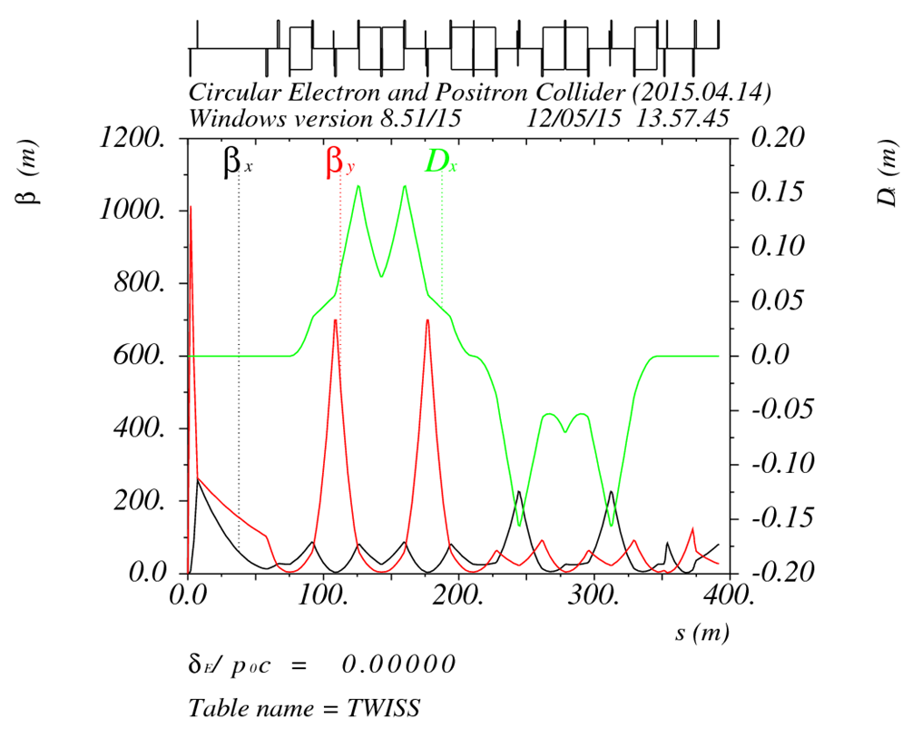
FFS_3.0mm_v1_Apr_2015

Slide 3
Geometry of FFS
This kind of FFS optics is not suitable ring.
The “S-like” geometry make difficulty for local double ring scheme.
It is better to be a part of arc section.

Slide 4
Design momentum P0 = 120.00000 GeV Revolution freq. f0 = 5469.6918 Hz
Energy loss per turn U0 = 3115.5066 MV Effective voltage Vc = 6870.0000 MV
Equilibrium position dz = 34.825065 mm Momentum compact. alpha = 3.3704E-5
Orbit dilation dl = .0000000 mm Effective harmonic # h = 117900.00
Bucket height dV/P0 = .0599891
Emittance X = 6.12176E-9 m Emittance Y = .00000000 m
Emittance Z = 2.89200E-6 m Energy spread = .00132831
Bunch Length = 2.17720579 mm Beam tilt = .00000000 rad
Beam size xi = .06998133 mm Beam size eta = .00000000 mm

Slide 5
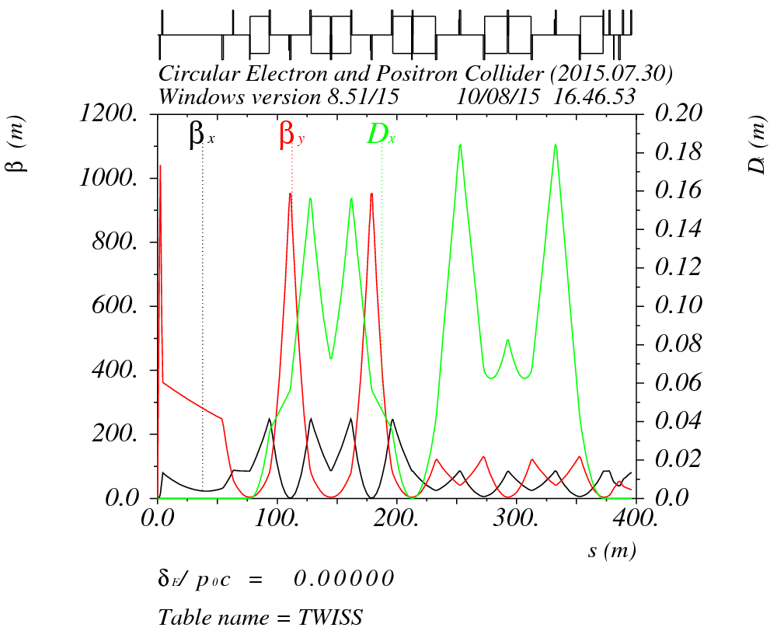
FFS_3.0mm_v3_July_2015
All bending angles have the same sign to meet the ring requirements (rather than the Linear Collider ones).
Dipole lengths and bending angles have been adjusted in order to meet the geometrical requirements of local double ring scheme.

Slide 6
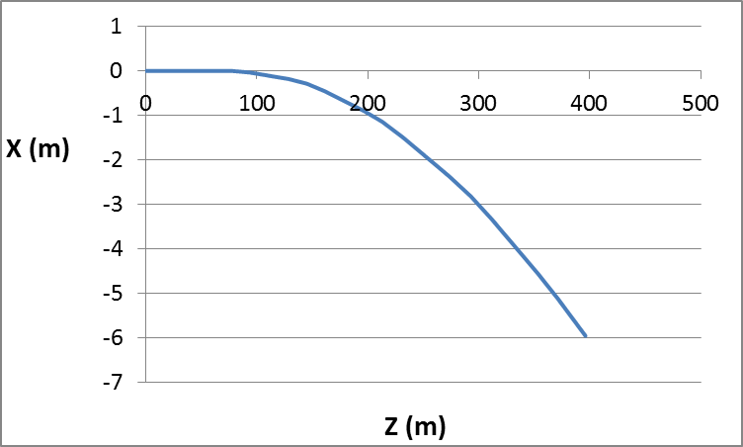
Geometry of FFS

Slide 7
In order to insert the FFS, the dipole angle in original arc should be reduced.
Design momentum P0 = 120.00000 GeV Revolution freq. f0 = 5468.0197 Hz
Energy loss per turn U0 = 2979.8801 MV Effective voltage Vc = 6870.0000 MV
Equilibrium position dz = 32.933539 mm Momentum compact. alpha = 3.2279E-5
Orbit dilation dl = .0000000 mm Effective harmonic # h = 118873.01
Bucket height dV/P0 = .0627310
Emittance X = 5.80037E-9 m Emittance Y = .00000000 m
Emittance Z = 2.73512E-6 m Energy spread = .00131190
Bunch Length = 2.08485359 mm Beam tilt = .00000000 rad
Beam size xi = .06811950 mm Beam size eta = .00000000 mm

Slide 8
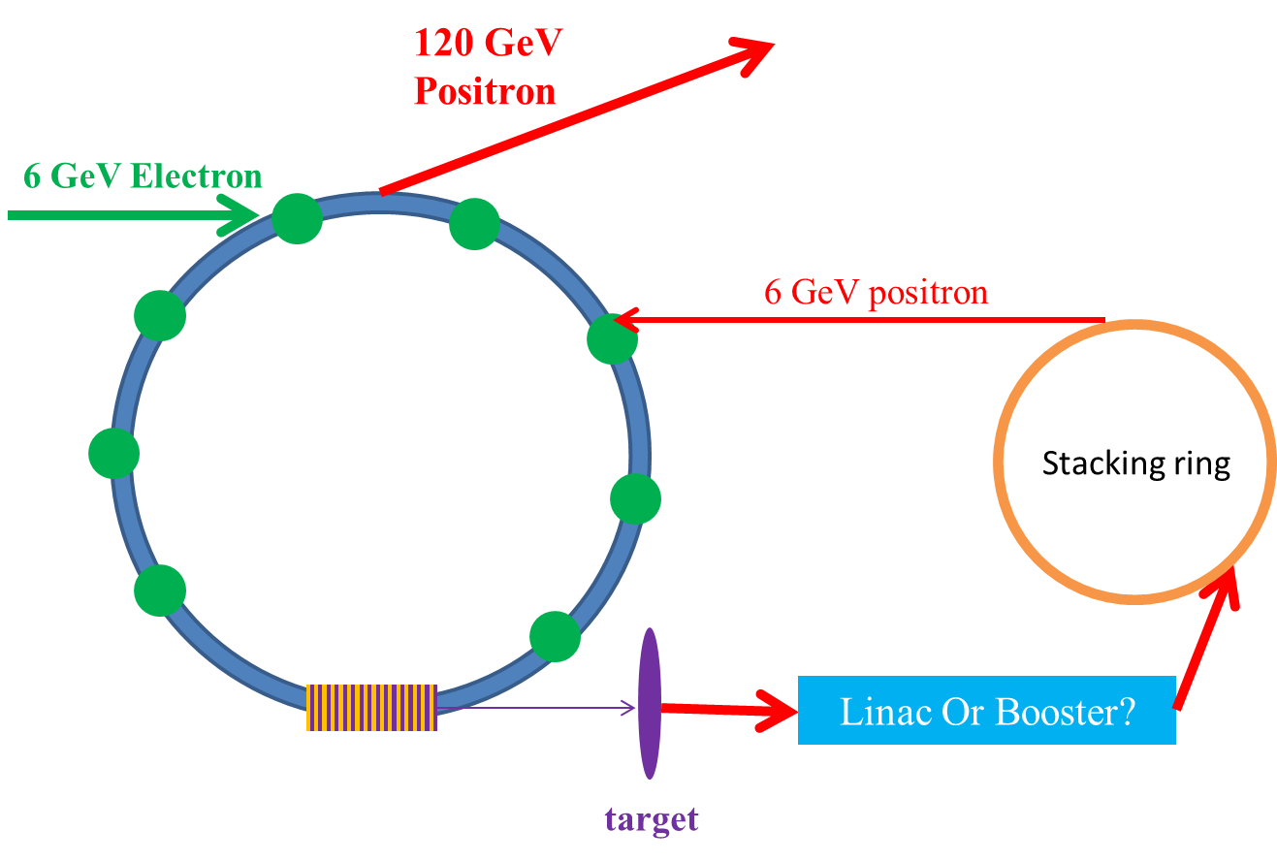
Undulator based positron source
*Form Xiaohao Cui

Slide 9
ILC damping ring
Energy (GeV) | 5.0
Bunch number | 1320/2625
Charge/ bunch | 2×10¹⁰
frf(MHz) | 650
αp | ～10⁻⁴
Injection emittance（normalized） x/y (mm) | 10/10
Extracted emittance（normalized） x/y (um) | 8/0.02
Damping time (ms) | <25 ms
Bunch length (mm) | 6
Energy spread (%) | <0.15

Slide 10
ILC damping ring extraction
Length of bunch train in main Linac: 1 ms (300km)
Circumference of DR << Length of bunch train in main Linac
Bunches need to be stacked in damping ring.
Bunch number per train: h
bunch interval in DR : Δt
bunch interval in main Linac : n×Δt
h can not be divided by n with no remainder
Single bunch extraction → kicker duration(up & down)< bunch interval in DR

Slide 11
CEPC stacking ring structure
50 bunches are storaged in booster with 50km circumference.
How to choose the circumference of the stacking ring?
Maximum circumference: 50km/3=17km, kicker speed: 1km/3/c =1.1us
Minimum circumference: 50km/49=1km, kicker speed :1km/49/c=68ns
example: 50km/8=6.3km, kicker speed :1km/8/c=416ns

Slide 12
summary
Do we need to redesign the geometry of CEPC FFS?
Work for the new FFS optics is going on.
Plan to do some FMA analysis for DA optimizaiton.
Make some consideration for CEPC stacking ring.

