Slide 1


Study on CEPC double beam pipe scheme
XIAO Ming, GAO Jie, WANG Yi-Wei, WANG Dou, BAI Sha
August 12,2015

Slide 2
outline
_
Number of separators
Separator system layout study
Time structure of bunch train
What to do next

Slide 3
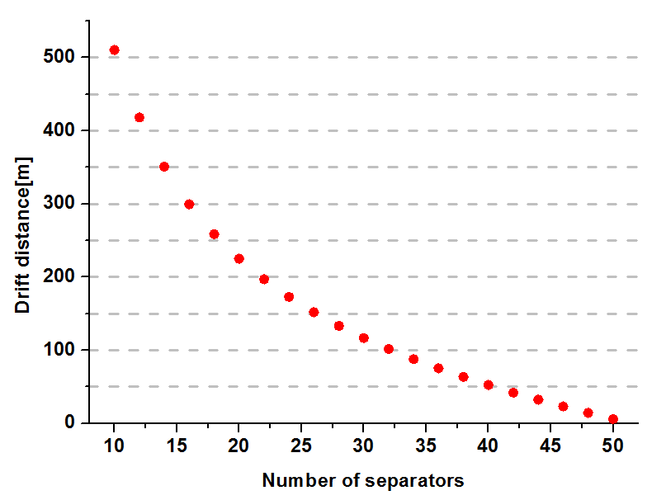
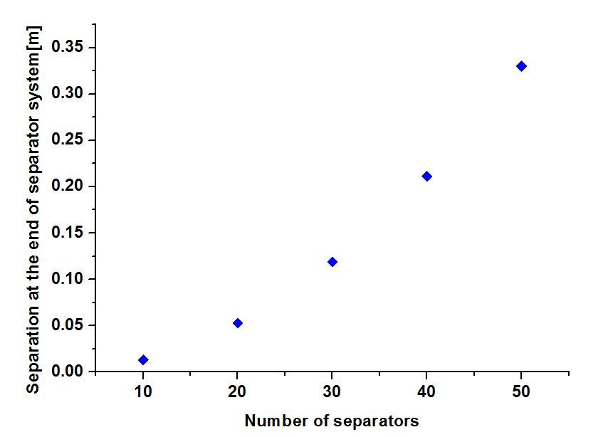
Number of separators
_
Max. deflection per separator is 66μrad.
In order to achieve at least 35cm×2 separation of the two beams, 20 separators is a good choice for the primary study.
225.152m
5.28cm

Slide 4
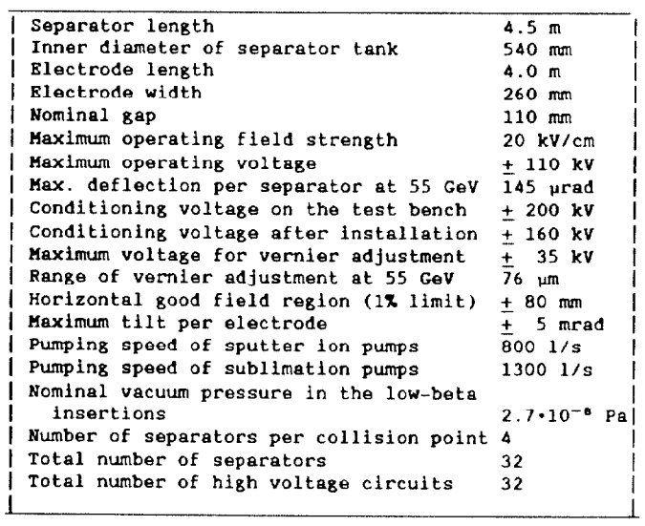
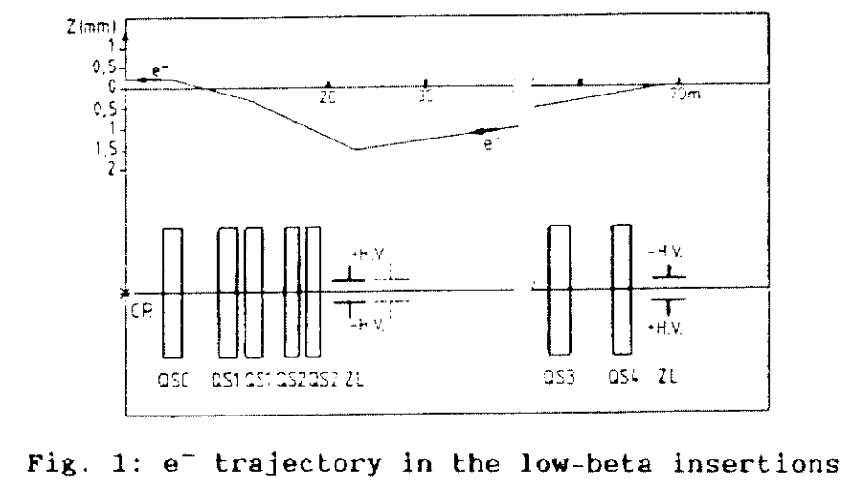
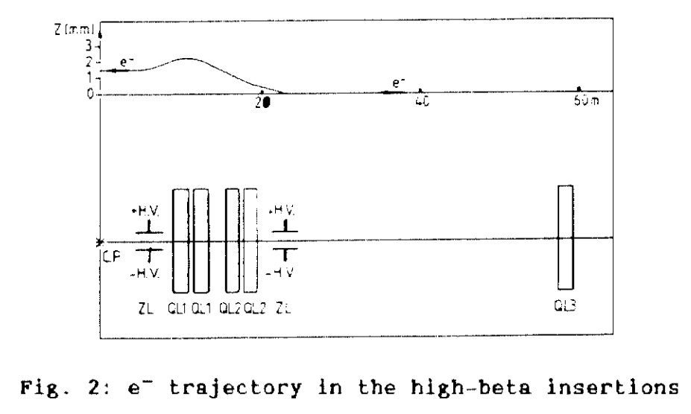
Separator system layout study
_

Slide 5
Layout of separators for CEPC
_
Beam travels through the separators, the motion could be decomposed.
We could treat the separators as drift section.
The arc design of CEPC Pre-CDR is FODO, we could use 5 separators replace the dipole(19.6m) to make the beam stable in separator system.
By separators
Beam motion along orbit

Slide 6
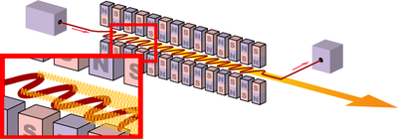
Electromagnetic separator system
_
Motivation
It is not effective to achieve a large separation for a high energy beam just by electric field.
Dipole could not separate electron and positron at the same time.
Why not combined separator and magnetic field?
The field of wiggler could be adopted.

Slide 7
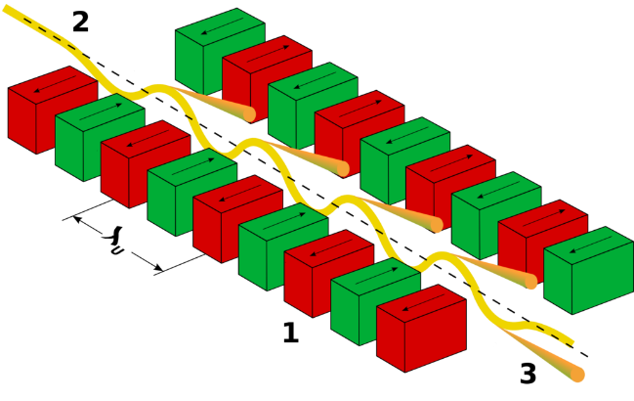
Electromagnetic separator system
_
Advantages
Fewer separators
Shorter drift distance
Working principle
Beam travels through separators to get some deflection
Then the beam goes through wiggler field from the arrow direction.
Beam after separators

Slide 8
Time structure of bunch train
_
We take the parameters design from CEPC pre-CDR. We assume that the local double section is about 10% of the whole ring.
Here we temporarily choose 120 FODO cells length (47.2m*120=5660m) to achieve a bunch train scheme, which would need another 1.416km on each side of IP.
Parameters | Value | Unit
Circumference | 54374 | m
Length of one FODO cell | 47.2 | m
Harmonic number | 118800
One bucket length in the ring | 0.46 | m
Bucket number in double beam pipe | 6156

Slide 9
Time structure of bunch train
_
parameters | Z | W | H
Beam energy[GeV] | 45 | 80 | 120
Synchrotron radiation power per beam[MW] | 50 | 50 | 50
SR loss/turn U₀[GeV] | 0.062 | 0.6 | 3.01
Beam current I[mA] | 796.8 | 84.03 | 16.62
Bunch population Ne[10¹¹] | 3.09 | 3.65 | 3.61
Bunch number | 2688 | 240 | 48
Bucket interval per bunch | 2 | 25 | 128
Distance between bunches[m] | 0.92 | 11.5 | 58.88
Bunch space time[ns] | 3.1 | 38.3 | 196.3

Slide 10
What to do next?
_
Local double beam pipe lattice design.
New final focus section might be taken into consideration.
crossing angle (30mrad or smaller)
Bunch train operation introduces an uneven load to the RF system, it should be checked.

Slide 11
Thank you!

