Slide 1
Updates of the FFS design and DA study
Yiwei Wang, Dou Wang, Sha Bai, Jie Gao
12 Aug 2015, CEPC AP meeting, C407

Slide 2
Outline
Update of the FFS design
Comparison of the DA
Summary

Slide 3
Version | Date | author | FT | CCS | MT | Natural chromaticity (incl. FODO) | Primary nonlinear corerction | High order correction | Dynamic aperture with whole ring | To be done | Remark
FFS_3.0mm_v0_Feb_2015 (350m) | 2015/2 | Yiwei Wang | 4 quads βy*=3.0mm L*=1.5m d=0.5m R=16mm Btip=4.7T | Ltot=264m βymax=6000m ΔU/U=3.3% Δε/ε=-2.5% | 4 quads | ξx= -36.9/4 ξy= -565.2/4 | 1st order ξ, 2nd order geo. aberr. | High order ξ (tune phase), 3rd order geo. aberr. from finite length sext. | with ARC_STRh_5FODO_STRIPh_8FODO_Oct_2014 0%: (17σx, 100σy) 2%: (1.5σx, 13.5σy) |  | For pre-CDR
FFS_3.0mm_v1_Mar_2015 (315m) | 2015/3 | Yiwei Wang | 2 quads βy*=3.0mm L*=1.5m d=0.5m R=16mm Btip=4.7T | Ltot=264m βymax=1200m ΔU/U=3.3% Δε/ε=-2.5% | 2 quads | ξx=-24.1/4 ξy=-306.9/4 | reduce ξ contribution from CCS, 1st order ξ, 2nd order geo. aberr. | High order ξ (tune phase), 3rd order geo. aberr. from finite length sext. | with ARC_STRh_5FODO_STRIPh_8FODO_Oct_2014 0%: (40σx, 180σy) 2%: (1σx, 3.5σy) much more symetric |  | Comments from the reviewers
FFS_3.0mm_v2_Jul_2015_tmp (315m) | 2015/7 | Yiwei Wang | 2 quads βy*=3.0mm L*=1.5m d=0.5m R=16mm Btip=4.7T | Ltot=264m βymax=1200m ΔU/U=3.3% Δε/ε=-2.5% | 2 quads | ξx=-28.6/4 ξy=-306.3/4 | reduce ξ contribution from CCS, 1st order ξ, 2nd order geo. aberr. | High order ξ (tune phase+additional sext.), 3rd order geo. aberr. from finite length sext. |  | an ARC with optimised dQ/dJ | Idea from Brickmann’s paper and Marica’s comments

Slide 4
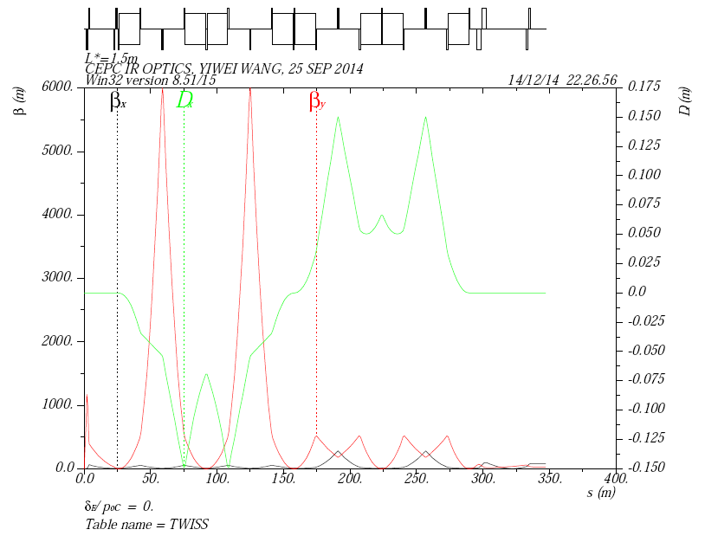
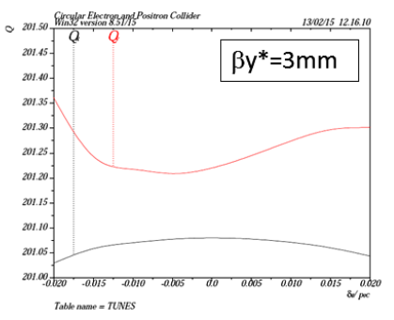
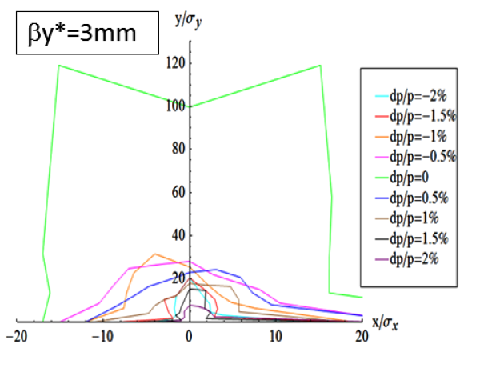
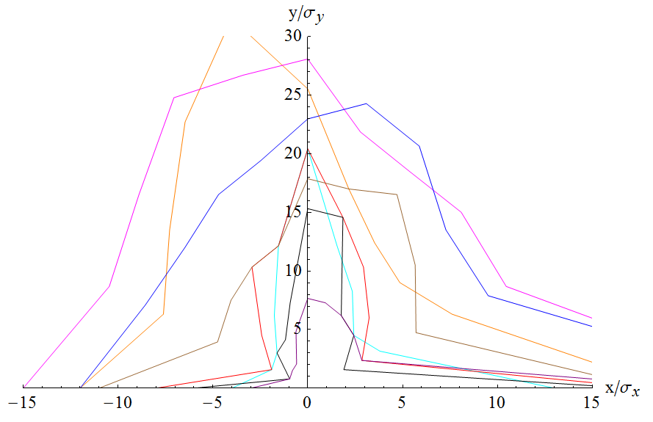
FFS_3.0mm_v0_Feb_2015
Version | Date | author | FT | CCS | MT | Natural chromaticity (incl. FODO) | Primary nonlinear corerction | High order correction | Dynamic aperture with whole ring | To be done | Remark
FFS_3.0mm_v0_Feb_2015 (350m) | 2015/2 | Yiwei Wang | 4 quads βy*=3.0mm L*=1.5m d=0.5m R=16mm Btip=4.7T | Ltot=264m βymax=6000m ΔU/U=3.3% Δε/ε=-2.5% | 4 quads | ξx= -36.9/4 ξy= -565.2/4 | 1st order ξ, 2nd order geo. aberr. | High order ξ (tune phase), 3rd order geo. aberr. from finite length sext. | with ARC_STRh_5FODO_STRIPh_8FODO_Oct_2014 0%: (17σx, 100σy) 2%: (1.5σx, 13.5σy) |  | For pre-CDR

Slide 5
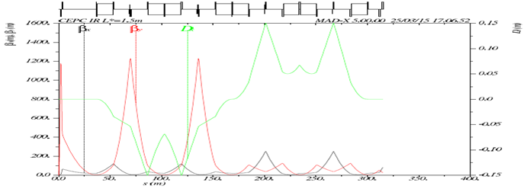
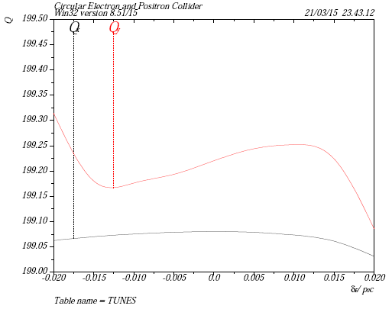
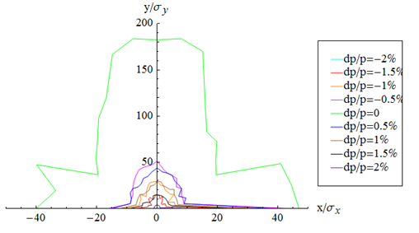
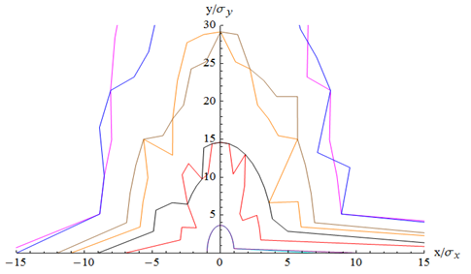
FFS_3.0mm_v1_Mar_2015
Version | Date | author | FT | CCS | MT | Natural chromaticity (incl. FODO) | Primary nonlinear corerction | High order correction | Dynamic aperture with whole ring | To be done | Remark
FFS_3.0mm_v1_Mar_2015 (315m) | 2015/3 | Yiwei Wang | 2 quads βy*=3.0mm L*=1.5m d=0.5m R=16mm Btip=4.7T | Ltot=264m βymax=1200m ΔU/U=3.3% Δε/ε=-2.5% | 2 quads | ξx=-24.1/4 ξy=-306.9/4 | reduce ξ contribution from CCS, 1st order ξ, 2nd order geo. aberr. | High order ξ (tune phase), 3rd order geo. aberr. from finite length sext. | with ARC_STRh_5FODO_STRIPh_8FODO_Oct_2014 0%: (40σx, 180σy) 2%: (1σx, 3.5σy) much more symetric |  | Comments from the reviewers

Slide 6
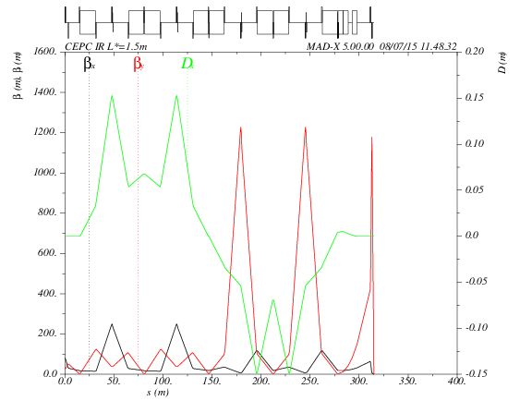
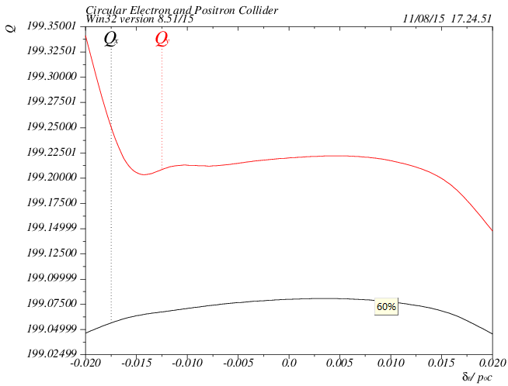
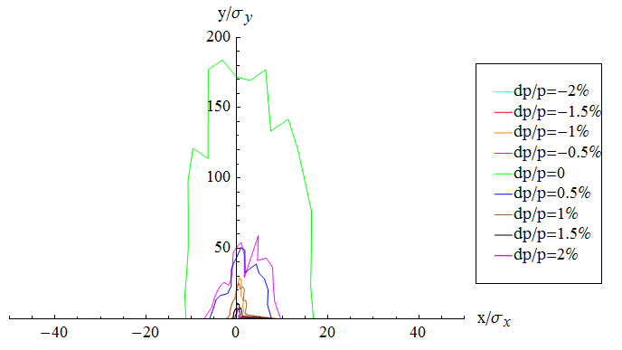
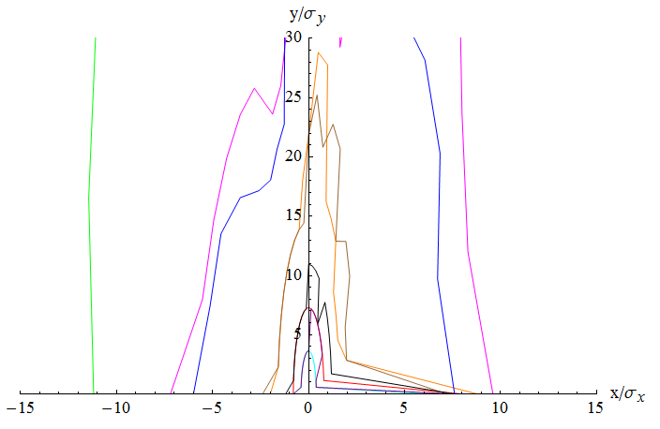
FFS_3.0mm_v2_Jul_2015_tmp
Version | Date | author | FT | CCS | MT | Natural chromaticity (incl. FODO) | Primary nonlinear corerction | High order correction | Dynamic aperture with whole ring | To be done | Remark
FFS_3.0mm_v2_Jul_2015_tmp (315m) | 2015/7 | Yiwei Wang | 2 quads βy*=3.0mm L*=1.5m d=0.5m R=16mm Btip=4.7T | Ltot=264m βymax=1200m ΔU/U=3.3% Δε/ε=-2.5% | 2 quads | ξx=-28.6/4 ξy=-306.3/4 | reduce ξ contribution from CCS, 1st order ξ, 2nd order geo. aberr. | High order ξ (tune phase+additional sext.), 3rd order geo. aberr. from finite length sext. |  | an ARC with optimised dQ/dJ | Idea from Brickmann’s paper and Marica’s comments

Slide 7
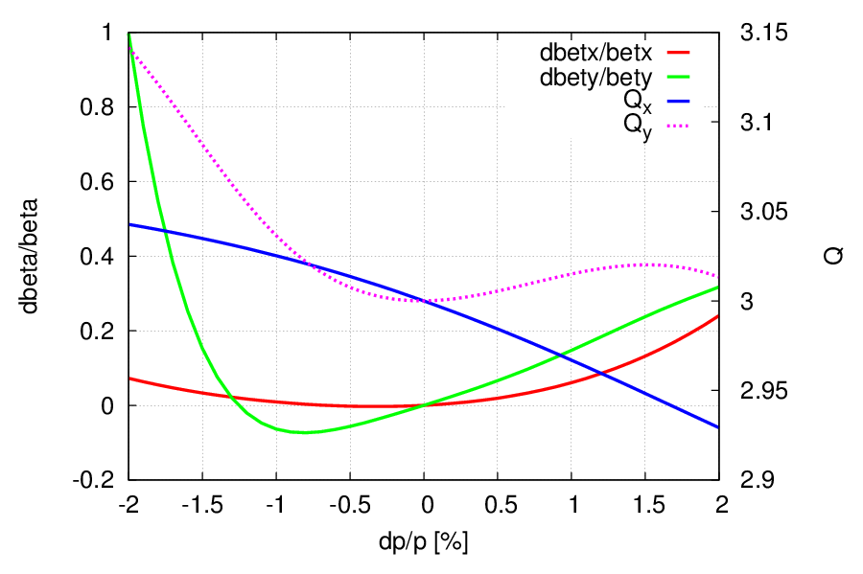
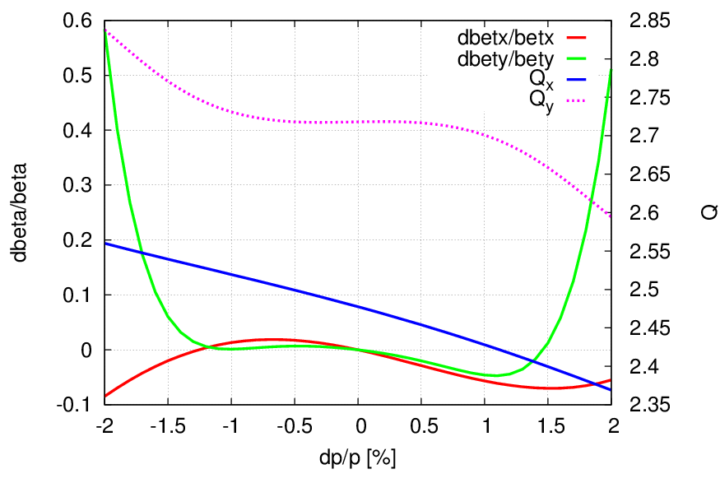
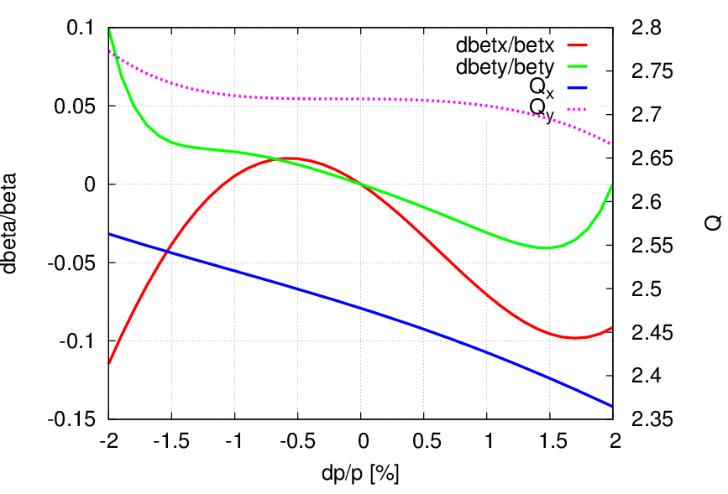
Tune vs deltap

Slide 8
Tune vs amplitude
Tune shift with amplitude:
d(Qx)/d(Ex) d(Qy)/(dEy) d(Qy)/d(Ex)
v0: -2.555503E+04 4.563207E+06 -8.407153E+04
v1: -2.687453E+04 1.265348E+06 -8.279601E+04
v2: 1.862831E+04? 1.261388E+06 -9.044593E+04

Slide 9
Summary
Additional sextupole added at the 1st image point to correct high order chromaticity
DA doesn’t increased as expected
Need to check more kinds of aberrations
Further work
Increase Dx
Tune Qx’ and Qy’
Move QDVL away from the 1st image point

Slide 10
Reserved

Slide 11
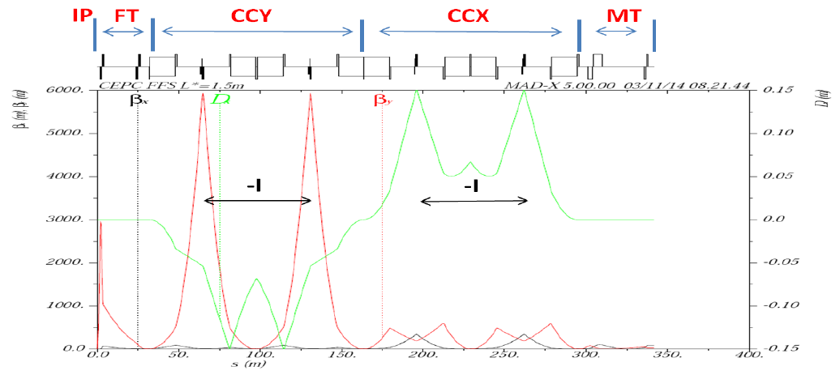
Generic final focus system
Linear latice design
FT:
4 quads
βy*, L*, d, Btip
CCS:
8 FODO cells
Ltot, βymax, ΔU/U, Δε/ε
MT:
4 quads
Primary nonlinear correction
1st order ξ
2nd order geo. aberr.

Slide 12
High order correction
High order ξ
geo. aberr. from finite length sext.
break down of –I matrix
2nd order dispersion
…

