Slide 1
Comparison of two lattices (v20140930 and v20150211)
H. Geng
2015.8.28

Slide 2
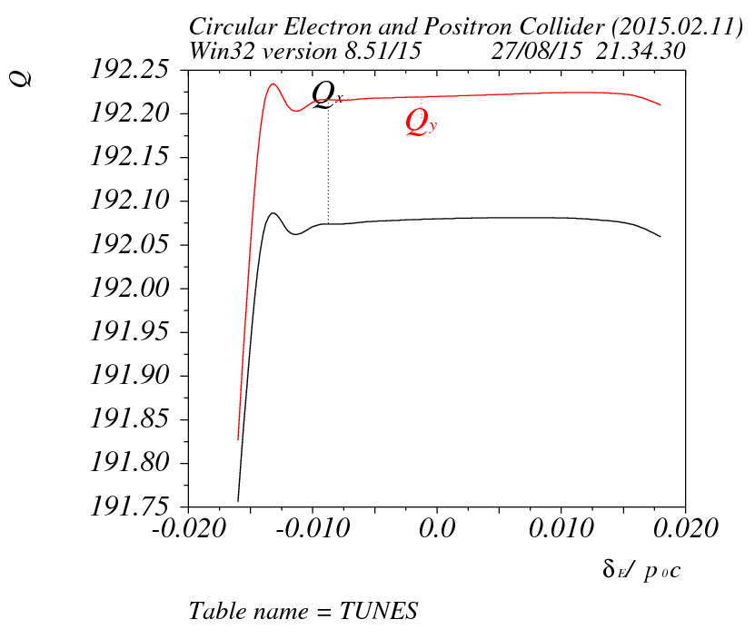
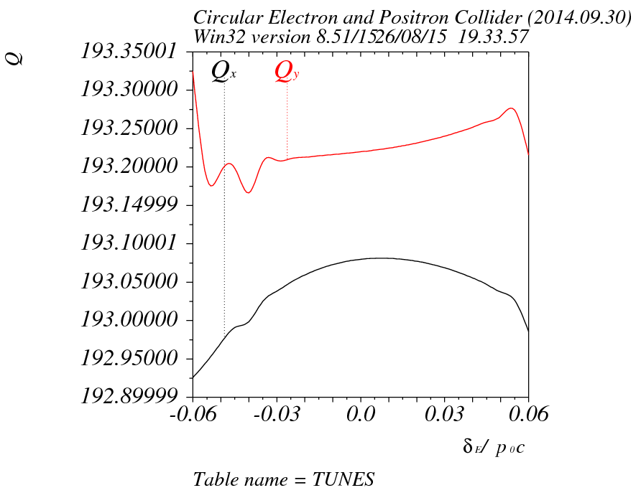
Tune v.s. dp/p

Slide 3
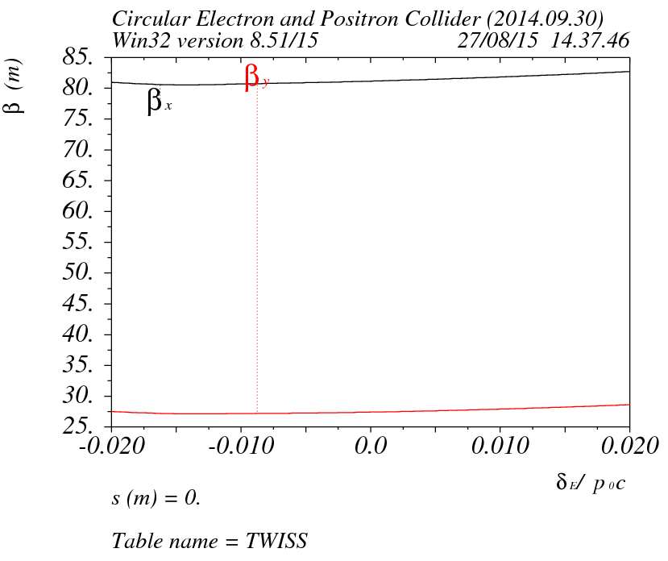
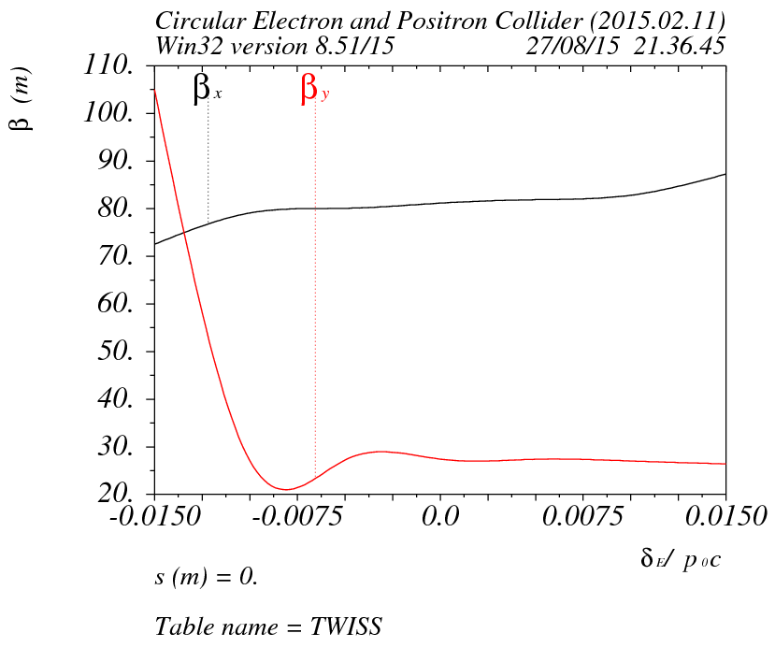
Beta v.s. dp/p

Slide 4
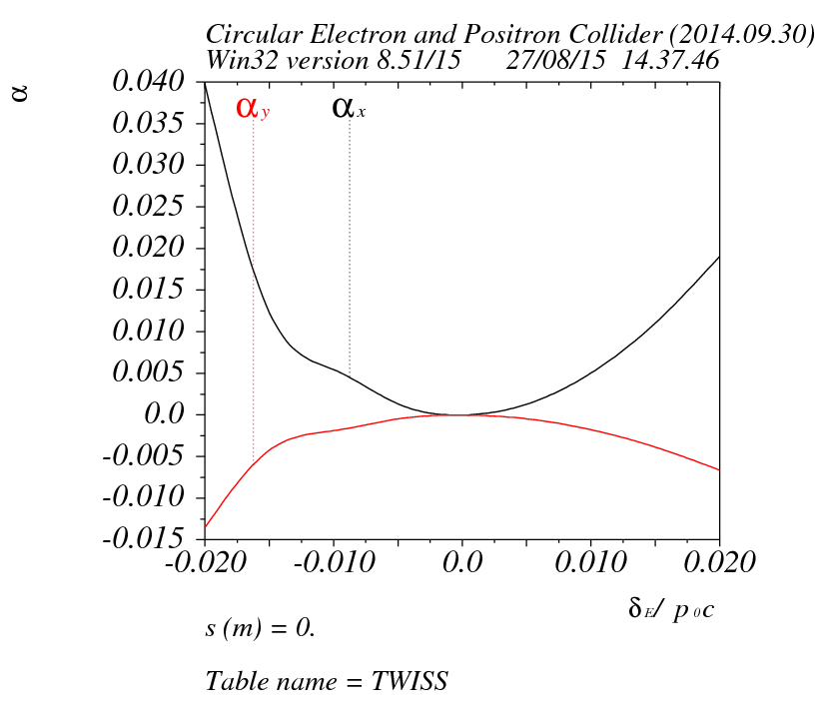
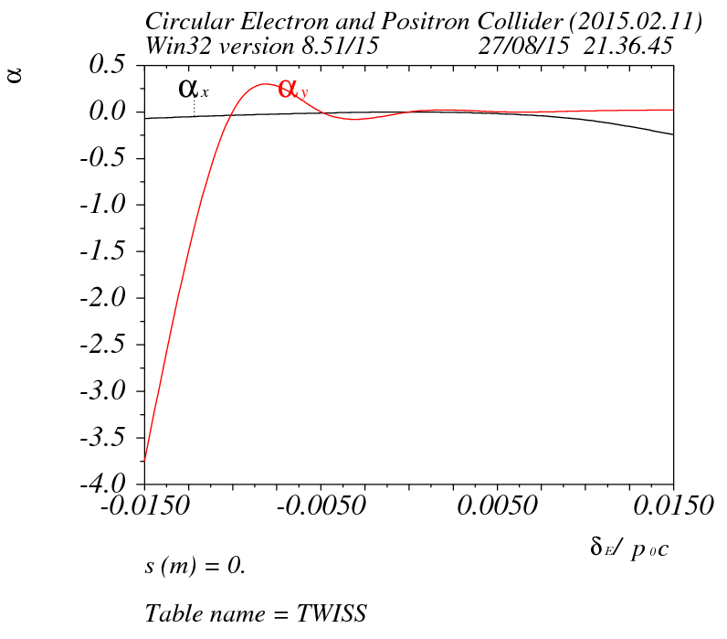
Alpha v.s. dp/p

Slide 5
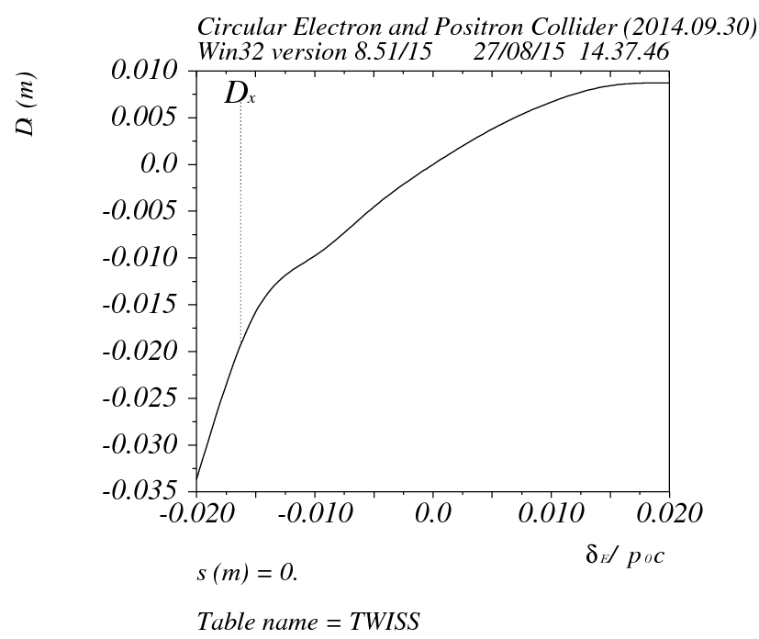
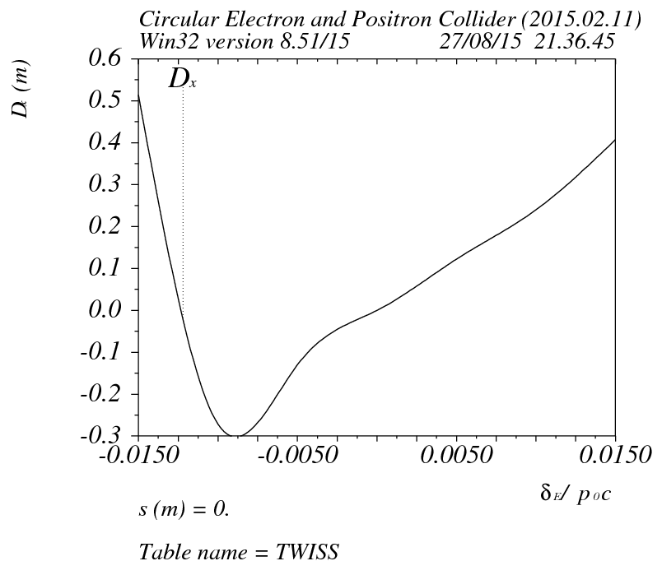
Dx v.s. dp/p

Slide 6
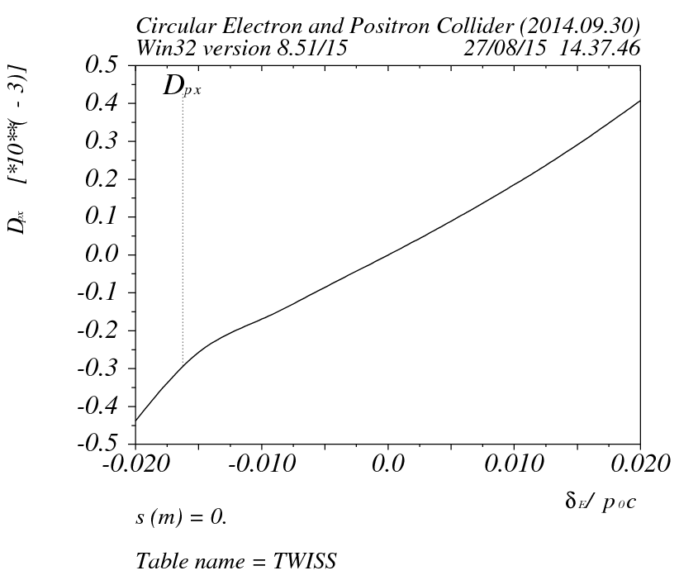
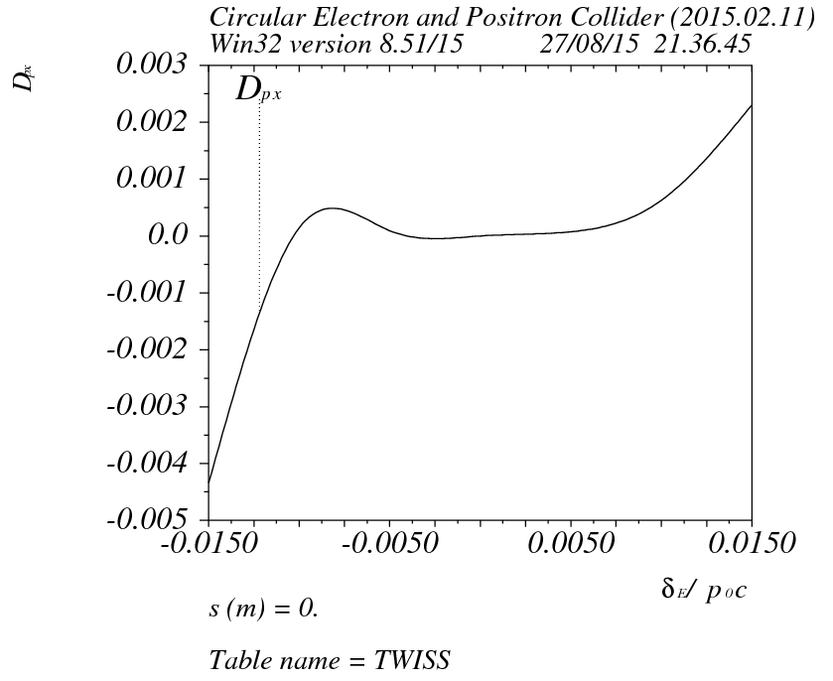
Dpx v.s. dp/p

Slide 7
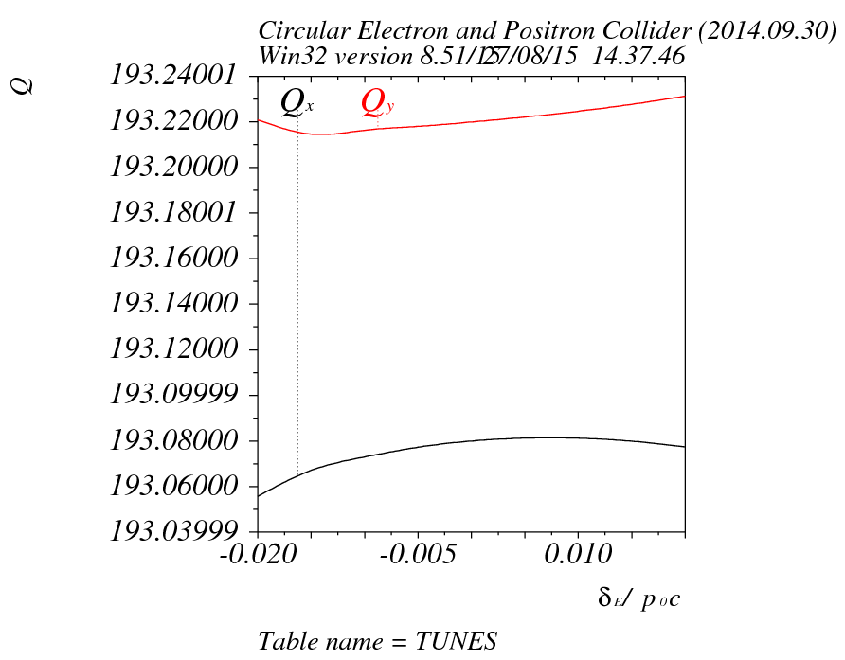
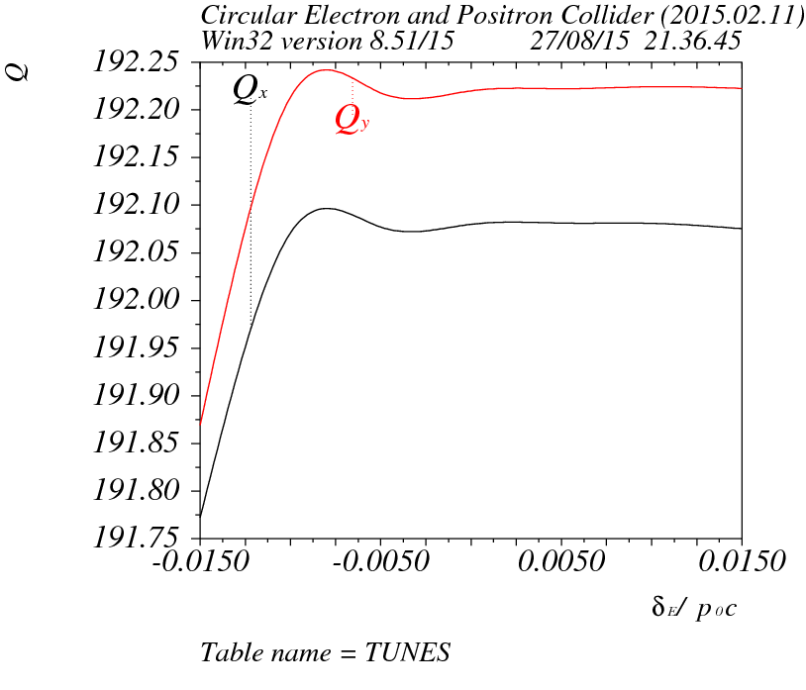
Tune v.s. dp/p

Slide 8
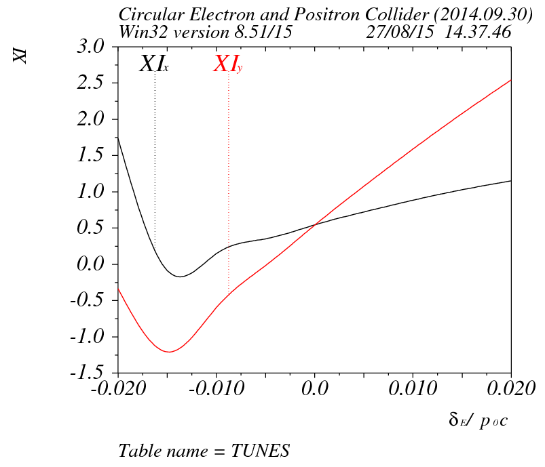
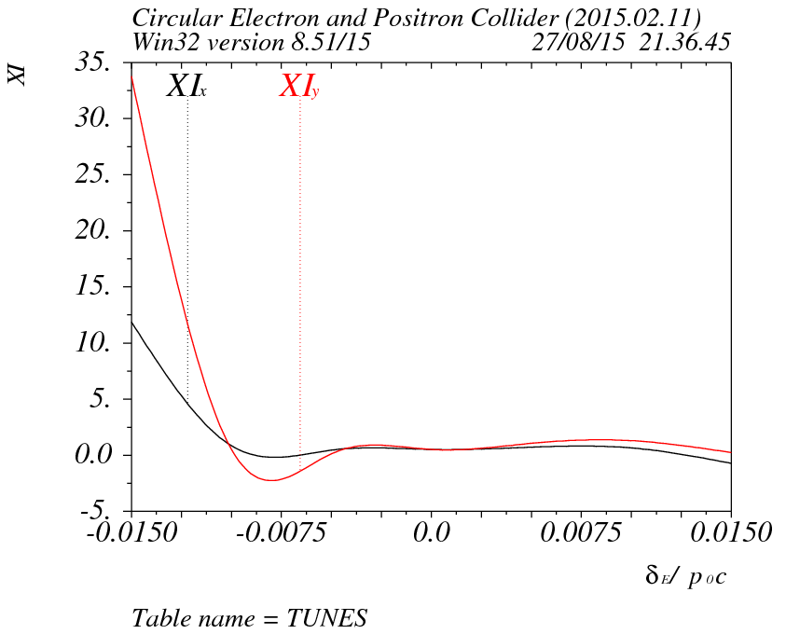
chromaticity

Slide 9
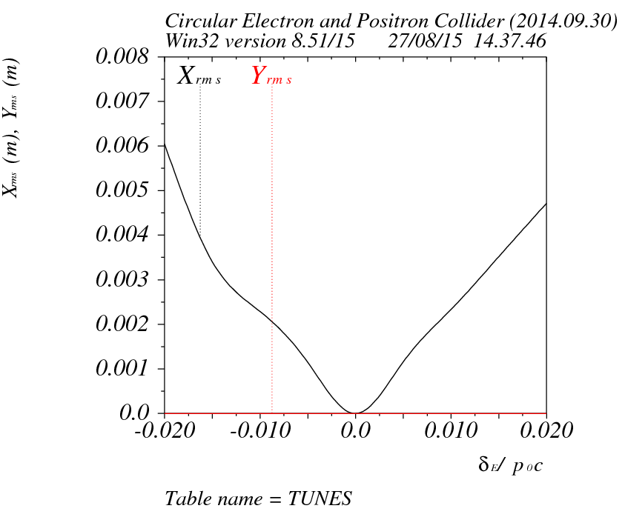
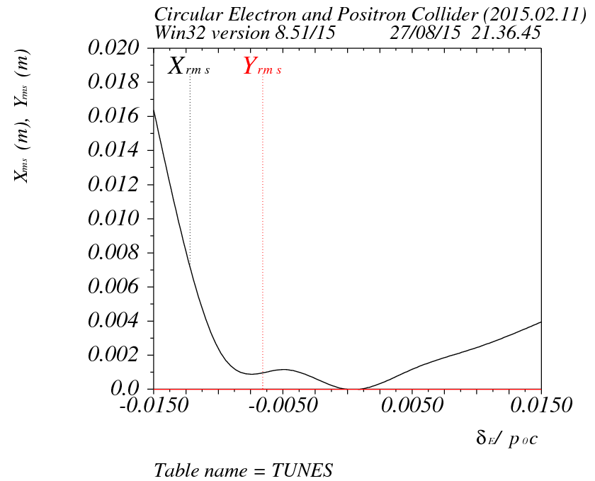
Maximum orbit v.s. dp/p

Slide 10
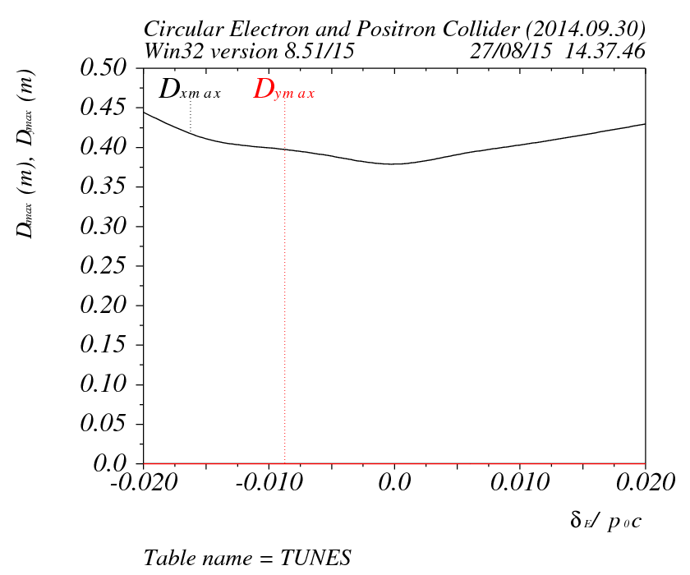
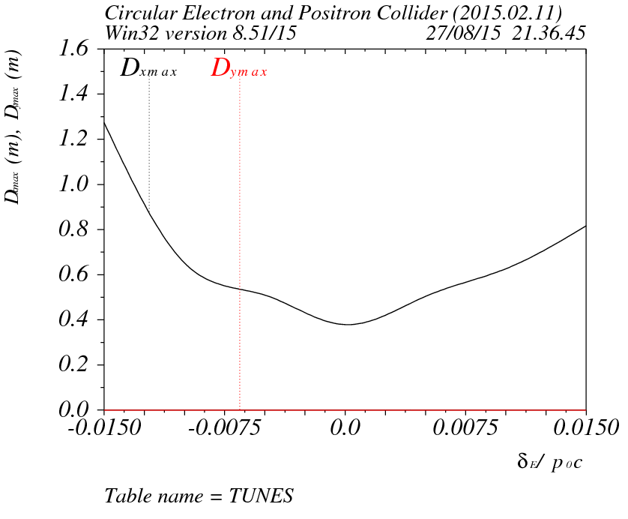
Maximum dispersion v.s. dp/p

Slide 11
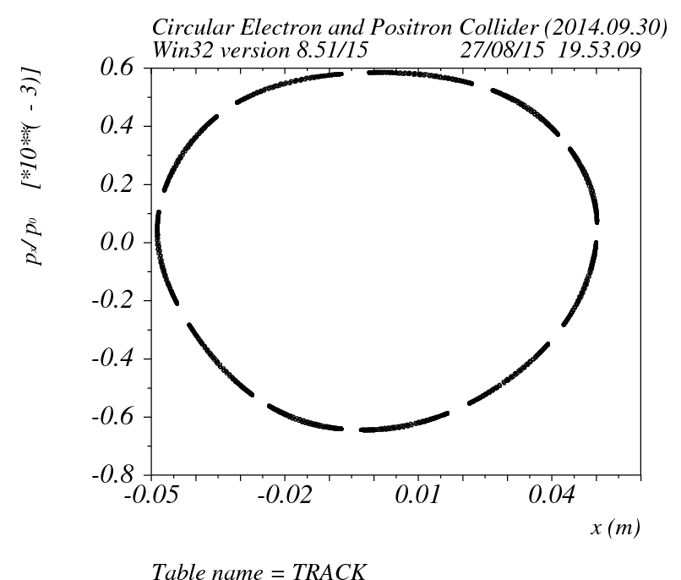
Tracking result (x=50mm,y=0,dp/p=0,1.5k turns)

Slide 12
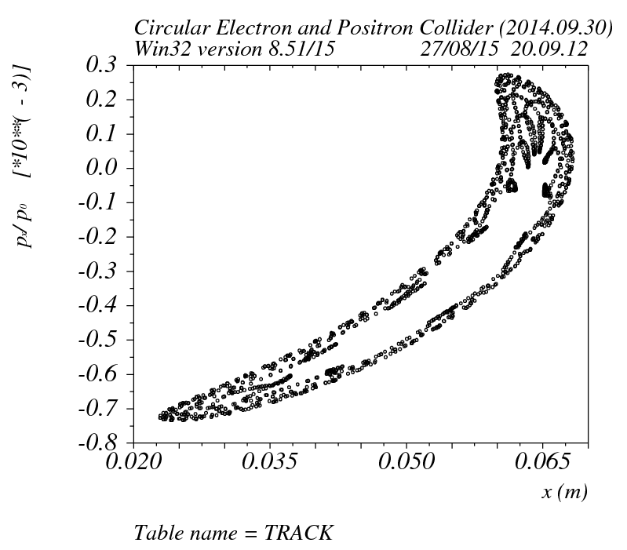
Tracking result (x=60mm,y=0,dp/p=0,1.5k turns)

Slide 13
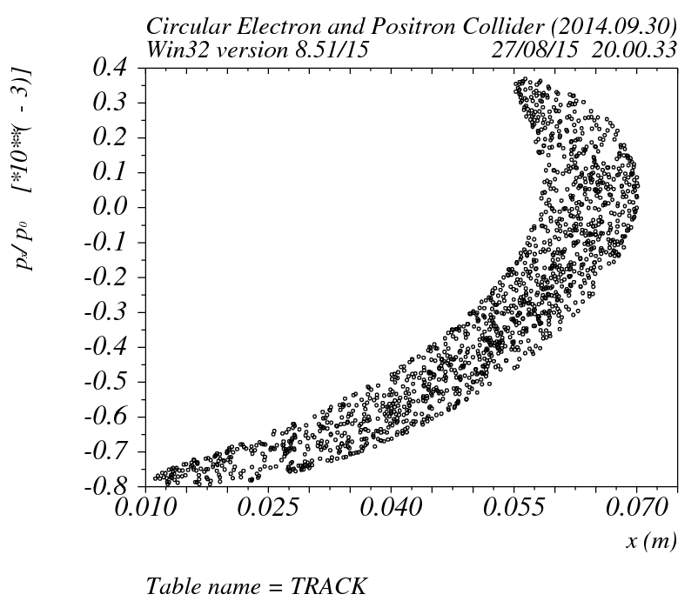
Tracking result (x=70mm,y=0,dp/p=0,1.5k turns)

Slide 14
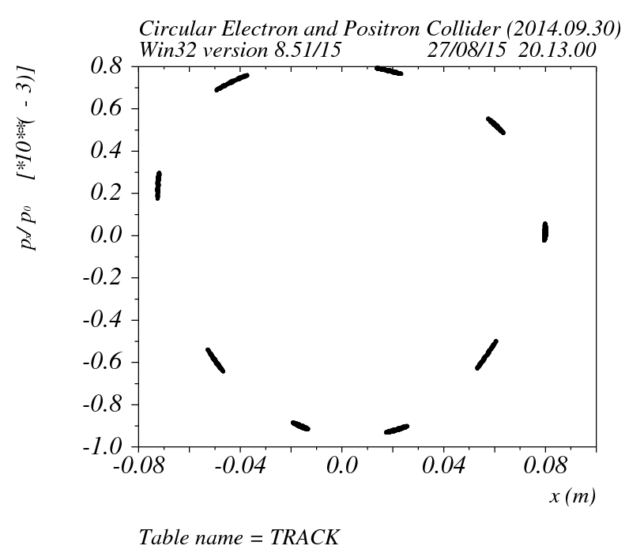
Tracking result (x=80mm,y=0,dp/p=0,1.5k turns)

Slide 15
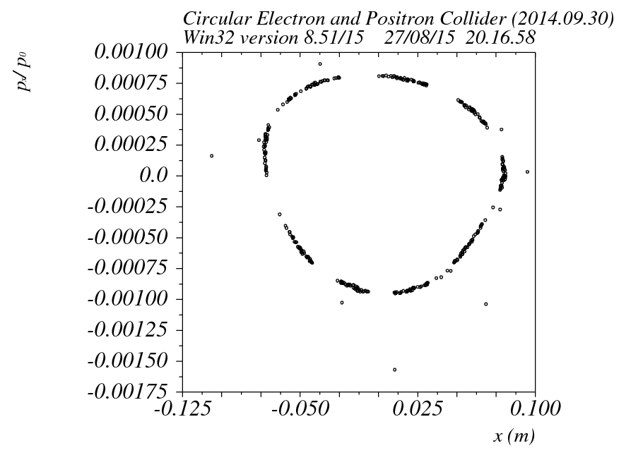
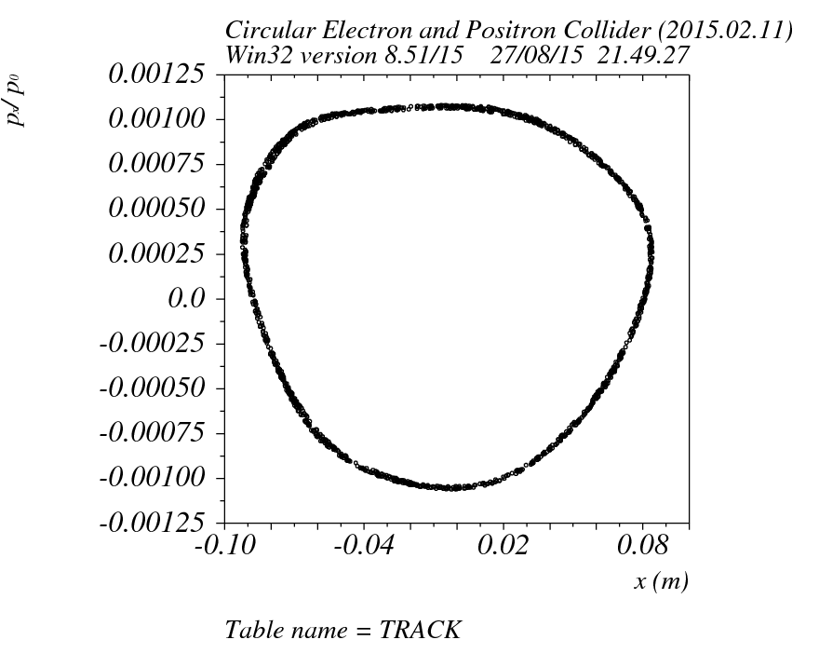
Tracking result (x=81mm,y=0,dp/p=0,1.5k turns)

Slide 16
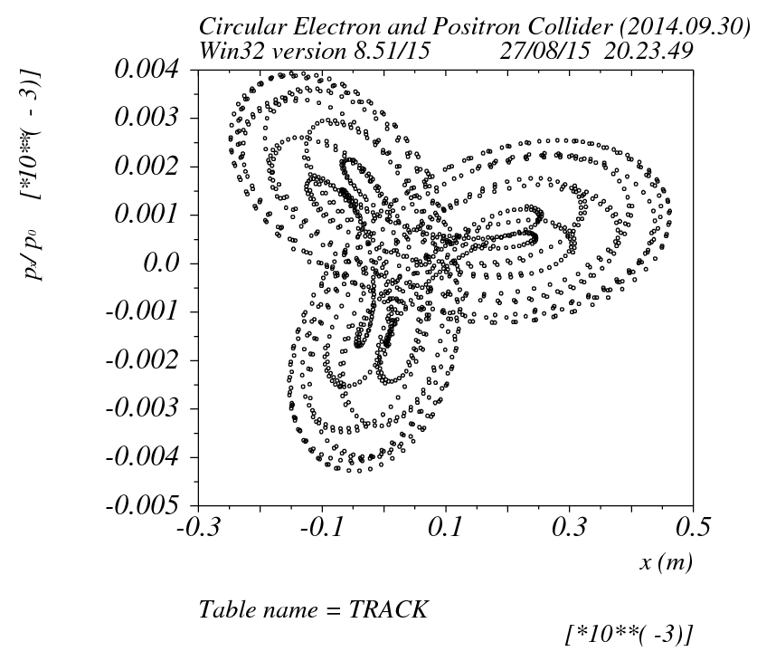
Tracking result (x=0,y=10mm,dp/p=0,1.5k turns)

Slide 17
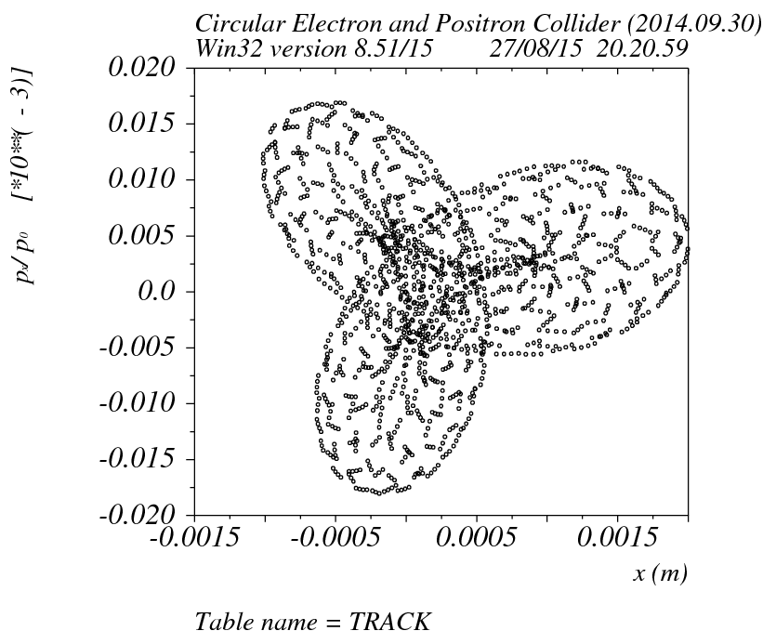
Tracking result (x=0,y=15mm,dp/p=0,1.5k turns)

Slide 18
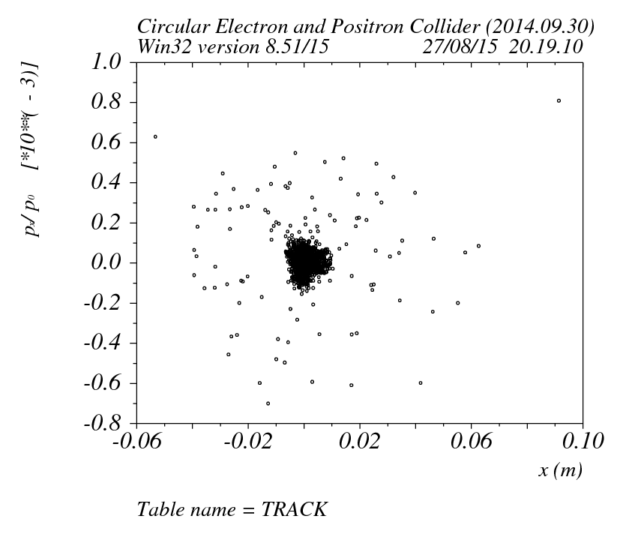
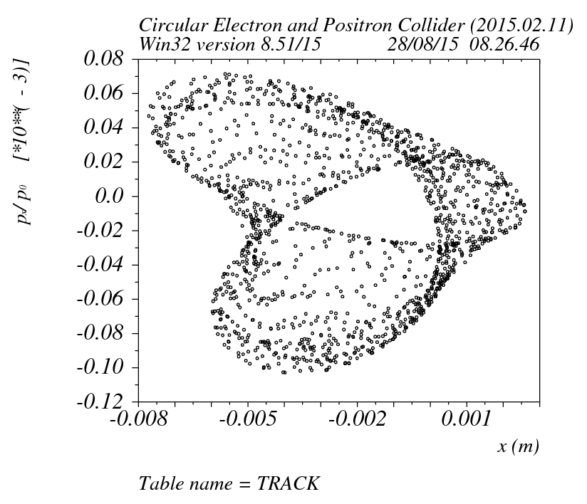
Tracking result (x=0,y=20mm,dp/p=0,1.5k turns)

Slide 19
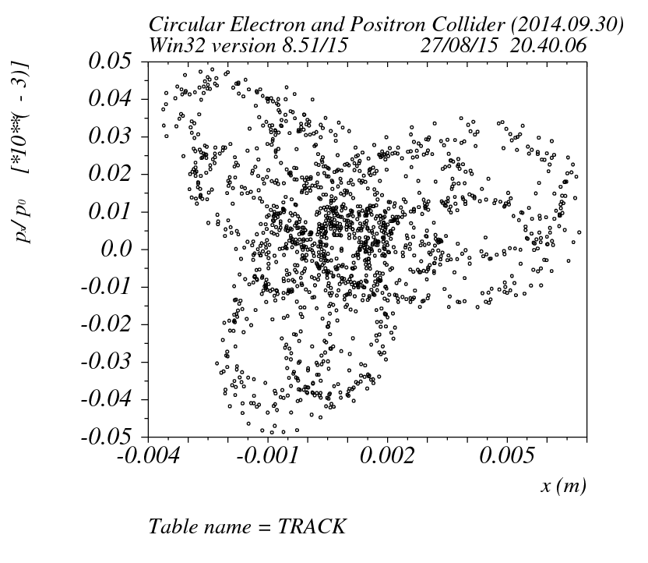
Tracking result (x=0,y=21mm,dp/p=0,1.5k turns)

Slide 20
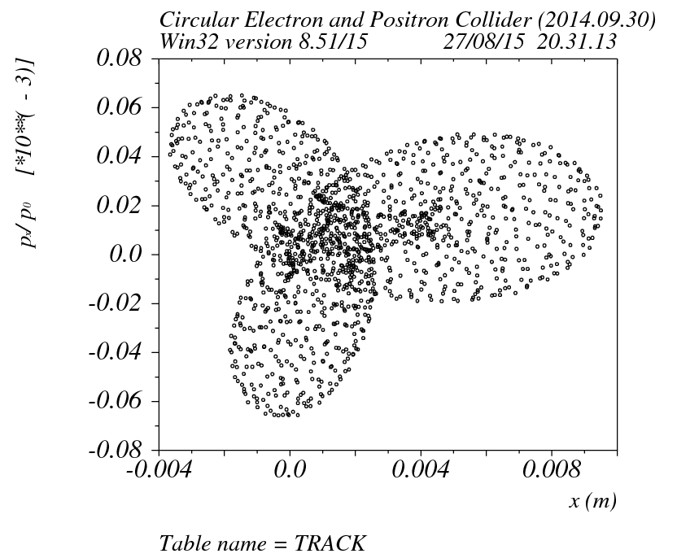
Tracking result (x=0,y=25mm,dp/p=0,1.5k turns)

Slide 21
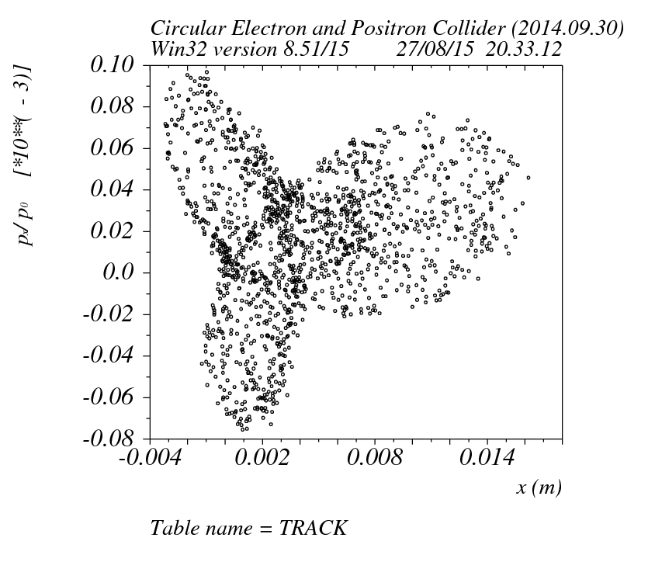
Tracking result (x=0,y=30mm,dp/p=0,1.5k turns)

Slide 22
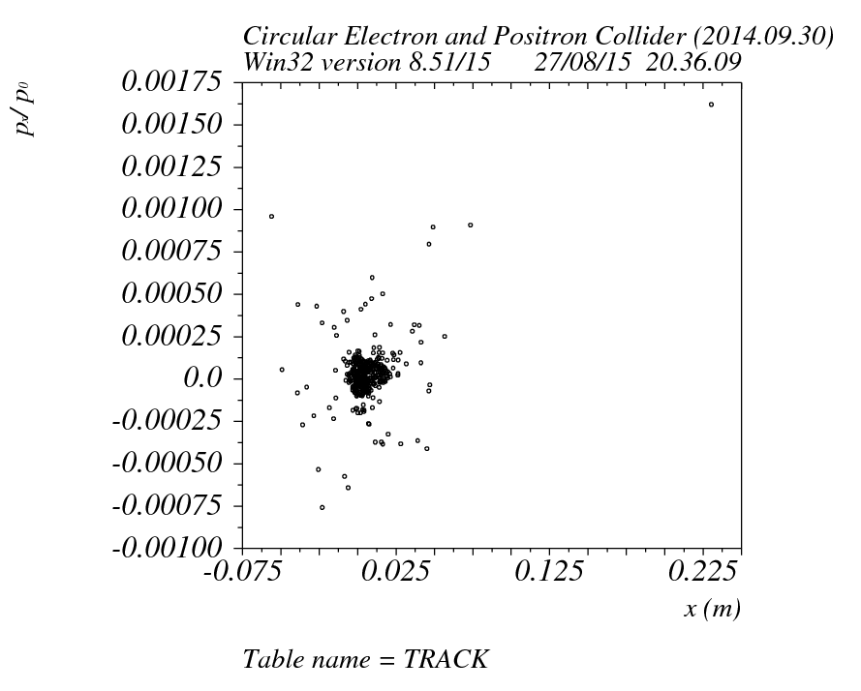
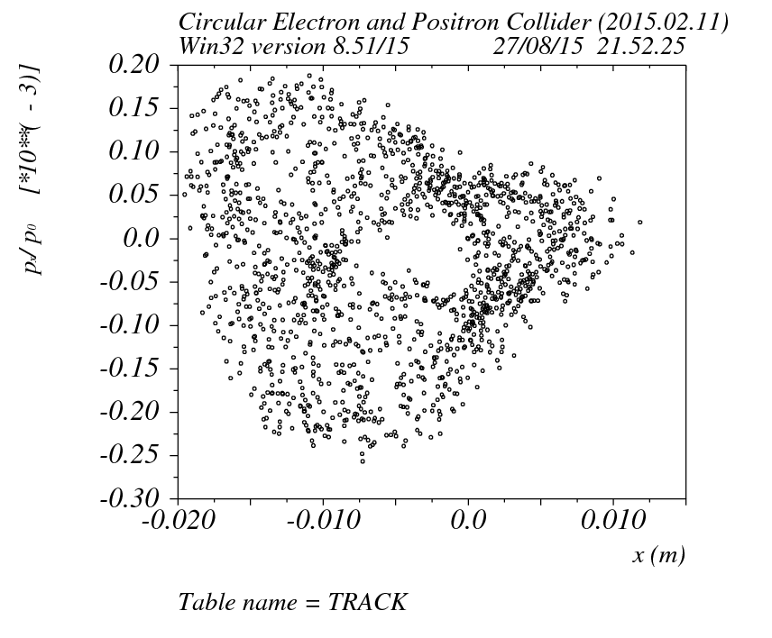
Tracking result (x=0,y=31mm,dp/p=0,1.5k turns)

Slide 23
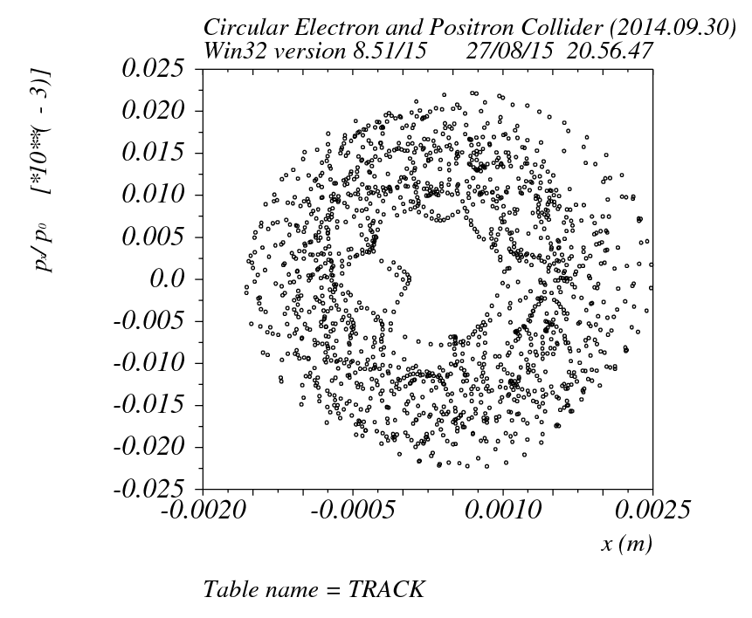
Tracking result (x=0,y=0,dp/p=0.35,1.5k turns)

Slide 24
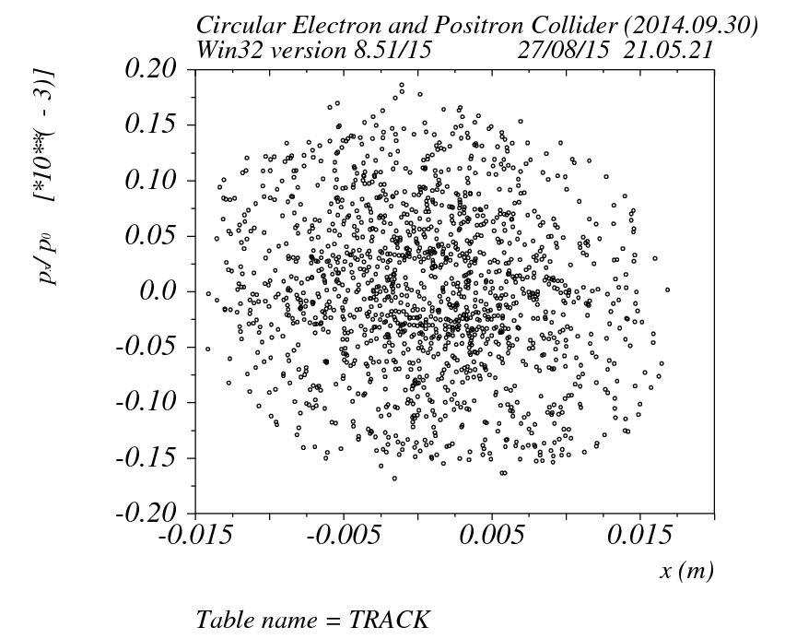
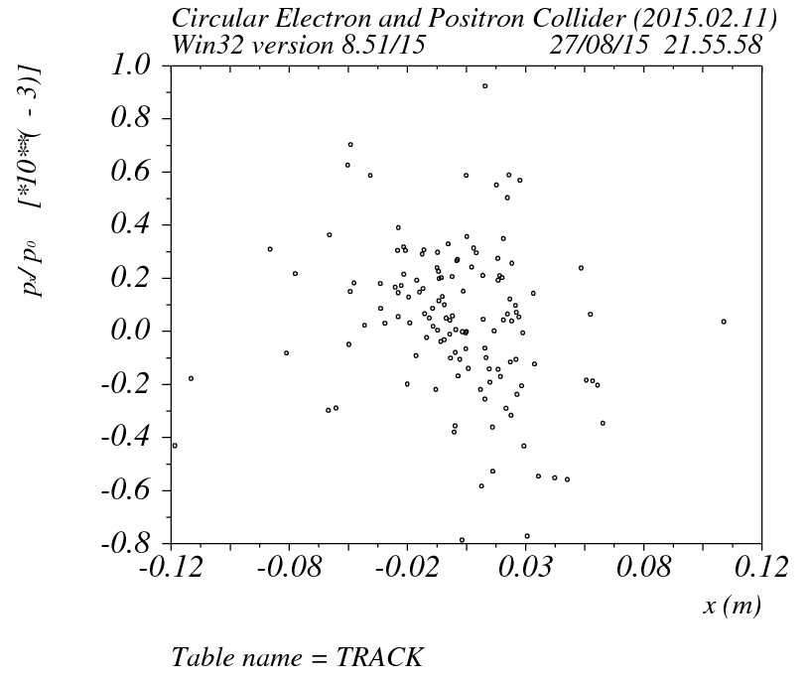
Tracking result (x=0,y=0,dp/p=0.055,1.5k turns)

Slide 25
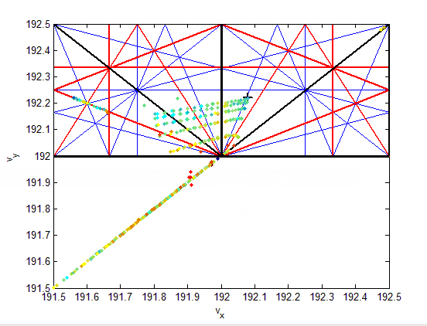
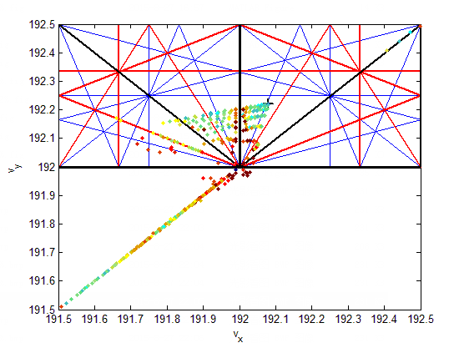
FMA results (x,y=20mm,dp/p=0)

Slide 26
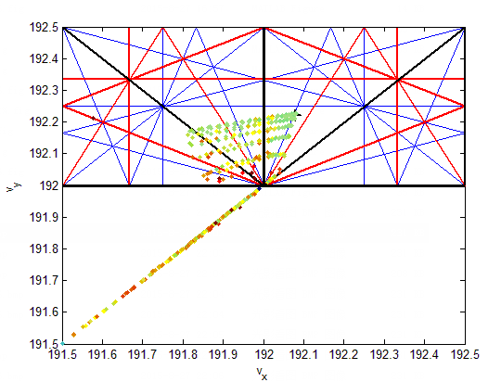
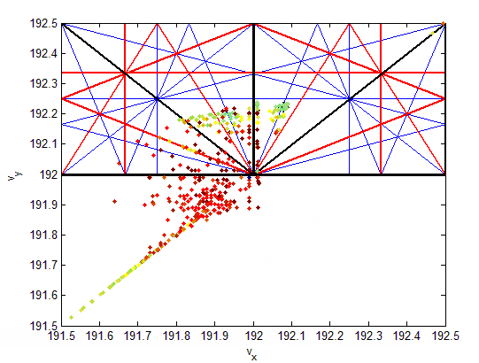
FMA results (x,y=20mm,dp/p=0.01)

Slide 27
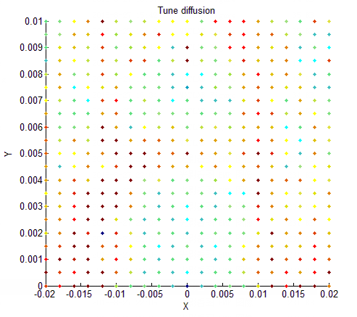
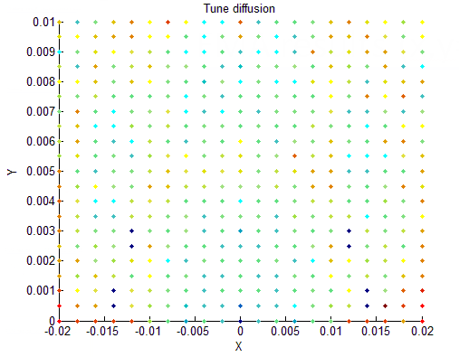
FMA results (x,y=20mm,dp/p=0.0)

Slide 28
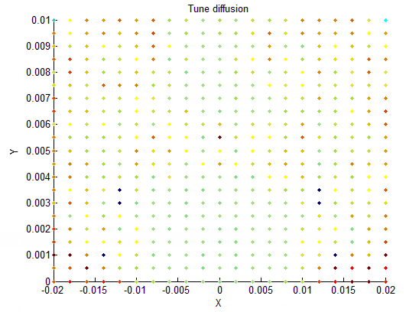
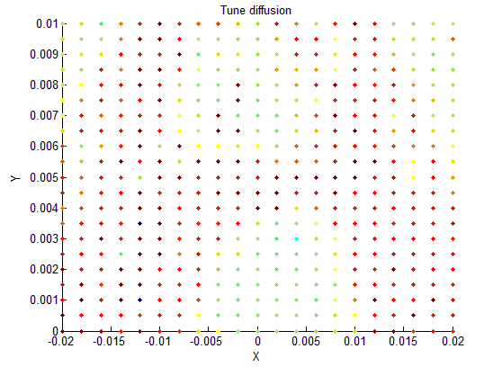
FMA results (x,y=20mm,dp/p=0.01)

Slide 29
Thanks !

Slide 30
Parameter | 20140930 (#S/#E) | 20150211 | Parameter | 20140930 | 20150211
Wx | 0.342/0.562 |  | T116 | 0.443529E+01 | -0.192336E+01
Wy | 0.298/0.565 |  | T126 | -0.651958E+03 | 0.322993E+03
DDx | 0.444/1.081 |  | T156 | 0.169757E+00 | 0.511740E+00
DDpx | 0.015 |  | T166 | -0.548352E+00 | 0.207565E+01
R16 | 0 | 0 | T336 | 0.893196E+01 | -0.414295E+01
R26 | 0 | 0 | T346 | -0.429292E+02 | 0.175806E+02
R56 | -1.433646 | -1.433903 | T566 | -0.147300E+00 | -0.386286E-01
R66 | 0.363438 | 0.363820

